Slide 1

We will begin in a few moments.
BIF Information Session – Metro IPMO
Wednesday, March 04, 2026
5:30pm – 7:00pm

Slide 2

We’re helping local businesses as we build.
BUSINESS INTERRUPTION FUND (BIF)

Slide 3
BIF Information Session Agenda
Welcome & Introductions
BIF Program Overview
BIF Administrative Guidelines
BIF Grants Activity To Date
Crenshaw/LAX & Regional Connector BIF Outcomes
BIF Eligibility Requirements
BIF Outreach in the Community
BIF Award Flow
Navigating the Metro Website
BIF Application Process
BIF Financial Documentation
Commercial Property Owners
Presumptive Eligibility Award (PEA)
Contact Information
Questions & Answers
Workshop Survey
3

Slide 4
BIF Program Overview
What is Metro’s Business Interruption Fund (BIF)?
Metro’s Goal: Help small “mom and pop” businesses continue to thrive throughout construction and post construction.
Financial assistance up to $60,000 per impact year to small “mom and pop” businesses directly impacted by Metro transit rail construction along four project areas:
Current Projects
  D Line Extension – Sections 1, 2 & 3
  East San Fernando Valley Light Rail Transit Project
Past Projects
  Crenshaw/LAX Transit Project**
  Regional Connector, Little Tokyo area** and 2nd/Broadway Segment *
          * Eligibility ended as of June 30, 2017.
          ** Eligibility ended as of December 31, 2023.
4

Slide 5
BIF Administrative Guidelines
BIF Administrative Guidelines have governed the BIF since inception of the program in 2015.​
The Guidelines determine the mission, purpose, perimeters, structure and policies of the BIF program.
The Guidelines are approved by Metro Board of Directors, reviewed by County Counsel and cannot be changed arbitrarily.
However, the Guidelines are updated regularly as needed.
5

Slide 6
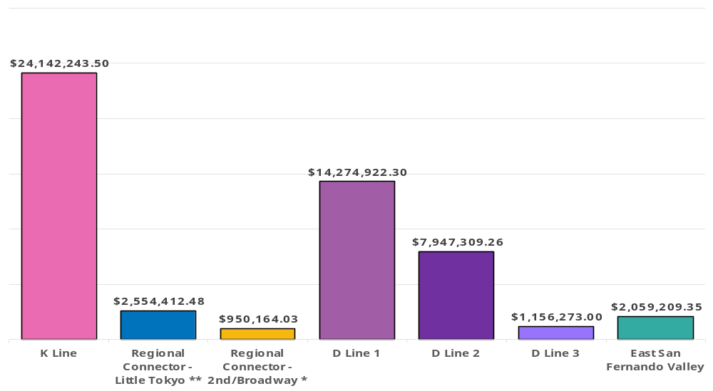
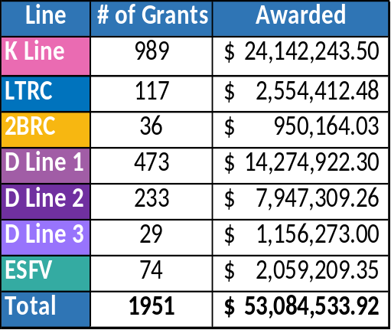
BIF Grant Activity to Date
Total Value of BIF Grants Awarded:
$ 53,084,533.92
Program Inception to Date
(March 2015 – February 25, 2026)
6

Slide 7
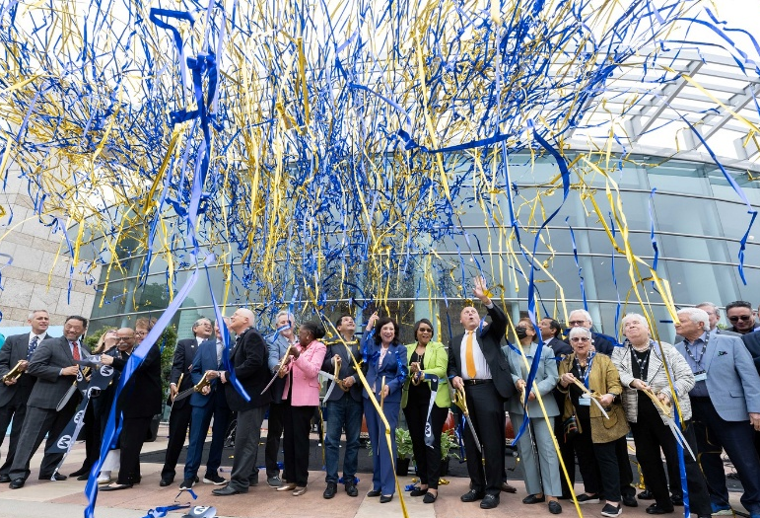
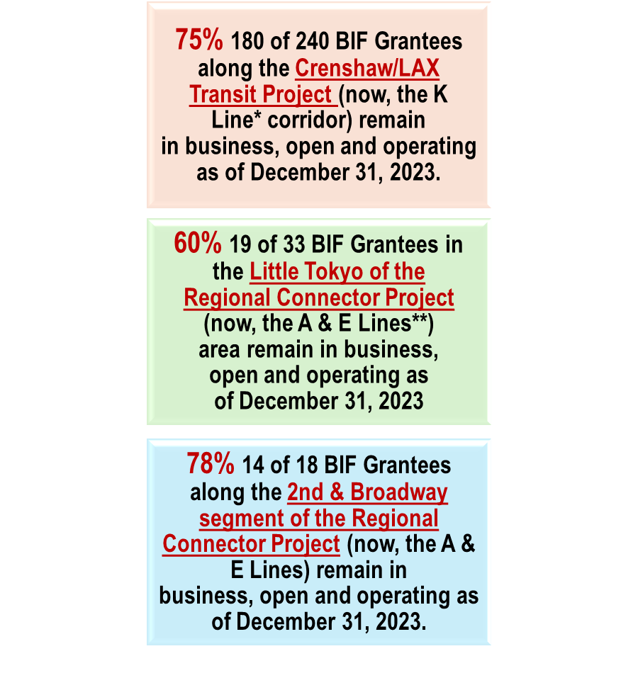
Metro’s BIF has successfully preserved small “mom and pop” businesses along the K Line and the A & E Line corridors.
June 16, 2023 – Grand Opening of the Regional Connector
(Now A & E Lines)
*Metro’s K Line opened in October 2022 with 7 new stations.
**Metro’s Regional Connector Project opened three new stations along the A & E Lines in June 2023.

Slide 8
BIF Eligibility Requirements
Small “mom and pop” business with 25 or fewer total full-time employees.
Businesses located immediately adjacent to the rail corridor and directly impacted by Metro construction.
For-profit business or non-religious, non-profit.
Continuous operation for at least 2 years along the corridor.
Must be a solvent business.
Must be able to produce relevant financial records demonstrating a loss of business revenue directly related to period of Metro’s construction disruption.
Must be in good standing with all local, state and federal taxing and licensing authorities.
Initial BIF applications must be submitted within 180 days from the end of the quarter of direct impact.
Meet other technical qualifications.
8

Slide 9
BIF Eligibility Requirements Cont.
How does a business owner demonstrate
direct impact?
Immediately adjacent to a rail corridor: Business property line must abut or face:
    Rail corridor;
    Construction staging area; or
    Construction storage area
Construction period for direct impact: Metro rail construction activity occurred in front of the business or on the block in which the business is situated.
9

Slide 10
BIF Eligibility Requirements Cont.
What is the amount of grant funding a business owner
can receive?
Eligible businesses must be able to demonstrate a loss of business revenue directly related to the period of construction disruption.
Financial threshold: Maximum per impact year/business = not to exceed $60,000.
Covers delinquent fixed operating expenses first: Rent/Mortgage, Utilities, Insurance, Payroll and others upon review.
Note: Special provisions exist for commercial property owners.
10

Slide 11
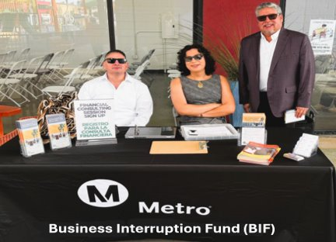
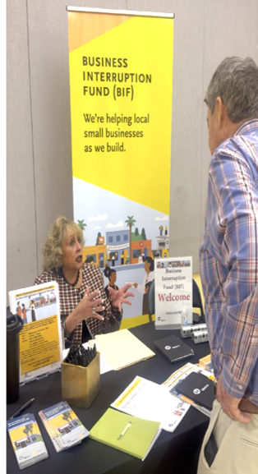
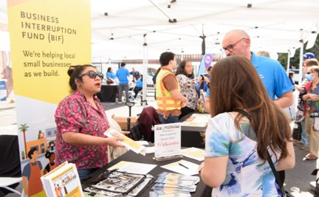
BIF Outreach in the Community
BIF Outreach Efforts
BIF Fund Administrator conducts outreach and engagement.
Outreach begins in advance of construction impacts to those businesses that are potentially eligible.
BIF Fund Administrator determines eligibility in accordance with the BIF Administrative Guidelines.
BIF Business Advisors work directly with business owners to collect financial documentation.
BIF Business Advisors can also help or refer business owners to appropriate resources as needed.
From top right (clockwise): Plaza del Valle (Jan 2026); Community Meeting (Feb. 2026); and
Metro Life Event (Feb. 2026)

Slide 12
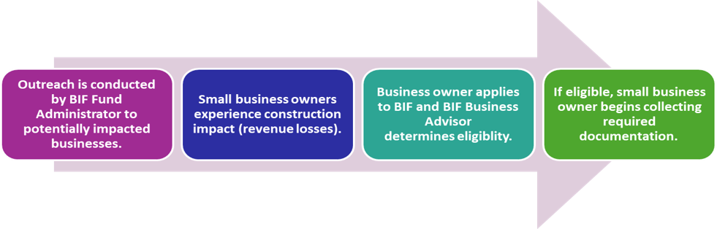
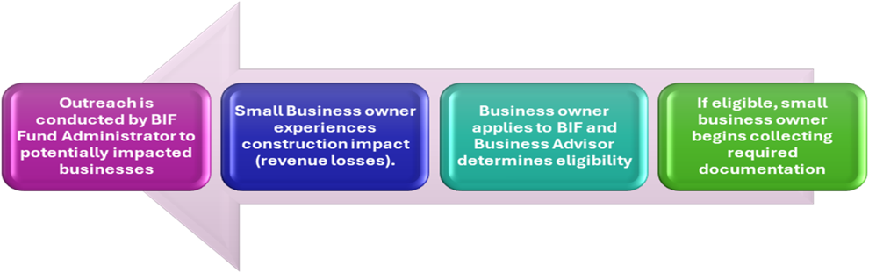
BIF Award Flow
START HERE
FINISH HERE
12

Slide 13
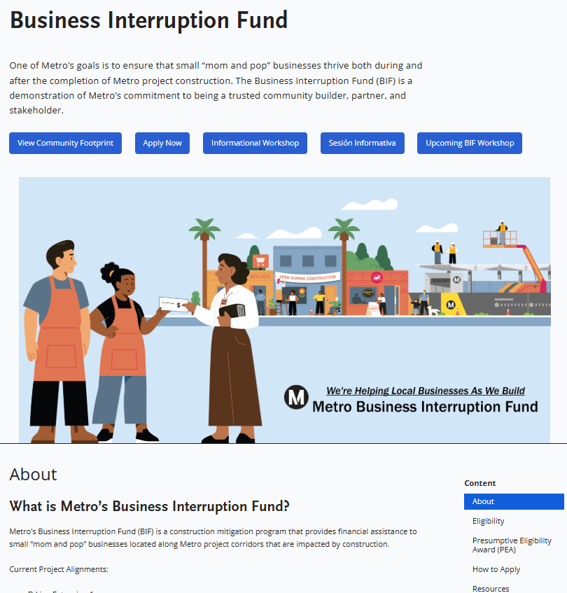
Navigating the Metro Website
Click Here for translation
Visit Metro.net/bif
Metro will translate entire page
13

Slide 14
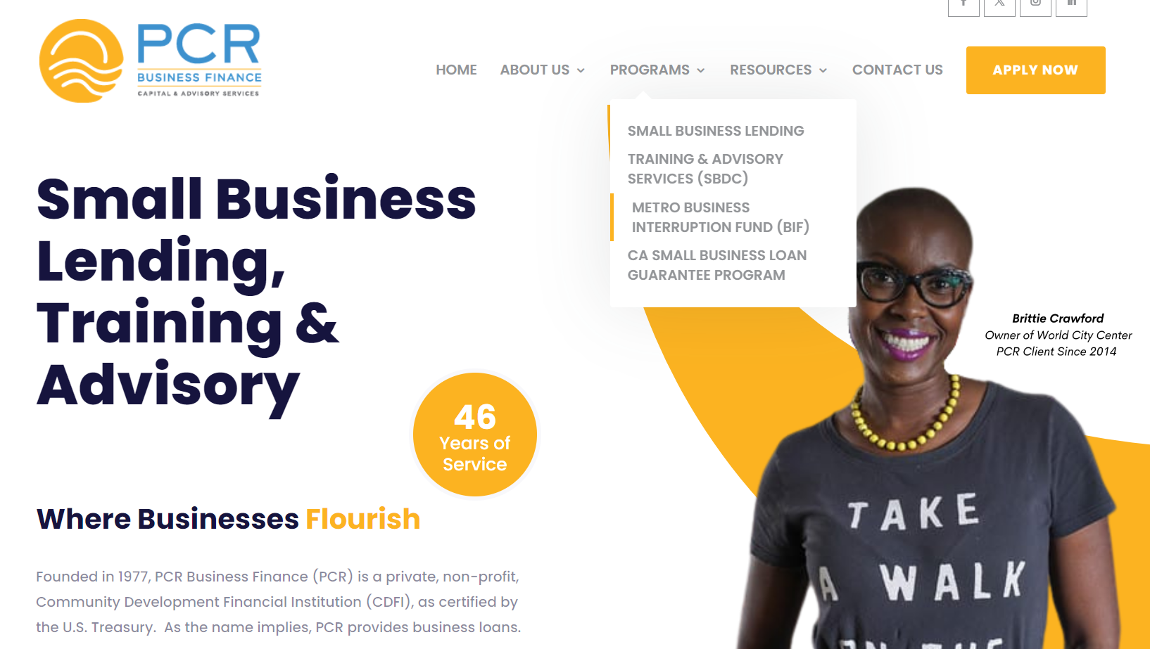
BIF Application Process
www.pcrcorp.org
14

Slide 15
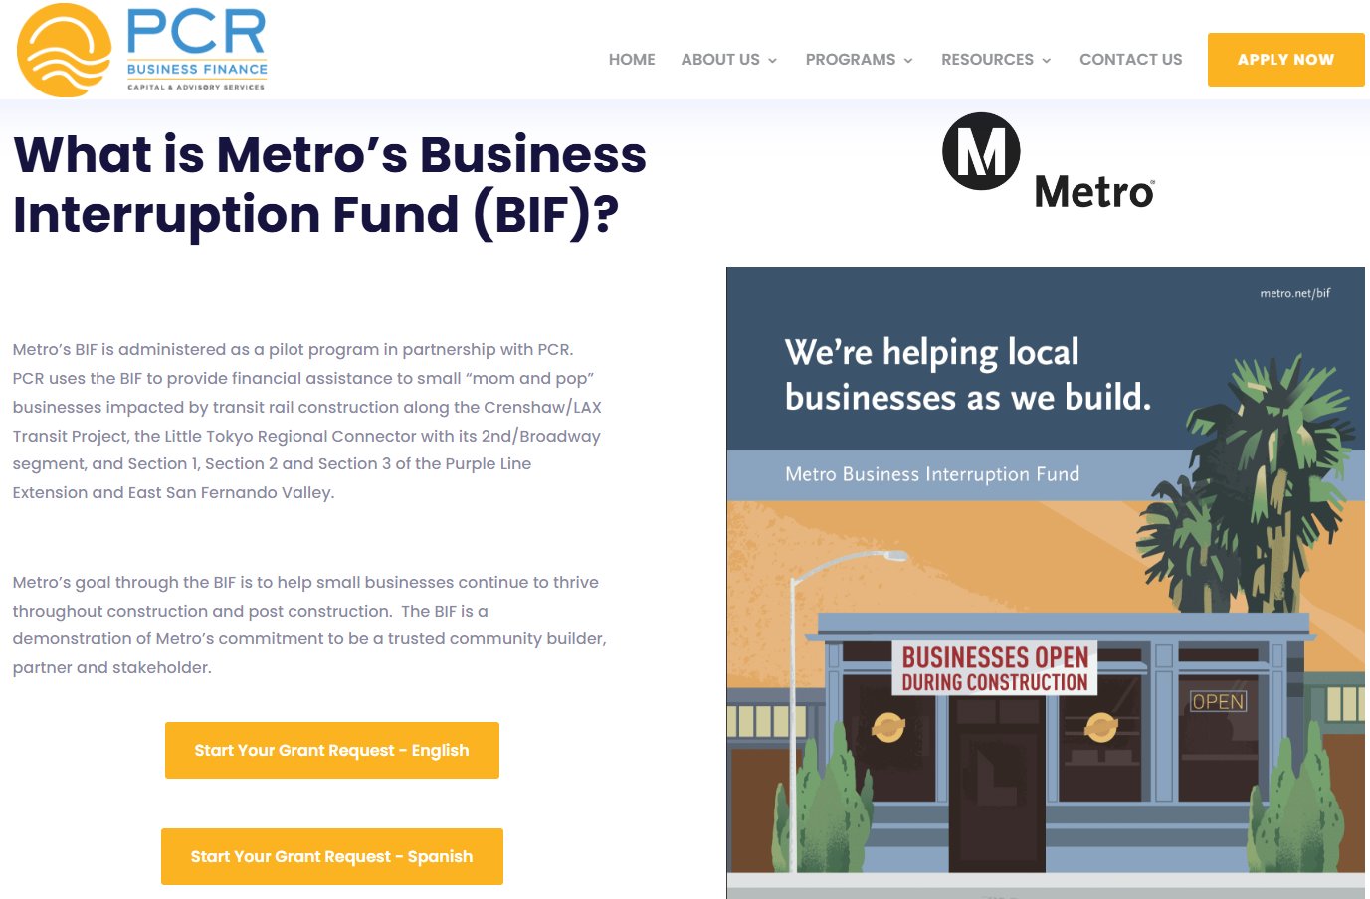
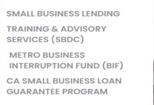
BIF Application Process Cont.
www.pcrcorp.org
15

Slide 16
BIF Financial Documentation
What financial documents are considered?
  Current Year Tax Return (mandatory)
  Business Bank Statements
  California Tax and Fee Administration Statements (Formerly Board of Equalization Statements (BOE)
  Profit & Loss Statements (P & L)
  Sales Receipts
  Point of sale
  Other requested documentation to help determine business revenue loss
  Additional considerations may apply on a case-by-case basis
  BIF Financial Analysis:
  Compares the pre-impact revenue period to the impact revenue period.
16

Slide 17
Commercial Property Owners
Are commercial property owners eligible to apply?
YES. Commercial property owners must meet all eligibility requirements.
Commercial property owners generally apply for rental revenue loss from their tenants. However, tenants and their property owners may not both file for the same revenue loss time- period. Property owners may also file a claim for delinquent mortgage, utilities, insurance and other expenses as determined by the program administrator.
Other special provisions apply for commercial property owners.
Note: Residential property owners are not eligible to apply.
17

Slide 18
Presumptive Eligibility Award
What is it?
The Presumptive Eligibility Award (PEA) is a grant alternative that offers up to $1,500 per impact year to small “mom and pop” businesses, including micro-businesses such as sidewalk and street vendors.
    The PEA has less restrictive documentation requirements than the typical BIF award, and targets businesses that may not have access to extensive financial records.
    However, the difference in relevant documentation from the BIF depends on the type of business and is determined on a case-by-case basis.
    The PEA has the same eligibility requirements as the BIF, requiring that applicants be either for-profit or non-religious non-profits located on a Metro project corridor for at least 2 years with 25 or fewer full-time employees.
    A small business applies to the Presumptive Eligibility Award (PEA) in the same way as the regular BIF award by submitting the application to the Fund Administrator.
18

Slide 19
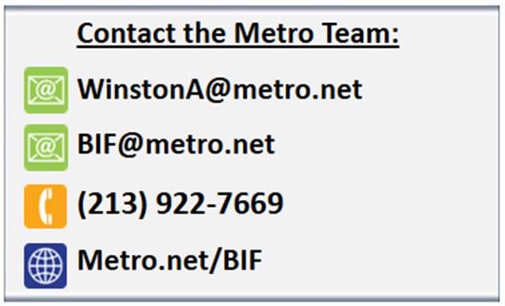
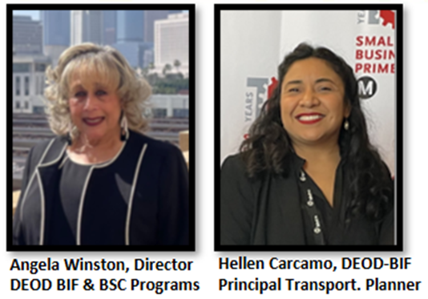
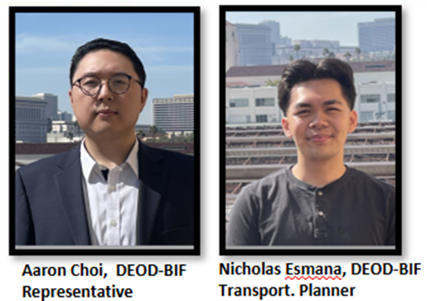
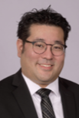
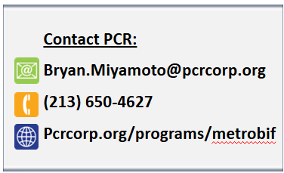
BIF Contact Information
Contact the Fund Administrator:
Pacific Coast Regional (PCR)
Bryan Miyamoto, VP & Metro BIF
Program Manager

Slide 20
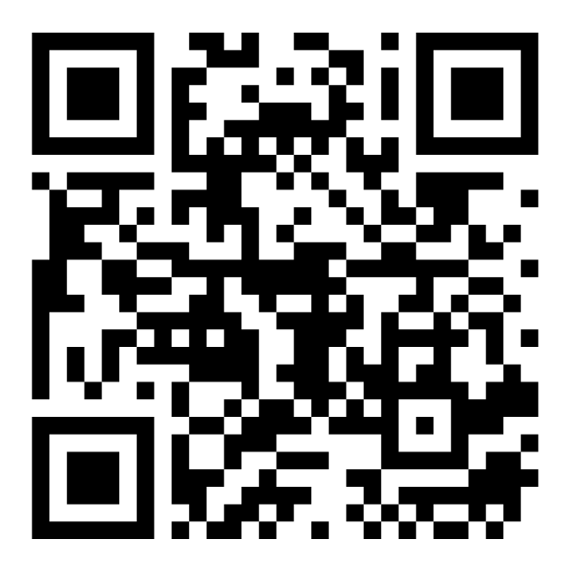
Survey
We would love to hear your thoughts!
Please take a few minutes to complete our survey.
Your feedback will help us serve you better.

Slide 21
Thank You for Joining Us!!

