Slide 1
Public Safety Advisory Committee (PSAC)
Thursday, July 9, 2026

Slide 2
Agenda Item #1
Call to Order
  Meeting Protocols
  Membership Attendance
  PSAC Mission & Objectives
  Approval of July 9, 2026 Agenda
  Approval of June 4, 2026 Meeting Minutes
  Announcements

Slide 3



Meeting Protocols
Meeting Protocols
Public attendees may join via Zoom webinar format.
Attendee cameras are off, and microphones are muted.
We will invite your feedback during the public comment period
after each agenda item.
During the public comment period, use the ‘raise hand’
icon or submit your comment using the ‘Q&A’ feature.
Those joining by phone press *9 to raise hand and *6 to Unmute.
The meeting will be recorded and posted on the Metro PSAC website.

Slide 4
Community Meeting Guidelines​
Metro is committed to ensuring that all participants can fairly and clearly share their ideas, comments, and concerns at this meeting. Help us provide a safe and equitable process.
During this meeting, please:
    Respect the format and protocols of the meeting
    Allow everyone an opportunity to comment
    Treat fellow community members, Metro staff, and PSAC members with respect
    Address all comments to Metro staff and PSAC members
    Maintain a conversational tone

Slide 5
Agenda Item #1
Call to Order
  Meeting Protocols
  Membership Attendance
  PSAC Mission & Objectives
  Approval of July 9, 2026 Agenda
  Approval of June 4, 2026 Meeting Minutes
  Announcements

Slide 6
PSAC Objectives​
  Enhance the Customer Experience by addressing perceptions of safety for riders and employees through infrastructure.
  Enhance the Customer Experience by addressing perceptions of safety for riders and employees through transparency and the use of data and technology.
  Enhance the Customer Experience tied to safety ​for people with disabilities and aging.
  Monitor strategies to address unhoused people sheltering on the system.
  Monitor strategies that provide alternatives to ​law enforcement on the system.

Slide 7
July 9, 2026 - Agenda Items
Call to Order
General Public Comment
Executive Committee Procedures: 1) Emergency Election – Secretary Replacement; 2) Election – Chair Pro Tempore
Department of Public Safety (DPS) Update and DPS Fiscal Year 2027 Budget Update
Feedback on World Cup Fan Zones and Activations

Slide 8
Agenda Item #1
Public Comment

Slide 9
Announcements

Slide 10
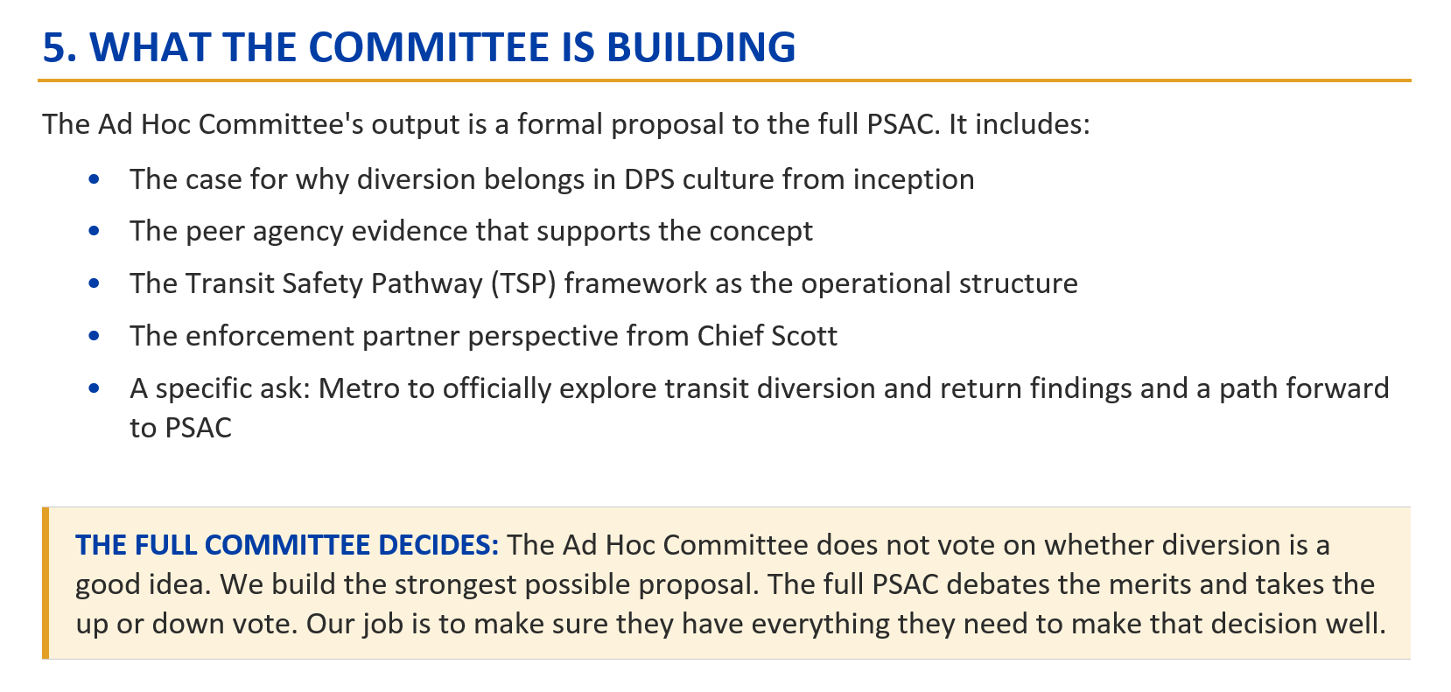
Diversion Court Ad Hoc Committee
First Meeting – July 7, 2026

Slide 11

PSAC Cohort 5
Applications available the week of July 13th
For more information, visit our website:
Public Safety Advisory Committee (PSAC) - LA Metro

Slide 12
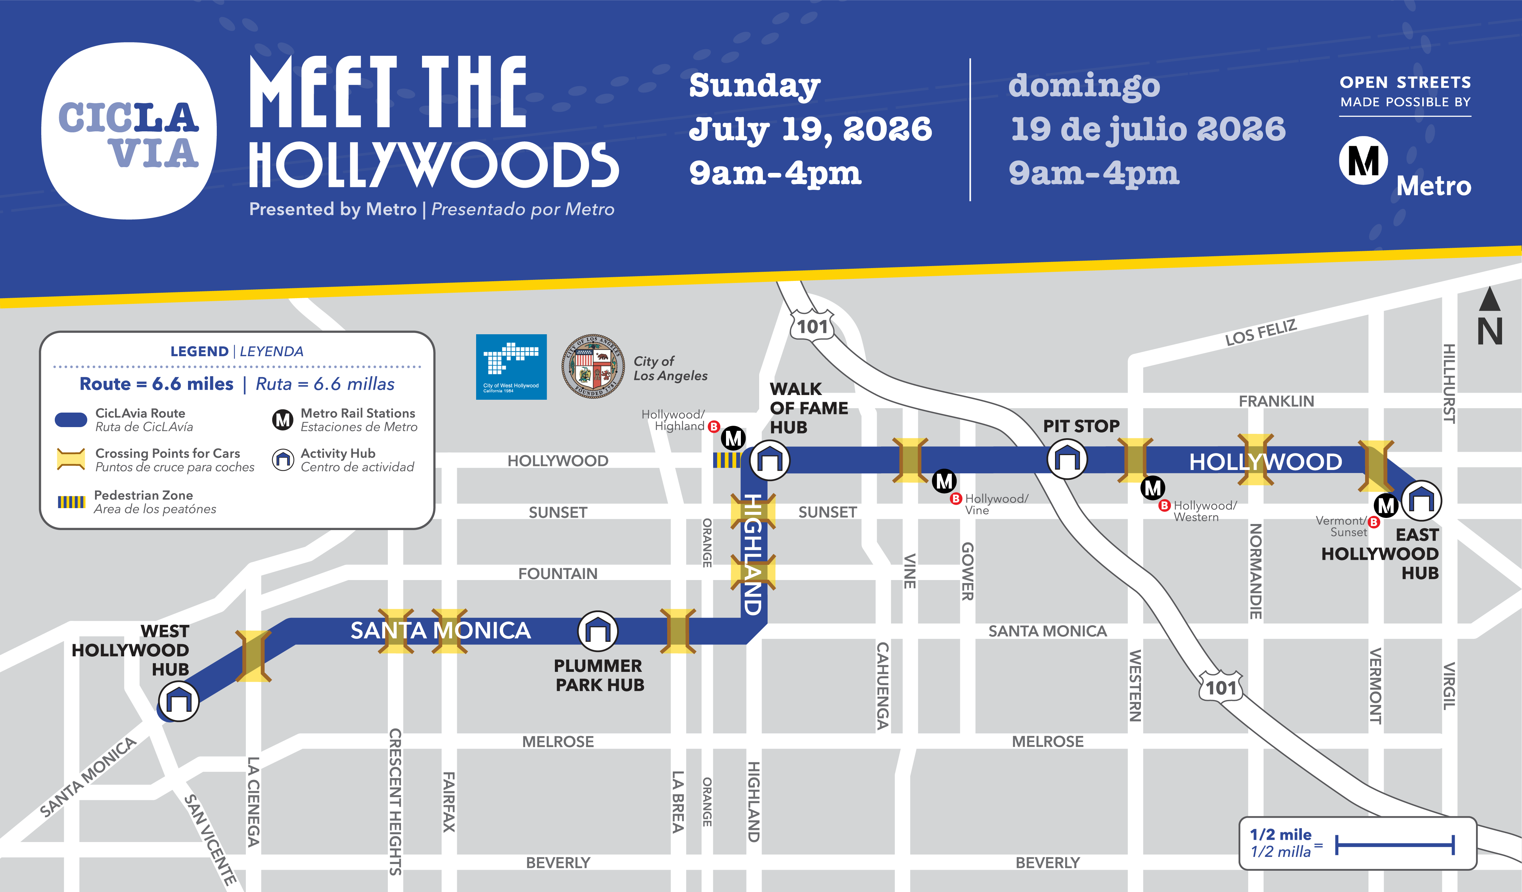
CicLAvia July 19, 2026 – Meet the Hollywoods

Slide 13
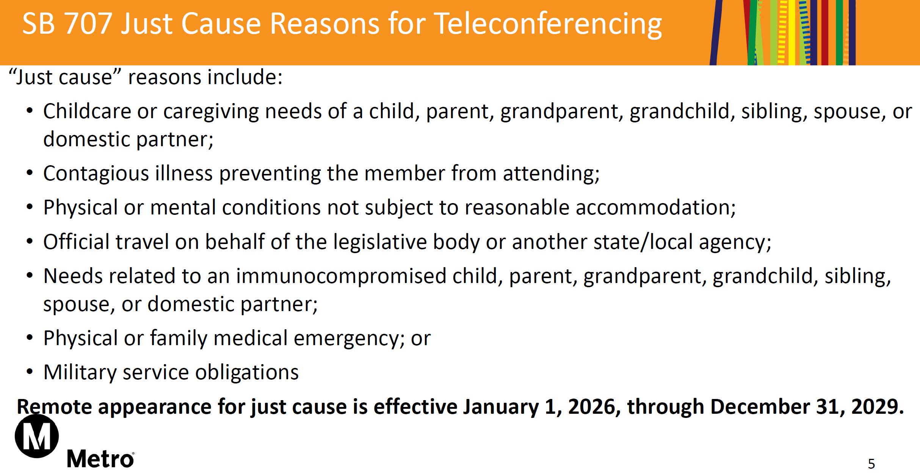
SB 707 – Just Cause Reasons Reminder

Slide 14

Cooling Stations
Heat Mitigation - LA Metro
Heat_Mitigation_Guidebook_26-1540.pdf

Slide 15
Next PSAC Meeting
Reminder
There is NO PSAC Meeting during the month of August.
Our next meeting is September 3, 2026 at 6 p.m.

Slide 16
Agenda Item #2
General Public Comment

Slide 17
Agenda Item #3
Executive Committee Procedures:
1) Emergency Election – Secretary Replacement;
2) Election – Chair Pro Tempore
Erica Boatman-Dixon, Facilitator

Slide 18
Monthly Executive Committee Meetings
The Executive Committee typically meets the third Tuesday of the month in the late afternoon.

Slide 19
Secretary Duties per the Bylaws
The Secretary shall perform the duties of roll-taking at the general membership meetings, establishing that meeting quorum has been met to commence meetings, and tallying votes for any actions and motions. Attendance shall be taken in person only, unless the general meeting is held virtually. In the absence of the Secretary, the Vice-Chairperson shall assume responsibility for roll-taking and quorum certification. In the event that both the Secretary and the Vice Chair are absent, the Facilitator shall take attendance. The Secretary shall also record and maintain the meeting minutes for all Executive Committee meetings.

Slide 20
PSAC 2026-2027 Executive Committee Candidates
Please select the name of the candidate who is most qualified to fill the duties of this position.
Secretary Candidate(s):
1.

Slide 21
Chair Pro Tempore Duties per the Bylaws
If the Chairperson, Vice Chairperson, and Secretary are all unavailable to preside over a meeting, a Chair Pro Tempore shall be appointed to ensure continuity. If the Chair Pro Tempore is filling the role of Chair and Vice Chair, then the Facilitator shall take over the Secretary role. The Chair Pro Tempore shall be selected by the Executive Committee and will receive training, as needed, to fulfill the duties of the office. The Executive Committee may designate a Chair Pro Tempore in advance for anticipated absences or appoint a standing Chair Pro Tempore to serve in the event of unexpected vacancies.

Slide 22
PSAC 2026-2027 Executive Committee Candidates
Please select the name of the candidate who is most qualified to fill the duties of this position.
Chair Pro Tempore Candidate(s):
1.

Slide 23
Congratulations to the Secretary
and
the 2026-2027
PSAC Chair Pro Tempore!

Slide 24
Agenda Item #3
Public Comment

Slide 25
Agenda Item #4
Department of Public Safety (DPS) Update and DPS Fiscal Year 2027 Budget Update
William “Bill” Scott, Chief of Police and Emergency Management

Slide 26
Department of Public Safety
Updates
PSAC Meeting | July 9, 2026
William Scott
Chief of Police and Emergency Management

Slide 27
FY27 Budget
DPS received approval for 64 new FTEs to include sworn officers, command staff, dispatchers, and administrative staff to stand up new initiatives like sworn officer hiring and implementing key systems such as Computer-Aided Dispatch (CAD) and Records Management Systems (RMS).
Additionally, DPS received funding for foundational initiatives like field training program, uniforms and equipment, and policy management.
Key supporting departments like ITS, Vendor Contract Management, Chief People Office and Customer Experience also received FTEs and non-labor budget.

Slide 28
Developing and Integrating the
Care-Based Services Division Framework
DPS’s Care-Based Services Division will house Metro’s four care-based programs: HOME, Metro Ambassadors, Crisis Response Teams, and Community Intervention Specialists.
Staff have initiated several key steps in developing the crisis response program, including:
  hiring a Senior Director for program oversight – Completed FY26 Q1
  researching evidence-based practices – Ongoing
  developing an operational manual and standard operating procedures – Completed FY26 Q4
  identifying and integrating HIPAA compliant practices – Ongoing
  developing job descriptions – Completed FY26 Q4
  identifying essential crisis response training – Ongoing
  developing an onboarding program – Ongoing
  begin recruiting of crisis response teams – Ongoing

Slide 29
Hiring and Recruitment Progress
Care-Based Services Personnel
Metro is recruiting two Deputy Executive Officers (DEOs) — one to oversee the Ambassador and Community Intervention Specialist (CIS) programs, and the other to oversee the Homeless Outreach Management and Engagement teams and Crisis Response Teams.
Two Clinical Manager positions for the Crisis Response Teams were posted in June, which will mark the first Crisis Response team program hires since the Senior Director joined earlier this year.
Sworn Officers
Key command positions were recently filled in the Administrative Services Division, including Deputy Chief and Transit Police Sergeant.
A dedicated recruitment microsite (www.joinmetrodps.com) launched in late May and generated significant interest, receiving over 900 applications within the first 24 hours
Staff is targeting the hiring of 40 lateral officers by the end of the calendar year, consistent with the approved FY27 budget.

Slide 30
Zones and Deployment
A zone-based deployment model will provide greater efficiency, flexibility, and responsiveness while allowing officers to become more familiar with the communities and areas they serve.
Staff developed seven geographic zones across the Metro system.
  Establishing geographic zones is a critical step in the deployment model, as the zones will serve as the foundation for determining initial staffing and deployment levels.
To support this effort, weekly integrated deployment meetings have been established with all public safety layers to evaluate the current deployment of all personnel, assess the rationale for existing assignments, and make deployment adjustments to improve efficiency and the best usage of resources.

Slide 31
Stakeholder Coordination
A strategic engagement plan for Chief Scott ensures he engages with riders, key internal and external stakeholders, and media and keeps the public informed about the new Department and the progress the agency has made towards creating a comprehensive and integrated public safety ecosystem.
Engagements included, but not limited to:
  Technical Advisory Committee on April 1
  On-the-Move Presentation on April 3
  Public Safety Advisory Committee on May 7
  Annual Older Adult Transportation Expo on May 15
  KCBS Interview on May 28
  Daily News Interview on June 11
  KJLH Steve Harvey Show Interview on June 25
  Spectrum News Interview on July 2

Slide 32
Next Steps
Continue to actively engage employees and the public during the implementation of the DPS.
Continue to expand recruitment and hiring strategy to meet FY27 hiring goals.

Slide 33
Questions?

Slide 34
Agenda Item #4
Public Comment

Slide 35
Agenda Item #5
Feedback on World Cup Fan Zones and Activations
Danielle Valentino, Manager, Customer Engagement Integration

Slide 36
Agenda Item #5
Public Comment

Slide 37
Next PSAC Meeting
Reminder
There is NO PSAC Meeting during the month of August.
Our next meeting is September 3, 2026 at 6 p.m.

Slide 38
Thank You
Next PSAC Meeting
Thursday, September 3, 2026

