Slide 1
We will begin in a few moments.
710 Task Force
Zero-Emission Truck Working Group
Meeting #9
August 16, 2022
Notes:
Erika

Slide 2
710 Task Force
Notes:
Erika

Slide 3

Facilitator
Erika C.B. Morales
Partner, Morales + Morales
Notes:
Erika

Slide 4
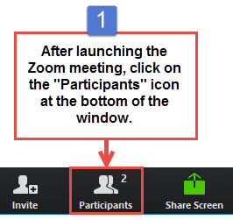
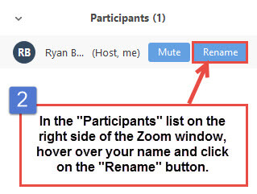
Task Force Member, CLC Member, and
Participant Identification
Please change your Zoom screen name to include: Name and Organization Name
(and if you are a Task Force Member, CLC Member)
Notes:
Erika

Slide 5

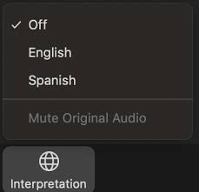
Interpretation/ Interpretación
Click the Interpretation icon in your meeting controls to enter the Spanish room
(Optional) To hear the interpreted language only, click Mute Original Audio
>Haga clic en el ícono de Interpretación en
los controles de su reunión para ingresar la sala
en español
(Opcional) Para escuchar solo el idioma interpretado, haga clic en “Mute Original Audio”
o “Silenciar audio original”
Notes:
ERIKA– please ask if anyone needs Spanish interpretation
IF NOT—NO NEED TO REVIEW THIS SLIDE, subsequent slides no need to read the Spanish instructions

Slide 6

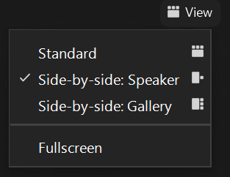
Turn on Camera / Prende la cámara
To start and stop your video, click the camera icon at the bottom left of your control panel
Para iniciar y detener su video, haga clic en el ícono de la cámara en la parte inferior izquierda de su panel de control
To switch between views during the meeting click or tap on Standard, Side-by-side Speaker View, and Side-by-side Gallery View at the top right corner of your zoom screen
Para cambiar entre vistas durante la reunión, haga clic o toque Estándar, Vista de orador en paralelo y Vista de Galería en Paralelo en la esquina superior derecha de la pantalla de zoom
Notes:
Erika

Slide 7
Zoom Protocols
Click Raise Hand in your meeting controls or
Press*9 on the phone line.
To lower your hand, click Raise Hand in your meeting controls.
Comments & questions can also be provided in writing by using the Chat function.
The Chat button is located on the control panel at the bottom of your screen.
Notes:
Erika

Slide 8
Welcome!
Notes:
Erika

Slide 9
Welcome, Agenda Review, and purpose of the
I-710 South Corridor Zero-Emission Truck (ZET)
Working Group
Notes:
Erika

Slide 10
Meeting Objectives
Refine Zero-Emission Truck Program Principles and Overview of Process
Review Zero-Emission Truck Program Framework
Discussion of CARB Rules and Anticipated Changes to Class 8 Heavy Duty Engine Types
Discuss anticipated Zero-Emission Infrastructure Needs and Next Steps
Notes:
Erika

Slide 11


Detailed Agenda
1:00pm 1:10pm | Welcome, Agenda Review, and Purpose of the Zero-Emission Truck Working Group (10 minutes) Agenda Item #1: Metro Update (10 min) 1.1 ZET Program – Metro Board Direction (5 minutes) 1.2 ZET Program Development Timeline (5 minutes)
1:20pm 2:00pm | Agenda Item #2: I-710 South Corridor Zero-Emission Truck Program Principles (40 minutes) 2.1 Recap (30 minutes) 2.2 Proposed Principle (10 minutes) Agenda Item #3: Program Framework (20 minutes) 3.1 Overview of Tasks 1-5 (10 minutes) Task 1 Focus: Identify physical infrastructure needs to support the full deployment of ZE heavy-duty trucks along the I-710 South Corridor Task 4 Focus: Develop a full-funding strategy to realize the ZE drayage deployment along the I-710 South Corridor
2:20pm 2:30pm | Agenda Item #4: CARB Rules and Anticipated Changes to Class 8 Heavy Duty Engine Types (10 minutes) William Robertson, Vehicle Program Specialist, California Air Resources Board (10 minutes) Agenda Item #5: Anticipated Infrastructure Needs to Support Energy Demand through 2040 (20 minutes) Akiko Yamagami, Manager, Transportation Planning, Goods Movement, LA Metro (15 minutes) Working Group Discussion (5 minutes)
2:50pm 3:00pm | Closing Remarks and Next Steps (10 minutes) Adjourn

Slide 12
Agenda Item #1:
Metro Update
Notes:
Erika

Slide 13
Agenda Item #1.1:
I-710 South Corridor ZET Program Recap
Metro Board Direction
Notes:
Erika

Slide 14
ZET Program Recap – Metro Board Direction
Metro Board Direction and desired outcomes
$200 million minimum funding target
Leverage $50 million local matches with private, regional, state, and federal funding
Accelerated ZE deployment in the I-710 South Corridor
Collaboration with regional stakeholders
Independent, accelerated process from overall 710 Task Force Investment Plan process
Strategies to accomplish outcomes
Identify discretionary grant opportunities
Convene and collaborate with community and regional stakeholders
Develop a scope of work for the ZET Program
Identify regional funding partners
Identify near and long-term opportunities
Identify policy and legislative barriers to implementation
Notes:
Michael

Slide 15
Agenda Item #1.2:
I-710 South Corridor ZET Program
Development Timeline
Notes:
Erika

Slide 16

ZET Program Development Timeline
This timeline shows key activities and dates for the Zero-Emission Truck (ZET) Program Development.
March
JULY 2022/AUGUST 2022
SEPTEMBER 2022
OCTOBER 2022
NOVEMBER 2022
ZET WG continues the discussion on Program Framework, Priorities, and Scope.
ZET WG evaluates proposed program Principles.
ZET WG discussions proposed Priorities and Scope.
ZET WG discusses the Pre-Investment Plan Opportunity and its relevance to the ZE Truck Program.
ZET WG Report preparation for Metro Board's September Meeting.
ZET WG incorporates findings
from Truck Technology Comparative Report.
  Based on the Transition Plan, identify the number of charging and fueling stations needed for
  LA County over time
  Seek ZET WG input on considerations and questions
  for the Implementation Plan.
ZET WG receives status report on approach for MSPP Phase
ZET WG reports to the 710 Task Force with an update on the scope of work for ZET Program Structure and Protocols following September meetings of CLC and Equity Working Group
ZET WG will vote on the ZET Program Framework, Principles and Tasks.
ZET Transition Plan Report to ZET WG and Task Force.
Metro Board considers ZET Program Framework, Principles, and Tasks (if approved)
Equity Working Group provides input to the ZET WG on equity issues.
Community Leadership Committee (CLC) provides input to the ZET WG on working with communities to shape the ZET policies and programs.
February
20XX
April
Notes:
MICHAEL
Move July/August to one column to add November
If time allows in October, bring to Task Force as a presentation. Can't bring to Metro board unless finalized a month in advance
D. Report back in September 2022 on the development and implementation of this Investment
Strategy, including the minimum of three initiatives applying for available State and Federal
funding in Calendar Year 2022.

Slide 17
Agenda Item #2:
I-710 South Corridor ZET Program
Proposed Principles
Notes:
Erika

Slide 18
Agenda Item #2.1:
I-710 South Corridor
ZET Program Proposed Principles Recap
Notes:
Erika

Slide 19
ZET Program Principles – Introduction and Overview
Metro Board action in October 2021 (Motion 16) committed $50 million as seed funding for an I-710 South Zero Emission (ZE) Truck program to support the deployment of zero-emission trucks and supporting zero-emission truck infrastructure.
The ZET Program Framework and Principles incorporate these fundamental elements and seek to leverage and amplify that $50 million seed funding.
The Program Framework and Principles for the Zero-Emission Truck Program were developed through collaboration with the 710 Zero-Emission Truck Working Group. Five major themes were brought forward through discussions with the Working Group for consideration:
  Community Engagement
  Strategic partnerships and funding opportunities
  Legislative and policy initiatives
  Truck subsidies
  Environmental impacts and equitable outcomes
Notes:
Michael
When the Metro Board action in October 2021 (Motion 16) to commit $50 million as seed funding for an I-710 South Zero Emission (ZE) Truck program,. itIt was understood at the time that the full corridor deployment of zero emission trucks and supporting infrastructure would cost more than $50 million. With that in mind, this Project Framework and Principles incorporate these fundamental elements and seek to leverage and amplify that $50 million seed funding.
The Program Framework and Principles for the Zero Emission Truck Program were developed through collaboration with the 710 Zero Emission Truck Working Group. Five major themes were brought forward through discussions with the Working Group for consideration:
Community Engagement
Strategic partnerships and funding opportunities
Legislative and policy initiatives
Truck subsidies
Environmental impacts and equitable outcomes
Program Framework
LA Metro recommends to the ZE Truck Working Group that the majority seed funding of $50 million be allocated towards deployment of supporting clean transportation infrastructure (electric and hydrogen) with a small set-aside of money reserved to support ZE truck purchases for independent owner/operators truck owners who live and work in the corridor. …. The recommendation is based on a working group consensus that vehicle technology is well advanced to a level for commercialization to reach 2030 goals, but that supporting infrastructure (I.e., charging/fueling stations and energy supply) is lagging. There is a critical need to accelerate wide deployment. The Working Group also recommends strongly that throughout the implementation plan development process, corridor communities and freight industry communities are engaged to ensure that the implementation plan is designed such that their needs will be fulfilled when the Zero Emission Truck program is deployed.

Slide 20
Principle 1 – Maximize Leverage of Seed Funding
Maximize leverage of seed funding by collaborating with regional partners and funding agencies.
The ZE Truck Program will utilize $50 million of seed funding provided by LA Metro. This seed funding will be leveraged by pursuing additional discretionary regional, state, and federal funding to reach a minimum funding target of $200 million.
To leverage the $50 million most effectively and to eliminate bottlenecks for the deployment of ZE technology, the ZE Truck Working Group will collaborate with the Mobile Source Reduction Committee (MSRC) to identify a minimum of $45 million to serve as seed funding to leverage investment in regionally significant infrastructure projects
  The remaining funds (≤ $5 million) will be eligible to support other objectives, including a targeted need-based grant assistance program for corridor-based trucking companies/small fleets to secure subsidies for conversion from diesel to ZE truck technology.
The ZE Truck Program will work with the Ports of LA and Long Beach Clean Truck Fund Rate Program, SCAG's ZE Truck Study, and other initiatives to maximize funding impact.
The ZE Truck Program will focus on regionally significant ZE infrastructure (charging/ZE fueling facilities) within the study area that will complement existing efforts to deploy domicile-based ZE infrastructure within the study area.
The ZE Truck Program should develop a strategy to fund community benefits as part of the overall $200 million target. The strategy to leverage seed funding must also include a commitment to including community benefits.
Notes:
KC: have a process to clearly define what community benefits are and how they will be incorporated into investment.
While seeking grant support, including a community benefit measure in grant application consideration and program development. Not only strengthen application, but provide support in the funding portfolio for the project
CTC Committee has procedural equity as a priority. They will be looking to support these kinds of measures in applications.
Monitor emissions once built, mitigating construction emissions, cover ongoing operations of charging facilities (measure increase/decrease). As we move through committees, make sure to focus on rectifying past harms and mitigate future harms. Seeking funding to mitigate any of those impacts
Here’s What We Heard
Consider replacing "owner/operator" as a term because the model is in flux. We should not pin funding priorities to owner/operators because they may not exist as we know them today.
Add a mobile source pollution reduction review committee
Encourage support for domicile and public charging, where there aren't many resources currently available
Need greater clarity on specific areas of infrastructure development (e.g. trucking stations, ports, garages, homes)
Michael
Process—Strategic funding opportunities

Slide 21
Principle 2 – Community Engagement
Employ a transparent community engagement framework that centers corridor residents and stakeholders throughout the development process and ensures community benefits are uplifted when considering investments.
The ZE Truck WG will work with at minimum the 710 Task Force, Community Leadership Committee, and Equity Working Group to identify equitable outcomes and participate in discussions on how to identify and integrate community benefits into every aspect of planning, development, and implementation of the ZE Truck Program, including general approaches to siting infrastructure within the corridor.
Once the ZE Truck Program identifies potential ZE infrastructure sites, the ZE Truck Program will engage and collaborate with the communities directly impacted by the selected sites throughout the planning and implementation process for specific projects.
The ZE Truck Program commits to equitable community engagement centered on the intentional education of CLC members and corridor residents around ZE truck and infrastructure deployment, operations, and impact.
Notes:
KCD: depends on what the decision is and what the process is within that structure.
Disconnect last time: would review and city council didn't necessarily listen. Figure out how community input isn't just public comment.
SDS: CEHAJ partnering with LACI. Haven't gone beyond CEHAJ members into community with regard to siting concerns.
Discuss what decision-making power could look like with ZET and EWG
Not happening as a part of the broader CBO strategy unless we push. Can offer CLC and other community members an educational workshop to share info (record it).
CEHAJ Letter
Include
Here’s What We Heard
Education around ZE truck and infrastructure deployment, operations, and impact is important for community buy-in
Educate communities intentionally by providing deeper context, rather than bombarding them with information
Consider community events and opportunities for the trucking industry to interact with community members to build understanding
Michael
SB 671 letter REFERENCE

Slide 22
Principle 3 – Corridor Community Benefits
Ensure and create corridor community benefits delivered through the ZE Truck Program
Deploying zero-emission (ZE) heavy-duty truck technology and supporting infrastructure within the corridor to displace diesel trucks will play a critical role in reducing long-standing, continual harmful health impacts generated by diesel truck technology that disproportionately affect our I-710 South Corridor residents.
The ZE Truck Program is intended to address the needs of our local communities, many of which are minority and disadvantaged economically, that are adjacent to the I-710 South Freeway and have borne for many years the myriad impacts associated with the movement of people and goods through the corridor.
The ZE Truck Program will provide and protect corridor community benefits at the outset and throughout all phases of the project by creating economic opportunities through job training and workforce development associated with ZE infrastructure development and operation within the corridor, and within the region, where possible.
Specific targets and measurable performance indicators will be established and monitored through the ZE Truck Program and on an ongoing basis to understand whether the protections afforded to residents through these investments lead to meaningful improvements in the lives of corridor residents.
Notes:
KCD: clarify what types of "protections"
SDS: (e.g. idling, illegal parking, air quality mitigation, monitor air pollution throughout operation)
Need further clarification on "concerns to repair past harms" - have a deeper dive into this discussion
Core purpose of the program not necessarily changing, more the "how"
Purpose is to accelerate a regional program that will, overall, repair past harms. This isn't reparation mitigation, but a strategic catalytic program to accelerate ZE deployment.
Here’s What We Heard
Where will funding for other benefits come from? How will additional infrastructure be paid for?
Some infrastructure may be simple
Would like to see specific targets and measurable performance indicators
Will the Task Force and CLC vote on these principles?
Process—Strategic funding opportunities

Slide 23
Principle 4 – Coordination
Coordinate ZE Truck Infrastructure Deployment and ZE Truck Strategies with planning, funding, and strategy developed by regional and community partners, state and federal agencies, funding partners, and other key stakeholders.
The ZE Truck Working Group brings together approximately 50 stakeholder organizations to develop a ZE Truck Program to be considered by the Metro Board of Directors upon completion. Many of these stakeholder organizations are also considering or advancing plans, strategies and/or investment in ZE Class 8 Truck and Infrastructure technology.
The ZE Truck Working Group will coordinate with funding partners, regional agencies, and local communities to identify a set of projects that will advance the deployment of ZE Class 8 truck technology within the I-710 South Corridor study area that is coordinated with other efforts within the region and study area.
The ZE Truck Working Group will develop the ZE Truck Program to be aligned with and able to secure funding from discretionary program opportunities at the regional, state, and federal level.
The goal for the ZE Truck Working Group is to create a program that is compatible with and enhances other regional efforts while also elevating the role this program can play in delivering ZE heavy duty truck technology in the I-710 South Corridor on an accelerated basis. This includes the application of the Equity Planning and Evaluation Tool in collaboration with corridor residents that ensures the ZE Truck Program has incorporated community input into its consideration, design and implementation.
Notes:
Here’s What We Heard
Will require a concerted effort from many agencies to execute this effort. Must continue working together on these topics
Michael
LA Metro and its partners, working through the 710 Task Force ZE Truck Working Group, brings together approximately 50 stakeholder organizations—from community representatives to regional government, freight industry to air quality regulators, transit operators to regional planners, and public health advocates to research institutions—to develop a ZE Truck Program that is part of a multimodal Investment Plan for the I-710 South Corridor that will be considered by the Metro Board of Directors upon completion.
This Program is intended to reflect and address the needs of our local communities, many of which are minority and disadvantaged economically, that are adjacent to the I-710 South Freeway and have borne for many years the myriad impacts—including those to public health resulting from toxic tailpipe emissions, as well as particulate matter (PM) from brake and tire dust—associated with the movement of people and goods through the corridor.

Slide 24
Principle 5 – Workforce Development
Work with regional and community partners to prioritize workforce development efforts that ensure community benefits in support of ZE truck and infrastructure deployment
The ZE Truck Program will continue to work with its regional and community partners to understand the job training and workforce needs to meet the increasing demand for new technology-based vehicles and infrastructure maintenance and operations.
The ZE Truck Program will work with labor partners to pursue local and targeted hire opportunities, where possible, for the implementation, operation and maintenance of ZE infrastructure. These efforts will bolster community access to quality job opportunities that support families, pay living wages, and support economic empowerment. This principle is a significant initiative of the Metro Goods Movement Strategic Plan as well as the 710 Task Force to ensure community benefit.
The ZE Truck Program will also coordinate with other Workforce Development opportunities in the region, including the Ports' Goods Movement Training Campus, Metro's future Center for Excellence and programs sponsored by university/academic institutions.
Notes:
Need to determine next steps (working within Metro's WFD team)
Here’s What We Heard
Increase knowledge regarding ZE infrastructure, carbon reduction goals, etc.
Need to consider implications and performance metrics for old hires vs. New hires, employment retention, and minimizing job loss
Important to frame this effort as a community benefit that creates jobs and develops new skills in the workforce

Slide 25
Principle 6 – Equitable Outcomes
Develop performance metrics and evaluate outcomes of the ZE Truck Program that ensure community and corridor benefits
The ZE Truck Program—through collaboration with regional, community and regulatory partners—will work together to develop a variety of pertinent performance metrics to measure improvements in air quality, the movement of people and goods, safety, and quality of life for residents along the corridor. This includes efforts to work with the 710 Task Force, Equity Working Group, and CLC to apply principles from the Equity Planning and Evaluation Tool and create alignment with the 710 Task Force process, vision and goals.
These metrics will be used to monitor performance, identify and evaluate sustainable outcomes, and identify potential areas of improvement that reduce disparities and maximize benefits for local communities.
Notes:
Good for staff to review EPET and see what ZET can already answer. Beginning this process would help ground the conversation. (perhaps collaboratively between ZET staff and EWG staff)
Can take principles from EPET to apply here, unsure if we can wait until it's finalized.
Specific question from EPET included in CEHAJ footnote:
Here’s What We Heard
Limit the number of metrics to a handful of truly meaningful ones
Celebrate equitable outcomes
Measure job growth, education, and community involvement levels
Proposed Changes
Michael
The ZE Truck Program, through collaboration with regional partners, will work together to develop a variety of performance metrics to measure improvements in air quality, the movement of people and goods, safety, and quality of life for residents along the corridor.
These metrics will be used to monitor performance, evaluate sustainable outcomes, and identify potential areas of improvement that reduce disparities and maximize benefits for local communities.

Slide 26
Principle 7 – Legislative Platform
Develop a comprehensive legislative platform for broad consideration that comprises initiatives and policies designed to support the accelerated, equitable deployment of ZE Class 8 Truck and Infrastructure deployment in the I-710 South Corridor and region
The ZE Truck Working Group has identified a series of disincentives and barriers for truck owners and companies to accept subsidies for securing a ZE Class 8 truck, especially as an upgrade over a current diesel Class 8 Truck. Additionally, the working group also has identified the need for greater incentives and outreach necessary to support greater deployment of ZE Class 8 trucks.
Legislative support will be needed to implement a comprehensive set of policies to reduce disincentives, eliminate barriers, and support incentives to assist fleet owners, particularly corridor-based independent trucking companies/small fleets, to transition from diesel to ZE technology expeditiously.
Notes:
Here’s What We Heard
Board and Supervisors need to drive as a priority
Partner with legislators
Provide a no-interest loan to the ports so they can accelerate their programs.
Public investment should catalyze not replace existing private investments.
Include the decision-making process for this principle as there can be a risk of catering to special interests.

Slide 27
Principle 8 – Expeditious Deployment of Resources
What we Heard
Move expeditiously to deploy funding to implement the ZET Program. The buying power of $50 million in seed funding will only decrease over time due to inflation and other factors, while the net impact of that investment catalyst will decrease over time. The opportunity to create the most positive impact with this funding is in the next five years.
Proposed Principle
The ZE Truck Program will expedite investment in ZE Infrastructure and vehicle deployment within the corridor with the goal of leveraging and expending all ZET Program leveraged resources by FY 2027-28.
The ZE Truck Working Group will ensure that the effort to expedite the deployment of the $50 million in seed funding will be conducted in a manner that supports community engagement principles and effective outreach.
Notes:
Michael
Taylor Thomas - Getting the funding out for infrastructure and deployment as quickly as possible is important and we can support that, but getting all of this money out by the end of 2024 is unrealistic given how slowly planning and environmental review happens. I support including a goal to expedite funding
Thomas Jelenic - general comment - concerned that none of the principles are focused on actually expediting the delivery of Zero Emissions infrastructure. Money needs to be spent and be spent quickly.
Jelenic-spend by 2024 for meaningful impact

Slide 28
Agenda Item 3:
Program Framework
Notes:
Erika

Slide 29
Agenda Item 3.1:
Overview
Notes:
Erika

Slide 30

Preliminary Tasks
Task 1: Identify physical infrastructure needs to support the full deployment of ZE heavy-duty trucks along the
I-710 South Corridor.
Task 2: Create a mechanism to assist small trucking businesses to access ZE trucks in a timely manner
Task 3: Ensure LA County has a skilled workforce to support large-scale ZE Truck deployment
Task 4: Develop a full-funding strategy to realize ZE drayage deployment along I-710 South
Task 5: Develop performance measures and establish monitoring processes
30

Slide 31
Preliminary Tasks
Task 1: Identify physical infrastructure needs to support the full deployment of ZE heavy-duty trucks along I-710 South Corridor.
  1.1 Estimate the number of charging and fueling stations to support the number of ZE drayage trucks over the next 10 years, both regional and small in scope.
  1.2 Develop an energy supply plan to ensure that sufficient energy will be provided without compromising other energy uses along the corridor.
  1.3 Develop a methodology and evaluation criteria in collaboration with the Task Force, CLC, Equity Working Group and other representatives living in the corridor for ZE infrastructure location and types of infrastructure being deployed.
  1.4 Identify existing legislative and regulatory barriers that hinder the deployment of physical support infrastructure
  1.5 Collaborate with regional partners to chart a regional path for ZE infrastructure development
31
Notes:
CEHAJ letter
commits to having representatives living in corridor communities play a role in co-designing the infrastructure site plan, including location and the types of infrastructure being deployed

Slide 32
Preliminary Tasks
Task 2: Create a mechanism to assist small corridor-based trucking businesses to access ZE trucks in a timely manner
  2.1 Draft a mechanism for Metro to provide technical assistance focused on supporting corridor-based (as a first priority) independent owner/operators/small fleets in transitioning to Class 8 ZE trucks
  2.2 Partner with CARB to design and roll out a pilot program that is specifically aimed at leasing Class 8 ZE trucks to corridor-based small business owners so that they can test the concept and provide real user feedback
  2.3 Explore additional funding and incentive opportunities to cover the cost differential between a new Class 8 ZE truck and a used diesel Class 8 truck
  2.4 Establish a multi-year technical assistance service aimed at helping small businesses with vehicle and charging infrastructure installation from beginning to end, focusing on those businesses within the I-710 South Corridor study area.
32
Notes:
Erika

Slide 33
Preliminary Tasks
Task 3: Ensure LA County has a skilled workforce to support large scale ZE Truck deployment
  3.1 Evaluate various workforce efforts within LA County that are geared towards workers engaged in ZE heavy duty vehicles and infrastructure
  3.2 Identify Metro’s role in supporting workforce investment in support of ZE truck deployment and supporting infrastructure
  3.3 Collaborate with partners to establish a workforce development outreach strategy, including outreach to labor, academic institutions and other agencies/jurisdictions/community groups
33
Notes:
Erika

Slide 34
Preliminary Tasks
Task 4: Develop a full-funding strategy to realize ZE drayage deployment along I-710 South
  4.1 Identify regional partners and their programs that Metro could leverage seed funding
  4.2 Identify immediate opportunities to support grant applications underway
  4.3 Monitor and support near-term deployment programs
  4.4 Develop or advocate for augmented or new revenue streams to support ongoing implementation of clean truck technology
  4.5 Develop a framework for funding community benefits, including job training, workforce development, and improved public health
34
Notes:
Erika

Slide 35
Preliminary Tasks
Task 5: Develop performance measures and establish monitoring processes
  5.1 Identify performance metrics and targets in consultation with corridor communities and the freight industry
  5.2 Examine mid- and long-term impacts associated with the operation of ZE infrastructure facilities
  5.3 Develop a performance monitoring and reporting system that includes specific metrics for improving public health, economic empowerment, and community benefits
  5.4 Coordinate the implementation and evaluation of the program with Metro’s Highway Program and other teams, local communities, the Gateway Cities COG, public and private sector stakeholders (local, regional, state, and national), utilities, and supporting infrastructure providers
  5.5 Identify lessons learned and recommend modifications to the Countywide Clean Truck Initiative and other clean truck programs developed by or coordinated with Metro
  5.6 Collect, maintain, and distribute information on local, regional, state, and national truck programs (e.g., scope, eligibility, available funding) to impacted parties
35
Notes:
Erika

Slide 36
Agenda Item #4:
CARB Rules and Anticipated Changes to
Class 8 Heavy Duty Engine Types
Notes:
Erika

Slide 37

Speaker
William Robertson
Vehicle Program Specialist
Mobile Source Control Division
California Air Resources Board
Notes:
BIOGRAPHIES
Bill Robertson serves as the California Air Resources Board’s Heavy Duty Technology advisor. Current responsibilities include advising CARB’s Low NOx and incentive programs. He has been with CARB for 14 years working on various emissions and toxicity projects relating heavy duty diesel and alternative fuel exhaust. He has also participated in developing test procedures and vehicle and engine testing facilities. His educational background includes a Ph.D. in physical chemistry from Yale University and a B.S. in chemistry from Andrews University.

Slide 38
CARB Rules and Anticipated Changes to ​Heavy Duty Engine Types ​
William Robertson
8/16/2022

Slide 39
Part of a Broad Effort
Scoping Plan (economy-wide GHGs)
State Implementation Plans (criteria emissions)
Mobile Source Strategy
Zero Emission/GHG Rules
  Innovative Clean Transit, ZE Airport Shuttles,
  Advanced Clean Cars-II
Criteria Rules
  Truck & Bus Rule, HD-Inspection/Maintenance,
  Omnibus Low NOx standards,
  (pending) Tier 5 Off Road Low NOx
Incentives, Demonstration & Technology Advancement

Slide 40
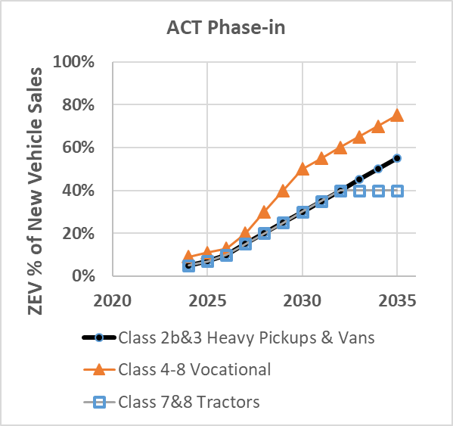
Advanced Clean Trucks: Supply
Manufacturer-facing
Assures minimum sales of ZE trucks
Increasing percentage of sales
ACT Credit trading between vehicles classes
Requires production of Class 8 ZE tractors

Slide 41
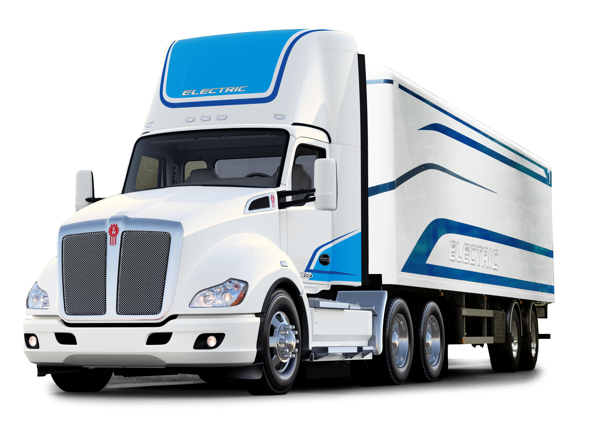
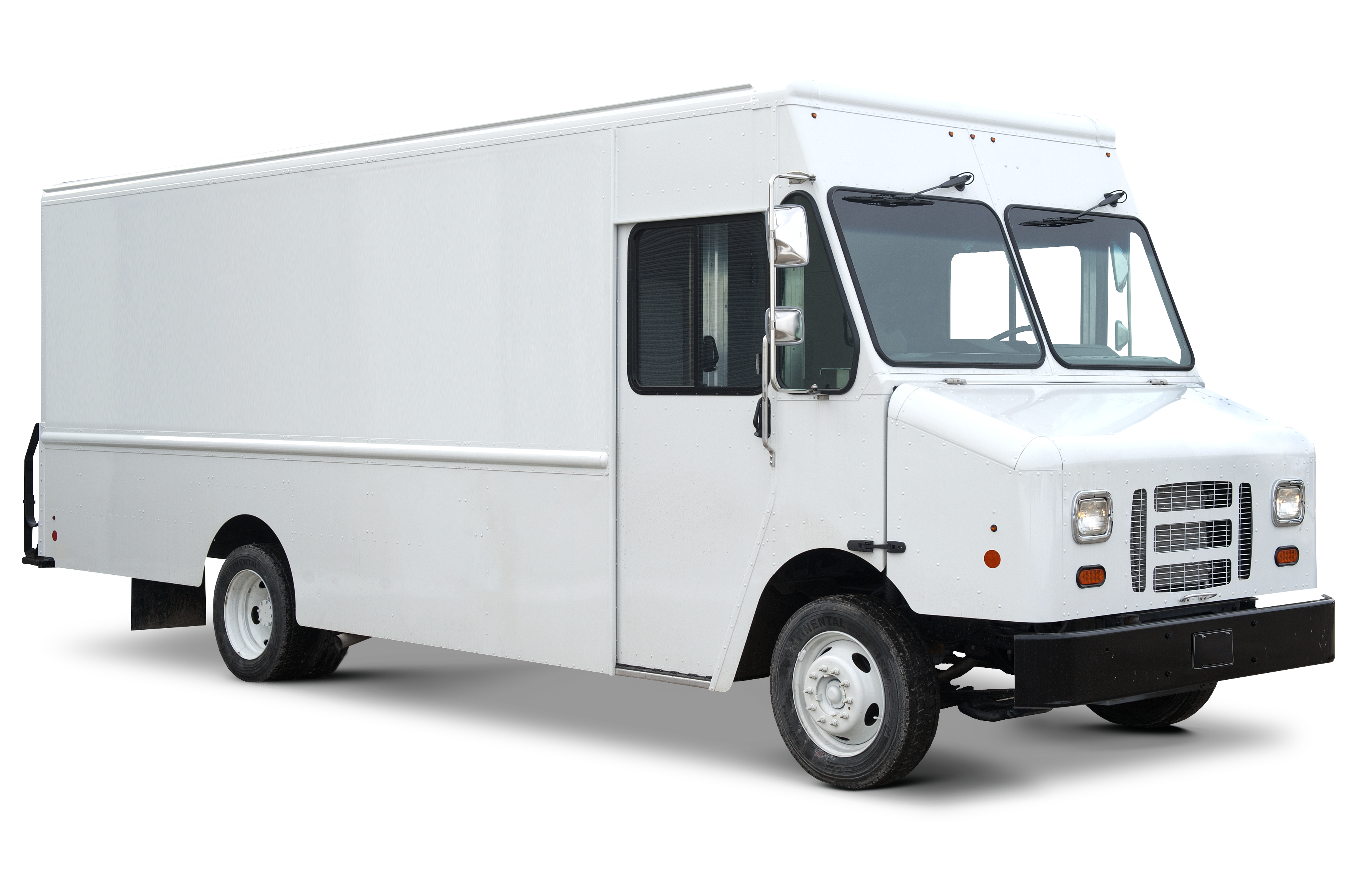
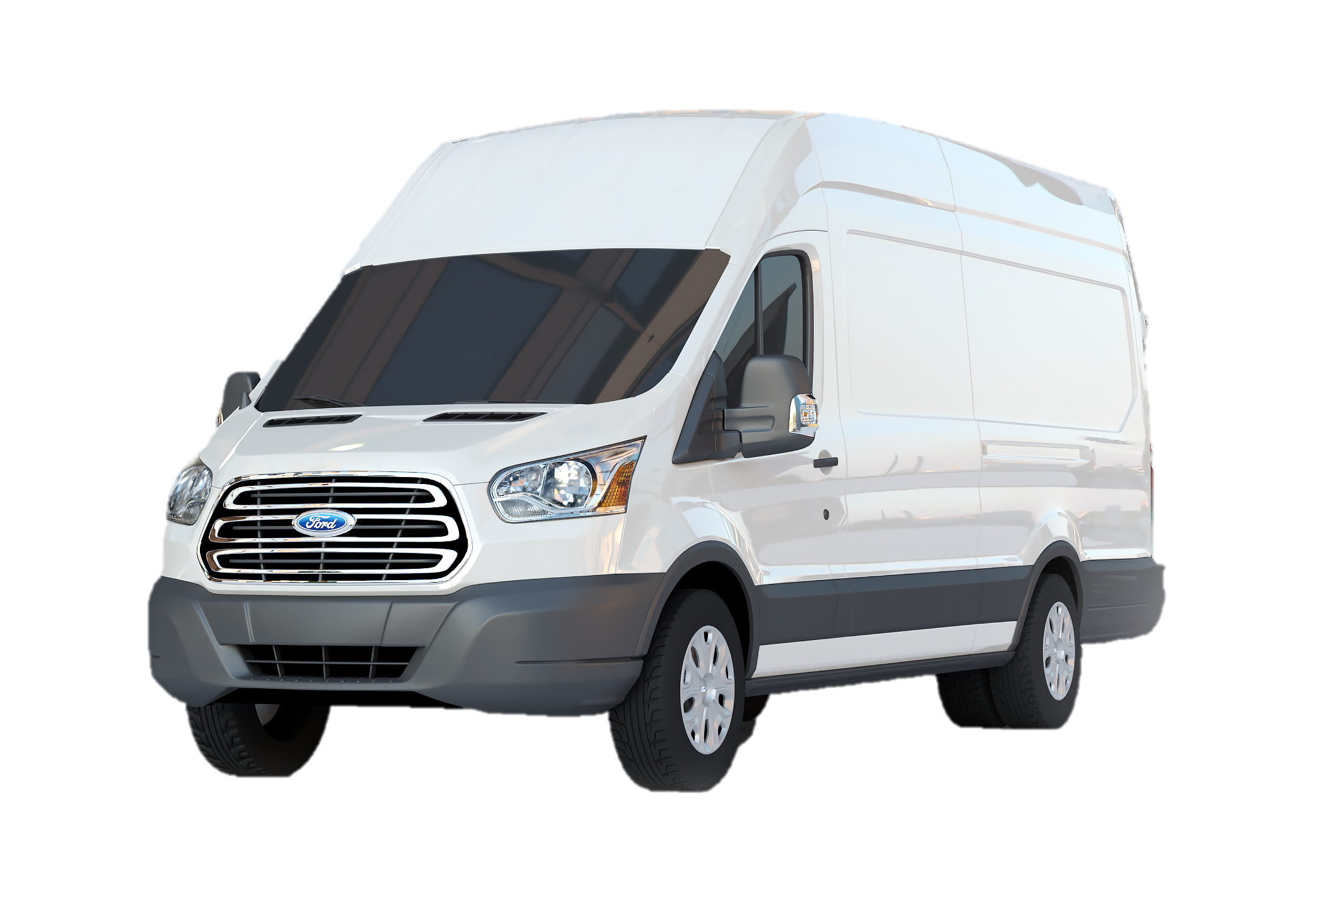
(pending) Advanced Clean Fleets: Demand
Fleet-facing
Roughly pairs with ACT ZE supply
Three fleet categories:
  ‘Drayage’ 100% ZE by 2035
  ‘Public’ ZE % of annual purchases
  ‘Priority & Federal’
  ZE % of fleet schedule or retirement by model year pathways
Combustion Sales sunset in 2040

Slide 42
ACFleets Technology Mix
(ACTrucks ZEVs dotted line)

Slide 43
Resources
Advanced Clean Trucks
https://ww2.arb.ca.gov/our-work/programs/advanced-clean-trucks
Advanced Clean Fleets
https://ww2.arb.ca.gov/our-work/programs/advanced-clean-fleets
2022 Scoping Plan
https://ww2.arb.ca.gov/our-work/programs/ab-32-climate-change-scoping-plan/2022-scoping-plan-documents
2020 Mobile Source Strategy
https://ww2.arb.ca.gov/resources/documents/2020-mobile-source-strategy

Slide 44
Questions?
Notes:
Erika

Slide 45
Agenda Item #5:
Anticipated Infrastructure Needs to Support Energy Demand through 2040
Notes:
Michael to introduce Akiko

Slide 46
Medium/Heavy-duty Vehicle Population in LA County
Notes:
Data from EMFAC2021, vehicle inventory
Akiko

Slide 47
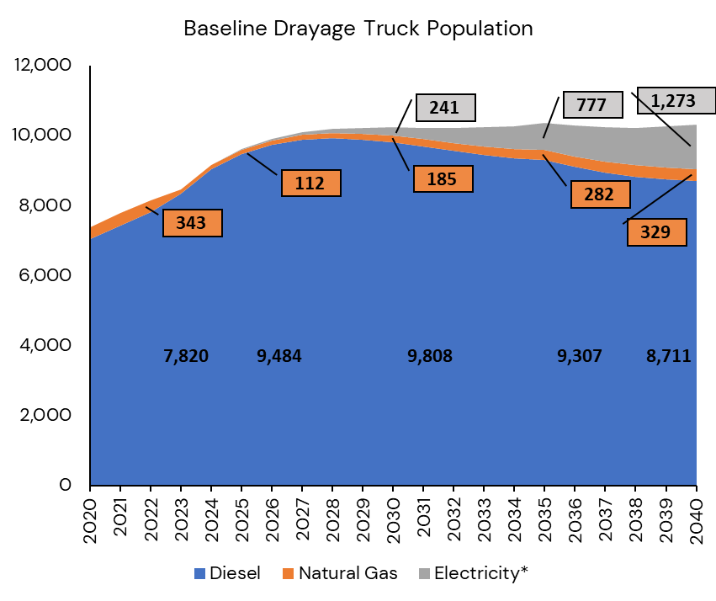
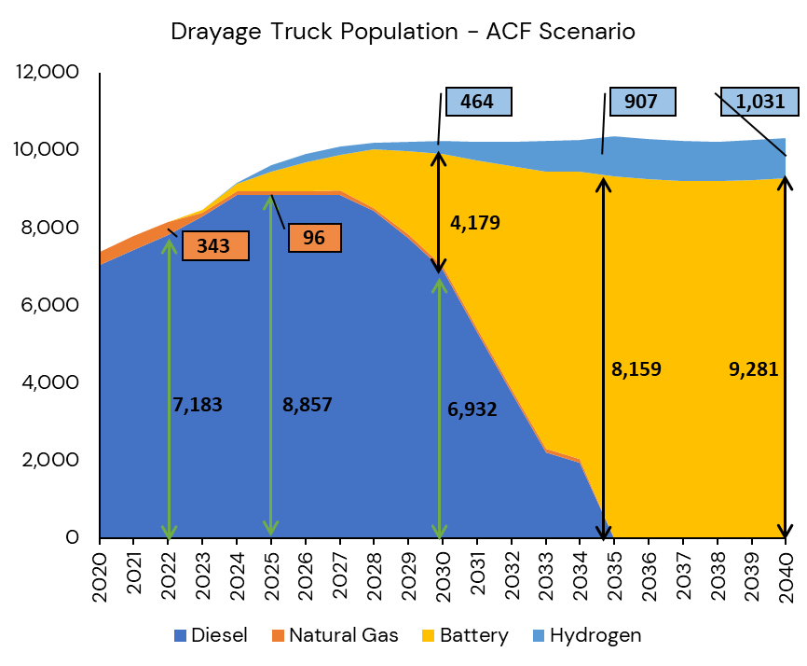
Projected Changes to Drayage Truck Technology Mix

Slide 48

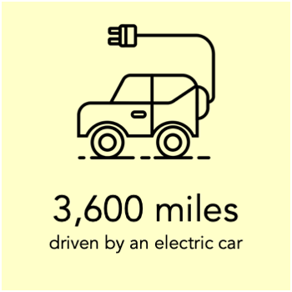
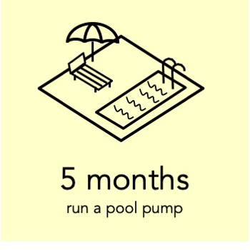

Infrastructure Needs & Cost Assessment –
Battery Electric Drayage Trucks
Projected daily aggregate energy needs to support Battery Electric Class 8 drayage trucks
What can you do with a Megawatt-Hour?
Year | Energy Needs
2020 | 1 MWh per day
2025 | 133 MWh per day
2030 | 760 MWh per day
2035 | 2,457 MWh per day
2040 | 2,444 MWh per day
Source: Freeingenergy.com
Notes:
Akiko

Slide 49
Infrastructure Needs & Cost Assessment –
Battery Electric Drayage Trucks
Number of Charging Ports by Power Level and Access Type
Anticipated Infrastructure
Investment Needs ($ millions)
 | Public | Private | Semi-Private
 | 250-360 kW | 20-30 kW
2025 | 202 | 302 | 202
2030 | 1,156 | 1,728 | 1,156
2035 | 3,739 | 5,590 | 3,739
2040 | 3,720 | 5,562 | 3,720
 | 250-360 kW | 20-30 kW
2025 | $37 | $8
2030 | $209 | $48
2035 | $677 | $154
2040 | $673 | $153
Notes:
Akiko
# of charging ports needed assumes that trucks requiring semi-public charging lots for overnight charging, i.e., small fleets and small businesses, would also require public daytime fast charging. Therefore, it was assumed that the # of charging ports required for public fast charging will be the same of the # of semi-public overnight charging ports.
- this assumption results in a conservative estimate.

Slide 50


Infrastructure Needs & Cost Assessment –
Hydrogen Drayage Trucks
Projected daily aggregate energy needs to support Hydrogen Class 8 drayage trucks
How much power does 1 kg of Hydrogen produce?
1 kg (2.2 pounds) = 1 gallon (6.2 pounds)
of gasoline
Year | Energy Needs
2020 | 10 kg per day
2025 | 740 kg per day
2030 | 8,100 kg per day
2035 | 15,800 kg per day
2040 | 18,000 kg per day
Source: Alternative Fuel Data Center
Notes:
Akiko

Slide 51
Infrastructure Needs & Cost Assessment –
Hydrogen Drayage Trucks
Number of Hydrogen Fueling Stations Needed
Throughput Capacity in kg | 2020 | 2025 | 2030 | 2035 | 2040
1000 | 0 | 1 | 7 | 13 | 15
2000 | 0 | 0 | 3 | 7 | 8
3000 | 0 | 0 | 2 | 4 | 5
4000 | 0 | 0 | 2 | 3 | 4
5000 | 0 | 0 | 1 | 3 | 3
Notes:
Akiko
The numbers assume that 100% of hydrogen fuel cell trucks will use public fueling stations.

Slide 52
Infrastructure Needs & Cost Assessment –
Hydrogen Drayage Trucks
Unit Cost Assumptions ($ in millions)
Scenario | Estimated Capital Cost
Low | $4
Medium | $6
High | $8
Estimated Capital Cost of Hydrogen Stations to Meet Hydrogen Drayage Truck Demand ($ in million)
Throughput Capacity in kg | Capital Cost Scenario Assumption | 2020 | 2025 | 2030 | 2035 | 2040
1000 | Low | $0 | $4 | $28 | $52 | $60
2000 | Low | $0 | $0 | $12 | $28 | $32
3000 | Medium | $0 | $0 | $12 | $24 | $30
4000 | High | $0 | $0 | $16 | $24 | $32
5000 | High | $0 | $0 | $8 | $24 | $24
Notes:
Akiko

Slide 53
Working Group Discussion
Notes:
Erika

Slide 54
Closing Remarks and Next Steps
Notes:
E
METRO NEXT STEPS
Protocols for vetting proposals – leveraging of funds
Legislative calendar (Norm Emerson-GCCOG), roadmap-applications-timelines
Additional Technical Support-in addition to Akiko
IMMEDIATE NEXT STEPS
--Slides and Confirmation- Jack Symington-LACI-slides (Susan)-SEPTEMBER
-Refine principles slides in presentation-CEHAJ Letter (Trey)-COMPLETE-draft response
-Michael-Fernando-Susan-Mtg re CEHAJ letter
-Tasks Worksheet Update (Susan has an example)
Agenda Item #6-focused discussions
Submit TCEP application, develop grant application
Finalize $5MM TA expertise
Local hiring policy
Erika
Difference between things we generate and things we are a part of
How do we get the $200 m
How do we use Metros’ unique position in the county
How do we create our own program?
How do we respond to other programs that want to partner with us?
How do we create technical expertise- to develop this program
Technical working group?
Keep to ourselves?
We need to develop our community outreach discussion-formalize it
Have plan in place
Advanced work in outreach
AQMD=scope
COMMUNITY EDUCATION
Akiko-Watson Land-realities of developing infrastructure
rika

Slide 55
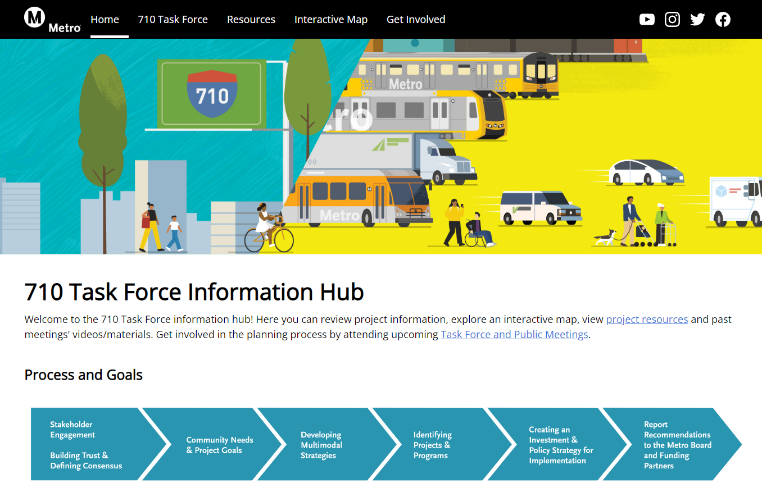
710 Task Force Information Hub
http://www.metro.net/710-hub
Extension of the current Metro.net website
User-friendly site for additional content
Graphics, meeting materials, calendar of meetings, maps, future surveys, and interactive tools

Slide 56
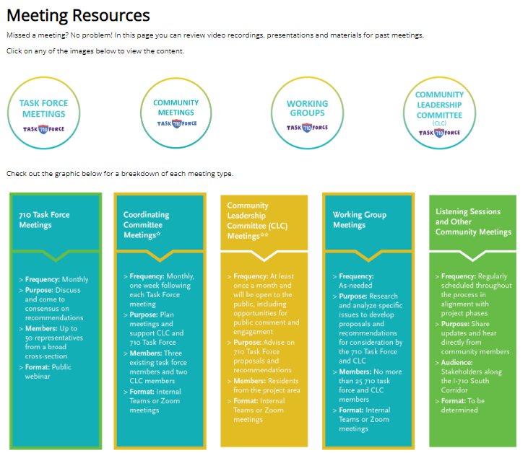
710 Task Force Information Hub
  Tool Features:
Infographics on TF process and decision-making process
Meeting Materials
  Task force meetings, Community meetings, Working groups & CLC meetings
StoryMap
  Demographics, transit and environmental info
Online Surveys (launching soon)
  Project Naming Poll
  Interactive Mapping & Survey Tool
Contact form
Calendar of Events
Notes:
https://710-south-corridor-task-force-lametro.hub.arcgis.com/

Slide 57
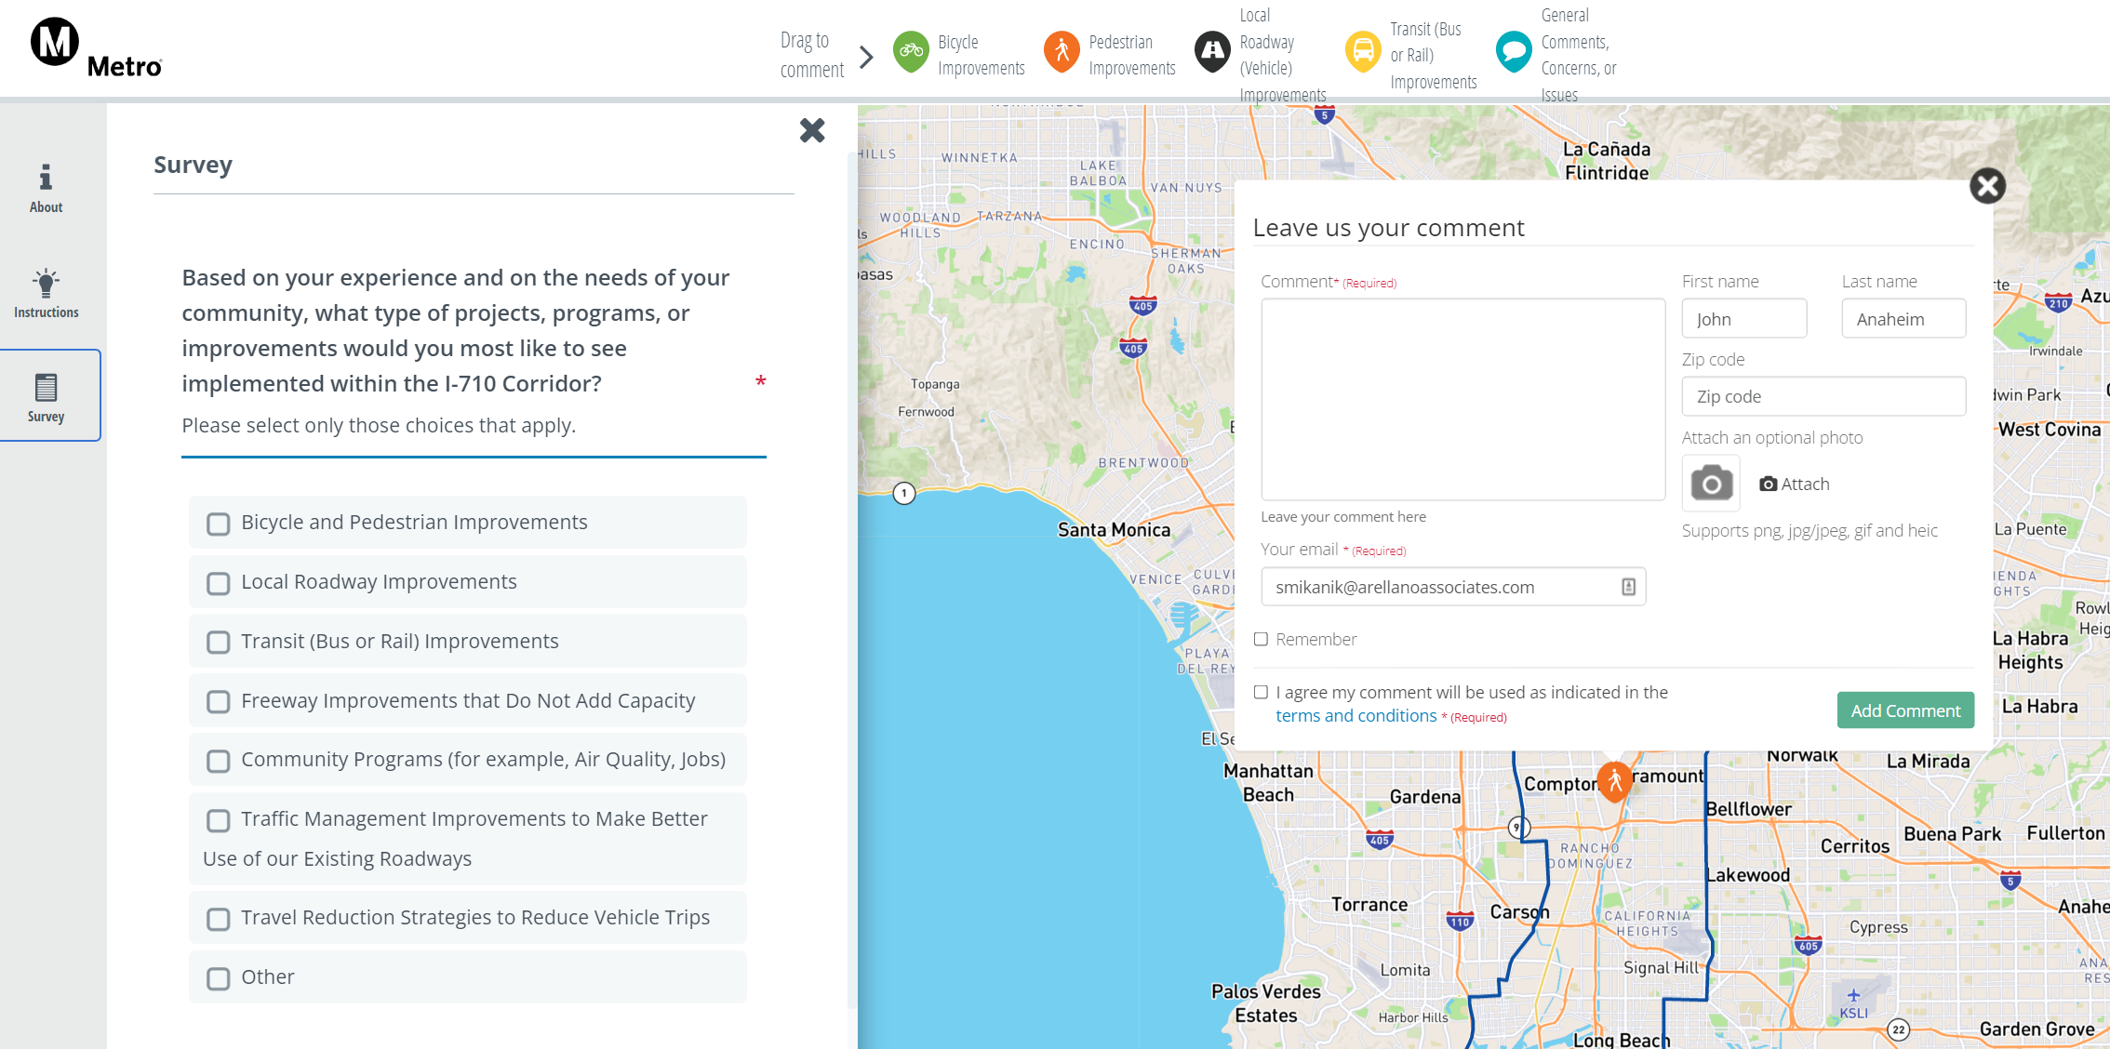


Interactive Mapping Tool and Survey
  Live for Six Weeks
Beta test: July 18 available for input from CES and Coordinating Committee
Full launch: August 2
Close survey: September 12
  Tool Objectives
  Engage the public in the decision-making process
  Gather public input on projects and programs
  Gather geo-coded data (location-centric) comments on project map
English
Español
Notes:
Nancy
ADD QR CODE
Link: Metro 710 Task Force and Investment Plan | Social Pinpoint (mysocialpinpoint.com)
PART OF THE HUB

Slide 58
Multimodal Strategies, Projects & Programs
Public Workshops
              Tuesday, August 30
              5-7pm
              Saturday, September 17 10am-12pm
Notes:
Erika
Metro and the project team invite you to attend the public workshops and help us invite as many as possible to join us.
The dates and times were carefully set up to allow a variety of options and access to maximize participation
Feel free to push out the meeting flyer – these public workshops will be round 3 to support the Multimodal Strategies, Projects and Programs phase, including gathering input on the interactive mapping tool and survey
The meeting flyer will be shared with you along with a toolkit that will include easy-to-share assets (social media suggested content and widgets, and links for more information)

Slide 59
Key Dates
              Working Group Meetings
      Equity Working Group #5
      Thursday, August 25, 5-7pm
      Zero-Emissions Truck Working Group #9
      Tuesday, September 20, 1-3pm
              Task Force Meeting
      Task Force Meeting #12
      Monday, September 12, 5-7:30pm
              Community Leadership Committee Meeting
      Meeting #6
      Thursday, August 18, 5-7pm
              Coordinating Committee Meeting
      Wednesday, August 24, 3:30-5pm
              Public Workshops
      Multimodal Strategies, Projects & Programs
              Tuesday, August 30, 5-7pm
              Saturday, September 17, 10am-12pm
      Metro I-710 South Corridor Mapping Tool and Survey
              Metro I-710 South Corridor Mapping Tool and Survey
              Tuesday, August 2 - Thursday, September 12
For the most updated list of meeting dates, visit http://www.metro.net/710-hub

Slide 60
Can’t attend the meeting? Reach out to us!
Michael Cano, Executive Officer (Interim)
Countywide Planning & Development
Metro
One Gateway Plaza, MS 99-13-1
Los Angeles, CA 90012
213.922.4710
710corridor@metro.net
metro.net/projects/i-710-corridor
@metrolosangeles
losangelesmetro
Notes:
Michael

Slide 61
Thank you!
Notes:
Erika

