Slide 1
We will begin in a few moments.
LB-ELA Corridor Task Force
Zero-Emission Truck Working Group
Meeting #20
February 20, 2024
Notes:
Erika

Slide 2
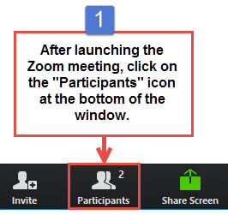
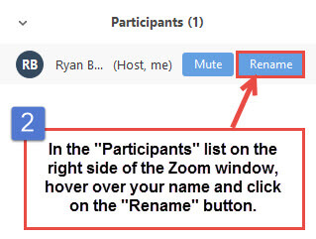


Working Group Member Identification
Notes:
Erika

Slide 3

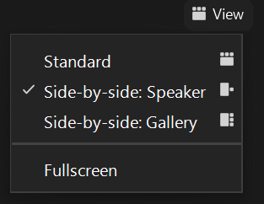
Turn on Camera
To start and stop your video, click the camera icon at the bottom left of your control panel
To switch between views during the meeting click or tap on Standard, Side-by-side Speaker View, and Side-by-side Gallery View at the top right corner of your zoom screen
Notes:
ERIKA

Slide 4

Logistics
Click Interpretation to choose your language.
To hear the interpreted language only, click Mute Original Audio (Optional).
Change your Zoom screen name to include name, agency/organization.
Click Raise Hand in your meeting controls, Press*9 on the phone line, or raise your hand physically.
To lower your hand, click Raise Hand in your meeting controls.
The Q&A button is located on the control panel at the bottom of your screen.
To mute and unmute, click the microphone icon on the bottom left of your control panel.
To start and stop your video, click the camera icon at the bottom left of your control panel.
Technology & interpretation support: 323.609.3345
Notes:
Laura

Slide 5
We will begin in a few moments.
LB-ELA Task Force
Zero-Emission Truck Working Group
Meeting #20
February 20, 2024
Notes:
Erika

Slide 6
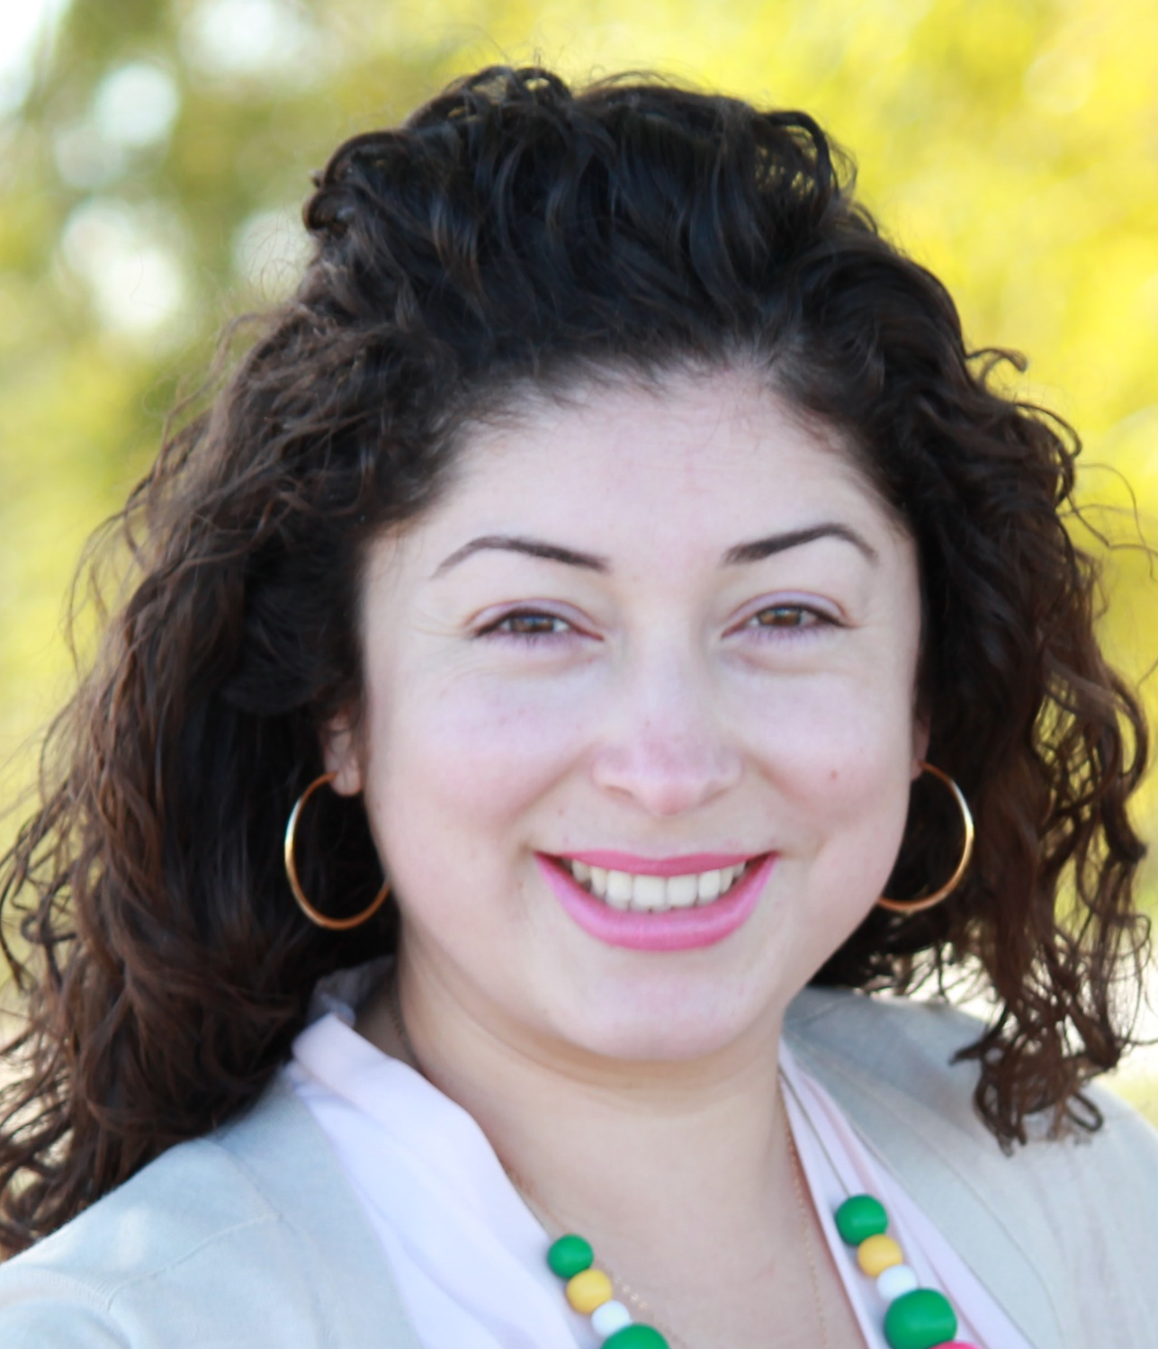
Facilitator
Erika C.B. Morales
Partner, Morales + Morales Partners
Notes:
Erika

Slide 7
Welcome, Agenda Review, and Purpose
Zero-Emission Truck (ZET) Working Group
Long Beach – East Los Angeles Corridor Task Force
Notes:
ERIKA

Slide 8
Meeting Objectives
Provide an Overview of the ZET Working Group Accomplishments
Present and discuss the ZET Recommended Projects & Programs in the Draft LB-ELA Corridor Investment Plan
Present and discuss the Mobile Source Pollution Reduction Review Committee (MSRC) Cooperative Agreement and joint Request for Proposal (RFP)
Notes:
Erika

Slide 9
Detailed Agenda
2:15pm 2:30pm | Closing Remarks & Next Steps Adjournment
1:00pm 1:05pm | Welcome, Agenda Review, and Purpose of the Zero-Emission Truck Working Group Agenda Item #1: Metro Update
1:15pm 2:00pm | Agenda Item #2: ZET Recommended Projects & Programs in the Investment Plan Agenda Item #3: Mobile Source Air Pollution Reduction Review Committee (MSRC) -Cooperative Agreement and joint Request for Proposal (RFP)
Notes:
Agenda topics
MSRC Update
Grant funding matrix
Akiko slides
Community benefits
Prioritize efforts to improve impacted areas and work with local agencies to provide resources to those communities. (Laura Cortez, EYCEJ)
Implement plans to divert traffic from sensitive receptors and minimize impact on communities is key. (Sylvia Betancourt, EYCEJ)
Conduct route studies revolving around identifying exposure on routes and how we can re-route truck to improve the air quality in those areas that are most impacted. ((Ambar Rivera, CBE)
Local jurisdictions need to be engaged in discussions about siting, permitting, utilities, access, etc. (Nancy Pfeffer, Gateway Cities COG)
Zoning classifications will determine potential sites; use mapping tools to identify pollution pockets; mitigate impacts to roads and sensitive receptors. (Kareem Gongora, CCA)
Facilitate conversations with truck drivers to gain perspective of their experience and needs. (Lily O’Brien, LA County)
Build focus groups with independent owners & operators to get their input; put together the plan to create proposals for grant funding opportunities. (Laura Cortez, EYCEJ)
Work with schools, community centers, and parks along the corridor to engage with the key local stakeholders to work on outreach strategies. (Sylvia Betancourt, LBACA)
Create funding mechanisms with local municipalities to build these local public electrification locations and create a fund to support this initiative. (Kareem Gongora, CCA)
Legislative platform
Report out on highlights from WFD panels
Advancing the WFD for ZET Program
What are the areas of overlap with the overall Task Force process
Include Task Force slides that show support for WFD in Task Force

Slide 10
Agenda Item #1:
Metro Update
Notes:
Michael

Slide 11
ZET Program – Metro Board Direction
Metro Board Direction and desired outcomes
$200 million minimum funding target
Leverage Board-approved $50 million with private, regional, state, and federal funding
Accelerated ZE deployment in the Long Beach-East LA (LB-ELA, formerly I-710 South) Corridor
Collaboration with regional stakeholders
Independent from but aligned with overall LB-ELA Corridor Mobility Investment Plan process
Strategies to accomplish outcomes
Convene and collaborate with community and regional stakeholders
Develop a scope of work for the ZET Program
Identify regional funding partners
Identify discretionary grant opportunities
Identify near and long-term opportunities
Identify policy and legislative barriers to implementation
Develop approaches to understanding potential community impacts and creating community benefits
Notes:
Michael

Slide 12
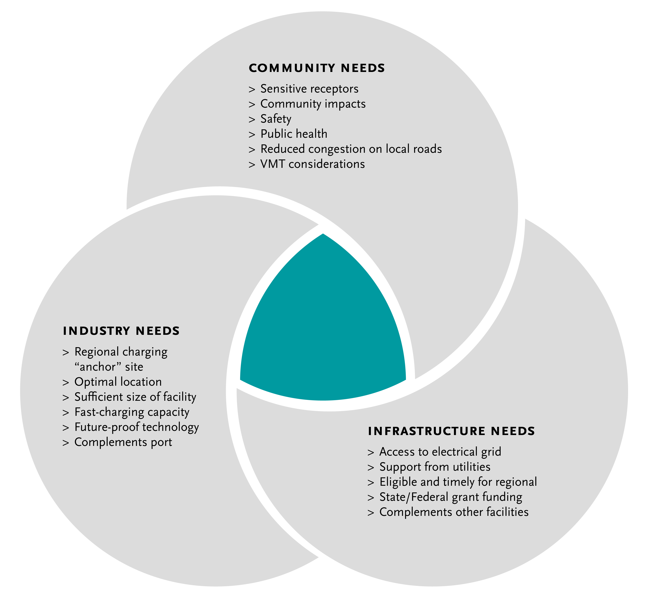
Metro Vision:
Regional Zero-Emissions MD/HD Truck Charging and Fueling Facilities
12
Notes:
Michael

Slide 13
ZET Working Group Progress
ZET Working Group members and key partners vetted the following topics in shaping the ZET Program:
Goals and objectives for the ZET Program in the context of Motion 16 (Directors Hahn and Dutra);
Industry perspectives and the role of stakeholders in the LB-ELA Corridor Task Force;
Air quality and environmental justice challenges and opportunities for the LB-ELA Corridor, as brought forward by the EPA;
Air quality context from the South Coast Air Quality Management District (SCAQMD)
  challenges in meeting upcoming federal air quality attainment deadlines due to the slow rollout;
  scaling of ZET technology and infrastructure to replace the large volume of diesel trucks moving goods in the region;
State of clean truck technology
  efforts to accelerate the commercialization of the ZE Class 8 heavy-duty trucks;
  Governor’s annual budget and the prospects for ZE trucks & infrastructure funding opportunities

Slide 14
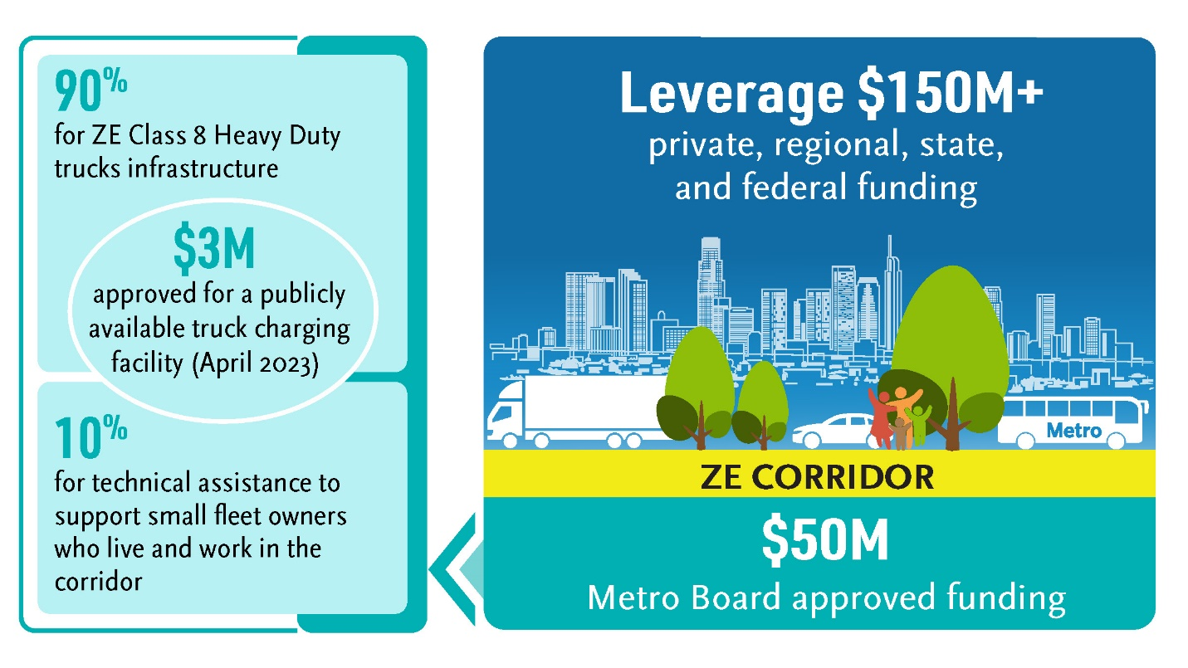
ZET Working Group Progress - Continued
Federal funding opportunities and collaboration with United States Department of Transportation representatives;
Strategies to ensure proper community participation through engagement activities at key planning decision points regarding ZE Infrastructure siting;
Strategies to best leverage Metro’s $50 million in seed funding:
  -with the state and federal governments’ existing and future resources,
  -while exploring partnerships with organizations already offering incentives to deploy ZE truck technology and infrastructure, such as the POLA, POLB, the CARB, and SCAQMD.

Slide 15
ZET Working Group Progress - Continued
Through focus group discussions, stakeholder interviews, guest speakers, and panel presentations, the Working Group determined the need to:
  Create a structured outreach plan to connect supply and demand on workforce development and training opportunities
  Establish a regional collaborative to improve coordination, sequencing, and efficiency in the development of corridor-specific Zero-Emission charging infrastructure
  Identify several initiatives that require additional research
  Understand the current and future state of hydrogen as an alternative clean transportation fuel, including potential impacts to local communities
Approved up to $3 million in seed funding to support the development of a publicly available ZE Charging Facility.
  This Wilmington facility will support the advancement of Board direction by catalyzing other regional agencies, including the Port of LA, and private partners to fully fund the project and leverage Metro’s contribution with an additional $12 million.
Notes:
Staff has identified an opportunity to leverage a portion of the $50 million (up to $3 million) in seed
funding for a $15 million ZET charging facility identified by the Los Angeles Cleantech Incubator
(LACI), funded initially with a $1.5 million Community Project Funding award secured Representative
Nanette Diaz Barragán (CA-44), and owned by the Harbor Department of the City of Los Angeles
(Port of LA.
This project demonstrates alignment with the ZET Program Principles, and staff believes Metro’s
funding commitment will support the advancement of Board direction by catalyzing other regional
agencies, including the Port of LA, and private partners to fully fund the project and leverage Metro’s
contribution with an additional $12 million.
Support for a California Environmental Quality Act categorical exemption and statutory permit approval deadlines for ZE charging facilities;
Improved awareness of statutorily created streamlining opportunities for municipalities to improve the timing and sequencing of ZE infrastructure development;
Allocation of additional funding for increased road maintenance because of the increased weight of battery electric trucks; and
Support for small fleet owners burdened by high vehicle insurance costs.

Slide 16
ZET Presenters
Transportation & Environmental Agencies
Federal
  Andrew Wishnia, Deputy Assistant Secretary for Climate Policy, US Department of Transportation
  Charles Small, Deputy Assistant Director for Intergovernmental Affairs, US Department of Transportation
  Morgan Capilla, U.S. Environmental Protection Agency
  Karina O’Connor, U.S. Environmental Protection Agency
State
  Peter Christensen, Air Resource Supervisor, California Air Resource Board (CARB)
  Hannah Walter, Associate Deputy Director, California Transportation Commission (CTC)
  Kayla Giese, SB 671 Assessment Coordinator, California Transportation Commission (CTC)
  John Frala, Professor Alternative Fuels Technology, Rio Hondo College; Clean Transportation Program Advisor, California Energy Commission (CEC)
  Micah Wofford, Energy Commission Specialist, California Energy Commission ​(CEC)
  Michelle Vater, Freight and Transit Unit Supervisor, California Energy Commission ​(CEC)
Regional/County
  Dr. Matt Miyasato, First Element Fuel
  Seungbum Ha, Program Supervisor – Electric & Hybrid Vehicles, SCAQMD
    Alison Linder, Accelerated Electrification Team and Clean Technology Program, Southern California Association of Governments (SCAG)
    Jannet Malig, Statewide Director Advanced Transportation & Logistics, Cerritos College; Co-Director, Long Beach Clean Cities
    Sean Wilder, Energy and Environmental Services, LA County Internal Services Department
    Cris Liban, Chief Sustainability Officer, LA Metro
    Quintin Sumabat, Deputy Executive Officer, Vehicle Engineering and Acquisitions, LA Metro
Ports
  Leela Rao, Environmental Specialist, Port of Long Beach
  Jacob Goldberg, Environmental Specialist, Port of Los Angeles

Slide 17
ZET Presenters
Academic/Research/Policy Foundation
  Dr. Genevieve Giuliano, Ferraro Chair in Effective Local Government, Distinguished Professor at USC Sol Price School of Public Policy, USC METRANS ​
  Dr. Tyler Reeb, Director of Research and Workforce Development, Center for International Trade and Transportation(CITT), Cal State University of Long Beach (CSULB)
  Alycia Gilde, U.S. Department of Energy
  Tom Brotherton, Director, Market Acceleration, CALSTART
  Bill Van Amburg, Global Strategic Advisor Zero-Emission Commercial Vehicles, Energy and Sustainability, CALSTART
  Jack Symington, Senior Program Manager, Los Angeles Cleantech Incubator (LACI)
Labor and Economic/Workforce Development
  Robert Chavez, Program Manager, South Bay Workforce Investment Board
Private Sector
  Carlo Bertani, Environment, Sustainability and Decarbonization, Maersk
  Salim Youssefzadah, CEO, Watt EV
  Patrick Couch, SVP, Gladstein, Neandross, and Associates
  JT Steenkamp, Director, Infrastructure Projects and Technology, Prologis ​
  Henrik Holland, Global Head of Project Mobility, Prologis
  Keir Opie*, Principal, Cambridge Systematics, Project Team
*No longer with organization

Slide 18
A Balanced Approach to Zero-Emissions
Metro is committed to exploring all viable zero-emission technologies, including battery-electric and hydrogen, to meet regulatory mandates and sustainability goals without endorsing one solution. Metro is also committed to investing its CMIP funds in a manner that aligns with and advances the LB-ELA Corridor Task Force Vision, Goals, and Guiding Principles.
Addressing Community Concerns: Recognizes concerns regarding public health, emissions during hydrogen production, transportation safety, and potential leakage, affirming Metro's dedication to minimizing impacts and educating communities.
Compliance with Clean Fleets Rule: California's 2035 Zero-Emission (ZE) drayage truck mandate focused on tailpipe emissions, highlighting the need for comprehensive approaches to achieve ZE outcomes.
State and Federal Investments: Significant investments in hydrogen and battery-electric technologies, including up to $1.2 billion Regional Clean Hydrogen Hub (H2Hubs) award, indicating strong governmental support for diverse ZE solutions.
Community Advocacy and Education: Metro aims to serve as a community advocate in ZE Truck (ZET) technology policy discussions, ensuring community concerns are addressed, supporting research, and facilitating educational initiatives on ZE technologies.
Expert Panel Discussions and Symposia: Plans to organize expert panels, symposia, and community education events to deepen understanding of hydrogen technology, its state of development, and its implications for the LB-ELA Corridor.
Collaborative Efforts for ZE Future: Continue collaboration with stakeholders to develop a ZE future that benefits the LB-ELA Corridor, emphasizing the importance of community input and guidance in educational and policy initiatives.

Slide 19
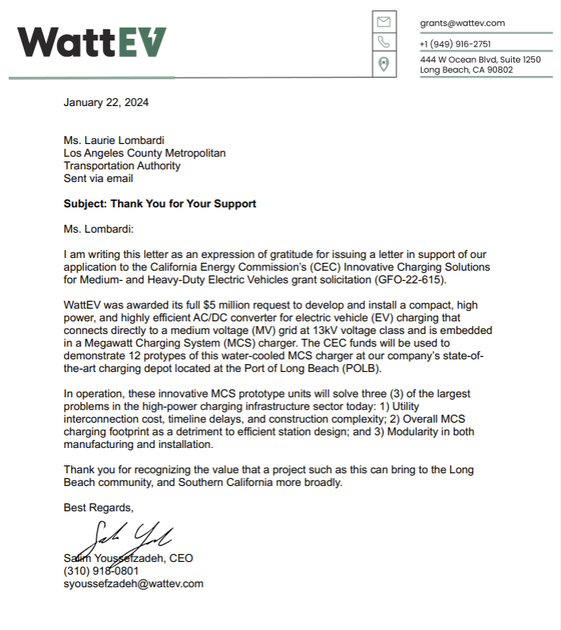
ZET Infrastructure Deployment – A Positive Step Forward

Slide 20
Agenda Item #2:
ZET Recommended Projects & Programs
in The Investment Plan

Slide 21

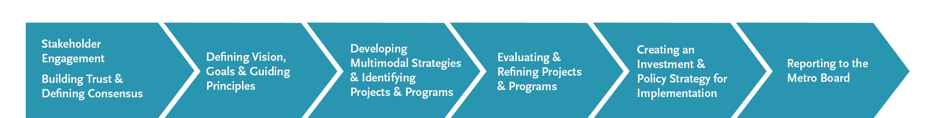
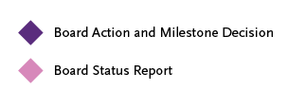
ZET in the Investment Plan
The ZE Truck and Infrastructure Program is part of the LB-ELA Corridor Mobility Investment Plan and is aligned with the LB-ELA Corridor Vision, Goals, and Guiding Principles.
*
Notes:
Michael
ZET program has been integrated into the final plan, emphasizing its significance.
aligned with the vision, goals, and guiding principles.

Slide 22
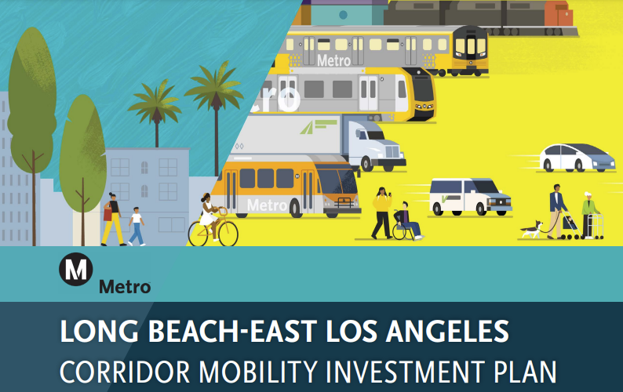

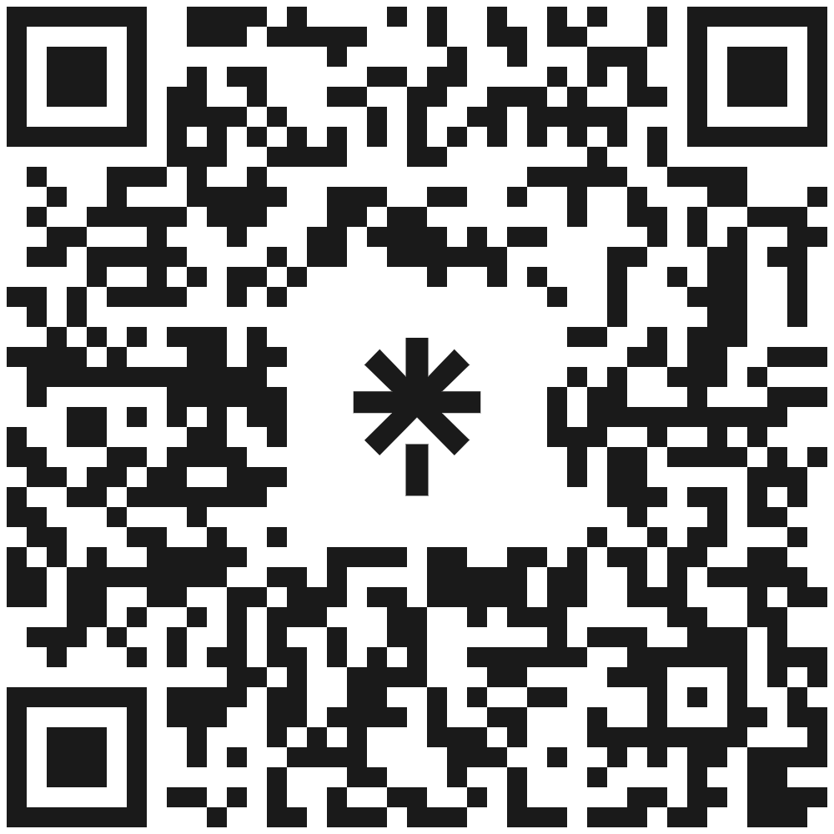
Investment Plan Update and Key Dates
The Public Comment Period is open for the Draft Corridor Mobility Investment Plan until March 1, 2024
Access the Investment Plan here
January 31-March 1 Public Comment Period
Wednesday, March 20 Metro Planning and Programming Committee – 1:00 pm
Thursday, March 28 Metro Board of Directors – 10:00 am

Slide 23
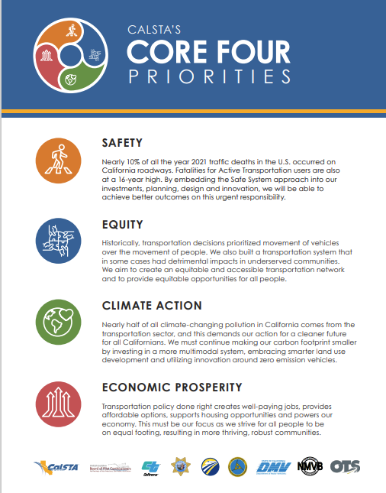
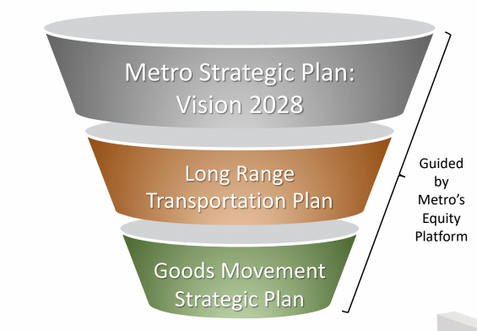
Metro’s Coordinated Planning Efforts
LB-ELA Corridor Mobility
Investment Plan
The Zero-Emission Truck and Infrastructure Program is aligned with the LB-ELA Corridor Vision, Goals, and Guiding Principles and is folded into the Draft CMIP.
Notes:
Michael
Incorporate references to the LRTP (Long-Range Transportation Plan) Vision 2028 and the relevant graphics from previous presentations.
Show alignment with major policy frameworks from both the state and metro levels.
Emphasize continuity by placing the LRTP Vision 2028 and the GMSP (General Mobility Strategic Plan) side by side, indicating alignment with past policies.

Slide 24
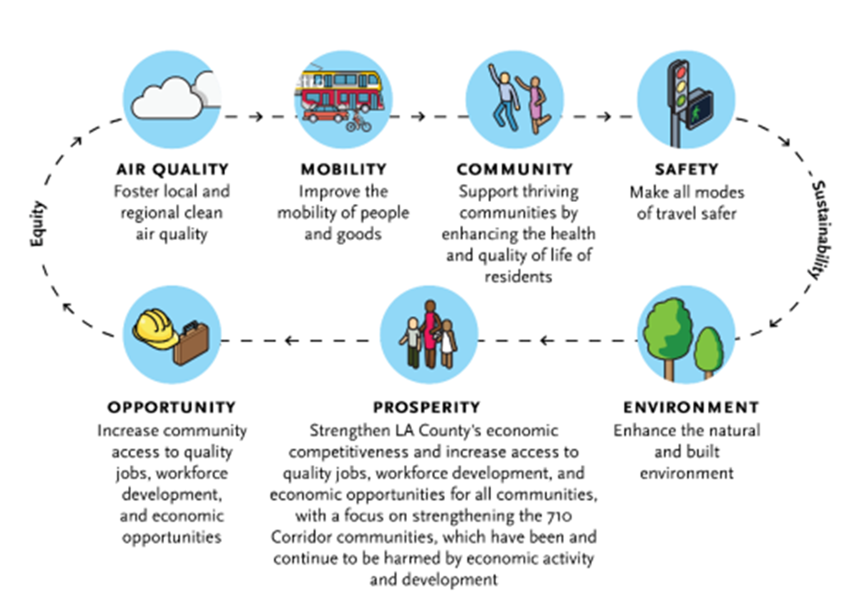
Investment Plan - Vision, Guiding Principles and Goals
Vision
An equitable, shared LB-ELA Corridor transportation system that provides safe, quality multimodal options for moving people and goods that will foster clean air (zero emissions), healthy and sustainable communities, and economic empowerment for all residents, communities, and users in the Corridor.
Guiding Principles
Equity A commitment to (1) strive to rectify past harms; (2) provide fair and just access to opportunities; and (3) eliminate disparities in project processes, outcomes, and community results. The plan seeks to elevate and engrain the principle of Equity across all goals, objectives, strategies, and actions through a framework of Procedural, Distributive, Structural, and Restorative Equity, and by prioritizing an accessible and representative participation process for communities most impacted by the I-710. | Sustainability Development that meets the needs of the present without compromising the ability of future generations to meet their own needs. A commitment to sustainability to satisfy and improve basic social, health, and economic needs/conditions, both present and future, and the responsible use and stewardship of the environment, all while maintaining or improving the well-being of the environment on which life depends.
Goals
Notes:
Michael

Slide 25
ZET Program Principles*
1
2
3
4
Maximize leverage of seed funding
by collaborating with regional partners and funding agencies.
Expeditious Deployment of Resources
to maximize the buying power and benefit of investment while supporting community engagement and effective outreach.
Coordination
with regional and funding partners, government agencies, and key stakeholders.
Community Engagement
that centers corridor residents and stakeholders throughout the development process.
5
6
7
8
Workforce Development
that ensures community benefits and access to opportunity through the
pursuit and implementation of ZE Technology.
Corridor Community Benefits
by creating economic opportunities, improving air quality, and reducing long-standing health impacts generated by diesel trucks.
Equitable Outcomes
ensured by performance metrics that evaluate sustainable outcomes.
Legislative Platform
designed to support the accelerated, equitable deployment of ZE technology by reducing barriers and increasing incentives to adoption.
*The Zero-Emission Truck and Infrastructure Program Principles are aligned with the LB-ELA Corridor Vision, Goals, and Guiding Principles. The Program is part of the Draft CMIP.
Notes:
Michael

Slide 26
Improving Local & Regional Air Quality
The Investment Plan identifies
air quality as the #1 challenge:
  Air quality is the number one area of concern for respondents.
  The LB-ELA Corridor accounts for 20% of all particulate emissions in Southern California.
  The high levels of diesel pollutants affecting communities within a quarter mile of the freeway have earned the name “diesel death zone” referring to the linkage between diesel pollution and respiratory and cardiovascular health conditions.
1, 2, 3, 4
Chapters
Foundational Chapters
6
Corridor Community Benefits
by creating economic opportunities, improving air quality, and reducing long-standing health impacts generated by diesel trucks.

Slide 27
Bold Steps - Improving Local & Regional Air Quality
The Investment Plan takes bold steps to combat air quality issues.
Chapters
1, 2, 3, 4
Foundational Chapters
Chapters
6
Includes a bold and clear statement about the negative impact of the freeway (and any potential freeway widening) on air quality.​
Describes air quality goals as key pillars of the Plan, with input from the ZE Truck Working Group.
Tracks air quality trends, tree coverage, and other environmental indicators.
Lifts up the Air Quality Goal and Sustainability Guiding Principle, which guide all project selection.
Corridor Community Benefits
by creating economic opportunities, improving air quality, and reducing long-standing health impacts generated by diesel trucks.
Notes:
Particulate Matter Reduction Pilot Project is included on the intial list

Slide 28
Decreasing negative impacts of the freight movement
The Investment Plan seeks to decrease negative impacts on local communities through new & better ways to move freight.
Chapters
1, 2, 3, 4
Foundational Chapters
6
Describes the national freight significance of the corridor, with substantial impacts borne by residents adjacent to the I-710.
Describes a policy shift from simply moving freight to serving the health, connectivity, and other quality-of-life needs of local communities.
Corridor Community Benefits
by creating economic opportunities, improving air quality, and reducing long-standing health impacts generated by diesel trucks.

Slide 29
Leveraged Measure R/M Funding
$3.2B+
$743M
**Community Programs will receive and leverage funds other than Measure R/M, which is eligible for transportation projects and programs

Slide 30
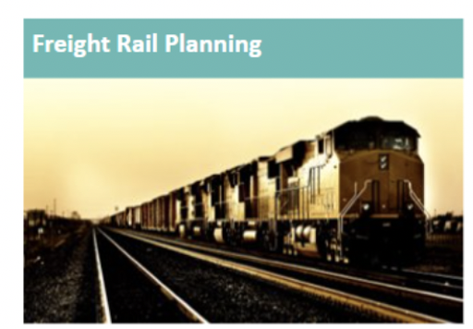
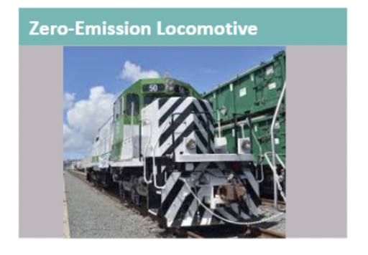
Bold Steps – New & Better Ways to Move Freight
The Investment Plan supports new and better ways to move freight and goods to decrease negative impacts on local communities.
Chapters
5, 6, 7, 8
Actionable Chapters
Freight/goods movement projects included in the Investment Plan are those that minimize negative environmental impacts, modernize technology, and upgrade infrastructure.
The List of Projects Recommended for Initial Investment includes ZE truck infrastructure and freight rail electrification projects/programs.
The Investment Plan supports moving more cargo through the Alameda Corridor, leveraging major on-dock rail investments by the Ports.
Metro will lead and partner with communities and agencies to identify and pilot strategies to reduce, capture, and mitigate Particulate Matter generated from freeway usage to complement tailpipe emission reduction strategies.

Slide 31
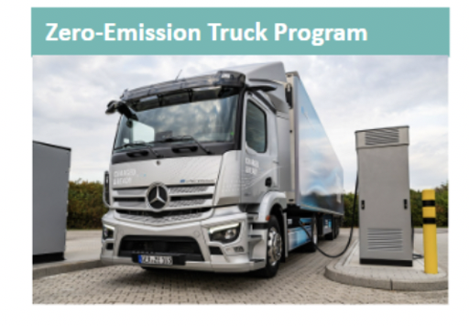
Clean Truck Infrastructure (ZET)
Project/‌Program name | Clean Truck Infrastructure [LB-ELA_0023]
Project/‌Program description | The Clean Truck Infrastructure project (0023) would install charging infrastructure for zero-emission trucks.
Project/‌Program lead | Metro/‌Caltrans/‌Ports
Metro role | Partner
Location | Study Area Wide
Top scoring goals/‌principles | Air Quality; Opportunity; Environment
Flags | Equity Flag: Medium See related implementation requirements/‌guidance below
Modes | Goods Movement only
Phase (life cycle) | Implementation
Implementation requirements/‌guidance | Siting of zero-emission truck infrastructure should avoid displacements, right-of-way and neighborhood impacts. Wherever these impacts are under consideration, Metro and jurisdictions should proactively engage residents, businesses, and property owners to understand site-specific conditions and discuss opportunities for relocation assistance and other community benefits. Construction impacts such as noise pollution, dust emissions, traffic delays/‌diversion, and business interruptions should be carefully assessed and planned with mitigation strategies in place. Facilities that require the expansion or addition of paved areas should incorporate materials and designs that maintain or increase pervious cover, and/or landscaping elements that allow for sufficient stormwater runoff.
Potential for packaging | Combined with 0004
Estimated cost | NA
Funding sources and eligibility | 0023 may be funded exclusively through Measure R, in which case it would be led by Metro. Trade Corridor Enhancement Program
Estimated Metro match (R&M) and eligibility | $50 million * *Already committed by Metro board (shared with LB-ELA_0004) Minimum local matches are as follows: 10 percent – CIF; 20 percent – PIPD, Reduction of Truck Emissions at Port Facilities

Slide 32
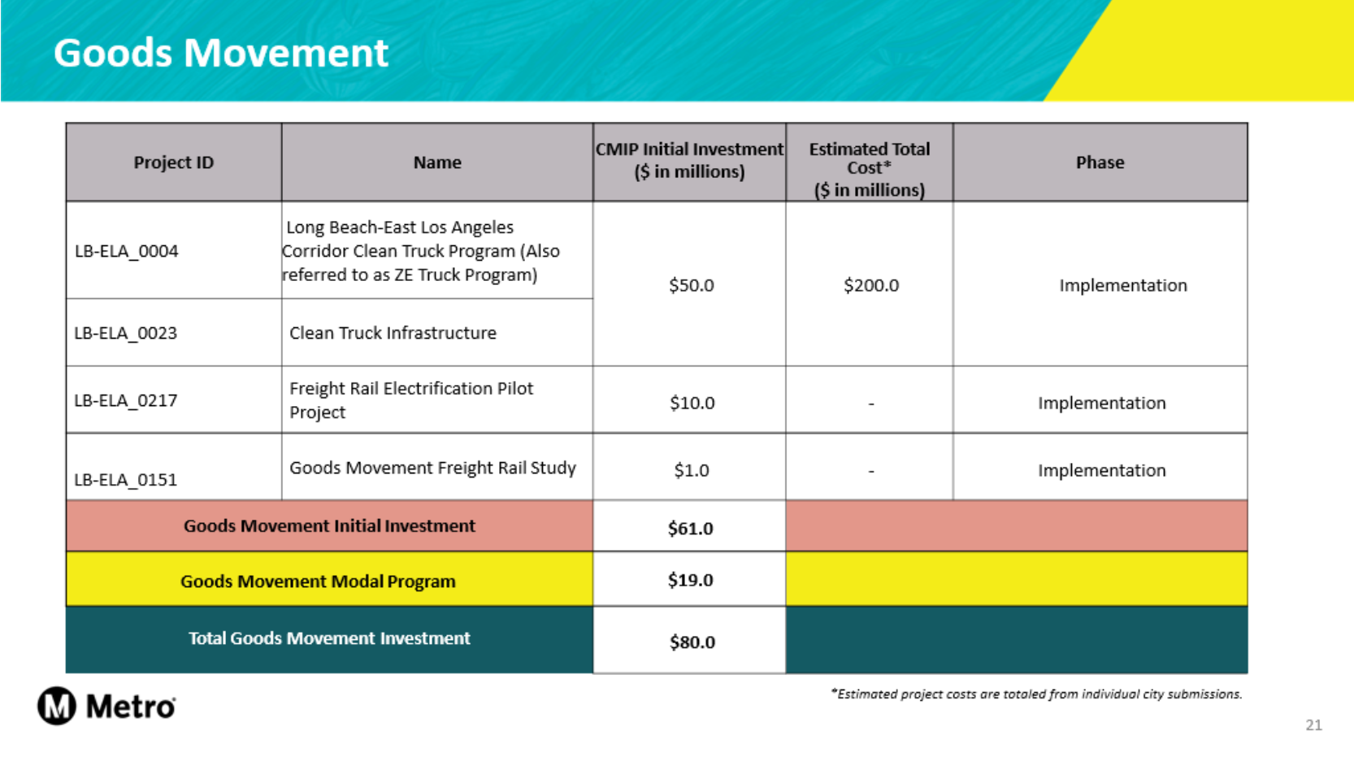
Bold Steps – New & Better Ways to Move Freight
Decreasing negative impacts of freight movement

Slide 33
I-710 Particulate Matter (PM) Reduction Pilot Project
Project/‌Program name | I-710 Particulate Matter (PM) Reduction Pilot Project (LB-ELA_0157)
Project/‌Program description | Implement a pilot project on I-710 to deploy and evaluate measures to reduce exposure of nearby populations to particulate matter, specifically localized sources of entrained/‌fugitive dust, tire wear, and brake wear associated with traffic on the freeway. These measures may include roadside vegetation barriers within available Caltrans’ right-of-way, air filters for nearby schools or community facilities, pavement materials, frequent street-sweeping, and deployment of air quality monitoring systems, among others. In addition, include options to examine the effectiveness of “cool pavement” applications to reduce heat island effects. As part of the work plan, the pilot project would include a study element to assess and document the efficacy of the various measures
Project/‌Program lead | Metro
Metro role | Partner/‌Fund
Top scoring goals/‌principles | Community and Sustainability Principle
Flags | none
Modes | Freeway, Goods Movement
Phase (life cycle) | Development Define and conduct a study of the efficacy of various methods to reduce particulate matter emissions from the I-710 freeway, especially from non-tailpipe emissions. Also included in the study is determining the heat island reduction effects of “cool pavement.”
Implementation requirements/‌guidance | N/A
Potential for packaging | The findings of this study may lead to projects that can be implemented by other programs and projects in the CMIP.
Estimated cost | $7 million for the design, execution and documentation of the pilot program
Funding sources and eligibility | Congestion Mitigation and Air Quality (CMAQ) Improvement Program
Estimated Metro match (R&M) and eligibility | $3 million
Notes:
Particulate Matter Reduction Pilot Project is included on the intial list

Slide 34
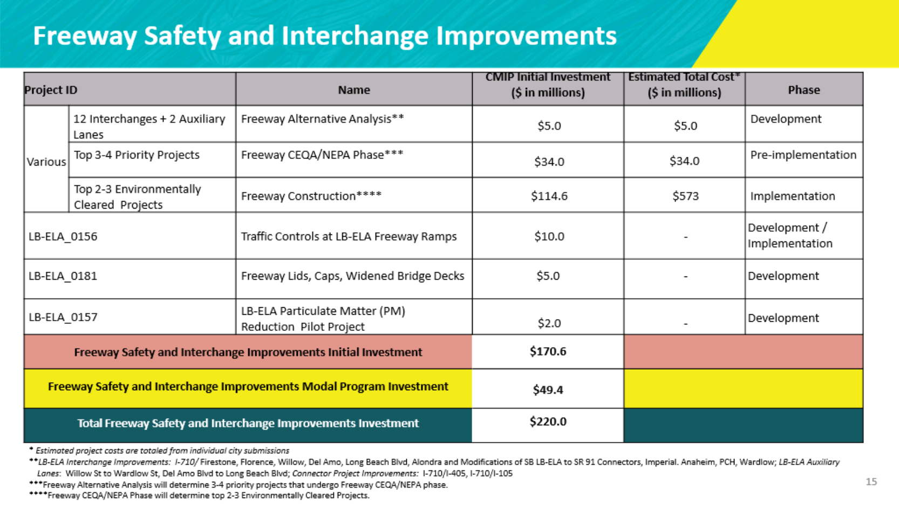
Freeway Safety and Interchange Improvements
Notes:
Investment Plan Highlights
Funding for the ICM (Integrated Corridor Management) for the 710, emphasizing mitigation of impacts. (identify project/funding amount)
Arterial improvements aimed at enhancing safety, particularly focusing on freeway crossings and reducing conflict points.
Identification and investment in key corridors for complete street transformations, including the Shoreline Shoemaker project.
Freeway safety and ii
Emphasize Reconnecting Communities
Inclusion of a study in the modal program for arterial safety and addressing truck traffic concerns raised by Genevieve Giuliano.
Funding for Freeway Safety and Interchange Improvements - Allocation of funds for technology initiatives such as on-ramps with subsidiary lanes, with a focus on enhancing safety and connectivity.
Reconnecting Communities-Emphasis on addressing conflict points at the top of ramps, especially concerning pedestrian, bicycle, and freeway traffic interactions.

Slide 35
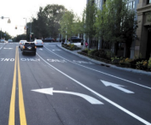
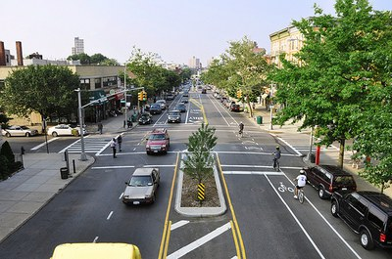
Arterial Roadways/Complete Streets
Initial Investment Recommendations: $115.9M
  Development $0.0M
  Pre-Implementation $9.0M
  Implementation $106.1M
  Modal Program Recommendations: $72.1M
  Development $7.2M
  Pre-Implementation $3.6M
  Future Implementation $61.3M
  Total Initial Investment and Modal Programs: $188.0M
Intersection Improvements
Intersection Improvements
Intersection Improvements
Complete Streets
Notes:
Includes funding commitments for near and longer term projects.
Community Program funding is front loaded

Slide 36
Arterial Roadways/Complete Streets
Project ID | Name | CMIP Initial Investment ($ in millions) | Estimated Total Cost* ($ in millions) | Phase
LB-ELA_0057 | Atlantic Complete Street Corridor | $68.6 | $457.2 | Implementation
LB-ELA_0058 | Florence Complete Street Corridor | $24.9 | $124.5 | Implementation
LB-ELA_0010 | Shoemaker Bridge/Shoreline Drive | $9.0 | $560.0 | Pre-implementation
LB-ELA_0060 | Alondra Complete Street Corridor | $9.0 | $45.0 | Implementation
LB-ELA_0061 | Slauson Complete Street Corridor | $3.6 | $18.0 | Implementation
LB-ELA_0062 | Long Beach Complete Street Corridor | $0.8 | - | Pre-implementation
Arterial Roadways/Complete Streets Initial Investment |  | $115.9
Arterial Roadways/Complete Streets Modal Program |  | $72.1
Total Arterial Roadways/Complete Streets Investment |  | $188.0
*Estimated project costs are totaled from individual city submissions.
19

Slide 37

Arterial Roadways/Complete Streets
Project/‌Program name | Shoemaker Bridge/‌Shoreline Drive [LB-ELA_0010]
Project/‌Program description | I-710 Improvements/‌Shoemaker Bridge Replacement: Replace the Existing Shoemaker Bridge with a New Bridge. The New Bridge Will Be Reduced to Have Two Mixed-Flow Lanes in the NB and in the SB Directions to Tie the Flow into I-710. The New Bridge Will Also Include Pedestrian and Bicycle Access. Additionally, Bicycle, Pedestrian, and Street Enhancements Will Be Provided on Adjacent Thoroughfares.
Project/‌Program lead | Long Beach/‌COG
Metro role | Support
Location | Long Beach
Top scoring goals/‌principles | Safety, Mobility, Equity
Flags | Equity Flag: Moderate See related implementation requirements/‌guidance below to address equity issues
Modes | Arterial Roadway, Freeway Safety and Interchange Improvements, Active Transportation
Phase | Pre-Implementation
Implementation requirements/‌guidance | Although the Investment Plan investment is recommended for design-only, there are several implementation recommendations when the project continues to implementation: Displacements and Physical Impacts: The project entails a major roadway redesign and bridge reconstruction with both temporary and permanent impacts to the existing right-of-way and surrounding recreational facilities, however the project will result in a permanent net gain in parkland acres due to roadway consolidation. Design should minimize impacts to existing facilities where possible, and Long Beach should proactively engage the community to set expectations around the project’s potential impacts, in the context of its broader benefits. Construction Impacts: Noise pollution, dust emissions, traffic delays/‌diversion, interruptions to recreational facility access, and business interruptions should be carefully assessed and planned with mitigation strategies in place.
Potential for packaging | Congestion Pricing [LB-ELA_0153] I-710 LA River Bike Path [LB-ELA_0055] Integrated corridor management (ICM) Phase 2 Ocean Blvd to SR-91 [new proposed project]
Estimated cost | $500 million
Potential funding sources | BIP, RAISE, INFRA, TCEP
Grant matching fund requirements | Minimum Local Match: 0% – RAISE (Rural, HDC, APP), TCEP (if Caltrans nominated) 20% – RAISE (Urban), BIP (Planning, non-large bridge) 30% – TCEP 40% – INFRA 50% – BIP (large bridge)
Recommended Measure R/M investment | $9.03 million (for partial design)

Slide 38
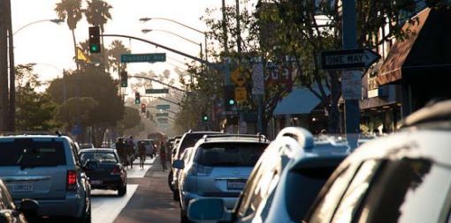
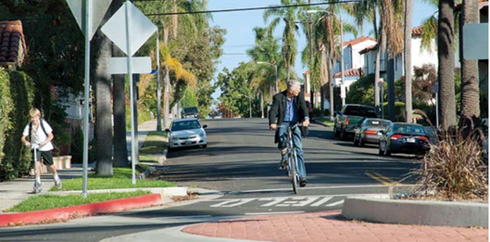
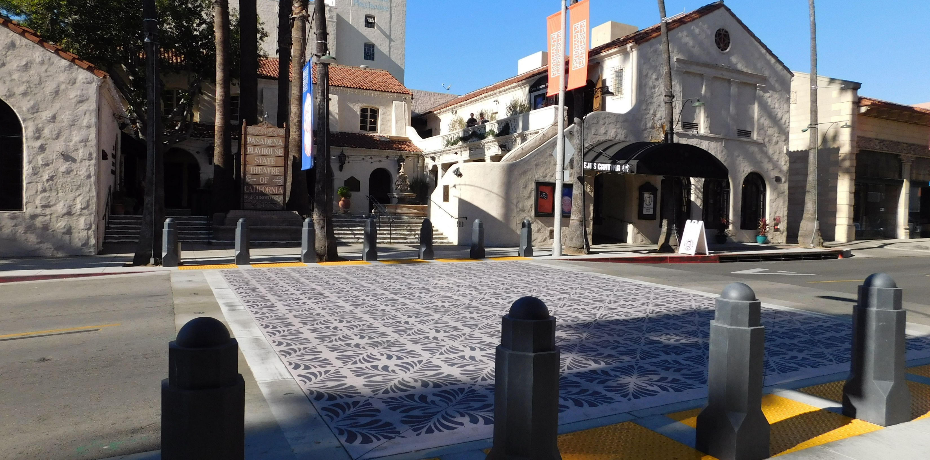
Arterial Roadways/Complete Streets
Intersection Improvements
Traffic Management Features
Traffic Calming Features
Complete Streets
Visual Improvements

Slide 39
Active Transportation
Project/‌Program name | Humphreys Avenue Pedestrian/Bicycle Overcrossing [LB-ELA_0139]
Project/‌Program description | The Los Angeles County Metropolitan Transportation Authority (Metro), in collaboration with the California Department of Transportation (Caltrans) and Los Angeles County Department of Public Works (LADPW), plans to construct a pedestrian and bicycle overcrossing (Humphreys Avenue Crossing) near the existing Humphreys Avenue vehicle bridge in East Los Angeles. The project aims to reconnect the historically divided East L.A. neighborhood caused by Interstate 710 (I-710). The Crossing, serving as a dedicated pedestrian/cyclist route, addresses the barrier created by I-710 and enhances accessibility for vulnerable populations, connecting to essential facilities and Humphreys Avenue Elementary School. Originating from Metro Board's Motion 22.1 in 2015, the Humphreys Avenue Crossing received approval and funding, signifying a step towards rectifying past planning decisions. Although not selected for a Reconnecting Communities Pilot grant, the project earned high ratings and continues to expand in collaboration with LA County to incorporate pedestrian accessibility improvements, further maximizing its community benefits.
Project/‌Program lead | Metro/Caltrans/‌LA County/COG
Metro role | Partner
Location | East Los Angeles
Top scoring goals/‌principles | Community, Safety
Flags | Equity Flag: NA CIC Flag: NA
Modes | Active Transportation/TDM
Phase | Implementation
Implementation requirements/‌guidance | NA
Potential for packaging | NA
Estimated cost | $24.3 million
Potential funding sources | State: Reconnecting Communities (Pilot) grant in September 2023
Grant matching fund requirements | Minimum local match: 20% – RCP
Recommended Measure R/M investment | $1 million (study)

Slide 40
Community Programs
What are Community Programs?
Executive Summary
Chapter 1 – Background
Chapter 2 – The Task Force and Task Force Charter Process
Chapter 3 – Existing Conditions and Future Projections
Chapter 4 – Vision, Goals, and Guiding Principles
Chapter 5 – Development of Multimodal Strategies, Projects and Programs
Chapter 6 – Evaluation and Prioritization
Chapter 7 – Recommended Investment Plan
Chapter 8 – Funding Strategy
Community Programs incorporate a range of benefits that are responsive to equity issues facing the LB-ELA Corridor, and which are not addressed through typical transportation infrastructure investments.
Some are focused on addressing current burdens that exist as a result of past policy, disinvestment, and infrastructure development;
Others are proactive measures to sustain community stability and maximize benefits as projects are implemented in the future.
The Investment Plan recommends $40M of Initial Funding for development of 15 Community Programs
Notes:
Michael

Slide 41
Community Programs by Topic Area
Working Group Topic Area | Programs
Air Quality/‌ Community Health | Bus Electrification Projects
 | LB-ELA Corridor Community Health Benefit Program
 | Zero-Emission Infrastructure for Autos
 | Air Quality Monitoring Stations
Environment | LB-ELA Corridor Energy Reduction/‌Greenhouse Gas (GHG) Emissions Reduction Program
 | LB-ELA Corridor “Urban Greening” Initiative
 | Public Art/‌Aesthetics
Housing Stabilization/ ‌Land Use | WSAB Transit-Oriented Development Strategic Implementation Plan and Program (TOD SIP)
 | Transit-Oriented Communities/‌Land Use
 | Homeless Programs
 | Housing Stabilization Policies
Job Creation/ ‌Work Opportunities | Vocational Educational Programs
 | Targeted Hire Programs
 | Employment/‌Recruitment Initiatives
 | Economic Stabilization Policies

Slide 42
Lifting Up the Local Community
The Investment Plan will provide economic opportunities by addressing workforce development, targeted hire, and new jobs
Metro’s Measure-funded Projects advanced to construction resulting from this Investment Plan would be subject to Metro’s Project Labor Agreement (PLA) and corresponding Construction Careers Policy (CCP), which are applied to all federal projects with a construction value greater than $2.5 million.
  Metro’s PLA is unique in that Metro is the first transit agency in the nation to adopt such an agreement with national targeted hiring goals for federally funded projects with Federal Transit Administration (FTA) approval. The PLA and CCP were approved by Metro’s Board of Directors on January 26, 2012, and subsequently renewed on January 26, 2017.
  The PLA and CCP require prime contractors to ensure that a minimum of 40 percent of all hours of project work are performed by local targeted workers, with priority given to those in Community Areas, defined as economically disadvantaged areas within a five-mile radius of the project.
The CCP and PLA have exceeded their goals since they were implemented.
  Between 2012 and 2018, close to 60 percent of workers on Metro projects were from economically disadvantaged communities, 22 percent of work was performed by apprentices, and close to 12 percent of all hours worked were performed by workers with disadvantaged backgrounds.
Notes:
The purpose of the PLA is to set procedures for hiring targeted workers and for facilitating the entry of workers into apprenticeship programs. PLAs are effective tools for providing avenues for workers to obtain apprenticeship training, many of which will lead to more secure and higher-paid unionized jobs.
The PLA and CCP require prime contractors to ensure that a minimum of 40 percent of all hours of project work are performed by local targeted workers, with priority given to those in Community Areas, defined as economically disadvantaged areas within a five-mile radius of the project.

Slide 43
Lifting Up the Local Community
The Investment Plan provides economic opportunities by addressing workforce development, targeted hire, and new jobs
Implementation Guidance for Community Programs will include workforce development, targeted hire, and new jobs as evaluation criteria. Issues to be addressed in Implementation and Next Steps:
  Ensure existing policies and programs position the local labor force of today to support the goods movement industry of tomorrow
  Identify education and skill gaps that need to be addressed
  Identify opportunities to partner across industries and regions to enhance the labor force
  Provide adequate mobility options to connect existing and future workers to these jobs and industries
  Add a variety of Equity Criteria into project evaluation to accomplish these goals.

Slide 44
Establish Working Groups by Topic Area
Why are we setting up more working groups?
  Continuity and stewardship of Vision/Goals/Guiding Principles
  Hold Metro accountable to Community Program commitments
  Build upon ZET Program successes/lessons learned
What are we looking for in working group members and program partners?
  Complementary roles – Leadership / Funding / Technical Expertise
  Technical knowledge and community relationships
  Other agencies to fill gaps in Metro’s jurisdictional authority
Notes:
Why are we setting up more working groups?
Programs will need stewardship beyond adoption of the investment plan to fine tune the details and ensure continuity with vision/goals/principles
Maintain accountability for Metro’s commitments to Community Program investments which are not clearly defined at the time of CMIP adoption
ZET working group was successful! We want to build on this and use as a model for additional programs

Slide 45
Working Group Objectives/Activities
  Identify existing programs that Metro can support
  Identify additional funding opportunities for Community Programs
  Define detailed program objectives, parameters, and actions
  Determine funding allocations within topic areas
Notes:
What will working groups do?
Identify existing programs that Metro can support through funding, grant-writing, technical assistance, or other facilitation roles
Identify additional funding/grant opportunities for Community Programs ineligible for Measure R/M funding (i.e., no direct transportation nexus)
Define detailed objectives, parameters, and actions for new Community Programs
Determine funding allocations within topic areas based on Community Program pathways and funding needs

Slide 46
Potential Partners by Community Program Topic Area
Air Quality/Community Health
Environment
Gateway Cities COG
SCAQMD
CARB
AB617 Community Steering Committees
Southern California Clinics Association
EYCEJ
Earthjustice
LBACA
SELA Collaborative
Coalition for Clean Air
LA County ISD Clean Transportation Team
Southern California Edison
LACI
Metro Partners: Sustainability Team; I-710 ZET Program; Metro Bus Electrification
GCCOG Regional Climate Collaborative
SCAQMD
EYCEJ
Earthjustice
CBE
Compton Community Garden
Eastmont Community Center
SELA Collaborative
TreePeople
GrowGood
Friends of the LA River
Caltrans District Art Coordinator
SoCalREN
Metro Partners: Metro Art Program; Sustainability Team, LRTP Team
Housing Stabilization/Land Use
Job Creation/Work Opportunities
Gateway Cities COG
Legal Aid Foundation of Los Angeles
LA Care
Fair Housing Foundation
PATH
BASTA Long Beach
East LA Women’s Center
Fair Opportunity for Change
Forgotten Children, Inc.
InnerCity Struggle
ACT-LA Coalition
Jordan’s Disciples
Kingdom Causes Bellflower
Restoration Diversion Services
Salvation Army
Metro Partners: TOC Programs; Homeless Outreach Pilot; Room to Work; Joint Development Team; First/Last Mile Team
LA County Economic Development Corporation Business Support Program
LA County Department of Economic Opportunity
CALSTART
Vocational Schools, Training Centers, and Workforce Development Organizations
SELA Collaborative
Metro Partners: Diversity and Economic Opportunity Department (DEOD); WIN-LA; Room to Work; Internship and Entry-Level Trainee Program; E3 (Expose-Educate-Employ); Transportation Career Academy Program
Notes:
Not an exhaustive list, and not an obligation for those listed – just ideas to get started

Slide 47
Preliminary Timeline (near-term)
When will Community Program Working Groups be formed?
February ‘24
March ‘24
April ‘24
May ‘24
June ‘24
July-Aug ‘24
Member Outreach/Recruitment
Development of Working Group Structures
Confirm Membership
WG Kick-offs

Slide 48
Agenda Item #3:
Mobile Source Air Pollution
Reduction Review Committee (MSRC)
  Cooperative Agreement
  Joint Request for Proposal (RFP)
Notes:
Erika
Introduce item, Akiko

Slide 49
MSRC Cooperative Agreement
Motivations to Partner
  A leading organization that supports and funds publicly accessible charging and fueling infrastructure for heavy-duty vehicles in the South Coast Air Basin
  A long-standing relationship with the South Coast AQMD, San Pedro Bay Ports, and private entities that develop their sites to support zero-emission trucks
        MSRC’s experience, expertise and established relationship will help Metro advance the ZET Program expeditiously.
  Jointly pursue funding opportunities to leverage Metro’s seed funding, and jointly support promising projects within the LB-ELA Corridor
Past Engagement​
  MSRC’s Request for Information for Publicly Accessible Zero Emission Infrastructure to Support Goods Movement in November 2022​
  Proposed projects within the LB-ELA Corridor were evaluated against the LB-ELA ZET Program Principles and shared with the Working Group in March 2023. ​
  One of the projects was the Port of Los Angeles owned land, and submitted by LACI ​
        Working Group supported Metro to contribute a portion of the ZET seed funding.
Cooperative Agreement
  A cooperative agreement between Metro and South Coast AQMD (MSRC’s administrative agency) was reviewed and approved by the AQMD’s Governing Board on February 2, 2024.

Slide 50
MSRC Joint Request for Proposal
Background:
The November 2022 MSRC RFI projects have been funded through the proposers’ own funds, MSRC, and other mechanisms.
There are new near-term proposals for charging and fueling sites within the LB-ELA corridor.
Opportunities for Metro
Partner with MSRC to release a joint RFP and include evaluation criteria that reflect the ZET Program Principles
  Community Engagement – willingness to engage communities to identify equitable outcomes and community benefits, and provide more information to increase awareness
  Corridor Community Benefits – willingness to use this opportunity to address local community needs and enhance quality of life
  Equitable Outcomes – willingness to strive for equitable outcomes through Metro supported projects
Leverage the seed funding to accelerate the ZET support infrastructure deployment

Slide 51
Closing Remarks & Next Steps
Notes:
Erika

Slide 52

Stay connected to this project
Michael Cano
Executive Officer
Countywide Planning & Development
LA Metro
One Gateway Plaza, MS 99-13-1
Los Angeles, CA 90012
213.418.3010 W
213.305.0423 C
710corridor@metro.net
https://www.metro.net/projects/lb-ela-corridor-plan/
@metrolosangeles
losangelesmetro
Notes:
Erika

Slide 53
Thank you!
Notes:
Erika

Slide 54
Transit
Initial Investment Recommendations: $29.0M
  Development $0.0M
  Pre-Implementation $5.0M
  Implementation $24.0M
  Modal Program Recommendations: $96M
  Development $9.6M
  Pre-Implementation $4.8M
  Future Implementation $81.6M
  Total Initial Investment and Modal Programs: $125.0M
Notes:
Transit Enhancements
• Improving Rider Experience: Recommends investments in transit facilities, focusing on safety and amenities to enhance the overall transit experience.

Slide 55
Transit
Project ID | Name | CMIP Initial Investment ($ in millions) | Estimated Total Cost* ($ in millions) | Phase
LB-ELA_0203 | Bus Stop Improvements | $19.0 | $19.0* | Development / Implementation
LB-ELA_0175 | Install Quad Safety Gates at all A Line [Blue Line] Crossings | $5.0 | $5.0* | Development / Pre-implementation
LB-ELA_0168 | Compton Transit Management Operations Center Enhancements | $2.0 | $27.0** | Pre-Implementation / Implementation
LB-ELA_0146 | Metro Bus Priority Lane Corridor along Line 260 (Atlantic Blvd.) | $1.0 | - | Pe-implementation
LB-ELA_0144 | Metro Bus Priority Lane Corridor along Line 111 (Florence) | $1.0 | - | Pre-implementation
LB-ELA_0141 | Metro Bus Priority Lane Corridor along Line 60 (Long Beach Blvd.) | $0.5 | - | Pre-implementation
LB-ELA_0142 | Metro Bus Priority Lane Corridor along Line 108 (Slauson) | $0.5 | - | Pre-implementation
Transit Initial Investment |  | $29.0
Transit Modal Program |  | $ 96.0
Total Transit Investment |  | $ 125.0
*Estimated project costs are totaled from individual city submissions.
** Total cost based on installation of a defined number of improvements.
***Project cost based on Blue Line First Last Mile estimate for Compton.

Slide 56
Active Transportation
Initial Investment Recommendations: $32.9M
  Development $0.5M
  Pre-Implementation $4.5M
  Implementation $27.9M
  Modal Program Recommendations: $57.1M
  Development $5.7M
  Pre-Implementation $2.9M
  Future Implementation $48.6M
  Total Initial Investment and Modal Programs: $90M
Notes:
Active Transportation
• Promoting Human-Powered Travel: Invests in projects supporting walking, bicycling, and rolling, aligning with Metro’s Active Transportation Strategic Plan.
Modal Investments and Future Outlook
- Active Transportation: Draw parallels between the Plan's investments in these areas and the Committee's recommendations on fostering sustainable and efficient transportation.
- Transit Enhancements: Highlight the alignment of transit improvements with the Committee's vision for an accessible and improved transit experience.
Includes funding commitments for near and longer term projects.
Community Program funding is front loaded

Slide 57
Active Transportation
Project ID | Name | CMIP Initial Investment ($ in millions) | Estimated Total Cost ($ in millions)* | Phase
LB-ELA_0017 | Regionally significant bike projects from the Metro Active Transportation Plan | $15.7 | $41.4** | Development / Implementation
LB-ELA_0008 | Blue Line First/Last Mile Plan Improvements | $9.8 | $13.5 | Development / Implementation
LB-ELA_0111 | West Santa Ana Branch Bike & Pedestrian Trail | $3.8 | $7.6** | Development / Pre-implementation
LB-ELA_0006 | Rail to River Active Transportation Corridor Segment B | $3.2 | $6.3 | Pre-implementation
LB-ELA_0165 | Compton Creek Bike Underpasses | $0.5 | - | Development / Pre-Implementation
Active Transportation Initial Investment |  | $32.9
Active Transportation Modal Program |  | $57.1
Total Active Transportation Investment |  | $90.0
*Estimated project costs are totaled from individual city submissions.
**Estimated project cost based on miles of bike facilities.
Notes:
What does Active Transportation cover?
Projects and programs that support the safe movement of travelers using human-powered methods of travel, such as walking, bicycling, or rolling to get from one place to another.
What is Metro’s Commitment to advancing Active Transportation?
Metro’s commitment to advancing Active Transportation is reflected in the 2023 Active Transportation Strategic Plan (ATSP)
Overview
Metro has a proactive role in countywide active transportation planning and establishes proposals for regional bikeways, pedestrian districts, and First/Last Mile (FLM) improvement areas surrounding transit stations.
Many of the high-scoring AT programs are corridor-wide or regional programs that focus on implementing bicycle and pedestrian safety projects from existing active transportation plans, including Metro’s 2023 ATSP.
While several selected projects from these programs are recommended for near-term funding, these plans include numerous other projects that will require further development.
Other AT program elements:
greening and other sustainability features,
personal security enhancements, and
other elements to enhance the user experience and quality of life of a corridor.
AT Near-Term Recommendations
Distinct projects on the Multimodal Strategies, Projects, and Programs (MSPP) which rated highly and are more ready for implementation.
Regionally important AT Corridors as reflected in Metro’s recently updated ASTP and Long Beach’s Bicycle Master Plan
Projects which received funding in 2023 from California’s Active Transportation Program (ATP), elevated for inclusion in the initial funding recommendations.
The AT funding investment is based on:
• funding for projects that received state ATP awards but still have a partial funding gap.
• funding for projects that are prioritized in the Metro ATSP, especially those that close gaps in the regional AT network and those that provide access to EFC areas.
• funding to advance distinct projects that need support

Slide 58
