Slide 1
We will begin in a few moments.
LB-ELA Task Force
Zero-Emission Truck Working Group
Special Meeting #19
October 31, 2023
Notes:
Erika

Slide 2
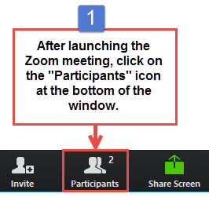
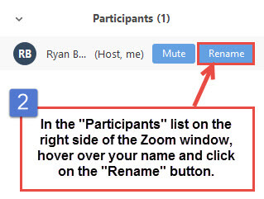


Working Group Member Identification
Notes:
Erika

Slide 3

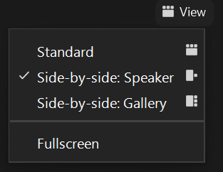
Turn on Camera
To start and stop your video, click the camera icon at the bottom left of your control panel
To switch between views during the meeting click or tap on Standard, Side-by-side Speaker View, and Side-by-side Gallery View at the top right corner of your zoom screen
Notes:
ERIKA

Slide 4

Logistics
Click Interpretation to choose your language.
To hear the interpreted language only, click Mute Original Audio (Optional).
Change your Zoom screen name to include name, agency/organization.
Click Raise Hand in your meeting controls, Press*9 on the phone line, or raise your hand physically.
To lower your hand, click Raise Hand in your meeting controls.
The Q&A button is located on the control panel at the bottom of your screen.
To mute and unmute, click the microphone icon on the bottom left of your control panel.
To start and stop your video, click the camera icon at the bottom left of your control panel.
Technology & interpretation support: 323.609.3345
Notes:
Laura

Slide 5
We will begin in a few moments.
LB-ELA Task Force
Zero-Emission Truck Working Group
Special Meeting #19
October 31, 2023
Notes:
Erika

Slide 6
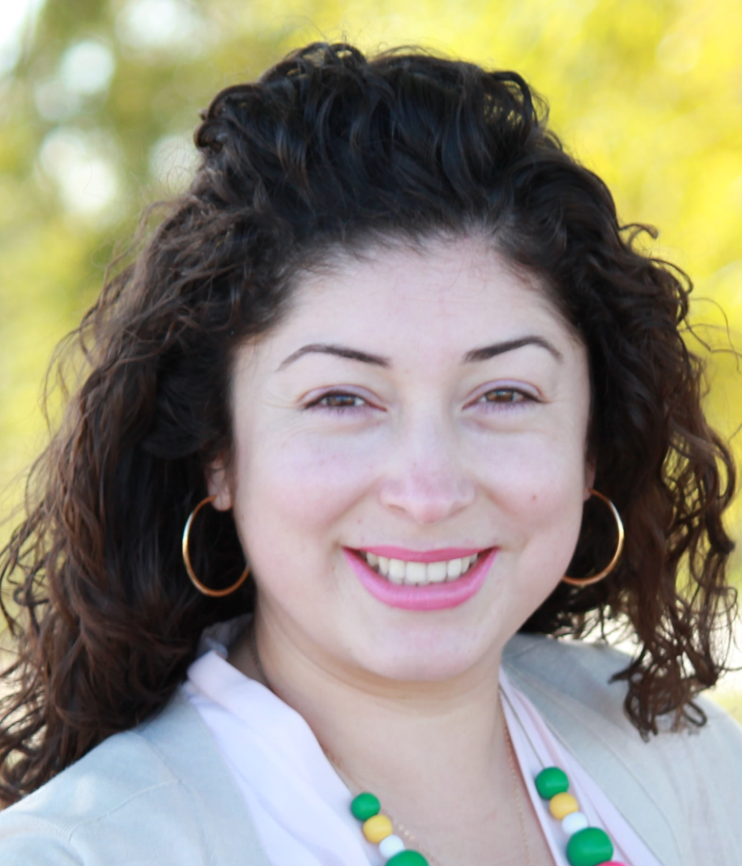
Facilitator
Erika C.B. Morales
Partner, Morales + Morales Partners
Notes:
Erika

Slide 7
Welcome, Agenda Review, and Purpose
of the
Long Beach – East LA Corridor
Zero-Emission Truck (ZET) Working Group
Notes:
ERIKA

Slide 8
Detailed Agenda
1:00pm 1:05pm | Welcome, Agenda Review, and Purpose of the Zero-Emission Truck Working Group Agenda Item #1: Metro Update
1:15pm 1:50pm 2:00pm | Agenda Item #2: LACI Blueprint Implementation Grant Funding Request Presentation by Jack Symington, Senior Program Manager, LACI Working Group Discussion Closing Remarks and Upcoming Meetings Adjournment
Notes:
https://calstart.org/zev-infrastructure-phase-in/
CTC: Barriers and Opportunities; Recommendations
LACI: Gaps & Opportunities 2023
CALSTART: Phasing in U.S. Charging Infrastructure: Barriers & Opportunities

Slide 9
Meeting Objectives
Receive information on LACI's California Energy Commission's (CEC) Blueprint Implementation Grant Funding Request
Conduct a test for consensus on whether to support the LACI's request to commit a portion of the $50 million in seeding funding for the LACI's CEC Blueprint Implementation Program
Notes:
Erika, Akiko

Slide 10
Agenda Item #1:
Metro Update
Notes:
Akiko

Slide 11
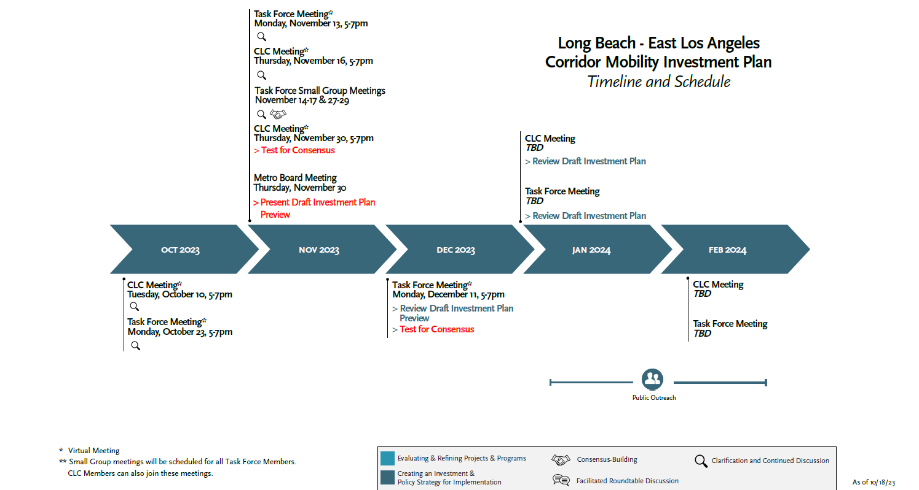

Where We Are
Next Steps
We Are Here
Evaluate Projects
Tier Projects
Prioritize Projects for Funding
Prepare Draft Investment Plan
Winter 2023/24
Notes:
Akiko

Slide 12
ZET Program Recap – Metro Board Direction
Metro Board Direction and desired outcomes
$200 million minimum funding target
Leverage Board-approved $50 million with private, regional, state, and federal funding
Accelerated ZE deployment in the Long Beach-East LA (LB-ELA, formerly I-710 South) Corridor
Collaboration with regional stakeholders
Independent from but aligned with overall LB-ELA Corridor Task Force Investment Plan process
Strategies to accomplish outcomes
Convene and collaborate with community and regional stakeholders
Develop a scope of work for the ZET Program
Identify regional funding partners
Identify discretionary grant opportunities
Identify near and long-term opportunities
Identify policy and legislative barriers to implementation
Develop approaches to understanding potential community impacts and creating community benefits
Notes:
Akiko

Slide 13
ZET Program Principles – Overview
1
2
3
4
Maximize leverage of seed funding
by collaborating with regional partners and funding agencies.
Expeditious Deployment of Resources
to maximize the buying power and benefit of investment while supporting community engagement and effective outreach.
Coordination
with regional and funding partners, government agencies, and key stakeholders.
Community Engagement
that centers corridor residents and stakeholders throughout the development process.
5
6
7
8
Workforce Development
that ensures community benefits and access to opportunity through the pursuit and implementation of ZE Technology.
Corridor Community Benefits by creating economic opportunities, improving air quality, and reducing long-standing health impacts generated by diesel trucks.
Equitable Outcomes
ensured by performance metrics that evaluate sustainable outcomes.
Legislative Platform
designed to support the accelerated, equitable deployment of ZE technology by reducing barriers and increasing incentives to adoption.
Notes:
Akiko

Slide 14
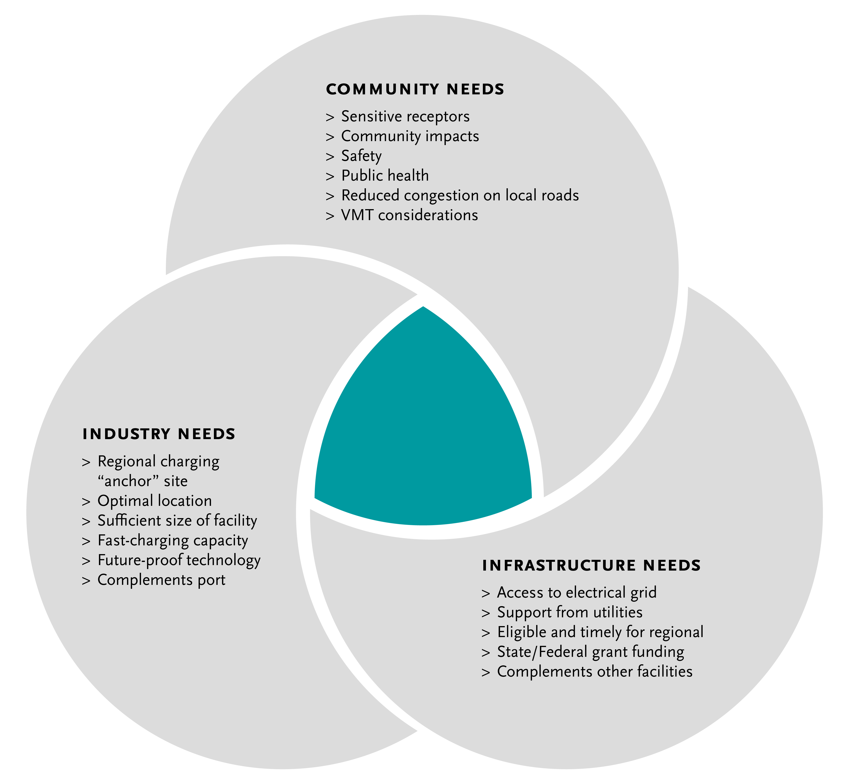
Metro Vision: Regional Zero-Emissions MD/HD Truck Charging and Fueling Facilities
14
Notes:
Akiko

Slide 15
Agenda Item #2:
LACI Blueprint Implementation Grant Funding Request
Presentation – Jack Symington, Senior Program Manager, LACI
Notes:
Erika

Slide 16
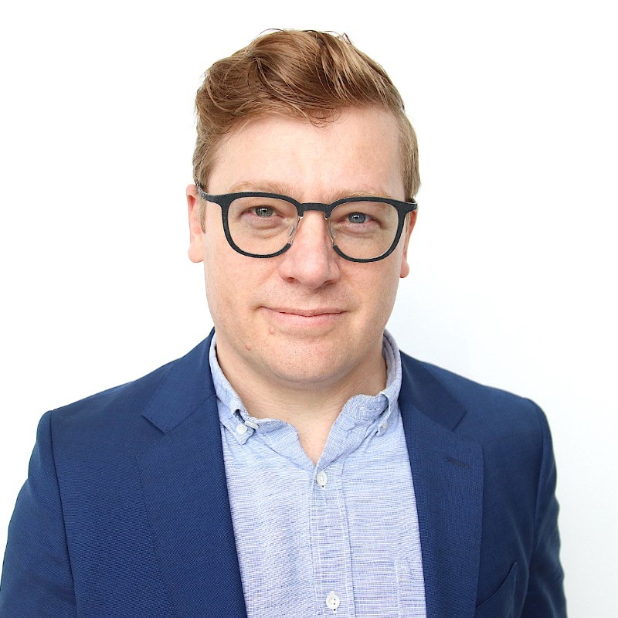
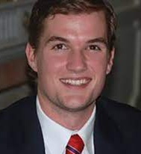


JT Steenkamp
Director, Infrastructure Projects and Technology
Prologis
Jack Symington
Senior Program Manager
Los Angeles Cleantech Incubator
Henrik Holland
Global Head of Project Mobility
Prologis
Notes:
Michael
Jack Symington
is LACI’s Senior Program Manager for Transportation focusing on goods movement planning and projects while developing the next generation of pilot projects to bring heavy-duty trucking closer to a zero-emission future.
Previously, Jack worked for BYD, managing various CARB and CEC demonstration projects for on-road and off-road heavy-duty battery-electric trucks.
These projects entailed coordinating with utilities across California on infrastructure installation, while also developing deployment strategies to fit fleets’ unique needs.

Slide 17

LACI Proposed LB-ELA Corridor Charging Project
LACI is building an application to the open CEC Grant Funding Opportunity: M/HD ZEV Blueprint Implementation
Goal is to fund shovel-ready sites identified in LACI’s 710 Blueprint; prioritizing two sites
Minimum 25% match - more match creates more competitive application
Metro interested in providing co-funding for one site: 2161 Technology Place, Long Beach - Prologis facility
LACI looking to include this co-funding in GFO application due November 13th; would strengthen application
Project aligns with Metro’s goals for ZE Truck Program Investment
Opportunity to partner with CEC, MSRC, CalSTA, Prologis for leveraged investment immediately adjacent to San Pedro Bay Port complex
17
Notes:
Michael
Public charging will require public investment to amortize capital costs.
Innovative partnerships can unlock value and mitigate risk.
SB 671 must identify barriers and solutions for long-term funding success
Focus on expanding charging opportunities corridor-wide and analyzing long-term benefits of ZE infrastructure for corridor stakeholders
Collaborate with other agencies, community groups, and residents to analyze data and determine how charging locations will receive priority and ensure community benefits will be at the forefront of advancing ZE infrastructure

Slide 18
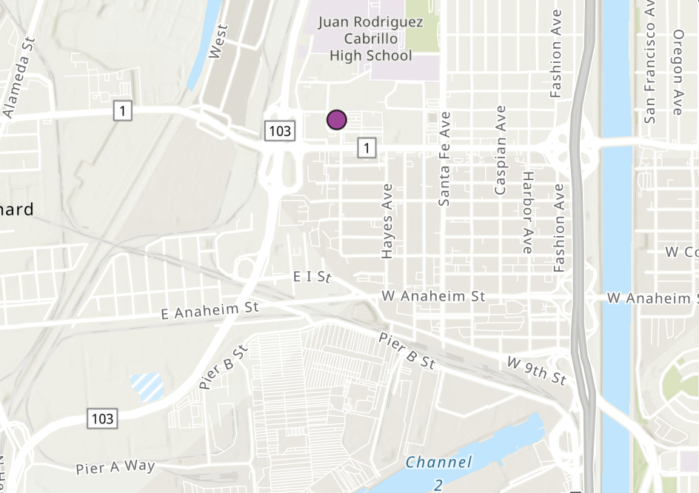
2161 Technology Place - Project Details - Tech. Specs and Funding
Total Budget: $10,000,000
12 dual-port 360 kW chargers (24 dispensers for simultaneous charging) and 2 MWh BESS
Hybrid public/shared setup
Fleets committed for utilization
Remaining % made publicly available
Projected completion in Q1 2025 (12 months from agreement)
Co-funders
MSRC: $557,280
CalSTA: $1,857,600
CEC: $2,900,000 (proposed in grant)
Prologis: $2,685,120
Metro: $2,000,000
18
Notes:
Michael
Public charging will require public investment to amortize capital costs.
Innovative partnerships can unlock value and mitigate risk.
SB 671 must identify barriers and solutions for long-term funding success
Focus on expanding charging opportunities corridor-wide and analyzing long-term benefits of ZE infrastructure for corridor stakeholders
Collaborate with other agencies, community groups, and residents to analyze data and determine how charging locations will receive priority and ensure community benefits will be at the forefront of advancing ZE infrastructure

Slide 19
2161 Technology Place - Project Details - Community and Workforce
Community Engagement
Prologis Technology Place complex identified in 710 Blueprint - prioritized in top four facilities for site walk
CalEnviroscreen: 90th percentile pollution burden; 96th overall percentile
Workforce Development
Collaboration with Breathe SoCal for three job placement events; ten scholarships to Rio Hondo
Partnership with Jobs For the Future (JFF) on development of digital learning and development program
Partnership with Pacific Gateway for community-based job candidate opportunities
19
Notes:
Michael
Public charging will require public investment to amortize capital costs.
Innovative partnerships can unlock value and mitigate risk.
SB 671 must identify barriers and solutions for long-term funding success
Focus on expanding charging opportunities corridor-wide and analyzing long-term benefits of ZE infrastructure for corridor stakeholders
Collaborate with other agencies, community groups, and residents to analyze data and determine how charging locations will receive priority and ensure community benefits will be at the forefront of advancing ZE infrastructure

Slide 20
ZET Program Principles – Overview
1
2
3
4
Maximize leverage of seed funding
by collaborating with regional partners and funding agencies.
Community Engagement
that centers corridor residents and stakeholders throughout the development process.
Corridor Community Benefits by creating economic opportunities, improving air quality, and reducing long-standing health impacts generated by diesel trucks.
Coordination
with regional and funding partners, government agencies, and key stakeholders.
5
6
7
8
Workforce Development
that ensures community benefits and access to opportunity through the pursuit and implementation of ZE Technology.
Equitable Outcomes
ensured by performance metrics that evaluate sustainable outcomes.
Legislative Platform
designed to support the accelerated, equitable deployment of ZE technology by reducing barriers and increasing incentives to adoption.
Expeditious Deployment of Resources
to maximize the buying power and benefit of investment while supporting community engagement and effective outreach.
Notes:
Michael
The Metro Board committed $50 million as seed funding for an I-710 South Zero Emission (ZE) Truck program to support the accelerated deployment of zero-emission trucks and supporting zero-emission infrastructure (October 2021, Motion 16).
The ZET Program Framework and Principles will be used as a guide as Metro seeks to leverage and amplify the $50 million seed funding within the Corridor.
The Principles were developed through collaboration with the 710 Zero-Emission Truck Working Group.
Five major themes were brought forward by the Working Group:
Community engagement
Strategic partnerships and funding opportunities
Legislative and policy initiatives
Truck subsidies
Environmental impacts and equitable outcomes
Community Leadership Committee (CLC) provided input on September 22
Equity Working Group (EWG) providing equity-focused input today, September 29
At the October 18th ZET Working Group Meeting, the ZET Working Group will:
review input from the Equity Working Group
Vote to approve the ZET Program Principles
Review ZET Program Principles with the Task Force
Metro Project Team to present the ZET Principles to the Metro Board of Directors

Slide 21
ZET Program Principles – 2161 Technology Place, Long Beach
1
2
3
4
Maximize leverage of seed funding
$2M ZE Truck Program
$10M Project
4x Leverage (CEC, MSRC, CalSTA, Prologis)
Community Engagement
Identified in LACI 710 Blueprint
Falls within an AB 617 Community; will address with CLC
Corridor Community Benefits Public charging station will benefit smaller operators’
Shared aspect increases near-term utilization for tenants of Prologis
Coordination
Working with CEC, LACI, CalSTA, MSRC and Prologis
Project is part of larger Prologis network development
5
6
7
8
Workforce Development
Prologis has thorough workforce development initiative in the larger project to address skills gaps and local hires
Equitable Outcomes
Charging infrastructure for smaller fleets; investment in training with Breathe SoCal
Legislative Platform
Aligns with goals of CTC SB 671 Draft Assessment; can inform Metro’s approach to permitting
Expeditious Deployment of Resources
Project can move forward with existing deployment plans and committed co-funding in place
Notes:
Michael
The Metro Board committed $50 million as seed funding for an I-710 South Zero Emission (ZE) Truck program to support the accelerated deployment of zero-emission trucks and supporting zero-emission infrastructure (October 2021, Motion 16).
The ZET Program Framework and Principles will be used as a guide as Metro seeks to leverage and amplify the $50 million seed funding within the Corridor.
The Principles were developed through collaboration with the 710 Zero-Emission Truck Working Group.
Five major themes were brought forward by the Working Group:
Community engagement
Strategic partnerships and funding opportunities
Legislative and policy initiatives
Truck subsidies
Environmental impacts and equitable outcomes
Community Leadership Committee (CLC) provided input on September 22
Equity Working Group (EWG) providing equity-focused input today, September 29
At the October 18th ZET Working Group Meeting, the ZET Working Group will:
review input from the Equity Working Group
Vote to approve the ZET Program Principles
Review ZET Program Principles with the Task Force
Metro Project Team to present the ZET Principles to the Metro Board of Directors

Slide 22

Metro Vision - Regional Zero-Emissions MD/HD Truck Charging Facility/ies
Residential community and Cabrillo High School immediately adjacent to facility
Directly available off of SR-103 exit coming from POLA/LB (VMT reduction and safety)
Providing infrastructure for multiple fleets of varying size
Optimal location for port traffic
Sufficient size
Fast-charging capacity with resiliency built-in
Access to electrical grid
Ongoing support from utilities
Storage incorporated
Part of a larger Prologis charging network
Sufficient regional/federal funding profile
22
Notes:
Michael

Slide 23
Prologis’ other facilities in 710 Corridor are similarly positioned for Metro funding
Locations:
Commerce, Compton, Vernon
Total Project Costs (three sites):
$53,677,000
Total Committed Funding:
MSRC: $3,220,611
CalSTA: $10,735,370
Prologis: $29,721,019
Total Equipment Funded:
128 Charging Dispensers (64 dual port 360kW)
9 MWh Battery energy storage
ZET Principles Alignment
Projects incorporate the same investment in community and workforce development
Similar industrial/heavy commercial locations near major corridors with the 710 Focus Area
Leveraged co-funding from other regional stakeholders
23
Notes:
Michael
Public charging will require public investment to amortize capital costs.
Innovative partnerships can unlock value and mitigate risk.
SB 671 must identify barriers and solutions for long-term funding success
Focus on expanding charging opportunities corridor-wide and analyzing long-term benefits of ZE infrastructure for corridor stakeholders
Collaborate with other agencies, community groups, and residents to analyze data and determine how charging locations will receive priority and ensure community benefits will be at the forefront of advancing ZE infrastructure

Slide 24
Proposed Next Steps
November 13th: CEC grant application due date
November 16th: LACI’s presentation and test for consensus to the CLC
After the CEC grant award announcement
> Metro Board approval request on the $2 million Metro contribution

Slide 25
Working Group Discussion
Notes:
Erika
Introduce item, Akiko

Slide 26
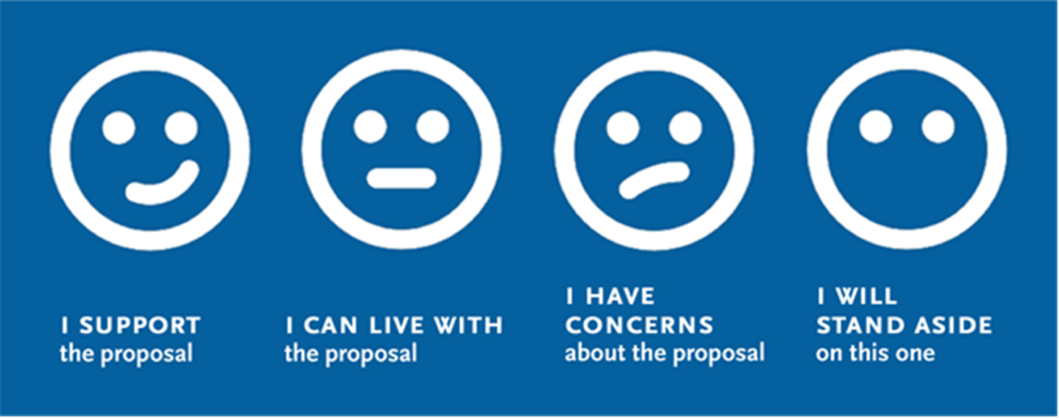
Funding Support for LACI Proposed Blueprint Implementation
I support LACI's request to commit up to $2M of the $50M in seed funding for the LACI's CEC Blueprint Implementation.
Notes:
Erika

Slide 27
Closing Remarks & Next Steps
Notes:
Erika

Slide 28
Upcoming Meeting Schedule
CLC – Virtual Meeting
Thursday, November 16, 5-7pm
Task Force –Small Group Meetings – Virtual Meetings
November 14-17, 27-29
CLC – Virtual Meeting
Thursday, November 30, 5-7pm
Equity Working Group – Virtual Meeting
Thursday, December 7, 5-7pm
Metro Meetings
Executive Committee Meeting
Thursday, November 16, 11am
Draft Investment Plan - Preview
Board Meeting
Thursday, November 30, 10am Draft Investment Plan - Preview
Executive Committee Meeting
Thursday, January 18, 11am
Draft Investment Plan
Board Meeting
Thursday, January 25, 10am
Draft Investment Plan
For the most updated list of meeting dates, please visit:
https://www.metro.net/projects/lb-ela-corridor-plan/
Notes:
Erika

Slide 29

Stay connected to this project
Michael Cano
Executive Officer
Countywide Planning & Development
LA Metro
One Gateway Plaza, MS 99-13-1 Los Angeles, CA 90012
213.418.3010 W
213.305.0423 C
710corridor@metro.net
https://www.metro.net/projects/lb-ela-corridor-plan/
@metrolosangeles
losangelesmetro
Notes:
Erika

Slide 30
Thank you!
Notes:
Erika

Slide 31
Issues for Future Discussion
In early August, Governor Newsom directed the Office of Business and Economic Development (GO-Biz) to create a Hydrogen Market Development Strategy for California to help guide the state’s clean, renewable hydrogen market.
The strategy will be designed to:
Focus on leveraging hydrogen to accelerate clean energy deployment and decarbonize the state’s transportation and industrial sectors;
Build on the 2022 Scoping Plan while leveraging the upcoming SB 1075 hydrogen report and ARCHES’ (Alliance for Renewable Clean Hydrogen Energy Systems) cross sector, multi-stakeholder hydrogen market white papers;
Define state agencies roles and responsibilities, including CARB, CEC, and the Public Utilities Commission;
Identify shared strategies to deliver projects, which may include new financing models, permitting modifications, and procurement initiatives;
Engage relevant stakeholders, including local communities, to advance equity and deliver environmental and economic benefits; and
Ensure state agencies and partners continue to move in the same direction to accelerate the use of renewable energy throughout California’s economy and increase the resilience and reliability of the state’s energy system.
For more information, please visit https://www.gov.ca.gov/wp-content/uploads/2023/08/Letter-to-Director-Meyers.pdf
Notes:
Michael/Erika to facilitate

Slide 32
Agenda Item #5: Status Report on Recent Funding Opportunities
Notes:
Michael
Pull updated grant info from Metro June Board Report

Slide 33
Funding & Regulatory Updates
2023-24
$847 million for ZEVs
Includes $165 million for drayage trucks and infrastructure at CARB and CEC
SB 125
The bill would establish the Zero-Emission Transit Capital Program under the administration of the Transportation Agency and would require funds appropriated under the program to be allocated to regional transportation planning agencies pursuant to a population-based formula and another formula based on transit operator revenues within the jurisdiction of those regional transportation planning agencies, as specified. The bill would authorize a regional transportation planning agency, subject to the requirements described below, to fund zero-emission transit equipment and transit operating expenditures, as specified.
SB 149
The bill aims to provide unique streamlining benefits to critical infrastructure projects. To receive these benefits, applicants must bear the cost of expedited record preparation required for streamlined proceedings. They must also fund GHG analyses and meet stringent GHG reduction requirements.
Provides for resolution of CEQA challenges within 270 days.
33
Notes:
Michael
AB 102
SB 125 - https://legiscan.com/CA/text/SB125/id/2831757
SB 149

Slide 34
Funding Updates: State Budget 2023-24
What's happening now
Governor's budget
Recent funding opportunities
AB 365 - Sales Tax Exclusion for Zero-Emission and Near-Zero-Emission Drayage Trucks
https://ww2.arb.ca.gov/2022-assembly-bill-365-odonnell-patrick-sales-tax-exclusion-zero-emission-and-near-zero-emission
O'Donnell's office
AB 95
34
Notes:
Michael
AB 102
SB 125
SB 149

Slide 35
Legislative Platform
Regional Collaborative Overview
Create a working group to coordinate and collaborate with regional stakeholders to identify priority sites and streamline ZE infrastructure deployment
Electrical Transmission Facility Projects (SB 420)
Streamlines regulatory approvals for electrical transmission projects
Expedites grid capacity expansion to reduce delays
Exempts rebuilding a new construction form certification requirements
Funding support for large fleets
Consider creating a new zero-emission truck incentive program aimed at assisting high priority fleets with 100-500 trucks, who are subject to the Advanced Clean Fleets regulation
Notes:
Michael
SB 420 aims to streamline regulatory approvals for electrical transmission projects in California. This legislation seeks to expedite grid capacity expansion, aligning with the state's zero-emission vehicle goals. Currently, regulations add significant delays to these projects.
SB 420 proposes exempting rebuilding and new construction of certain electrical transmission facilities from certification requirements. It also suggests raising the voltage threshold to 130kV for utilities to construct charging stations for zero-emission trucks.
Background
The Governor’s Executive Order N-79-20 requires the California Air Resources Board (CARB) to develop and propose strategies to achieve 100% zero-emissions from medium and heavy-duty on-road vehicles in the State by 2045 where feasible and by 2035 from drayage trucks.
Expanding grid capacity to meet the demand for charging ZE Trucks is a critical component to achieve zero-emissions from medium and heavy-duty vehicles by 2045 and drayage trucks by 2035. The permitting timeline for expanding electrical capacity needs to be streamlined to achieve the State’s goals.

Slide 36
Legislative Platform: Timing SB 420: Electricity: Electrical Transmission Facility Projects
Overview
Streamlines regulatory approvals for electrical transmission projects
Expedites grid capacity expansion to reduce delays
Exempts rebuilding a new construction form certification requirements
Relevance
Expanding grid capacity to meet the demand for charging ZE Trucks is a critical component to achieve zero-emissions from medium and heavy-duty vehicles by 2045 and drayage trucks by 2035.
Reduces implementation timeline by 2-3 years
Support
Utilities, including Southern California Edison and LADWP
Harbor Trucking Association and California Trucking Association
City of LA
Notes:
Michael
SB 420 aims to streamline regulatory approvals for electrical transmission projects in California. This legislation seeks to expedite grid capacity expansion, aligning with the state's zero-emission vehicle goals. Currently, regulations add significant delays to these projects.
SB 420 proposes exempting rebuilding and new construction of certain electrical transmission facilities from certification requirements. It also suggests raising the voltage threshold to 130kV for utilities to construct charging stations for zero-emission trucks.
Background
The Governor’s Executive Order N-79-20 requires the California Air Resources Board (CARB) to develop and propose strategies to achieve 100% zero-emissions from medium and heavy-duty on-road vehicles in the State by 2045 where feasible and by 2035 from drayage trucks.
Expanding grid capacity to meet the demand for charging ZE Trucks is a critical component to achieve zero-emissions from medium and heavy-duty vehicles by 2045 and drayage trucks by 2035. The permitting timeline for expanding electrical capacity needs to be streamlined to achieve the State’s goals.

Slide 37
Station Development Stages/State Level Strategic Actions
Project Development
Explore shortening public state agency application process for funding where feasible
Refine existing funding programs to incentivize zero-emission freight infrastructure where possible
Funding/Financing awarded
Synchronize state and local funding with other key processes where possible to facilitate efficient award delivery and optimize public funding sources
Permitting
Create model station development process (zoning and building permits) as appropriate with federal state, and local partners
Design and Engineering
Create model station development process (zoning and building permits) as appropriate with federal, state, regional, and local partners
Building and Inspection
Take a corridor approach to batch and sequence station buildout

Slide 38
Legislative Platform: People Regional Collaborative for ZE Infrastructure Deployment
Overview
Create a working group to coordinate and collaborate with regional stakeholders to identify priority sites and streamline ZE infrastructure deployment
Relevance
Important to coalesce around existing sites and available resources to coordinate and prioritize site development. This should be done concurrently with conducting Phase I feasibility studies to account for longer term plans beyond the next 5-7 years.
Support
Caltrans
SCAG
Ports
Utilities
City of LA
Gateway Cities COG
Notes:
Michael

Slide 39
Legislative Platform: Money Funding Support for Large and Small Fleets.
Overview
Consider creating a new zero-emission truck incentive program aimed at assisting high priority fleets with 100-500 trucks, who are subject to the Advanced Clean Fleets regulation
Relevance
Explore continued incentive options for larger fleets because they have the financial means to implement charging solutions at their sites. Their success will provide subsequent opportunities for smaller fleets down the road.
Support
California Transportation Commission
Harbor Trucking Association and California Trucking Association
Opposition
CARB economic analysis indicates that larger fleets don’t need additional support to transition
CTC work group and independent owner/operators did not agree with this analysis
Notes:
Michael
Hydrogen: SB 671 work, want to have a conversation: concerns that we should be articulating, (potential panel for hydrogen next meeting)
State agencies and the Legislature should consider creating a new limited-term (five-year) zero-emission truck incentive program aimed at assisting high-priority fleets, such
as larger drayage fleets with 100 to 500 trucks, who are subject to the Advanced Clean Fleets regulation with purchasing zero-emission trucks. Program development should take place with input from the fleets who
will be impacted and should be flexible to ensure support in a way that is considerate of their needs. The California Air Resources Board could administer this program.

Slide 40
Legislative Platform: Money Funding Support for Small Fleets
Overview
Explore subsidies, sales tax incentives/penalties, income tax penalties, additional funding for road repair and maintenance
Relevance
Notes:
Michael
State agencies and the Legislature should consider creating a new limited-term (five-year) zero-emission truck incentive program aimed at assisting high-priority fleets, such as larger drayage fleets with 100 to 500 trucks, who are subject to the Advanced Clean Fleets regulation with purchasing zero-emission trucks. Program development should take place with input from the fleets who will be impacted and should be flexible to ensure support in a way that is considerate of their needs. The California Air Resources Board could administer this program.

Slide 41
Legislative Platform: Money Funding Support for Large and Small Fleets.
Overview
Consider creating a new zero-emission truck incentive program aimed at assisting high priority fleets with 100-500 trucks, who are subject to the Advanced Clean Fleets regulation
Relevance
Explore continued incentive options for larger fleets because they have the financial means to implement charging solutions at their sites. Their success will provide subsequent opportunities for smaller fleets down the road.
Support
California Transportation Commission
Harbor Trucking Association and California Trucking Association
Opposition
CARB economic analysis indicates that larger fleets don’t need additional support to transition
CTC work group and independent owner/operators did not agree with this analysis
Notes:
Michael
Hydrogen: SB 671 work, want to have a conversation: concerns that we should be articulating, (potential panel for hydrogen next meeting)
State agencies and the Legislature should consider creating a new limited-term (five-year) zero-emission truck incentive program aimed at assisting high-priority fleets, such
as larger drayage fleets with 100 to 500 trucks, who are subject to the Advanced Clean Fleets regulation with purchasing zero-emission trucks. Program development should take place with input from the fleets who
will be impacted and should be flexible to ensure support in a way that is considerate of their needs. The California Air Resources Board could administer this program.

Slide 42
Legislative Platform: Money Funding Support for Small Fleets
Overview
Explore subsidies, sales tax incentives/penalties, income tax penalties, additional funding for road repair and maintenance
Relevance
Notes:
Michael
State agencies and the Legislature should consider creating a new limited-term (five-year) zero-emission truck incentive program aimed at assisting high-priority fleets, such as larger drayage fleets with 100 to 500 trucks, who are subject to the Advanced Clean Fleets regulation with purchasing zero-emission trucks. Program development should take place with input from the fleets who will be impacted and should be flexible to ensure support in a way that is considerate of their needs. The California Air Resources Board could administer this program.

Slide 43
Key Takeaways: ZET Program as a Catalyst for Workforce Development & Job Training
What are the best ways to engage communities and generate support?
Create programs that meet needs of employers and educate community about jobs available (how to apply/how to get trained)
Create a “jobs coordinator” component to hiring/employment part of project
Implement program like Construction Utility Pathways Program (CUP) to connect employers/job opportunities with community
Empower local businesses and landowners to tap into Fed/State incentives to repurpose land for charging facilities
Ensure that planned labor agreements involve clear standards/requirements for local hiring
Invest in community engagement, particularly to ensure a diverse workforce
43
Notes:
Akiko

Slide 44
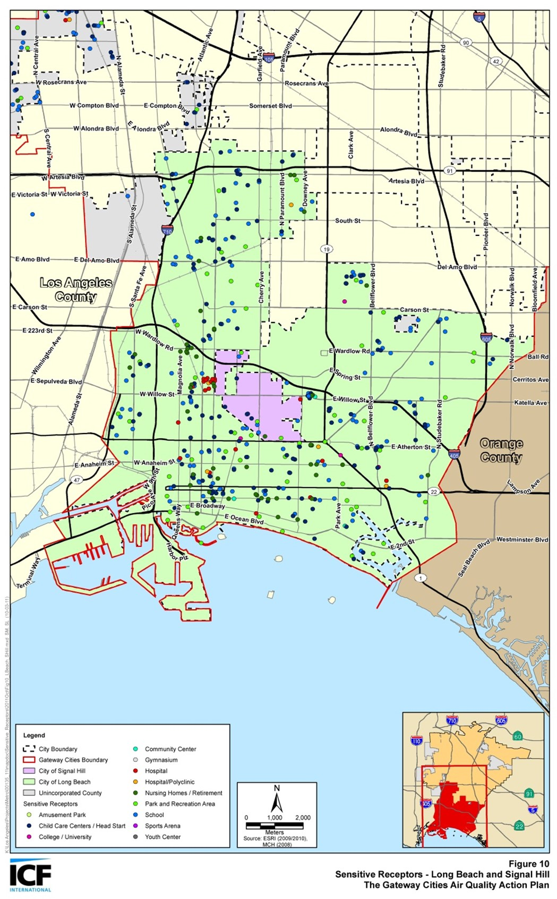
Community Engagement around Sensitive Receptors
The California Air Resources Board (CARB) defines sensitive receptors as places where children, the elderly, and those with pre-existing respiratory health conditions are most likely to congregate, such as:
Schools and schoolyards,
Parks and playgrounds,
Daycare centers,
Nursing homes,
Hospitals, and
Residential communities
Local government can play a significant role in improving health outcomes through land use decisions, truck route planning, and mitigation measures
Communities can develop effective outreach programs to reduce the exposure of children and the elderly by developing a list of sensitive receptor sites to aid in planning efforts
44
Notes:
Michael, Susan A

Slide 45
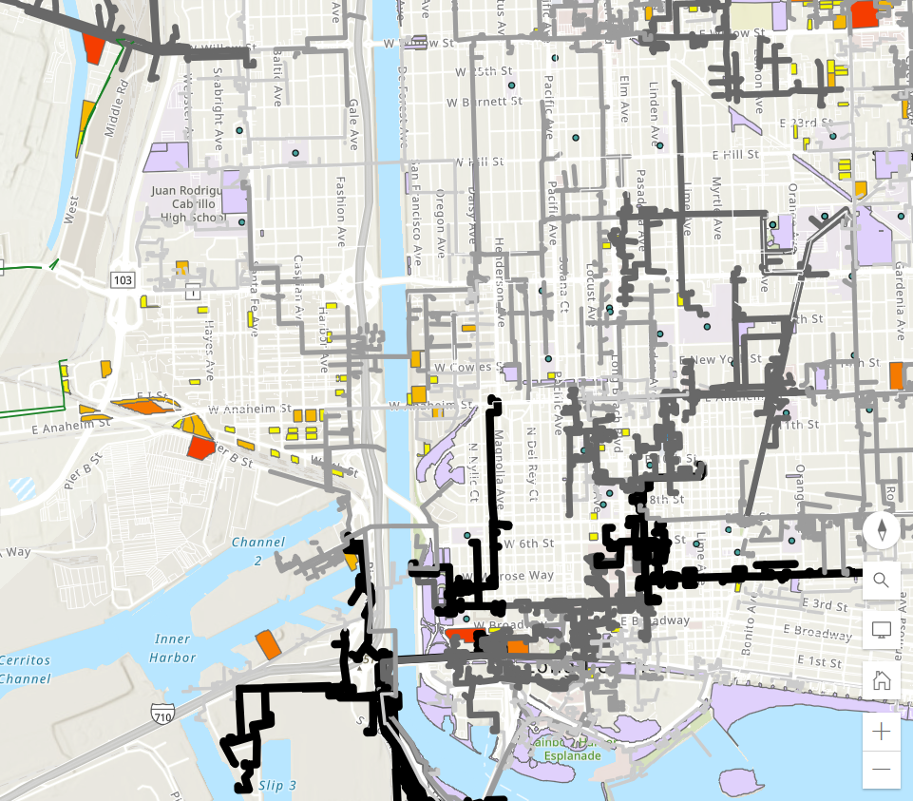
Community Engagement around Sensitive Receptors
Schools and schoolyards
Hospitals
Parks
Available parcels of land
Grid capacity
45
Notes:
Michael, Susan A

Slide 46
ZET as a Catalyst for Corridor Community Benefit Programs
Characterize and evaluate potential cancer and non-cancer health risks associated with exposure to toxic air contaminants (TACs) from both stationary and mobile sources.
Identify significant sources and locations of TAC emissions within the jurisdiction
Assess existing exposures of sensitive receptors including children, senior citizens, and people with respiratory illnesses and identify priority communities.
Develop and implement mitigation measures to reduce TAC emissions and to avoid the over-concentration of these facilities near sensitive receptors.
Prioritize use of resources to reduce TACs in the most highly impacted areas (i.e., priority communities)
46
Notes:
Michael, Susan A

Slide 47
Today's ZET planning agenda
Status report
Legislative platform overview
Interviews conducted/pending
Opportunities/barriers discussion
Review format and content
Identify key issues
Large fleet vs. Small fleet support
Permitting timelines
Regional collaborative to identify priority sites
Select initiatives to highlight for Metro Board
Create fact sheets on proposed initiatives (e.g., collaborative)
Next ZET WG meeting
Agenda
Dates (10/3)
Notes:
When to coordinate further with Hector

Slide 48
Progress Assessment on Physical Infrastructure Needs Analysis (Task 1)
Task 1. Identify physical infrastructure needs to support full deployment of ZE drayage trucks along I-710
Subtasks | Products/Activities Completed | Additional Analyses Needed
1.1 Estimate the number of charging and fueling stations to support the number of ZE drayage trucks over the next 10 years, both regional and small in scope. | Metro - Clean Truck Technology Comparative Report LACI I-710 Investment Blueprint POLB – Fueling the Future Fleets | Agree on the drayage truck population to be served Agree on the charging port power level
1.2 Develop an energy supply plan to ensure that sufficient energy will be provided without compromising other energy uses along the corridor. | Industry/Infrastructure Focus Group highlights | Collaborate with utilities to verify existing energy supplies, their future infrastructure investment plans Verify existing and future transmission network and distribution system capacity for the Corridor Understand roles of various state agencies that are involved in statewide energy supply and demand planning and infrastructure delivery (CEC, CPUC, and CARB)
48
Notes:
Michael

Slide 49
Progress Assessment on Physical Infrastructure Needs Analysis (Task 1) Cont’d
Task 1. Identify physical infrastructure needs to support full deployment of ZE drayage trucks along I-710
Subtasks | Products/Activities Completed | Additional Analyses Needed
1.3 Develop a methodology and evaluation criteria for ZE charging/fueling site selection | Preliminary performance measures ZET Program Principles LACI 710 Investment Blueprint Project methodology and evaluation criteria | Delineate measurable metrics from stated community desirable outcomes Develop evaluation methodology for each criterion Identify existing data and data needs to perform evaluation
1.4 Identify existing legislative and regulatory barriers that hinder the deployment of physical support infrastructure | Focus Group input, breakout group | Confirm legislative priorities Initiate a Southern California’s legislative platform to advance ZET program
1.5 Collaborate with regional partners to chart a regional path for ZE infrastructure development | Partner with MSRC, Ports, AQMD and SCAG on regional ZET infrastructure deployment project | Memorialize Metro’s partnership with MSRC through a cooperative agreement Consider forming a regional ZET collaborative to cross-leverage members' expertise in project development and delivery Engage state agencies in our energy planning discussion
49
Notes:
Michael

Slide 50
ZET
Issue | Principle
Timing | Support efforts to streamline clean freight infrastructure development
 | Identify opportunities to increase speed of delivery of clean freight infrastructure
 | Foster standardized approach and timing for permitting and approval processes
 | Develop a streamlined approach to awarding and accessing public funds
Notes:
Michael

Slide 51
ZET Legislative Priority Recommendations
Issue | Principle
Money | Support fleet owners with the costs of transition to ZE technology
 | Align funding programs to support the transition
 | Ensure appropriate access to infrastructure for all freight types and movers across early minimum viable network
 | Support local jurisdictions in identifying funding opportunities to assist with increased need for street maintenance
Notes:
Michael

Slide 52
ZET Legislative Priority Recommendations
Issue | Principle
People | Create a corridor-first approach
 | Support an “ecosystem approach” to corridor development to ensure coordination & timeliness
 | Coordinate funding and project delivery opportunities (e.g. innovative public private partnership opportunities; reduction of public support once demand established)
Notes:
Michael

Slide 53
Legislative Platform Tasks
Advocate for the creation and passage of legislation that promotes the development and deployment of zero-emission drayage charging facilities. Legislation could include provisions for funding, incentives, streamlined permitting processes, and regulations that encourage private investment in ZE charging/fueling infrastructure.
Secure funding: Lobby for federal and state funding to support the installation and expansion of charging infrastructure at the Ports of LA and Long Beach. Explore opportunities such as grants, tax credits, and partnerships with public and private entities to secure the necessary financial resources.
Collaborate with utility companies: Work closely with utility companies to ensure sufficient electrical grid capacity to support the charging infrastructure. Encourage partnerships between utilities and charging infrastructure providers to optimize grid integration, manage electricity demand, and explore innovative pricing and billing models.
Streamline permitting and regulations: Identify and address regulatory barriers that may impede the rapid deployment of ZE charging or fueling infrastructure. Advocate for streamlined permitting processes and standardized regulations to facilitate the installation of charging stations at the port and surrounding areas, while also recognizing community concerns that may arise from this streamlined approach.
Notes:
Michael

Slide 54
Legislative Platform Tasks (cont.)
Public-private partnerships: Encourage collaboration between public entities, private stakeholders, and drayage trucking companies to accelerate the deployment of charging infrastructure. Develop incentives and agreements to incentivize private investment and ensure the availability of ZE charging or fueling facilities at key locations within the ports.
Promote workforce development: Advocate for programs that support workforce development and training for the installation, operation, and maintenance of zero-emission drayage charging infrastructure. Collaborate with educational institutions and industry associations to create training programs that meet the specific needs of the industry.
Public awareness and outreach: Launch a public awareness campaign to highlight the benefits of zero-emission drayage and the importance of ZE charging and fueling infrastructure. Educate the public, policymakers, and industry stakeholders about the positive impacts on air quality, public health, and sustainability by accelerating the deployment of ZE trucks in place of existing diesel trucks.
Notes:
Michael

Slide 55
Zero-Emission Truck Working Group #16 Highlights
Summary
Held virtually via Zoom on Tuesday, May 23
20 Working Group members in attendance
Highlights
Received information on the Mobile Source Air Pollution Reduction Review Committee (MSRC) Cooperative Agreement, Metro staff intent to seek a Board approval to contribute the seed funding towards the Port of LA owned parcel development as a ZET charging depot, and the Charging and Fueling Infrastructure (CFI) Grant development.
ZET pilot project lessons learned from regional partners
Discussed how partnerships with Original Equipment Manufacturers (OEMs), Fuel providers, and dealerships were cultivated
Be flexible to adopt to dynamic environment surrounding ZE technologies
Workforce Development Panel Discussions
Learned how workforce development opportunities were curated and created through Zero-Emission infrastructure development
Reviewed existing resources and relationships that enable workforce development programs, including how to create and maintain a skilled workforce, ensure LA County residents reap benefits from these job opportunities, and determine how best to gain community support on these programs.
Notes:
Michael

Slide 56
Metro June 2023 Board Meetings
Planning & Programming Committee (June 14, 2023)
LB-ELA Corridor Task Force Update
Draft LB-ELA Investment Plan scheduled for November 2023
Final Investment Plan scheduled for Winter/Spring 2024
Summary of stakeholder engagement activities and emphasis on public health improvements
2. LB-ELA Corridor ZET Program Update
Committee support on Metro’s seed funding contribution (up to $3 M) for the proposed POLA site
These items were approved and/or received and filed and will go to the full Board Meeting (June 22, 2023) on consent.
Notes:
Michael

