Slide 1
We will begin in a few moments.
LB-ELA Task Force
Zero-Emission Truck Working Group
Meeting #18
October 3, 2023
Notes:
Erika

Slide 2
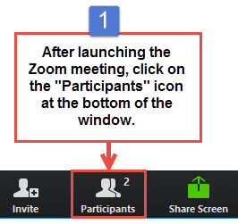
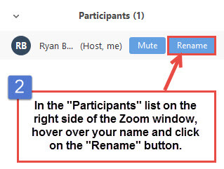


Working Group Member Identification
Notes:
Erika

Slide 3

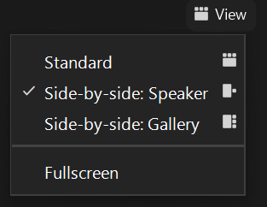
Turn on Camera
To start and stop your video, click the camera icon at the bottom left of your control panel
To switch between views during the meeting click or tap on Standard, Side-by-side Speaker View, and Side-by-side Gallery View at the top right corner of your zoom screen
Notes:
ERIKA

Slide 4

Logistics
Click Interpretation to choose your language.
To hear the interpreted language only, click Mute Original Audio (Optional).
Change your Zoom screen name to include name, agency/organization.
Click Raise Hand in your meeting controls, Press*9 on the phone line, or raise your hand physically.
To lower your hand, click Raise Hand in your meeting controls.
The Q&A button is located on the control panel at the bottom of your screen.
To mute and unmute, click the microphone icon on the bottom left of your control panel.
To start and stop your video, click the camera icon at the bottom left of your control panel.
Technology & interpretation support: 323.609.3345
Notes:
Laura

Slide 5
Detailed Agenda
1:00pm 1:05pm | Welcome, Agenda Review, and Purpose of the Zero-Emission Truck Working Group Agenda Item #1: Metro Update
1:15pm 1:45pm 2:50pm 3:00pm | Agenda Item #2: California's Advanced Clean Fleets Rule: Prospects, Pathways, and Challenges Preliminary results - Dr. Genevieve Giuliano Agenda Item #3: Developing a ZET Program Legislative Platform Closing Remarks and Upcoming Meetings Adjournment
Notes:
https://calstart.org/zev-infrastructure-phase-in/
CTC: Barriers and Opportunities; Recommendations
LACI: Gaps & Opportunities 2023
CALSTART: Phasing in U.S. Charging Infrastructure: Barriers & Opportunities

Slide 6
We will begin in a few moments.
LB-ELA Task Force
Zero-Emission Truck Working Group
Meeting #18
October 3, 2023
Notes:
Erika

Slide 7

Facilitator
Erika C.B. Morales
Partner, Morales + Morales Partners
Notes:
Erika

Slide 8
Welcome, Agenda Review, and Purpose
of the
Long Beach – East LA Corridor
Zero-Emission Truck (ZET) Working Group
Notes:
ERIKA

Slide 9
Detailed Agenda
1:00pm 1:05pm | Welcome, Agenda Review, and Purpose of the Zero-Emission Truck Working Group Agenda Item #1: Metro Update
1:15pm 1:45pm 2:50pm 3:00pm | Agenda Item #2: California's Advanced Clean Fleets Rule: Prospects, Pathways, and Challenges Preliminary results - Dr. Genevieve Giuliano Agenda Item #3: Developing a ZET Program Legislative Platform Closing Remarks and Upcoming Meetings Adjournment
Notes:
https://calstart.org/zev-infrastructure-phase-in/
CTC: Barriers and Opportunities; Recommendations
LACI: Gaps & Opportunities 2023
CALSTART: Phasing in U.S. Charging Infrastructure: Barriers & Opportunities

Slide 10
Meeting Objectives
Review Legislative Platform issues and principles
Present Highlights from Stakeholder Interviews
Discuss areas of consensus and potential legislative priorities
Identify areas for more in-depth discussion
Notes:
Erika

Slide 11
Agenda Item #1:
Metro Update
Notes:
Michael

Slide 12
ZET Program Recap – Metro Board Direction
Metro Board Direction and desired outcomes
$200 million minimum funding target
Leverage Board-approved $50 million with private, regional, state, and federal funding
Accelerated ZE deployment in the Long Beach-East LA (LB-ELA, formerly I-710 South) Corridor
Collaboration with regional stakeholders
Independent from but aligned with overall LB-ELA Corridor Task Force Investment Plan process
Strategies to accomplish outcomes
Convene and collaborate with community and regional stakeholders
Develop a scope of work for the ZET Program
Identify regional funding partners
Identify discretionary grant opportunities
Identify near and long-term opportunities
Identify policy and legislative barriers to implementation
Develop approaches to understanding potential community impacts and creating community benefits
Notes:
Michael

Slide 13
ZET Program Principles – Overview
1
2
3
4
Maximize leverage of seed funding
by collaborating with regional partners and funding agencies.
Expeditious Deployment of Resources
to maximize the buying power and benefit of investment while supporting community engagement and effective outreach.
Coordination
with regional and funding partners, government agencies, and key stakeholders.
Community Engagement
that centers corridor residents and stakeholders throughout the development process.
5
6
7
8
Workforce Development
that ensures community benefits and access to opportunity through the pursuit and implementation of ZE Technology.
Corridor Community Benefits by creating economic opportunities, improving air quality, and reducing long-standing health impacts generated by diesel trucks.
Equitable Outcomes
ensured by performance metrics that evaluate sustainable outcomes.
Legislative Platform
designed to support the accelerated, equitable deployment of ZE technology by reducing barriers and increasing incentives to adoption.
Notes:
Michael

Slide 14
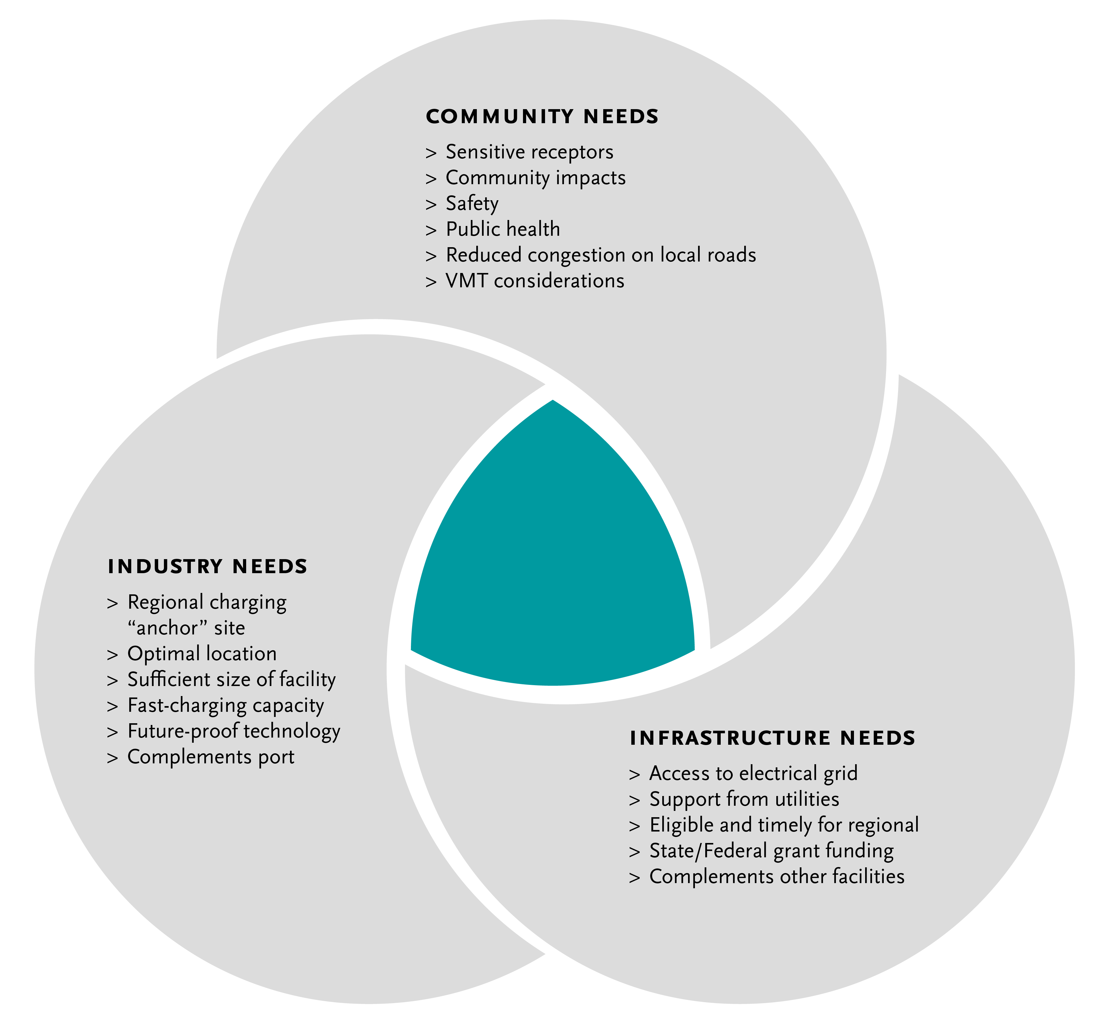
Metro Vision: Regional Zero-Emissions MD/HD Truck Charging and Fueling Facilities
14
Notes:
Michael

Slide 15
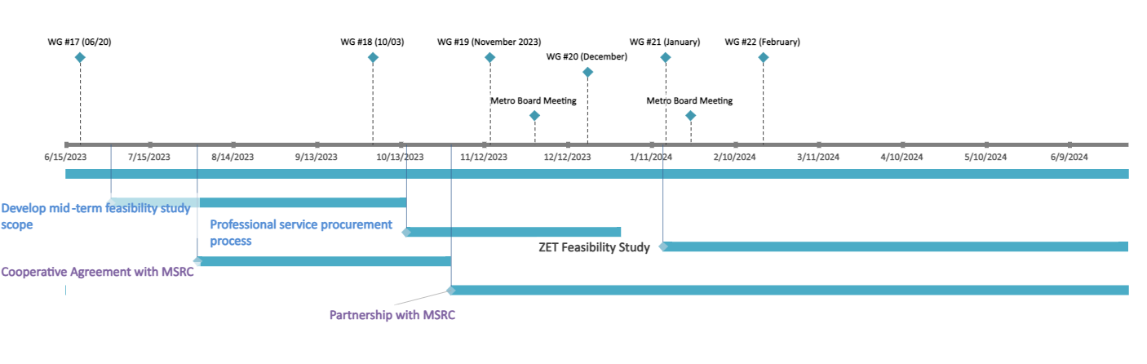

Where We're Going in 2023-24
15
Notes:
Akiko

Slide 16
Agenda Item #2:
California's Advanced Clean Fleets Rule:
Prospects, Pathways, and Challenges
Preliminary Results – Dr. Genevieve Giuliano
Notes:
Erika

Slide 17
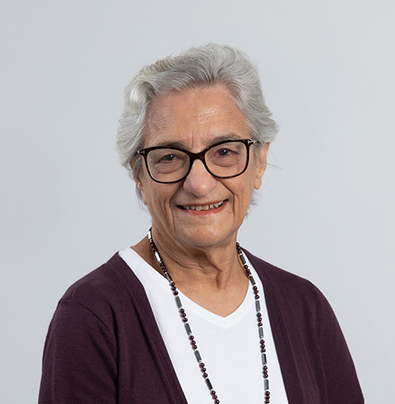
Guest Presenter
Dr. Genevieve Giuliano
Ferraro Chair in Effective Local Government
Distinguished Professor at USC Sol Price School of Public Policy
Notes:
Erika
Dr. Giuliano’s research areas include relationships between land use and transportation, transportation policy analysis, travel behavior, and information technology applications in transportation.
She has published over 170 papers and given invited lectures around the world.
She is a past Chair of the Executive Committee of the Transportation Research Board, and of the Council of University Transportation Centers.
She has received numerous distinguished scholarship and service awards
At the state level, she is working with Caltrans and CARB on the implementation of the California Sustainable Freight Action Plan.

Slide 18
California’s Advanced Clean Fleets Rule: Prospects, Pathways, and Challenges
Marlon G. Boarnet and Genevieve Giuliano
USC Sol Price School of Public Policy
METRANS Transportation Consortium
Research Assistance: Clemens Pilgram, Qifan Shao, Ruoyu Chen

Slide 19
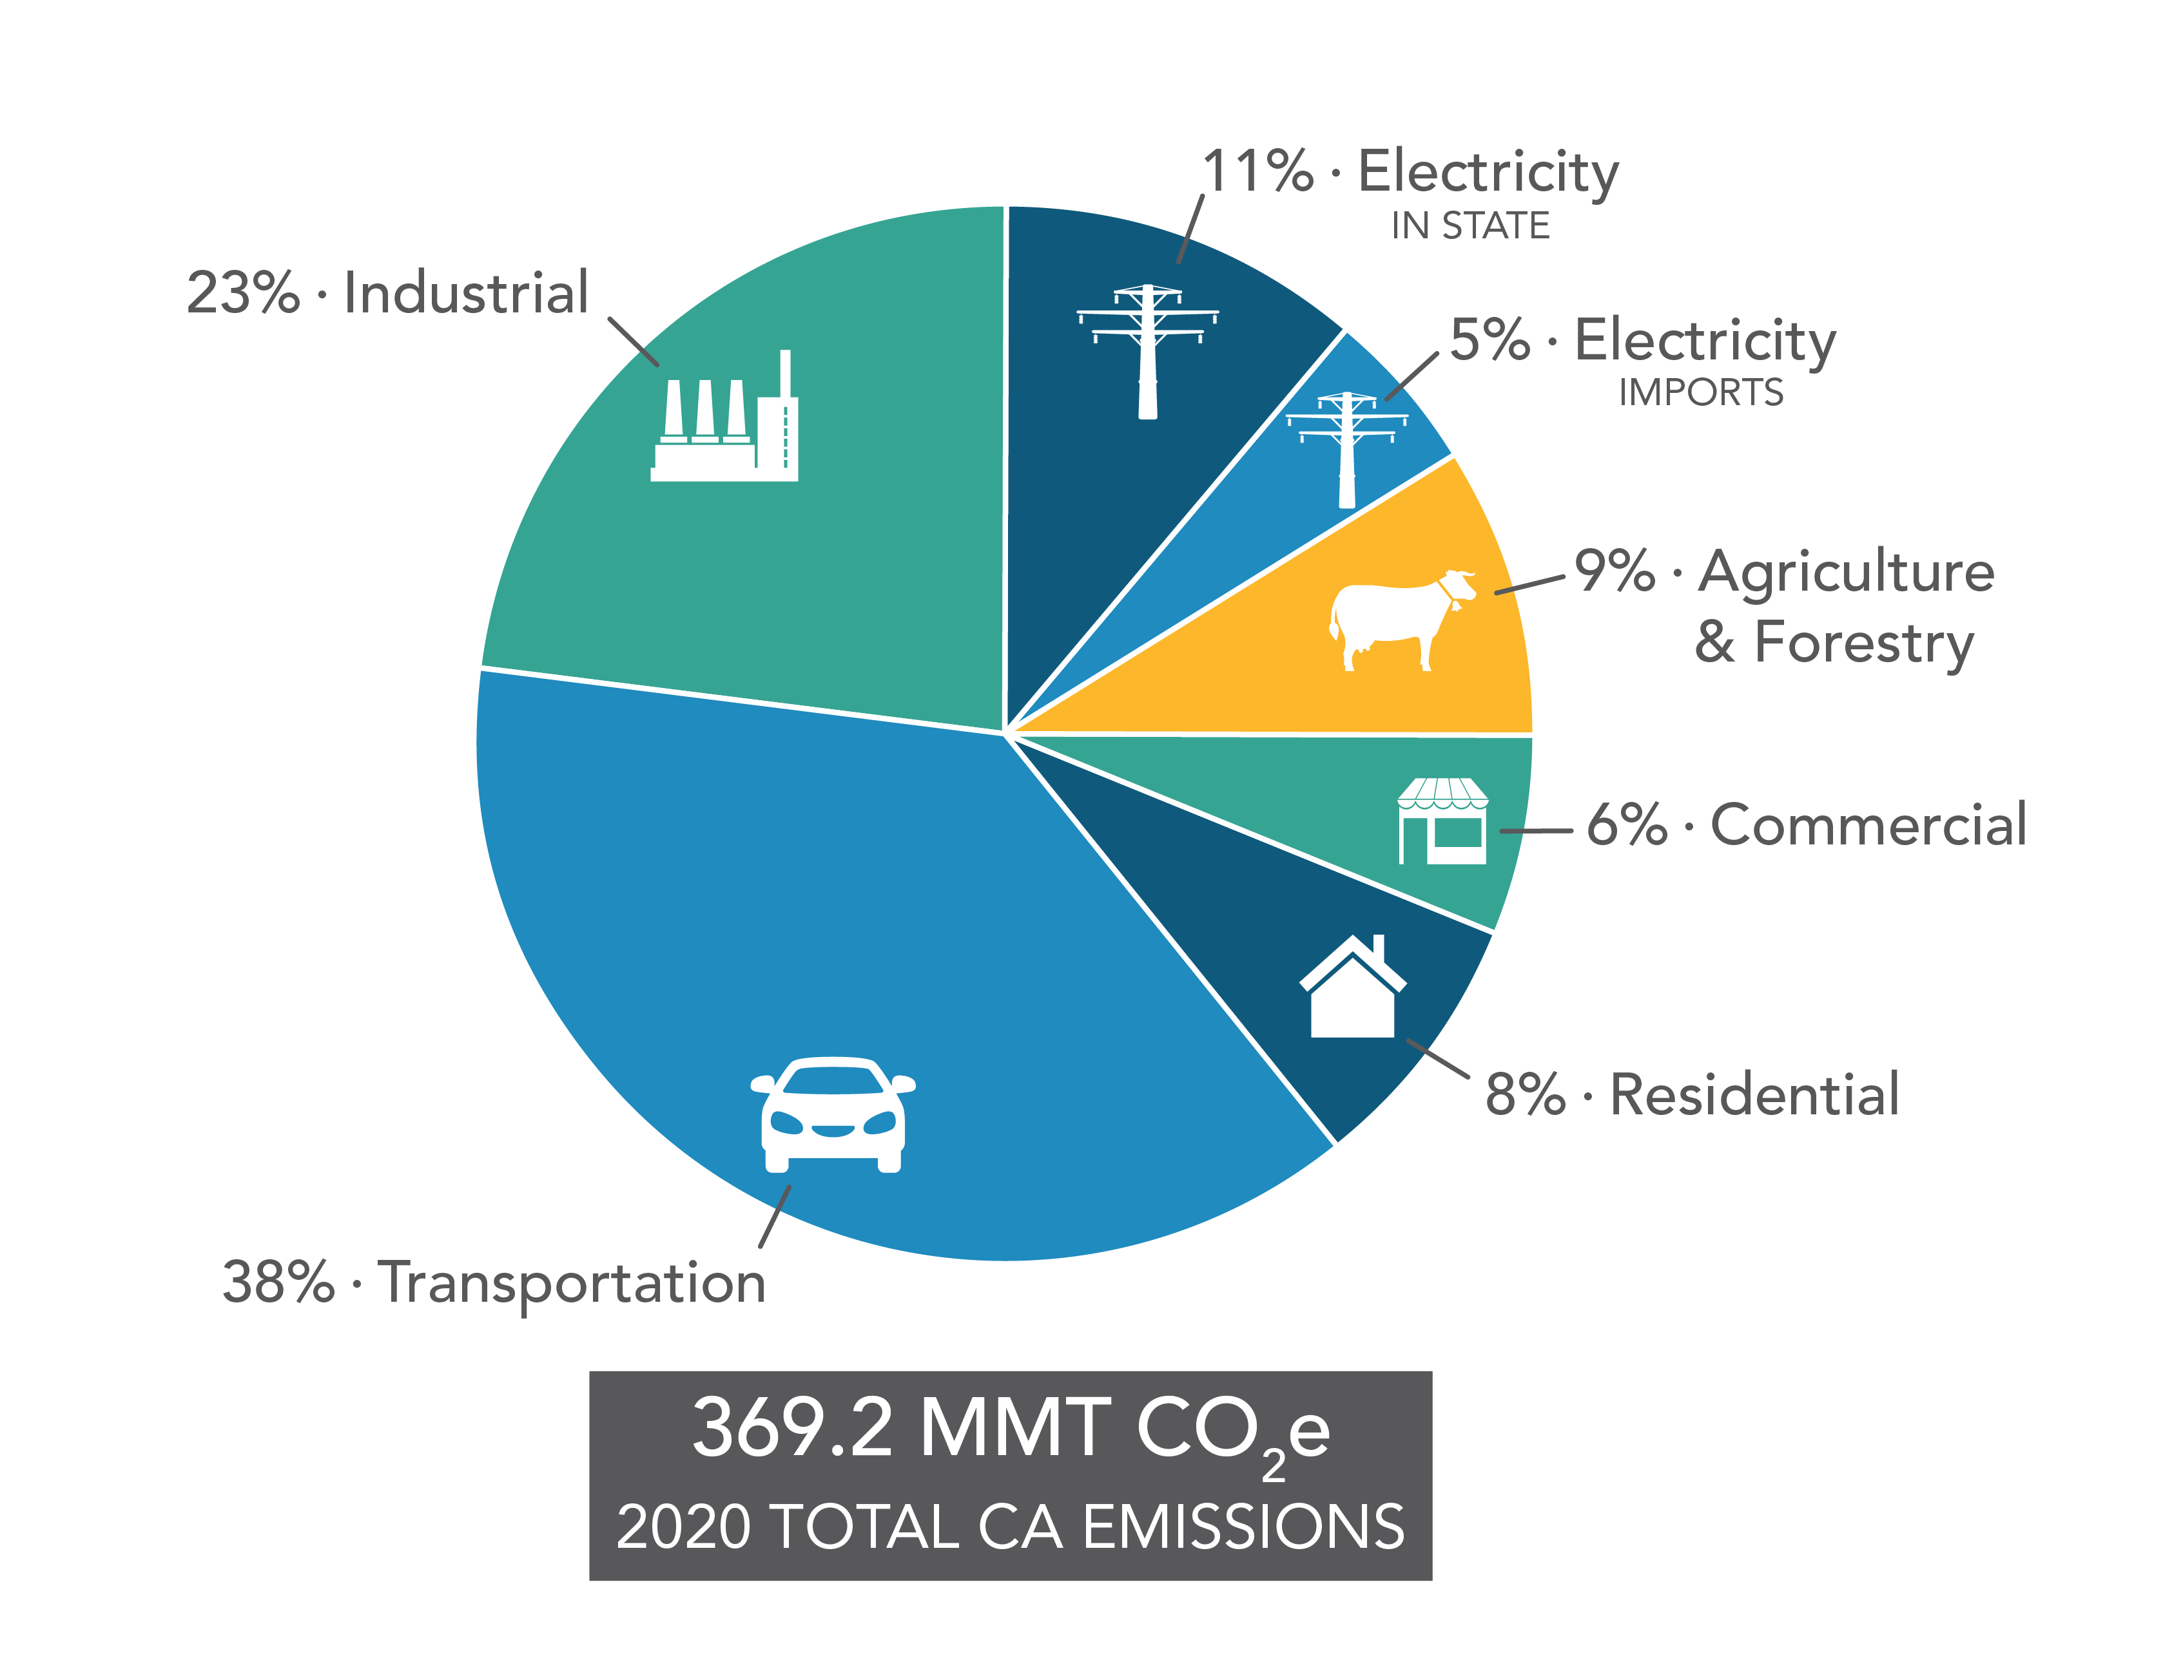
The Context
Local Emissions: 5,400 annual premature deaths from PM 2.5 exposure in California
Global Greenhouse Gas Emissions: Transport = 38% of California GHG emissions; heavy duty trucks are 24% of transport GHG
Source: https://ww2.arb.ca.gov/ghg-inventory-graphs

Slide 20

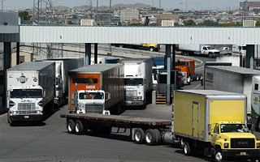
What is the Advanced Clean Fleets (ACF) Regulation?​
The ACF sets targets for zero emission truck fleets in California​
Government
Medium and heavy-duty
Drayage (carry cargo from port to local destinations)
Drayage is on the fastest time frame
Jan. 1, 2024 – all new trucks entering drayage fleet must be zero emission
Jan. 1, 2025 – trucks removed from drayage fleet if older than 13 years and more than 800,000 miles, to maximum age of 18 years
2035 – 100% zero emission drayage fleet statewide
This Photo by Unknown Author is licensed under CC BY-SA-NC

Slide 21
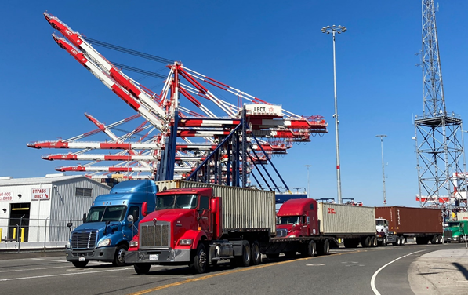
Drayage Truck Fleets at the Ports of Los Angeles and Long Beach
The drayage truck industry
Lots of small companies
Firms with 20 trucks or less:
Are about 70% of all firms serving the ports
Do about 28% of all truck moves
The drayage truck registry
All trucks used for drayage must be part of the drayage truck registry
About 20,000 trucks in registry
All trucks in registry must meet engine age criteria: 2010 or newer
Few zero emission vehicles – 46 battery electric, 1 hydrogen fuel cell

Slide 22
What this project is doing
Interview stakeholders and early adopters
Estimate the needed pace of change
Highlight needed next steps
Starting with the drayage fleet, will expand analysis to medium and heavy-duty fleets
The Advanced Clean Fleets regulation is ambitious, and there are several changes that need to happen quickly.

Slide 23
Early Adopters: Results from Industry/Fleet Owner Interviews
Firm with about 800 trucks has 15% BE trucks in 65 truck So Cal drayage facility, has ordered 20 hydrogen fuel cell trucks
Firm with about 200 trucks in CA has 6 battery electric trucks (BET) in use; has ordered 20 hydrogen fuel cell trucks
One firm currently uses 20-25% BE trucks at one depot serving short drays to and from the San Pedro Bay ports (POLA and POLB)
Motivations
Learn in advance of CA regulations
Serve customers who have ESG goals
Internal zero emission goals

Slide 24
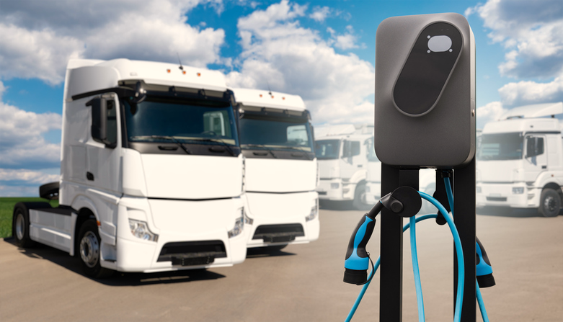
Characteristics of Early Adopters
Interviews with firms, early adopters are:
Larger companies
Partners with OEM’s (truck manufacturers)
Motivated by ESG (Environment, Sustainability, Governance) goals
Have routes that fit with current range and charging technology
Short distance trips to and from ports and home depot
Use trucks less than 3 shifts per day; enough idle time for charging

Slide 25
The S-Curve and the Pace of Change
How quickly will battery electric trucks (BETs) be in the drayage fleet?
One Estimate:
Status quo demand for drayage in ports
Diesel trucks are replaced by BETs as diesels age out
Current fleet size is sufficient in 2024
BET performance gradually improves
Estimate → 12% to 15% zero emission by 2026 (approximately 2,600 to 3,300 battery electric by 2026)

Slide 26
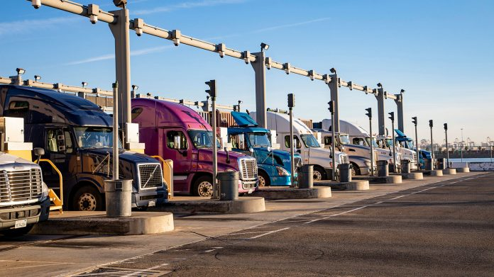
We have about two years
And three big challenges …

Slide 27
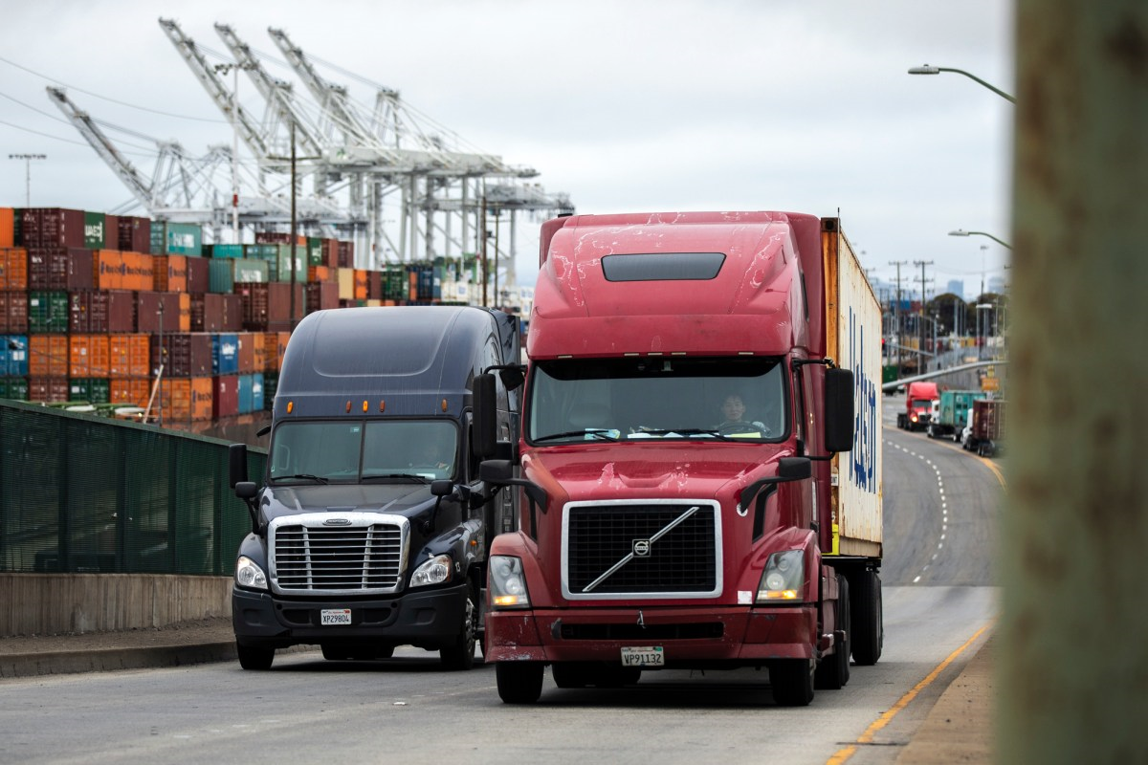
Challenge 1: Price
Purchase Price
New Diesel Truck: $120 - $150K; used 2017 or newer $90K or less
Battery Electric: $400 - $590K
Hydrogen Fuel Cell: $420 - > $600K (estimate)
Subsidies and Tax Credits
Inflation Reduction Act: up to $40K tax credit
HVIP (Hybrid and Zero-Emission Truck and Bus Incentive Project):
$150K voucher for battery electric
$240K for hydrogen fuel cell
Battery electric is the only zero emission truck commercially available, so early years of transition will be battery electric trucks.

Slide 28
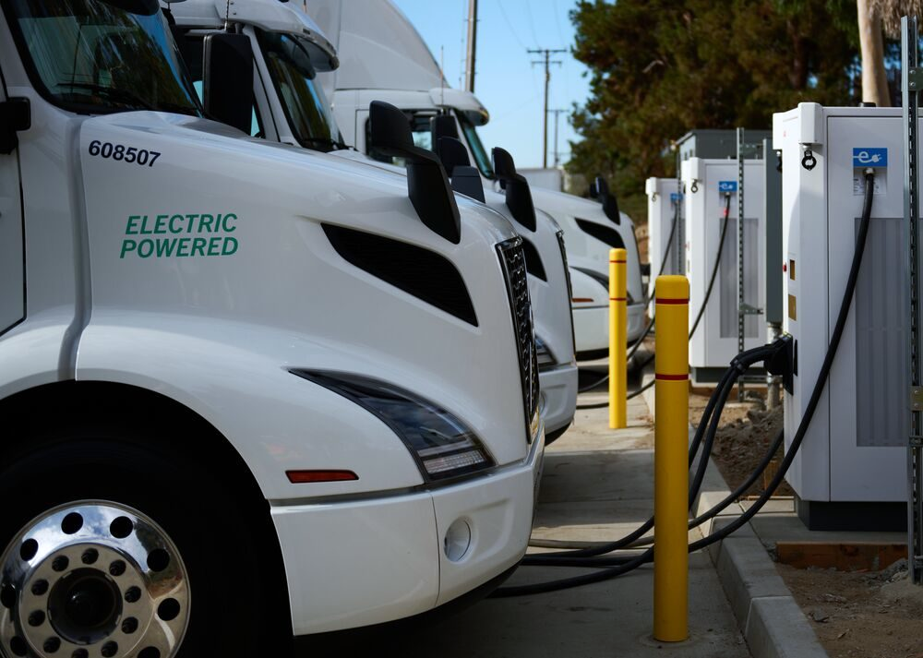
Challenge 2: Performance
Battery Electric (BE) Duty Cycle
Expected performance vs operational experience
Battery charge time
4 to 6 hours for full charge
Fast charge options generally not available
Range = 150 miles (expected to improve)
Additional weight: batteries weigh about 5000 lbs
Implications of above
Constraints on hours BE truck can be in service per day
Constraints on distance BE truck can travel before recharge
Constraints on load weight
→ Need to replace one diesel truck with more than one BE truck

Slide 29
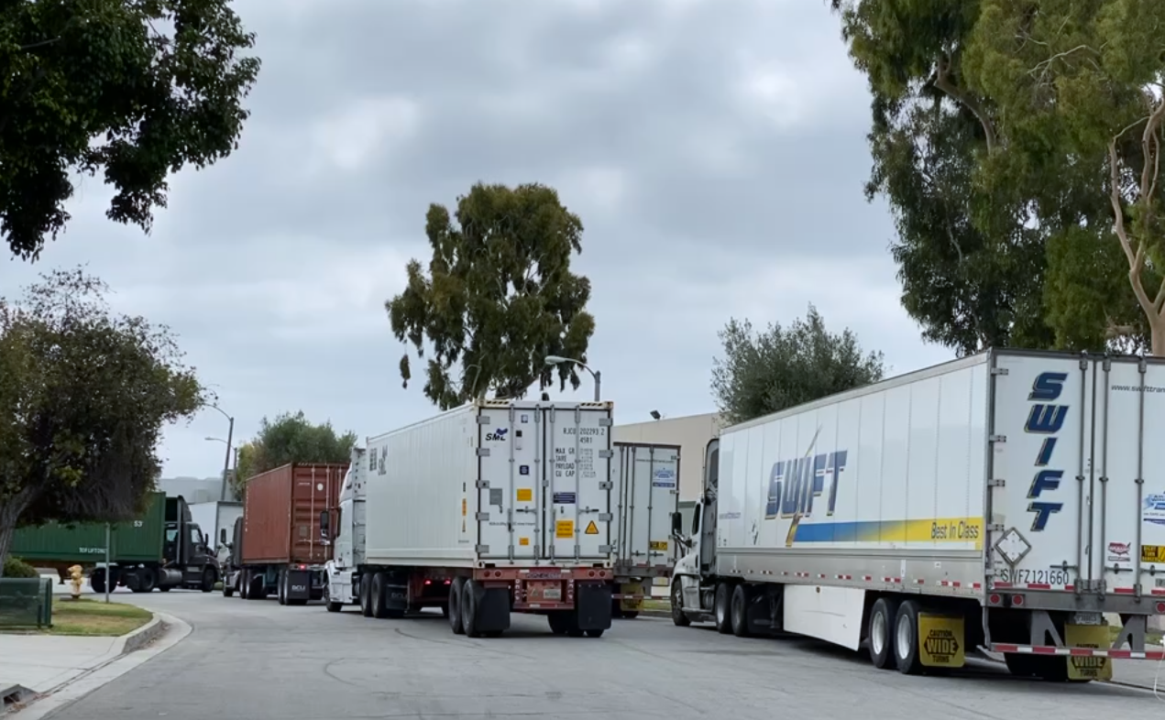
Challenge 3: Infrastructure
Charging Infrastructure
No public infrastructure, must have charging facilities on site
On-site charging not always feasible
About 30% of drayage fleet parks on streets or on private lots
Lease property is common
On-site charging infrastructure
Additional cost and time for permits, up to two years
Availability of electricity capacity
Sub-station upgrades can take 5 years or more

Slide 30
Next Steps for the Drayage Fleet
Will need approximately 2,600-3,300 zero emission trucks in the 2024 to 2026 timeframe
Almost certainly battery electric
Likely in medium and large firms
We have approximately two years to:
Permit and build charging infrastructure
Adapt operations to charge time
Purchase new vehicles and support large and small firms
When hydrogen fuel cell trucks become commercially available at a mass market, might create opportunity for those trucks to serve:
Operations requiring three shifts per day / short fuel times
Hauls outside of battery electric range

Slide 31
Next Steps for this Study
We will continue to interview industry stakeholders
We will expand the study to:
Drayage fleets statewide
Medium and heavy-duty truck fleets (non-drayage) statewide
Results to be released in January 2024
Thank you!

Slide 32
Working Group Discussion
Notes:
Erika
Introduce item, Michael

Slide 33
Agenda Item #3: Creating a ZET Program
Legislative Platform
Notes:
Erika
Introduce item, Michael

Slide 34
Today's Frame
In our last meeting, we discussed as part of ZET Program Principles moving forward to develop a Legislative Platform.
Notes:
Michael

Slide 35
ZET Program Principles – Overview
1
2
3
4
Maximize leverage of seed funding
by collaborating with regional partners and funding agencies.
Expeditious Deployment of Resources
to maximize the buying power and benefit of investment while supporting community engagement and effective outreach.
Coordination
with regional and funding partners, government agencies, and key stakeholders.
Community Engagement
that centers corridor residents and stakeholders throughout the development process.
5
6
7
8
Workforce Development
that ensures community benefits and access to opportunity through the pursuit and implementation of ZE Technology.
Corridor Community Benefits by creating economic opportunities, improving air quality, and reducing long-standing health impacts generated by diesel trucks.
Equitable Outcomes
ensured by performance metrics that evaluate sustainable outcomes.
Legislative Platform
designed to support the accelerated, equitable deployment of ZE technology by reducing barriers and increasing incentives to adoption.
Notes:
Michael
Develop a legislative platform with policy solutions that reduce barriers for truck owners or companies to secure a ZE truck.
Support incentives and outreach necessary to accelerate deployment of ZE Class 8 trucks
Work with regional partners to prioritize highway and street maintenance.

Slide 36
Today's Frame
Today, we will bring you up to date on actions taken during the past few months to develop a Legislative Platform.
Notes:
Michael
Want to bring a legislative platform recommendation that board can discuss and approve for things we collectively see as being necessary of accelerating deployment of ZE trucks in the corridor
Goal: creating time and space to consider everyone's points of view and identify a platform
Examples of what we've heard: eliminating sales tax penalties, income tax penalties, need for more funding

Slide 37
ZET Legislative Platform Discussion Highlights
Summary
Metro conducted 10 legislative platform discussions with key stakeholders
25 Working Group members and other stakeholders participated
Highlights
Representatives from key stakeholder groups (including CTC, GCCOG, SCAG, Caltrans, CEHAJ, LACI, Utilities, Ports, and Trucking Associations) discussed:
Barriers to implementation,
Disincentives and lack of proper incentives/funding,
The need for legislative clarity or support, and
Other items related to ZET adoption and ZE Infrastructure implementation
Discussions coalesced around key themes:
Maintaining regional coordination to identify priority sites for ZE infrastructure development,
Streamlining permitting processes for utilities, and
Ensuring continued funding support for large and small fleets to transition.
Notes:
Michael

Slide 38
ZET Legislative Platform Objective: Supporting a Corridor First Approach
Transform the I-710/LB-ELA Study Area
into the nation's first zero-emission
goods movement corridor
Notes:
Michael

Slide 39
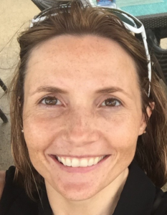
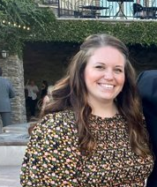
Guest Speakers
Hannah Walter
Kayla Giese
Associate Deputy Director California Transportation Commission
SB 671 Coordinator California Transportation Commission
Notes:
Michael

Slide 40
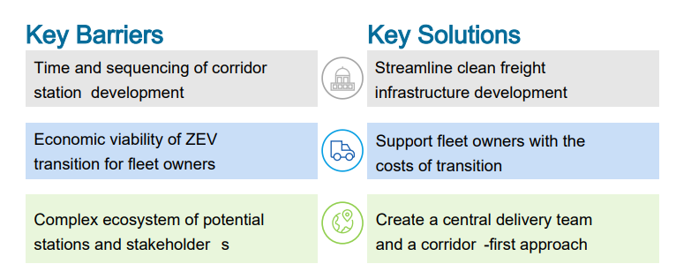
Framing Our Discussion
What are the key Barriers and Solutions to developing a zero emissions goods movement corridor?
California Transportation Commission – SB671 Assessment Recommendations Draft, page 6
Complex ecosystem of potential stations and stakeholders
Create a central delivery team and a corridor-first approach
Notes:
Michael to introduce Kayla/Hannah to review slide

Slide 41
Key Barriers and Solutions Summary
Issue | Principle
Timing | Support efforts to streamline clean freight infrastructure development Identify opportunities to increase speed of delivery of clean freight infrastructure Foster standardized approach and timing for permitting and approval processes
Money | Support fleet owners with the costs of transition to ZE technology Align funding programs to support the transition Ensure appropriate access to infrastructure for all freight types and movers across early minimum viable network Support local jurisdictions in identifying funding opportunities to assist with increased need for street maintenance
People | Create a corridor-first approach Support an “ecosystem approach” to corridor development to ensure coordination & timeliness Coordinate funding and project delivery opportunities (e.g. innovative public private partnership opportunities; reduction of public support once demand established)
Notes:
Michael

Slide 42
ZET Legislative Platform
Issue | Principle
People | Create a corridor-first approach
Support an “ecosystem approach” to corridor development to ensure coordination & timeliness ​
Coalesce around existing sites and available resources to coordinate and prioritize site development. This should be done concurrently with conducting Phase I feasibility studies to account for longer term plans beyond the next 5-7 years. (Caltrans/SCAG)
Work directly with local jurisdictions to understand land-use policies, identify available land for infrastructure deployment, and establish preferred truck patterns. (GCCOG)
Work with local communities to determine what to do with available parcels of land. (CEHAJ)
Coordinate and collaborate with regional stakeholders, including private companies, to understand the process of site development and implementation (Caltrans/SCAG)
Engage private companies who are intimately aware of the processes of site development and implementation (Caltrans/SCAG)
Establish a small forum for continued conversations (3-4 times a year) among key agencies to coordinate and optimize site development across the region. Potential group members include AQMD, CEC, CT, HTA, LACI, Metro, MSRC, POLA, POLB, and SCAG. (Caltrans/SCAG)
Notes:
Michael
SCAG/Caltrans:
Scott Strelecki, James Shankel

Slide 43
ZET Legislative Platform
Issue | Principle
Timing | Support efforts to streamline clean freight infrastructure development
Identify opportunities to increase speed of delivery of clean freight infrastructure | A central delivery team should be created to coordinate state and local stakeholders and carry out recommendations and shorten the station development timeframe. (CTC) Increase coordination among transportation agencies, the freight industry, and utilities to improve the efficiency of infrastructure development. (SCE) Maintain regular engagement about legislation and to support projects that will advance deployment of ZE infrastructure and truck deployment (POLB) Participate in a regionally coordinated effort to advance deployment if convened by a regional agency (POLB) Utilize AQMD’s regional model for regional ZE truck ecosystem. (SCAG) Engage with potential hosts for charging infrastructure sites even if formal agreements are not in place to kickstart projects. (SCE) The Legislature should pursue a Categorical Exemption from the California Environmental Quality Act (CEQA) for zero-emission freight charging and hydrogen fueling stations. (CTC) The Legislature should seek delegated authority for the California State Transportation Agency to act as the National Environmental Policy Act lead on zero-emission infrastructure projects to allow for a quicker process. Existing law (Public Resources Code 13979.2) allows this for some transportation projects, but zero-emission infrastructure projects are not currently included as eligible. (CTC)
Notes:
Michael
CTC
Hannah/Kayla
Here's what you told us in our Roundtable Discussions:
Multiple agencies and multiple permits required in pre-construction phases
Lack of clear permitting processes and lead time add to elongated overall permit process completion for proposed projects
CTC Recommendation:
The central MVN1 delivery team could act as a station development accelerator through coordination with local leaders
Match project sponsors with eligible funding sources
Coordinate with utilities
Develop WFD programs
Notify local leads of upcoming projects
Coordinate with municipalities to batch and streamline permitting
Standardize zoning and design
Monitor buildout and delivery of stations
Develop lessons learned and cost/development database to inform future build-outs

Slide 44
ZET Legislative Platform
Issue | Principle
Timing | Support efforts to streamline clean freight infrastructure development
Standardized approach and timing for permitting & approval processes ​
The central delivery team should work with a consultant to create a set of standardized station development model(s) (zoning and building permits) that can be replicated for each station across a priority corridor, based on affected local municipality guidelines. (CTC)
Support SB 420 to raise the threshold from 50kV to 150kV for utilities to require CPUC review, reducing implementation planning time by 2-3 years (SCE)
The Legislature should consider a default permit approval deadline for zero-emission freight charging and hydrogen fueling stations that allows a permit for a charging station to be approved by default if it is not approved or otherwise commented on within a specified time period. (CTC)
Establish process for stakeholders to engage with the CPUC to navigate the licensing and approval process. (SCE)
Coordinate with GO-Biz to understand how to streamline permitting processes at the point of implementation (POLB)
Explore differences in permitting times and utility requirements. These could be conflated and the processes to overcome them are different. (POLB)
Work in partnership with SCE to streamline their process (POLB)
Notes:
Michael
SCE/LADWP/City of LA
Vishal Patel, Greg Sarvas, Michael Samulon?
CTC
The Legislature should consider a default permit approval deadline for zero-emission freight charging and hydrogen fueling stations similar to AB 970 (McCarty, Chapter 710, Statutes of 2021) that allows a permit for a charging station to be approved by default if it is not approved or otherwise commented on within a specified time period. AB 970 is specific to passenger battery electric vehicle stations, but the Commission is recommending the addition of battery electric vehicle and fuel cell electric vehicle stations for medium- and heavy-duty vehicles to this section of law, or that a new section allowing this same thing for these types of stations be added. (CTC)

Slide 45
ZET Legislative Platform
Issue | Principle
Money | Support fleet owners with the costs of transition to ZE technology
Ensure appropriate access to infrastructure for all freight types and movers across early minimum viable network ​
Income tax burden on incentive recipients relating to purchase of ZE vehicles (ZET Working Group)
Sales tax and vehicle registration fees assessed based on the Manufacturer's suggested retail price (ZET Working Group)
Support legislation that provides equitable opportunities for all fleets, not excluding larger fleets. Very few fleets, especially those dealing with Class 7 and 8 tractors, are adequately prepared to comply with the new regulations. (HTA/CTA)
Support legislation that does not exclude support for larger fleets in transitioning. These fleets with capital resources will likely be a strong mover towards broader commercialization. (POLB)
Establish a more precise threshold for small fleets that accounts for factors like fleet size and service load. (HTA/CTA)
The California Air Resources Board and, if necessary, the Legislature should consider creating a provision within the Low Carbon Fuel Standard program to support buildout and operation of fast charging and hydrogen refueling infrastructure for medium-duty and heavy-duty vehicles, similar to the existing capacity crediting provision in the Low Carbon Fuel Standard regulation. (CTC)
Notes:
Michael
HTA/CTA
Matt Schrap, Chris Shimoda
Here's what we heard from you in our Roundtable Discussions:
Income tax burden on incentive recipients relating to purchase of ZE vehicles
e.g., Carl Moyer Program incentives are considered income, and by increasing recipients’ annual gross incomes the incentives then subject recipients to a higher income tax bracket and higher taxes overall.
Sales tax and vehicle registration fees assessed based on the Manufacturer's suggested retail price
HVIP point-of-sale vouchers reduce out-of-pocket cost, but state registration fee and sales tax are imposed based on MSRP of ZE trucks. Legislation (AB 784) exists that creates exemptions for ZE Buses.
Buy America and Build America Policy
Could increase overall project cost due to higher unit cost, and sometimes scarcity of required parts or manufacturers in an emerging industry sector.

Slide 46
ZET Legislative Platform
Issue | Principle
Money | Support fleet owners with the costs of transition to ZE technology
Align funding programs to support the transition. ​
State agencies and the Legislature should consider creating a new limited-term (five-year) zero-emission truck incentive program aimed at assisting high-priority fleets, such as larger drayage fleets with 100 to 500 trucks, who are subject to the Advanced Clean Fleets regulation with purchasing zero-emission trucks. Program development should take place with input from the fleets who will be impacted and should be flexible to ensure support in a way that is considerate of their needs. The California Air Resources Board could administer this program. (CTC)
The Legislature should consider authorizing a vehicle buy-back program that would appropriate funds to a state agency who could work with truck sales companies to set aside funds to buy back used zero-emission trucks from fleets once they reach their useful life as a “new” vehicle. This could be a part of existing or new truck incentive programs. (CTC)
Notes:
Michael
CTC
Hannah, Kayla
The Legislature should consider a default permit approval deadline for zero-emission freight charging and hydrogen fueling stations similar to AB 970 (McCarty, Chapter 710, Statutes of 2021) that allows a permit for a charging station to be approved by default if it is not approved or otherwise commented on within a specified time period. AB 970 is specific to passenger battery electric vehicle stations, but the Commission is recommending the addition of battery electric vehicle and fuel cell electric vehicle stations for medium- and heavy-duty vehicles to this section of law, or that a new section allowing this same thing for these types of stations be added. (CTC)

Slide 47
ZET Legislative Platform Discussion Summary
Summary
Identify legislative priorities that align with the goals of Metro to support the transition to zero emission transportation.
Explore subsidies, sales tax incentives, income tax penalties, and retrofitting trucks to encourage the adoption of zero-emission (ZE) vehicles.
Fast-tracking the installation of ZE equipment is also emphasized.
Engage communities to:
Address local impacts resulting from the installation and ongoing operation of ZE truck infrastructure.
Receive input on truck patterns through local communities
Consider best practices, additional funding for local road maintenance, and the need to balance infrastructure development with local needs and concerns.
Streamline processes in a thoughtful manner, engage with utility companies, and coordinate with agencies like GO-Biz to overcome these challenges
Coordinate efforts to address permitting issues, workforce development, and rail electrification. There is a need for regular engagement and communication to ensure shared priorities and messaging.
Notes:
Michael

Slide 48
ZET Legislative Platform
Issue | Principle
Money | Support fleet owners with the costs of transition to ZE technology
Support local jurisdictions in identifying funding opportunities to assist with increased need for street maintenance ​
Work with Federal Highway Administration to consider increasing gross vehicle weight limits of ZE trucks on highways (CTC)
Budget for increased maintenance and repair costs and consider new ways to reduce repair cost (CTC)
Seek additional funding opportunities to assist cities with increased street maintenance needed to support heavier ZE trucks. (GCCOG)
Explore options to establish "green gates" at Ports to increase revenue and encourage adoption through quicker turnaround times (GCCOG)
Notes:
Michael
GCCOG
Hector

Slide 49
Working Group Discussion
What topics need additional discussion?
How should Metro continue working with regional stakeholders to develop an effective legislative platform?
Notes:
Michael/Erika to facilitate
Possible discussion topics
Hydrogen
CEQA categorial exemption
In early August, Governor Newsom directed the Office of Business and Economic Development (GO-Biz) to create a Hydrogen Market Development Strategy for California to help guide the state’s clean, renewable hydrogen market.
The strategy will be designed to:
Focus on leveraging hydrogen to accelerate clean energy deployment and decarbonize the state’s transportation and industrial sectors;
Build on the 2022 Scoping Plan while leveraging the upcoming SB 1075 hydrogen report and ARCHES’ (Alliance for Renewable Clean Hydrogen Energy Systems) cross sector, multi-stakeholder hydrogen market white papers;
Define state agencies roles and responsibilities, including CARB, CEC, and the Public Utilities Commission;
Identify shared strategies to deliver projects, which may include new financing models, permitting modifications, and procurement initiatives;
Engage relevant stakeholders, including local communities, to advance equity and deliver environmental and economic benefits; and
Ensure state agencies and partners continue to move in the same direction to accelerate the use of renewable energy throughout California’s economy and increase the resilience and reliability of the state’s energy system.
For more information, please visit https://www.gov.ca.gov/wp-content/uploads/2023/08/Letter-to-Director-Meyers.pdf

Slide 50
Closing Remarks & Next Steps
Notes:
Erika

Slide 51
Upcoming Meeting Schedule Calendario de Próximas Reuniones
CLC Meeting
Virtual Meeting
Tuesday, October 10, 5-7pm
Task Force Meeting
Virtual Meeting
Monday, October 23, 5-7pm
For the most updated list
of meeting dates, please visit:
https://www.metro.net/projects/lb-ela-corridor-plan/
Para obtener la lista más actualizada de
las fechas de las reuniones, visite:
https://www.metro.net/projects/lb-ela-corridor-plan/
Notes:
Erika

Slide 52
Stay connected to this project
Michael Cano
Executive Officer
Countywide Planning & Development
LA Metro
One Gateway Plaza, MS 99-13-1 Los Angeles, CA 90012
213.418.3010 W
213.305.0423 C
710corridor@metro.net
https://www.metro.net/projects/lb-ela-corridor-plan/
@metrolosangeles
losangelesmetro
Notes:
Erika

Slide 53
Thank you!
Notes:
Erika

Slide 54
Issues for Future Discussion
In early August, Governor Newsom directed the Office of Business and Economic Development (GO-Biz) to create a Hydrogen Market Development Strategy for California to help guide the state’s clean, renewable hydrogen market.
The strategy will be designed to:
Focus on leveraging hydrogen to accelerate clean energy deployment and decarbonize the state’s transportation and industrial sectors;
Build on the 2022 Scoping Plan while leveraging the upcoming SB 1075 hydrogen report and ARCHES’ (Alliance for Renewable Clean Hydrogen Energy Systems) cross sector, multi-stakeholder hydrogen market white papers;
Define state agencies roles and responsibilities, including CARB, CEC, and the Public Utilities Commission;
Identify shared strategies to deliver projects, which may include new financing models, permitting modifications, and procurement initiatives;
Engage relevant stakeholders, including local communities, to advance equity and deliver environmental and economic benefits; and
Ensure state agencies and partners continue to move in the same direction to accelerate the use of renewable energy throughout California’s economy and increase the resilience and reliability of the state’s energy system.
For more information, please visit https://www.gov.ca.gov/wp-content/uploads/2023/08/Letter-to-Director-Meyers.pdf
Notes:
Michael/Erika to facilitate

Slide 55
Agenda Item #5: Status Report on Recent Funding Opportunities
Notes:
Michael
Pull updated grant info from Metro June Board Report

Slide 56
Funding & Regulatory Updates
2023-24
$847 million for ZEVs
Includes $165 million for drayage trucks and infrastructure at CARB and CEC
SB 125
The bill would establish the Zero-Emission Transit Capital Program under the administration of the Transportation Agency and would require funds appropriated under the program to be allocated to regional transportation planning agencies pursuant to a population-based formula and another formula based on transit operator revenues within the jurisdiction of those regional transportation planning agencies, as specified. The bill would authorize a regional transportation planning agency, subject to the requirements described below, to fund zero-emission transit equipment and transit operating expenditures, as specified.
SB 149
The bill aims to provide unique streamlining benefits to critical infrastructure projects. To receive these benefits, applicants must bear the cost of expedited record preparation required for streamlined proceedings. They must also fund GHG analyses and meet stringent GHG reduction requirements.
Provides for resolution of CEQA challenges within 270 days.
56
Notes:
Michael
AB 102
SB 125 - https://legiscan.com/CA/text/SB125/id/2831757
SB 149

Slide 57
Funding Updates: State Budget 2023-24
What's happening now
Governor's budget
Recent funding opportunities
AB 365 - Sales Tax Exclusion for Zero-Emission and Near-Zero-Emission Drayage Trucks
https://ww2.arb.ca.gov/2022-assembly-bill-365-odonnell-patrick-sales-tax-exclusion-zero-emission-and-near-zero-emission
O'Donnell's office
AB 95
57
Notes:
Michael
AB 102
SB 125
SB 149

Slide 58
Legislative Platform
Regional Collaborative Overview
Create a working group to coordinate and collaborate with regional stakeholders to identify priority sites and streamline ZE infrastructure deployment
Electrical Transmission Facility Projects (SB 420)
Streamlines regulatory approvals for electrical transmission projects
Expedites grid capacity expansion to reduce delays
Exempts rebuilding a new construction form certification requirements
Funding support for large fleets
Consider creating a new zero-emission truck incentive program aimed at assisting high priority fleets with 100-500 trucks, who are subject to the Advanced Clean Fleets regulation
Notes:
Michael
SB 420 aims to streamline regulatory approvals for electrical transmission projects in California. This legislation seeks to expedite grid capacity expansion, aligning with the state's zero-emission vehicle goals. Currently, regulations add significant delays to these projects.
SB 420 proposes exempting rebuilding and new construction of certain electrical transmission facilities from certification requirements. It also suggests raising the voltage threshold to 130kV for utilities to construct charging stations for zero-emission trucks.
Background
The Governor’s Executive Order N-79-20 requires the California Air Resources Board (CARB) to develop and propose strategies to achieve 100% zero-emissions from medium and heavy-duty on-road vehicles in the State by 2045 where feasible and by 2035 from drayage trucks.
Expanding grid capacity to meet the demand for charging ZE Trucks is a critical component to achieve zero-emissions from medium and heavy-duty vehicles by 2045 and drayage trucks by 2035. The permitting timeline for expanding electrical capacity needs to be streamlined to achieve the State’s goals.

Slide 59
Legislative Platform: Timing SB 420: Electricity: Electrical Transmission Facility Projects
Overview
Streamlines regulatory approvals for electrical transmission projects
Expedites grid capacity expansion to reduce delays
Exempts rebuilding a new construction form certification requirements
Relevance
Expanding grid capacity to meet the demand for charging ZE Trucks is a critical component to achieve zero-emissions from medium and heavy-duty vehicles by 2045 and drayage trucks by 2035.
Reduces implementation timeline by 2-3 years
Support
Utilities, including Southern California Edison and LADWP
Harbor Trucking Association and California Trucking Association
City of LA
Notes:
Michael
SB 420 aims to streamline regulatory approvals for electrical transmission projects in California. This legislation seeks to expedite grid capacity expansion, aligning with the state's zero-emission vehicle goals. Currently, regulations add significant delays to these projects.
SB 420 proposes exempting rebuilding and new construction of certain electrical transmission facilities from certification requirements. It also suggests raising the voltage threshold to 130kV for utilities to construct charging stations for zero-emission trucks.
Background
The Governor’s Executive Order N-79-20 requires the California Air Resources Board (CARB) to develop and propose strategies to achieve 100% zero-emissions from medium and heavy-duty on-road vehicles in the State by 2045 where feasible and by 2035 from drayage trucks.
Expanding grid capacity to meet the demand for charging ZE Trucks is a critical component to achieve zero-emissions from medium and heavy-duty vehicles by 2045 and drayage trucks by 2035. The permitting timeline for expanding electrical capacity needs to be streamlined to achieve the State’s goals.

Slide 60
Station Development Stages/State Level Strategic Actions
Project Development
Explore shortening public state agency application process for funding where feasible
Refine existing funding programs to incentivize zero-emission freight infrastructure where possible
Funding/Financing awarded
Synchronize state and local funding with other key processes where possible to facilitate efficient award delivery and optimize public funding sources
Permitting
Create model station development process (zoning and building permits) as appropriate with federal state, and local partners
Design and Engineering
Create model station development process (zoning and building permits) as appropriate with federal, state, regional, and local partners
Building and Inspection
Take a corridor approach to batch and sequence station buildout

Slide 61
Legislative Platform: People Regional Collaborative for ZE Infrastructure Deployment
Overview
Create a working group to coordinate and collaborate with regional stakeholders to identify priority sites and streamline ZE infrastructure deployment
Relevance
Important to coalesce around existing sites and available resources to coordinate and prioritize site development. This should be done concurrently with conducting Phase I feasibility studies to account for longer term plans beyond the next 5-7 years.
Support
Caltrans
SCAG
Ports
Utilities
City of LA
Gateway Cities COG
Notes:
Michael

Slide 62
Legislative Platform: Money Funding Support for Large and Small Fleets.
Overview
Consider creating a new zero-emission truck incentive program aimed at assisting high priority fleets with 100-500 trucks, who are subject to the Advanced Clean Fleets regulation
Relevance
Explore continued incentive options for larger fleets because they have the financial means to implement charging solutions at their sites. Their success will provide subsequent opportunities for smaller fleets down the road.
Support
California Transportation Commission
Harbor Trucking Association and California Trucking Association
Opposition
CARB economic analysis indicates that larger fleets don’t need additional support to transition
CTC work group and independent owner/operators did not agree with this analysis
Notes:
Michael
Hydrogen: SB 671 work, want to have a conversation: concerns that we should be articulating, (potential panel for hydrogen next meeting)
State agencies and the Legislature should consider creating a new limited-term (five-year) zero-emission truck incentive program aimed at assisting high-priority fleets, such
as larger drayage fleets with 100 to 500 trucks, who are subject to the Advanced Clean Fleets regulation with purchasing zero-emission trucks. Program development should take place with input from the fleets who
will be impacted and should be flexible to ensure support in a way that is considerate of their needs. The California Air Resources Board could administer this program.

Slide 63
Legislative Platform: Money Funding Support for Small Fleets
Overview
Explore subsidies, sales tax incentives/penalties, income tax penalties, additional funding for road repair and maintenance
Relevance
Notes:
Michael
State agencies and the Legislature should consider creating a new limited-term (five-year) zero-emission truck incentive program aimed at assisting high-priority fleets, such as larger drayage fleets with 100 to 500 trucks, who are subject to the Advanced Clean Fleets regulation with purchasing zero-emission trucks. Program development should take place with input from the fleets who will be impacted and should be flexible to ensure support in a way that is considerate of their needs. The California Air Resources Board could administer this program.

Slide 64
ZET Legislative Platform Discussion: Action Items
Summary
Advocate for changes that expedite the permitting process.
Engage with GoBiz to understand why certain changes have not yet been implemented.
Engage with communities to address local impacts of ZE trucks, including infrastructure siting and education around hydrogen infrastructure
Establish partnerships and collaborations among agencies like Metro, MSRC (Mobile Source Air Pollution Reduction Review Committee), and POLA (Port of Los Angeles) is seen as a crucial next step. Regular engagement and communication are suggested to ensure that shared priorities and messaging are aligned.
Notes:
Michael

Slide 65
ZET Legislative Platform Discussion: Key Takeaways
Summary
Identify legislative priorities that align with the goals of Metro to support the transition to zero emission transportation.
Explore subsidies, sales tax incentives, income tax penalties, and retrofitting trucks to encourage the adoption of zero-emission (ZE) vehicles.
Fast-tracking the installation of ZE equipment is also emphasized.
Engage communities to:
Address local impacts resulting from the installation and ongoing operation of ZE truck infrastructure.
Receive input on truck patterns through local communities
Consider best practices, additional funding for local road maintenance, and the need to balance infrastructure development with local needs and concerns.
Streamline processes in a thoughtful manner, engage with utility companies, and coordinate with agencies like GoBiz to overcome these challenges
Coordinate efforts to address permitting issues, workforce development, and rail electrification. There is a need for regular engagement and communication to ensure shared priorities and messaging.
Notes:
Michael

Slide 66
Legislative Platform: People Regional Collaborative for ZE Infrastructure Deployment
Overview
Create a working group to coordinate and collaborate with regional stakeholders to identify priority sites and streamline ZE infrastructure deployment
Relevance
Important to coalesce around existing sites and available resources to coordinate and prioritize site development. This should be done concurrently with conducting Phase I feasibility studies to account for longer term plans beyond the next 5-7 years.
Support
Caltrans
SCAG
Ports
Utilities
City of LA
Gateway Cities COG
Notes:
Michael

Slide 67
Legislative Platform: Money Funding Support for Large and Small Fleets.
Overview
Consider creating a new zero-emission truck incentive program aimed at assisting high priority fleets with 100-500 trucks, who are subject to the Advanced Clean Fleets regulation
Relevance
Explore continued incentive options for larger fleets because they have the financial means to implement charging solutions at their sites. Their success will provide subsequent opportunities for smaller fleets down the road.
Support
California Transportation Commission
Harbor Trucking Association and California Trucking Association
Opposition
CARB economic analysis indicates that larger fleets don’t need additional support to transition
CTC work group and independent owner/operators did not agree with this analysis
Notes:
Michael
Hydrogen: SB 671 work, want to have a conversation: concerns that we should be articulating, (potential panel for hydrogen next meeting)
State agencies and the Legislature should consider creating a new limited-term (five-year) zero-emission truck incentive program aimed at assisting high-priority fleets, such
as larger drayage fleets with 100 to 500 trucks, who are subject to the Advanced Clean Fleets regulation with purchasing zero-emission trucks. Program development should take place with input from the fleets who
will be impacted and should be flexible to ensure support in a way that is considerate of their needs. The California Air Resources Board could administer this program.

Slide 68
Legislative Platform: Money Funding Support for Small Fleets
Overview
Explore subsidies, sales tax incentives/penalties, income tax penalties, additional funding for road repair and maintenance
Relevance
Notes:
Michael
State agencies and the Legislature should consider creating a new limited-term (five-year) zero-emission truck incentive program aimed at assisting high-priority fleets, such as larger drayage fleets with 100 to 500 trucks, who are subject to the Advanced Clean Fleets regulation with purchasing zero-emission trucks. Program development should take place with input from the fleets who will be impacted and should be flexible to ensure support in a way that is considerate of their needs. The California Air Resources Board could administer this program.

Slide 69
Key Takeaways: ZET Program as a Catalyst for Workforce Development & Job Training
What are the best ways to engage communities and generate support?
Create programs that meet needs of employers and educate community about jobs available (how to apply/how to get trained)
Create a “jobs coordinator” component to hiring/employment part of project
Implement program like Construction Utility Pathways Program (CUP) to connect employers/job opportunities with community
Empower local businesses and landowners to tap into Fed/State incentives to repurpose land for charging facilities
Ensure that planned labor agreements involve clear standards/requirements for local hiring
Invest in community engagement, particularly to ensure a diverse workforce
69
Notes:
Akiko

Slide 70
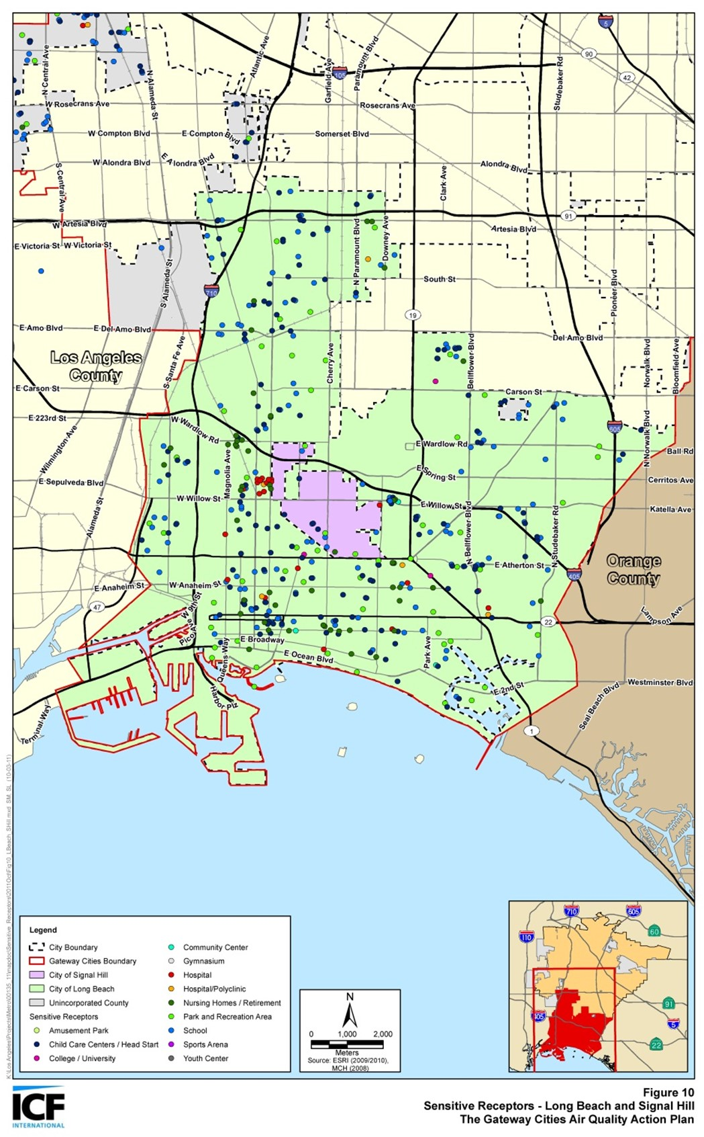
Community Engagement around Sensitive Receptors
The California Air Resources Board (CARB) defines sensitive receptors as places where children, the elderly, and those with pre-existing respiratory health conditions are most likely to congregate, such as:
Schools and schoolyards,
Parks and playgrounds,
Daycare centers,
Nursing homes,
Hospitals, and
Residential communities
Local government can play a significant role in improving health outcomes through land use decisions, truck route planning, and mitigation measures
Communities can develop effective outreach programs to reduce the exposure of children and the elderly by developing a list of sensitive receptor sites to aid in planning efforts
70
Notes:
Michael, Susan A

Slide 71
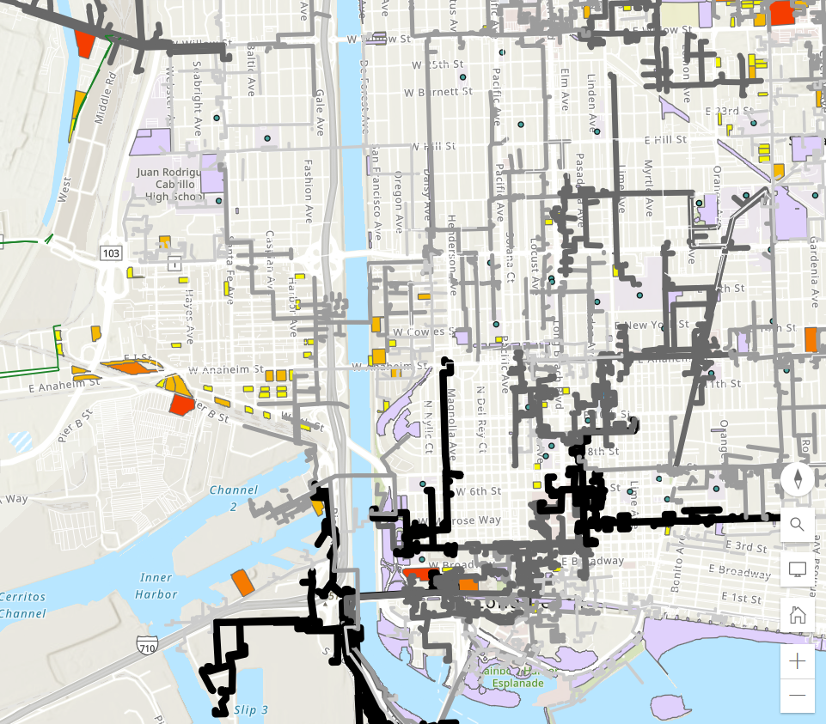
Community Engagement around Sensitive Receptors
Schools and schoolyards
Hospitals
Parks
Available parcels of land
Grid capacity
71
Notes:
Michael, Susan A

Slide 72
ZET as a Catalyst for Corridor Community Benefit Programs
Characterize and evaluate potential cancer and non-cancer health risks associated with exposure to toxic air contaminants (TACs) from both stationary and mobile sources.
Identify significant sources and locations of TAC emissions within the jurisdiction
Assess existing exposures of sensitive receptors including children, senior citizens, and people with respiratory illnesses and identify priority communities.
Develop and implement mitigation measures to reduce TAC emissions and to avoid the over-concentration of these facilities near sensitive receptors.
Prioritize use of resources to reduce TACs in the most highly impacted areas (i.e., priority communities)
72
Notes:
Michael, Susan A

Slide 73
Today's ZET planning agenda
Status report
Legislative platform overview
Interviews conducted/pending
Opportunities/barriers discussion
Review format and content
Identify key issues
Large fleet vs. Small fleet support
Permitting timelines
Regional collaborative to identify priority sites
Select initiatives to highlight for Metro Board
Create fact sheets on proposed initiatives (e.g., collaborative)
Next ZET WG meeting
Agenda
Dates (10/3)
Notes:
When to coordinate further with Hector

Slide 74
Progress Assessment on Physical Infrastructure Needs Analysis (Task 1)
Task 1. Identify physical infrastructure needs to support full deployment of ZE drayage trucks along I-710
Subtasks | Products/Activities Completed | Additional Analyses Needed
1.1 Estimate the number of charging and fueling stations to support the number of ZE drayage trucks over the next 10 years, both regional and small in scope. | Metro - Clean Truck Technology Comparative Report LACI I-710 Investment Blueprint POLB – Fueling the Future Fleets | Agree on the drayage truck population to be served Agree on the charging port power level
1.2 Develop an energy supply plan to ensure that sufficient energy will be provided without compromising other energy uses along the corridor. | Industry/Infrastructure Focus Group highlights | Collaborate with utilities to verify existing energy supplies, their future infrastructure investment plans Verify existing and future transmission network and distribution system capacity for the Corridor Understand roles of various state agencies that are involved in statewide energy supply and demand planning and infrastructure delivery (CEC, CPUC, and CARB)
74
Notes:
Michael

Slide 75
Progress Assessment on Physical Infrastructure Needs Analysis (Task 1) Cont’d
Task 1. Identify physical infrastructure needs to support full deployment of ZE drayage trucks along I-710
Subtasks | Products/Activities Completed | Additional Analyses Needed
1.3 Develop a methodology and evaluation criteria for ZE charging/fueling site selection | Preliminary performance measures ZET Program Principles LACI 710 Investment Blueprint Project methodology and evaluation criteria | Delineate measurable metrics from stated community desirable outcomes Develop evaluation methodology for each criterion Identify existing data and data needs to perform evaluation
1.4 Identify existing legislative and regulatory barriers that hinder the deployment of physical support infrastructure | Focus Group input, breakout group | Confirm legislative priorities Initiate a Southern California’s legislative platform to advance ZET program
1.5 Collaborate with regional partners to chart a regional path for ZE infrastructure development | Partner with MSRC, Ports, AQMD and SCAG on regional ZET infrastructure deployment project | Memorialize Metro’s partnership with MSRC through a cooperative agreement Consider forming a regional ZET collaborative to cross-leverage members' expertise in project development and delivery Engage state agencies in our energy planning discussion
75
Notes:
Michael

Slide 76
ZET
Issue | Principle
Timing | Support efforts to streamline clean freight infrastructure development
 | Identify opportunities to increase speed of delivery of clean freight infrastructure
 | Foster standardized approach and timing for permitting and approval processes
 | Develop a streamlined approach to awarding and accessing public funds
Notes:
Michael

Slide 77
ZET Legislative Priority Recommendations
Issue | Principle
Money | Support fleet owners with the costs of transition to ZE technology
 | Align funding programs to support the transition
 | Ensure appropriate access to infrastructure for all freight types and movers across early minimum viable network
 | Support local jurisdictions in identifying funding opportunities to assist with increased need for street maintenance
Notes:
Michael

Slide 78
ZET Legislative Priority Recommendations
Issue | Principle
People | Create a corridor-first approach
 | Support an “ecosystem approach” to corridor development to ensure coordination & timeliness
 | Coordinate funding and project delivery opportunities (e.g. innovative public private partnership opportunities; reduction of public support once demand established)
Notes:
Michael

Slide 79
Next Steps
Debrief from last meeting
Identify Michael's priorities for the remainder of 2023
Bench contract RFP?
Board Report?
Recharacterize legislative program?
CTC Recommendations
Review and comment?
Stakeholder interviews
Review, prioritize, and clarify Metro role on legislative initiatives
Set up meeting with internal Metro governmental affairs team
Set up meeting with Hector to review items for CARB review
Next meeting
Panel discussion on hydrogen
Recommendations on participants and framing
Possible dates
11/14
12/5
12/12
Potential Metro initiatives
Charging/fueling infrastructure RFP?
Workforce development?
Metro's role in partnership with others
Notes:
Michael

Slide 80
Legislative Platform Tasks
Advocate for the creation and passage of legislation that promotes the development and deployment of zero-emission drayage charging facilities. Legislation could include provisions for funding, incentives, streamlined permitting processes, and regulations that encourage private investment in ZE charging/fueling infrastructure.
Secure funding: Lobby for federal and state funding to support the installation and expansion of charging infrastructure at the Ports of LA and Long Beach. Explore opportunities such as grants, tax credits, and partnerships with public and private entities to secure the necessary financial resources.
Collaborate with utility companies: Work closely with utility companies to ensure sufficient electrical grid capacity to support the charging infrastructure. Encourage partnerships between utilities and charging infrastructure providers to optimize grid integration, manage electricity demand, and explore innovative pricing and billing models.
Streamline permitting and regulations: Identify and address regulatory barriers that may impede the rapid deployment of ZE charging or fueling infrastructure. Advocate for streamlined permitting processes and standardized regulations to facilitate the installation of charging stations at the port and surrounding areas, while also recognizing community concerns that may arise from this streamlined approach.
Notes:
Michael

Slide 81
Legislative Platform Tasks (cont.)
Public-private partnerships: Encourage collaboration between public entities, private stakeholders, and drayage trucking companies to accelerate the deployment of charging infrastructure. Develop incentives and agreements to incentivize private investment and ensure the availability of ZE charging or fueling facilities at key locations within the ports.
Promote workforce development: Advocate for programs that support workforce development and training for the installation, operation, and maintenance of zero-emission drayage charging infrastructure. Collaborate with educational institutions and industry associations to create training programs that meet the specific needs of the industry.
Public awareness and outreach: Launch a public awareness campaign to highlight the benefits of zero-emission drayage and the importance of ZE charging and fueling infrastructure. Educate the public, policymakers, and industry stakeholders about the positive impacts on air quality, public health, and sustainability by accelerating the deployment of ZE trucks in place of existing diesel trucks.
Notes:
Michael

Slide 82
Zero-Emission Truck Working Group #16 Highlights
Summary
Held virtually via Zoom on Tuesday, May 23
20 Working Group members in attendance
Highlights
Received information on the Mobile Source Air Pollution Reduction Review Committee (MSRC) Cooperative Agreement, Metro staff intent to seek a Board approval to contribute the seed funding towards the Port of LA owned parcel development as a ZET charging depot, and the Charging and Fueling Infrastructure (CFI) Grant development.
ZET pilot project lessons learned from regional partners
Discussed how partnerships with Original Equipment Manufacturers (OEMs), Fuel providers, and dealerships were cultivated
Be flexible to adopt to dynamic environment surrounding ZE technologies
Workforce Development Panel Discussions
Learned how workforce development opportunities were curated and created through Zero-Emission infrastructure development
Reviewed existing resources and relationships that enable workforce development programs, including how to create and maintain a skilled workforce, ensure LA County residents reap benefits from these job opportunities, and determine how best to gain community support on these programs.
Notes:
Michael

Slide 83
Metro June 2023 Board Meetings
Planning & Programming Committee (June 14, 2023)
LB-ELA Corridor Task Force Update
Draft LB-ELA Investment Plan scheduled for November 2023
Final Investment Plan scheduled for Winter/Spring 2024
Summary of stakeholder engagement activities and emphasis on public health improvements
2. LB-ELA Corridor ZET Program Update
Committee support on Metro’s seed funding contribution (up to $3 M) for the proposed POLA site
These items were approved and/or received and filed and will go to the full Board Meeting (June 22, 2023) on consent.
Notes:
Michael

