Slide 1
We will begin in a few moments.
LB-ELA Task Force
Zero-Emission Truck Working Group
Small Group Meeting
June 20, 2023
Notes:
Erika

Slide 2
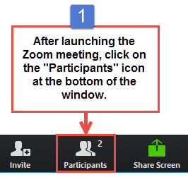
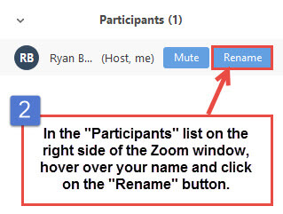


Working Group Member Identification
Notes:
Erika

Slide 3

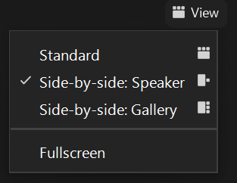
Turn on Camera
To start and stop your video, click the camera icon at the bottom left of your control panel
To switch between views during the meeting click or tap on Standard, Side-by-side Speaker View, and Side-by-side Gallery View at the top right corner of your zoom screen
Notes:
ERIKA

Slide 4

Logistics
Click Interpretation to choose your language.
To hear the interpreted language only, click Mute Original Audio (Optional).
Change your Zoom screen name to include name, agency/organization.
Click Raise Hand in your meeting controls, Press*9 on the phone line, or raise your hand physically.
To lower your hand, click Raise Hand in your meeting controls.
The Q&A button is located on the control panel at the bottom of your screen.
To mute and unmute, click the microphone icon on the bottom left of your control panel.
To start and stop your video, click the camera icon at the bottom left of your control panel.
Technology & interpretation support: 323.609.3345
Notes:
Laura

Slide 5
Detailed Agenda
1:00pm 1:05pm | Welcome, Agenda Review, and Purpose of the Zero-Emission Truck Working Group Agenda Item #1: Metro Update Metro Board Report – June
1:15pm 1:30pm 1:50pm | Agenda Item #2: Mid- to Longer-term Feasibility Study Agenda Item #3: Creating a ZET Program Legislative Platform Agenda Item #4: ZET Program as a Catalyst for Community Benefit Programs Susan Ambrosini, Principal, AECOM, Lead, Equity Working Group Working Group Discussion Next Steps
2:30pm . 2:40pm 2:50pm 3:00pm | Agenda Item #5: Grant Funding Opportunities Recent awards Grant Submissions Agenda Item #6: ZET Program as a Catalyst for Workforce Development & Job Training Lessons learned and next steps from panel discussions Identify Metro’s role in supporting workforce investment Collaborate with partners to establish a workforce development outreach strategy Working Group Discussion Closing Remarks and Upcoming Meetings Adjournment
Notes:
Agenda topics
MSRC Update
Grant funding matrix
Akiko slides
Community benefits
Prioritize efforts to improve impacted areas and work with local agencies to provide resources to those communities. (Laura Cortez, EYCEJ)
Implement plans to divert traffic from sensitive receptors and minimize impact on communities is key. (Sylvia Betancourt, EYCEJ)
Conduct route studies revolving around identifying exposure on routes and how we can re-route truck to improve the air quality in those areas that are most impacted. ((Ambar Rivera, CBE)
Local jurisdictions need to be engaged in discussions about siting, permitting, utilities, access, etc. (Nancy Pfeffer, Gateway Cities COG)
Zoning classifications will determine potential sites; use mapping tools to identify pollution pockets; mitigate impacts to roads and sensitive receptors. (Kareem Gongora, CCA)
Facilitate conversations with truck drivers to gain perspective of their experience and needs. (Lily O’Brien, LA County)
Build focus groups with independent owners & operators to get their input; put together the plan to create proposals for grant funding opportunities. (Laura Cortez, EYCEJ)
Work with schools, community centers, and parks along the corridor to engage with the key local stakeholders to work on outreach strategies. (Sylvia Betancourt, LBACA)
Create funding mechanisms with local municipalities to build these local public electrification locations and create a fund to support this initiative. (Kareem Gongora, CCA)
Legislative platform
Report out on highlights from WFD panels
Advancing the WFD for ZET Program
What are the areas of overlap with the overall Task Force process
Include Task Force slides that show support for WFD in Task Force

Slide 6
We will begin in a few moments.
LB-ELA Task Force
Zero-Emission Truck Working Group
Meeting #17
June 20, 2023
Notes:
Erika

Slide 7

Facilitator
Erika C.B. Morales
Partner, Morales + Morales Partners
Notes:
Erika

Slide 8
Welcome, Agenda Review, and Purpose
of the
Long Beach – East LA Corridor
Zero-Emission Truck (ZET) Working Group
Notes:
ERIKA

Slide 9
Detailed Agenda
1:00pm 1:05pm | Welcome, Agenda Review, and Purpose of the Zero-Emission Truck Working Group Agenda Item #1: Metro Update Metro Board Report – June
1:15pm 1:30pm 1:50pm | Agenda Item #2: Mid- to Longer-term Feasibility Study Agenda Item #3: Creating a ZET Program Legislative Platform Agenda Item #4: ZET Program as a Catalyst for Community Benefit Programs Susan Ambrosini, Principal, AECOM, Lead, Equity Working Group Working Group Discussion Next Steps
2:30pm . 2:40pm 2:50pm 3:00pm | Agenda Item #5: Grant Funding Opportunities Recent awards Grant Submissions Agenda Item #6: ZET Program as a Catalyst for Workforce Development & Job Training Lessons learned and next steps from panel discussions Identify Metro’s role in supporting workforce investment Collaborate with partners to establish a workforce development outreach strategy Working Group Discussion Closing Remarks and Upcoming Meetings Adjournment
Notes:
Agenda topics
MSRC Update
Grant funding matrix
Akiko slides
Community benefits
Prioritize efforts to improve impacted areas and work with local agencies to provide resources to those communities. (Laura Cortez, EYCEJ)
Implement plans to divert traffic from sensitive receptors and minimize impact on communities is key. (Sylvia Betancourt, EYCEJ)
Conduct route studies revolving around identifying exposure on routes and how we can re-route truck to improve the air quality in those areas that are most impacted. ((Ambar Rivera, CBE)
Local jurisdictions need to be engaged in discussions about siting, permitting, utilities, access, etc. (Nancy Pfeffer, Gateway Cities COG)
Zoning classifications will determine potential sites; use mapping tools to identify pollution pockets; mitigate impacts to roads and sensitive receptors. (Kareem Gongora, CCA)
Facilitate conversations with truck drivers to gain perspective of their experience and needs. (Lily O’Brien, LA County)
Build focus groups with independent owners & operators to get their input; put together the plan to create proposals for grant funding opportunities. (Laura Cortez, EYCEJ)
Work with schools, community centers, and parks along the corridor to engage with the key local stakeholders to work on outreach strategies. (Sylvia Betancourt, LBACA)
Create funding mechanisms with local municipalities to build these local public electrification locations and create a fund to support this initiative. (Kareem Gongora, CCA)
Legislative platform
Report out on highlights from WFD panels
Advancing the WFD for ZET Program
What are the areas of overlap with the overall Task Force process
Include Task Force slides that show support for WFD in Task Force

Slide 10
Meeting Objectives
During this meeting, the working group will discuss:
Mid- to Longer-term Feasibility Study
  Receive Metro’s initial thoughts on a feasibility study to address mid- to longer-term infrastructure feasibility study and provide input
Creating a ZET Program Legislative Platform
  Review known shortcomings in existing programs that may require legislative advocacy for improvements and discuss new findings
ZET Program as a Catalyst for Community Benefit Programs
  Receive a presentation and discuss criteria that should be considered in site selection to minimize impacts and maximize community benefits
Grant Funding Opportunities
  Receive a status report on recent awards and pending opportunities for funding
ZET Program as a Catalyst for Workforce Development & Job Training
  Receive a review of key takeaways and discuss next steps
Notes:
Erika

Slide 11
Agenda Item #1:
Metro Update
Notes:
Erika

Slide 12
ZET Program Recap – Metro Board Direction
Metro Board Direction and desired outcomes
$200 million minimum funding target
Leverage Board-approved $50 million with private, regional, state, and federal funding
Accelerated ZE deployment in the Long Beach-East LA (LB-ELA, formerly I-710 South) Corridor
Collaboration with regional stakeholders
Independent from but aligned with overall LB-ELA Corridor Task Force Investment Plan process
Strategies to accomplish outcomes
Convene and collaborate with community and regional stakeholders
Develop a scope of work for the ZET Program
Identify regional funding partners
Identify discretionary grant opportunities
Identify near and long-term opportunities
Identify policy and legislative barriers to implementation
Develop approaches to understanding potential community impacts and creating community benefits
Notes:
Michael

Slide 13
Zero-Emission Truck Working Group #16 Highlights
Summary
  Held virtually via Zoom on Tuesday, May 23
  20 Working Group members in attendance
Highlights
Received information on the Mobile Source Air Pollution Reduction Review Committee (MSRC) Cooperative Agreement, Metro staff intent to seek a Board approval to contribute the seed funding towards the Port of LA owned parcel development as a ZET charging depot, and the Charging and Fueling Infrastructure (CFI) Grant development.
ZET pilot project lessons learned from regional partners
  Discussed how partnerships with Original Equipment Manufacturers (OEMs), Fuel providers, and dealerships were cultivated
  Be flexible to adopt to dynamic environment surrounding ZE technologies
Workforce Development Panel Discussions
  Learned how workforce development opportunities were curated and created through Zero-Emission infrastructure development
  Reviewed existing resources and relationships that enable workforce development programs, including how to create and maintain a skilled workforce, ensure LA County residents reap benefits from these job opportunities, and determine how best to gain community support on these programs.
Notes:
Michael

Slide 14
Metro June 2023 Board Meetings
Planning & Programming Committee (June 14, 2023)
  LB-ELA Corridor Task Force Update
    Draft LB-ELA Investment Plan scheduled for November 2023
    Final Investment Plan scheduled for Winter/Spring 2024
    Summary of stakeholder engagement activities and emphasis on public health improvements
  2. LB-ELA Corridor ZET Program Update
    Committee support on Metro’s seed funding contribution (up to $3 M) for the proposed POLA site
    These items were approved and/or received and filed and will go to the full Board Meeting (June 22, 2023) on consent.
Notes:
Michael

Slide 15
ZET Program Principles – Overview
1
2
3
4
Maximize leverage of seed funding
by collaborating with regional partners and funding agencies.
Expeditious Deployment of Resources
to maximize the buying power and benefit of investment while supporting community engagement and effective outreach.
Coordination
with regional and funding partners, government agencies, and key stakeholders.
Community Engagement
that centers corridor residents and stakeholders throughout the development process.
5
6
7
8
Workforce Development
that ensures community benefits and access to opportunity through the
pursuit and implementation of ZE Technology.
Corridor Community Benefits
by creating economic opportunities, improving air quality, and reducing long-standing health impacts generated by diesel trucks.
Equitable Outcomes
ensured by performance metrics that evaluate sustainable outcomes.
Legislative Platform
designed to support the accelerated, equitable deployment of ZE technology by reducing barriers and increasing incentives to adoption.

Slide 16
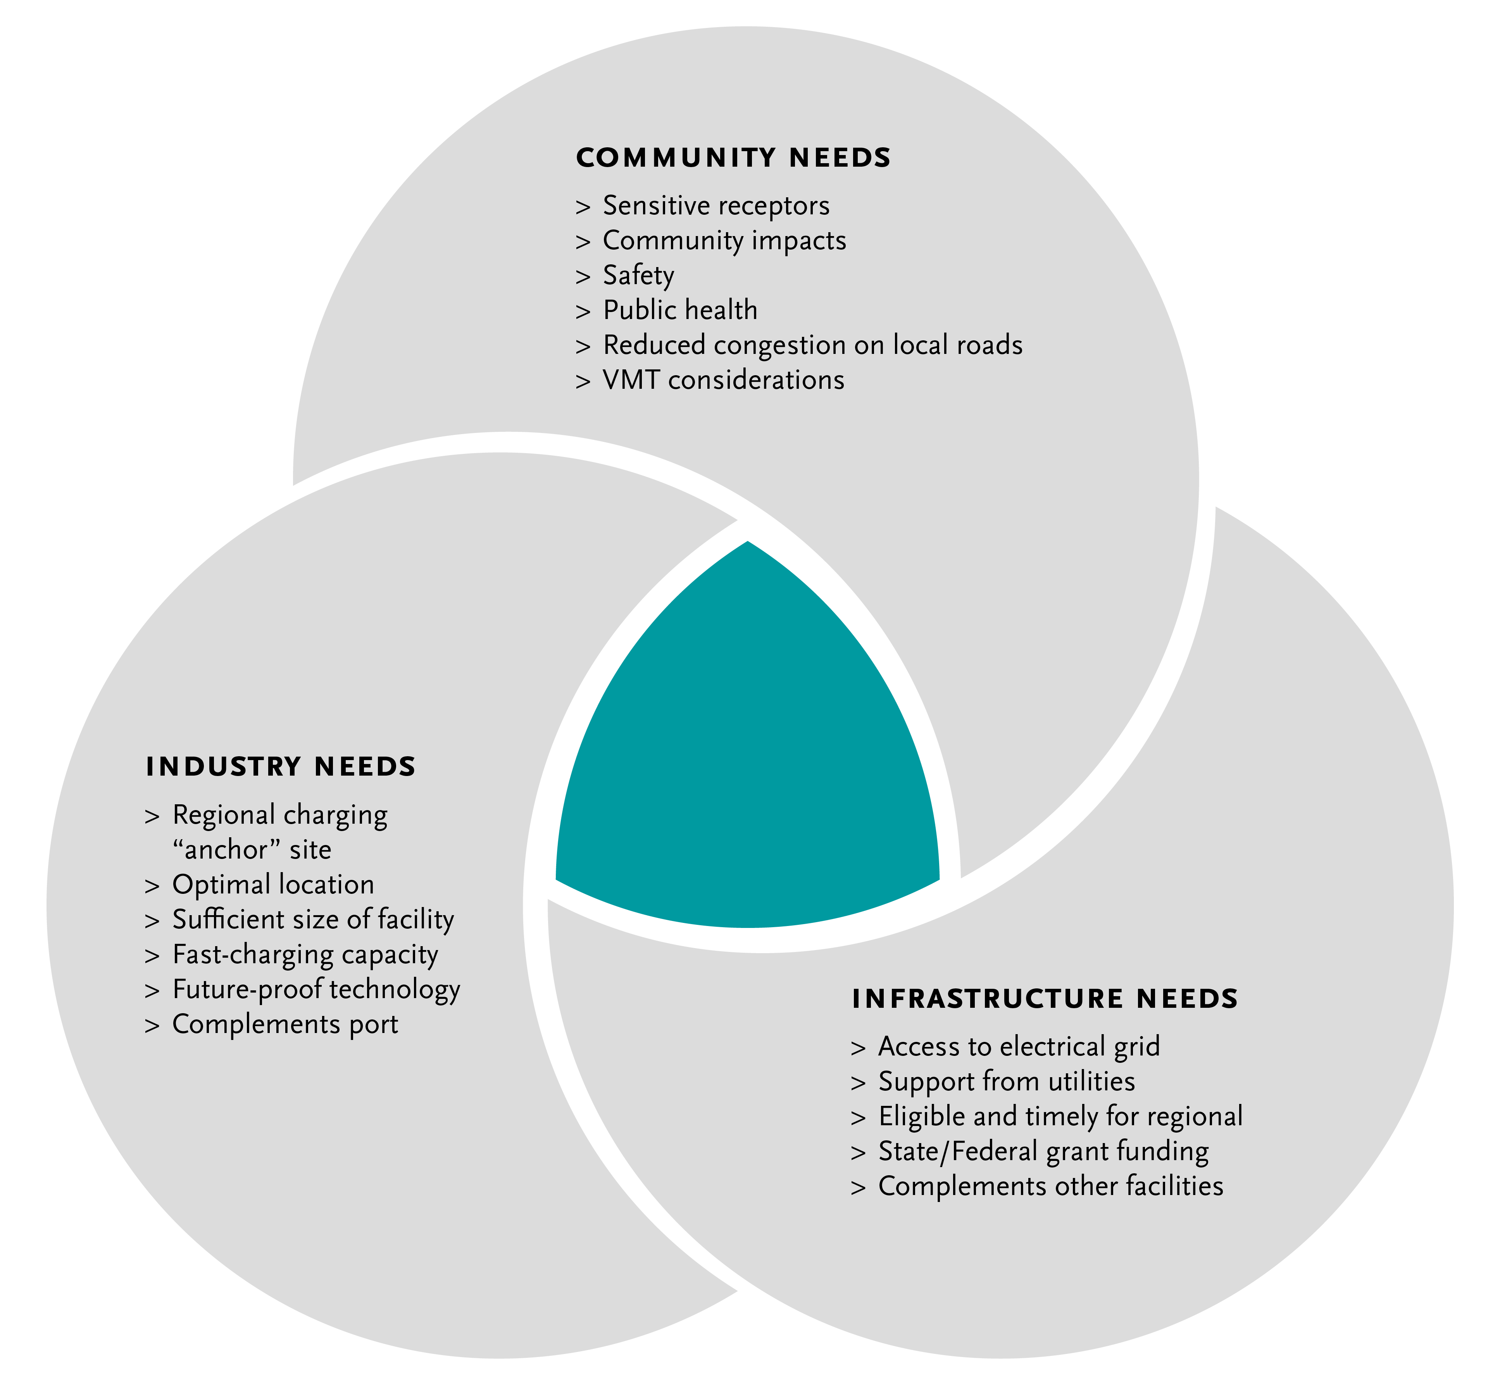
Metro Vision:
Regional Zero-Emissions MD/HD Truck Charging Facility/ies
16
Notes:
Michael

Slide 17
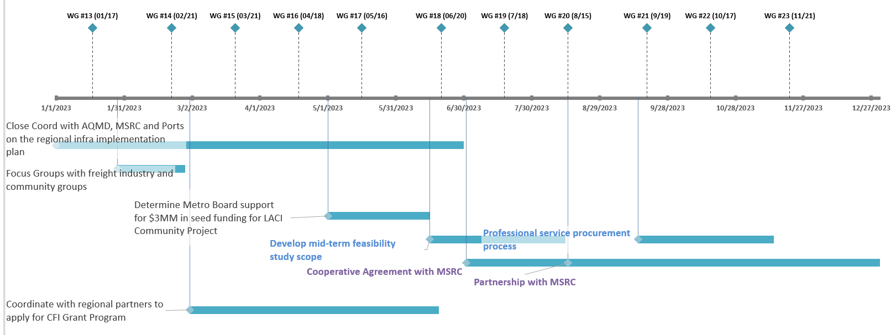

Where We're Going in 2023
17
Notes:
Michael
Task 1: Identify physical infrastructure needs to support the full deployment of ZE heavy duty trucks along I-710 South.

Slide 18
Progress Assessment on Physical Infrastructure Needs Analysis (Task 1)
Task 1. Identify physical infrastructure needs to support full deployment of ZE drayage trucks along I-710
Subtasks | Products/Activities Completed | Additional Analyses Needed
1.1 Estimate the number of charging and fueling stations to support the number of ZE drayage trucks over the next 10 years, both regional and small in scope. | Metro - Clean Truck Technology Comparative Report LACI I-710 Investment Blueprint POLB – Fueling the Future Fleets | Agree on the drayage truck population to be served Agree on the charging port power level
1.2 Develop an energy supply plan to ensure that sufficient energy will be provided without compromising other energy uses along the corridor. | Industry/Infrastructure Focus Group highlights | Collaborate with utilities to verify existing energy supplies, their future infrastructure investment plans Verify existing and future transmission network and distribution system capacity for the Corridor Understand roles of various state agencies that are involved in statewide energy supply and demand planning and infrastructure delivery (CEC, CPUC, and CARB)
18
Notes:
Michael

Slide 19
Progress Assessment on Physical Infrastructure Needs Analysis (Task 1) Cont’d
Task 1. Identify physical infrastructure needs to support full deployment of ZE drayage trucks along I-710
Subtasks | Products/Activities Completed | Additional Analyses Needed
1.3 Develop a methodology and evaluation criteria for ZE charging/fueling site selection | Preliminary performance measures ZET Program Principles LACI 710 Investment Blueprint Project methodology and evaluation criteria | Delineate measurable metrics from stated community desirable outcomes Develop evaluation methodology for each criterion Identify existing data and data needs to perform evaluation
1.4 Identify existing legislative and regulatory barriers that hinder the deployment of physical support infrastructure | Focus Group input, breakout group | Confirm legislative priorities Initiate a Southern California’s legislative platform to advance ZET program
1.5 Collaborate with regional partners to chart a regional path for ZE infrastructure development | Partner with MSRC, Ports, AQMD and SCAG on regional ZET infrastructure deployment project | Memorialize Metro’s partnership with MSRC through a cooperative agreement Consider forming a regional ZET collaborative to cross-leverage members' expertise in project development and delivery Engage state agencies in our energy planning discussion
19
Notes:
Michael

Slide 20
Agenda Item #2:
Mid- to Longer-term Feasibility Study
Notes:
Erika
Introduce item, Akiko

Slide 21
Purpose and Need
Purpose: Identify at least two sites to be developed as regional ZET charging or fueling depots within the LB-ELA Corridor. These sites must have or have nearly enough energy supply to meet the anticipated zero-emission heavy-duty truck charging demand in 2035.
Need: Charging or refueling demand from heavy-duty trucks, particularly from drayage trucks, that need quick opportunity charging or high capacity refueling within the LB-ELA corridor.
  Estimated number of battery-electric trucks serving the San Pedro Bay Ports in 2035: 14,700
  Number of BE HD trucks needing public access charging by 2035: 8,500
  Estimated range of public charging units needed by 2035: 1,400- 4,300
  Estimated number of fuel cell trucks statewide by 2035: 1,600
  Type of technology:
  Battery electric: ultra-fast charging that would recharge from almost empty to 80% in less than 30 minutes, such as megawatt chargers.
  Hydrogen refueling: refueling speed in less than 30 minutes for a full refuel.
    Source for estimated number of trucks: POLB Fueling the Future Fleets and Metro Clean Truck Technology Comparative Report
Notes:
Akiko
Feasibility study intended to address the unmet infrastructure demand beyond existing shovel ready projects.
We’ve heard from the freight industry stakeholders that we need ultra-fast chargers to be comparable to diesel refueling (5-12 minutes @25 gallons per minute)

Slide 22
Feasibility Study and Subsequent Documents
Feasibility Study
Defining Requirements
Supply analysis
Conceptual Plan
Site developer
Environmental Clearance
Demand analysis
Operational requirements
Impact analysis
Community Benefits
Private entity partnerships
Site operator
Preliminary cost estimates
Conceptual drawings
NEPA
Engineering and Design
Required permits and issuing agencies
CEQA
Community Input
Industry Input (Small Business Drayage Needs)
Packaging elements for discretionary grants
Notes:
Akiko
Supply analysis
Energy supply
Size of the land
Land owner willingness to partner
Demand analysis
HDT population needing to charge or refuel at such regional sites
Satisfied demand and unmet demand
Development process
Permits needed and issuing agencies
Sequencing of required permits
Impact analysis
HDT travel patterns
Land use compatibility
Potential mitigation measures
Operational analysis
Interoperability
Equipment availability
Vehicle maneuverability
Payment method
Partnership
Community Benefits
Defining community desired outcomes
Assessment of benefits
Conceptual Plan
Site developer
Site operator
Conceptual drawings
Preliminary cost estimates
Discretionary Grant opportunities

Slide 23
Agenda Item #3: Creating a ZET Program
Legislative Platform
Notes:
Erika
Introduce item, Michael

Slide 24
ZET Program Principles – Overview
1
2
3
4
Maximize leverage of seed funding
by collaborating with regional partners and funding agencies.
Expeditious Deployment of Resources
to maximize the buying power and benefit of investment while supporting community engagement and effective outreach.
Coordination
with regional and funding partners, government agencies, and key stakeholders.
Community Engagement
that centers corridor residents and stakeholders throughout the development process.
5
6
7
8
Workforce Development
that ensures community benefits and access to opportunity through the
pursuit and implementation of ZE Technology.
Corridor Community Benefits
by creating economic opportunities, improving air quality, and reducing long-standing health impacts generated by diesel trucks.
Equitable Outcomes
ensured by performance metrics that evaluate sustainable outcomes.
Legislative Platform
designed to support the accelerated, equitable deployment of ZE technology by reducing barriers and increasing incentives to adoption.
Notes:
Michael

Slide 25
Principle 8
Legislative Platform – designed to support the accelerated, equitable deployment of ZE technology by reducing barriers and increasing incentives to adoption.
Develop a legislative platform with policy solutions that reduce barriers for truck owners or companies to secure a ZE truck.
Support incentives and outreach necessary to accelerate deployment of ZE Class 8 trucks
Work with regional partners to prioritize highway and street maintenance.
Notes:
Michael

Slide 26
Legislative Platform Tasks
Advocate for the creation and passage of legislation that promotes the development and deployment of zero-emission drayage charging facilities. Legislation could include provisions for funding, incentives, streamlined permitting processes, and regulations that encourage private investment in ZE charging/fueling infrastructure.
Secure funding: Lobby for federal and state funding to support the installation and expansion of charging infrastructure at the Ports of LA and Long Beach. Explore opportunities such as grants, tax credits, and partnerships with public and private entities to secure the necessary financial resources.
Collaborate with utility companies: Work closely with utility companies to ensure sufficient electrical grid capacity to support the charging infrastructure. Encourage partnerships between utilities and charging infrastructure providers to optimize grid integration, manage electricity demand, and explore innovative pricing and billing models.
Streamline permitting and regulations: Identify and address regulatory barriers that may impede the rapid deployment of ZE charging or fueling infrastructure. Advocate for streamlined permitting processes and standardized regulations to facilitate the installation of charging stations at the port and surrounding areas, while also recognizing community concerns that may arise from this streamlined approach.
Notes:
Michael

Slide 27
Legislative Platform Tasks (cont.)
Public-private partnerships: Encourage collaboration between public entities, private stakeholders, and drayage trucking companies to accelerate the deployment of charging infrastructure. Develop incentives and agreements to incentivize private investment and ensure the availability of ZE charging or fueling facilities at key locations within the ports.
Promote workforce development: Advocate for programs that support workforce development and training for the installation, operation, and maintenance of zero-emission drayage charging infrastructure. Collaborate with educational institutions and industry associations to create training programs that meet the specific needs of the industry.
Public awareness and outreach: Launch a public awareness campaign to highlight the benefits of zero-emission drayage and the importance of ZE charging and fueling infrastructure. Educate the public, policymakers, and industry stakeholders about the positive impacts on air quality, public health, and sustainability by accelerating the deployment of ZE trucks in place of existing diesel trucks.
Notes:
Michael

Slide 28
Legislative Platform – What we heard so far
Income tax burden on incentive recipients relating to purchase of ZE vehicles
  e.g., Carl Moyer Program incentives are considered income, and by increasing recipients’ annual gross incomes the incentives then subject recipients to a higher income tax bracket and higher taxes overall.
Sales tax and vehicle registration fees assessed based on the Manufacturer's suggested retail price
  HVIP point-of-sale vouchers reduce out-of-pocket cost, but state registration fee and sales tax are imposed based on MSRP of ZE trucks. Legislation (AB 784) exists that creates exemptions for ZE Buses.
Multiple agencies and multiple permits required in pre-construction phases
  Lack of clear permitting processes and lead time add to elongated overall permit process completion for proposed projects
Buy America and Build America Policy
  Could increase overall project cost due to higher unit cost, and sometimes scarcity of required parts or manufacturers in an emerging industry sector.
Notes:
Michael
Want to bring a legislative platform recommendation that board can discuss and approve for things we collectively see as being necessary of accelerating deployment of ZE trucks in the corridor
Goal: creating time and space to consider everyone's points of view and identify a platform
Examples of what we've heard: eliminating sales tax penalties, income tax penalties, need for more funding
1. Incentives and Financial Support: The trucking industry often supports legislative measures that provide financial incentives and support mechanisms for fleet owners and operators to transition to zero-emission trucks. This can include grants, subsidies, tax credits, or other financial incentives to help offset the higher costs of acquiring and operating zero-emission trucks.
2. Infrastructure Development: Trucking industry stakeholders typically advocate for legislation that promotes the development of robust charging and refueling infrastructure for zero-emission trucks. This includes measures to accelerate the deployment of charging stations and hydrogen refueling stations along major transportation corridors and in strategic locations.
3. Research and Development Funding: The industry often seeks legislative support for research and development programs focused on advancing zero-emission truck technologies. This can include funding for research initiatives, pilot projects, and technology demonstrations that aim to improve the performance, range, and cost-effectiveness of zero-emission trucks.
4. Streamlined Permitting and Regulations: Trucking industry representatives may advocate for streamlined permitting processes and regulatory frameworks to facilitate the deployment of zero-emission trucks. This can involve working with policymakers to establish clear and efficient regulatory pathways for zero-emission truck manufacturers, fleet operators, and infrastructure developers.

Slide 29
Working Group Discussion
Additional items for consideration?
How should Metro work with regional stakeholders to develop an effective legislative platform?
Notes:
Michael/Erika to facilitate

Slide 30
Agenda Item #4: ZET Program as a Catalyst for
Community Benefit Programs
Susan Ambrosini, Principal, AECOM,
Lead, Equity Working Group
    Presentation: Which criteria should be considered in site selection to minimize impacts and maximize community benefits?
    Working Group Discussion
    Next Steps
Notes:
Erika
Introduce item, Michael

Slide 31
ZET Program Principles – Overview
1
2
3
4
Maximize leverage of seed funding
by collaborating with regional partners and funding agencies.
Expeditious Deployment of Resources
to maximize the buying power and benefit of investment while supporting community engagement and effective outreach.
Coordination
with regional and funding partners, government agencies, and key stakeholders.
Community Engagement
that centers corridor residents and stakeholders throughout the development process.
5
6
7
8
Workforce Development
that ensures community benefits and access to opportunity through the
pursuit and implementation of ZE Technology.
Corridor Community Benefits
by creating economic opportunities, improving air quality, and reducing long-standing health impacts generated by diesel trucks.
Equitable Outcomes
ensured by performance metrics that evaluate sustainable outcomes.
Legislative Platform
designed to support the accelerated, equitable deployment of ZE technology by reducing barriers and increasing incentives to adoption.
Notes:
Michael

Slide 32
Principle 6
Corridor Community Benefits – By creating economic opportunities, improving air quality, and reducing long-standing health impacts generated by diesel trucks.
Address needs of local communities, many of which have borne impacts of travel and goods movement along the I-710 corridor.
Provide and protect corridor community benefits at the outset and throughout the project through ZE job training and workforce development.
Establish metrics to understand if investments are leading to meaningful benefits.
Notes:
Michael
Public health, WFD, strategic routing of trucks, add-ons to charging stations
EQUITY CONSIDERATIONS
Local hire and job training are critical and must be in accessible locations
Prioritize funding for local owner-operators (e.g., access to chargers, discounted rates, technical assistance)
Communities can assist in identifying areas for improvements (e.g., air filtration, tree planting, beautification)

Slide 33
Community Focus Group Attendees
ATTENDEES
Name | Organization
Gloria Roberts​ | Caltrans​
Dan Rodman​ | City of LA​
Michael Samulon​ | City of LA​
Chris Chavez​ | Coalition for Clean Air​
Dr. Joe Lyou​ | Coalition for Clean Air​
Kareem Gongora​ | Coalition for Clean Air​
Ambar Rivera​ | Communities for a Better Environment​
Jennifer Ganata​ | Communities for a Better Environment​
Jocelyn Del Real​ | East Yard Communities for Environmental Justice​
Laura Cortez​ | East Yard Communities for Environmental Justice​
Lilly O'Brien​ | LA County Supervisor Holly Mitchell​
Viviana Gomez​ | LA County Supervisor Janice Hahn​
Sylvia Betancourt​ | Long Beach Alliance for Children with Asthma
Najah Louis​ | National Resources Defense Council​
February, 8, 2023
Notes:
Michael

Slide 34
Community Focus Group Highlights
Location Priorities & Safety Measures
Prioritize efforts to improve impacted areas and work with local agencies to provide resources to those communities
Determine locations that minimize impact and maximize community benefits
  Implement plans to divert traffic from sensitive receptors
  Use mapping tools, conduct route studies, and convene with local stakeholders to identify pollution pockets, improve air quality, mitigate impacts to roads, and minimize impact to communities
  Leverage understanding of current truck movements to facilitate adoption of ZE technology
Community Engagement
Work with schools, community centers, and parks along the corridor to engage with the key local stakeholders to work on outreach strategies that educate communities on the benefits of ZE technology
Facilitate conversations with truck drivers to gain perspective of their experience and needs and determine a plan to support them with grant funding opportunities
Create funding mechanisms with local municipalities to build these local public electrification locations and create a fund to support this initiative.
February, 8, 2023
Notes:
Michael
Name
Organization
Gloria Roberts, Caltrans
Dan Rodman, City of LA
Michael Samulon, City of LA
Chris Chavez, Coalition for Clean Air
Dr. Joe Lyou , Coalition for Clean Air
Kareem Gongora , Coalition for Clean Air
Ambar Rivera , Communities for a Better Environment
Jennifer Ganata , Communities for a Better Environment
Jocelyn Del Real , East Yard Communities for Environmental Justice
Laura Cortez , East Yard Communities for Environmental Justice
Lilly O'Brien , LA County Supervisor Holly Mitchell
Viviana Gomez , LA County Supervisor Janice Hahn
Sylvia Betancourt , Long Beach Alliance for Children with Asthma
Najah Louis , National Resources Defense Council
Community Engagement
Facilitate conversations with truck drivers to gain perspective of their experience and needs.
Build focus groups with independent owners & operators to get their input; put together the plan to create proposals for grant funding opportunities. (Laura Cortez, EYCEJ)
Work with schools, community centers, and parks along the corridor to engage with the key local stakeholders to work on outreach strategies. (Sylvia Betancourt, LBACA)
Create funding mechanisms with local municipalities to build these local public electrification locations and create a fund to support this initiative. (Kareem Gongora, CCA)
Safety Measures
Prioritize efforts to improve impacted areas and work with local agencies to provide resources to those communities. (Laura Cortez, EYCEJ)
Implementing plans to divert traffic from sensitive receptors and minimize impact on communities is key. (Sylvia Betancourt, EYCEJ)
Conduct route studies revolving around identifying exposure on routes and how we can re-route truck to improve the air quality in those areas that are most impacted. ((Ambar Rivera, CBE)
Location Priorities
Leverage understanding of current truck movements, where they refuel, etc. (Michael Ippoliti, Volvo)
Identify real estate first. It is more difficult to identify an acre or more of land in this region. The location should have amenities for drivers. (Ian Hostetler, Electrify America)
Multiple sites may best serve the needs of drivers. A single mega-site could require drivers to go out of their way and increase traffic. (Rustam Kocher, WattEV)
Smaller stations spread out will decrease the impacts that the larger facility would cause.
(Viviana Gomez, LA County)
Local jurisdictions need to be engaged in discussions about siting, permitting, utilities, access, etc. (Nancy Pfeffer, Gateway Cities COG)
Zoning classifications will determine potential sites; use mapping tools to identify pollution pockets; mitigate impacts to roads and sensitive receptors. (Kareem Gongora, CCA)

Slide 35
Example Work Program Tasks
Task 5: Develop performance measures and establish monitoring processes
  5.1 Identify performance metrics and targets in consultation with corridor communities and freight industry
  5.2 Examine mid- and long-term impacts associated with the operation of ZE infrastructure facilities
  5.3 Develop a performance monitoring and reporting system
  5.4 Coordinate the implementation and evaluation of the program with Metro’s Highway Program and other teams, local communities, the Gateway Cities COG, public and private sector stakeholders (local, regional, state, and national), utilities, and supporting infrastructure providers
  5.5 Identify lessons learned and recommend modifications to the Countywide Clean Truck Initiative and other clean truck programs developed by or coordinated with Metro
  5.6 Collect, maintain, and distribute information on local, regional, state, and national truck programs
  (e.g., scope, eligibility, available funding) to impacted parties
35
Notes:
Michael
0218 Air Quality Monitoring Stations
0191 Zero Emission Infrastructure for Autos
0134 LB-ELA Corridor Energy Reduction / GHG Reductions Program – ZET program is focused on a specific intent (to advance deployment of ZE infrastructure). Rather than incorporating all these unrelated benefits, we want to include other programs that specifically include those benefits within the overall LB-ELA CMIP
0113 Urban Greening
Traffic signal upgrades and synchronization throughout various cities
0202 Traffic Calming – Corridor wide program to implement traffic calming features throughout the corridor. Program would provide resources throughout the corridor as needed. (e.g. truck restrictions)
0186 Economic Stabilization Policies – Work with cities, COunty of LA, and public agencies to propose and pass stabilizations policies to support disadvantaged communities, provide grant writing assistance to secure needed funding
0195 Targeted Hire Programs – support the development of targeted and local hire programs to increase the share of public dollars devoted to local job creation
0196 Employment/Recruitment Initiatives – Partner with public agencies, large employers, and local businesses to conduct recruitment at locations within the LB-ELA Corridor (including job fairs and workshops)
0197 Vocational Educational Programs

Slide 36
Performance Measures and Desired Outcomes – Examples
Workforce Development and Jobs
Net increase in jobs
Increase in per capita income
Growth in new manufacturing and deploying infrastructure
Environmental
Reduction in GHG Emissions
Amount of EV subsidies for small fleets
Community
Reduced household energy costs
36
Notes:
Michael
Kinds of performance measures and desired outcomes-Inflation Reduction Act-associated with EV’s
Workforce Development and Jobs
1.2-1.3 million jobs in 2030, net increase
Increase per capita income by $4,000/yr
Significantly growing new manufacturing and deploying infrastructure
Environmental, Public Health Benefits
1 gigaton of reduction in GHG emissions by 2030 (10x positive climate impact than any other US legislation)
3 groups have done modeling
Landing on 40% reduction in GHG emissions in 2030 relative to 2005
Reduce emissions from particulates, sox, nox
More than 4,000 avoided premature deaths by 2030 (just in 2030), grows over time
More than 100,000 avoided asthma attacks annually by 2030, most in young children
Benefits tend to be in communities of color (more heavily concentrated)
$80/yr in reduced household energy costs by 2030
More than 20,000 Americans die prematurely each year as a result of motor vehicle pollution on our roads and highways. These impacts disproportionately affect people of color and low-income families
America’s heavy-duty trucks and buses are responsible for over 420MM tons of climate pollution
Air pollution standards that ensure all new heavy-duty trucks and buses sold for urban and community use are zero-emitting by 2035, and all such vehicles sold are zero-emission by 2040, would:
Prevent over 57,000 premature deaths by 2050
Eliminate more than 4.7 billion metric tons of climate pollution by 2050
Significantly reduce NOx by more than 10 million tons by 2050
Reduce particulate pollution by a total of nearly 200,000 tons by 2050
Save $485 billion in health and environmental benefits as a result of pollution reductions

Slide 37
Equity Evaluation Criteria
2
EQUITY
All equity criteria are related to the project goals
Equity criteria focus on addressing disparities within each goal area
Equity Criteria
Air Quality
Environment
Mobility
Community/
Health Benefits
Safety
Opportunity /
Prosperity
Project Goals
Notes:
Aryeh

Slide 38
Equity Evaluation Criteria
There are two types of Equity criteria: EFC Lens, and Qualitative
Equity Criteria
Equity Focus Community (EFC) Lens Criteria
Qualitative Equity Criteria
Applicable to all quantitative, geographic metrics
Measures project benefit to EFC areas relative to non-EFC area benefit
Applicable to some qualitative metrics – particularly related to existing disparities
Focus on benefits to specific impacted populations, and potential to repair past harms
Notes:
Aryeh
Add reminder about EFCs to slide or talking points

Slide 39
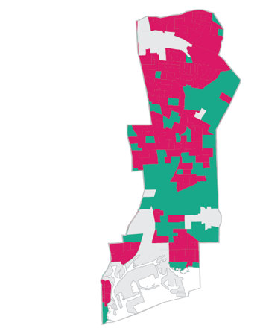
Equity Evaluation Criteria – EFC Lens Example
Goal Evaluation Criteria
Equity Evaluation Criteria
AQ1: Reduce Emissions
EFC-AQ1: EFC Lens Criteria
What is the potential overall ability of this project to reduce emissions in the corridor?
How much could this project reduce emissions in EFC areas relative to non-EFC areas?
Notes:
Aryeh
Add reminder about EFCs to slide or talking points

Slide 40
Equity Evaluation Criteria – Qualitative Example
Goal Evaluation Criteria
Equity Evaluation Criteria
EN6: Reduce heat island; provide cooling
EQ-EN6: Includes urban greening and cooling for areas of low tree canopy and high heat island burden
Does this project include features that help cool the environment and reduce the urban heat island effect?
Does this project provide cooling benefits to communities with the highest need?
Notes:
Aryeh
Add reminder about EFCs to slide or talking points

Slide 41
LB-ELA Community Benefits – Related Programs
Project/Program | Description and Potential Connection to ZET Program
Air Quality Monitoring Stations LB-ELA_0218 | New air quality monitoring stations in coordination with SCAQMD. Locate monitoring stations in proximity to major ZET infrastructure.
Zero Emission Infrastructure for Autos LB-ELA_0191 | Develop and site additional charging stations for zero emission autos within the corridor. Include personal ZE vehicle charging opportunities at ZET charging sites, or within surrounding communities.
Energy / GHG Reduction Programs LB-ELA_0134 | Provide funding and education targeted to GHG reduction strategies, such as renewable energy projects and solar-power generation, energy-efficient lighting, tree planting. Incorporate solar panels, energy-efficient lighting, tree planting as part of ZET infrastructure.
Urban Greening LB-ELA_0113 | LB-ELA projects must be sensitive to existing environmental context and consider incorporating "Urban Greening" elements that foster environmental resilience. Include context-appropriate Urban Greening elements as part of ZET infrastructure sites.
Targeted Hire Programs LB-ELA_0195 | Support the development of targeted and local hire programs. Establish Project Labor Agreements that specify local and targeted hire goals for ZET infrastructure projects.
Employment / Recruitment Initiatives LB-ELA_0196 | Conduct recruitment and provide information to residents regarding work opportunities. Actively advertise and recruit for ZET infrastructure positions to ensure that job opportunities for ZET projects benefit local communities.
Vocational Educational Programs LB-ELA_0197 | Expand vocational and education programs for community residents within the LB-ELA Corridor. Provide vocational training for skills related to ZET infrastructure within communities selected for charging sites.
Traffic Calming Program LB-ELA_0202 | Implement Traffic Calming Features including restrictions on trucks over a certain weight using non-designated truck routes, including signage and geofencing alerts. Apply truck restrictions surrounding ZET facilities to ensure that increased truck traffic does not spill into surrounding neighborhoods and present adverse noise and safety impacts.
41
Notes:
Michael, Susan A.
0218 Air Quality Monitoring Stations
0191 Zero Emission Infrastructure for Autos
0134 LB-ELA Corridor Energy Reduction / GHG Reductions Program – ZET program is focused on a specific intent (to advance deployment of ZE infrastructure). Rather than incorporating all these unrelated benefits, we want to include other programs that specifically include those benefits within the overall LB-ELA CMIP
0113 Urban Greening
Traffic signal upgrades and synchronization throughout various cities
0202 Traffic Calming – Corridor wide program to implement traffic calming features throughout the corridor. Program would provide resources throughout the corridor as needed. (e.g. truck restrictions)
0186 Economic Stabilization Policies – Work with cities, County of LA, and public agencies to propose and pass stabilizations policies to support disadvantaged communities, provide grant writing assistance to secure needed funding
0195 Targeted Hire Programs – support the development of targeted and local hire programs to increase the share of public dollars devoted to local job creation
0196 Employment/Recruitment Initiatives – Partner with public agencies, large employers, and local businesses to conduct recruitment at locations within the LB-ELA Corridor (including job fairs and workshops)
0197 Vocational Educational Programs

Slide 42
Agenda Item #5: Grant Funding Opportunities
  Recent awards
  Pending applications
Notes:
Michael
Pull updated grant info from Metro June Board Report

Slide 43
Grant Funding Updates
California Transportation Commission
Anticipated announcement on June 28/29
The CTC will consider a total of $202.344 million in ATP, Port, highway, and technology projects for the LB-ELA Corridor. The following are from SB 1 Trade Corridor Enhancement Program:
  Metro I-710 Integrated Corridor Management (ICM) Project (Metro PIPO project)
  Recommended award: $27.84 million
  Port of LA Maritime Support Facility Access — Terminal Island Project
  Recommended for $14.936 million
  Port of LB Pier B Early Rail Project
  Recommended for $70.442 million
California Transportation Agency
Port and Freight Infrastructure Program (Announcement TBD)
POLB/POLA seeking state Port & Freight Infrastructure Program funds – $840 M available for Southern California
Awards: To date, $116.24 M awarded to LB-ELA projects since May 2022
$30.0 M – Reconnecting Communities – W. Shoreline Drive (Long Beach)
$30.14 M – Port Infrastructure Development Prog. – Mid. Harbor Terminal ZE Conversion Project
$56.1 M – State Active Transportation Program (ATP) – Five projects awarded
43
Notes:
Michael
The projects are as follows:
Southeast LA Transit Improvements Project — Metro PIPO project — Recommended award: $14.5 million — SB 1 Solutions for Congested Corridors Program (TCEP)
I-710 Integrated Corridor Management (ICM) Project — Metro PIPO project — Recommended award: $27.84 million — SB 1 Trade Corridor Enhancement Program
Green Port Gateway: Pier B Early Rail Project — Port of Long Beach project — Recommended for $70.442 million — SB 1 TCEP
Maritime Support Facility Access — Terminal Island Project — Port of Los Angeles project — Recommended for $14.936 million — SB 1 TCEP
Total: $127.718 million
Additionally $74.626 million in local Active Transportation Program (ATP) projects are recommended by SCAG for funding by the CTC. These projects comprise 11 projects for implementation and 2 for planning in the jurisdictions of Carson (2), Cudahy, Downey, Huntington Park, Los Angeles, Maywood, Paramount, Signal Hill, South Gate (2) and unincorporated LA County (2). The Huntington Park project is a Metro PIPO project for which Metro provided technical and grant assistance.
The CTC will consider a total of $202.344 million in ATP, Port, highway, and technology projects for the LB-ELA Corridor on June 28-29, 2023. Three of the four projects submitted for the PIPO are recommended for funding!

Slide 44
Recently Completed and Upcoming Opportunities
  Federal Charging and Fueling Infrastructure (CFI) Discretionary Grant Program
  Tri-state application submitted by the CEC/Caltrans joint team on June 13th
  Over 100 support letters received
  Support letter template is available if interested in submitting
  Partnership with MSRC
  Key to advancing shovel-ready projects within the Corridor
  Key to pursuing upcoming funding opportunities for these near-term projects
  State SB1 Trade Corridor Enhancement Program (TCEP) FY2024 cycle and FY2026
  Federal Infrastructure for Rebuilding America (INFRA) program, future CFI cycles
Notes:
Michael
Start working with MSRC (sign co-op agreement within next couple of months)
Feasibility study underway
Determine coordinated regional
These next steps tie back to the strategy that the WG developed to reach the funding target.
Bullet 1: Staff learned and shared the promising opportunities/shovel ready projects that exist within the corridor through the MSRC’s RFI responses.
Metro is working on a coop agreement to partner with MSRC to leverage our seed funding.
CFI: The CFI application development is currently underway, the deadline to submit is June 13th.
Metro, POLA/POLB and MSRC joined with Caltrans/CEC in a tri-state application with Oregon & Washington
State SB1 Trade Corridor Enhancement (TCEP) Program FY2024 cycle and FY2026 cycle – supportive of ZET Infrastructure projects
Feasibility study to address medium- and long-term charging and fueling infrastructure demand and project development
Ultra-fast charging and hydrogen refueling stations
Addressing infrastructure needs beyond immediate private sector demand

Slide 45
Agenda Item #6: ZET Program as a Catalyst for
Workforce Development & Job Training
  Lessons learned from May panel discussions
  Identify Metro’s role in supporting workforce investment
  Collaborate with partners to establish workforce development outreach strategy
  Working Group Discussion
Notes:
Erika
Introduce item, Akiko

Slide 46
ZET Program Principles – Overview
1
2
3
4
Maximize leverage of seed funding
by collaborating with regional partners and funding agencies.
Expeditious Deployment of Resources
to maximize the buying power and benefit of investment while supporting community engagement and effective outreach.
Coordination
with regional and funding partners, government agencies, and key stakeholders.
Community Engagement
that centers corridor residents and stakeholders throughout the development process.
5
6
7
8
Workforce Development
that ensures community benefits and access to opportunity through the
pursuit and implementation of ZE Technology.
Corridor Community Benefits
by creating economic opportunities, improving air quality, and reducing long-standing health impacts generated by diesel trucks.
Equitable Outcomes
ensured by performance metrics that evaluate sustainable outcomes.
Legislative Platform
designed to support the accelerated, equitable deployment of ZE technology by reducing barriers and increasing incentives to adoption.
Notes:
Akiko

Slide 47
Principle 5
Workforce Development – that ensures community benefits and access to opportunity through the pursuit and implementation of ZE Technology.
Work with regional and community partners to understand job training and workforce needs related to ZET.
Work with labor partners to pursue local and targeted hire opportunities.
Increase community access to quality job opportunities that pay living wages.
Coordinate with existing workforce development programs.
Notes:
Akiko provide details
3.1
Evaluate various workforce efforts within LA County that are geared towards workers engaged in ZE vehicles and infrastructure
3.1a
Partner with community colleges, and labor leaders to develop ZE-related employment and training programs
3.1b
Work with partners to understand the challenges, barriers, and opportunities for ZE-related employment
3.2
Identify Metro’s role in supporting workforce investment in support of ZE truck deployment and supporting infrastructure
3.2a
Engage workforce development partners to identify where Metro may add value to support their initiatives
3.2b
Explore if there are programs that Metro may develop or support for this endeavor
3.3
Collaborate with partners to establish workforce development outreach strategy
3.3a
Utilize walk-up centers and other outreach mechanisms to discuss employment opportunities with residents

Slide 48
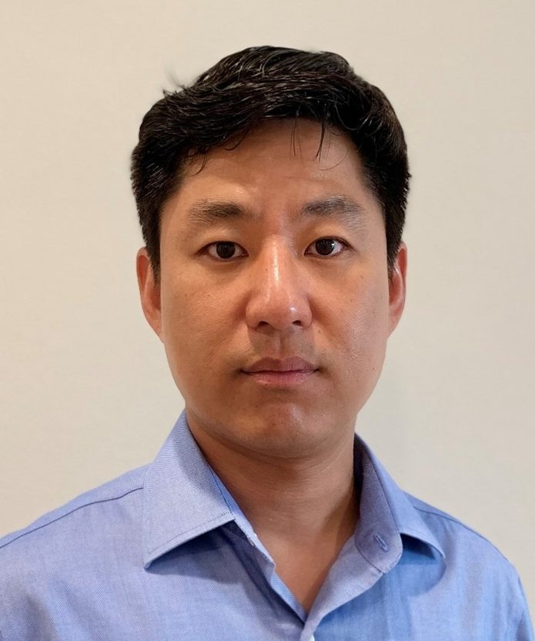
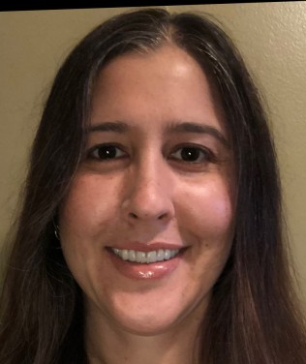
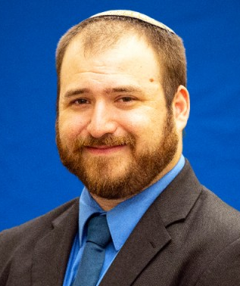
Scaling Beyond Pilot Projects - Lessons Learned in Developing Charging/Fueling Infrastructure
Panelists
Seungbum Ha
Leela Rao
Jacob Goldberg
Program Supervisor –
Electric & Hybrid Vehicles
South Coast Air Quality Management District
Environmental Specialist
Port of Long Beach
LB-ELA CP Task Force Member
Environmental Specialist
Port of Los Angeles
Notes:
Akiko
Leela Rao
Senior Environmental Specialist at the Port of Long Beach. In this capacity, she is working to implement the Clean Air Action Plan, a joint effort with the Port of Los Angeles to reduce emissions from all freight transportation sources operating at the ports. Leela is the environmental staff lead on the Clean Truck Program, which aims to achieve zero emission drayage operation by 2035, and manages the Port’s largest demonstration grant, a project valued at over $100 million to demonstrate over 100 pieces of zero and near-zero emission equipment. She also manages the Port’s harbor craft and air monitoring programs. Prior to her work at the Port of Long Beach Leela was a manager at the California Air Resources Board and a staffer at the Environmental Protection Agency.
Seungbum Ha
is with South Coast AQMD and has worked in the Technology Demonstration group for 7 years. He received his Ph.D. in Mechanical Engineering, specializing in electro-chemistry for Li-ion battery and fuel cell.
He has worked at Argonne National Laboratory in Chemical Science and Engineering Department, where he researched for Li-ion battery development and techno-economic modeling.
He works on zero and near-zero emission medium/heavy duty truck demonstration projects including the DOE ZECT II, CARB GGRF and CEC zero-emission drayage truck projects, as well as EPA projects on zero-emission airport shuttles. He also has worked on microgrid development projects.

Slide 49
Scaling Beyond Pilot Projects - Lessons Learned in Developing Charging/Fueling Infrastructure Key Takeaways
How did you implement or cultivate relationships with Original Equipment Manufacturers (OEMs), fuel providers, Third-Party Logistics (3PLs), and dealerships?
  Relationships driven by terminal and fleet partners
  Determining what OEM partners were comfortable with; letting them lead the way
What does it take to scale from an infrastructure that will support an entire corridor?
  Projects should be fully invested with different groups/government agencies/universities/etc.
  Critical to determine how coordination can expedite deployment and commercialization of ZE technology
49
Notes:
Akiko

Slide 50
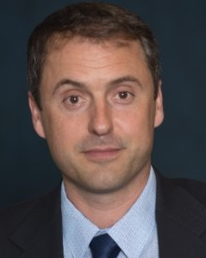
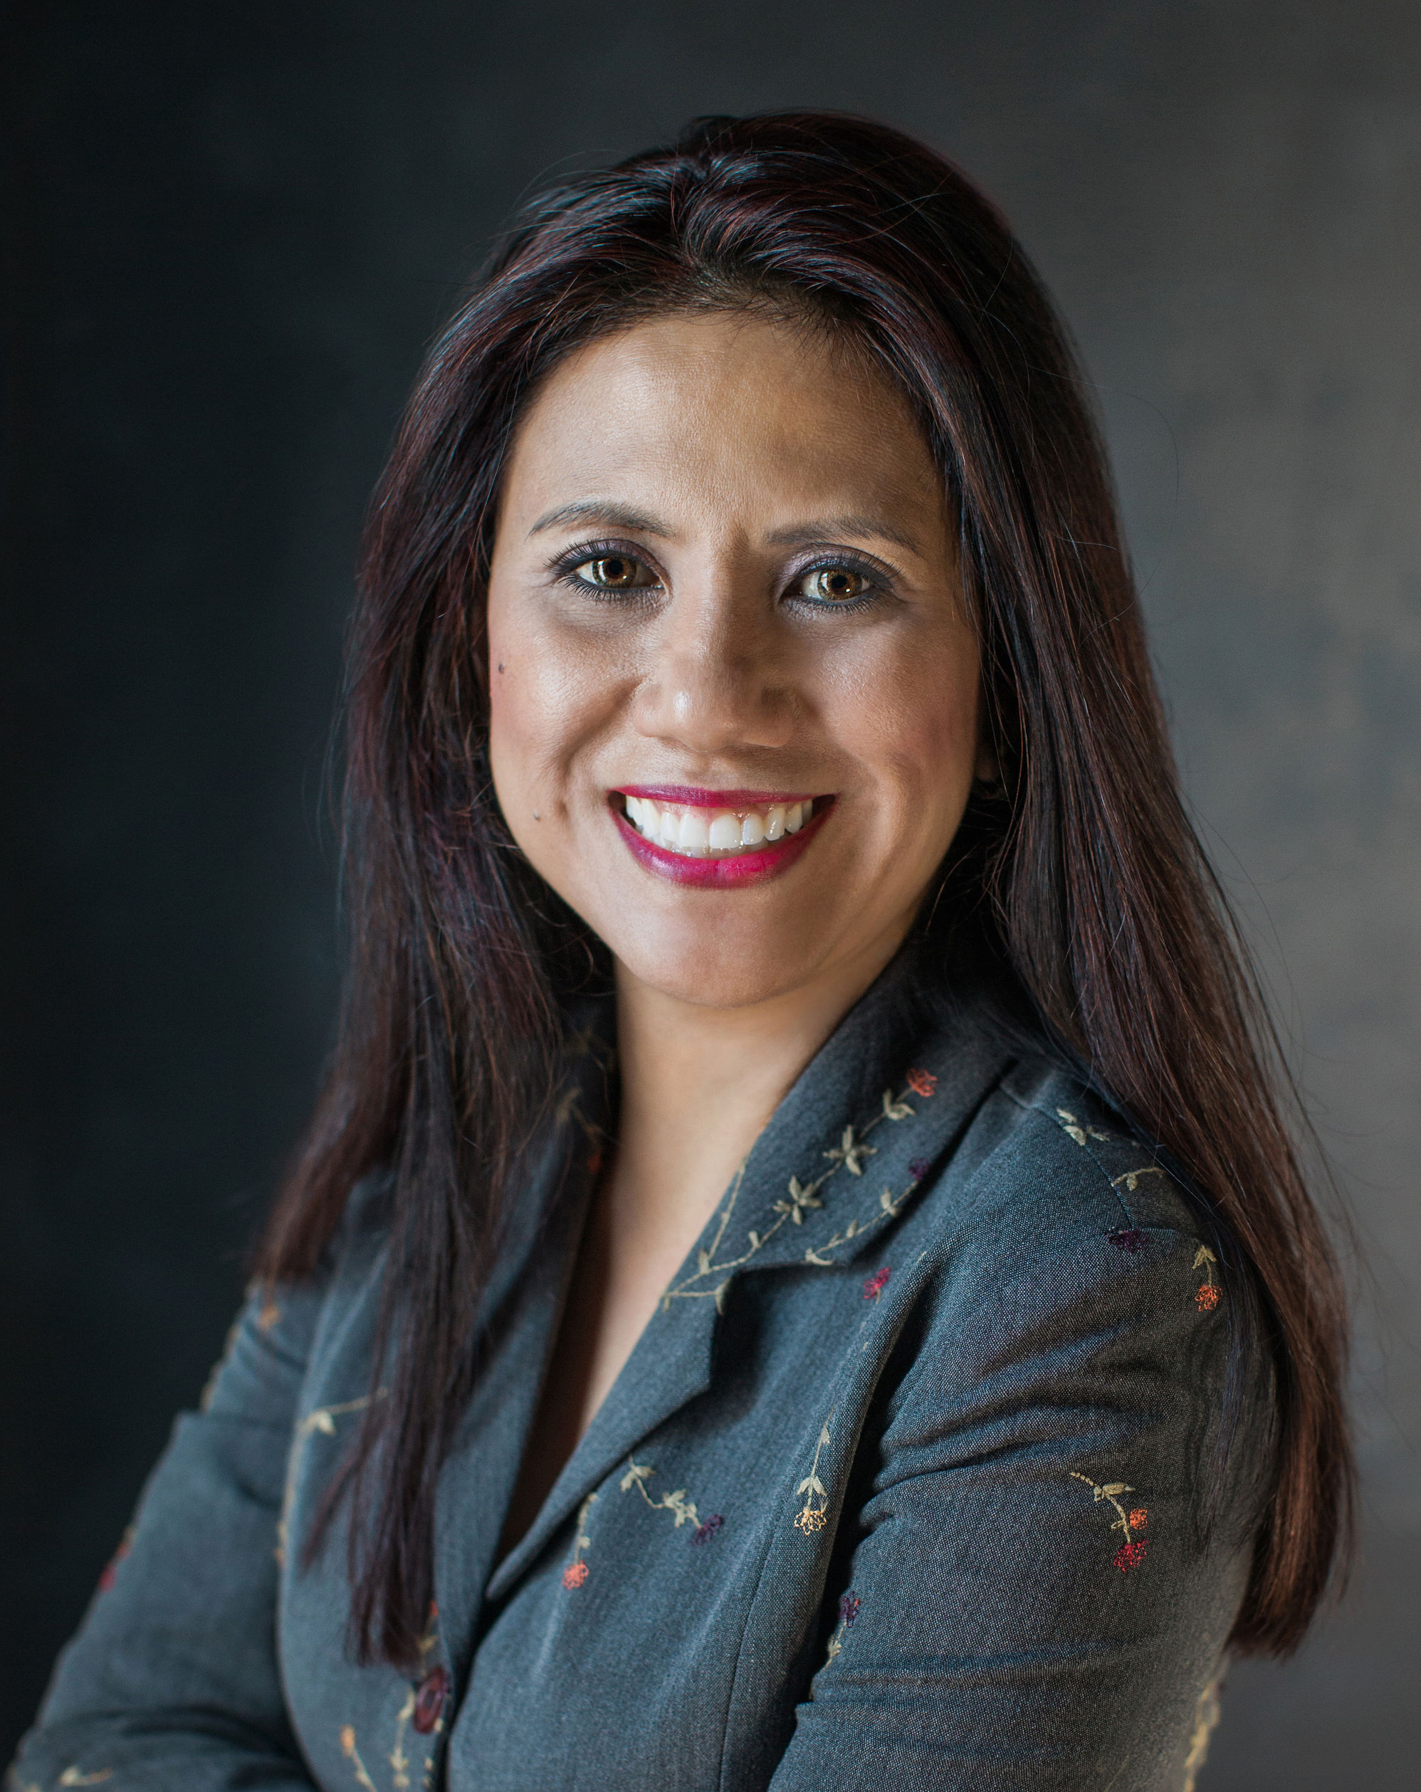
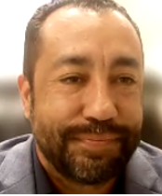
ZET Program as a Catalyst for Workforce Development & Job Training
Panelists
Dr. Tyler Reeb
Jannet Malig
Robert Chavez
Director of Research and Workforce Development
Center for International Trade and Transportation
Cal State University of Long Beach
Statewide Director Advanced Transportation & Logistics
Cerritos College
Co-Director
Long Beach Clean Cities
Program Manager
South Bay Workforce Investment Board
Notes:
Akiko
Jannet Malig
Jannet Malig is a visionary leader and changemaker in the transportation industry. She is the Advanced Transportation and Logistics (ATL) Statewide Director for the California Community Colleges Workforce and Economic Development Division. In that role, she oversees efforts across the state to create relevant career pathways and foster a 21st-century workforce. She works with industry and professional associations, government organizations, and colleges to provide direction for curriculum development in emerging occupations; expand industry certificate programs, and determine short- and long-term industry training needs for high school and college career technical education programs.
Prior to becoming Statewide Director, Malig was ATL Deputy Sector Navigator for the Los Angeles and Orange County Regions and Director of the Advanced Transportation Technology & Renewable Center at Cerritos. Before entering higher education, she was Senior Marketing Manager for Hitachi Automotive Products, where she led the company’s sales strategy for all markets and analyzed new products and channels for expansion. She’s also held marketing and product management positions for Zyliss USA and Denso Sales California.
She holds an MBA from Chapman University and earned her associate degree from Cerritos College, where she’s now based. She is active in the transportation industry and serves as Co-Coordinator for the Long Beach Clean Cities Coalition and serves on the board President of the Southern California Regional Transit Training Consortium. Malig also previously served on the boards of the Municipal Equipment Maintenance Association and the Cerritos Regional Chamber of Commerce.

Slide 51
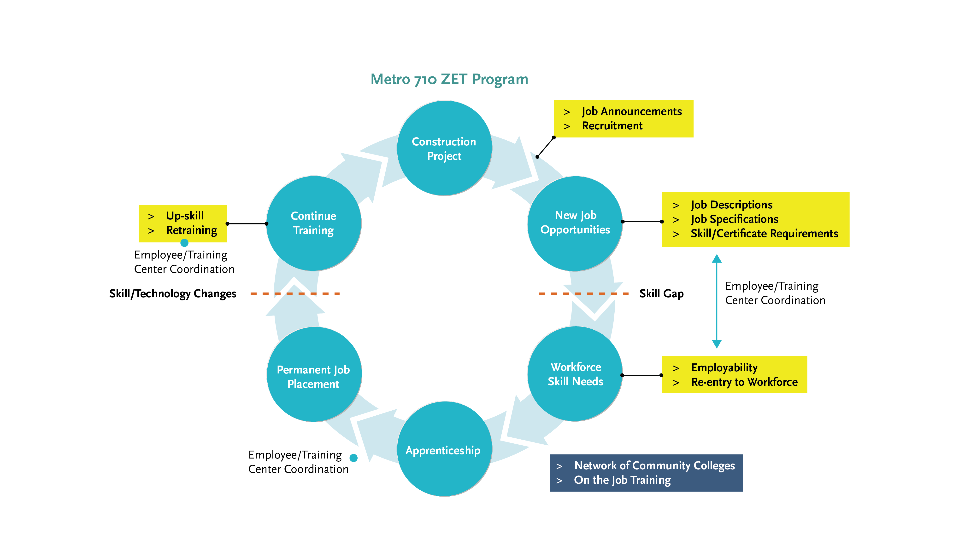
Cycle of Workforce Investment
Notes:
Akiko
This is graphic depicts how Metro can be a catalyst.
Metro brings construction projects, and that's where the job opportunity/training cycle starts.
The cycle continues as project delivery methods or trade standards get modernized, they bring in training needs for existing workers to have their skills updated.
So that they can continue to take advantage on the job opportunities that will be brought on by future construction projects.

Slide 52
Key Takeaways:
ZET Program as a Catalyst for Workforce Development & Job Training
How do we create and maintain a sufficient workforce pool to support ZE truck programs?
  Focus on upskilling existing workforce instead of trying to hire all new employees
  Invest in local hires within the community
  Implement organizational strategy of working with OEMs
  Focus on being the backbone support for “collective impact” by keeping continuity and ensuring progress on a common agenda
How do we ensure that LA County residents, particularly corridor residents, reap the benefit of job opportunities presented by the ZE truck programs?
  Work with employers to get word out into community about job opportunities
  Going into community colleges to recruit for construction jobs
  Working with pre-existing job training programs
  Build out apprenticeships
52
Notes:
Akiko
Empower local businesses and landowners to tap into Fed/State incentives to repurpose land for charging facilities
Ensure that planned labor agreements involve clear standards/requirements for local hiring
Invest in community engagement, particularly to ensure a diverse workforce

Slide 53
Key Takeaways:
ZET Program as a Catalyst for Workforce Development & Job Training
What are the best ways to engage communities and generate support?
  Create programs that meet needs of employers and educate community about jobs available (how to apply/how to get trained)
  Create a “jobs coordinator” component to hiring/employment part of project
  Implement program like Construction Utility Pathways Program (CUP) to connect employers/job opportunities with community
  Empower local businesses and landowners to tap into Fed/State incentives to repurpose land for charging facilities
  Ensure that planned labor agreements involve clear standards/requirements for local hiring
  Invest in community engagement, particularly to ensure a diverse workforce
53
Notes:
Akiko

Slide 54
Closing Remarks & Next Steps
Notes:
Erika

Slide 55

Newsletter and Updated Project Hub
Notes:
Erika
We are excited to announce our new Project Newsletter and Hub! The project team has heard your requests and has worked to streamline communications and reduce the frequency of project notifications.
In this video I will review our updated newsletter protocols and walk you through the updated project hub.

Slide 56
Upcoming Meetings and Project Information
              CLC In-Person Hybrid Meeting #16
      Thursday, June 22, 5-7pm
      Location: Horchatería Rio Luna
      15950 Paramount Boulevard
      Paramount, CA 90723
      Corridor Tours for Task Force & CLC Members
      Saturday, June 24, 8:30am-2:00pm or
      Wednesday, June 28, 8:30am-2:00pm
      RSVP Required
      Equity Working Group #13 – Equity Planning and Evaluation Tool Workshop
      Thursday, June 29, 5-7pm
      New Meeting Schedule
      Combined Task Force & CLC - Hybrid Meeting
      Monday, July 10, 5-8pm
      Location: South Gate Park Auditorium
      4900 Southern Avenue
      South Gate, CA 90280
      Combined Task Force & CLC - Virtual Meeting
      Thursday, July 20, 5-7pm
For the most updated list
of meeting dates, please visit
https://www.metro.net/projects/lb-ela-corridor-plan/
Notes:
Erika

Slide 57
Stay connected to this project
Michael Cano
Executive Officer
Countywide Planning & Development
LA Metro
One Gateway Plaza, MS 99-13-1
Los Angeles, CA 90012
213.418.3010 W
213.305.0423 C
710corridor@metro.net
https://www.metro.net/projects/lb-ela-corridor-plan/
@metrolosangeles
losangelesmetro
Notes:
Erika

Slide 58
Thank you!
Notes:
Erika

Slide 59
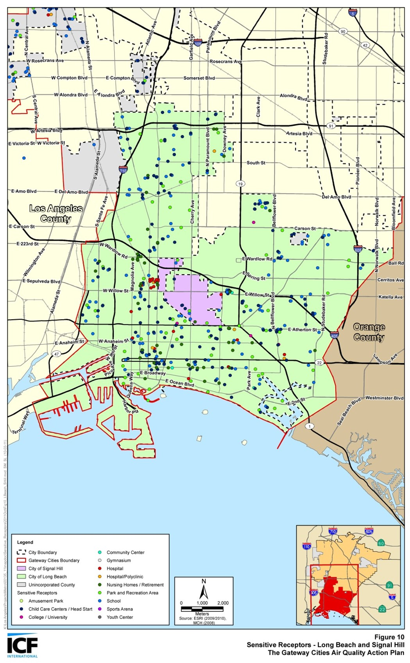
Community Engagement around Sensitive Receptors
The California Air Resources Board (CARB) defines sensitive receptors as places where children, the elderly, and those with pre-existing respiratory health conditions are most likely to congregate, such as:
  Schools and schoolyards,
  Parks and playgrounds,
  Daycare centers,
  Nursing homes,
  Hospitals, and
  Residential communities
Local government can play a significant role in improving health outcomes through land use decisions, truck route planning, and mitigation measures
Communities can develop effective outreach programs to reduce the exposure of children and the elderly by developing a list of sensitive receptor sites to aid in planning efforts
59
Notes:
Michael, Susan A

Slide 60
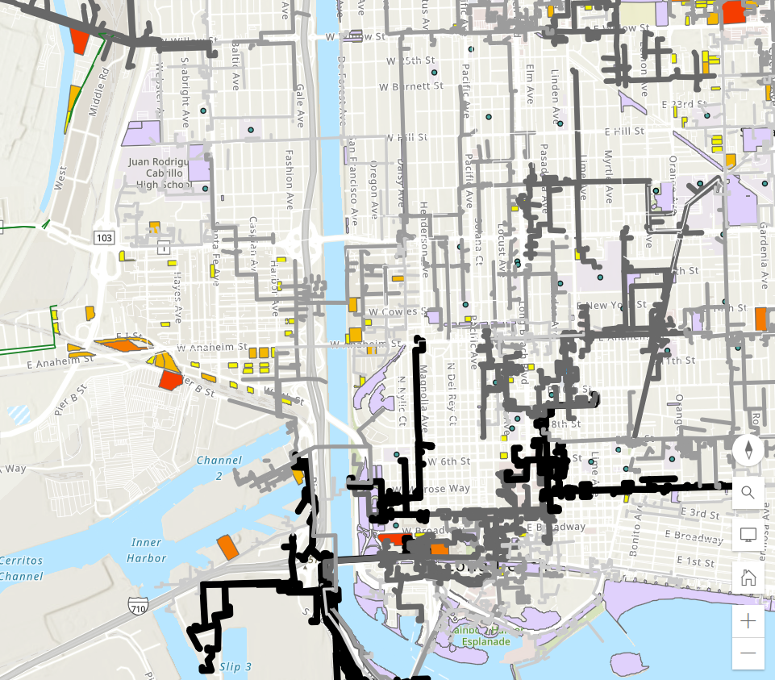
Community Engagement around Sensitive Receptors
Schools and schoolyards
Hospitals
Parks
Available parcels of land
Grid capacity
60
Notes:
Michael, Susan A

Slide 61
ZET as a Catalyst for Corridor Community Benefit Programs
Characterize and evaluate potential cancer and non-cancer health risks associated with exposure to toxic air contaminants (TACs) from both stationary and mobile sources.
Identify significant sources and locations of TAC emissions within the jurisdiction
Assess existing exposures of sensitive receptors including children, senior citizens, and people with respiratory illnesses and identify priority communities.
Develop and implement mitigation measures to reduce TAC emissions and to avoid the over-concentration of these facilities near sensitive receptors.
Prioritize use of resources to reduce TACs in the most highly impacted areas (i.e., priority communities)
61
Notes:
Michael, Susan A

