Slide 1
We will begin in a few moments.
LB-ELA Task Force
Zero-Emission Truck Working Group
Meeting #16
May 23, 2023
Notes:
Erika

Slide 2
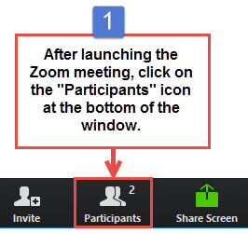
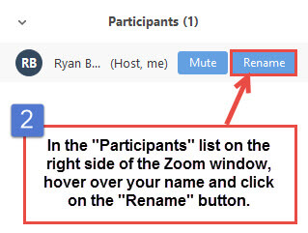


Working Group Member Identification
Notes:
Erika

Slide 3

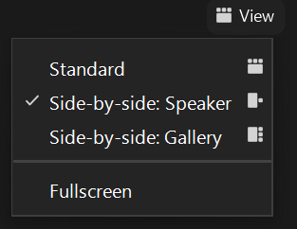
Turn on Camera
To start and stop your video, click the camera icon at the bottom left of your control panel
To switch between views during the meeting click or tap on Standard, Side-by-side Speaker View, and Side-by-side Gallery View at the top right corner of your zoom screen
Notes:
ERIKA

Slide 4

Logistics
Click Interpretation to choose your language.
To hear the interpreted language only, click Mute Original Audio (Optional).
Change your Zoom screen name to include name, agency/organization.
Click Raise Hand in your meeting controls, Press*9 on the phone line, or raise your hand physically.
To lower your hand, click Raise Hand in your meeting controls.
The Q&A button is located on the control panel at the bottom of your screen.
To mute and unmute, click the microphone icon on the bottom left of your control panel.
To start and stop your video, click the camera icon at the bottom left of your control panel.
Technology & interpretation support: 323.609.3345
Notes:
Laura

Slide 5
Detailed Agenda
1:00pm 1:05pm | Welcome, Agenda Review, and Purpose of the Zero-Emission Truck Working Group Agenda Item #1: Metro Update (10 minutes) MSRC Cooperative Agreement LACI Program Update CFI Grant Submittal Update US EPA Request for Information
1:15pm | Agenda Item #2: Scaling Beyond Pilot Projects - Lessons Learned in Developing Charging/Fueling Infrastructure Moderator: Akiko Yamagami, Sr Transportation Manager, Metro Panelists: Seungbum Ha, Program Supervisor – Electric & Hybrid Vehicles, South Coast Air Quality Management District Leela Rao, Environmental Specialist, Port of Long Beach Jacob Goldberg, Environmental Specialist, Port of Los Angeles
1:50pm . 2:50pm 3:00pm | Agenda Item #3: ZET Program as a Catalyst for Workforce Development & Job Training Moderator: Akiko Yamagami, Sr Transportation Manager, Metro Panelists: Dr. Tyler Reeb, Director of Research & Workforce Development Center for International Trade and Transportation (CITT) Cal State University of Long Beach (CSULB) Jannet Malig, Statewide Director Advanced Transportation & Logistics, Cerritos College; Co-Director, Long Beach Clean Cities John Frala, Professor Alternative Fuels Technology, Rio Hondo College; Clean Transportation Program Advisor, California Energy Commission Robert Chavez, Program Manager, South Bay Workforce Investment Board Closing Remarks and Upcoming Meetings Adjournment

Slide 6
We will begin in a few moments.
LB-ELA Task Force
Zero-Emission Truck Working Group
Meeting #16
May 23, 2023
Notes:
Erika

Slide 7
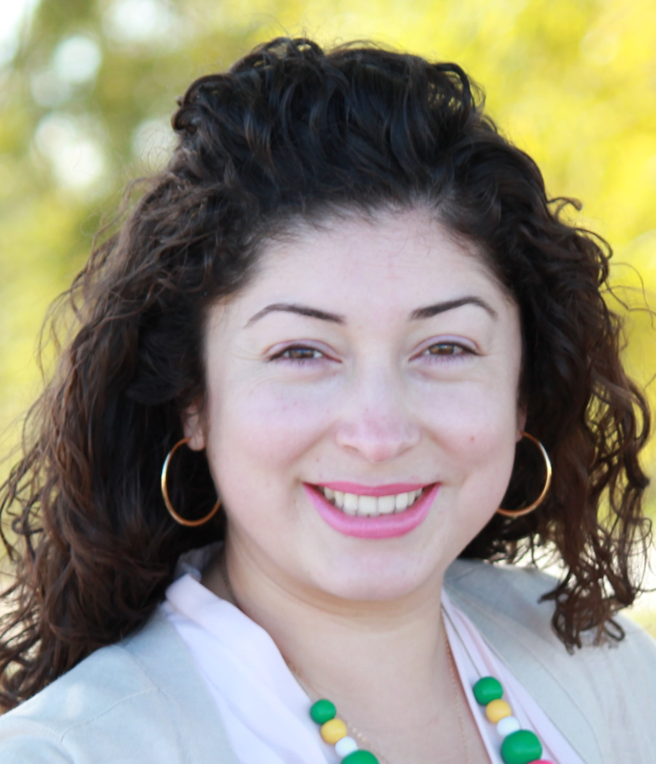
Facilitator
Erika C.B. Morales
Partner, Morales + Morales Partners
Notes:
Erika

Slide 8
Welcome, Agenda Review, and Purpose
of the
Long Beach – East LA Corridor
Zero-Emission Truck (ZET) Working Group
Notes:
ERIKA

Slide 9
Detailed Agenda
1:00pm 1:05pm | Welcome, Agenda Review, and Purpose of the Zero-Emission Truck Working Group Agenda Item #1: Metro Update (10 minutes) MSRC Cooperative Agreement LACI Program Update CFI Grant Submittal Update US EPA Request for Information
1:15pm | Agenda Item #2: Scaling Beyond Pilot Projects - Lessons Learned in Developing Charging/Fueling Infrastructure Moderator: Akiko Yamagami, Sr Transportation Manager, Metro Panelists: Seungbum Ha, Program Supervisor – Electric & Hybrid Vehicles, South Coast Air Quality Management District Leela Rao, Environmental Specialist, Port of Long Beach Jacob Goldberg, Environmental Specialist, Port of Los Angeles
1:50pm . 2:50pm 3:00pm | Agenda Item #3: ZET Program as a Catalyst for Workforce Development & Job Training Moderator: Akiko Yamagami, Sr Transportation Manager, Metro Panelists: Dr. Tyler Reeb, Director of Research & Workforce Development Center for International Trade and Transportation (CITT) Cal State University of Long Beach (CSULB) Jannet Malig, Statewide Director Advanced Transportation & Logistics, Cerritos College; Co-Director, Long Beach Clean Cities John Frala, Professor Alternative Fuels Technology, Rio Hondo College; Clean Transportation Program Advisor, California Energy Commission Robert Chavez, Program Manager, South Bay Workforce Investment Board Closing Remarks and Upcoming Meetings Adjournment

Slide 10
Meeting Objectives
During this meeting, the working group will:
Hear a panel discussion reviewing lessons learned and key takeaways in scaling and building charging/fueling infrastructure that would support the entire 710 South Corridor.
Hear a panel discussion that considers various perspectives and experience with workforce development programs, including how to create and maintain a sufficient workforce, ensure LA County residents reap benefits from these job opportunities, and determine how best to gain community support on these programs.

Slide 11
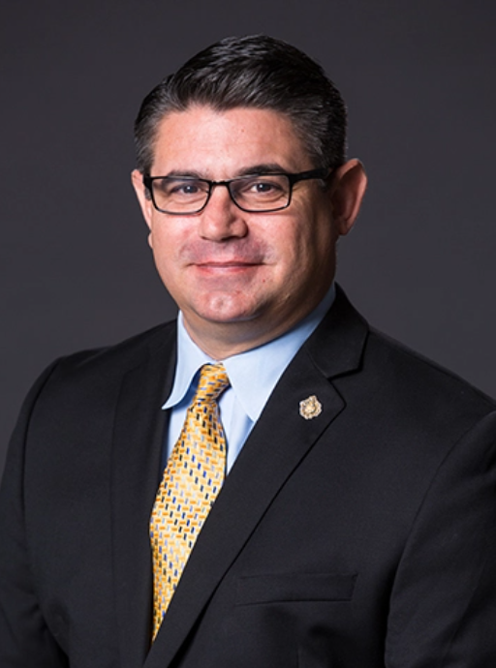
In Memoriam – Rick Cameron
Notes:
Michael/Erika
We are saddened to hear of the untimely passing of Rick Cameron, our former Deputy Executive Director of Planning and Development at the Port of Long Beach. Along with Rick’s many friends, contacts and colleagues throughout the logistics industry and environmental community, we here at the Port will miss Rick’s warmth, intellect and sense of dedication. He was a leader and respected for his expertise in environmentally sustainable development. His legacy carries on in the Port’s achievements in delivering on its lasting commitment to being the Green Port, and also in the many Port teammates and leaders whom he trained and mentored over his more than 24 years at the Port. Our thoughts are with Rick’s family at this difficult time.

Slide 12
Agenda Item #1:
Metro Update
Notes:
Erika

Slide 13
ZET Program Recap – Metro Board Direction
Metro Board Direction and desired outcomes
$200 million minimum funding target
Leverage Board-approved $50 million with private, regional, state, and federal funding
Accelerated ZE deployment in the Long Beach-East LA (LB-ELA, formerly I-710 South) Corridor
Collaboration with regional stakeholders
Independent from but aligned with overall LB-ELA Corridor Task Force Investment Plan process
Strategies to accomplish outcomes
Convene and collaborate with community and regional stakeholders
Develop a scope of work for the ZET Program
Identify regional funding partners
Identify discretionary grant opportunities
Identify near and long-term opportunities
Identify policy and legislative barriers to implementation
Develop approaches to understanding potential community impacts and creating community benefits
Notes:
Michael

Slide 14
ZET Meeting #15 Recap
Summary
Held virtually via Zoom on Tuesday, April 25, 2022
22 participants (21 Working Group Members, 1 CLC member)
Key Takeaways
An informal test for consensus was conducted on the staff recommendation to provide up to $3M in funding for LACI's Proposed Community Project.
Several Working Group members said they supported the project
There was a concern raised about streamlining CEQA as a potential legislative initiative – staff affirmed that this item would not be included as part of Metro's board action.
Staff will take a recommendation to the Metro Board in June to program funding.
The Working Group received information on plans for a regionally-coordinated Charging & Fueling Infrastructure Grant application, including how it aligns with ZET Program Principles.
The Working Group received a presentation on workforce development frameworks and how to coordinate efforts to develop a framework for the LB-ELA Corridor
14
Notes:
Michael
Public charging will require public investment to amortize capital costs.
Innovative partnerships can unlock value and mitigate risk.
SB 671 must identify barriers and solutions for long-term funding success
Focus on expanding charging opportunities corridor-wide and analyzing long-term benefits of ZE infrastructure for corridor stakeholders
Collaborate with other agencies, community groups, and residents to analyze data and determine how charging locations will receive priority and ensure community benefits will be at the forefront of advancing ZE infrastructure

Slide 15
ZET Program Principles – Overview
1
2
3
4
Maximize leverage of seed funding
by collaborating with regional partners and funding agencies.
Expeditious Deployment of Resources
to maximize the buying power and benefit of investment while supporting community engagement and effective outreach.
Coordination
with regional and funding partners, government agencies, and key stakeholders.
Community Engagement
that centers corridor residents and stakeholders throughout the development process.
5
6
7
8
Workforce Development
that ensures community benefits and access to opportunity through the pursuit and implementation of ZE Technology.
Corridor Community Benefits by creating economic opportunities, improving air quality, and reducing long-standing health impacts generated by diesel trucks.
Equitable Outcomes
ensured by performance metrics that evaluate sustainable outcomes.
Legislative Platform
designed to support the accelerated, equitable deployment of ZE technology by reducing barriers and increasing incentives to adoption.

Slide 16
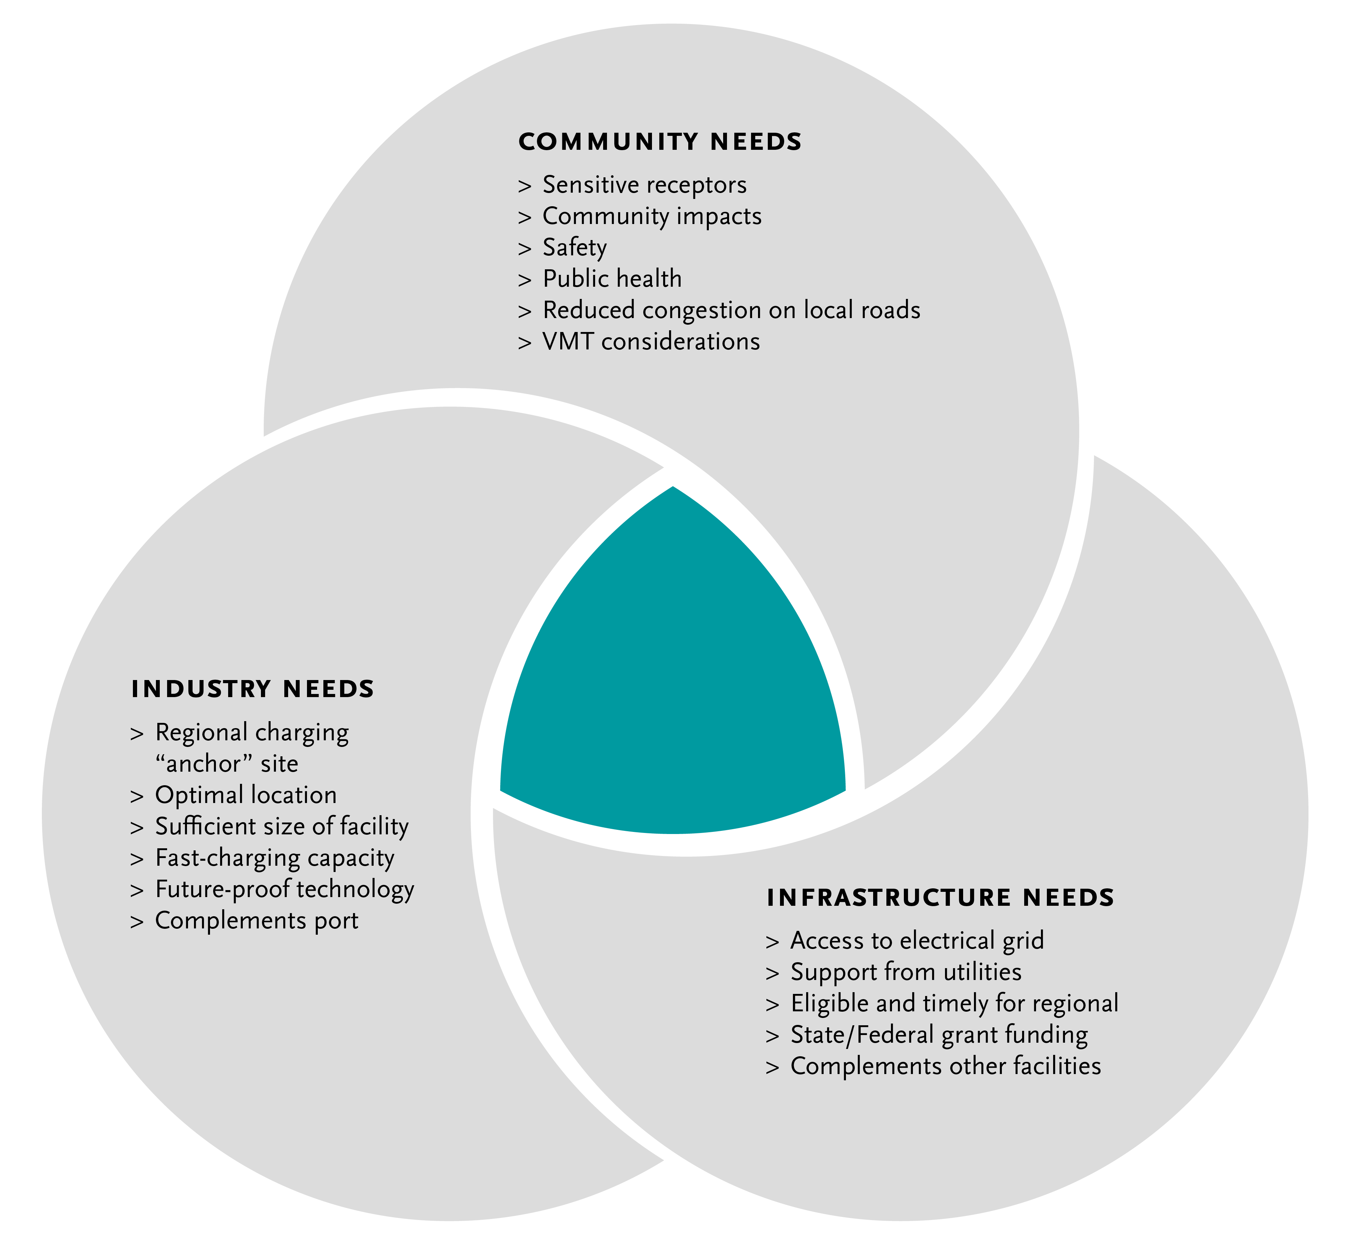
Metro Vision - Regional Zero-Emissions MD/HD Truck Charging Facility/ies
16
Notes:
Michael

Slide 17
Key Findings & Next Steps
Metro Vision for regional ZET charging facilities | Public charging station(s) for use primarily by smaller drayage fleets and independent owner/operators, but accessible for all heavy-duty trucks Origins and destinations within Southern California Port or transload trips that are clustered in the region Multiple trips per day Access needed for midday opportunity charging
Where | West of 710, near ports, or along the Alameda Corridor
Next Steps | Work with local jurisdictions and logistics/real estate professionals to determine land ownership Coordinate with utilities on current capacity and/or where it needs to be added Map out fueling stations in that area to determine where trucks are already filling up Examine existing truck routes and location of sensitive receptors to align charging facility site(s) with community needs Connect with small fleets/drivers to understand their needs, experience, and opportunities Research grant funding opportunities to assist in pursuing next steps
Notes:
Michael/Akiko
MSRC Update
Staff is working with County council to draft up a co-op agreement with MSRC
LACI Program Update
Bringing to Metro Board at June meeting for approval
CFI Grant Submittal Update
Grant deadline extended to mid-June

Slide 18
US EPA Request for Information (RFI) ZE Heavy-Duty Vehicles and Infrastructure
Development of Guidance for Zero-Emission Clean Heavy-Duty Vehicles, Port Equipment, and Fueling Infrastructure Deployment under Inflation Reduction Act Funding Programs
EPA especially interested in availability, market price, and performance of ZE trucks, ZE port equipment, and other charging/fueling infrastructure needs in the near term (1-3 years, and 1-5 years for port equipment) and whether components of these systems are manufactured in the US
Comment deadline: June 5, 2023
More information can be found here
Notes:
Michael

Slide 19
Agenda Item #2: Scaling Beyond Pilot Projects – Lessons Learned in Developing Charging/Fueling Infrastructure
Introduction
Panel Discussion
Working Group Q&A
Notes:
Erika
Introduce item, Akiko

Slide 20
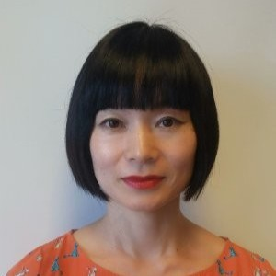
Facilitator
Akiko Yamagami
Senior Manager, Transportation Planning, Goods Movement
LA Metro
Notes:
Erika

Slide 21
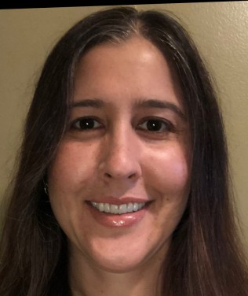
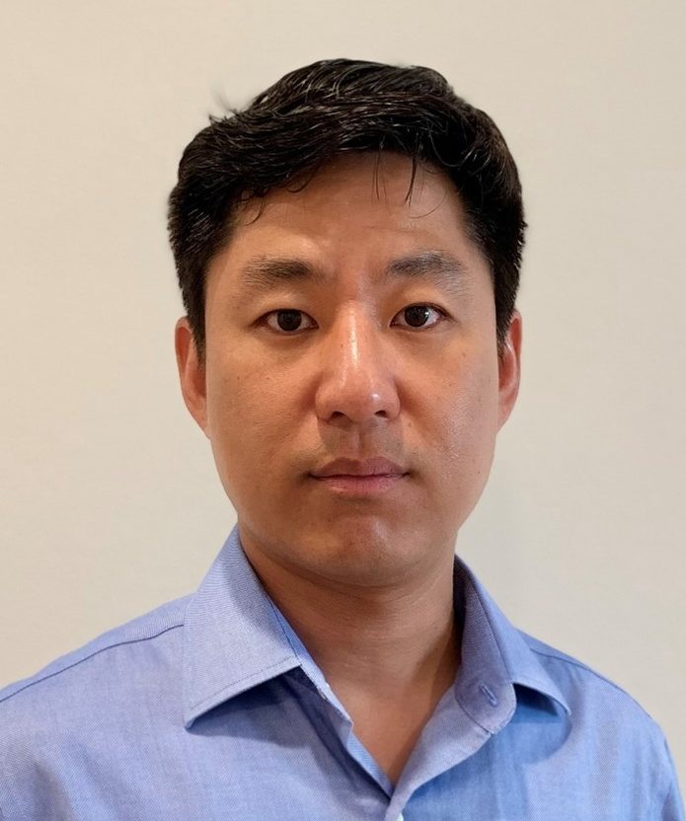
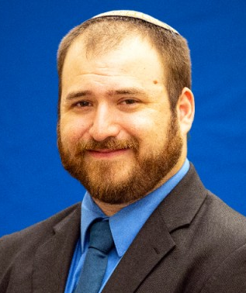
Panelists
Leela Rao
Environmental Specialist
Port of Long Beach
LB-ELA CP Task Force Member
Seungbum Ha
Program Supervisor – Electric & Hybrid Vehicles
South Coast Air Quality Management District
Jacob Goldberg
Environmental Specialist
Port of Los Angeles
Notes:
Akiko
Leela Rao
Senior Environmental Specialist at the Port of Long Beach. In this capacity, she is working to implement the Clean Air Action Plan, a joint effort with the Port of Los Angeles to reduce emissions from all freight transportation sources operating at the ports. Leela is the environmental staff lead on the Clean Truck Program, which aims to achieve zero emission drayage operation by 2035, and manages the Port’s largest demonstration grant, a project valued at over $100 million to demonstrate over 100 pieces of zero and near-zero emission equipment. She also manages the Port’s harbor craft and air monitoring programs. Prior to her work at the Port of Long Beach Leela was a manager at the California Air Resources Board and a staffer at the Environmental Protection Agency.
Seungbum Ha
is with South Coast AQMD and has worked in the Technology Demonstration group for 7 years. He received his Ph.D. in Mechanical Engineering, specializing in electro-chemistry for Li-ion battery and fuel cell.
He has worked at Argonne National Laboratory in Chemical Science and Engineering Department, where he researched for Li-ion battery development and techno-economic modeling.
He works on zero and near-zero emission medium/heavy duty truck demonstration projects including the DOE ZECT II, CARB GGRF and CEC zero-emission drayage truck projects, as well as EPA projects on zero-emission airport shuttles. He also has worked on microgrid development projects.

Slide 22
Facilitated Discussion Questions
For your respective projects, you have an impressive list of partners that are technology OEMs, fuel providers, 3PLs and dealerships. Did you have relationships with these entities before the project? If not, how did you identify them and get them involved in your project?
What were the challenges and lessons learned from your projects? Do they apply to Metro as we embark on deploying ZE infrastructure corridor-wide?
Do you have specific lessons learned that you recommend Metro consider to minimize impacts from ZE trucks accessing these publicly accessible charging or refueling stations?
Did your organization track the number of jobs created because of your ZE truck project? If so, could you talk about what type of jobs were created, and who received the job opportunities? What efforts were made to connect local residents to these jobs?
22

Slide 23
Agenda Item #3: ZET Program as a Catalyst for Workforce Development & Job Training
Introduction
Panel Discussion
Working Group Q&A
Notes:
Erika
Introduce item, Akiko

Slide 24
Principle 5
Workforce Development – that ensures community benefits and access to opportunity through the pursuit and implementation of ZE Technology.
Work with regional and community partners to understand job training and workforce needs related to ZET.
Work with labor partners to pursue local and targeted hire opportunities.
Increase community access to quality job opportunities that pay living wages.
Coordinate with existing workforce development programs.
Notes:
Akiko provide details
3.1
Evaluate various workforce efforts within LA County that are geared towards workers engaged in ZE vehicles and infrastructure
3.1a
Partner with community colleges, and labor leaders to develop ZE-related employment and training programs 3.1b
Work with partners to understand the challenges, barriers, and opportunities for ZE-related employment
3.2
Identify Metro’s role in supporting workforce investment in support of ZE truck deployment and supporting infrastructure
3.2a
Engage workforce development partners to identify where Metro may add value to support their initiatives
3.2b
Explore if there are programs that Metro may develop or support for this endeavor
3.3
Collaborate with partners to establish workforce development outreach strategy
3.3a
Utilize walk-up centers and other outreach mechanisms to discuss employment opportunities with residents

Slide 25
Task 3: Ensure LA County has skilled workforce to support large scale ZE Truck deployment
 | Objective | Task
3.1 | Evaluate various workforce efforts within LA County that are geared towards workers engaged in ZE vehicles and infrastructure
 | 3.1.a | Partner with community colleges, and labor leaders to develop ZE-related employment and training programs
 | 3.1.b | Work with partners to understand the challenges, barriers, and opportunities for ZE-related employment
3.2 | Identify Metro’s role in supporting workforce investment in support of ZE truck deployment and supporting infrastructure
 | 3.2.a | Engage workforce development partners to identify where Metro may add value to support their initiatives
 | 3.2.b | Explore if there are programs that Metro may develop or support for this endeavor
3.3 | Collaborate with partners to establish workforce development outreach strategy
 | 3.3.a | Utilize walk-up centers and other outreach mechanisms to discuss employment opportunities with residents
25
Notes:
Akiko

Slide 26
Demystifying Workforce Investment Mechanisms
Overview
How do we create and maintain a sufficient workforce pool to support ZE truck programs?
How do we ensure that LA County residents, particularly corridor residents, reap the benefit of job opportunities presented by ZE truck programs?
What are the best ways to engage communities and generate support for such programs?
Notes:
Akiko
Discuss opportunities for community engagement and education. Where are the entry points?
What is Metro's role in this, how can Metro coordinate with elements within this existing framework?
How can Metro and its partners create opportunities for residents to gain skills and training on new technologies?
What is Metro's role in working with its regional partners on a targeted local hire program for ZET infrastructure development?
Who are the regional partners Metro should engage in developing a targeted local hire program?
What best practices in developing WFD and job training are applicable in developing this program?
What are elements of this process that Metro should be informed of?
What can Metro do to capitalize on WFD opportunities that will be presented through ZET Program?
Consider various perspectives and experience with existing workforce development programs
Review challenges, successes, and best practices in administering workforce development programs
Discuss strategies for how to close the gap between the needs of employers and the workforce
Determine strengths, weaknesses, opportunities, and threats for workforce development for the ZET program and the LB-ELA Corridor

Slide 27
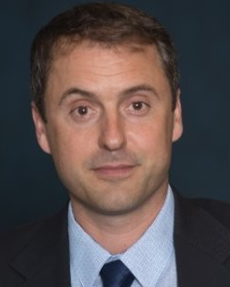
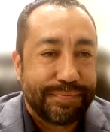
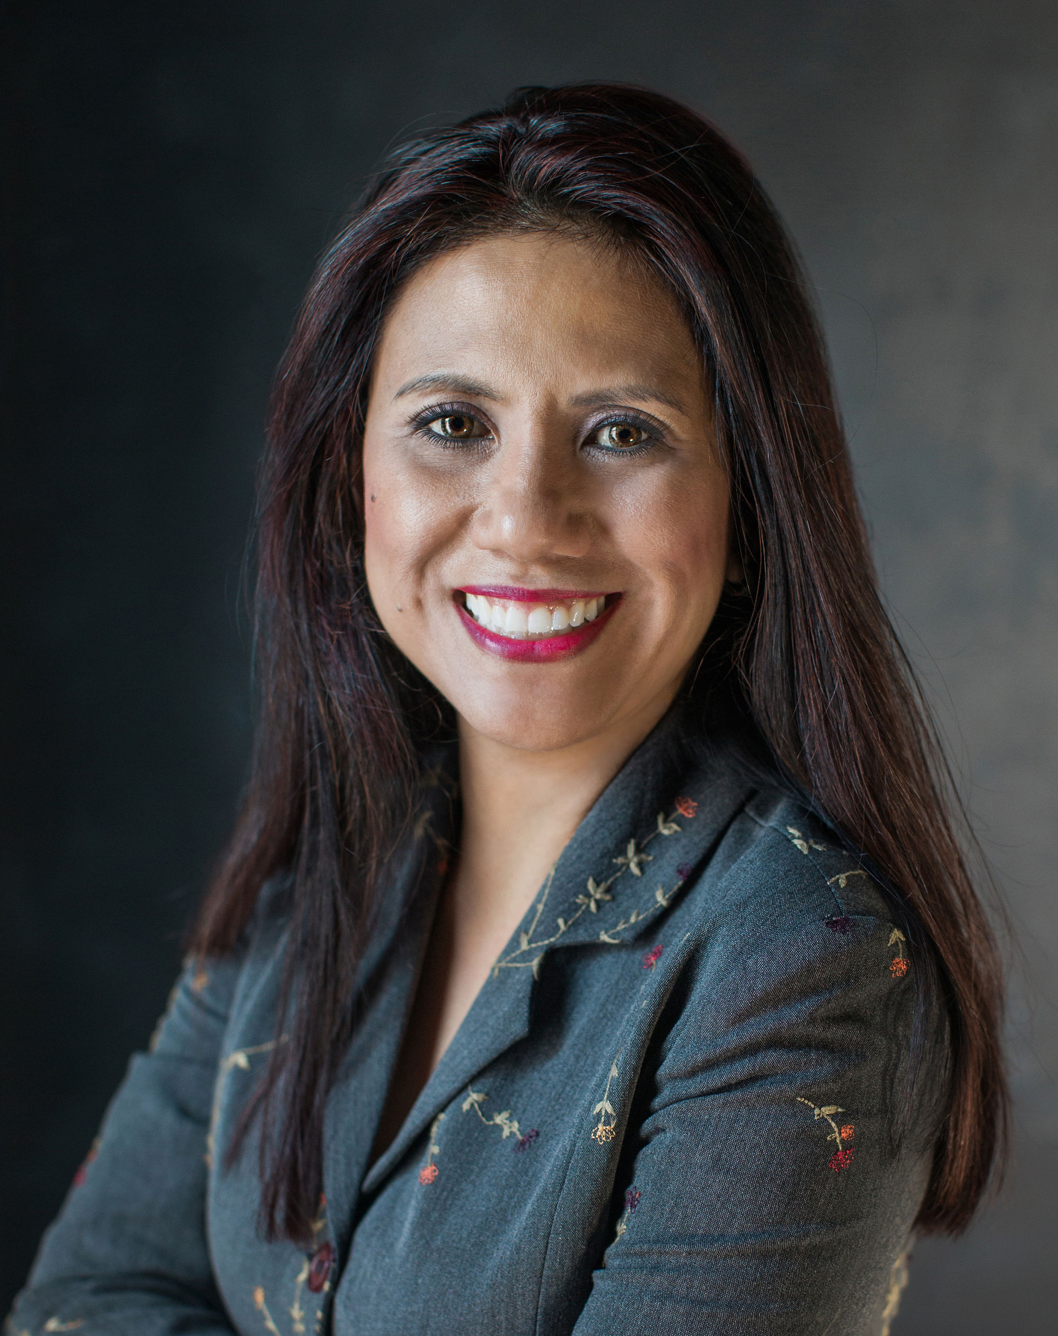
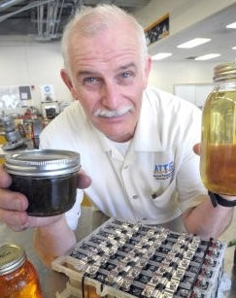
Panelists
Dr. Tyler Reeb
Robert Chavez
Director of Research and Workforce Development
Center for International Trade and Transportation
Cal State University of Long Beach
Program Manager
South Bay Workforce Investment Board
John Frala
Jannet Malig
Professor Alternative Fuels Technology
Rio Hondo College
Clean Transportation Program Advisor
California Energy Commission
Statewide Director Advanced Transportation & Logistics
Cerritos College
Co-Director
Long Beach Clean Cities
Notes:
Akiko
Jannet Malig
Jannet Malig is a visionary leader and changemaker in the transportation industry. She is the Advanced Transportation and Logistics (ATL) Statewide Director for the California Community Colleges Workforce and Economic Development Division. In that role, she oversees efforts across the state to create relevant career pathways and foster a 21st-century workforce. She works with industry and professional associations, government organizations, and colleges to provide direction for curriculum development in emerging occupations; expand industry certificate programs, and determine short- and long-term industry training needs for high school and college career technical education programs.
Prior to becoming Statewide Director, Malig was ATL Deputy Sector Navigator for the Los Angeles and Orange County Regions and Director of the Advanced Transportation Technology & Renewable Center at Cerritos. Before entering higher education, she was Senior Marketing Manager for Hitachi Automotive Products, where she led the company’s sales strategy for all markets and analyzed new products and channels for expansion. She’s also held marketing and product management positions for Zyliss USA and Denso Sales California.
She holds an MBA from Chapman University and earned her associate degree from Cerritos College, where she’s now based. She is active in the transportation industry and serves as Co-Coordinator for the Long Beach Clean Cities Coalition and serves on the board President of the Southern California Regional Transit Training Consortium. Malig also previously served on the boards of the Municipal Equipment Maintenance Association and the Cerritos Regional Chamber of Commerce.
Tyler Reeb oversees a multimillion‐dollar portfolio of sponsored research that addresses Intelligent Transportation Systems (ITS), smart communities, zero‐emission technologies, automation, data privacy, community engagement, and a range of workforce development issues. He is the principal author and editor of the book "Empowering the New Mobility Workforce" (Elsevier 2019), which was endorsed by the late Norman Mineta. His research‐driven reports, publications, and workforce development programs promote innovation and civic partnerships between leaders in business, government, and education. “Transportation in GIS,” a pilot class Tyler developed in partnership with Los Angeles Trade Tech College, won the Award of Excellence for Opportunity and Empowerment at the 2019 American Planning Association Los Angeles Awards.

Slide 28
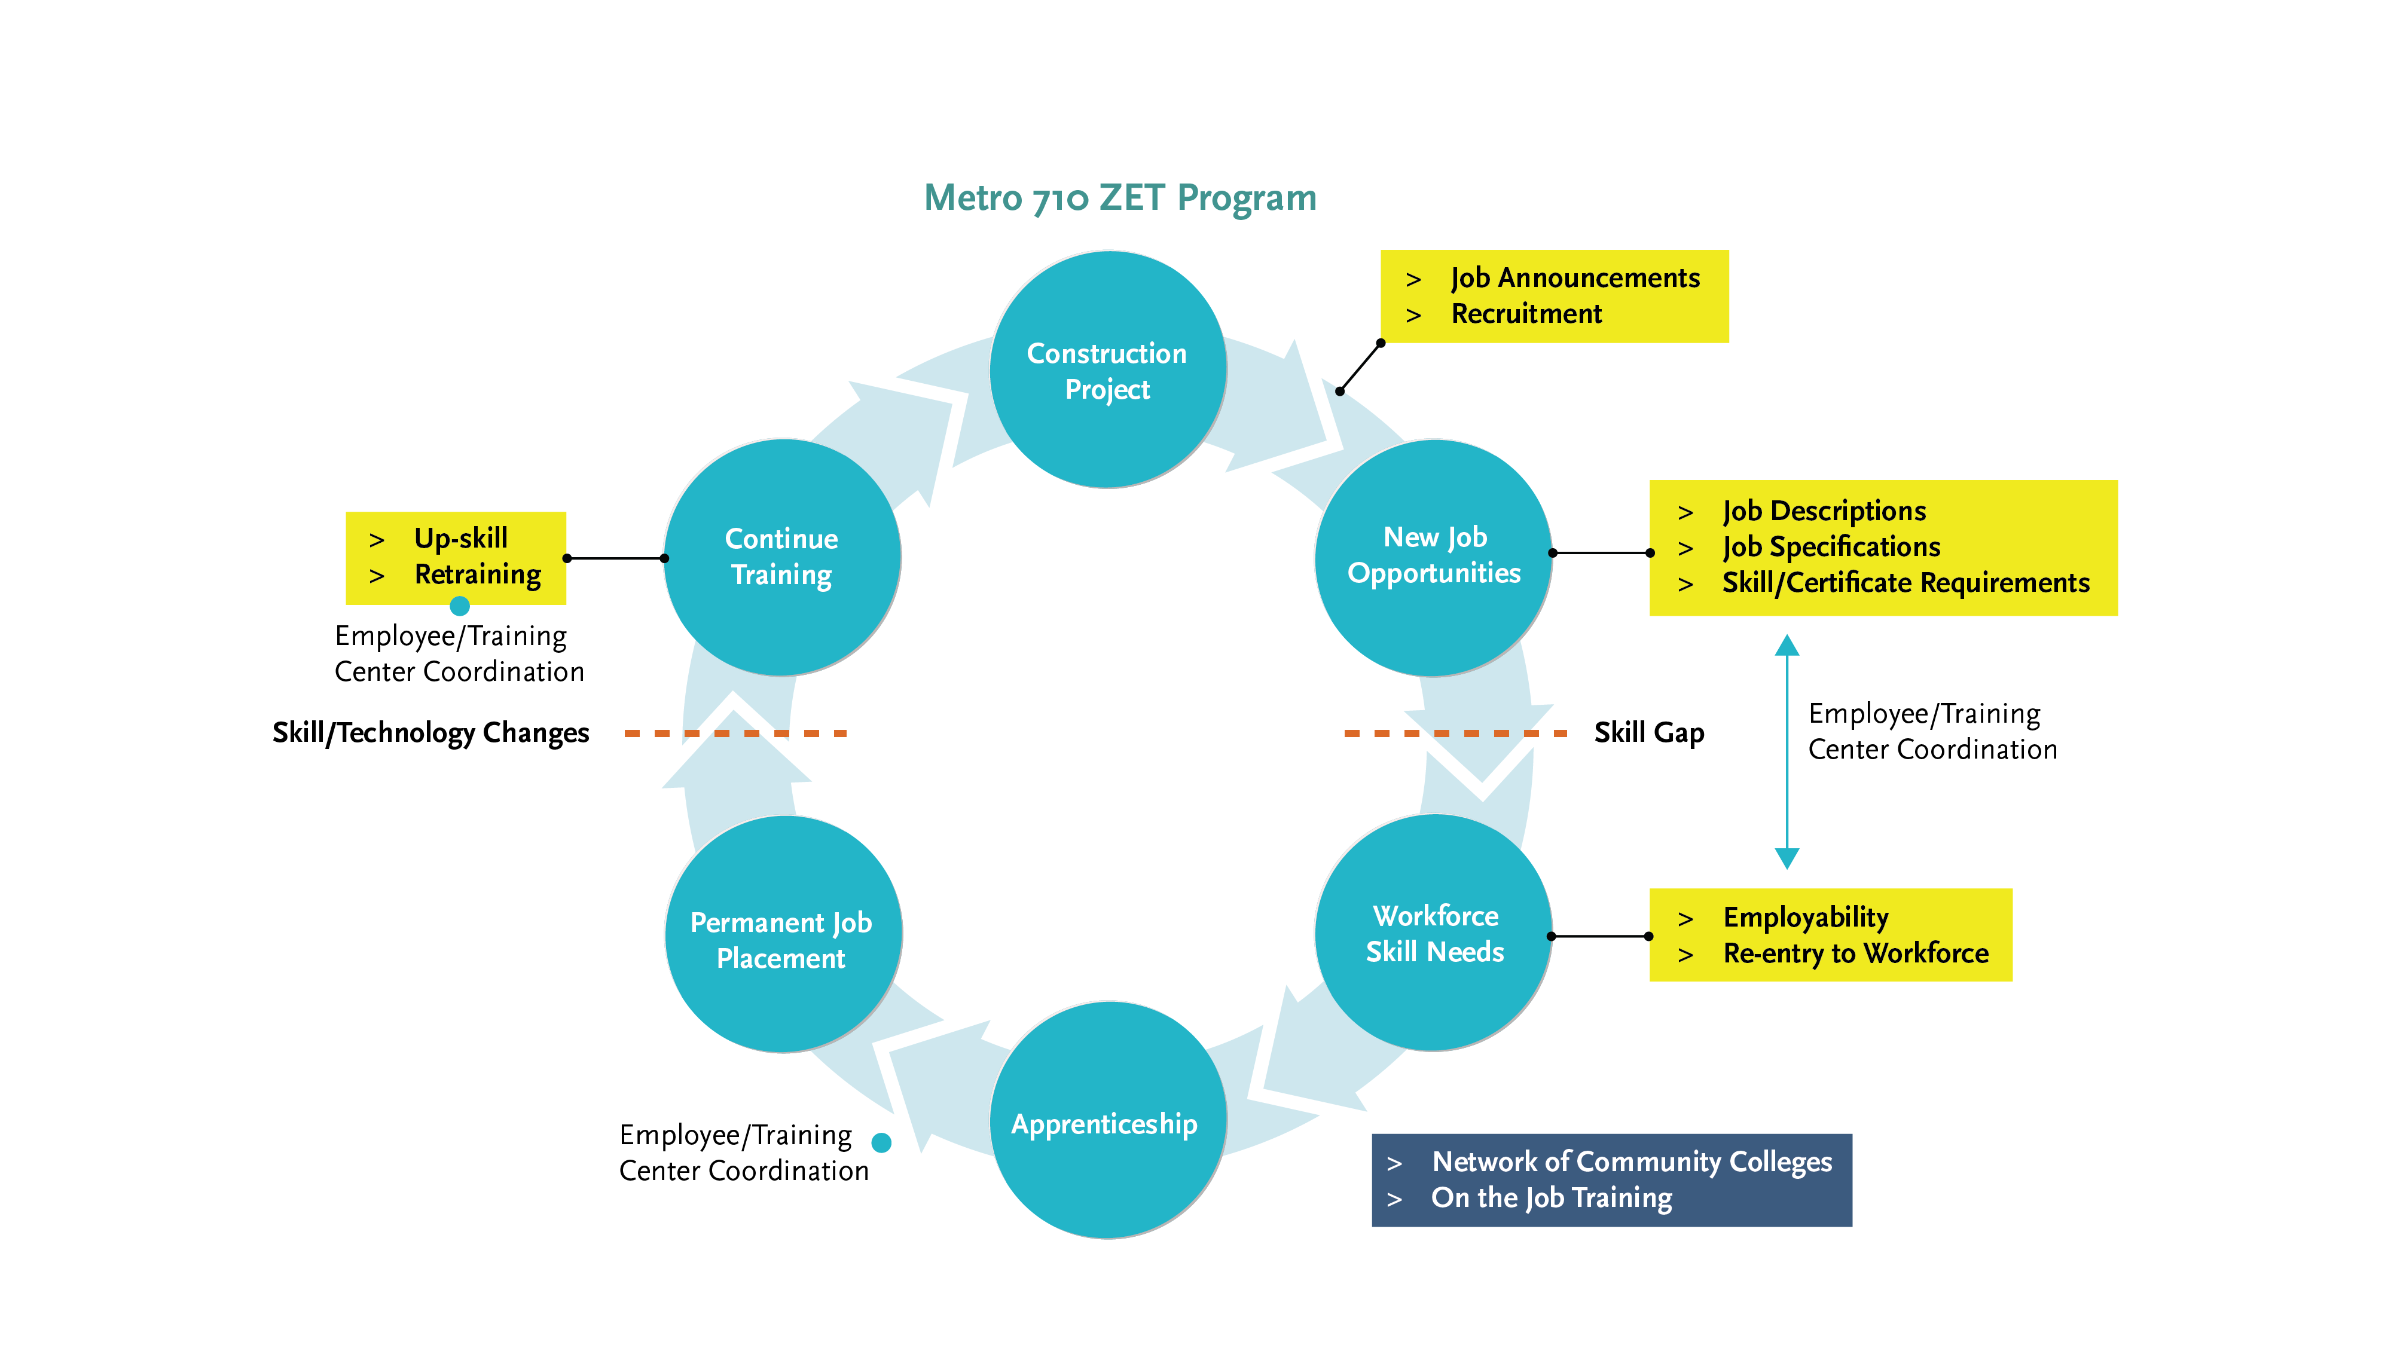
Cycle of Workforce Investment
Notes:
Akiko
Robert, you told me that construction projects bring jobs. Please share with us some of the construction projects that took place, or taking place in your area, and what type of business needs new constructions bring to the area
Tyler, some of these business needs are defining job specifications, and skill requirements. Could you talk about what types of jobs and skills are most needed in enabling sufficient labor pool to support zero-emission trucks and infrastructure?
I’d like to segue to the key players in workforce investment process to talk about who provides much needed training, and how they ensure that the training programs provided meet skill sets and employability from employers are seeking. John and Jannet, could you talk about the training programs that your respective community colleges provide?
Please share who the programs are targeted to, and the success of your programs.
Also, how does your program work as a resource to those who are seeking employment opportunities?
Tyler, could you talk about the rapid speed of technology advancement that we are living through and the effects that are being brought onto us because of the 4th Industrial Revolution, and the implications to today’s and tomorrow’s workforce?
We’ve made a full circle at this point in explaining this cycle of job opportunities/workforce training/investment/continued training needs. At this time, I’d like to take some questions from the audience.
What resources do we have around the 710 Corridor to leverage to advance this framework?
Benefits for community
Job stability, career growth

Slide 29
Closing Remarks and Next Steps
Notes:
Michael
METRO NEXT STEPS
Protocols for vetting proposals – leveraging of funds
Legislative calendar (Norm Emerson-GCCOG), roadmap-applications-timelines
Additional Technical Support-in addition to Akiko
IMMEDIATE NEXT STEPS
--Slides and Confirmation- Jack Symington-LACI-slides (Susan)-SEPTEMBER
-Refine principles slides in presentation-CEHAJ Letter (Trey)-COMPLETE-draft response
-Michael-Fernando-Susan-Mtg re CEHAJ letter
-Tasks Worksheet Update (Susan has an example)
Agenda Item #6-focused discussions
Submit TCEP application, develop grant application
Finalize $5MM TA expertise
Local hiring policy
Erika
Difference between things we generate and things we are a part of
How do we get the $200 m
How do we use Metros’ unique position in the county
How do we create our own program?
How do we respond to other programs that want to partner with us?
How do we create technical expertise- to develop this program
Technical working group?
Keep to ourselves?
We need to develop our community outreach discussion-formalize it
Have plan in place
Advanced work in outreach
AQMD=scope
COMMUNITY EDUCATION
Akiko-Watson Land-realities of developing infrastructure
rika

Slide 30
Upcoming Meetings and Project Information
Community Leadership Committee Meeting
Meeting #16
Thursday, June 22, 5-7pm
Task Force Meeting
Task Force Meeting #21
Monday, June 12, 5-7pm
Working Group Meetings
Equity Working Group #13 Thursday, June 29, 5-7pm
Zero-Emissions Truck Working Group #17 Tuesday, June 20, 1-3pm
For the most updated list
of meeting dates, please visit http://www.metro.net/710-hub
Notes:
Erika
Our Lady of Guadalupe Day is celebrated on December 12 every year. The day has been declared a national holiday in Mexico. Devotees honor the day when Virgin Mary made an appearance to a young man on this day in 1531.

Slide 31

Stay connected to this project
Michael Cano
Executive Officer
Countywide Planning & Development
LA Metro
One Gateway Plaza, MS 99-13-1 Los Angeles, CA 90012
213.418.3010 W
213.305.0423 C
710corridor@metro.net
https://www.metro.net/projects/lb-ela-corridor-plan/
@metrolosangeles
losangelesmetro
Notes:
Erika

Slide 32
In Memoriam – Rick Cameron
Notes:
Shana Espinoza
We are saddened to hear of the untimely passing of Rick Cameron, our former Deputy Executive Director of Planning and Development at the Port of Long Beach. Along with Rick’s many friends, contacts and colleagues throughout the logistics industry and environmental community, we here at the Port will miss Rick’s warmth, intellect and sense of dedication. He was a leader and respected for his expertise in environmentally sustainable development. His legacy carries on in the Port’s achievements in delivering on its lasting commitment to being the Green Port, and also in the many Port teammates and leaders whom he trained and mentored over his more than 24 years at the Port. Our thoughts are with Rick’s family at this difficult time.

Slide 33
Thank you!
Notes:
Erika

Slide 34
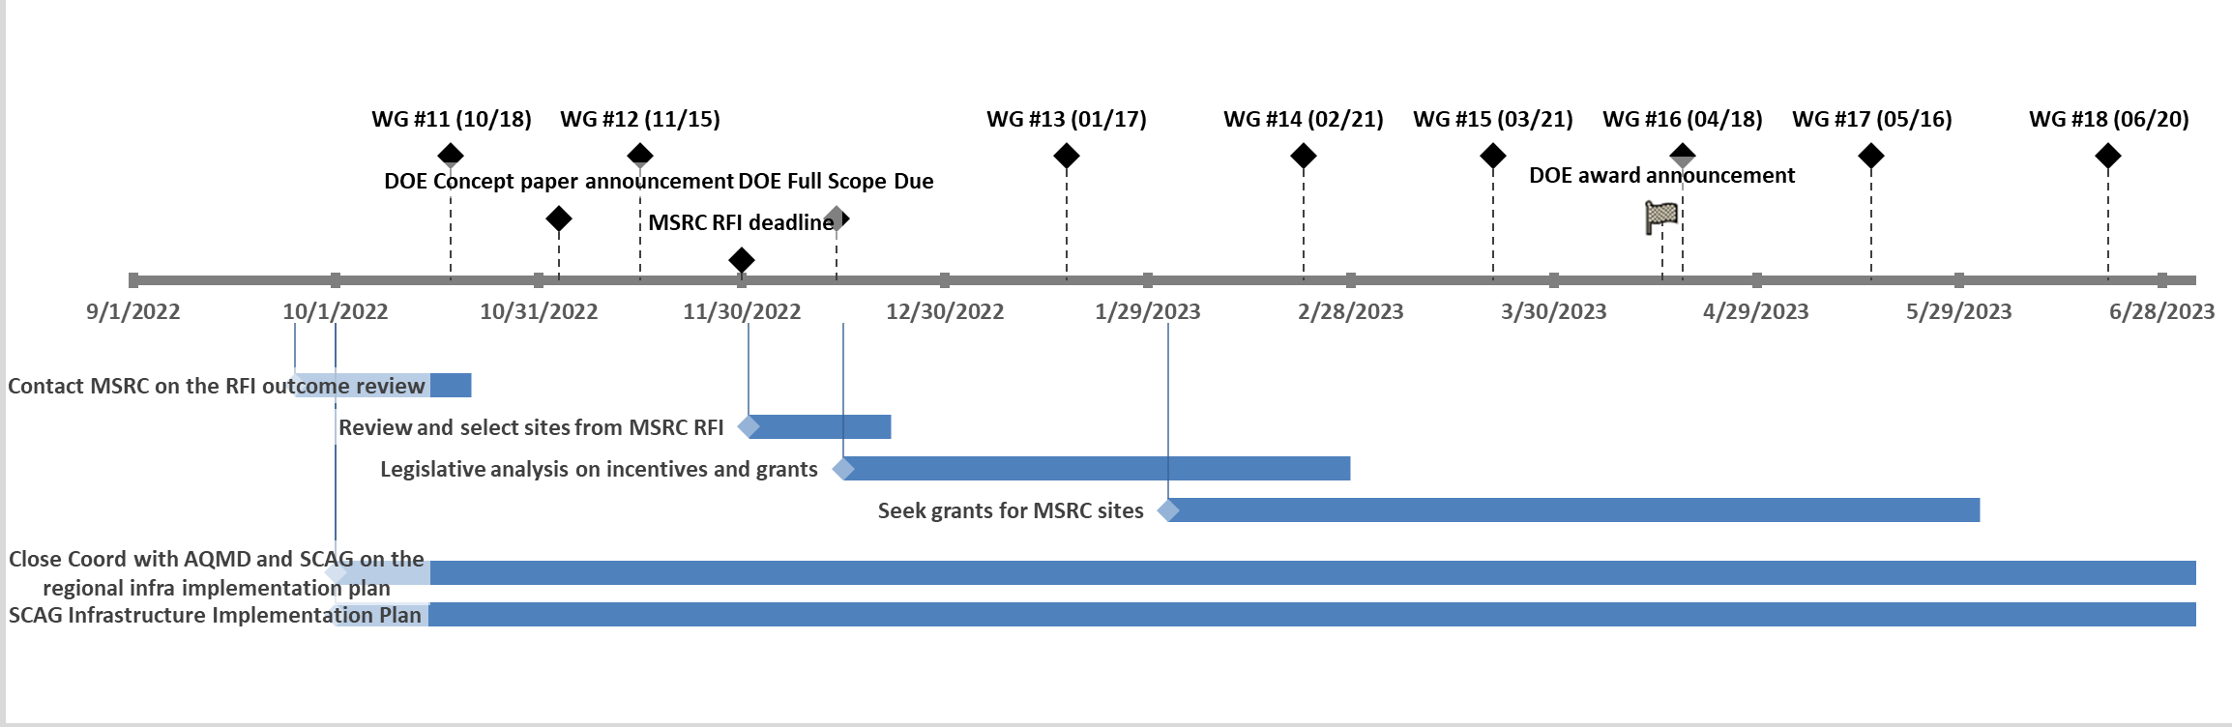
ZET Program Outlook
34

Slide 35
Workforce Development for ZE Infrastructure Expenditure
Overview
How can we create workforce development opportunities for corridor residents?
How can we support corridor residents in obtaining skills and training?
35

Slide 36
Tasks
Start | End | Duration | Label
10/1/2022 | 4/30/2024 | 420 | SCAG Infrastructure Implementation Plan
9/25/2022 | 10/10/2022 | 26 | Contact MSRC on the RFI outcome review
10/1/2022 | 6/30/2023 | 280 | Close Coord with AQMD and SCAG on the regional infra implementation plan
12/1/2022 | 12/20/2022 | 21 | Review and select sites from MSRC RFI
12/15/2022 | 2/28/2023 | 75 | Legislative analysis on incentives and grants
2/1/2023 | 4/30/2023 | 120 | Seek grants for MSRC sites

Slide 37
Milestones
Date |  |  | Label | Position
10/18/2022 |  |  | WG #11 (10/18) | 30
11/3/2022 |  |  | DOE Concept paper announcement | 15
11/15/2022 |  |  | WG #12 (11/15) | 30
11/30/2022 |  |  | MSRC RFI deadline | 5
12/14/2022 |  |  | DOE Full Scope Due | 15
1/17/2023 |  |  | WG #13 (01/17) | 30
2/21/2023 |  |  | WG #14 (02/21) | 30
3/21/2023 |  |  | WG #15 (03/21) | 30
4/15/2023 |  |  | DOE award announcement | 15
4/18/2023 |  |  | WG #16 (04/18) | 30
5/16/2023 |  |  | WG #17 (05/16) | 30
6/20/2023 |  |  | WG #18 (06/20) | 30

Slide 38
RFI for Zero-Emission Infrastructure to Support Goods Movement
Summary
23 responses submitted on November 30, 2022
Metro expressed our interest to partner with MSRC to support promising proposals within the 710 Corridor.
Some responses include multiple sites.
Not all responses are located within the 710 Corridor.
Metro identified total 18 sites within the Corridor.
Metro’s initial evaluation criteria
The proposed project is located within the 710 Corridor.
The target customers are heavy-duty trucks.
The project includes committed site(s) for charging or refueling.
The project aligns with the 710 ZET Program Principles.
38

Slide 39
RFI for Zero-Emission Infrastructure to Support Goods Movement
 | City | # of Chargers | Electric Energy Range | # of Hydrogen Dispensers | Total Project Cost ($ in millions) | MSRC Fund Requested ($ in millions) | Possible Metro Contribution ($ in millions) | Completion Date
1 | Commerce |  |  |  |  | N.S.
2 | Compton |  |  |  |  | N.S.
3 | Compton | 25 | 150 kW | 0 | $ 2.5 | N.S. | $ 0.5
4 | Existing Truck Stops | 0 | N/A | 2 | $ 10.0 | $ 2.0 | $ 2.0 | Q4 2024
5 | Long Beach | 54 | 360 kW | 0 | $ 9.3 | N.S. | $ 1.9 | 1 Yr from the start of Engineering and Permitting
6 | Long Beach | 30 | 350 kW | 0 | $ 9.7 | N.S. | $ 1.9 | Q2 2024
7 | Long Beach | 4 | 360 kW and MCS | 0 | $ 5.4 | N.S. | $ 1.1 | Dec-24
8 | Long Beach | 31 | 180 kW & 350 kW | 0 | $ 12.9 | $ 13.9 | $ 2.6 | Q2 2024
9 | Long Beach | TBD |  |  |  | N.S.
10 | Los Angeles | TBD |  |  |  | N.S.
11 | Los Angeles | TBD |  |  |  | N.S.
12 | Los Angeles | 5 | 350 kW | 0 | $ 2.7 | $ 0.3 | $ 0.5 | Q3 2024
13 | Rancho Dominguez | 40 | 175 kW | 0 | $ 39.0 | $ 20.0 | $ 7.8 | Q2 2024
14 | Vernon | 12 | 360 kW | 0 | $ 13.9 | N.S. | $ 2.8 | 1 Yr from the start of Engineering and Permitting
15 | Vernon | 29 | 180 kW | 0 | $ 29.0 | $ 16.8 | $ 5.8 | Q2 2024
16 | Vernon | 5 | 350 kW | 0 | $ 2.7 | $ 0.3 | $ 0.5 | Q3 2024
17 | Wilmington/Los Angeles | 6 | 350 kW | 0 | $ 4.2 | N.S. | $ 0.8 | Dec-23
18 | Wilmington/Los Angeles |  |  |  |  | N.S.
 |  | 241 |  | 2 | $ 141.3 |  | $ 28.3
39
N.S.: Not specified in the application
Notes:
While we need to get more inforamtion through MSRC to fully populate this table, with the given information, we know that there could be 241 HD truck chargers and 2 hydrogen dispensers planned in the next couple of years.
There is one proposal with hydrogen fueling service, but this proposal is focused on providing the service, and they’d need to work with existing truck stops within the corridor to install hydrogen dispensers.
Not all proposals specified how much funding they are seeking from MSRC.
Applying the 1:4 leveraging ratio and given the estimated total cost of the proposed projects of $141.3 million, Metro’s potential seed funding contribution could be $28.3 million.
Site 13 & 15 are in the process of acquiring the land, and it may take longer than estimated to have the project commercially available.

Slide 40
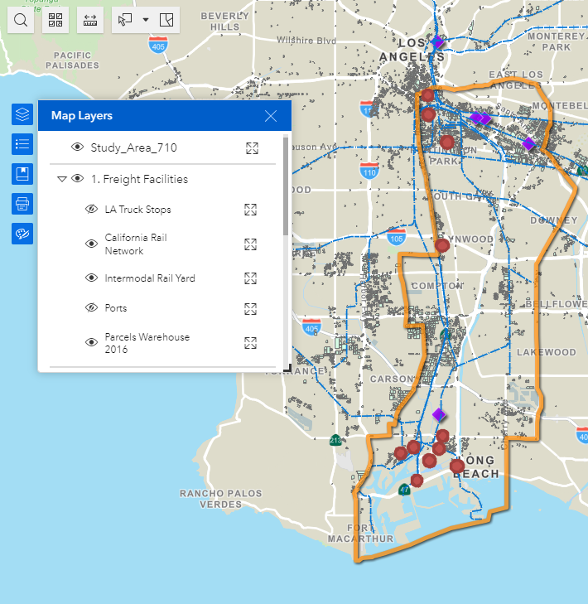
RFI for Zero-Emission Infrastructure to Support Goods Movement
Mapping of 11 sites with known addresses
Several sites are within the Port owned properties
Two major clusters; near the ports and northern end of the 710 Corridor
Need to work through MSRC to get addresses of unidentified sites
40

Slide 41
RFI for Zero-Emission Infrastructure to Support Goods Movement
Preliminary evaluation against the ZET Program Principles
 | City | 1. Maximizing leverage of seed funding | 2. Community Engagement | 3. Corridor Community Benefits | 4. Coordination | 5. Workforce Development | 6. Equitable Outcomes | 7. Legislative Platform | 8. Expeditious Deployment of Resources
1 | Commerce |  | X |  | X | X | Vehicle Pool
2 | Compton |  | X |  | X | X | Vehicle Pool
3 | Compton
4 | Existing Truck Stops |  | Coordinates through Coalition for Clean Air and Breathe SoCal |  | X |  |  |  | X
5 | Long Beach |  | X |  | X | X | Vehicle Pool |  | X
6 | Long Beach |  |  |  | X |  |  |  | X
7 | Long Beach |  |  |  | X | X | Truck-as-a-Service |  | X
8 | Long Beach |  |  |  | X |  | Long-term vehicle lease |  | X
9 | Long Beach |  |  |  | X
41
Notes:
Because these proposals were prepared to respond to MSRC’s RFI, they didn’t necessarily discuss extensively on how they envision conducting activities that align with the 710 ZET Program Principals.
Particularly with principle 2, 3, 5, 6, and 7.
For proposals that did not discuss expected project completion, we need more information, but for now, they are considered not meeting principle 8.
(principle 6) All sites are proposed to be publicly accessible to offer both opportunity and domicile charging to small businesses who may face challenges locating reliable charging sites.

Slide 42
RFI for Zero-Emission Infrastructure to Support Goods Movement
Preliminary evaluation against the ZET Program Principles
 | City | 1. Maximizing leverage of seed funding | 2. Community Engagement | 3. Corridor Community Benefits | 4. Coordination | 5. Workforce Development | 6. Equitable Outcomes | 7. Legislative Platform | 8. Expeditious Deployment of Resources
10 | Los Angeles |  |  |  | X
11 | Los Angeles |  |  |  | X
12 | Los Angeles |  |  |  | X |  | Fleet Rental |  | X
13 | Rancho Domingues |  |  |  |  |  |  |  | X
14 | Vernon |  | X |  | X | X |  |  | X
15 | Vernon |  |  |  |  |  |  |  | X
16 | Vernon |  |  |  | X |  | Fleet Rental |  | X
17 | Wilmington/LA |  |  |  | X |  |  |  | X
18 | Wilmington/LA
42

Slide 43
Agenda Item #5: Community Education & CBO Partnerships
Introduction
Panel Discussion
Task Force Discussion
Notes:
Erika

Slide 44
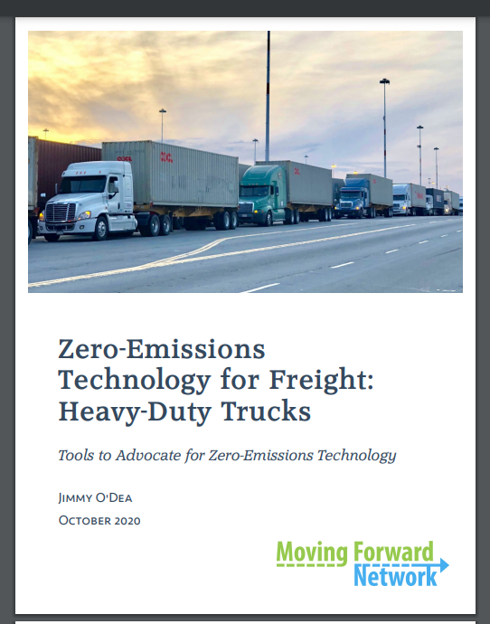
Community Education & Engagement
44
Notes:
Jack
Funding will be used to develop a detailed regional investment plan for innovative infrastructure solutions at industrial facilities and commercial zones along critical freight arteries feeding into I-710 freeway.
This plan will
Leverage existing goods movement real estate assets (e.g. ports, warehouses, distribution centers, retail locations) to provide charging for different supply chain fleets
Prepare local city governments to most effectively and efficiently site and permit the needed charging infrastructure.
Be shared with energy service providers and investors looking to lay the foundation for battery powered electric trucks in Southern California.

Slide 45
Agenda Item #6: Identifying Sensitive Receptors
Introduction
Task Force Discussion
Notes:
Erika

Slide 46
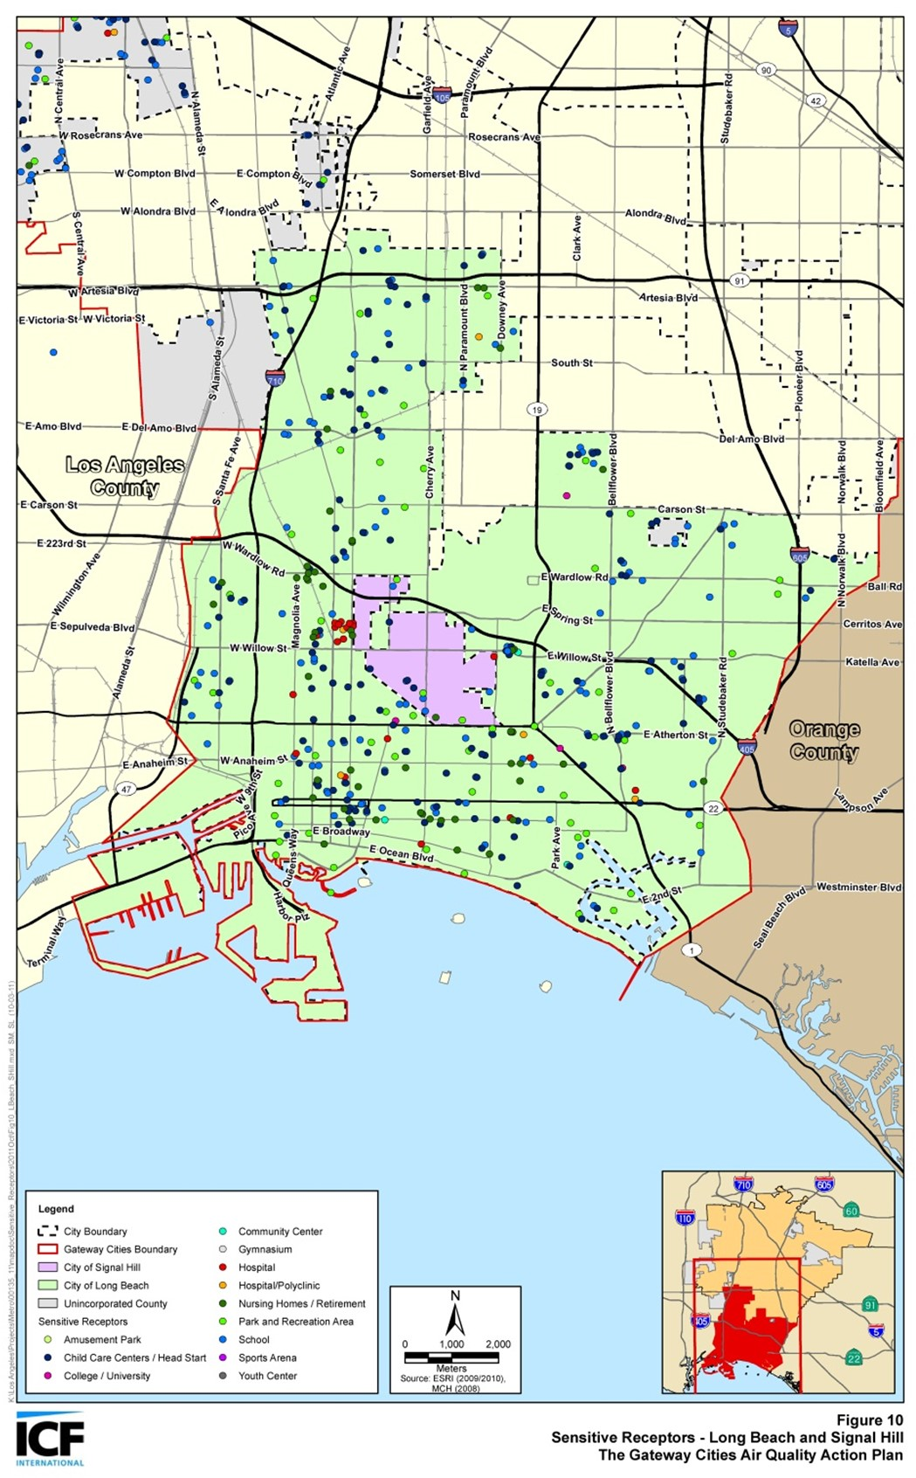
Community Engagement around Sensitive Receptors
The California Air Resources Board (CARB) defines sensitive receptors as places where children, the elderly, and those with pre-existing respiratory health conditions are most likely to congregate, such as:
Schools and schoolyards,
Parks and playgrounds,
Daycare centers,
Nursing homes,
Hospitals, and
Residential communities
Local government can play a significant role in improving health outcomes through land use decisions, truck route planning, and mitigation measures
Communities can develop effective outreach programs to reduce the exposure of children and the elderly by developing a list of sensitive receptor sites to aid in planning efforts
46

Slide 47
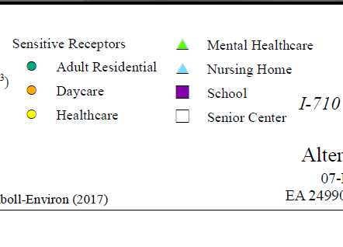
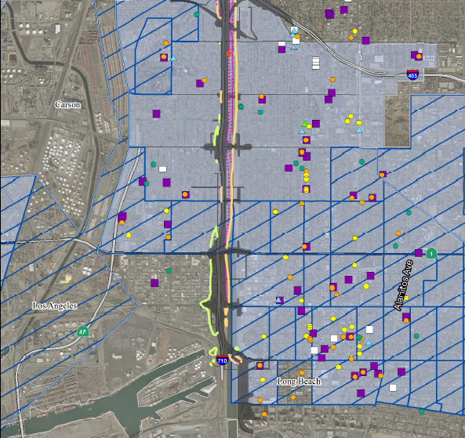
Community Engagement around Sensitive Receptors
47

Slide 48
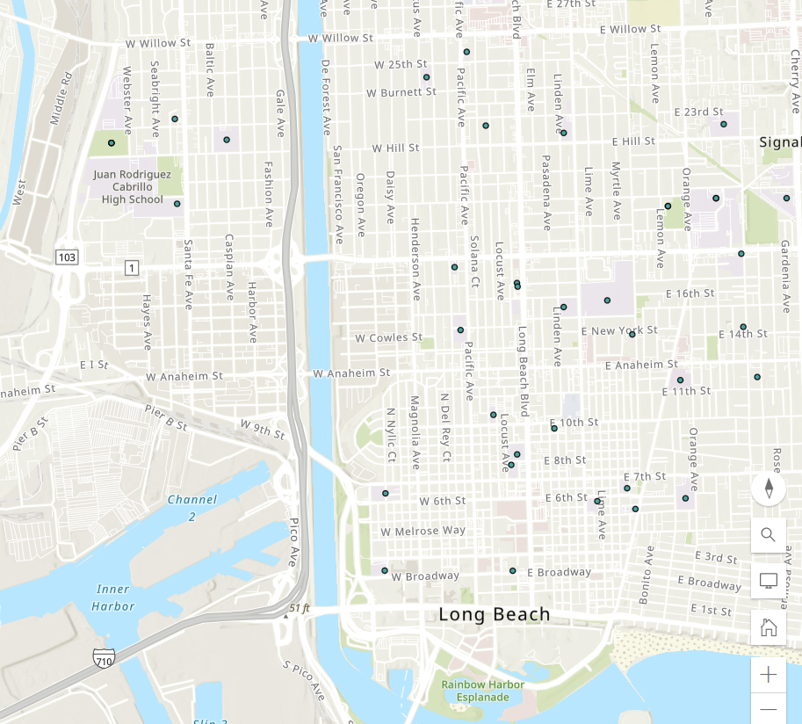
Community Engagement around Sensitive Receptors
Schools and schoolyards
Hospitals
Parks
Available parcels of land
Grid capacity
48

Slide 49

Community Engagement around Sensitive Receptors
Schools and schoolyards
Hospitals
Parks
Available parcels of land
Grid capacity
49

Slide 50
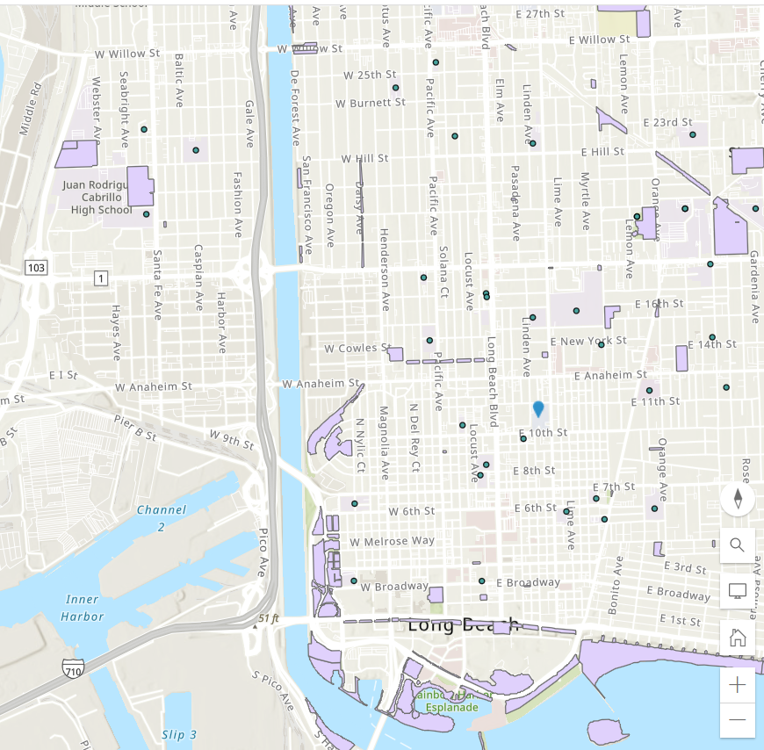
Community Engagement around Sensitive Receptors
Schools and schoolyards
Hospitals
Parks
Available parcels of land
Grid capacity
50

Slide 51
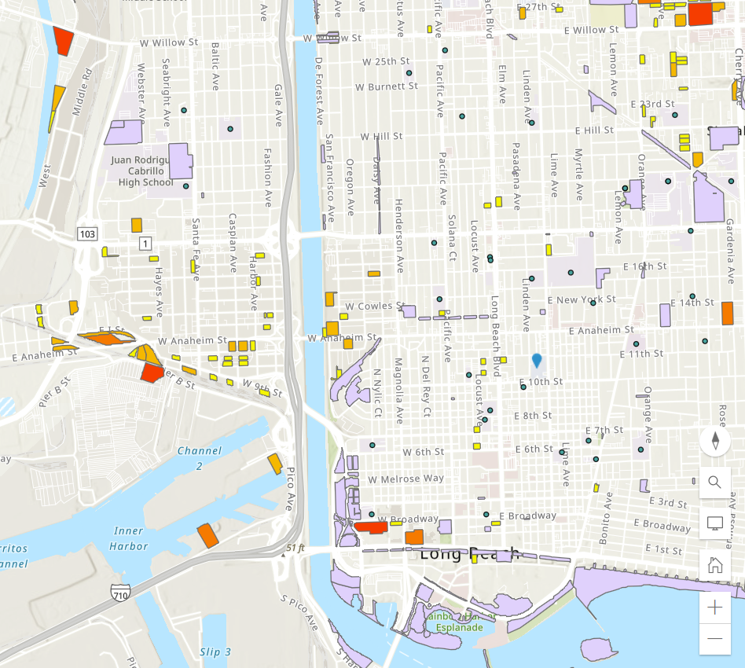
Community Engagement around Sensitive Receptors
Schools and schoolyards
Hospitals
Parks
Available parcels of land
Grid capacity
51

Slide 52
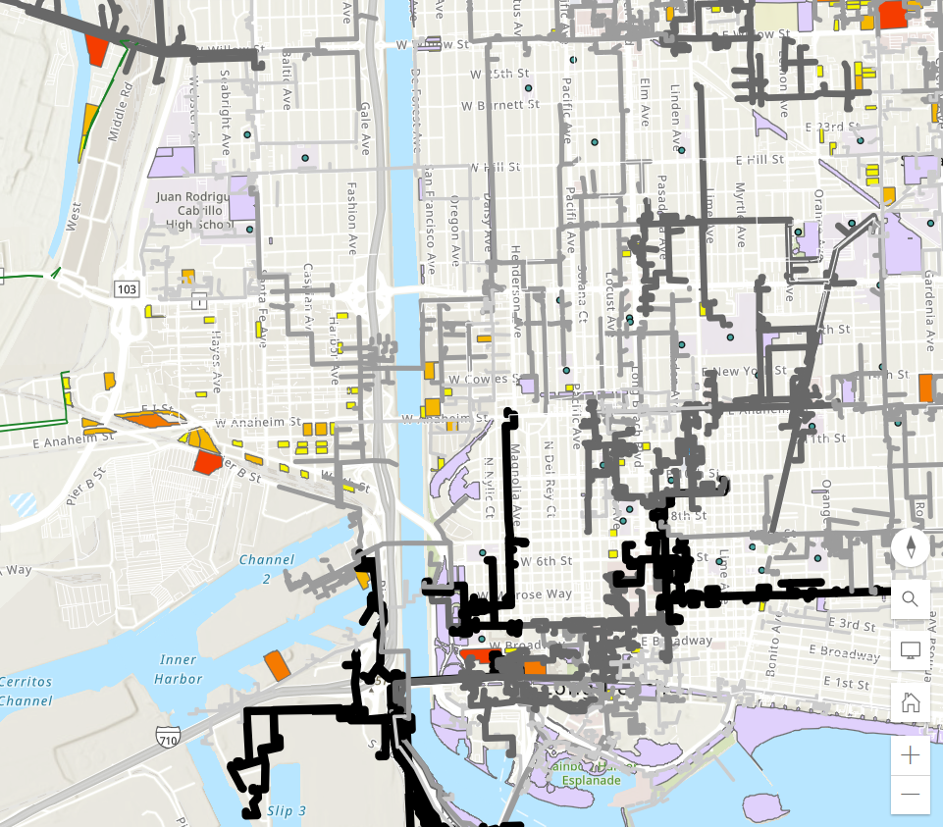
Community Engagement around Sensitive Receptors
Schools and schoolyards
Hospitals
Parks
Available parcels of land
Grid capacity
52

Slide 53
Developing a Sensitive Receptor Exposure Reduction Plan - Example
Characterize and evaluate potential cancer and non-cancer health risks associated with exposure to toxic air contaminants (TACs) from both stationary and mobile sources.
Identify significant sources and locations of TAC emissions within the jurisdiction
Assess existing exposures of sensitive receptors including children, senior citizens, and people with respiratory illnesses and identify priority communities.
Develop and implement mitigation measures to reduce TAC emissions and to avoid the over-concentration of these facilities near sensitive receptors.
Prioritize use of resources to reduce TACs in the most highly impacted areas (i.e., priority communities)
53

Slide 54
Developing a Sensitive Receptor Exposure Reduction Plan –
Next Steps
Gather existing sensitive receptor data from Metro projects and regional partners
Determine role for community members in ground-truthing existing maps for additional sites
Work with regional partners to examine current truck routes, explore improvements, and determine opportunities for truck route enforcement
54
Notes:
What is Metro's role as relates to sensitive receptors?
Do cities already have them mapped?
Is there a role for community in ground-truthing those maps, what needs to be added?
710 EIR had sensitive receptors? (check in with Lucy D. and Ernesto)
Policy enforcement options (discuss with Gloria R, Caltrans, with how guidance on truck routes could influence activity)

