Slide 1
We will begin in a few moments.
LB-ELA Task Force
Zero-Emission Truck Working Group
Meeting #15
April 25, 2023
Notes:
Erika

Slide 2
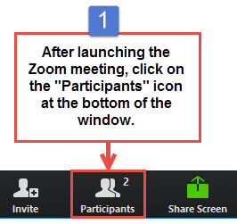
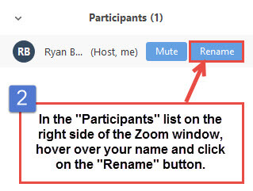


Working Group Member Identification
Notes:
Erika

Slide 3

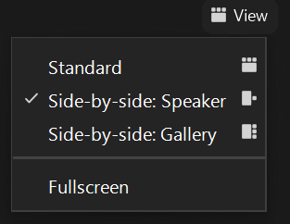
Turn on Camera
To start and stop your video, click the camera icon at the bottom left of your control panel
To switch between views during the meeting click or tap on Standard, Side-by-side Speaker View, and Side-by-side Gallery View at the top right corner of your zoom screen
Notes:
ERIKA

Slide 4

Logistics
Click Interpretation to choose your language.
To hear the interpreted language only, click Mute Original Audio (Optional).
Change your Zoom screen name to include name, agency/organization.
Click Raise Hand in your meeting controls, Press*9 on the phone line, or raise your hand physically.
To lower your hand, click Raise Hand in your meeting controls.
The Q&A button is located on the control panel at the bottom of your screen.
To mute and unmute, click the microphone icon on the bottom left of your control panel.
To start and stop your video, click the camera icon at the bottom left of your control panel.
Technology & interpretation support: 323.609.3345
Notes:
Laura

Slide 5
Detailed Agenda
1:00pm 1:05pm | Welcome, Agenda Review, and Purpose of the Zero-Emission Truck Working Group Agenda Item #1: Metro Update (10 minutes)
1:15pm 1:35pm | Agenda Item #2: LACI Project Update Introduction & Context LACI Update Test for Consensus Agenda Item #3: U.S. DOT Charging & Fueling Infrastructure Grant Opportunity Presentation (15 mins) Working Group Discussion (5 mins)
1:55pm . 2:40pm 2:45pm | Agenda Item #4: Workforce Development in ZE Infrastructure Deployment Dr. Tyler Reeb Director of Research and Workforce Development Center for International Trade and Transportation (CITT) Cal State University of Long Beach (CSULB) Introduction (5 mins) Overview – Tyler Reeb (15 mins) Interactive Discussion (25 mins) Closing Remarks and Upcoming Meetings Adjournment
Notes:
#1: LACI Project update
Introduce jack, principle
Jack update
Next steps for process (port RFP process)
Test for consensus
Do you support the staff recommendation to use of a $3M of the $50M in seed funding to leverage this opportunity
Charging & Fueling Infrastructure grant opportunity
Putting forth a state application
Create slides for CLC and EWG re: Community Project Funding Award
Secondary site identified in 710 blueprint work – need to house the project under LACI and not the port. As an early action investment, seems to be aligned with principles
Having someone from Arches come in to discuss state's hydrogen hub application, set the stage for how 710 fits into that – how metro would address the issue of hydrogen I nthe context of the arches application being submitted on behalf of CA. Do we want to use this as an opportunity to respond with how our efforts are being positioned (hydrogen trucks aren't available yet)
Upcoming additional funding opportunities
Need a WG decision on supporting LACI in March – seeking support for Metro to commit a portion of funding for Rep Barragan
Los Angeles Cleantech Incubator: First to Last Mile: Creating an Integrated Goods Movement Charging Network around the I-710 Corridor. This project will create a plan for innovative infrastructure solutions at industrial facilities and commercial zones along critical freight arteries feeding into Southern California’s I-710 freeway. The project will explore how private sector fleets can establish an integrated network that leverages existing industrial and commercial real estate assets while providing greatest benefit to municipalities and communities.
LACI was recently awarded federal funds for the Creating an Integrated Goods Movement Charging Network around the I-710 Corridor.
Metro will seek ZET Working Group Support at its March 21st Meeting, and Board consideration in April to use Metro funds as a local contribution to secure federal funding for this project.
Motion 9 Board Directive
Engages city, county, and regional partners, including the South Coast Air Quality Management District and Los Angeles Cleantech Incubator, to organize and support local initiatives as part of the project’s Investment Plan; and
Los Angeles Cleantech Incubator (LACI) is a member of the Zero-Emission Truck Working Group
Metro will serve on the advisory committee
Asking for a financing contribution. If WG approves,

Slide 6
We will begin in a few moments.
LB-ELA Task Force
Zero-Emission Truck Working Group
Meeting #15
April 25, 2023
Notes:
Erika

Slide 7

Facilitator
Erika C.B. Morales
Partner, Morales + Morales Partners
Notes:
Erika

Slide 8
Welcome, Agenda Review, and Purpose
of the
Zero-Emission Truck (ZET) Working Group
Notes:
ERIKA

Slide 9
Detailed Agenda
1:00pm 1:05pm | Welcome, Agenda Review, and Purpose of the Zero-Emission Truck Working Group Agenda Item #1: Metro Update (10 minutes)
1:15pm 1:35pm | Agenda Item #2: LACI Project Update Introduction & Context LACI Update Test for Consensus Agenda Item #3: U.S. DOT Charging & Fueling Infrastructure Grant Opportunity Presentation (15 mins) Working Group Discussion (5 mins)
1:55pm . 2:40pm 2:45pm | Agenda Item #4: Workforce Development in ZE Infrastructure Deployment Dr. Tyler Reeb Director of Research and Workforce Development Center for International Trade and Transportation (CITT) Cal State University of Long Beach (CSULB) Introduction (5 mins) Overview – Tyler Reeb (15 mins) Interactive Discussion (25 mins) Closing Remarks and Upcoming Meetings Adjournment
Notes:
Erika

Slide 10
Meeting Objectives
During this meeting, the working group will:
Receive status report on LACI's Community Project Funding Request
Participate in a Test for Consensus on the staff recommendation for the funding request
Learn about a federal discretionary grant opportunity and regional and state efforts to advance charging and fueling infrastructure
Receive a presentation on workforce development and discuss how Metro and its partners can create opportunities for residents to gain skills and training on new technologies as well as targeted local hire on ZET infrastructure development

Slide 11
Agenda Item #1:
Metro Update
Notes:
Erika

Slide 12
ZET Program Recap – Metro Board Direction
Metro Board Direction and desired outcomes
$200 million minimum funding target
Leverage $50 million local matches with private, regional, state, and federal funding
Accelerated ZE deployment in the I-710 South (now Long Beach-East LA) Corridor
Collaboration with regional stakeholders
Independent, accelerated process from overall 710 (LB-ELA) Task Force Investment Plan process
Strategies to accomplish outcomes
Identify discretionary grant opportunities
Convene and collaborate with community and regional stakeholders
Develop a scope of work for the ZET Program
Identify regional funding partners
Identify near and long-term opportunities
Identify policy and legislative barriers to implementation
Notes:
Michael

Slide 13
ZET Meeting #14 Recap
Summary
Held virtually via Zoom on Tuesday, March 21, 2022
28 participants (25 Working Group Members, 3 CLC members)
Key Takeaways
LACI's Proposed Community Project aligns with ZET Program principles and Metro’s vision for regional MD/HD charging facilities. Concerns expressed included:
Ensuring that the charging stations do not cause harm to surrounding neighborhoods
Local hire program for the project
Mobile Source Reduction Committee's RFI Results aligns with the ZET Program principles. Next steps included:
Working with MSRC to gather more information on proposed projects
Conducting community engagement and outlining local hire targets
Verifying proposed schedules, permitting, and energy reliability
13
Notes:
Michael
Public charging will require public investment to amortize capital costs.
Innovative partnerships can unlock value and mitigate risk.
SB 671 must identify barriers and solutions for long-term funding success
Focus on expanding charging opportunities corridor-wide and analyzing long-term benefits of ZE infrastructure for corridor stakeholders
Collaborate with other agencies, community groups, and residents to analyze data and determine how charging locations will receive priority and ensure community benefits will be at the forefront of advancing ZE infrastructure

Slide 14
ZET Program Principles – Overview
1
2
3
4
Maximize leverage of seed funding
by collaborating with regional partners and funding agencies.
Expeditious Deployment of Resources
to maximize the buying power and benefit of investment while supporting community engagement and effective outreach.
Coordination
with regional and funding partners, government agencies, and key stakeholders.
Community Engagement
that centers corridor residents and stakeholders throughout the development process.
5
6
7
8
Workforce Development
that ensures community benefits and access to opportunity through the pursuit and implementation of ZE Technology.
Corridor Community Benefits by creating economic opportunities, improving air quality, and reducing long-standing health impacts generated by diesel trucks.
Equitable Outcomes
ensured by performance metrics that evaluate sustainable outcomes.
Legislative Platform
designed to support the accelerated, equitable deployment of ZE technology by reducing barriers and increasing incentives to adoption.

Slide 15
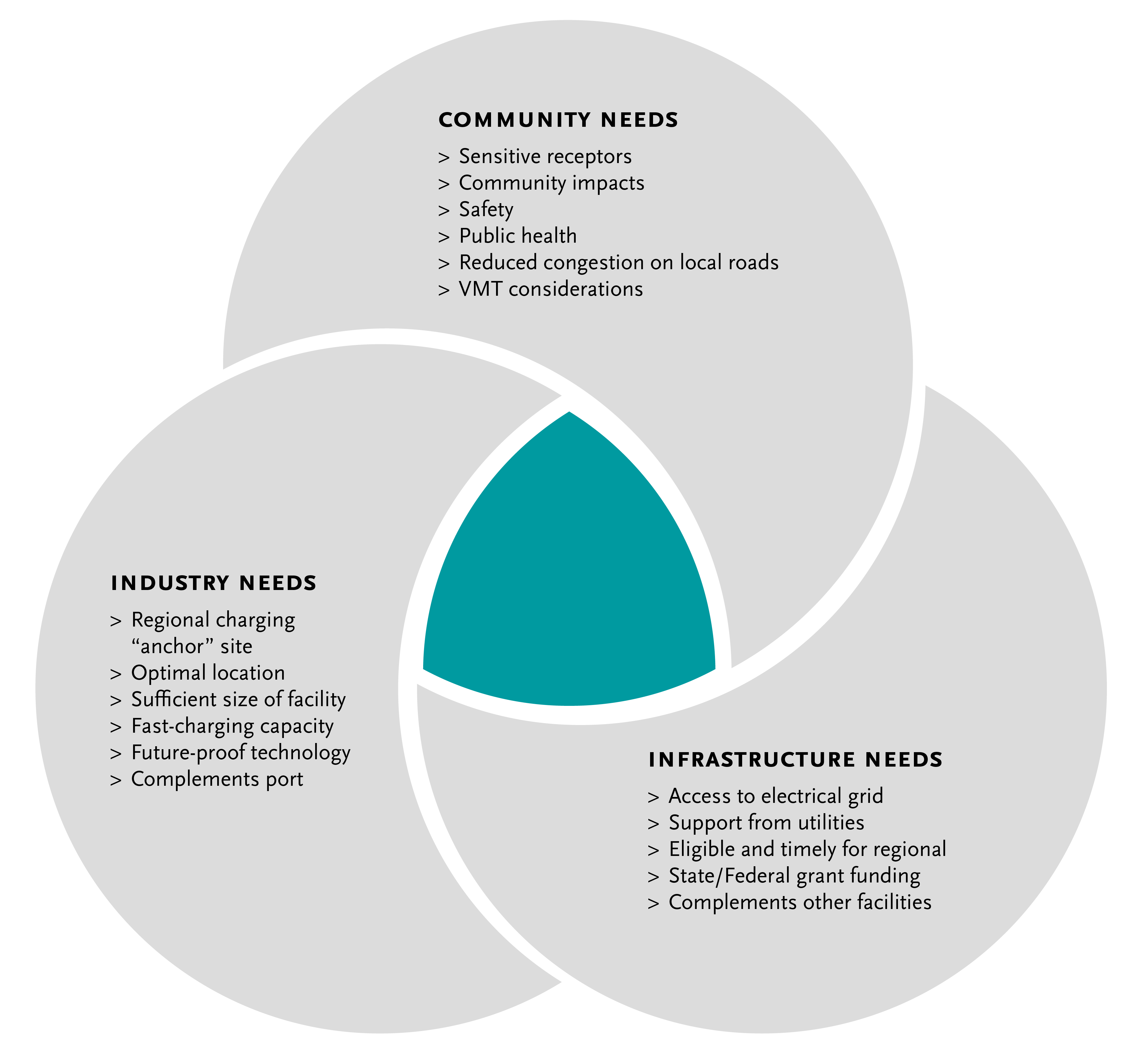
Metro Vision - Regional Zero-Emissions MD/HD Truck Charging Facility/ies
15
Notes:
Michael

Slide 16
Key Findings & Next Steps
Metro Vision for regional ZET charging facilities | Public charging station(s) for use primarily by smaller drayage fleets and independent owner/operators, but accessible for all heavy-duty trucks Origins and destinations within Southern California Port or transload trips that are clustered in the region Multiple trips per day Access needed for midday opportunity charging
Where | West of 710, near ports, or along the Alameda Corridor
Next Steps | Work with local jurisdictions and logistics/real estate professionals to determine land ownership Coordinate with utilities on current capacity and/or where it needs to be added Map out fueling stations in that area to determine where trucks are already filling up Examine existing truck routes and location of sensitive receptors to align charging facility site(s) with community needs Connect with small fleets/drivers to understand their needs, experience, and opportunities Research grant funding opportunities to assist in pursuing next steps
Notes:
Michael
Discussion around sensitive receptors
Share preliminary map of receptors and ask what else
Truck route map (caltrans)
Would there be one or more charging facility locations?
Who are the primary users?
Where would the facility/ies potentially be located?
What is the infrastructure needed?

Slide 17
Agenda Item #2: LACI Project Update
Introduction
Working Group Discussion (10 mins)
Notes:
Michael
introduce principle, provide update, open for questions with Jack
Do you support the staff recommendation to use of a $3M of the $50M in seed funding to leverage this opportunity

Slide 18

LACI Proposed LB-ELA Corridor Charging Project
LACI submitted a Community Project Funding request for $1.5M to Congresswoman Nanette Barragan (CA-44) in May 2022; awarded January 2023
Outlined role $1.5M can play in catalyzing other regional agencies to fund a $15M truck charging station
Per Community Project Funding guidelines, project must occur on publicly-held land and provide public benefit
Proposed sites
1519 East I Street
816 N Lansing Avenue, Wilmington CA 90744
(either side of East I St. between Alameda St. and Henry Ford Ave)
Project aligns with Metro’s goals for ZE Truck Program Investment
Opportunity to partner on regional collaboration and begin ZE Truck Program investments with small funding commitment ($3M)
18
Notes:
Michael
Public charging will require public investment to amortize capital costs.
Innovative partnerships can unlock value and mitigate risk.
SB 671 must identify barriers and solutions for long-term funding success
Focus on expanding charging opportunities corridor-wide and analyzing long-term benefits of ZE infrastructure for corridor stakeholders
Collaborate with other agencies, community groups, and residents to analyze data and determine how charging locations will receive priority and ensure community benefits will be at the forefront of advancing ZE infrastructure

Slide 19
ZET Program Principles – 1519 East I St, Wilmington CA 90744
1
2
3
4
Maximize leverage of seed funding
$3M ZE Truck Program
$15M Project
4x Leverage (POLA, Federal, Private Sector)
Expeditious Deployment of Resources
Project can move forward to selecting a private sector operator by year-end. Federal funding catalyzing other partners to action
Coordination
Working with POLA, LACI, Dept. of Housing and Urban Development, LADWP (potentially MSRC)
Community Engagement
Identified in LACI 710 Blueprint
Falls within an AB 617 Community; will address with CLC
5
6
7
8
Workforce Development
Can meet Metro’s local hire requirements; potential to integrate other regional workforce programs into pipeline
Corridor Community Benefits Public charging station will benefit smaller operators transition to ZE
Legislative Platform
Project can identify how to fine-tune CEQA to deploy infrastructure expeditiously while maintaining environmental standards
Equitable Outcomes
Can determine appropriate metrics to evaluate within Task Force, CLC and working groups
Notes:
Michael
The Metro Board committed $50 million as seed funding for an I-710 South Zero Emission (ZE) Truck program to support the accelerated deployment of zero-emission trucks and supporting zero-emission infrastructure (October 2021, Motion 16).
The ZET Program Framework and Principles will be used as a guide as Metro seeks to leverage and amplify the $50 million seed funding within the Corridor.
The Principles were developed through collaboration with the 710 Zero-Emission Truck Working Group.
Five major themes were brought forward by the Working Group:
Community engagement
Strategic partnerships and funding opportunities
Legislative and policy initiatives
Truck subsidies
Environmental impacts and equitable outcomes
Community Leadership Committee (CLC) provided input on September 22
Equity Working Group (EWG) providing equity-focused input today, September 29
At the October 18th ZET Working Group Meeting, the ZET Working Group will:
review input from the Equity Working Group
Vote to approve the ZET Program Principles
Review ZET Program Principles with the Task Force
Metro Project Team to present the ZET Principles to the Metro Board of Directors

Slide 20
Metro Vision - Regional Zero-Emissions MD/HD Truck Charging Facility/ies
20
Notes:
Michael
LACI briefed the Community Leadership Committee (CLC) on 3/27 and Equity Working Group (EWG) on 3/30 to gather feedback and answer any questions.
The Zero-Emissions Truck Working Group will hear highlights from input received from the CLC and EWG, and a vote will be taken at its April meeting on 4/18.
The Task Force will consider the ZET Working Group recommendation at its May meeting on 5/8.
The Board will be asked to consider the Task Force recommendation on the LACI funding request at the May Metro Board Meeting.

Slide 21
LACI Proposed LB-ELA Corridor Charging Project Funding Request Update
Metro/LACI briefed the Zero-Emissions Truck Working Group at its March meeting. Input from Working Group members included:
Ensuring that the charging stations do not cause harm to surrounding neighborhoods
Requesting more information on local hiring for the project
Metro/LACI briefed the Community Leadership Committee (CLC) on 3/27 and Equity Working Group (EWG) on 3/30 on the project and no new concerns were raised.
The Metro Board will consider staff recommendation to allocate $3M from the Board’s overall commitment of $50M in seed funding to support the LACI project.
21
Notes:
LACI Next Steps, provided by Jack:
- POLA currently developing RFP for battery electric charging at designated parcel; exploring possibility of including adjacent parcel for larger site
- LACI and Metro coordinating with state and regional stakeholders on US DOT Charging and Fueling Infrastructure Discretionary Grant application that could include additional funding for site

Slide 22
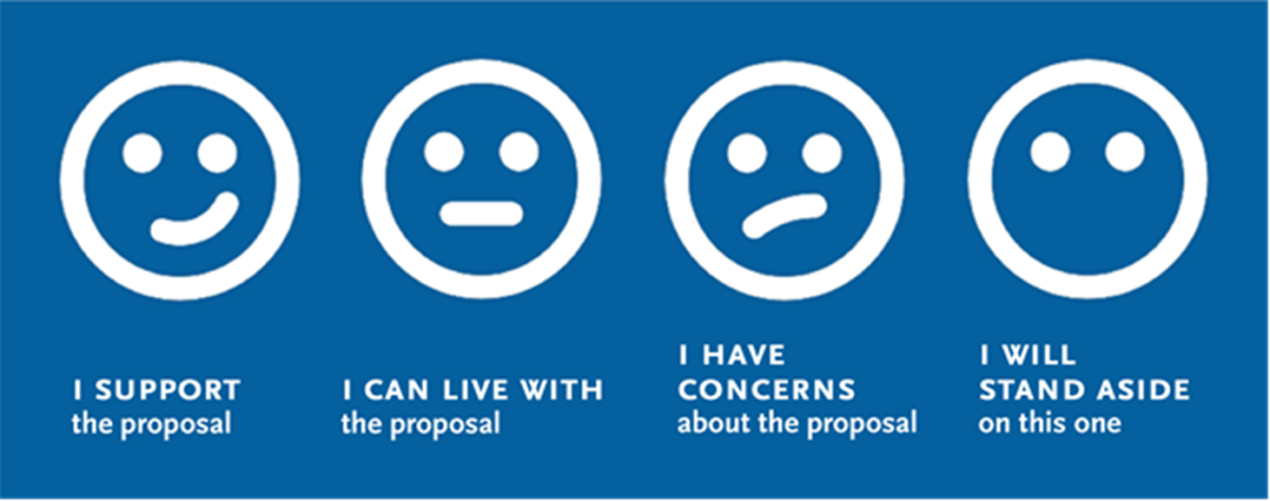
Funding Support for LACI Proposed LB-ELA Corridor Charging Project
I support the staff recommendation to commit up to $3M of the $50M in seed funding for the LACI Community Project.
Notes:
Erika

Slide 23
Agenda Item #3: U.S. DOT Charging & Fueling Infrastructure Grant Opportunity
Presentation
Working Group Discussion
Notes:
Erika
Introduce Akiko
LA Metro and partners are exploring options for an application to the new Charging and Fueling Infrastructure (CFI) Discretionary Grant Program established by the Bipartisan Infrastructure Law. This effort is occurring in conjunction with the recently discussed Mobile Source Reduction Committee (MSRC) Request for Information (RFI) process to identify potential locations for investments in clean transportation funding for publicly accessible infrastructure.

Slide 24
Charging & Fueling Infrastructure (CFI) Grant Opportunity
Overview
CFI Discretionary Grant Program established by the Bipartisan Infrastructure Law
Notice of Funding Opportunity released early March 2023
Provides $2.5 billion over five years
Current round of funding from fiscal years 2022 and 2023 is $700 million
$350 million for the Community Charging and Fueling Program
$350 million for the Alternative Fuel Corridor Grants
Intended to support buildout of charging or fueling infrastructure along designated Alternative Fuel Corridors (AFCs)
Applications due May 30, 2023
24
Notes:
Akiko
Background notes:
The U.S. Department of Transportation’s new Charging and Fueling Infrastructure (CFI) Discretionary Grant Program, established by the Bipartisan Infrastructure Law, will provide $2.5 billion over five years to a wide range of applicants, including cities, counties, local governments, and Tribes. This round of funding makes up to $700 million from fiscal years 2022 and 2023 funding available to strategically deploy EV charging and other alternative vehicle-fueling infrastructure projects in publicly accessible locations in urban and rural communities, as well as along designated Alternative Fuel Corridors (AFCs).
The Community Program will provide $1.25 billion to strategically deploy publicly accessible EV charging infrastructure, and hydrogen, propane, or natural gas fueling infrastructure in communities. Infrastructure may be located on any public road or in other publicly accessible locations such as parking facilities at public buildings, public schools, and public parks, or in publicly accessible parking facilities owned or managed by a private entity.
The Corridor Program will provide $1.25 billion to strategically deploy publicly accessible EV charging infrastructure and hydrogen, propane, and natural gas fueling infrastructure along designated alternative fuel corridors (AFCs).

Slide 25
Charging & Fueling Infrastructure (CFI) Grant Opportunity
Regional and State Coordination
Opportunity to communicate to the federal government on the massive funding needs to realize zero-emission goods movement corridors
One statewide application that includes I-710 ZET Program
Partner agencies for the FY22 & FY23 funding cycle
California Energy Commission
Caltrans
LA Cleantech Incubator
Ports of Los Angeles & Long Beach
Southern California Association of Governments
South Coast Air Quality Management District
25
Notes:
Akiko

Slide 26
CFI Alignment with ZET Program Principles
1
2
3
4
Maximize leverage of seed funding
On-going collaboration with the state and regional agencies
Expeditious Deployment of Resources
Criterion #5: CFI Program Vision – expand deployment of public charging and fueling infrastructure
Coordination
On-going collaboration with the state and regional agencies to pursue this funding opportunity
Community Engagement
Criterion #3: Equity, Community Engagement and Justice 40
5
6
7
8
Workforce Development
Criterion #4: Workforce Development, Job Quality, and Wealth Creation
Corridor Community Benefits Criterion #1: Safety
Criterion #2: Climate Change, Resilience and Sustainability
Criterion #3 and Criterion #4
Equitable Outcomes
Criterion #3 evaluation includes an equity analysis and assessment to ensure proportional impacts and removal of transportation related disparities to all populations in a project area
Legislative Platform
Communicate the magnitude of investment needs to the federal government
Notes:
Akiko
Maximize leverage of seed funding by collaborating with regional partners and funding agencies.
Expeditious Deployment of Resources to maximize the buying power and benefit of investment while supporting community engagement and effective outreach.
Coordination with regional and funding partners, government agencies, and key stakeholders.
Community Engagement that centers corridor residents and stakeholders throughout the development process.
Workforce Development that ensures community benefits and access to opportunity through the pursuit and implementation of ZE Technology.
Corridor Community Benefits by creating economic opportunities, improving air quality, and reducing long-standing health impacts generated by diesel trucks.
Equitable Outcomes ensured by performance metrics that evaluate sustainable outcomes.
Legislative Platform designed to support the accelerated, equitable deployment of ZE technology by reducing barriers and increasing incentives to adoption.

Slide 27
Next Steps
Weekly coordination calls to develop the statewide application with partner agencies
Develop compelling narrative to highlight the knowledge and efforts made by this group, regional and state partners
Clarify agency roles and responsibilities
Application due date: May 30, 2023
Looking Beyond CFI
Prepare for other state and federal funding opportunities
Work closely with MSRC and Southern California partners to further detail out the 710 ZET Program rollout plan
27
Notes:
Akiko
Because these proposals were prepared to respond to MSRC’s RFI, they didn’t necessarily discuss extensively on how they envision conducting activities that align with the 710 ZET Program Principals.
Particularly, we are interested in their willingness and desire to address
Community engagement activities to draw out community concerns and desires, i.e., mitigating localize traffic, noise, safety, project related job opportunities, etc.
Incorporating community benefits, i.e., community desires, in the project design
Their thoughts on incorporating workforce investments and training to benefit surrounding communities

Slide 28
Agenda Item #4: Workforce Development for ZE Infrastructure Expenditure
Introduction
Overview
Interactive Discussion
Notes:
Erika
Introduce item, Akiko

Slide 29
Principle 5
Workforce Development – that ensures community benefits and access to opportunity through the pursuit and implementation of ZE Technology.
Work with regional and community partners to understand job training and workforce needs related to ZET.
Work with labor partners to pursue local and targeted hire opportunities.
Increase community access to quality job opportunities that pay living wages.
Coordinate with existing workforce development programs.
Notes:
Erika review slide/Akiko provide details
3.1
Evaluate various workforce efforts within LA County that are geared towards workers engaged in ZE vehicles and infrastructure
3.1a
Partner with community colleges, and labor leaders to develop ZE-related employment and training programs 3.1b
Work with partners to understand the challenges, barriers, and opportunities for ZE-related employment
3.2
Identify Metro’s role in supporting workforce investment in support of ZE truck deployment and supporting infrastructure
3.2a
Engage workforce development partners to identify where Metro may add value to support their initiatives
3.2b
Explore if there are programs that Metro may develop or support for this endeavor
3.3
Collaborate with partners to establish workforce development outreach strategy
3.3a
Utilize walk-up centers and other outreach mechanisms to discuss employment opportunities with residents

Slide 30
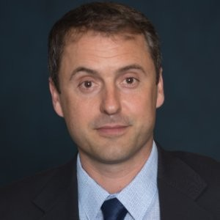
Panelist
Dr. Tyler Reeb
Director of Research and Workforce Development
Center for International Trade and Transportation
Cal State University of Long Beach
Notes:
Akiko
Tyler Reeb oversees a multimillion‐dollar portfolio of sponsored research that addresses Intelligent Transportation Systems (ITS), smart communities, zero‐emission technologies, automation, data privacy, community engagement, and a range of workforce development issues.
He is the principal author and editor of the book "Empowering the New Mobility Workforce" (Elsevier 2019), which was endorsed by the late Norman Mineta.
His research‐driven reports, publications, and workforce development programs promote innovation and civic partnerships between leaders in business, government, and education. “Transportation in GIS,” a pilot class Tyler developed in partnership with Los Angeles Trade Tech College, won the Award of Excellence for Opportunity and Empowerment at the 2019 American Planning Association Los Angeles Awards.
As a journalist, he has covered topics ranging from telecommunications and aerospace technologies to politics and urban planning to arts and culture. He researched communications technologies at the FCC’s International Bureau and covered surveillance and civil rights issues related to the passage of the U.S.A. PATRIOT Act. He actively promotes civic engagement through his research, writing, and advocacy. It was in that spirit that he co-founded the ReThinking Greater Long Beach conference series, which convened concerned citizens, scholars, and journalists to generate innovative solutions to some of the most pressing concerns facing south Los Angeles County.

Slide 31
Sustainable Freight Foundations Pilot Findings
Developed by
California State University, Long Beach
Center for International Trade and Transportation (CITT)
In partnership with the California Energy Commission
and the
Governor’s Office of Business and Economic Development

Slide 32

Principal Research Questions:
What are sustainable freight jobs?
Where are the workforce training and education gaps?
What are the competencies required by employers to address these gaps?
What is the structure of training that responds most effectively to these competencies?

Slide 33
Research Methodology: Continual Refinement of Competencies
Solicited input from industry associations and working groups; Burning Glass research; webinars; industry publications
Gathered feedback from industry and education/training partners using SurveyMonkey
Conducted on-site visits to employers and in-depth interviews
Reviewed job postings
Surveyed participants throughout the course of the pilot

Slide 34
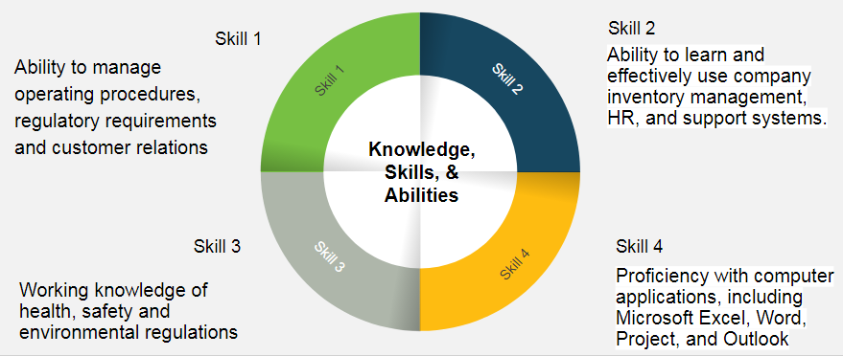
Example of Target Occupation: Terminal Manager - Job Posting
Description: Provides integrated terminaling, storage, transportation and related services for customers engaged in the distribution and marketing of light refined petroleum products, heavy refined petroleum products, crude oil, chemicals, fertilizers and other liquid products.
0

Slide 35
Targeted Industry Sectors
Drayage
Trucking
Rail
Manufacturers (OEMs)
Distribution and Warehousing
Transloading Facilities
Freight Forwarders
Terminals
Notes:
We refined the target industry sectors

Slide 36
Targeted Middle Management Occupational Titles (Current list is over 100 job titles)
Fleet Managers
Facilities Managers
Transportation Specialists
Safety and Security Operations Managers (Safety, Security, and Environmental Compliance Managers)
Freight Managers
Environmental and Land Use Planners
Documentation Managers
Compliance Managers
Notes:
We refined the targeted middle management occupations based on feedback from lead instructors. These titles come directly from industry, based on our SB-1 research on middle-skill competencies for SC and transportation jobs.

Slide 37

Participants reported new skill sets learned were used in their establishments to:
“Plan for installing new charging stations”
“Purchase new equipment”
“ID problem areas in operations using KPIs”
“Respond to company’s regulatory compliance needs”
“Build fluency with business aspects”
“Write/revise legal contracts (shifting risk)”
“Develop competitive and critical skills (particularly during this economic downturn)”
“Prepare for roles not yet defined in the sustainable freight landscape”
“Develop KPIs”

Slide 38
Research Findings: Workforce Needs
Current Issues in Freight Systems and Management
Introduction to Energy, Infrastructure and Sustainability
Introduction to Regulatory Compliance
Introduction to Data/Metrics
Capstone Project
Sustainable Freight Foundations Certificate
Introduction to Digital Skills Building
Notes:
Added the session in RED: Introduction to Data and Metrics

Slide 39

Participants reported they acquired the following skill sets/competencies:
Identifying
stakeholders/positions
Identifying
issues/drivers
Identifying
infrastructure requirements
Developing
SMART KPIs/Metrics
Identifying and Analyzing
CARB and other Regulations
Participating
using the Administrative Procedure Act
Drafting/Revising
contracts: shifting risk
Creating
Excel pivot tables
Presenting
data and your story
Presenting
an elevator speech

Slide 40
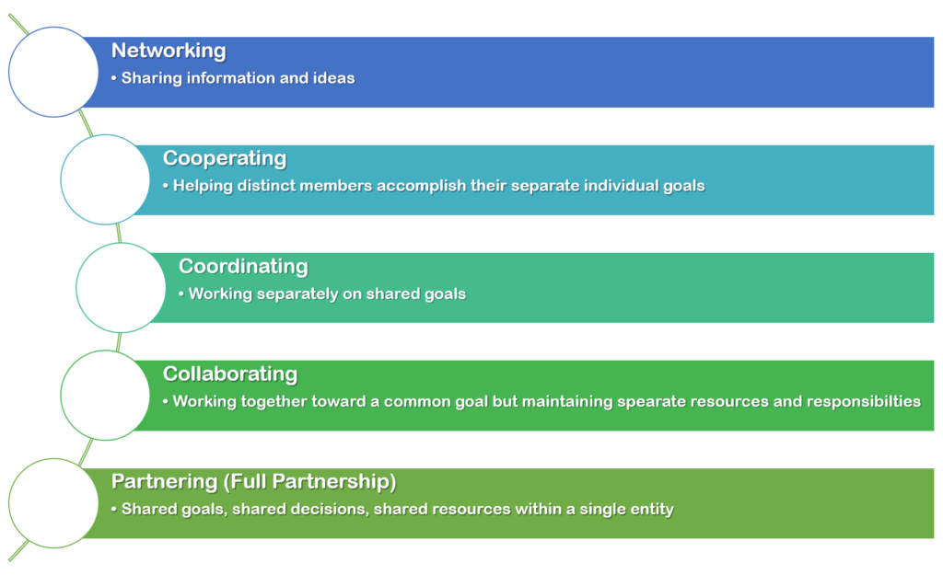
Useful Frameworks for Workforce Development Partnerships
Developmental Evaluation and the partnership continuum.

Slide 41
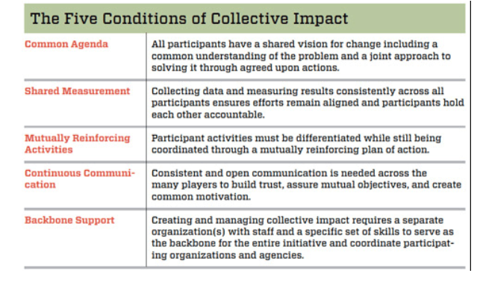
Useful Frameworks for Workforce Development Partnerships

Slide 42
Discussion/Q&A
What is your biggest workforce development challenge?
How would you define the term “community readiness” in terms of workforce development?

Slide 43
Workforce Development for ZE Infrastructure Expenditure – Introductory Topics
How can Metro and its partners create opportunities for residents to gain skills and training on new technologies?
What is Metro's role in working with its regional partners on a targeted local hire program for ZET infrastructure development?
Who are the regional partners Metro should engage in developing a targeted local hire program?
43
Notes:
Background
How can LB-ELA Corridor communities think globally and act locally to encourage workforce opportunities?
Many of the global supply chain challenges have local solutions
Need to address an aging workforce and skills gaps due to shifts in transformational technologies
Infrastructure and maintenance involved with truck electrification and fuel cell technologies
Rerouting trucks, new ways of moving goods, innovative last-mile solutions
How can LB-ELA Corridor communities sustain economic vitality and competitiveness?
Employers looking to address skills gaps should look to upskill within their own ranks
Employers and leaders in government education need to be more centrally involved in K-12 and post-secondary continuum
Need to rely on CLC, community leaders, employers, and operators to ask and understand what is happening on the ground

Slide 44
Closing Remarks and Next Steps
Notes:
Michael
METRO NEXT STEPS
Protocols for vetting proposals – leveraging of funds
Legislative calendar (Norm Emerson-GCCOG), roadmap-applications-timelines
Additional Technical Support-in addition to Akiko
IMMEDIATE NEXT STEPS
--Slides and Confirmation- Jack Symington-LACI-slides (Susan)-SEPTEMBER
-Refine principles slides in presentation-CEHAJ Letter (Trey)-COMPLETE-draft response
-Michael-Fernando-Susan-Mtg re CEHAJ letter
-Tasks Worksheet Update (Susan has an example)
Agenda Item #6-focused discussions
Submit TCEP application, develop grant application
Finalize $5MM TA expertise
Local hiring policy
Erika
Difference between things we generate and things we are a part of
How do we get the $200 m
How do we use Metros’ unique position in the county
How do we create our own program?
How do we respond to other programs that want to partner with us?
How do we create technical expertise- to develop this program
Technical working group?
Keep to ourselves?
We need to develop our community outreach discussion-formalize it
Have plan in place
Advanced work in outreach
AQMD=scope
COMMUNITY EDUCATION
Akiko-Watson Land-realities of developing infrastructure
rika

Slide 45
Upcoming Meetings and Project Information
Community Leadership Committee Meeting
Meeting #15
Thursday, May 18, 5-7pm
Task Force Meeting
Task Force Meeting #20
Monday, May 1, 5-7pm
Task Force Meeting #20.5
Monday, May 8, 5-7pm
Working Group Meetings
Equity Working Group #12 Thursday, April 27, 5-7pm
Zero-Emissions Truck Working Group #16 Tuesday, May 16, 1-3pm
For the most updated list
of meeting dates, please visit http://www.metro.net/710-hub
Notes:
Erika
Our Lady of Guadalupe Day is celebrated on December 12 every year. The day has been declared a national holiday in Mexico. Devotees honor the day when Virgin Mary made an appearance to a young man on this day in 1531.

Slide 46

Stay connected to this project
Michael Cano
Executive Officer
Countywide Planning & Development
LA Metro
One Gateway Plaza, MS 99-13-1 Los Angeles, CA 90012
213.418.3010 W
213.305.0423 C
710corridor@metro.net
https://www.metro.net/projects/lb-ela-corridor-plan/
@metrolosangeles
losangelesmetro
Notes:
Erika

Slide 47
Thank you!
Notes:
Erika

Slide 48
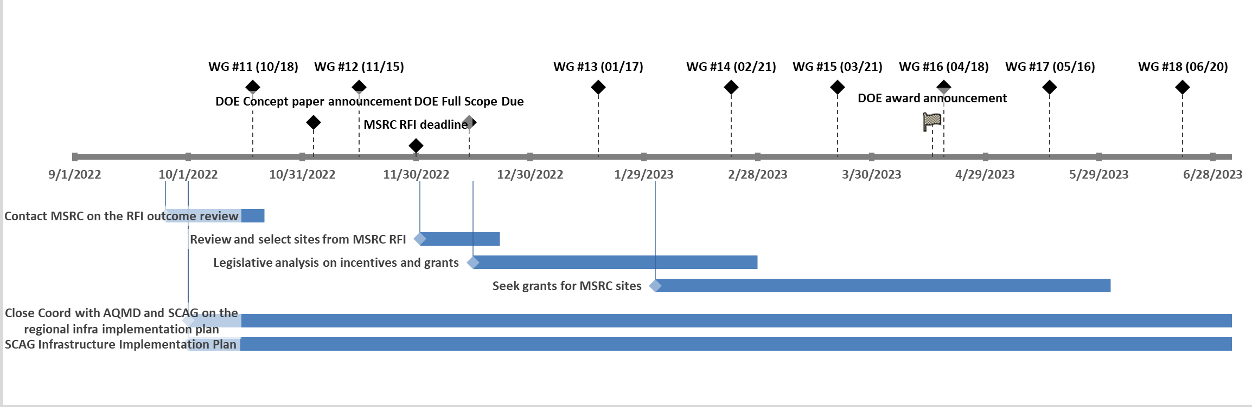
ZET Program Outlook
48

Slide 49
Workforce Development for ZE Infrastructure Expenditure
Overview
How can we create workforce development opportunities for corridor residents?
How can we support corridor residents in obtaining skills and training?
49

Slide 50
Tasks
Start | End | Duration | Label
10/1/2022 | 4/30/2024 | 420 | SCAG Infrastructure Implementation Plan
9/25/2022 | 10/10/2022 | 26 | Contact MSRC on the RFI outcome review
10/1/2022 | 6/30/2023 | 280 | Close Coord with AQMD and SCAG on the regional infra implementation plan
12/1/2022 | 12/20/2022 | 21 | Review and select sites from MSRC RFI
12/15/2022 | 2/28/2023 | 75 | Legislative analysis on incentives and grants
2/1/2023 | 4/30/2023 | 120 | Seek grants for MSRC sites

Slide 51
Milestones
Date |  |  | Label | Position
10/18/2022 |  |  | WG #11 (10/18) | 30
11/3/2022 |  |  | DOE Concept paper announcement | 15
11/15/2022 |  |  | WG #12 (11/15) | 30
11/30/2022 |  |  | MSRC RFI deadline | 5
12/14/2022 |  |  | DOE Full Scope Due | 15
1/17/2023 |  |  | WG #13 (01/17) | 30
2/21/2023 |  |  | WG #14 (02/21) | 30
3/21/2023 |  |  | WG #15 (03/21) | 30
4/15/2023 |  |  | DOE award announcement | 15
4/18/2023 |  |  | WG #16 (04/18) | 30
5/16/2023 |  |  | WG #17 (05/16) | 30
6/20/2023 |  |  | WG #18 (06/20) | 30

Slide 52
RFI for Zero-Emission Infrastructure to Support Goods Movement
Summary
23 responses submitted on November 30, 2022
Metro expressed our interest to partner with MSRC to support promising proposals within the 710 Corridor.
Some responses include multiple sites.
Not all responses are located within the 710 Corridor.
Metro identified total 18 sites within the Corridor.
Metro’s initial evaluation criteria
The proposed project is located within the 710 Corridor.
The target customers are heavy-duty trucks.
The project includes committed site(s) for charging or refueling.
The project aligns with the 710 ZET Program Principles.
52

Slide 53
RFI for Zero-Emission Infrastructure to Support Goods Movement
 | City | # of Chargers | Electric Energy Range | # of Hydrogen Dispensers | Total Project Cost ($ in millions) | MSRC Fund Requested ($ in millions) | Possible Metro Contribution ($ in millions) | Completion Date
1 | Commerce |  |  |  |  | N.S.
2 | Compton |  |  |  |  | N.S.
3 | Compton | 25 | 150 kW | 0 | $ 2.5 | N.S. | $ 0.5
4 | Existing Truck Stops | 0 | N/A | 2 | $ 10.0 | $ 2.0 | $ 2.0 | Q4 2024
5 | Long Beach | 54 | 360 kW | 0 | $ 9.3 | N.S. | $ 1.9 | 1 Yr from the start of Engineering and Permitting
6 | Long Beach | 30 | 350 kW | 0 | $ 9.7 | N.S. | $ 1.9 | Q2 2024
7 | Long Beach | 4 | 360 kW and MCS | 0 | $ 5.4 | N.S. | $ 1.1 | Dec-24
8 | Long Beach | 31 | 180 kW & 350 kW | 0 | $ 12.9 | $ 13.9 | $ 2.6 | Q2 2024
9 | Long Beach | TBD |  |  |  | N.S.
10 | Los Angeles | TBD |  |  |  | N.S.
11 | Los Angeles | TBD |  |  |  | N.S.
12 | Los Angeles | 5 | 350 kW | 0 | $ 2.7 | $ 0.3 | $ 0.5 | Q3 2024
13 | Rancho Dominguez | 40 | 175 kW | 0 | $ 39.0 | $ 20.0 | $ 7.8 | Q2 2024
14 | Vernon | 12 | 360 kW | 0 | $ 13.9 | N.S. | $ 2.8 | 1 Yr from the start of Engineering and Permitting
15 | Vernon | 29 | 180 kW | 0 | $ 29.0 | $ 16.8 | $ 5.8 | Q2 2024
16 | Vernon | 5 | 350 kW | 0 | $ 2.7 | $ 0.3 | $ 0.5 | Q3 2024
17 | Wilmington/Los Angeles | 6 | 350 kW | 0 | $ 4.2 | N.S. | $ 0.8 | Dec-23
18 | Wilmington/Los Angeles |  |  |  |  | N.S.
 |  | 241 |  | 2 | $ 141.3 |  | $ 28.3
53
N.S.: Not specified in the application
Notes:
While we need to get more inforamtion through MSRC to fully populate this table, with the given information, we know that there could be 241 HD truck chargers and 2 hydrogen dispensers planned in the next couple of years.
There is one proposal with hydrogen fueling service, but this proposal is focused on providing the service, and they’d need to work with existing truck stops within the corridor to install hydrogen dispensers.
Not all proposals specified how much funding they are seeking from MSRC.
Applying the 1:4 leveraging ratio and given the estimated total cost of the proposed projects of $141.3 million, Metro’s potential seed funding contribution could be $28.3 million.
Site 13 & 15 are in the process of acquiring the land, and it may take longer than estimated to have the project commercially available.

Slide 54
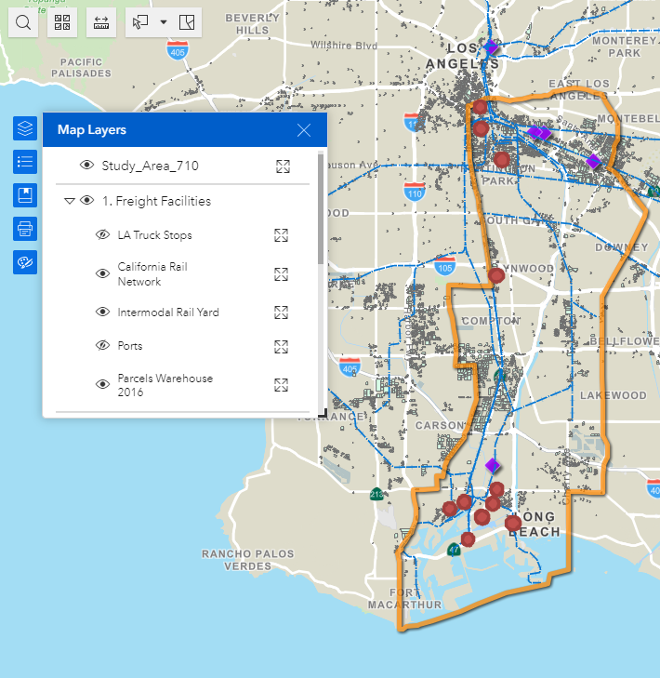
RFI for Zero-Emission Infrastructure to Support Goods Movement
Mapping of 11 sites with known addresses
Several sites are within the Port owned properties
Two major clusters; near the ports and northern end of the 710 Corridor
Need to work through MSRC to get addresses of unidentified sites
54

Slide 55
RFI for Zero-Emission Infrastructure to Support Goods Movement
Preliminary evaluation against the ZET Program Principles
 | City | 1. Maximizing leverage of seed funding | 2. Community Engagement | 3. Corridor Community Benefits | 4. Coordination | 5. Workforce Development | 6. Equitable Outcomes | 7. Legislative Platform | 8. Expeditious Deployment of Resources
1 | Commerce |  | X |  | X | X | Vehicle Pool
2 | Compton |  | X |  | X | X | Vehicle Pool
3 | Compton
4 | Existing Truck Stops |  | Coordinates through Coalition for Clean Air and Breathe SoCal |  | X |  |  |  | X
5 | Long Beach |  | X |  | X | X | Vehicle Pool |  | X
6 | Long Beach |  |  |  | X |  |  |  | X
7 | Long Beach |  |  |  | X | X | Truck-as-a-Service |  | X
8 | Long Beach |  |  |  | X |  | Long-term vehicle lease |  | X
9 | Long Beach |  |  |  | X
55
Notes:
Because these proposals were prepared to respond to MSRC’s RFI, they didn’t necessarily discuss extensively on how they envision conducting activities that align with the 710 ZET Program Principals.
Particularly with principle 2, 3, 5, 6, and 7.
For proposals that did not discuss expected project completion, we need more information, but for now, they are considered not meeting principle 8.
(principle 6) All sites are proposed to be publicly accessible to offer both opportunity and domicile charging to small businesses who may face challenges locating reliable charging sites.

Slide 56
RFI for Zero-Emission Infrastructure to Support Goods Movement
Preliminary evaluation against the ZET Program Principles
 | City | 1. Maximizing leverage of seed funding | 2. Community Engagement | 3. Corridor Community Benefits | 4. Coordination | 5. Workforce Development | 6. Equitable Outcomes | 7. Legislative Platform | 8. Expeditious Deployment of Resources
10 | Los Angeles |  |  |  | X
11 | Los Angeles |  |  |  | X
12 | Los Angeles |  |  |  | X |  | Fleet Rental |  | X
13 | Rancho Domingues |  |  |  |  |  |  |  | X
14 | Vernon |  | X |  | X | X |  |  | X
15 | Vernon |  |  |  |  |  |  |  | X
16 | Vernon |  |  |  | X |  | Fleet Rental |  | X
17 | Wilmington/LA |  |  |  | X |  |  |  | X
18 | Wilmington/LA
56

Slide 57
Agenda Item #5: Community Education & CBO Partnerships
Introduction
Panel Discussion
Task Force Discussion
Notes:
Erika

Slide 58
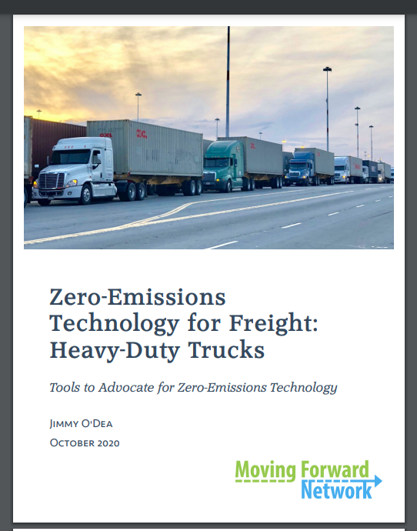
Community Education & Engagement
58
Notes:
Jack
Funding will be used to develop a detailed regional investment plan for innovative infrastructure solutions at industrial facilities and commercial zones along critical freight arteries feeding into I-710 freeway.
This plan will
Leverage existing goods movement real estate assets (e.g. ports, warehouses, distribution centers, retail locations) to provide charging for different supply chain fleets
Prepare local city governments to most effectively and efficiently site and permit the needed charging infrastructure.
Be shared with energy service providers and investors looking to lay the foundation for battery powered electric trucks in Southern California.

Slide 59
Agenda Item #6: Identifying Sensitive Receptors
Introduction
Task Force Discussion
Notes:
Erika

Slide 60
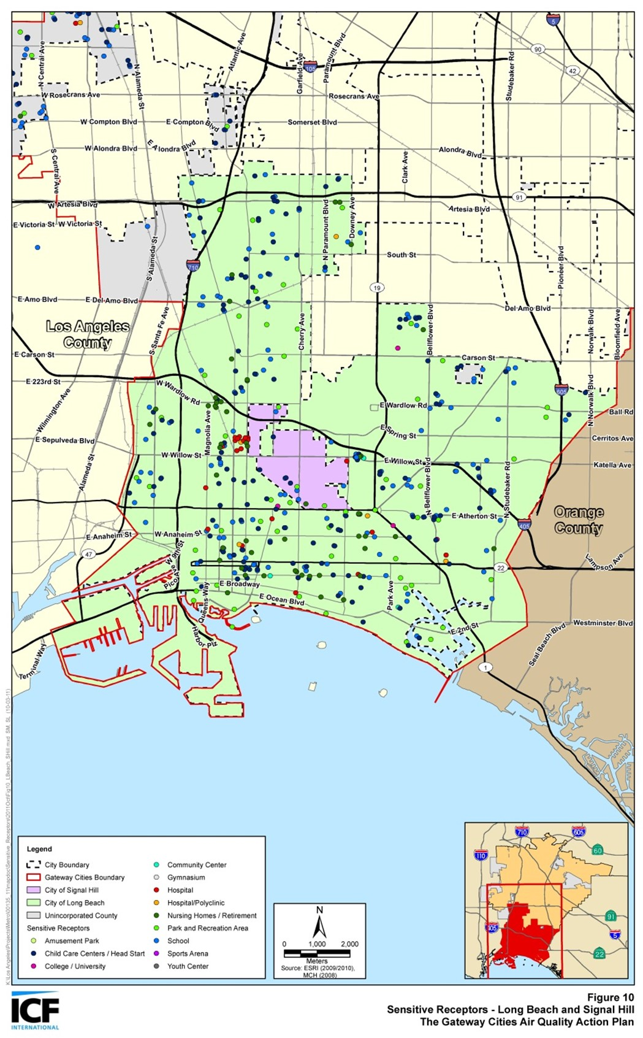
Community Engagement around Sensitive Receptors
The California Air Resources Board (CARB) defines sensitive receptors as places where children, the elderly, and those with pre-existing respiratory health conditions are most likely to congregate, such as:
Schools and schoolyards,
Parks and playgrounds,
Daycare centers,
Nursing homes,
Hospitals, and
Residential communities
Local government can play a significant role in improving health outcomes through land use decisions, truck route planning, and mitigation measures
Communities can develop effective outreach programs to reduce the exposure of children and the elderly by developing a list of sensitive receptor sites to aid in planning efforts
60

Slide 61
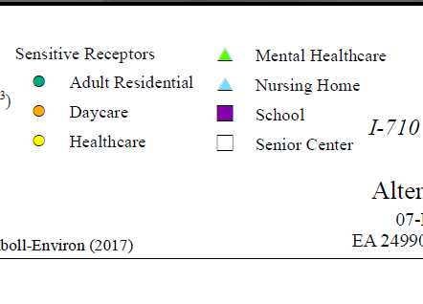
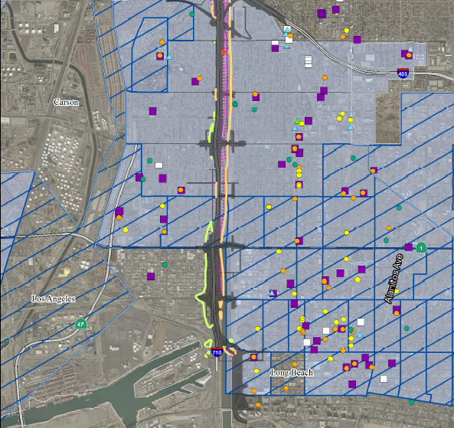
Community Engagement around Sensitive Receptors
61

Slide 62
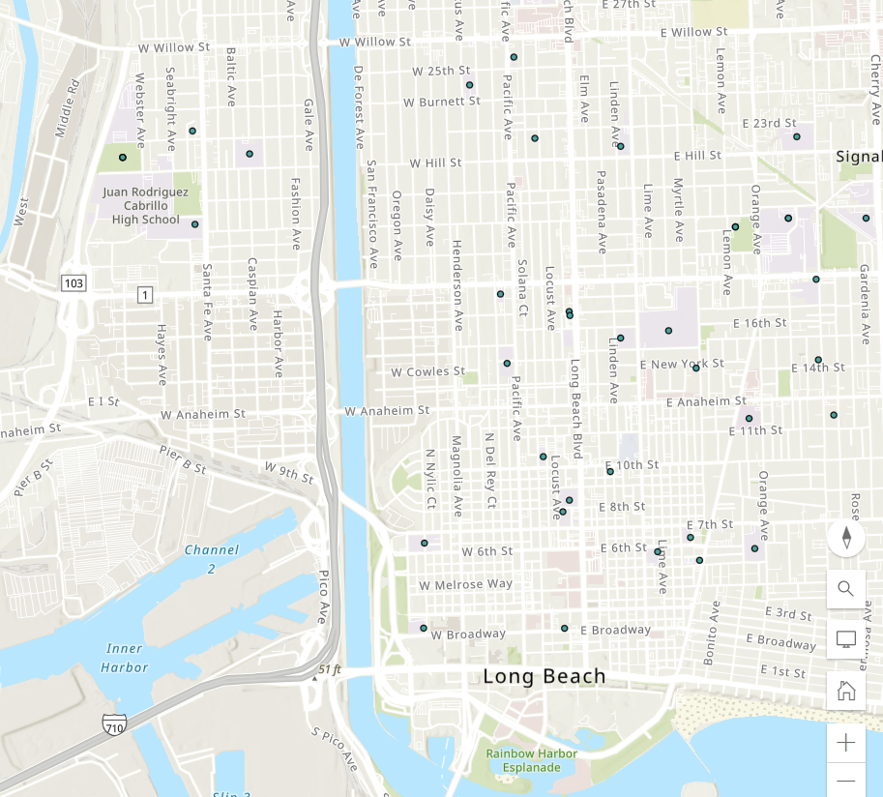
Community Engagement around Sensitive Receptors
Schools and schoolyards
Hospitals
Parks
Available parcels of land
Grid capacity
62

Slide 63

Community Engagement around Sensitive Receptors
Schools and schoolyards
Hospitals
Parks
Available parcels of land
Grid capacity
63

Slide 64
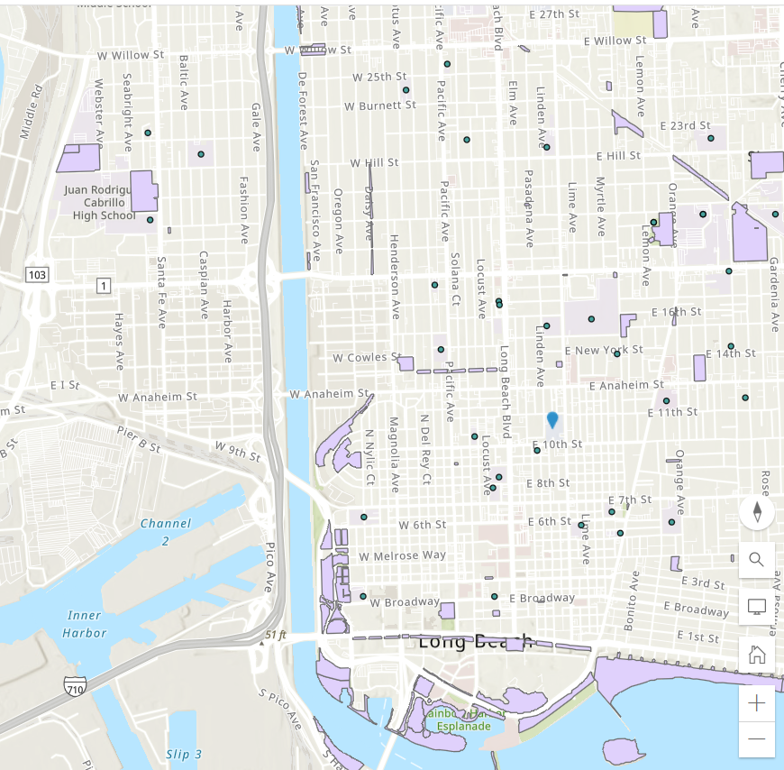
Community Engagement around Sensitive Receptors
Schools and schoolyards
Hospitals
Parks
Available parcels of land
Grid capacity
64

Slide 65
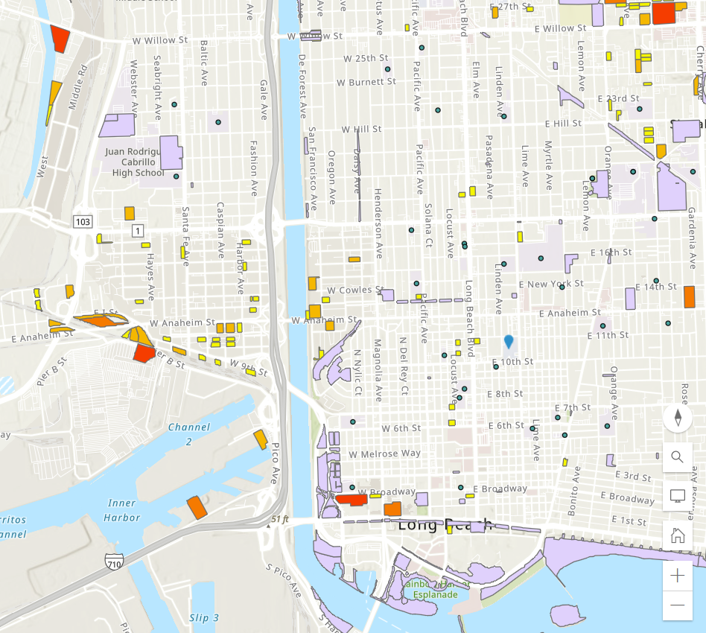
Community Engagement around Sensitive Receptors
Schools and schoolyards
Hospitals
Parks
Available parcels of land
Grid capacity
65

Slide 66
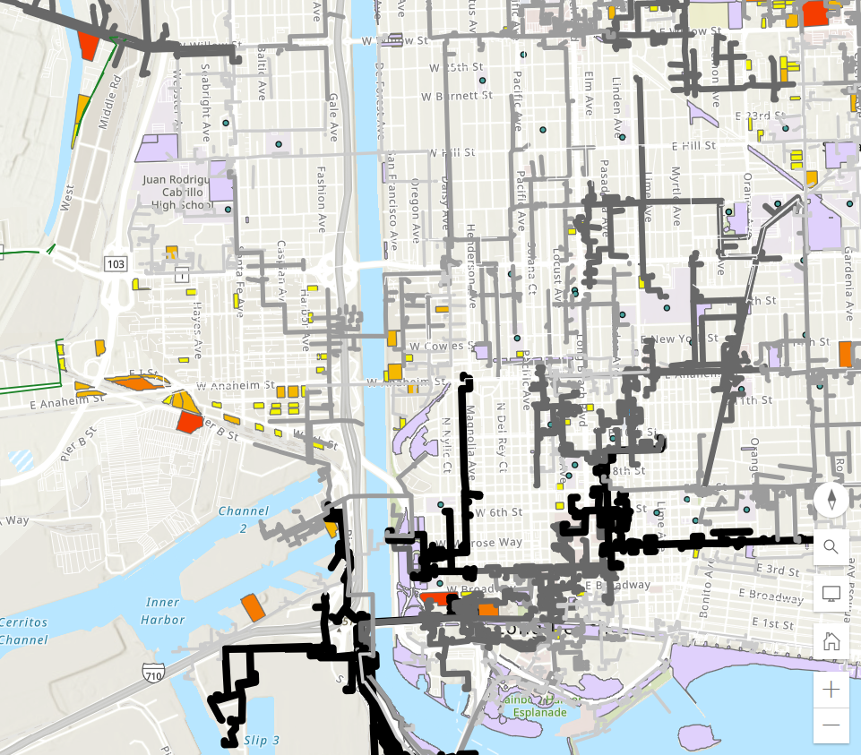
Community Engagement around Sensitive Receptors
Schools and schoolyards
Hospitals
Parks
Available parcels of land
Grid capacity
66

Slide 67
Developing a Sensitive Receptor Exposure Reduction Plan - Example
Characterize and evaluate potential cancer and non-cancer health risks associated with exposure to toxic air contaminants (TACs) from both stationary and mobile sources.
Identify significant sources and locations of TAC emissions within the jurisdiction
Assess existing exposures of sensitive receptors including children, senior citizens, and people with respiratory illnesses and identify priority communities.
Develop and implement mitigation measures to reduce TAC emissions and to avoid the over-concentration of these facilities near sensitive receptors.
Prioritize use of resources to reduce TACs in the most highly impacted areas (i.e., priority communities)
67

Slide 68
Developing a Sensitive Receptor Exposure Reduction Plan –
Next Steps
Gather existing sensitive receptor data from Metro projects and regional partners
Determine role for community members in ground-truthing existing maps for additional sites
Work with regional partners to examine current truck routes, explore improvements, and determine opportunities for truck route enforcement
68
Notes:
What is Metro's role as relates to sensitive receptors?
Do cities already have them mapped?
Is there a role for community in ground-truthing those maps, what needs to be added?
710 EIR had sensitive receptors? (check in with Lucy D. and Ernesto)
Policy enforcement options (discuss with Gloria R, Caltrans, with how guidance on truck routes could influence activity)

Slide 69
Task 3: Ensure LA County has skilled workforce to support large scale ZE Truck deployment
 | Objective | Task | Lead | Partner | Timeframe | Cost/Funding
3.1 | Evaluate various workforce efforts within LA County that are geared towards workers engaged in ZE vehicles and infrastructure
 | 3.1a | Partner with community colleges, and labor leaders to develop ZE-related employment and training programs
 | 3.1b | Work with partners to understand the challenges, barriers, and opportunities for ZE-related employment
3.2 | Identify Metro’s role in supporting workforce investment in support of ZE truck deployment and supporting infrastructure
 | 3.2a | Engage workforce development partners to identify where Metro may add value to support their initiatives
 | 3.2b | Explore if there are programs that Metro may develop or support for this endeavor
3.3 | Collaborate with partners to establish workforce development outreach strategy
 | 3.3a | Utilize walk-up centers and other outreach mechanisms to discuss employment opportunities with residents
69

Slide 70
Workforce Development for ZE Infrastructure Expenditure – Panel Discussion Topics
Overview
Current and historical examples of workforce development programs in the region
Best practices and lessons learned in workforce development training
Experience implementing mandatory or voluntary local hire requirements
Opportunities to coordinate with existing workforce development programs
70

Slide 71
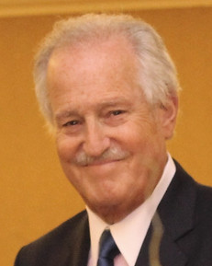
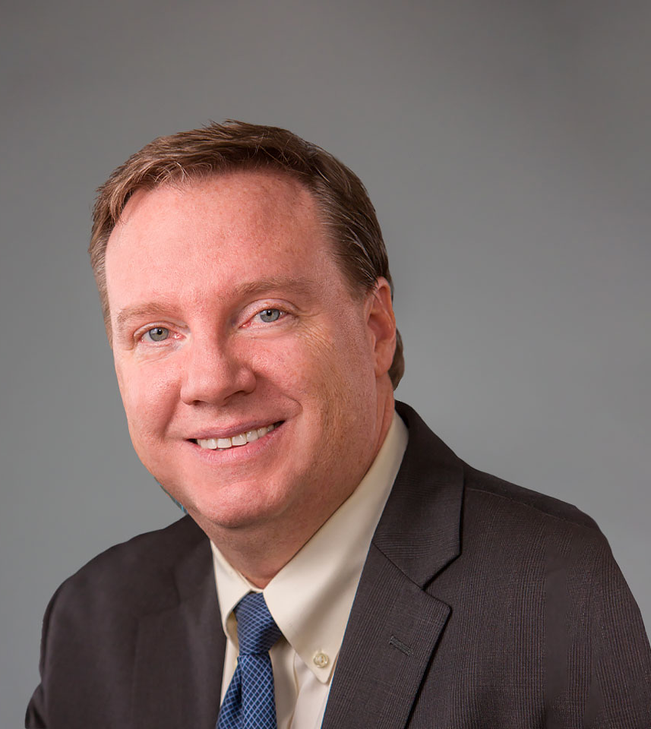

Panelists
Facilitator
Jan Vogel
Executive Director/CEO
South Bay Workforce Investment Board
Dr. Tom O’Brien
Executive Director
Center for International Trade and Transportation
Cal State University of Long Beach
Niki Okuk
Deputy Director
CALSTART
Notes:
Michael
Dr. Tom O’Brien
Executive Director of the Center for International Trade and Transportation (CITT) at California State University, Long Beach (CSULB)
Associate Director of Long Beach Programs for the METRANS Transportation Center.
Director of the Federal Highway Administration (FWHA) Southwest Regional Surface Transportation Workforce Center.
His teaching and research focus on logistics, supply chain management, and goods movement policy.
Dr. O’Brien has a Master’s degree in Urban Planning and Development and a Ph.D. in Policy, Planning, and Development from the University of Southern California.
He is both an Eno and Eisenhower Transportation Fellow and a member of the Transportation Research Board's Intermodal Freight Transport Committee.
Jan Vogel
For over 39 years, Mr. Jan Vogel has served as the Executive Director of the South Bay Workforce Investment Board (SBWIB) which encompasses eleven cities in the Los Angeles South Bay region in California
The SBWIB has also been recognized for being one of the highest performing Workforce Investment Boards in the state of California.
Mr. Vogel is a leader in apprenticeship development and has initiated many efforts for establishing apprenticeship programs utilizing innovative approaches for employer engagement and job seeker recruitment for both union and non-union apprenticeship models.
Additionally, he formulated a variety of pre-apprentice programs leading to registered apprenticeships that were incorporated into a region-wide training directory called I-TRAIN, a system that Mr. Vogel created to ensure providers delivered approved quality education and training to students and job seekers.
Most recently, he has developed a pre apprenticeship program in Aerospace Engineering called AERO-Flex.
Niki Okuk

