Slide 1
We will begin in a few moments.
LB-ELA Task Force
Zero-Emission Truck Working Group
Meeting #14
March 21, 2023
Notes:
Erika

Slide 2
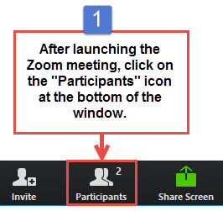
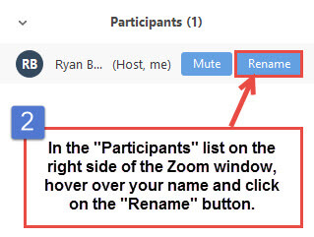


Working Group Member Identification
Notes:
Erika

Slide 3

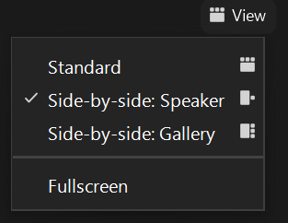
Turn on Camera
To start and stop your video, click the camera icon at the bottom left of your control panel
To switch between views during the meeting click or tap on Standard, Side-by-side Speaker View, and Side-by-side Gallery View at the top right corner of your zoom screen
Notes:
ERIKA

Slide 4

Logistics
Click Interpretation to choose your language.
To hear the interpreted language only, click Mute Original Audio (Optional).
Change your Zoom screen name to include name, agency/organization.
Click Raise Hand in your meeting controls, Press*9 on the phone line, or raise your hand physically.
To lower your hand, click Raise Hand in your meeting controls.
The Q&A button is located on the control panel at the bottom of your screen.
To mute and unmute, click the microphone icon on the bottom left of your control panel.
To start and stop your video, click the camera icon at the bottom left of your control panel.
Technology & interpretation support: 323.609.3345
Notes:
Laura

Slide 5
Detailed Agenda
1:00pm 1:05pm | Welcome, Agenda Review, and Purpose of the Zero-Emission Truck Working Group Agenda Item #1: Metro Update (10 minutes)
1:15pm 1:45pm | Agenda Item #2: LACI's Community Project Funding Award for a Drayage Truck Charging Station Presentation by Jack Symington, Senior Program Manager, LACI Presentation (10 mins) Working Group Discussion (20 mins) Agenda Item #3: Mobile Source Reduction Committee RFI Results Presentation by Akiko Yamagami, Transportation Planning Manager, Goods Movement Planning, Metro Presentation (10 mins) Working Group Discussion (10 mins)
2:05pm 2:20pm 2:30pm | Agenda Item #4: First to Last Mile: Creating an Integrated Goods Movement Charging Network around the I-710 Corridor (15 minutes) Presentation by Jack Symington, Senior Program Manager, LACI Presentation (10 mins) Task Force Discussion (5 mins) Closing Remarks and Upcoming Meetings Adjournment
Notes:
Create slides for CLC and EWG re: Community Project Funding Award
Secondary site identified in 710 blueprint work – need to house the project under LACI and not the port. As an early action investment, seems to be aligned with principles
Having someone from Arches come in to discuss state's hydrogen hub application, set the stage for how 710 fits into that – how metro would address the issue of hydrogen I nthe context of the arches application being submitted on behalf of CA. Do we want to use this as an opportunity to respond with how our efforts are being positioned (hydrogen trucks aren't available yet)
Upcoming additional funding opportunities
Need a WG decision on supporting LACI in March – seeking support for Metro to commit a portion of funding for Rep Barragan
Los Angeles Cleantech Incubator: First to Last Mile: Creating an Integrated Goods Movement Charging Network around the I-710 Corridor. This project will create a plan for innovative infrastructure solutions at industrial facilities and commercial zones along critical freight arteries feeding into Southern California’s I-710 freeway. The project will explore how private sector fleets can establish an integrated network that leverages existing industrial and commercial real estate assets while providing greatest benefit to municipalities and communities.
LACI was recently awarded federal funds for the Creating an Integrated Goods Movement Charging Network around the I-710 Corridor.
Metro will seek ZET Working Group Support at its March 21st Meeting, and Board consideration in April to use Metro funds as a local contribution to secure federal funding for this project.
Motion 9 Board Directive
Engages city, county, and regional partners, including the South Coast Air Quality Management District and Los Angeles Cleantech Incubator, to organize and support local initiatives as part of the project’s Investment Plan; and
Los Angeles Cleantech Incubator (LACI) is a member of the Zero-Emission Truck Working Group
Metro will serve on the advisory committee
Asking for a financing contribution. If WG approves,

Slide 6
We will begin in a few moments.
LB-ELA Task Force
Zero-Emission Truck Working Group
Meeting #14
March 21, 2023
Notes:
Erika

Slide 7
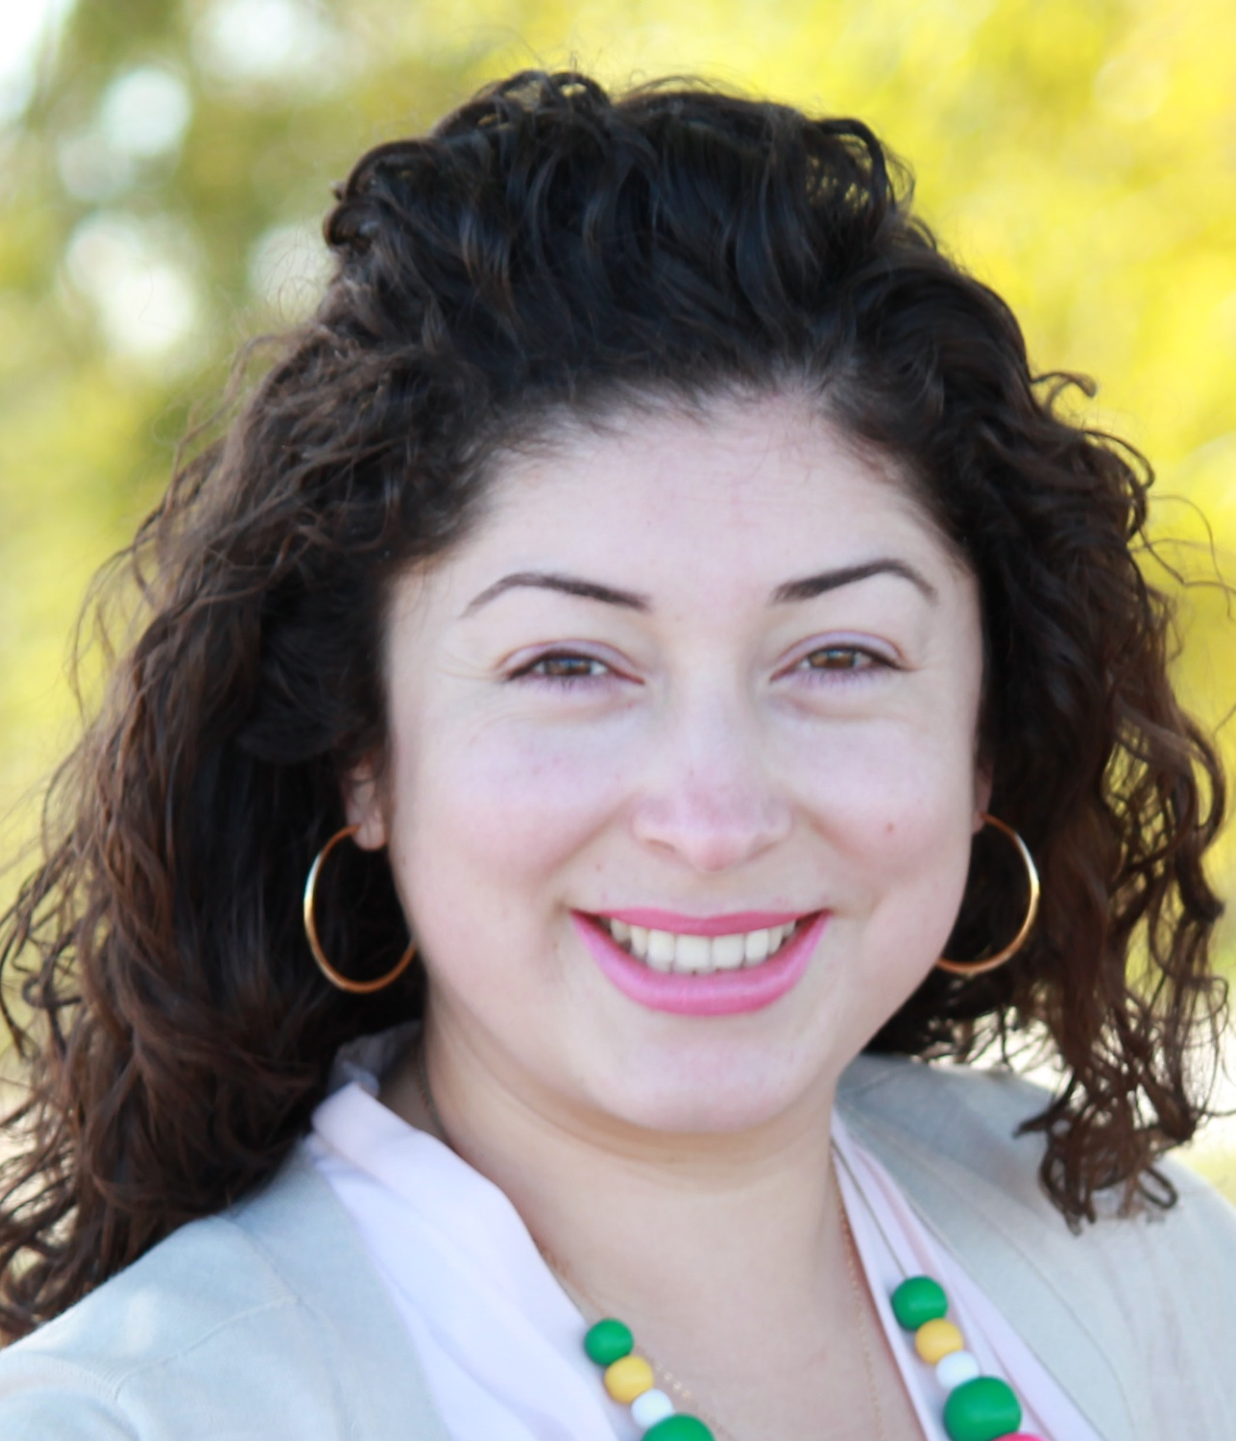
Facilitator
Erika C.B. Morales
Partner, Morales + Morales Partners
Notes:
Erika

Slide 8
Welcome, Agenda Review, and Purpose
of the
Zero-Emission Truck (ZET) Working Group
Notes:
ERIKA

Slide 9
Detailed Agenda
1:00pm 1:05pm | Welcome, Agenda Review, and Purpose of the Zero-Emission Truck Working Group Agenda Item #1: Metro Update (10 minutes)
1:15pm 1:45pm | Agenda Item #2: LACI's Community Project Funding Award for a Drayage Truck Charging Station Presentation by Jack Symington, Senior Program Manager, LACI Presentation (10 mins) Working Group Discussion (20 mins) Agenda Item #3: Mobile Source Reduction Committee RFI Results Presentation by Akiko Yamagami, Transportation Planning Manager, Goods Movement Planning, Metro Presentation (10 mins) Working Group Discussion (10 mins)
2:05pm 2:20pm 2:30pm | Agenda Item #4: First to Last Mile: Creating an Integrated Goods Movement Charging Network around the I-710 Corridor (15 minutes) Presentation by Jack Symington, Senior Program Manager, LACI Presentation (10 mins) Working Group Discussion (5 mins) Closing Remarks and Upcoming Meetings Adjournment
Notes:
Create slides for CLC and EWG re: Community Project Funding Award
Secondary site identified in 710 blueprint work – need to house the project under LACI and not the port. As an early action investment, seems to be aligned with principles
Having someone from Arches come in to discuss state's hydrogen hub application, set the stage for how 710 fits into that – how metro would address the issue of hydrogen I nthe context of the arches application being submitted on behalf of CA. Do we want to use this as an opportunity to respond with how our efforts are being positioned (hydrogen trucks aren't available yet)
Upcoming additional funding opportunities
Need a WG decision on supporting LACI in March – seeking support for Metro to commit a portion of funding for Rep Barragan
Los Angeles Cleantech Incubator: First to Last Mile: Creating an Integrated Goods Movement Charging Network around the I-710 Corridor. This project will create a plan for innovative infrastructure solutions at industrial facilities and commercial zones along critical freight arteries feeding into Southern California’s I-710 freeway. The project will explore how private sector fleets can establish an integrated network that leverages existing industrial and commercial real estate assets while providing greatest benefit to municipalities and communities.
LACI was recently awarded federal funds for the Creating an Integrated Goods Movement Charging Network around the I-710 Corridor.
Metro will seek ZET Working Group Support at its March 21st Meeting, and Board consideration in April to use Metro funds as a local contribution to secure federal funding for this project.
Motion 9 Board Directive
Engages city, county, and regional partners, including the South Coast Air Quality Management District and Los Angeles Cleantech Incubator, to organize and support local initiatives as part of the project’s Investment Plan; and
Los Angeles Cleantech Incubator (LACI) is a member of the Zero-Emission Truck Working Group
Metro will serve on the advisory committee
Asking for a financing contribution. If WG approves,

Slide 10
Meeting Objectives
During this meeting, the working group will:
Receive information on LACI's Community Project Funding Award for a drayage truck charging station
Participate in a discussion on support for regional and local partners
Discuss results from the Mobile Source Reduction Committee's recent RFI outlining potential sites for charging infrastructure
Receive information on LACI's First to Last Mile: Creating an Integrated Goods Movement Charging Network around the I-710 Corridor
Notes:
KeAndra

Slide 11
Agenda Item #1:
Metro Update
Notes:
ERIKA

Slide 12
ZET Program Recap – Metro Board Direction
Metro Board Direction and desired outcomes
$200 million minimum funding target
Leverage $50 million local matches with private, regional, state, and federal funding
Accelerated ZE deployment in the I-710 South (now Long Beach-East LA) Corridor
Collaboration with regional stakeholders
Independent, accelerated process from overall 710 (LB-ELA) Task Force Investment Plan process
Strategies to accomplish outcomes
Identify discretionary grant opportunities
Convene and collaborate with community and regional stakeholders
Develop a scope of work for the ZET Program
Identify regional funding partners
Identify near and long-term opportunities
Identify policy and legislative barriers to implementation
Notes:
Michael

Slide 13
ZET Meeting #13 Recap
Summary
Held virtually via Zoom on Tuesday, February 21, 2022
25 participants (21 Participants, 4 CLC members)
Key Takeaways
Determined next steps to implement Metro's Vision for regional charging facilities, including identifying a polygon of potential locations for facilities, determining land ownership, coordinating with utilities, mapping out existing truck movements, and identifying sensitive receptors.
Metro to determine funding opportunities on the horizon, to include several opportunities with immediate funding to support ZET
Metro to consider conducting a focus group with small fleets and truck operators to gain an understanding of their perspective
13
Notes:
Michael
Public charging will require public investment to amortize capital costs.
Innovative partnerships can unlock value and mitigate risk.
SB 671 must identify barriers and solutions for long-term funding success
Focus on expanding charging opportunities corridor-wide and analyzing long-term benefits of ZE infrastructure for corridor stakeholders
Collaborate with other agencies, community groups, and residents to analyze data and determine how charging locations will receive priority and ensure community benefits will be at the forefront of advancing ZE infrastructure

Slide 14
ZET Program Principles – Overview
1
2
3
4
Maximize leverage of seed funding
by collaborating with regional partners and funding agencies.
Expeditious Deployment of Resources
to maximize the buying power and benefit of investment while supporting community engagement and effective outreach.
Coordination
with regional and funding partners, government agencies, and key stakeholders.
Community Engagement
that centers corridor residents and stakeholders throughout the development process.
5
6
7
8
Workforce Development
that ensures community benefits and access to opportunity through the pursuit and implementation of ZE Technology.
Corridor Community Benefits by creating economic opportunities, improving air quality, and reducing long-standing health impacts generated by diesel trucks.
Equitable Outcomes
ensured by performance metrics that evaluate sustainable outcomes.
Legislative Platform
designed to support the accelerated, equitable deployment of ZE technology by reducing barriers and increasing incentives to adoption.

Slide 15
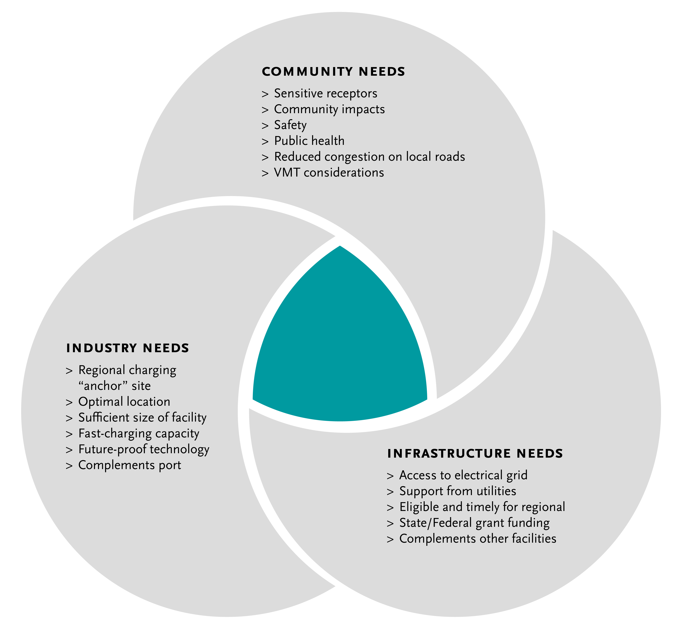
Metro Vision - Regional Zero-Emissions MD/HD Truck Charging Facility/ies
15
Notes:
Michael

Slide 16
Key Findings & Next Steps
Metro Vision for regional ZET charging facilities | Public charging station(s) for use primarily by smaller drayage fleets and independent owner/operators, but accessible for all heavy-duty trucks Origins and destinations within Southern California Port or transload trips that are clustered in the region Multiple trips per day Access needed for midday opportunity charging
Where | West of 710, near ports, or along the Alameda Corridor
Next Steps | Work with local jurisdictions and logistics/real estate professionals to determine land ownership Coordinate with utilities on current capacity and/or where it needs to be added Map out fueling stations in that area to determine where trucks are already filling up Examine existing truck routes and location of sensitive receptors to align charging facility site(s) with community needs Connect with small fleets/drivers to understand their needs, experience, and opportunities Research grant funding opportunities to assist in pursuing next steps
Notes:
Discussion around sensitive receptors
Share preliminary map of receptors and ask what else
Truck route map (caltrans)
Would there be one or more charging facility locations?
Who are the primary users?
Where would the facility/ies potentially be located?
What is the infrastructure needed?

Slide 17
Agenda Item #2:
Los Angeles Cleantech Incubator's (LACI)
Community Project Funding Award for a
Drayage Truck Charging Station
Presentation by: Jack Symington, Senior Program Manager, LACI
Presentation
Discussion
Notes:
Erika

Slide 18
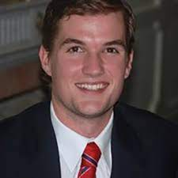

Jack Symington
Senior Program Manager
Los Angeles Cleantech Incubator
Notes:
Michael
Jack Symington
is LACI’s Senior Program Manager for Transportation focusing on goods movement planning and projects while developing the next generation of pilot projects to bring heavy-duty trucking closer to a zero-emission future.
Previously, Jack worked for BYD, managing various CARB and CEC demonstration projects for on-road and off-road heavy-duty battery-electric trucks.
These projects entailed coordinating with utilities across California on infrastructure installation, while also developing deployment strategies to fit fleets’ unique needs.

Slide 19
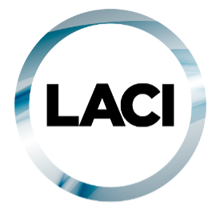
LACI Proposed LB-ELA Corridor Charging Project
LACI submitted a Community Project Funding request for $1.5M to Congresswoman Nanette Barragan (CA-44) in May 2022; awarded January 2023
Outlined role $1.5M can play in catalyzing other regional agencies to fund a $15M truck charging station
Per Community Project Funding guidelines, project must occur on publicly-held land and provide public benefit
Proposed sites are 1519 East I St and 816 N Lansing Ave, Wilmington CA 90744 (either side of East I St. between Alameda St. and Henry Ford Ave)
Project aligns with Metro’s goals for ZE Truck Program Investment
Opportunity to partner on regional collaboration and begin ZE Truck Program investments with small funding commitment ($3M)
19
Notes:
Michael
Public charging will require public investment to amortize capital costs.
Innovative partnerships can unlock value and mitigate risk.
SB 671 must identify barriers and solutions for long-term funding success
Focus on expanding charging opportunities corridor-wide and analyzing long-term benefits of ZE infrastructure for corridor stakeholders
Collaborate with other agencies, community groups, and residents to analyze data and determine how charging locations will receive priority and ensure community benefits will be at the forefront of advancing ZE infrastructure

Slide 20
ZET Program Principles – 1519 East I St, Wilmington CA 90744
1
2
3
4
Maximize leverage of seed funding
$3M ZE Truck Program
$15M Project
4x Leverage (POLA, Federal, Private Sector)
Community Engagement
Identified in LACI 710 Blueprint
Falls within an AB 617 Community; will address with CLC
Corridor Community Benefits Public charging station will benefit smaller operators transition to ZE
Coordination
Working with POLA, LACI, Dept. of Housing and Urban Development, LADWP (potentially MSRC)
5
6
7
8
Workforce Development
Can meet Metro’s local hire requirements; potential to integrate other regional workforce programs into pipeline
Equitable Outcomes
Can determine appropriate metrics to evaluate within Task Force, CLC and working groups
Legislative Platform
Project can identify how to fine-tune CEQA to deploy infrastructure expeditiously while maintaining environmental standards
Expeditious Deployment of Resources
Project can move forward to selecting a private sector operator by year-end. Federal funding catalyzing other partners to action
Notes:
Michael
The Metro Board committed $50 million as seed funding for an I-710 South Zero Emission (ZE) Truck program to support the accelerated deployment of zero-emission trucks and supporting zero-emission infrastructure (October 2021, Motion 16).
The ZET Program Framework and Principles will be used as a guide as Metro seeks to leverage and amplify the $50 million seed funding within the Corridor.
The Principles were developed through collaboration with the 710 Zero-Emission Truck Working Group.
Five major themes were brought forward by the Working Group:
Community engagement
Strategic partnerships and funding opportunities
Legislative and policy initiatives
Truck subsidies
Environmental impacts and equitable outcomes
Community Leadership Committee (CLC) provided input on September 22
Equity Working Group (EWG) providing equity-focused input today, September 29
At the October 18th ZET Working Group Meeting, the ZET Working Group will:
review input from the Equity Working Group
Vote to approve the ZET Program Principles
Review ZET Program Principles with the Task Force
Metro Project Team to present the ZET Principles to the Metro Board of Directors

Slide 21
Metro Vision - Regional Zero-Emissions MD/HD Truck Charging Facility/ies
21
Notes:
Michael
LACI briefed the Community Leadership Committee (CLC) on 3/27 and Equity Working Group (EWG) on 3/30 to gather feedback and answer any questions.
The Zero-Emissions Truck Working Group will hear highlights from input received from the CLC and EWG, and a vote will be taken at its April meeting on 4/18.
The Task Force will consider the ZET Working Group recommendation at its May meeting on 5/8.
The Board will be asked to consider the Task Force recommendation on the LACI funding request at the May Metro Board Meeting.

Slide 22
Agenda Item #3:
Mobile Source Reduction Committee RFI Results
Presentation by: Akiko Yamagami,
Transportation Planning Manager, Metro
Presentation
Discussion
Notes:
Erika
The MSRC is seeking willing partners to help facilitate investment in publicly accessible infrastructure to support an equitable transition of goods movement trucks to zero emissions. A key objective of this Request for Information is the identification of locations where the MSRC could make Clean Transportation Funding investments in publicly accessible infrastructure.

Slide 23
RFI for Zero-Emission Infrastructure to Support Goods Movement
Summary
23 responses submitted on November 30, 2022
Metro expressed our interest to partner with MSRC to support promising proposals within the 710 Corridor.
Some responses include multiple sites.
Not all responses are located within the 710 Corridor.
Metro identified total 18 sites within the Corridor.
Metro’s initial evaluation criteria
The proposed project is located within the 710 Corridor.
The target customers are heavy-duty trucks.
The project includes committed site(s) for charging or refueling.
The project aligns with the 710 ZET Program Principles.
23

Slide 24
RFI for Zero-Emission Infrastructure to Support Goods Movement
 | City | # of Chargers | Electric Energy Range | # of Hydrogen Dispensers | Total Project Cost ($ in millions) | MSRC Fund Requested ($ in millions) | Possible Metro Contribution ($ in millions) | Completion Date
1 | Commerce |  |  |  |  | N.S.
2 | Compton |  |  |  |  | N.S.
3 | Compton | 25 | 150 kW | 0 | $ 2.5 | N.S. | $ 0.5
4 | Existing Truck Stops | 0 | N/A | 2 | $ 10.0 | $ 2.0 | $ 2.0 | Q4 2024
5 | Long Beach | 54 | 360 kW | 0 | $ 9.3 | N.S. | $ 1.9 | 1 Yr from the start of Engineering and Permitting
6 | Long Beach | 30 | 350 kW | 0 | $ 9.7 | N.S. | $ 1.9 | Q2 2024
7 | Long Beach | 4 | 360 kW and MCS | 0 | $ 5.4 | N.S. | $ 1.1 | Dec-24
8 | Long Beach | 31 | 180 kW & 350 kW | 0 | $ 12.9 | $ 13.9 | $ 2.6 | Q2 2024
9 | Long Beach | TBD |  |  |  | N.S.
10 | Los Angeles | TBD |  |  |  | N.S.
11 | Los Angeles | TBD |  |  |  | N.S.
12 | Los Angeles | 5 | 350 kW | 0 | $ 2.7 | $ 0.3 | $ 0.5 | Q3 2024
13 | Rancho Dominguez | 40 | 175 kW | 0 | $ 39.0 | $ 20.0 | $ 7.8 | Q2 2024
14 | Vernon | 12 | 360 kW | 0 | $ 13.9 | N.S. | $ 2.8 | 1 Yr from the start of Engineering and Permitting
15 | Vernon | 29 | 180 kW | 0 | $ 29.0 | $ 16.8 | $ 5.8 | Q2 2024
16 | Vernon | 5 | 350 kW | 0 | $ 2.7 | $ 0.3 | $ 0.5 | Q3 2024
17 | Wilmington/Los Angeles | 6 | 350 kW | 0 | $ 4.2 | N.S. | $ 0.8 | Dec-23
18 | Wilmington/Los Angeles |  |  |  |  | N.S.
 |  | 241 |  | 2 | $ 141.3 |  | $ 28.3
24
N.S.: Not specified in the application
Notes:
While we need to get more inforamtion through MSRC to fully populate this table, with the given information, we know that there could be 241 HD truck chargers and 2 hydrogen dispensers planned in the next couple of years.
There is one proposal with hydrogen fueling service, but this proposal is focused on providing the service, and they’d need to work with existing truck stops within the corridor to install hydrogen dispensers.
Not all proposals specified how much funding they are seeking from MSRC.
Applying the 1:4 leveraging ratio and given the estimated total cost of the proposed projects of $141.3 million, Metro’s potential seed funding contribution could be $28.3 million.
Site 13 & 15 are in the process of acquiring the land, and it may take longer than estimated to have the project commercially available.

Slide 25
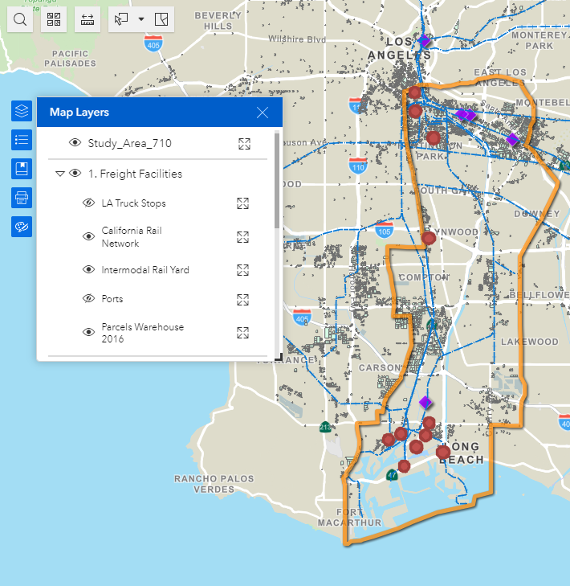
RFI for Zero-Emission Infrastructure to Support Goods Movement
Mapping of 11 sites with known addresses
Several sites are within the Port owned properties
Two major clusters; near the ports and northern end of the 710 Corridor
Need to work through MSRC to get addresses of unidentified sites
25

Slide 26
RFI for Zero-Emission Infrastructure to Support Goods Movement
Preliminary evaluation against the ZET Program Principles
 | City | 1. Maximizing leverage of seed funding | 2. Community Engagement | 3. Corridor Community Benefits | 4. Coordination | 5. Workforce Development | 6. Equitable Outcomes | 7. Legislative Platform | 8. Expeditious Deployment of Resources
1 | Commerce |  | X |  | X | X | Vehicle Pool
2 | Compton |  | X |  | X | X | Vehicle Pool
3 | Compton
4 | Existing Truck Stops |  | Coordinates through Coalition for Clean Air and Breathe SoCal |  | X |  |  |  | X
5 | Long Beach |  | X |  | X | X | Vehicle Pool |  | X
6 | Long Beach |  |  |  | X |  |  |  | X
7 | Long Beach |  |  |  | X | X | Truck-as-a-Service |  | X
8 | Long Beach |  |  |  | X |  | Long-term vehicle lease |  | X
9 | Long Beach |  |  |  | X
26
Notes:
Because these proposals were prepared to respond to MSRC’s RFI, they didn’t necessarily discuss extensively on how they envision conducting activities that align with the 710 ZET Program Principals.
Particularly with principle 2, 3, 5, 6, and 7.
For proposals that did not discuss expected project completion, we need more information, but for now, they are considered not meeting principle 8.
(principle 6) All sites are proposed to be publicly accessible to offer both opportunity and domicile charging to small businesses who may face challenges locating reliable charging sites.

Slide 27
RFI for Zero-Emission Infrastructure to Support Goods Movement
Preliminary evaluation against the ZET Program Principles
 | City | 1. Maximizing leverage of seed funding | 2. Community Engagement | 3. Corridor Community Benefits | 4. Coordination | 5. Workforce Development | 6. Equitable Outcomes | 7. Legislative Platform | 8. Expeditious Deployment of Resources
10 | Los Angeles |  |  |  | X
11 | Los Angeles |  |  |  | X
12 | Los Angeles |  |  |  | X |  | Fleet Rental |  | X
13 | Rancho Domingues |  |  |  |  |  |  |  | X
14 | Vernon |  | X |  | X | X |  |  | X
15 | Vernon |  |  |  |  |  |  |  | X
16 | Vernon |  |  |  | X |  | Fleet Rental |  | X
17 | Wilmington/LA |  |  |  | X |  |  |  | X
18 | Wilmington/LA
27

Slide 28
RFI for Zero-Emission Infrastructure to Support Goods Movement
Next Steps
Work through MSRC to get more information on proposed projects to determine their alignment with the 710 ZET Program Principles
Open to working with Metro to conduct community engagement and education?
Flexibility in incorporating surrounding community desires and addressing their concerns related to the project(s)?
Open to setting a reasonable local hiring target for the project(s)?
Verify the reasonableness of their proposed schedule based on CEQA and permitting process
Verify the reasonableness of their proposed energy reliability
28
Notes:
Because these proposals were prepared to respond to MSRC’s RFI, they didn’t necessarily discuss extensively on how they envision conducting activities that align with the 710 ZET Program Principals.
Particularly, we are interested in their willingness and desire to address
Community engagement activities to draw out community concerns and desires, i.e., mitigating localize traffic, noise, safety, project related job opportunities, etc.
Incorporating community benefits, i.e., community desires, in the project design
Their thoughts on incorporating workforce investments and training to benefit surrounding communities

Slide 29
Agenda Item #4:
First to Last Mile: Creating an Integrated Goods Movement Charging Network around the I-710 Corridor
Presentation by: Jack Symington, Senior Program Manager, Los Angeles Cleantech Incubator (LACI)
Presentation
Task Force Discussion
Notes:
Erika

Slide 30
LACI has an announced Dept. of Energy award with LB-ELA Task Force Partners
TITLE: First to Last Mile: Creating an Integrated Goods Movement Charging Network around the I-710 Corridor
Objectives:
Create a plan for innovative infrastructure solutions at industrial facilities and commercial zones along critical freight arteries feeding into I-710 freeway.
Identify existing goods movement real estate assets (e.g. ports, warehouses, distribution centers, retail locations) to provide charging for different M/HD fleets that can expand the proportion of duty cycles completed by a battery-electric truck
Prepare local city governments to most effectively and efficiently site and permit the needed charging infrastructure.
Evaluate different charging form factors that can meet the needs of medium- and heavy-duty vehicles and integrate into a range of properties.
Leverage learnings from CEC-funded I-710 Blueprint and Zero Emission Delivery Zone pilots
*Metro will be a participant in Energy Services and Community Advisory Groups (led by Gateway Cities COG)*
Amount: $688,000 (w/ funded partners UC Riverside, CEHAJ Gateway Cities COG)
Timeline: 24 months (beginning Q3 2023)
Supporting Partners:
bp pulse fleet
City of LA / LA Clean Cities Coalition
Dependable Highway Express
Electrify America
IKEA
LADWP
Metro
Shell Recharge Solutions
SE LA Workforce Development Board
SCE
Volvo
Walmart
Wave
4Gen Logistics
30
Notes:
Jack
Funding will be used to develop a detailed regional investment plan for innovative infrastructure solutions at industrial facilities and commercial zones along critical freight arteries feeding into I-710 freeway.
This plan will
Leverage existing goods movement real estate assets (e.g. ports, warehouses, distribution centers, retail locations) to provide charging for different supply chain fleets
Prepare local city governments to most effectively and efficiently site and permit the needed charging infrastructure.
Be shared with energy service providers and investors looking to lay the foundation for battery powered electric trucks in Southern California.

Slide 31
Closing Remarks and Next Steps
Notes:
Michael
METRO NEXT STEPS
Protocols for vetting proposals – leveraging of funds
Legislative calendar (Norm Emerson-GCCOG), roadmap-applications-timelines
Additional Technical Support-in addition to Akiko
IMMEDIATE NEXT STEPS
--Slides and Confirmation- Jack Symington-LACI-slides (Susan)-SEPTEMBER
-Refine principles slides in presentation-CEHAJ Letter (Trey)-COMPLETE-draft response
-Michael-Fernando-Susan-Mtg re CEHAJ letter
-Tasks Worksheet Update (Susan has an example)
Agenda Item #6-focused discussions
Submit TCEP application, develop grant application
Finalize $5MM TA expertise
Local hiring policy
Erika
Difference between things we generate and things we are a part of
How do we get the $200 m
How do we use Metros’ unique position in the county
How do we create our own program?
How do we respond to other programs that want to partner with us?
How do we create technical expertise- to develop this program
Technical working group?
Keep to ourselves?
We need to develop our community outreach discussion-formalize it
Have plan in place
Advanced work in outreach
AQMD=scope
COMMUNITY EDUCATION
Akiko-Watson Land-realities of developing infrastructure
rika

Slide 32
You're Invited!
Interagency Transportation Equity Advisory Committee Meeting - Tuesday, March 21, 1pm
Los Angeles County Metropolitan Transportation Authority Board Room One Gateway Plaza Los Angeles, CA 90012
Agenda and In-Person/Virtual Meeting information here
UCLA Institute of Transportation Studies Reception - Tuesday, March 21, 4:30pm
Homebound Brew Haus at Union Station 800 North Alameda Street Los Angeles, CA 90012
California Transportation Committee Meeting - Wednesday, March 22, 1pm; Thursday, March 23, 9am
Los Angeles Union Station Ticket Concourse 800 North Alameda Street Los Angeles, CA 90012
Agenda and In-Person/Virtual Meeting information here
Notes:
Dr. Joe Lyou, California Transportation Commissioner and Task Force Member, cordially invites Task Force and Community Leadership Committee Members to the upcoming California Transportation Commission (CTC) meeting and events that are taking place at LA Metro and Union Station, including:
The first-ever meeting of the Interagency Transportation Equity Advisory Committee (Committee). This Committee is a priority for the California Transportation Commission (Commission), California State Transportation Agency (CalSTA), and the California Department of Transportation (Caltrans) and is intended to elevate diverse and historically marginalized voices to advise these agencies on how to achieve meaningful outcomes in transportation equity, environmental justice, and equitable economic opportunities, especially as related to transportation planning and programming.
Join the California Transportation Commission to understand the issues discussed and how transportation projects move forward at CTC.

Slide 33
Upcoming Meetings and Project Information
Community Leadership Committee Meeting
Meeting #13 & 13.5
Thursday, March 23, 5-7pm
Monday, March 27, 5-7pm
Task Force Meeting
Task Force Meeting #19
Monday, April 10, 5-7pm
Working Group Meetings
Equity Working Group #11 Thursday, March 30, 5-7pm
Zero-Emissions Truck Working Group #15 Tuesday, April 18, 1-3pm
For the most updated list
of meeting dates, please visit http://www.metro.net/710-hub
Notes:
Erika
Our Lady of Guadalupe Day is celebrated on December 12 every year. The day has been declared a national holiday in Mexico. Devotees honor the day when Virgin Mary made an appearance to a young man on this day in 1531.

Slide 34

Stay connected to this project
Michael Cano
Executive Officer
Countywide Planning & Development
LA Metro
One Gateway Plaza, MS 99-13-1 Los Angeles, CA 90012
213.418.3010 W
213.305.0423 C
710corridor@metro.net
https://www.metro.net/projects/lb-ela-corridor-plan/
@metrolosangeles
losangelesmetro
Notes:
Erika

Slide 35
Thank you!
Notes:
Erika

