Slide 1
We will begin in a few moments.
LB-ELA Task Force
Zero-Emission Truck Working Group
Meeting #12
January 17, 2022
Notes:
Erika

Slide 2
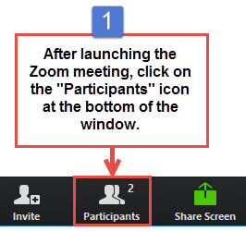
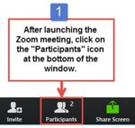
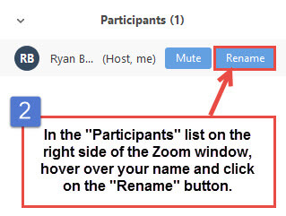
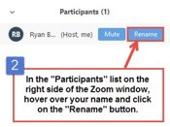


Task Force and CLC Member Identification
Identificación de miembros del Comité Consultivo y CLC
Task Force and CLC Members, please change your Zoom screen name to include: Name and Organization/Jurisdiction
Miembros del Comité Consultivo y del CLC, por favor cambie su nombre de pantalla de Zoom para incluir: Nombre y su organización
Notes:
Erika

Slide 3

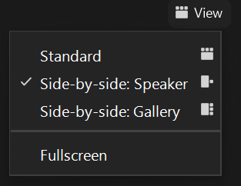
Turn on Camera / Prende la cámara
To start and stop your video, click the camera icon at the bottom left of your control panel
Para iniciar y detener su video, haga clic en el ícono de la cámara en la parte inferior izquierda de su panel de control
To switch between views during the meeting click or tap on Standard, Side-by-side Speaker View, and Side-by-side Gallery View at the top right corner of your zoom screen
Para cambiar entre vistas durante la reunión, haga clic o toque Estándar, Vista de orador en paralelo y Vista de Galería en Paralelo en la esquina superior derecha de la pantalla de zoom
Notes:
ERIKA

Slide 4

Logistics/Logística
Click Interpretation to choose your language.
To hear the interpreted language only, click Mute Original Audio (Optional).
Change your Zoom screen name to include name, CLC, jurisdiction.
Click Raise Hand in your meeting controls, Press*9 on the phone line, or raise your hand physically.
To lower your hand, click Raise Hand in your meeting controls.
The Q&A button is located on the control panel at the bottom of your screen.
To mute and unmute, click the microphone icon on the bottom left of your control panel.
To start and stop your video, click the camera icon at the bottom left of your control panel.
Technology & interpretation support: 323.609.3345
Haga clic en Interpretación para elegir su idioma.
Para escuchar solo el idioma interpretado, haga clic en “Mute Original Audio” o “Silenciar audio original” (Opcional)
Por favor cambien su nombre de pantalla de Zoom para incluir: Su nombre, CLC, la jurisdicción que representan
Haga clic en “Raise Hand” o “Levantar la mano” en los controles de la reunión, presione *9 en la línea telefónica, o levante la mano físicamente.
Para bajar la mano, haga clic en “Raise Hand” o “Levantar la mano” en los controles de la reunión.
El botón Q&A se encuentra en el panel de control en la parte inferior de la pantalla.
Para silenciar y cancelar el silencio, haga clic en el icono del micrófono en la parte inferior izquierda de su panel de control.
Para iniciar y detener su video, haga clic en el icono de la cámara en la parte inferior izquierda de su panel de control.
Apoyo de tecnología y de interpretación en español 323.609.3345​
Notes:
Laura

Slide 5
Detailed Agenda
1:00pm 1:05pm | Welcome, Agenda Review, and Purpose of the Zero-Emission Truck Working Group Agenda Item #1: Metro Update (10 minutes)
1:15pm | Agenda Item #2: Background Presentations (60 minutes) Truck Market Segmentation Volumes by Type Presentation by Keir Opie, Principal, Cambridge Systematics Presentation (10 minutes) Questions (5 minutes) Potential Locations for MD HD Truck Charging Facilities Presentation by Jack Symington, Senior Program Manager Transportation, Los Angeles Cleantech Incubator Presentation (10 minutes) Questions (5 minutes) Expeditious Deployment of Resources –State and Federal Grants Presentation by Kayla Giese, SB 671 Assessment Coordinator, California Transportation Commission Presentation (10 minutes) Questions (5 minutes) Discussion (15 minutes)
2:15pm 2:30pm 2:55pm 3:00pm | Agenda Item #3: ZET Program – Community Needs Jack Symington, Senior Program Manager, Transportation, Los Angeles Cleantech Incubator CEHAJ Participants in LACI Blueprint Project Overview (5 minutes) Facilitated Discussion (10 minutes) Agenda Item #4: Metro’s Sustainability and Transportation Electrification Policies Cris Liban, Chief Sustainability Officer, LA Metro Overview (Video) Discussion Closing Remarks and Upcoming Meetings Adjournment

Slide 6
We will begin in a few moments.
LB-ELA Task Force
Zero-Emission Truck Working Group
Meeting #12
January 17, 2022
Notes:
Erika

Slide 7

Facilitator
Erika C.B. Morales
Partner, Morales + Morales Partners
Notes:
Erika

Slide 8
Welcome, Agenda Review, and Purpose
of the
Long Beach-East LA Corridor Zero-Emission Truck (ZET)
Working Group
Notes:
ERIKA

Slide 9
Detailed Agenda
1:00pm 1:05pm | Welcome, Agenda Review, and Purpose of the Zero-Emission Truck Working Group Agenda Item #1: Metro Update (10 minutes)
1:15pm | Agenda Item #2: Background Presentations (60 minutes) Truck Market Segmentation Volumes by Type Presentation by Keir Opie, Principal, Cambridge Systematics Presentation (10 minutes) Questions (5 minutes) Potential Locations for MD HD Truck Charging Facilities Presentation by Jack Symington, Senior Program Manager Transportation, Los Angeles Cleantech Incubator Presentation (10 minutes) Questions (5 minutes) Expeditious Deployment of Resources –State and Federal Grants Presentation by Kayla Giese, SB 671 Assessment Coordinator, California Transportation Commission Presentation (10 minutes) Questions (5 minutes) Discussion (15 minutes)
2:15pm 2:30pm 2:55pm 3:00pm | Agenda Item #3: ZET Program – Community Needs Jack Symington, Senior Program Manager, Transportation, Los Angeles Cleantech Incubator CEHAJ Participants in LACI Blueprint Project Overview (5 minutes) Facilitated Discussion (10 minutes) Agenda Item #4: Metro’s Sustainability and Transportation Electrification Policies Cris Liban, Chief Sustainability Officer, LA Metro Overview (Video) Discussion Closing Remarks and Upcoming Meetings Adjournment

Slide 10
Meeting Objectives
During this meeting, the working group will:
Receive presentations on:
  Truck Market Segmentation Volumes by Type
  Potential Locations for MD HD Truck Charging Facilities
  SB 671 Update
Discuss Community Concerns about Siting of Charging Facilities
Discuss potential evaluation criteria and performance measures, and metrics for evaluating equity for the Long Beach-East Los Angeles Corridor ZE Truck Program
Notes:
KeAndra

Slide 11
Agenda Item #1:
Metro Update
Notes:
ERIKA

Slide 12
ZET Program Recap – Metro Board Direction
Metro Board Direction and desired outcomes
$200 million minimum funding target
Leverage $50 million local matches with private, regional, state, and federal funding
Accelerated ZE deployment in the I-710 South (now Long Beach-East LA) Corridor
Collaboration with regional stakeholders
Independent, accelerated process from overall 710 (LB-ELA) Task Force Investment Plan process
Strategies to accomplish outcomes
Identify discretionary grant opportunities
Convene and collaborate with community and regional stakeholders
Develop a scope of work for the ZET Program
Identify regional funding partners
Identify near and long-term opportunities
Identify policy and legislative barriers to implementation
Notes:
Michael

Slide 13
ZET Meeting #11 Recap
Summary
Held virtually via Zoom on Tuesday October 18, 2022
28 participants (25 Task Force Members/Alternates, 3 CLC members)
Highlights
Vote to approve the ZET Principles
Receive presentations and engage in discussion on the following topics:
ZET related Multimodal Strategies, Projects, and Programs
Federal Transportation Legislation – Inflation Reduction Act
Publicity Accessible Goods Movement Zero-Emissions Infrastructure – MSRC Request for Information
13
Notes:
Michael

Slide 14
ZET Program Principles – Overview
1
2
3
4
Maximize leverage of seed funding
by collaborating with regional partners and funding agencies.
Community Engagement
that centers corridor residents and stakeholders throughout the development process.
Corridor Community Benefits
by creating economic opportunities, improving air quality, and reducing long-standing health impacts generated by diesel trucks.
Coordination
with regional and funding partners, government agencies, and key stakeholders.
5
6
7
8
Workforce Development
that ensures community benefits and access to opportunity through the
pursuit and implementation of ZE Technology.
Equitable Outcomes
ensured by performance metrics that evaluate sustainable outcomes.
Legislative Platform
designed to support the accelerated, equitable deployment of ZE technology by reducing barriers and increasing incentives to adoption.
Expeditious Deployment of Resources
to maximize the buying power and benefit of investment while supporting community engagement and effective outreach.
Notes:
Michael
The Metro Board committed $50 million as seed funding for an I-710 South Zero Emission (ZE) Truck program to support the accelerated deployment of zero-emission trucks and supporting zero-emission infrastructure (October 2021, Motion 16).
The ZET Program Framework and Principles will be used as a guide as Metro seeks to leverage and amplify the $50 million seed funding within the Corridor.
The Principles were developed through collaboration with the 710 Zero-Emission Truck Working Group.
Five major themes were brought forward by the Working Group:
Community engagement
Strategic partnerships and funding opportunities
Legislative and policy initiatives
Truck subsidies
Environmental impacts and equitable outcomes
Community Leadership Committee (CLC) provided input on September 22
Equity Working Group (EWG) providing equity-focused input today, September 29
At the October 18th ZET Working Group Meeting, the ZET Working Group will:
review input from the Equity Working Group
Vote to approve the ZET Program Principles
Review ZET Program Principles with the Task Force
Metro Project Team to present the ZET Principles to the Metro Board of Directors

Slide 15
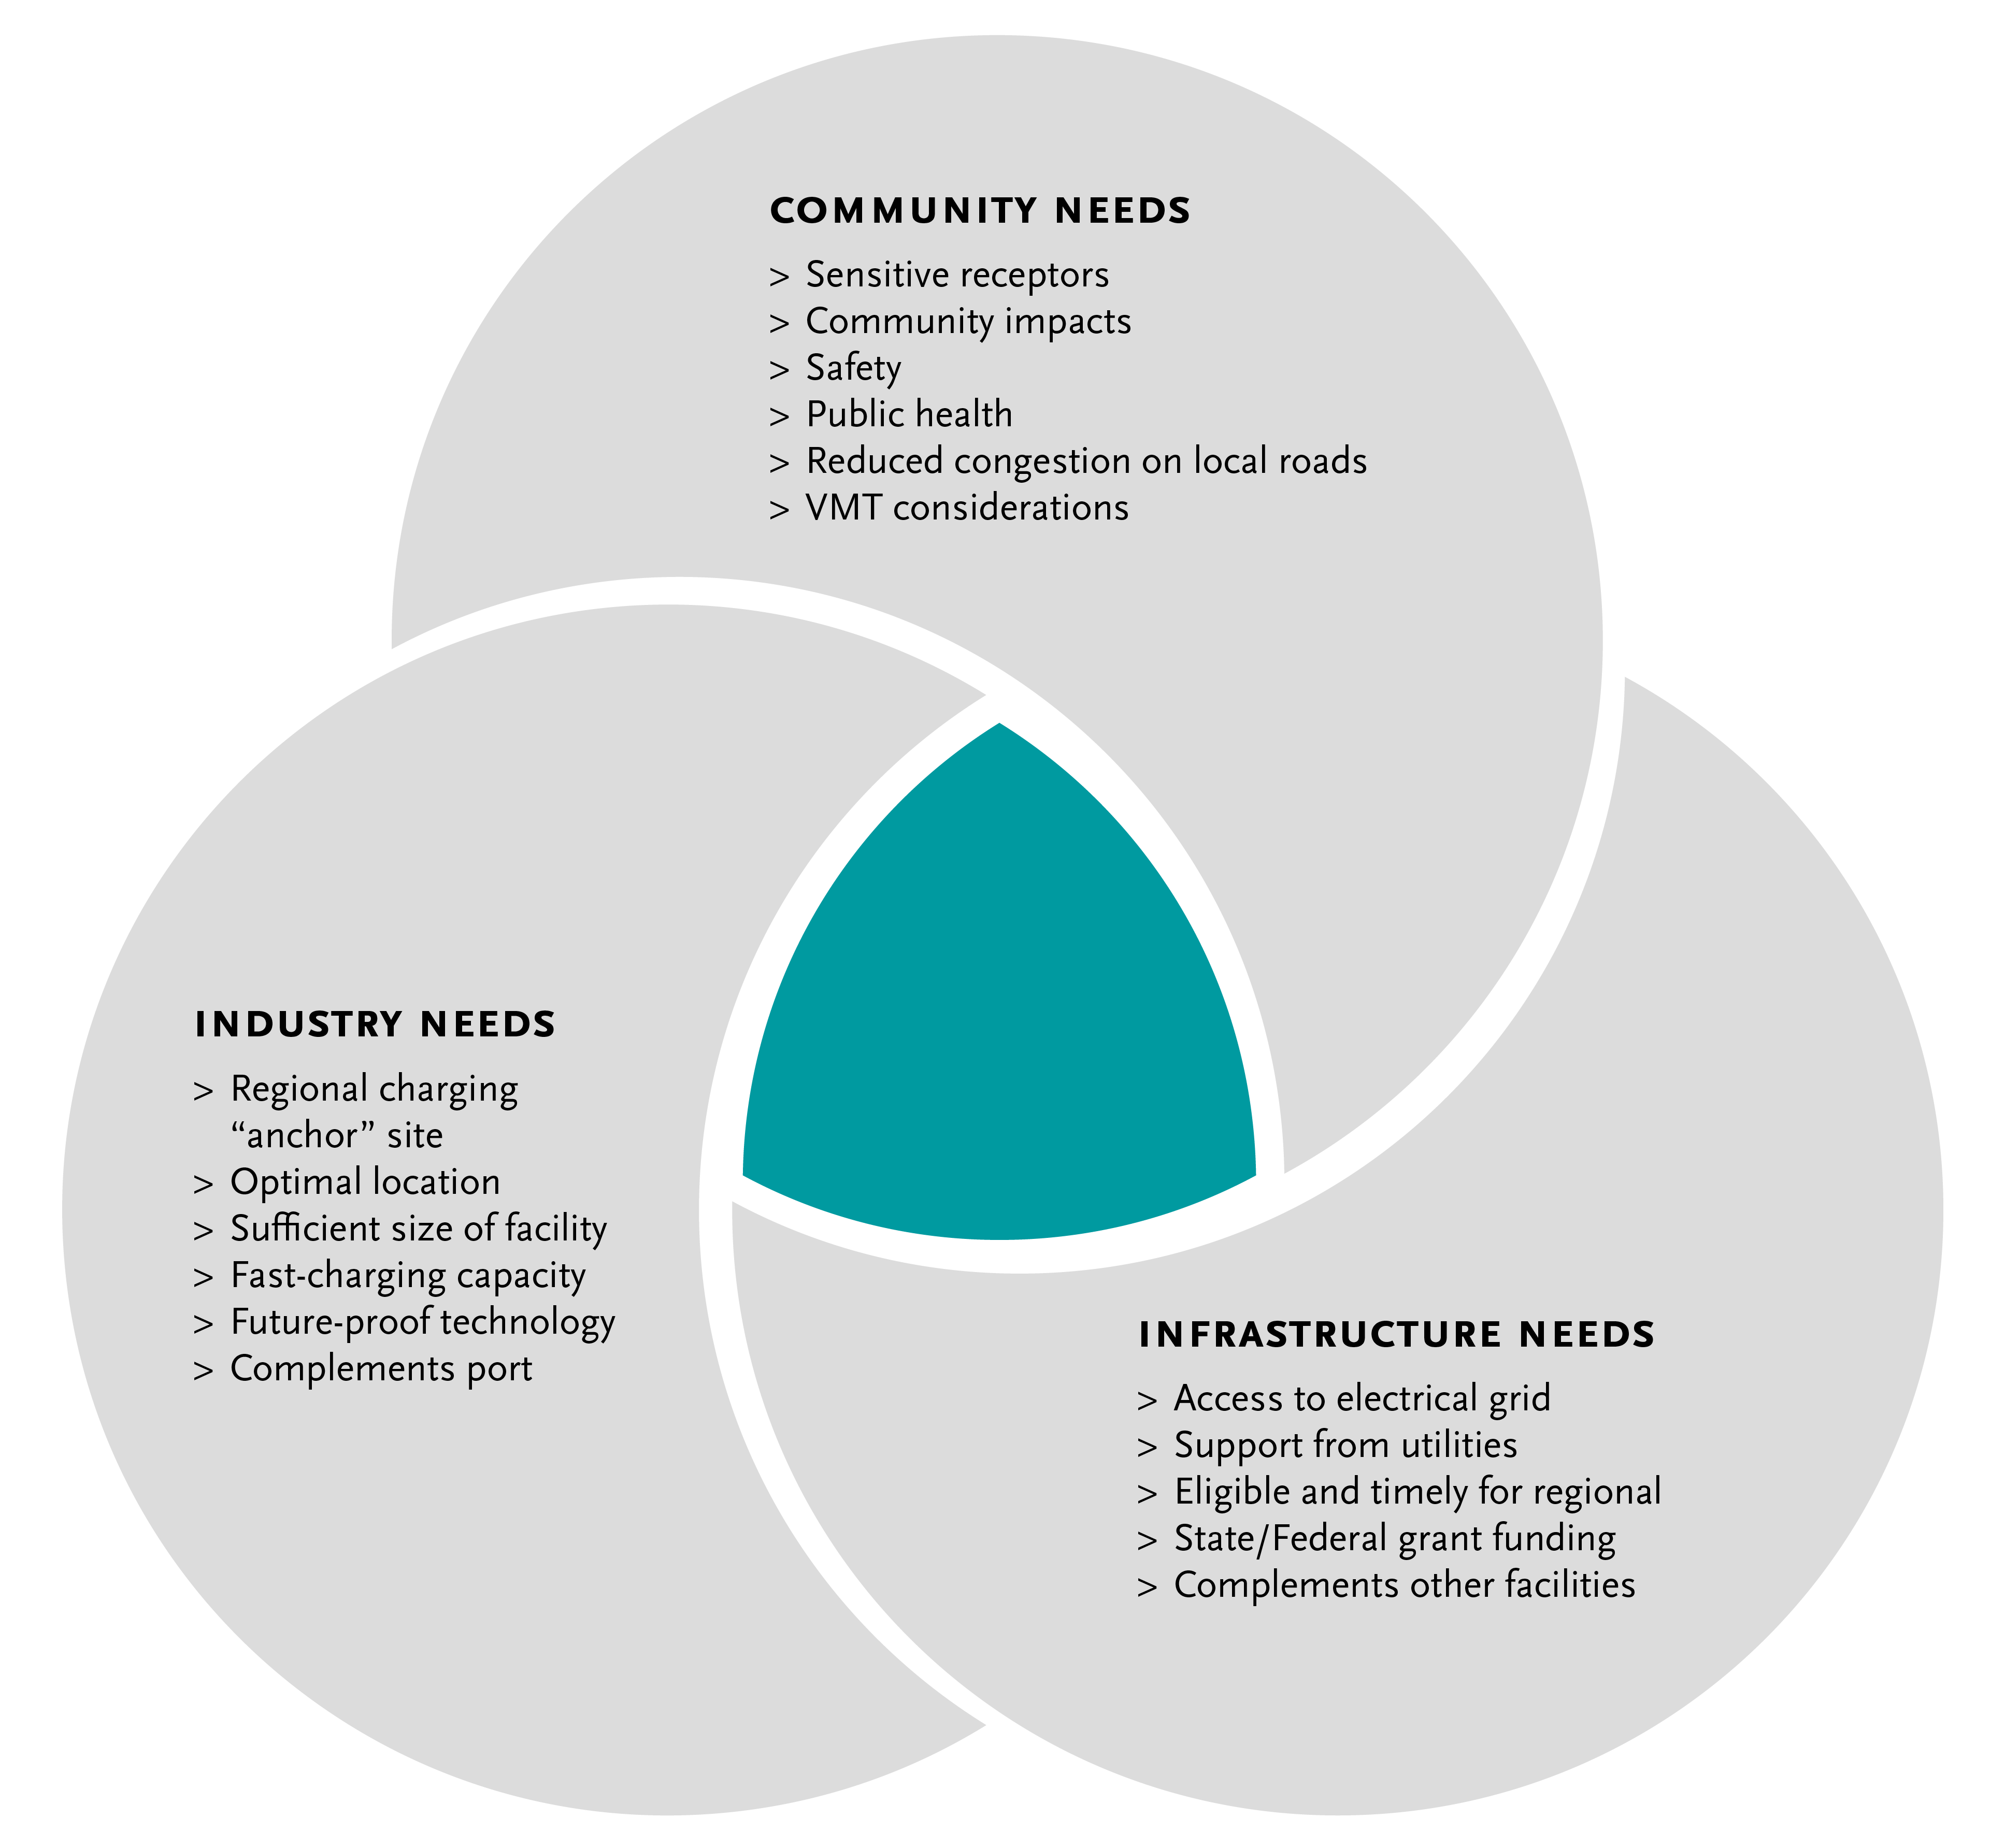
Metro Vision -
Regional Zero-Emissions MD/HD Truck Charging Facility
15
Notes:
Michael

Slide 16
Agenda Item #2:
Background Presentations
Truck Market Segmentation Volumes by Type
Keir Opie, Principal, Cambridge Systematics
Presentation (10 minutes)
Discussion (10 minutes)
Notes:
Michael

Slide 17

Presenter
Keir Opie
Principal
Cambridge Systematics
Notes:
Michael
Keir Opie, Principal with Cambridge Systematics, shares a data-driven look at the trip origin and destination patterns, trip purposes, trip lengths, and trip end densities throughout the corridor, as well as additional information regarding transit travel and a focus on travel patterns of residents of areas identified by Metro as equity focus communities. The presentation "Long Beach to East Los Angeles Corridor Trip Characteristics" is intended to help define the existing conditions of travel in the corridor and help lay the groundwork to evaluate the impacts of potential future improvement projects for the corridor.

Slide 18
Types of Truck Trips in the
Long Beach – East Los Angeles Corridor
Port-Related Truck Trips
  Port Primary Truck Trips - Containers
    Trips with origin or destination at the ports
    Includes trips to/from near and off-dock railyards, transload facilities and other warehouses or distribution centers
  Port Non-Container Truck Trips* (e.g., car carriers, bulk products, specialized cargo)
Non-Port Truck Trips
  Port Secondary Transload Truck Trips
  (from warehouses to railyards and other warehouses)
  Domestic Intermodal Trips (to/from railyards)
  All other truck trips such as deliveries to office, retail and home

Slide 19
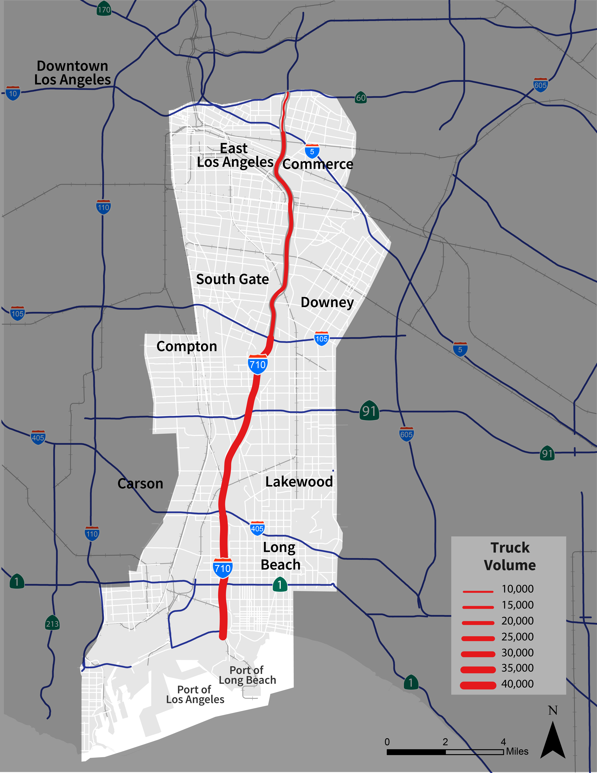
I-710 Freeway Truck Volumes
Substantially heavier truck volumes occur at southern end of corridor, near the Ports with nearly 40,000 daily heavy-duty trucks
Truck volume and truck percentage is extremely high south of SR-91 as compared to typical freeways
I-710 Mainline location: | Daily Trucks | Port Truck %
Bet. SR60 & I-10 | 10,000 | 10%
Bet. I-5 & SR60 | 15,000 | 13%
Bet. I-105 & I-5 | 19,000 | 32%
Bet. SR91 & I-105 | 34,000 | 53%
Bet. I-405 & SR91 | 35,000 | 69%
South of I-405 | 39,000 | 85%

Slide 20
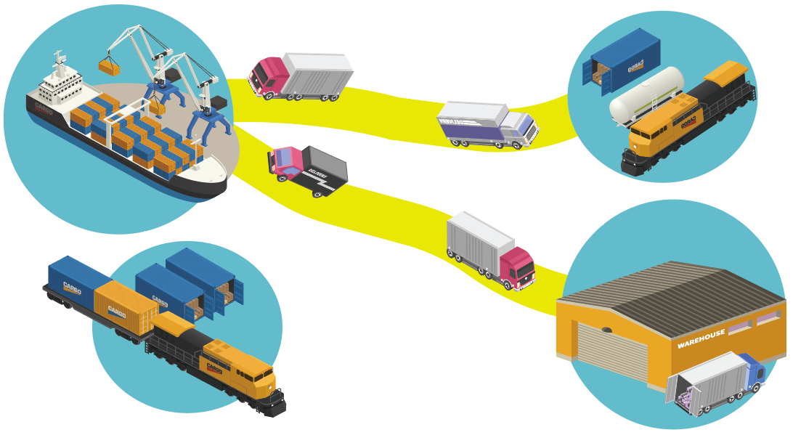





Port Primary Container Truck Trips
Near-Dock (< 5 miles)
and Off-Dock Railyards
On-Dock Rail*
(no truck trips)
Inland Point Intermodal*
Truck trips
*Inland Point Intermodal (IPI)
the movement of “intact” marine containers by rail
Warehouse, Transload Facility, or other destination

Slide 21
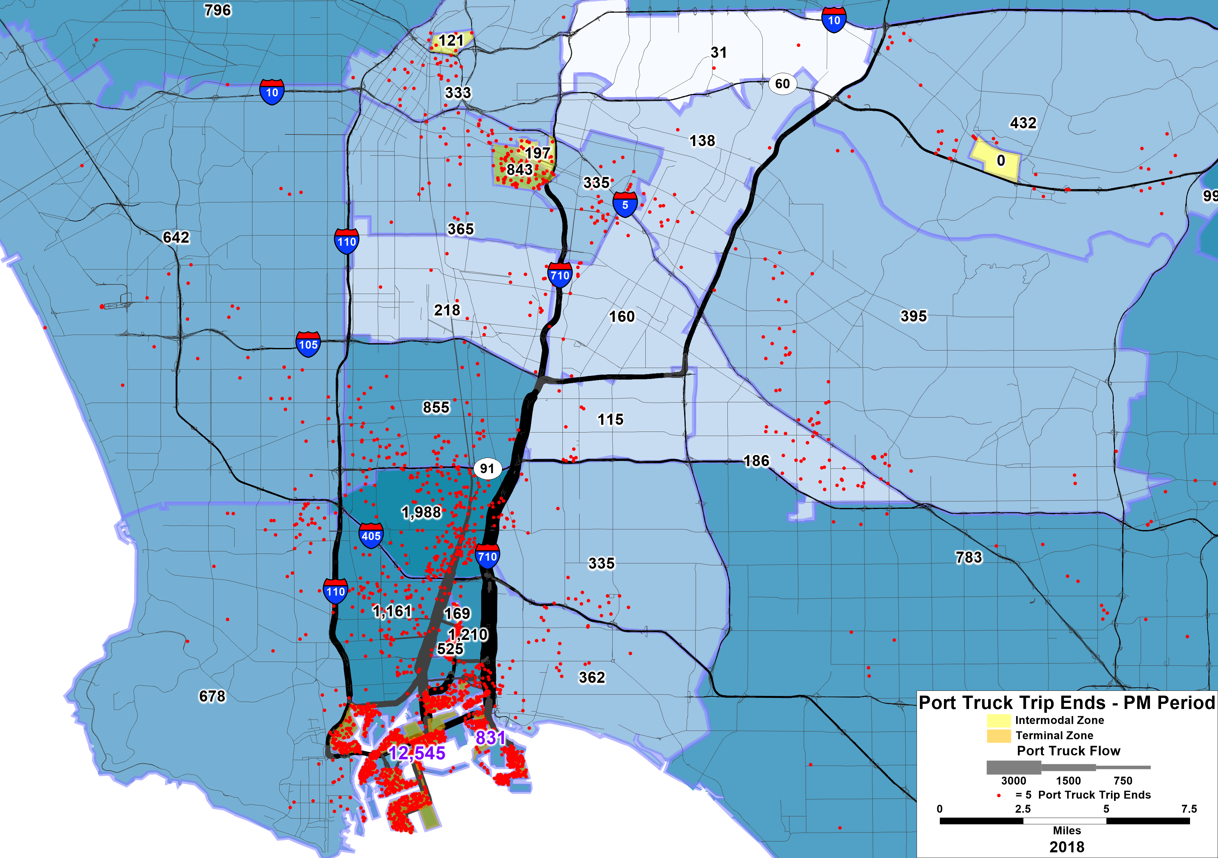
Port Truck Trip Patterns (PM Period)
Preliminary Working Document. Subject to Change.

Slide 22
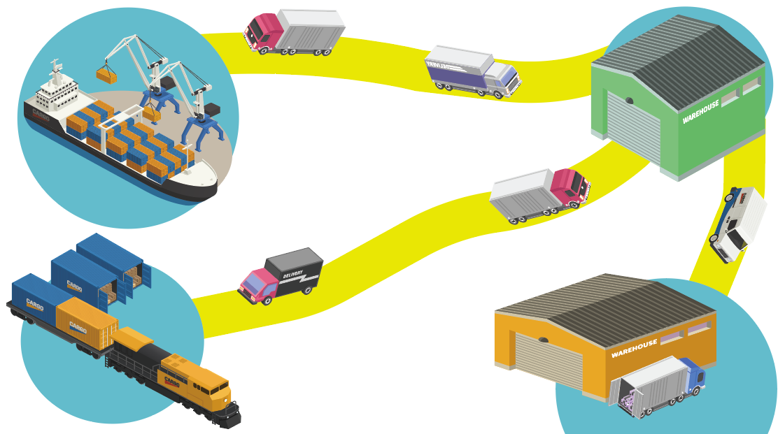

Transload (Secondary) Truck Trips
Transload Facility
Port Primary
Truck Trips
Secondary Truck Trips
Transload to Truck
Secondary Truck Trips Transload to Rail
Off-dock Railyard
Warehouse or
Distribution Center

Slide 23
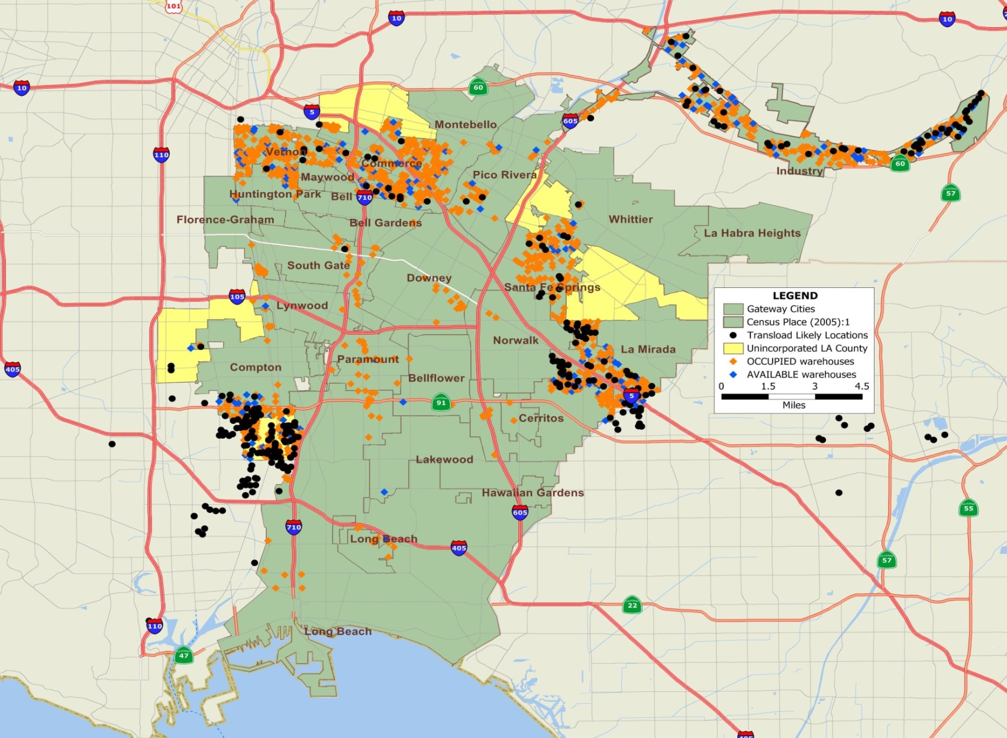
Warehouse and Transload Locations
Warehouses (orange and blue dots) and
Transload Facilities (black dots)

Slide 24
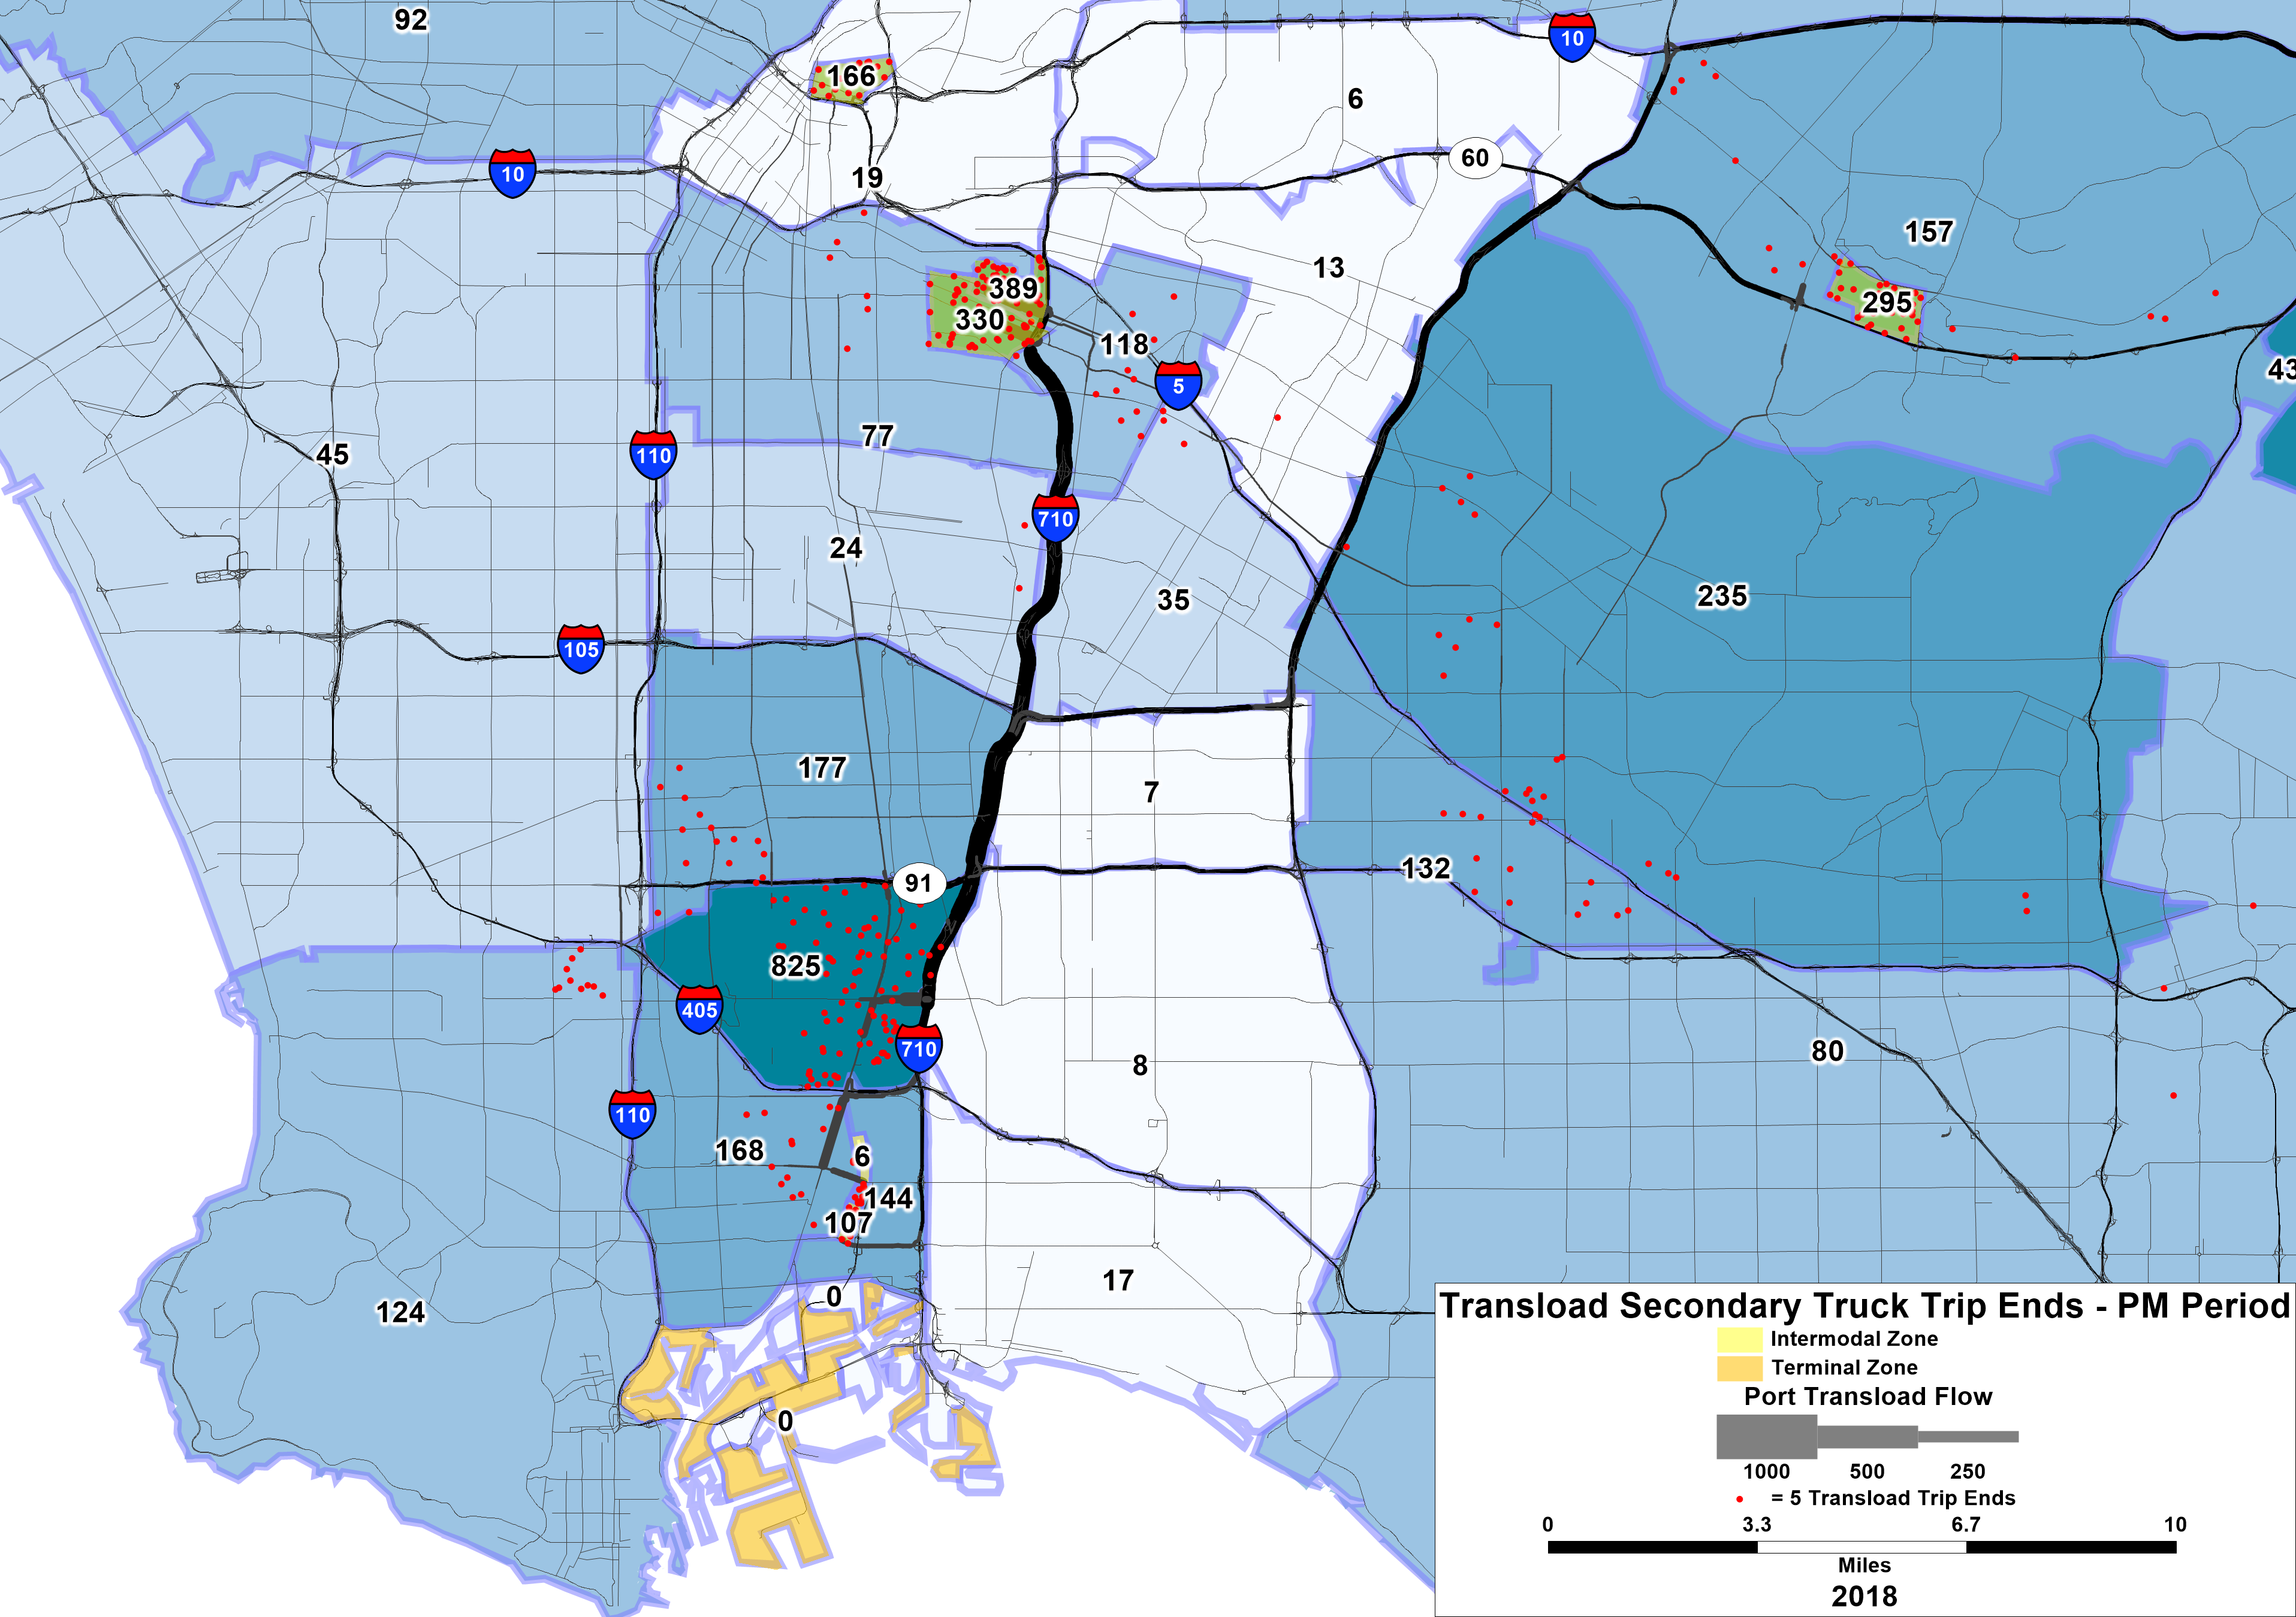
Transload Secondary Truck Trips

Slide 25
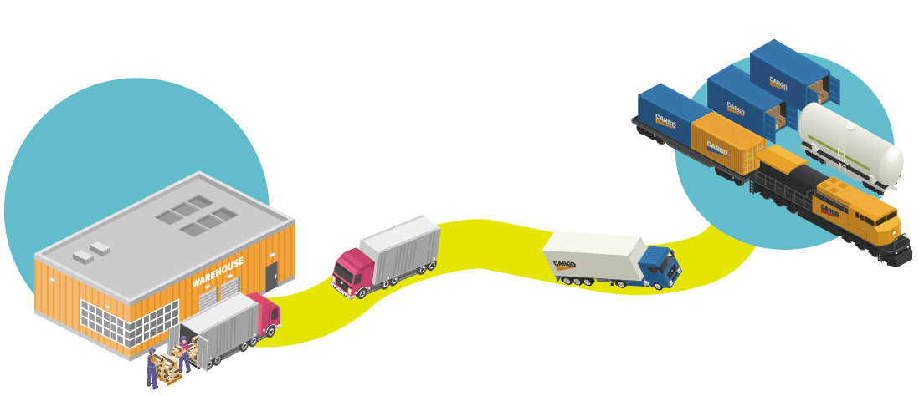
Domestic Intermodal Truck Trips
(Not Directly Port-Related)
Intermodal Railyard (Off-Dock)
Warehouse, manufacturing, etc.

Slide 26
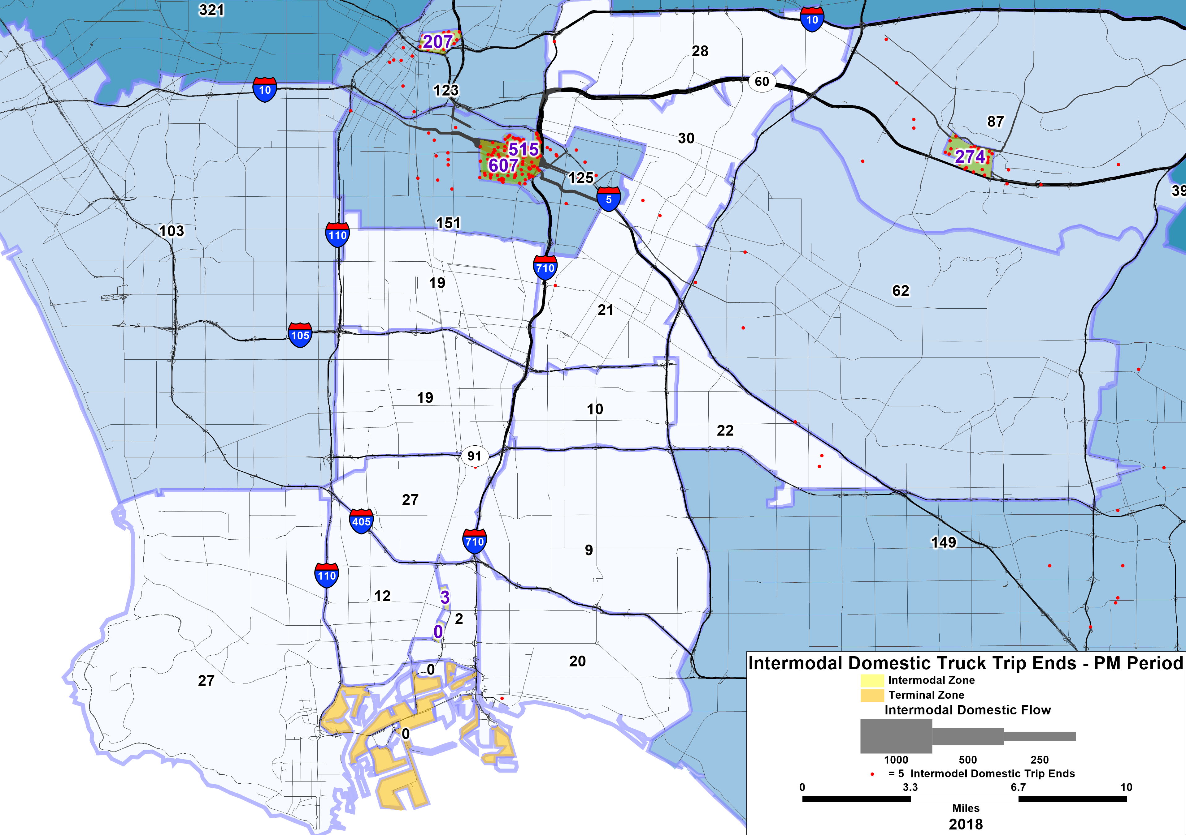
Intermodal Truck Trip Patterns (PM Period)
Preliminary Working Document. Subject to Change.

Slide 27

Domestic - Other Truck Trips
(not Port-Related)
Warehouse, manufacturing, etc.
Office, Retail, etc.

Slide 28
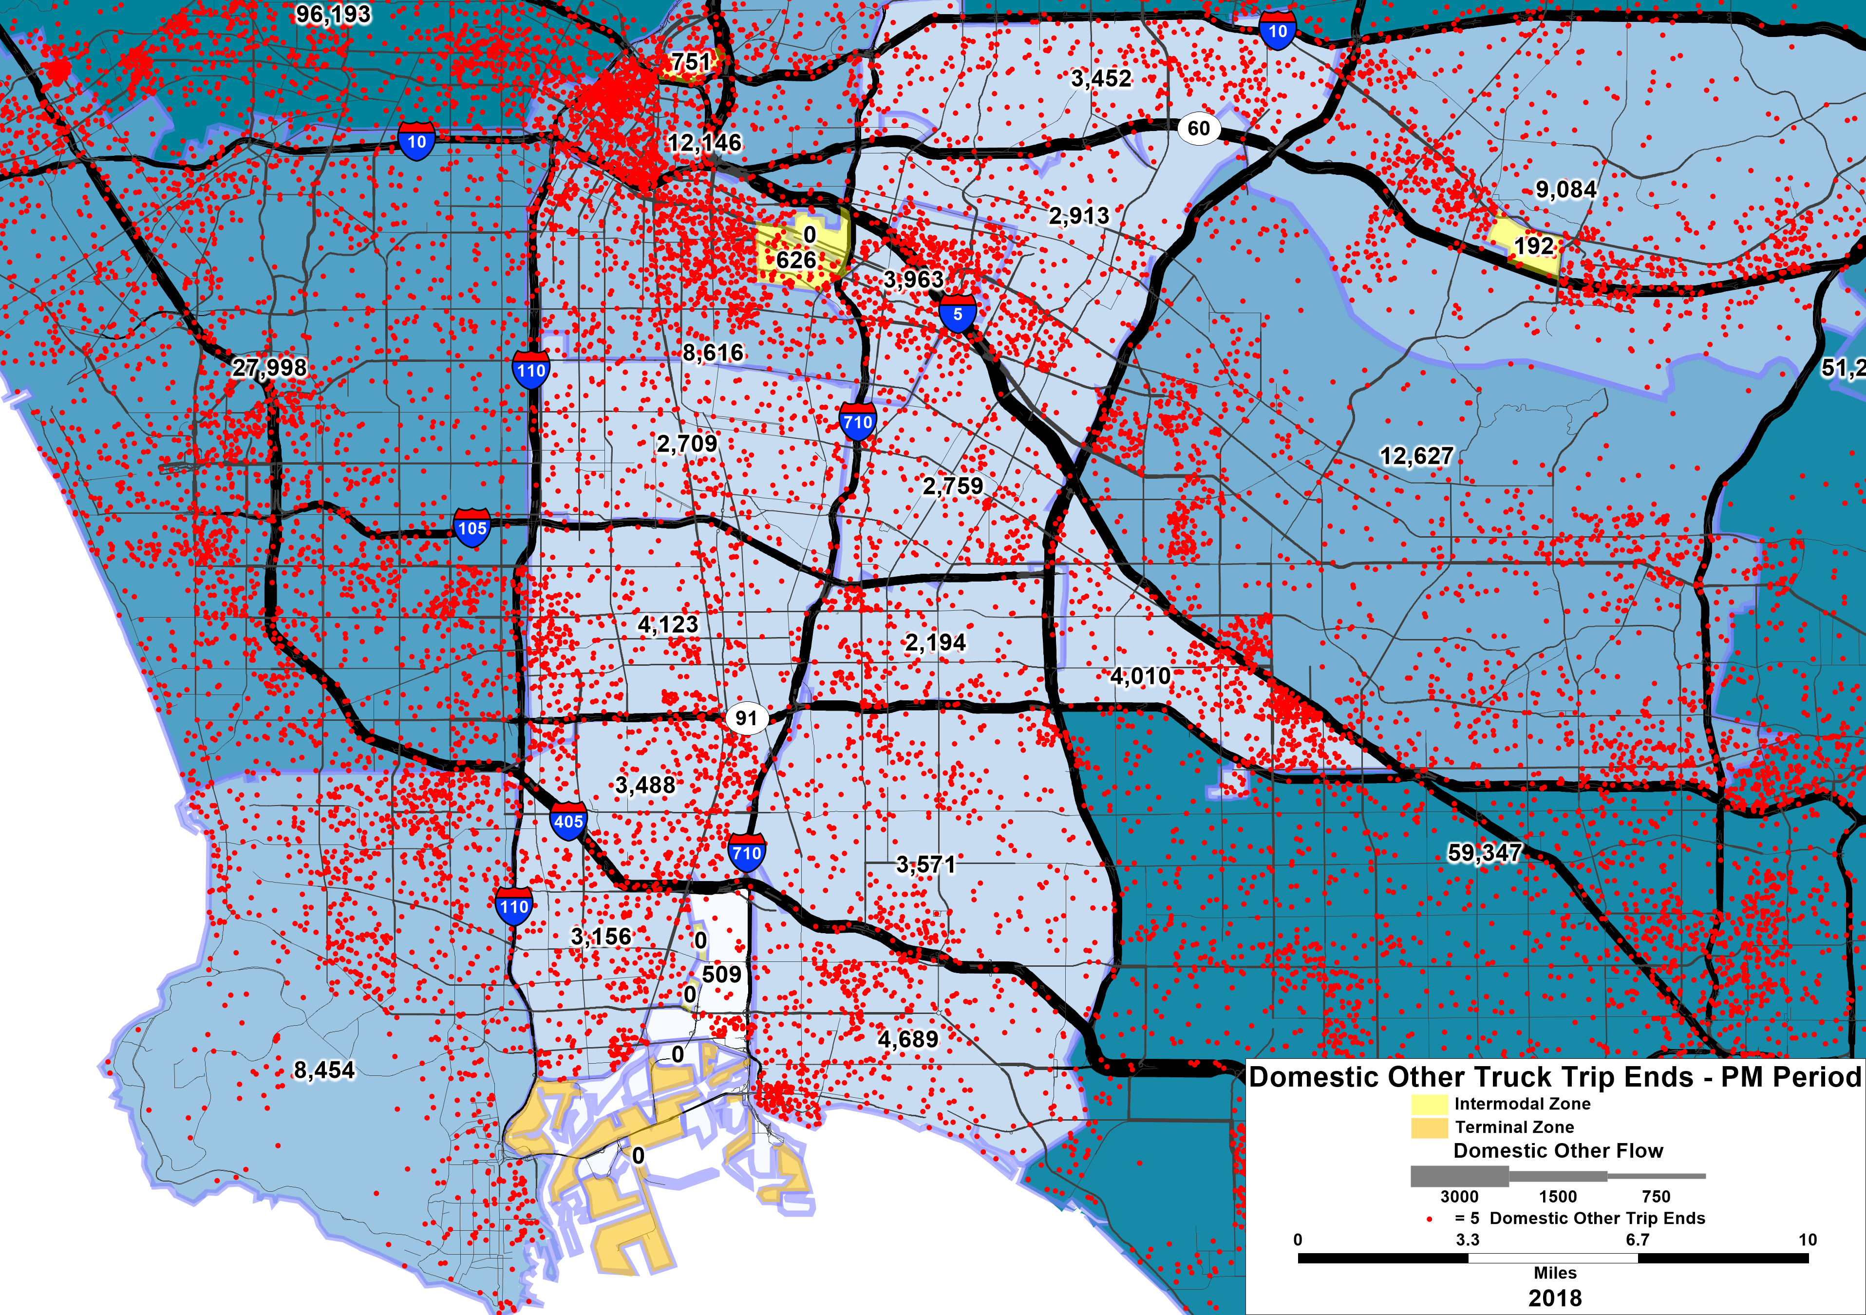
Domestic Non-Port Truck Trips (PM Period)

Slide 29
Key Findings: Corridor Truck Trips
The Long Beach – East Los Angeles Corridor has “regular” truck volumes like all corridors, with deliveries to home, retail, and other destinations
But the corridor also has substantial Port-related truck trips as well as goods movement related truck trips not directly connected to the Port
The corridor has both “intermodal” and “transload” truck trips where ocean shipping containers and goods are transferred from truck to rail
The Port truck trips have one end of each trip in the Ports and the other end along the corridor such as at warehouses and intermodal yards
The additional truck trips due to the Ports and goods movement activities add tens of thousands of truck trips per day beyond what occurs in other freeway corridors
The Port and goods movement truck trips are concentrated on the I-710 freeway as well as major arterial truck routes that connect to warehousing and intermodal yards such as in Carson, Rancho Dominguez, and the downtown rail yards in East Los Angeles

Slide 30
Keir Opie
Principal
Cambridge Systematics
kopie@camsys.com

Slide 31
Questions:
Truck Market Segmentation Volumes by Type
Notes:
Erika

Slide 32
Agenda Item #2:
Background Presentations
Potential Locations for MD HD Truck Charging Facilities
Jack Symington, Senior Program Manager Transportation,
Los Angeles Cleantech Incubator
Presentation (10 minutes)
Discussion (10 minutes)
Notes:
Erika

Slide 33
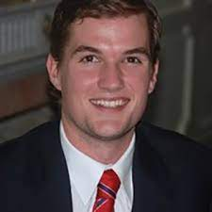
Presenter
Jack Symington
Senior Program Manager
Los Angeles Cleantech Incubator
Notes:
Erika
Jack Symington
is LACI’s Senior Program Manager for Transportation focusing on goods movement planning and projects while developing the next generation of pilot projects to bring heavy-duty trucking closer to a zero-emission future.
Previously, Jack worked for BYD, managing various CARB and CEC demonstration projects for on-road and off-road heavy-duty battery-electric trucks.
These projects entailed coordinating with utilities across California on infrastructure installation, while also developing deployment strategies to fit fleets’ unique needs.

Slide 34

LB-ELA Corridor Plan ZE Truck Working Group
An Investment Blueprint for HD Charging for Supporting Battery-Electric Drayage along the I-710 Corridor

Slide 35









An Investment Blueprint for HD Charging to Support Battery-Electric Drayage along the I-710 Corridor
Plan
Timeline
LACI will create an investment blueprint for heavy-duty charging depots adjacent to the busy I-710 freight corridor that can support battery electric trucks serving the San Pedro Bay Ports. Following a selection framework that will incorporate grid infrastructure and drayage duty cycles, LACI will identify priority locations for public and private heavy-duty charging infrastructure.
The final blueprint will provide a high-level budget for infrastructure deployments that will enable 100% battery-electric drayage at the San Pedro Ports, extrapolating from specific site evaluations that will include initial capital costs.
8/21
11/21
5/22
10/22
2/23
CEC Approval
Kickoff Meeting
Grid & Traffic Map
Site Assessments
Investment Blueprint
Products
Grid Transmission and Distribution Analysis
Drayage Density Traffic Map
Facility Identification
Charging Depot Business Model
Corridor Charging Investment Blueprint
Partners
10x Impact
Successfully outlining how to electrify a critical goods movement region sets a precedent for other intermodal regions in CA and the U.S.
Accurately assessing costs of depot provides shovel-ready projects to speed transition

Slide 36


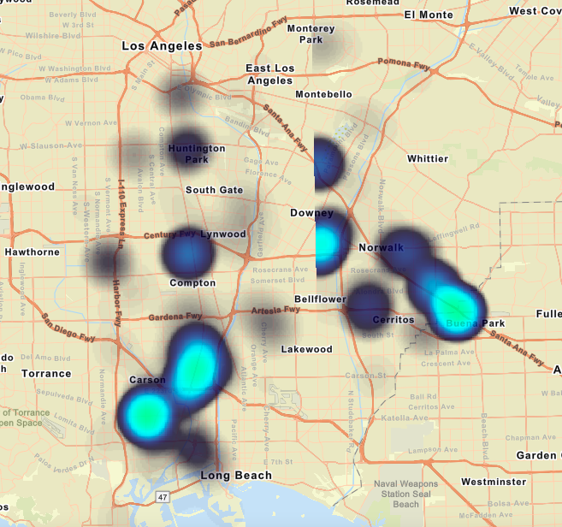
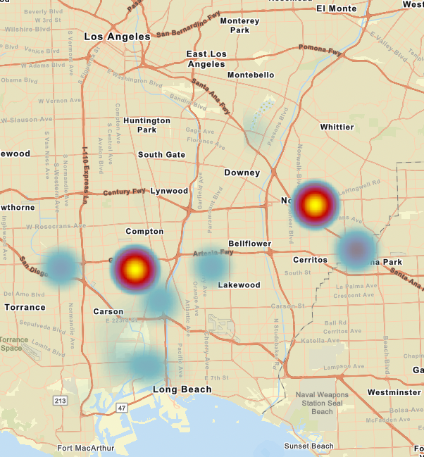
Truck Traffic Maps Created for Blueprint
Heatmap of Trucks Stationary for 30 min - 3 hours
Heatmap of Trucks Stationary for at least 3 hours

Slide 37
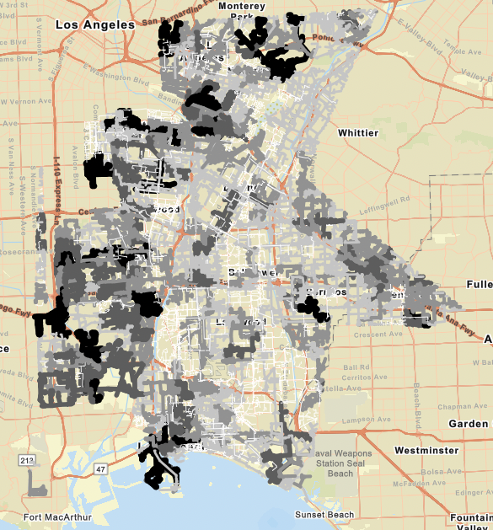
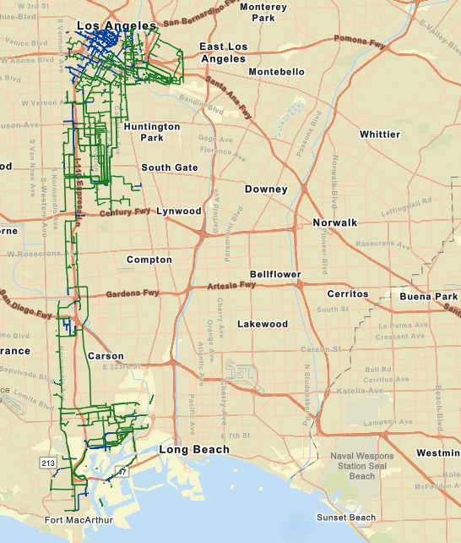
Grid Maps Created for Blueprint
SCE Grid Circuits’ Capacity Map
LADWP High Voltage Circuits Locations

Slide 38
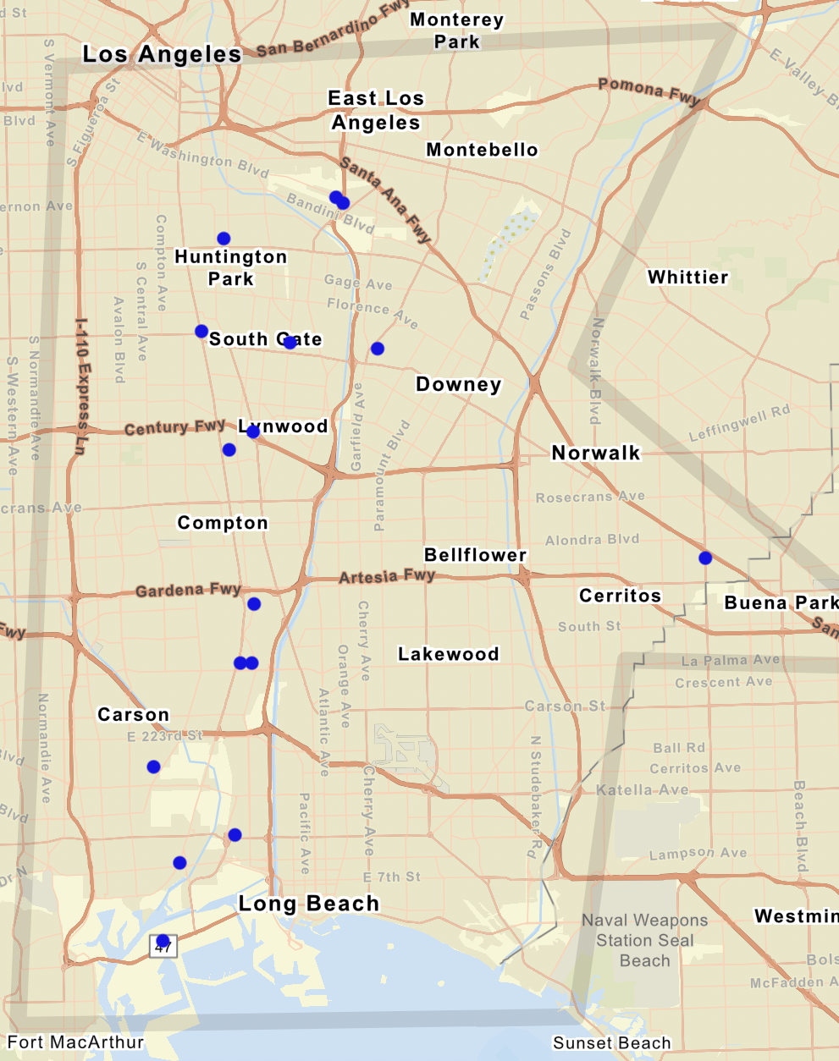
Priority Site Selections
Address | City | State | Zip | Location Type
5525 S Soto St | Vernon | CA | 90058 | Warehouse
4223 Independence Ave | South Gate | CA | 90280 | Yard
5960 Shull St | Bell Gardens | CA | 90201 | Existing Building
4560 E Washington Blvd | Commerce | CA | 90040 | Gas Station
4817 Sheila St | Commerce | CA | 90040 | Yard
4552 Ardine St | South Gate | CA | 90280 | Yard
11508 Long Beach Blvd | Lynwood | CA | 90262 | Park and Ride
20100 Alameda St | Compton | CA | 90221 | Warehouse
20101 S Santa Fe Ave | Compton | CA | 90221 | Warehouse
18020 S Santa Fe Ave | Compton | CA | 90221 | Warehouse
1071 E 233rd St | Carson | CA | 90745 | Warehouse
2161 Technology Pl | Long Beach | CA | 90810 | Warehouse
Pier S Ave and Henry Ford Ave | Long Beach | CA | 90744 | Yard
16424 Valley View Blvd | La Mirada | CA | 90638 | Distribution Center
1519 E I St | Wilmington | CA | 90744 | Yard
435 E Weber Ave | Compton | CA | 90222 | Fleet Depot

Slide 39
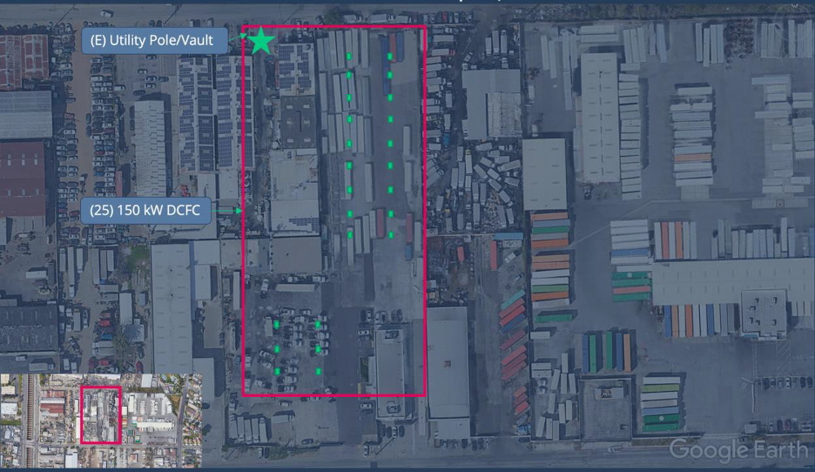
Example of Site Assessment (435 E Weber)

Slide 40
Summary of Cost Estimations
Total Capital Cost Range: $670,000 - $5,050,000 (from 5 to 40 chargers)
Cost per Charger (all-in) Range: $97k-$138k
Cost per kWh Range: $0.28 - $0.43 (evaluated only at four facilities)
**What estimations did not include:
Grid upgrades (potentially >$10M)
High voltage components ($500-$750k per site)
Environmental reports and/or needed mitigation (tbd)
Site improvements: grading, striping, paving ($250k per acre)
Distributed energy resources (microgrid, solar, storage–variable costs depending on site)
Takeaways:
Opportunity to manage truck traffic across region
Public charging will require public investment to amortize capital costs
Innovative partnerships can unlock value, mitigate risk
Most circuits could only handle one large (>50 charger) depot without needing grid upgrades

Slide 41
Questions:
Potential Locations
MD/HD Truck Charging Facilities
Notes:
Erika

Slide 42
Agenda Item #2:
Background Presentations
SB 671 Update
Kayla Giese, SB 671 Assessment Coordinator
California Transportation Commission
Presentation (10 minutes)
Discussion (10 minutes)
Notes:
ERIKA

Slide 43
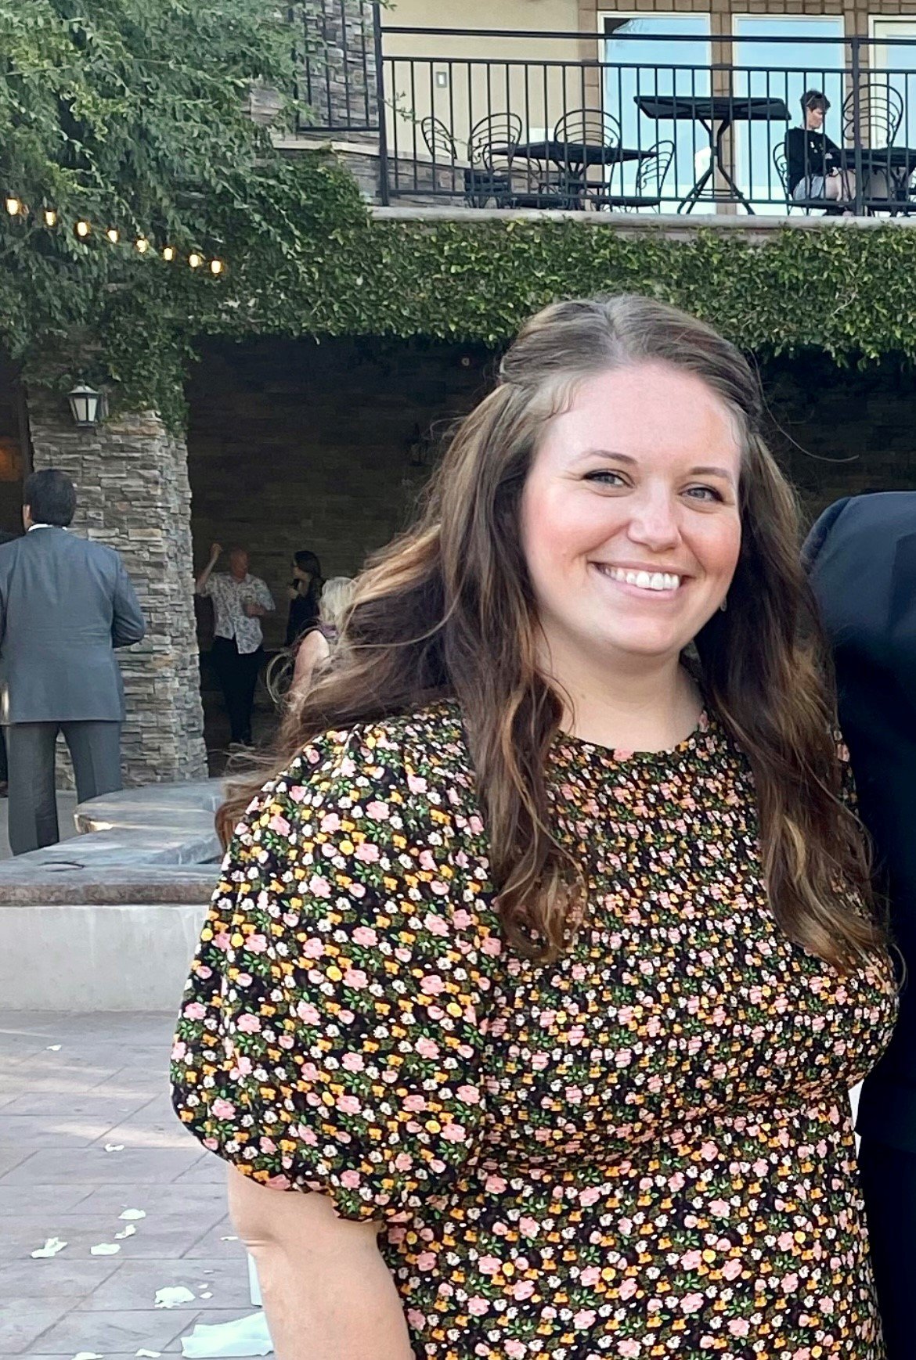
Presenter
Kayla Giese
SB 671 Assessment Coordinator
California Transportation Commission
Notes:
Michael

Slide 44
Senate Bill 671
Senate Bill 671
California Transportation Commission

Slide 45
SB 671 High-Level Requirements
The Clean Freight Corridor Efficiency Assessment is due December 1, 2023, to the Legislature.
It must be incorporated into the California Transportation Plan and the California Freight Mobility Plan.
The California Transportation Commission, California Air Resources Board, and California Energy Commission shall incorporate, to the extent feasible and applicable, the Assessment’s findings and recommendations in their programs and guidelines.

Slide 46
Status of Bill Requirements
Notes:
Microgrids will also be included in the assessment

Slide 47
Current Work

Slide 48
Estimate Number of ZERO-Emission Freight Stations Needed (3 scenarios)
Accelerated BEV Adoption | Accelerated FCEV/FCHEV Adoption | Balanced BEV+FCEV/FCHEV Adoption
Time (2025, 2030, 2035, 2040)
Zero-emission vehicle numbers
Powertrain adoption (how many BEV and how many FCEV/FCHEV)
Sensitivities for powertrain adoption (how fast will the vehicles be adopted)
Use cases (public versus depot)
Outcomes
Constraints (money, time, energy)
Notes:
The first is an accelerated BEV adoption, then an accelerated FCEV/FCHEV adoption, then a balanced approach.
Even in the accelerated FCEV/FCHEV adoption, we realize there will be many BEVs, but it is a different assumption about the rate of FCEVs.
For all of them we’re looking at 2025, 2030, 2035, and 2040 to see impacts over time, Remember the EO goal is 100% by 2045.
Then we’ll look at powertrain adoption, or what is the estimated split between BEV and FCEV/FCHEV.
For sensitivities, this looks at how fast we think vehicles will be adopted. In the balanced scenario we’ll look at the base case, accelerated adoption, and what it would look like to reach net zero in 2050.
We’ll also look at the use case and estimate the split between depot and public charging.
Well see what those outcomes look like
And then apply constraints of cost and time

Slide 49
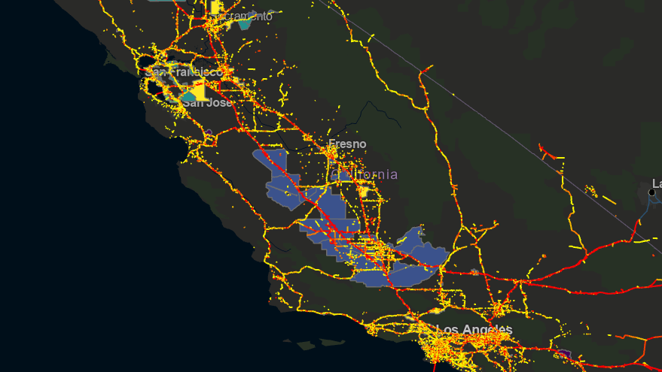
Map stations to potential locations
Once stations are identified, the CTC will work to map them to potential priority locations.
Notes:
Optimization of locations from Army Corps – looks at “hubness” areas, areas best suited for stations based on freight business needs
In this example, the lighter the color, the better
The blocks are census tracts
The lines are truck flows

Slide 50
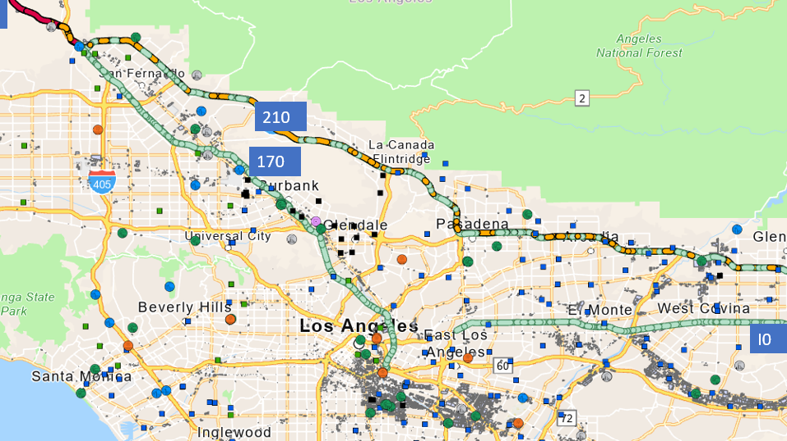
Identify Electric Infrastructure
As part of our modeling efforts, we’re coordinating with the CPUC and the CEC to identify where existing distribution and transmission lines are compared to station locations.

Slide 51
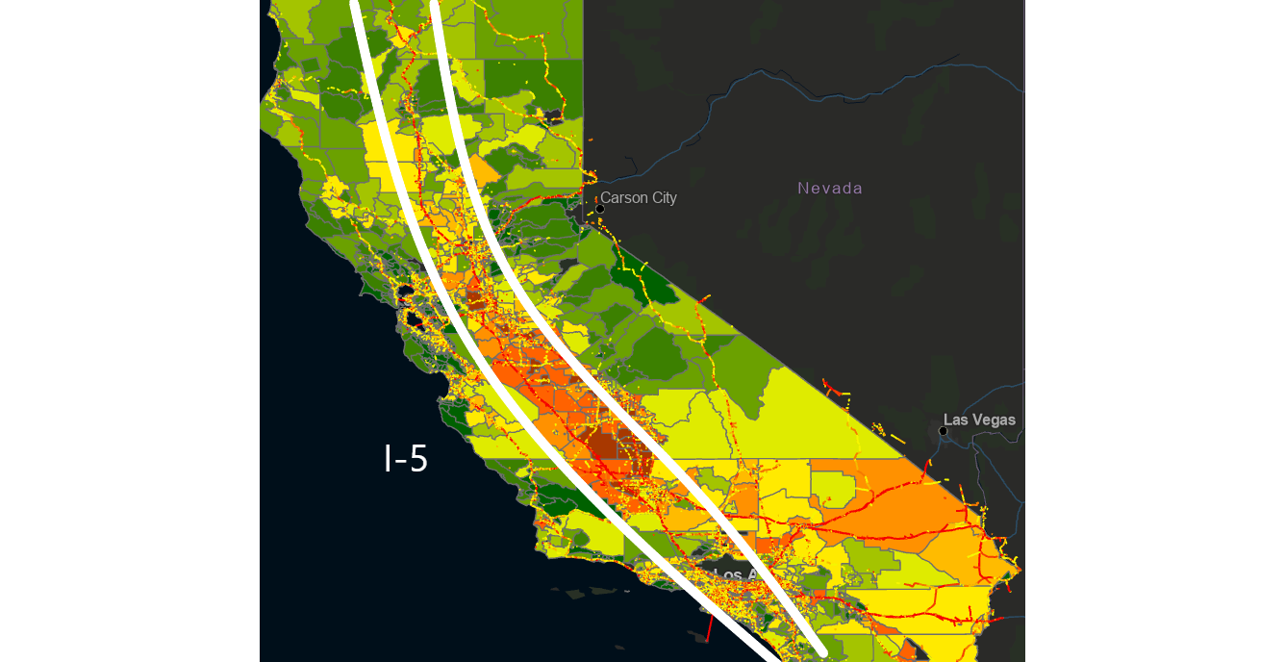
Identify
Top 5 freight corridors
Top 5 freight corridors with the most truck traffic and exposure to diesel contaminants
Notes:
Commission staff are working with the consultant and CARB to identify these now.

Slide 52
Draft Barriers and Solutions
SB 671 must identify barriers and solutions
Commission staff are gathering information to articulate barriers and solutions.

Slide 53
Timeline
Draft due to Commissioners in August 2023
Final Assessment due in December 2023

Slide 54
Questions:
SB 671 Update
Notes:
Erika

Slide 55
Discussion:
Potential Locations for Truck Charging Facilities
Notes:
Erika

Slide 56
Agenda Item #3:
ZET Program – Community Needs
Overview (5 minutes)
Facilitated Discussion (10 minutes)
Jack Symington, Senior Program Manager, Transportation, LACI
CEHAJ Participants in LACI Blueprint Project
Notes:
ERIKA

Slide 57
Agenda Item #4:
ZET Program
Metro’s Sustainability and Transportation
Electrification Policies
Notes:
ERIKA

Slide 58
ZET Principle 6 – Equitable Outcomes
Equitable Outcomes – ensured by performance metrics that evaluate sustainable outcomes.
Develop a variety of localized performance metrics to measure improvements and quality of life for residents along the corridor.
Work with the 710 Task Force, Equity Working Group, and CLC to apply principles from the EPET.
Monitor performance over time, evaluate outcomes, and identify potential areas of improvement.
Notes:
Erika
EQUITY CONSIDERATIONS
Add PM 2.5 to the GHG emissions metric
Incorporate people most disadvantaged/impacted by the 710 South Corridor into employment metrics
Consider health metrics comprehensively (e.g., asthma and cancer rates)

Slide 59

Performance Measures and Desired Outcomes – Examples
Workforce Development and Jobs
Net increase in jobs
Increase in per capita income
Growth in new manufacturing and deploying infrastructure
Environmental
Reduction in GHG Emissions
Amount of EV subsidies for small fleets
Public Health
Avoided premature deaths over time
Avoided asthma attacks in young children
Community
Reduced household energy costs
59
Notes:
Erika
Kinds of performance measures and desired outcomes-Inflation Reduction Act-associated with EV’s
Workforce Development and Jobs
1.2-1.3 million jobs in 2030, net increase
Increase per capita income by $4,000/yr
Significantly growing new manufacturing and deploying infrastructure
Environmental, Public Health Benefits
1 gigaton of reduction in GHG emissions by 2030 (10x positive climate impact than any other US legislation)
3 groups have done modeling
Landing on 40% reduction in GHG emissions in 2030 relative to 2005
Reduce emissions from particulates, sox, nox
More than 4,000 avoided premature deaths by 2030 (just in 2030), grows over time
More than 100,000 avoided asthma attacks annually by 2030, most in young children
Benefits tend to be in communities of color (more heavily concentrated)
$80/yr in reduced household energy costs by 2030
More than 20,000 Americans die prematurely each year as a result of motor vehicle pollution on our roads and highways. These impacts disproportionately affect people of color and low-income families
America’s heavy-duty trucks and buses are responsible for over 420MM tons of climate pollution
Air pollution standards that ensure all new heavy-duty trucks and buses sold for urban and community use are zero-emitting by 2035, and all such vehicles sold are zero-emission by 2040, would:
Prevent over 57,000 premature deaths by 2050
Eliminate more than 4.7 billion metric tons of climate pollution by 2050
Significantly reduce NOx by more than 10 million tons by 2050
Reduce particulate pollution by a total of nearly 200,000 tons by 2050
Save $485 billion in health and environmental benefits as a result of pollution reductions

Slide 60


Anticipating the Next Phase
NEXT
PHASE
NEXT
PHASE
November 2022 to January 2023 —Seeking input on criteria to evaluate and refine projects and programs
Early 2023—Projects will begin to undergo evaluation & prioritization in the next phase
60
Notes:
Susan A

Slide 61
Evaluation Criteria
Vision, Principles,
and Goals
Other Considerations
(cost-effectiveness, ease of implementation)
Evaluation Criteria
The benchmark or standard against which the projects and programs will be evaluated to measure relevance, impact, sustainability, effectiveness, and fit. Think in terms of “outcomes" or "desired states".
Notes:
Susan A
Evaluation criteria: less detailed – DESIRED STATES
Performance measures: specific actions
We may need to explain quantitative versus qualitative. We can leave that up to the presenter. Quantitative measures are usually expressed in terms of a number. Qualitative measures use words to describe the level of improvement or benefit. Sometimes for qualitative measures we might use a letter grade to judge the performance (“A” = excellent or “F” = failure). As a clue, anywhere we use the term “assessment” in the example performance measures, then that would be a qualitative measure.

Slide 62
Evaluation Criteria
Vision, Principles,
and Goals
Other Considerations
(cost-effectiveness, ease of implementation)
Evaluation Criteria
Performance Measures
Qualitative
Quantitative
The metric or process used to assess the performance of the projects and programs according to the evaluation criteria.
Notes:
Susan A
Evaluation criteria: less detailed – DESIRED STATES
Performance measures: specific actions
We may need to explain quantitative versus qualitative. We can leave that up to the presenter. Quantitative measures are usually expressed in terms of a number. Qualitative measures use words to describe the level of improvement or benefit. Sometimes for qualitative measures we might use a letter grade to judge the performance (“A” = excellent or “F” = failure). As a clue, anywhere we use the term “assessment” in the example performance measures, then that would be a qualitative measure.

Slide 63
Examples of Project Evaluation Criteria
EXAMPLE
Evaluation Criteria
Increased use of ZE drayage trucks
Increased deployment of ZE charging/fueling infrastructure
Eligibility for support from significant State and/or Federal funding programs
Example of Project Improvement:
New charging/fueling stations for zero-emissions trucks along existing routes throughout study area
Notes:
Michael
Evaluation criteria: less detailed – DESIRED STATES
Performance measures: specific actions
We may need to explain quantitative versus qualitative. We can leave that up to the presenter. Quantitative measures are usually expressed in terms of a number. Qualitative measures use words to describe the level of improvement or benefit. Sometimes for qualitative measures we might use a letter grade to judge the performance (“A” = excellent or “F” = failure). As a clue, anywhere we use the term “assessment” in the example performance measures, then that would be a qualitative measure.

Slide 64
Examples of Project Evaluation Criteria
EXAMPLE
Evaluation Criteria
Eligibility for support from significant State and/or Federal funding programs
Performance Measures
Amount of state and federal grant funding available (for zero-emissions medium and heavy-duty truck infrastructure deployment)
Quantitative
Example of Project Improvement:
New charging/fueling stations for zero-emissions trucks along existing routes throughout study area
Notes:
Michael
Evaluation criteria: less detailed – DESIRED STATES
Performance measures: specific actions
We may need to explain quantitative versus qualitative. We can leave that up to the presenter. Quantitative measures are usually expressed in terms of a number. Qualitative measures use words to describe the level of improvement or benefit. Sometimes for qualitative measures we might use a letter grade to judge the performance (“A” = excellent or “F” = failure). As a clue, anywhere we use the term “assessment” in the example performance measures, then that would be a qualitative measure.

Slide 65
Examples of Project Evaluation Criteria
EXAMPLE
Evaluation Criteria
State and federal grant funding awarded for zero-emissions medium and heavy-duty truck infrastructure deployment
Performance Measures
Resources for planning and deploying ZE truck charging/fueling facilities in the study area
Qualitative
Increase in number of new fast-charging/fueling docks for ZE trucks
Overall awarded amount and leverage achieved
Quantitative
Locate charging facilities along existing routes throughout the study area consistent with the ZET Program Principles
Transformational
Example of Project Improvement:
New charging/fueling stations for zero-emissions trucks in the study area
Notes:
Michael
Focus on # of chargers/high-speed chargers
Susan
Evaluation criteria: less detailed – DESIRED STATES
Performance measures: specific actions
We may need to explain quantitative versus qualitative. We can leave that up to the presenter. Quantitative measures are usually expressed in terms of a number. Qualitative measures use words to describe the level of improvement or benefit. Sometimes for qualitative measures we might use a letter grade to judge the performance (“A” = excellent or “F” = failure). As a clue, anywhere we use the term “assessment” in the example performance measures, then that would be a qualitative measure.
Site infrastructure away from neighborhoods, schools, and playgrounds
Gain community buy-in and

Slide 66
Evaluating for Equity
Key Issues
Equity assessments must consider several quantitative and qualitative measures:
  What a project accomplishes locally and regionally
  How a project is implemented
  Who is meaningfully involved in the planning and implementation process, and how
  Who receives project benefits or faces negative project impacts
  When projects are implemented in each community, based on factors such as need and historical disinvestment
Notes:
Michael
Evaluation criteria: less detailed – DESIRED STATES
Performance measures: specific actions
We may need to explain quantitative versus qualitative. We can leave that up to the presenter. Quantitative measures are usually expressed in terms of a number. Qualitative measures use words to describe the level of improvement or benefit. Sometimes for qualitative measures we might use a letter grade to judge the performance (“A” = excellent or “F” = failure). As a clue, anywhere we use the term “assessment” in the example performance measures, then that would be a qualitative measure.

Slide 67
Initial List of Projects & Programs: Zero-Emission Trucks
Project ID | Name (if applicable) | Short Description | Source
LB-ELA_0004 | Long Beach-East Los Angeles Corridor Clean Truck Program | In January 2021, the Metro Board approved the 2021 Goods Movement Strategic Plan, which included a Countywide Clean Truck Initiative, with the 710 South Clean Truck Program identified as a goods movement strategic priority. At its October 2021 meeting, the Metro Board acted to recommit $50 million from Measure R I-710 South Corridor funds as seed funding for the 710 South Clean Truck Program, which has been subsequently renamed the LB-ELA Zero Emissions Truck Program. The objective of this program is to turn over diesel trucks in favor of zero emissions trucks in the LB-ELA Corridor. The program would contribute subsidy funding to deploy a number of zero emissions trucks on I-710 as well as seed funding to develop electric charging/refueling stations for zero emissions trucks. | Metro LRTP, SPP Survey, SPP Mapping, CA-7
LB-ELA_0023 | Clean Truck Infrastructure | Install charging infrastructure for zero emissions trucks. | Metro 2028 Mobility Concept Plan, SPP Survey, SPP Mapping
Notes:
Michael
Evaluation criteria: less detailed – DESIRED STATES
Performance measures: specific actions
We may need to explain quantitative versus qualitative. We can leave that up to the presenter. Quantitative measures are usually expressed in terms of a number. Qualitative measures use words to describe the level of improvement or benefit. Sometimes for qualitative measures we might use a letter grade to judge the performance (“A” = excellent or “F” = failure). As a clue, anywhere we use the term “assessment” in the example performance measures, then that would be a qualitative measure.

Slide 68
Closing Remarks and Next Steps
Notes:
Michael
METRO NEXT STEPS
Protocols for vetting proposals – leveraging of funds
Legislative calendar (Norm Emerson-GCCOG), roadmap-applications-timelines
Additional Technical Support-in addition to Akiko
IMMEDIATE NEXT STEPS
--Slides and Confirmation- Jack Symington-LACI-slides (Susan)-SEPTEMBER
-Refine principles slides in presentation-CEHAJ Letter (Trey)-COMPLETE-draft response
-Michael-Fernando-Susan-Mtg re CEHAJ letter
-Tasks Worksheet Update (Susan has an example)
Agenda Item #6-focused discussions
Submit TCEP application, develop grant application
Finalize $5MM TA expertise
Local hiring policy
Erika
Difference between things we generate and things we are a part of
How do we get the $200 m
How do we use Metros’ unique position in the county
How do we create our own program?
How do we respond to other programs that want to partner with us?
How do we create technical expertise- to develop this program
Technical working group?
Keep to ourselves?
We need to develop our community outreach discussion-formalize it
Have plan in place
Advanced work in outreach
AQMD=scope
COMMUNITY EDUCATION
Akiko-Watson Land-realities of developing infrastructure
rika

Slide 69
Upcoming Meetings and Project Information
              Community Leadership Committee Meeting
      Meeting #11
      Thursday, January 19, 5-7pm
      Meeting #11.5
      Monday, January 23, 5-7pm
              Task Force Meeting
      Task Force Meeting #17
      Monday, February 13, 5-7pm
              Working Group Meetings
      Zero-Emissions Truck Working Group #13
      Tuesday, February 21, 1-3pm
For the most updated list
of meeting dates, please visit http://www.metro.net/710-hub
Notes:
Erika
Our Lady of Guadalupe Day is celebrated on December 12 every year. The day has been declared a national holiday in Mexico. Devotees honor the day when Virgin Mary made an appearance to a young man on this day in 1531.

Slide 70
Can’t attend the meeting? Reach out to us!
Michael Cano, Executive Officer (Interim)
LA Metro
Federal/State Policy & Programming
Countywide Planning & Development
One Gateway Plaza, MS 99-13-1
Los Angeles, CA 90012
213.418.3010
710corridor@metro.net
metro.net/projects/i-710-corridor
@metrolosangeles
losangelesmetro
Notes:
Erika

Slide 71
Thank you!
Notes:
Erika

