Slide 1

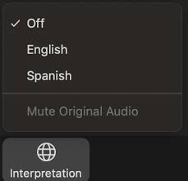
Interpretation/ Interpretación
Click the Interpretation icon in your meeting controls to enter the Spanish room
(Optional) To hear the interpreted language only, click Mute Original Audio
Haga clic en el ícono de Interpretación en los controles de su reunión para ingresar la sala en español
(Opcional) Para escuchar solo el idioma interpretado, haga clic en “Mute Original Audio” o “Silenciar audio original”
Notes:
ERIKA

Slide 2
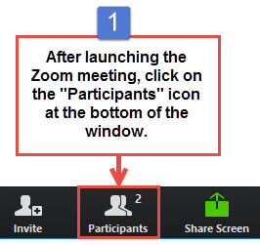
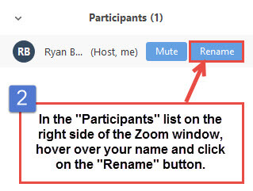
Participant Identification
Please change your Zoom screen name to include: Name and Organization Name (and if you are a Task Force Member, CLC Member)
Notes:
ERIKA

Slide 3

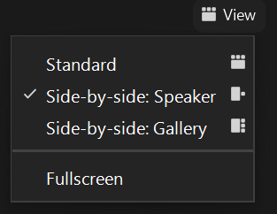
Turn on Camera / Prende la cámara
To start and stop your video, click the camera icon at the bottom left of your control panel
Para iniciar y detener su video, haga clic en el ícono de la cámara en la parte inferior izquierda de su panel de control
To switch between views during the meeting click or tap on Standard, Side-by-side Speaker View, and Side-by-side Gallery View at the top right corner of your zoom screen
Para cambiar entre vistas durante la reunión, haga clic o toque Estándar, Vista de orador en paralelo y Vista de Galería en Paralelo en la esquina superior derecha de la pantalla de zoom
Notes:
ERIKA

Slide 4
Zoom Protocols
Click Raise Hand in your meeting controls or
Press*9 on the phone line.
To lower your hand, click Raise Hand in your meeting controls.
Comments & questions can also be provided in writing by using the Chat function.
The Chat button is located on the control panel at the bottom of your screen.
Notes:
ERIKA

Slide 5


Detailed Agenda
1:00pm 1:05pm | Welcome, Agenda Review, and Purpose of the Zero-Emission Truck Working Group Agenda Item #1: Metro Update (10 minutes)
1:15pm 1:45pm | Agenda Item #2: ZET Program Framework and Principles Process Overview (5 minutes) Principles: Presentation and Discussion (10 minutes) Equity Considerations (10 minutes) Vote (5 minutes) Agenda Item #3: Multimodal Strategies, Projects & Programs Overview (5 minutes) MSPP Clean Transportation Examples (10 minutes) Discussion (5 minutes)
2:05pm | Agenda Item #4: Federal Transportation Legislation – Inflation Reduction Act Report by Raffi Hamparian, Senior Director of Federal Affairs / Government Relations, LA Metro (10 minutes) Question and Answer (5 minutes)
2:20pm 2:30pm | Agenda Item #5: Goods Movement Zero-Emission Infrastructure – MSRC Request for Information Report by Akiko Yamagami, Transportation Planning Manager, Goods Movement Planning, LA Metro Overview (5 minutes) Discussion (5 minutes) Closing Remarks and Upcoming Meetings
Notes:
ERIKA

Slide 6
We will begin in a few moments.
710 Task Force
Zero-Emission Truck Working Group
Meeting #11
October 18, 2022
Notes:
Erika

Slide 7
710 Task Force
Notes:
ERIKA

Slide 8
Welcome, Agenda Review, and Purpose of the
I-710 South Corridor Zero-Emission Truck (ZET)
Working Group
Notes:
ERIKA

Slide 9
Meeting Objectives
Vote to approve the ZET Principles
Receive presentations and engage in discussion on the following topics:
ZET related Multimodal Strategies, Projects, and Programs
Federal Transportation Legislation – Inflation Reduction Act
Publicly Accessible Goods Movement Zero-Emission Infrastructure – MSRC Request for Information
Notes:
ERIKA

Slide 10
Detailed Agenda
1:00pm 1:05pm | Welcome, Agenda Review, and Purpose of the Zero-Emission Truck Working Group Agenda Item #1: Metro Update (10 minutes)
1:15pm 1:45pm | Agenda Item #2: ZET Program Framework and Principles Process Overview (5 minutes) Principles: Presentation and Discussion (10 minutes) Equity Considerations (10 minutes) Vote (5 minutes) Agenda Item #3: Multimodal Strategies, Projects & Programs Overview (5 minutes) MSPP Clean Transportation Examples (10 minutes) Discussion (5 minutes)
2:05pm | Agenda Item #4: Federal Transportation Legislation – Inflation Reduction Act Report by Raffi Hamparian, Senior Director of Federal Affairs / Government Relations, LA Metro (10 minutes) Question and Answer (5 minutes)
2:20pm 2:30pm | Agenda Item #5: Goods Movement Zero-Emission Infrastructure – MSRC Request for Information Report by Akiko Yamagami, Transportation Planning Manager, Goods Movement Planning, LA Metro Overview (5 minutes) Discussion (5 minutes) Closing Remarks and Upcoming Meetings
Notes:
ERIKA

Slide 11
Agenda Item #1:
Metro Board Update
Notes:
ERIKA

Slide 12
September Metro Board Actions
Metro Board approved the following items:
Vision Statement / Guiding Principles / Goals APPROVED
Pre-Investment Plan Opportunity APPROVED
Re-naming the I-710 South Corridor Project to “East Los Angeles – Long Beach Corridor Mobility Investment Plan” APPROVED
Notes:
MICHAEL

Slide 13
ZET Program Recap – Metro Board Direction
Metro Board Direction and desired outcomes
$200 million minimum funding target
Leverage $50 million local matches with private, regional, state, and federal funding
Accelerated ZE deployment in the I-710 South Corridor
Collaboration with regional stakeholders
Independent, accelerated process from overall 710 Task Force Investment Plan process
Strategies to accomplish outcomes
Identify discretionary grant opportunities
Convene and collaborate with community and regional stakeholders
Develop a scope of work for the ZET Program
Identify regional funding partners
Identify near and long-term opportunities
Identify policy and legislative barriers to implementation
Notes:
Michael

Slide 14
Task Force Meeting #12 Recap
Summary
Held virtually via Zoom on Monday, September 12
58 participants (40 Task Force Members/Alternates, 2 CLC members, and 10 Members of the Public)
Highlights
Approved the “Prosperity” Goal and completed the Vision & Goals Consensus Checkpoint
Discussed the Multimodal Strategies, Projects & Programs phase and related public engagement
Received presentation from the Gateway Cities COG I-710 South Ad-Hoc Committee
14
Notes:
Michael

Slide 15

Zero-Emission Truck Working Group Meeting #10 Recap
Summary
Held virtually via Zoom on Tuesday, September 20
30 participants (13 Task Force Members, 4 Ex-Officio, 4 CLC Members, 9 ZET WG Members)
Meeting topics included:
Applying Best Practices of Getting to ZERO to the 710 South Corridor Infrastructure
Regional EV Charging Study to Accelerate Electrification
Is the Electric Grid Ready?
2019 Electric Vehicle Charging Guidebook for Medium-Duty and Heavy-Duty Commercial Fleets
EV Charging Infrastructure for Southern California Warehouses
15
Notes:
Michael
Agenda Item #3: Medium-Duty and Heavy-Duty Infrastructure, Global Commercial Vehicle Drive to Zero
Presentation by Bill Van Amburg, Global Strategic Advisor Zero Emission Commercial Vehicles, Energy and Sustainability (15 minutes)
Facilitated Discussion (10 minutes)
Agenda Item #4: Regional Roadmap for Zero-Emission Vehicle Infrastructure
Overview by Alison Linder, Senior Regional Planner, Southern California Association of Governments (10 minutes)
Question and Answer (5 minutes)
Agenda Item #5: If EV’s are the Future, is the Grid Ready? (30 minutes)
Moderator: Micah Wofford, Energy Commission Specialist, California Energy Commission
Panel Discussion
Sean Wilder, Energy and Environmental Services, LA County Internal Services Department
Salim Youssefzadah, CEO, WattEV
Quintin Sumabat, Deputy Executive Officer, Vehicle Engineering and Acquisitions, LA Metro
Agenda Item #6: 2019 Electric Vehicle Charging Guidebook for Medium-Duty and Heavy-Duty Commercial Fleets (10 minutes)
Presentation by Patrick Couch, SVP, Gladstein, Neandross, and Associates
Question and Answer (5 minutes)
Agenda Item #7: Electric Vehicle Charging Infrastructure for Southern California Warehouses – MAERSK Performance Team Report
Report by Carlo Bertani, MAERSK (10 minutes)
Question and Answer (5 minutes)

Slide 16
Agenda Item #2:
I-710 South Corridor
ZET Program Framework and Principles
Process Overview (5 minutes)
Principles: Presentation and Discussion (10 minutes)
Equity Considerations (10 minutes)
Vote (5 minutes)
Notes:
Erika

Slide 17
ZET Program Principles – Introduction and Overview
The Metro Board committed $50 million as seed funding for an I-710 South Zero Emission (ZE) Truck program to support the accelerated deployment of zero-emission trucks and supporting zero-emission infrastructure (October 2021, Motion 16).
The ZET Program Framework and Principles will be used as a guide as Metro seeks to leverage and amplify the $50 million seed funding within the Corridor.
The Principles were developed through collaboration with the 710 Zero-Emission Truck Working Group.
Five major themes were brought forward by the Working Group:
Community engagement
Strategic partnerships and funding opportunities
Legislative and policy initiatives
Truck subsidies
Environmental impacts and equitable outcomes
Notes:
Michael

Slide 18
ZET Proposed Principles – Timeline of Input
Community Leadership Committee (CLC) provided input on September 22
Equity Working Group (EWG) providing equity-focused input today, September 29
At the October 18th ZET Working Group Meeting, the ZET Working Group will:
review input from the Equity Working Group
Vote to approve the ZET Program Principles
Review ZET Program Principles with the Task Force
Metro Project Team to present the ZET Principles to the Metro Board of Directors
Notes:
Michael

Slide 19
ZET Program Principles – Introduction and Overview
1
2
3
4
Maximize leverage of seed funding
by collaborating with regional partners and funding agencies.
Community Engagement
that centers corridor residents and stakeholders throughout the development process.
Corridor Community Benefits by creating economic opportunities, improving air quality, and reducing long-standing health impacts generated by diesel trucks.
Coordination
with regional and funding partners, government agencies, and key stakeholders.
5
6
7
8
Workforce Development
that ensures community benefits and access to opportunity through the pursuit and implementation of ZE Technology.
Equitable Outcomes
ensured by performance metrics that evaluate sustainable outcomes.
Legislative Platform
designed to support the accelerated, equitable deployment of ZE technology by reducing barriers and increasing incentives to adoption.
Expeditious Deployment of Resources
to maximize the buying power and benefit of investment while supporting community engagement and effective outreach.
Notes:
Michael

Slide 20
Principle 1
Maximize leverage of seed funding – by collaborating with regional partners and funding agencies.
Pursue additional regional, state, and federal funding to reach $200 million
Use $45M seed funding to leverage investment in regionally significant infrastructure projects
Use $5M seed funding to support corridor-specific and small fleet objectives
Fund community benefits as part of overall strategy
Notes:
Erika review slide/Michael provide details

Slide 21
Principle 2
Community Engagement – that centers corridor residents and stakeholders throughout the development process.
Work with 710 Task Force, CLC, and EWG to identify equitable outcomes and integrate Community Benefits.
Engage and collaborate with communities directly impacted by the proposed sites.
Increase awareness of ZE operations and impact through community tours and educational initiatives.
Notes:
Erika review slide/Michael provide details
EQUITY CONSIDERATIONS
Engage city councils, planning commissions, seniors, faith-based communities, school districts, and colleges/universities
Leverage CLC connections
Educate communities in culturally relevant, accessible ways using different modes of teaching (e.g., videos, audio slides)

Slide 22
Principle 3
Corridor Community Benefits – By creating economic opportunities, improving air quality, and reducing long-standing health impacts generated by diesel trucks.
Address needs of local communities, many of which have borne impacts of travel and goods movement along the I-710 corridor.
Provide and protect corridor community benefits at the outset and throughout the project through ZE job training and workforce development.
Establish metrics to understand if investments are leading to meaningful benefits.
Notes:
Erika review slide/Michael provide details
EQUITY CONSIDERATIONS
Local hire and job training are critical and must be in accessible locations
Prioritize funding for local owner-operators (e.g., access to chargers, discounted rates, technical assistance)
Communities can assist in identifying areas for improvements (e.g., air filtration, tree planting, beautification)

Slide 23
Principle 4
Coordination – With regional and funding partners, government agencies, and key stakeholders.
Coordinate with funding partners, regional agencies, and local communities to support deployment of ZE technology in the corridor.
Align ZET program with criteria to secure funding at the regional, state, and federal levels.​
Create a program that is compatible with and enhances other regional efforts.
Notes:
Erika review slide/Michael provide details

Slide 24
Principle 5
Workforce Development – that ensures community benefits and access to opportunity through the pursuit and implementation of ZE Technology.
Work with regional and community partners to understand job training and workforce needs related to ZET.
Work with labor partners to pursue local and targeted hire opportunities.
Increase community access to quality job opportunities that pay living wages.
Coordinate with existing workforce development programs.
Notes:
Erika review slide/Michael provide details

Slide 25
Principle 6
Equitable Outcomes – ensured by performance metrics that evaluate sustainable outcomes.
Develop a variety of localized performance metrics to measure improvements and quality of life for residents along the corridor.
Work with the 710 Task Force, Equity Working Group, and CLC to apply principles from the EPET.
Monitor performance over time, evaluate outcomes, and identify potential areas of improvement.
Notes:
Erika review slide/Michael provide details
EQUITY CONSIDERATIONS
Add PM 2.5 to the GHG emissions metric
Incorporate people most disadvantaged/impacted by the 710 South Corridor into employment metrics
Consider health metrics comprehensively (e.g., asthma and cancer rates)

Slide 26
Principle 7
Legislative Platform – designed to support the accelerated, equitable deployment of ZE technology by reducing barriers and increasing incentives to adoption.
Develop a legislative platform with policy solutions that reduce barriers for truck owners or companies to secure a ZE truck.
Support incentives and outreach necessary to accelerate deployment of ZE Class 8 trucks
Work with regional partners to prioritize highway and street maintenance.
Notes:
Erika review slide/Michael provide details

Slide 27
Principle 8
Expeditious Deployment of Resources – to maximize the buying power and benefit of investment while supporting community engagement and effective outreach.
Ensure that the effort to meet funding deadlines and expedite the deployment of seed funding will also uphold community engagement principles and support effective outreach.
Aim to leverage and expend all ZET Program resources by FY 2027-28.
Notes:
Erika review slide/Michael provide details

Slide 28
ZET Program Principles – Review
1
2
3
4
Maximize leverage of seed funding
by collaborating with regional partners and funding agencies.
Community Engagement
that centers corridor residents and stakeholders throughout the development process.
Corridor Community Benefits by creating economic opportunities, improving air quality, and reducing long-standing health impacts generated by diesel trucks.
Coordination
with regional and funding partners, government agencies, and key stakeholders.
5
6
7
8
Workforce Development
that ensures community benefits and access to opportunity through the pursuit and implementation of ZE Technology.
Equitable Outcomes
ensured by performance metrics that evaluate sustainable outcomes.
Legislative Platform
designed to support the accelerated, equitable deployment of ZE technology by reducing barriers and increasing incentives to adoption.
Expeditious Deployment of Resources
to maximize the buying power and benefit of investment while supporting community engagement and effective outreach.
Notes:
Erika

Slide 29
Key Equity Considerations for ZET Program & Principles
Engage city councils, planning commissions, seniors, faith-based communities, school districts, and colleges/universities
Leverage CLC connections
Educate communities in culturally relevant, accessible ways using different modes of teaching (e.g., videos, audio slides)
Community Engagement and Decision-making Input
Local hire and job training are critical and must be in accessible locations
Prioritize funding for local owner-operators (e.g., access to chargers, discounted rates, technical assistance)
Communities can assist in identifying areas for improvements (e.g., air filtration, tree planting, beautification)
Community Benefits related to ZET Program
Add PM 2.5 to the GHG emissions metric
Incorporate people most disadvantaged/impacted by the 710 South Corridor into employment metrics
Consider health metrics comprehensively (e.g., asthma and cancer rates)
Performance Metrics and Evaluation of Equitable Outcomes
Notes:
Erika

Slide 30

ZET Program Principles
I approve the ZET Program Principles.
Yes
No
Abstain
Notes:
Erika
MOTION
One vote per organization

Slide 31
Agenda Item #3:
Multimodal Strategies, Projects & Programs
Overview (5 minutes)
MSPP Clean Transportation Examples (5 minutes)
Discussion (5 minutes)

Slide 32
Overview: Multimodal Strategies, Projects and Programs
In this section, we will:
Review Multimodal Strategies, Projects, and Programs Process (MSPP)
Review input received to date from survey, mapping exercise, public workshops, Community Leadership Committee, and Equity Working Group
Working Group Actions:
Provide feedback and recommendations on the most important
ZET-related MSPP for consideration.
Notes:
Erika

Slide 33

What We Are Hearing So Far - Public Workshops
Category | Suggested Projects & Programs – Some Key Highlights
Bicycle | Improve safety for bikeways including safe crossings Extend bike paths to connect to the LA River
Pedestrians | Sidewalk and crosswalk improvements including ADA accessibility Create cross-streets to protect pedestrians from cars exiting the freeway
Roadway | Traffic calming strategies Revamping crosswalks along roadways
Transit (Bus or Rail) | Increase safety and security by installing security cameras and working with law enforcement Increase police presence in areas that have transit
Other Mobility | Opportunities for electric buses and express lanes for electric vehicles Connect communities through parks, green and walkable space
Community Programs | Incentivize businesses to promote telecommuting Work with LA Metro to create ambassador programs in cities along the corridor
General Comments | Address air quality issues and particulate matter from storage container lots Increase HVAC units in schools Identify industrial facilities that house many trucks that need to transition to Zero-Emissions
Public Workshops were held on 8/30 and 9/17/22
Notes:
Erika
These are a selection of some of the comments that we received during the August 30th and September 17th MSPP Public Workshops.

Slide 34
What We Are Hearing So Far – Equity Working Group
Category | Suggested Projects & Programs – Some Key Highlights
Bicycle | Add dedicated bike lanes to protect bicyclists from vehicular traffic
Pedestrians | Safe pathways to transit centers and hubs Add lighting, landscaping and safe access to the Los Angeles River
Roadway | Convert an existing lane to create a zero-emissions truck lane on the freeway Apply traffic calming features to local streets (traffic lights, roundabout gardens)
Transit (Bus or Rail) | Provide more express bus and rapid transit to make transit more competitive to the automobile Shuttle services targeted towards differently abled community populations
Other Mobility | Provide access to reasonably priced fresh produce and healthy food Measures to facilitate the use of freight rail rather than trucks to reduce traffic on the freeway
Community Programs | Provide workforce development for greener jobs Air filters and clean air systems for schools
General Comments | Plant trees to provide more tree canopy. Plant drought-tolerant vegetation.
Equity Working Group #6 was held on 8/25/22.
Notes:
Erika
These are a selection of some of the comments that we received during the August 30th MSPP Public Workshop. #1

Slide 35
What We Are Hearing So Far – Interactive Mapping Comments
Category | Suggested Projects & Programs – Some Key Highlights
Bicycle | Extend the LA River Bike Trail further north More bike lanes as well as barrier-separated bike routes on city streets
Pedestrians | Safe pedestrian walkways with railings to cross over I-710 Better cross walks, traffic lights, and pedestrian safety features near schools
Roadway | Truck prohibitions on impacted neighborhood streets to keep trucks on designated truck routes Speed bumps and traffic calming features particularly near schools
Transit (Bus or Rail) | Dedicated bus lanes on heavily used bus routes Signal prioritization for Blue Line trains on Long Beach Blvd and in downtown LA
Other Mobility | Expand on-dock and near-dock freight facilities to move more cargo by rail rather than trucks. Improve signal synchronization
Community Programs | Safety guards and additional security features for schools Create additional green space to encourage bicycle use and walking
General Comments | Lighting and more security at Metro rail stations and on the trains Convert diesel trucks to zero emissions trucks.
Interactive Mapping Comments collected from 8/1-10/3/22.
Notes:
Erika
These are a selection of some of the comments that have come in via the Social Pinpoint Mapping exercise as of September 7th, 2022. [Ernesto: please note that we have received hundreds of comments, so these are just some examples that we have picked to show the variety and general tone/tenor of the comments.]

Slide 36
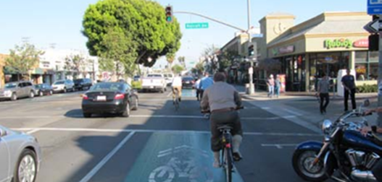

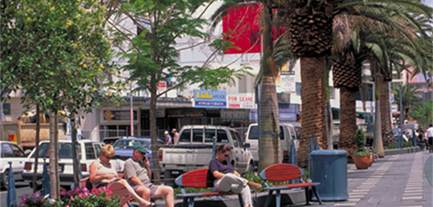
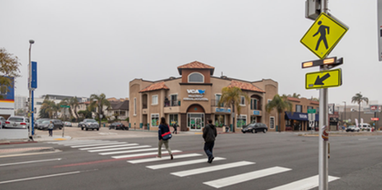
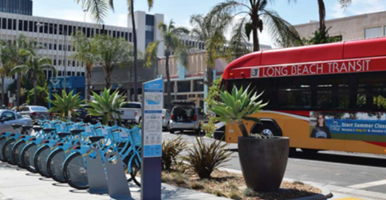
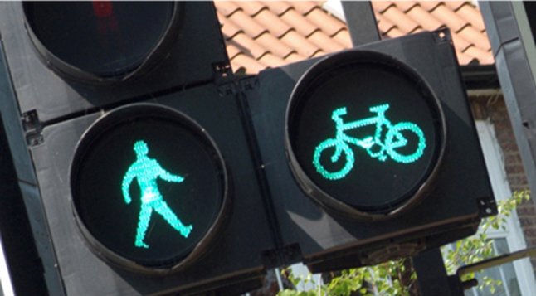
Project & Program Examples Bicycle and Pedestrian Improvements
Bike Lanes
Shared-Use Path
Pedestrian Safety and Amenities
New bicycle lane on existing roadways, indicated by striping, signage, and physical barriers.
New bicycle paths just for bicyclists and pedestrians.
Wider sidewalks, lighting, benches, shade trees, landscaping, and trash receptacles to improve the safety and comfort of the pedestrian experience.
Crossing Safety Enhancements
Bike Share Programs
Bike/Ped Traffic Controls
High Visibility Paint, Flashing Signals, Pedestrian Safety Island, Curb Extensions, or Bulb-outs to create short crossing distances and increased awareness of crossing locations.
Low-cost, short-term bike rental from strategically placed docks or stations.
Leading Pedestrian Interval, Bike crossing signals, No turn on red signals, signals and controls to reduce conflicts between pedestrians, bicyclists, and drivers.
Notes:
Erika
Different MSPP we have discussed
Highlight ZET

Slide 37
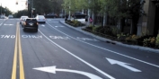
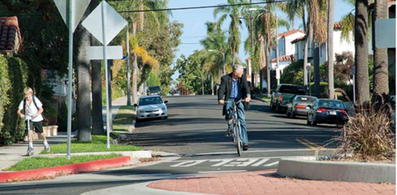
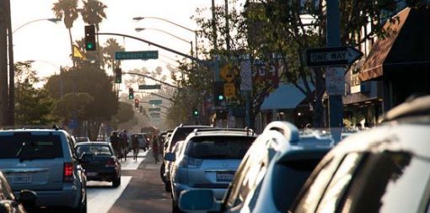
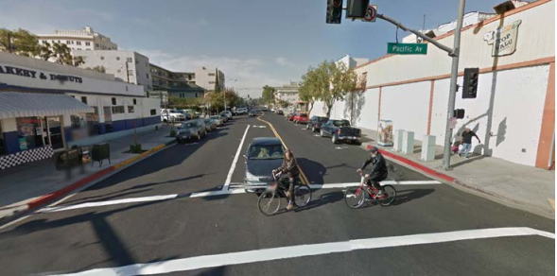
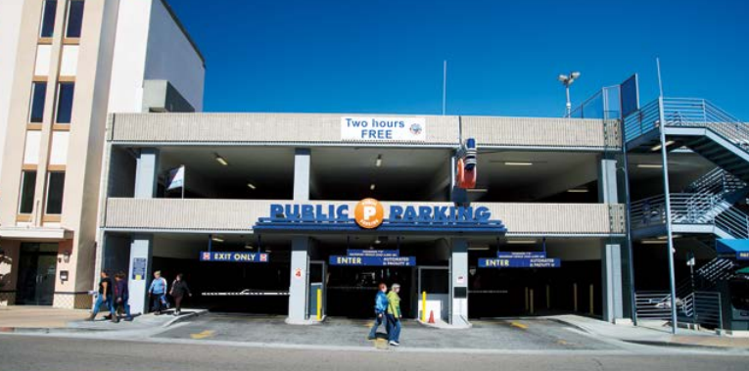
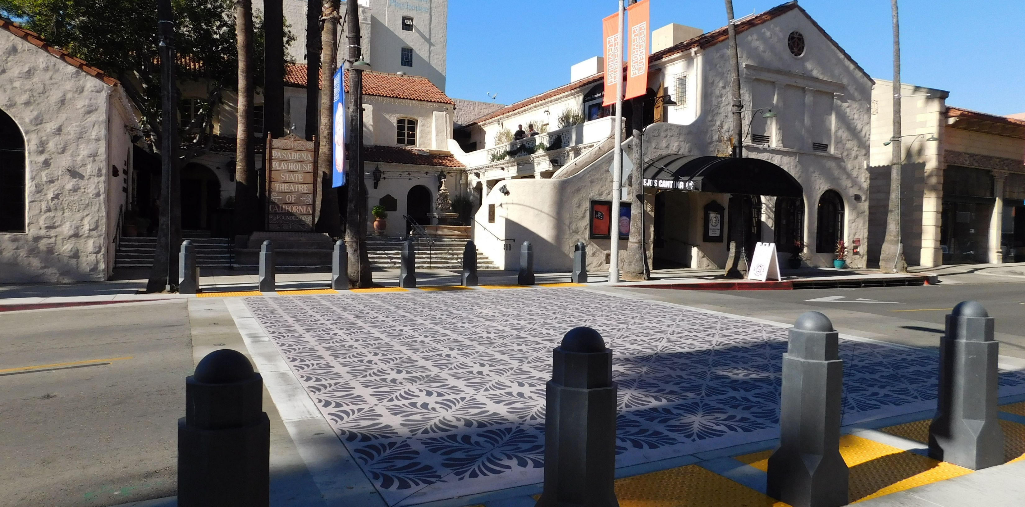
Project & Program Examples Local Roadway & Traffic Management Improvements
Intersection Improvements
Traffic Calming Features
Traffic Management Features
Turn lanes and other design features to reduce traffic queues at congested intersections.
Roundabouts, speed humps, and other design features or signage to slow traffic on local streets or near schools.
Traffic signal coordination on major arterial corridors to maximize “green time” based on actual traffic conditions.
Added Roadway Lanes
Parking Options
Visual Improvements
Roadway reconfiguration to add travel lanes, designate parking lanes for peak hour travel lanes, or establish bus only lanes
Additional street parking, public/shared parking lots, or public/shared parking structures.
Landscaping, hardscaping, public art, and other design features to improve the appearance of the roadway.
Notes:
Erika

Slide 38
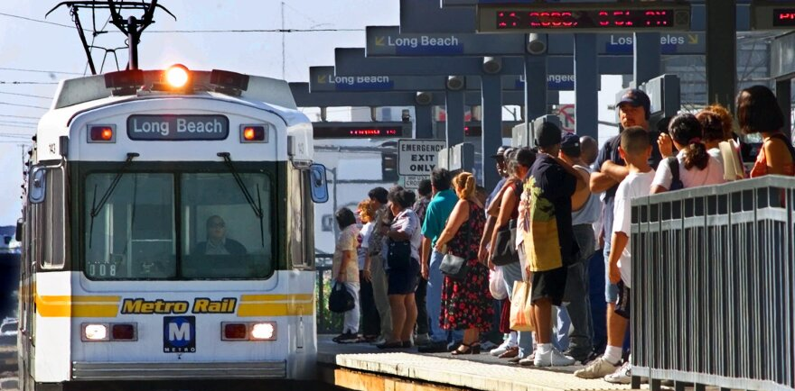
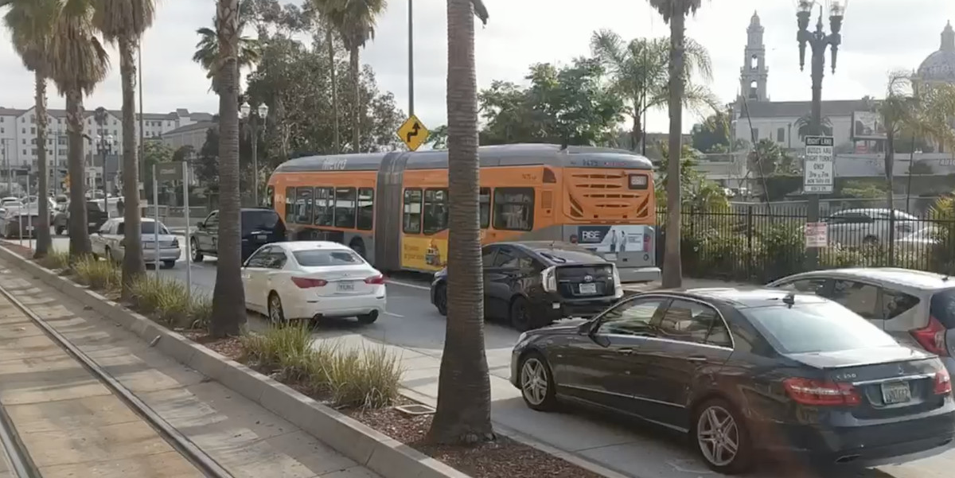
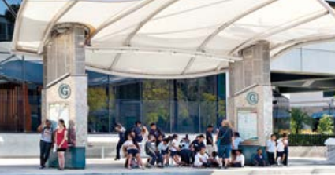
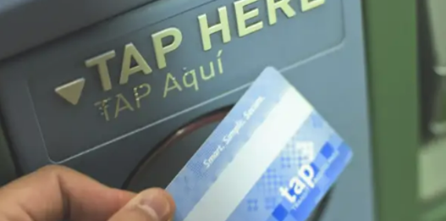
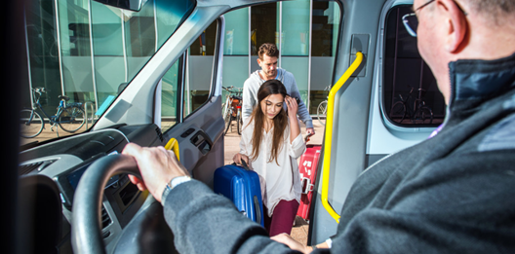
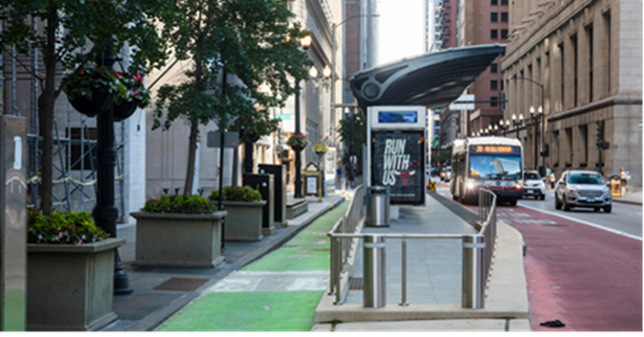
Project & Program Examples Transit (Bus or Rail) Improvements
Transit Service Improvements
Bus Priority Lanes
Improved Transit Amenities
Additional transit routes or increase in frequency of existing services to reduce waiting times at bus stop and train stations.
Bus priority lanes on local streets to improve bus travel times and reliability.
Improved amenities such as lighting, security cameras, shelters at bus stops and at train stations.
Bus Boarding Improvements
Transit Fare Discounts
Shuttle Services
Bus Boarding Improvements
Increased transit fare discounts for low-income riders, students, and seniors.
On-demand transit shuttles (shuttle rides by appointment) in more communities.
Improvements for more efficient bus stopping and boarding such as all-door boarding, and/or design features such as bus bulb-outs or boarding islands
Notes:
Erika

Slide 39
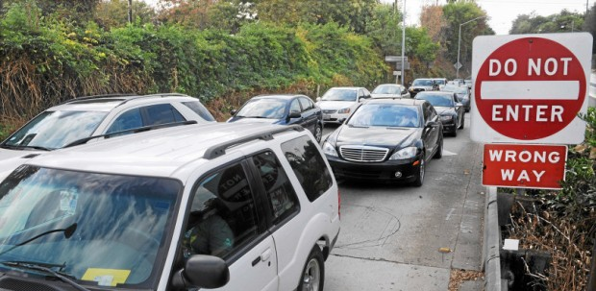

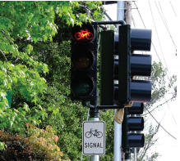
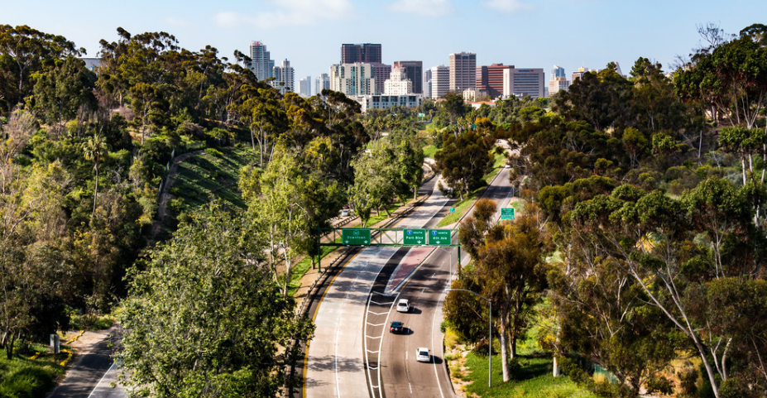
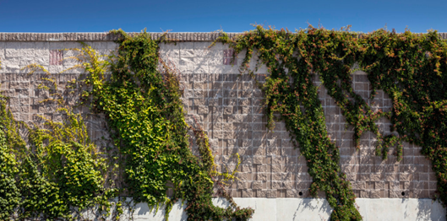
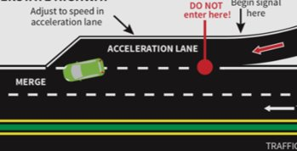
Project & Program Examples Freeway Improvements that Do Not Add Capacity
Interchange Improvements
Zero-emission Truck Lane
Traffic Signals
Introduce improvements that make it safer and easier for vehicles to get on and off the freeway.
Create a dedicated lane on the freeway just for zero emissions trucks.
Control features, such as traffic signals, to protect bicyclists and pedestrians at the freeway ramps.
Landscaping Features
Sound Wall Improvements
Design Improvements
Incorporate landscaping, hardscaping, and other design features along the freeway to improve visual experience.
Higher sound walls along the freeway to reduce noise.
Spot improvements, such as acceleration/deceleration lanes near interchanges, to relieve congestion bottlenecks.
Notes:
Erika- turn over to Michael (ZE)

Slide 40
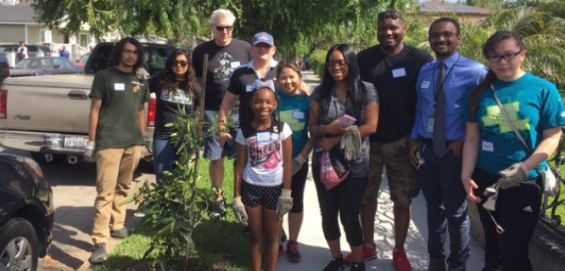
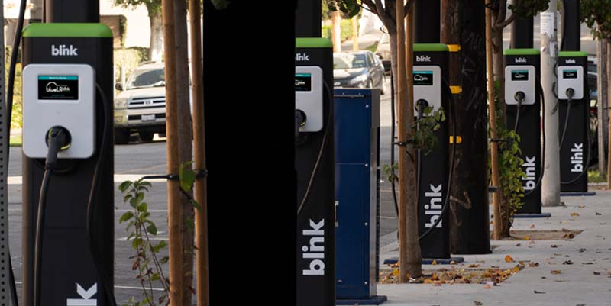
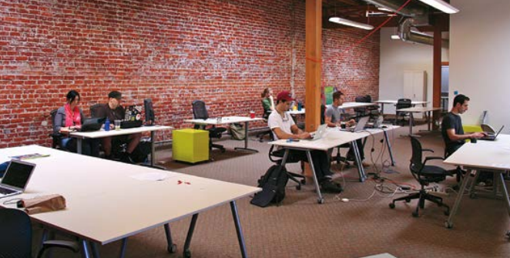
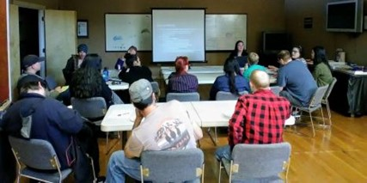
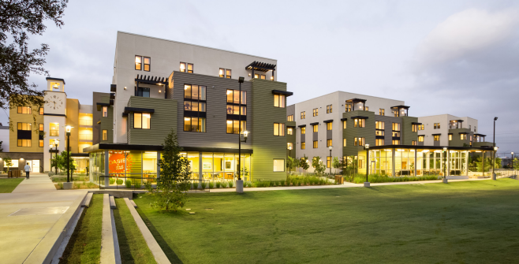
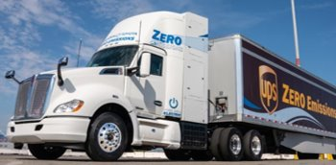
Project & Program Examples Community Programs
Health Benefits Program
EV Car-Share & Charging
Local Hire and Workforce
Development
Air filters for schools or vegetation buffers to reduce the harmful effects of air pollution.
Programs to provide short-term rental of electric vehicles and charging infrastructure for Zero-emission personal vehicles and trucks.
Targeted and local hire programs to increase the share of public dollars that is devoted to creation of local jobs in the communities, and education/training of the local workforce.
Anti-displacement Strategies
Community Development Programs
Zero Emissions Trucks
Affordable housing policies, low-income rental assistance programs, tenants' rights education and legal representation to prevent unjust evictions.
Incentive programs to build affordable and mixed income housing, development of local parks, and other community resources​
Program to reduce diesel trucks in favor of zero emissions trucks
Notes:
Michael
Equity Considerations
Local Hire and Workforce Development (top, far right)
Community Beautification (see community development programs-bottom, middle)

Slide 41
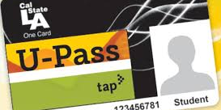
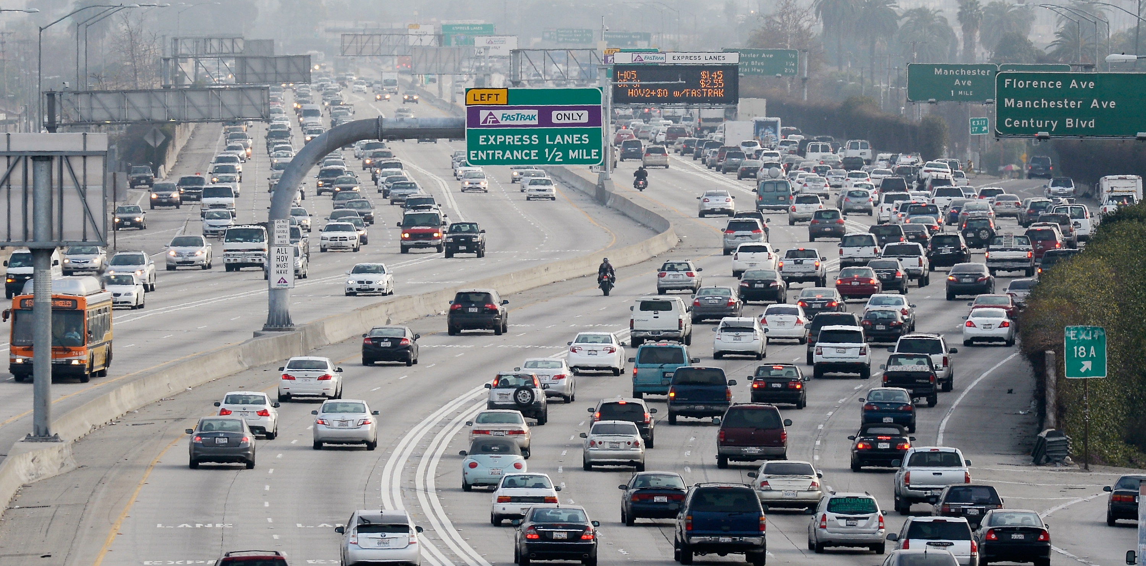

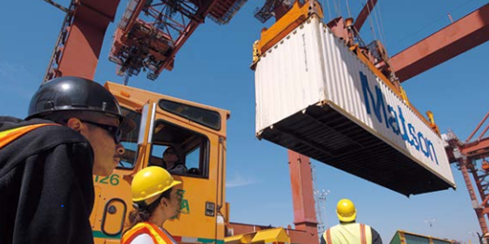

Project & Program Examples Travel Reduction Strategies to Reduce Vehicle Trips
Transit Incentives
Driving Disincentives
Carpool and Vanpool Programs
Provide transit passes to workers or students to encourage transit use.
Parking restrictions, higher parking charges, tolls, and other policies to encourage alternative modes of travel to the automobile.
Programs to increase the number of people traveling per vehicle and reducing single-occupant vehicle trips.
On-Dock Freight Rail Facilities
Short-haul Freight Rail
Freight rail infrastructure in port facilities to reduce truck trips associated with goods movement.
Inland port/implement short haul freight rail service to reduce local truck trips in the Corridor.
Notes:
Michael

Slide 42
Working Group Discussion
What is missing or
needs to be added?
Notes:
Erika/Michael

Slide 43
Agenda Item 4:
Federal Transportation Legislation –
Inflation Reduction Act
Report by Raffi Hamparian, Director of Federal Affairs, LA Metro (15 minutes)
Question and Answer (5 minutes)
Notes:
Erika – introduce Agenda Item/Michael

Slide 44
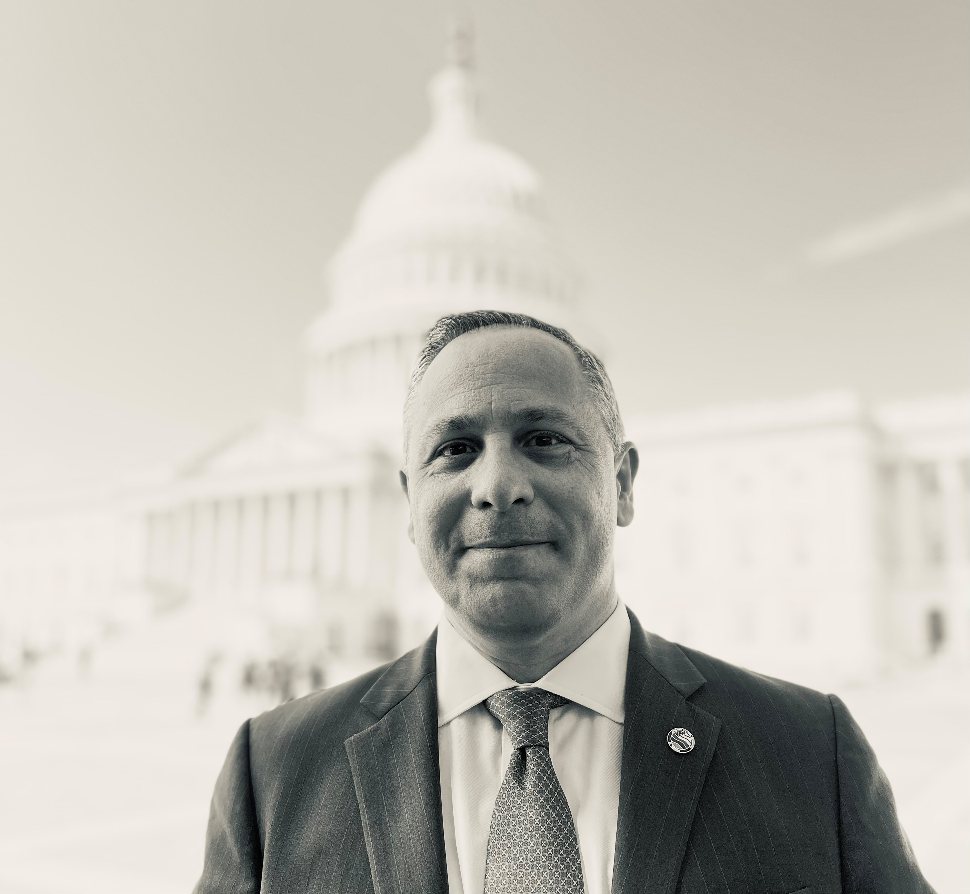
Speaker
Raffi Hamparian
Senior Director of Federal Affairs / Government Relations
LA Metro
Notes:
Michael
Born in New York City and raised in New Jersey, Hamparian is a graduate of Rutgers, the State University of New Jersey, where he also earned a master’s degree in international relations. Hamparian has worked for a number of members of Congress, most recently as the chief foreign affairs aide for former New Jersey Congressman Steven R. Rothman. He currently serves as the director of Federal Affairs for the Los Angeles County Metropolitan Transportation Authority.

Slide 45
Question and Answer
Notes:
Erika/Michael

Slide 46
Agenda Item #5:
Agenda Item #5: Goods Movement Zero-Emission Infrastructure – MSRC Request for Information
Report by Akiko Yamagami, Transportation Planning Manager, Goods Movement Planning, LA Metro
Overview (5 minutes)
Discussion (5 minutes)
Notes:
Erika

Slide 47
Goods Movement Zero-Emission Infrastructure – MSRC Request for Information
Overview
The MSRC has $50 million in Clean Transportation Funding and is seeking willing partners to help facilitate investment in publicly accessible infrastructure to support an equitable transition of goods movement trucks to zero emissions.
Objective – the identification of locations where the MSRC could make Clean Transportation Funding investments in publicly accessible infrastructure.
Purpose
– to enable the transition to zero-emission goods movement, especially for fleets and independent operators who do not domicile at a commercial yard.
– to identify stakeholders who are property owners or those whose interest in a real property would allow the construction of EV and/or H2 refueling infrastructure
Notes:
Akiko

Slide 48
Goods Movement Zero-Emission Infrastructure – MSRC Request for Information
Who Should Respond?
All parties who have a stake in the transition of goods movement trucks to zero-emissions should consider submitting an Information Package under this RFI.
Property owners interested in working with the MSRC to build hydrogen fuel cell and/or battery electric truck EVSE infrastructure on their property.
How to Respond?
Interested parties are asked to submit an Information Package that identifies the respondent’s potential role and available resources to partner with the MSRC to develop zero-emission infrastructure, with a goal to have infrastructure available for use by 2026.
Closes on November 30, 2022
Meeting materials includes the RFI.
For additional information, see http://www.cleantransportationfunding.org/requests-for-proposal/2022/publicly-accessible-goods-movement-zero-emission-infrastructure-rfi
Notes:
Akiko
Who Should Respond?
The Ports
Warehouse, distribution, & logistics facilities that could offer opportunity charging
Logistics real estate and supply chain logistics developers
Truck stops & truck service centers
Trucking companies that could offer daytime opportunity charging/refueling
Trucking companies that could provide overnight opportunity charging for fleets and independent owner-operators, particularly those without a home base for charging
Caltrans
Local governments, including cities, counties, public agencies, etc.
Owners of existing public access electric charging plazas/destination points, hydrogen refueling stations open to capacity expansion, or petroleum fueling stations open to redevelopment
Commercial real estate development companies and service agents
Zero-Emission-related Business Enterprises, including:
Charging as a-Service (CaaS) providers
Trucking as a Service (TaaS) providers
EVSE & H₂ technology providers
Engineering, architecture, construction, & infrastructure development firms
Agencies seeking to leverage their available zero-emission infrastructure funding
County Transportation Commissions
State Agencies
Metropolitan Planning Organization (SCAG)
Local Governments
Nongovernmental organizations & non-profits

Slide 49
Discussion
Notes:
Akiko

Slide 50
Closing Remarks and Next Steps
Notes:
Michael
METRO NEXT STEPS
Protocols for vetting proposals – leveraging of funds
Legislative calendar (Norm Emerson-GCCOG), roadmap-applications-timelines
Additional Technical Support-in addition to Akiko
IMMEDIATE NEXT STEPS
--Slides and Confirmation- Jack Symington-LACI-slides (Susan)-SEPTEMBER
-Refine principles slides in presentation-CEHAJ Letter (Trey)-COMPLETE-draft response
-Michael-Fernando-Susan-Mtg re CEHAJ letter
-Tasks Worksheet Update (Susan has an example)
Agenda Item #6-focused discussions
Submit TCEP application, develop grant application
Finalize $5MM TA expertise
Local hiring policy
Erika
Difference between things we generate and things we are a part of
How do we get the $200 m
How do we use Metros’ unique position in the county
How do we create our own program?
How do we respond to other programs that want to partner with us?
How do we create technical expertise- to develop this program
Technical working group?
Keep to ourselves?
We need to develop our community outreach discussion-formalize it
Have plan in place
Advanced work in outreach
AQMD=scope
COMMUNITY EDUCATION
Akiko-Watson Land-realities of developing infrastructure
rika

Slide 51
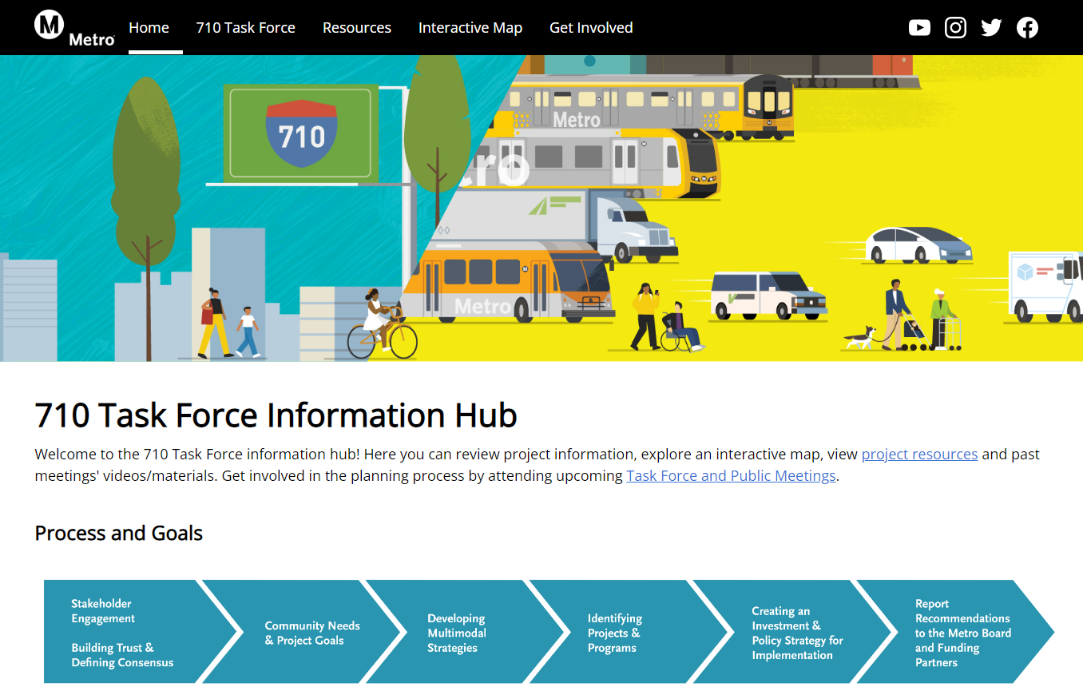
710 Task Force Information Hub
http://www.metro.net/710-hub
Extension of the current Metro.net website
User-friendly site for additional content
Graphics, meeting materials, calendar of meetings, maps, future surveys, and interactive tools
Notes:
Erika

Slide 52
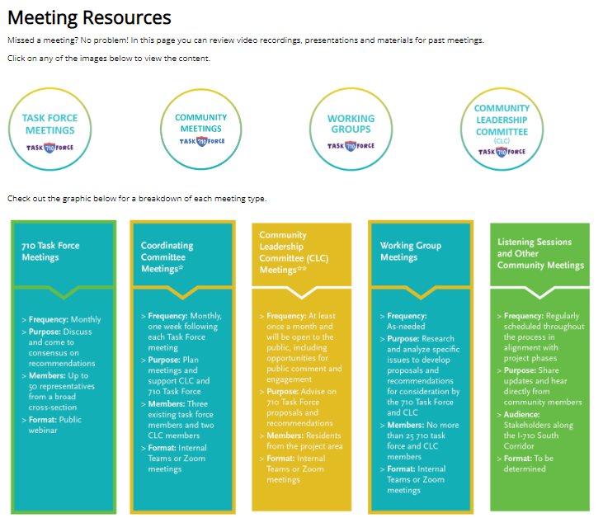
710 Task Force Information Hub
Tool Features:
Infographics on TF process and decision-making process
Meeting Materials
Task force meetings, Community meetings, Working groups & CLC meetings
StoryMap
Demographics, transit and environmental info
Online Surveys (launching soon)
Project Naming Poll
Interactive Mapping & Survey Tool
Contact form
Calendar of Events
Notes:
Erika
https://710-south-corridor-task-force-lametro.hub.arcgis.com/

Slide 53
Key Dates
Working Group Meetings
Equity Working Group #8 Thursday, October 27, 5-7pm
Zero-Emissions Truck Working Group #12
Tuesday, November 15, 1-3pm
Coordinating Committee
Wednesday, October 26, 3:30-5pm
Community Leadership Committee Meeting
Meeting #8
Thursday, October 20, 5-7pm
Task Force Meeting
Task Force Meeting #14
Monday, November 14, 5-7pm
For the most updated list of meeting dates, visit http://www.metro.net/710-hub
Notes:
Erika

Slide 54
Can’t attend the meeting? Reach out to us!
Michael Cano, Executive Officer (Interim) LA Metro
Federal/State Policy & Programming
Countywide Planning & Development One Gateway Plaza, MS 99-13-1 Los Angeles, CA 90012
213.418.3010
710corridor@metro.net
metro.net/projects/i-710-corridor
@metrolosangeles
losangelesmetro
Notes:
Erika

Slide 55
Thank you!
Notes:
Erika

