Slide 1
We will begin in a few moments.
710 Task Force
Zero-Emission Truck Working Group
Meeting #10
September 20, 2022
Notes:
Erika

Slide 2
710 Task Force

Slide 3

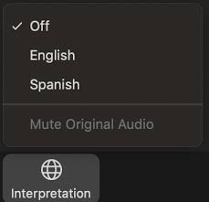
Interpretation/ Interpretación
Click the Interpretation icon in your meeting controls to enter the Spanish room
(Optional) To hear the interpreted language only, click Mute Original Audio
Haga clic en el ícono de Interpretación en los controles de su reunión para ingresar la sala en español
(Opcional) Para escuchar solo el idioma interpretado, haga clic en “Mute Original Audio” o “Silenciar audio original”

Slide 4
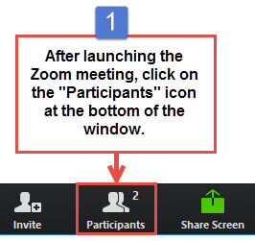
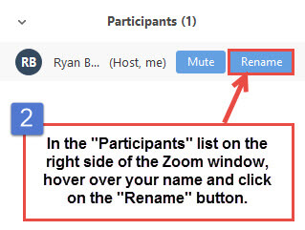
Task Force Member, CLC Member, and Participant Identification
Please change your Zoom screen name to include: Name and Organization Name (and if you are a Task Force Member, CLC Member)

Slide 5

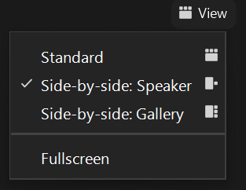
Turn on Camera / Prende la cámara
To start and stop your video, click the camera icon at the bottom left of your control panel
Para iniciar y detener su video, haga clic en el ícono de la cámara en la parte inferior izquierda de su panel de control
To switch between views during the meeting click or tap on Standard, Side-by-side Speaker View, and Side-by-side Gallery View at the top right corner of your zoom screen
Para cambiar entre vistas durante la reunión, haga clic o toque Estándar, Vista de orador en paralelo y Vista de Galería en Paralelo en la esquina superior derecha de la pantalla de zoom

Slide 6
Zoom Protocols
Click Raise Hand in your meeting controls or
Press*9 on the phone line.
To lower your hand, click Raise Hand in your meeting controls.
Comments & questions can also be provided in writing by using the Chat function.
The Chat button is located on the control panel at the bottom of your screen.

Slide 7
710 Task Force
Zero-Emission Truck Working Group
Meeting #10
September 20, 2022
Notes:
Erika

Slide 8
Welcome, Agenda Review, and Purpose of the
I-710 South Corridor Zero-Emission Truck (ZET)
Working Group

Slide 9


Meeting Objectives
Receive presentations and engage in discussion on the following topics:
Applying Best Practices of Getting to ZERO to the 710 South Corridor Infrastructure
Regional EV Charging Study to Accelerate Electrification
Is the Electric Grid Ready?
2019 Electric Vehicle Charging Guidebook for Medium-Duty and Heavy-Duty Commercial Fleets
EV Charging Infrastructure for Southern California Warehouses
Engage in a discussion on the next steps in developing the ZET Program.
Notes:
Agenda Item 3 RESOURCE: https://www.transportation.gov/sites/dot.gov/files/2022-05/USDOT-BIL-Innovation-Fact_Sheet-Master.pdf

Slide 10
Detailed Agenda
1:00pm 1:05pm | Welcome, Agenda Review, and Purpose of the Zero-Emission Truck Working Group (5 minutes) Agenda Item #1: Metro Update (5 min) ZET Program – Metro Board Direction
1:10pm 1:15pm 1:40pm | Agenda Item #2: I-710 South Corridor Zero-Emission Truck Program Proposed Principles (5 minutes) Agenda Item #3: Medium-Duty and Heavy-Duty Infrastructure, Global Commercial Vehicle Drive to Zero Presentation by Bill Van Amburg, Global Strategic Advisor Zero Emission Commercial Vehicles, Energy and Sustainability (15 minutes) Facilitated Discussion (10 minutes) Agenda Item #4: Regional Roadmap for Zero-Emission Vehicle Infrastructure Overview by Alison Linder, Senior Regional Planner, Southern California Association of Governments (10 minutes) Question and Answer (5 minutes)
1:55pm 2:25pm | Agenda Item #5: If EV’s are the Future, is the Grid Ready? (30 minutes) Moderator: Micah Wofford, Energy Commission Specialist, California Energy Commission Panel Discussion Sean Wilder, Energy and Environmental Services, LA County Internal Services Department Salim Youssefzadah, CEO, WattEV Quintin Sumabat, Deputy Executive Officer, Vehicle Engineering and Acquisitions, LA Metro Agenda Item #6: 2019 Electric Vehicle Charging Guidebook for Medium-Duty and Heavy-Duty Commercial Fleets (10 minutes) Presentation by Patrick Couch, SVP, Gladstein, Neandross, and Associates Question and Answer (5 minutes)
2:45pm 3:00pm | Agenda Item #7: Electric Vehicle Charging Infrastructure for Southern California Warehouses – MAERSK Performance Team Report Report by Carlo Bertani, MAERSK (10 minutes) Question and Answer (5 minutes) Closing Remarks and Next Steps
Notes:
Agenda Item 3 RESOURCE: https://www.transportation.gov/sites/dot.gov/files/2022-05/USDOT-BIL-Innovation-FactSheet-Master.pdf

Slide 11
Agenda Item #1.1:
Metro Board Update

Slide 12
Metro Board Update
Metro Staff to report to Board on the following:
Board approved Motion #9 (Directors Hahn, Solis, Mitchell, & Dutra) that provided direction for the development of the I-710 South Corridor Investment Plan. Motion #9 also asked for the following items to return to the Board for consideration:
Vision Statement / Guiding Principles / Goals
Pre-Investment Plan Opportunity
Re-naming the I-710 South Corridor Project This Board report provides recommendations for all items requested.
September 2022 710 Task Force Report to the Metro Board of Directors
Notes:
Michael

Slide 13
ZET Program Recap – Metro Board Direction
Metro Board Direction and desired outcomes
$200 million minimum funding target
Leverage $50 million local matches with private, regional, state, and federal funding
Accelerated ZE deployment in the I-710 South Corridor
Collaboration with regional stakeholders
Independent, accelerated process from overall 710 Task Force Investment Plan process
Strategies to accomplish outcomes
Identify discretionary grant opportunities
Convene and collaborate with community and regional stakeholders
Develop a scope of work for the ZET Program
Identify regional funding partners
Identify near and long-term opportunities
Identify policy and legislative barriers to implementation
Notes:
Michael

Slide 14
Agenda Item #2:
I-710 South Corridor ZET Program
Proposed Principles

Slide 15
ZET Program Principles – Introduction and Overview
Metro Board Action in October 2021 (Motion 16) committed $50 million as seed funding for an I-710 South Zero Emission (ZE) Truck program to support the deployment of zero-emission trucks and supporting zero-emission truck infrastructure.
The ZET Program Framework and Principles incorporate these fundamental elements and seek to leverage and amplify that $50 million seed funding.
The Program Framework and Principles for the Zero-Emission Truck Program were developed through collaboration with the 710 Zero-Emission Truck Working Group. Five major themes were brought forward through discussions with the Working Group for consideration:
Community Engagement
Strategic partnerships and funding opportunities
Legislative and policy initiatives
Truck subsidies
Environmental impacts and equitable outcomes

Slide 16
ZET Program Principles – Introduction and Overview
Principle 1 | Maximize leverage of seed funding by collaborating with regional partners and agencies.
Principle 2 | Employ a transparent community engagement framework that centers corridor residents and stakeholders throughout the development process and ensures community benefits are uplifted when considering investments.
Principle 3 | Ensure and create corridor community benefits delivered through the ZE Truck Program.
Principle 4 | Coordinate ZE Truck Infrastructure Deployment and ZE Truck Strategies with planning, funding, and strategy developed by regional and community partners, state and federal agencies, funding partners, and other key stakeholders.
Principle 5 | Work with regional and community partners to prioritize workforce development efforts that ensure community benefits in support of ZE truck and infrastructure deployment.
Principle 6 | Develop performance metrics and evaluate outcomes of the ZE Truck Program that ensure community and corridor benefits.
Principle 7 | Develop a comprehensive legislative platform for board consideration that comprises initiatives and policies designed to support the accelerated, equitable deployment of ZE Class 8 Truck and Infrastructure deployment in the I-710 South Corridor and region.
Principle 8 | The ZE Truck Program will expedite investment in ZE Infrastructure and vehicle deployment within the corridor with the goal of leveraging and expending all ZET Program leveraged resources by FY 2027-28.

Slide 17
ZET Proposed Principles
Next Steps
Community Leadership Committee (CLC) to provide input on Thursday, September 22nd.
Equity Working Group (EWG) to provide equity-focused input on Thursday, September 29th.
At the October 18th ZET Working Group Meeting, the ZET Working Group:
Review input CLC and EWG
make final refinements to the ZET Proposed Principles
Review recommendations to the Task Force on November 14th.
Metro Project Team to present the ZET Principles with the Metro Board of Directors at its November 2022 Meeting.

Slide 18
Agenda Item #3:
Medium-Duty and Heavy-Duty Infrastructure,
Global Commercial Vehicle Drive to Zero
Presentation by Bill Van Amburg,
Global Strategic Advisor Zero Emission Commercial Vehicles, Energy and Sustainability
(15 minutes)
Facilitated Discussion (15 minutes)

Slide 19

Speaker
Bill Van Amburg
Global Strategic Advisor Zero Emission Commercial Vehicles,
Energy and Sustainability
Notes:
Bill Van Amburg has over 40 years of experience, including technology development, commercialization and marketing.
He is considered an industry expert in advanced technologies for transportation.
Bill is the Initiative leader for the medium- and heavy-duty truck and off-road equipment sector, the largest practice area at CALSTART.

Slide 20



MHDV Infrastructure – Policy Maker Guidance
For Metro I-710 Task Force
September 20, 2022

Slide 21
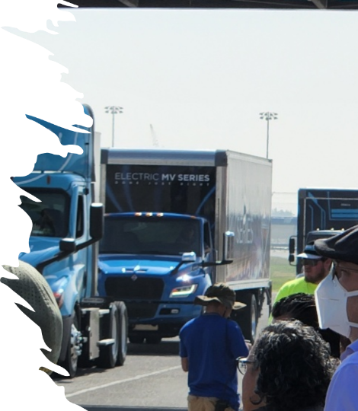
Agenda
Context – Pace of Change
Drive to Zero and Policy Maker Engagement
MHDV ZE Infrastructure Guidance
Demand Forecasting
Remaining Gaps

Slide 22
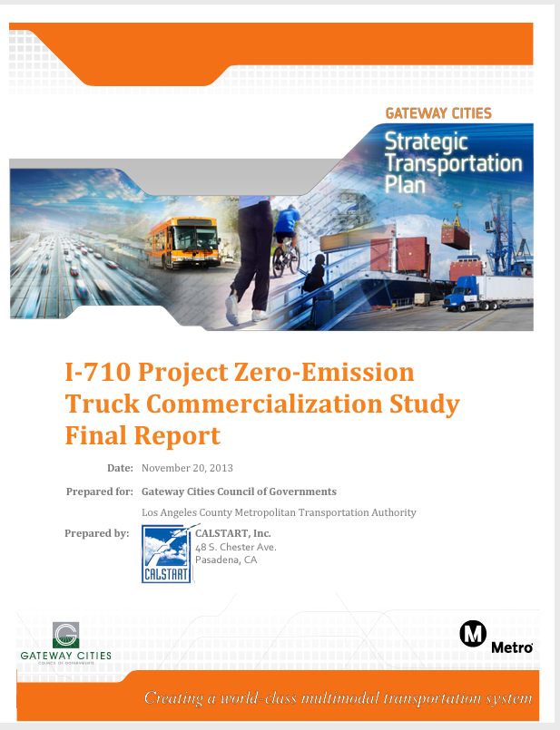
I-710 Zero-Emission Drayage Truck
Commercialization & Phase-In Process
Tech Validate
& Demonstrate
Pre-production
Deploy &
Assessments
Early
Production
Deployments
Pre-Production ZE Drayage Trucks; Deploy Infrastructure; Expand Supporting Markets
Assess Pre-Production ZET;
Expand Infrastructure
ZE Drayage Truck Production & Ramp-Up
Expand Tech Capability; Infrastructure Framework;
Build Supporting Markets; Business Model
Stage 4
Stage 3
Stage 2
Fleet, maintenance training
Final infrastructure deployment
ZE Truck Incentives, Operational
Requirements
Phase in
Stage1
Broader Infrastructure deployment
Assess & Validate vehicles
Install pilot infrastructure
Expand ZE vocational deployments
Regulations or Requirements Established
Develop Infrastructure Plan
Business Case Refinement
Support Additional ZE Markets
OEM Council
ZE Yard hostlers
Early Production Wave 1
Targeted ZE Drayage Demos
Enabling tech
ZET Pre-Production
ZET Pre-Production
User Incentives
Production Ramp-up – Phase-In
Assess
2013 2014 2015 2016 2017 2018 2019 2020 2021 2022 2023 2024 2025
https://calstart.org/libraries-i-710_project-i-710_project_zero-emission_truck_commercialization_study_final_report-sflb-ashx/

Slide 23


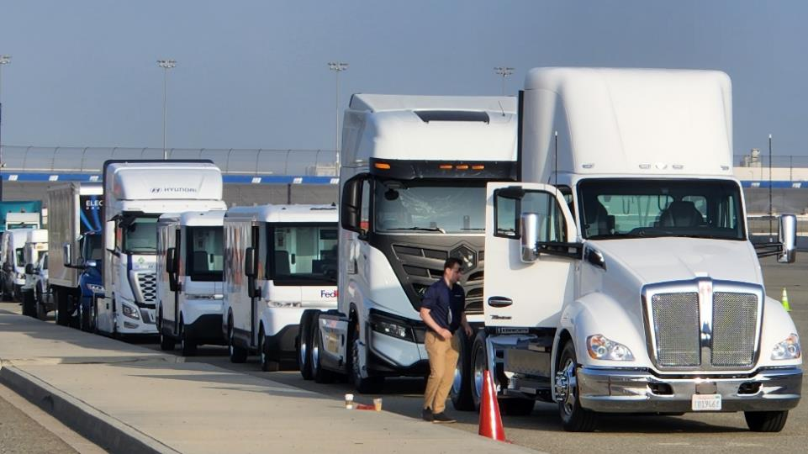

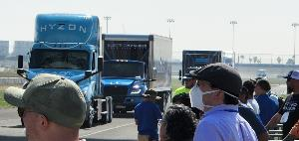
38 products available now 500+ attendees
www.calstart.org/cctupdate

Slide 24
Zero-emission vehicles are coming in waves, taking foothold in beachhead applications where technology is ready first
Notes:
Deployment of ZE trucks follows a well-established strategy where ZE technologies will come in waves, taking hold first for transit buses because of predictable routes and the ability to charge at depots overnight. See wave 1 in chart.
We call those beachheads, using a military term where you first secure your territory to then advance.
Technology transfer. All investments in battery technology, powertrain and components can be transferred to other applications such as shuttle vans, urban delivery vans (wave 2), and MD regional delivery (wave 3). This can all be accomplished in the short/medium term. From there, the same investments can then be leveraged to larger and long-distance applications.
In short, success comes from growth of core supply chains, transferring similar powertrain and components across applications. As technology matures, they expand across applications and get more affordable as each succeeding market builds volume.
The beachhead strategy, which we developed jointly with CARB and that informed CARB’s investment strategy and HVIP, sets the pace of ZE technology commercialization based on tech readiness by application and potential for technology transfer as technology matures and market expands.
Although the first beachheads for on-road are transit buses and urban delivery vehicles, ZE class 8 tractors are also advancing much faster than expected. They’re emerging now for regional haul, in the next 2-3 years for longer haul, and after 2025 for long haul. Project 800 is a clear example of this trend.

Slide 25
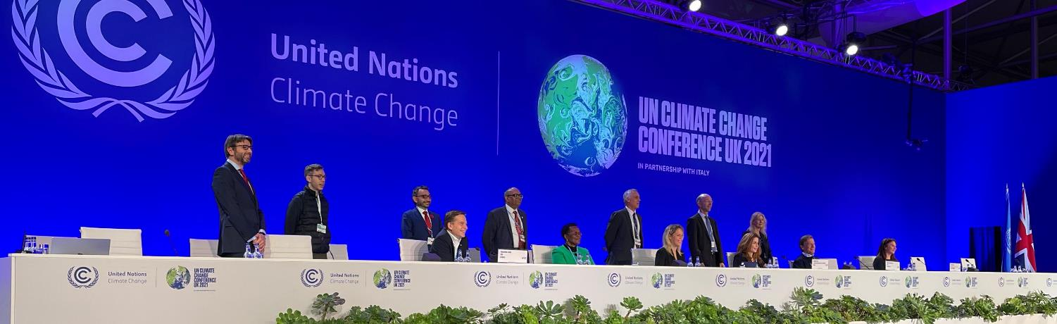
















Global MOU – the first international agreement on zero-emissions trucks and buses
Share of new MHDVs that are zero emissions
100% by 2040
30% by 2030
Austria
Canada
Chile
Denmark
Finland
Portugal
Uruguay
Switzerland
Luxembourg
Netherlands
New Zealand
Norway
Scotland
Wales
United Kingdom
Turkey
Notes:
During COP26, for the first time 15 leading countries and over 35 subnational governments and industries aligned on a common ambition toward 100% zero-emission trucks and buses by 2040 latest and at least 30% new sales by 2030..
There’s a good degree of diversity in these set of countries, including representation from the Americas, Europe and Asia-Pacific, different sizes (from Canada to Luxembourg) and levels of economic development (from Norway to Uruguay).
This sector has never been unified, and just 2 years ago, we’d never imagine that HDVs would be even close to catching up with LDVs, but now that’s within reach.
There are some large markets missing from this list - most notably China, US and Germany – and we hope to build their support this year.
So this group of countries need to grow.
Besides growing the group: we need to make this ambition a reality. That is the main challenge: And for that we need active engagement with industry

Slide 26






Global MOU goes beyond (non-binding) targets, and establishes a forum supporting countries to develop action plans to meet the targets, and monitoring progress through robust, consistent, and transparent data reporting
Action Plan
Data Reporting and Progress Dashboard
Forum to report progress and exchange lessons
Policy ecosystem
Regulations
Incentives
Investments
Non-binding Targets

Slide 27
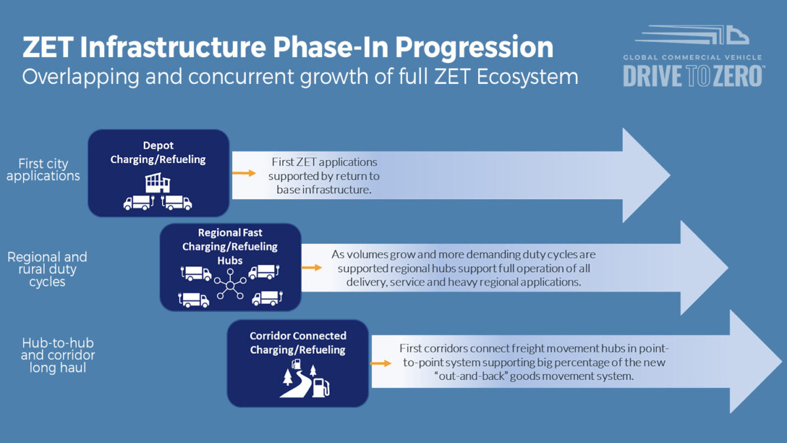
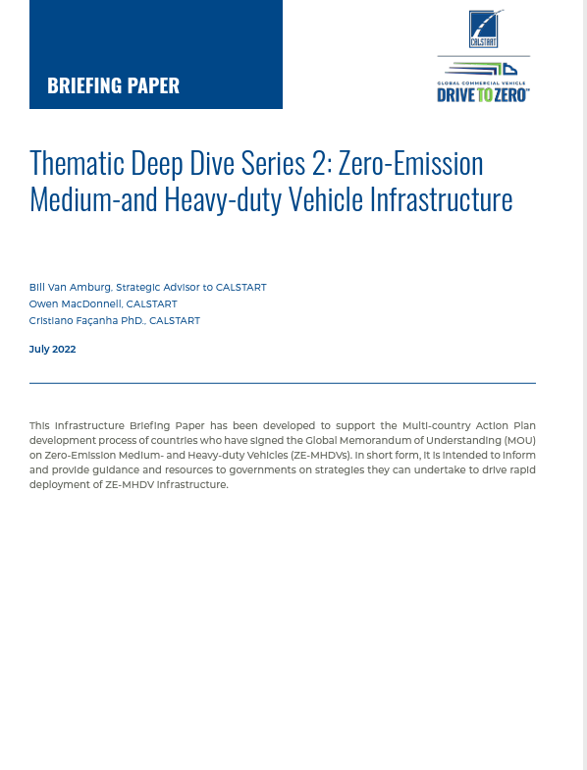
Context for Infrastructure – Guidance to Policy Makers
https://globaldrivetozero.org/publication/tdd2_infrastructure/

Slide 28
Core Guidance to Global Policy Makers
Zero-Emission MHDVs are ready for greatly expanded deployments in all regional applications and emerging longer range routes.
Infrastructure is a critical enabling capability and potential limiter that must keep pace with and anticipate the rapid growth of ZE-MHDVs or risk slowing the market.
Do not delay policy adoption and vehicle implementation because of either/or technology choices; battery electric and fuel cell electric systems are complementary.

Slide 29
Infrastructure Guidance – Key Actions for Government
Utility investment regulatory framework - Plan for, invest in and take an active role in installing ZE-MHDV infrastructure at the pace required to meet rapid market growth.
Utility rate structure – Encourage and require utilities and power providers to design competitive and conducive rate structures to users of zero emission commercial vehicles. Addressing electrical rate cost, time of day considerations, demand charges and other utility rate design structures and refining them for commercial vehicle success is critical.
Roadmapping and anticipating demand – Establish strong ZE-MHDV market demand roadmaps to assist utilities, transport ministries, municipalities and industry in preparing for and anticipating demand for charging and refueling assets needed to accommodate the rapid growth of ZECVs. An overlay of utility distribution grid capacity showing stronger and weaker zones for energy delivery, will highlight areas that can accommodate immediate demand and those needing capacity expansion investments.
Spurring Early Markets and Investments – Support the initial market for ZE-MHDV infrastructure and in establishing attractive conditions for private investment and capital to quickly scale these markets and assume their primary role in funding this expansion.

Slide 30
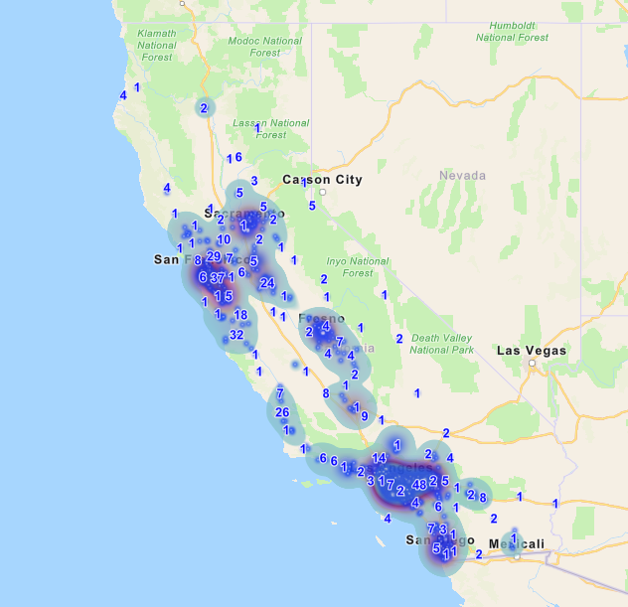
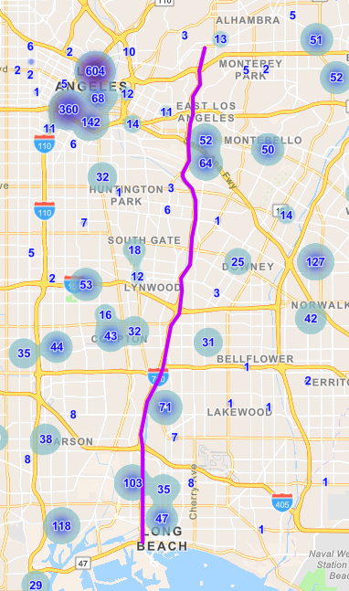
From: HVIP data

Slide 31
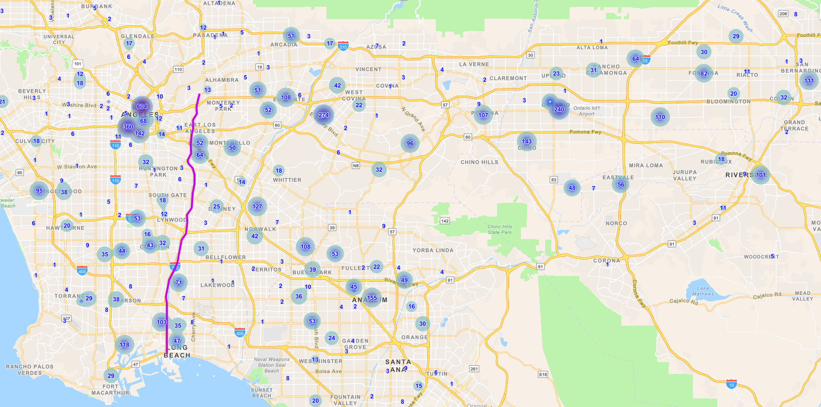
Regional Approaches Support Better Local Decisions

Slide 32
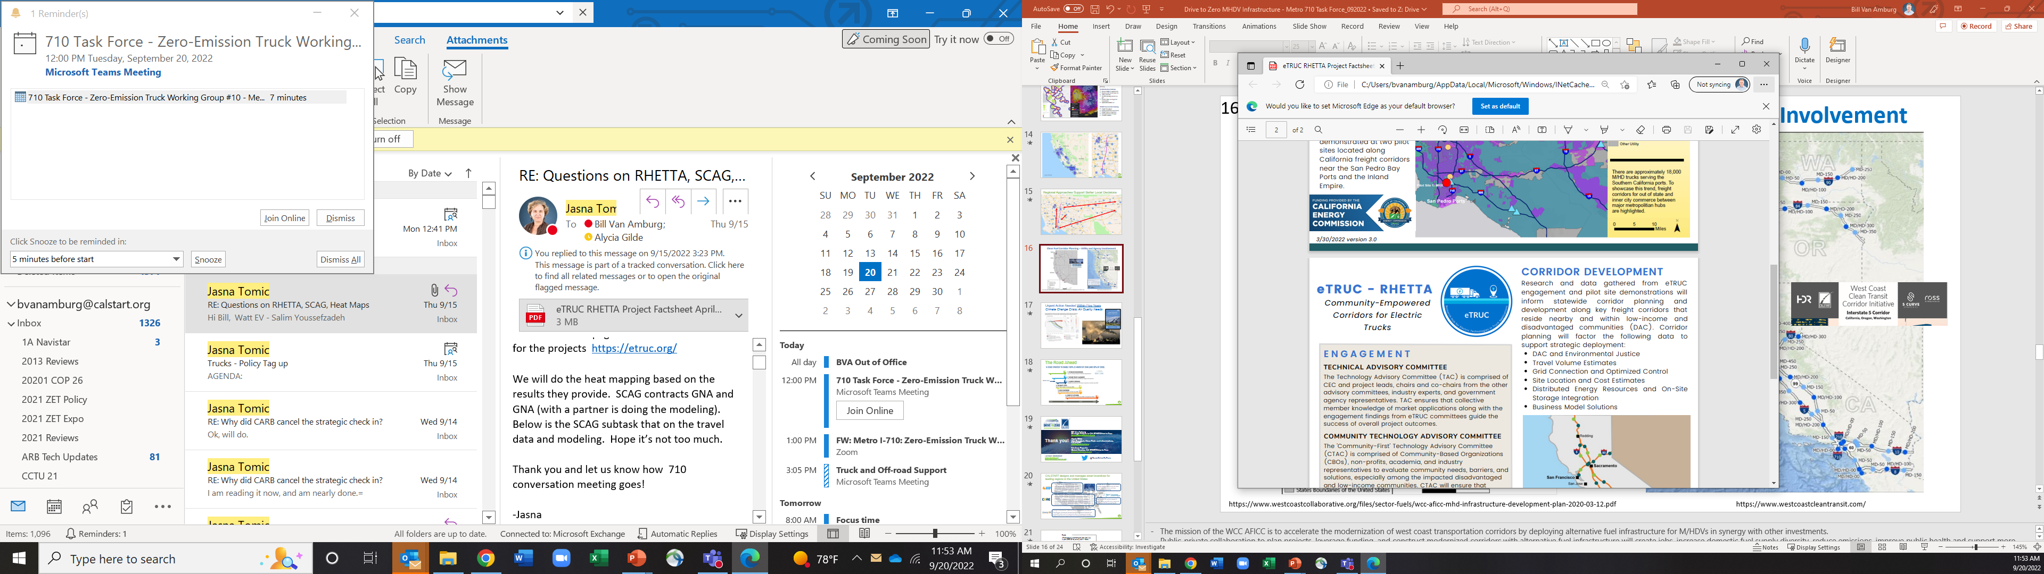
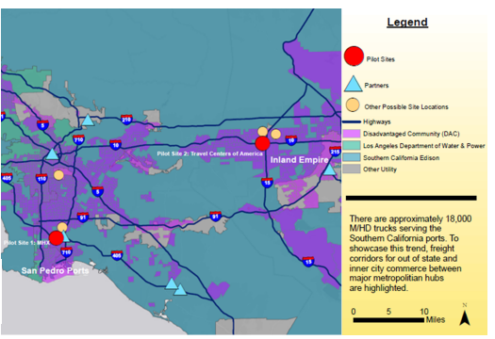
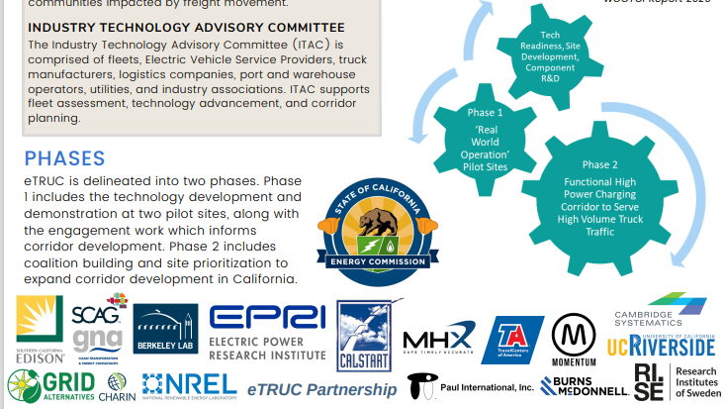

Slide 33
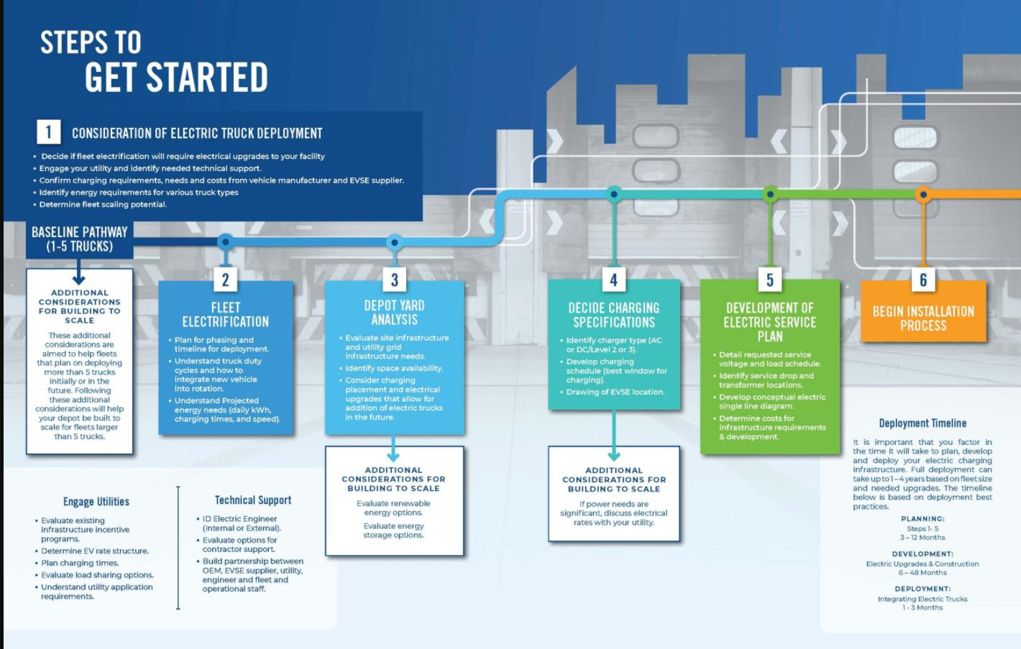

https://www.californiahvip.org/infrastructure/

Slide 34
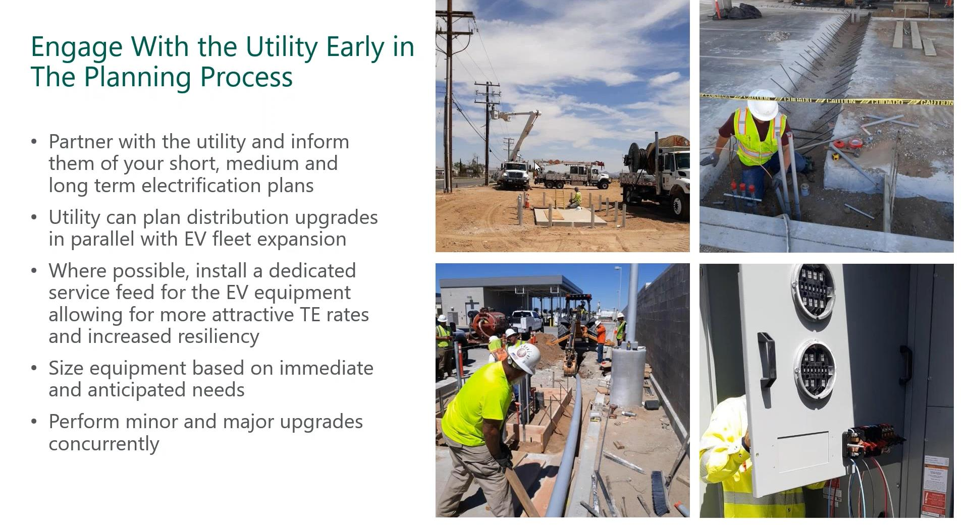

x

Slide 35
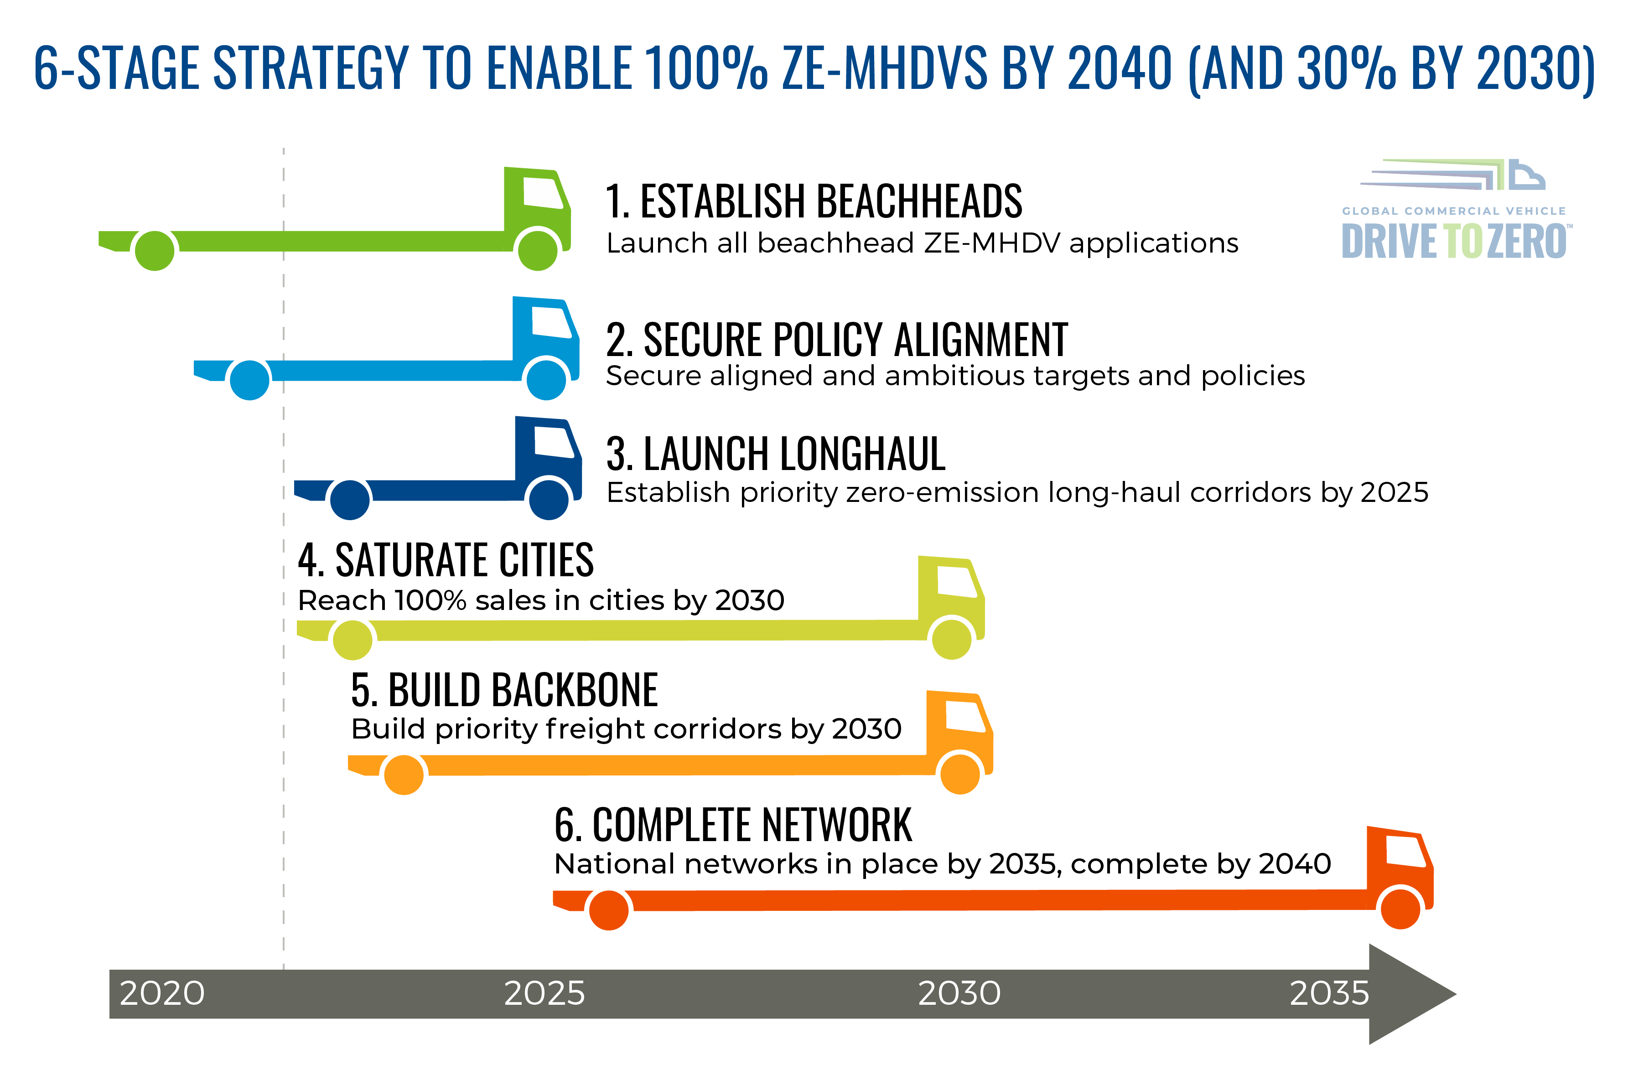
The Road Ahead
We Are Here

Slide 36



Thank you!
Bill Van Amburg
Strategic Advisor to CALSTART/Drive to Zero
bvanamburg@calstart.org
Alycia Gilde
Vice President, Clean Fuels and Infrastructure, CALSTART
agilde@calstart.org
Cristiano Façanha Global Director, CALSTART/Drive to Zero cfacanha@calstart.org
For more information: www.calstart.org; www.globaldrivetozero.org
@TeamDriveToZero

Slide 37
Agenda Item #4:
Regional Roadmap for
Zero-Emission Vehicle Infrastructure
Overview by Alison Linder, Senior Regional Planner,
Southern California Association of Governments (10 minutes)
Question and Answer (5 minutes)

Slide 38
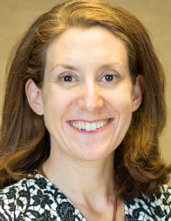
Speaker
Alison Linder, Phd
Accelerated Electrification Team and Clean Technology Program
Southern California Association of Governments
Notes:
Alison Linder is a Senior Regional Planner at the Southern California Association of Governments (SCAG) where she works on transportation, sustainability, resilience, and environmental justice.
As a Clean Cities Coordinator, she focuses on strategies and partnerships to advance zero and near zero emission technologies across modes such as passenger, transit, freight and new mobility.
She also leads the SCAG Accelerated Electrification Team and Clean Technology Program to set a regional vision for a zero emission transportation system and to support the region in implementation.

Slide 39
Supporting Infrastructure for Medium and Heavy Duty Zero Emission Trucks
Metro ZE Truck Working Group
September 2022
Alison Linder, PhD
linder@scag.ca.gov

Slide 40
ABOUT SCAG
Notes:
Populatiion udate is 18.6M

Slide 41

Clean Technology Vision
Introduction
Connect SoCal 2020 included the Accelerated Electrification Key Connection, creating a holistic and coordinated approach to de-carbonizing or electrifying passenger, transit and goods movement vehicles and a vision for a zero-emission transportation system or using cleaner mobility options where zero emission options are not feasible.
Notes:
Good morning, I’m Alison Linder, I work for the Southern California Association of Governments,
One of our core functions is to create a regional transportation plan to set a vision for the region and this happens every four years. Our last plan included a vision for zero emission transportation wherever possible with the use of cleaner mobility options where not feasible.
GM vision

Slide 42
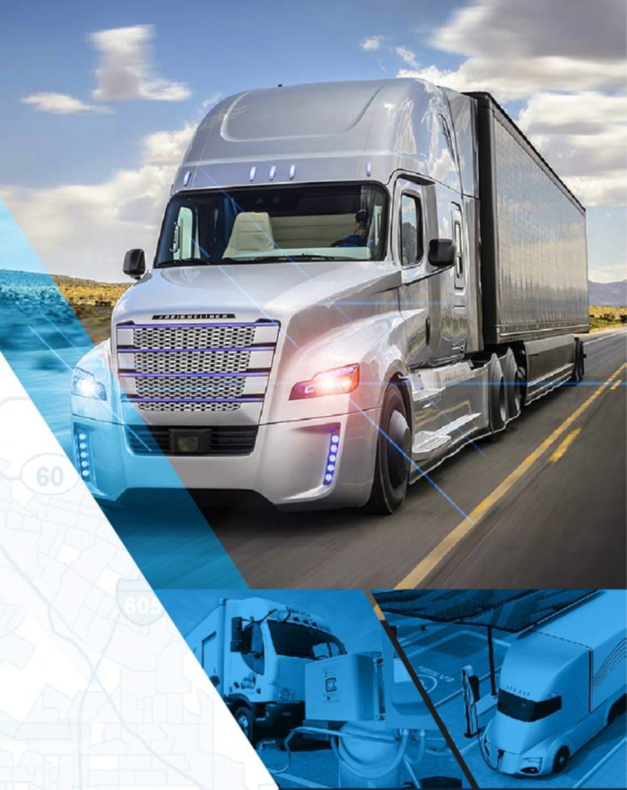
Supporting Infrastructure for Medium and Heavy Duty Zero Emission Trucks
SCAG Work – Research, Evaluation and Planning –MD/HD ZE Trucks
Goals and Objectives
Plan for Zero Emission Supporting Infrastructure focused on both Battery Electric and Hydrogen Fuel Cell trucks
Understand and address stakeholder concerns and needs
Understand site level needs for station development
Create a Regionally Supported Roadmap for MD/HD ZE Fueling Infrastructure
Notes:
The goal of doing this study and creating this plan was put forth in the 2020 Connect So Cal Plan.
We consulted with regioal partners and began putting an RFP together to address this.
This study will create a phased blueprint and action plan towards realizing this goal, and answer key questions about how stations in the region may operate to serve different truck markets and business functions. Though convened by SCAG, this study will be guided by a Technical Advisory Committee of key stakeholders, who will ultimately be instrumental in implementing this plan. Details related to the quantity, distribution and characteristics of charging and fueling stations will be quantified to the extent possible to help visualize and plan for infrastructure needs and investments. Up to 10 sites will be selected to provide a closer look at the needs of deploying an individual station.
oal is to create a regionally supported roadmap, which prioritizes locations and describes a phased approach to regional deployment
Partially funded by California Energy Commission (CEC) Research Hub for Electric Technologies in Truck Applications (RHETTA) grant as a sub-recipient to the Electric Power Research Institute (EPRI).
Will be doing regional identification of station locations to support their selection of demonstration sites for high powered charging technology
Additional funds to understand H2 powered ZE trucks
Potential new sources to understand grid capacity

Slide 43
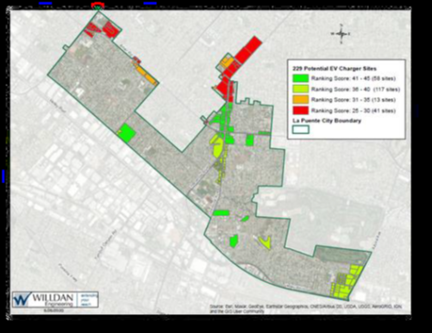
Supporting Infrastructure for Medium and Heavy Duty Zero Emission Trucks
SCAG Work – Research, Evaluation and Planning –MD/HD ZE Trucks ​
Expected Tasks and Deliverables
Refined understanding of truck markets, travel patterns, and relevant operational characteristics
Define demand of Charging Network by Market
Assessing the potential supply of land for stations
Distribution of Charging network; based on
Travel demand
Existing stations
Power and fueling supply
Potential Impacts to Surrounding Communities
other TBD
Notes:
Refined understanding of truck markets, travel patterns, and relevant operational characteristics
Define demand of Charging Network by Market
Assessing the potential supply of land for stations
Distribution of Charging network; based on
Travel demand
Existing stations
Power and fueling supply,
Potential impacts to surrounding communities
Other
Stakeholder Engagement and Outreach
Fleet Survey
Interviews
TAC
Assessment of 10 key sites
A regional action plan supported by participating stakeholders
Partner agencies, industry, land owners, developers, fleet operators etc
Final report
The first part of the study will focus on understanding the demand for medium and heavy duty charging as well as assessing the potential supply of land available for these stations.
We will have an analytical component to understand the behavior of different truck markets to better understand where they are likely to charge. Similarly, we need to know what amount of charging will already be provided by private fleets and therefore what the need is for charging that is publicly accessible.
We would then create a plan that distributes stations across the region in the prioritized locations.

Slide 44
Supporting Infrastructure for Medium and Heavy Duty Zero Emission Trucks – Expected Outreach
TAC
What are the characteristics of the drive?
Shift lengths, drive times, stop times, load size
What are current and future plans for infrastructure provision?
Stakeholder Surveys and Interviews
Fleet operators
Warehouse operators
Industry associations
Truck drivers
Terminal operators
Intermodal facilities
Truck stop owners/operators
DCFC network providers

Slide 45
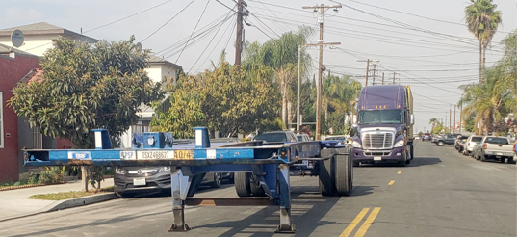
Supporting Infrastructure for Medium and Heavy Duty Zero Emission Trucks
SCAG Work – Research, Evaluation and Planning –MD/HD ZE Trucks ​
Expected Tasks and Deliverables (Continued)
Stakeholder Engagement and Outreach
Fleet Survey
Interviews
TAC
Assessment of 10 key sites
A regionally vetted action plan
Notes:
Refined understanding of truck markets, travel patterns, and relevant operational characteristics
Define demand of Charging Network by Market
Assessing the potential supply of land for stations
Distribution of Charging network; based on
Travel demand
Existing stations
Power and fueling supply,
Potential impacts to surrounding communities
Other
Stakeholder Engagement and Outreach
Fleet Survey
Interviews
TAC
Assessment of 10 key sites
A regional action plan supported by participating stakeholders
Partner agencies, industry, land owners, developers, fleet operators etc
Final report
The first part of the study will focus on understanding the demand for medium and heavy duty charging as well as assessing the potential supply of land available for these stations.
We will have an analytical component to understand the behavior of different truck markets to better understand where they are likely to charge. Similarly, we need to know what amount of charging will already be provided by private fleets and therefore what the need is for charging that is publicly accessible.
We would then create a plan that distributes stations across the region in the prioritized locations.

Slide 46
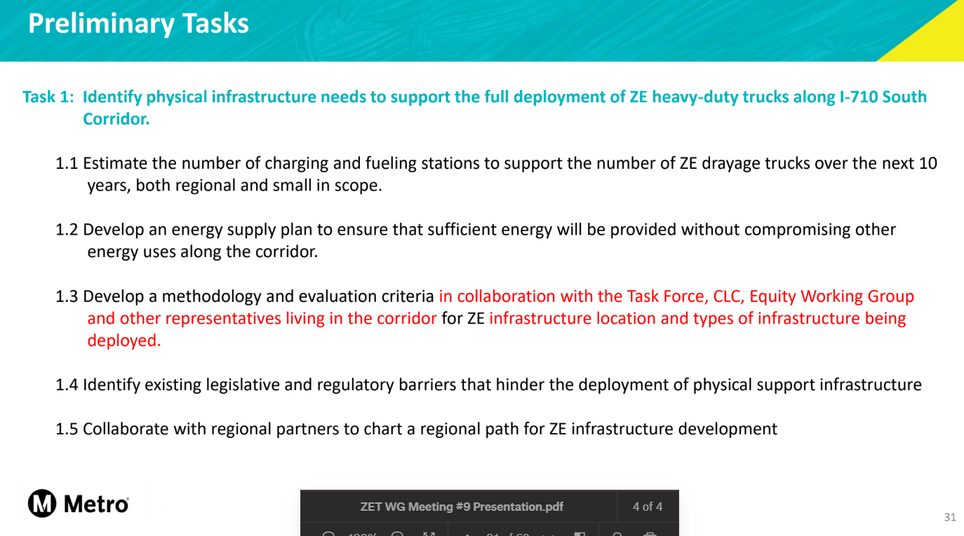
Collaboration with Metro and Regional Stakeholders
SCAG Work – Research, Evaluation and Planning –MD/HD ZE Trucks ​
Overlap with Metro Task 1
Our plan covers key routes and locations in 6 counties
Notes:
Want to support Metro and learn from the work already gong on as much as possible.
We are working on similar things with similar goals, and we can learn from each other.

Slide 47

Timeline and Next Steps
Kick-off
Convene Project TAC
Determine Data Plan to Define Truck Network
Anticipate 24 month project
Initial findings in 2024 Connect So Cal
(Potentially) Supplemental work on Power Supply
Notes:
Market understanding and energy demand
Location identification and phasing
Initial Site planning
Outreach throughout

Slide 48
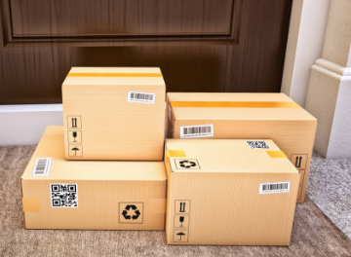
Everything you buy
touches a truck at some point!​
https://scag.ca.gov/alternative-fuels-vehicles

Slide 49
Agenda Item 5:
If EV’s are the Future, Is the Grid Ready?
Moderator: Micah Wofford, Energy Commission Specialist, California Energy Commission
Panel Discussion
Sean Wilder, Energy and Environmental Services, LA County Internal Services Department
Salim Youssefzadah, CEO, Watt EV
Quintin Sumabat, Deputy Executive Officer, Vehicle Engineering and Acquisitions, LA Metro
Notes:
Moderator talking points
Highlight relevant points from Bill Van Amburg and Allison Linder's presentations
Ensuring infrastructure is built to meet the needs and demands of the 21st century
Not just fixing today's infrastructure, we are rebuilding new infrastructure to meet these needs
What Metro might be able to do as a partner in these efforts to bring resources from the state and federal government
Identify where there is electricity capacity today for possible locations for siting charging stations
We are heading towards an EV future and are anticipating a large wave of heavy-duty ZETs coming online in the next couple of years
Hearing issues around infrastructure
Permit and siting challenges in relation to grid capacity
Aging infrastructure, need to upgrade energy infrastructure (grid in place to bring sufficient energy)
Site identification
Speaker intro (1 min each)
George – Highlight 1-2 challenges they've faced in establishing heavy-duty fleet charging sites
Salim – What challenges did you face in developing your charging facility near the ports?
Key Questions to focus discussion
How can we work together with utilities? Will utilities provide a map to assist in the siting of charging stations on where capacity exists today?

Slide 50
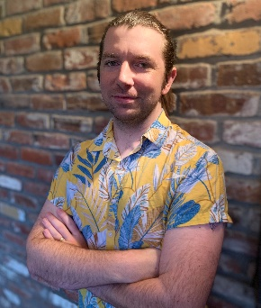



Moderator and Panelists
Micah Wofford (Moderator)
Sean Wilder (Panelist)
Energy Commission Specialist
Energy and Environmental Services
California Energy Commission
Los Angeles County Internal Services
Department
Salim Youssefzadah (Panelist)
Quintin Sumabat (Panelist)
Chief Executive Officer
Deputy Executive Officer
WattEV
Vehicle Engineering and
Acquisitions
LA Metro

Slide 51
Agenda Item #6:
2019 Electric Vehicle Charging Guidebook for
Medium-Duty and Heavy-Duty Commercial Fleets
Presentation by Patrick Couch, SVP, Gladstein, Neandross, and Associates

Slide 52
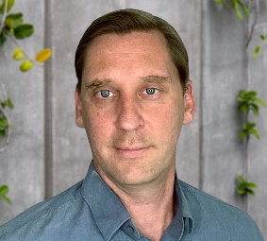
Speaker
Patrick Couch
Senior Vice President, Technical Services, & Partner
Gladstein, Neandross, and Associates
Notes:
Agenda Item #6: 2019 Electric Vehicle Charging Guidebook for Medium-Duty and Heavy-Duty Commercial Fleets
Speaker: Patrick Couch, SVP Technical Services & Partner, Gladstein, Neandross, and Associates
Patrick both leads and collaborates on a wide range of projects and market development initiatives for GNA’s clients and brings extensive experience in the research, development, and demonstration of a broad range of advanced mobile and stationary power technologies to the firm.
Patrick holds a B.S. and M.S in Mechanical Engineering from the University of California, Irvine.

Slide 53



MD/HD Fleet Charging Guidebook Overview
Patrick Couch, Senior Vice President
I-710 ZET Working Group September 20th, 2022

Slide 54
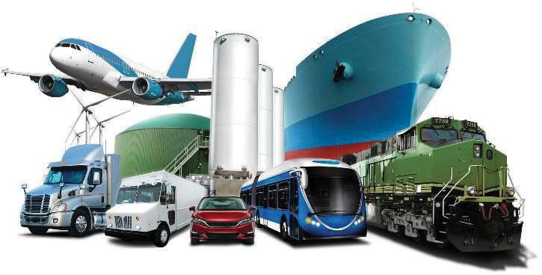
GNA Introduction & History
North America’s leading full-service clean transportation consulting firm.
Nearly 30 years of experience in:
Medium and heavy-duty transportation
Ports and goods movement
EV, hydrogen, natural gas, propane, biofuels, renewable fuels
Infrastructure and corridor development
Grant funding
Stakeholder education
2

Slide 55








































Over the past 29+ years
Managed the design and development of more clean fleet deployment projects than any other firm in North America
Overseen the development of some of the largest alternative fuel stations and corridors in the world
Secured more than $1 billion in grant funding for our clients with a +90% application success rate
Supported hundreds of clients in expanding brand reach, building market share, and achieving outreach goals
GNA’s Best In Class Client Roster: Leading Fleets, OEMs, Energy Companies, and Other Stakeholders
3

Slide 56






Some Electrification Challenges Facing Fleets
Diesel fueling deals in relatable units and fueling times are consistent.
Fleets understand diesel fuel and infrastructure design.
kilowatt
-hour
The terminology for EVs is new to fleet managers/buyers.
But they are “learning by doing” EV
infrastructure.
Fleets are built around diesel fueling, where price is independent of fueling time and speed.
Fleets are not static. Customers and
requirements change over time.
Flexible infrastructure solutions are key for large scale fleet adoption.
When, where, and how fast electricity is delivered affects price significantly.
To make EV infrastructure work, fleets need education, flexibility, and price stability
Page 4

Slide 57
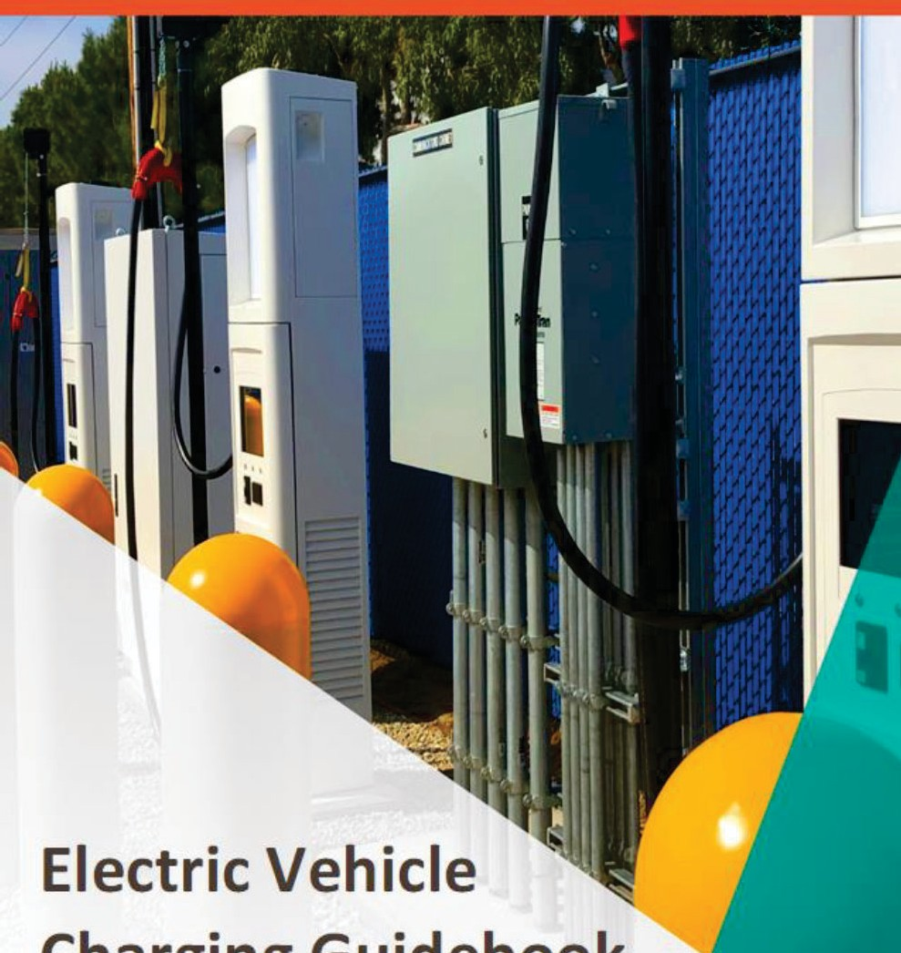

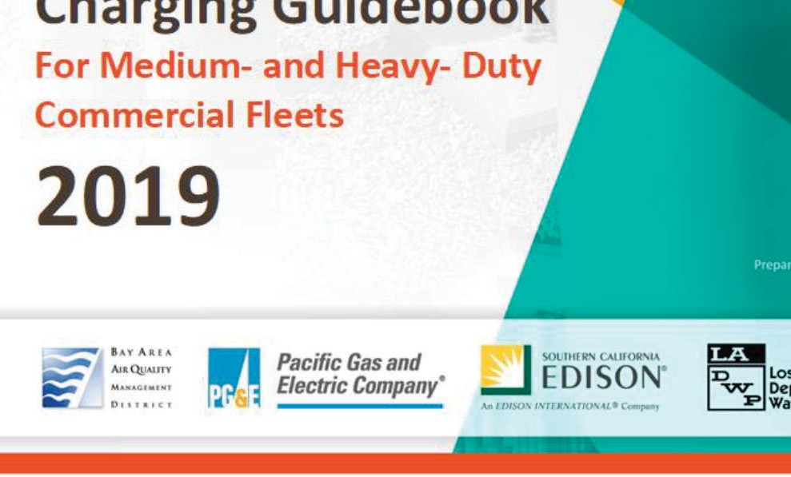
EV Charging Guidebook
Purpose
Charging 101 for fleet operators
Focus on MD/HD Commercial fleets, but applicable to many MD/HD fleet applications
Goal
Estimate fleet’s energy needs and charging time requirements.
Identify the charging equipment options.
Evaluate charging station configurations that work with existing space, support current and future operations, maximize equipment lifecycles, and control costs.
Identify which entities to engage for project design, permitting, and construction.
Discuss important details of the fleet’s electric service and electricity price bands with your utility.
http://www.gladstein.org/research
Page 5

Slide 58

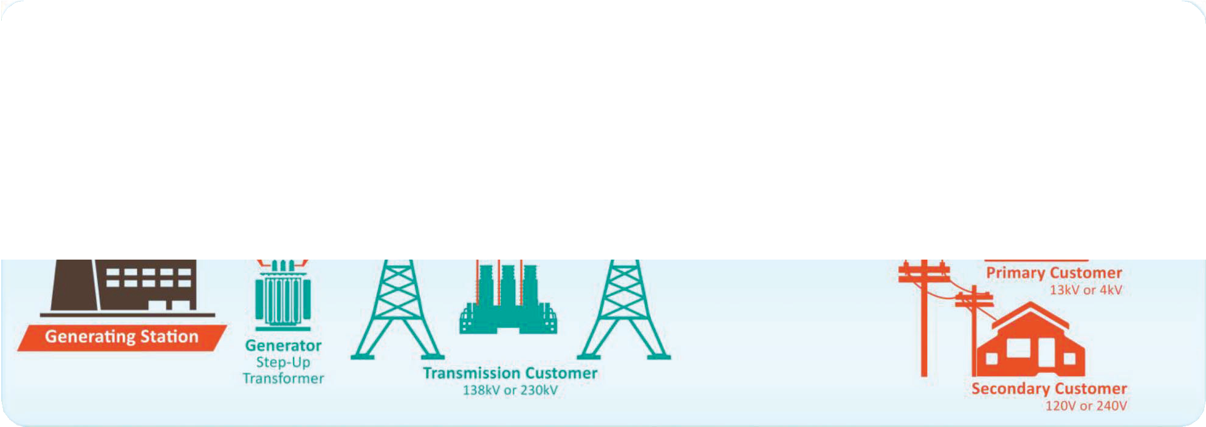
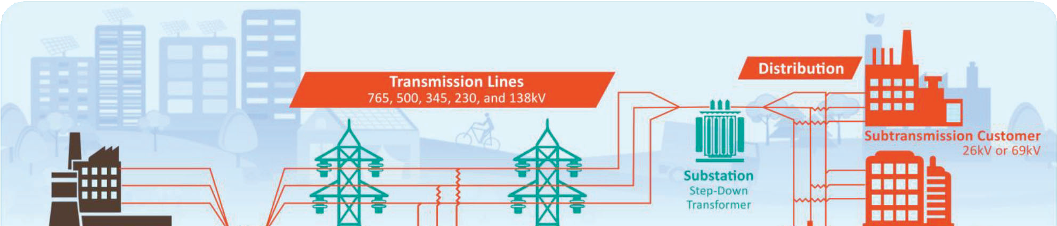


EV Charging Guidebook
Terminology and Definitions
Basic terminology and definitions related to EVSE and charging
Overview of electrical grid structure and major market participants (CA-focused)
OHM
KEY TERMS
Average Power: The amount of power that your fleet requires while charging, averaged over the charging window.
Charge Rate: The rate at which a BEV is charged, measured in kilowatts (kW).
Charging Window: The period of time in your fleet’s duty cycle when vehicles can charge.
kWh: Kilowatt-hour, a unit of measure for electrical energy. 1 kWh is the energy delivered by 1 kW of power for 1 hour.
Load profile: A graph showing the amount(s) of power that your fleet requires over the course of a day.
Watt: A unit defining the speed at which electrical energy is consumed (energy per second).
Volt
AMP
OHM
Page 6

Slide 59

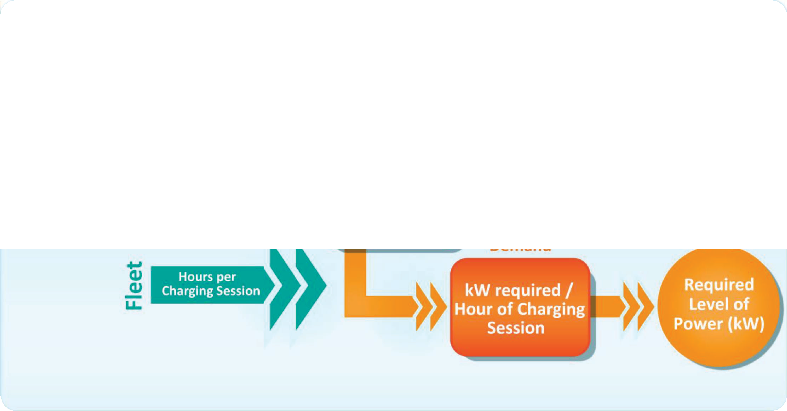
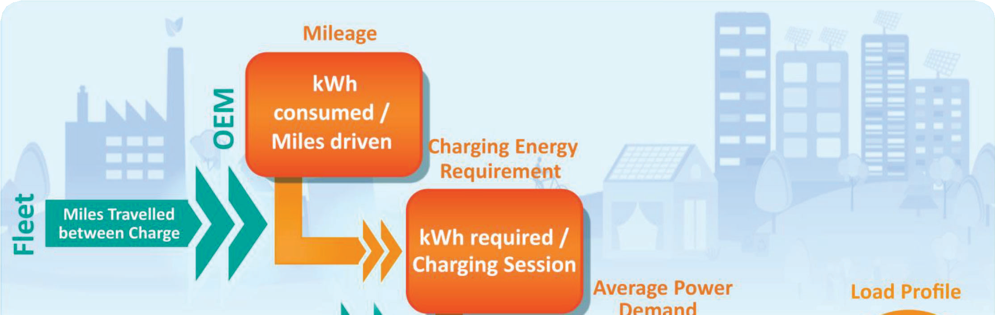

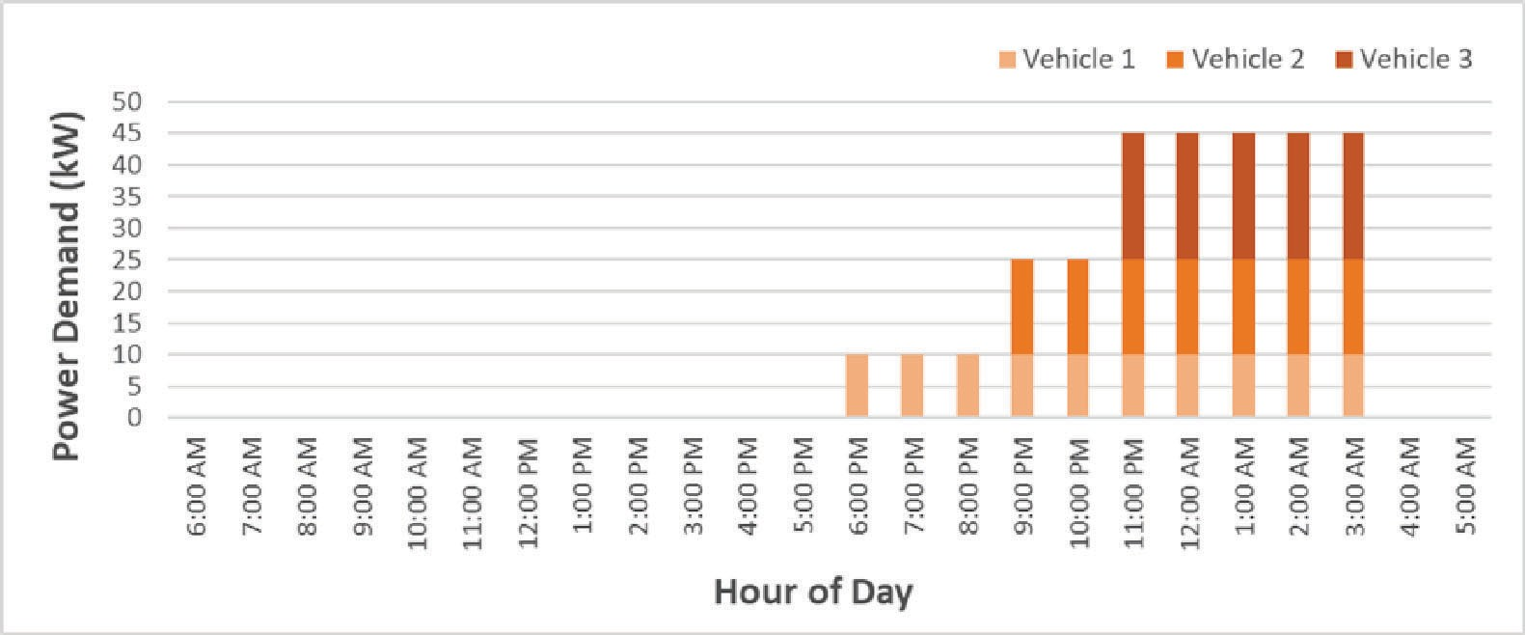
EV Charging Guidebook
Estimating EV Charging Loads
Process for estimating EV energy use based on vehicle type and “fuel” efficiency.
Worked examples translating energy use to power demand
Page 7

Slide 60
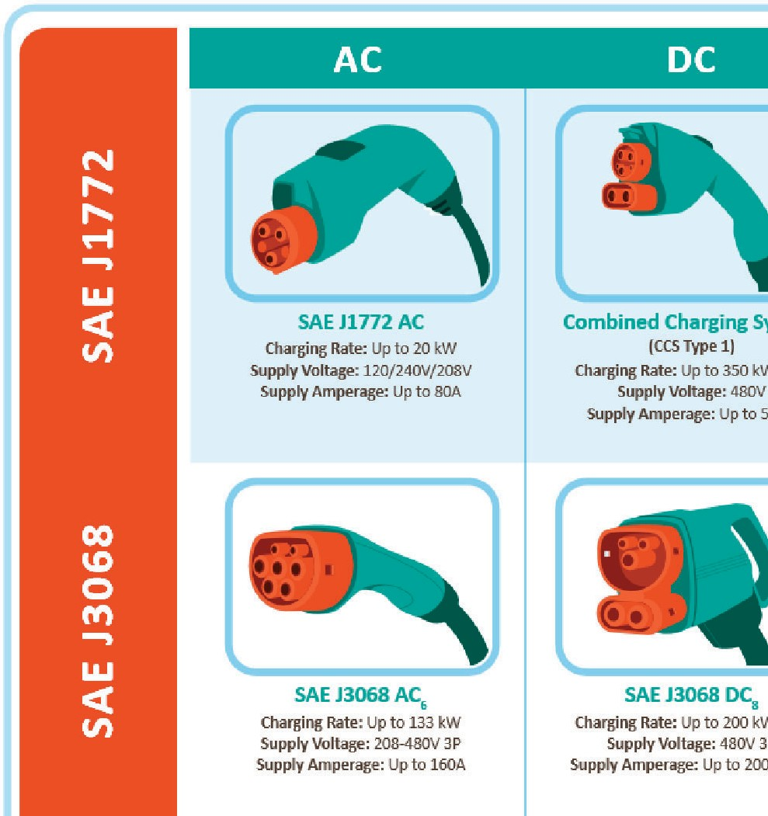
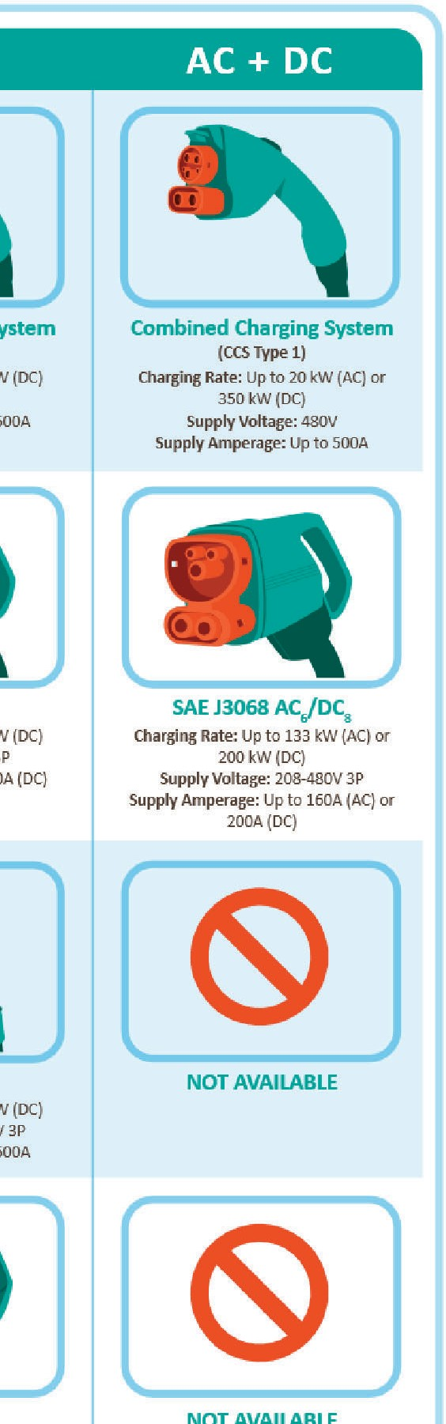
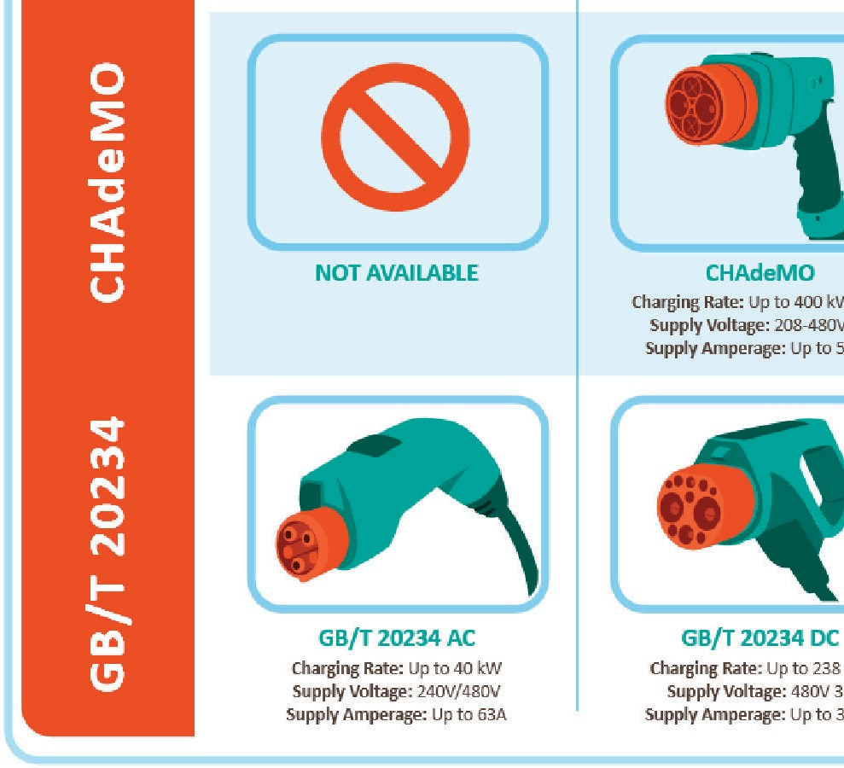
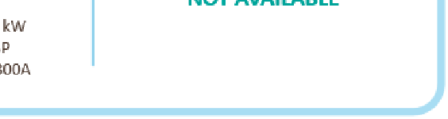
EV Charging Guidebook
Understanding EVSE Options
Overview of EVSE interface types and capabilities
Worked examples translating load profiles into EVSE selections
Example equipment costs
Charging Type | Power Level | Networkable | Price Range ($)
Level 1 AC | <2 kW | No | 500-1,000
Level 2 AC | <8 kW | No | 500-1,000
Level 2 AC | 10-20 kW | No | 700-1,500
Level 2 AC | <8 kW | Yes | 500-1,000
Level 2 AC | 10-20 kW | Yes | 3,000-6,500
Level 3 DCFC | 20-30 kW | Yes | 10,000-40,000
Level 3 DCFC | 50-150 kW | Yes | 50,000-100,000
Level 3 DCFC | >150 kW | Yes | 150,000+
Page 8

Slide 61

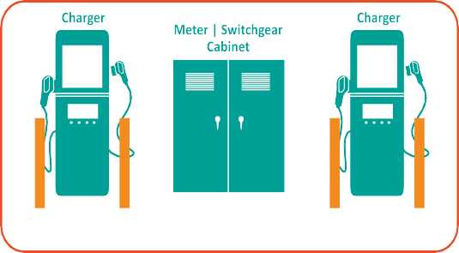















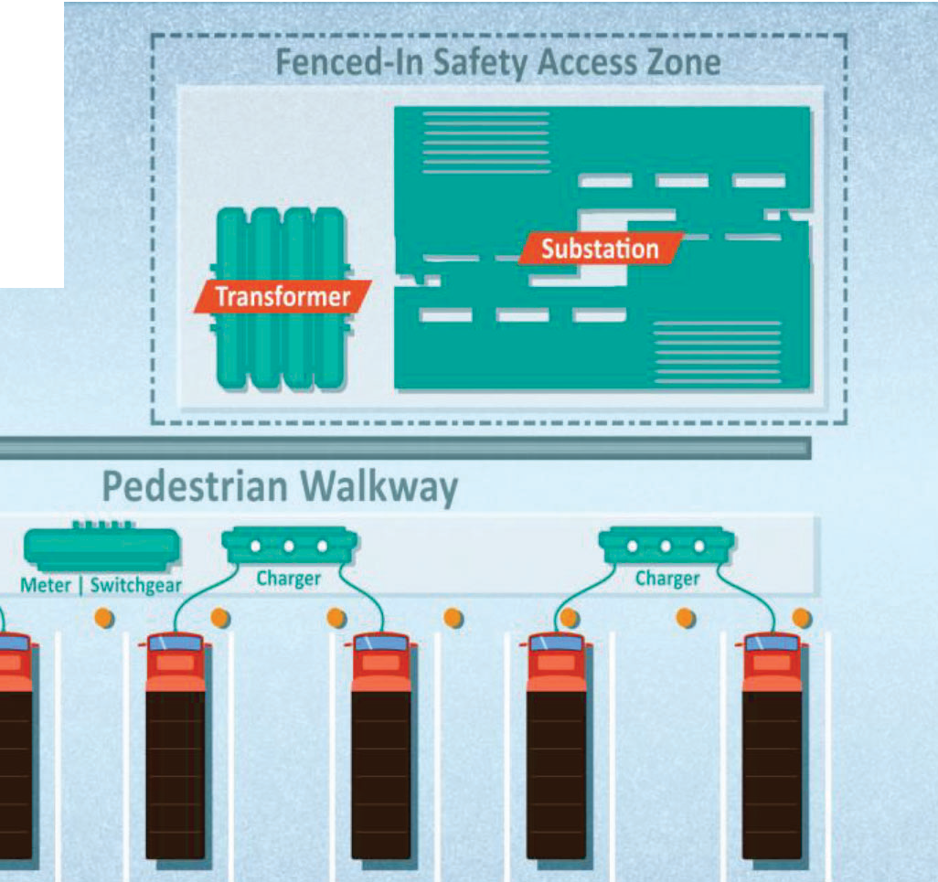


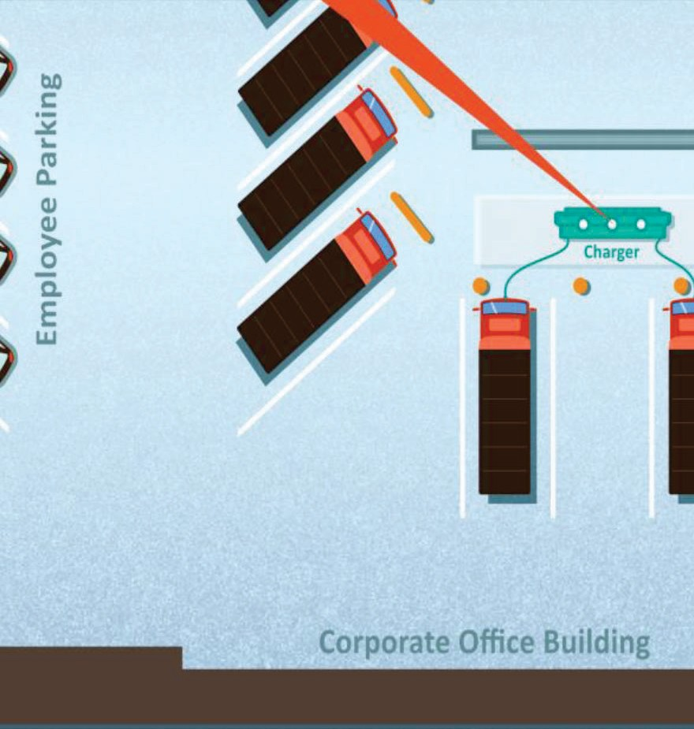
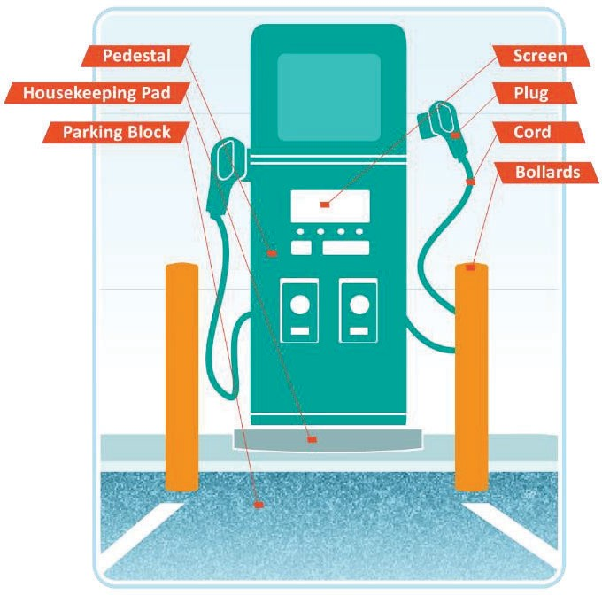

EV Charging Guidebook
Siting and Permitting EVSE
Anatomy of an EVSE
Considerations for siting EVSE equipment
Basic permitting process and timeline expectations
Page 9

Slide 62
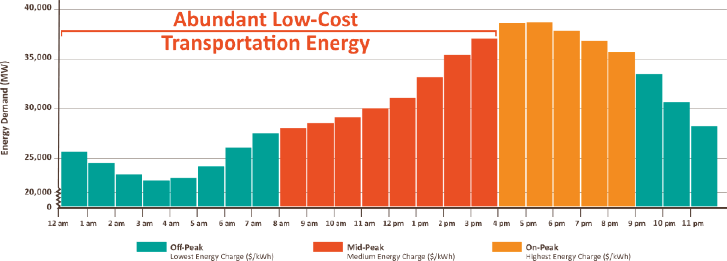
EV Charging Guidebook
Electricity Costs
Basic utility billing terms and concepts
Worked examples of EV charging cost calculations and impacts of charging behavior
Flat Rate: A rate structure under which you are billed at a single price per kilowatt-hour consumed regardless of time, season or application.
Time-of-Use (TOU): A rate structure under which you are billed different prices for power you consume according to the time and season when it is consumed.
Fixed Charge: A fee covering the regulator-approved costs that the utility pays to supply your power such as distribution and transmission ($/month).
Energy Charge: Your baseline price of electricity, charged based on
the amount of energy you consume ($/kWh).
Demand Charge: A fee applied to your greatest power draw during peak periods, on top of the rate that you pay for the energy ($/kW).
Seasonal Rates: Additional distribution fees covering the costs of addressing weather stressors on the electric grid during winter or summer.
Power Factor Adjustment: An adjustment to your demand charge according to how efficiently your facility consumes power.
Page 10

Slide 63
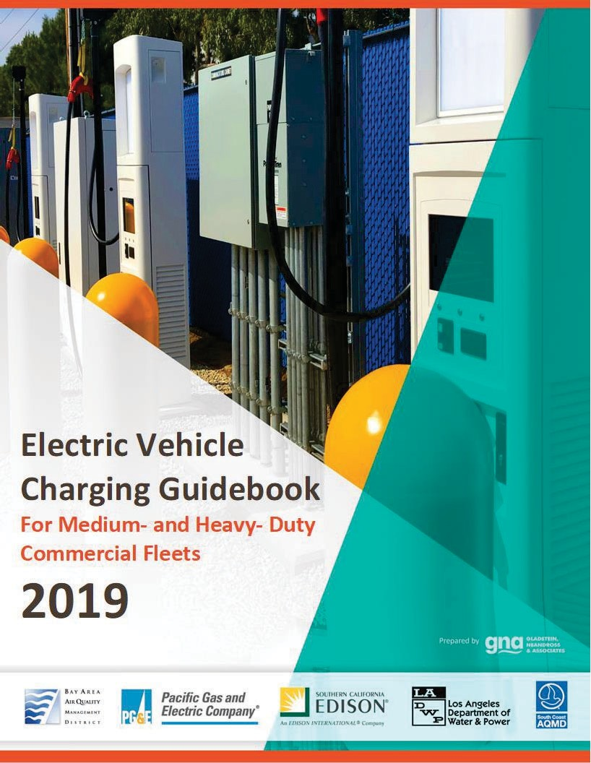
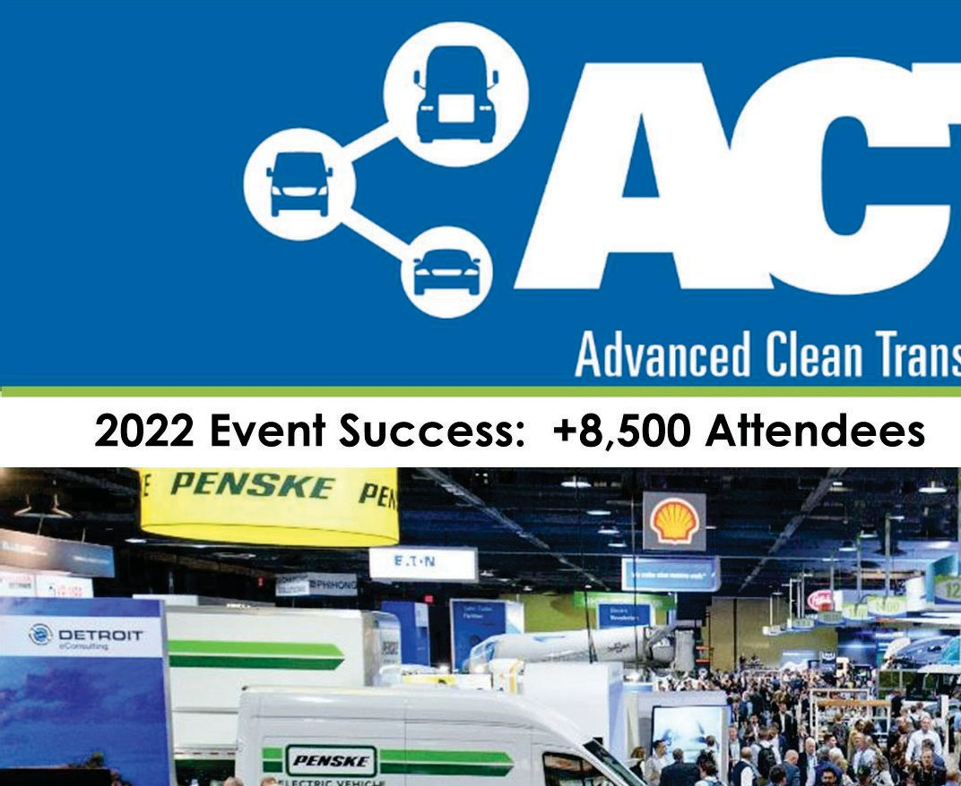
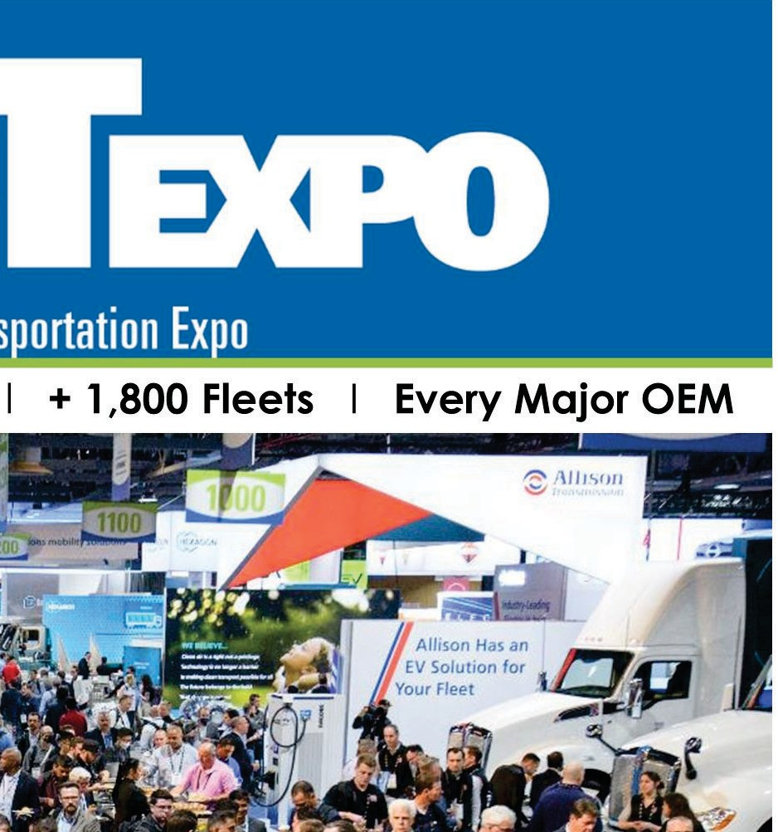



Summary
In theory there is no difference between theory and practice. In practice, there is.
~Yogi Berra
Page 11
http://www.gladstein.org/research

Slide 64




Patrick Couch
Sr. Vice President, Technical Services (310) 279-9150
THANK YOU!
patrick.couch@gladstein.org
Page 12

Slide 65
Agenda Item #7:
Electric Vehicle Charging Infrastructure
for Southern California
Report by Carlo Bertani, MAERSK

Slide 66
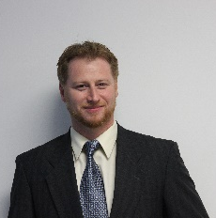

Speaker
Carlo Bertani
Environment, Sustainability and Decarbonization
MAERSK North America
Notes:
Agenda Item #7: Electric Vehicle Charging Infrastructure for Southern California Warehouses
Report by Carlo Bertani, MAERSK
Carlo Bertani is an environmental subject matter expert with over fifteen years of experience working for government, large corporations, and small businesses to create and accomplish their environmental sustainability goals.
Carlo currently works at Maersk, helping the world’s largest container shipping company achieve their ambitious sustainability and decarbonization goals; focusing primarily on electrification of trucks and cargo handling equipment, and working on future fuels strategy for the maritime industry.
Carlo will share with us Maersk’s program in support the future fleet of electric trucks, and the status of plans to install the charging infrastructure in the cities of Santa Fe Springs and Commerce as well as the additional sites are under consideration.

Slide 67
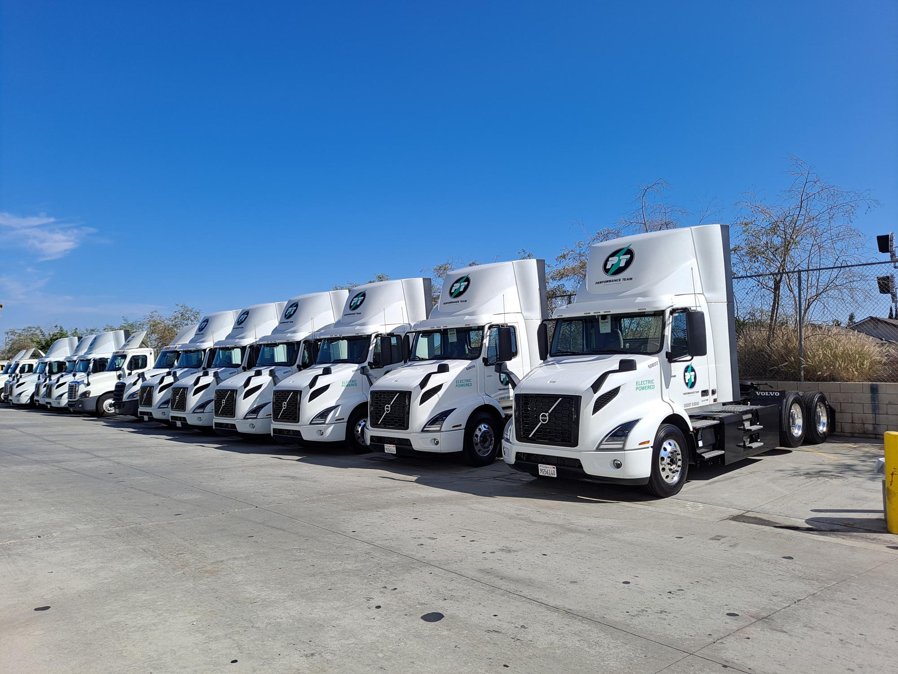
Maersk Transportation Decarbonization
Carlo Bertani, Maersk, Inland Decarbonization Lead

Slide 68

Our decarbonization focus within Transportation
Current Class 8 BEV and Infrastructure
16 BEV’s operational in Southern California (SFS → Port → SFS)
8 Dual port chargers constructed in Santa Fe Springs, CA
11 Dual port chargers under construction in Commerce, CA
Future Roadmap
Future expansion rollout in SoCal ,Chicago, New Jersey (+others)
420 additional Class 8 BEV on order (2023-2025)
18 Terminal Tractors starting Q4 2023
Leveraging Partnerships for shared charging infrastructure
Notes:
Mention informally about Rail

Slide 69


Challenges & Complications Solutions
Lead times and delays for infrastructure
Grid reliability
Inspector knowledge
Cost disparity vs. diesel
Lack of off-site charging infrastructure for HD trucks
Obtaining landlord approval for infrastructure builds
Plan ahead – choose facilities wisely
Work with your utility provider upfront
Participate in regulatory workshops
Develop partnerships with other industry players
Work with landlord and determine if there is overlap
with their sustainability goals

Slide 70
Closing Remarks and Next Steps
Notes:
METRO NEXT STEPS
Protocols for vetting proposals – leveraging of funds
Legislative calendar (Norm Emerson-GCCOG), roadmap-applications-timelines
Additional Technical Support-in addition to Akiko
IMMEDIATE NEXT STEPS
--Slides and Confirmation- Jack Symington-LACI-slides (Susan)-SEPTEMBER
-Refine principles slides in presentation-CEHAJ Letter (Trey)-COMPLETE-draft response
-Michael-Fernando-Susan-Mtg re CEHAJ letter
-Tasks Worksheet Update (Susan has an example)
Agenda Item #6-focused discussions
Submit TCEP application, develop grant application
Finalize $5MM TA expertise
Local hiring policy
Erika
Difference between things we generate and things we are a part of
How do we get the $200 m
How do we use Metros’ unique position in the county
How do we create our own program?
How do we respond to other programs that want to partner with us?
How do we create technical expertise- to develop this program
Technical working group?
Keep to ourselves?
We need to develop our community outreach discussion-formalize it
Have plan in place
Advanced work in outreach
AQMD=scope
COMMUNITY EDUCATION
Akiko-Watson Land-realities of developing infrastructure
rika

Slide 71

710 Task Force Information Hub
http://www.metro.net/710-hub
Extension of the current Metro.net website
User-friendly site for additional content
Graphics, meeting materials, calendar of meetings, maps, future surveys, and interactive tools

Slide 72

710 Task Force Information Hub
Tool Features:
Infographics on TF process and decision-making process
Meeting Materials
Task force meetings, Community meetings, Working groups & CLC meetings
StoryMap
Demographics, transit and environmental info
Online Surveys (launching soon)
Project Naming Poll
Interactive Mapping & Survey Tool
Contact form
Calendar of Events
Notes:
https://710-south-corridor-task-force-lametro.hub.arcgis.com/

Slide 73



Interactive Mapping Tool and Survey
Beta test: July 18 available for input from CES and Coordinating Committee
Full launch: August 2
Close survey: October 15
Tool Objectives
Engage the public in the decision-making process
Gather public input on projects and programs
Gather geo-coded data (location-centric) comments on project map
English
Español
Notes:
Nancy
ADD QR CODE
Link: Metro 710 Task Force and Investment Plan | Social Pinpoint (mysocialpinpoint.com)
PART OF THE HUB

Slide 74
Key Dates
Working Group Meetings
Equity Working Group #7 Thursday, September 29, 5-7pm
Zero-Emissions Truck Working Group #9
Tuesday, October 18, 1-3pm
Task Force Meeting
Task Force Meeting #13
Tuesday, October 11, 5-7:30pm
Community Leadership Committee Meeting
Meeting #7
Thursday, September 22, 5-7pm
Coordinating Committee Meeting
Wednesday, September 28, 3-5pm
Metro I-710 South Corridor Mapping Tool and Survey
Metro I-710 South Corridor Mapping Tool and Survey
Open until Saturday, October 15th
For the most updated list of meeting dates, visit http://www.metro.net/710-hub

Slide 75
Can’t attend the meeting? Reach out to us!
Michael Cano, Executive Officer (Interim) LA Metro
Federal/State Policy & Programming
Countywide Planning & Development One Gateway Plaza, MS 99-13-1 Los Angeles, CA 90012
213.418.3010
710corridor@metro.net
metro.net/projects/i-710-corridor
@metrolosangeles
losangelesmetro
Notes:
Michael

Slide 76
Thank you!
Notes:
Erika

