Slide 1
We will begin in a few moments.
710 Task Force
Zero-Emission Truck Working Group
Meeting #7
June 21, 2022
Notes:
Erika

Slide 2
710 Task Force
Notes:
Erika

Slide 3
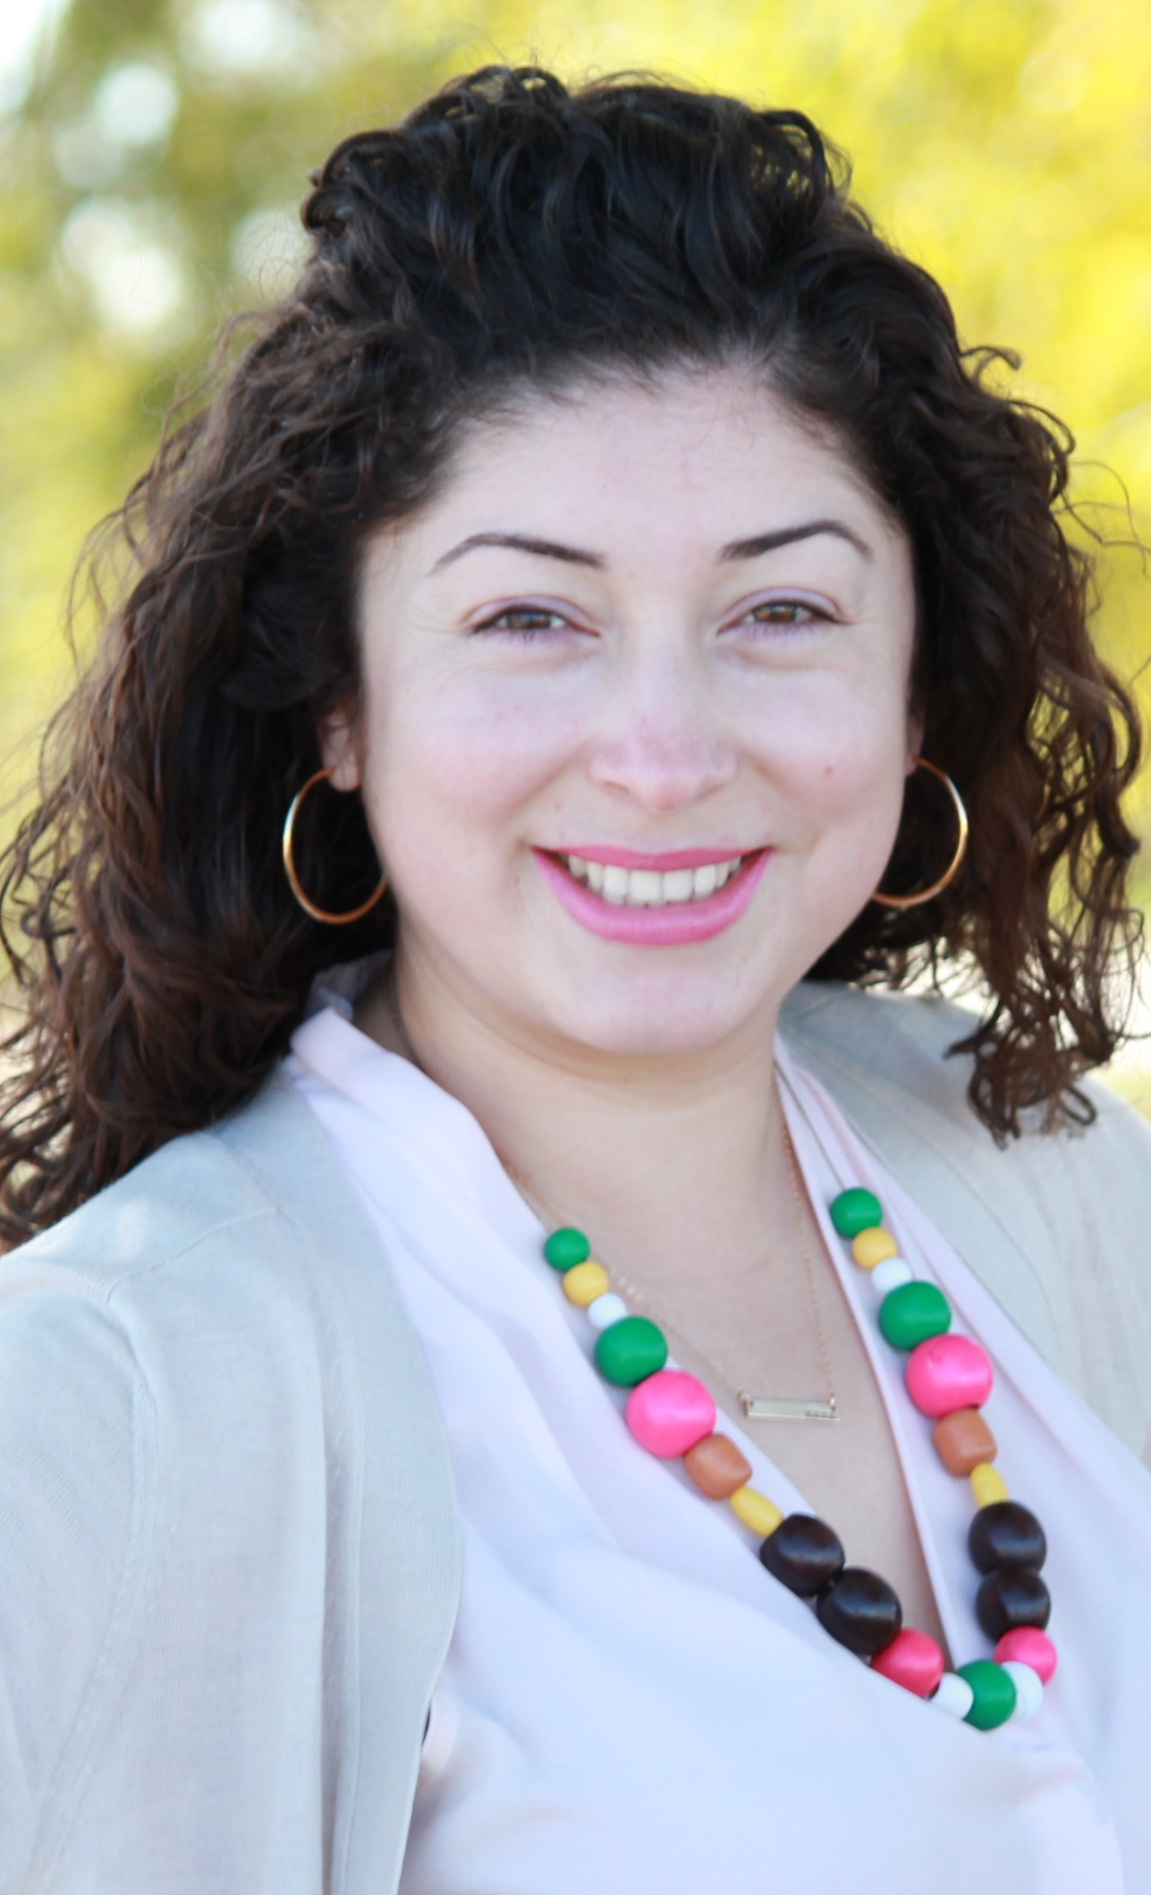
Facilitator
Erika C.B. Morales
Partner, Morales + Morales
Notes:
Erika

Slide 4
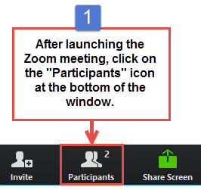
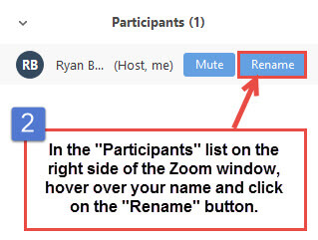
Task Force Member, CLC Member, and Participant Identification
Please change your Zoom screen name to include: Name and Organization Name
(and if you are a Task Force Member)
Notes:
Erika

Slide 5

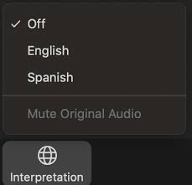
Interpretation/ Interpretación
Click the Interpretation icon in your meeting controls to enter the Spanish room
(Optional) To hear the interpreted language only, click Mute Original Audio
>Haga clic en el ícono de Interpretación en
los controles de su reunión para ingresar la sala
en español
(Opcional) Para escuchar solo el idioma interpretado, haga clic en “Mute Original Audio”
o “Silenciar audio original”
Notes:
ERIKA– please ask if anyone needs Spanish interpretation
IF NOT—NO NEED TO REVIEW THIS SLIDE, subsequent slides no need to read the Spanish instructions

Slide 6

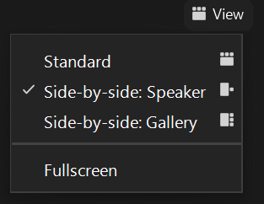
Turn on Camera / Prende la cámara
To start and stop your video, click the camera icon at the bottom left of your control panel
Para iniciar y detener su video, haga clic en el ícono de la cámara en la parte inferior izquierda de su panel de control
To switch between views during the meeting click or tap on Standard, Side-by-side Speaker View, and Side-by-side Gallery View at the top right corner of your zoom screen
Para cambiar entre vistas durante la reunión, haga clic o toque Estándar, Vista de orador en paralelo y Vista de Galería en Paralelo en la esquina superior derecha de la pantalla de zoom
Notes:
Erika

Slide 7

Raise Hand
Click Raise Hand in your meeting controls or
Press*9 on the phone line.
To lower your hand, click Raise Hand in your meeting controls.
Comments & questions can also be provided in writing by using the Chat function.
The Chat button is located on the control panel at the bottom of your screen.
Notes:
Erika

Slide 8
Welcome!
Notes:
Erika

Slide 9
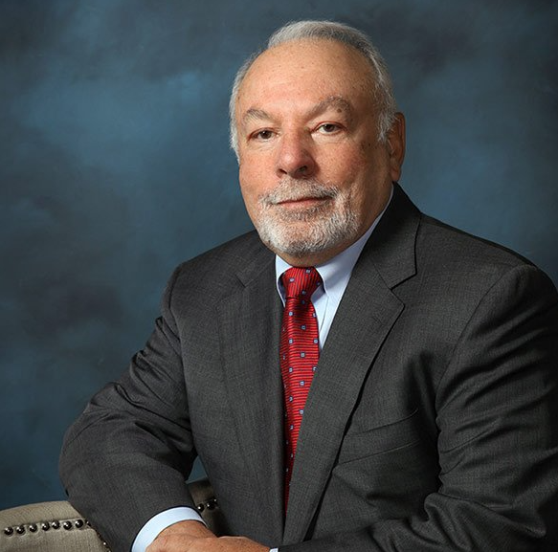
In Memorium – Victor LaRosa
Notes:
Michael
It is with deep sadness and heavy heart that I inform you of the passing of our beloved Vic La Rosa, CEO, President and Co-Founder.
After a valiant fight against lung cancer, Vic peacefully passed away
Vic was a crusader; he fought for cleaner air quality and received numerous awards throughout his career.
Our fleet of clean truck technologies are a tribute to Vic and his visions.
He was a leader; he was a driving force behind the success of our company.
Vic had a love for his family, friends, and employees. We have all suffered a terrible loss.
We will miss him more than words can express.
Bill Allen
EVP, COO, and Co-Founder

Slide 10
Meeting Objectives
Support Metro's goal to advance ZE deployment in the I-710 South Corridor
Conduct interactive discussion to refine priorities, strategies to accomplish outcomes, considerations & next steps.
Develop and refine the ZE Truck Program priorities and scope in preparation for a consensus check and possible vote on the Program framework in July
Identify remaining areas of inquiry or concern
Discuss Metro's Board action in May (Motion 9) calling for an Early Investment Program by September 2022
Notes:
Erika
WG Framework
focus on implementing ZE infrastructure along the corridor, employment of ZE techn, infra-niche metro can provide –regional public infrastructure-compliment domicile infrastructure)
Heavy leveraging-truck subsidies
Focus on small businesses, disadvantaged businesses-along the corridor
Identify funding opportunities (seek to leverage these funds)
Relationship w ports
Community Engagement =what does it look like? Sitings-more localized, w equity evaluation-impacts for selecting site
JULY---discuss, VOTE ON FRAMEWORK-establish parameters-final document –based on your feedback
This is your opportunity to identify what is missing
Grant opportunities
ZET Program (community engagement, what does infrastructure mean, kinds of technology needed, legislative aspects)
What are the gaps? What are we missing?
Railroads-Battery/Electric pilots (BNSF) TRCP-will it be resubmitted (check w Lena)
FORM---NOMINATIONS ON SHORT TERM PROJECTS
ARE YOU SUBMITTING GRANT THIS YEAR-GRANT READY PROJECTS
No local match
Costs to bring drayage system to LA—in the billions
LEVERAGED
RESPONSIVE TO THE CHALLENGES
ALIGNED WITH WHAT METRO/CALTRANS CAN DO
Call for projects
Letter – by July 1st
Identify regional funding partners
Identify near and long-term opportunities
Identify policy and legislative barriers to implementation
Identify discretionary grant opportunities
Convene and collaborate with community and regional stakeholders

Slide 11
Agenda
1:00 pm Welcome, Introductions, Agenda Review, and Purpose of the Zero-Emission Truck Working Group
1:10 pm Agenda Item #1: Project Team Update
1.1 Zero-Emission Program Development Timeline
1:20 pm Agenda Item #2: Interactive Discussion, Breakout Rooms, Report Outs, and Plenary Discussions
1:20-1:25 pm Introduction to Breakout Room Discussion topics and protocols; what we intend to accomplish
1:25-2:10 pm Breakout Room Discussions
2:10-2:50 pm Breakout Room Report Outs (4 mins each) followed by plenary discussions (4 mins each)
2:50 pm Agenda Item #3: Early Investment Plan
3.1 Phase III/IV Milestones: Early Initiative Projects
2:55 pm Closing Comments, Upcoming Meetings, Thank you
Notes:
Erika

Slide 12
Agenda Item #1:
Project Team Update
Notes:
Erika

Slide 13

Zero-Emission Truck Program Development Timeline
This sixteen-week timeline shows key activities and dates for the Zero-Emission Truck Program Development.
March
JUNE 2022
JULY 2022
AUGUST 2022
SEPTEMBER/OCTOBER 2022
ZET WG continues the discussion on Program Structure and Protocols at ZET WG #8.
ZET WG to vote on final Program Structure and Protocols.
ZET WG receives status report on approach for Multimodal Strategy/Projects & Programs phase
ZET WG discusses “early initiatives” that affect the ZE Truck Program.
Equity Working Group provides
input to the ZET WG on
equity issues.
Community Leadership Committee (CLC) provides input to the ZET WG on working with communities to shape the ZET policies and programs.
ZET WG reports to the 710 Task Force on the scope of work for ZET Program Structure and Protocols.
ZET WG Report preparation for Metro Board's September Meeting.
ZET WG incorporates findings
from Truck Technology
Comparative Report.
  Based on the Transition Plan, identify the number of charging and fueling stations needed for
  LA County over time
  Seek ZET WG input on considerations and questions
  for the Implementation Plan.
ZET Transition Plan Report to ZET WG and Task Force.
Metro Board considers ZET Program Scope of Work
Zero-Emission Truck Working Group (ZET WG) to develop scope of work for ZET Program.
ZET WG continues discussion on structuring the program protocols:
Identify regional funding partners
Identify near and long-term opportunities
Identify policy and legislative barriers to implementation
Identify discretionary grant opportunities
Convene and collaborate with community and regional stakeholders
Ensuring Community Benefit
Metro begins work on a Truck Technology Comparative Report.
ZET WG discussion regarding the distinction between the “Early Investment Plan” phase and Multimodal Projects and Programs Phase
February
20XX
April
Notes:
MICHAEL
We’re working on filling out the Scope of Work based what was discussed at the last ZET WG-breakout discussions, plenary session
Next month we’ll bring back to you a fully developed SOW for your consideration based on the outcomes of today’s deliberations
D. Report back in September 2022 on the development and implementation of this Investment
Strategy, including the minimum of three initiatives applying for available State and Federal
funding in Calendar Year 2022.

Slide 14
Agenda Item #2:
Interactive Discussions, Breakout Rooms,
Report Outs, and Plenary Discussions
Notes:
Erika

Slide 15
Metro Board Direction, Desired Outcomes and Strategies
Metro Board Direction and desired outcomes
$200 million minimum funding target
Leverage $50 million local matches with private, regional, state, and federal funding
ZE deployment in the I-710 South Corridor
Collaboration with regional stakeholders
Strategies to accomplish outcomes
Identify discretionary grant opportunities
Convene and collaborate with community and regional stakeholders
Develop a scope of work for the ZET Program
Identify regional funding partners
Identify near and long-term opportunities
Identify policy and legislative barriers to implementation
Notes:
Michael
Here is the Board Direction
Breakout Rooms have been formed around the strategies for the Scope of Work
No funds will be disbursed until there is a framework
Emphasis on Leveraging $50 million
Process—Strategic funding opportunities

Slide 16
Breakout Room Topics and Assignments
#3 – Legislative and Policy Initiatives
  Luke Klipp, Senior Transportation Deputy, Office of Los Angeles County Supervisor Janice Hahn, Dist. 4
  Viviana Gomez, Transportation Deputy, Office of Los Angeles County Supervisor Janice Hahn, Dist. 4
  David Libatique, Senior Director of Government Affairs, Port of Los Angeles
  Natalia Ospina, Staff Attorney, Environment, Equity & Justice Center, Natural Resources Defense Council
  Norman Emerson, Consultant, Gateway Cities Council of Governments
  Karen Heit, Gateway Cities Council of Governments
#4 – Strategic Set-Aside for Vehicle Subsidies
  Nicki Okuk, Deputy Director, CALSTART
  Eric Tate, Port Division Deputy Director, International Longshoremen Workers Union
  Sue Dexter, Researcher, METRANS Transportation Consortium
  Krystal Swinton, Senior Manager, Southern California Edison
  Amber Coluso, Air Quality Environmental Specialist, Port of Los Angeles
  Matt Schrap, Harbor Trucking Association
#5 – Environmental Impacts, Mitigation Strategies, and Program Outcomes
  Andrew Zellinger, Environmental Reviewer, U.S. Environmental Protection Agency, Region 9
  Thomas Jelenic, Vice President, Pacific Merchant Shipping Association
  Michael Leue, Chief Executive Officer, Alameda Corridor Transportation Authority
  Christopher Chavez, Deputy Policy Director, Coalition for Clean Air
  Marisa Perez, Transportation Policy Advisor, Gateway Cities Council of Governments
  Cris Liban, Chief Sustainability Officer, LA Metro
  Leela Rao, Environmental Specialist, Port of Long Beach
  Ryan Snyder, Senior Sustainability and Innovation Manager, Caltrans District 7
#1 – Equity Considerations, ZE Infrastructure Siting, and Program Outcomes
  Fernando Gaytan, Staff Attorney, EarthJustice
  Ali Saleh, Councilmember, City of Bell
  Carlos Montez, Senior Director, LA Metro
  Ambar Rivera, Staff Researcher, Communities for a Better Environment
  Lynda Bybee, Consultant, Gateway Cities Council of Government
  Phyllis Ollison, CLC Member
  Tiesha Davis, CLC Member
  Jack Symington, Program Manager, Transportation, Los Angeles Cleantech Incubator
  Kekoa Anderson, Gateway Cities COG
  Nancy Pfeffer, Executive Director, Gateways Cities Council of Governments
#2 – Strategic Partnerships and Funding Opportunities
  Dr. Aaron Katzenstein, Senior Manager, South Coast Air Quality Management District
  Gloria Roberts, Chief Deputy District Director, Caltrans, District 7
  Morgan Caswell, Manager of Air Quality Practices, Port of Long Beach
  Tim DeMoss, Environmental Affairs Officer, Port of Los Angeles
  Sydney Vergis, Division Chief Mobile Source Control Division, California Air Resources Board
  Mark Wenzel, Light-Duty EV Infrastructure and Analysis, California Energy Commission
  Dr. Joe Lyou, Commissioner, California Transportation Commission
  Hannah Walter, Associate Deputy Director, California Transportation Commission
  George Payba, Los Angeles Department of Water and Power
  Alison Linder, Senior Regional Planner, Southern California Association of Governments
16
Notes:
Michael
Strategic set asides
Leverage funds
Target drivers

Slide 17
Breakout Room #1 – Community Engagement, Community Benefits, Equity Considerations, Infrastructure Siting
WHAT WE HEARD | WHAT WE AGREED | BARRIERS/CHALLENGES | ADDITIONAL INFORMATION NEEDED | NEXT STEPS
Highlight the importance of community input, engagement, and transparency | Need to understand concerns/impacts on noise, safety, access, local street conditions Prevent or mitigate additional community harm during the deployment or operation of ZE infrastructure | TBD | Detail regarding appearance and exact location of sites | Schedule a presentation in June/July with LACI and CEHAJ on the Blueprint Project on process. Highlight Lessons Learned for application to TF projects.
Engage with community leaders and community-based organizations to leverage existing connections to communities throughout the corridor when determining infrastructure siting | Should not be a parallel process being done outside of the Task Force that usurps of supplants what comes out of this process. At the end of the day, the Task Force should have a final say under it's equity plan | Where sites land determines where outreach will occur. | What type of interactions are most effective? | TBD
Ensure that investment in the communities ties direct benefits to those residents | TBD | Unclear process to begin workforce development project | Get their ideas on how to roll job training process out | Connect with LA County Workforce Development Board, community colleges, training programs for ideas on how to roll this out.
Employ walk-up informational centers to discuss jobs, trainings, and zero-emissions movement | Ensure there is proper clarity around these discussions. Be clear about intentions. | TBD | Find locations for these centers | TBD
This is a partial view of this Breakout Session matrix. To view the complete matrix, click here.
17
Notes:
MICHA
Who do we need to connect with?
Opinion leaders, Community-based orgs, City Halls
Leverage existing connections to communities throughout the corridor
EV manufacturers
Labor Unions, Trucking Associations
Core group familiar with how equipment works, and which places are effective sites
Community Colleges, Training Programs (e.g. Cal State Long Beach)
Ensure that investment ties directly to those communities through high-road jobs, job training, commitment to local hire
What types of interactions are most effective?
Must have context for discussions, be clear about intentions
Where/When should we be having these conversations?
Depends on where these sites land to determine where this kind of outreach occurs
Walk-up centers
EL

Slide 18






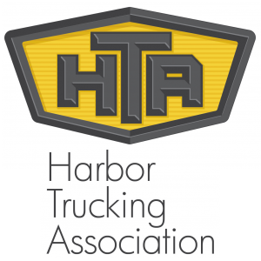


An Investment Blueprint for HD Charging to Support Battery-Electric Drayage along the I-710 Corridor
Plan
Timeline
LACI will create an investment blueprint for heavy-duty charging depots adjacent to the busy I-710 freight corridor that can support battery electric trucks serving the San Pedro Bay Ports. Following a selection framework that will incorporate grid infrastructure and drayage duty cycles, LACI will identify priority locations for public and private heavy-duty charging infrastructure.
The final blueprint will provide a high-level budget for infrastructure deployments that will enable 100% battery-electric drayage at the San Pedro Ports, extrapolating from specific site evaluations that will include initial capital costs.
.
8/21
10/21
4/22
7/22
10/22
CEC Approval
Kickoff Meeting
Grid & Traffic Map
Site Assessments
Investment Blueprint
Products
Grid Transmission and Distribution Analysis
Drayage Density Traffic Map
Charging Depot Business Model
Corridor Charging Investment Blueprint
Partners
10x Impact
Successfully electrifying a critical goods movement region sets a precedent for other intermodal regions in CA and the U.S.
Accurately assessing costs of depot provides shovel-ready projects to speed transition

Slide 19
Breakout Room #2 – Strategic Partnerships and Funding Opportunities
WHAT WE HEARD | WHAT WE AGREED ON | BARRIERS/CHALLENGES | ADDITIONAL INFORMATION NEEDED | NEXT STEPS
Where can Metro make the most impact within this framework of investment and planning that is going on at the regional level to make sure that we are consistent and collaborative in that approach? | Metro needs to be strategic in how it looks at different programs to see what fits into Metro's program and how Metro's program fits in the regional landscape. | We need an LA County approach to funding together as opposed to infighting or competing against each other for the same funds. | What opportunities are there for a cohesive regional planning effort that coordinates all parties and creates a blueprint going forward? | Create a holistic approach to planning and funding with Metro's partners (SCAG, LACI, SCAQMD, the Ports, etc.)
Work within the framework provided by the Board: • Metro Board Direction and desired outcomes • $200 million funding target • Leverage $50 million local matches with private, regional, state, and federal funding • ZE deployment in the I-710 South Corridor • Collaboration with regional stakeholders | Work within the framework provided by the Board | TBD | TBD | Strategies to accomplish outcomes • Identify discretionary grant opportunities • Convene and collaborate with community and regional stakeholders • Develop a scope of work for the ZET Program • Identify regional funding partners • Identify near and long-term opportunities • Identify policy and legislative barriers to implementation
While state gas tax funds that support most Senate Bill 1 programs are not eligible for clean truck subsidies due to Article XIX restrictions, programs like the Trade Corridor Enhancement Program, which also uses federal funding, could fund applications for clean truck subsidies and infrastructure using federal funds. | Identify urgent/near-term grant opportunities | Given Partners are working together regionally, Metro needs to understand which partners are going after specific grant funds, and how Metro can partner with them. Metro does not want to step on other’s toes by competing for the same grant funds | Determine if the grant guidelines for zero-emission funding programs through various state agencies align to help provide increased funding opportunities to support this program? | Determine which funding opportunities should be the top priorities to meet the goals for the ZET Program? Determine which grants are URGENT/Near term; within the next 5 years?
This is a partial view of this Breakout Session matrix. To view the complete matrix, click here.
19
Notes:
#1 – Review Board Direction and Strategic Objectives
Grant opportunities
#2 – Overall Goals, Objectives, and Strategies
What are the funding opportunities available to leverage local funding with state, federal and private funding sources to maximize investment in implementing the 710 Clean Truck Program?
URGENT/Near term; within the next 5 years?
Do the grant guidelines for zero-emission funding programs through various state agencies align to help provide increased funding opportunities to support this program?
Which funding opportunities would be the top priorities?
While state gas tax funds that support most Senate Bill 1 programs are not eligible for clean truck subsidies due to Article XIX restrictions, programs like the Trade Corridor Enhancement Program, which also uses federal funding, could fund applications for clean truck subsidies and infrastructure using federal funds.
SCAQMD, CARB, and various state and regional agencies have funding opportunities available to match “seed funding” provided by Metro for an early phase of the 710 Clean Truck Program
Input on Funding opportunities
Concern for Metro focusing more on infrastructure and Ports are looking more at trucks
May want to look on how to leverage funds
Look at both vehicle and infrastructure grant opportunities
#3 – Developing an Action Plan
Various programs that are occurring
Where we lead/partner (ports-best situated to fund truck subsidies)
Various Funding programs have money available
Input received
Edison Infrastructure Program
There is a lot of money in the next few years for this program. ZET WG Issues: how much rebate is available and what kind of projects will be looked at by the WG.
POLB and POLA re: Clean Truck Fund Rate (?) Aalog at the PORT of LA - ZET WG Issue: How much they can fund, how many trucks they are looking for,
Funding a study to identify sites on or near port property for charging facilities
ZET WG QUESTION: Where can we make the most impact?
POLB study found that there was more o a business case to be made for hydrogen fueling – hydrogen has become a major part of the ZE puzzle
More help is needed for charging to get off the ground for regional deployment of ZE electric' battery trucks – reason for that focus for their study
MSRC and the Energy Commission – grant applications – different type of opportunities -
Different kinds of solicitations coming outt ooking at different electrification opportunities in truck parking and charging lots
We need to be strategic in how we look at those to see what fits into our program
As well as a lot of money being pumped into hVIP program in the next fiscal year, and how we work with trucking companies and agencies to access those funds recognizing of course the challenges in terms of how much subsidies is needed to make that worwk.
There is an over subscription of those programs. Going on right now
Nutty program focused ore on light duty – while this program is ore heavy duty
Question – as a task force – we should be looking at how can we support electric buses, electric school busess, smaller trucks and delivery trucks as well as benefits in terms of public access for electric vehicles
Alameda Corridor - and how the trains operate on them from diesel to electric – how can Metro and the Task Force support that in terms of the overall transition to electric for freight
Or with the mindset that we need to look at
where the charging locations are
what the community impacts are
We need to have the same framework that applis to the truck program apply to the rail program as well
Given Partners are working together regionally
We need to understand which partners are going after different grant funds, and how we can partner with them, and not step on each others toes to complete for the same funds
Where can we make the most impact within this framework of investment and planning that is going on at the regional level to make sure that we are consistent and collaborative in that approach
Community input needs to be provided early on
We need to create a more holistic approach tp how we partner with SCAG LACI, the PORTS, etc. - we need an LA County approach to funding together as opposed to infighting
Natalia Ospina
Make Conection between group 1 and 2 – highlighted the need for community input and engagement
Need for transparency – understanding how the action plan and the processes around funding and partnership opportunities - and how that is being shared back through the task force process to the public and much more clearly delineating how they are working together and how that is feeding into the task force process
Not clear at the moment – really important from the start in order to understand how community input is going to be incorporated into any of the actions taken that come out of our discussions in Group 2.
Partner w AQMD/MSRC/LACI (infrastructure planning)/CARB/CEC
Need to show we know our place
Regional approach-private/industry/port investments
What is our role? How can we fulfill role in this partnership framework?
Where can we fill in gaps?
Where canwe add the most value? And Do the most good for the corridor?
Near-term time frame
RECOMMENDATIONS
Near-term regional public infra for ZE charging/fueling w in 710 corridor that compliments efforts wi region
What we've heard
-reactions

Slide 20
Breakout Room #3 – Legislative and Policy Initiatives
WHAT WE HEARD | WHAT WE AGREED ON | BARRIERS/ CHALLENGES | ADDITIONAL INFORMATION NEEDED | NEXT STEPS
There is a need for a more clearly coordinated state-level approach | TBD | There is no coordination between efforts: Go-Biz has oversight of ZE truck issues, CARB focuses on investment in equipment, CEC focuses on infrastructure, CALTRANS, CALSTA has received funding to advance the CAPTI (Climate Action Plan for Transportation Infrastructure) to alleviate congestion, IIJA Funding (HD has earliest requirements) | TBD | Advocate to state that 710 becomes a focus of these investments.
For many truck owners/operators, an even greater subsidy would be a minimum necessary to make the economic decision to make the transition to ZE technology. | TBD | Insufficient subsidy offered: The subsidy offered as an incentive by programs such as the CARB Hybrid and Zero-Emission Truck and Bus Voucher Incentive Program (HVIP) oftentimes does not come close to covering the cost differential between a new ZE truck and a used diesel truck that is still eligible to operate. | Explore additional funding and incentive opportunities to cover the cost differential between a new ZE truck and a used diesel truck | TBD
The trucking industry has raised several prominent concerns about the economic considerations truck owners/operators - especially those that are considered minority and/or disadvantaged small businesses – face when deciding not to transition from a diesel truck to a ZE truck. | A legislative exemption from income tax on subsidies to transition to ZE trucks could serve as an additional incentive for truck owners/operators to transition to ZE technology. | · Income tax - disincentive: Subsidies received by truck owners/operators as an incentive to transition from diesel to ZE technology are subject to income tax, thus creating a tax burden for smaller, minority, and/or disadvantaged truck owners/operators that undermines the purpose of the incentive funding. | TBD | Explore if grant funding by using a voucher program can assist with exposure on income tax. Connect with CALSTA and CALSTART Policy Staff to learn more about coalitions that may be working to address this issue.
This is a partial view of this Breakout Session matrix. To view the complete matrix, click here.
20
Notes:
What existing policy and legislative barriers need to be modified to support the acceleration of ZE truck tech adoption?
Federal excise tax of 12%
Landlords: need to incentivize installation
Operators would need to self-insure
Leased properties—landowners won’t allow for ZE infrastructure
Lack of clear policy framework, need to create a sustainable market for ZE trucks
What should our legislative priorities and goals be to support the ZET program?
A more clearly coordinated state-level approach
Permitting pathway to siting ZE infrastructure—not enough CalTrans right of way
City support for siting—incentives, assistance, work with school districts for clean school buses

Slide 21
Breakout Room #4 – Small Set-aside for Truck Subsidies
WHAT WE HEARD | WHAT WE AGREED ON | BARRIERS/CHALLENGES | ADDITIONAL INFORMATION NEEDED | NEXT STEPS
Metro could provide hands-on services to individuals throughout the grant and incentives process. Break down the jargon, support with technical assistance to help small businesses |  | Small businesses and small scale fleet owners typically do not have resources to monitor grant opportunities, incentive programs, and apply and manage. How these programs are written typically require technical understanding that these businesses do not have. |  | Engage small business community, truck drivers about grant prospects
 |  |  | SB 372 CARB has a mandate to create fleet technical assistance and to create more funding available for electric trucks | Explore options to establish a technical support program to assist small businesses to apply for grants and incentive programs
 |  |  | Air District and Caltrans have info on fleet registration in the corridor | Assemble fleet working group
This is a partial view of this Breakout Session matrix. To view the complete matrix, click here.
21
Notes:
What should the aspirational goal be for leveraging Metro resources?
Invest where greatest needs are—small business, minority/female-owned, directly benefitting trucks on the corridor
Establish a working group for fleets to learn about the technical assistance process
What funding opportunities to invest in truck subsidies are available?
Potential partnership with Southern California Edison
What should Metro do to help?
Handholding individuals through the process, breaking down the jargon
Understand the industry—what they need, how to help
Technical assistance helping small businesses purchasing

Slide 22
Breakout Room #5 – Environmental Impacts, Mitigation Strategies, and Program Outcomes
WHAT WE HEARD | WHAT WE AGREED ON | BARRIERS/CHALLENGES | ADDITIONAL INFORMATION NEEDED | NEXT STEPS
ZET Program objectives need to be quantifiable and time-bound e.g. target turnover of truck fleet by specific date-____of trucks should be ZE (electric/hydrogen) by _____ date | TBD | TBD | TBD | TBD
Goal to eliminate greenhouse gas emissions from electric and hydrogen production. | TBD | TBD | TBD | TBD
Goal to eliminate health risks of I-710 South Corridor residents from truck emissions (priority pollutants, greenhouse gases, diesel particulate matter) in the corridor. | TBD | TBD | TBD | TBD
Strategy to not utilize eminent domain to site ZE Infrastructure | TBD | TBD | TBD | TBD
This is a partial view of this Breakout Session matrix. To view the complete matrix, click here.
22
Notes:
What are the objectives for the ZET Program from the environmental perspective?
Objectives should be quantitative and time-bound
E.g., target turnover of truck fleet by specific date
Goals/Strategies
Eliminate truck emissions (criteria pollutants) and reduce GHG, diesel particulate matter
Do not utilize eminent domain to site ZE infrastructure
Eliminate GHG emissions from electric and hydrogen production
What are the strategic considerations and key features we should build into the program in order to minimize potential impacts?
Traffic mitigation at charging stations
Use existing ROW where possible
Land-sharing between independent owner-operators and fleet operators (in-kind contribution of land to count as a funding match or provide car charging/fueling in the facilities
How can we evaluate outcomes of the ZET program?
Mention the mitigations that benefit the public
Measure truck travelling (e.g., ZE truck trips, ZE truck VMT)
Use existing truck infrastructure for charging facilities

Slide 23
Breakout Room Report Outs
Notes:
Erika

Slide 24
Agenda Item 3:
Project Team Updates
Notes:
Erika

Slide 25
Agenda Item #3.1:
Phase III/IV Milestones: Early Investment Plan
Notes:
Erika
1.1 Proposal for additional CLC Member (5 minutes)
Task Force Discussion (5 minutes)
Public Comment (5 minutes)
Vote (5 minutes)

Slide 26
Phase III/IV Milestones: Early Investment Initiatives
June 16 Nomination Applications available
June 23 Presentation at Community Leadership Committee
July 1 Nomination Applications due
July 11 List of Nominations shared at Task Force Meeting #10
July 21 List of Nominations shared with the Community Leadership Committee
August 8 Task Force considers Early Investment Initiative Nominations
September Metro staff presents the slate of Early Investment Initiative to the Metro Board

Slide 27
Upcoming Meetings
              Community Leadership Committee
      Thursday, June 23, 5-7pm
              Working Groups
      Equity Working Group #4
      Thursday, June 30, 5-7pm
      Zero-Emission Truck Working Group Meeting #8
      Tuesday, July 19, 1-2:30pm
              Task Force
      Task Force Meeting #10
      Monday, July 11, 5-7:30 pm

Slide 28
Closing Comments, Upcoming Meetings, Thank You
Notes:
Erika

Slide 29
Can’t attend the meeting? Reach out to us!
Michael Cano, Deputy Executive Officer,
Countywide Planning & Development
Metro
One Gateway Plaza, MS 99-13-1
Los Angeles, CA 90012
213.922.4710
710corridor@metro.net
metro.net/projects/i-710-corridor
@metrolosangeles
losangelesmetro
Notes:
Michael

Slide 30
Thank you!
Notes:
Erika

Slide 31
EXTRA SLIDES

Slide 32
New I-710 South Corridor Motion
Develop and Implement a project Investment Plan, which:
1. Incorporates feedback from the 710 Task Force and its Working Groups and Community
Leadership Committee, the Corridor Cities, and the Gateway Cities Council of Governments,
and community stakeholders;
2. Aligns initiatives with funding opportunities, including:
An Early Investment Plan for a minimum of three initiatives that will apply for available State and Federal funding opportunities in Calendar Year 2022; and
b. A Mid- and Long-Term Investment Plan for initiatives that can reasonably apply for Federal and State funding opportunities in out years;
3. Leverages applicable Measure R and Measure M funds to maximize deliverables and Federal
and State funding matches;
Notes:
Michael—highlighting direction to return to Board – JUNE
Multiple rounds input
Taken input
Received, appreciate it
Recommendations-best captures discussions with you

Slide 33
New I-710 South Corridor Motion
4. Provides a suite of major investments that can be completed no later than 2028;
5. Identifies Federal funding opportunities that can be incorporated into the Infrastructure
Investment and Jobs Act “Grants Strategy and 5-Year Implementation Plan” currently under
development for presentation to the Metro Board;
B. Engage the California Department of Transportation and State Transportation Agency,
California Air Resources Board, California Energy Commission, and the U.S. Departments of
Energy and Transportation and U.S. Environmental Protection Agency, to develop guidance
around the Mid- and Long-Term Investment Plan.
C. Engage city, county, and regional partners, including the South Coast Air Quality Management
District and Los Angeles Cleantech Incubator, to organize and support local initiatives as part of
the project’s Investment Plan; and
D. Report back in September 2022 on the development and implementation of this Investment
Strategy, including the minimum of three initiatives applying for available State and Federal
funding in Calendar Year 2022.

Slide 34
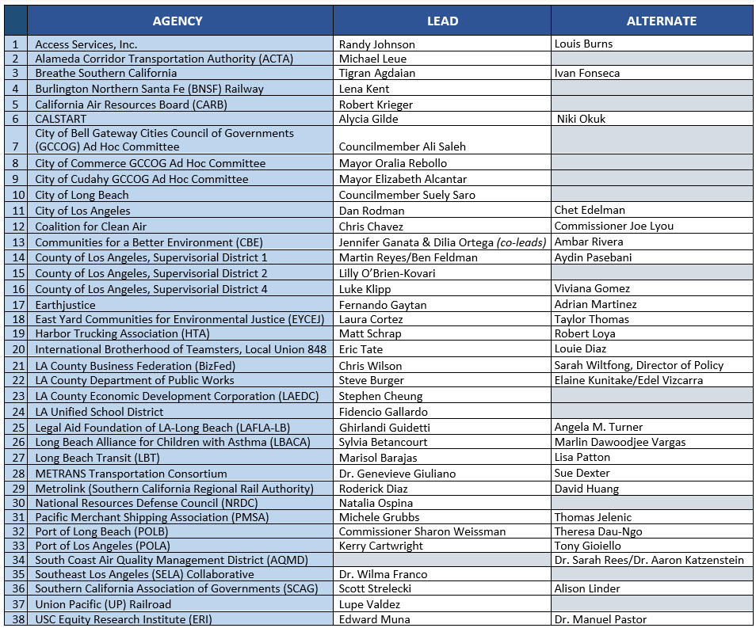
Task Force and Community Leadership Committee Members
TASK FORCE MEMBERS
COMMUNITY LEADERSHIP COMMITTEE MEMBERS
 | NAME | JURISDICTION
1 | Leticia Rodriguez | Bell
2 | Natalie Diaz Rubio | Bell Gardens
3 | Emmanuel Godinez | Boyle Heights
4 | Fa’alagilagi (Lagi) Meni-Siliga | Carson
5 | Alfonso Garate | Commerce
6 | Phyllis Ollison | Compton
7 | Martha Fierro | Cudahy
8 | Amelia Carballo | Downey
9 | Miyuki Gomez | East LA (unincorp.)
10 | Guadalupe Arellano | East LA (unincorp.)
11 | Kathleen Barajas | East LA (unincorp.)
12 | Jose Rodolfo Vallejo | Huntington Park
13 | Maria Reyes | Long Beach
14 | Marcos Lopez | Long Beach
15 | Marlene Sanchez | Long Beach
16 | Elizabeth Zamarripa | Lynwood
17 | Ivan Rojas | Lynwood
18 | Jamila Cervantes (they/them) | Maywood
19 | Kevin Shin | Signal Hill
20 | Esmeralda Hernandez | South Gate
21 | Viridiana (Viri) Preciado Cervantes | Walnut Park (unincorp.)
22 | Tiesha Davis | Wilmington/San Pedro (San Pedro)
23 | Manuel Arellano | Wilmington/San Pedro (Wilmington)
24 | Sinetta Farley | East/Rancho Dominguez (unincorp.)

Slide 35
Zero-Emission Truck Program Development Timeline
UPDATED WITH JULIE RUSH’S TIMELINE
This sixteen-week timeline shows key activities and dates for the Zero-Emission Truck Program Development.
ZET WG continues the discussion on structuring the ZET program:
  Community Engagement
  Community Benefits
  Equity Considerations
  Strategic Partnerships
  Funding Opportunities
  Legislative and Policy Initiatives
  Small Set-aside for Vehicle Subsidies
  Environmental Impacts
  Mitigation Strategies
  Program Outcomes
  ZET WG receives status report on Hahn motion
ZET WG discussion regarding the distinction between the “Early Investment Plan” phase and Multimodal Projects and Programs Phase
CES WG reviews draft outreach and public meeting plan to receive input on Multimodal Strategies/Projects & Programs milestone and amplify awareness of the Task Force planning process and related activities including the ZET program
March
JUNE 2022
JULY 2022
AUGUST 2022
SEPTEMBER/OCTOBER 2022
ZET WG receives status report on approach for Multimodal Strategy/Projects & Programs phase
ZET WG discusses “early initiatives” that affect the ZE Truck Program.
ZET WG continues the discussion on the ZET Program Structure and Protocols and votes on scope of work for ZET Program.
Equity Working Group provides
input to the 710 Task Force on
equity issues.
Community Leadership Committee (CLC) provides input to the 710 Task Force on working with communities to shape the ZET policies and programs.
ZET WG provides input on Multimodal Strategies and Initial Set of Projects & Programs as they relate to ZET initiatives.
ZET WG continues the discussion on the ZET Program Structure and Protocols and reports to the Task Force on scope of work for ZET Program Structure and Protocols.
Report preparation on ZET Program for Metro Board's September Meeting.
ZET WG incorporates findings
from Truck Technology
Comparative Report.
  Based on the Transition Plan, identify the number of charging and fueling stations needed for
  LA County over time
  Seek ZET WG input on considerations and questions
  for the Implementation Plan.
ZET Transition Plan Report to ZET WG and Task Force.
Report to Metro Board of Directors on ZET Program,
February
20XX
April
Notes:
MICHAEL

Slide 36
Zero-Emission Truck Working Group Meeting #6 Recap
Summary
Held virtually via Zoom on Tuesday, May 17
51 participants ( 17 Task Force Members/Alternates, 3 CLC members, and 10 Working Group Members)
Highlights
  Zero-Emission (ZE) Truck Program Design Breakout Room Discussions on the following topics:
    Community Engagement, Community Benefits, Equity Considerations, ZE Infrastructure Siting, Program Outcomes
    Strategic Partnerships and Funding Opportunities
    Legislative and Policy Initiatives
    Small Set-Aside for Vehicle Subsidies
    Environmental Impacts, Mitigation Strategies, and Program Outcomes
36

Slide 37
Zero-Emission Truck Working Group – Updates
Topics reviewed and discussed at monthly meetings (November 2021-June 2022):
  Goals and objectives for the 710 South Clean (now ZE) Truck Program
  Industry perspectives and the role of stakeholders in the 710 South Task Force
  Air quality and environmental justice challenges and opportunities in the corridor
  The state of clean truck technology and efforts to accelerate the commercialization of
  ZE Class 8 trucks
  Governor Newsom’s FY2022 budget and the prospects for ZE trucks and infrastructure
  funding opportunities
  Strategies to leverage Metro’s $50 million in seed funding at the state and federal level
  ZET Program Recommendation and associated policies, programs, and timing for advancing
  to Metro Board
Notes:
MICHAEL
Meetings to-date:
November 29, 2021
January 25, 2021
February 24, 2021
March 22, 2022
April 19, 2022
May 17, 2022

Slide 38
Breakout Room Topics and Assignments – ZET WG #6
#3 – Legislative and Policy Initiatives (Nickie)
  Luke Klipp, Senior Transportation Deputy, Office of Los Angeles County Supervisor Janice Hahn, Dist. 4
  Viviana Gomez, Transportation Deputy, Office of Los Angeles County Supervisor Janice Hahn, Dist. 4
  Nancy Pfeffer, Executive Director, Gateways Cities Council of Governments
  David Libatique, Senior Director of Government Affairs, Port of Los Angeles
#4 – Strategic Set-Aside for Vehicle Subsidies (Akiko)
  Niki Okuk, Deputy Director, CALSTART
  Norman Emerson, Consultant, Gateway Cities Council of Government
  Eric Tate, Port Division Deputy Director, International Longshoremen Workers Union
  Sue Dexter, METRANS Transportation Consortium
#5 – Environmental Impacts, Mitigation Strategies, and Program Outcomes (Julie)
  Tim DeMoss, Environmental Affairs Officer, Port of Los Angeles
  Julie Rush, AECOM
  Andrew Zellinger, Environmental Reviewer, U.S. Environmental Protection Agency, Region 9
  Ryan Snyder, Senior Sustainability and Innovation Manager, Caltrans District 7
#1 – Community Engagement, Community Benefits, Equity Considerations, ZE Infrastructure Siting, and Program Outcomes (Susan A.)
  Fernando Gaytan, Staff Attorney, EarthJustice
  Christopher Chavez, Deputy Policy Director, Coalition for Clean Air
  Ali Saleh, Councilmember, City of Bell
  Carlos Montez, LA Metro
  Ambar Rivera, Staff Researcher, Communities for a Better Environment
  Alison Linder, Senior Regional Planner, Southern California Association of Governments
  Marisa Perez, Transportation Policy Advisor, Gateway Cities Council of Governments
  Lynda Bybee, Consultant, Gateway Cities Council of Government
  Phyllis Ollison, CLC Member
  Tiesha Davis, CLC Member
#2 – Strategic Partnerships and Funding Opportunities (Michael)
  Michael Leue, Chief Executive Officer, Alameda Corridor Transportation Authority
  Jack Symington, Program Manager, Transportation, Los Angeles Cleantech Incubator
  Krystal Swinton, Senior Manager, Southern California Edison
  Thomas Jelenic, Vice President, Pacific Merchant Shipping Association
  Leela Rao, Port of Long Beach
  Kekoa Anderson, Gateway Cities COG
  James Shankel, Caltrans, District 7
  Natalia Ospina, Natural Resources Defense Council
Notes:
Erika
One Page Document
1-Here’s what we heard
2-Here’s what we think you agreed on
3-Here’s where we disagree
4-Additional Information needed
Trey-1, 4
Susan-2
Nora-3,5

Slide 39
Strategy #1: Stakeholder Engagement and Collaboration
Strategy 2.1 Establish a Zero-Emission Truck Working Group consisting of representatives from community groups, local/state/federal agencies, the trucking industry, air quality regulators, the ports, utilities, Caltrans, researchers, and manufacturers.
Working with Metro and Caltrans 710 Task Force, Equity Working Group, and Office of Equity and Race, identify equity issues related to the development and implementation of the ZEV initiative, focusing on avoiding unnecessary financial, operational and quality of life burdens on equity-focused communities.
  Engage with community leaders and community-based organizations to leverage existing connections to communities throughout the corridor when determining infrastructure siting
    Understand the physical and noise impacts of stations in communities
    Understand concerns about impacts on safety, access, and condition of local streets
  Highlight the importance of community input, engagement, and transparency
    Employ walk-up informational centers to discuss jobs, trainings, and the zero-emissions movement.
    Ensure there is proper context and clarity around these discussions
  Work with trucking associations and EV companies to understand effective placement and operational considerations for ZE infrastructure
  Ensure affected communities benefit directly from implementation of the ZE Truck Program, including job opportunities
  Do not utilize eminent domain to site ZE infrastructure
39
Notes:
MICHAEL
Who do we need to connect with?
Opinion leaders, Community-based organizations, City Halls
Leverage existing connections to communities throughout the corridor
Electric Vehicle manufacturers
Labor Unions, Trucking Associations
Core group familiar with how the equipment works, and which places are effective sites
Community Colleges, Training Programs (e.g. Cal State Long Beach)
Ensure that investment ties directly to those communities through high-road jobs, job training, commitment to local hire
What types of interactions are most effective?
Must have context for discussions, be clear about intentions
Where/When should we be having these conversations?
Depends on where these sites land to determine where this kind of outreach occurs
Walk-up centers

Slide 40
Strategy #1: Stakeholder Engagement and Collaboration cont.
Strategy 2.1 Establish a Zero Emission Truck Working Group consisting of representatives from community groups, local/state/federal agencies, the trucking industry, air quality regulators, the ports, utilities, Caltrans, researchers, and manufacturers
Develop small groups to focus on equity implications, coordination with existing regional efforts, technology and funding/financing.
Ensure that planning, development and deployment of vehicle technologies and supporting infrastructure take place in a concerted and simultaneous manner.
  Site infrastructure in conjunction with Metro partners and collaborative study-GCCOG/Metro-cities.
Work with regional partners to ensure that LA County will have a sufficient labor pool with appropriate skillsets to meet the increasing demand for new technology-based vehicles and infrastructure maintenance and operations.
  Ensure that corridor residents have access to job opportunities
    Engage with colleges, vocational schools, and training programs to develop job training programs that will benefit residents of the corridor
    Establish partnership with LA County Workforce Development Board, Cal State Long Beach, and other key job training organizations throughout the corridor
Identify and prioritize specific clean truck programs to be developed through the initiative.
  Support with technical assistance to help small businesses purchasing
Propose governance and delivery mechanisms to oversee and implement the ZEV initiative’s various programs.
40
Notes:
MICHAEL
Highlights from Breakout Room #1
Who do we need to connect with?
Opinion leaders, Community-based organizations, City Halls
Leverage existing connections to communities throughout the corridor
Electric Vehicle manufacturers
Labor Unions, Trucking Associations
Core group familiar with how the equipment works, and which places are effective sites
Community Colleges, Training Programs (e.g. Cal State Long Beach)
Ensure that investment ties directly to those communities through high-road jobs, job training, commitment to local hire
What types of interactions are most effective?
Must have context for discussions, be clear about intentions
Where/When should we be having these conversations?
Depends on where these sites land to determine where this kind of outreach occurs
Walk-up centers

Slide 41
Strategy #2: Develop an information clearinghouse in partnership with other agencies for Countywide Clean Truck Initiative programs.
Develop a collaborative structure for maintaining an information clearinghouse with local, regional, state and national partner agencies.
    Explore opportunities to establish a concerted policy framework that supports a sustainable market for ZE Trucks
      Permitting pathway
      Caltrans right of way
Examine POLB study to look at sites suitable for publicly accessible truck charging with an equity focus.
  Collect, maintain and distribute information on local, regional, state and national truck programs (e.g., scope, eligibility, available funding) to impacted parties.
  Develop a white paper in partnership with key stakeholders focusing on the characteristics, challenges and opportunities facing the trucking industry in LA County.
    Build off lessons from near term deployment (ZE25) and focus on the trucks-near port facilities before expanding efforts up the 710 Corridor.
    Partner with trucking association to understand economic considerations for truck owners/operators, particularly those considered minority and/or disadvantaged.
    Understand challenges of straight purchase assistance versus leasing
      Issues with worker misclassification
      ATRIP developing ISEF – truck as a service. Lease, short-term rental models
    Give opportunities to small operators while maintaining flexibility
    Understand the tendency for ZE and Hydrogen to compete for charging infrastructure/funding
    Explore options for traffic mitigation at charging stations
41
Notes:
MICHAEL
Action Plan-Next steps/Responsibility/Timeline
Who do we need to connect with?
Opinion leaders, Community-based organizations, City Halls
Leverage existing connections to communities throughout the corridor
Electric Vehicle manufacturers
Labor Unions, Trucking Associations
Core group familiar with how the equipment works, and which places are effective sites
Community Colleges, Training Programs (e.g. Cal State Long Beach)
Ensure that investment ties directly to those communities through high-road jobs, job training, commitment to local hire
What types of interactions are most effective?
Must have context for discussions, be clear about intentions
Where/When should we be having these conversations?
Depends on where these sites land to determine where this kind of outreach occurs
Walk-up centers

Slide 42
Strategy #3: Establish revenue streams to fund the
ZEV Program
  Secure Metro-controlled funding as seed funding.
  Identify opportunities to leverage seed funding.
    Explore existing funding opportunities through SCAQMD, CARB, and various state and regional agencies for early phase of the ZE Truck Program
    Explore SCAQMD Joint Electric Truck Scaling Initiative
    Trade Corridor Enhancement Program, which also uses federal funding, could fund applications for clean truck subsidies and infrastructure using federal funds.
    Explore State/IIJE Funding which should develop a carbon reduction and ZE infrastructure deployment plan ¹⁶
  Develop or advocate for augmented or new revenue streams to support ongoing implementation of clean truck technology countywide.
    Establish an advocacy mechanism for heavy and medium duty charging infrastructure
    Explore SB372 for Medium and heavy-duty fleet purchasing assistance program
    Advocate for ongoing incentives for public truck charging and hydrogen fuel stations
    Focus on heavy-duty funding (mandates are closer, more complicated, hard to abate)
Notes:
HIGHLIGHTS
Overall Goals, Objectives, and Strategies
What are the funding opportunities available to leverage local funding with state, federal, and private funding sources to maximize investment in implementing the 710 Clean Truck Program in the near term/in the long term?
Do the grant guidelines for zero-emission funding programs through various state agencies align to help provide increased funding opportunities to support this program?
Which funding opportunities would be the top priorities?
While state gas tax funds that support most Senate Bill 1 programs are not eligible for clean truck subsidies due to Article XIX restrictions, programs like the Trade Corridor Enhancement Program, which also uses federal funding, could fund applications for clean truck subsidies and infrastructure using federal funds.
SCAQMD, CARB, and various state and regional agencies have funding opportunities available to match “seed funding” provided by Metro for an early phase of the 710 Clean Truck Program
Input on Funding opportunities
Concern for Metro focusing more on infrastructure and Ports are looking more at trucks
May want to look at how to leverage funds
Look at both vehicle and infrastructure grant opportunities

Slide 43
Strategy #4: Develop scope, funding eligibility, funding methods, evaluation processes, performance metrics and performance monitoring mechanisms for programs developed through the ZET Program
  Coordinate with other established programs.
    NEVI Program (CTC and CalTrans) - light-duty focus
    Edison Infrastructure Program
    Define eligibility requirements and evaluation process.
  Finalize funding levels, financing options and funding strategies.
  Identify delivery mechanisms and governance needs.
  Develop performance metrics to measure success.
    Determine goal for fleet turnover to ZE trucks by a specific date
    Determine goal to eliminate criteria pollutants and reduce greenhouse gas emissions
    Determine goal to reduce diesel particulate matter
    Monitor the unemployment rate at the census track level as a baseline to track success
    Evaluate changes in public health throughout implementation of the ZE Truck Program
  Develop a performance monitoring system.
  Identify opportunities to work with and leverage existing regional efforts to develop and implement zero-emission transit fleets and infrastructure, including co-locating zero-emission charging and fueling infrastructure to serve public and private sector operations.
    Co-locating work with school districts, clean school buses
    Determine incentive structure for cities to site ZE infrastructure facilities
      Assistance in street maintenance, condition of local streets
      Explore incentive structure for a city to accept light and heavy-duty infrastructure
    Explore public charging on POLB and POLA property
    Explore transitional charging opportunities
    Sharing land between independent owner operators and fleet operators (in-kind contribution of land to count as a funding match or provide car charging/fueling in the facilities)
    Use existing ROW where possible
    Use existing truck infrastructure for charging facilities
Notes:
Ensuring community benefits
Monitoring outcomes

Slide 44
Strategy #5: Develop and implement the Program on the I-710 corridor. Metro to serve as lead partner
  Initiate the ZET Working Group as part of the 710 Task Force.
  Develop program parameters and evaluation process.
  Receive and incorporate feedback and input from community groups into the design of the program.
    Utilize opportunities to deploy ZE charging and fueling stations along the 710 Corridor with community input
  Coordinate the implementation and evaluation of the program with Metro’s Highway Program, the Gateway Cities COG, local, regional, state and national stakeholders from the public and private sectors, including utility and supporting infrastructure providers.
    Evaluate the change in travel patterns related to ZE Truck infrastructure
      Mitigate traffic at charging stations
  Handholding individuals through the process, breaking down the jargon
  Understand the industry—what they need, how to help
  Technical assistance helping small businesses purchasing
Determine the availability of the electrical grid throughout design of ZE Truck Program
  Identify lessons learned and recommend modifications to the Countywide Clean Truck Initiative and other clean truck programs developed by or coordinated with Metro.

Slide 45
Breakout Room Topics and Assignments – ZET WG #7
#3 – Legislative and Policy Initiatives (Nickie)
  Luke Klipp, Senior Transportation Deputy, Office of Los Angeles County Supervisor Janice Hahn, Dist. 4
  Viviana Gomez, Transportation Deputy, Office of Los Angeles County Supervisor Janice Hahn, Dist. 4
  Randy Johnson, Director of Government Affairs & Outreach, Access Services
  Nancy Pfeffer, Executive Director, Gateways Cities Council of Governments
  Michele Grubbs, Vice President, Pacific Merchant Shipping Association
  David Libatique, Senior Director of Government Affairs, Port of Los Angeles
#4 – Strategic Set-Aside for Vehicle Subsidies (Akiko)
  Niki Okuk, Deputy Director, CALSTART
  Mathew Schrap, Chief Executive Officer, Harbor Trucking Association
  Norman Emerson, Member, Gateway Cities Council of Government
  Eric Tate, Port Division Deputy Director, International Longshoremen Workers Union
  Morgan Caswell, Manager of Air Quality Practices, Port of Long Beach
  Sue Dexter, Equity Research Institute, USC
#5 – Environmental Impacts, Mitigation Strategies, and Program Outcomes (Julie)
  Tim DeMoss, Environmental Affairs Officer, Port of Los Angeles
  Chris Cannon, Director of Environmental Management, Port of Los Angeles
  Adrian Martinez, Senior Attorney, EarthJustice
  Connell Dunning, Environmental Scientist, Environmental Protection Agency
  Andrew Zellinger, Environmental Reviewer, U.S. Environmental Protection Agency, Region 9
  Morgan Capilla, Environmental Justice Coordinator, U.S. Environmental Protection Agency, Region 9
  Ryan Snyder, Senior Sustainability and Innovation Manager, Caltrans District 7
#1 – Community Engagement, Community Benefits, Equity Considerations, ZE Infrastructure Siting, and Program Outcomes
  Fernando Gaytan, Staff Attorney, EarthJustice
  Christopher Chavez, Deputy Policy Director, Coalition for Clean Air
  Ali Saleh, Councilmember, City of Bell
  Ambar Rivera, Staff Researcher, Communities for a Better Environment
  Alison Linder, Senior Regional Planner, Southern California Association of Governments
  Marisa Perez, Transportation Policy Advisor, Gateway Cities Council of Governments
#2 – Strategic Partnerships and Funding Opportunities
  Aaron Katzenstein, South Coast Air Quality Management District
  Michael Leue, Chief Executive Officer, Alameda Corridor Transportation Authority
  Sharon Weissman, Vice President, Long Beach Board of Harbor Commissioners, Port of Long Beach
  Theresa Dau-Ngo, Port of Long Beach
  Tony Gioelle, Deputy Executive Director of Development, Port of Los Angeles
  Jason Groves, Business Development Transportation Electrification, Southern California Edison
  Jack Symington, Program Manager, Transportation, Los Angeles Cleantech Incubator
  Damon Hannaman, Senior Advisor, Key Accounts, Southern California Edison
  George Payba, Environmental Affairs Officer, Los Angeles Department of Water and Power
  Jose Maria Paz, Electrical Engineering Associate, Los Angeles Department of Water and Power
  Karina O’Connor, Environmental Engineer, U.S. Environmental Protection Agency, Region 9
  Thomas Jelenic, Vice President, Pacific Merchant Shipping Association
  Dr. Joe Lyou, President, CEO, Coalition for Clean Air
45
If your name does not appear on this list, please contact Nora Casillas at ncasillas@arellanoassociates.com to be assigned a Breakout Room.
Notes:
Erika
Strategies
Lead/Next Steps/Resources/Timeline

Slide 46
Breakout #1: Community Engagement, Community Benefits, Equity Considerations, ZE Infrastructure Siting, and Program Outcomes
Breakout #1: Community Engagement, Community Benefits, Equity Considerations, ZE Infrastructure Siting, and Program Outcomes
WHAT WE HEARD | WHAT WE AGREED | BARRIERS/CHALLENGES | ADDITIONAL INFORMATION NEEDED | NEXT STEPS
Engage with community leaders and community-based organizations to leverage existing connections to communities throughout the corridor when determining infrastructure siting | Should not be a parallel process being done outside of the Task Force that usurps of supplants what comes out of this process. At the end of the day, the Task Force should have a final say under it's equity plan | Where sites land determines where outreach will occur. | What type of interactions are most effective? | TBD
Highlight the importance of community input, engagement, and transparency | Need to understand concerns/impacts on noise, safety, access, local street conditions Prevent or mitigate additional community harm during the deployment or operation of ZE infrastructure | TBD | Detail regarding appearance and exact location of sites | Schedule a presentation in June/July with LACI and CEHAJ on the Blueprint Project on process. Highlight Lessons Learned for application to TF projects.
Ensure that investment in the communities ties direct benefits to those residents | TBD | Unclear process to begin workforce development project | Get their ideas on how to roll job training process out | Connect with LA County Workforce Development Board, community colleges, training programs for ideas on how to roll this out.
Employ walk-up informational centers to discuss jobs, trainings, and zero-emissions movement | Ensure there is proper clarity around these discussions. Be clear about intentions. | TBD | Find locations for these centers | TBD
Work with trucking associations and EV companies to understand effective placement and operational considerations of ZE infrastructure | TBD | TBD | Caltrans and other vehicle producers: what is their vision when creating electric cars and how people would charge them? | TBD
Ensure support for small and local businesses. Give preference to local companies doing business in the corridor | TBD | TBD | TBD | TBD
Essential to have labor at the table. Important to get a core group of folks who are familiar with how this equipment works | TBD | TBD | TBD | TBD
Notes:
Who do we need to connect with?
Opinion leaders, Community-based organizations, City Halls
Leverage existing connections to communities throughout the corridor
EV manufacturers
Labor Unions, Trucking Associations
Core group familiar with how the equipment works, and which places are effective sites
Community Colleges, Training Programs (e.g. Cal State Long Beach)
Ensure that investment ties directly to those communities through high-road jobs, job training, commitment to local hire
What types of interactions are most effective?
Must have context for discussions, be clear about intentions
Where/When should we be having these conversations?
Depends on where these sites land to determine where this kind of outreach occurs
Walk-up centers

Slide 47
Breakout Room #5 – Environmental Impacts, Mitigation Strategies, and Program Outcomes
What are the objectives for the ZET Program from the environmental perspective?
Objectives should be quantitative and time-bound
  E.g., target turnover of truck fleet by specific date
Goals/Strategies
  Eliminate truck emissions (criteria pollutants) and reduce GHG, diesel particulate matter
  Do not utilize eminent domain to site ZE infrastructure
  Eliminate GHG emissions from electric and hydrogen production
What are the strategic considerations and key features we should build into the program in order to minimize potential impacts?
Traffic mitigation at charging stations
Use existing ROW where possible
Land-sharing between independent owner-operators and fleet operators (in-kind contribution of land to count as a funding match or provide car charging/fueling in the facilities
How can we evaluate outcomes of the ZET program?
Mention the mitigations that benefit the public
Measure truck travelling (e.g., ZE truck trips, ZE truck VMT)
Use existing truck infrastructure for charging facilities
47
Notes:
MICHAEL

