Slide 1
We will begin in a few moments.
710 Task Force
Zero-Emission Truck Working Group
Meeting #6
May 17, 2022
Notes:
Erika

Slide 2
710 Task Force
Notes:
Erika

Slide 3
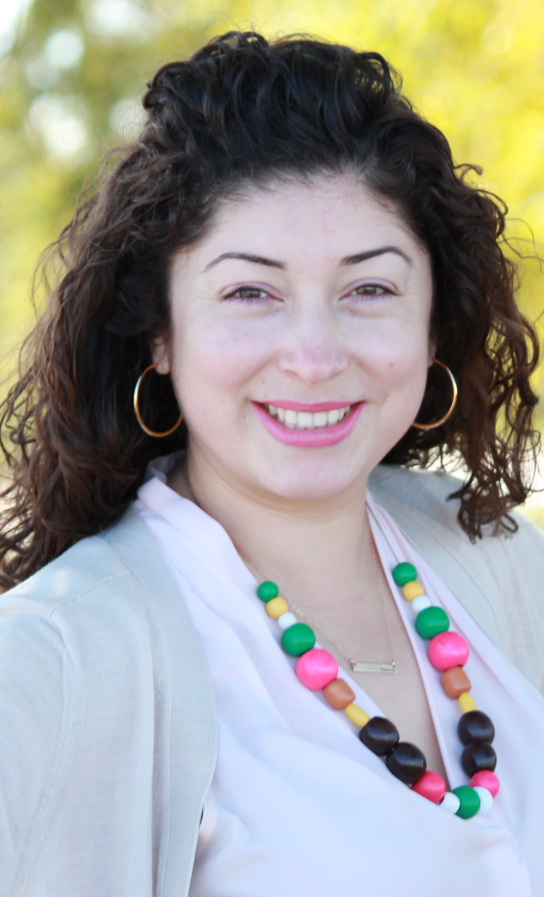
Facilitator
Erika C.B. Morales
Partner, Morales + Morales
Notes:
Erika

Slide 4
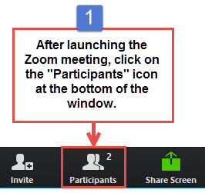
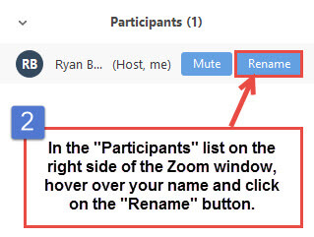
Task Force Member and Participant Identification
Please change your Zoom screen name to include: Name and Organization Name
(and if you are a Task Force Member)
Notes:
Erika

Slide 5

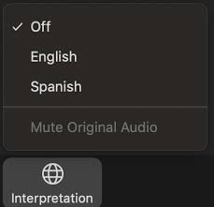
Interpretation/ Interpretación
Click the Interpretation icon in your meeting controls to enter the Spanish room
(Optional) To hear the interpreted language only, click Mute Original Audio
>Haga clic en el ícono de Interpretación en
los controles de su reunión para ingresar la sala
en español
(Opcional) Para escuchar solo el idioma interpretado, haga clic en “Mute Original Audio”
o “Silenciar audio original”
Notes:
ERIKA– please ask if anyone needs Spanish interpretation
IF NOT—NO NEED TO REVIEW THIS SLIDE, subsequent slides no need to read the Spanish instructions

Slide 6

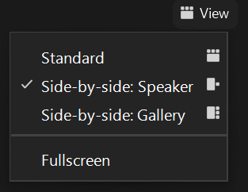
Turn on Camera / Prende la cámara
To start and stop your video, click the camera icon at the bottom left of your control panel
Para iniciar y detener su video, haga clic en el ícono de la cámara en la parte inferior izquierda de su panel de control
To switch between views during the meeting click or tap on Standard, Side-by-side Speaker View, and Side-by-side Gallery View at the top right corner of your zoom screen
Para cambiar entre vistas durante la reunión, haga clic o toque Estándar, Vista de orador en paralelo y Vista de Galería en Paralelo en la esquina superior derecha de la pantalla de zoom
Notes:
Erika

Slide 7

Raise Hand
Click Raise Hand in your meeting controls or
Press*9 on the phone line.
To lower your hand, click Raise Hand in your meeting controls.
Comments & questions can also be provided in writing by using the Chat function.
The Chat button is located on the control panel at the bottom of your screen.
Notes:
Erika

Slide 8
Welcome!
Notes:
Erika

Slide 9
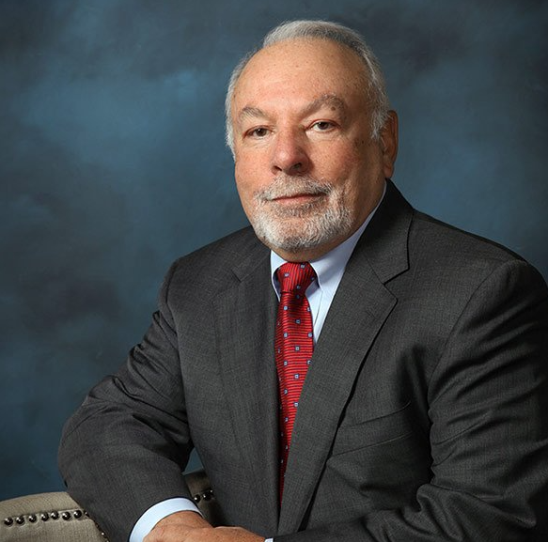
In Memorium – Victor LaRosa
Notes:
Michael
It is with deep sadness and heavy heart that I inform you of the passing of our beloved Vic La Rosa, CEO, President and Co-Founder.
After a valiant fight against lung cancer, Vic peacefully passed away
Vic was a crusader; he fought for cleaner air quality and received numerous awards throughout his career.
Our fleet of clean truck technologies are a tribute to Vic and his visions.
He was a leader; he was a driving force behind the success of our company.
Vic had a love for his family, friends, and employees. We have all suffered a terrible loss.
We will miss him more than words can express.
Bill Allen
EVP, COO, and Co-Founder

Slide 10
Meeting Objectives
Prepare for the June Board Report on ZET Program
Present ZET Program Recommendation based on Working Group input
Based on Metro Board direction, conduct an interactive discussion to refine priorities, strategies to accomplish outcomes, considerations & next steps
  Test consensus on the ZET Program recommendation
Notes:
Erika
Develop a scope of work for the ZET Program
Identify regional funding partners
Identify near and long-term opportunities
Identify policy and legislative barriers to implementation
Identify discretionary grant opportunities
Convene and collaborate with community and regional stakeholders

Slide 11
Agenda
1:00 pm Welcome, Introductions, Agenda Review, and Purpose of the Zero-Emission Truck Working Group
1:10 pm Agenda Item #1: Project Team Update
1.1 June Board Report
1:20 pm Agenda Item #2: ZET Program Recommendation – Interactive Discussion with Breakout Rooms followed by Report Outs and Plenary Discussions
1:20-1:25 pm Introduction to Breakout Room Discussion topics and protocols; what we intend to accomplish
1:25-1:55 pm Breakout Room Discussions
1:55-2:45 pm Breakout Room Report Outs (5 mins each) followed by plenary discussions (5 mins each)
  2:45 pm Agenda Item #3: Test and confirm consensus on the ZET Program Recommendation
2:55 pm Closing Comments, Upcoming Meetings, Thank you
Notes:
Erika

Slide 12
Agenda Item 1:
Project Team Update
Notes:
Erika

Slide 13
Metro Board Direction – June Board Report
Share recommendations from the ZE Truck Working Group for the development of the program, use of the $50 million, as well as near-term opportunities to seek funding.
Provide an overview of funding opportunities available at the regional, state, and federal level.
Share input from Working Group on Board requests.
Notes:
Michael
Need to come to a decision
Rationale to transmit to the Board
(Dutra request) BIL will offer $380 million to the state to support zero emission infrastructure. The state (Caltrans/CalSTA) will need to submit a state plan to the federal government to harness the funds. How is Metro coordinating and what is Metro going to submit to the state?
Michael Turner stated that question is more of what specific items Metro is going to submit. Dutra responded that he'd like to know what our plan is and requested a staff report back in May.
(Hahn request) With respect to the three options for how the $50 million will be spent,
1) how do we choose the option and
2) when can the Board approve the option?
Staff anticipate the ZET Working Group to make a formal recommendation at its April meeting. Staff will then be able to report back to the Board on the outcome.
Staff anticipate strategic recommendations will be ready to be reported back in May.
Does it need to be approved by the Task Force at #8 Meeting?
Items with no specific dates, but requested for follow-up information:
(Cano) report back to the Board realities of income tax penalty and sales tax imposed on truck owners in trying to minimize ZE truck purchasing cost.
(Solis) with respect to the double whammy that truck owners face with subsidies and sales taxes when purchasing zero emission trucks, what financial assistance opportunities exist through the state to support independent truck owners?
(Solis) What relief can be offered to residents along the heavy air pollution corridors to subsidize air filters?
Metro to provide follow up information to the Metro Board:
Income tax penalty and sales tax imposed on truck owners in trying to minimize zero-emission truck purchasing cost
State financial assistance to independent truck owners for the purchase of zero-emission trucks
Subsidies for air filters to provide relief to residents along the corridor
How to harness funding opportunities for workforce development being released by the Department of Labor
Truck Parking – Can Metro work with Union Pacific to share space at its railyard in the City of Commerce along I-710 for overnight truck parking?
How to make ZE trucks affordable for small business owners? Is there an innovative mechanism like a housing development trust fund, etc., in which participants contribute money to purchase a property jointly?

Slide 14

Zero-Emission Truck Program Development Timeline
This sixteen-week timeline shows key activities and dates for the Zero-Emission Truck Program Development.
March
APRIL 2022
MAY 2022
JUNE 2022
JULY 2022
Zero-Emission Truck Working Group (ZET WG) to finalize recommendation on $50 million funding use.
ZET WG begins discussion on structuring the program protocols:
  Evaluation Criteria
  Funding Leverage Opportunities
  Maximum participation share
  Public Benefit
  Community engagement
  Pilot projects
Metro begins work on a Truck Technology Comparative Report.
ZET Working Group Reports its recommendation for the ZET Program to the 710 Task Force.
Equity Working Group provides
input to the 710 Task Force on
equity issues.
Community Leadership Committee (CLC) provides input to 710 Task Force on working with communities to shape the ZET policies and programs.
ZET WG continues discussion on Program Structure and Protocols at ZET WG #6.
ZET WG to vote on final Program Structure and Protocols.
ZET WG reports out to the Task Force on ZET Program Structure and Protocols to 710 Task Force.
ZET WG incorporates findings
from Truck Technology
Comparative Report.
  Based on the Transition Plan, identify the number of charging and fueling stations needed for
  LA County over time
  Seek ZET WG input on considerations and questions
  for the Implementation Plan.
ZET Transition Plan Report to ZET Working Group and Task Force.
February
20XX
April
Notes:
MICHAEL

Slide 15
Zero-Emission Truck Working Group – Updates
Topics reviewed and discussed at monthly meetings (November 2021-May 2022):
  Goals and objectives for the 710 South Clean (now ZE) Truck Program
  Industry perspectives and the role of stakeholders in the 710 South Task Force
  Air quality and environmental justice challenges and opportunities in the corridor
  The state of clean truck technology and efforts to accelerate the commercialization of
  ZE Class 8 trucks
  Governor Newsom’s FY2022 budget and the prospects for ZE trucks and infrastructure
  funding opportunities
  Strategies to leverage Metro’s $50 million in seed funding at the state and federal level
  ZET Program Recommendation and associated policies, programs, and timing for advancing
  to Metro Board
Notes:
MICHAEL
Meetings to-date:
November 29, 2021
January 25, 2021
February 24, 2021
March 22, 2022
April 19, 2022
May 17, 2022

Slide 16
Zero-Emission Truck Working Group #5 Recap
Summary
Held virtually via Zoom on Tuesday, April 19
27 participants (9 Task Force/Alternates, 7 Ex-Officio Members, 4 CLC Members in attendance, 7 Working Group Members)
Highlights
  Strategies to leverage Metro’s $50 million in seed funding at the state and federal level
  ZET Program Recommendation and associated policies, programs, and timing for advancing
  to Metro Board
16
Notes:
MICHAEL

Slide 17
Agenda Item 2:
ZET Program Recommendation –
Interactive Discussion with Breakout Rooms followed by Report Outs and Plenary Discussions
Notes:
Erika
1:20-1:25pm Introduction to Breakout Room Discussion topics and protocols; what we intend to accomplish
1:25-1:55pm Breakout Room Discussions
1:55-2:45pm Breakout Room Report Outs (5 mins each) followed by Plenary Discussions (5 mins each)

Slide 18
Strategic Partnerships and Funding Opportunities
Metro Board Direction and desired outcomes
$200 million funding target
Leverage $50 million local matches with private, regional, state, and federal funding
ZE deployment in the I-710 South Corridor
Collaboration with regional stakeholders
Strategies to accomplish outcomes
Identify discretionary grant opportunities
Convene and collaborate with community and regional stakeholders
Develop a scope of work for the ZET Program
Identify regional funding partners
Identify near and long-term opportunities
Identify policy and legislative barriers to implementation
Notes:
Michael

Slide 19
Breakout Room Information
TOPICS
#1 – Community Engagement and Benefits, Equity Considerations, ZE Infrastructure Siting, and Program Outcomes
#2 – Strategic Partnerships and Funding Opportunities
#3 – Legislative and Policy Initiatives
#4 – Small Set-Aside for Vehicle Subsidies
#5 – Environmental Impacts, Mitigation Strategies, and Program Outcomes
AGENDA
Review Board Direction and Strategic Objectives
Overall Goals, Objectives, and Strategies
Developing an Action Plan
Ensuring Community Benefits
1:20-1:25pm Introduction to Breakout Room Discussion topics and protocols; what we intend to accomplish
1:25-1:55pm Breakout Room Discussions
1:55-2:45pm Breakout Room Report Outs (5 mins each) followed by Plenary Discussions (5 mins each)
Notes:
ERIKA

Slide 20
Breakout Room Topics and Assignments
#3 – Legislative and Policy Initiatives
  Luke Klipp, Senior Transportation Deputy, Office of Los Angeles County Supervisor Janice Hahn, Dist. 4
  Viviana Gomez, Transportation Deputy, Office of Los Angeles County Supervisor Janice Hahn, Dist. 4
  Randy Johnson, Director of Government Affairs & Outreach, Access Services
  Nancy Pfeffer, Executive Director, Gateways Cities Council of Governments
  Michele Grubbs, Vice President, Pacific Merchant Shipping Association
  David Libatique, Senior Director of Government Affairs, Port of Los Angeles
#4 – Strategic Set-Aside for Vehicle Subsidies
  Niki Okuk, Deputy Director, CALSTART
  Mathew Schrap, Chief Executive Officer, Harbor Trucking Association
  Norman Emerson, Member, Gateway Cities Council of Government
  Eric Tate, Port Division Deputy Director, International Longshoremen Workers Union
  Morgan Caswell, Manager of Air Quality Practices, Port of Long Beach
  Sue Dexter, Equity Research Institute, USC
#5 – Environmental Impacts, Mitigation Strategies, and Program Outcomes
  Tim DeMoss, Environmental Affairs Officer, Port of Los Angeles
  Chris Cannon, Director of Environmental Management, Port of Los Angeles
  Adrian Martinez, Senior Attorney, EarthJustice
  Connell Dunning, Environmental Scientist, Environmental Protection Agency
  Andrew Zellinger, Environmental Reviewer, U.S. Environmental Protection Agency, Region 9
  Morgan Capilla, Environmental Justice Coordinator, U.S. Environmental Protection Agency, Region 9
  Ryan Snyder, Senior Sustainability and Innovation Manager, Caltrans District 7
#1 – Community Engagement, Community Benefits, Equity Considerations, ZE Infrastructure Siting, and Program Outcomes
  Fernando Gaytan, Staff Attorney, EarthJustice
  Christopher Chavez, Deputy Policy Director, Coalition for Clean Air
  Ali Saleh, Councilmember, City of Bell
  Ambar Rivera, Staff Researcher, Communities for a Better Environment
  Alison Linder, Senior Regional Planner, Southern California Association of Governments
  Marisa Perez, Transportation Policy Advisor, Gateway Cities Council of Governments
#2 – Strategic Partnerships and Funding Opportunities
  Matt Miyasato, Deputy Executive Officer, Science & Technology Advancement, South Coast Air Quality Management District
  Aaron Katzenstein, South Coast Air Quality Management District
  Michael Leue, Chief Executive Officer, Alameda Corridor Transportation Authority
  Sharon Weissman, Vice President, Long Beach Board of Harbor Commissioners, Port of Long Beach
  Theresa Dau-Ngo, Port of Long Beach
  Tony Gioelle, Deputy Executive Director of Development, Port of Los Angeles
  Jason Groves, Business Development Transportation Electrification, Southern California Edison
  Jack Symington, Program Manager, Transportation, Los Angeles Cleantech Incubator
  Damon Hannaman, Senior Advisor, Key Accounts, Southern California Edison
  George Payba, Environmental Affairs Officer, Los Angeles Department of Water and Power
  Jose Maria Paz, Electrical Engineering Associate, Los Angeles Department of Water and Power
  Karina O’Connor, Environmental Engineer, U.S. Environmental Protection Agency, Region 9
  Thomas Jelenic, Vice President, Pacific Merchant Shipping Association
  Dr. Joe Lyou, President, CEO, Coalition for Clean Air
If your name does not appear on this list, please contact Nora Casillas at ncasillas@arellanoassociates.com to be assigned a Breakout Room.
Notes:
Erika

Slide 21
Agenda Item 2:
ZET Program Recommendation –
Report Outs and Plenary Discussions
Notes:
Erika and Michael
Are we missing anything?
Should we ask additional questions?

Slide 22
Agenda Item 3:
Test and Confirm Consensus on the
Zero-Emission Truck Program Recommendation
Notes:
Erika

Slide 23
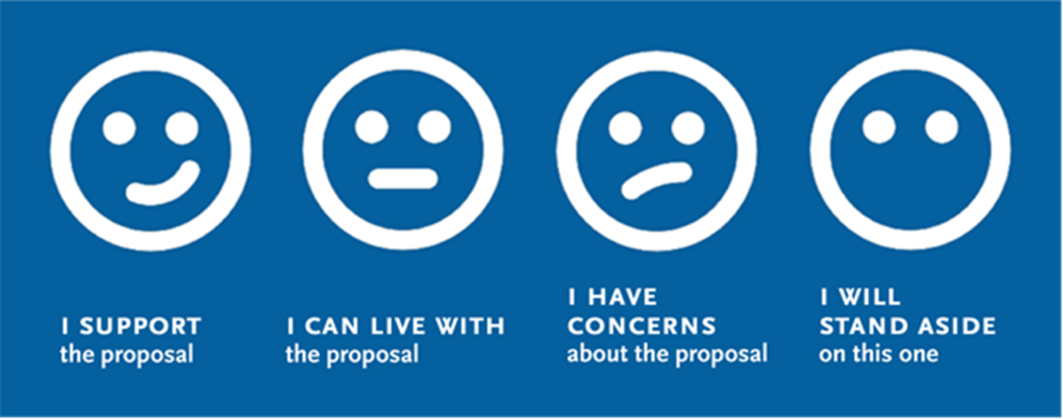
710 ZE Truck Program Draft Recommendation
Metro should leverage its $50 million to implement ZE Infrastructure with a small set-aside for strategic funding opportunities targeted to ZE truck subsidies.
Notes:
The Metro Zero Emission Truck Program should invest its resources primarily on infrastructure for ZEV with a small carve out for small fleets to achieve strategic funding opportunities.
TEST FOR CONSENSUS
I support the proposal
I can live with the proposal
I have concerns about the proposal
I will stand aside on this one

Slide 24




Zero-Emission Truck Working Group Vote
Metro should leverage its $50 million on ZE Infrastructure with a small set-aside for targeted ZE truck subsidies.
Yes
No
Abstain
24
Notes:
Erika

Slide 25
Closing Comments, Upcoming Meetings, Thank You
Notes:
Erika

Slide 26
Upcoming Meetings
              Working Groups
      Equity Working Group #3
      Wednesday, May 18, 5-7pm
              Community Leadership Committee
      Meeting #3
      Thursday, May 19, 5-7pm
      Meeting #3, continued
      Monday, May 23, 5-7pm
              Task Force
      Task Force Meeting #9
      Monday, June 13, 5-7:30pm
Notes:
Erika

Slide 27
Can’t attend the meeting? Reach out to us!
Michael Cano, Deputy Executive Officer,
Countywide Planning & Development
Metro
One Gateway Plaza, MS 99-13-1
Los Angeles, CA 90012
213.922.4710
710corridor@metro.net
metro.net/projects/i-710-corridor
@metrolosangeles
losangelesmetro
Notes:
Michael

Slide 28
Thank you!
Notes:
Erika

Slide 29
EXTRA SLIDES
Notes:
Erika

Slide 30
Vehicle Funding Opportunities
UPDATE AND REPLACE WITH INPUT RECEIVED FROM LACI
PROGRAM NAME | FUNDING TYPE | DESCRIPTION | ELIGIBILITY | TOTAL PROGRAM AMOUNT | FUNDING CYCLE AND KEY DATES
HVIP (California Air Resources Board) | Voucher | Point-of-sale discounts to power California communities and drive commercial technology transformation | public transit buses; class 8 tractors performing drayage operations; public school buses | $196.6 million | 3/30/2022
HVIP (California Air Resources Board) | Voucher | pilot funding for incentives geared towards helping small trucking fleets and independent owner operators access zero-emission trucks. | small trucking fleets and independent owner operators | $23.4 million | 6/1/2022
HVIP (California Air Resources Board) |  | Drayage
Carl Moyer Memorial Air Quality Standards Attainment Program (CARB) | Grant | Projects that reduce emissions from heavy-duty on-road and off-road equipmnent qualify for Moyer grants. These projects go beyond regulatory requirements by replacing, repowering or retrofitting older, higher emitting engines. Eligible engines includ on-road trucks over 14,000lbs gvw, among others. | public and private operators | $60 million
VW Mitigation Trust Combustion Freight and Marine Projects (SCAQMD) | Grant | Combustion Freight and Marine Projects Category. Intended to accelerate the replacement of older, higher polluting engines throughout the state of CA, including areas that are disproportionately impacted by air pollution, such as freight corridors, ports and rail yards. | Public and private that own or operate | $60M/$26M currently avaiable | on-going
Diesel Emissions Reductions Grant (US Environmental Protection Agency) | Grant
2022-23 Proposed Budget (CEC/CARB) |  | Over 4 years, for transit buses and infrastructure |  | $460 M
2022-23 Proposed Budget (CEC/CARB) |  | Over 4 years, for drayage trucks and infrastructure |  | $475M
2022-23 Proposed Budget |  | Over 4 years, clean trucks, buses and off-road vehicles |  | $1.1 billion
Notes:
LACI
Ports

Slide 31
Infrastructure Funding Opportunities
UPDATE AND REPLACE WITH INPUT RECEIVED FROM LACI
Notes:
LACI
Ports

Slide 32
Desired Outcomes of Procedural Equity
Procedural Equity
Proactive and accessible community engagement that bridges linguistic, technology, and ability gaps to meet communities where they are and enable participatory and representative decision-making processes.
Ongoing systems of accountability and communication to build and maintain trust
Notes:
Susan
Change to slide build with larger font sizes
Add screenshot of this slide to Miro board

Slide 33
Desired Outcomes of Procedural Equity
Earned trust between Metro, community members, and community partners
A collection of project ideas and feedback from a range of people that accurately reflect the project area’s population
Community-identified metrics and benchmarks for project evaluation
Project outcomes that reflect the priorities and needs of communities most impacted by the I-710 and other past planning and policy harms
Meaningful experiences that inspire participants to maintain involvement across remaining project phases and implementation of the Investment Plan, as well as other future planning processes
Procedural Equity
Proactive and accessible community engagement that bridges linguistic, technology, and ability gaps to meet communities where they are and enable participatory and representative decision-making processes.
Ongoing systems of accountability and communication to build and maintain trust
Notes:
Susan
Change to slide build with larger font sizes
Add screenshot of this slide to Miro board

Slide 34
Outreach and Engagement Approach
Task Force established as a broad coalition of community leaders and advocates, industry, and elected representatives
CLC brings an expanded range of community perspectives, lived experience, expertise, and leadership skills into the process
Working Groups engage Task Force and CLC members with specific interest, experience, or stake in detailed topic areas
Outreach and engagement throughout, including surveys and public workshops, to gather priorities and input from general public
As we move forward into more substantive conversations around strategies, projects, and programs,
we want to continue building an
inclusive, effective, and meaningful outreach and engagement plan
Notes:
Susan

Slide 35
Methods for Meaningful Engagement
Procedural Equity requires us to:
  Meaningfully engage with a sample of community members that reflects the study area’s overall population
  Communicate in a transparent and accountable way about how community input is reflected in the decision-making outcomes.
Notes:
Susan

Slide 36
Methods for Meaningful Engagement
Procedural Equity requires us to meaningfully engage with a sample of community members that reflects the study area’s overall population, and to communicate in a transparent and accountable way about how community input is reflected in the decision-making outcomes.
Discussion for today:
  Who do we need to connect with?
  What type of interactions are most effective?
  Where should we be having these conversations?
  When is the right time to most effectively engage?
  How do communicate about why it is important to participate?
Notes:
Susan

Slide 37
Methods for Meaningful Engagement
Procedural Equity requires us to meaningfully engage with a sample of community members that reflects the study area’s overall population and to communicate in a transparent and accountable way about how community input is reflected in the decision-making outcomes.
Discussion for Today: Who do we need to connect with? What type of interactions are most effective? Where should we be having these conversations? When is the right time to most effectively engage? How do communicate about why it is important to participate?
Potential engagement methods for next phases of the project:
Easy-to-understand survey, using existing partnerships for distribution and available in multiple languages
In-person and/or virtual public meetings in partnership with CBOs
Booths at community events and gathering spaces, including markets, schools, businesses, cultural/faith-based events
Ongoing communications through e-blasts, newsletters, social media, advertising, and in-person canvassing
Focus groups or smaller group meetings
Notes:
Susan

Slide 38
Questions for the EWG
In your experience, which of these engagement or outreach methods below have been most or least effective for developing a list of community-driven strategies and projects? Ideas for other methods?
Easy-to-understand survey, using existing partnerships for distribution and available in multiple languages
In-person and/or virtual public meetings in partnership with CBOs
Booths at community events and gathering spaces, including markets, schools, businesses, cultural/faith-based events
Ongoing communications through e-blasts, newsletters, social media, advertising, and in-person canvassing
Focus groups or smaller group meetings
Notes:
Susan
Increase font size
Switch to Miro Board

Slide 39
Questions for the EWG
In your experience, which of these engagement or outreach methods below have been most or least effective for developing a list of community-driven strategies and projects? Ideas for other methods?
How can we most effectively engage individuals without access to/comfort using technology, facing language barriers, with disabilities, or the unhoused, when developing a list of strategies and projects?
Notes:
Susan

Slide 40
Questions for the EWG
In your experience, which of these engagement or outreach methods below have been most or least effective for developing a list of community-driven strategies and projects? Ideas for other methods?
How can we most effectively engage individuals without access to/comfort using technology, facing language barriers, with disabilities, or the unhoused, when developing a list of strategies and projects?
Are there other specific groups or geographic areas that you are concerned have not been reached or engaged meaningfully? How can we expand our reach to these specific groups and geographic areas?
Notes:
Susan

Slide 41
Questions for the EWG
In your experience, which of these engagement or outreach methods below have been most or least effective for developing a list of community-driven strategies and projects? Ideas for other methods?
How can we most effectively engage individuals without access to/comfort using technology, facing language barriers, with disabilities, or the unhoused, when developing a list of strategies and projects?
Are there other specific groups or geographic areas that you are concerned have not been reached or engaged meaningfully? How can we expand our reach to these specific groups and geographic areas?
In your experience, what strategies work best when communicating about the importance of the Task Force’s work? How do you typically explain this work to members of your own community?
Notes:
Susan

Slide 42
Development of the 710 ZE Truck Program
Options emerging for use of $50 million:
Focus on ZE Infrastructure only
  Will require a strong community outreach component to plan, site and implement ZE infrastructure
  Work with current pilot programs / early adopters
  Will need fast-tracked Regional ZE infrastructure planning for Metro/Caltrans
    Partner with SCAG, AQMD, LACI, Communities, etc.
  Many opportunities for Metro to leverage $50 million many times over – TCEP, IIJA, CARB, CEC
Focus primarily on ZE Infrastructure with some targeted subsidy funding
  Targeted subsidy funding will need to layer on top of other funding sources (Ports, AQMD, CARB, etc.)
  What will be the focus? Small Business, Independent Owners/Operators in corridor, etc.?
Focus primarily on subsidy funding for ZE truck purchases/leases
  Need a strong business case as subsidy need per ZE truck is extremely expensive in near term
    Also, dependent upon access to ZE infrastructure for charging/fueling.
Notes:
1) Should Metro use the $50 m for ze infrastructure development in the corridor
Main focus of the Metro program
2) If we were to target funding to help provide subsidies for zev deployment, what are key considerations we should consider?
3) Are there specific programs that Metro funds can help enhance (targeting funding for zev’s)
How can we leverage the $50m Metro funds for the deployment of zev in the corridor-to leverage funds, accelerate zev deployment
DEGREES OF AGREEMENT-Infrastructure only
These are options (above)
Present proposal-what are your thoughts?
MOTION—trucks and infrastructure
Partner with all/some of you-existing programs
-what we’ve heard
Primary focus on infrastructure deployment
Subsidy funding-how do we structure, goals (ie owner operators, etc)
Discussion-Miroboard-Pros and cons of each option
Community outreach/land use-RFP-help support the planning for this effort
Ports-their funding -$90m program
Metro-$50m =must be used in the corridor
Infrastructure focus

Slide 43
Development of the 710 Zero-Emission Truck Program
Other Elements to consider:
Drayage segmentation to create near-to-long term strategies for ZE deployment
Tax and incentive funding barriers to adoption
Workforce development linked to I-710 S Corridor Communities
Truck parking + ZE charging/fueling infrastructure
Pilot programs to battle entrained particulate matter generation
Vegetation and other truck emission mitigations
Technology / Innovation applications to reduce Truck VMT / idling
Work with Caltrans, local jurisdictions and other agencies to identify potential ROW and property sites and zoning considerations
Notes:
These are additional issues we will have to discuss
This will help--Infrastructure discussion
What do we need to get more info on?
Things we don’t know-that we need to learn

Slide 44
Community Benefits
How do we ensure and create community benefits?
  Improve air quality along the 710 Corridor by deploying zero emission charging facilities/infrastructure at key locations along the 710 Corridor
  Ensure that corridor residents have access to job opportunities
  Ensure support for small and local businesses
  Provide job training programs to support the Zero-Emission Truck (ZET) Program.
  Prevent or mitigate additional community harm during the deployment or operation of zero emission infrastructure.
  Give preference to truckers who live or do business in the corridor.
  Give preference to local companies doing business in the corridor to implement the ZET Program
  Other (please specify)
Notes:
Focus on things they would like to see
What’s missing?
LEADING QUESTIONS:
How do we prevent additional community harm? Infrastructure, construction, additional traffic
Track the trucks purchased with the funding utilize the infrastructure, stay in the 710 corridor area. Recipients are operating in the area desired.
There are other programs that are operating at the same time (Governor’s mandate, ports, AQMD, etc.)
Could we give preference to any truckers (in terms of subsidy program) who live/whose business is in the corridor.
Work with companies to install infrastructure-can we give preference to companies in the corridor?

Slide 45
Community Engagement
How do we structure community engagement to develop and evaluate the program? (What options that you would like to see considered)
  Ensure community voices are incorporated into the decision-making process
  Create partnerships with community-based organizations, such as the Southeast Los Angeles (SELA) Collaborative, and compensate them for their efforts
  Collaborate with local community organizations, including:
    710 South Working Groups and Community Leadership Committee to design the community engagement strategy.
    Gateway Cities Council of Governments Ad Hoc Committee
    Faith-based communities to ensure their participation in the community engagement strategy.
    School districts to reach administrators, teachers, parents and students as part of the community engagement strategy.
    Other (Please specify) __________________
Notes:
Focus on things they would like to see
What’s missing?
LEADING QUESTIONS:
Ports do a lot of stakeholder outreach; can offer joint meeting with Metro stakeholders to discuss these issues, successes we’ve had
Community engagement should be led by local stakeholder groups; some of the planning funds can be used to have these groups lead community engagement efforts

Slide 46
Policy and Legislative Recommendations
What policy and legislative recommendations for Clean Transportation Programs should Metro and its partners support? (Select all the options that you would like to see considered)
  Make the 710 South corridor a priority at the national and state level for deploying zero emission trucks and personal vehicles implementing clean transportation infrastructure
  Support Governor Newsom’s proposed budget and its levels of funding for Clean Transportation Programs.
  Advocate for additional incentives for public truck charging and fueling stations.
  Seize opportunities to deploy ZET charging and fueling stations along the 710 corridor.
  Other (Please specify)_________________________________

Slide 47
Program Outcomes
How can we evaluate the outcomes of the Zero-Emission Truck (ZET) Program?
  Reduce diesel truck emissions along the corridor including those caused by tires, brakes and idling trucks
  Support energy-efficient refrigeration as one method to mitigate air pollution
  Evaluate the change in travel patterns related to zero-emission truck charging locations.
  Evaluate changes (positive or negative) in public health due to the ZET Program
  Other (Please specify)

Slide 48
Breakout Room Topics

Slide 49
#1 – Community Engagement and Benefits, Equity Considerations, ZE Infrastructure Siting, and Program Outcomes
Review Board Direction and Strategies to accomplish outcomes
Overall Goals, Objectives, and Strategies for community engagement
III. Structuring community engagement to develop and evaluate the program
Ensure community voices are incorporated into the decision-making process
Create partnerships with community-based organizations, such as the Southeast Los Angeles (SELA) Collaborative, and compensate them for their efforts
Collaborate with local community organizations
IV. Developing an Action Plan
V. Ensuring community benefits
Notes:
Breakout Room #1 - Strategic Partnerships and Funding Opportunities
How can we effectively plan for the corridor and create a "masterplan" for implementing ZE infrastructure in the I-710 South Corridor that links to efforts at the Ports and the region?
Consider Metro's role and opportunity in relation to other agencies and partners in the region
Breakout Room #2 - Community Engagement
How do we structure community engagement to develop and evaluate the program?
How do we include equity considerations in developing and implementing the program?
How do we ensure near-term benefits are delivered by the program?
What other elements should we consider for our program, and what funding considerations should be included?
What eligibility criteria and protocol should Metro use to evaluate external requests for use of its funds?
Should there be minimum leveraging requirements for infrastructure? For truck subsidies? For planning work?
How do we ensure and create community and corridor benefits?
How can we evaluate outcomes of the ZET Program (emissions, public health, etc.)
How do we evaluate and ensure the general public benefit for the program?
Breakout Room #3 – Legislative and Policy Initiatives
What kinds of policy and legislative recommendations should we make to Metro and our partners?
Breakout Room #4 - Strategic Setaside for Truck Subsidies
What is the public benefit?
What should the participant share be?
(10/1?); Cap ($5 million per 100 trucks?)
What truck subsidies available in the near term to meet strategic funding opportunities?
Breakout Room #5 - Environmental Impacts and Mitigation Measures
How do we ensure near-term benefits are delivered through the program?
How should we view pilot programs and other innovative/technology concepts?

Slide 50
#2 – Strategic Partnerships and Funding Opportunities
Overall Goals, Objectives, and Strategies
II. Structuring community engagement to develop and evaluate the program
Ensure community voices are incorporated into the decision-making process
Create partnerships with community-based organizations, such as the Southeast Los Angeles (SELA) Collaborative, and compensate them for their efforts
Collaborate with local community organizations
Developing an Action Plan
IV. Ensuring community benefits
Notes:
Breakout Room #1 - Strategic Partnerships and Funding Opportunities
How can we effectively plan for the corridor and create a "masterplan" for implementing ZE infrastructure in the I-710 South Corridor that links to efforts at the Ports and the region?
Consider Metro's role and opportunity in relation to other agencies and partners in the region
Breakout Room #2 - Community Engagement
How do we structure community engagement to develop and evaluate the program?
How do we include equity considerations in developing and implementing the program?
How do we ensure near-term benefits are delivered by the program?
What other elements should we consider for our program, and what funding considerations should be included?
What eligibility criteria and protocol should Metro use to evaluate external requests for use of its funds?
Should there be minimum leveraging requirements for infrastructure? For truck subsidies? For planning work?
How do we ensure and create community and corridor benefits?
How can we evaluate outcomes of the ZET Program (emissions, public health, etc.)
How do we evaluate and ensure the general public benefit for the program?
Breakout Room #3 – Legislative and Policy Initiatives
What kinds of policy and legislative recommendations should we make to Metro and our partners?
Breakout Room #4 - Strategic Setaside for Truck Subsidies
What is the public benefit?
What should the participant share be?
(10/1?); Cap ($5 million per 100 trucks?)
What truck subsidies available in the near term to meet strategic funding opportunities?
Breakout Room #5 - Environmental Impacts and Mitigation Measures
How do we ensure near-term benefits are delivered through the program?
How should we view pilot programs and other innovative/technology concepts?

Slide 51
#3 – Legislative and Policy Initiatives
Overall Goals, Objectives, and Strategies
II. Structuring community engagement to develop and evaluate the program
Developing an Action Plan
IV. Ensuring community benefits
Notes:
Breakout Room #1 - Strategic Partnerships and Funding Opportunities
How can we effectively plan for the corridor and create a "masterplan" for implementing ZE infrastructure in the I-710 South Corridor that links to efforts at the Ports and the region?
Consider Metro's role and opportunity in relation to other agencies and partners in the region
Breakout Room #2 - Community Engagement
How do we structure community engagement to develop and evaluate the program?
How do we include equity considerations in developing and implementing the program?
How do we ensure near-term benefits are delivered by the program?
What other elements should we consider for our program, and what funding considerations should be included?
What eligibility criteria and protocol should Metro use to evaluate external requests for use of its funds?
Should there be minimum leveraging requirements for infrastructure? For truck subsidies? For planning work?
How do we ensure and create community and corridor benefits?
How can we evaluate outcomes of the ZET Program (emissions, public health, etc.)
How do we evaluate and ensure the general public benefit for the program?
Breakout Room #3 – Legislative and Policy Initiatives
What kinds of policy and legislative recommendations should we make to Metro and our partners?
Breakout Room #4 - Strategic Setaside for Truck Subsidies
What is the public benefit?
What should the participant share be?
(10/1?); Cap ($5 million per 100 trucks?)
What truck subsidies available in the near term to meet strategic funding opportunities?
Breakout Room #5 - Environmental Impacts and Mitigation Measures
How do we ensure near-term benefits are delivered through the program?
How should we view pilot programs and other innovative/technology concepts?

Slide 52
#4 – Small Set-Aside for Vehicle Subsidies
Overall Goals, Objectives, and Strategies for community engagement
II. Structuring community engagement to develop and evaluate the program
Developing an Action Plan
IV. Ensuring community benefits
Notes:
Breakout Room #1 - Strategic Partnerships and Funding Opportunities
How can we effectively plan for the corridor and create a "masterplan" for implementing ZE infrastructure in the I-710 South Corridor that links to efforts at the Ports and the region?
Consider Metro's role and opportunity in relation to other agencies and partners in the region
Breakout Room #2 - Community Engagement
How do we structure community engagement to develop and evaluate the program?
How do we include equity considerations in developing and implementing the program?
How do we ensure near-term benefits are delivered by the program?
What other elements should we consider for our program, and what funding considerations should be included?
What eligibility criteria and protocol should Metro use to evaluate external requests for use of its funds?
Should there be minimum leveraging requirements for infrastructure? For truck subsidies? For planning work?
How do we ensure and create community and corridor benefits?
How can we evaluate outcomes of the ZET Program (emissions, public health, etc.)
How do we evaluate and ensure the general public benefit for the program?
Breakout Room #3 – Legislative and Policy Initiatives
What kinds of policy and legislative recommendations should we make to Metro and our partners?
Breakout Room #4 - Strategic Setaside for Truck Subsidies
What is the public benefit?
What should the participant share be?
(10/1?); Cap ($5 million per 100 trucks?)
What truck subsidies available in the near term to meet strategic funding opportunities?
Breakout Room #5 - Environmental Impacts and Mitigation Measures
How do we ensure near-term benefits are delivered through the program?
How should we view pilot programs and other innovative/technology concepts?

Slide 53
#5 – Environmental Impacts, Mitigation Strategies, and Program Outcomes
Overall Goals, Objectives, and Strategies for community engagement
II. Structuring community engagement to develop and evaluate the program
Developing an Action Plan
IV. Ensuring community benefits
Notes:
Breakout Room #1 - Strategic Partnerships and Funding Opportunities
How can we effectively plan for the corridor and create a "masterplan" for implementing ZE infrastructure in the I-710 South Corridor that links to efforts at the Ports and the region?
Consider Metro's role and opportunity in relation to other agencies and partners in the region
Breakout Room #2 - Community Engagement
How do we structure community engagement to develop and evaluate the program?
How do we include equity considerations in developing and implementing the program?
How do we ensure near-term benefits are delivered by the program?
What other elements should we consider for our program, and what funding considerations should be included?
What eligibility criteria and protocol should Metro use to evaluate external requests for use of its funds?
Should there be minimum leveraging requirements for infrastructure? For truck subsidies? For planning work?
How do we ensure and create community and corridor benefits?
How can we evaluate outcomes of the ZET Program (emissions, public health, etc.)
How do we evaluate and ensure the general public benefit for the program?
Breakout Room #3 – Legislative and Policy Initiatives
What kinds of policy and legislative recommendations should we make to Metro and our partners?
Breakout Room #4 - Strategic Setaside for Truck Subsidies
What is the public benefit?
What should the participant share be?
(10/1?); Cap ($5 million per 100 trucks?)
What truck subsidies available in the near term to meet strategic funding opportunities?
Breakout Room #5 - Environmental Impacts and Mitigation Measures
How do we ensure near-term benefits are delivered through the program?
How should we view pilot programs and other innovative/technology concepts?

