Slide 1
We will begin in a few moments.
710 Task Force Meeting #4
Zero-Emission Truck Working Group
March 22, 2022
Notes:
Erika

Slide 2
710 TASK FORCE
Notes:
Erika

Slide 3
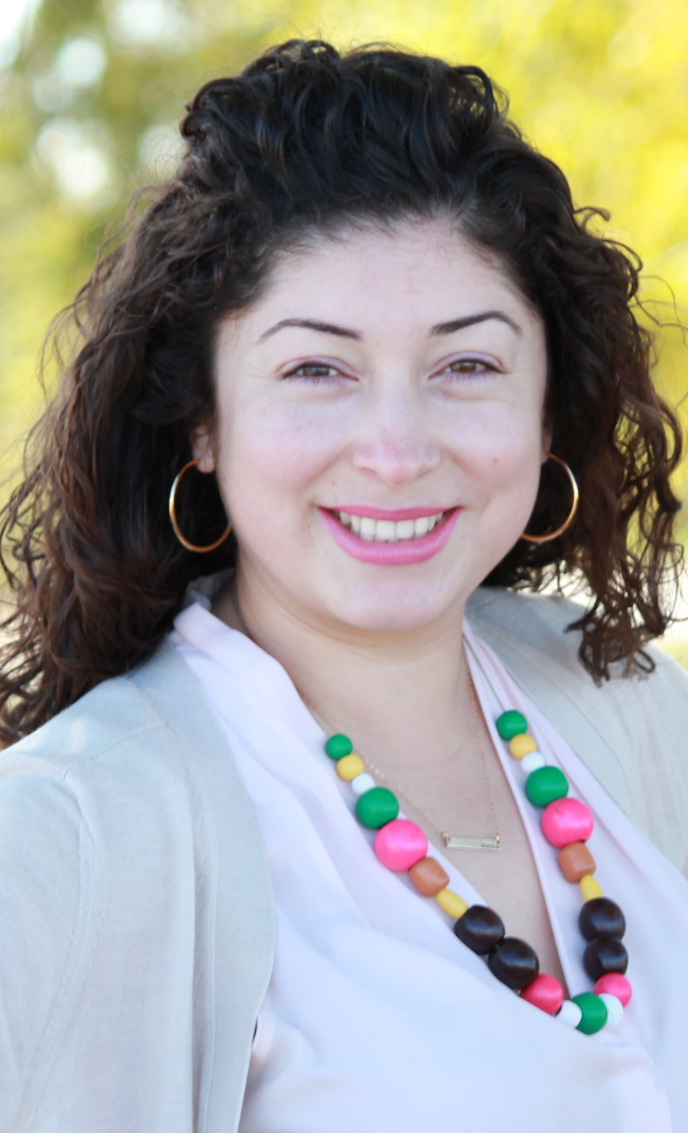
Facilitator
Erika C.B. Morales
Partner, Morales + Morales
Notes:
Erika
We are making adjustments based on feedback regarding Public Comment
Public comment after each topic-1 minute per person
At end of meeting-public comment-2 minutes per person

Slide 4
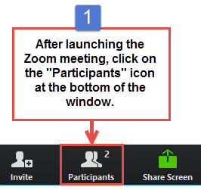
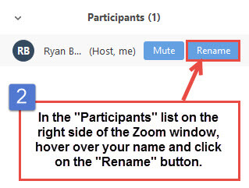
Task Force Member Identification
Task Force Members, please change your Zoom screen name to include: Name and Organization Name
Notes:
Erika

Slide 5

Raise Hand
Click Raise Hand in your meeting controls or
Press*9 on the phone line.
To lower your hand, click Raise Hand in your meeting controls.
Comments & questions can also be provided in writing by using the Chat function.
The Chat button is located on the control panel at the bottom of your screen.
Notes:
Erika

Slide 6
Welcome!
Notes:
Erika

Slide 7
Agenda
1:00 pm Welcome, Introductions, Agenda Review, and Purpose of the Zero-Emission Truck Working Group
1:05 pm Agenda Item #1: Project Team Presentation
1:10 pm Agenda Item #2: Funding Opportunities
1:45 pm Agenda Item #3: Working Group Discussion
2:25 pm Closing Comments, Next Steps, Thank you
Notes:
Erika

Slide 8
Agenda
1:00 pm Welcome, Introductions, Agenda Review, and Purpose of the Zero-Emission Truck Working Group (5 minutes)
1:05 pm Agenda Item #1: Project Team Presentation (5 minutes)
    Objectives for Zero-Emission Truck Working Group Meeting #4
1:10 pm Agenda Item #2: Funding Opportunities (35 minutes)
US Department of Transportation
  Andrew Wishnia, Deputy Assistant Secretary for Climate Policy
  Charles Small, Deputy Assistant Director for Intergovernmental Affairs
1:45 pm Agenda Item #3: Project Team Updates/Working Group Discussion (40 minutes)
  Zero-Emission Truck Working Group – Updates
    Zero-Emission Truck Working Group #3 Highlights
      SB 671 Update and Next Steps
  Funding Opportunities
  Program Development
  Other elements to consider
2:25 pm Closing Comments, Next Steps, Thank you: (5 minutes)
Notes:
Erika
What are programs that are coming up –apply ZE technology
As a public agency-how can we partner with fed gov –draw investment into corridor-equity, supply chain, air quality concern-corridor
To best leverage $50 million
As we develop our program-what are your recommendations?
Programs
Have wg – fill in funding matrix
Jack Symington
jack@laincubator.org
213.358.6500
Natalia Ospina
312-651-7932
Nospina@nrdc.org
Universe of Funding Opportunities
CLC
TF for approval
DOT may have to start meeting with their presentation
If they have extra time-q&a
Infrastructure/truck funding opportunities
Chart-check off-one or both
Program, cycle, funding amount, type of funding
What are the other programs that exist?
Port, AQMD, SCAG
What is our role?
What can we do with this program that works within regional framework?
Funding tied to ports, funding tied to corridor
FOLLOW UP---SCAG representation needed in ZE WG (ZE Freight Corridors)
The needs for planning, prog dev, leveraging funds, community engagement
Metro’s role
DRAFT RECOMMENDATIONS-following meeting
CALSTART
1:45 pm Agenda Item 3: Transportation Electrification Partnership Project (25 minutes)
California Energy Commission Clean Transportation Program
Jack Symington, Program Manager, Los Angeles Cleantech Incubator (invited)
Natalia Ospina, Staff Attorney, Environment, Equity & Justice Center, National Resources Defense Council (invited)
2:00 pm Agenda Item 4: Community Involvement with Zero-Emission Truck Working Group (15 minutes)
Transformative Climate Communities Grant Program: Round 4

Slide 9
Agenda Item #1:
Project Team Presentation
Notes:
Erika

Slide 10
Meeting Objectives
Present Zero-Emissions Truck Program Funding Opportunities and Partnerships
Zero-Emissions Truck Program priorities, goals, considerations, and next steps
Notes:
Community Involvement with the Zero-Emissions Truck Working Group

Slide 11
Agenda Item #2:
Funding Opportunities
Notes:
Erika

Slide 12
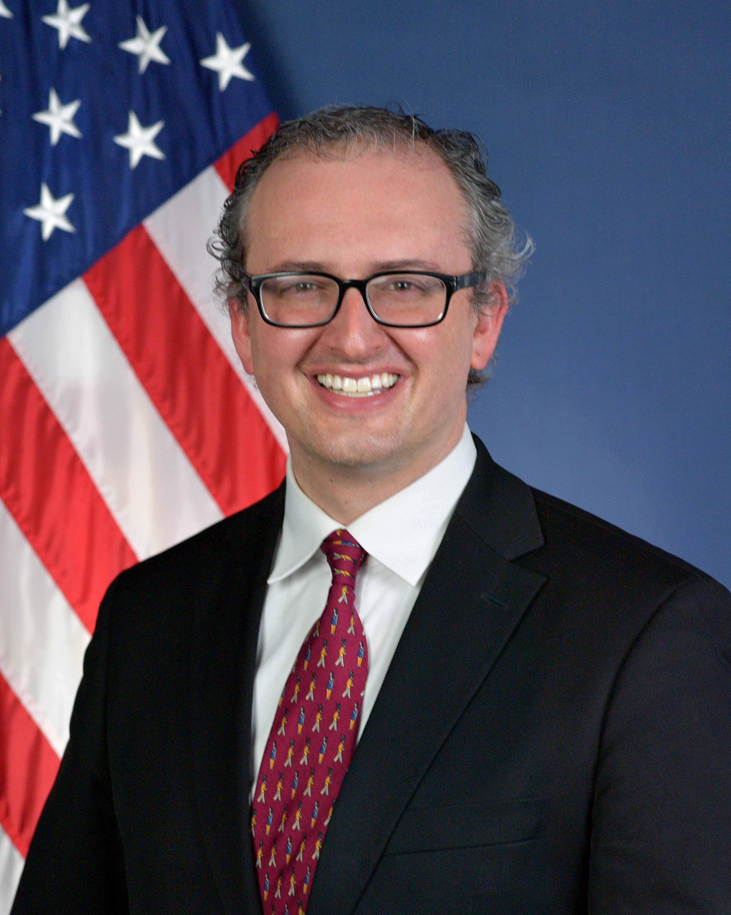
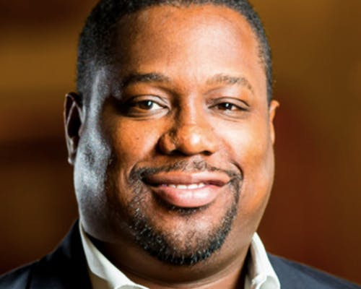
Speakers
Andrew Wishnia
Deputy Assistant Secretary for Climate Policy
US Department of Transportation
Charles Small
Deputy Assistant Director for Intergovernmental Affairs
US Department of Transportation
Notes:
Erika to introduce Speakers
Michael to facilitate discussion w speakers
BIOGRAPHIES
Andrew Wishnia
Serves as Deputy Assistant Secretary for Climate Policy in the Office of the Assistant Secretary for Transportation Policy in the U.S. Department of Transportation.
Previously served at the U.S. Senate Committee on Environment and Public Works, including as Senior Policy Advisor
He also served at the Federal Highway Administration as Special Assistant for Policy to the FHWA Administrator
as a Senior Program Manager at the White House Council on Environmental Quality.
and as a legislative assistant to Congressman John Yarmuth.
Charles Small
Mr. Small serves as the Deputy Assistant Secretary for Intergovernmental Affairs for the U.S. Department of Transportation. In this role, he serves as the primary liaison for state, county and local elected officials leading outreach and engagement strategy with non-federal stakeholders.
Prior to this, he served for four years as the Director of Federal Affairs and National Engagement for Mayor Eric Garcetti and the City of Los Angeles where worked to secure federal funding supporting the region’s infrastructure agencies.
Before his service to the City of Los Angeles, he spent five years as the Associate Director of Federal Affairs for the State of New York.
Mr. Small also served in the Obama Administration at the Office of the United States Trade Representative and began his career with Senator Barbara Boxer (D-California).
He is a native of Southern California.
What would you like to know from local stakeholders?
Biden Administration-ZE Technology, Supply Chain, Equity-
How can we partner on programs that have been approved?
And what are the funding opportunities in the future?
We have $50m we’d like to leverage
Share information prior to meeting- 1) Share Existing Conditions Video/Timestamps, 2) Share Board Motion 3) community, industry, ports—this is local wg 4) is there anything we should know about the Administration’s visit to SoCal?

Slide 13
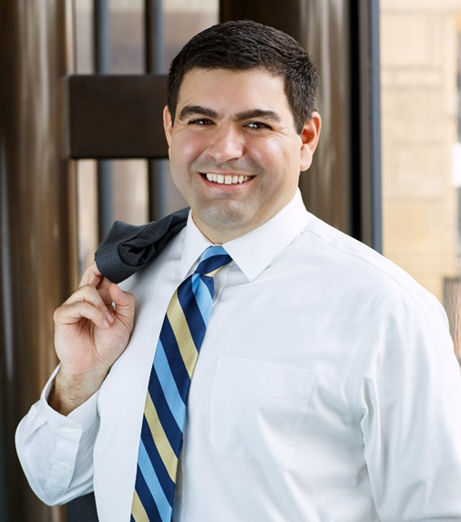
Moderator
Michael Cano
LA Metro
Executive Officer (Interim)
Countywide Planning & Development
Notes:
Erika

Slide 14
Agenda Item #3:
Project Team Updates
Working Group Discussion
Notes:
Erika

Slide 15
Zero-Emission Truck (formerly Clean Truck) Program
Working Group Meeting #3 – Report Out
Summary
Held virtually via Zoom on Thursday, February 24
26 participants (15 Task Force Members, 2 Ex-Officio Task Force Members, 9 Members of the Public)
Meeting topics included:
  Zero-Emission Truck Program Options
  Explore Grant Funding Opportunities
  Highlights
  Examples of Successful Clean Truck Programs (Infrastructure-based, truck-based, hybrid, other considerations)
  Significant incentives are needed to accelerate the market for zero-emission freight.
  Prioritizing equity and community engagement are key to long-term success and public health benefits.
  Tailoring program design to meet the biggest barriers to adoption considers a combination of innovative approaches.
  Leveraging best practices, funding resources, and partnerships extend the reach of every incentive dollar.

Slide 16
Senate Bill 671 Update and Next Steps
710 Task Force approved the submittal of a joint letter of support for nominating the I-710 South Corridor as a priority freight corridor for the CTC's SB 671 Clean Freight Corridor Efficiency Assessment
Corridor to be submitted includes:
  I-710 S Freeway from Long Beach to SR-60
  Ports of LA and Long Beach
  Alameda Corridor
  I-710 South Corridor Study Area
Other considerations:
  Community engagement for both infrastructure development and siting
  Priority for investment due to supply chain disruptions and need for investment in clean technology

Slide 17

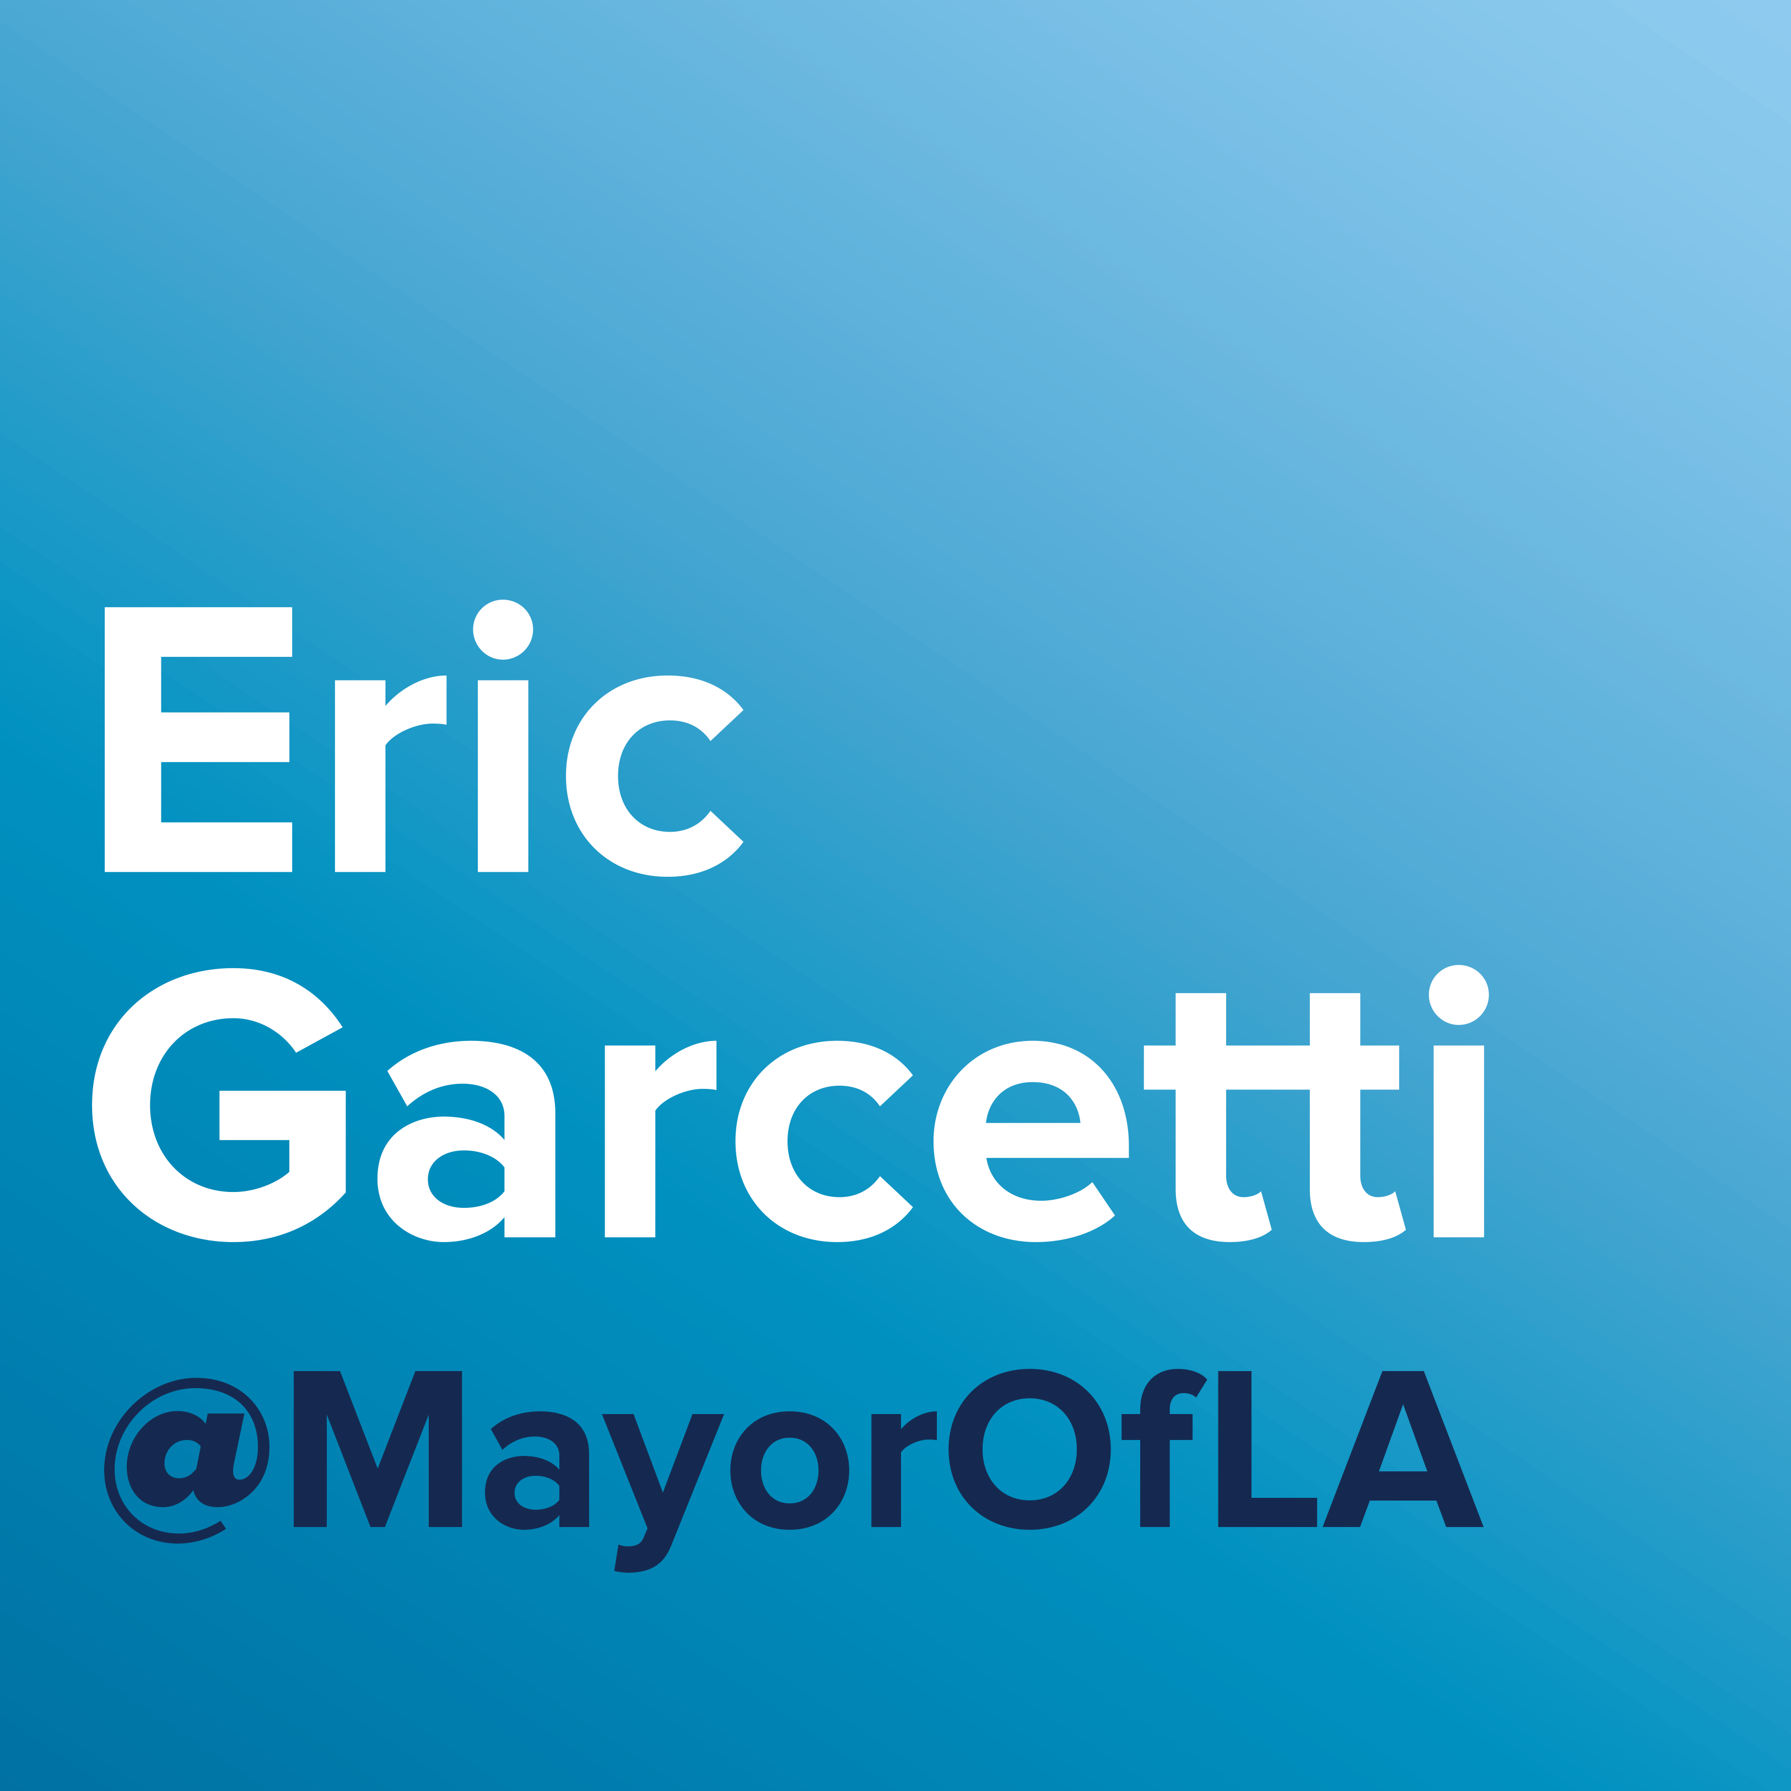
















Senate Bill 671 Nomination and Letter of Support

Slide 18
Zero-Emission Truck Working Group – Updates
Meetings to-date:
  November 29, 2021
  January 25, 2021
  February 24, 2022
  March 22, 2022
Topics reviewed and discussed:
  Goals and objectives for the 710 South Clean Truck Program
  Industry perspectives and the role of stakeholders in the 710 South Task Force
  Air quality and environmental justice challenges and opportunities in the corridor
  The state of clean truck technology and efforts to accelerate the commercialization of ZE Class 8 trucks
  Governor Newsom’s FY2022 budget and the prospects for ZE trucks and infrastructure funding opportunities
  Strategies to leverage Metro’s $50 million in seed funding at the state and federal level
  Request to re-name group as the Zero-Emission Truck Working Group to align with Board motion

Slide 19
Zero-Emission Truck Working Group –
Funding Opportunities
Governor's Budget Proposal
  $6.1 Billion for ZE Vehicle related activities overall
  New funding program: ZEV Fueling Infrastructure Grants
    $600 Million over 4 years
    EV charging infrastructure; prioritize fast-charging infrastructure
SB-1 Trade Corridor Enhancement Program
  $300 Million per year + apportionment to California from federal IIJA (FAST Act successor)
  ZE Infrastructure is eligible and desired; ZE subsidies for rolling stock ineligible (Article XIX)
CARB HVIP
  ZE truck and bus subsidy focused – $46 Million of $197 Million available March 30th for Class 8 trucks
CA Energy Commission (CEC)
  Infrastructure-focused -- $1.4 Billion plan to build out ZEV infrastructure (2021-23)
Federal Programs: IIJA/BIL, INFRA, etc.
  Infrastructure-focused

Slide 20
Development of the 710 Zero-Emission Truck Program
Options emerging for use of $50 million:
Focus on ZE Infrastructure only
  Will require a strong community outreach component to plan, site and implement ZE infrastructure
  Work with current pilot programs / early adopters
  Will need fast-tracked Regional ZE infrastructure planning for Metro/Caltrans
    Partner with SCAG, AQMD, LACI, Communities, etc.
  Many opportunities for Metro to leverage $50 million many times over – TCEP, IIJA, CARB, CEC
Focus primarily on ZE Infrastructure with some targeted subsidy funding
  Targeted subsidy funding will need to layer on top of other funding sources (Ports, AQMD, CARB, etc.)
  What will be the focus? Small Business, Independent Owners/Operators in corridor, etc.?
Focus primarily on subsidy funding for ZE truck purchases/leases
  Need a strong business case as subsidy need per ZE truck is extremely expensive in near term
    Also, dependent upon access to ZE infrastructure for charging/fueling.
Notes:
1) Should Metro use the $50 m for ze infrastructure development in the corridor
Main focus of the Metro program
2) If we were to target funding to help provide subsidies for zev deployment, what are key considerations we should consider?
3) Are there specific programs that Metro funds can help enhance (targeting funding for zev’s)
How can we leverage the $50m Metro funds for the deployment of zev in the corridor-to leverage funds, accelerate zev deployment
DEGREES OF AGREEMENT-Infrastructure only
These are options (above)
Present proposal-what are your thoughts?
MOTION—trucks and infrastructure
Partner with all/some of you-existing programs
-what we’ve heard
Primary focus on infrastructure deployment
Subsidy funding-how do we structure, goals (ie owner operators, etc)
Discussion-Miroboard-Pros and cons of each option
Community outreach/land use-RFP-help support the planning for this effort
Ports-their funding -$90m program
Metro-$50m =must be used in the corridor
Infrastructure focus

Slide 21
Development of the 710 Zero-Emission Truck Program
Other elements to consider:
  Drayage segmentation to create near-to-long term strategies for ZE deployment
  Consideration of Metro's role and opportunity in relation to other agencies and partners in the region
  Tax and incentive funding barriers to adoption
  Workforce development linked to I-710 S Corridor Communities
  Truck parking + ZE charging/fueling infrastructure
  Pilot programs to battle entrained particulate matter generation
  Vegetation and other truck emission mitigations
  Technology / Innovation applications to reduce Truck VMT / idling

Slide 22
Development of the 710 Zero-Emission Truck Program
Option 1: Metro should use its $50 million for ZE infrastructure only.
  OPPORTUNITIES
  Many opportunities for Metro to leverage $50 million many times over – TCEP, IIJA, CARB, CEC
  Work with current pilot programs / early adopters
  CHALLENGES
  Will require a strong community outreach component to plan, site, and implement ZE infrastructure
  Community support may be challenging to secure.
  Will need fast-tracked Regional ZE infrastructure planning for Metro/Caltrans
    Partner with SCAG, AQMD, LACI, Communities, etc.
Notes:
Present slide information
Opportunities-
Challenges-
2) Miroboard-document additional opportunities, challenges

Slide 23
Development of the 710 Zero-Emission Truck Program
Option 2: Metro should use its $50 million primarily on ZE Infrastructure with some targeted subsidy funding.
  OPPORTUNITIES
  Achieves Metro Board direction on one of the use of Metro funds for vehicle subsidies.
  CHALLENGES
  Determining the focus-Small Business, Independent Owners/Operators in corridor, etc.?
  Targeted subsidy funding will need to layer on top of other funding sources (Ports, AQMD, CARB, etc.)
Notes:
Present slide information
2) Miroboard-document additional opportunities, challenges

Slide 24
Development of the 710 Zero-Emission Truck Program
Option 3: Metro should use its $50 million primarily on subsidy funding for ZE truck purchases/leases.
  OPPORTUNITIES
  Meet the Metro Board directive on subsidy funding for ZE truck purchases/leases.
  Provide support to small fleets and independent operators.
  CHALLENGES
  A strong business case will need to be made on the level of subsidy per ZE truck which is expensive in the near term.
  Dependent upon access to ZE infrastructure for charging/fueling.
Notes:
Present slide information
2) Miroboard-document additional opportunities, challenges

Slide 25
Development of the 710 Zero-Emission Truck Program
DRAFT RECOMMENDATION
Metro should use its $50 million primarily on ZE Infrastructure with some targeted subsidy funding.
Notes:
Mentimeter Poll
DEGREES OF AGREEMENT
I support the proposal
I can live with the proposal
I have concerns about the proposal
I will stand aside on this one

Slide 26
Upcoming Meetings
  Vision & Goals Development Public Meeting
    Wednesday, March 23, 5:30-7:00pm
Community Leadership Committee
    Thursday, March 31, 5-6:30pm
Working Groups
  Equity
    Tuesday, April 5, 5-7pm
Zero-Emission Truck
  Tuesday, April 19, 1-2:30pm
  Tuesday , May 17, 1-2:30pm
Task Force
Task Force Meeting #7
  Monday, April 11, 5-7:30 pm
Task Force Meeting #8
  Monday, May 9, 5-7:30pm
Notes:
Michael

Slide 27
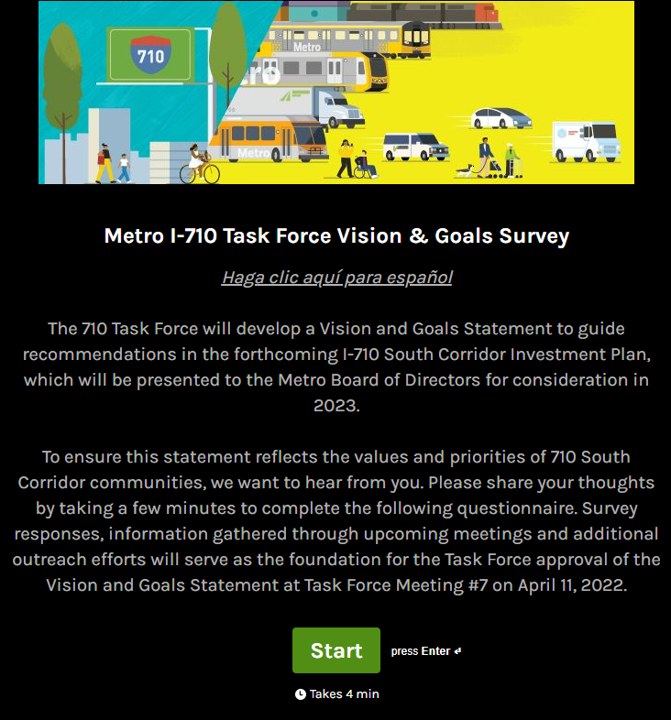
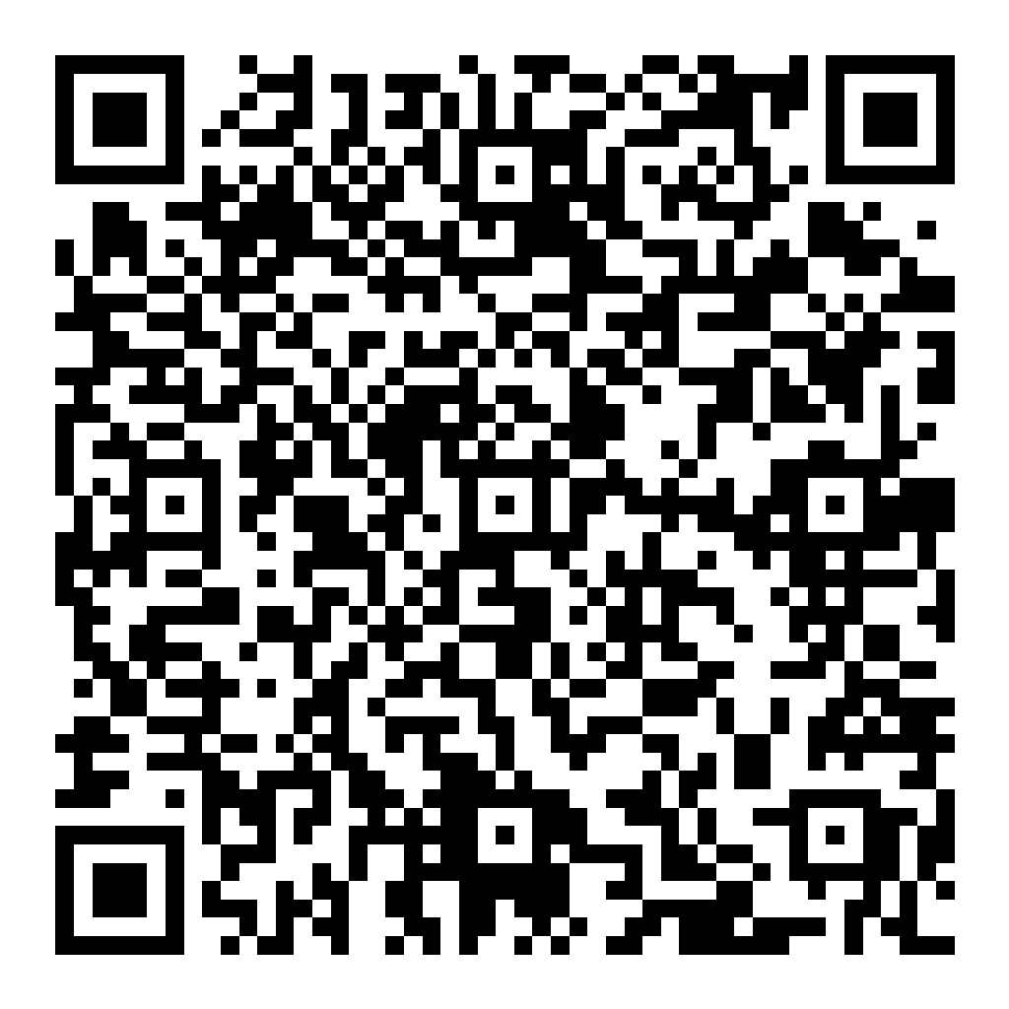
Metro I-710 South Corridor Vision & Goals Summary Update
Over 3,000 stakeholders received the survey via email.
The survey is being administered between February 22, 2022-March 25, 2022
4 questions
  3 open-ended questions
  1 closed-ended question
240 Respondents as of March 18, 2022
Notes:
Michael

Slide 28
Can’t attend the meeting? Reach out to us!
Michael Cano, Deputy Executive Officer,
Countywide Planning & Development
Metro
One Gateway Plaza, MS 99-13-1
Los Angeles, CA 90012
213.922.4710
710corridor@metro.net
metro.net/projects/i-710-corridor
@metrolosangeles
losangelesmetro
Notes:
Michael

