Slide 1
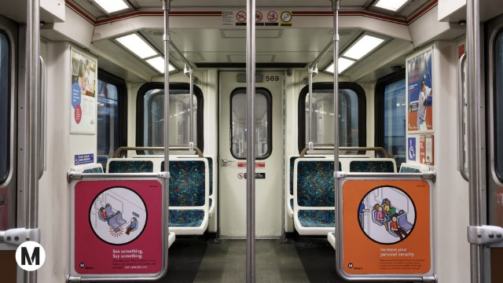
We will get going in just a moment

Slide 2

Thank you for joining us!

Slide 3
Fairfax Street Decking Removal
Wilshire Blvd. Full Closures
July 26, 2022

Slide 4
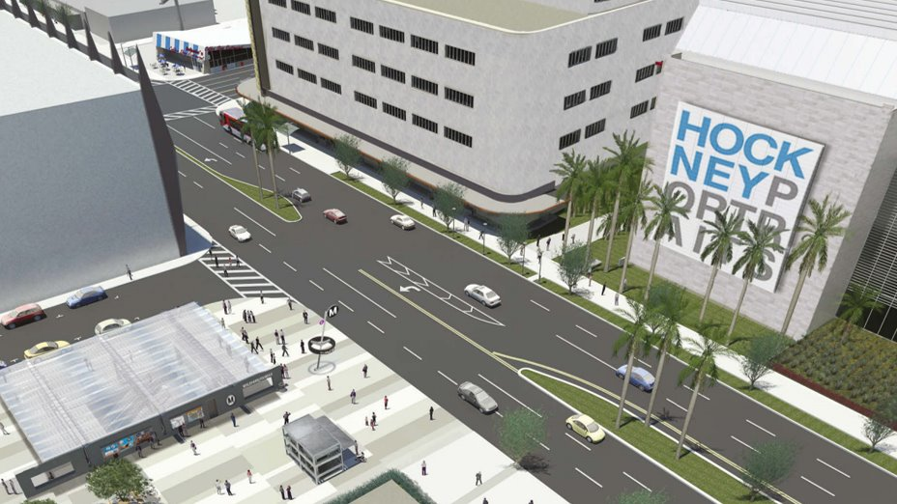
Wilshire/Fairfax Station Rendering

Slide 5
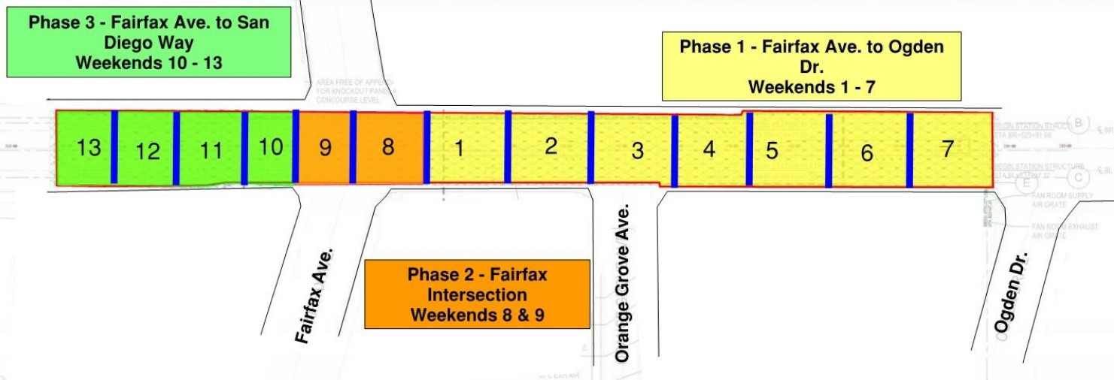
Fairfax Decking Removal - Sequence
Weekend | Dates
1 | September 9 – September 12
2 | September 16 – September 19
3 | September 23 – September 26
4 | September 30 – October 3
5 | October 7 – October 10
6 | October 14 – October 17
7 | October 21 – October 24
8 | October 28 – October 31
9 | November 4 – November 7
Veteran’s Day (No work) | November 11 – November 14
10 | November 18 – November 21
Thanksgiving (No work) | November 25 – November 28
11 | December 2 – December 5
12 | December 9 – December 12
13 | December 16 – December 19

Slide 6
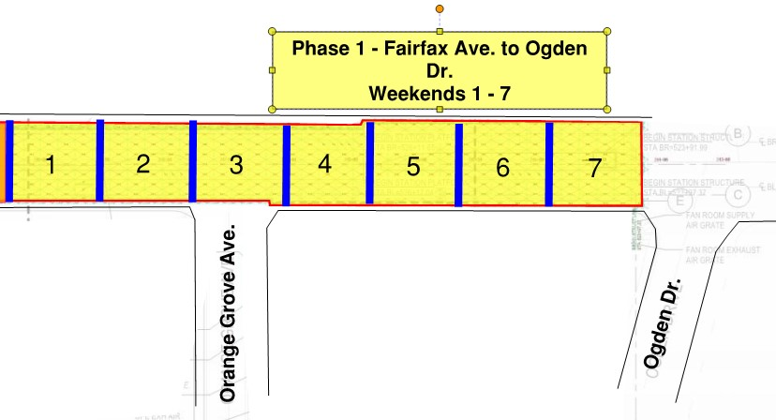
Fairfax Decking Removal – Phase 1
Work will begin at 9pm on Friday night and continue through 6am on Monday morning. As a contingency, the design-builder has requested approval to extend work hours as late as 12 noon on Monday. The extension will only be used in the event of an emergency.
Decking Removal will begin at the Wilshire/Fairfax Station over the weekend of September 9 to September 12.
Phase 1, the area immediately east of Fairfax Av, will be the first section restored.
A full closure on Wilshire Bl will be in place over the duration of this work. Eastbound traffic will be detoured at Fairfax Av, and westbound traffic will be detoured at La Brea Av
Weekend | Dates
1 | September 9 – September 12
2 | September 16 – September 19
3 | September 23 – September 26
4 | September 30 – October 3
5 | October 7 – October 10
6 | October 14 – October 17
7 | October 21 – October 24

Slide 7
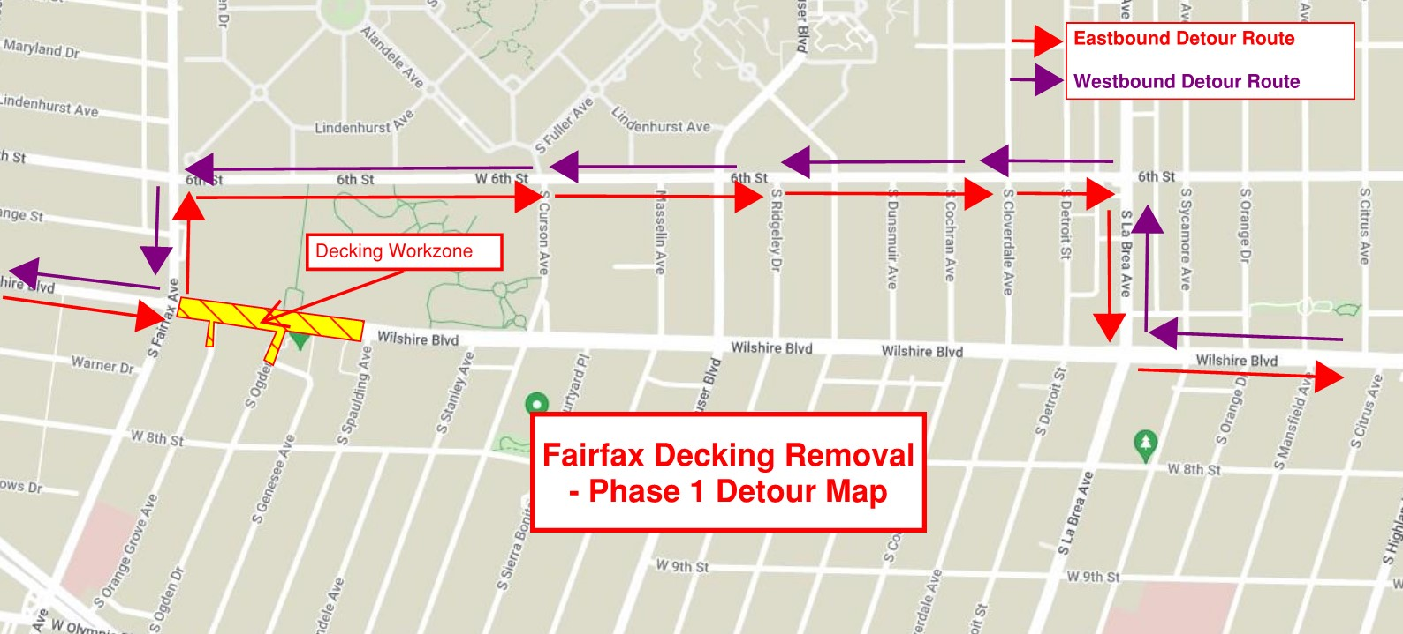
Fairfax Decking Removal – Phase 1 Detour Map
Eastbound Wilshire > Northbound Fairfax Av > Eastbound 6th St > Southbound La Brea Av > Eastbound Wilshire
Westbound Wilshire > Westbound 6th St > Southbound Fairfax Av > Westbound Wilshire

Slide 8
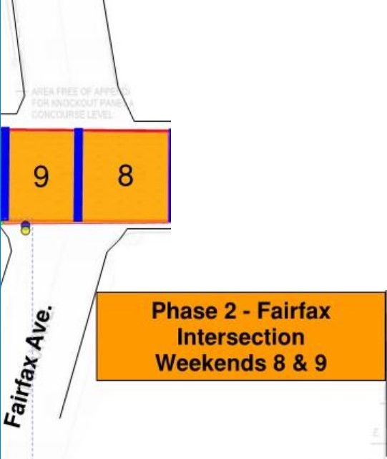
Fairfax Decking Removal – Phase 2
Work will begin at 9pm on Friday night and continue through 6am on Monday morning. As a contingency, the Design-Builder has requested approval to extend work hours as late as 12 noon on Monday. The extension will only be used in the event of an emergency.
Following Phase 1 Decking Removal, STS will begin working within the Wilshire/Fairfax Intersection.
This work will take two weekends to complete, October 28 – October 31, and November 4 to November 7
Full closures will be in place on Wilshire Bl and Fairfax Av. All traffic will be detoured around the workzone.
Southbound Fairfax Av traffic will be detoured at 6th St
Northbound Fairfax Av traffic will be detoured at Olympic Bl
Eastbound Wilshire Bl traffic will be detoured at La Cienega Bl and San Vicente Bl
Westbound Wilshire Bl traffic will be detoured at La Brea Av
Weekend | Dates
8 | October 28 – October 31
9 | November 4 – November 7

Slide 9
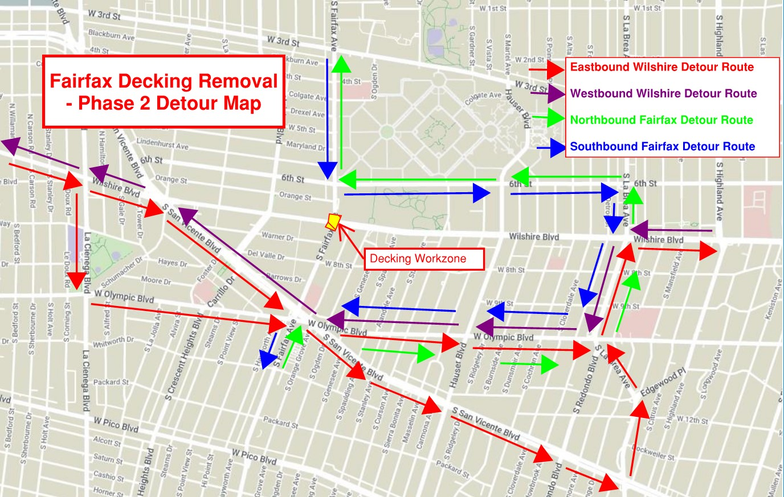
Fairfax Decking Removal – Phase 2 Detour Map
Eastbound Wilshire > Southbound La Cienega Bl> Westbound Olympic Bl > Northbound La Brea Av > Eastbound Wilshire
Eastbound Wilshire > Southbound San Vicente Bl > Northbound La Brea Av > Eastbound Wilshire
Westbound Wilshire > Southbound La Brea Av > Westbound Olympic Bl > Northbound San Vicente Bl > Westbound Wilshire
Northbound Fairfax Av > Eastbound Olympic Bl > Northbound La Brea Av > Westbound 6th St > Northbound Fairfax Av
Southbound Fairfax Av > Eastbound 6th St > Southbound La Brea Av > Westbound Olympic Bl > Southbound Fairfax Av

Slide 10
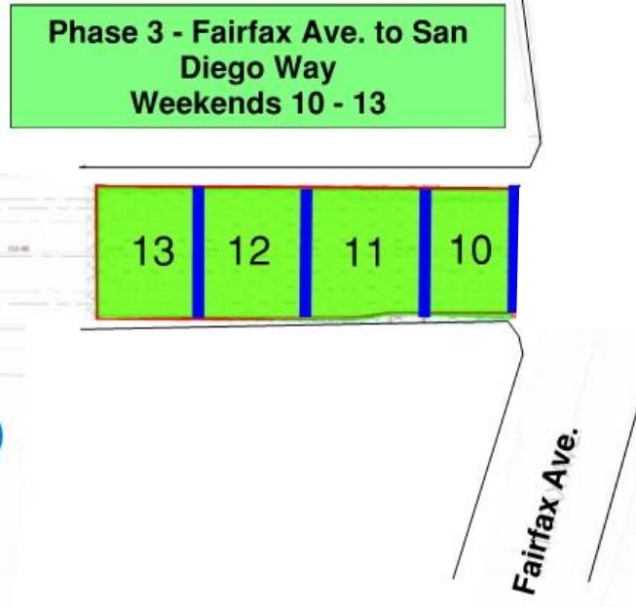
Fairfax Decking Removal – Phase 3
Work will begin at 9pm on Friday night and continue through 6am on Monday morning. As a contingency, the Design-Builder has requested approval to extend work hours as late as 12 noon on Monday. The extension will only be used in the event of an emergency.
Following Phase 2 Removal, the third and final phase of work will begin to the west of Fairfax Av
This work will take place over 4 weekends, beginning on November 18.
Full closures will be in place at Fairfax Av and San Diego Way
Eastbound Wilshire will be detoured at La Cienega Bl or San Vicente Bl
Westbound Wilshire will be detoured at Fairfax Av
Weekend | Dates
Veteran’s Day (No work) | November 11 – November 14
10 | November 18 – November 21
Thanksgiving (No work) | November 25 – November 28
11 | December 2 – December 5
12 | December 9 – December 12
13 | December 16 – December 19

Slide 11
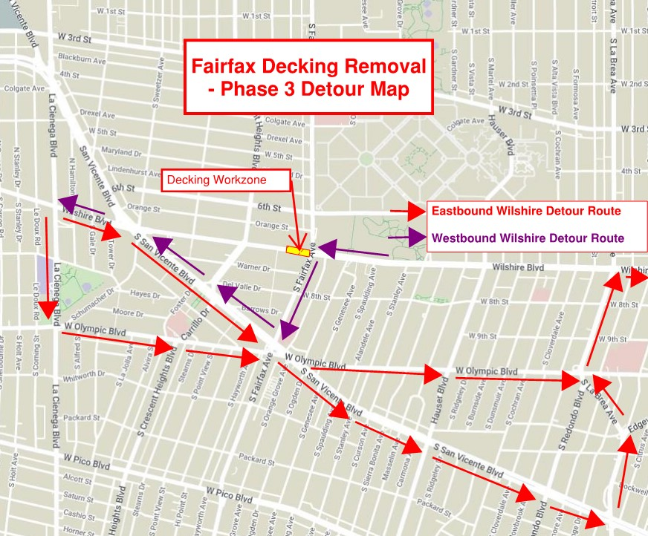
Fairfax Decking Removal – Phase 3 Detour Map
Eastbound Wilshire > Southbound La Cienega Bl > Eastbound Olympic Bl > Northbound La Brea Av > Eastbound Wilshire
Eastbound Wilshire > Southbound San Vicente Bl > Northbound La Brea Av > Eastbound Wilshire
Westbound Wilshire > Southbound Fairfax Av > Northbound San Vicente Bl > Westbound Wilshire

Slide 12
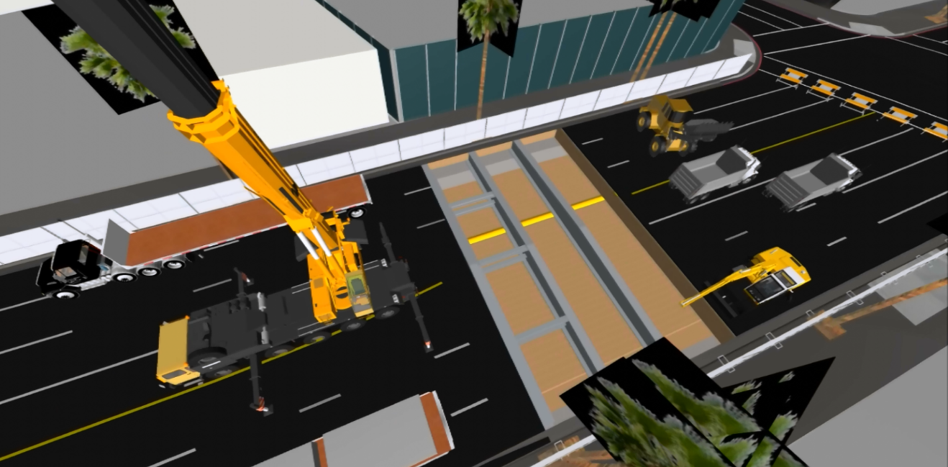
Fairfax Station – Decking Removal
Dozens of trucks will be used each weekend to haul steel, decking panels, and SOE out of the area.
Excavators and haul trucks will be utilized during backfilling operations.
Large cranes and other heavy equipment will lift the steel beams and deck panels out of the ground.

Slide 13
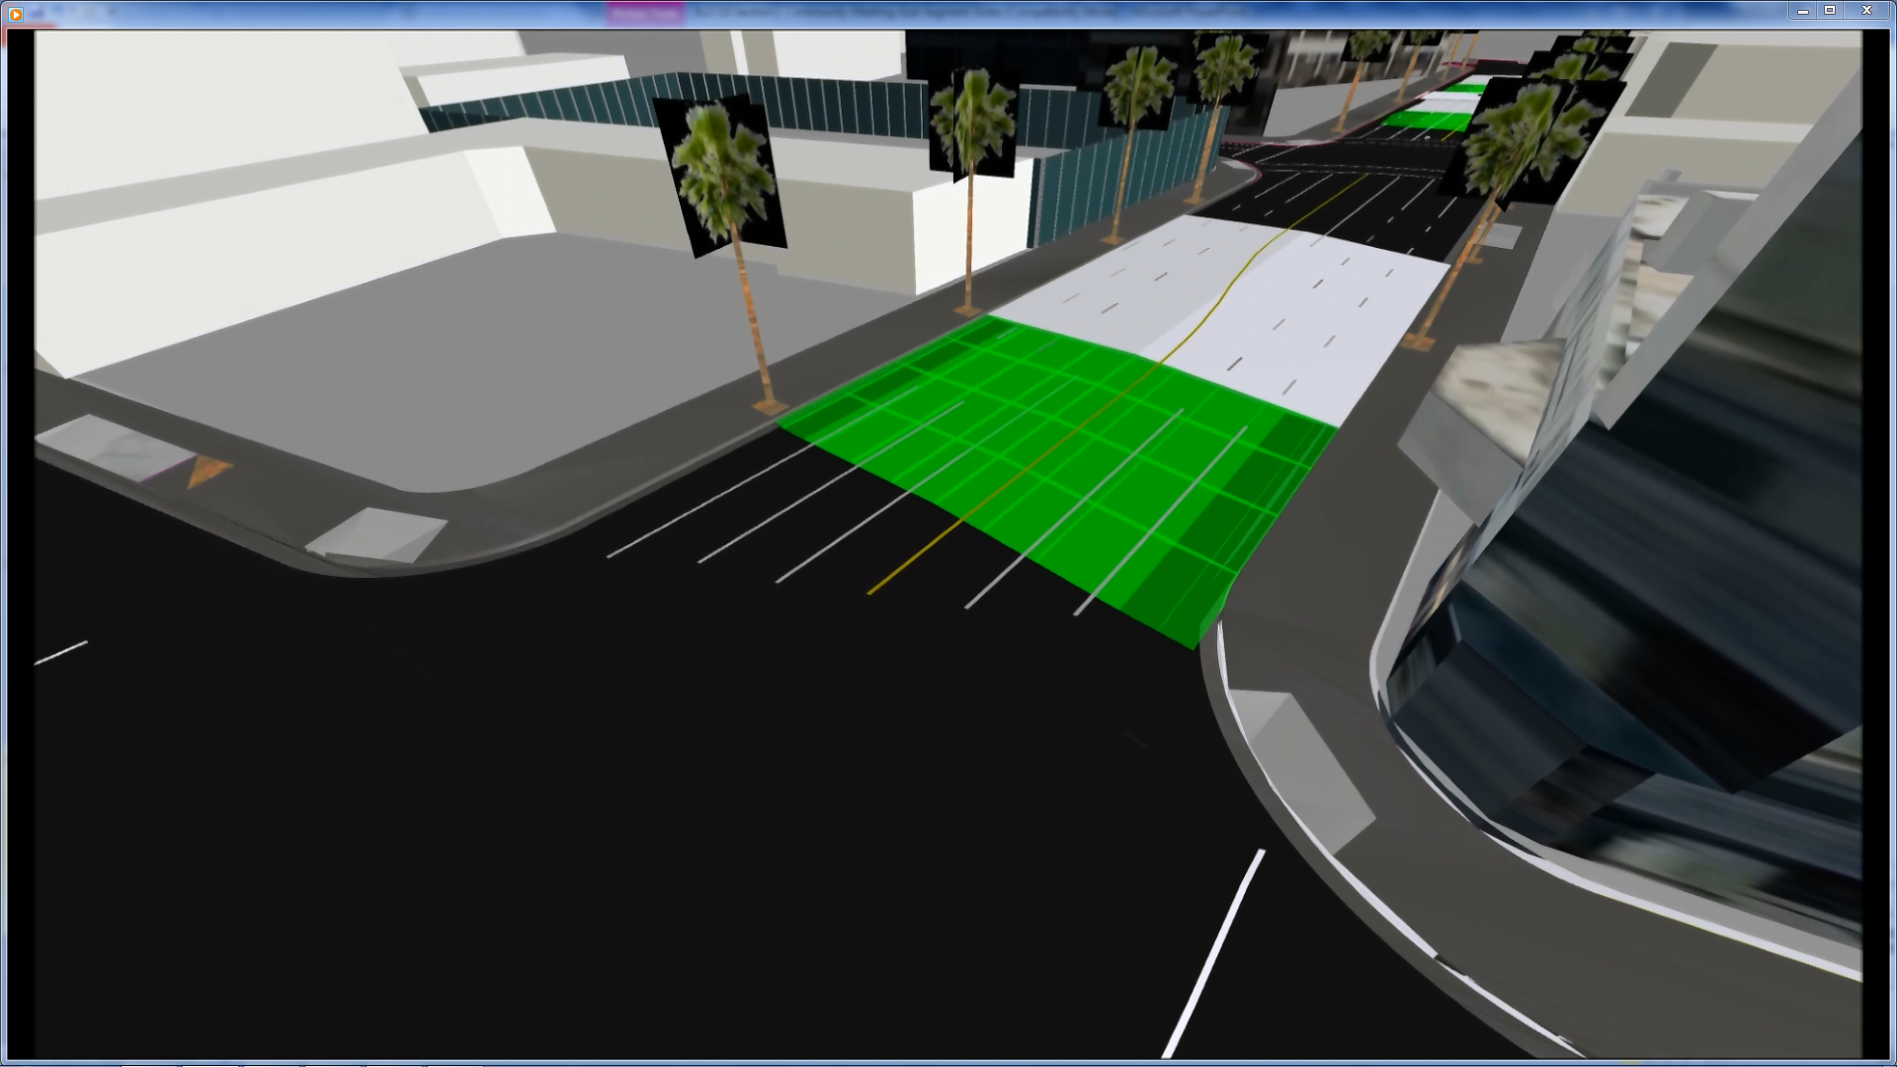
Fairfax Station – Decking Removal
Following decking removal, steel beams and SOE haul out, and backfilling and utility placement, a new street surface will be placed from curb to curb.
Work will progress east to west, from one weekend to the next.

Slide 14
La Brea Station – Decking Removal Equipment
Aboveground
Cranes
Haul trucks, dump trucks
Concrete pump
Loaders
Saw cutter, jackhammer
Vibrator, roller
Belowground
Compact excavators
Compact bulldozers
Man lifts, forklifts
Graders
Loaders

Slide 15
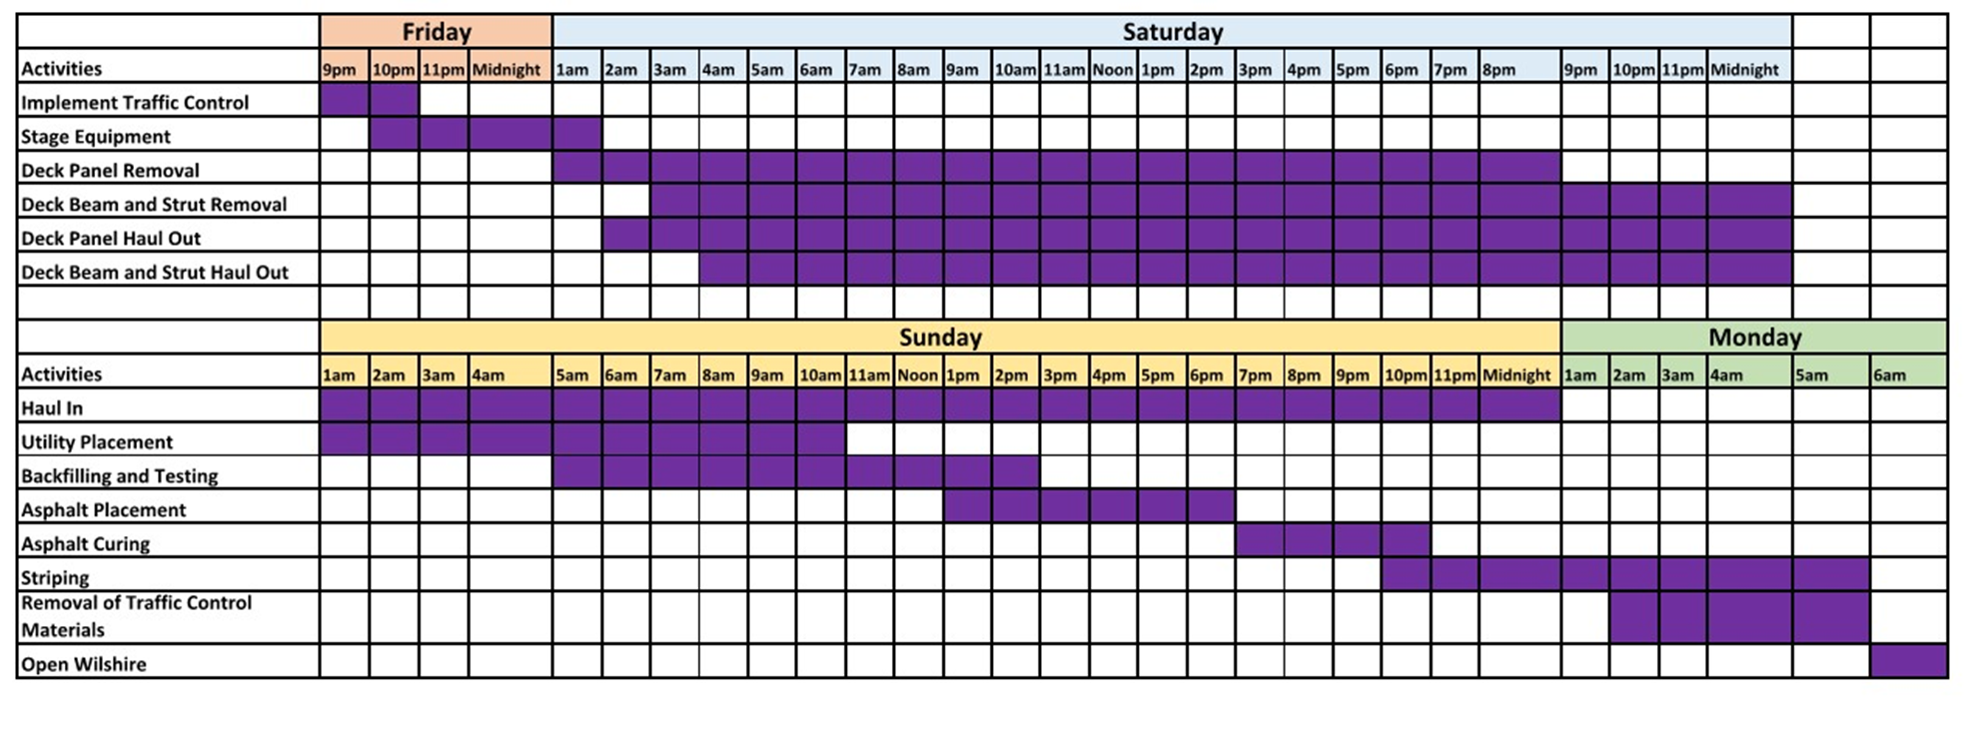
Fairfax Station – Decking Removal Schedule
* Subject to Change
Decking removal will begin at 9pm on Friday and continue until Monday at 6am during 10 weekends between September 9, 2022 through December 19, 2022.

Slide 16
Fairfax Station – Decking Removal Sequence (Part 1)
Activity | Occurs
Design-builder begins to remove deck panels along Wilshire Blvd. | Once road is closed to traffic (9pm)
Crews begin removing steel beams and support for excavation above the station | All day Saturday
Utilities will be relocated as needed. Trucks loaded with backfilling materials will be staged around the deck openings. | Saturday
Testing and quality assurance conclude prior to asphalt placement | All day Sunday

Slide 17
Fairfax Station – Decking Removal Sequence (Part 2)
Activity | Occurs
Asphalt placement | Begins after backfilling (asphalt requires approximately four hours to cure/cool before it can carry weigh)
City agencies test asphalt to ensure that it will be safe for commuters | After curing
The final steps of decking removal includes striping, removing traffic control devices, and opening the road | Sunday night and Monday morning

Slide 18
Outreach Schedule
Outreach | Occurs
STS and Metro discusses closures with Council District 5. | May 2022
Affected residents and business owners invited to online meetings to discuss decking removal. Meeting announcement appears on Weekly Look Ahead. | One month before work begins
Wilshire/Fairfax decking removal presented during quarterly webinar. | One month before work begins
Door-to-door outreach conducted. A Construction Notice will be widely distributed adjacent to the Wilshire/La Brea intersection. | One month before work begins
A Construction Notice will be re-issued on the Metro website and distributed to the Metro Email List. Computer message signs will be placed at the work area. | One week before work begins
A Construction Notice describing the work will be sent in the Weekly Look Ahead email. | Weekly

Slide 19
Stay Informed
Next Decking Removal Community Meeting
August 2, 2022 at 6:00PM Via Zoom https://zoom.us/j/96626476708
Webinar ID: 966 2647 6708
Call us on the Project Hotline: 213-922-6934​
  For project questions, concerns and complaints​
  Live during construction work hours ​
  Monday through Friday, 7am to 5pm​
  After 5pm: Leave a voicemail; staff with return call within 24 hours​
  Callers can speak with a person via the Hotline after 5pm by pressing 1​
​
Project Email: purplelineext@metro.net ​
​Receive email project updates and construction notices​
Responses within 24 hours

