Slide 1


Information Station #3
Projects & Programs
March 2024

Slide 2

Balanced scorecard slide 5
Initial List of Projects & Programs: Categories
Projects are organized by “improvement category”
All projects and programs should support a multimodal future for the Corridor.
Improvement categories represent different modes
INFORMATION FOR DISCUSSION PURPOSES ONLY – SUBJECT TO CHANGE

Slide 3








TYPE: ACTIVE TRANSPORTATION / TRAVEL DEMAND MANAGEMENT (TDM)
Range of Improvements (Partial List)
Bike Lanes
Shared-Use Path
Pedestrian Safety and Amenities
New bicycle lane on existing roadways, indicated by striping, signage, and physical barriers.
New bicycle paths just for bicyclists and pedestrians.
Wider sidewalks, lighting, benches, shade trees, landscaping, and trash receptacles to improve the safety and comfort of the pedestrian experience.
Crossing Safety Enhancements
Bike Share Programs
Bike/Ped Traffic Controls
High Visibility Paint, Flashing Signals, Pedestrian Safety Island, Curb Extensions, or Bulb-outs to create short crossing distances and increased awareness of crossing locations.
Low-cost, short-term bike rental from strategically placed docks or stations.
Leading Pedestrian Interval, Bike crossing signals, no turn on red signals, signals and controls to reduce conflicts between pedestrians, bicyclists, and drivers.

Slide 4




Project Types & Subtypes
TYPE: ACTIVE TRANSPORTATION / TDM
SUBTYPES
Bicycle Routes / Facilities
Pedestrian / First Last Mile
Safety & Amenities
TDM Strategies
New Bike Paths/Trails
New Buffer/Barrier-Protected Bike Routes
New Bike Lanes
New, Signed Bike Routes
New pedestrian/bike:
  Overcrossings
  Pathways
  Connections to rail, transit, LA River
New Crosswalks, sidewalks
High visibility crosswalks
Wider sidewalks
Street crossing enhancements
Bike parking, repair stations
Bike share programs
Traffic controls for ped/bikes
ADA improvements
Shading, trees, landscaping
Security & lighting
Vanpools/carpool programs
Telecommuting programs
Promotional Campaigns to encourage Alternative Modes of Travel
INFORMATION FOR DISCUSSION PURPOSES ONLY – SUBJECT TO CHANGE

Slide 5

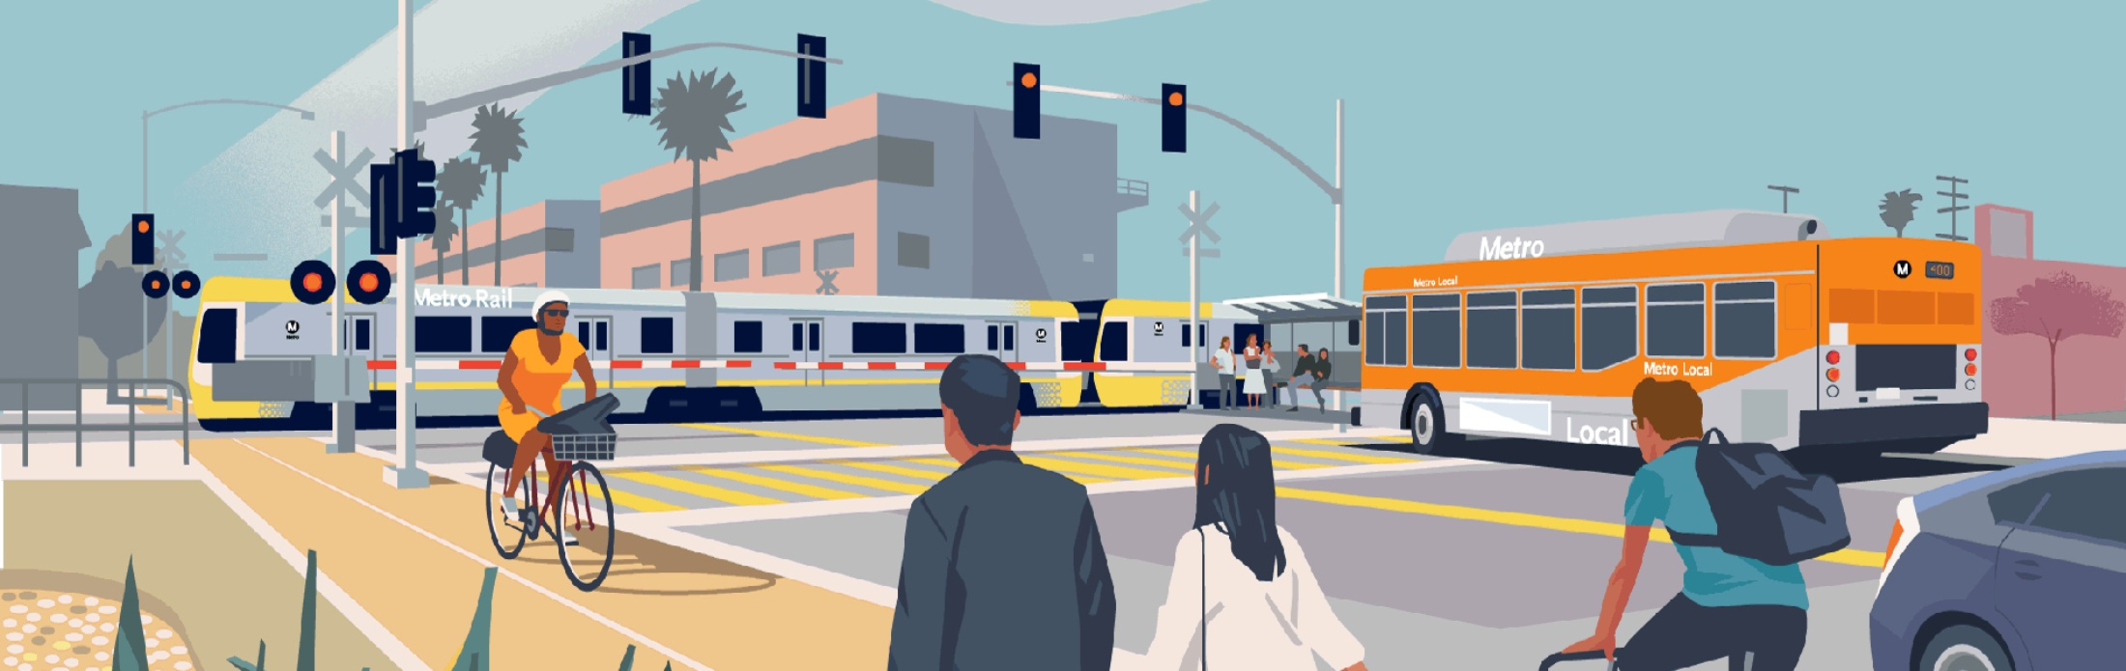
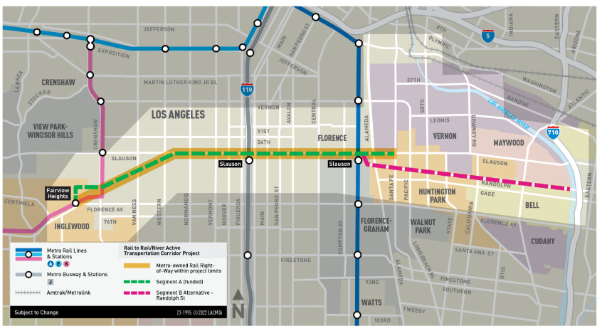
TYPE: ACTIVE TRANSPORTATION
SUBTYPE: Bicycle Route & Facilities
CASE STUDY: Bike Facilities/Paths
Randolph Bike & Pedestrian Project
(LB-ELA_0066) & Randolph Street Bike and Pedestrian Facilities Project (LB-ELA_0128)
Also known as the Rail to Rail/River Active Transportation Corridor Project
Segment A – Rail to Rail (metro.net/r2rb)
Will connect the Metro K Line, J Line (Silver), and
A Line (Blue).
Under construction; targeted for completion in late 2024.
Segment B – Rail to River (metro.net/r2ra)
Will connect the Metro A Line (Blue) Slauson Station to LA River.
Supplemental Alternatives Analysis being conducted to study/re-evaluate alternatives.

Slide 6

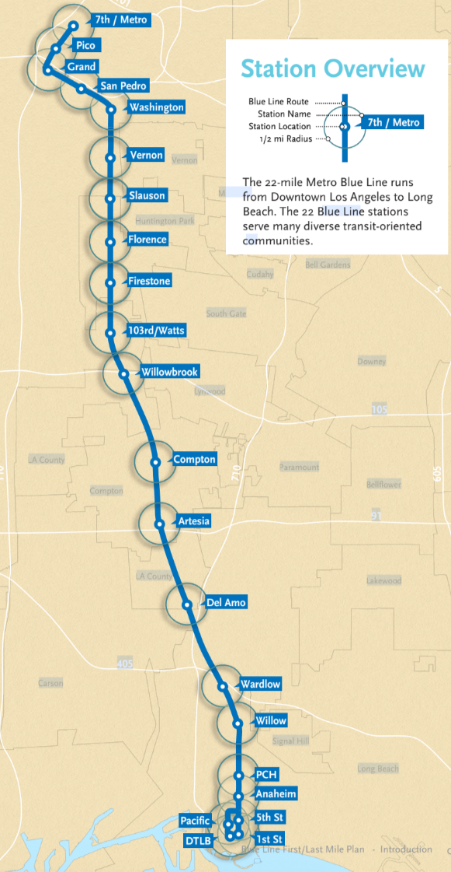
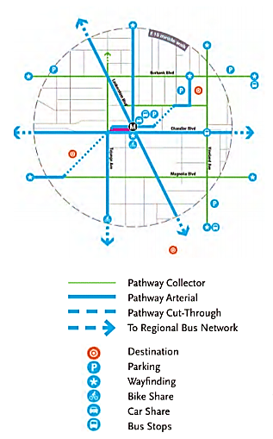
TYPE: ACTIVE TRANSPORTATION / TDM
SUBTYPE: Pedestrian & First/Last Mile (FLM)
CASE STUDY: Pedestrian & FLM
Blue Line First Last Mile Plan Improvements (LB-ELA_0008)
Prepared for all 22 Metro A Line (Blue) stations
Station-by-station recommendations, including:
    Pedestrian improvements (sidewalks, crosswalks, lighting)
    Land scaping, including more trees to supply shade and encourage walking
    Bike lanes and supporting facilities
    Bus stop improvements
    Pickup/drop-off locations near stations
  Learn more about FLM at: metro.net/first-last

Slide 7
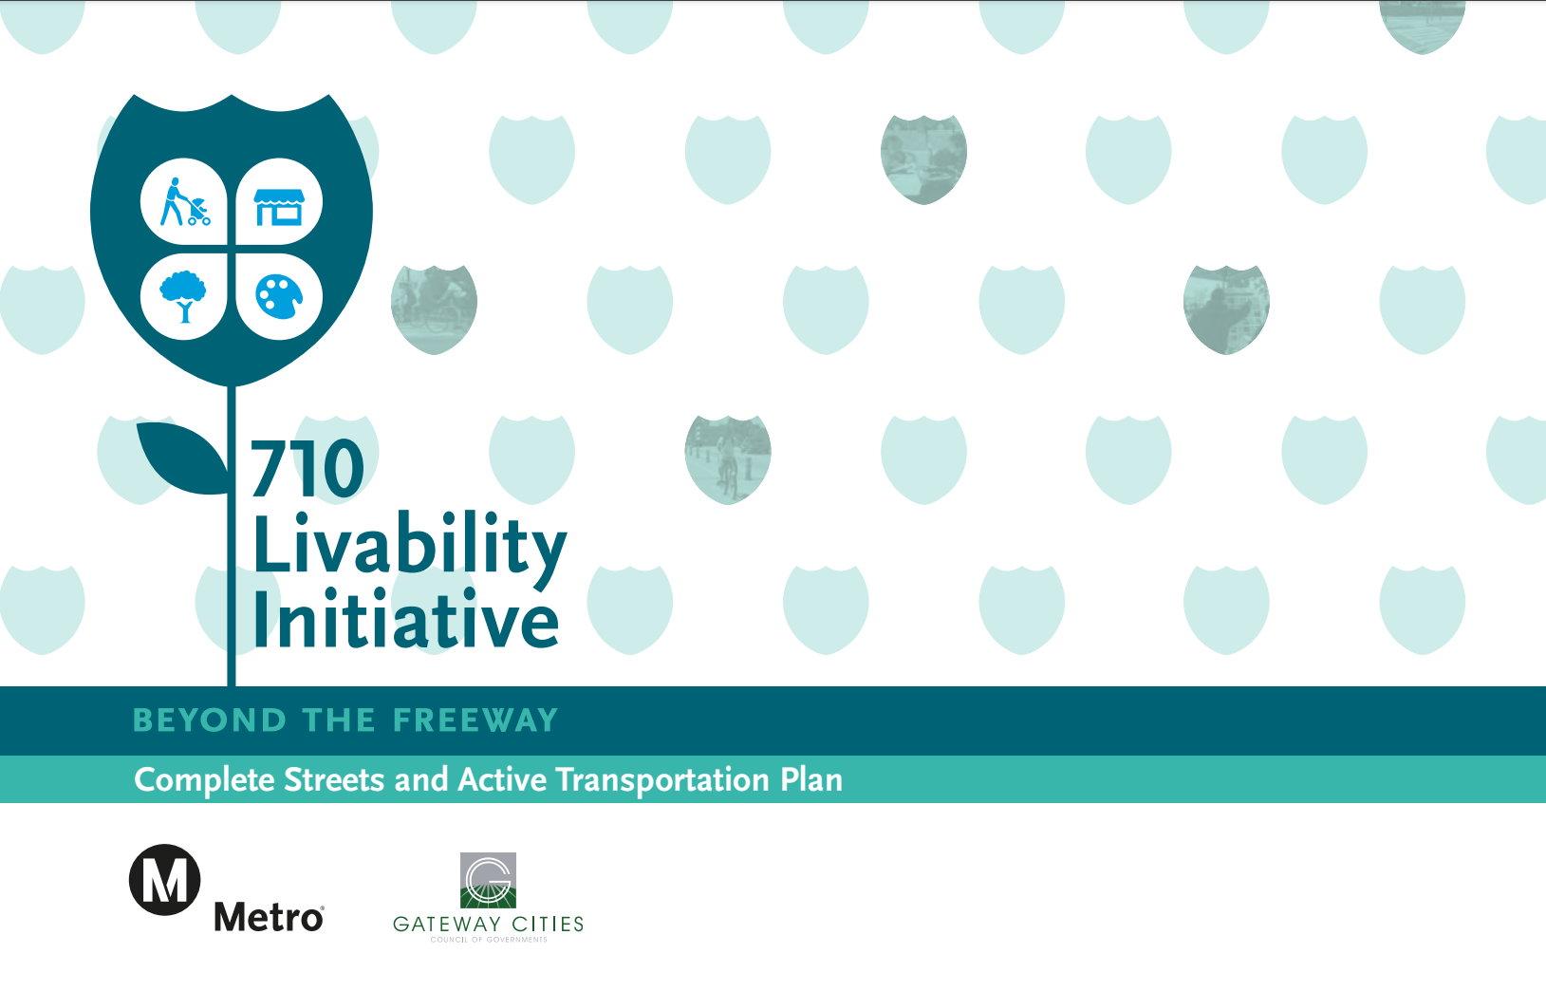
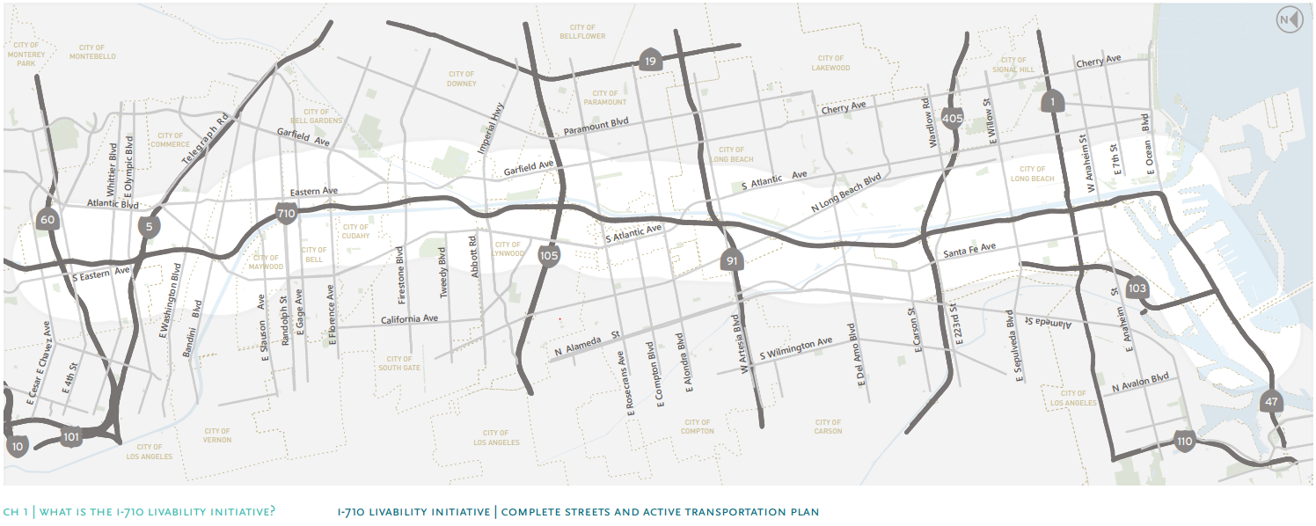
TYPE: ACTIVE TRANSPORTATION / TDM
SUBTYPE: Safety & Amenities
CASE STUDY:
I-710 Livability Initiative (LB-ELA_0214)
Led by the Gateway Cities Council of Governments and Metro
Planned in coordination with corridor cities and communities located one-mile east and west of the I-710.
Objective: improve street accessibility for all modes of transportation—walking, bicycling, bus and train, and to improve connections across the freeway.
Potential Benefits to I-710 Neighborhoods
    Upgraded crosswalks and traffic signals to benefit all commuters
    New Bicycle Lanes and Bicycle stations
    Much needed Shade at Bus Stops and Rest Areas
    Improved Lighting for better visibility and safer streets
    Better access to the LA River, Parks and Open Space
    Community Beautification through Public Art project
  Learn more at: www.gatewaycog.org/initiatives-and-projects/intelligent-transportation-systems/710-livability

Slide 8

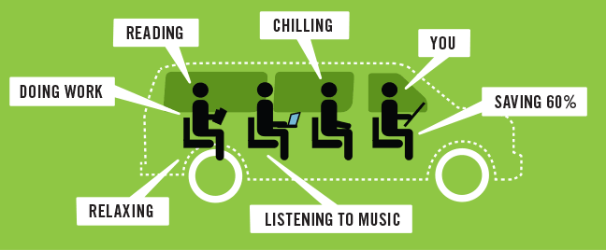
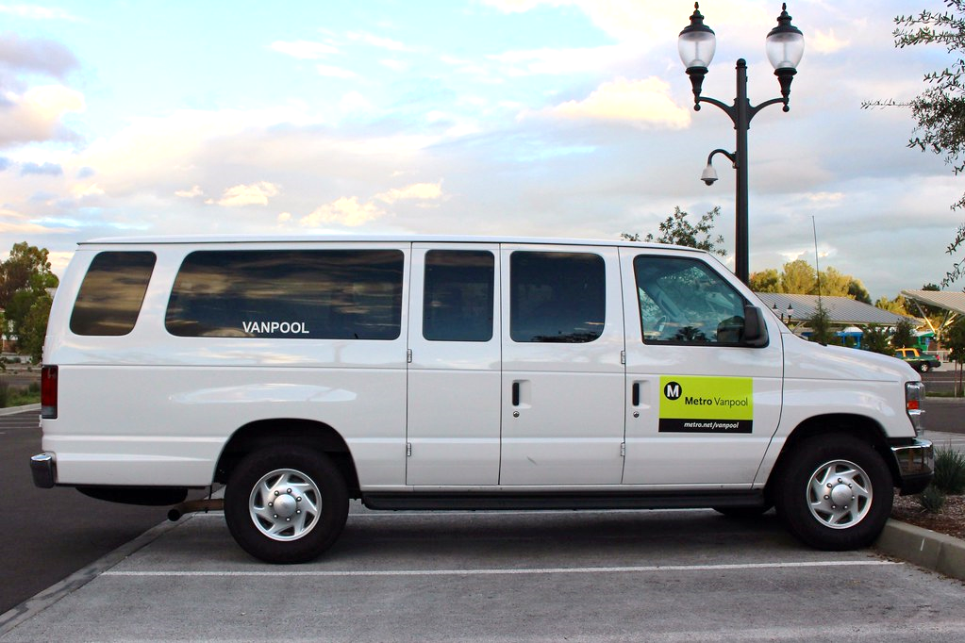
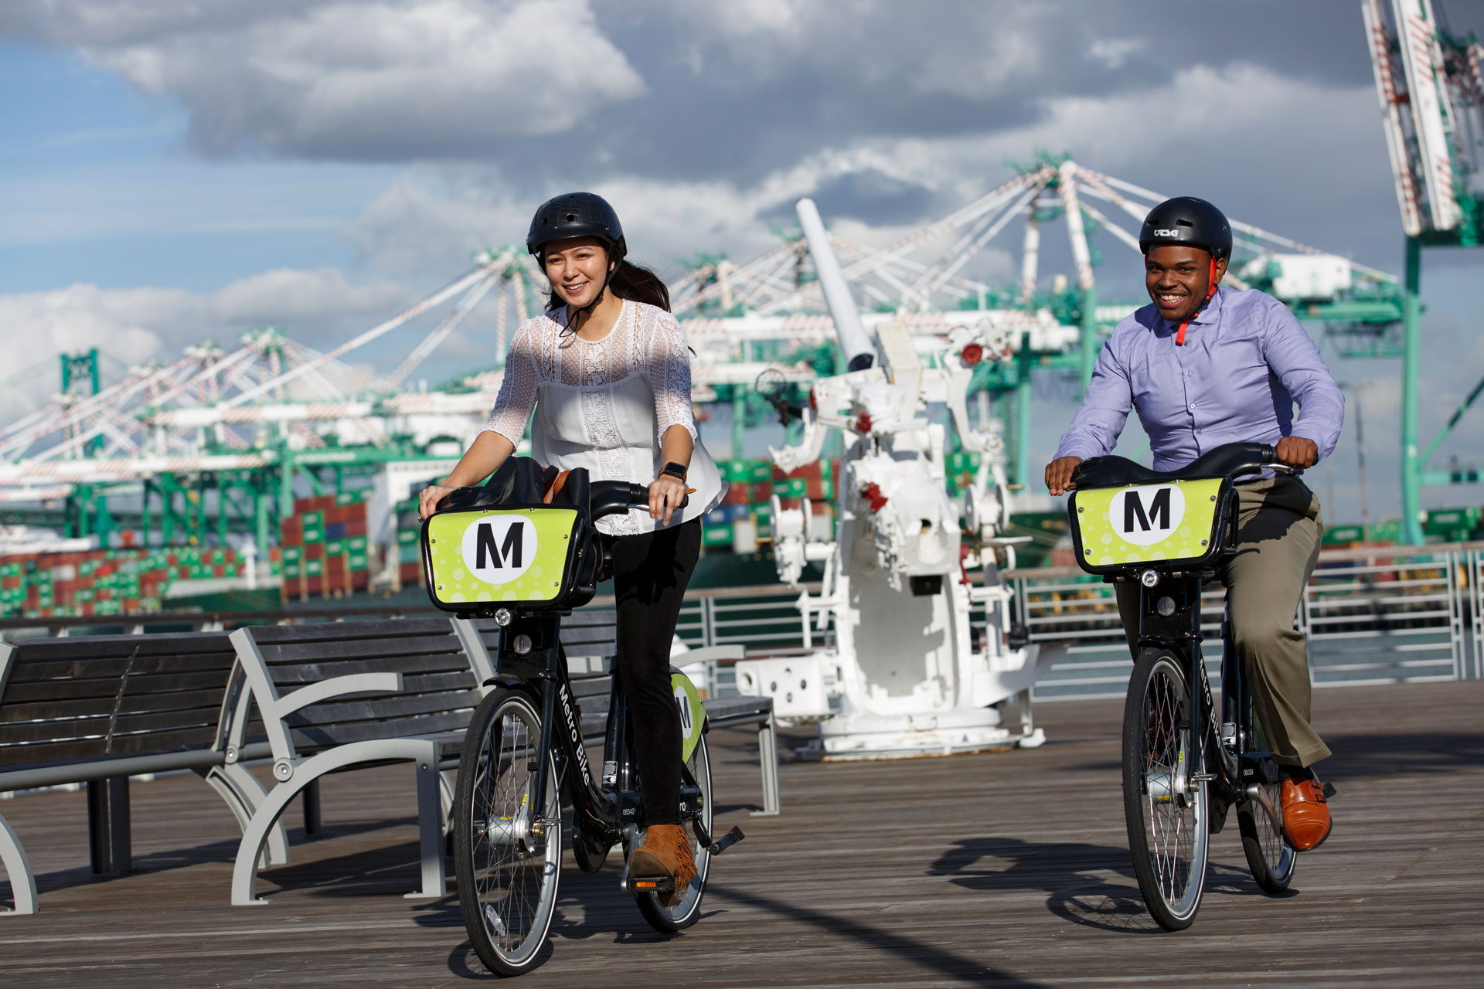
TYPE: ACTIVE TRANSPORTATION / TDM
SUBTYPE: TDM Strategies
CASE STUDY:
Metro Rideshare/Shared Mobility (LB-ELA_198)
Goal: Take single occupancy vehicles off the road.
Helps ease work commute by providing a ride in a van with others you know and work with!
Reduces emissions per person.
Provides transit service in areas and at times that lack it!
Metro services include:
Carpooling/Ridematching Services
Metro Vanpool
Metro Bike Share/Active Transportation
Learn more at:
www.metro.net/riding/rideshare

Slide 9





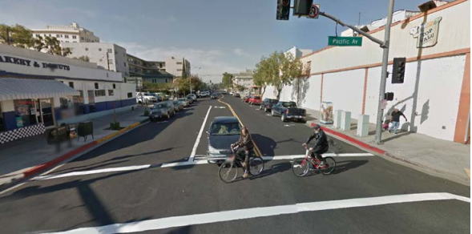
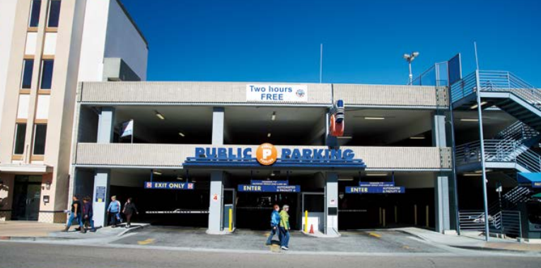

TYPE: ARTERIAL ROADWAYS/ COMPLETE STREETS
Range of Improvements (Partial List)
Intersection Improvements
Traffic Calming Features
Traffic Management Features
Turn lanes and other design features to reduce traffic queues at congested intersections.
Roundabouts, speed humps, and other design features or signage to slow traffic on local streets or near schools.
Traffic signal coordination on major arterial corridors to maximize “green time” based on actual traffic conditions.
Added Roadway Lanes
Parking Options
Visual Improvements
Roadway reconfiguration to add travel lanes, designate parking lanes for peak hour travel, or establish bus only lanes.
Additional street parking, public/shared parking lots, or public/shared parking structures.
Landscaping, hardscaping, public art, and other design features to improve the appearance of the roadway.

Slide 10





Project Types & Subtypes
TYPE: ARTERIAL ROADWAY/ COMPELTE STREETS
SUBTYPES
Complete Streets
TSM* / ITS**
Traffic Calming
General Local / Regional Roadway
Green spaces, trees, bioswales
Bike/pedestrian improvements
Public art
Signage
Transit stop amenities
Operational/safety improvements
ADA upgrades
LED street lighting
Stormwater retention
Traffic / Ped signal upgrades
Video camera installation
Equipment upgrades
Emergency vehicle priority
Signage
Signal Synchronization
Advanced technologies to manage traffic and to inform traveling public
Speed Reductions
Speed Bumps
Truck Restrictions in Neighborhoods
Roundabouts
Road Diets
Stop Signs, Traffic Signals
Speed Enforcement Cameras
Flashing Crosswalks
School Zone Warning Devices
Stormwater treatment
Upgrade traffic signals, sidewalks, crosswalks, driveways, ramps
New/improved bridges
ADA upgrades
Intersection Improvements
Pedestrian circulation / safety
Streetscape improvements
Bike and pedestrian improvements
Roadway widening/realignment
*TSM Signal Coordination, Transportation Systems Management (TSM)
**ITS Integrated Transportation Systems
INFORMATION FOR DISCUSSION PURPOSES ONLY – SUBJECT TO CHANGE

Slide 11
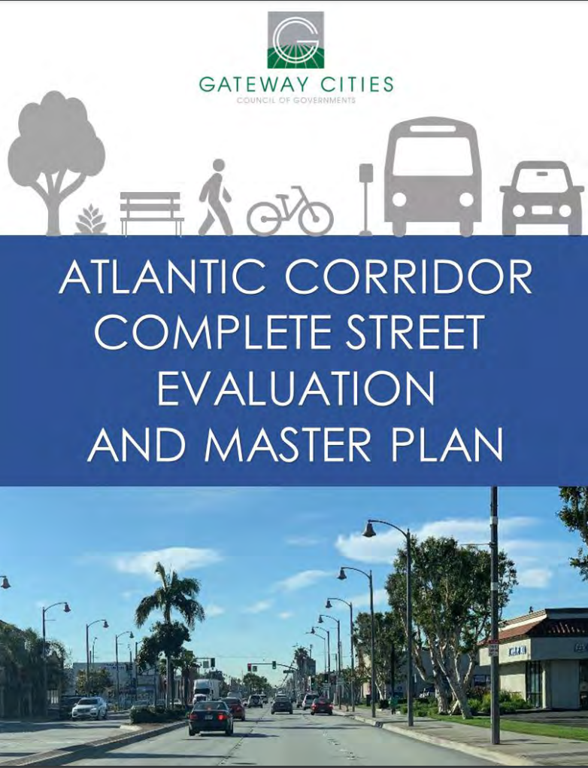
TYPE: ARTERIAL ROADWAYS/COMPLETE STREETS
SUBTYPE: Complete Streets
CASE STUDY:
Atlantic Complete Street Corridor (LB-ELA_0057)
The Gateway Cities COG began the Atlantic Corridor Complete Street efforts in 2019.
Key project features:
  Multimodal bicycle, pedestrian, and transit stop features and amenities.
  Safety and traffic calming features.
  Landscaping, hardscaping (aesthetic treatments), public green spaces, trees.
  Water quality features (bioswales, tree wells).
Learn more at:
www.gatewaycog.org/initiatives-and-projects/intelligent-transportation-systems/complete-street-initiative

Slide 12
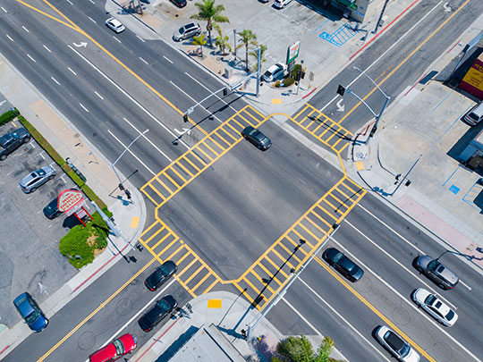
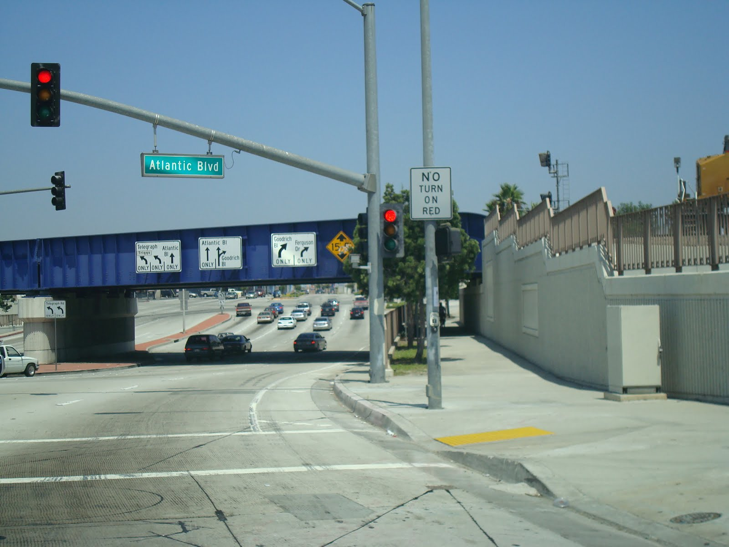
TYPE: ARTERIAL ROADWAYS/ COMPLETE STREETS
SUBTYPE: TSM / ITS
CASE STUDY: Mixmaster Traffic signal Improvements (LB-ELA_0071)
Traffic signal upgrade at Telegraph / Eastern / Atlantic.
Also consider improvements such as turning lane pavement markings, striping, and enhanced signage so that approaching traffic can get properly aligned well in advance of this intersection.
Learn more at https://pw.lacounty.gov/TNL/ITS/i5/index.shtml

Slide 13
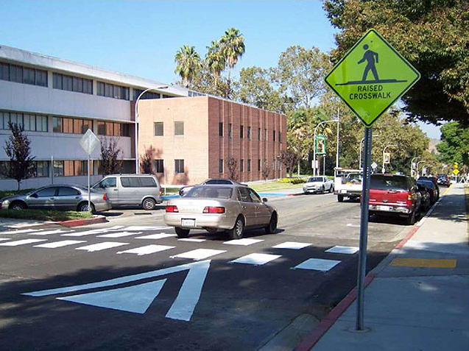
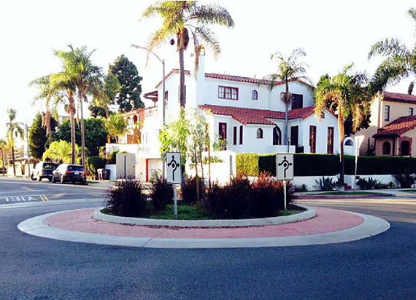
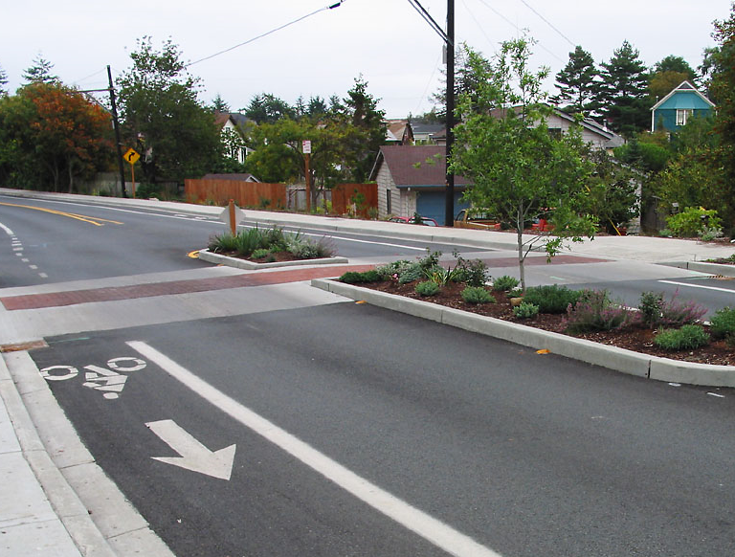
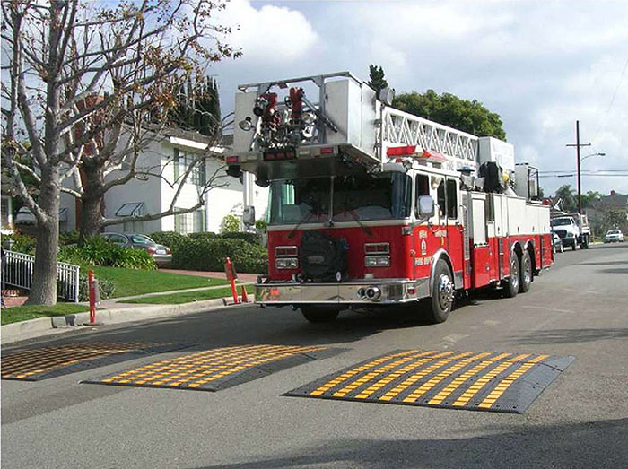
TYPE: ARTERIAL ROADWAYS/COMPLETE STREETS
SUBTYPE: Traffic Calming
Traffic Calming
Local street design techniques that reduce traffic speeds and discourage traffic incursion in residential neighborhoods to improve local street safety and neighborhood quality of life.
Techniques include physical traffic barriers
(e.g., speed humps), revised street configurations, and traffic speed enforcement.
Raised pedestrian crossing
Roundabouts
Raised median and crossing
Humps for emergency vehicles

Slide 14
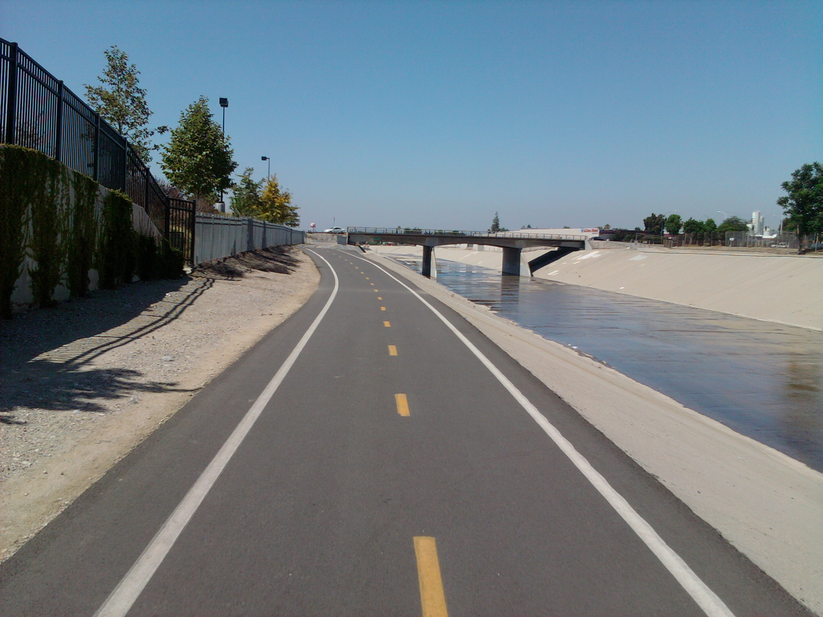
TYPE: ARTERIAL ROADWAYS/ COMPLETE STREETS
SUBTYPE: General Local / Regional Roadway
CASE STUDY: Florence Avenue Bridge Rehabilitation (LB-ELA_0079)
Rehabilitate arterial bridge over the Rio Hondo River Channel.
Learn more at https://lf.downeyca.org/WebLink/DocView.aspx?id=220677&dbid=0&repo=Downey&cr=1

Slide 15


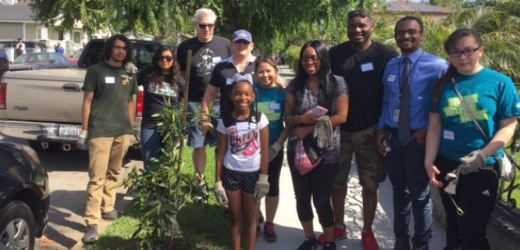
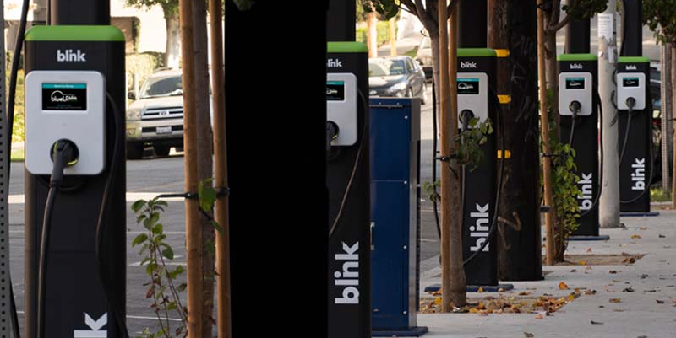
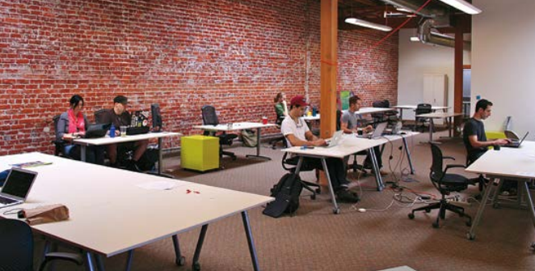
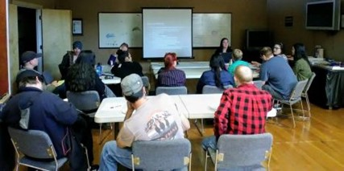
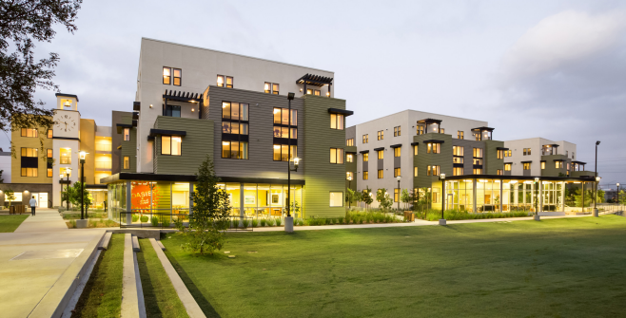
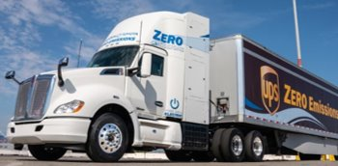
TYPE: COMMUNITY PROGRAMS
Health Benefits Program
EV Car-Share & Charging
Local Hire and Workforce
Development
Air filters for schools or vegetation buffers to reduce the harmful effects of air pollution.
Programs to provide short-term rental of electric vehicles and charging infrastructure for Zero-emission personal vehicles and trucks.
Programs to increase the share of public dollars that is devoted to creation of local jobs in the communities, and education/training of the local workforce.
Anti-displacement Strategies
Community Development Programs
Zero Emissions Trucks
Affordable housing policies, low-income rental assistance programs, tenants' rights education and legal representation to prevent unjust evictions.
Incentive programs to build affordable and mixed income housing, development of local parks, and other community resources​.
Program to reduce diesel trucks in favor of zero emissions trucks.

Slide 16




Project Types & Subtypes
TYPE: COMMUNITY PROGRAMS
SUBTYPES
Air Quality / Community Health
Environment
Housing Stabilization / Land Use
Job Creation /
Work Opportunities
Zero Emission Infrastructure for Autos
Bus Electrification
Community Health Benefit Programs
Air Filters for Schools & Facilities
Environmental Building Improvements
Health Education / Outreach
Community Health Screening
Vegetation Barriers/Buffer Landscaping
Greenhouse Gas Emissions Reduction, Zero Emissions Infrastructure for Autos
Renewable Energy/Solar
Urban Greening, Trees, Green Space, Greenbelts, Drought Tolerant Planting Parklets
Habitat Restoration / Connectivity
Public Art / Aesthetics
Housing/Rent Stabilization Policies
Anti-Displacement Programs
Rental Assistance Programs
Inclusionary Housing
Transit Oriented Communities
Homeless Programs
Partnership with Comm. Orgs
Density Bonus Programs
Community Land Trusts
Grant Writing Assistance
Targeted Local Hire
Employment Recruitment Initiatives
Vocational Educational Programs
Economic Stabilization Policies
Workforce Education & Development
Partnerships with Employers
Partnerships with Academic Institutions
INFORMATION FOR DISCUSSION PURPOSES ONLY – SUBJECT TO CHANGE

Slide 17
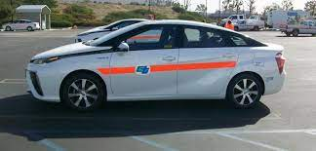
TYPE: COMMUNITY PROGRAMS
SUBTYPE: Air Quality / Community Health
CASE STUDY: Zero Emission Infrastructure for Autos (LB-ELA_0191)
Work with local jurisdictions (Cities, County of Los Angeles), public agencies, and private-public partners to develop and site additional charging stations for zero emissions vehicles within the LB-ELA Corridor.
Provide grant writing assistance in order to help secure funding. In addition, provide technical support to share best practices such as: identification of incentives and/or policy requirements for new development.
Learn more at https://dot.ca.gov/programs/sustainability/zero-emission-vehicles

Slide 18


TYPE: COMMUNITY PROGRAMS
SUBTYPE: Environment
CASE STUDY: Public Arts / Aesthetics
ADD (LB-ELA_0190)
Policy initiative that would require that a percentage of transportation construction funds for major public work projects be earmarked for public art, landscaping, urban design elements, and other aesthetic features for the projects.
Learn more at https://art.metro.net/

Slide 19
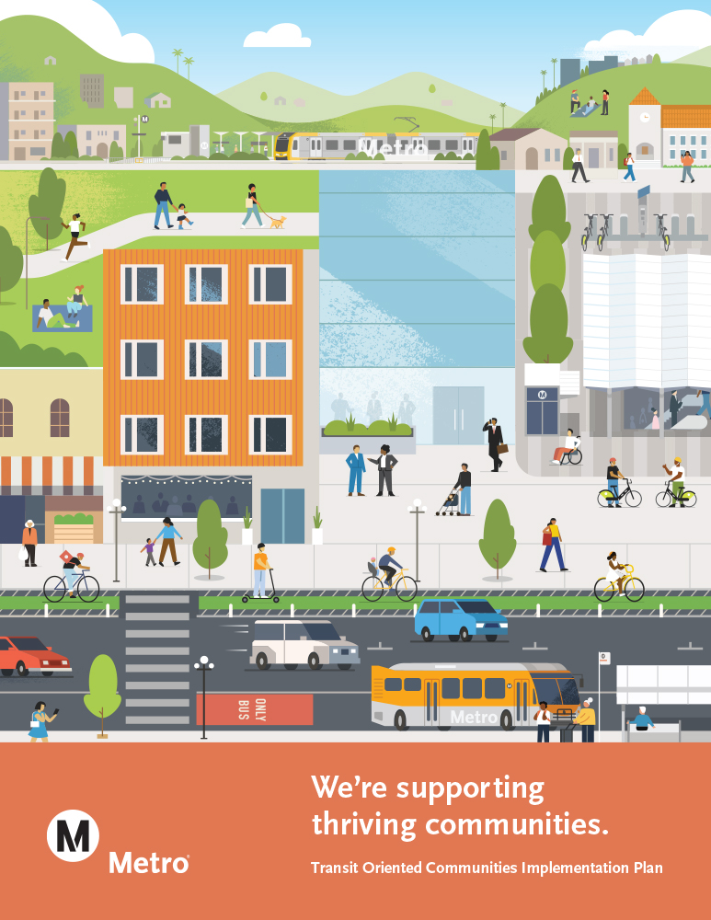
TYPE: COMMUNITY PROGRAMS
SUBTYPE: Housing Stabilization / Land Use
CASE STUDY: Transit Oriented Communities / Land Use (LB-ELA_0193)
Work with the local jurisdictions (Cities, County of Los Angeles) to apply best practices and design guidelines to encourage transit-oriented development near rail stations and heavily utilized bus routes within the LB-ELA Corridor. Provide technical resources such as grant writing assistance and technical assistance for community development and land use planning.
Assist local jurisdictions in coordination with property owners and developers to ensure safe construction and strengthen connections to transit.
Learn more at https://www.metro.net/about/transit-oriented-communities/

Slide 20
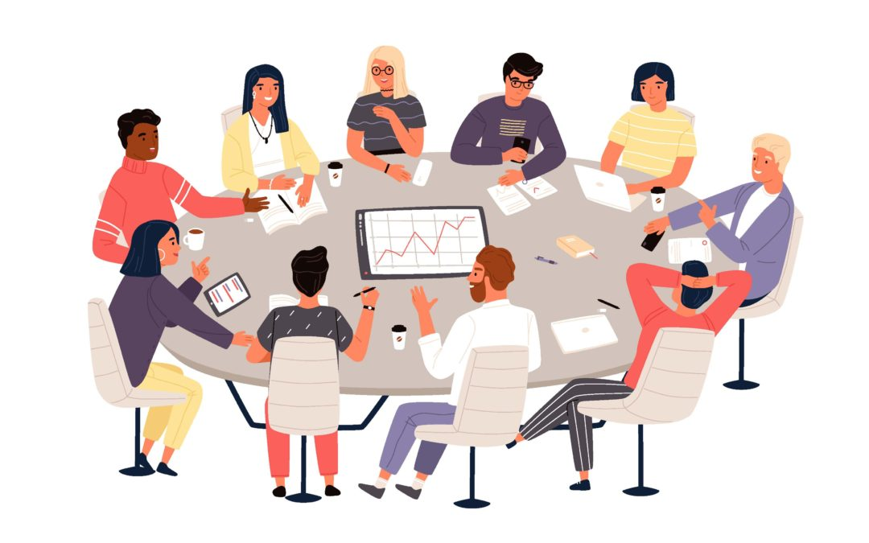
TYPE: COMMUNITY PROGRAMS
SUBTYPE: Job Creation / Work Opportunities
CASE STUDY: Economic Stabilization Opportunities
ADD (LB-ELA_0186)
Work with Cities, County of Los Angeles, and public agencies to propose and pass community stabilization policies to support disadvantaged communities within the LB-ELA Corridor.
Provide grant writing assistance to secure needed funding.
Learn more about at https://www.gatewaycog.org/media/userfiles/subsite_9/files/committees/2022/1-710-ad-hoc/Final%20Report%20I-710%20AHC%20May%202022.pdf

Slide 21


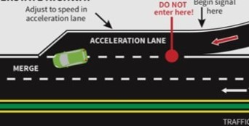
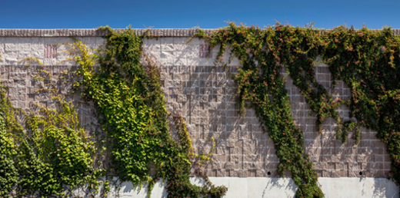
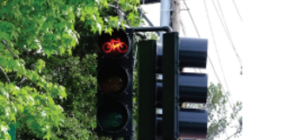
TYPE: FREEWAY SAFETY & INTERCHANGE IMPROVEMENTS
ZE Truck Programs
ITS
Trucks or vehicles that produce no tailpipe emissions of criteria pollutants.
Integrated system and web-based application to provide real-time information to users on optimal transit routes and transit options.
Freeway Improvements
TDM
Improvements including interchanges, soundwalls, new lanes, etc.
A communications process that transmits two or more streaming digital signals over a common channel.

Slide 22




Project Types & Subtypes
TYPE: FREEWAY SAFETY & INTERCHANGE IMPROVEMENTS
SUBTYPES
Icon
Icon
Icon
Icon
Freeway Improvements
Freeway Amenities/ITS
Zero Emissions Lanes on I-710
Congestion Pricing
Local Interchange modernization
Safety improvements
Re-designed on- and off-ramps
Auxiliary lanes
ITS
Particulate Matter Reduction Pilot Project
Soundwalls
Zero Emissions Truck Travel Zones Restrictions
Zero Emissions Truck Lanes
Closed Circuit Television Camera (CCTV)
Mixed-Flow Traffic Lanes
INFORMATION FOR DISCUSSION PURPOSES ONLY – SUBJECT TO CHANGE

Slide 23
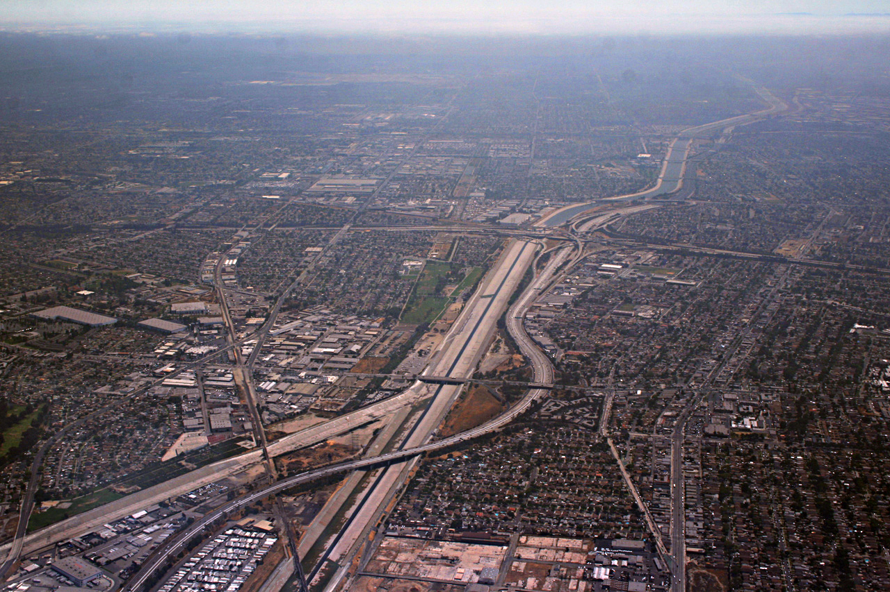
TYPE: FREEWAY SAFETY & INTERCHANGE IMPROVEMENTS
SUBTYPE: Freeway Improvements
Icon
CASE STUDY: Interchange Improvements along I-710
Upgrade of I-710 Interchanges to improve operations, safety, and sight distance for traffic entering and exiting the freeway. Improve traffic controls to address safety concerns of bicyclists, pedestrians at ramp termini.
Learn more about I-710 interchange improvements at
https://dot.ca.gov/-/media/dot-media/district-7/documents/projects/cmcp/cmcp-sr91-factsheet-feb2021-a11y.pdf

Slide 24
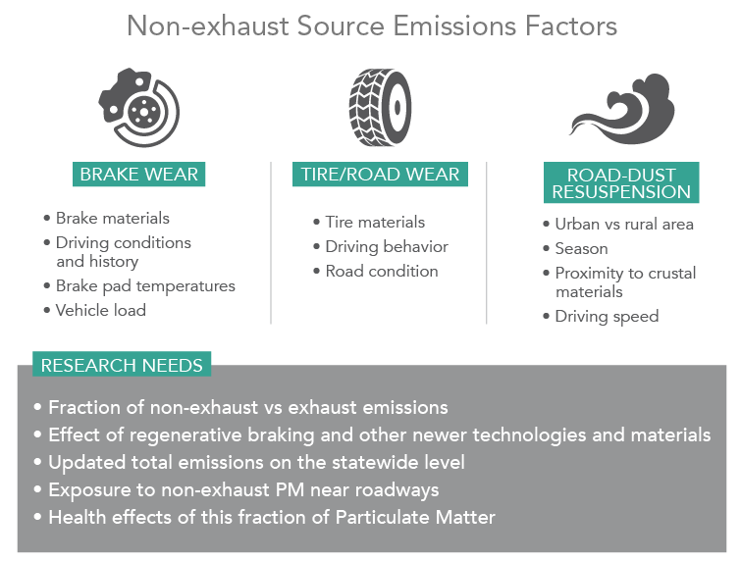
TYPE: FREEWAY SAFETY & INTERCHANGE IMPROVEMENTS
SUBTYPE: Freeway Amenities/ITS
Icon
CASE STUDY: Particulate Matter (PM) Reduction Pilot Project (LB-ELA_0157)
Implement a pilot project on I-710 to deploy and evaluate measures to reduce exposure of nearby populations to particulate matter, specifically localized sources of entrained/fugitive dust, tire wear, and brake wear associated with traffic on the freeway.
These measures may include roadside vegetation barriers within available Caltrans’ right-of-way, air filters for nearby schools or community facilities, pavement materials, frequent street-sweeping, and deployment of air quality monitoring systems, among others.
As part of the work plan, the pilot project would include a study element to assess and document the efficacy of the various measures.
Learn more about a similar pilot program at https://www.sdapcd.org/content/dam/sdapcd/documents/grants/Final_Project%20Plan_Short-Haul%20ZE%20Truck%20Pilot.pdf

Slide 25


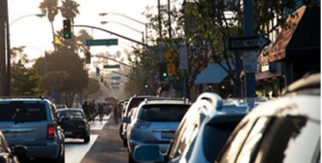
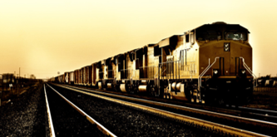
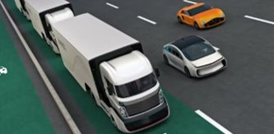
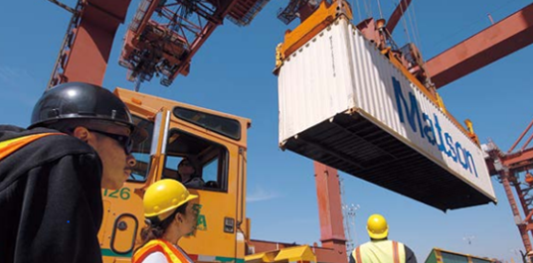
TYPE: GOODS MOVEMENT
ZET Truck Programs
ITS
Freight Rail
Trucks or vehicles that produce no tailpipe emissions of criteria pollutants.
Integrated system and web-based application to provide real-time information to users on optimal transit routes and transit options.
Railroads and trains to transport cargo as opposed to human passengers.
Goods Movement
TDM
Ports
The distribution of freight by all modes of transportation, including marine, air, rail, and truck.
A communications process that transmits two or more streaming digital signals over a common channel.
A rail facility in which cargo is transferred from drayage truck to train or vice-versa.

Slide 26



Project Types
TYPE: GOODS MOVEMENT
SUBTYPES
Icon
Icon
Icon
Truck Programs/ITS
Freight Rail, Goods Movement, TDM
Ports
Zero-Emissions Trucks
Zero Emission Infrastructure
Grade Separation
At-grade crossing
Container terminal wharf
Drayage truck movements
Shore-side power
Intermodal yards
On-dock railyard
Freight Rail
Goods movement
Time Division Multiplexing (TDM)
Multimodal options
On Dock Rail Expansion
Port Railyard
INFORMATION FOR DISCUSSION PURPOSES ONLY – SUBJECT TO CHANGE

Slide 27
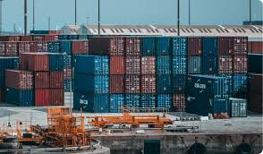
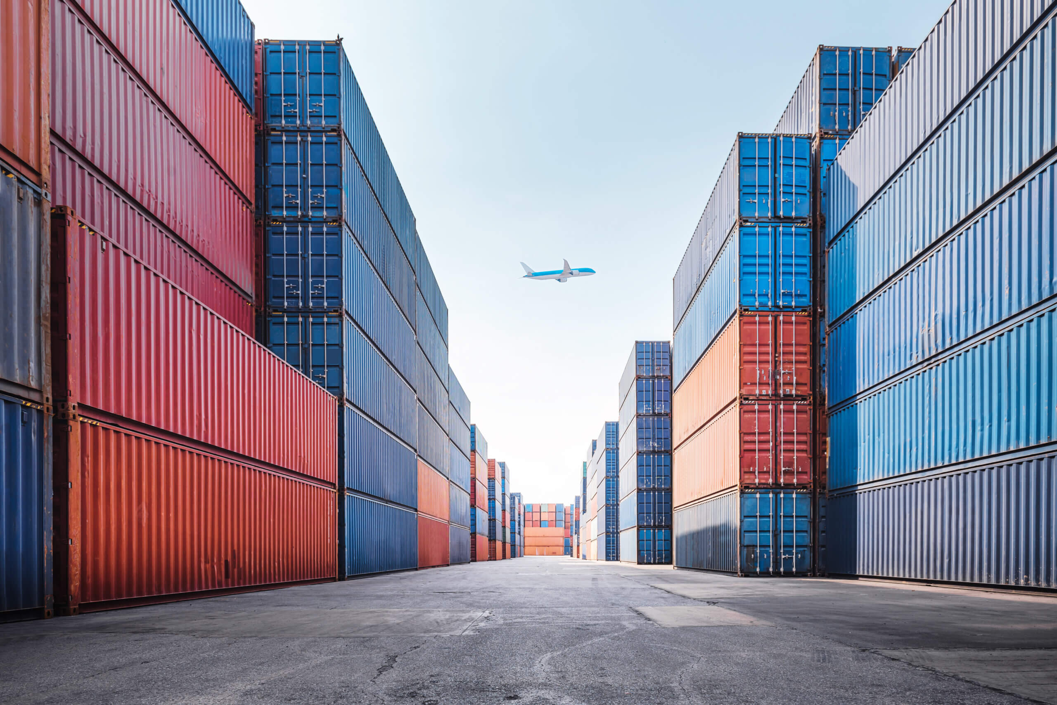
TYPE: GOODS MOVEMENT
SUBTYPE: Truck Program/ITS
Icon
CASE STUDY: Empty Container Management
(LB-ELA_0023)
Provide a mix of incentives/fee penalties to encourage shippers/marine terminals to clear empty containers from docks/near dock facilities at the Ports to reduce congestion and unnecessary truck trip movements.
Extend use of off-peak hours for empty returns.
Learn more at https://dtsc.ca.gov/managing-empty-containers/

Slide 28
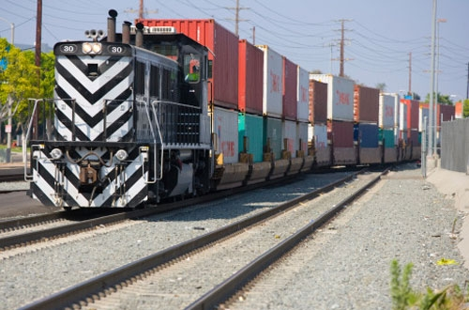
TYPE: GOODS MOVEMENT
SUBTYPE: Freight Rail, Goods Movement, TDM
Icon
CASE STUDY: West Basin Container Terminal Railyard Modernization (LB-ELA_0026)
On-dock railyard expansion to accommodate electric operated rail-mounted gantry cranes.
Learn more about the construction at https://www.rtands.com/freight/yards-terminals/port-of-los-angeles-begins-construction-on-west-basin-railyard/

Slide 29
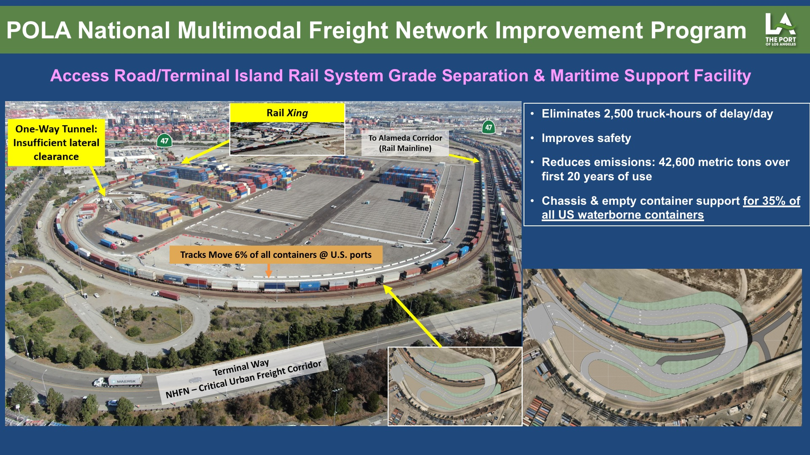
TYPE: GOODS MOVEMENT
SUBTYPE: Ports
Icon
CASE STUDY: Port of Los Angeles National Multimodal Freight Network (NMFN) Improvement Program (LB-ELA_0131)
The project consists of constructing a four-lane, rail-roadway grade separation that eliminates a significant truck access impediment to an important container terminal support facility located on Terminal Island, at the centroid of the Ports of Los Angeles-Long Beach (POLA-POLB).
Learn more at https://catc.ca.gov/-/media/ctc-media/documents/programs/Senate-Bill-1/TCEP/fact-sheets/factsheets/12-msf-terminal-island-fs.pdf

Slide 30

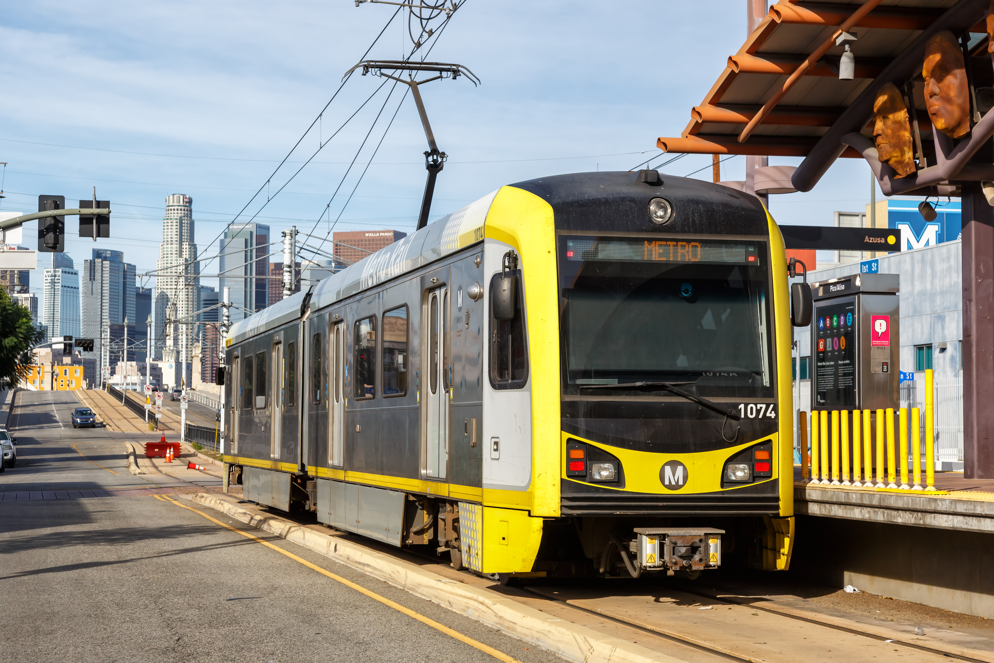
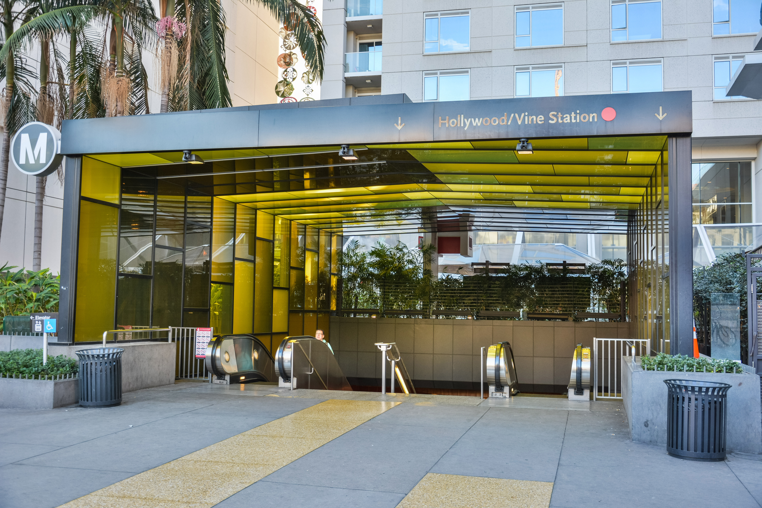
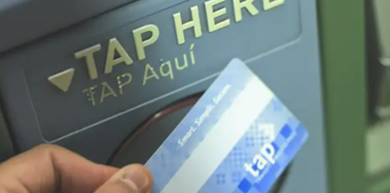
TYPE: TRANSIT
LRT & BRT
Rail Line Station Improvements
Bus Transit & Amenities
Light rail transit and bus rail transit for faster and more frequent travel times.
Upgrade and expand the existing rail line stations that service the corridor.
Improve bus line services and programs for all riders.

Slide 31




Project Types
TYPE: TRANSIT
SUBTYPES
Icon
Icon
Icon
Icon
High-Capacity Transit
Rail Line / Station Improvements
Bus
Transit
Transit Amenities
Light rail transit (LRT)
Bus rapid transit (BRT)
Shared-use
Quad safety gates
Supervisory Control and Data Acquisition System (SCADA)
On-demand bus (Micro-Transit)
Metro Mico Transit Zones
Bus priority lane corridors
Discount programs
Ridership experience
INFORMATION FOR DISCUSSION PURPOSES ONLY – SUBJECT TO CHANGE

Slide 32
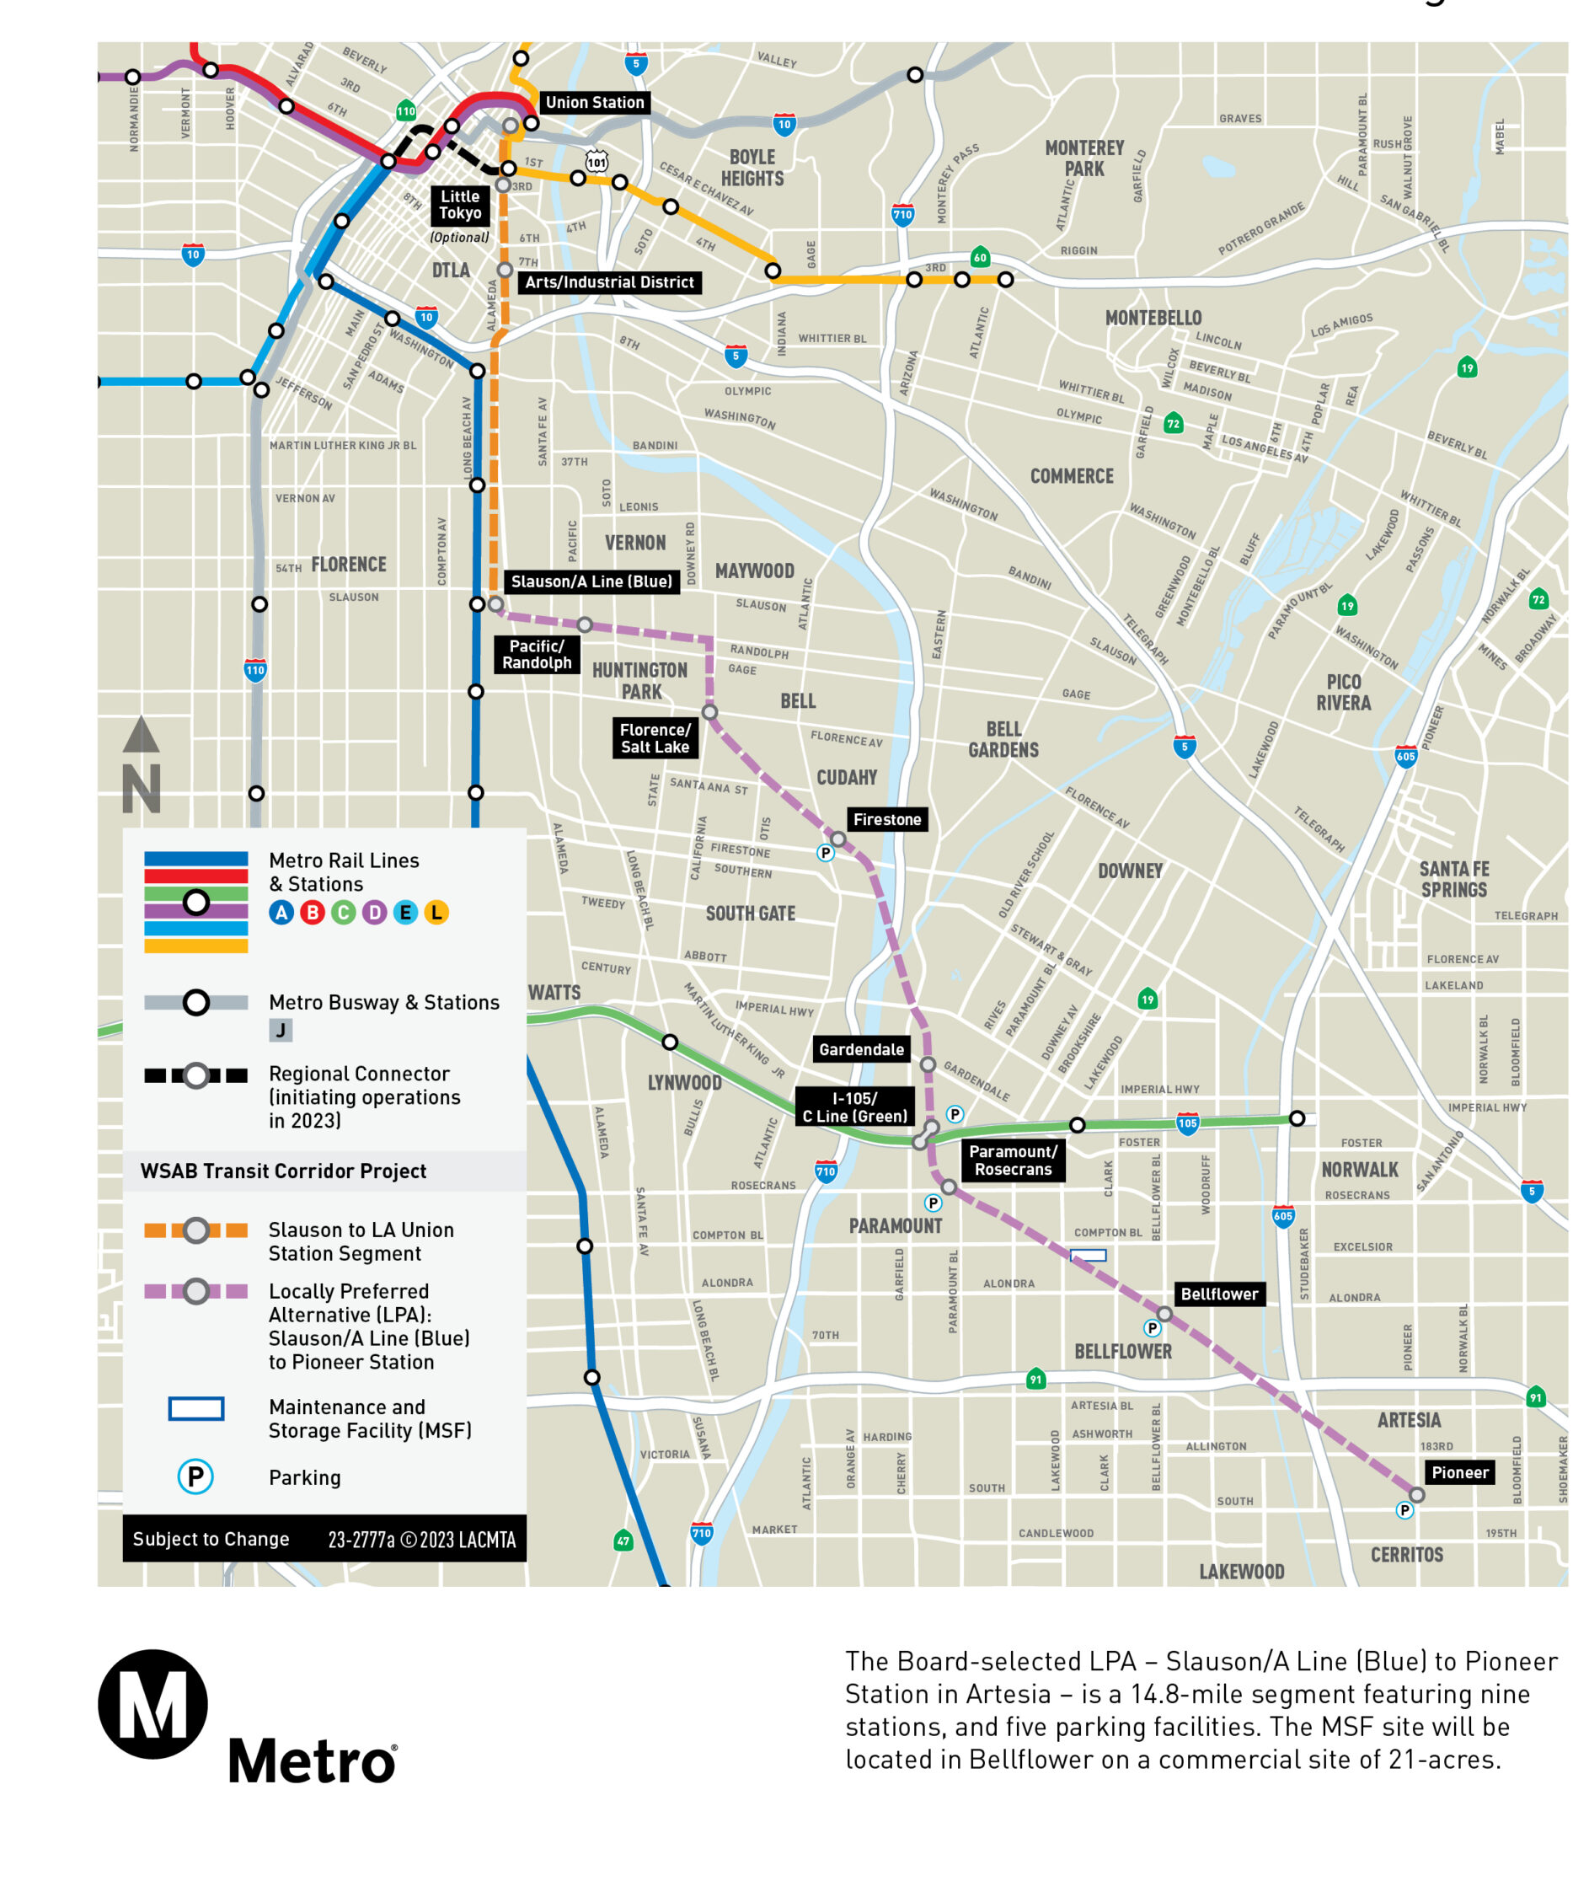
TYPE: TRANSIT
SUBTYPE: High-Capacity Transit
Icon
CASE STUDY: Southeast Gateway Line formerly known as the West Santa Ana Branch Transit Corridor (LB-ELA_0001)
The Project consists of 12 stations and is a 19-mile light rail transit corridor that will connect southeast LA County to downtown Los Angeles, serving the cities and communities of Artesia, Cerritos, Bellflower, Paramount, Downey, South Gate, Cudahy, Bell, Huntington Park, Vernon, unincorporated Florence-Graham community of LA County and downtown Los Angeles.
Complete 4.5-mile section between Slauson A Line and Union Station.
Learn more at https://www.metro.net/projects/west-santa-ana/

Slide 33
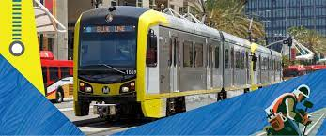
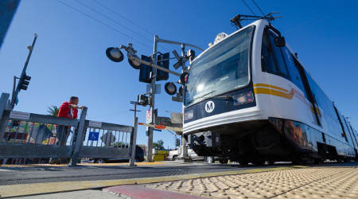
TYPE: TRANSIT
SUBTYPE: Rail Line / Station Improvements
Icon
CASE STUDY: Line A (Blue Line) Transit Priority/Signal Synchronization (LB-ELA_0160)
Enhanced signal prioritization/synchronization so that the A Line (Blue Line) has higher priority in areas where the LRT trains operate in mixed flow traffic.
Learn more at https://www.dctcinc.com/projects/la-metro-blue-line-signal-rehabilitation-project

Slide 34
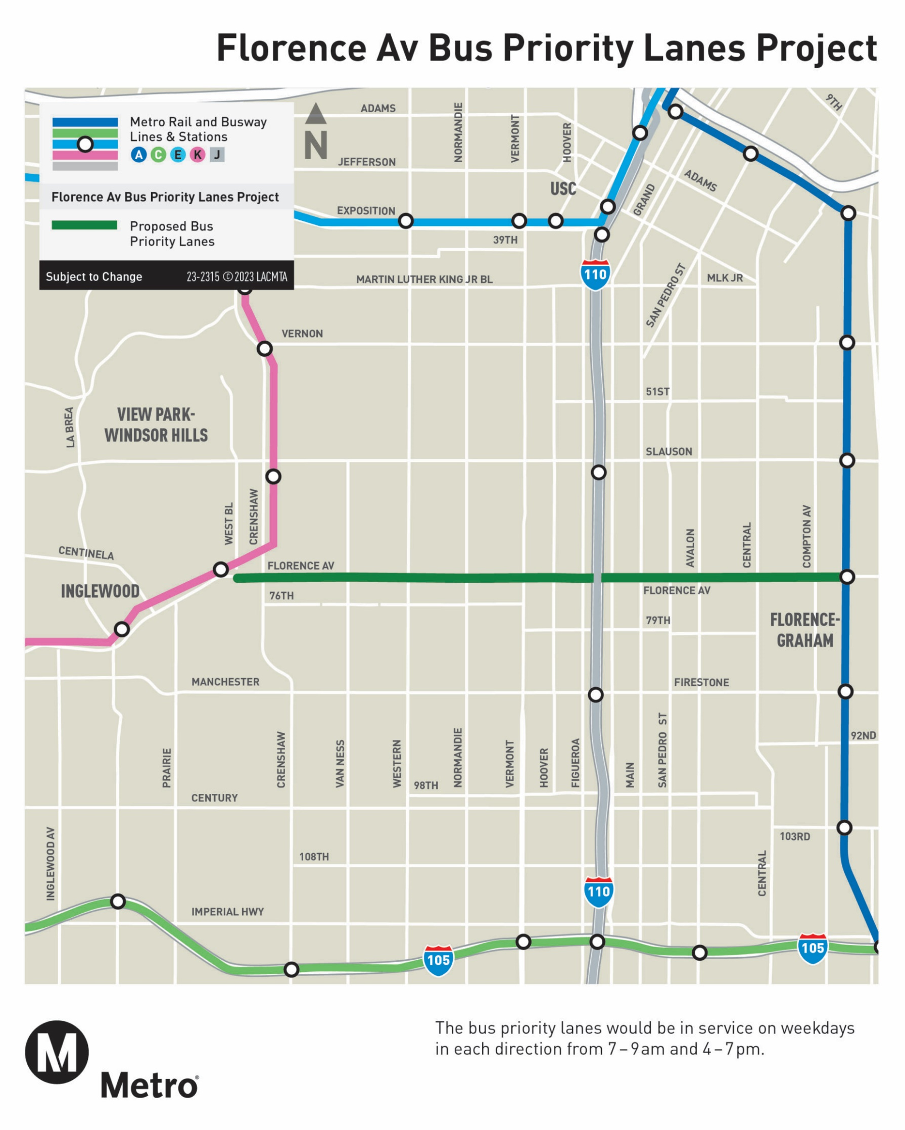
TYPE: TRANSIT
SUBTYPE: Bus Transit
Icon
CASE STUDY: Metro Bus Priority Lanes
Florence Av Bus Priority Lanes Project
Improve bus times, speeds, and reliability.
Proposed improvements would include: transit signal prioritization, bus priority lanes and bus stop bulb outs, all door boarding, bus stop and layover improvements.
Learn more about a bus priority lane project at https://www.metro.net/projects/florence-av-bus-priority-lanes-project/

Slide 35
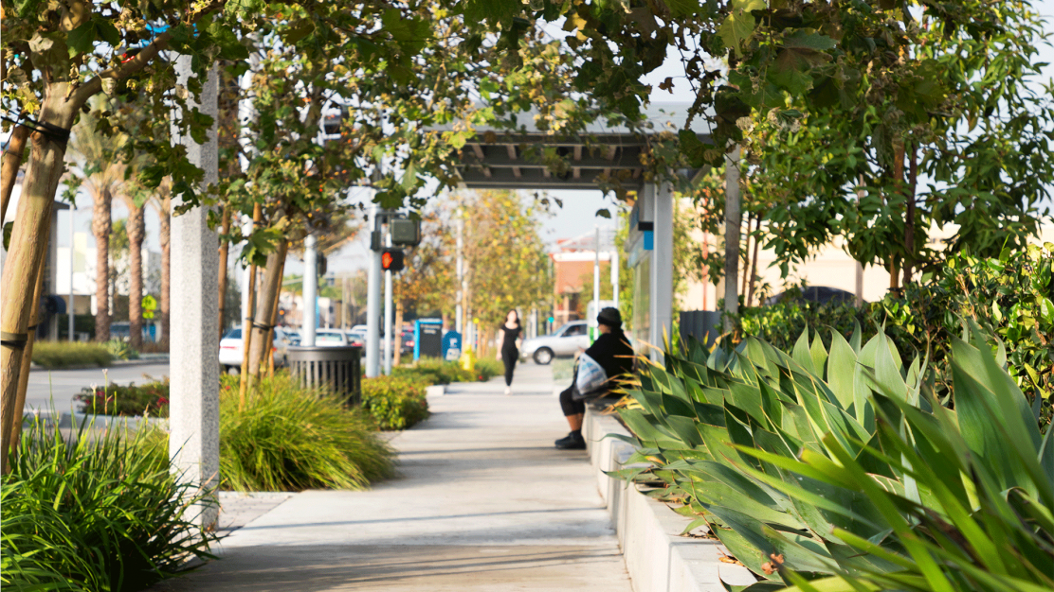
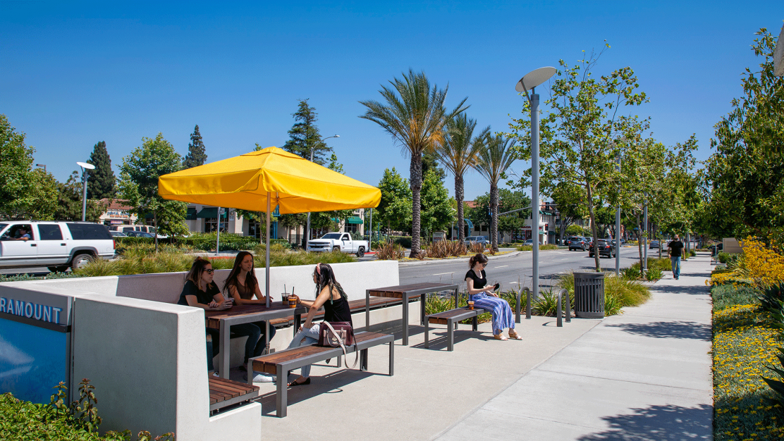
TYPE: TRANSIT
SUBTYPE: Transit Amenities
Icon
CASE STUDY: Bus Shelter Upgrades (LB-ELA_0118)
Upgrade bus shelters at various locations based on need and equity assessments.
Learn more about the newest bus shelters installed by the City of Paramount at https://studio-111.com/portfolio/detail/paramount-boulevard/

Slide 36

Stay Connected
Michael Cano, Executive Officer,
Countywide Planning & Development
Metro
One Gateway Plaza, MS 99-13-1
Los Angeles, CA 90012
213.922.4710
710corridor@metro.net
metro.net/projects/i-710-corridor
@metrolosangeles
losangelesmetro
INFORMATION FOR DISCUSSION PURPOSES ONLY – SUBJECT TO CHANGE
Notes:
Roundtable #2 (Vision and Goals)
TF Meeting #11
Listening Session #1
Dashboard

