Slide 1


Information Station #2
Partnering with Communities
March 2024

Slide 2

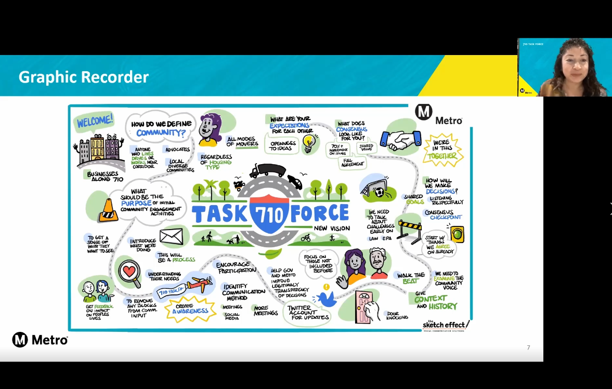
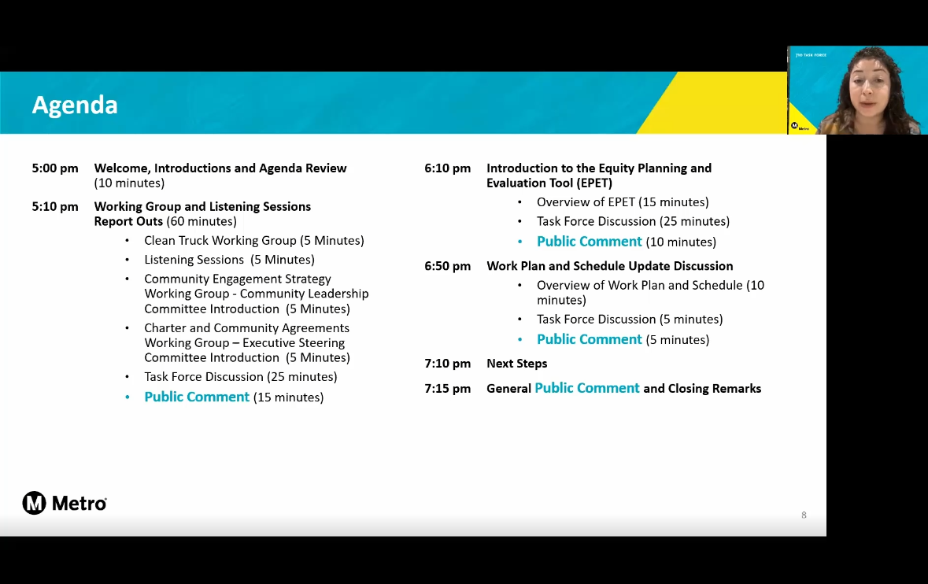
Engagement Efforts Leading up to Draft Investment Plan Release
Task Force Meetings
Community Engagement Strategy Working Group Meetings
Focus Groups
Listening Sessions and Public Workshops
Community Leadership Committee (CLC)
Coordinating Committee (CC)
Online tools
Historical input from previous 710 environmental project
Community-Based Organization (CBO) Partnerships
Notes:
Lilian

Slide 3








































Task Force
INFORMATION FOR DISCUSSION PURPOSES ONLY – SUBJECT TO CHANGE

Slide 4




Community Leadership Committee
Maria Reyes, Long Beach Marlene Sanchez, Long Beach
Aide Castro, Lynwood Elizabeth Zamarripa, Lynwood
Jamila Cervantes, Maywood​​
Andres Duarte, Montebello
Tiesha Davis, San Pedro
Esmeralda Hernandez, South Gate
Viridiana Preciado Cervantes, Walnut Park
Manuel Arellano, Wilmington
Dora Douglas, Vernon Kevin Shin, At-Large
Includes representatives from corridor communities:
Luis Mesa, Bell​
Natalie Diaz Rubio, Bell Gardens​​
Emmanuel Godinez, Boyle Heights​​
Fa'alagilagi Meni-Siliga, Carson​​
Alfonso Garate, Commerce​​
Phyllis Ollison, Compton​​
Irma Lopez, Cudahy​
Guadalupe Arellano, East LA Kathleen Barajas, East LA Miyuki Gomez, East LA
Sinetta Farley, East/Rancho Dominguez​
Jose Rodolfo Vallejo, Huntington Park​​
Dan Wamba, Lakewood​
Marcos Lopez, Long Beach​​
INFORMATION FOR DISCUSSION PURPOSES ONLY – SUBJECT TO CHANGE
Notes:
Declare that this Task Force process is the most ambitious planning effort by Metro to engage and involve communities for a subregional plan

Slide 5

Working Groups
Purpose of Working Groups
  Research, analyze, and discuss specific issues
  Develop proposals and recommendations for CLC /
  Task Force consideration
  Help facilitate focused and constructive meetings
Established Working Groups
  Equity Working Group (meets monthly)
  Zero-Emissions Truck Working Group (meets monthly)
  Coordinating Committee (meets as needed)
Participants
  Task force members
  CLC members
  Additional stakeholders and experts
INFORMATION FOR DISCUSSION PURPOSES ONLY – SUBJECT TO CHANGE

Slide 6




















Partnerships with Community Based Organizations
CBO* Partnership Goals
  Establish a consistent and equitable approach to partnering with CBOs
  Ensure greater outcomes in public participation, especially leading up to and following the release
  of the Draft Community Investment Plan.
  Reach additional communities and stakeholders
  not captured within the project database.
  Provide project information to equity-focused communities (EFC) and other areas served by
  CBO partners, while being part of the process by providing feedback and receiving updates.
  Cultivate trust with the community.
  Foster positive relationships with active CBOs.
Notification Activities
Engagement Activities
Flyers & Posters Distribution
  Event information booths
Door-to-door notices
  Pop-up outreach booths
Eblasts/e-newsletters
Transit-intercepts
Banners & Lawn Signs
Business Corridor Outreach
Notification Toolkit
School Outreach
Phone banking & SMS texts
CBO Co-hosted meetings
Social media posts
Other outreach efforts
  Website/Other Announcements
*CBO Community based organizations
INFORMATION FOR DISCUSSION PURPOSES ONLY – SUBJECT TO CHANGE
Notes:
Stephanie

Slide 7


CBO Partnerships
28 CBO Partners
ALL operating within Equity Focused Communities in the project area
Avance Latino
Black Women Rally for Action
Calvary Chapel Compton
COFEM (SELA Collaborative)
Compton Advocates Coalition
Eastmont Community Center
East LA College (ELA)
East LA College (South Gate)
FoodCycle
Good Faith Missionary Baptist Church
Hoops 4 Justice
La Comadre
MAOF – Downey
MAOF – HQ Montebello
Mujeres Unidas Sirviendo Activamente
National Council of Negro Women (Long Beach)
Northwest Downey Little League
Rancho Los Amigos National Rehabilitation Center/Foundation
Regional Hispanic Institute
Streets Are For Everyone (SAFE)
Salvation Army Red Shield
Southeast Community Development Corporation (SELA) Collaborative
South Gate Junior Athletics Association
Tower of Faith Evangelic Church
Unearth and Empower Communities
YMCA – Montebello/Commerce
YMCA – Southeast Rio Vista (Maywood)
YMCA – Weingart East LA
INFORMATION FOR DISCUSSION PURPOSES ONLY – SUBJECT TO CHANGE

Slide 8
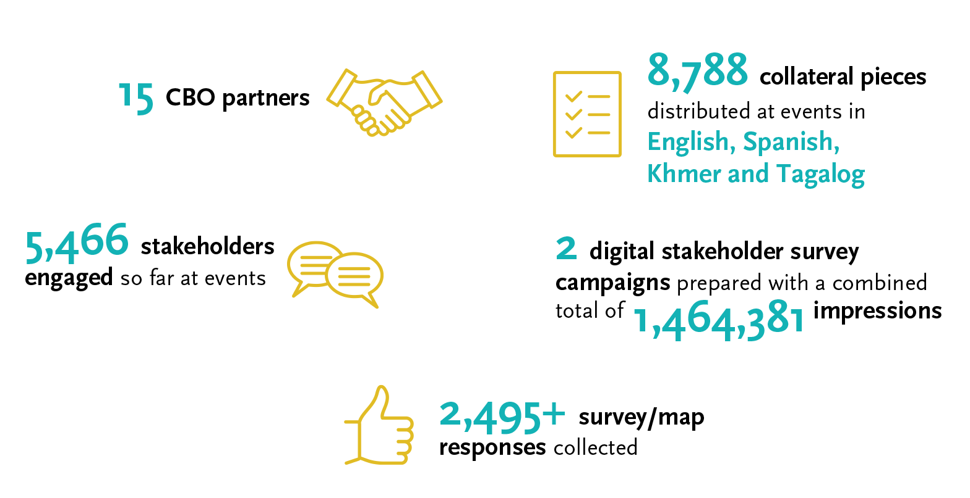
Prior Public Engagement – CBO & Public Engagement
Notes:
Michael
15 CBO partners – CBO reps that receive compensation for their work – relating to the MSPP
-Eastmont Community Center (CBO Charter)
-SELA Collaborative (CBO Charter)
-Good Faith Missionary Baptist Church (CBO Charter)
-FaithWorks Compton (CBO Charter)
-Tower of Faith Evangelistic Church (CBO Charter)
-Long Beach Gray Panthers (No CBO Charter)
-Teamsters Local 848 (No CBO Charter))
-Families in Good Health (Cambodian) -Unsure of CBO Charter)
-Long Beach Negro Council of Women (CBO Charter)
-CITT/CSULB (No CBO Charter)
-Pat Brown Institute/CSULA (No CBO Charter)
-Council of Mexican States (COFEM) (CBO Charter)
-Salvation Army (CBO Charter)
-Communities for a Better Environment (CBO Charter)
-Avance Latino (CBO Charter)
Social Media, Next Door, website

Slide 9
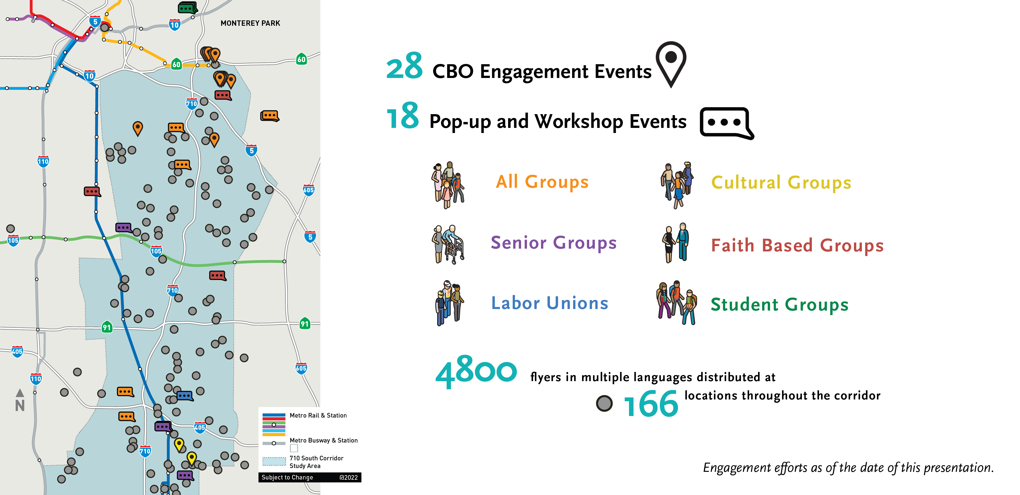
Prior Public Engagement – CBO & Public Engagement
Notes:
Michael
15 CBO partners – CBO reps that receive compensation for their work – relating to the MSPP
-Eastmont Community Center (CBO Charter)
-SELA Collaborative (CBO Charter)
-Good Faith Missionary Baptist Church (CBO Charter)
-FaithWorks Compton (CBO Charter)
-Tower of Faith Evangelistic Church (CBO Charter)
-Long Beach Gray Panthers (No CBO Charter)
-Teamsters Local 848 (No CBO Charter))
-Families in Good Health (Cambodian) -Unsure of CBO Charter)
-Long Beach Negro Council of Women (CBO Charter)
-CITT/CSULB (No CBO Charter)
-Pat Brown Institute/CSULA (No CBO Charter)
-Council of Mexican States (COFEM) (CBO Charter)
-Salvation Army (CBO Charter)
-Communities for a Better Environment (CBO Charter)
-Avance Latino (CBO Charter)
Social Media, Next Door, website

Slide 10











Community Engagement Activities
Winter 2024
Release of Draft CMIP starting on Wed., Jan. 31
Public comment period through Fri., March 1
Release of Draft CMIP
Wednesday, January 31, 2024
First Community Meetings
Thursday, February 1
Virtual (12-2pm) & In-Person (6-8pm)
Video Recording of Virtual Presentation (English/Spanish)
Week of February 5
Comment Period
Wednesday, January 31 to Friday, March 1
Metro
Metro
Jan 2024
Feb 2024
Mar 2024
TF & CLC Activities (during & post Draft CIP Release)
Roundtables #2 & #3
Informational Campaign
Post Engagement
Community Meetings
8+ meetings
Community Engagement
Informational Booths
30+ targeted activities
Pop-Up Events
*CMIP Corridor Mobility Investment Plan
INFORMATION FOR DISCUSSION PURPOSES ONLY – SUBJECT TO CHANGE

Slide 11




Explore the LB-ELA Corridor StoryMap & Dashboard!
Visit: metro.net/lb-ela-cp-hub
INFORMATION FOR DISCUSSION PURPOSES ONLY – SUBJECT TO CHANGE

Slide 12

Community Meetings
In-Person
In-Person | Meeting Location
COMMERCE Thursday, February 1, 2024 6-8pm | Bristow Park Community Center​ 1466 S McDonnell Ave Commerce, CA 90040
LYNWOOD Wed., February 7, 2024 6-8pm | Bateman Hall 11331 Ernestine Ave Lynwood, CA 90262
LONG BEACH Monday, February 12, 2024 6-8pm | Museum of Latin American Art 628 Alamitos Ave Long Beach, CA 90802
COMPTON​ Wed., February 21, 2024 6-8pm | East Rancho Dominguez Park 15116 Atlantic Ave East Compton, CA 90221
PARAMOUNT Wed., March 13, 2024 6-8pm | Paramount Elk Lodge #1804 8108 Alondra Bl Paramount, CA 90723
INFORMATION FOR DISCUSSION PURPOSES ONLY – SUBJECT TO CHANGE

Slide 13
Community Meetings
Virtual
Virtual | Local Streaming Sites
MEETING #1 – Lunch Thursday, February 1, 2024 12-2pm | EAST LOS ANGELES East Los Angeles College (ELA campus) 1301 Avenida Cesar Chavez Monterey Park, CA 91754
MEETING #2 – Weekend Saturday, February 3, 2024 10-11:30am | SOUTH GATE East Los Angeles College South Gate Campus 2340 Firestone Blvd. South Gate, CA 90280 | LONG BEACH Salvation Army Community Ctr 3000 Long Beach Blvd. Long Beach, CA 90807
Virtual Meeting #3 – Evening Monday, February 5, 2024 6-8pm | LONG BEACH Cabrillo High School 2001 Santa Fe Ave. Long Beach, CA 90810
MEETING #4 – Evening Wednesday, Feb. 13, 2024 6-8pm | MAYWOOD Southeast Rio Vista YMCA 4801 E. 58th St. Maywood, CA 90270 | DOWNEY Rancho Los Amigos National Rehabilitation Center 7601 Imperial Hwy Downey, CA 90242
MEETING #5 – Evening Thursday, Feb. 14, 2024 6-8pm | BELL Bell Technology Center 4357 Gage Av Bell, CA 90201
INFORMATION FOR DISCUSSION PURPOSES ONLY – SUBJECT TO CHANGE

Slide 14

Get Involved!
Join us!
Comment
Get informed!
Sign-up for updates
Community Meetings
In-person, virtual, local viewing sites
metro.net/lb-ela-cp-hub
Access the Project Hub & StoryMap, including the NEW Dashboard
Information Booths
Local community events
710corridor@metro.net
213.418.3010
Review the Draft Investment Plan and Other Resources
Pop-ups at activity centers
Transit stations/stops, markets, other
Michael Cano, Executive Officer,
Countywide Planning & Development
Metro
One Gateway Plaza, MS 99-13-1
Los Angeles, CA 90012
Learn more about the Draft Corridor Mobility Investment Plan
as well as options to engage with us and submit your comments by Monday, April 1, 2024: metro.net/lb-ela-cp-hub

Slide 15

Stay Connected
Michael Cano, Executive Officer,
Countywide Planning & Development
Metro
One Gateway Plaza, MS 99-13-1
Los Angeles, CA 90012
213.922.4710
710corridor@metro.net
metro.net/projects/i-710-corridor
@metrolosangeles
losangelesmetro
INFORMATION FOR DISCUSSION PURPOSES ONLY – SUBJECT TO CHANGE
Notes:
Roundtable #2 (Vision and Goals)
TF Meeting #11
Listening Session #1
Dashboard

