Slide 1
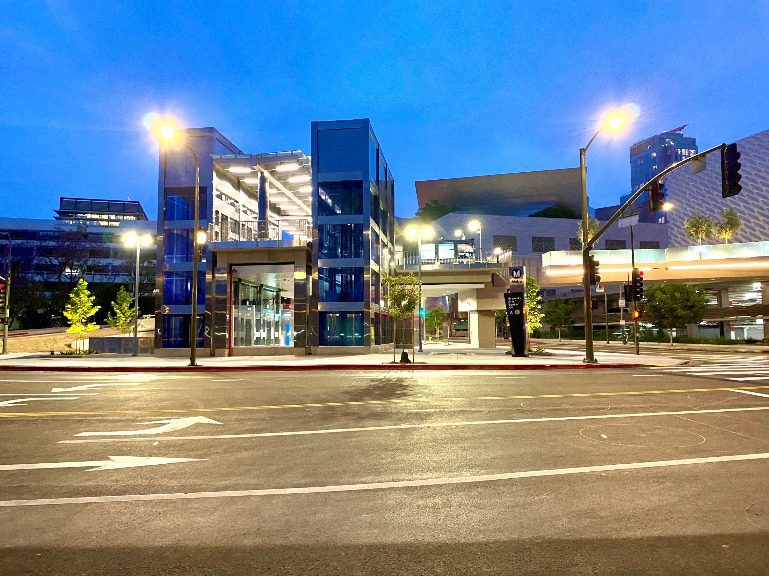
Los Angeles County
Metropolitan Transportation Authority
METRO CONSTRUCTION SAFETY
August 2023 FTA Quarterly Review
Data accumulated through June 2023
Metro construction projects have an average
Recordable Incident rate of 1.6
Compared to the National average of 2.4
Photo: Regional Connector
“Hope Station Opening Day”
* Crenshaw and Regional Connector projects have been deleted from this report as both lines are operational.

Slide 2
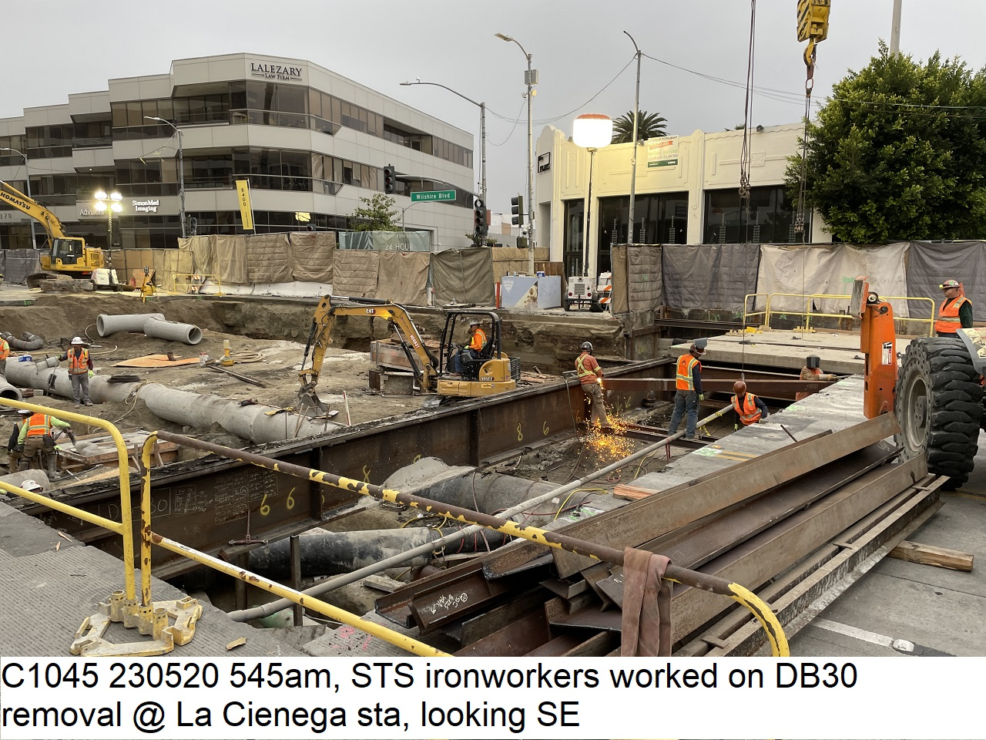

Westside Purple Line Extension Section 1 Project
Data and Statistics as of: June 30, 2023
Project to Date Total Work Hours: 8,755,485.79
Total Recordable Injuries: 41
Recordable Injury Rate per 200,000 Labor Hours: 0.94
BLS National Heavy Construction Incident Rate: 2.4
Total Days Away Cases: 3
DART Injury Rate: 0.07
National DART Rate: 1.5

Slide 3
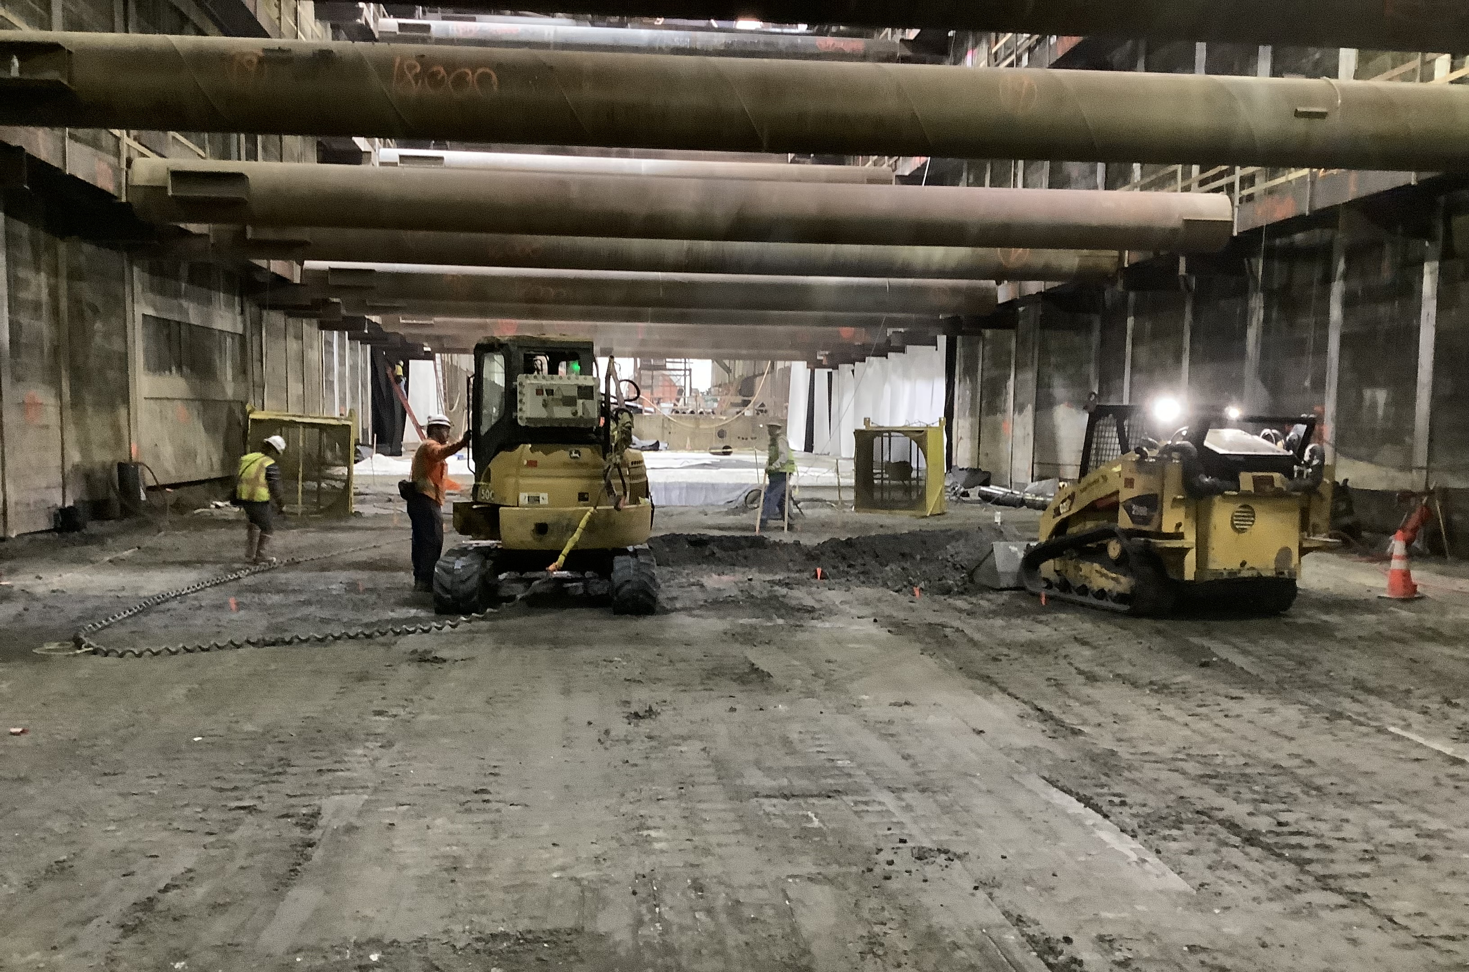
Westside Purple Line Extension Section 2 Project
Data and Statistics as of: June 30, 2023
Project to Date Total Work Hours: 3,390,250
Total Recordable Injuries: 51
Recordable Injury Rate per 200,000 Labor Hours: 3.01
BLS National Heavy Construction Incident Rate: 2.4
Total Days Away Cases: 11
DART Injury Rate: 0.65
National DART Rate: 1.5

Slide 4
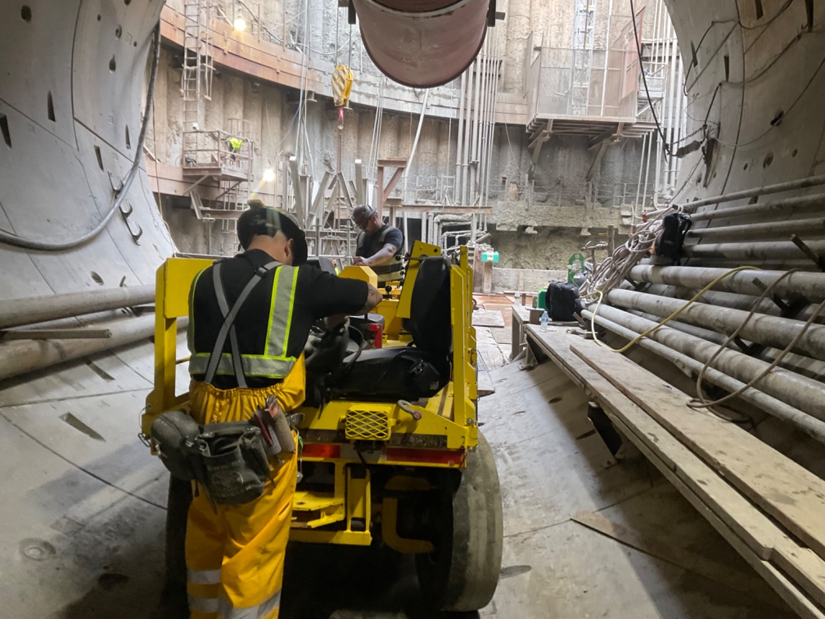
Westside Purple Line Extension Section 3 Project
Data and Statistics as of: June 30, 2023
Project to Date Total Work Hours: 2,729,633
Total Recordable Injuries: 20
Recordable Injury Rate per 200,000 Labor Hours: 1.47
BLS National Heavy Construction Incident Rate: 2.4
Total Days Away Cases: 5
DART Injury Rate: 0.37
National DART Rate: 1.5

