Slide 1
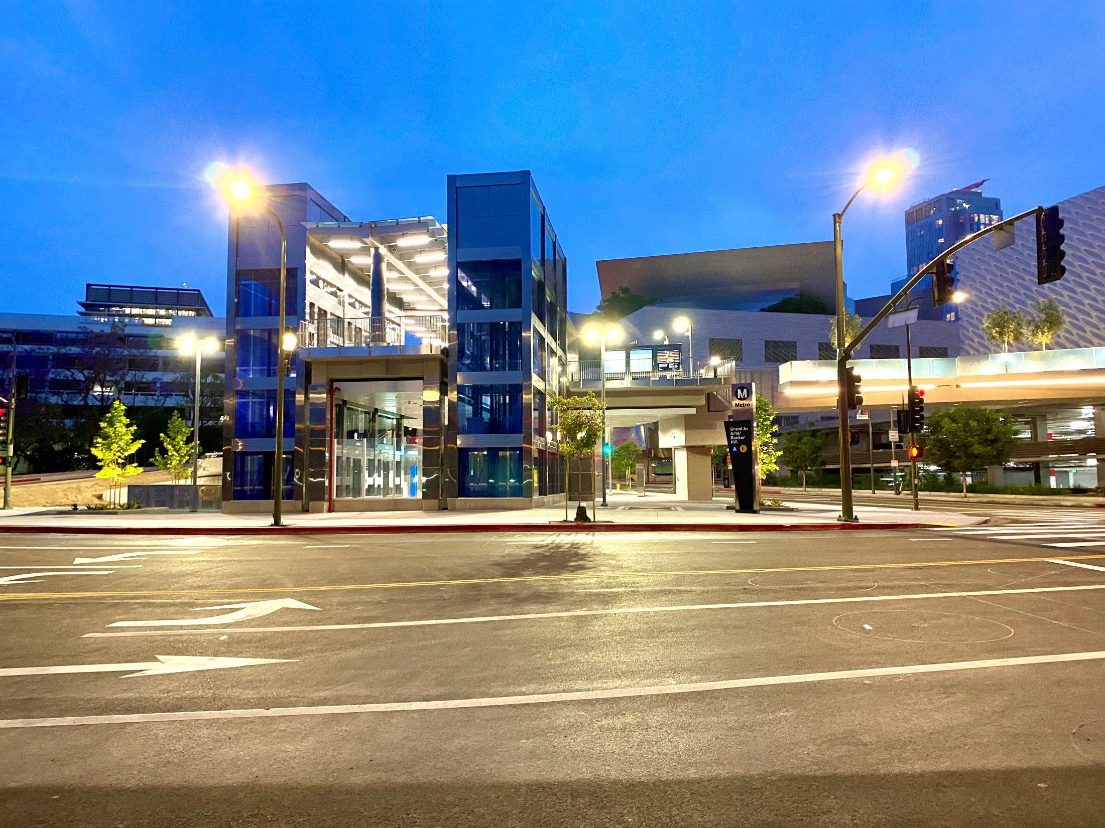
Los Angeles County
Metropolitan Transportation Authority
METRO CONSTRUCTION SAFETY
October 2023 FTA Quarterly Review
Data accumulated through August 2023
Metro construction projects have an average
Recordable Incident rate of 1.5
Compared to the National average of 2.4
Photo: Regional Connector
“Hope Station Opening Day”

Slide 2
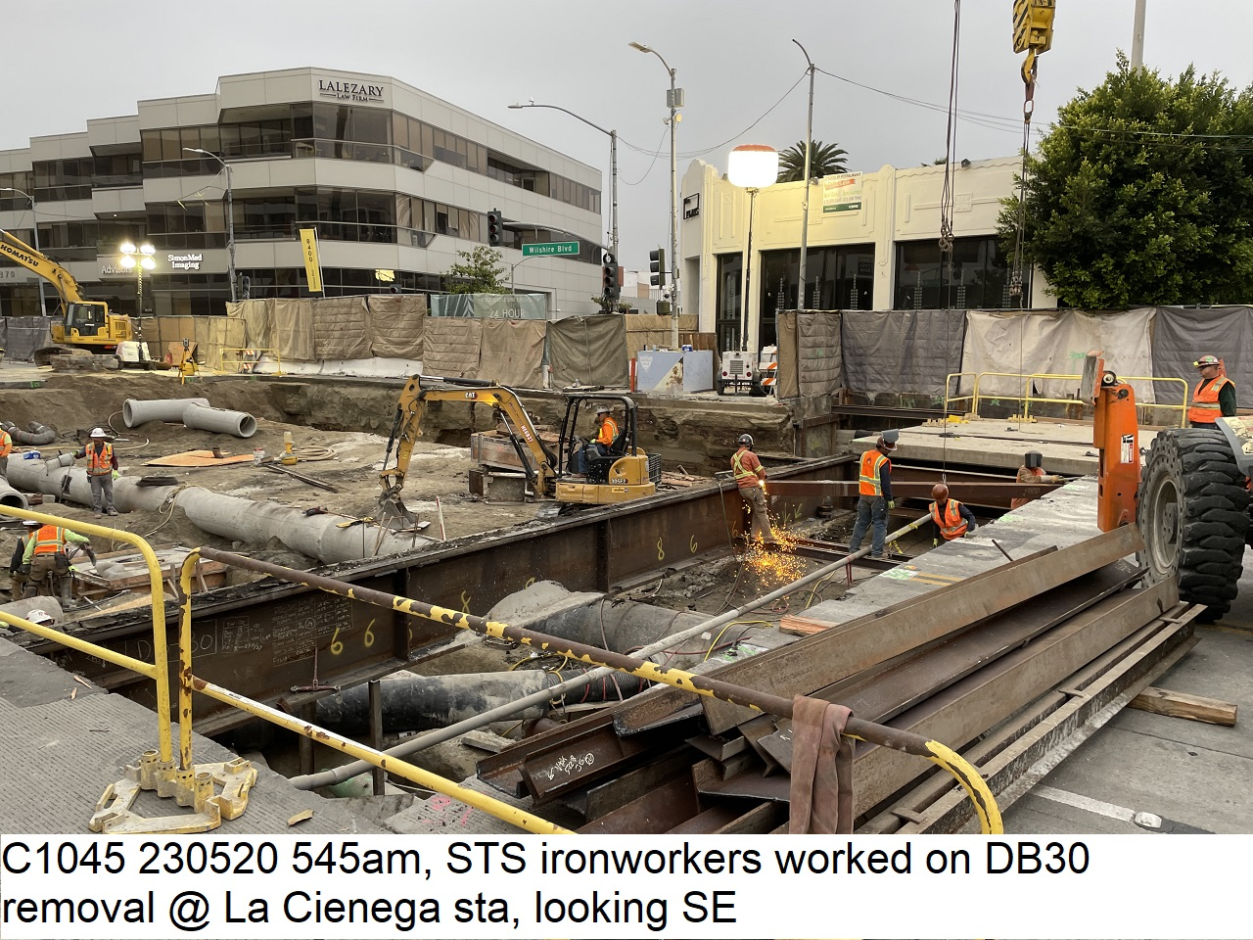

Westside Purple Line Extension Section 1 Project
Data and Statistics as of: August 31, 2023
Project to Date Total Work Hours: 9,005,501
Total Recordable Injuries: 42
Recordable Injury Rate per 200,000 Labor Hours: 0.92
BLS National Heavy Construction Incident Rate: 2.4
Total Days Away Cases: 3
DART Injury Rate: 0.09
National DART Rate: 1.5

Slide 3
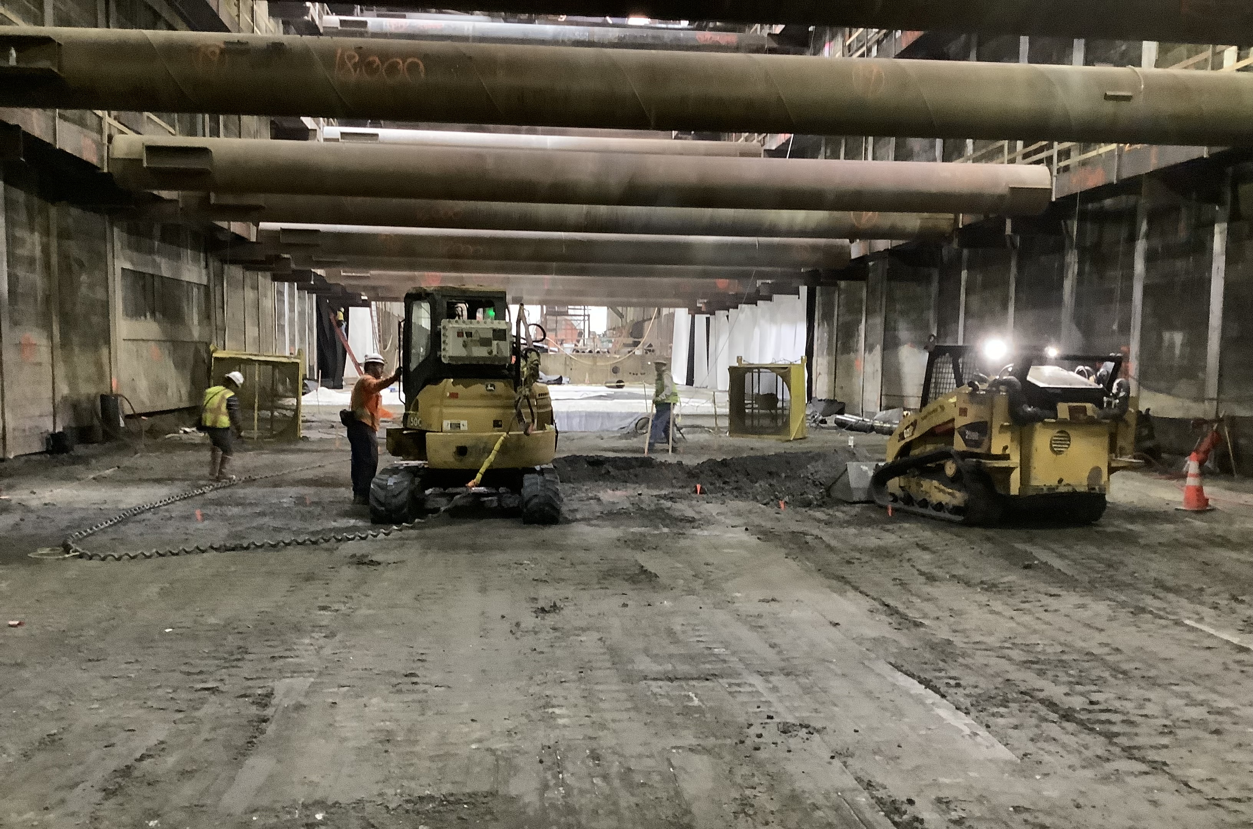
Westside Purple Line Extension Section 2 Project
Data and Statistics as of: August 31, 2023
Project to Date Total Work Hours: 3,546,623
Total Recordable Injuries: 53
Recordable Injury Rate per 200,000 Labor Hours: 2.99
BLS National Heavy Construction Incident Rate: 2.4
Total Days Away Cases: 11
DART Injury Rate: 0.62
National DART Rate: 1.5

Slide 4
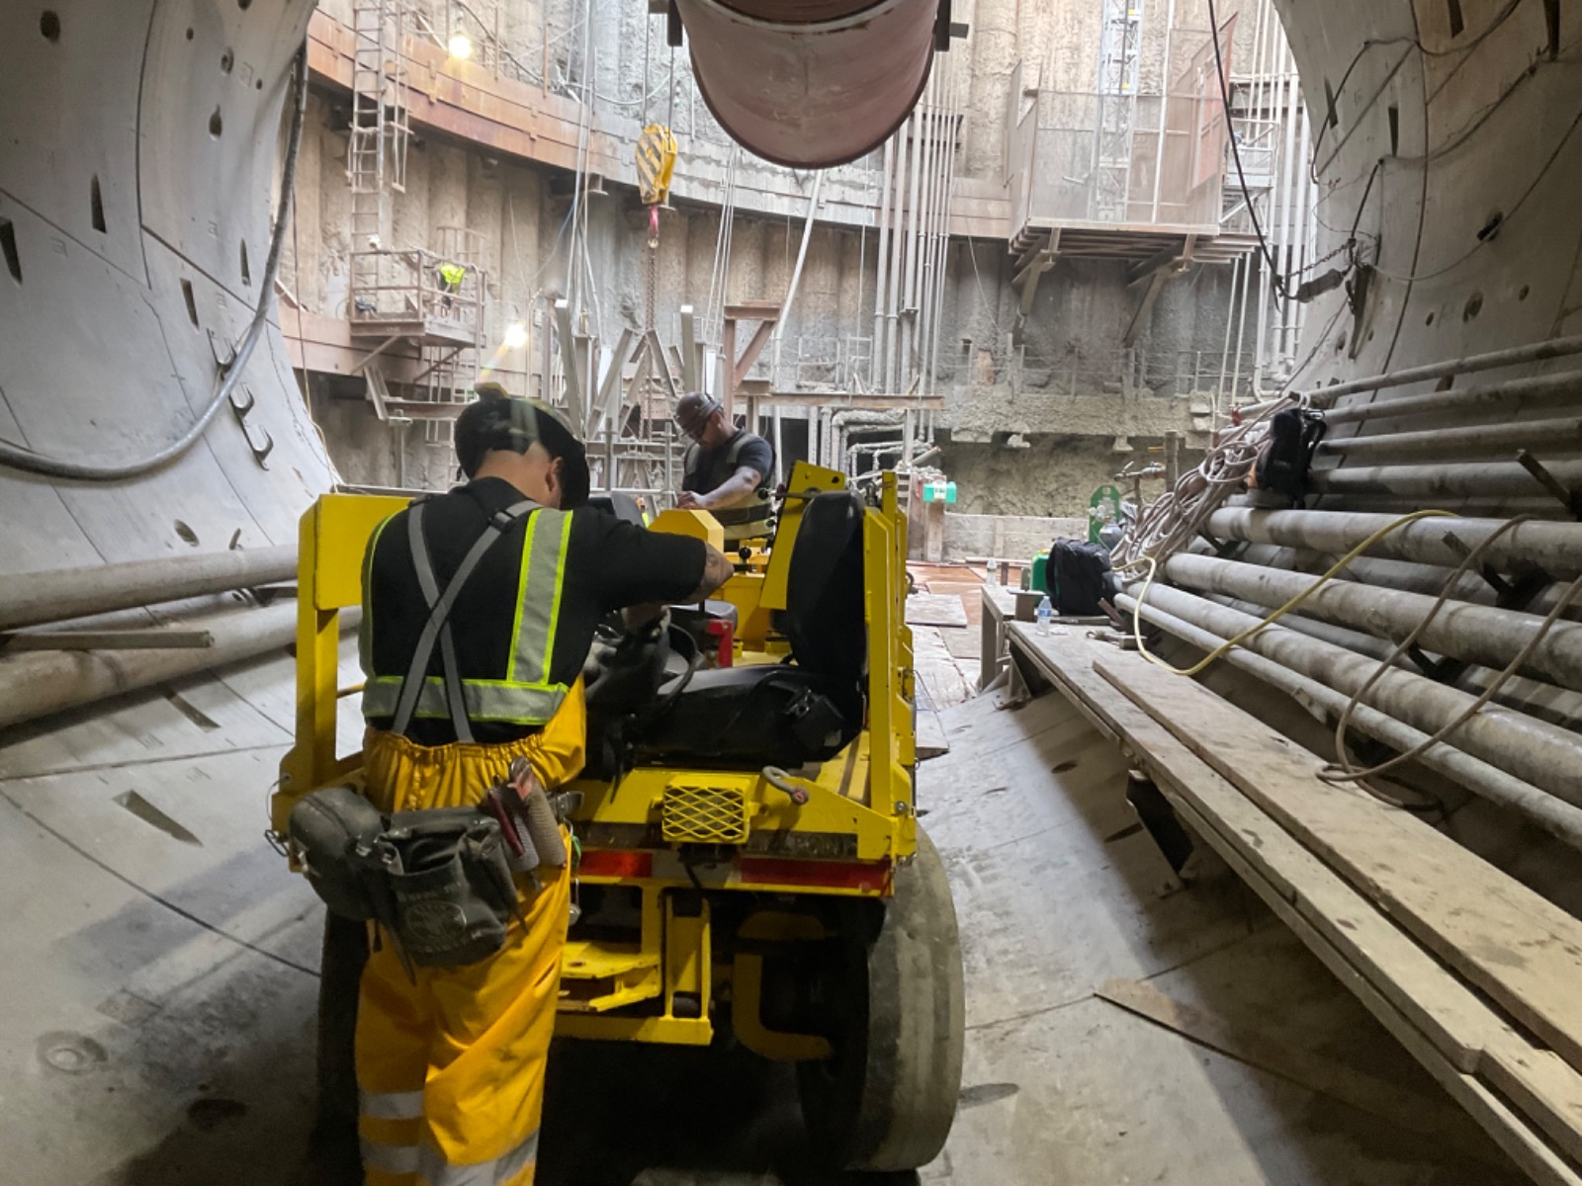
Westside Purple Line Extension Section 3 Project
Data and Statistics as of: August 31, 2023
Project to Date Total Work Hours: 2,827,845
Total Recordable Injuries: 20
Recordable Injury Rate per 200,000 Labor Hours: 1.63
BLS National Heavy Construction Incident Rate: 2.4
Total Days Away Cases: 5
DART Injury Rate: 0.35
National DART Rate: 1.5

