Slide 1
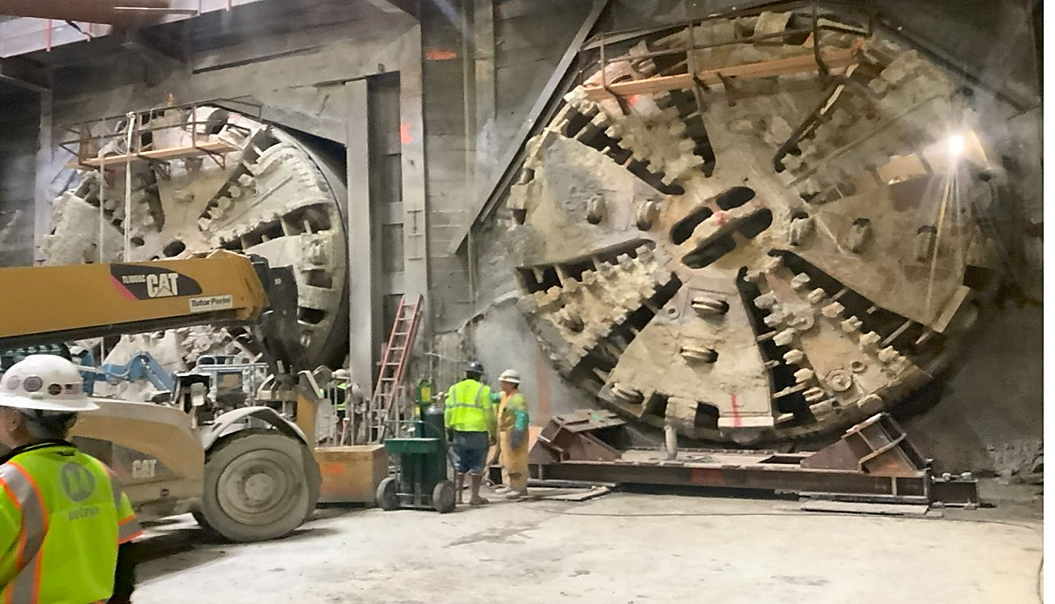

Los Angeles County
Metropolitan Transportation Authority
METRO CONSTRUCTION SAFETY
December 2023 FTA Quarterly Review
Data accumulated through October 2023
Metro construction projects have an average
Recordable Incident rate of 1.7
Compared to the National average of 2.4

Slide 2
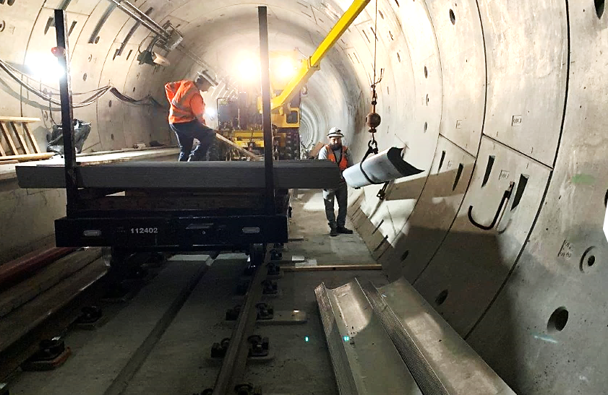

Westside Purple Line Extension Section 1 Project
Data and Statistics as of: October 31, 2023
Project to Date Total Work Hours: 9,262,172
Total Recordable Injuries: 41
Recordable Injury Rate per 200,000 Labor Hours: 0.88
BLS National Heavy Construction Incident Rate: 2.4
Total Days Away Cases: 4
DART Injury Rate: 0.09
National DART Rate: 1.5

Slide 3
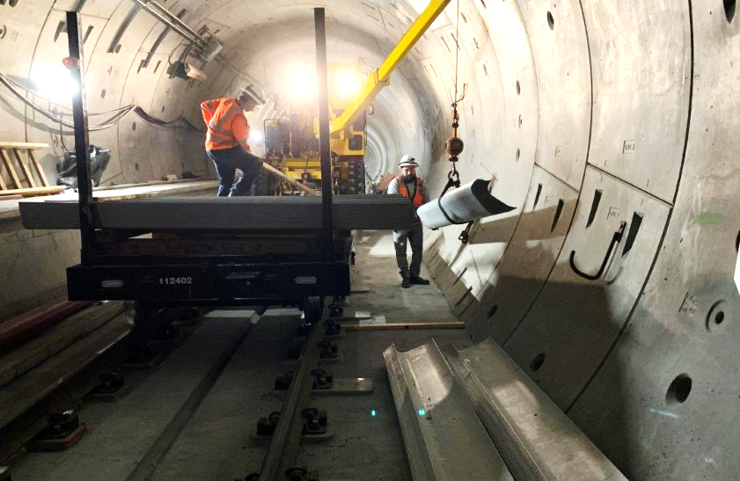
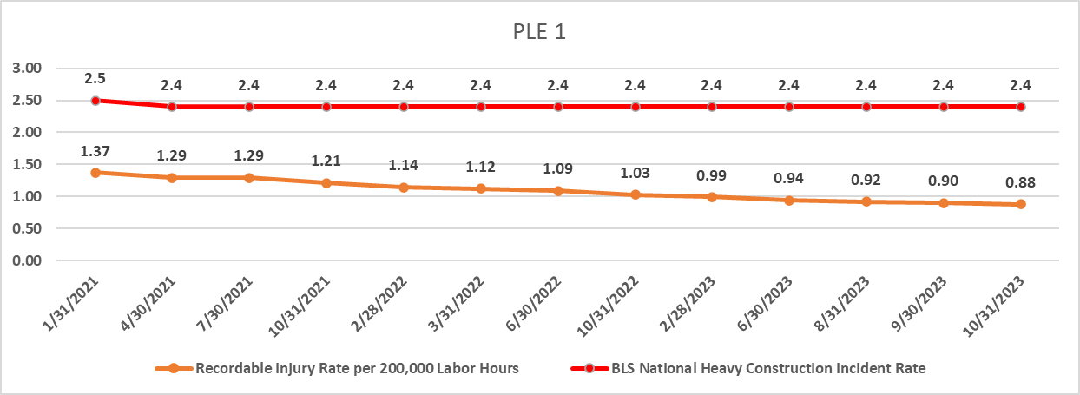
Westside Purple Line Extension Section 1 Project

Slide 4
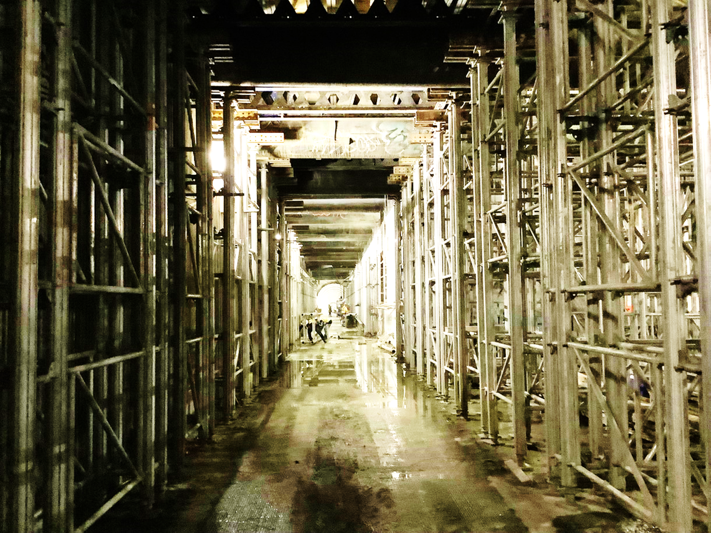
Westside Purple Line Extension Section 2 Project
Data and Statistics as of: October 31, 2023
Project to Date Total Work Hours: 3,685,978
Total Recordable Injuries: 53
Recordable Injury Rate per 200,000 Labor Hours: 2.88
BLS National Heavy Construction Incident Rate: 2.4
Total Days Away Cases: 11
DART Injury Rate: 0.60
National DART Rate: 1.5

Slide 5
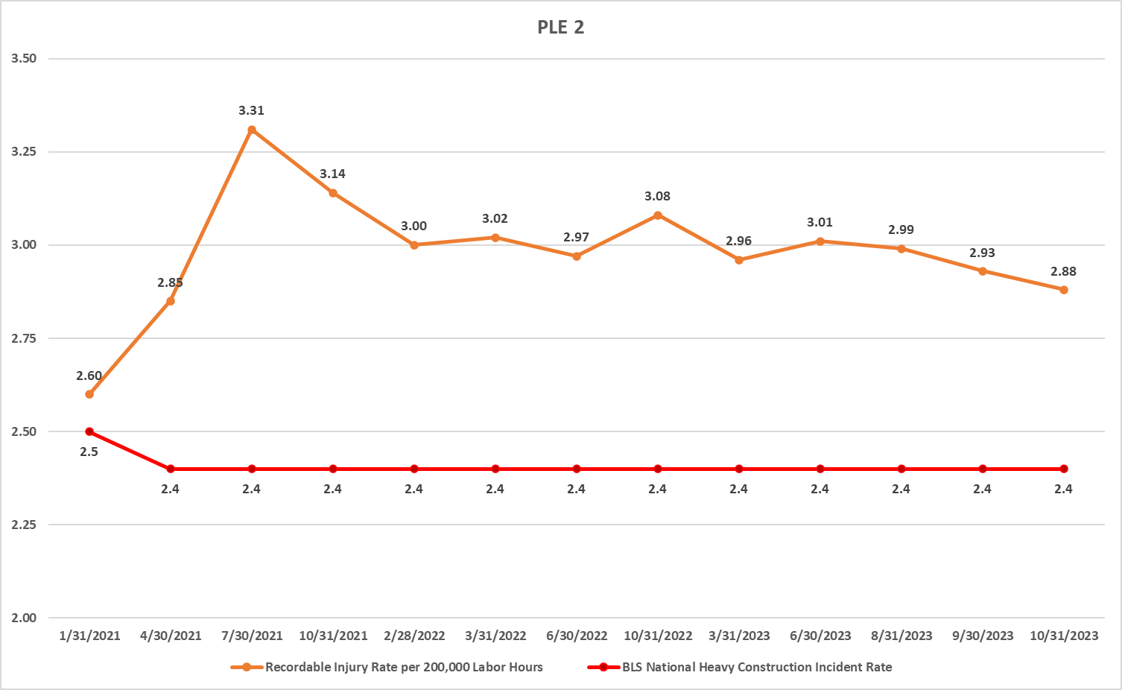
Westside Purple Line Extension Section 2 Project

Slide 6
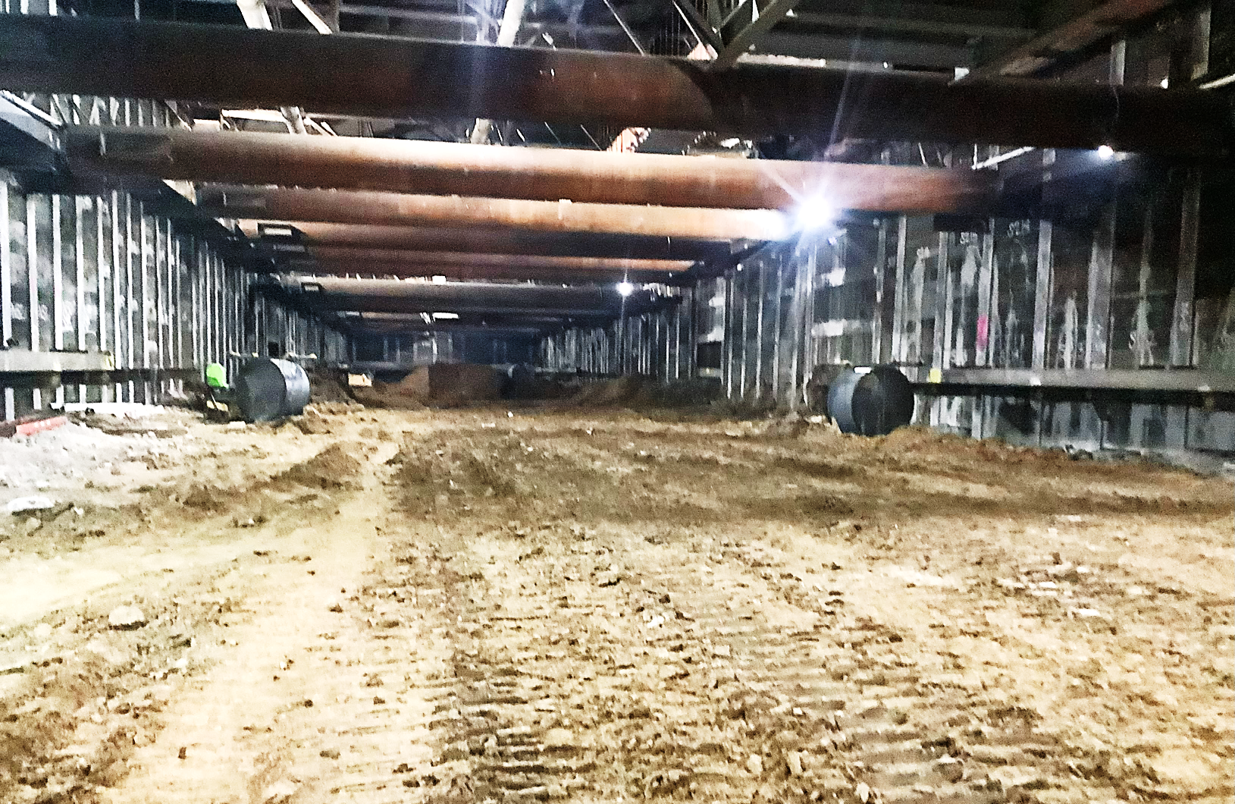
Westside Purple Line Extension Section 3 Project
Data and Statistics as of: October 31, 2023
Project to Date Total Work Hours: 2,927,611
Total Recordable Injuries: 20
Recordable Injury Rate per 200,000 Labor Hours: 1.37
BLS National Heavy Construction Incident Rate: 2.4
Total Days Away Cases: 5
DART Injury Rate: 0.34
National DART Rate: 1.5

Slide 7
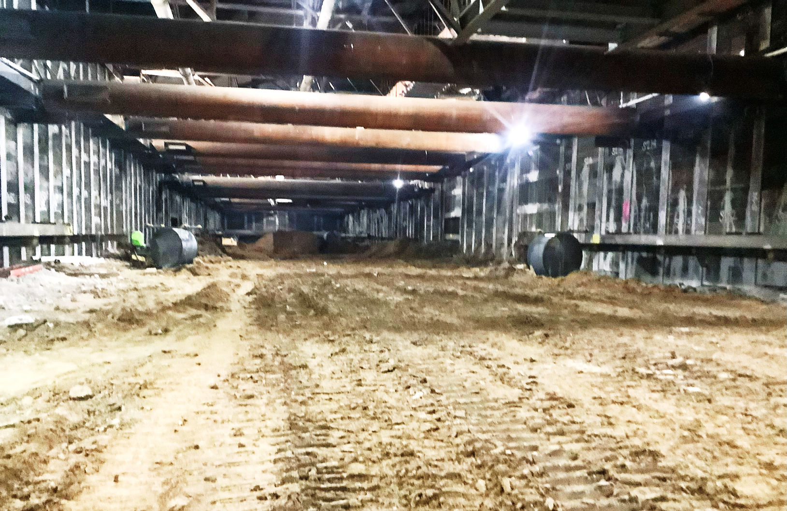
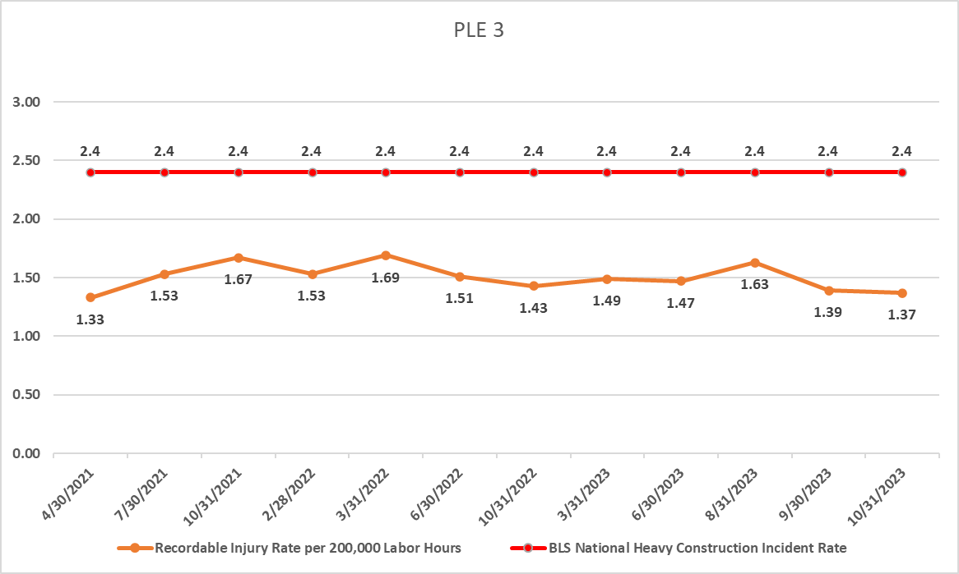
Westside Purple Line Extension Section 3 Project

Slide 8
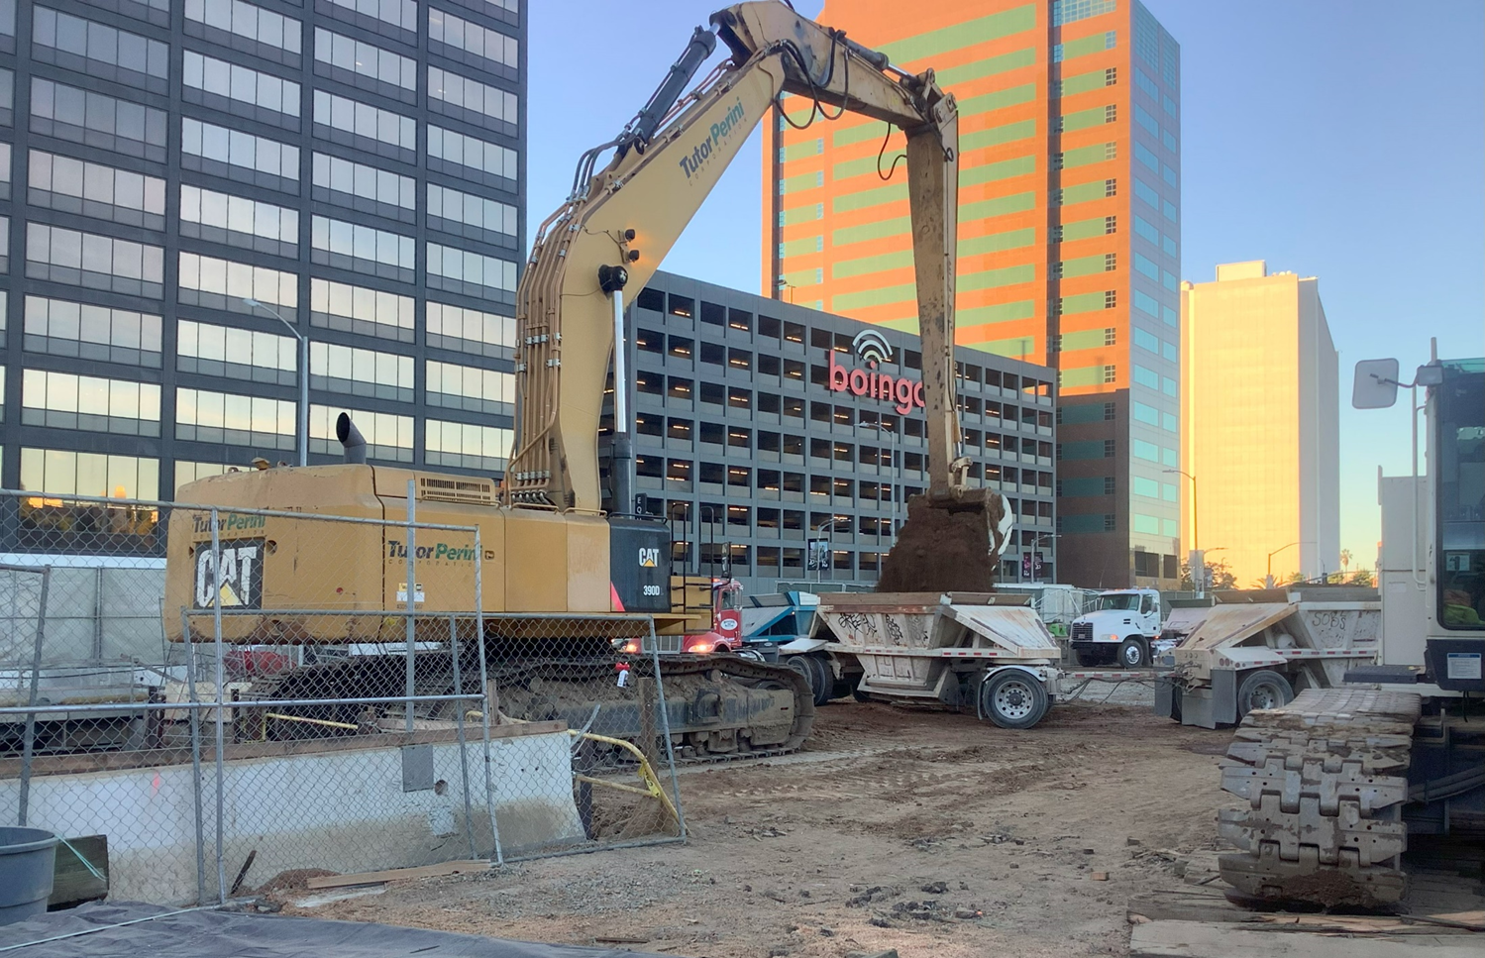
Westside Purple Line Extension Section 3 Project
C1152 Stations Contract
Data and Statistics as of: October 31, 2023
Project to Date Total Work Hours: 1,359,127
Total Recordable Injuries: 0
Recordable Injury Rate per 200,000 Labor Hours: 0
BLS National Heavy Construction Incident Rate: 2.4
Total Days Away Cases: 0
DART Injury Rate: 0
National DART Rate: 1.5

Slide 9
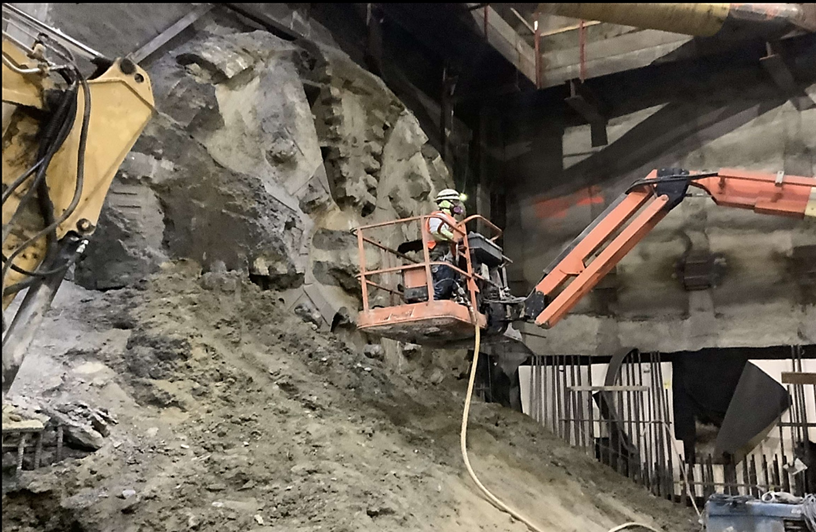
Westside Purple Line Extension Section 3 Project
C1151 Tunnels Contract
Data and Statistics as of: October 31, 2023
Project to Date Total Work Hours: 1,568,484
Total Recordable Injuries: 20
Recordable Injury Rate per 200,000 Labor Hours: 2.55
BLS National Heavy Construction Incident Rate: 2.4
Total Days Away Cases: 5
DART Injury Rate: 0.64
National DART Rate: 1.5

Slide 10
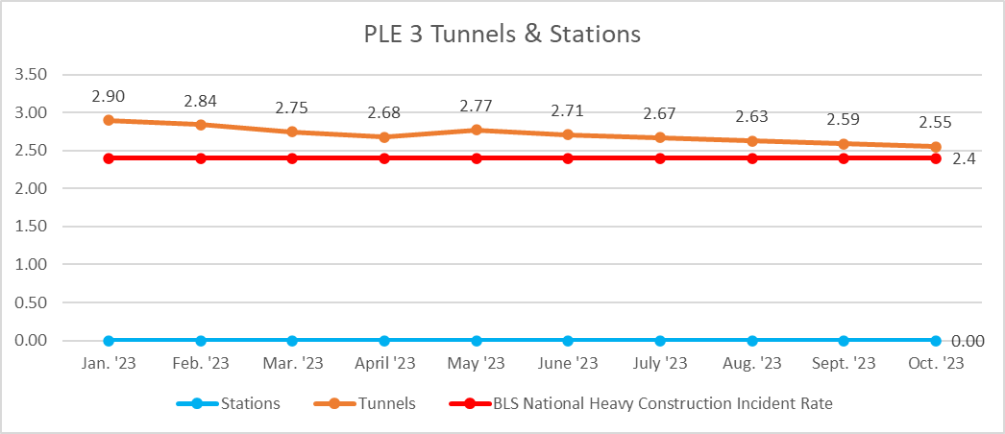
Westside Purple Line Extension Section 3 Project

