Slide 1
LONE HILL TO WHITE DOUBLE TRACK STUDY
Community Open Houses May 16 & 17
Notes:
METRO – Danielle
Write Draft on the slides

Slide 2

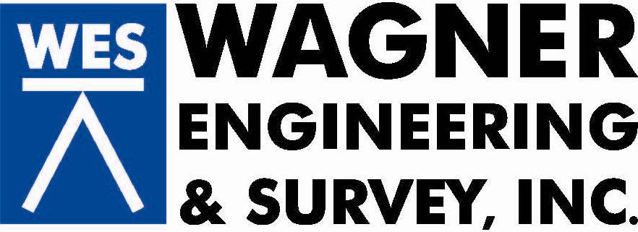
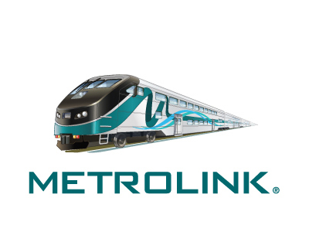


PROJECT TEAM & COLLABORATORS
Notes:
Danielle introduces Jay to introduce the team and partner agencies
Welcome and introduction of team members and partners
METRO, METROLINK, CITIES, ULV,

Slide 3
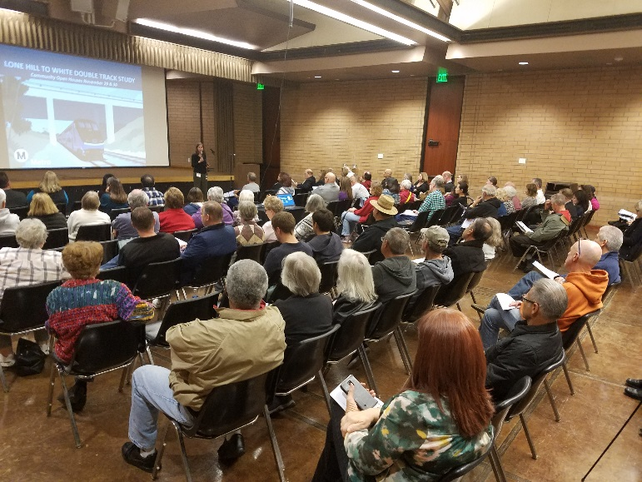
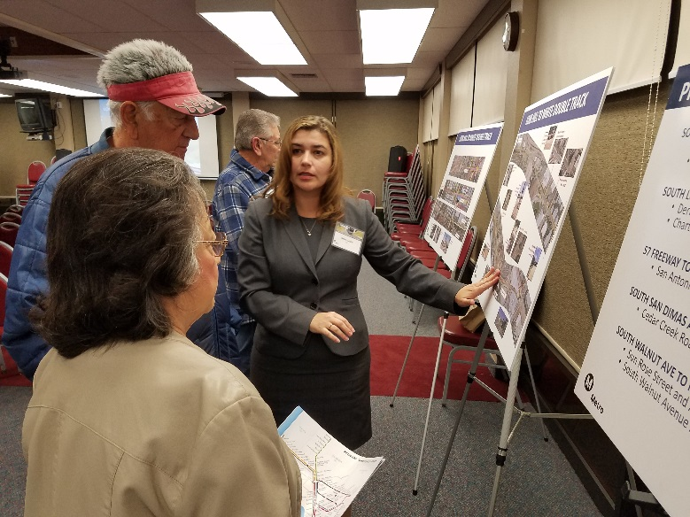
OPEN HOUSE SERIES
Tuesday, May 16, 2017
6-8:00 pm
La Verne City Council Chambers
3660 D Street
La Verne, CA 91750
Wednesday, May 17, 2017
6-8:00 pm
San Dimas
Plummer Community Building
245 E. Bonita Avenue
San Dimas, CA 91773
Notes:
Introductions by Danielle Valentino, Community Relations:
Metro is hosting a series of meetings for the LHW project….

Slide 4
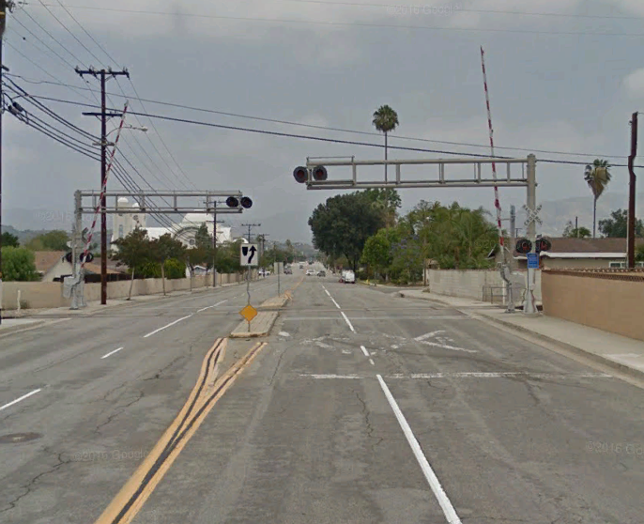
AGENDA
  Open House (6 pm - 6:30 pm)
  Presentation (6:30 pm - 7 pm)
    Public Outreach
    Study Location, Goals, Objectives
    Study Features
    Environmental Evaluation Study
      Noise & Vibration Assessments
    Schedule
    Next Steps
  Q&A/Open House (7 pm - 8 pm)
Notes:
Danielle
Please convey that specific questions about noise measurements & other specific topics related to their homes will be addressed at the board stations.

Slide 5
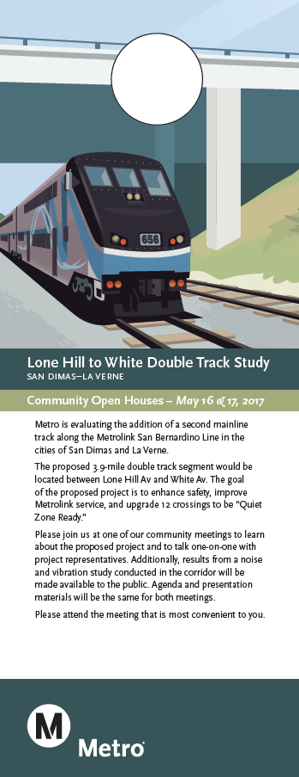
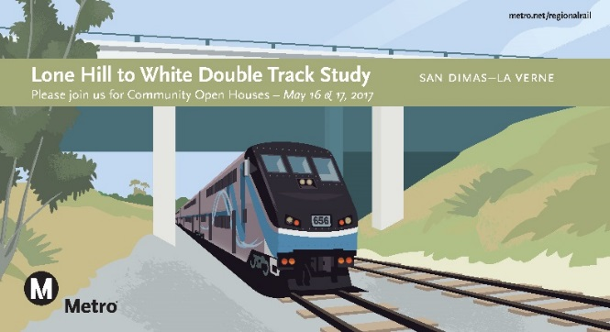
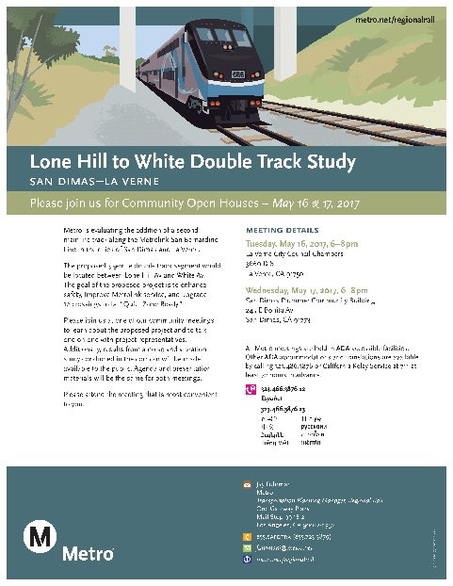
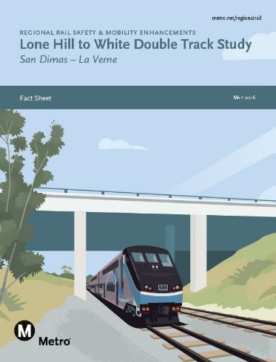

COMMUNITY OUTREACH APPROACH
Ensure the process is transparent - Community is aware and informed about the project
Communicate often, early and strategically - Inform and engage all level of stakeholders
Communication Tools - Fact Sheet, FAQ, Newsletter, Website, Helpline, Email, Social Media
855.SAFE.TRX 855.723.3879
Notes:
Danielle
Outreach at Covina and Pomona North Metrolink Stations
Newspaper ads – San Dimas and La Verne Community News
Direct mail - Parcel and occupant lists, agency list, project database
Door hangers
E-Mail
Social Media - Facebook
NextDoor.com
Helpline
Seat Drops (Metrolink train)
Extended outreach - Chambers, libraries, community centers, schools, local, state & federal offices and associations

Slide 6
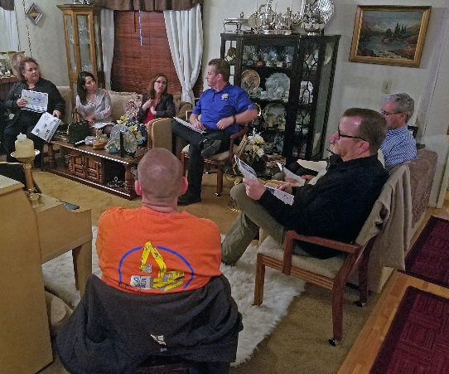
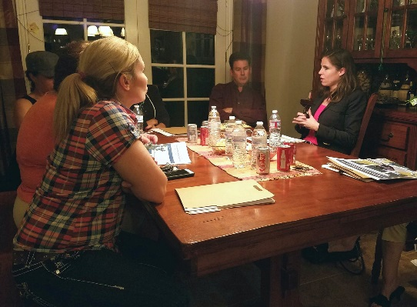
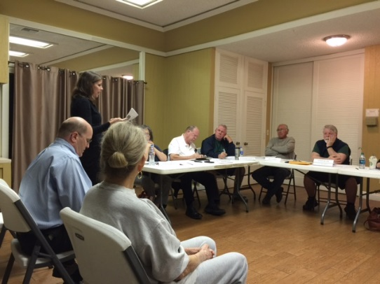
COMMUNITY OUTREACH
Public Meetings:
San Dimas - November 29, 2016
La Verne – November 30, 2016
Briefings:
University of La Verne – August 29 & November 16
La Cuesta Encantada HOA – March 13
Park La Verne HOA – March 14
Canyon Creek Village HOA – March 22
Puddingstone Village HOA – March 22
The Gables at San Dimas HOA – March 23
Montecito Village HOA – April 6
Puddingstone Tiburon HOA – April 13
Legislative, City and Agency Briefings
Pomona Fairplex – May 15
Notes:
Danielle:
Additional Outreach included:
Monthly Project Development Team Meetings
City Executive Staff Briefings
San Dimas and La Verne
Elected Official and Government Agency Briefings
Key Stakeholder and Community Organizations
HOA communities
Public Meetings (November 2016)
Follow up briefings as needed

Slide 7
“WHAT WE HEARD”
Noise & Vibration - Community concerned about noise and vibration impacts.
Noise & Vibration Study - How will community be involved in the noise and vibration study and what is involved in the study? What was involved in the site selection process?
Support & Opposition - Supportive of double tracking, or making the corridor “Quiet Zone Ready.” In support if Quiet Zone implemented.
Quiet Zone: What is involved in making project Quiet Zone Ready and what are the costs associated with it? Who will be responsible for maintenance? Funding?
Safety– How will you make the crossings safe?
Schedule – When will construction begin?
Length of Double-Track – Why doesn’t the double track stretch to Union Station?
Notes:
Danielle speaks to what we heard; then introduces Jay

Slide 8
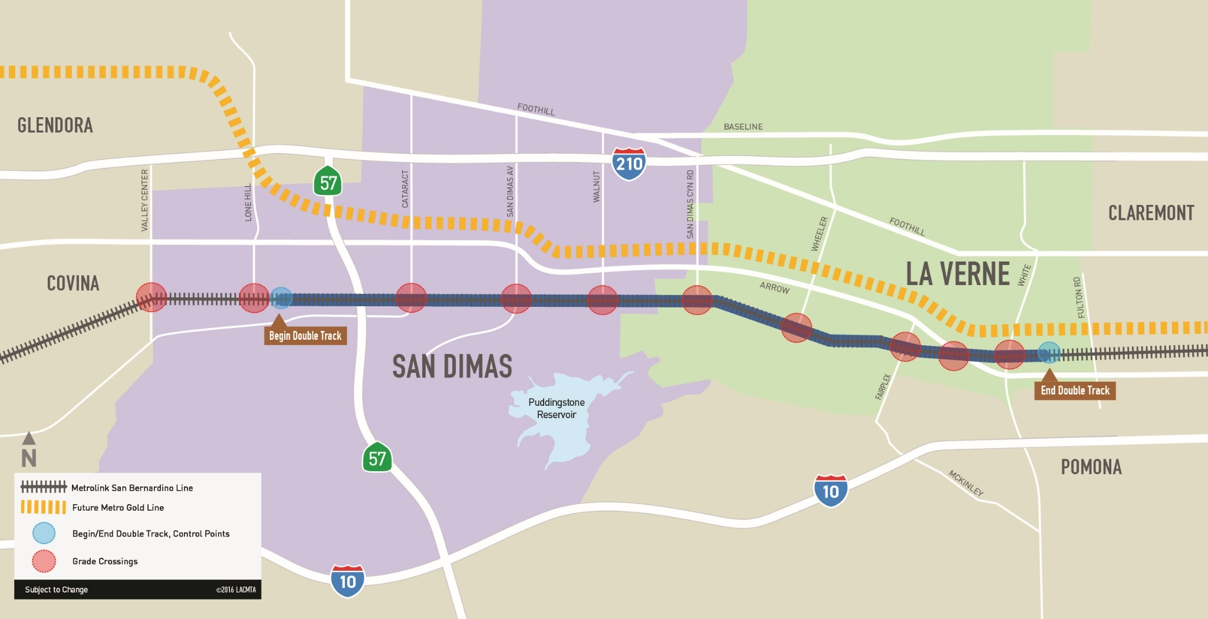
PROJECT LOCATION
Double-tracking of 3.9 miles of railroad track between Lone Hill Avenue in San Dimas and White Avenue in La Verne.
Foothill Gold Line Extension
Lone Hill to White Project
Notes:
Jay
The proposed project involves the double-tracking of approximately 3.9 miles of railroad track between Lone Hill Avenue in San Dimas and White Avenue in La Verne.
(New Board)

Slide 9
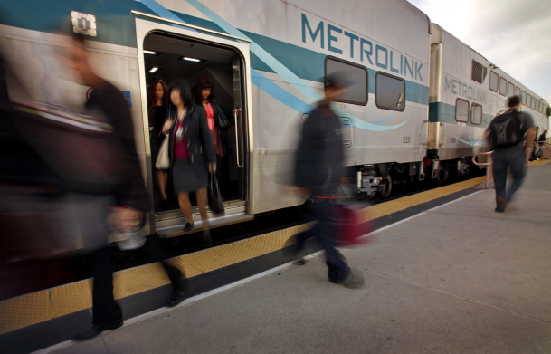
BACKGROUND
The San Bernardino Line (SBL) is the busiest in the Metrolink system, averaging 10,000 boardings per weekday.
38 Metrolink revenue trains and up to 4 Union Pacific Railroad (UPRR) trains travel through the corridor every weekday.
The Metro-owned corridor on the Metrolink San Bernardino Line is 70% single track.
Metro, in coordination with Metrolink, initiated the Lone Hill to White Double Track Project (LHW) Study in Summer of 2016 between the cities of San Dimas and La Verne.
The study includes an environmental evaluation and up to 30% design.
Metro is collaborating with key corridor operators (Metrolink and Foothill Gold Line Construction Authority).
Notes:
Jay
Metro is collaborating closely with project partner Metrolink on deployment of Tier 4 locomotives – state-of-the-art clean burning locomotives – to start this Fall 2017.
Metro partnering with Foothill Gold Line Construction Authority on joint shared crossings in the cities of La Verne, Pomona and Claremont.
Metro collaborating with SBCTA (previously SANBAG) on DMU Study.

Slide 10

PROJECT GOALS & OBJECTIVES
IMPROVE SAFETY & ACCESSIBILITY FOR ALL
  Enhance safety through double track (beyond Positive Train Control)
  Reduce the risk of train accidents and prevent pedestrians, cars, trucks, and train collisions
  Lengthen the existing platform at Pomona Fairplex Station
IMPROVE METROLINK SERVICE FOR PASSENGERS
  Improve travel times
  Greater ability to add future service (subject to demand and funding)
  Reduce delays due to trains waiting for another train to pass
  Improve reliability and efficiency for Metrolink riders
IMPROVE QUALITY OF LIFE FOR COMMUNITIES
  Metro will design the 12 grade crossings to be “Quiet Zone Ready”
  Cities will choose to pursue Quiet Zone designation
Notes:
Jay

Slide 11
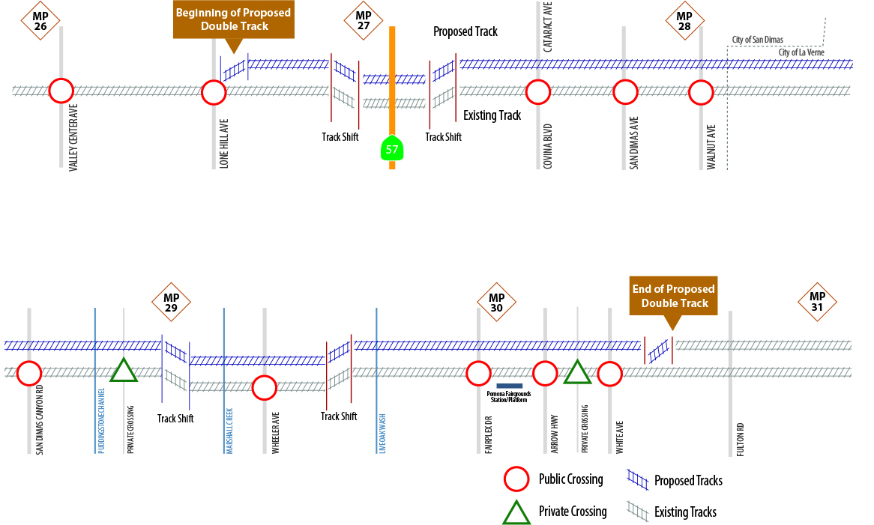
CURRENT AND PROPOSED CONDITION
San Dimas Crossings
La Verne Crossings
Notes:
(Ne Board)

Slide 12
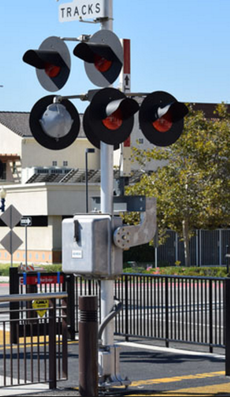
PROJECT DESIGN FEATURES
3.9 miles of second mainline track between Lone Hill Avenue and White Ave.
12 roadway at-grade crossings.
Design elements at each grade crossing to improve safety & to meet Quiet Zone standards.
Sidewalk and driveway modifications at grade crossings to enhance safety.
Connections to industry spur tracks.
Extend platform at the Pomona Fairgrounds station.
Notes:
Stephanie
(New Board)

Slide 13
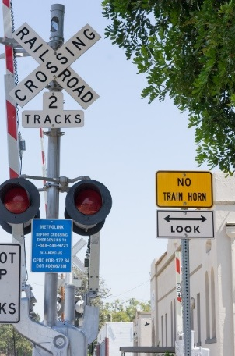
“QUIET ZONE READY” OPPORTUNITY
Metro will design grade crossings to be “Quiet Zone Ready.”
A Quiet Zone is a stretch of rail track where the Federal Railroad Administration (FRA) does not require trains to sound their horn at rail crossings.
Local cities apply for an application for Quiet Zones to the FRA and the California Public Utilities Commission near the end of the construction process.
It’s anticipated that local cities would be responsible for any ongoing annual costs associated with liability insurance and new infrastructure maintenance.
PROJECT PURPOSE AND NEED
Notes:
Stephanie
(New Board)

Slide 14
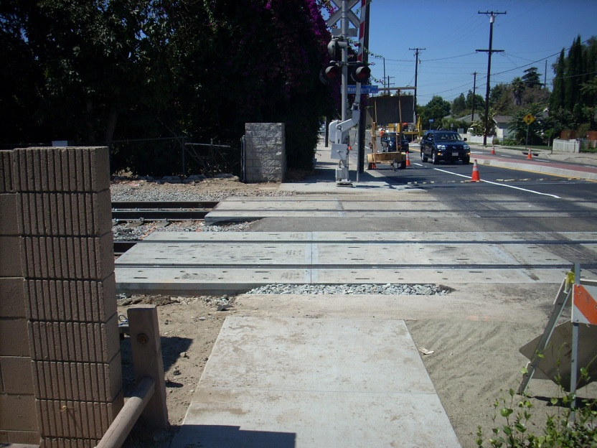
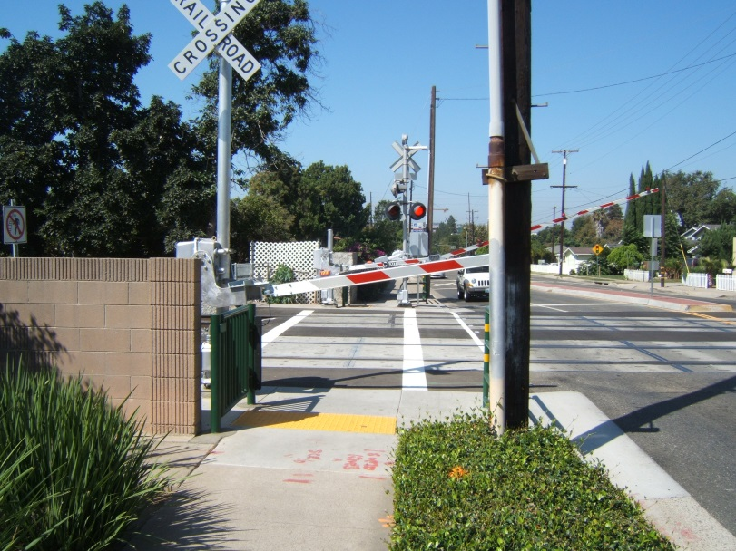
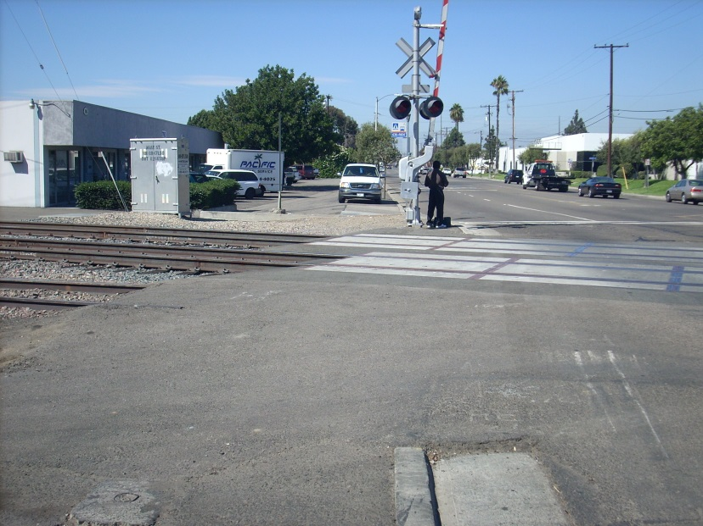
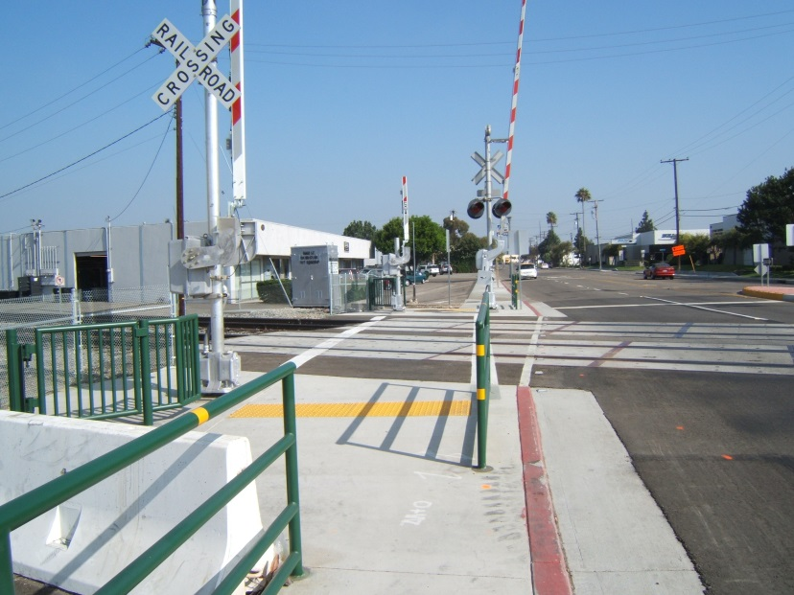
CURRENT VS QUIET ZONE READY ENHANCEMENTS
BEFORE
AFTER
Notes:
Stephanie

Slide 15
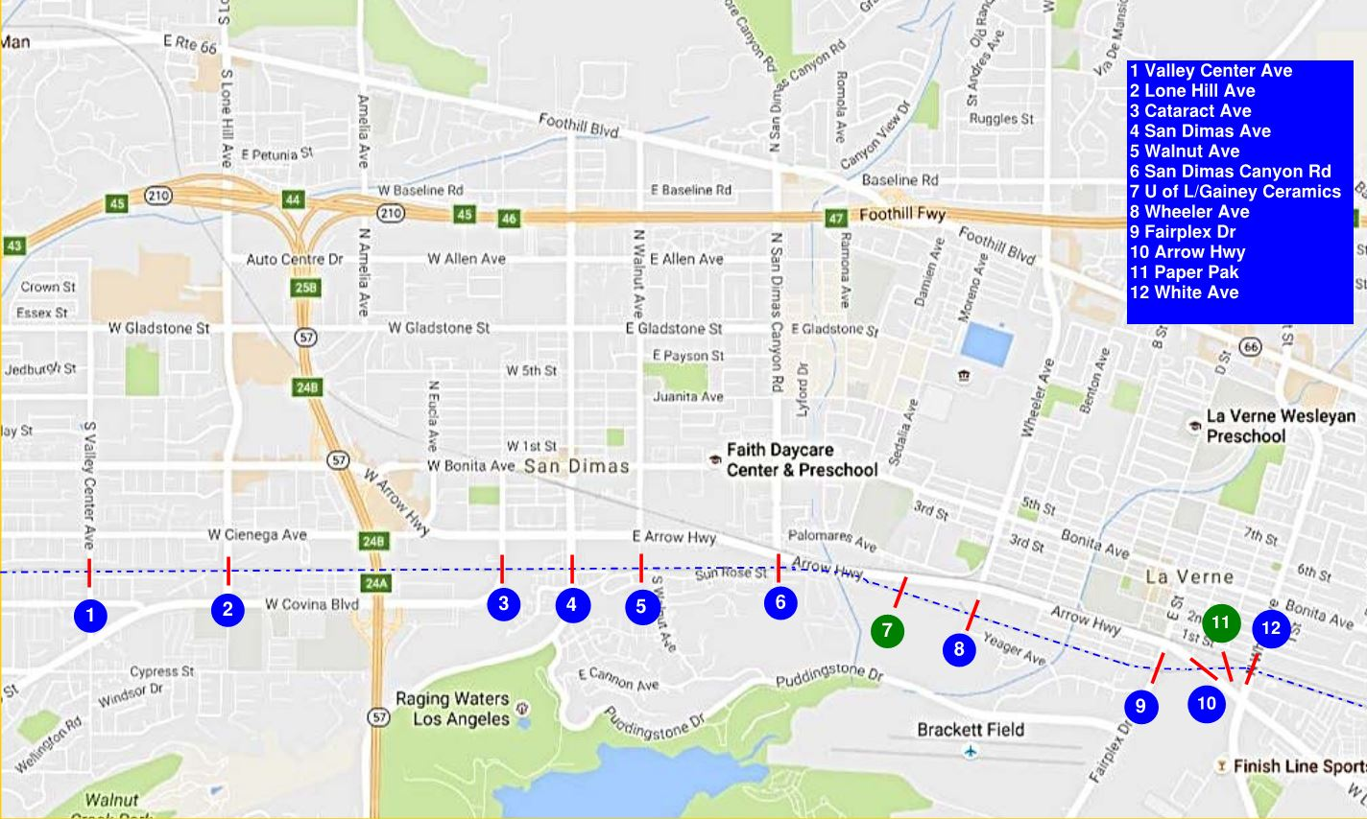
PEDESTRIAN SAFETY ENHANCEMENTS
Private crossings
Public street crossings
Notes:
Stephanie
Green dots = Private crossings
Blue dots = Public street crossings

Slide 16
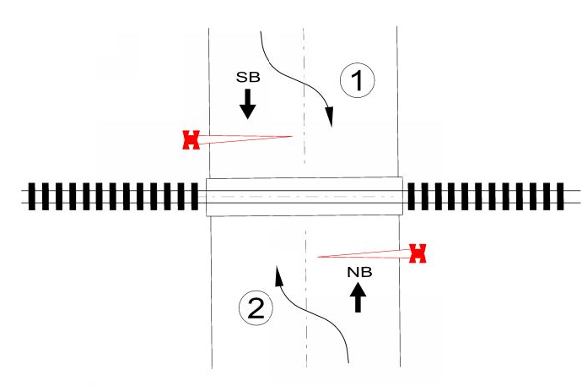
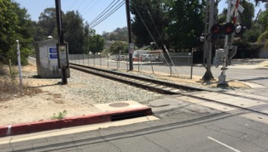
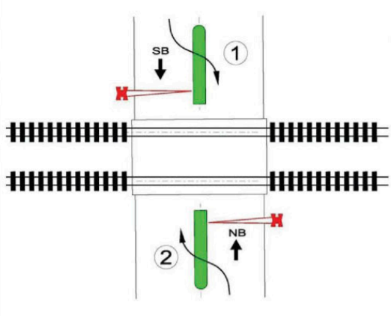
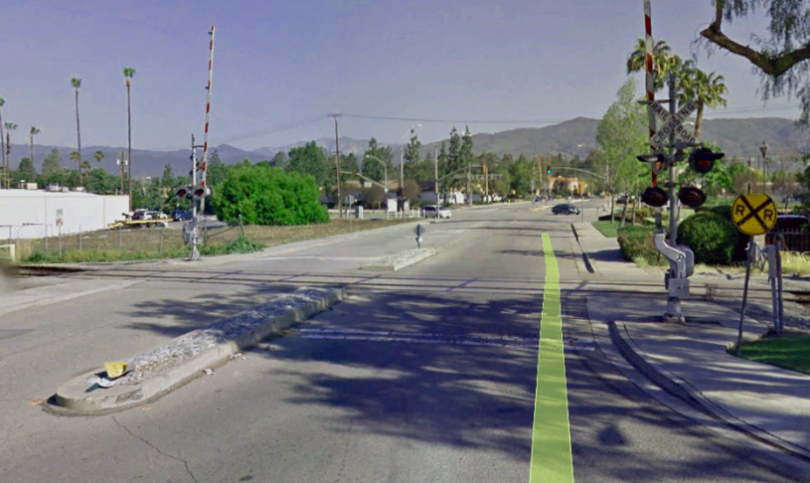
SAFETY ENHANCEMENT CONCEPTS
EXISTING CONDITION
NEW OR EXTENDED MEDIANS to deter vehicles from driving around lowered gates
Notes:
Stephanie
EXISTING CONDITIONS allow drivers to swerve around gates that have dropped into horizontal position to stop vehicles
NEW OR EXTENDED MEDIANS to deter vehicles from driving around lowered gates

Slide 17
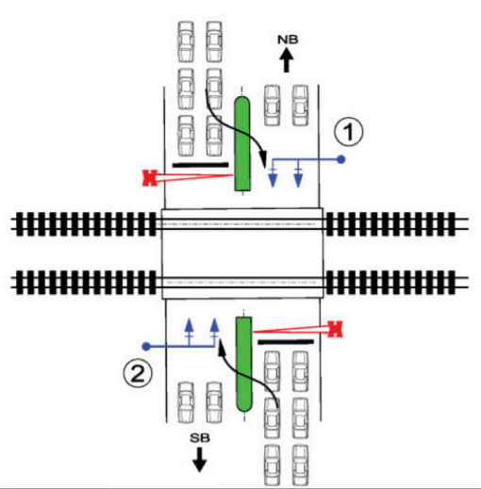
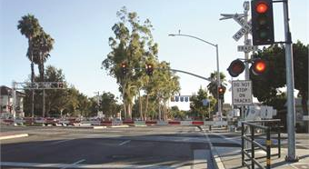
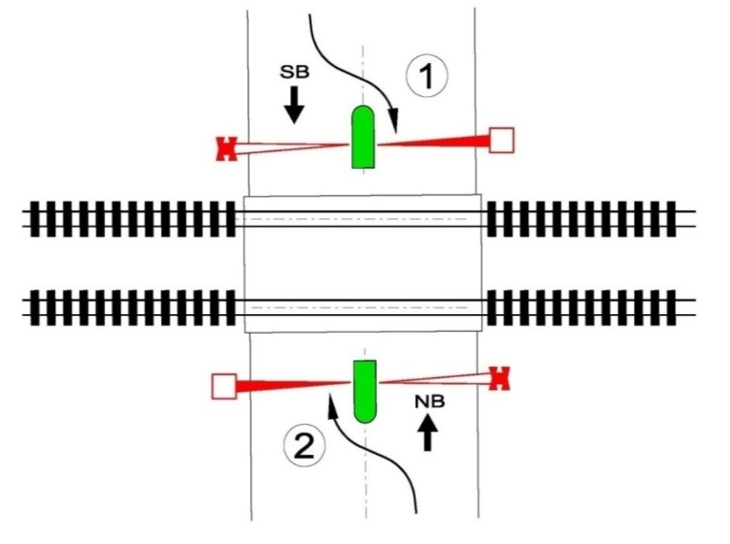
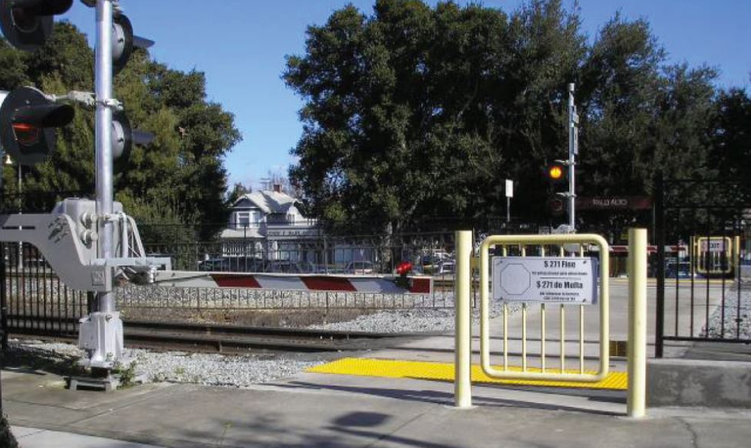
SAFETY ENHANCEMENT CONCEPTS (cont’d)
COORDINATED TRAFFIC SIGNALS to eliminate the danger of vehicles stalling on the tracks
QUAD GATES
ADDITIONAL CROSSING GATE ARMS to deter motorists from crossing the tracks when a train is passing and SWING GATES to deter pedestrians from trespassing and crossing the tracks
Notes:
Stephanie
COORDINATED TRAFFIC SIGNALS to eliminate the danger of vehicles stalling on the tracks
NEW WARNING DEVICES, including flashers and bells, and improved signs to warn drivers and pedestrians of upcoming train tracks
Stephanie introduces Debra

Slide 18
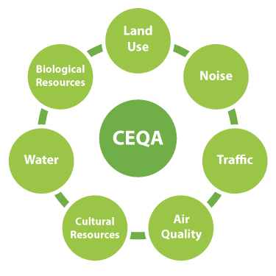
ENVIRONMENTAL EVALUATION
Provided information to the community
Evaluated the project in accordance with State and Federal laws:
  California Environmental Quality Act (CEQA)
  National Environmental Policy Act (NEPA)
Conducted appropriate technical and environmental analyses
Completed an environmental evaluation for 30% design
CEQA/NEPA
Notes:
Debra
Maybe mention the top three areas of the study that the community is most likely to be concerned about i.e. noise, community impacts, ROW
(New Board)

Slide 19
ENVIRONMENTAL EVALUATION
Conducted technical and environmental
analyses for the following key areas:
  Noise and vibration
  Air quality/greenhouse gas
  Traffic and transportation
  Biological and jurisdictional resources
  Historic architectural and archaeological resources
  Storm water and water quality
  Geotechnical
  Hazards and hazardous materials
  Utilities
  Paleontological Resources
Notes:
Debra
Maybe discuss the top three areas of the study that the community is most likely to be concerned about i.e. noise, community impacts, ROW

Slide 20
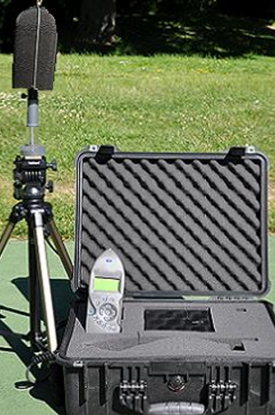
NOISE & VIBRATION ASSESSMENT
Noise Methodology
  Measured existing 24-hour noise levels of Metrolink and freight train passbys at selected locations along the right-of-way.
  Used Federal Transit Administration (FTA) criteria based on existing noise levels.
  Calculated future noise levels for the proposed project.
  Reviewed FTA criteria to assess potential noise impact.
Vibration Methodology
  Measured vibration transmission of Metrolink and freight train passbys.
  Calculated existing and future conditions.
  Compared change to FTA criteria.
Notes:
Steven and Debra
Noise Methodology
Vibration Methodology
(New Board)

Slide 21
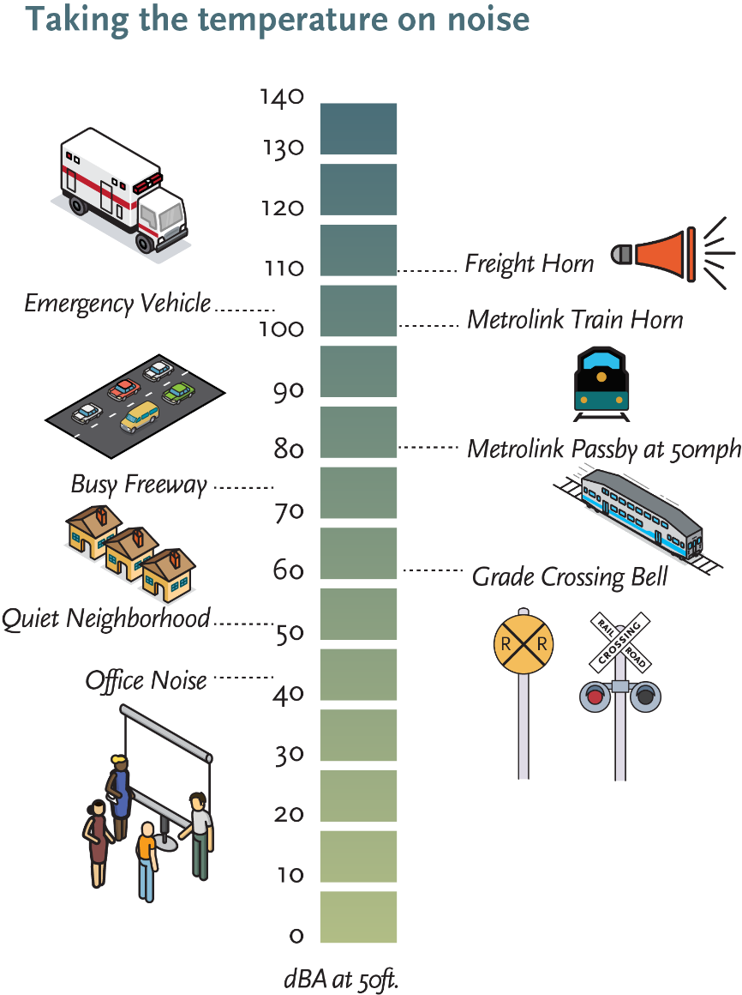
HOW DO WE MEASURE NOISE & VIBRATION?
Receivers are the locations that are sensitive to noise and vibration (i.e. residences).
Decibels are the measurement units of noise and vibration.
Measurements are conducted using monitors for noise and vibration.
Existing noise is the total noise level from all sources in a given area, either within a building or in an outside environment.
Notes:
Steven and Debra
New board placer with noise & vibration map

Slide 22
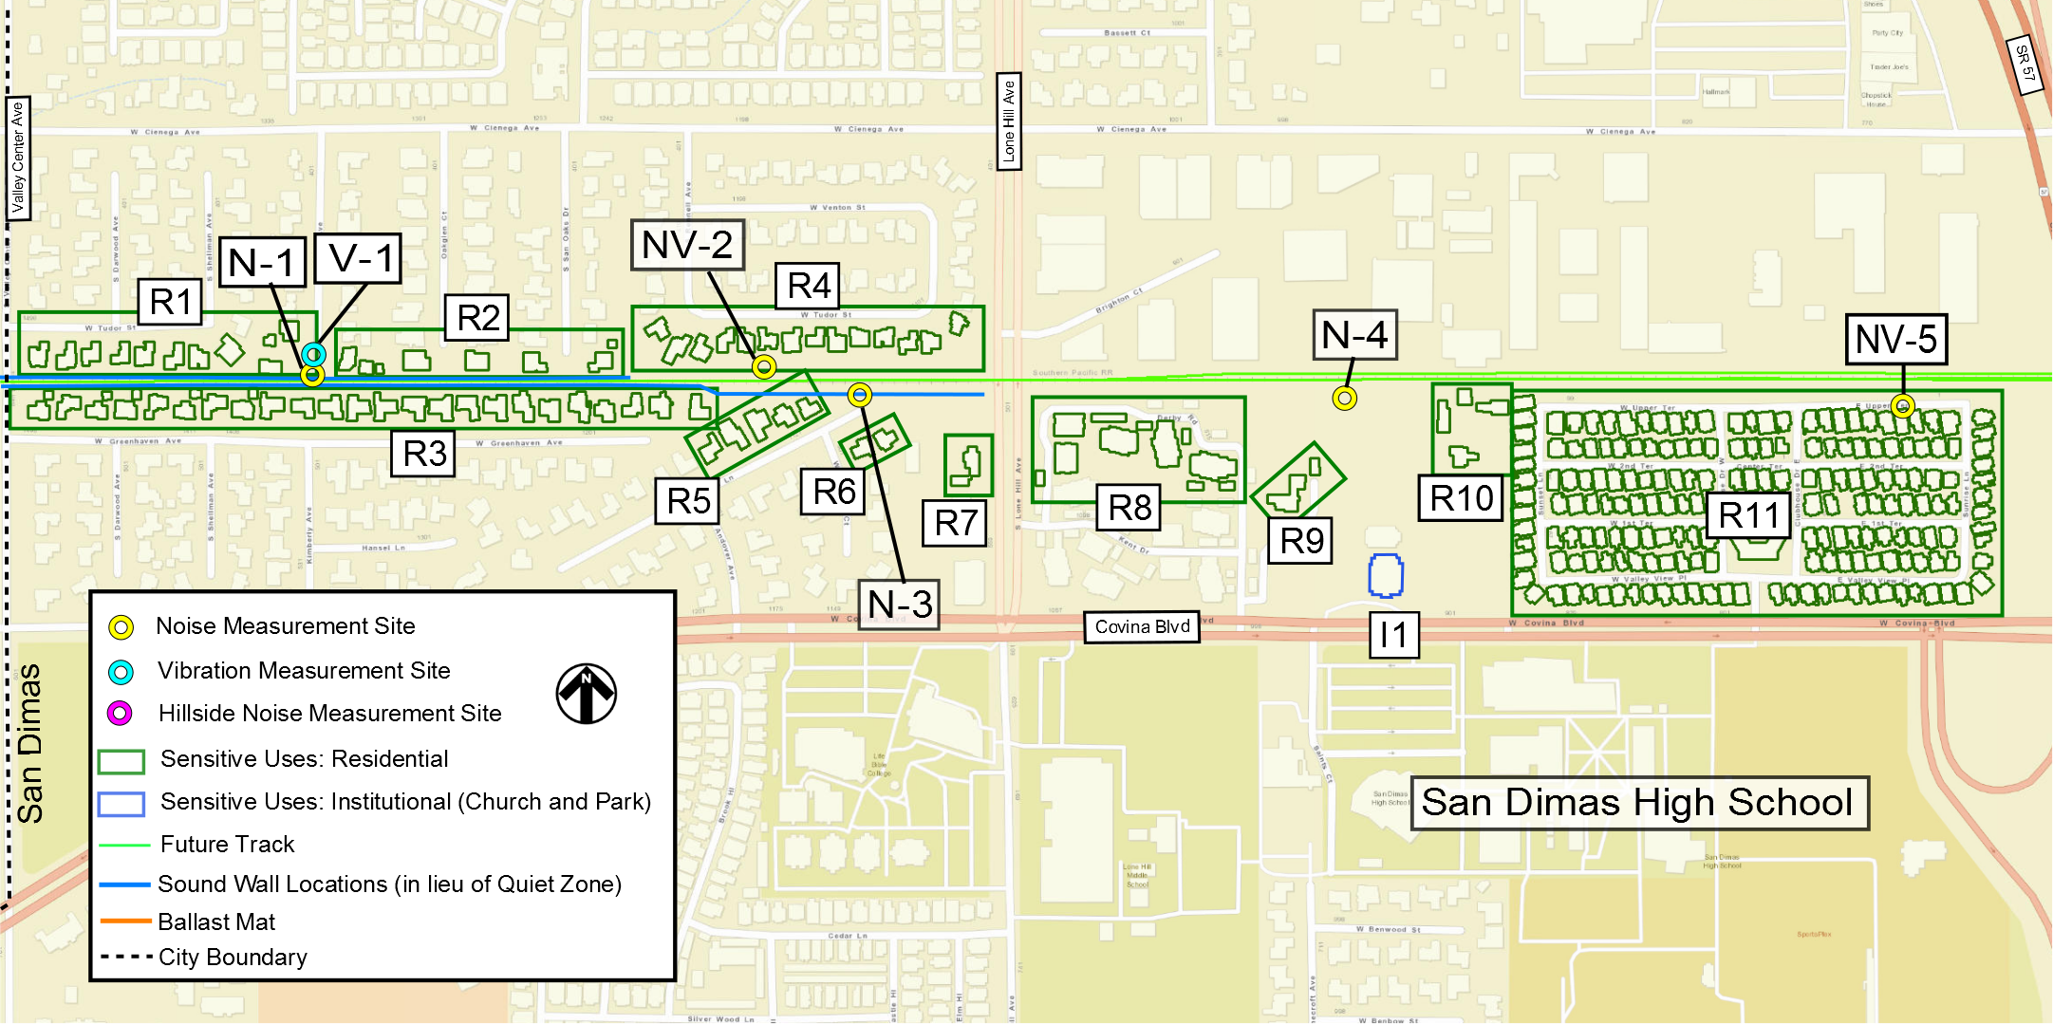
NOISE & VIBRATION ASSESSMENT
Noise and Vibration Measurement Receiver Locations – Valley Center Ave to 57 Freeway
Valley Center Av
Charter Oak Mobile Home Estates
Notes:
Updates needed by Tony
Sound Wall locations in lieu of Quiet Zone (in the legend)
Mitigation based on noise and vibration study

Slide 23
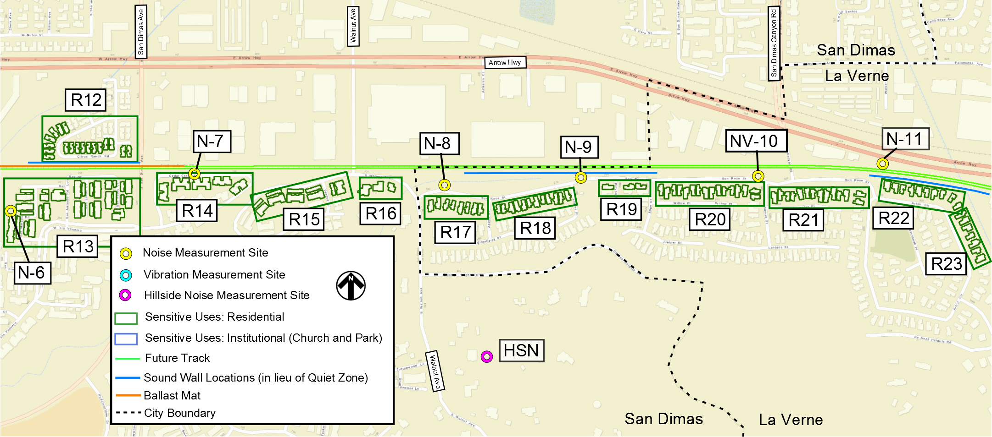
NOISE & VIBRATION ASSESSMENT
Noise and Vibration Measurement Receiver Locations – South Cataract Ave to Arbor Circle
Notes:
Sound Walls in lieu of Quiet Zones

Slide 24
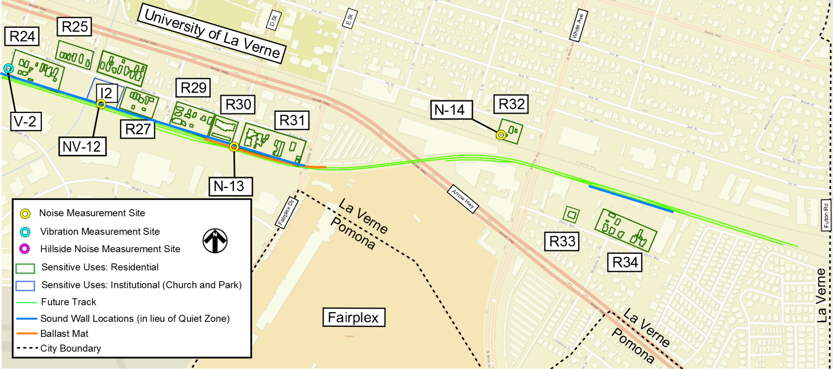
NOISE & VIBRATION ASSESSMENT
Noise and Vibration Measurement Receiver Locations – “A” Street to North White Ave
Arrow Hwy
A St
White Av

Slide 25
EXISTING NOISE LEVELS vs PREDICTED LEVELS with SOUND WALLS
Existing Condition
Proposed Project with Sound Walls
Notes:
Steven and Debra
Blue = existing noise levels
Orange = conditions with Sound Walls
Noise will increase regardless of this project. Why?
What is assumed, what are the existing conditions.
Call out box – Existing conditions
Call out box – Quiet Zone & Soundwalls
Use dashed line instead of a solid color line for one line for Quiet Zone Line

Slide 26
EXISTING NOISE LEVELS vs PREDICTED LEVELS with QUIET ZONE
Existing Condition
Proposed Project with Quiet Zone
Notes:
Steven and Debra
Blue = existing noise levels
Orange = conditions with Quiet Zone
Explain how we arrived at predicted noise level & variables involved
Use dashed line instead of a solid color line for one line for Sound wall line

Slide 27
NOISE & VIBRATION SUMMARY
Noise Levels With Project
  With Quiet Zones, improvements in noise levels throughout corridor (6-8 decibel noise reduction).
  Without Quiet Zones, sound walls will be required at selected locations to reduce noise levels (5 decibel noise reduction).
Vibration Levels With Project
  Vibration levels are compliant throughout the Project except at two locations.
  Ballast Mats for new track will reduce vibrations (3 decibel reduction).
Project with Quiet Zone
Project with Sound Walls
Note: Based on average 24 hour noise measurements
Notes:
Debra
Existing condition = Navy Blue
Sound Walls = Teal
Quiet Zone = Orange

Slide 28
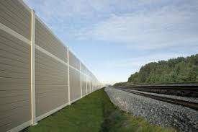
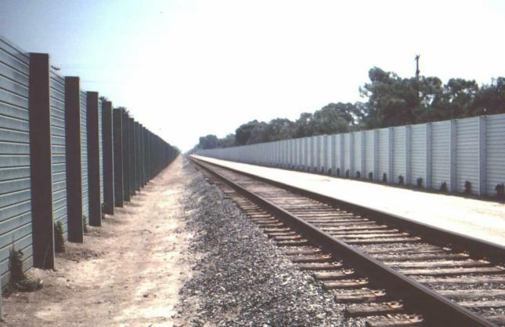
ENVIRONMENTAL ISSUE - NO QUIET ZONE
If City does not move forward with quiet zones:
Metro would pursue sound walls as an alternate mitigation strategy.
Concepts only
Notes:
Debra
Debra hands off to Danielle

Slide 29

ENVIRONMENTAL EVALUATION
Air Quality and Greenhouse Gases:
  Standard measures and project design features to be
  implemented to reduce construction impacts.
  The use of Metrolink Tier 4 trains will reduce air
  emissions during operations.
  Traffic and Transportation:
  Detours during construction of street safety
  improvements will allow continued access. (temporary impact)
  One queuing traffic lane to be improved for cars waiting for trains to pass.
  Biological and Jurisdictional Resources:
  No sensitive vegetation communities present and no potential impact for federal or state-listed plants or wildlife. Preconstruction biological surveys will be performed.
  No wetlands to be directly impacted. Jurisdictional waters will require permits.
Notes:
Debra

Slide 30
ENVIRONMENTAL EVALUATION
CEQA Environmental Issues:
  Aesthetics
  Agriculture and Forestry Resources
  Air Quality
  Biological Resources
  Cultural Resources
  Geology & Soils
  Greenhouse Gas Emissions
  Hazards & Hazardous Materials
  Hydrology & Water Quality
  Land Use & Planning
  Mineral Resources
  Noise & Vibration
  Population & Housing
  Public Services
  Recreation
  Transportation & Traffic
  Utilities & Service Systems
NEPA Environmental Issues:
  Land Use
  Cultural Resources
  Parks and Recreational Facilities
  Transportation
  Noise & Vibration
  Air Quality
  Hazardous Materials & Wastes
  Property Acquisition
  Community Impacts & Environmental Justice
  Wetlands
  Floodplains, Water Quality
  Navigable Waterways, Coastal Zones
  Prime & Unique Farmlands
  Critical Habitat & Endangered Species
  Public Safety
  Cumulative Impacts
Notes:
Debra
NEPA issues are provided in the Federal Railroad Administration (FRA) Categorical Exclusion Worksheet
Include if needed, not sure it should be shown

Slide 31
ENVIRONMENTAL NEXT STEPS
What is Next in the Process:
  Review comments from the community and key stakeholders
  Finalize technical reports and memoranda
  Complete CEQA and NEPA documentation
  Metro (lead agency) review and consideration of project approvals
  File notices after Metro agency approval
Notes:
Debra
Debra hands off to Danielle

Slide 32
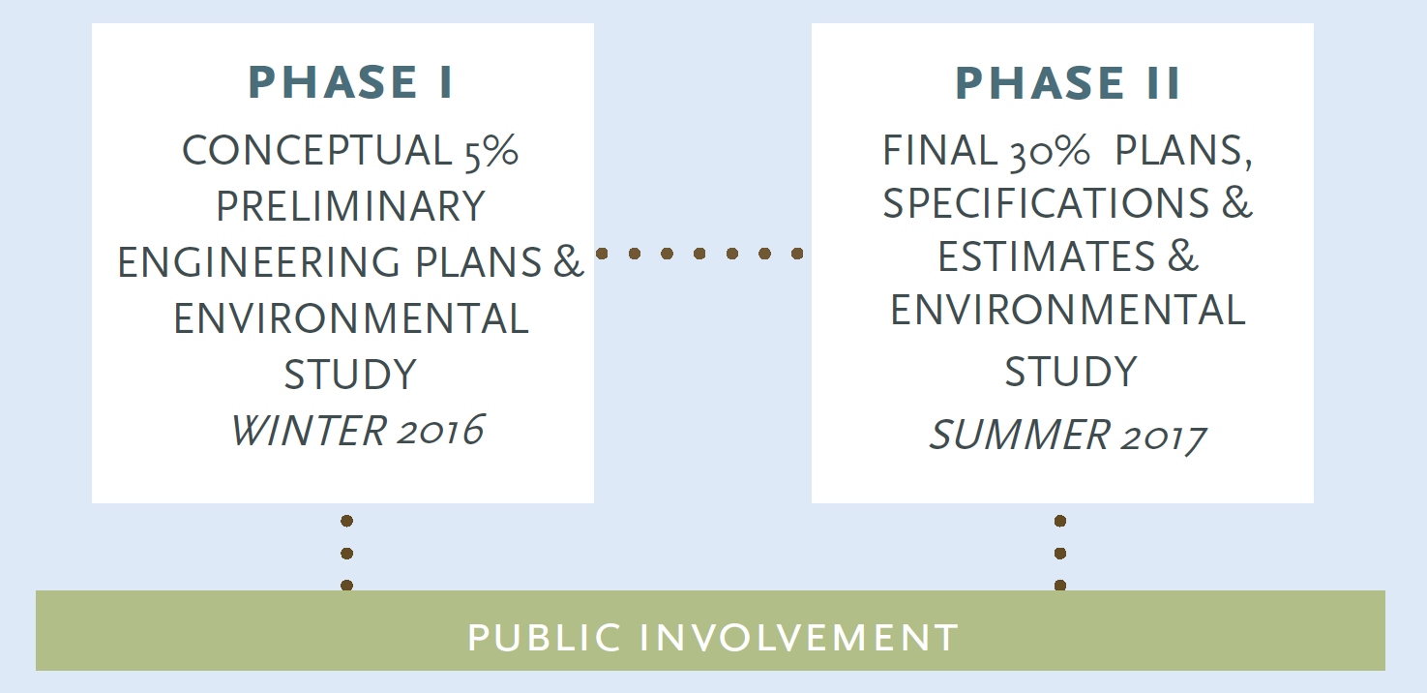
SCHEDULE
We Are Here
Notes:
Danielle
(New Board)

Slide 33
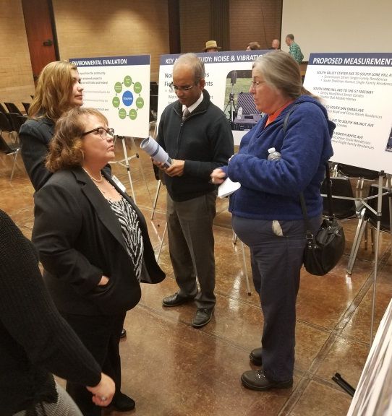
NEXT STEPS
Complete 30% Design and Environmental Clearance
Seek Metro Board Authorization for Final Design in Late 2017
Notes:
Danielle

Slide 34




STAY CONNECTED
Jay Fuhrman
Metro
Transportation Planning Manager, Regional Rail
One Gateway Plaza
Mail Stop 99-18-2
Los Angeles, CA 90012-2952
Metro.net/regionalrail
855.SAFE.TRX (855.723.3879)
fuhrmanj@metro.net
Notes:
Danielle

Slide 35
QUIET ZONE APPROVAL PROCESS
Notice Of Intent
Develop Existing Conditions Analysis
Conduct Field Diagnostic Meetings at Crossing(s)
Enter FRA Calculator for Crossing(s) at Corridor
Design/ Construct “Quiet Zone Ready” Improvements
Notice of Establishment
Notes:
Existing Conditions Analysis consists of identification of existing equipment, accident data at crossing, ADT information and train counts

