Slide 1
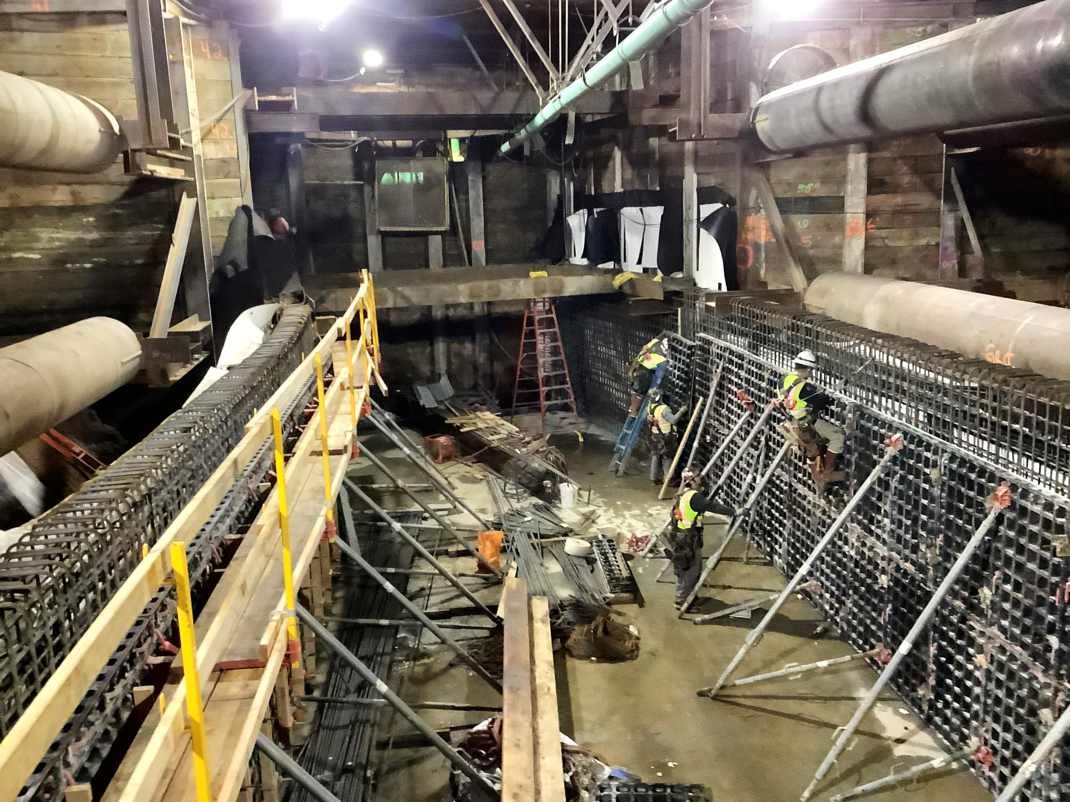
Los Angeles County
Metropolitan Transportation Authority
METRO CONSTRUCTION SAFETY
March 2024 FTA Quarterly Review
Data accumulated through January 2024
Metro construction projects have an average
Recordable Incident rate of 1.7
Compared to the National average of 2.4
Photo; PLE 2 Century City Constellation Blvd Station

Slide 2
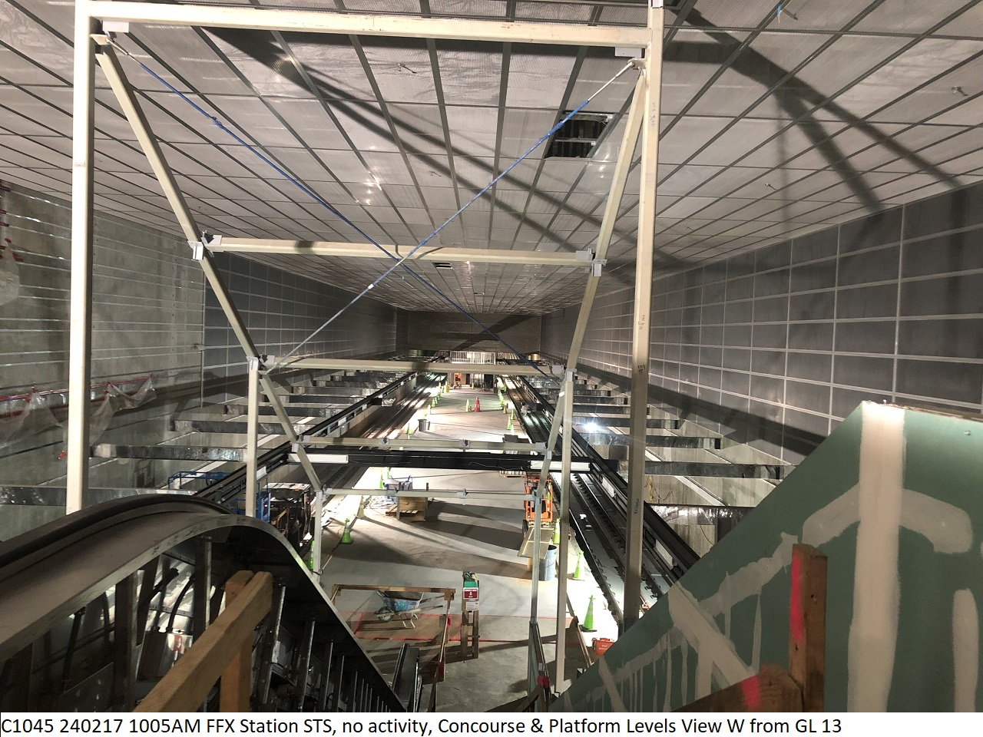

Westside Purple Line Extension Section 1 Project
Data and Statistics as of: January 31, 2024
Project to Date Total Work Hours: 9,608,516
Total Recordable Injuries: 41
Recordable Injury Rate per 200,000 Labor Hours: 0.85
BLS National Heavy Construction Incident Rate: 2.4
Total Days Away Cases: 4
DART Injury Rate: 0.08
National DART Rate: 1.5

Slide 3
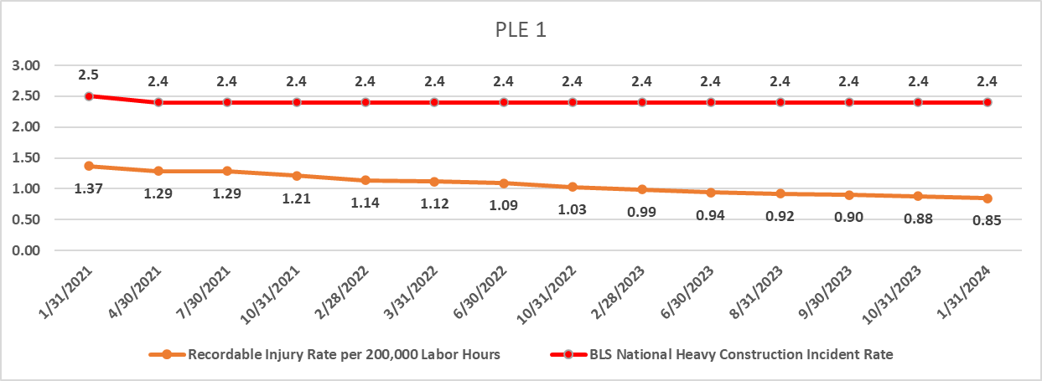
Westside Purple Line Extension Section 1 Project

Slide 4
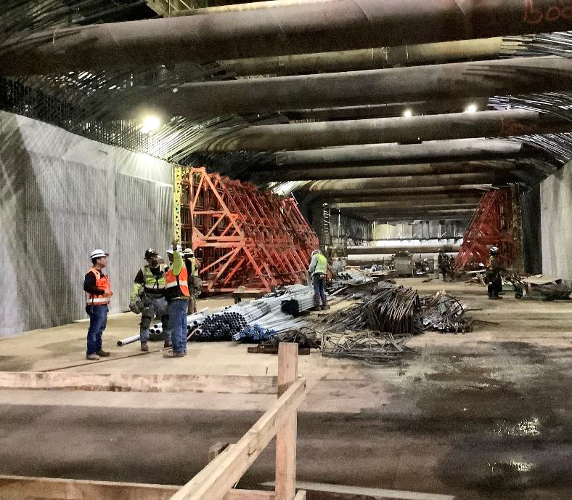
Westside Purple Line Extension Section 2 Project
Data and Statistics as of: January 31, 2024
Project to Date Total Work Hours: 3,862,976
Total Recordable Injuries: 54
Recordable Injury Rate per 200,000 Labor Hours: 2.80
BLS National Heavy Construction Incident Rate: 2.4
Total Days Away Cases: 12
DART Injury Rate: 0.62
National DART Rate: 1.5

Slide 5
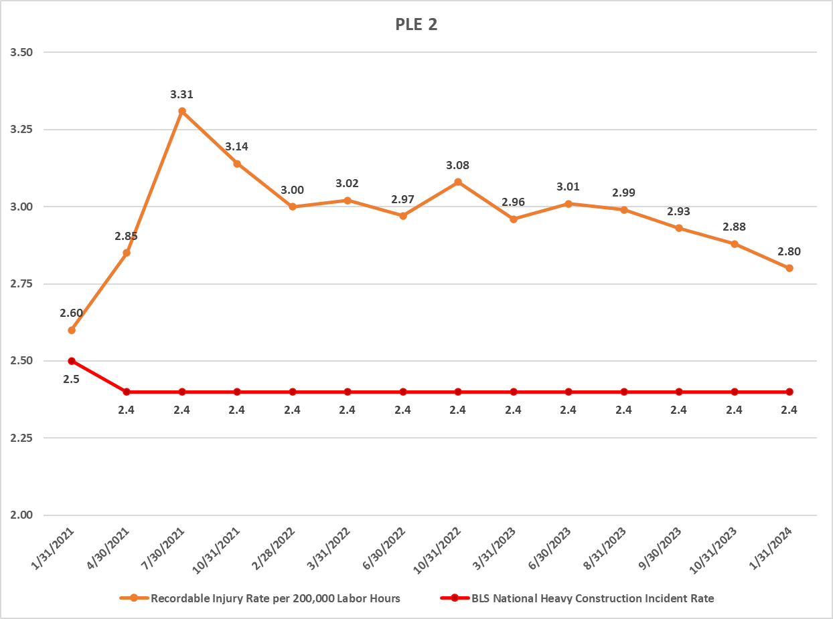
Westside Purple Line Extension Section 2 Project

Slide 6
Westside Purple Line Extension Section 3 Project
Data and Statistics as of: January 31, 2024
Project to Date Total Work Hours: 3,098,984
Total Recordable Injuries: 21
Recordable Injury Rate per 200,000 Labor Hours: 1.35
BLS National Heavy Construction Incident Rate: 2.4
Total Days Away Cases: 5
DART Injury Rate: 0.32
National DART Rate: 1.5

Slide 7
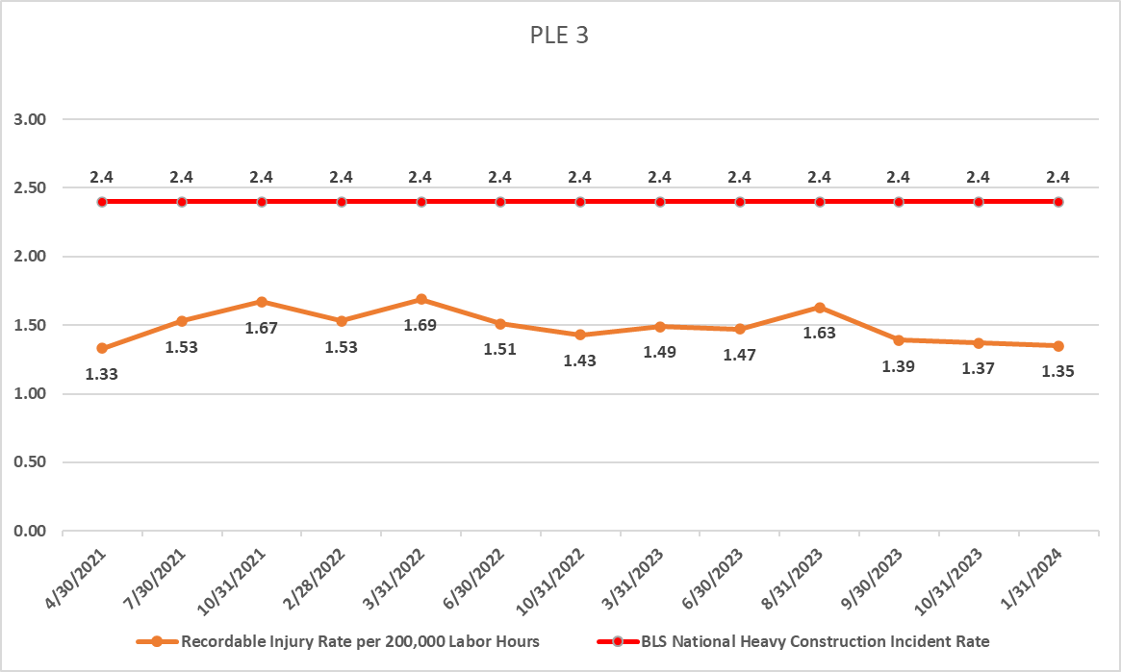
Westside Purple Line Extension Section 3 Project

Slide 8
Westside Purple Line Extension Section 3 Project
C1152 Stations Contract
Data and Statistics as of: January 31, 2024
Project to Date Total Work Hours: 1,453,277
Total Recordable Injuries: 0
Recordable Injury Rate per 200,000 Labor Hours: 0
BLS National Heavy Construction Incident Rate: 2.4
Total Days Away Cases: 0
DART Injury Rate: 0
National DART Rate: 1.5
(*Two injuries occurred in February with no severity determination, First Aid or Recordable)

Slide 9
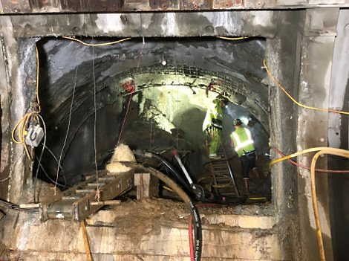
Westside Purple Line Extension Section 3 Project
C1151 Tunnels Contract
Data and Statistics as of: January 31, 2024
Project to Date Total Work Hours: 1,645,667
Total Recordable Injuries: 21
Recordable Injury Rate per 200,000 Labor Hours: 2.55
BLS National Heavy Construction Incident Rate: 2.4
Total Days Away Cases: 5
DART Injury Rate: 0.61
National DART Rate: 1.5

Slide 10
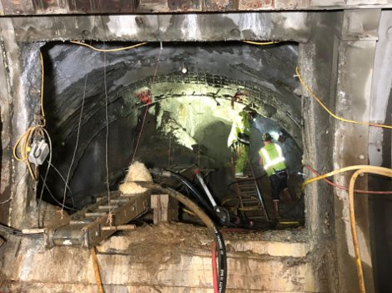
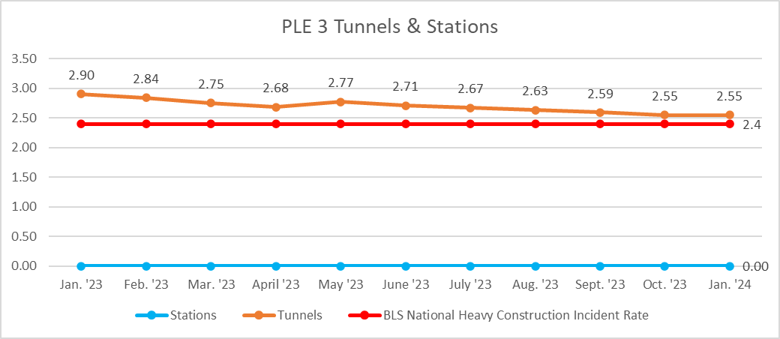
Westside Purple Line Extension Section 3 Project
C1151 Tunnels Contract

