Slide 1


Slide 2
¡Bienvenidos!
We will begin in a few moments.
Comenzaremos en unos momentos.
Virtual Meeting #4/ Reunión Virtual #4
February 13, 2024/ 13 de febrero de 2024

Slide 3



Facilitators
Robert Cálix
Cal Strategic Management
Michael Cano
Countywide Planning & Development
Laura Hernandez
Arellano Associates

Slide 4
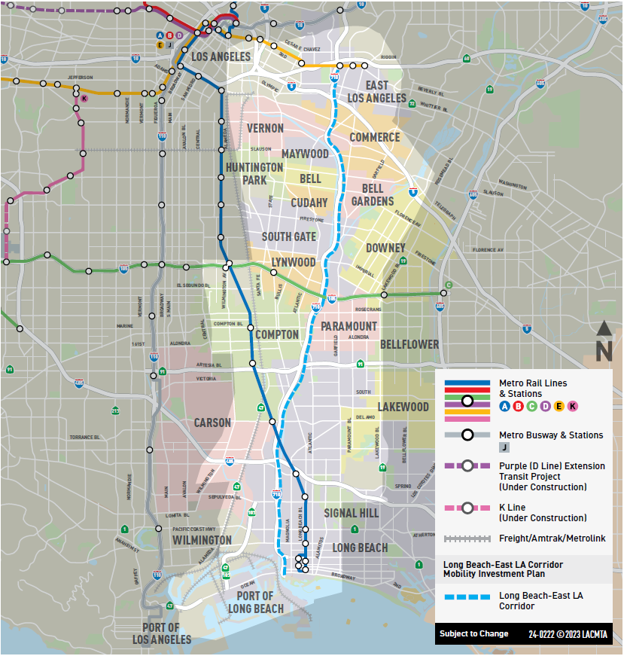


Icebreaker Question– Zoom Poll
  Northern segment–
  East LA, Commerce, Montebello, Vernon, Boyle Heights
  Southeast LA segment–
  Maywood, Huntington Park, Bell, Cudahy, Bell Gardens, South Gate, Downey, Lynwood
  Mid-Corridor–
  Compton, Paramount, Carson, Bellflower
  Southern segment–
  Lakewood, Signal Hill, Long Beach, San Pedro, Wilmington, Ports of LA and Long Beach
What city do you live, work, or spend most of your time in?
Communities are organized by segment, north to south
INFORMATION FOR DISCUSSION PURPOSES ONLY – SUBJECT TO CHANGE
4

Slide 5






Metro Project Team
Michael Cano
KeAndra Cylear-Dodds
Jessica Medina
Countywide Planning & Development
Equity and Race
Equity and Race
Avital Barnea
Lilian De Loza-Gutierrez
Multimodal Integrated
Planning
Community Relations
Ernesto Chaves
Lucy Delgadillo
Strategic Innovation
Highway Programs
5

Slide 6


Meeting Agenda
Welcome and Agenda Review
Formal Presentation > Overview and Background > Draft Corridor Mobility Investment Plan > Public Engagement Efforts > Next Steps
Public Comment on Draft Investment Plan (Moderated) Adjourn
Simultaneous Spanish interpretation available
Our Expectation: We will conduct a respectful meeting to allow ideas and comments to be shared in an open and fair environment
INFORMATION FOR DISCUSSION PURPOSES ONLY – SUBJECT TO CHANGE
6

Slide 7

Draft LB-ELA Corridor Mobility Investment Plan
Metro has a plan to improve the shared transportation system in the Long Beach-East Los Angeles Corridor (LB-ELA Corridor) to provide safe, quality travel options for moving people and goods.
The LB-ELA Corridor includes the following cities and communities:
Bell
Bellflower
Bell Gardens
Carson
Commerce
Compton
Cudahy
Downey
Unincorporated LA County
- East LA
- Walnut Park
- East Rancho Dominguez
Huntington Park
Lakewood
Long Beach
Los Angeles
- Boyle Heights
- San Pedro
- Wilmington
Lynwood
Maywood
Paramount
Signal Hill
South Gate
Vernon
7
INFORMATION FOR DISCUSSION PURPOSES ONLY – SUBJECT TO CHANGE

Slide 8
Corridor History
Freeway Expansion Focus (2000 – 2021)
2000
I-710 Major Corridor Study initiated by Metro, Caltrans, SCAG, and GCCOG, along with establishment of policy oversight, technical advisory, and community advisory committees.
2003
Citizens and advocacy groups voiced major concerns related to air quality and residential displacement impacts of proposed alternatives for the Locally Preferred Strategy
2008
Identification of corridor funding in Measure R
2015
Based on community feedback and changes in the logistics supply chain, development of a revised Draft EIR / Supplemental Draft EIS is initiated
2016
Identification of corridor funding in Measure M
2017
Public release of revised Draft EIR/Supplemental EIS
2018
Staff presented three alternatives to the Board
Board approval of Alternative 5C as the LPA for the project to advance in the environmental process.
2021
Board decision to suspend further work on the environmental clearance of the I-710 South Corridor Project LPA due to environmental, community impact and displacement concerns raised by local communities, Caltrans, and the EPA.
SCAG Southern California Association of Governments
GCCOG Gateway Cities Council of Governments
LPA Locally Preferred Alternative
EIR Environmental Impact Report
EIS Environmental Impact Statement
EPA Environmental Protection Agency
INFORMATION FOR DISCUSSION PURPOSES ONLY – SUBJECT TO CHANGE

Slide 9


Corridor History
Community Investment Plan Focus (2021 – 2023)
2021
Created LB-ELA Corridor Task Force per Board’s request to explore a more equitable and sustainable approach to addressing transportation & community challenges
2022
Adopted new name for the project: Long Beach-East LA Corridor Mobility Investment Plan
Task Force team begins work for the development of the Draft CMIP
Developed vision, goals and guiding principles approved by the Task Force and adopted by the Metro Board
Obtained public input to identify projects and program needed in communities along the
LB-ELA corridor
Developed multimodal strategies and identified projects and programs
Board approved Pre-Investment Plan Opportunity to advance corridor projects for grant funding
2023
Evaluated and refined projects/programs
Developed an Investment Policy Strategy for implementation
Explore more!
Scan or access the StoryMap at: metro.net/lb-ela-cp-hub
INFORMATION FOR DISCUSSION PURPOSES ONLY – SUBJECT TO CHANGE

Slide 10


Draft LB-ELA Corridor Mobility Investment Plan
A New Vision
Plan shares a prioritized list of multimodal transportation projects and programs that
Prioritizes projects and programs based on evaluation criteria.
Includes projects with different modes prioritized relative to each other.
Outlines phased funding strategy. Not all funding will be allocated at once; anticipated funding will become available at different timescales.
Serves as a living document;
Metro intends to revisit the Plan every few years.
End Goal –
Encouraging Equitable Outcomes
TRADITIONAL APPROACH
Freeway Expansion Focus 2000 – 2021
A NEW VISION
Community Investment Plan 2021 – today
INFORMATION FOR DISCUSSION PURPOSES ONLY – SUBJECT TO CHANGE

Slide 11


Maximizing our Local Funds
The Corridor Mobility Investment Plan (Investment Plan) will leverage about $743 million in sales tax revenue with state and federal funding
Expected to maximize the delivery of transportation projects and programs that provide safe, quality multimodal options for moving people and goods.
=
Local (Metro)
Delivery of more projects and programs that create safe, quality multimodal options for moving people and goods
in the LB-ELA corridor communities.
State
Federal
INFORMATION FOR DISCUSSION PURPOSES ONLY – SUBJECT TO CHANGE

Slide 12
Investment Plan Measure R/M Investment Summary
Total available Measure R/M Funds: $743M
Total Measure R/M Investment Summary
Initial Investment Recommendations: $449M
  Development $69.5M
  Pre-Implementation $62.5M
  Implementation $317M*
  Modal Program Recommendations: $294M
  Development $22.5M
  Pre-Implementation $14.7M
  Future Implementation $256.5M
  Total Initial Investment & Modal Programs: $743M
$449M
+
$743M
*leveraged investment in community programs to be determined
*Includes funding commitments for near - and longer-term projects.
INFORMATION FOR DISCUSSION PURPOSES ONLY – SUBJECT TO CHANGE
Notes:
Community Program funding is front loaded

Slide 13
CMIP Measure R/M Investment Summary –
Leveraged Funding
$3.2B+
$743M
*leveraged investment in community programs to be determined
INFORMATION FOR DISCUSSION PURPOSES ONLY – SUBJECT TO CHANGE

Slide 14
Overview and Background

Slide 15

CBO Partnering Strategy
Listen and learn. This project has been guided by the pillars of Metro's Equity Platform. Under the Listen and Learn Pillar, Metro has and continues to partner with Community-Based Organizations (CBOs) to inform the project's engagement strategy and materials.
Build trust. By working with these trusted community partners, Metro aims to rebuild trust with corridor communities that has eroded over the years. The goal of this engagement is to share and gather feedback on the Draft Investment Plan in a clear, open, and accessible manner.
Targeted Outreach. The CBOs enlisted are respected and trusted leaders within each of their communities, who can a help us reach more community members, especially people from underrepresented and impacted neighborhoods.
INFORMATION FOR DISCUSSION PURPOSES ONLY – SUBJECT TO CHANGE

Slide 16







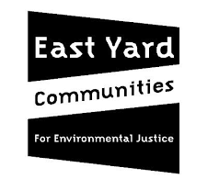

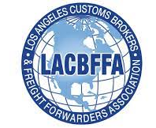
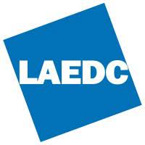






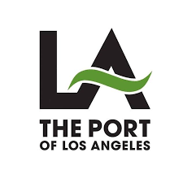




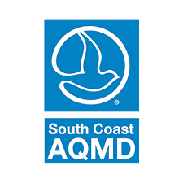
















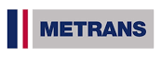
Task Force
INFORMATION FOR DISCUSSION PURPOSES ONLY – SUBJECT TO CHANGE

Slide 17




Community Leadership Committee
Maria Reyes, Long Beach Marlene Sanchez, Long Beach
Aide Castro, Lynwood Elizabeth Zamarripa, Lynwood
Jamila Cervantes, Maywood​​
Andres Duarte, Montebello
Tiesha Davis, San Pedro
Esmeralda Hernandez, South Gate
Viridiana Preciado Cervantes, Walnut Park
Manuel Arellano, Wilmington
Dora Douglas, Vernon Kevin Shin, At-Large
Includes representatives from corridor communities:
Luis Mesa, Bell​
Natalie Diaz Rubio, Bell Gardens​​
Emmanuel Godinez, Boyle Heights​​
Fa'alagilagi Meni-Siliga, Carson​​
Alfonso Garate, Commerce​​
Phyllis Ollison, Compton​​
Irma Lopez, Cudahy​
Guadalupe Arellano, East LA Kathleen Barajas, East LA Miyuki Gomez, East LA
Sinetta Farley, East/Rancho Dominguez​
Jose Rodolfo Vallejo, Huntington Park​​
Dan Wamba, Lakewood​
Marcos Lopez, Long Beach​​
INFORMATION FOR DISCUSSION PURPOSES ONLY – SUBJECT TO CHANGE
Notes:
Declare that this Task Force process is the most ambitious planning effort by Metro to engage and involve communities for a subregional plan

Slide 18

Working Groups
Purpose of Working Groups
  Research, analyze, and discuss specific issues
  Develop proposals and recommendations for CLC / Task Force consideration
  Help facilitate focused and constructive meetings
Established Working Groups
  Equity Working Group (meets monthly)
  Zero-Emission Truck Working Group (meets monthly)
  Coordinating Committee (meets as needed)
Participants
  Task force members
  CLC members
  Additional stakeholders and experts
CLC Community Leadership Committee
INFORMATION FOR DISCUSSION PURPOSES ONLY – SUBJECT TO CHANGE

Slide 19







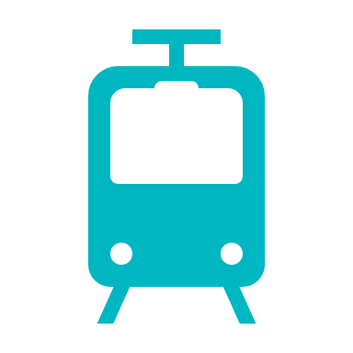





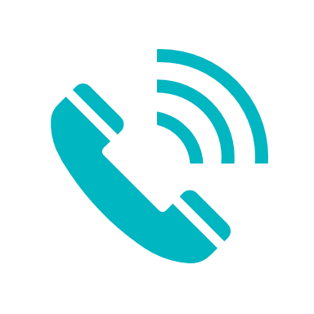




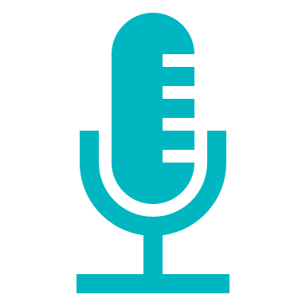

Partnerships with Community Based Organizations
CBO* Partnership Goals
  Ensure greater outcomes in public participation
  Reach additional communities and stakeholders
  Provide project information to equity-focused communities (EFC) and other areas
  Cultivate trust with the community.
  Foster positive relationships with active CBOs.
Notification Activities
Engagement Activities
Flyers & Posters Distribution
  Event information booths
Door-to-door notices
  Pop-up outreach booths
Eblasts/e-newsletters
Transit-intercepts
Banners & Lawn Signs
Business Corridor Outreach
Notification Toolkit
School Outreach
Phone banking & SMS texts
CBO Co-hosted meetings
Social media posts
Other outreach efforts
  Website/Announcements
*CBO Community based organizations
INFORMATION FOR DISCUSSION PURPOSES ONLY – SUBJECT TO CHANGE
Notes:
Ensure greater outcomes in public participation, especially leading up to and following the release
of the Draft Corridor Mobility Investment Plan (CMIP).
Reach additional communities and stakeholders
not captured within the project database.
Provide project information to equity-focused communities (EFC) and other areas served by
CBO partners, while being part of the process by providing feedback and receiving updates.
Cultivate trust with the community.
Foster positive relationships with active CBOs.

Slide 20


CBO Partnerships
Current 28 CBO Partners
ALL operating within Equity Focused Communities in the project area
Avance Latino
Black Women Rally for Action
Calvary Chapel Compton
COFEM (SELA Collaborative)
Compton Advocates Coalition
Eastmont Community Center
East LA College (ELA)
East LA College (South Gate)
FoodCycle
Good Faith Missionary Baptist Church
Hoops 4 Justice
La Comadre
MAOF – Downey
MAOF – HQ Montebello
Mujeres Unidas Sirviendo Activamente
National Council of Negro Women (Long Beach)
Northwest Downey Little League
Rancho Los Amigos National Rehabilitation Center/Foundation
Regional Hispanic Institute
Streets Are For Everyone (SAFE)
Salvation Army Red Shield
Southeast Community Development Corporation (SELA) Collaborative
South Gate Junior Athletics Association
Tower of Faith Evangelic Church
Unearth and Empower Communities
YMCA – Montebello/Commerce
YMCA – Southeast Rio Vista (Maywood)
YMCA – Weingart East LA
INFORMATION FOR DISCUSSION PURPOSES ONLY – SUBJECT TO CHANGE

Slide 21

Initial List of Projects & Programs: Engagement Sources
LB-ELA Corridor Project
September 2021 – Present
CBO & Outreach Engagement during
Multimodal Strategy Projects and Programs
(MSPP) Phase
September – November 2022
Engagement efforts continue throughout the project through multilingual outreach campaigns, engaging thousands of stakeholders and community members via:
Public Task Force and CLC meetings
Surveys and online tools
Newsletters and eblasts
INFORMATION FOR DISCUSSION PURPOSES ONLY – SUBJECT TO CHANGE

Slide 22






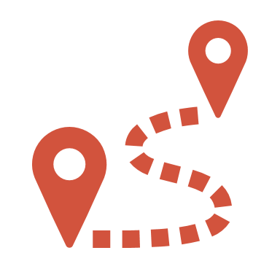
Survey Responses
Based on your experience and on the needs of your community, what type of projects, programs, or improvements would you most like to see implemented within your community and the LB-ELA Corridor?
*Results updated 11/29/22 at 10:00 am

Slide 23
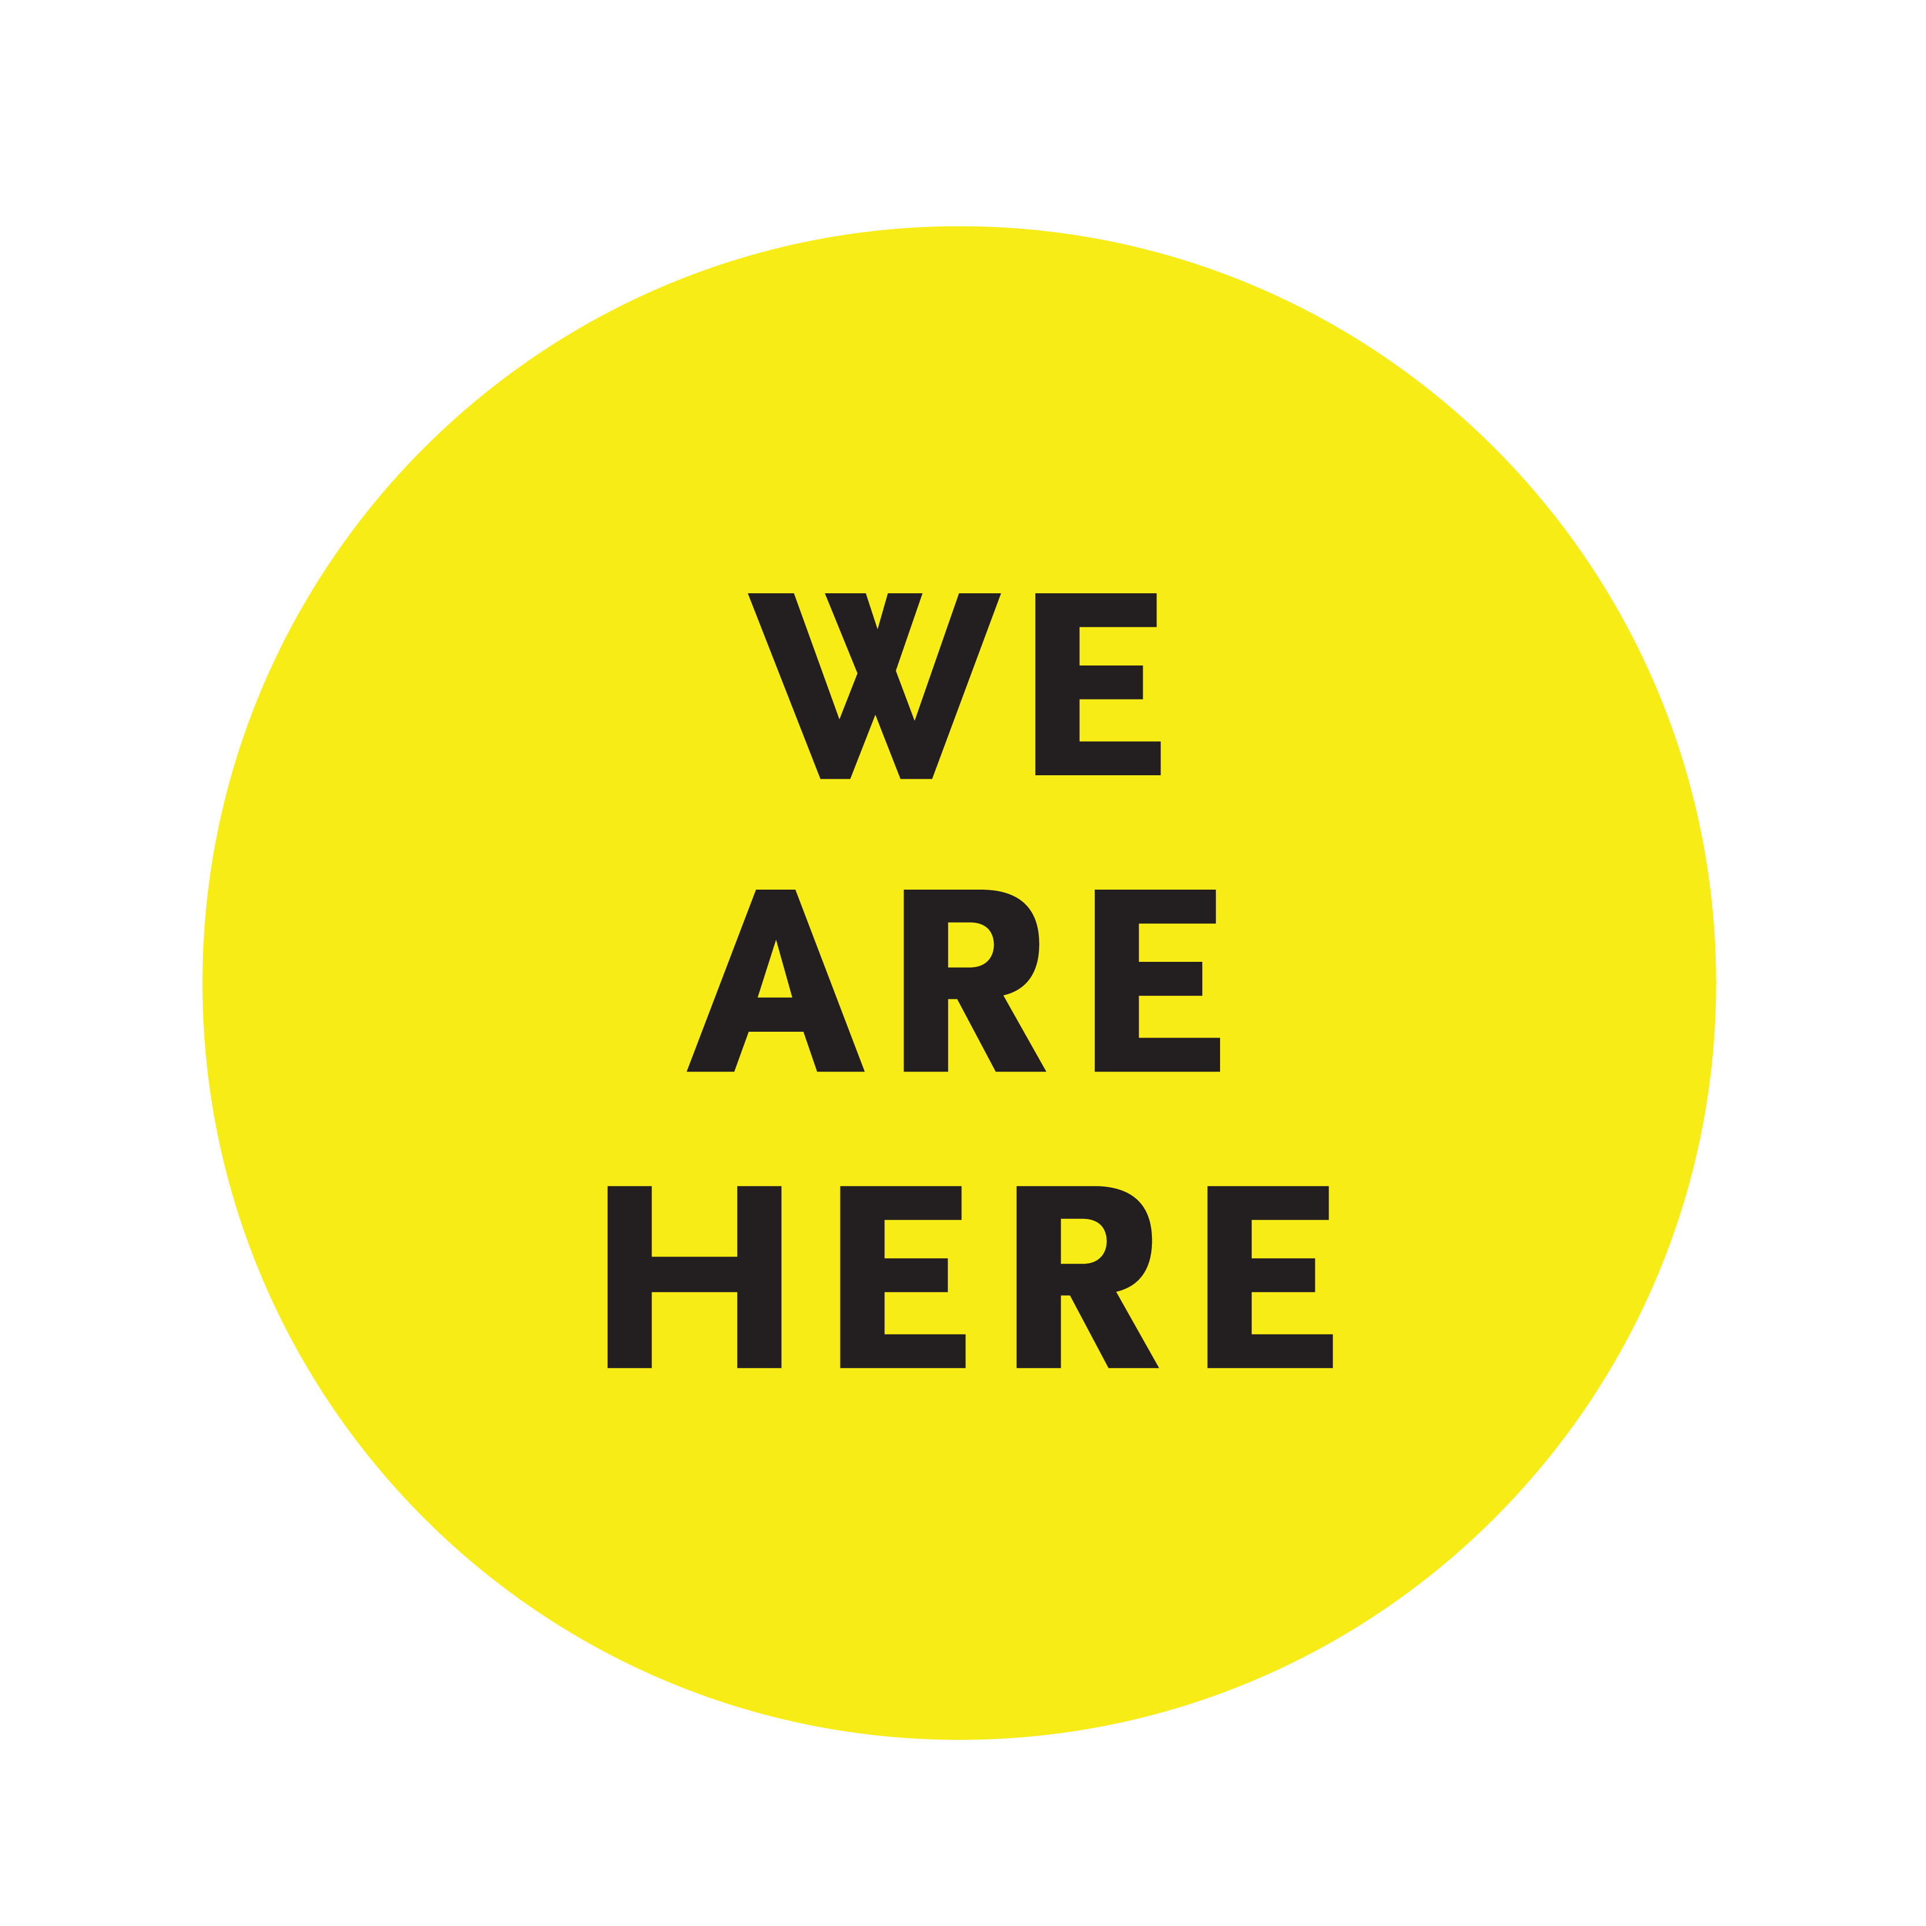


What’s Next: Previous & Future Milestones
2 ½ year process
September 2021
March 2024
*
INFORMATION FOR DISCUSSION PURPOSES ONLY – SUBJECT TO CHANGE

Slide 24
Draft Corridor Mobility Investment Plan
(Investment Plan)

Slide 25
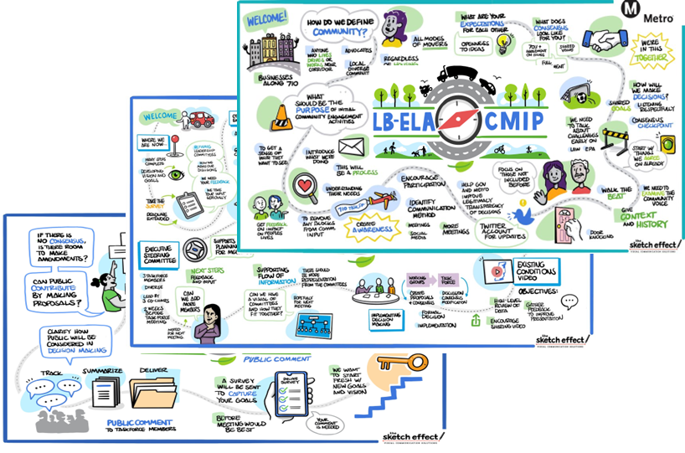



Vision Statement
"An equitable, shared I-710 South Corridor transportation system that provides safe, quality multimodal options for moving people and goods
that will foster clean air (zero emissions), healthy and sustainable communities, and economic empowerment for all residents, communities, and users in the corridor."
> Approved by the Task Force (July 2022) and adopted by Metro Board (September 2022)
What’s a “vision statement”?
A concise statement that captures the collective aspirations, desires, and outcomes of the project
INFORMATION FOR DISCUSSION PURPOSES ONLY – SUBJECT TO CHANGE

Slide 26
LB-ELA Corridor Guiding Principles
Guiding Principle
A value that guides all processes and outcomes through a cohesive and intentional framework
Equity Guiding Principle
"A commitment to: (1) strive to rectify past harms; (2) provide fair and just access to opportunities; and (3) eliminate disparities in project processes, outcomes, and community results."
"The plan seeks to elevate and engrain the principle of Equity across all goals, objectives, strategies, and actions through a framework of Procedural, Distributive, Structural, and Restorative Equity, and by prioritizing an accessible and representative participation process for communities most impacted by the I-710."
Sustainability Guiding Principle
"Development that meets the needs of the present without compromising the ability of future generations to meet their own needs."
"A commitment to the sustainability to satisfy and improve basic social, health, and economic needs/conditions, both present and future, and the responsible use and stewardship of the environment, all while maintaining or improving the well-being of the environment on which life depends."
Approved by the Task Force (July 2022) and adopted by Metro Board (September 2022)
INFORMATION FOR DISCUSSION PURPOSES ONLY – SUBJECT TO CHANGE

Slide 27

Goals
Approved by the Task Force (July 2022) and adopted by Metro Board (September 2022)
INFORMATION FOR DISCUSSION PURPOSES ONLY – SUBJECT TO CHANGE

Slide 28
Corridor Mobility Investment Plan Highlights
What is the Corridor Mobility Investment Plan (Investment Plan)?
The Investment Plan is a multiyear strategic planning document
Advances the Corridor’s Vision, Goals, and Guiding Principles as adopted by the Task Force and Community Leadership Committee
Provides recommendations to the Metro Board of Directors on initial projects and programs to fund, leverage, and implement
Also identifies longer-term project priorities and funding
Describes implementation strategies, roles, and responsibilities to help Metro, cities and agencies
Creates equity-focused planning and projects
Features 15 Community Programs and 5 Modal Programs
INFORMATION FOR DISCUSSION PURPOSES ONLY – SUBJECT TO CHANGE

Slide 29

Balanced scorecard slide 5
Initial List of Projects & Programs: Categories
Projects are organized by “improvement category”
All projects and programs should support a multimodal future for the Corridor.
Improvement categories represent different modes
INFORMATION FOR DISCUSSION PURPOSES ONLY – SUBJECT TO CHANGE

Slide 30








Investment Plan Measure R/M Investment Summary –
Active Transportation
Bike Lanes
Shared-Use Path
Pedestrian Safety / Amenities
Crossing Safety Enhancements
Micromobility
Bike/Pedestrian Traffic Controls
INFORMATION FOR DISCUSSION PURPOSES ONLY – SUBJECT TO CHANGE

Slide 31
Investment Plan Measure R/M Investment Summary –
Active Transportation
Initial Investment Recommendations: $32.9M
  Development $0.5M
  Pre-Implementation $4.5M
  Implementation $27.9M
  Modal Program Recommendations: $57.1M
  Development $5.7M
  Pre-Implementation $2.9M
  Future Implementation $48.6M
  Total Initial Investment & Modal Programs: $90M
INFORMATION FOR DISCUSSION PURPOSES ONLY – SUBJECT TO CHANGE
Notes:
Includes funding commitments for near and longer term projects.
Community Program funding is front loaded

Slide 32
Investment Plan Measure R/M Investment Summary –
Active Transportation
Project ID | Name | CMIP Initial Investment ($ in millions) | Estimated Total Cost ($ in millions)* | Phase
LB-ELA_0017 | Regionally significant bike projects from the Metro Active Transportation Plan | $15.7 | $41.4** | Development / Implementation
LB-ELA_0008 | Blue Line First/Last Mile Plan Improvements | $9.8 | $13.5 | Development / Implementation
LB-ELA_0111 | Southeast Gateway Line Bike & Pedestrian Trail | $3.8 | $7.6** | Development / Pre-implementation
LB-ELA_0006 | Rail to River Active Transportation Corridor Segment B | $3.2 | $6.3 | Pre-implementation
LB-ELA_0165 | Compton Creek Bike Underpasses | $0.5 | - | Development / Pre-Implementation
Active Transportation Initial Investment |  | $32.9
Active Transportation Modal Program |  | $57.1
Total Active Transportation Investment |  | $90.0
*Estimated project costs are totaled from individual city submissions.
**Estimated project cost based on miles of bike facilities.
INFORMATION FOR DISCUSSION PURPOSES ONLY – SUBJECT TO CHANGE
Notes:
What does Active Transportation cover?
Projects and programs that support the safe movement of travelers using human-powered methods of travel, such as walking, bicycling, or rolling to get from one place to another.
What is Metro’s Commitment to advancing Active Transportation?
Metro’s commitment to advancing Active Transportation is reflected in the 2023 Active Transportation Strategic Plan (ATSP)
Overview
Metro has a proactive role in countywide active transportation planning and establishes proposals for regional bikeways, pedestrian districts, and First/Last Mile (FLM) improvement areas surrounding transit stations.
Many of the high-scoring AT programs are corridor-wide or regional programs that focus on implementing bicycle and pedestrian safety projects from existing active transportation plans, including Metro’s 2023 ATSP.
While several selected projects from these programs are recommended for near-term funding, these plans include numerous other projects that will require further development.
Other AT program elements:
greening and other sustainability features,
personal security enhancements, and
other elements to enhance the user experience and quality of life of a corridor.
AT Near-Term Recommendations ?
Distinct projects on the Multimodal Strategies, Projects, and Programs (MSPP) which rated highly and are more ready for implementation.
Regionally important AT Corridors as reflected in Metro’s recently updated ASTP and Long Beach’s Bicycle Master Plan
Projects which received funding in 2023 from California’s Active Transportation Program (ATP), elevated for inclusion in the initial funding recommendations.
The AT funding investment is based on:
• funding for projects that received state ATP awards but still have a partial funding gap.
• funding for projects that are prioritized in the Metro ATSP, especially those that close gaps in the regional AT network and those that provide access to EFC areas.
• funding to advance distinct projects that need support
Add the recommended funding amount here for the Near-Term Recommendations.

Slide 33






Investment Plan Measure R/M Investment Summary –
Arterial Roadways / Complete Streets
Intersection Improvements
Traffic Management Features
Traffic Calming Features
Complete Streets
Visual Improvements
INFORMATION FOR DISCUSSION PURPOSES ONLY – SUBJECT TO CHANGE

Slide 34
Investment Plan Measure R/M Investment Summary –
Arterial Roadways/Complete Streets
Initial Investment Recommendations: $115.9M
  Development $0.0M
  Pre-Implementation $9.0M
  Implementation $106.1M
  Modal Program Recommendations: $72.1M
  Development $7.2M
  Pre-Implementation $3.6M
  Future Implementation $61.3M
  Total Initial Investment & Modal Programs: $188.0M
INFORMATION FOR DISCUSSION PURPOSES ONLY – SUBJECT TO CHANGE
Notes:
Includes funding commitments for near and longer term projects.
Community Program funding is front loaded

Slide 35
Investment Plan Measure R/M Investment Summary –
Arterial Roadways/Complete Streets
Project ID | Name | CMIP Initial Investment ($ in millions) | Estimated Total Cost* ($ in millions) | Phase
LB-ELA_0057 | Atlantic Complete Street Corridor | $68.6 | $457.2 | Implementation
LB-ELA_0058 | Florence Complete Street Corridor | $24.9 | $124.5 | Implementation
LB-ELA_0010 | Shoemaker Bridge/Shoreline Drive | $9.0 | $560.0 | Pre-implementation
LB-ELA_0060 | Alondra Complete Street Corridor | $9.0 | $45.0 | Implementation
LB-ELA_0061 | Slauson Complete Street Corridor | $3.6 | $18.0 | Implementation
LB-ELA_0062 | Long Beach Complete Street Corridor | $0.8 | - | Pre-implementation
Arterial Roadways/Complete Streets Initial Investment |  | $115.9
Arterial Roadways/Complete Streets Modal Program |  | $72.1
Total Arterial Roadways/Complete Streets Investment |  | $188.0
*Estimated project costs are totaled from individual city submissions.
19
INFORMATION FOR DISCUSSION PURPOSES ONLY – SUBJECT TO CHANGE

Slide 36







Investment Plan Measure R/M Investment Summary –
Freeway Safety and Interchange Improvements
Interchange Improvements
Design Improvements
Auxiliary Lanes
Traffic Signals
Landscaping Features
Sound Wall Improvements
INFORMATION FOR DISCUSSION PURPOSES ONLY – SUBJECT TO CHANGE

Slide 37
Investment Plan Measure R/M Investment Summary –
Freeway Safety and Interchange Improvements
Initial Investment Recommendations: $170.6M
  Development $9.0M
  Pre-Implementation $39.0M
  Implementation $122.6M
  Modal Program Recommendations: $49.4M
  Development $0.0M
  Pre-Implementation $2.5M
  Future Implementation $46.9M
  Total Initial Investment & Modal Programs: $220.0M
INFORMATION FOR DISCUSSION PURPOSES ONLY – SUBJECT TO CHANGE
Notes:
Includes funding commitments for near and longer term projects.
Community Program funding is front loaded

Slide 38
Investment Plan Measure R/M Investment Summary –
Freeway Safety and Interchange Improvements
Project ID | Project ID | Name | CMIP Initial Investment ($ in millions) | Estimated Total Cost* ($ in millions) | Phase
Various | 12 Interchanges + 2 Auxiliary Lanes | Freeway Alternative Analysis** | $5.0 | $5.0 | Development
 | Top 3-4 Priority Projects | Freeway CEQA/NEPA Phase*** | $34.0 | $34.0 | Pre-implementation
 | Top 2-3 Environmentally Cleared Projects | Freeway Construction**** | $114.6 | $573 | Implementation
LB-ELA_0156 | LB-ELA_0156 | Traffic Controls at LB-ELA Freeway Ramps | $10.0 | - | Development / Implementation
LB-ELA_0181 | LB-ELA_0181 | Freeway Lids, Caps, Widened Bridge Decks | $5.0 | - | Development
LB-ELA_0157 | LB-ELA_0157 | LB-ELA Particulate Matter (PM) Reduction Pilot Project | $2.0 | - | Development
Freeway Safety and Interchange Improvements Initial Investment | Freeway Safety and Interchange Improvements Initial Investment |  | $170.6
Freeway Safety and Interchange Improvements Modal Program Investment | Freeway Safety and Interchange Improvements Modal Program Investment |  | $49.4
Total Freeway Safety and Interchange Improvements Investment | Total Freeway Safety and Interchange Improvements Investment |  | $220.0
* Estimated project costs are totaled from individual city submissions
**LB-ELA Interchange Improvements: I-710/ Firestone, Florence, Willow, Del Amo, Long Beach Blvd, Alondra and Modifications of SB I-710 to SR 91 Connectors, Imperial. Anaheim, PCH, Wardlow; LB-ELA Auxiliary Lanes: Willow St to Wardlow St, Del Amo Blvd to Long Beach Blvd; Connector Project Improvements: I-710/I-405, I-710/I-105
***Freeway Alternative Analysis will determine 3-4 priority projects that undergo Freeway CEQA/NEPA phase.
****Freeway CEQA/NEPA Phase will determine top 2-3 Environmentally Cleared Projects.
INFORMATION FOR DISCUSSION PURPOSES ONLY – SUBJECT TO CHANGE
Notes:
TOTAL FOR BUNDLE
For implementation – we will have a CEQA NEPA process
LB-ELA_0033 LB-ELA/‌Firestone Interchange Improvements
LB-ELA_0034 LB-ELA/‌Florence Interchange Improvements
LB-ELA_0028 LB-ELA/‌Willow Interchange Improvements
LB-ELA_0029 LB-ELA/‌Del Amo Interchange Improvements
LB-ELA_0030 LB-ELA/‌Long Beach Boulevard Interchange Improvements
LB-ELA_0031 LB-ELA/‌Alondra Interchange Improvements and Modification of SB LB-ELA to SR 91 Connectors
LB-ELA_0032 LB-ELA/‌Imperial Interchange Improvements
LB-ELA_0035 LB-ELA Auxiliary Lanes (Willow St to Wardlow Rd)
LB-ELA_0036 LB-ELA/‌I-405 Connector Project Improvements
LB-ELA_0037 LB-ELA/‌I-105 Connector Project Improvements
LB-ELA_0038 LB-ELA Auxiliary Lanes (Del Amo Blvd to Long Beach Blvd)
LB-ELA_0091 LB-ELA/‌Anaheim Interchange Improvement
LB-ELA_0092 LB-ELA/‌PCH Interchange Improvement
LB-ELA_0093 LB-ELA/‌Wardlow Interchange Improvement

Slide 39






Investment Plan Measure R/M Investment Summary –
Goods Movement
Zero-Emission Truck Program
Zero-Emission Locomotive
Freight Rail Planning
On-Dock Freight Rail Facilities
INFORMATION FOR DISCUSSION PURPOSES ONLY – SUBJECT TO CHANGE

Slide 40
Investment Plan Measure R/M Investment Summary –
Goods Movement
Initial Investment Recommendations: $61.0M
  Development $20.0M
  Pre-Implementation $5.0M
  Implementation $36.0M
  Modal Program Recommendations: $19.0M
  Development $0.0M
  Pre-Implementation $1.0M
  Future Implementation $18.0M
  Total Initial Investment & Modal Programs: $80.0M
INFORMATION FOR DISCUSSION PURPOSES ONLY – SUBJECT TO CHANGE
Notes:
Includes funding commitments for near and longer term projects.
Community Program funding is front loaded

Slide 41
Investment Plan Measure R/M Investment Summary –
Goods Movement
Project ID | Name | CMIP Initial Investment ($ in millions) | Estimated Total Cost* ($ in millions) | Phase
LB-ELA_0004 | Long Beach-East Los Angeles Corridor Clean Truck Program (Also referred to as ZE Truck Program) | $50.0 | $200.0 | Implementation
LB-ELA_0023 | Clean Truck Infrastructure
LB-ELA_0217 | Freight Rail Electrification Pilot Project | $10.0 | - | Implementation
LB-ELA_0151 | Goods Movement Freight Rail Study | $1.0 | - | Implementation
Goods Movement Initial Investment |  | $61.0
Goods Movement Modal Program |  | $19.0
Total Goods Movement Investment |  | $80.0
*Estimated project costs are totaled from individual city submissions.
INFORMATION FOR DISCUSSION PURPOSES ONLY – SUBJECT TO CHANGE

Slide 42






Investment Plan Measure R/M Investment Summary –
Transit
Transit Service Improvements
Bus Priority Lanes
Bus Boarding Improvements
Bus Boarding Improvements
Improved Transit Amenities
Quad Gates
INFORMATION FOR DISCUSSION PURPOSES ONLY – SUBJECT TO CHANGE

Slide 43
Investment Plan Measure R/M Investment Summary – Transit
Initial Investment Recommendations: $29.0M
  Development $0.0M
  Pre-Implementation $5.0M
  Implementation $24.0M
  Modal Program Recommendations: $96M
  Development $9.6M
  Pre-Implementation $4.8M
  Future Implementation $81.6M
  Total Initial Investment & Modal Programs: $125.0M
INFORMATION FOR DISCUSSION PURPOSES ONLY – SUBJECT TO CHANGE
Notes:
Includes funding commitments for near and longer term projects.
Community Program funding is front loaded

Slide 44
Investment Plan Measure R/M Investment Summary – Transit
Project ID | Name | CMIP Initial Investment ($ in millions) | Estimated Total Cost* ($ in millions) | Phase
LB-ELA_0203 | Bus Stop Improvements | $19.0 | $19.0* | Development / Implementation
LB-ELA_0175 | Install Quad Safety Gates at all A Line [Blue Line] Crossings | $5.0 | $5.0* | Development / Pre-implementation
LB-ELA_0168 | Compton Transit Management Operations Center Enhancements | $2.0 | $27.0** | Pre-Implementation / Implementation
LB-ELA_0146 | Metro Bus Priority Lane Corridor along Line 260 (Atlantic Blvd.) | $1.0 | - | Pe-implementation
LB-ELA_0144 | Metro Bus Priority Lane Corridor along Line 111 (Florence) | $1.0 | - | Pre-implementation
LB-ELA_0141 | Metro Bus Priority Lane Corridor along Line 60 (Long Beach Blvd.) | $0.5 | - | Pre-implementation
LB-ELA_0142 | Metro Bus Priority Lane Corridor along Line 108 (Slauson) | $0.5 | - | Pre-implementation
Transit Initial Investment |  | $29.0
Transit Modal Program |  | $ 96.0
Total Transit Investment |  | $ 125.0
*Estimated project costs are totaled from individual city submissions.
** Total cost based on installation of a defined number of improvements.
***Project cost based on Blue Line First Last Mile estimate for Compton.
INFORMATION FOR DISCUSSION PURPOSES ONLY – SUBJECT TO CHANGE

Slide 45



Explore the LB-ELA Corridor StoryMap & Dashboard!
Visit: metro.net/lb-ela-cp-hub
INFORMATION FOR DISCUSSION PURPOSES ONLY – SUBJECT TO CHANGE

Slide 46
Next Phase of Public Engagement Efforts

Slide 47



Community Meetings
In-Person
In-Person | Meeting Location
COMMERCE Thursday, February 1, 2024 6-8pm | Bristow Park Community Center​ 1466 S McDonnell Ave Commerce, CA 90040
LYNWOOD Wed., February 7, 2024 6-8pm | Bateman Hall 11331 Ernestine Ave Lynwood, CA 90262
LONG BEACH Monday, February 12, 2024 6-8pm | Museum of Latin American Art 628 Alamitos Ave Long Beach, CA 90802
COMPTON​ Wed., February 21, 2024 6-8pm | East Rancho Dominguez Park 15116 Atlantic Ave East Compton, CA 90221
INFORMATION FOR DISCUSSION PURPOSES ONLY – SUBJECT TO CHANGE

Slide 48
Community Meetings
Virtual
Virtual | Local Streaming Sites
MEETING #1 – Lunch Thursday, February 1, 2024 12-2pm | EAST LOS ANGELES East Los Angeles College (ELA campus) 1301 Avenida Cesar Chavez Monterey Park, CA 91754
MEETING #2 – Weekend Saturday, February 3, 2024 10-11:30am | SOUTH GATE East Los Angeles College South Gate Campus 2340 Firestone Blvd. South Gate, CA 90280 | LONG BEACH Salvation Army Community Ctr 3000 Long Beach Blvd. Long Beach, CA 90807
Virtual Meeting #3 – Evening Monday, February 5, 2024 6-8pm | LONG BEACH Cabrillo High School 2001 Santa Fe Ave. Long Beach, CA 90810
MEETING #4 – Evening Wednesday, Feb. 13, 2024 6-8pm | MAYWOOD Southeast Rio Vista YMCA 4801 E. 58th St. Maywood, CA 90270 | DOWNEY Rancho Los Amigos National Rehabilitation Center 7601 Imperial Hwy Downey, CA 90242
INFORMATION FOR DISCUSSION PURPOSES ONLY – SUBJECT TO CHANGE

Slide 49






Find us at Information Booths & Pop-Ups
Information Booths
Local community events
Visit: metro.net/lb-ela-cp-hub
Pop-Ups at Activity Centers
Transit stations/stops, markets, other
INFORMATION FOR DISCUSSION PURPOSES ONLY – SUBJECT TO CHANGE

Slide 50



Get Involved!
Join us!
Comment
Get informed!
Sign-up for updates
Community Meetings
In-person, virtual, local viewing sites
metro.net/lb-ela-cp-hub
Access the Project Hub & StoryMap, including the NEW Dashboard
Information Booths
Local community events
710corridor@metro.net
213.418.3010
Review the Draft Investment Plan and Other Resources
Pop-ups at activity centers
Transit stations/stops, markets, other
Michael Cano, Executive Officer,
Countywide Planning & Development
Metro
One Gateway Plaza, MS 99-13-1
Los Angeles, CA 90012
Learn more about the Draft Corridor Mobility Investment Plan
as well as options to engage with us and submit your comments by Friday, March 1, 2024: metro.net/lb-ela-cp-hub

Slide 51
Public Comment on the Draft Investment Plan

Slide 52


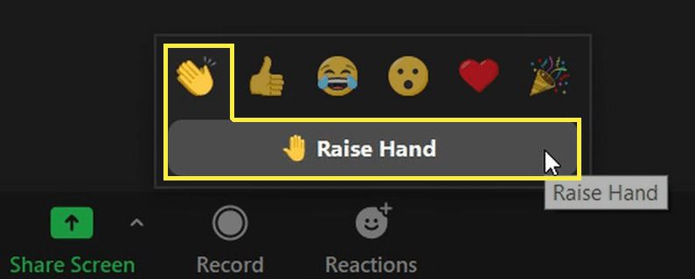

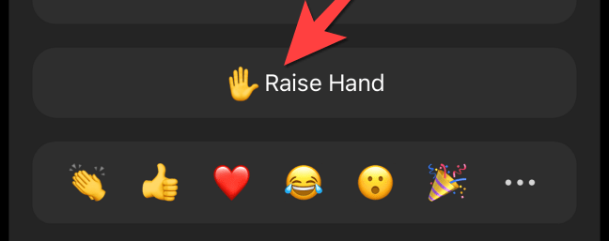




Ask Questions & Comment
Speak
  Click Raise Hand in your meeting controls
  Or Press*9 on the phone line.
  When it is your turn to speak, Press*6 unmute yourself
  To lower your hand, click Raise Hand in your meeting controls.
Submit a Written Inquiry
  Use the Q&A function to submit your comments and/or questions.
  Look for the Q&A button on the control panel, at the bottom of your screen.
Notes:
Erika

Slide 53
Next Steps

Slide 54
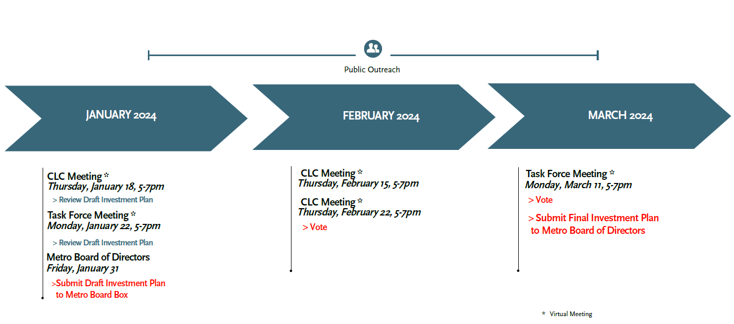
Next Steps – Project Schedule and Timeline
INFORMATION FOR DISCUSSION PURPOSES ONLY – SUBJECT TO CHANGE

Slide 55
Get Involved!
Join us!
Comment
Get informed!
Sign-up for updates
Community Meetings
In-person, virtual, local viewing sites
metro.net/lb-ela-cp-hub
Access the Project Hub & StoryMap, including the NEW Dashboard
Information Booths
Local community events
710corridor@metro.net
213.418.3010
Review the Draft Investment Plan and Other Resources
Pop-ups at activity centers
Transit stations/stops, markets, other
Michael Cano, Executive Officer,
Countywide Planning & Development
Metro
One Gateway Plaza, MS 99-13-1
Los Angeles, CA 90012
Learn more about the Draft Corridor Mobility Investment Plan
as well as options to engage with us and submit your comments by Friday, March 1, 2024: metro.net/lb-ela-cp-hub

Slide 56

Stay Connected
Michael Cano, Executive Officer,
Countywide Planning & Development
Metro
One Gateway Plaza, MS 99-13-1
Los Angeles, CA 90012
213.922.4710
710corridor@metro.net
metro.net/projects/i-710-corridor
@metrolosangeles
losangelesmetro
INFORMATION FOR DISCUSSION PURPOSES ONLY – SUBJECT TO CHANGE

Slide 57
Thank You for Joining Us!

