Slide 1

Thank you for joining us!

Slide 2
La Brea Street Decking Removal
Wilshire Blvd. Full Closures
March 15 & 16, 2022

Slide 3
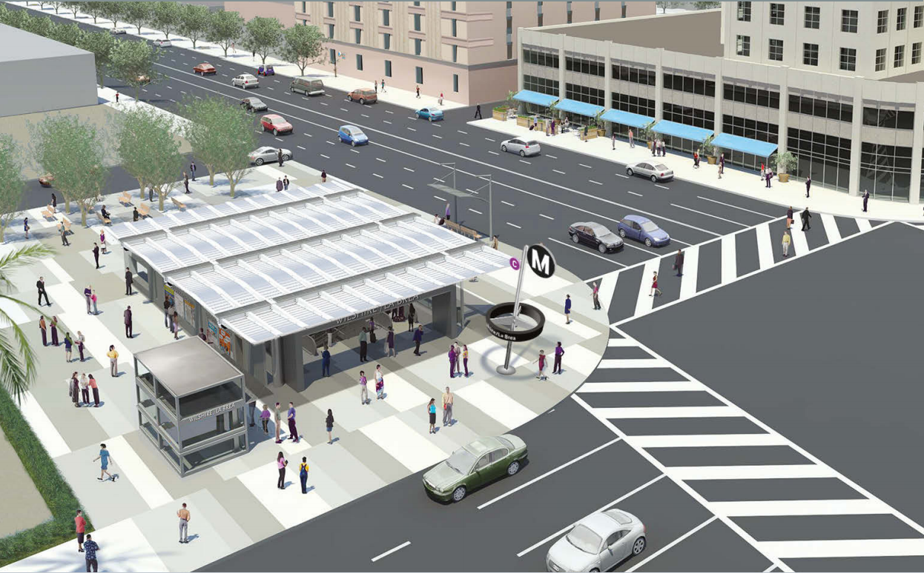
Wilshire/La Brea Station Rendering

Slide 4
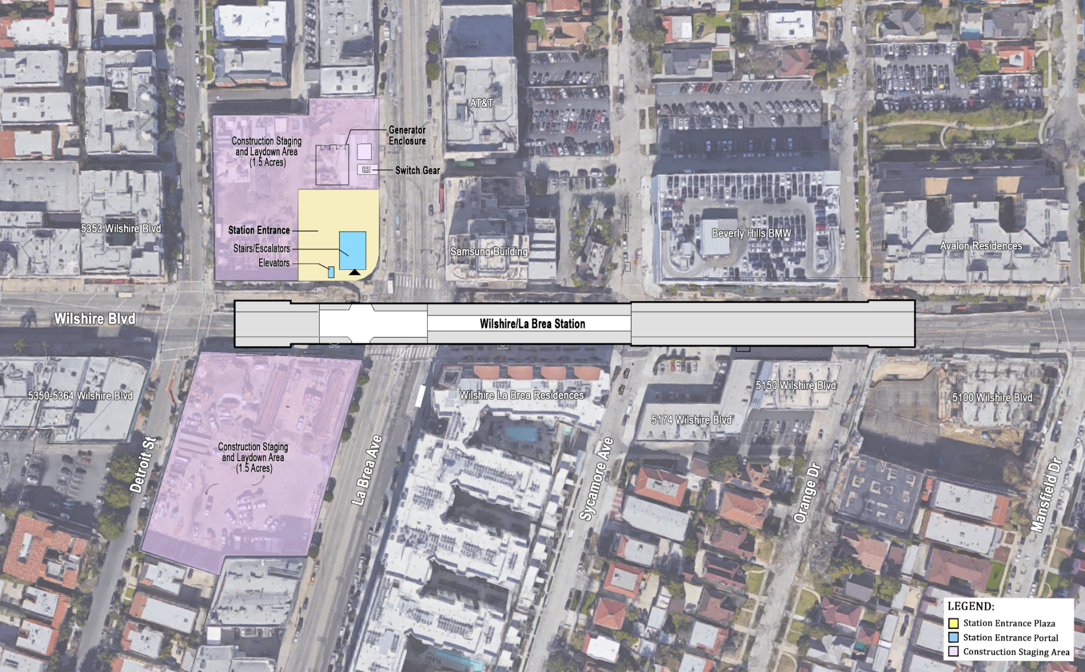
Wilshire/La Brea Station Box
Outline of the Wilshire/La Brea underground station box on Wilshire Bl. from Orange Dr. to Detroit St.

Slide 5
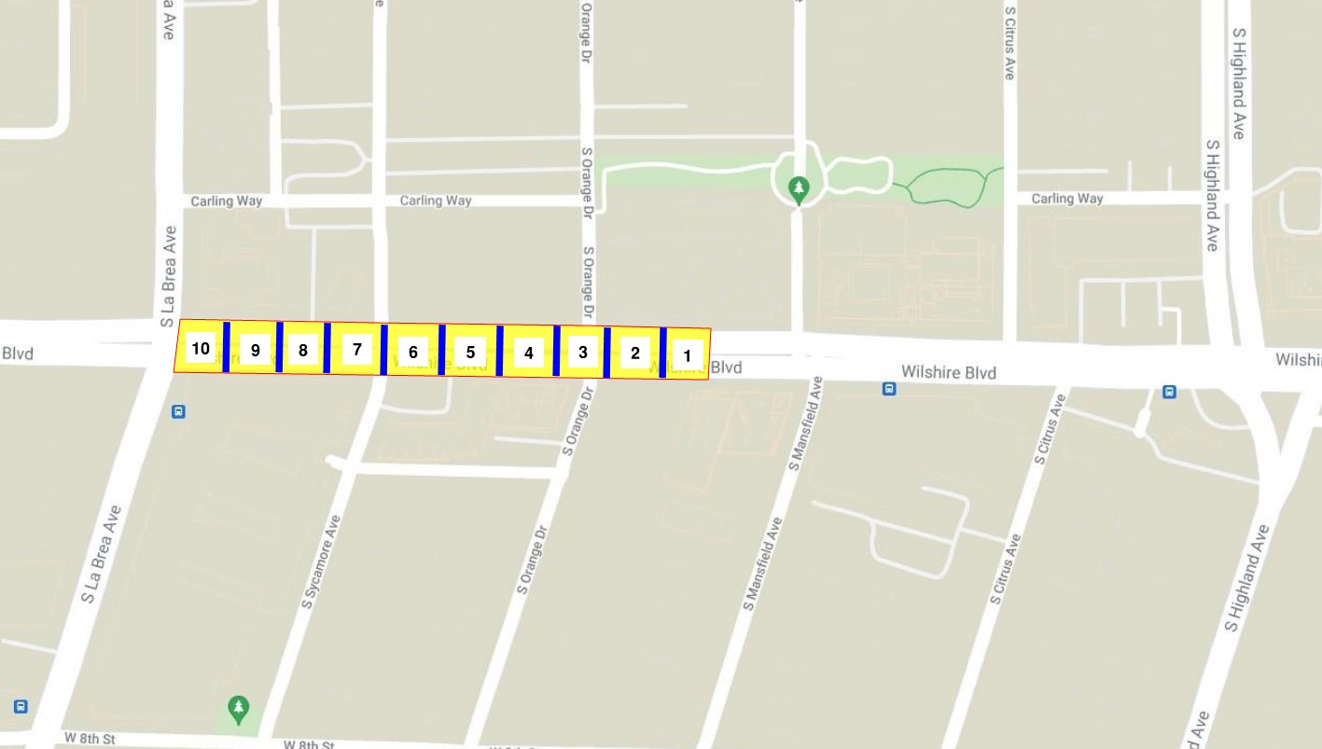
Wilshire/La Brea – Phase 1 Restoration (4.22 to 7.11.2022)
Weekend 1: April 22 – 25
Weekend 2: April 29 – May 2
Weekend 3: May 6 – 9
Weekend 4: May 13 – 16
Weekend 5: May 20 – 23
Memorial Day (No Work): May 27 – 30
Weekend 6: June 3 – 6
Weekend 7: June 10 – 13
Weekend 8: June 17 – 20
Weekend 9: June 24 – 27
Fourth of July (No Work): July 1 – 4
Weekend 10: July 8 – 11
Restoration work to progress from East to West

Slide 6
Wilshire/La Brea Station—Why Street Restoration Now?
Concrete deck panels installed along Wilshire Blvd. adjoining La Brea Ave.
  June to September 2016
Deck panels served as temporary bridge for street traffic and pedestrian access
  Construction of station box continued underground
Station construction now allows for the restoration of portions of Wilshire Blvd.
  Restoration to begin April 2022 between La Brea Ave. and Highland Ave.

Slide 7
La Brea Station – Decking Removal Sequence (Part 1)
Activity | Occurs
Removal of street deck panels along Wilshire Blvd. | Beginning April 2022 9pm to 6am Friday to Monday
Removal of steel beams and support for excavation above station | Saturdays
Utility relocation Construction materials in trucks staged at deck openings Backfilling | Saturdays
Asphalt placement | Sundays

Slide 8
La Brea Station – Decking Removal Sequence (Part 2)
Activity | Occurs
Asphalt testing | Sundays
City agencies examine asphalt | Sundays
Street striping Traffic control device removal Road opening | Sunday night Monday morning

Slide 9
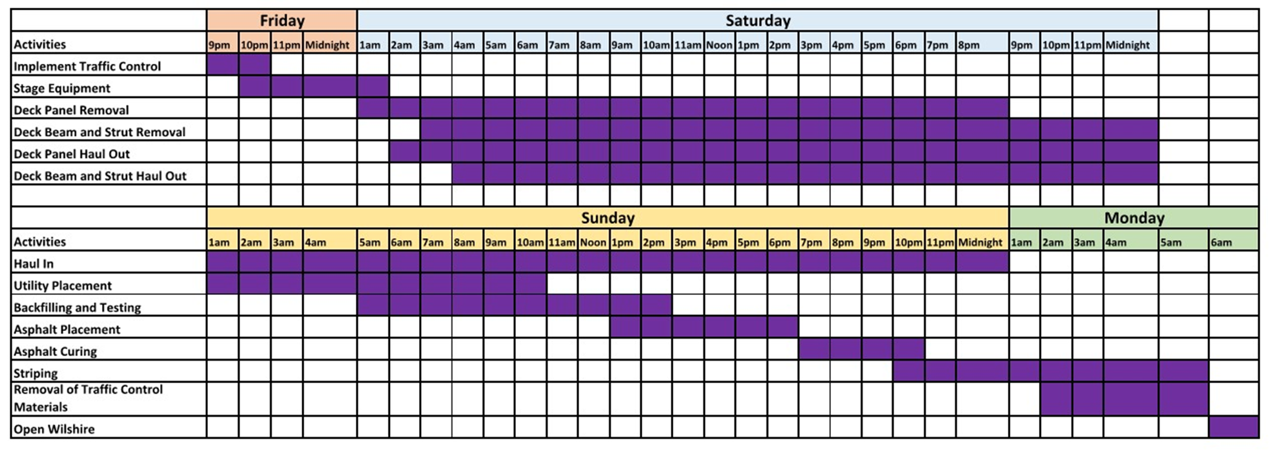
La Brea Station – Decking Removal Schedule
* Subject to Change
Decking removal will begin at 9pm on Friday and continue until Monday at 6am during 10 weekends between April 22 and July 11, 2022.

Slide 10
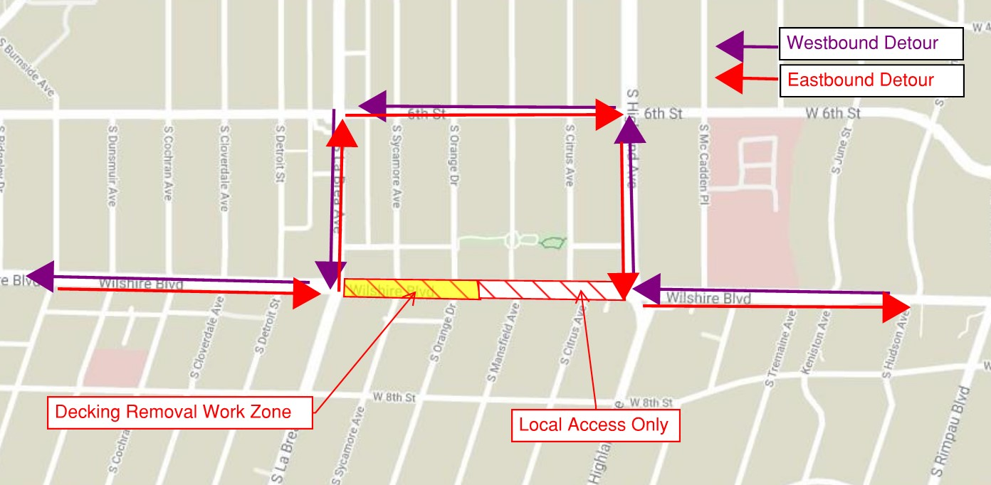
La Brea Station – Traffic Detour Routes

Slide 11
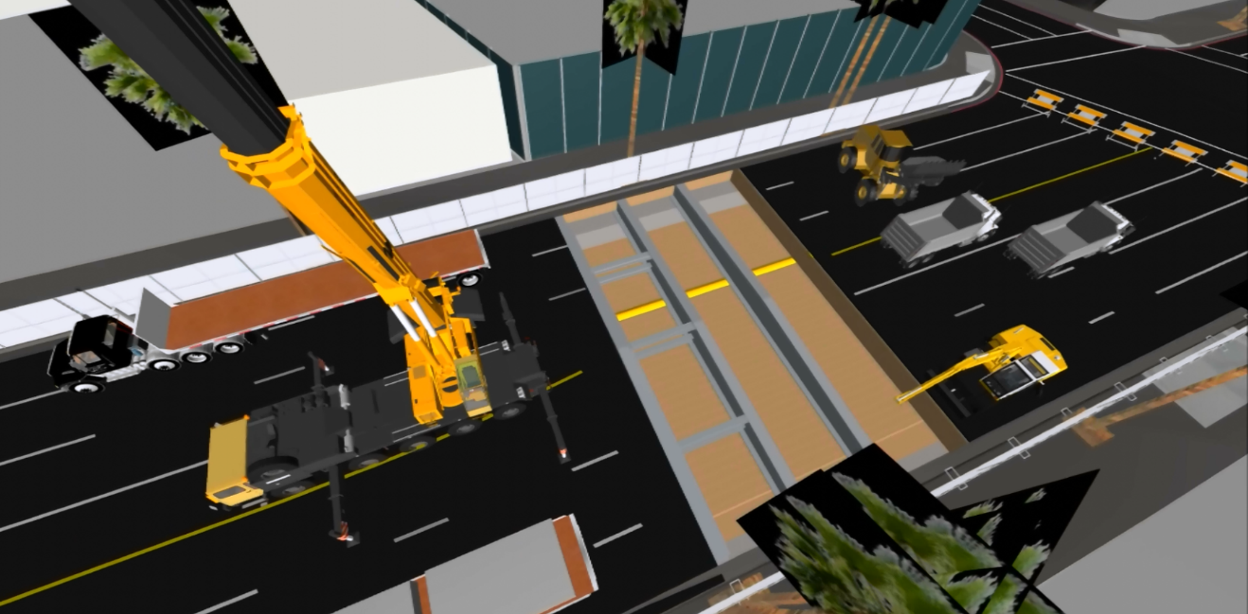
La Brea Station – Decking Removal
Dozens of trucks will be used each weekend to haul steel, decking panels, and SOE out of the area.
Excavators and haul trucks will be utilized during backfilling operations.
Large cranes and other heavy equipment will lift the steel beams and deck panels out of the ground.

Slide 12
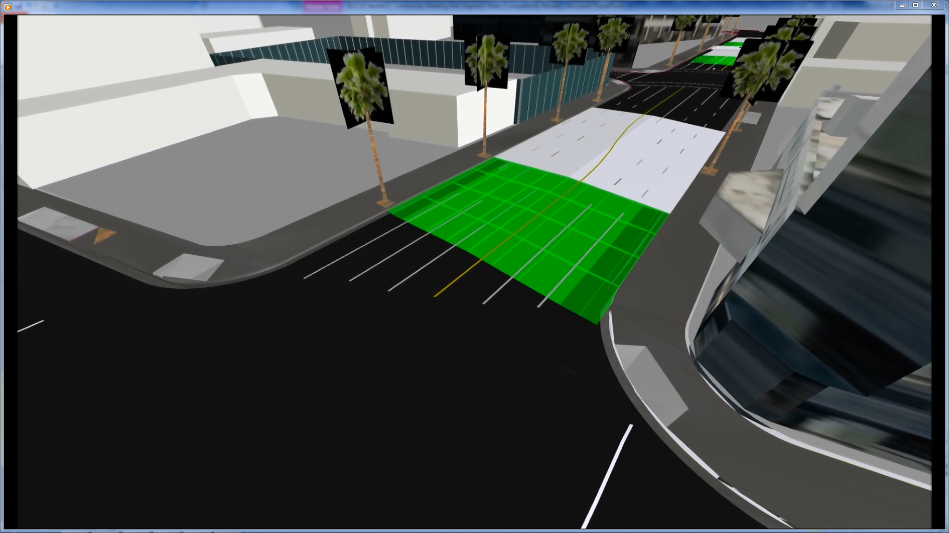
La Brea Station – Decking Removal
Following decking removal, steel beams and SOE haul out, and backfilling and utility placement, a new street surface will be placed from curb to curb.
Work will progress east to west, from one weekend to the next.

Slide 13
La Brea Station – Decking Removal Equipment
Aboveground
Cranes
Haul trucks, dump trucks
Concrete pump
Loaders
Saw cutter, jackhammer
Vibrator, roller
Belowground
Compact excavators
Compact bulldozers
Man lifts, forklifts
Graders
Loaders

Slide 14
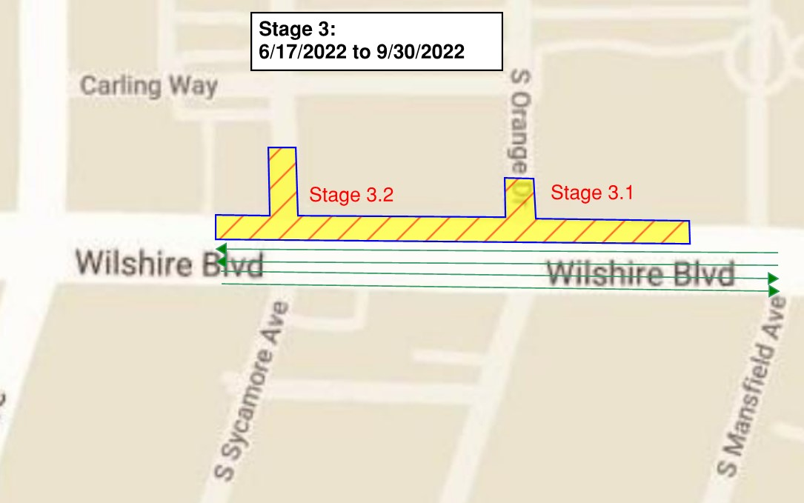
La Brea Station – Post Decking Restoration
*Dates Subject to Change
Starting: July 2022*
Duration: 3 – 6 months*
Curb, Gutter, Bus Pad Restoration
Following deck removal, a work zone will be established on the north side of Wilshire Blvd. between Mansfield Ave. and La Brea Ave.
Work zone supports:
Curb and gutter restoration
Streetlight installation
Tree well installation
Wheelchair and bus lane completion
Sycamore Restoration
Orange Restoration
A traffic control plan for this phase of street restoration is being developed. More specific information will be available later this year.

Slide 15
La Brea Station – Post Decking Restoration
*Dates Subject to Change
November 3, 2021: Purple Line Extension Quarterly Community Meeting/Webinar
December 23, 2021: Briefed Council District 5
January 18, 2022: La Brea Hancock Homeowners Association
January 26, 2022: Greater Wilshire Neighborhood Council, Transportation Committee
February 2, 2022: Purple Line Extension Quarterly Community Meeting/Webinar
February 15, 2022: Door-to-door outreach for businesses
February 17, 2022: Presentation to elected officials
February 23, 2022: Presentation to Wilshire stakeholders
March 10, 2022: Greater Miracle Mile Chamber of Commerce
March 15, 2022: Stakeholders invited to both presentations
March 16, 2022: Stakeholders invited to both presentations
April 1, 2022: Radio and print advertisements; WAZE notified
April 15, 2022: Construction Notice eblast; computer message road signs placed
April 22, 2022: Work begins
Ongoing activities: Construction Notices; weekly lookaheads; 24/7 Hotline, social media posts; monthly neighborhood council meetings

Slide 16
Outreach Schedule
Outreach | Occurs
Quarterly Community Update describes Wilshire/La Brea street restoration. | November 2021
Presentations to elected officials and stakeholders begin. | December 2021 - January 2022
Residents and business owners invited to a meeting describing work. | One month before work begins
Door-to-door outreach conducted Radio and print advertisements describe closures | Two to three weeks before work
New Construction Notice distributed; computer message signs placed around work area. | One week before work
Advertisements continue; new Construction Notice distributed via website and eblast; Weekly Look Ahead email serves as additional reminder. | Three days before each weekend

Slide 17
Stay Informed
Call us on the Project Hotline: 213-922-6934​
  For project questions, concerns and complaints​
  Live during construction work hours ​
  Monday through Friday, 7am to 5pm​
  After 5pm: Leave a voicemail; staff with return call within 24 hours​
  Callers can speak with a person via the Hotline after 5pm by pressing 1​
​
Project Email: purplelineext@metro.net ​
​Receive email project updates and construction notices​
Responses within 24 hours

