Slide 1
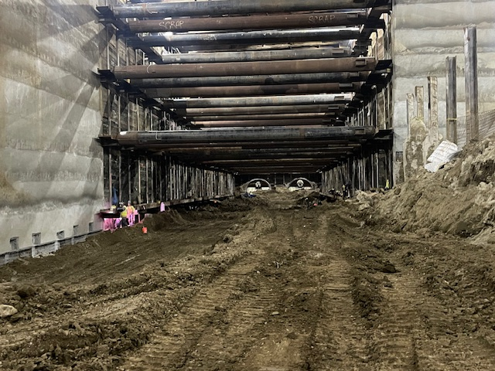
Los Angeles County
Metropolitan Transportation Authority
METRO CONSTRUCTION SAFETY
June 2024 FTA Quarterly Review
Data accumulated through April 2024
Metro construction projects have an average
Recordable Incident Rate of 1.7
Compared to the National Average of 2.4
Photo: PLE 3 Veterans Administration Station Westwood
photo by Bernard Rimando

Slide 2

Westside Purple Line Extension Section 1 Project
Data and Statistics as of: April 30, 2024
Project to Date Total Work Hours: 9,945,415
Total Recordable Injuries: 43
Recordable Injury Rate per 200,000 Labor Hours: 0.86
BLS National Heavy Construction Incident Rate: 2.4
Total Days Away Cases: 5
DART Injury Rate: 0.10
National DART Rate: 1.5

Slide 3
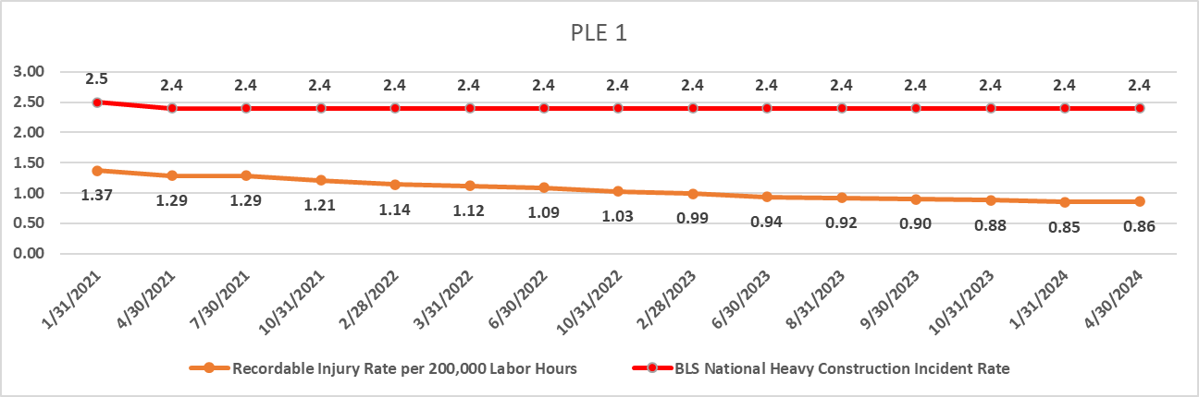
Westside Purple Line Extension Section 1 Project

Slide 4
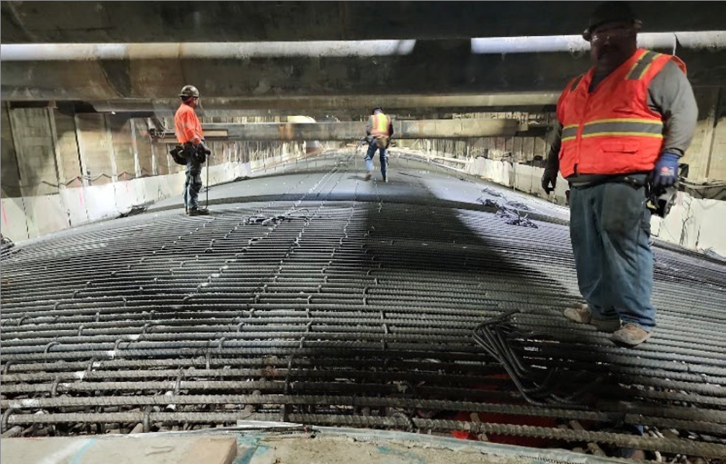
Westside Purple Line Extension Section 2 Project
Data and Statistics as of: April 30, 2024
Project to Date Total Work Hours: 4,122,608
Total Recordable Injuries: 55
Recordable Injury Rate per 200,000 Labor Hours: 2.67
BLS National Heavy Construction Incident Rate: 2.4
Total Days Away Cases: 12
DART Injury Rate: 0.58
National DART Rate: 1.5

Slide 5
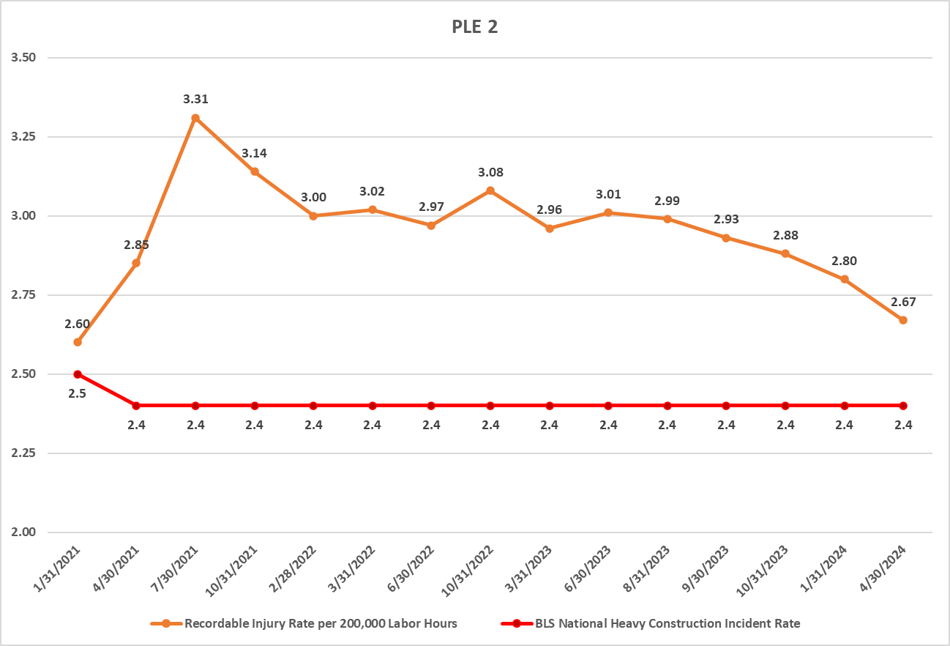
Westside Purple Line Extension Section 2 Project

Slide 6
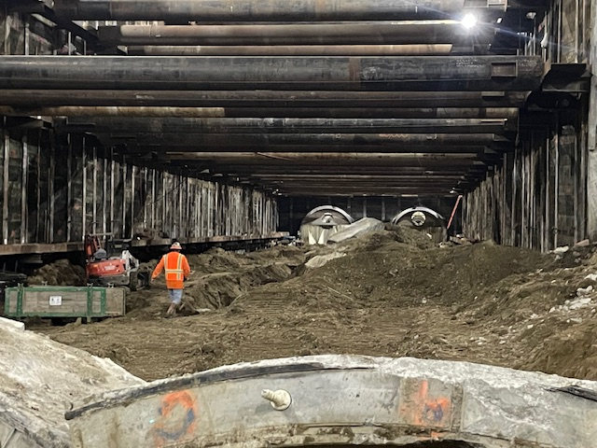
Westside Purple Line Extension Section 3 Projects
Data and Statistics as of: April 30, 2024
Project to Date Total Work Hours: 3,280,555
Total Recordable Injuries: 24
Recordable Injury Rate per 200,000 Labor Hours: 1.46
BLS National Heavy Construction Incident Rate: 2.4
Total Days Away Cases: 5
DART Injury Rate: 0.30
National DART Rate: 1.5

Slide 7
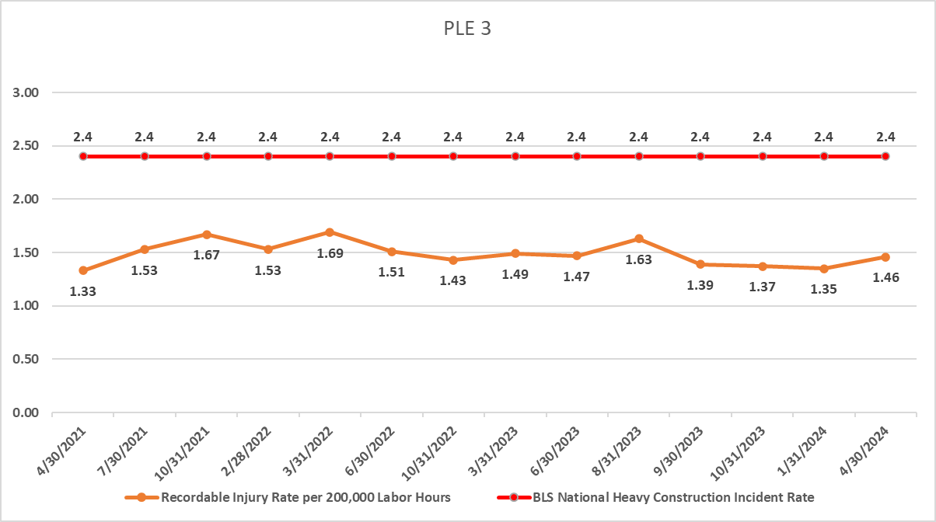
Westside Purple Line Extension Section 3 Projects

Slide 8
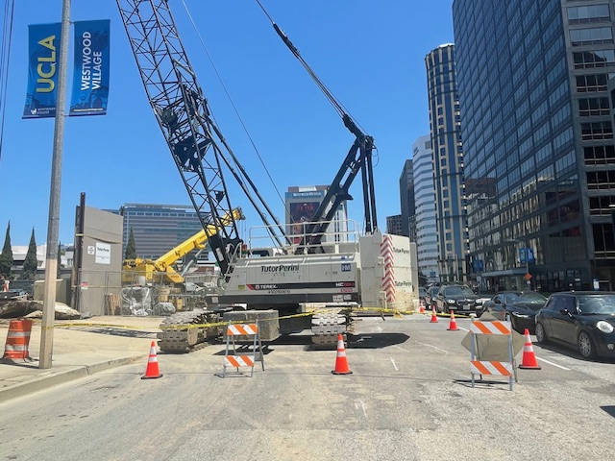
Westside Purple Line Extension Section 3 Project
C1152 Stations Contract
Data and Statistics as of: April 30, 2024
Project to Date Total Work Hours: 1,568,895
Total Recordable Injuries: 3
Recordable Injury Rate per 200,000 Labor Hours: 0.38
BLS National Heavy Construction Incident Rate: 2.4
Total Days Away Cases: 0
DART Injury Rate: 0
National DART Rate: 1.5

Slide 9
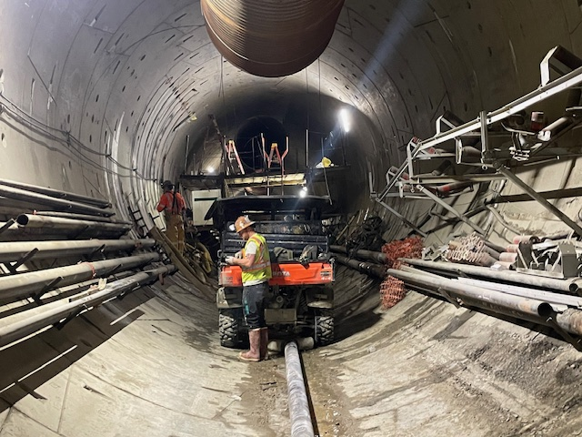
Westside Purple Line Extension Section 3 Project
C1151 Tunnels Contract
Data and Statistics as of: April 30, 2024
Project to Date Total Work Hours: 1,711,660
Total Recordable Injuries: 21
Recordable Injury Rate per 200,000 Labor Hours: 2.45
BLS National Heavy Construction Incident Rate: 2.4
Total Days Away Cases: 5
DART Injury Rate: 0.58
National DART Rate: 1.5

Slide 10
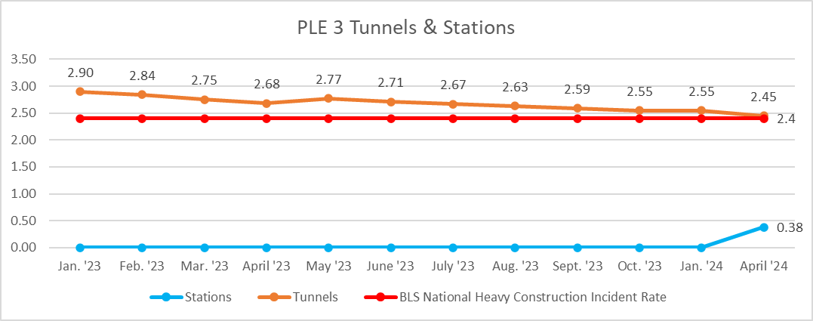
Westside Purple Line Extension Section 3 Project
C1151 Station and Tunnels

