Slide 1
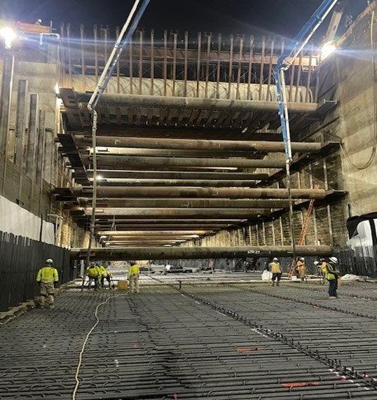
Los Angeles County
Metropolitan Transportation Authority
METRO CONSTRUCTION SAFETY
FTA Quarterly Review
Metro construction projects have an average
Recordable Incident Rate of 1.7
Compared to the National Average of 2.4
Photo: PLE 3 Veterans Administration Station

Slide 2
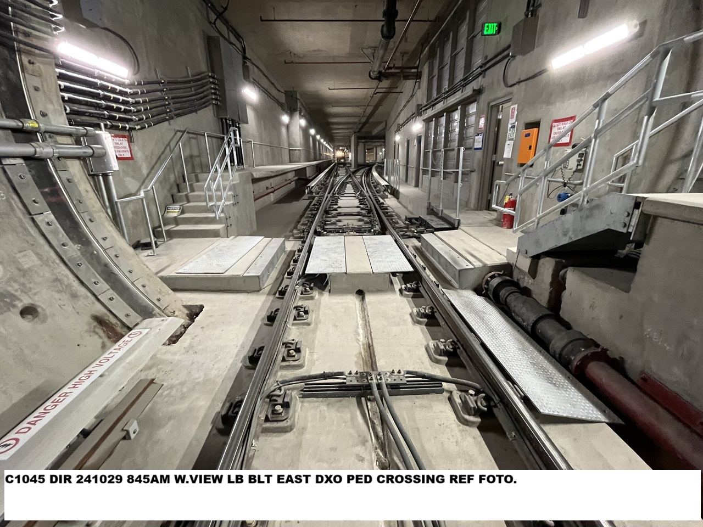
Westside Purple Line Extension Section 1 Project
Data and Statistics as of: September 30, 2024
Project to Date Total Work Hours: 10,456,342
Total Recordable Injuries: 44
Recordable Injury Rate per 200,000 Labor Hours: 0.84
BLS National Construction Incident Rate: 2.4
Total Days Away Cases: 5
DART Injury Rate: 0.10
National DART Rate: 1.5

Slide 3
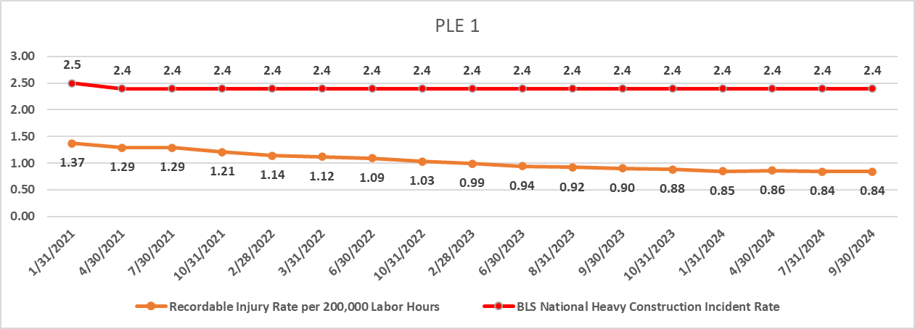
Westside Purple Line Extension Section 1 Project

Slide 4
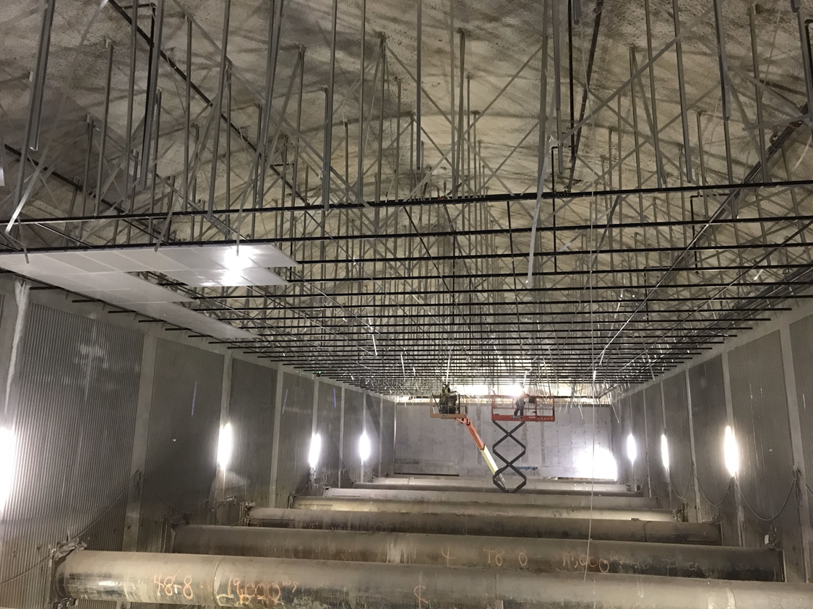
Westside Purple Line Extension Section 2 Project
Data and Statistics as of: October 31, 2024
Project to Date Total Work Hours: 4,757,014
Total Recordable Injuries: 56
Recordable Injury Rate per 200,000 Labor Hours: 2.35
BLS National Construction Incident Rate: 2.4
Total Days Away Cases: 12
DART Injury Rate: 0.50
National DART Rate: 1.5

Slide 5
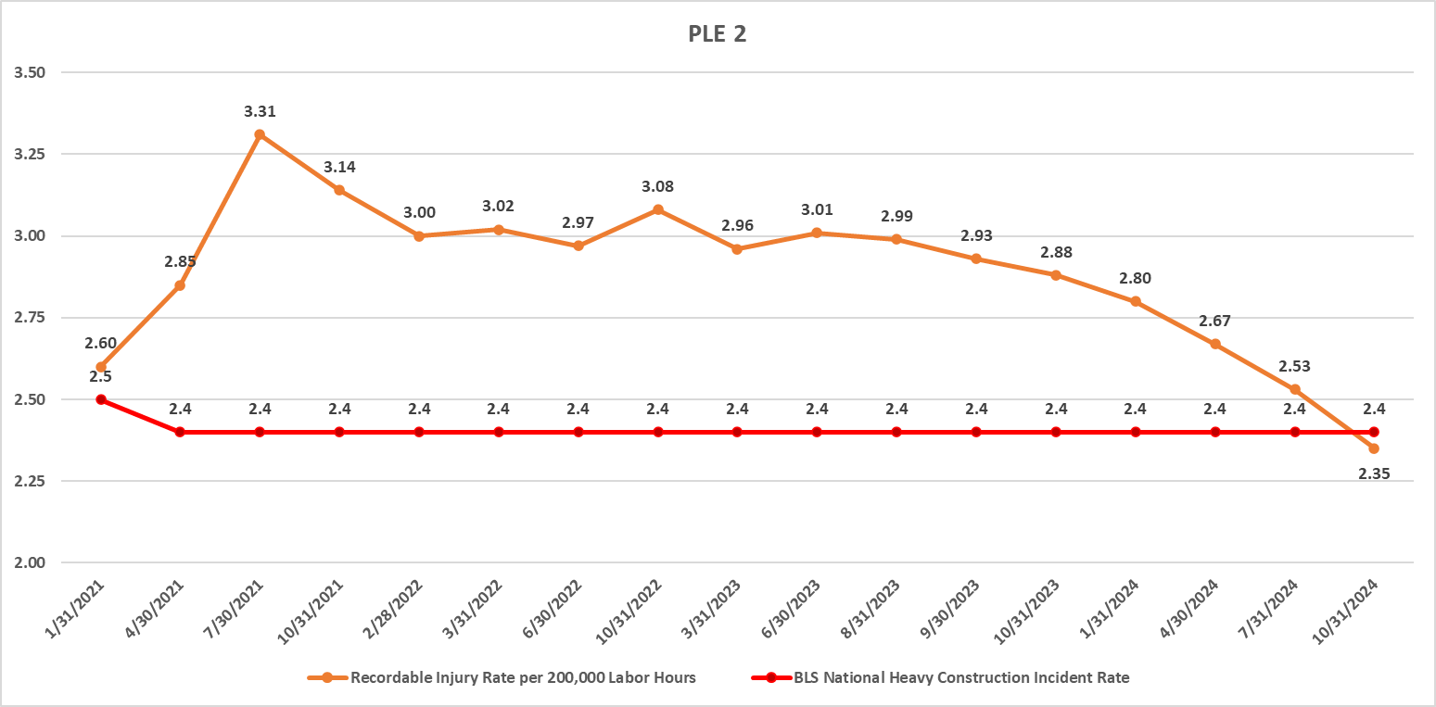
Westside Purple Line Extension Section 2 Project

Slide 6
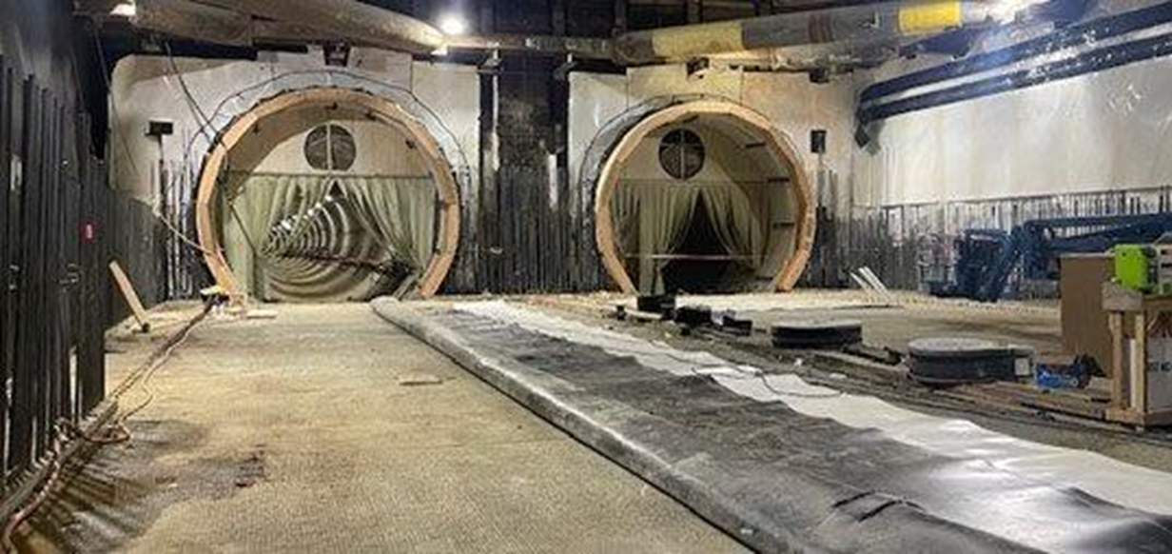
Westside Purple Line Extension Section 3 Projects
Data and Statistics as of: October 31, 2024
Project to Date Total Work Hours: 3,699,055
Total Recordable Injuries: 28
Recordable Injury Rate per 200,000 Labor Hours: 1.51
BLS National Construction Incident Rate: 2.4
Total Days Away Cases: 7
DART Injury Rate: 0.38
National DART Rate: 1.5

Slide 7
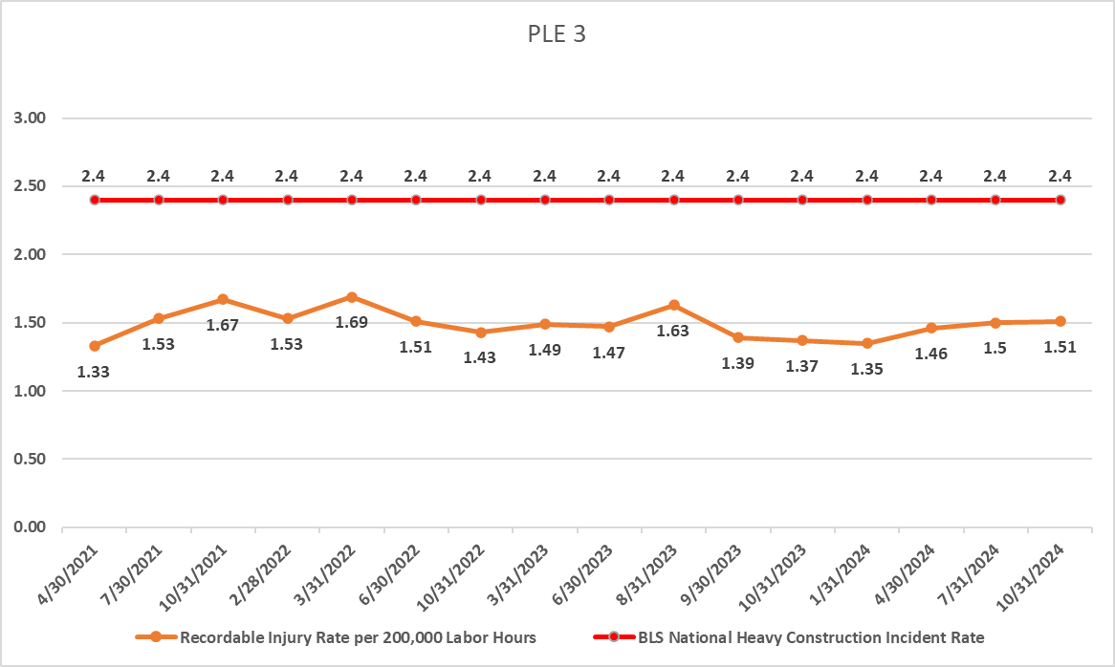
Westside Purple Line Extension Section 3 Projects

Slide 8
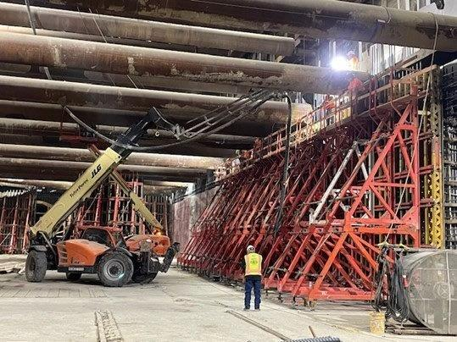
Westside Purple Line Extension Section 3 Project
C1152 Stations Contract
Data and Statistics as of: October 31, 2024
Project to Date Total Work Hours: 1,881,563
Total Recordable Injuries: 6
Recordable Injury Rate per 200,000 Labor Hours: 0.64
BLS National Construction Incident Rate: 2.4
Total Days Away Cases: 2
DART Injury Rate: 0.21
National DART Rate: 1.5

Slide 9
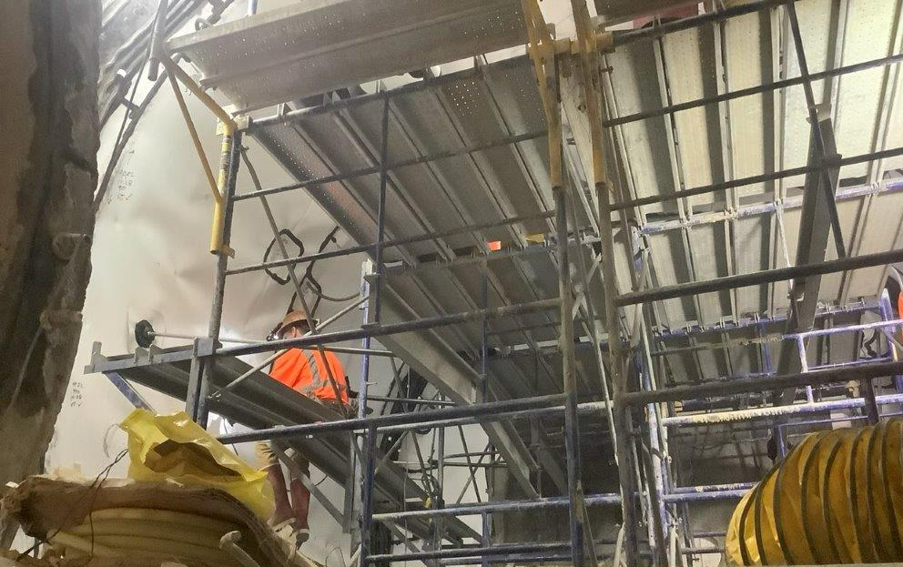
Westside Purple Line Extension Section 3 Project
C1151 Tunnels Contract
Data and Statistics as of: October 31, 2024
Project to Date Total Work Hours: 1,817,492
Total Recordable Injuries: 22
Recordable Injury Rate per 200,000 Labor Hours: 2.42
BLS National Construction Incident Rate: 2.4
Total Days Away Cases: 5
DART Injury Rate: 0.55
National DART Rate: 1.5

Slide 10
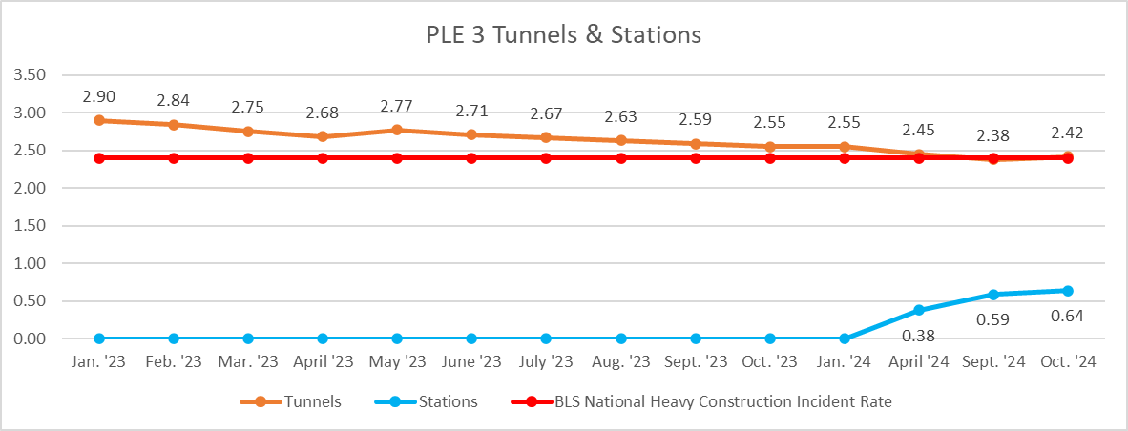
Westside Purple Line Extension Section 3 Project
C1151 Tunnels Contract

