Slide 2

We will begin soon

Slide 3
Panelist
Metro Purple (D) Line Extension Team
  Marlon Walker, Community Relations Manager
  Glyssa Robles, Principal Community Relations Officer
Metro New Media Team
  Stephanie Molen, Principal Community Relations Officer
Contractor Team
  Joanna Amador-Dempsey, Public Information Coordinator

Slide 4

Purple Line Extension Alignment

Slide 5
Sections 1, 2, & 3 Status
 | Forecasted Schedule
Section | Section 1 | Section 2 | Section 3
Length | 3.92 Miles | 2.59 Miles | 2.56 Miles
New Stations | Wilshire/La Brea Wilshire/Fairfax Wilshire/La Cienega | Wilshire/Rodeo Century City/ Constellation | Westwood/UCLA Westwood/VA Hospital
Pre-Construction Activities | 2014 – 2015 | 2016 – 2018 | 2018 – 2019
Construction | 2015 – 2024 | 2018 – 2025 | 2019 – 2027
Operations | 2024 | 2025 | 2027
*Subject to change. The PLE project team is working to deliver the project consistent with Measure M.

Slide 6
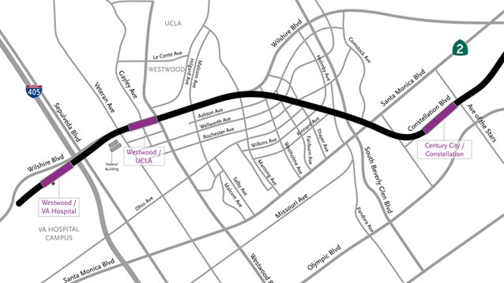
Section 3 Tunnel From Century City to Westwood

Slide 7
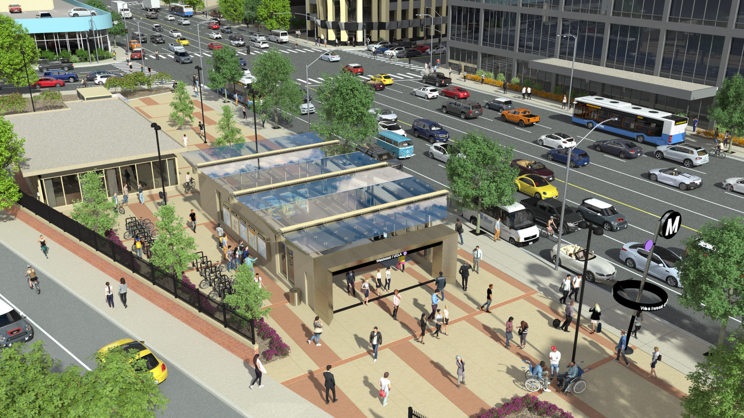
Westwood/UCLA Station Rendering (Northwest Entrance)

Slide 8
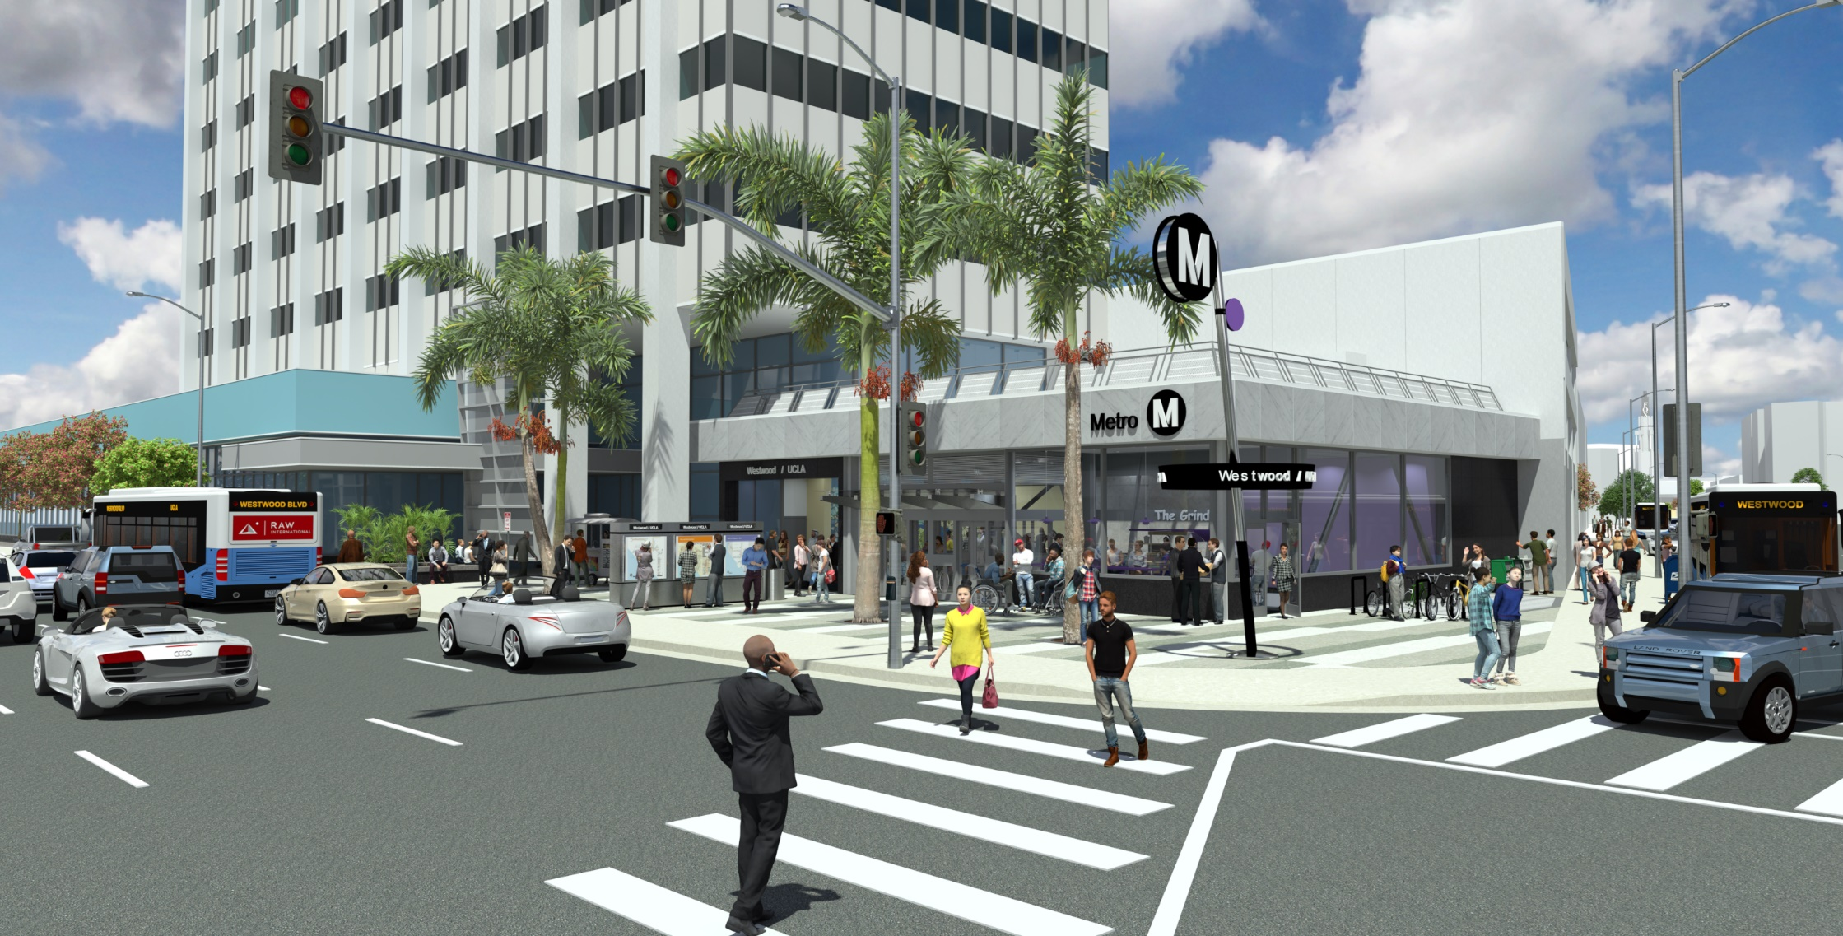
Westwood/UCLA Station Rendering (Northeast Entrance)

Slide 9
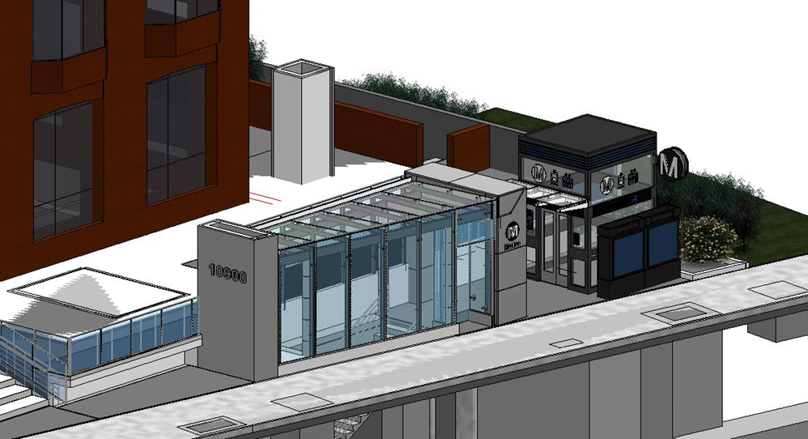
Westwood/UCLA Station Rendering (Southeast)
DRAFT

Slide 10

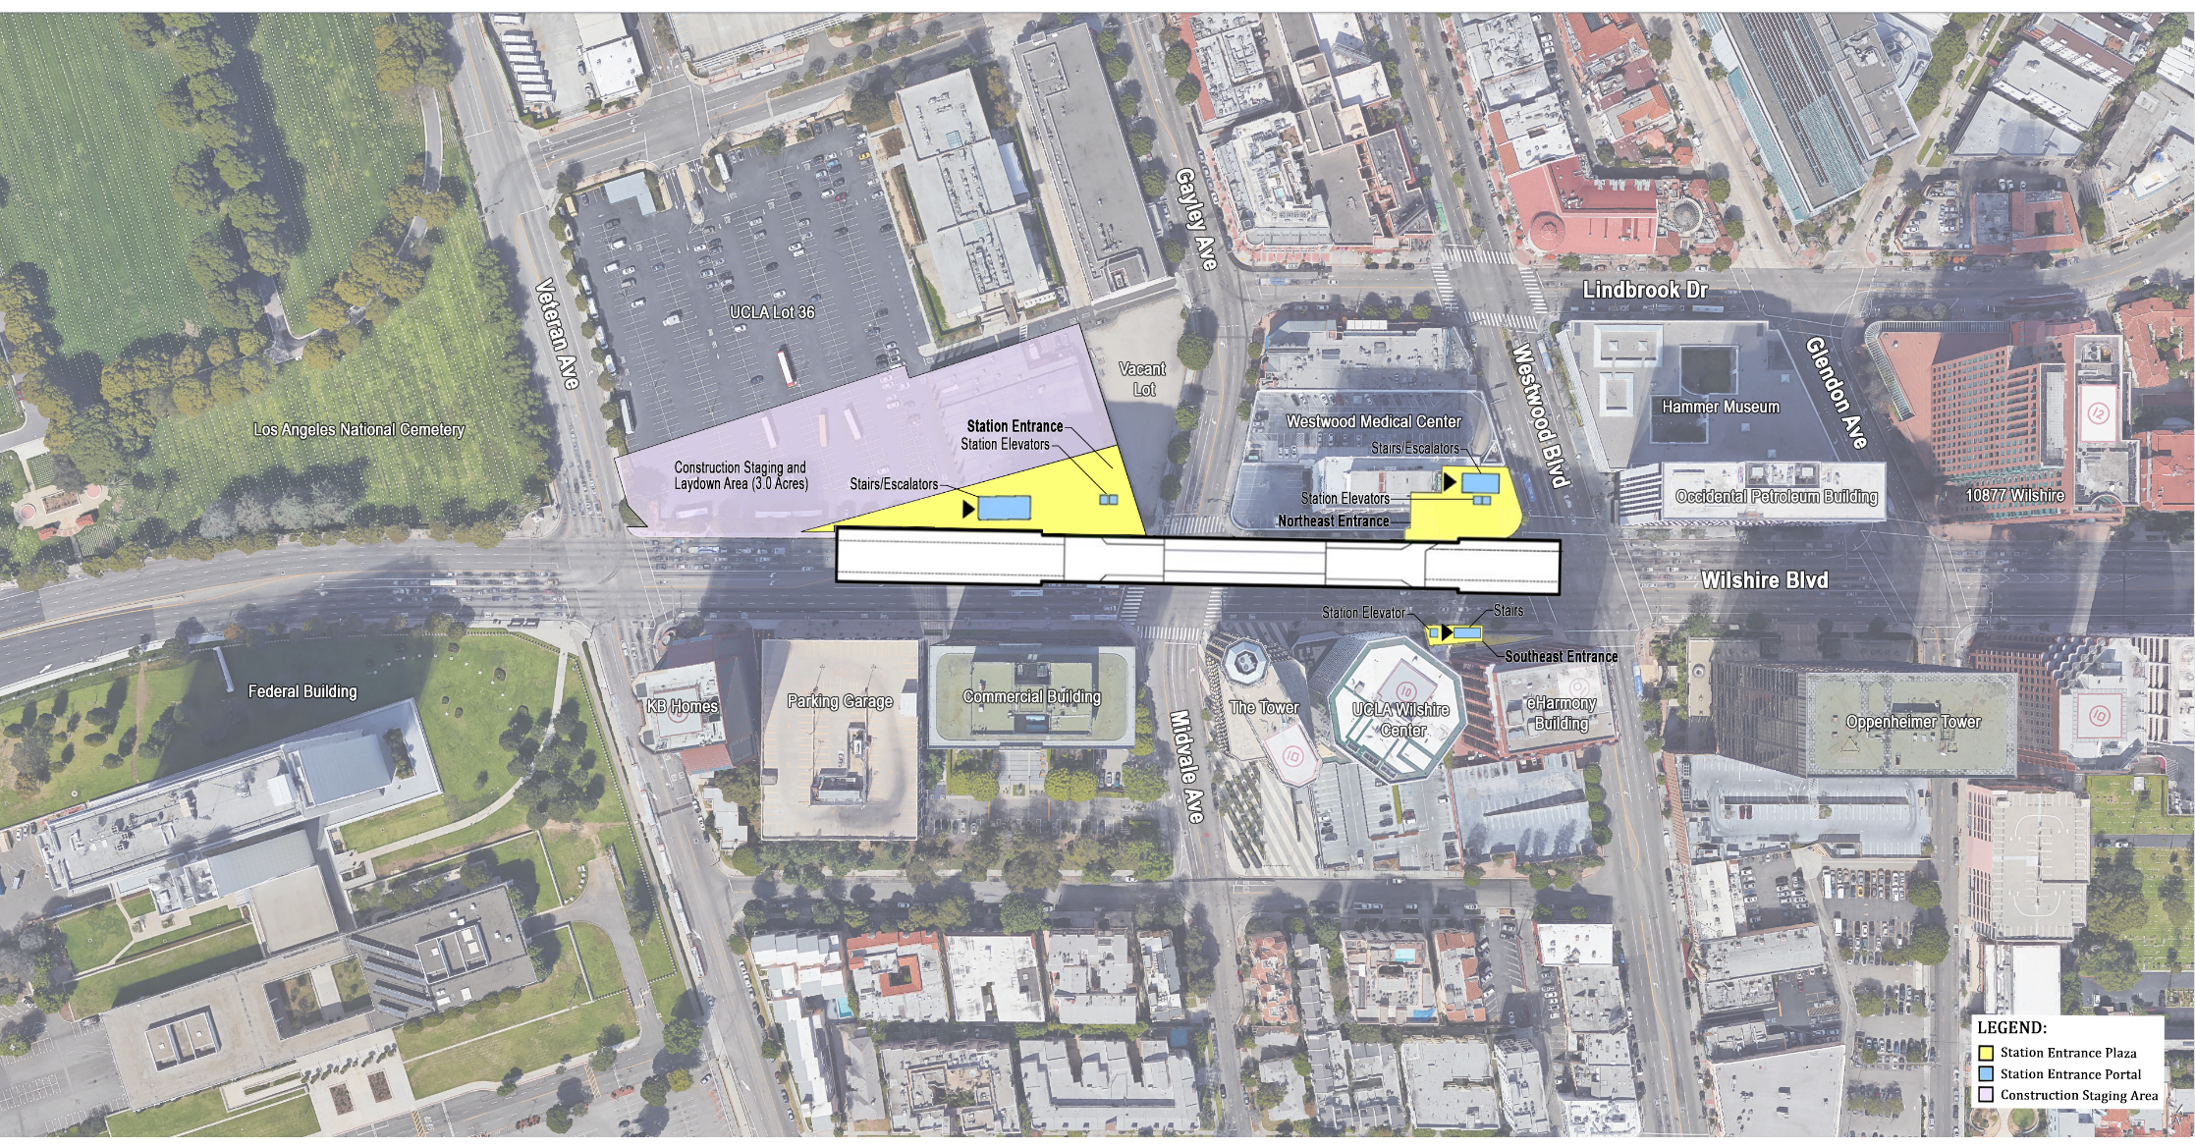
Westwood/UCLA Station Box
Rendering shows length of the underground station box on Wilshire Bl between
Westwood Bl and Veteran Av

Slide 11
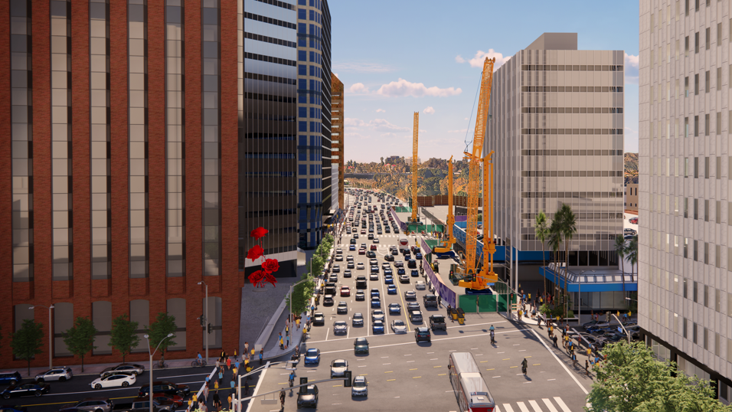
Piling for the Westwood/UCLA Station

Slide 12
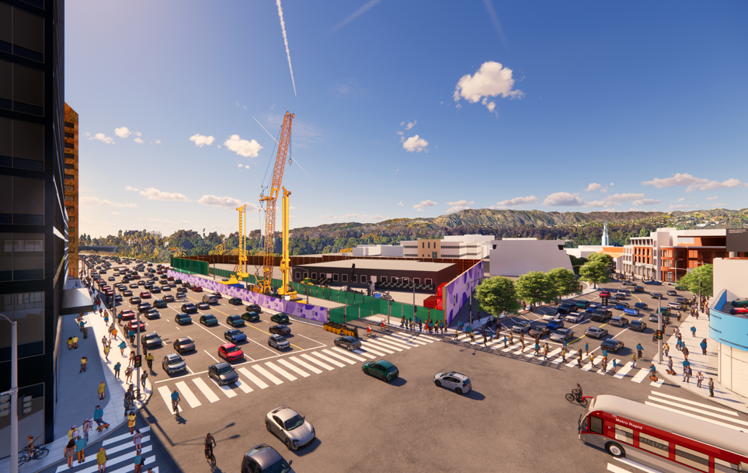
Piling for the Westwood/UCLA Station

Slide 13
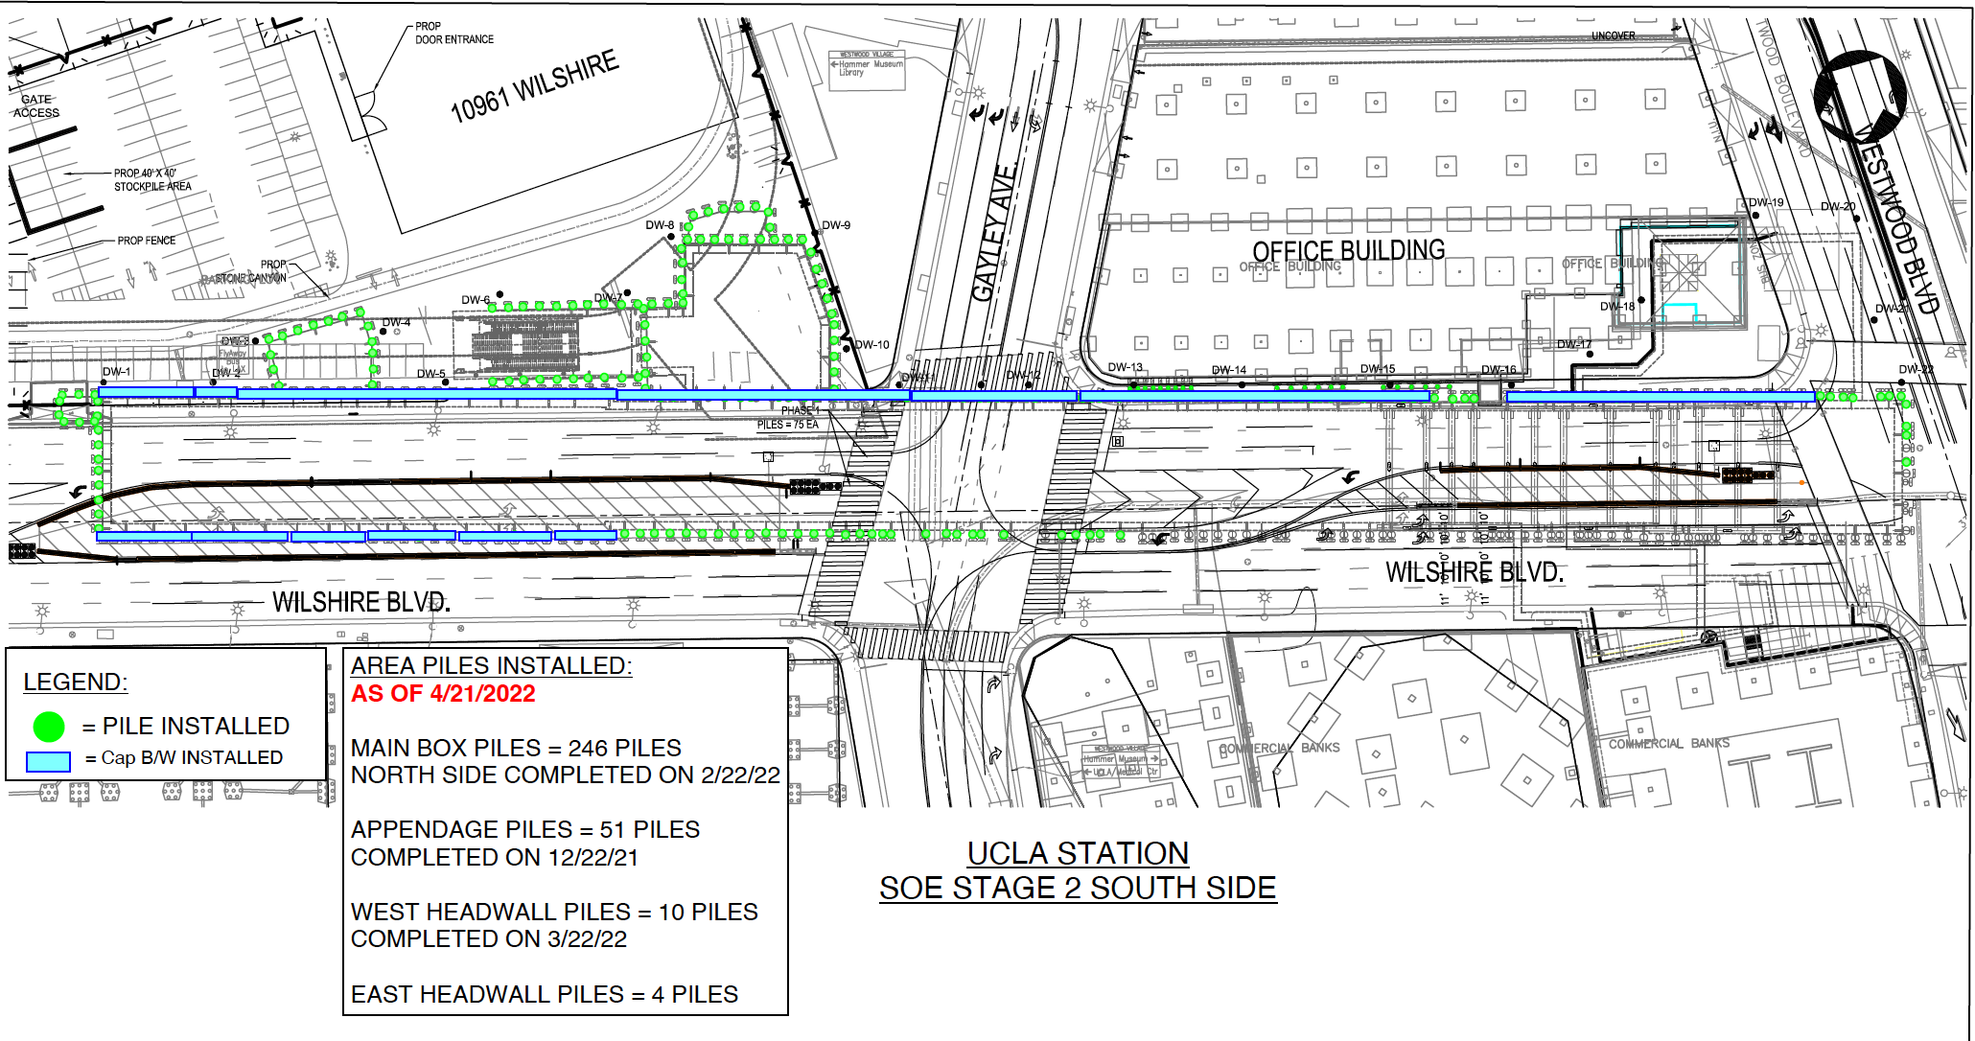
Westwood/UCLA Station Piling
311 Piles Installed. 468 Total Piles for Station.

Slide 14
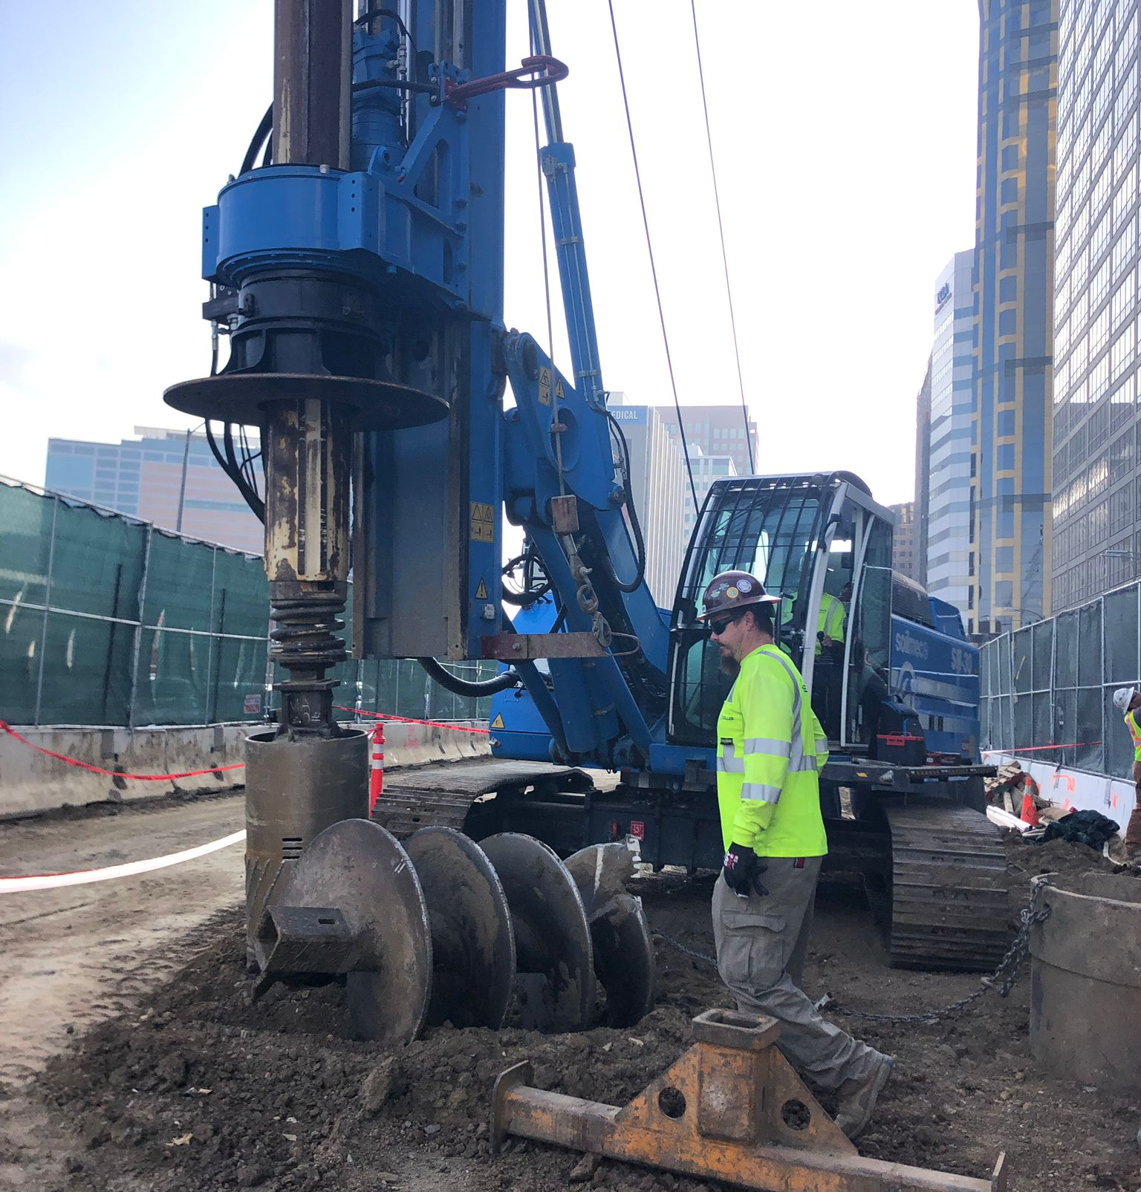
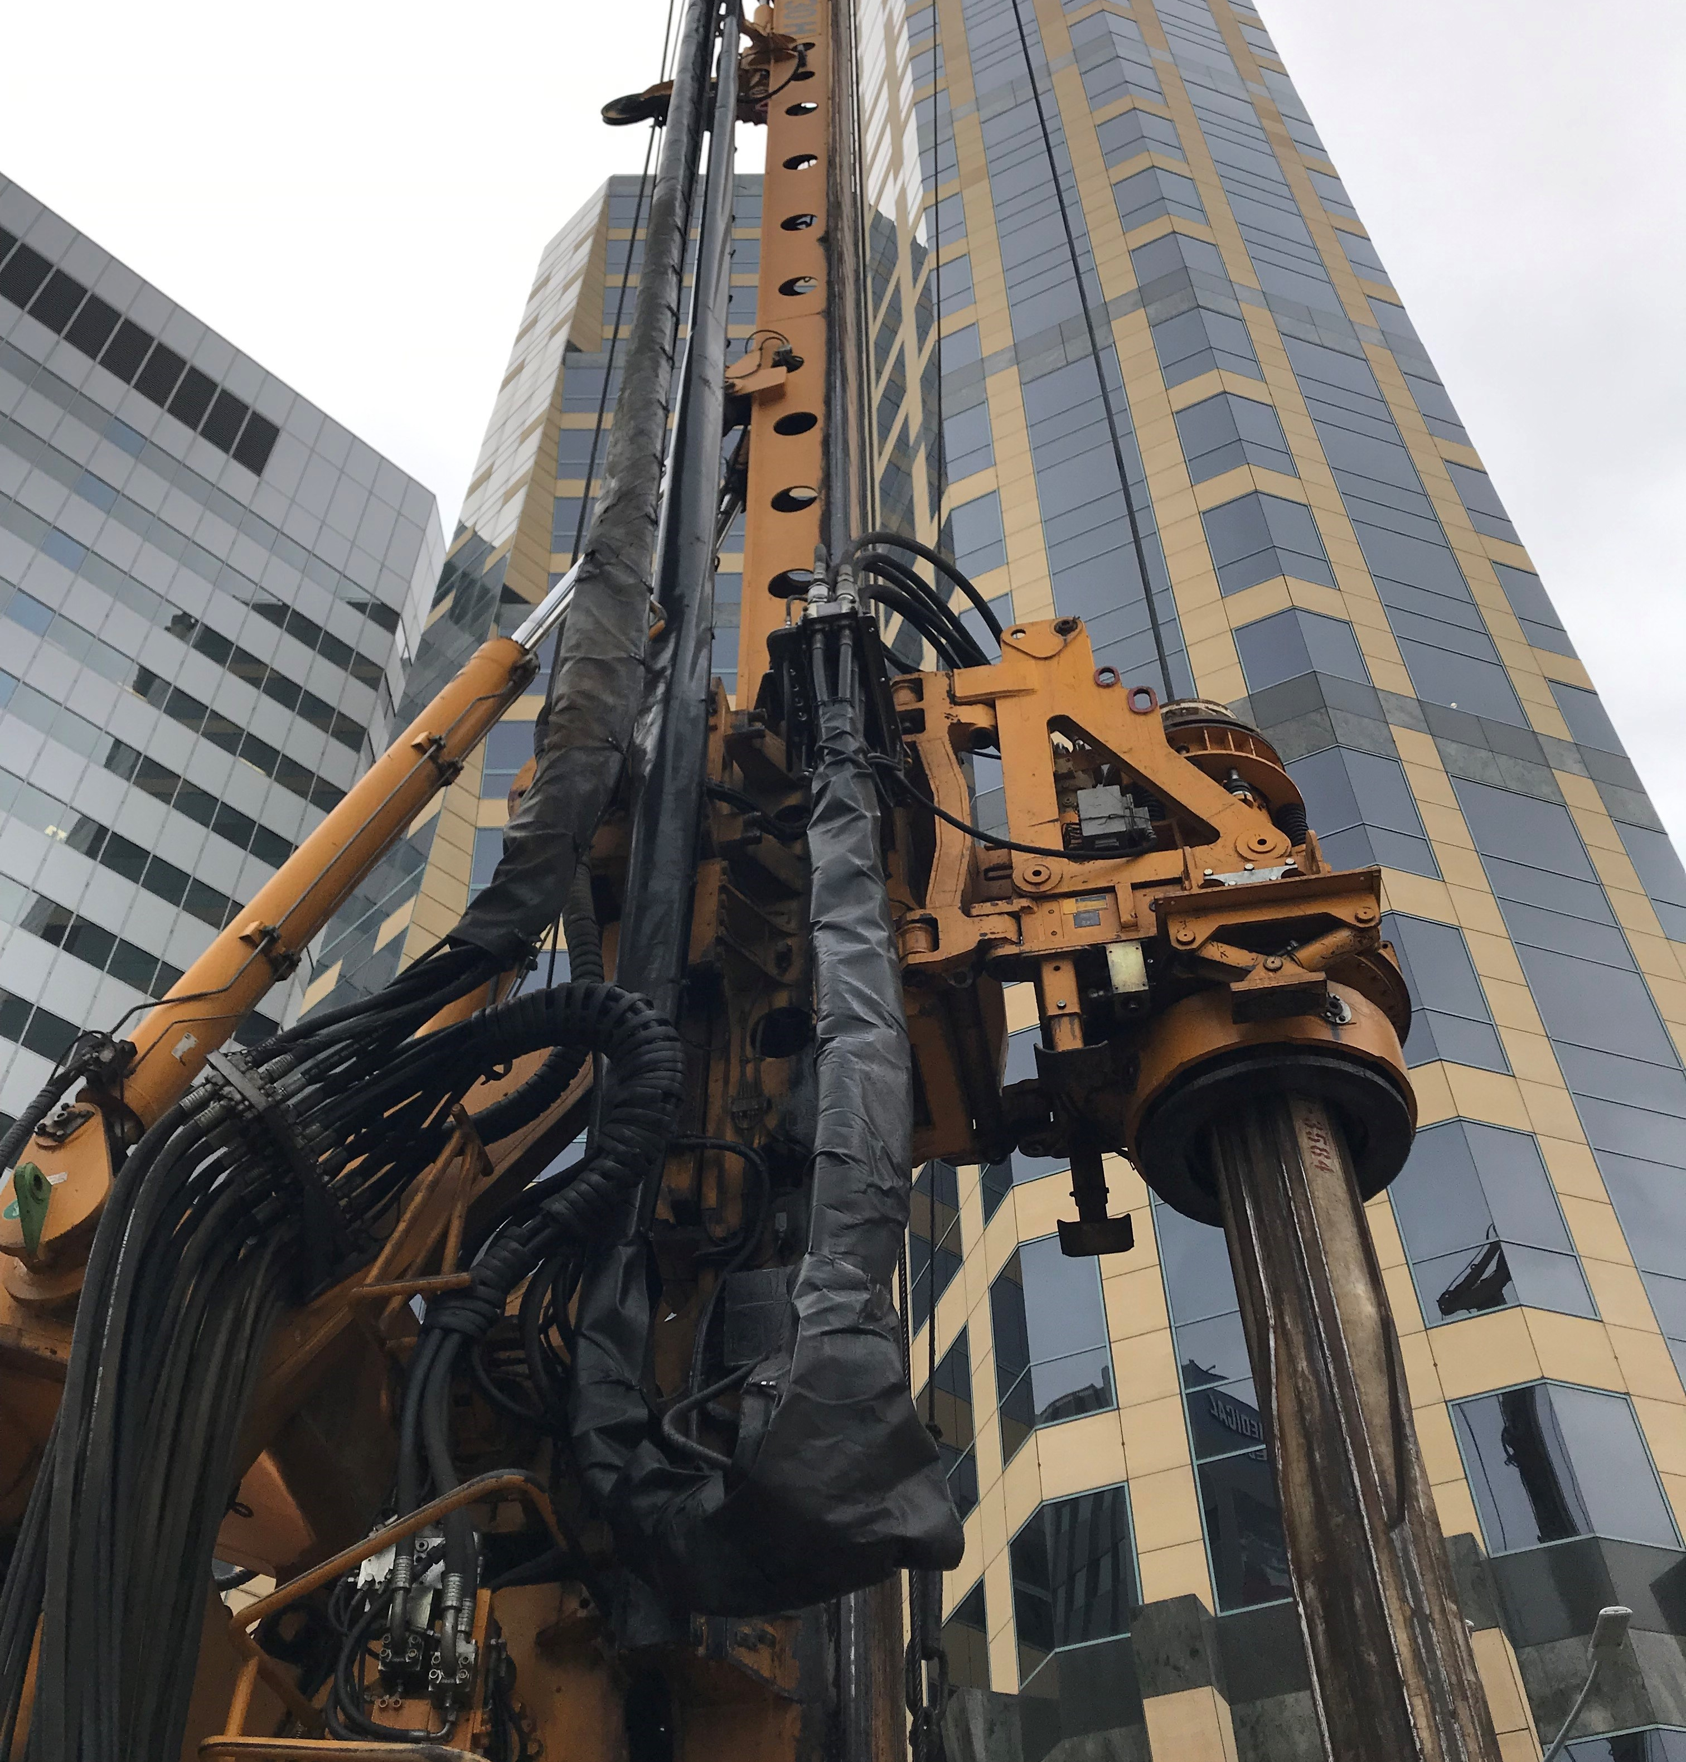
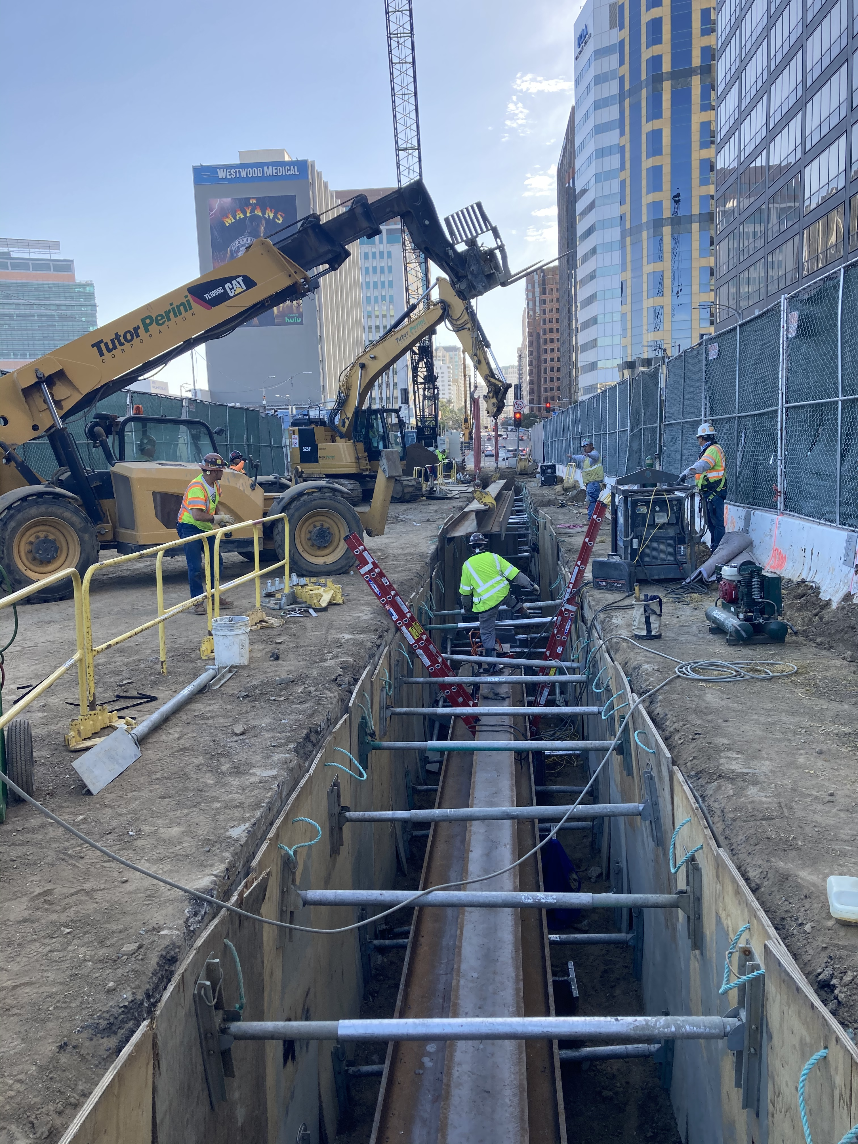
Piling Progress Westwood/UCLA Station

Slide 15
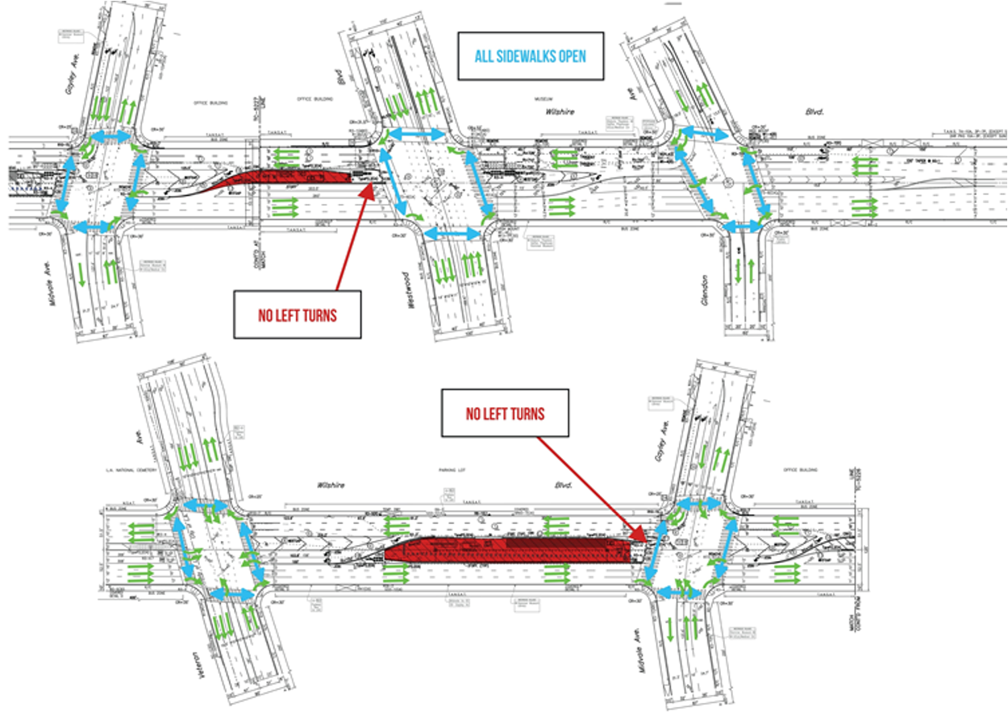
Westwood/UCLA Piling Stage 2
Nightly:
Mon to Thurs, 9pm to 6am
Weekend:
Continuous 9pm, Fri to 6am, Mon

Slide 16
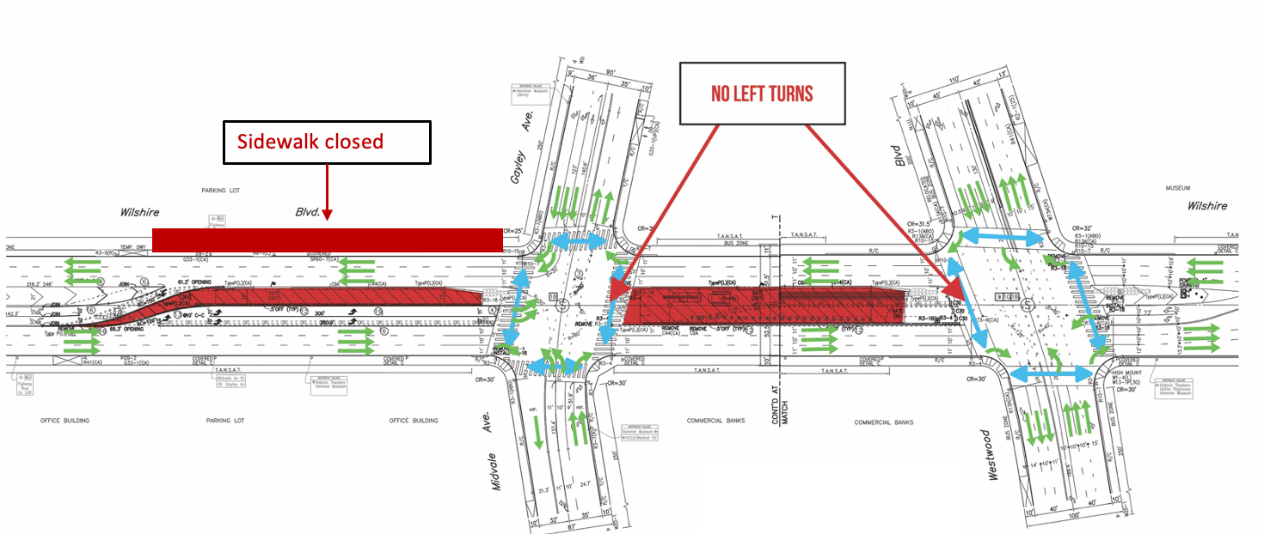
Stage 2F: May 20 through the end of June
Nightly:
Mon to Thurs, 9pm to 6am
Weekend:
Continuous 9pm, Fri to 6am, Mon

Slide 17
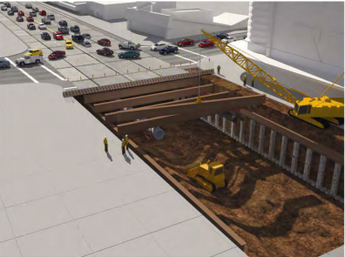
Decking for the Westwood/UCLA Station
Anticipated Summer 2022*
Deck installation will be on Wilshire Bl between Westwood Bl and Veteran Av.
Construction of a concrete deck, curb to curb, approximately 12 ft deep.
Decking will serve as temporary street surface.
*Construction is a dynamic process. The schedule is subject to change

Slide 18
Decking for the Westwood/UCLA Station
Traffic will travel on the deck panels while the station is constructed underground.
Temporary partial street closures will be implemented on Wilshire Bl. Traffic will be detoured around the construction work.
Station Box is 894 ft long, 75 ft wide, 65 ft deep.
Over 700 panels will be installed during decking.
*Construction is a dynamic process. The schedule is subject to change

Slide 19
Decking for the Westwood/UCLA Station
Duration:
There are 4 stages for decking with varying traffic patterns.
Anticipated for 14 weekends to complete
Typical Work Schedule:
Work will be completed on weekend, Friday to Monday, 11 pm to 6am
Work Activities:
Excavation to uncover cap beam and piles
Install deck beam supporting the deck panels
Restriping the deck panels for future community use
*Construction is dynamic and the schedule is subject to change​

Slide 20
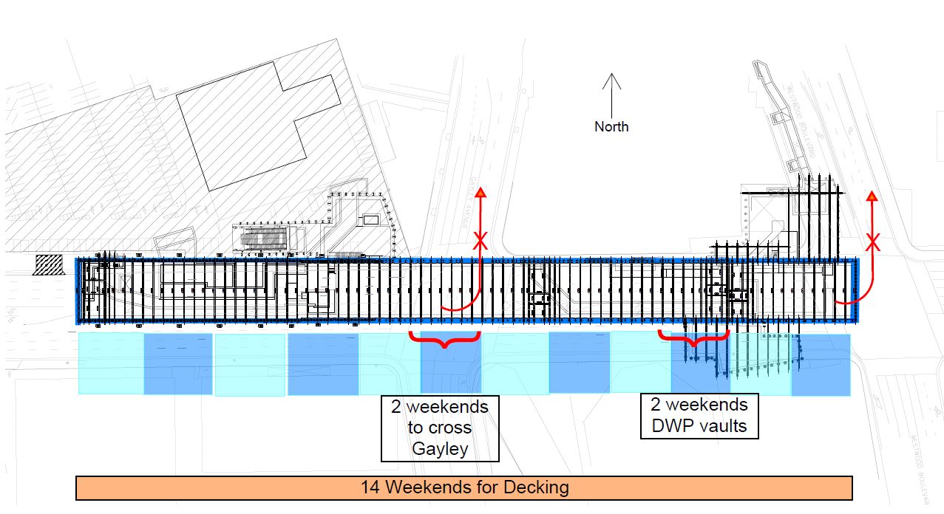
Decking for the Westwood/UCLA Station

Slide 21
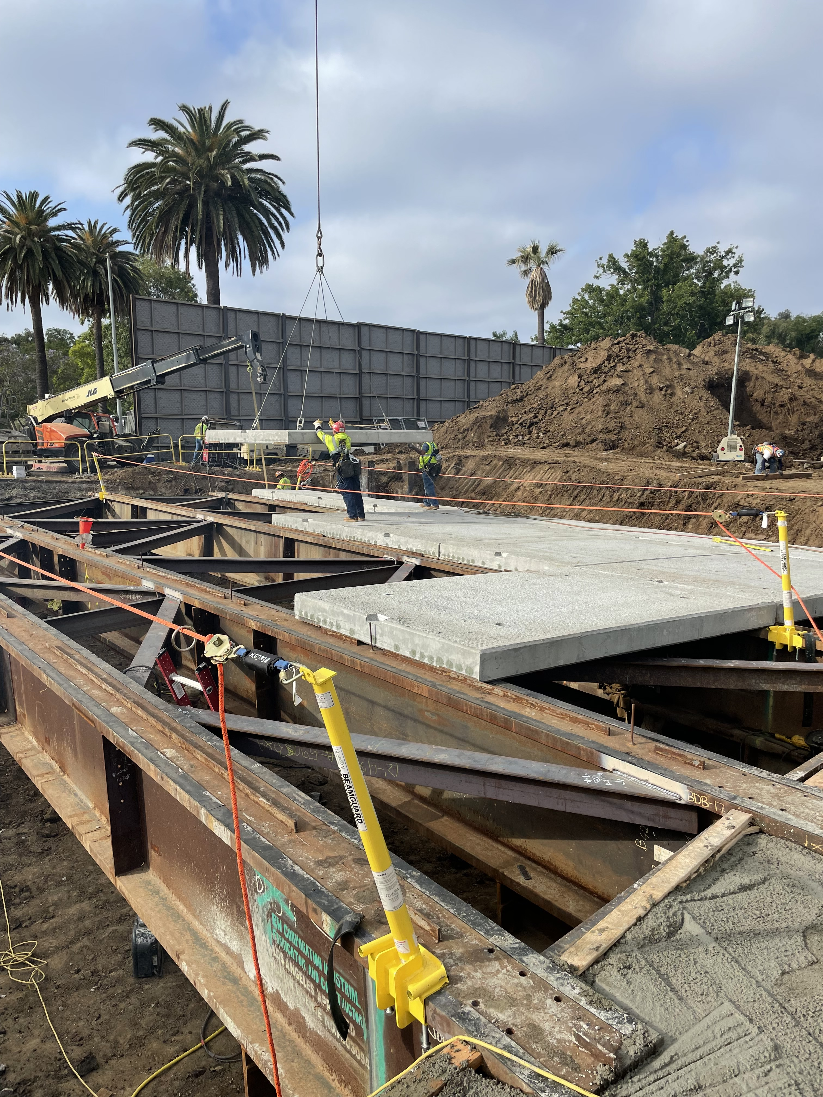
Examples of Decking on Bonsall Av at the VA Hospital Campus

Slide 22
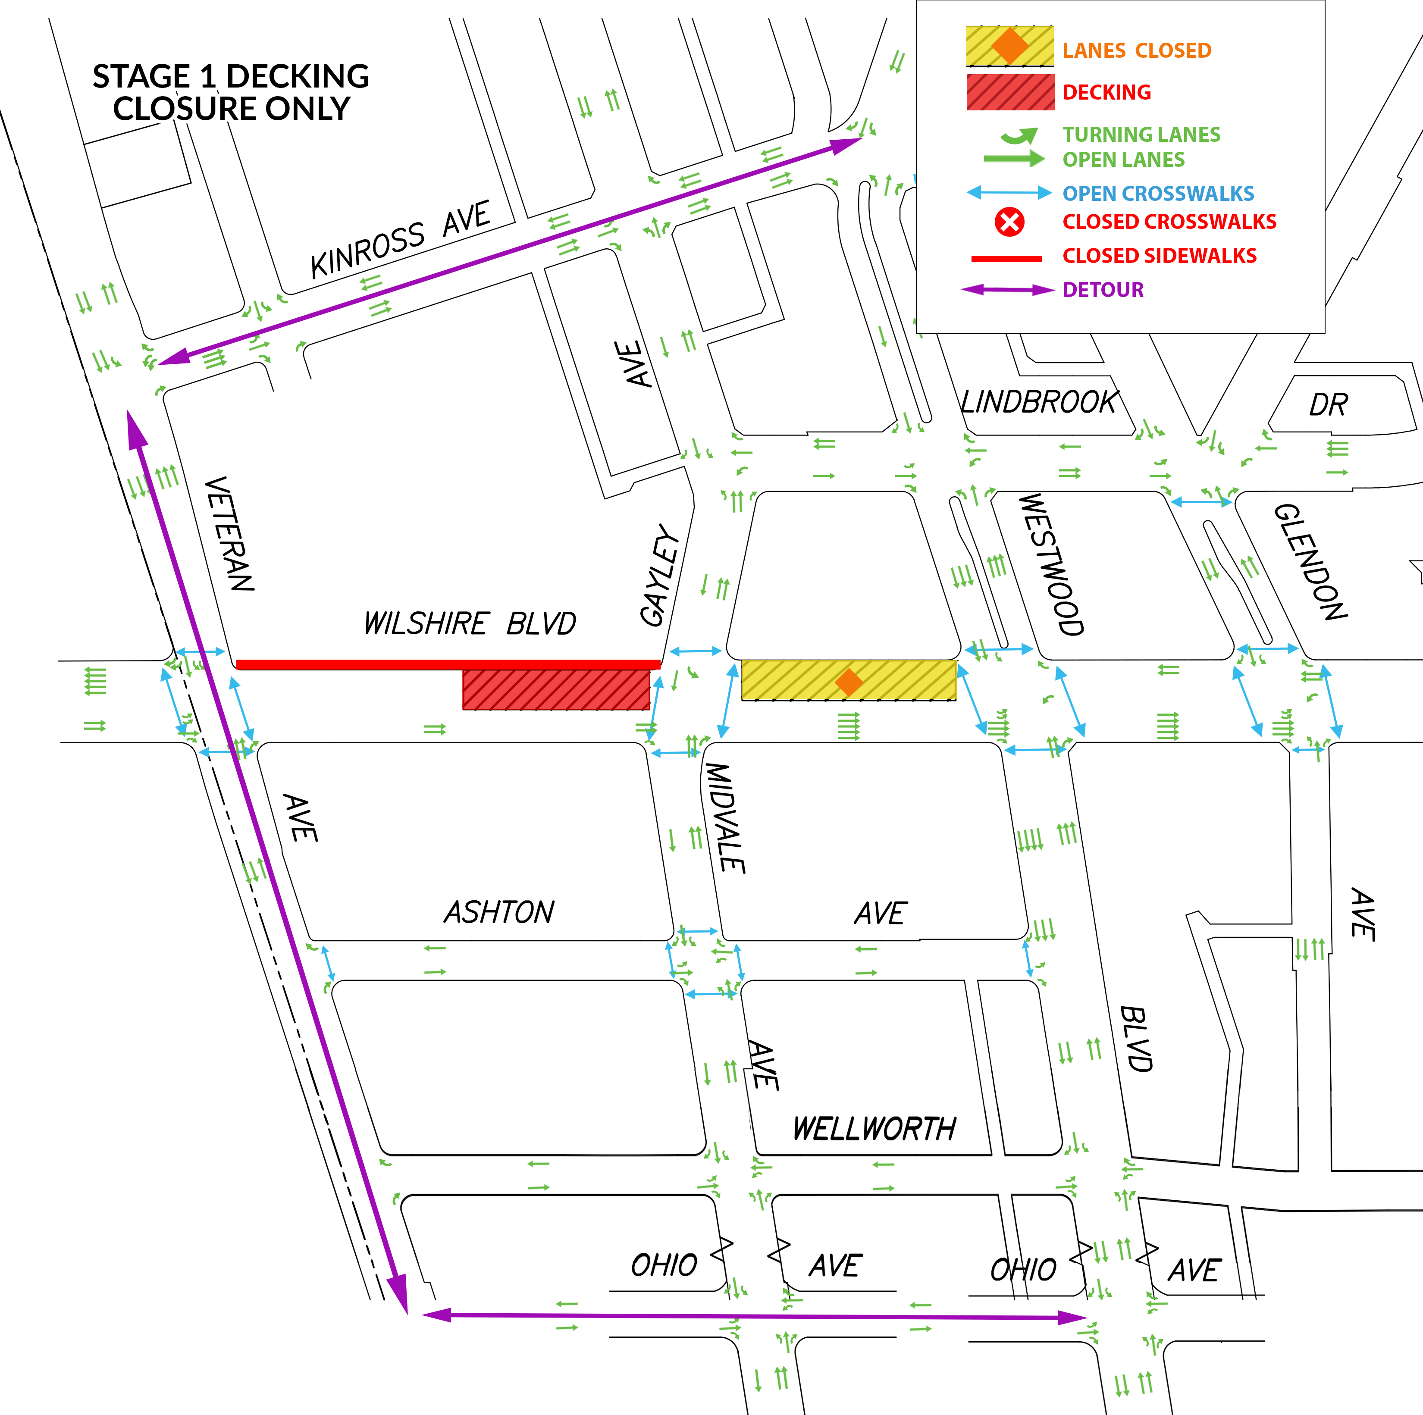
Decking: Stage 1
The red is the work area and yellow is the closure.
Eastbound Wilshire Bl traffic access maintained.
Westbound traffic detoured at Westwood Bl either to Kinross Av or Ohio Av.
*Construction is dynamic and the schedule is subject to change​. Plans are pending approval.

Slide 23
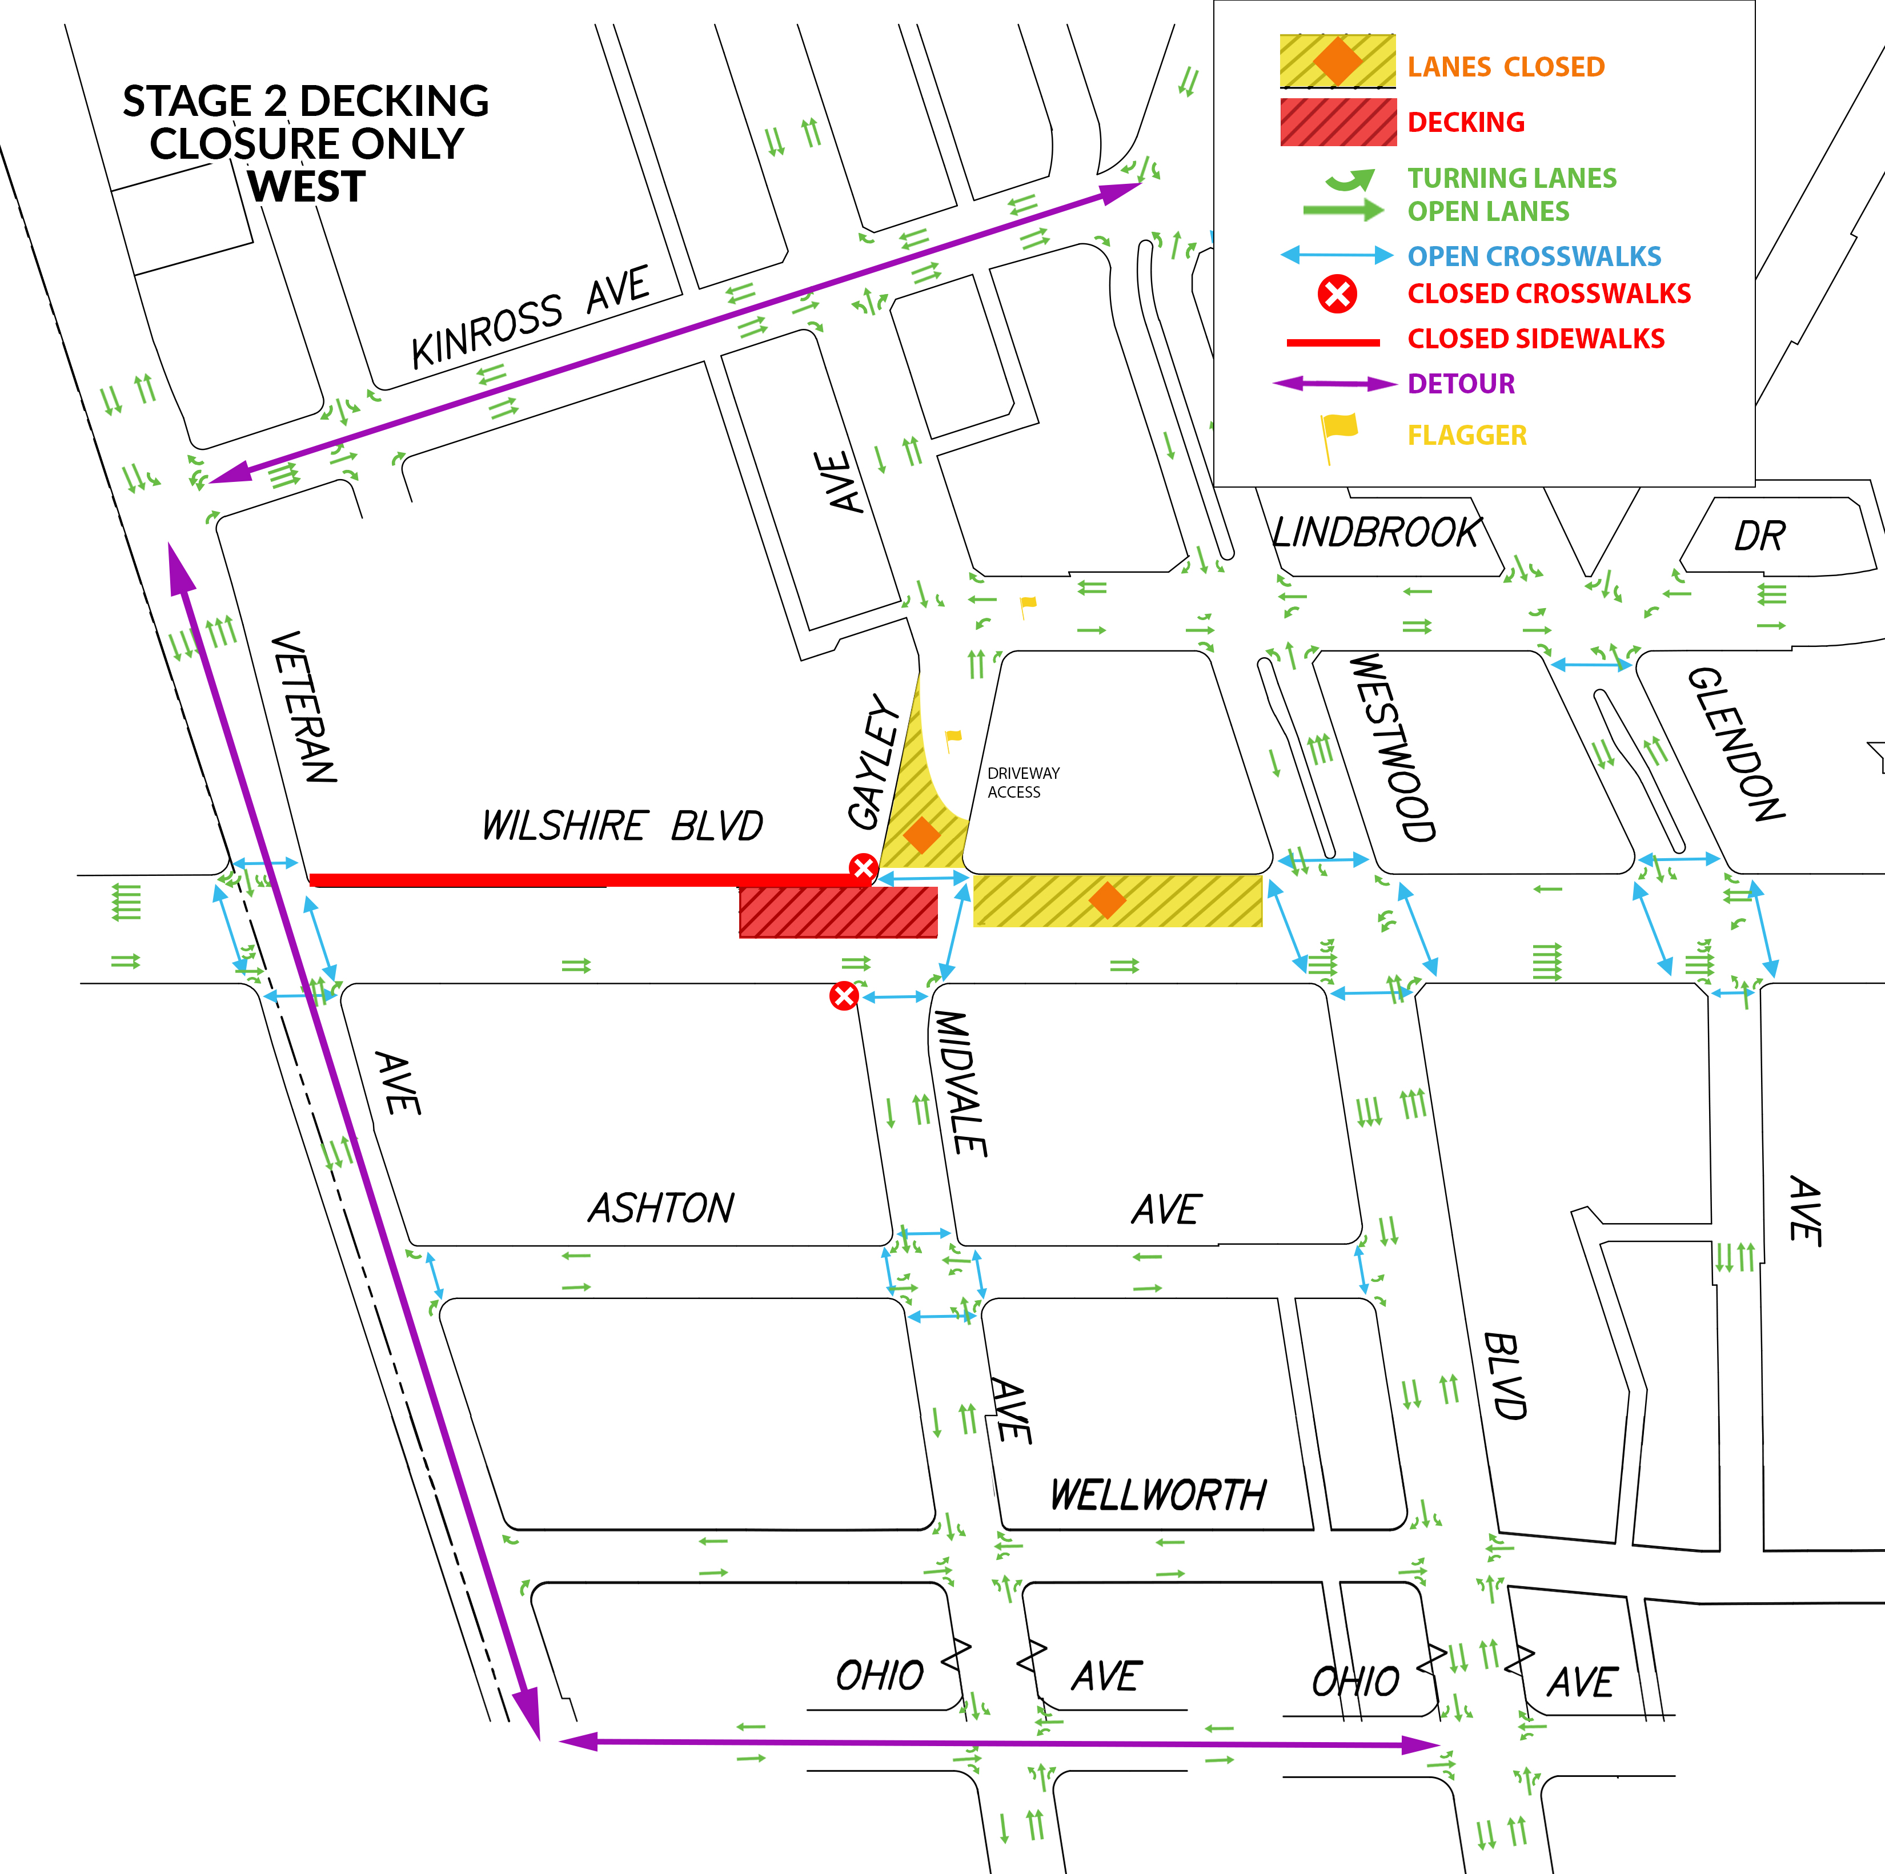
Decking: Stage 2 West
The red is the work area and yellow is the closure.​
Eastbound Wilshire Bl traffic access maintained.​
SB/NB Gayley Av thru traffic restricted.
Westbound traffic detoured at Westwood either to Kinross Av or Ohio Av.
*Construction is dynamic and the schedule is subject to change​. Plans are pending approval.

Slide 24
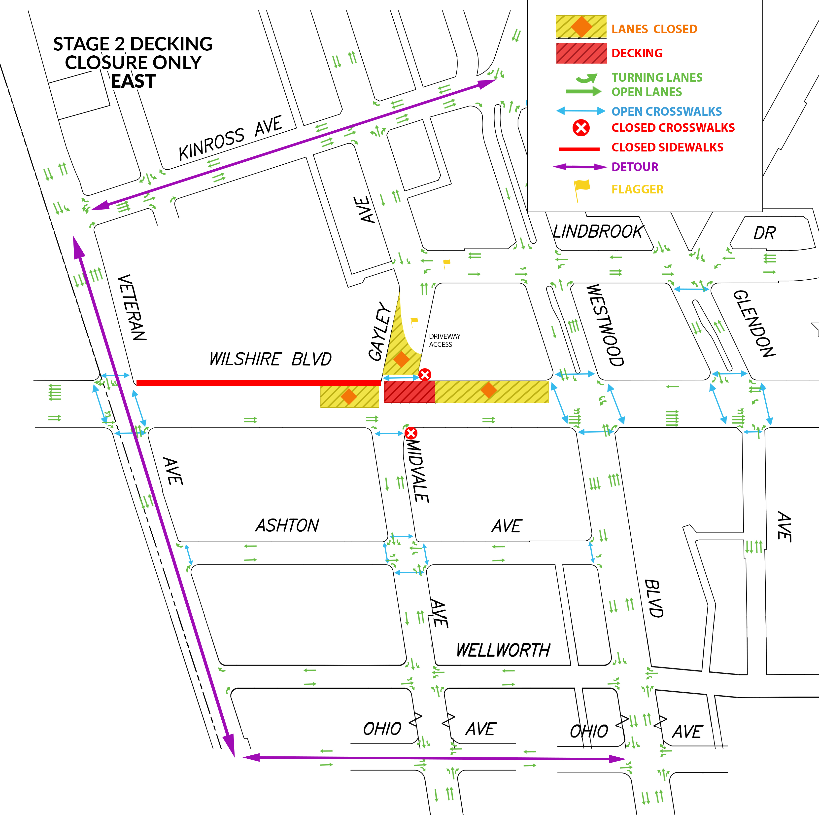
Decking: Stage 2 East
The red is the work area and yellow is the closure.​
Eastbound Wilshire Bl traffic access maintained.​
SB/NB Gayley Av thru traffic restricted.
Westbound traffic detoured at Westwood either to Kinross Av or Ohio Av.
*Construction is dynamic and the schedule is subject to change​. Plans are pending approval.

Slide 25
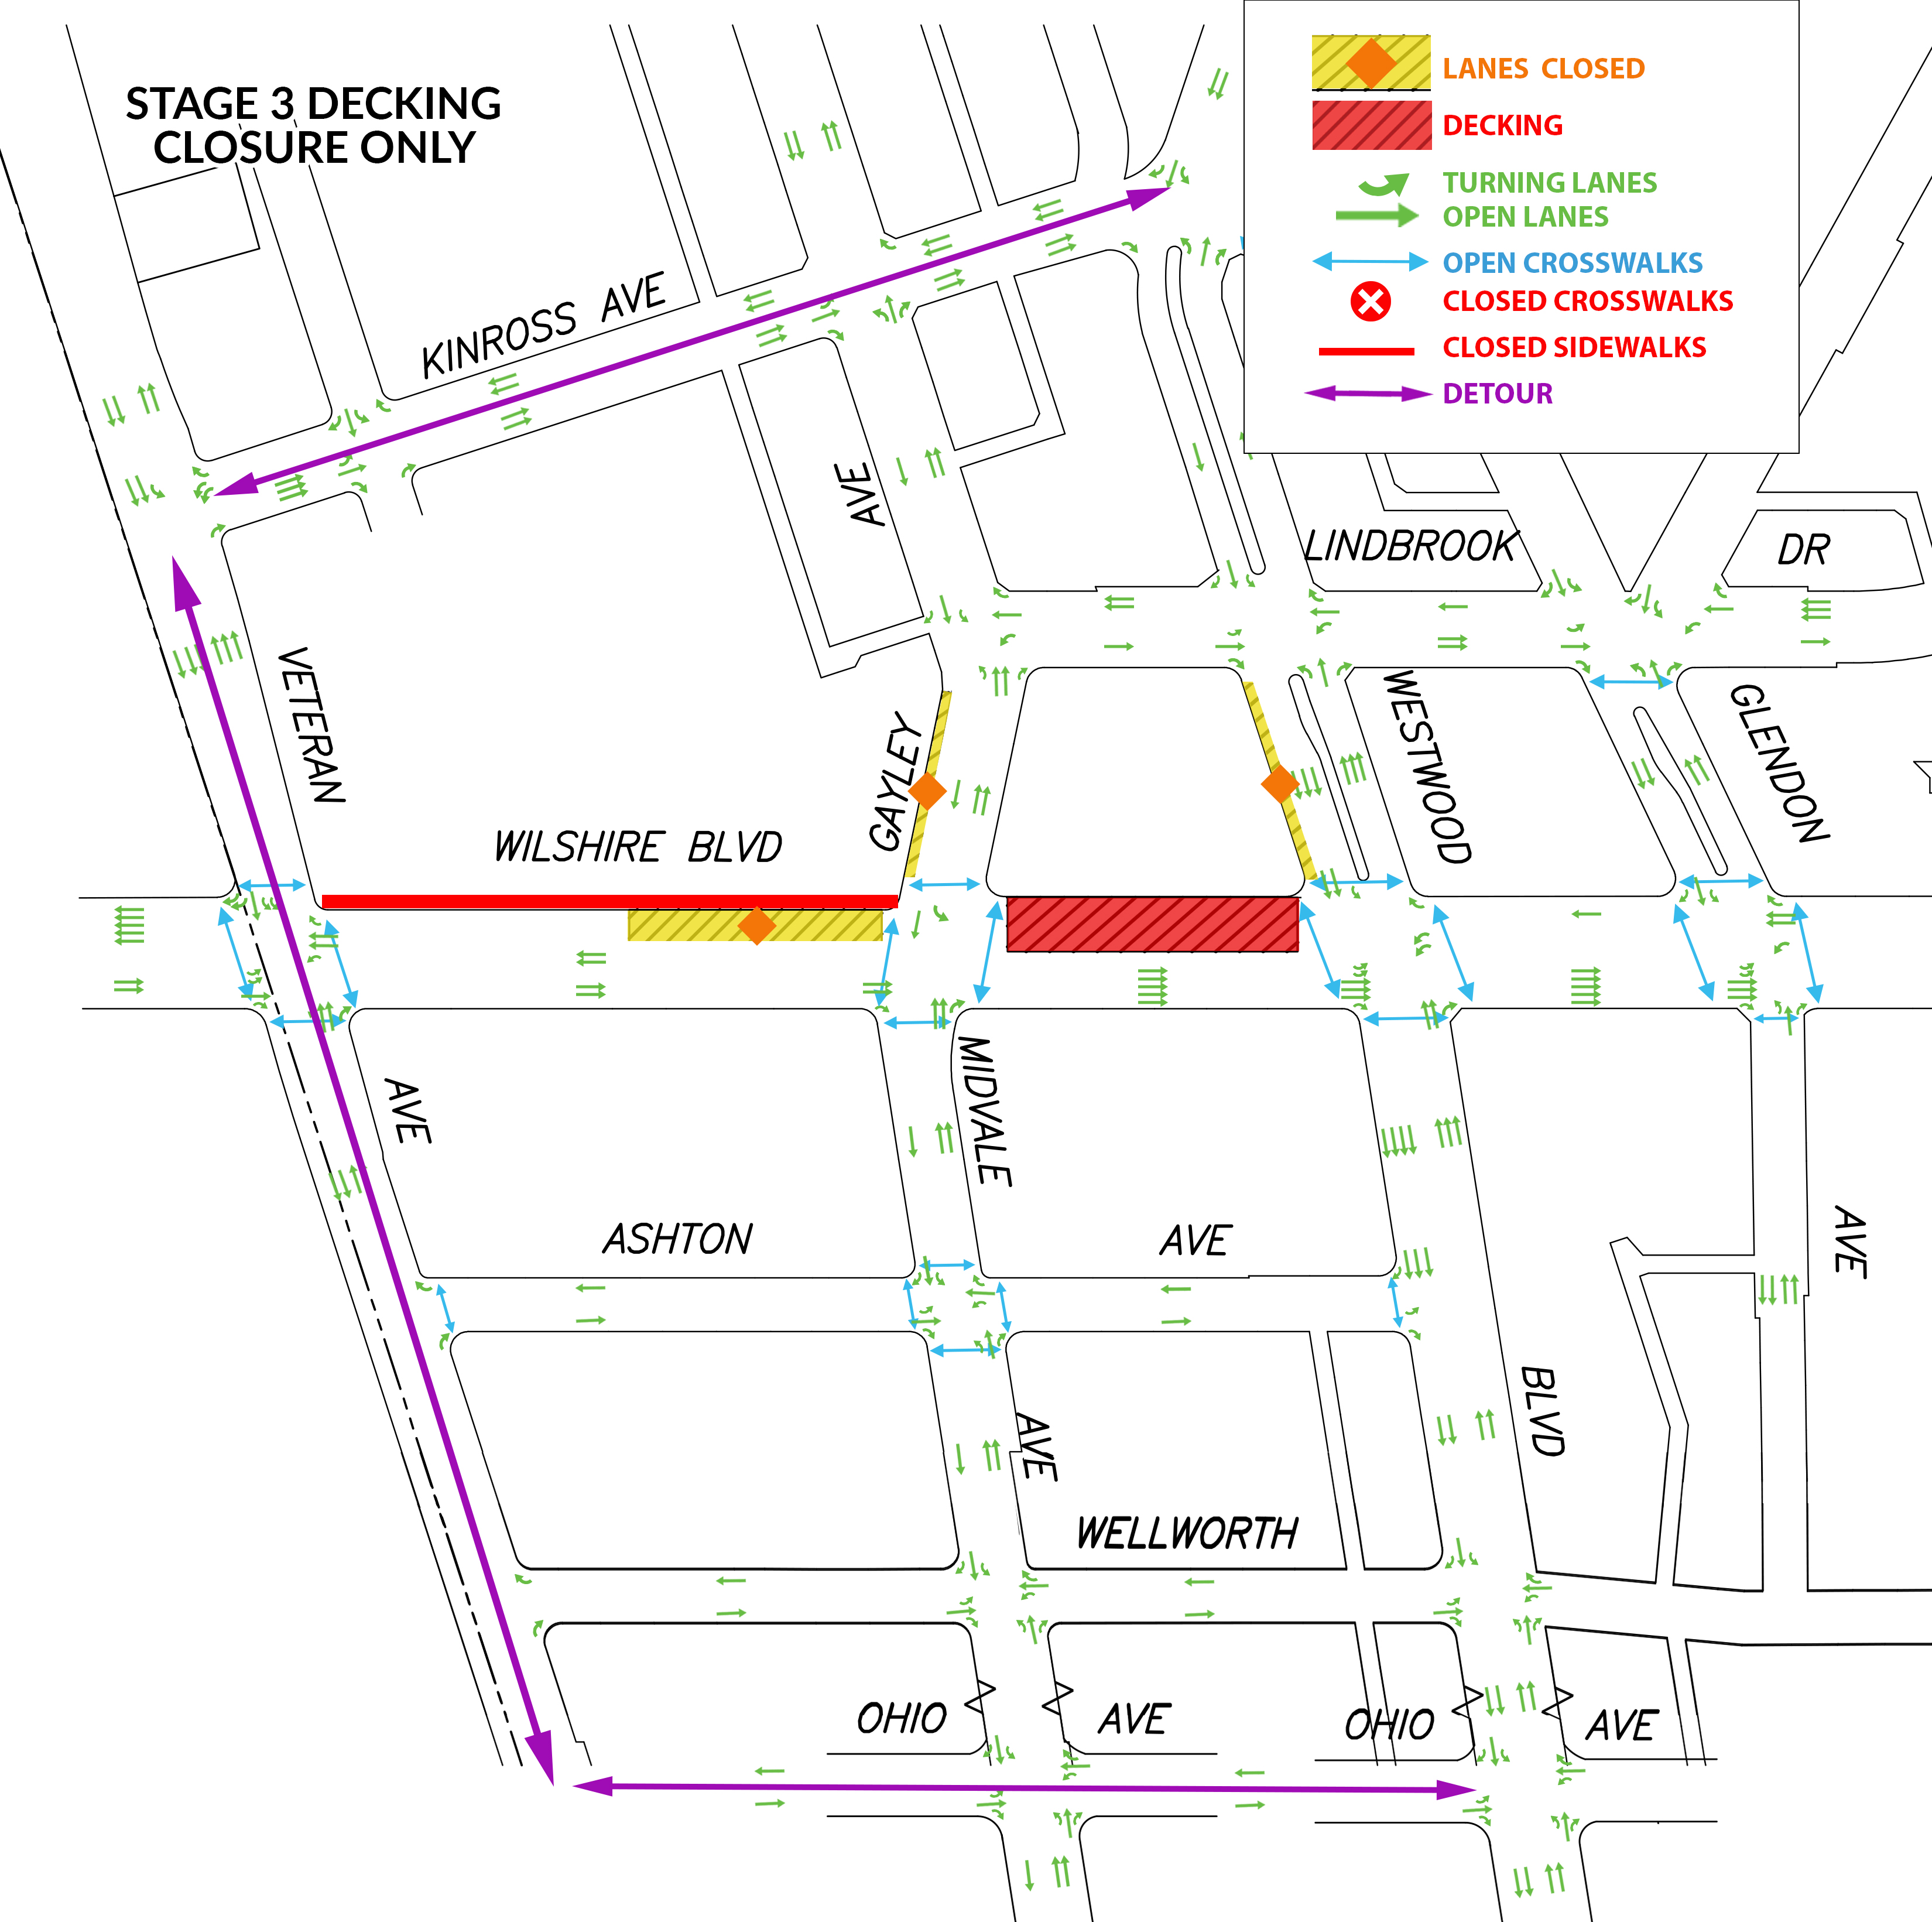
Decking: Stage 3
The red is the work area and yellow is the closure.
Eastbound Wilshire Bl traffic access maintained.
Westbound traffic detoured at Westwood Bl either to Kinross Av or Ohio Av.
*Construction is dynamic and the schedule is subject to change​. Plans are pending approval.

Slide 26
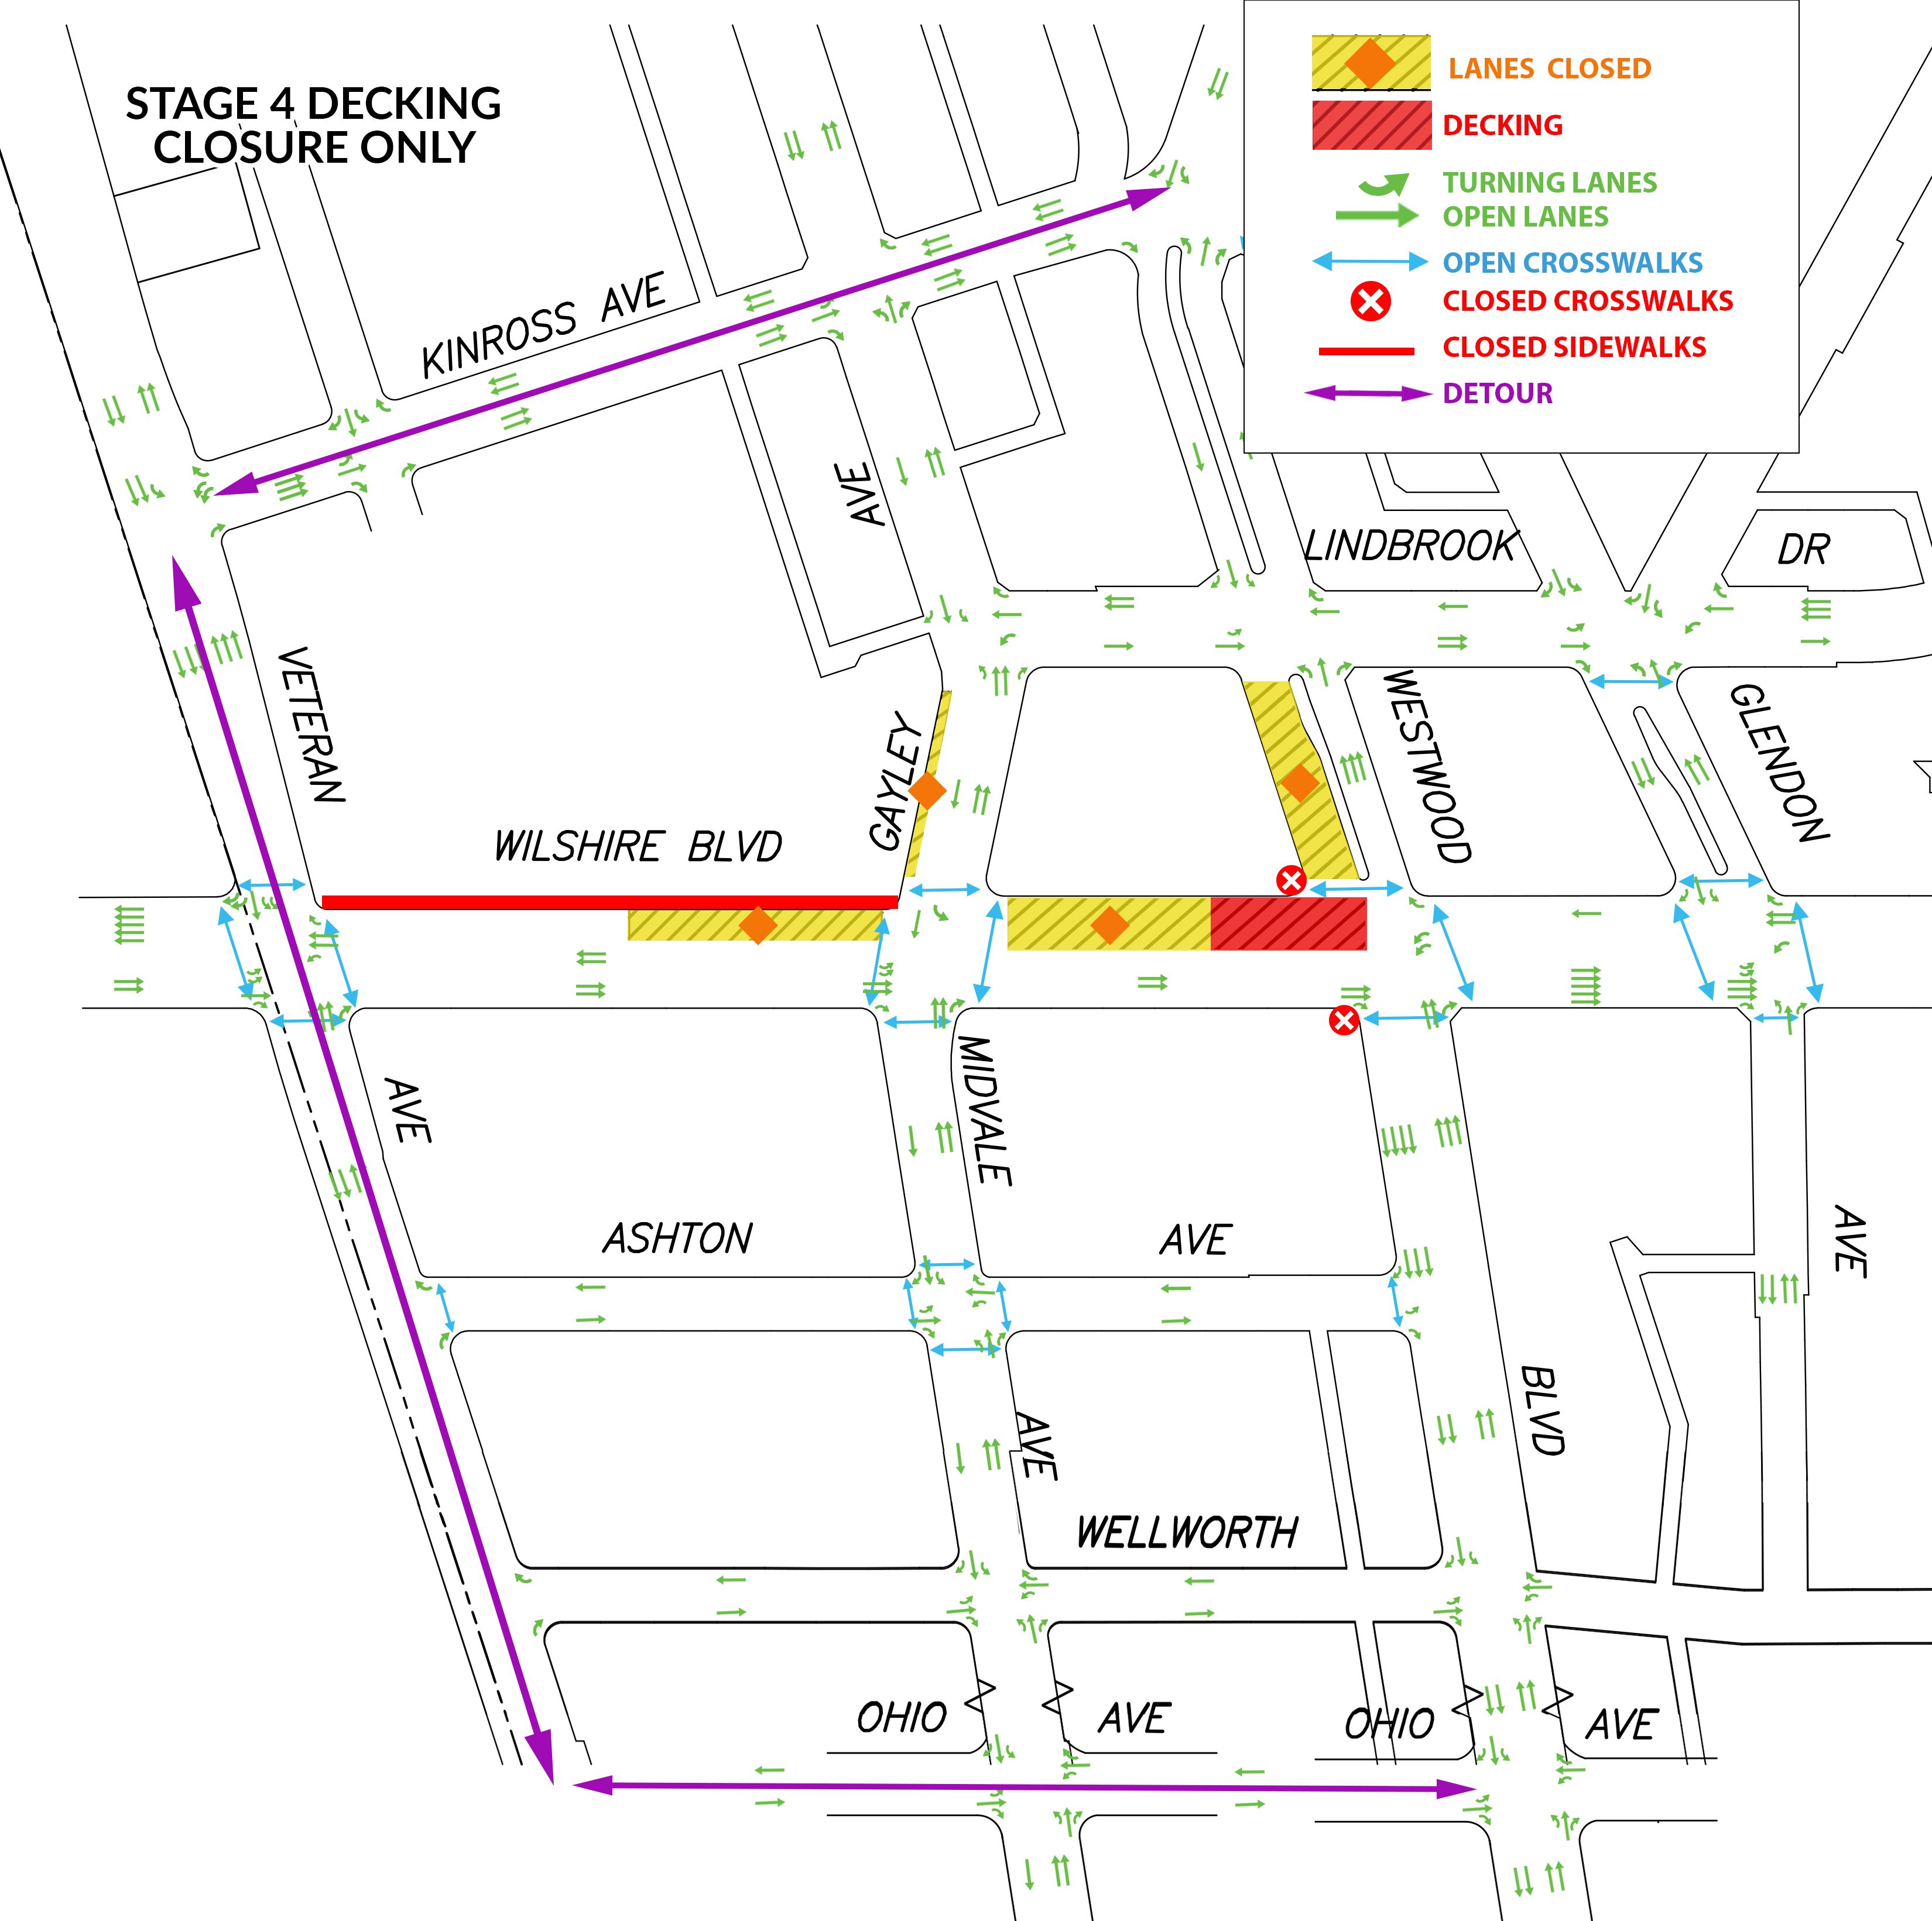
Decking: Stage 4
The red is the work area and yellow is the closure.
Eastbound Wilshire Bl traffic access maintained.
SB Westwood Bl closed to thru traffic.
Westbound traffic detoured at Westwood either to Kinross Av or Ohio Av.
*Construction is dynamic and the schedule is subject to change​. Plans are pending approval.

Slide 27
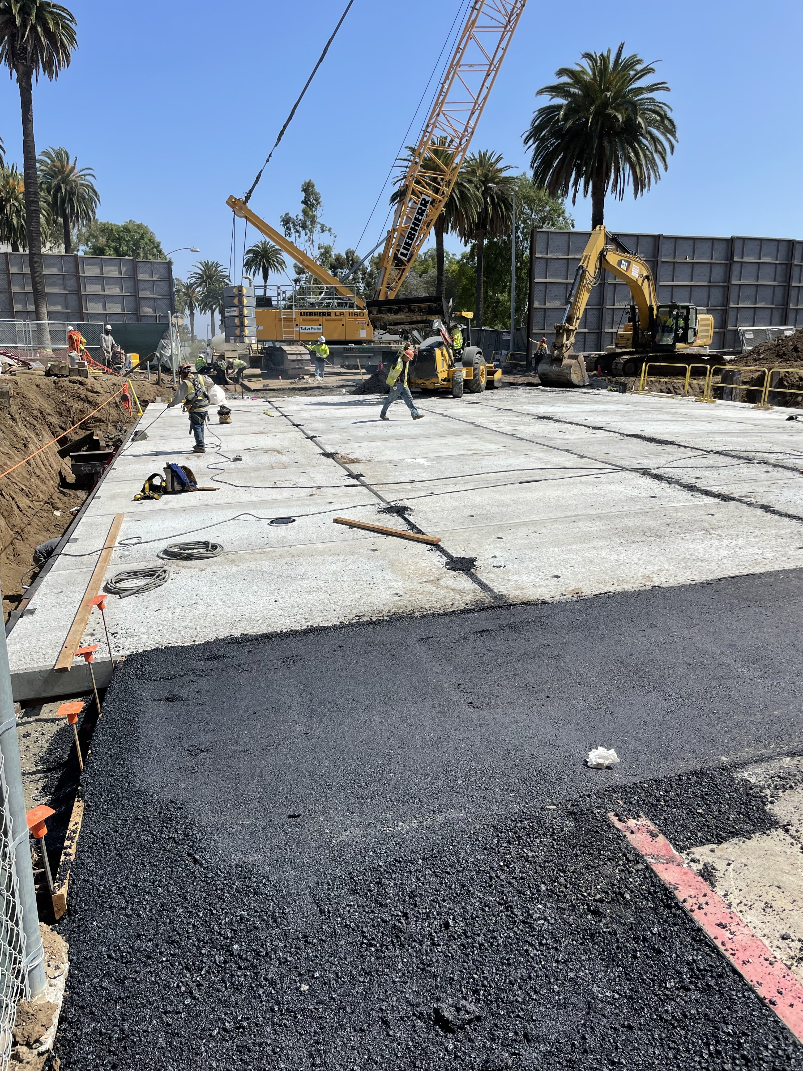
Examples of Decking on Bonsall Av at the West LA VA Campus

Slide 28
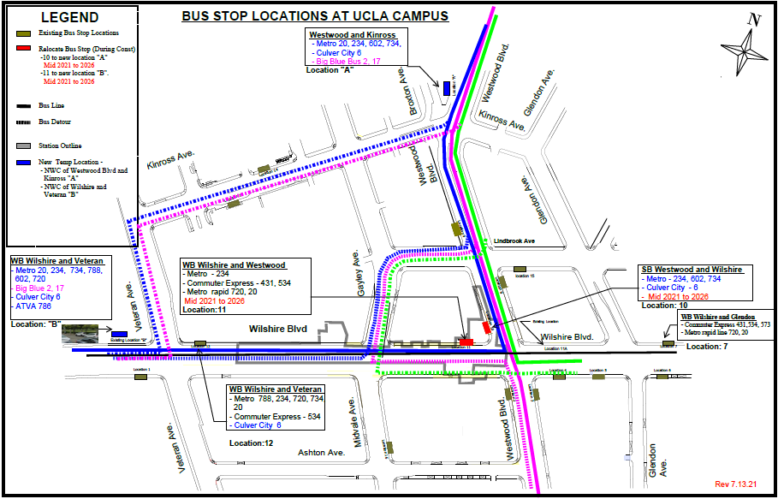
Temporary Bus Stops Relocation

Slide 29
Community Outreach
Community Meetings
Quarterly Webinars
Monthly Westwood Building Managers Meetings
Hand delivered construction notices
Email construction notices and updates
Paid media: radio, print, social media ads, UCLA kiosks

Slide 30
Construction Mitigation
Traffic enforcement by LAPD
Traffic control officers from LADOT
Coordinated adjusted signal timing
Pedestrian access is maintained
Crosswalk detours around active construction areas
Education and outreach to adjacent properties
Coordination with other developers and nearby projects

Slide 31
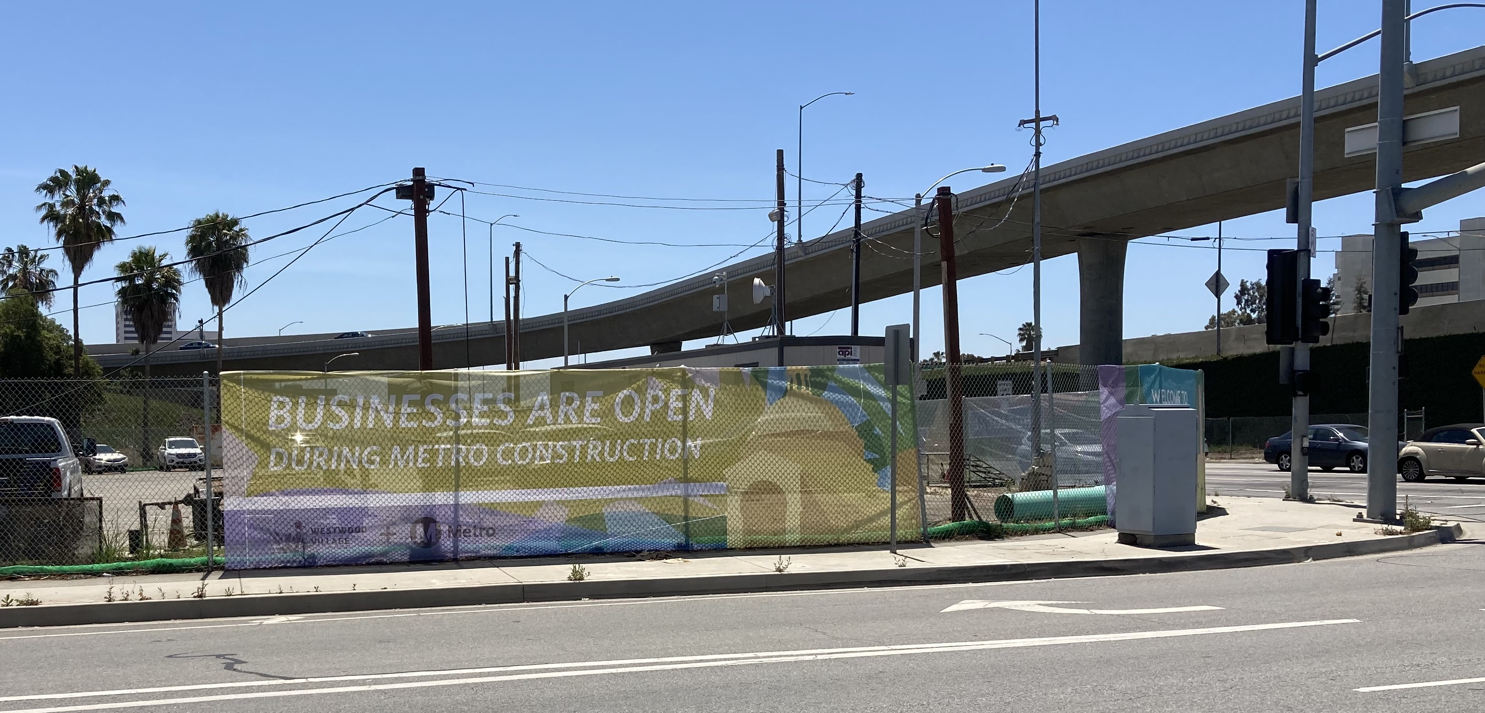
Construction Mitigation Banners

Slide 32
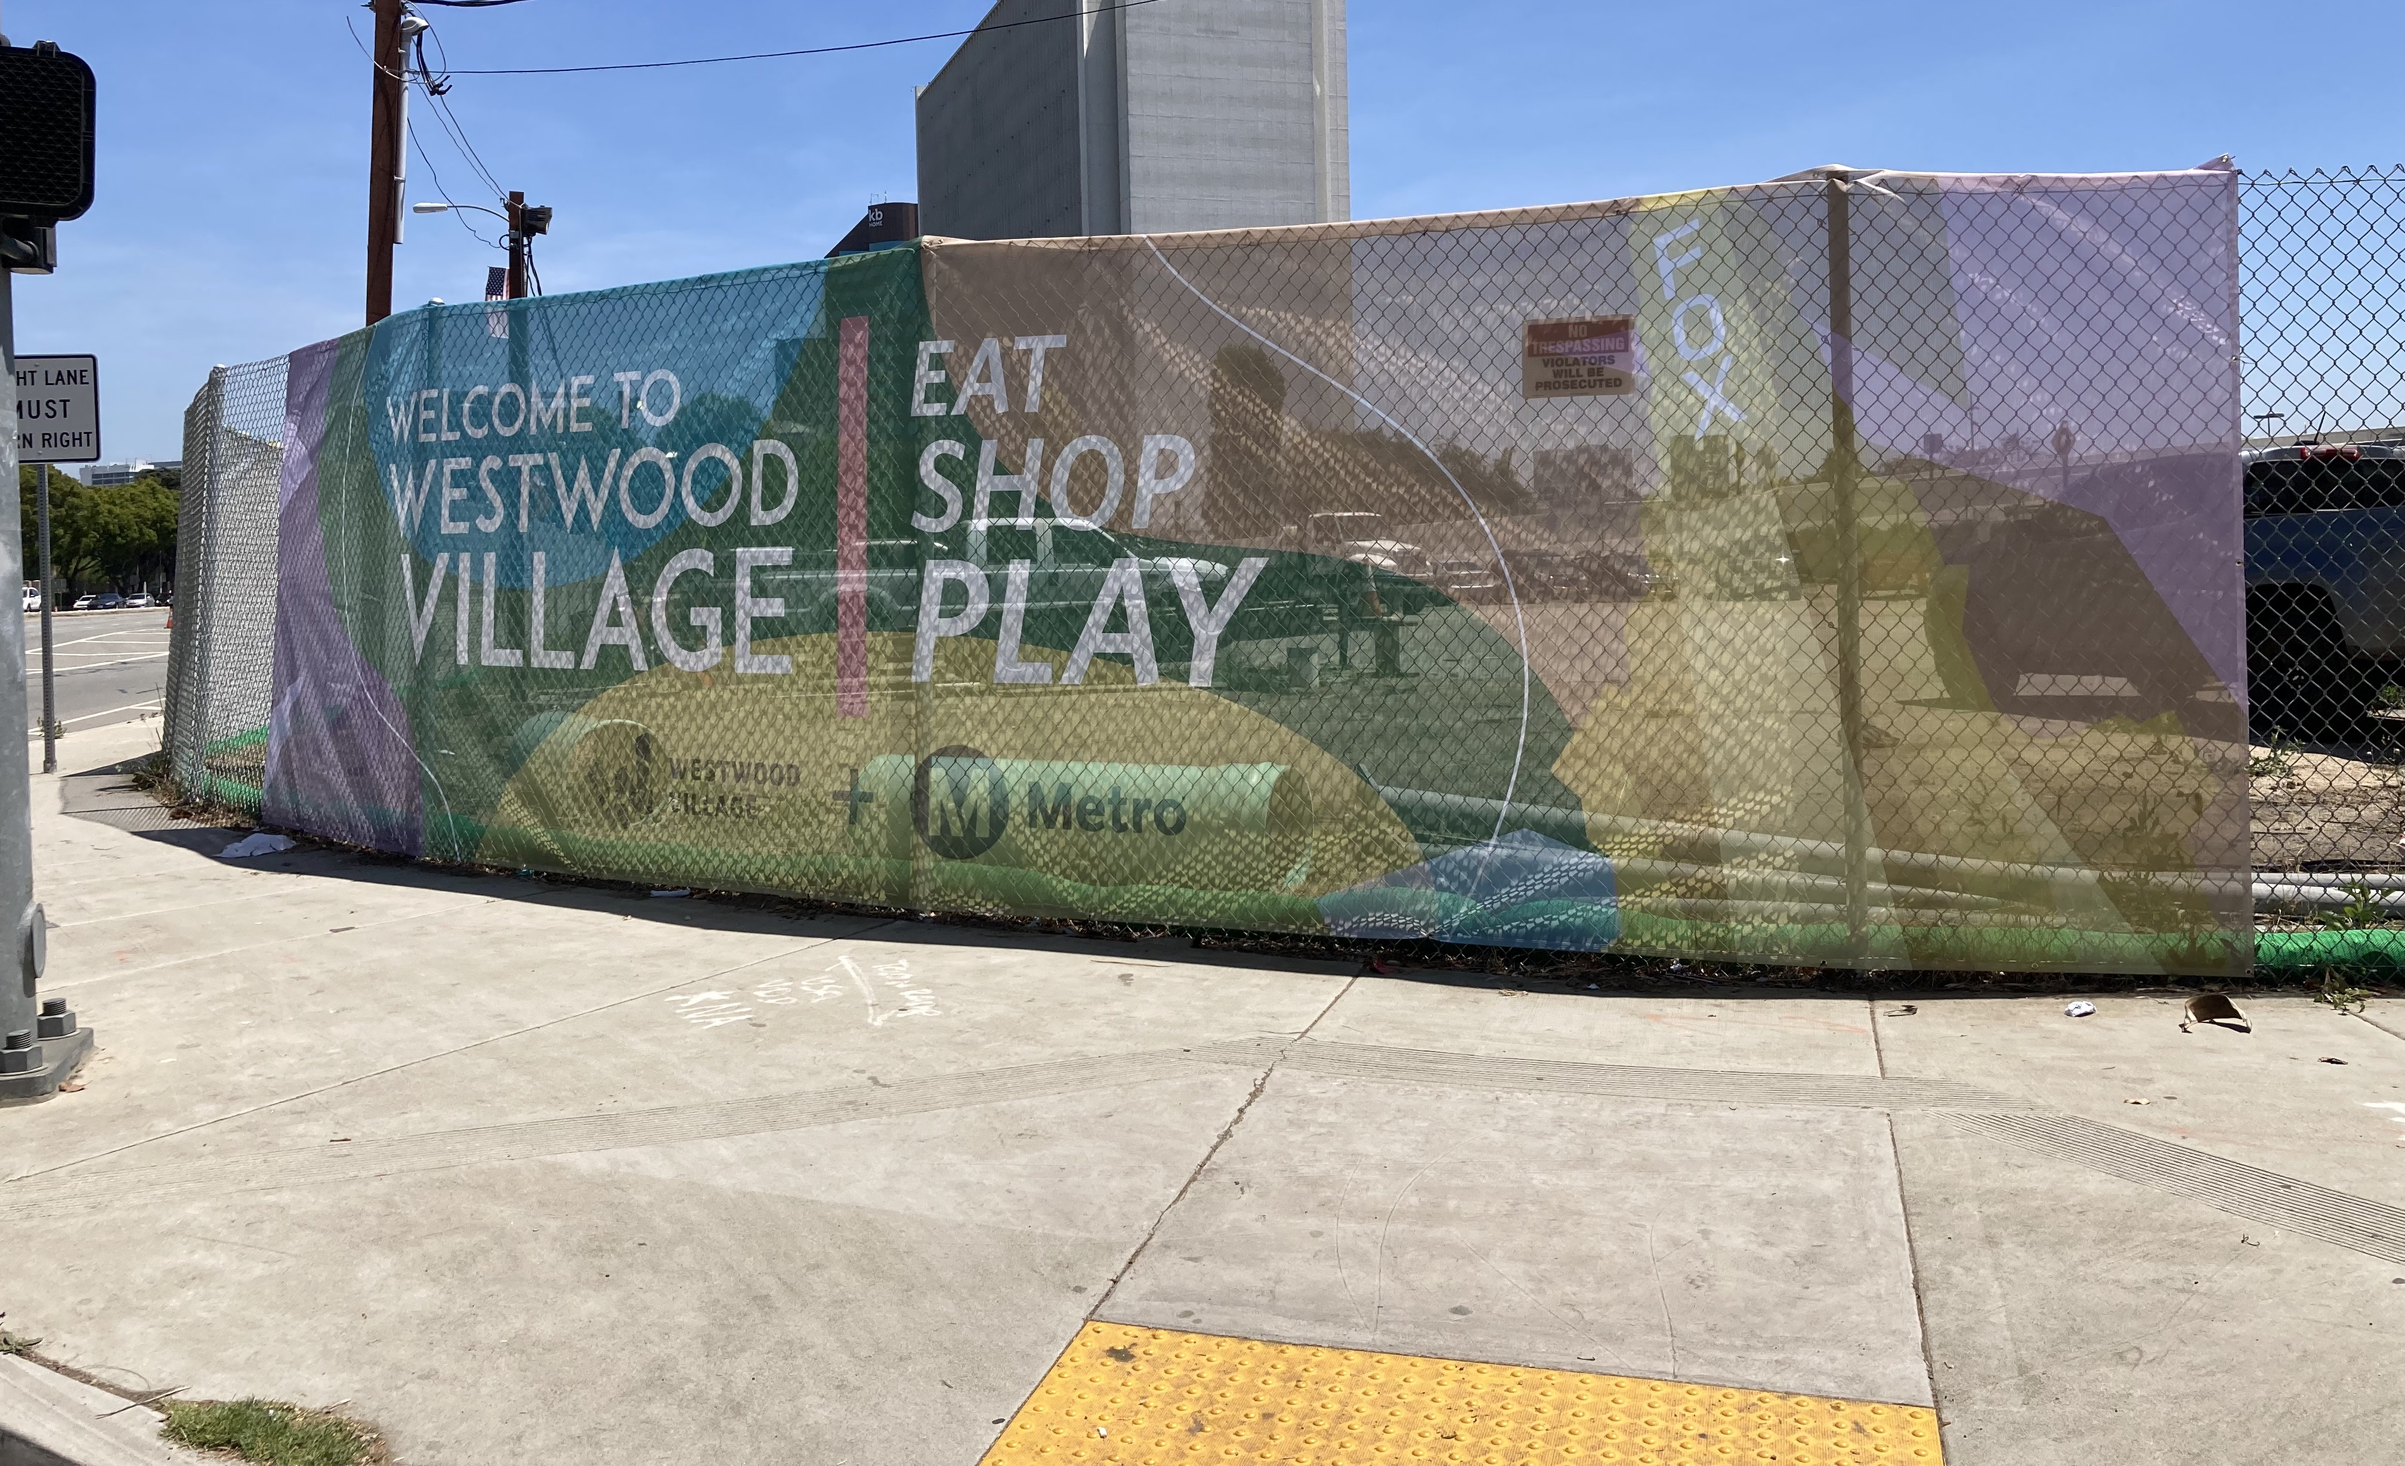
Construction Mitigation Banners

Slide 33

Stay in Touch
Lunch with Us Webinar:
Sections 1, 2, and 3 Construction Update
August 3, 2022
12pm to 1pm
Link to webinars available at metro.net/purple
213.922.6934
purplelineext@metro.net
metro.net/purple
@purplelineext
facebook.com/purplelineext

