Slide 1
We will begin in a few moments.
710 Task Force Meeting #3
Clean Truck Working Group
February 24, 2022
Notes:
Erika

Slide 2
710 TASK FORCE
Notes:
Erika

Slide 3
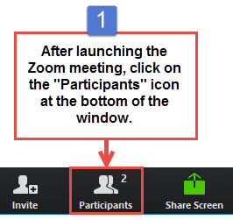
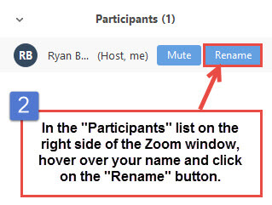
Task Force Member Identification
Task Force Members, please change your Zoom screen name to include: Name and Organization Name
Notes:
Erika

Slide 4

Raise Hand
Click Raise Hand in your meeting controls or
Press*9 on the phone line.
To lower your hand, click Raise Hand in your meeting controls.
Comments & questions can also be provided in writing by using the Chat function.
The Chat button is located on the control panel at the bottom of your screen.
Notes:
Erika

Slide 5
Welcome!
Notes:
Erika

Slide 6
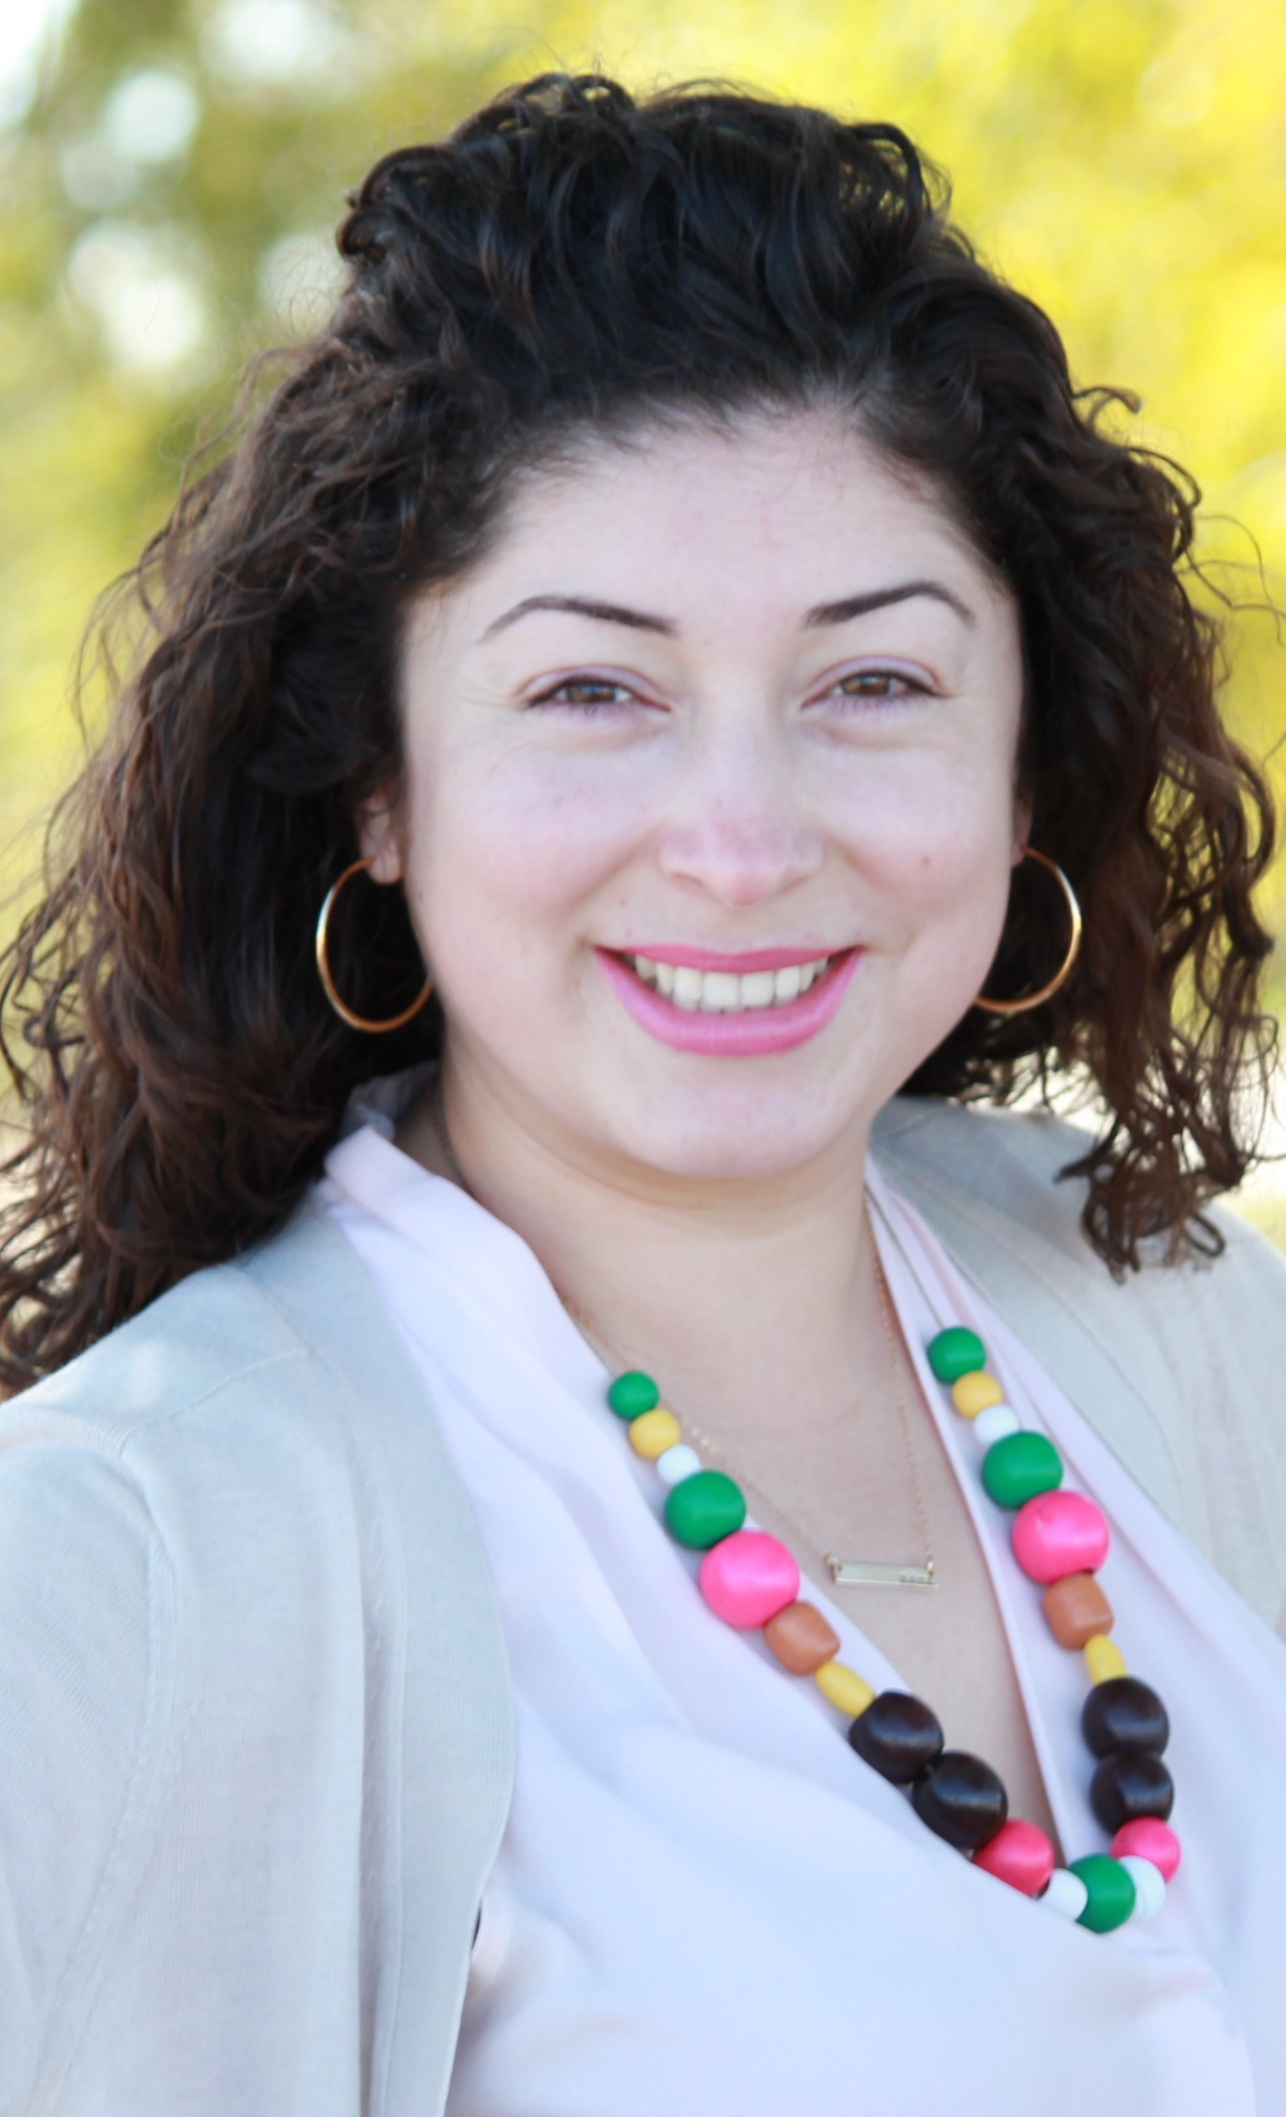
Facilitator
Erika C.B. Morales
Partner, Morales + Morales Partners
Notes:
Erika
We are making adjustments based on feedback regarding Public Comment
Public comment after each topic-1 minute per person
At end of meeting-public comment-2 minutes per person

Slide 7
Agenda
1:00 pm Welcome, Introductions, Agenda Review, and Purpose of the Clean Truck Working Group
1:05 pm Agenda Item #1: Project Team Presentation
1:15 pm Agenda Item #2: Successful Clean Truck Program Options
1:45 pm Agenda Item #2.1: Group Discussion
2:00 pm Agenda Item #2.2: Stakeholder Group Discussion
2:25 pm Closing Comments, Next Steps, Thank you

Slide 8
Agenda
1:00 pm Welcome, Introductions, Agenda Review, and Purpose of the Clean Truck Working Group (5 minutes)
1:05 pm Agenda Item #1: Project Team Presentation (10 minutes)
    Clean Truck Working Group #2 Highlights
    Objectives for Clean Truck Working Group Meeting #3
    SB 671 Update and Next Steps
    Community Involvement
    Re-naming this working group
1:15 pm Agenda Item #2: Successful Clean Truck Program Options (30 minutes)
(Infrastructure-based, truck-based, hybrid, other considerations)
  Alycia Gilde, Vice President, Clean Fuel & Infrastructure, CALSTART
  Tom Brotherton, Director, Market Acceleration, CALSTART
1:45 pm Agenda Item 2.1: Group Discussion (15 minutes)
  Peter Christensen, Air Resources Supervisor, California Air Resources Board
  Michelle Vater, Freight and Transit Unit Supervisor, California Energy Commission
2:00 pm Agenda Item 2.2: Stakeholder Group Discussion (25 minutes)
2:25 pm Closing Comments, Next Steps, Thank you: (5 minutes)
Notes:
Andrew Wishnia, Deputy Assistant Secretary for Climate Policy,
US Department of Transportation (invited)
Charles Small, Deputy Assistant Director for Intergovernmental Affairs, US Department of Transportation (invited)
Priorities, Partnerships, Goals, Considerations, Next Steps

Slide 9
Agenda Item #1:
Project Team Presentation
Notes:
Erika

Slide 10
Clean Truck Working Group Meeting #2
Highlights
Held virtually via Zoom on Tuesday, January 25th
27 participants (17 Task Force Members, 10 Members of the Public)
Meeting topics included:
  An overview and discussion of the federal regulatory approach to curbing emissions within the I-710 South Corridor
  An overview and discussion of what is needed to meet standards and mandates at the federal level
  A discussion on the impacts to emissions reduction goals, public health and meeting regulatory mandates caused by how long it will take to rollout ZE trucks at scale
  State-level funding and opportunities
  Key questions to consider for developing the Clean Truck Program
Action Items
    Invite representatives of the Environmental Protection Agency (EPA), the Department of Transportation (DOT), and the California Air Resources Board (CARB) to discuss grant funding opportunities.
    Share an example of a successful Clean Truck Program.
    Set priorities for the local Clean Truck Program.
    Develop Clean Truck Program responsive to regional partners and state/federal goals and opportunities
Notes:
Michael

Slide 11
Objectives for Today's Clean Truck Working Group Meeting #3
Present Successful Clean Truck Program Options
Work towards consensus on a Clean Truck Program priorities, goals, considerations, and next steps

Slide 12
Senate Bill 671 Update and Next Steps
710 Task Force approved the submittal of a joint letter of support for nominating the I-710 South Corridor as a priority freight corridor for the CTC's SB 671 Clean Freight Corridor Efficiency Assessment
Corridor to be submitted includes:
  I-710 S Freeway from Long Beach to SR-60
  Ports of LA and Long Beach
  Alameda Corridor
  I-710 South Corridor Study Area
Other considerations:
  Community engagement for both infrastructure development and siting
  Priority for investment due to supply chain disruptions and need for investment in clean technology
CTC staff have allowed us more time to submit the nomination form and letter – by February 2022
Draft application and letter shared with full Task Force for review prior to submission

Slide 13
Agenda Item #2:
Successful Clean Truck Program Options
Notes:
Erika

Slide 14
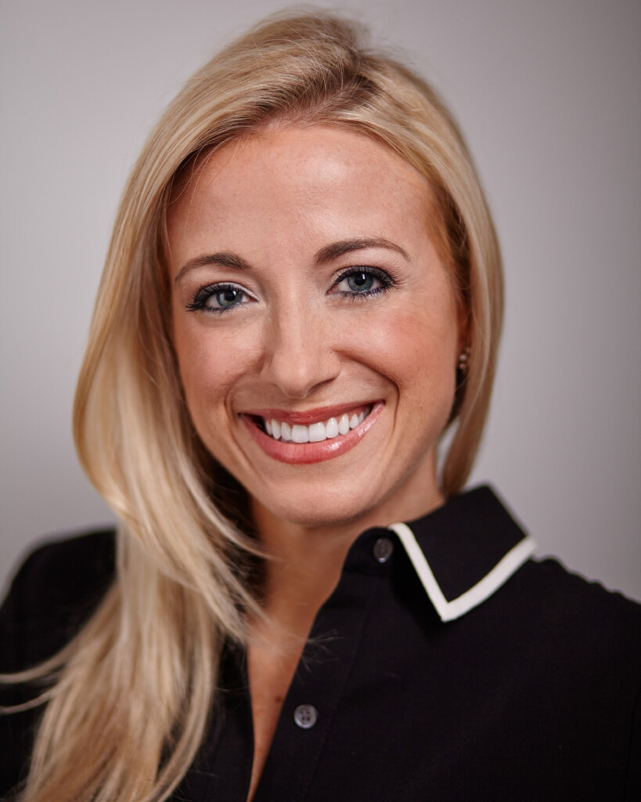

Speakers
Alycia Gilde
Vice President, Clean Fuel & Infrastructure
CALSTART
Tom Brotherton
Director, Market Acceleration
CALSTART
Notes:
BIOGRAPHIES
Alycia Gilde
Vice President, Clean Fuel & Infrastructure
oversees CALSTART’s Fuels and Infrastructure Initiative and is currently advancing the nation’s largest programs to develop and implement alternative fuel corridors for light, medium and heavy-duty vehicles.
Working in partnership with the Federal Highway Administration-building regional multi-state partnerships throughout the U.S. to expand federal designation of corridors for electric, natural gas, propane and hydrogen.
Co-leading U.S. Environmental Protection Agency’s West Coast Collaborative Alternative Fuel Infrastructure Corridor Coalition to evaluate infrastructure gaps and implement alternative fuel projects along transportation corridors in California, Oregon and Washington.
In the last five years at CALSTART
Leads the organization’s Market Acceleration Program including strategic development, problem solving and industry engagement to advance commercialization of clean vehicle technologies.
Initiatives include California’s Hybrid and Zero-Emission Truck and Bus Voucher Incentive Program, New York’s Truck Voucher Incentive Program and Illinois’s Drive Clean Chicago.
Leads CALSTART’s efforts to administer the California Air Resources Board’s Clean Off-Road Equipment Voucher Incentive Project.
Tom Brotherton
Director, Market Acceleration
Responsible for CALSTART’s market acceleration activities.
Oversees vehicle incentive programs in California, New York and Chicago.
oversees CALSTART’s E-Truck Task Force and a Vehicle Electrification Study for the US Army.
Tom recently developed a truck technology roadmap for the California Energy Commission to identify technologies and actions for the reduction of emissions and petroleum use in trucks. He has previously managed CALSTART’s U.S. Army contract, Technical Advisory Committee, as well as business development and membership outreach.
Tom has a BSE in Civil Engineering from Princeton University, and a MS in Civil Engineering from the University of Colorado, Boulder. He is a registered professional engineer in Colorado.

Slide 15
Discussion #2:
Clean Truck Program scope, priorities, partnerships, goals, considerations, and next steps
Notes:
Erika

Slide 16
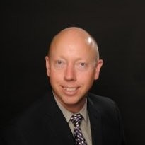
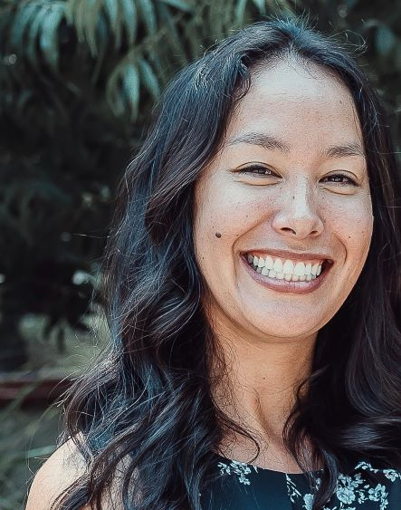
Speakers
Peter Christensen
Air Resources Supervisor
California Air Resources Board
Michelle Vater
Freight and Transit Unit Supervisor
California Energy Commission
Notes:
BIOGRAPHIES
PETER CHRISTENSEN
I'm proud to manage a team of professionals dedicated to continuing the long history of air quality improvement in California. Working together with industry and environmental stakeholders, other government agencies, academic institutions, and members of the public, we develop and implement innovative incentive programs to bring cleaner technologies to the entire spectrum of transportation: from cars and trucks to marine vessels and trains. Experience California Air Resources Board 13 years 8 months Air Resources Supervisor October 2011 - Present (10 years 5 months) Air Pollution Specialist July 2008 - October 2011 (3 years 4 months) Sacramento Metropolitan Air Quality Management District Air Quality Analyst January 1992 - June 2008 (16 years 6 months) Education University of California, Davis Environmental Biology & Management · (1987 - 2007)

Slide 17
Closing Comments, Next Steps, and Thank You
Notes:
Erika

Slide 18
Vision and Goals Key Input and Discussion Points
Survey
Released on Tuesday, February 22, 2022, to Task Force members and 710 South Corridor communities.
Open for response through Friday, March 25, 2022
Working Group Meetings
Wednesday, February 23, 2022 – Community Engagement Strategy
Objective: Discuss outreach strategy for Vision & Goals Survey and Public Workshop
Public Workshop
Wednesday, March 23, 2022
Objective: Obtain public comment on preliminary Vision & Goals Statement for 710 South Corridor
Community Leadership Committee Meetings
March/April 2022 To be determined
Task Force Meetings
March 14, 2022 Task Force Meeting #6 – Preliminary Survey Results
April 11, 2022 Task Force Meeting #7– Final Survey Results, Vote on Vision & Goals
Notes:
Jessica
March 2022 – Equity
> Objective: Discuss Disadvantaged Communities and Disparities
Add survey link

Slide 19
Upcoming Meetings
              Task Force Meetings
      Task Force Meeting #6
      Monday, March 14, 5-7:30pm
      Task Force Meeting #7
      Monday, April 11, 5-7:30 pm
      Task Force Meeting #8
      Monday, May 9, 5-7:30pm
              Working Group Meetings
      Community Engagement Strategy Working Group
      Wednesday, March 23, 5:30-7:00pm
      Clean Truck Working Group
      Tuesday, March 22, 1-2:30 pm – TOPIC: Grant Funding Opportunities
Public Workshop
Wednesday, March 23, 5:30-7:00pm
Notes:
Erika

Slide 20
Can’t attend the meeting? Reach out to us!
Michael Cano, Deputy Executive Officer,
Countywide Planning & Development
Metro
One Gateway Plaza, MS 99-13-1
Los Angeles, CA 90012
213.922.4710
710corridor@metro.net
metro.net/projects/i-710-corridor
@metrolosangeles
losangelesmetro

Slide 21
EXTRA SLIDES

Slide 22
Example of Successful Clean Truck Programs
Speaker 1
Title
Port of Los Angeles
Speaker 2
Title
Port of Long Beach
Speaker 3
Title
Agency
Notes:
MORGAN CAPILLA
EPA Region 9’s Environmental Review Branch,
Reviews and comments on environmental impact statements prepared by other federal agencies pursuant to the National Environmental Policy Act.
Previously Peace Corps volunteer in the Dominican Republic from 2012-2014 where she collaborated with a women’s association on grassroots initiatives. Through this work, she developed a profound appreciation for the ways in which grassroots movements can assist marginalized communities in overcoming environmental and public health disparities.
Master of Public Policy with a specialization in Environmental Policy from Duke University
B.A. in English with a minor in environmental studies from UCLA.
In her free time, she enjoys being outdoors, traveling, going to concerts, and tutoring at an international school in Oakland.
Karina O’Connor
LinkedIn Profile
LinkedIn Profile 2
Has worked with the EPA for 25 years.
Environmental Engineer for Region 9 where she is responsible for working with state and local air quality and transportation planning agencies to develop plans that meet Clean Air Act requirements.
Expert in EPA/DOT's transportation conformity regulations and application of measures to reduce impacts of transportation for criteria pollutants and greenhouse gases.
Works with agencies with implementation and development issues for State Implementation Plans (SIPs) and projects under NEPA, conformity and SB 375.
Also serves as Executive Director of the Sierra Environmental Education Collaborative for the past 14 years,
Earth Guardian Manager with Burning Man for 24 years,
Master of Science in Clinical Epidemiology and in Environmental Engineering from Stanford University
Bachelor Degree in Clinical Epidemiology and in Environmental Engineering from Purdue University.

Slide 23
Discussion #2
Notes:
Erika

Slide 24
Clean Truck Program Discussion
Priorities
Partnerships
Goals
Next Steps

Slide 25
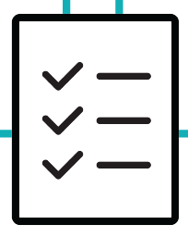
Vision & Goals Development: Eight-Week Timeline
This eight-week timeline shows key activities and dates for the Vision & Goals phase. The numbers on each circle indicate the first day of each week. The numbers in bold in each box indicate the specific target date for each key activity. The three colors represent each month from February to April.
Feb. 17 – Introduce Vision & Goals Phase at Task Force Meeting #5
Early March – Project Team reviews survey results, creates preliminary draft of Vision & Goals Statement
Mar. 23 – Vision & Goals Public Workshop
Mar. 25 – Close Vision & Goals Survey
Early April – Project Team incorporates input into Vision & Goals Statement Final Draft
START
FEBRUARY
14
21
28
MARCH
7
14
21
28
APRIL
4
11
END
Feb. 22 – Launch Vision & Goals Survey
Feb. 23 – Discuss survey outreach and workshop format at Community Engagement Strategy Working Group Meeting
TBD – Review Vision & Goals timeline at Coordinating Committee Meeting
Mar. 14 – Present preliminary survey results and first draft of Vision & Goals Statement at Task Force Meeting #6
March/April– Target to discuss Vision & Goals at CLC Meeting
Apr. 11 – Vision & Goals Consensus Checkpoint at Task Force Meeting #7
Ongoing Public Engagement – Task Force Members and members of the public may submit written comments, emails, or letters to Metro and Caltrans to provide input on the Vision & Goals Statement development and approval; Members of the public may also provide public comment during Task Force Meetings #5, 6, and 7
Notes:
Jessica

Slide 26
Agenda Item #3:
Grant Funding Opportunities
Notes:
Erika

Slide 27
Grant Funding Opportunities: Speakers
Speaker 1
Title
U. S. Environmental Protection Agency – Region 9
Speaker 2
Title
California Department of Transportation
Speaker 3
Title
California Air Resources Board
Notes:
MORGAN CAPILLA
EPA Region 9’s Environmental Review Branch,
Reviews and comments on environmental impact statements prepared by other federal agencies pursuant to the National Environmental Policy Act.
Previously Peace Corps volunteer in the Dominican Republic from 2012-2014 where she collaborated with a women’s association on grassroots initiatives. Through this work, she developed a profound appreciation for the ways in which grassroots movements can assist marginalized communities in overcoming environmental and public health disparities.
Master of Public Policy with a specialization in Environmental Policy from Duke University
B.A. in English with a minor in environmental studies from UCLA.
In her free time, she enjoys being outdoors, traveling, going to concerts, and tutoring at an international school in Oakland.
Karina O’Connor
LinkedIn Profile
LinkedIn Profile 2
Has worked with the EPA for 25 years.
Environmental Engineer for Region 9 where she is responsible for working with state and local air quality and transportation planning agencies to develop plans that meet Clean Air Act requirements.
Expert in EPA/DOT's transportation conformity regulations and application of measures to reduce impacts of transportation for criteria pollutants and greenhouse gases.
Works with agencies with implementation and development issues for State Implementation Plans (SIPs) and projects under NEPA, conformity and SB 375.
Also serves as Executive Director of the Sierra Environmental Education Collaborative for the past 14 years,
Earth Guardian Manager with Burning Man for 24 years,
Master of Science in Clinical Epidemiology and in Environmental Engineering from Stanford University
Bachelor Degree in Clinical Epidemiology and in Environmental Engineering from Purdue University.

Slide 28
Perspective from
South Coast Air Quality Management District
Notes:
Erika

Slide 29
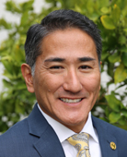
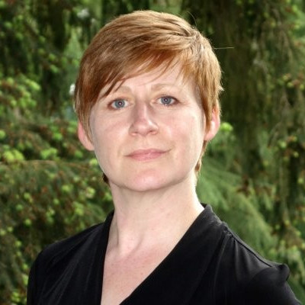
Speakers
Dr. Matt Miyasato
Deputy Executive Officer, Science & Technology Advancement
South Coast Air Quality Management District
Sarah Rees
Deputy Executive Officer
South Coast Air Quality Management District
Notes:
Dr. Matt Miyasato
Deputy Executive Officer for Science & Technology Advancement at the South Coast Air Quality Management District.
Responsible for the SCAQMD's Technology Advancement Office, Mobile Source Division, and Monitoring and Laboratory Analysis Division.
Identifies, evaluates and stimulates development and commercialization of clean air technologies, develop and coordinate mobile source regulations, and to conduct ambient monitoring, source testing and laboratory analysis.
Earned his undergraduate degree in Mechanical Engineering, and his Masters and Ph.D. in Engineering, specializing in combustion technologies and air pollution control – all from the University of California, Irvine.
Has worked at Southern California Edison in the Nuclear Engineering Department and at General Electric, where he designed burners and combustion modifications for utility boilers.He was also a research scientist at UCI, where he managed the industrial burner research program and has publications on combustion phenomena, active control, and laser diagnostics. Dr. Miyasato has also been a lecturer at UCI for the undergraduate air pollution control course.
Sarah Rees
LinkedIn Profile
Sarah Rees is the Assistant Deputy Executive Officer in the Planning, Rule Development, and Area Sources Division at the South Coast Air Quality Management District. In her role, she focuses on the implementation of transportation and mobile source programs, as well as development of the Air Quality Management Plan and other planning activities.
Sarah has over twenty years of experience in air quality and climate change matters at the state and federal level. Prior to joining the SCAQMD, Sarah directed the Office of Regulatory Policy and Management within EPA’s Office of Policy where she oversaw the Agency’s regulatory agenda and advised senior Agency management on the development of high-profile regulations. Previously, she served several roles within Washington State’s Department of Ecology, including directing Ecology’s programs to address climate change, and leading the planning and rules section within Ecology’s Air Quality Program. Trained as a chemical engineer, Sarah practiced environmental law for several years before obtaining a PhD in Engineering and Public Policy from Carnegie Mellon University.

Slide 30


South Coast AQMD
Regional Air Quality and Call to Action
I710 Clean Truck Working Group
January 25, 2022

Slide 31
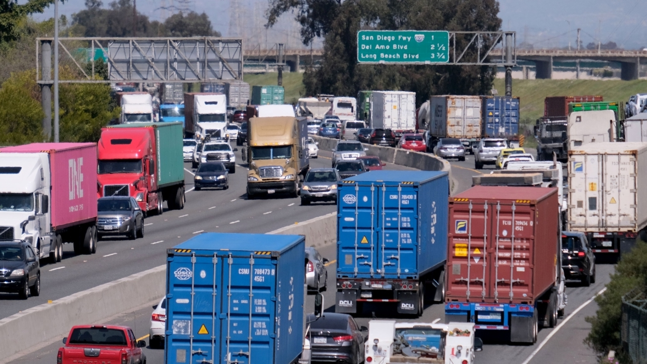
OVERVIEW
Our regions suffer from some of the worst air quality in the country
Heavy Duty trucks are the largest source of smog-forming emissions
The technology for trucks over 90% cleaner than current trucks is available and cost-effective
Delaying deployment is causing significant health impacts

Slide 32

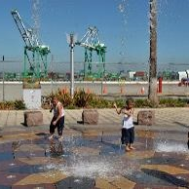
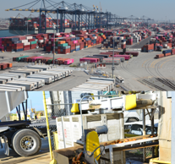
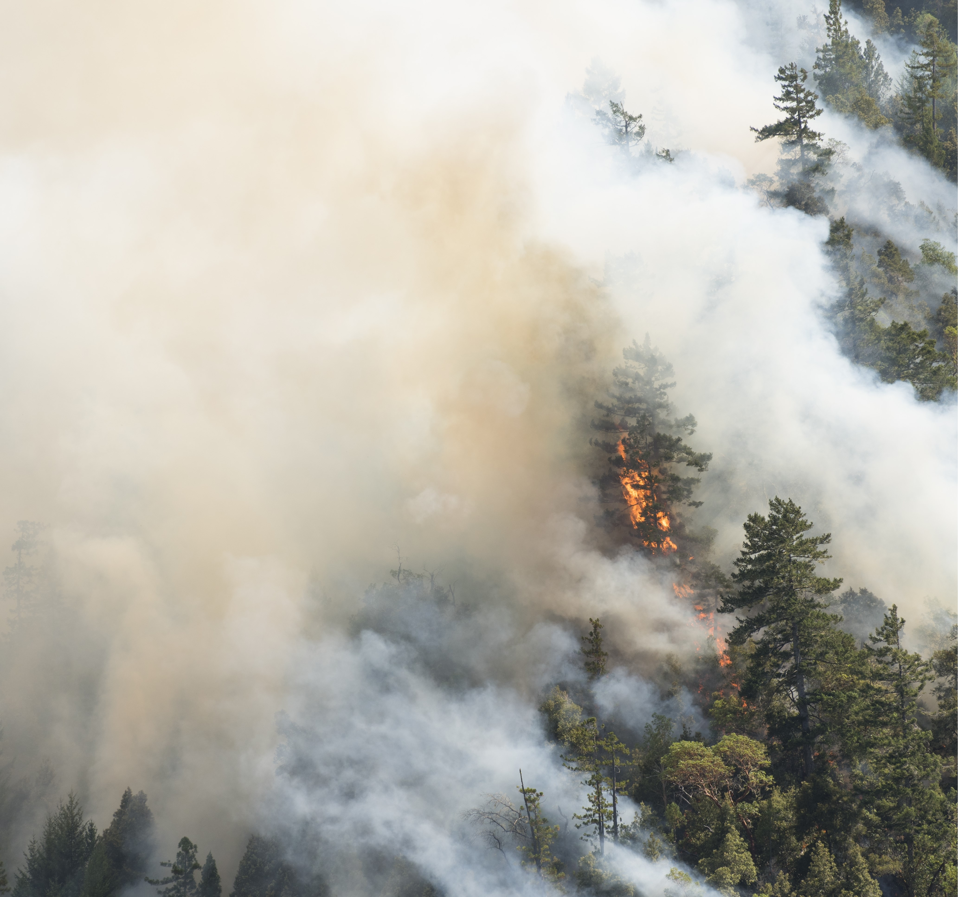
BACKGROUND
~17 Million People
Environmental Justice
Economy
Climate
Our jurisdiction would be 5th largest state after New York.
Nearly 67% of CA EJ population lives in South Coast region.
CA’s economy is 5th largest in the world. Southern CA Ports are the gateway to the nation.
Year-round fire season, drought, and heat-waves impact air quality, public health and the economy.
32

Slide 33
South Coast AQMD Attainment Challenges
- Upcoming Attainment Deadlines
Standard* | Concentration | Latest Attainment Year
2015 8-hr Ozone | 70 ppb | 2037
2008 8-hr Ozone | 75 ppb | 2031
1997 8-hr Ozone | 80 ppb | 2023
1979 1-hr Ozone | 120 ppb | 2022
2012 Annual PM2.5 | 12 μg/m³ | 2025
2006 24-hr PM2.5 | 35 μg/m³ | 2019

Slide 34
ADDRESSING TRUCK EMISSIONS are CRITICAL to ACHIEVING AIR QUALITY GOALS
Transition to zero and near-zero emission technologies is essential to meeting air quality goals

Slide 35

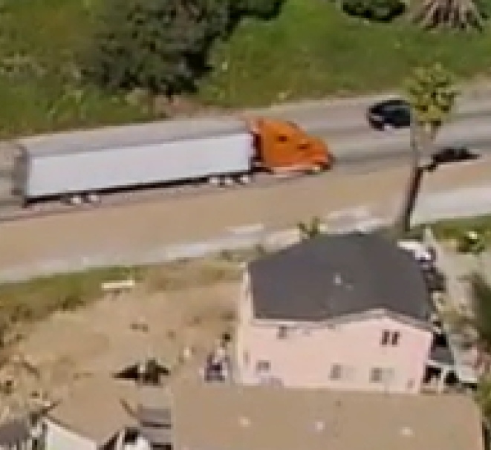
NEED FCOSTS OF NOT MEETING CLEAN AIR ACT REQUIREMENTS:
OR REVISED NOx EMISSION STANDARD FOR HEAVY-DUTY TRUCKS
Continued poor air quality for our residents
    Premature death, higher hospitalization rates, increased asthma, more sever asthma attacks
    Tens of billions of dollars per year in monetized health impacts
    Impact is greater in environmental justice communities
Potentially millions of dollars in extra costs on major sources every year
Potentially billions of dollars in lost transportation revenue affecting tens of billions of dollars in projects
Potentially significant curtailing of economic activity

Slide 36
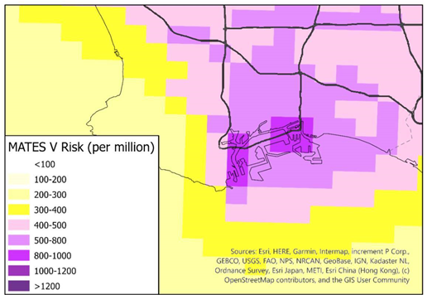
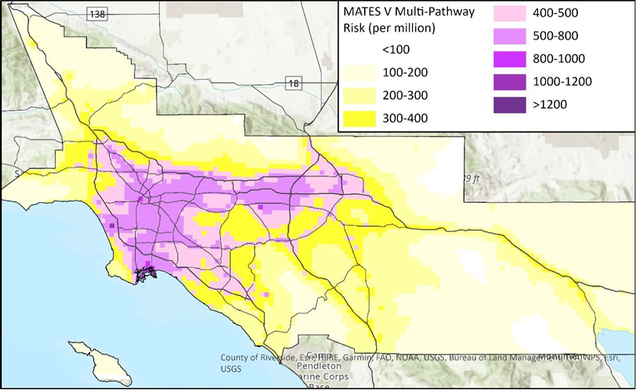
MATES
Multiple Air Toxics
Exposure Study
(MATES V)

Slide 37
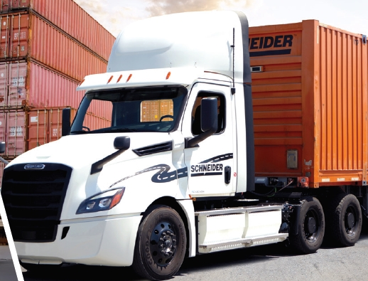

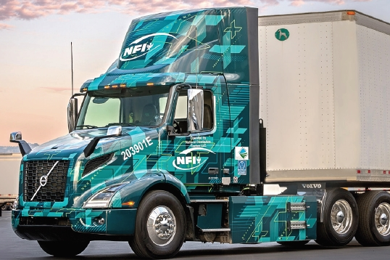
State of Technology
South Coast AQMD leading efforts to commercialize heavy-duty,
class 8 Zero Emission Trucks – Volvo, Daimler, Petebilt, Kenworth, BYD
Scale of Zero Emission Truck commercialization is in infancy

Slide 38
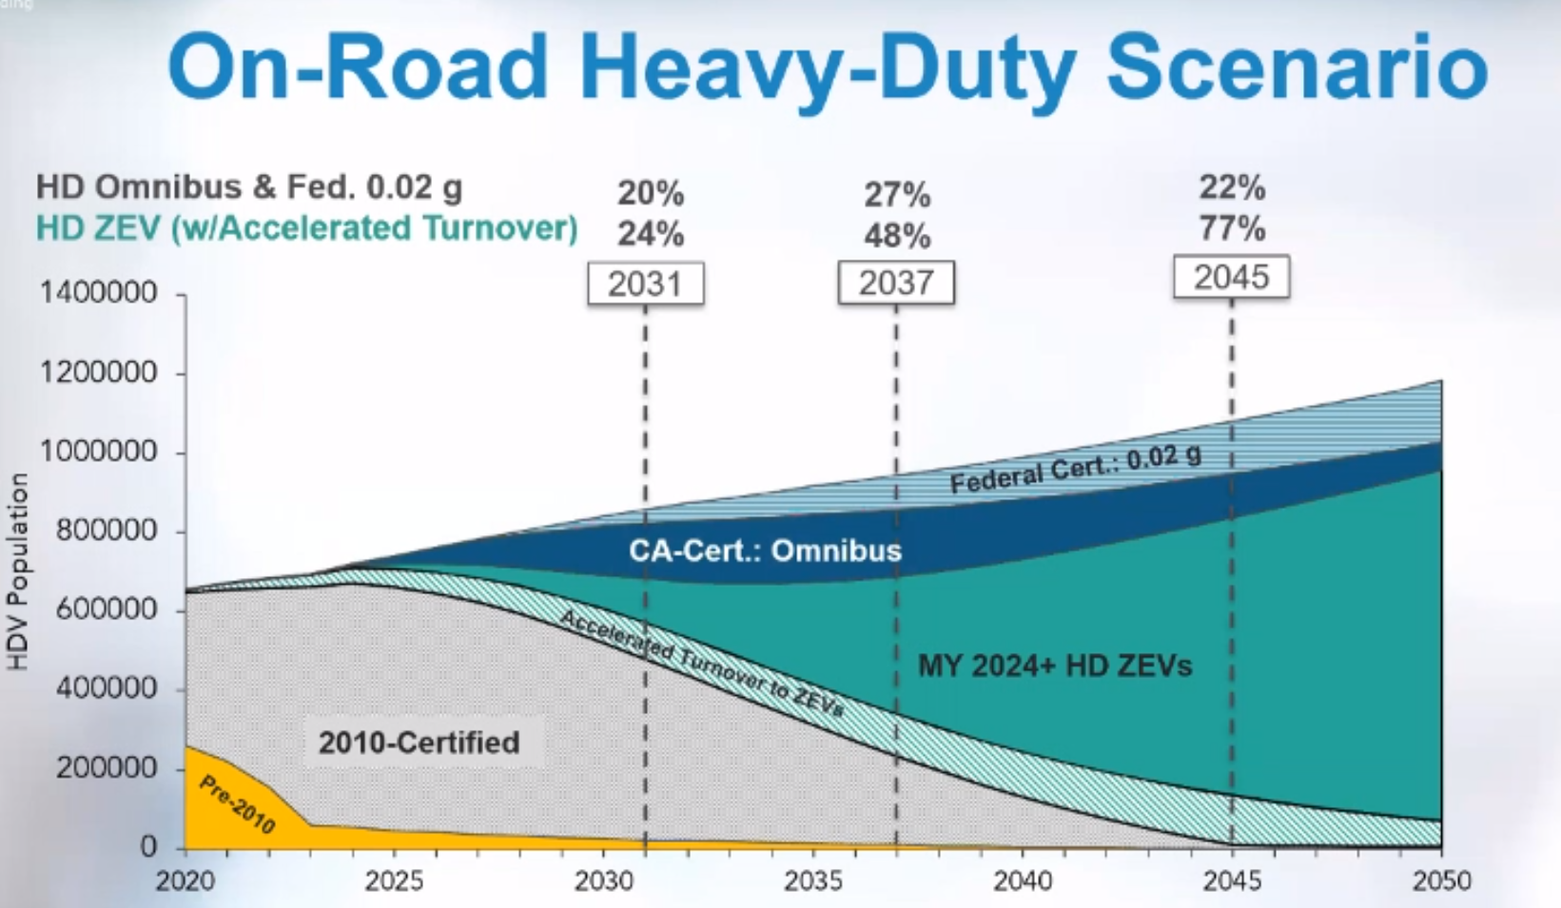
DIESEL

Slide 39
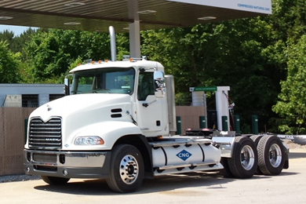
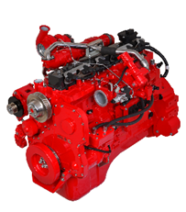
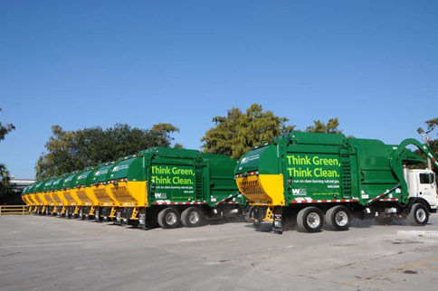
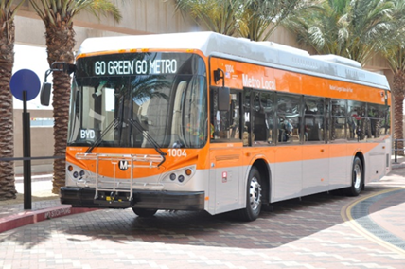
Near-Zero Engines
8.9L engine certified at 0.02 g/bhp-hr NOx in 2016
12L engine certified at 0.02 g/bhp-hr NOx in 2018

Slide 40
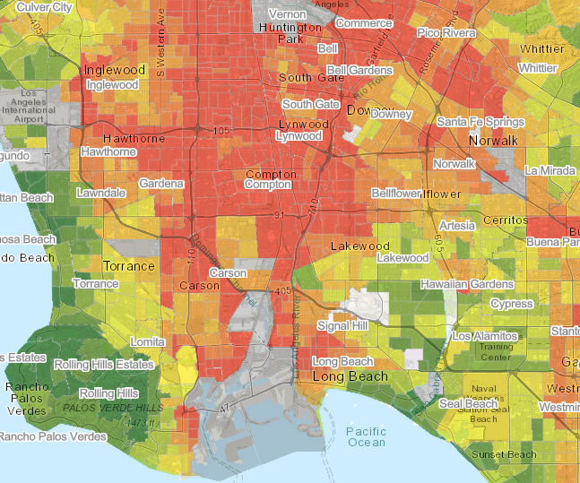
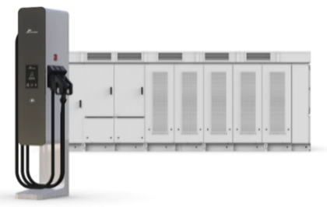
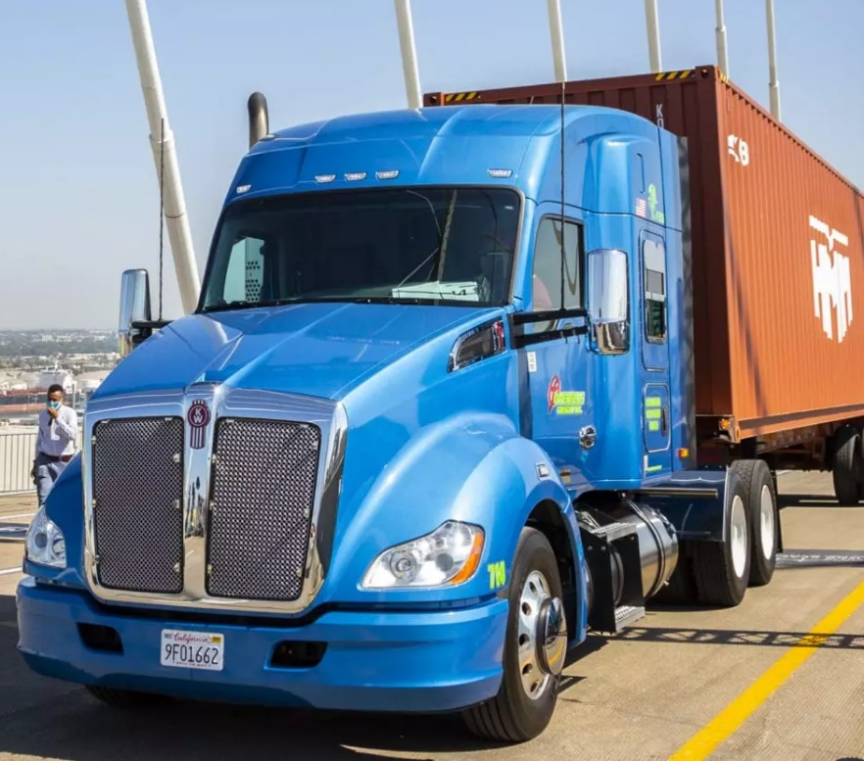
Summary
Diesel emissions from trucks represent a significant on-going health concern, especially in disadvantaged communities
South Coast AQMD is leading the state and nation in commercializing Zero Emission class 8 trucks
The scale to commercialize and adopt ZETs (incl. infrastructure) is not on pace to meet our air quality goals
NZE offers near-term, lower cost emission reductions

Slide 41
Working Group Discussion #2:
Notes:
Erika

Slide 42
South Coast AQMD: Guiding Questions
How do we balance the desired end state (ZE technology) with the needed interim steps to reduce air pollution, meet federal requirements and improve public health for EJ communities?
Besides public health impacts that continue year over year, what does LA County risk by the South Coast basin not meeting the 2023 standards requirement?
How do NZE trucks (NG, etc.) compare to – and differ from – existing diesel trucks in terms of energy production, emissions, availability and public health outcomes—especially for I-710 South Corridor communities?
Are there strategies that could ensure that NZE adoption to replace diesel is a temporary step as LA County pursues a ZE-only future?

Slide 43
Governor’s Budget –
Prospects for 2022 for Clean Truck/
Infrastructure Funding
Notes:
Erika

Slide 44
Speakers
Michael Turner
Deputy Executive Officer, Government Relations
Metro

Slide 45
Discussion #3:
Governor’s Budget –
Prospects for 2022 for Clean Truck/
Infrastructure Funding
Notes:
Erika

Slide 46
Governor's Budget – Focusing Questions
Metro's Clean Truck Program
  How do we best leverage the state's existing and future resources?
Metro's role,
  How can we best utilize Metro's $50 million commitment?
  How can we best partner with the Ports on their efforts?
Metro secures ZE trucks for LA County
  Will Metro's clean truck program buy truck, and/or lease trucks?
  Consideration: State programs are generally first come first served.
Should Metro consider using its funding to focus on ZE infrastructure delivery more than ZE trucks to support existing ZE truck funding at the Ports/AQMD?

Slide 47
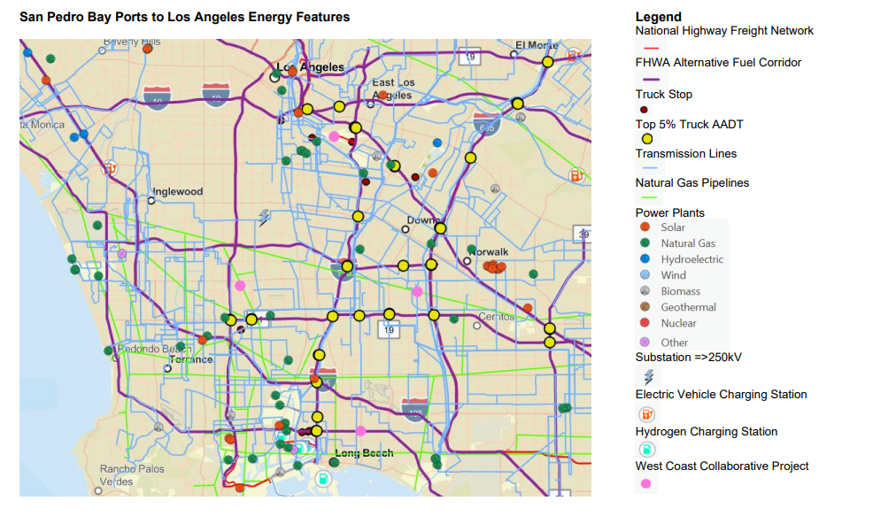
San Pedro Bay Ports to Los Angeles Energy Features

