Slide 1
We will begin in a few moments.
710 Task Force Meeting
Clean Truck Working Group
January 25, 2022
Notes:
Erika

Slide 2
710 TASK FORCE
Notes:
Erika

Slide 3
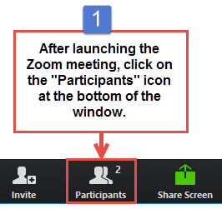
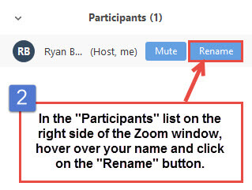
Task Force Member Identification
Task Force Members, please change your Zoom screen name to include: Name and Organization Name
Notes:
Erika

Slide 4

Raise Hand
Click Raise Hand in your meeting controls or
Press*9 on the phone line.
To lower your hand, click Raise Hand in your meeting controls.
Comments & questions can also be provided in writing by using the Chat function.
The Chat button is located on the control panel at the bottom of your screen.
Notes:
Erika

Slide 5
Welcome!
Notes:
Erika

Slide 6
Agenda
1:00 pm Welcome, Introductions, Agenda Review, and Purpose of the Clean Truck Working Group (5 minutes)
1:05 pm Project Team Presentations (5 minutes)
Objective for Clean Truck Working Group Meeting #2
SB 671 Update and Next Steps
1:10 pm Environmental Protection Agency (EPA) (15 minutes)
EPA Presentation
1:25 pm Discussion #1 (10 minutes)
1:35pm Air Quality Management District (AQMD)
Clean Air Act Regulatory Framework – South Coast AQMD (15 minutes)
AB 617 Truck Incentives plan (5 minutes)
1:55 pm Discussion #2 (10 minutes)
2:05 pm Governor’s Budget – Prospects for 2022 Clean Truck/Infrastructure Funding
Metro Presentation Michael Turner (10 minutes)
2:15 pm Discussion #3: (5 minutes)
2:25 pm Closing Comments, Next Steps, Thank you: (5 minutes)

Slide 7

Facilitator
Erika C.B. Morales
Partner, Morales + Morales Partners
Notes:
Erika
We are making adjustments based on feedback regarding Public Comment
Public comment after each topic-1 minute per person
At end of meeting-public comment-2 minutes per person

Slide 8
Objective for Today's Clean Truck Working Group Meeting
Understand and discuss federal regulatory approach to curbing emissions within the I-710 South Corridor
Understand and discuss what is needed to meet standards and mandates at the federal level
Receive information on and discuss State-level funding and opportunities
Formulate key Questions to consider for developing the Clean Truck Program

Slide 9
Senate Bill 671 Update and Next Steps
710 Task Force approved the submittal of a joint letter of support for nominating the I-710 South Corridor as a priority freight corridor for the CTC's SB 671 Clean Freight Corridor Efficiency Assessment
Corridor to be submitted includes:
I-710 S Freeway from Long Beach to SR-60
Ports of LA and Long Beach
Alameda Corridor
I-710 South Corridor Study Area
Other considerations:
Community engagement for both infrastructure development and siting
Priority for investment due to supply chain disruptions and need for investment in clean technology
CTC staff have allowed us more time to submit the nomination form and letter – by February 2022
Draft application and letter to be shared with full Task Force within the next week for review prior to submission

Slide 10
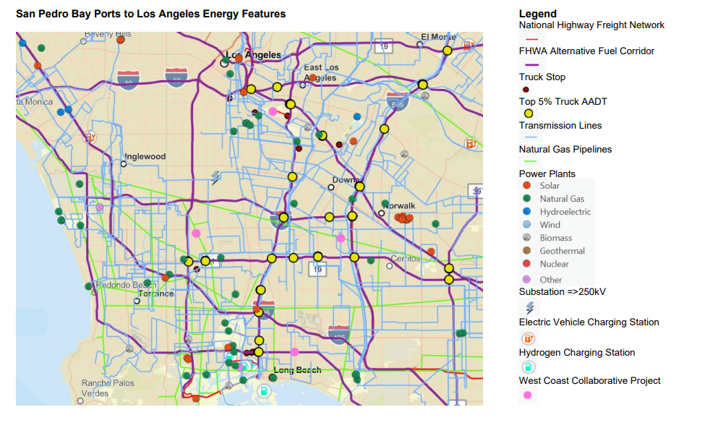
San Pedro Bay Ports to Los Angeles Energy Features

Slide 11
Perspective from the
US Environmental Protection Agency
Notes:
Erika

Slide 12
Speakers
Morgan Capilla
Environmental Protection Specialist
U. S. Environmental Protection Agency – Region 9
Karina O’Connor
Environmental Engineer
U. S. Environmental Protection Agency – Region 9
Notes:
MORGAN CAPILLA
EPA Region 9’s Environmental Review Branch,
Reviews and comments on environmental impact statements prepared by other federal agencies pursuant to the National Environmental Policy Act.
Previously Peace Corps volunteer in the Dominican Republic from 2012-2014 where she collaborated with a women’s association on grassroots initiatives. Through this work, she developed a profound appreciation for the ways in which grassroots movements can assist marginalized communities in overcoming environmental and public health disparities.
Master of Public Policy with a specialization in Environmental Policy from Duke University
B.A. in English with a minor in environmental studies from UCLA.
In her free time, she enjoys being outdoors, traveling, going to concerts, and tutoring at an international school in Oakland.
Karina O’Connor
LinkedIn Profile
LinkedIn Profile 2
Has worked with the EPA for 25 years.
Environmental Engineer for Region 9 where she is responsible for working with state and local air quality and transportation planning agencies to develop plans that meet Clean Air Act requirements.
Expert in EPA/DOT's transportation conformity regulations and application of measures to reduce impacts of transportation for criteria pollutants and greenhouse gases.
Works with agencies with implementation and development issues for State Implementation Plans (SIPs) and projects under NEPA, conformity and SB 375.
Also serves as Executive Director of the Sierra Environmental Education Collaborative for the past 14 years,
Earth Guardian Manager with Burning Man for 24 years,
Master of Science in Clinical Epidemiology and in Environmental Engineering from Stanford University
Bachelor Degree in Clinical Epidemiology and in Environmental Engineering from Purdue University.

Slide 13
Working Group Discussion #1:
Notes:
Erika

Slide 14
EPA: Guiding Questions
Reaction to Data Maps/Existing Conditions showing PM 2.5 concentrations and solutions to addressing these impacts
Discussions on a pathway for any 710 Project (as constituted by the Task Force) to move forward considering the Hot Spot analysis will likely be triggered in this corridor even with ZE trucks
How should we move forward in understanding EPA’s perspective on a project in this area? What does a successful Clean Truck Program and I-710 Project look like?
What is EPA’s knowledge of and guidance for regions trying to reduce entrained (non-tailpipe) PM generation immediately in support of impacted community health?

Slide 15
Perspective from
South Coast Air Quality Management District
Notes:
Erika

Slide 16
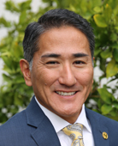
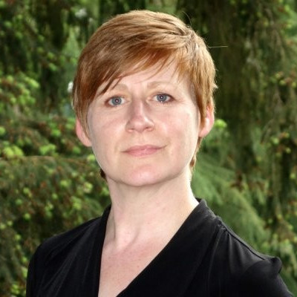
Speakers
Dr. Matt Miyasato
Deputy Executive Officer, Science & Technology Advancement
South Coast Air Quality Management District
Sarah Rees
Deputy Executive Officer
South Coast Air Quality Management District
Notes:
Dr. Matt Miyasato
Deputy Executive Officer for Science & Technology Advancement at the South Coast Air Quality Management District.
Responsible for the SCAQMD's Technology Advancement Office, Mobile Source Division, and Monitoring and Laboratory Analysis Division.
Identifies, evaluates and stimulates development and commercialization of clean air technologies, develop and coordinate mobile source regulations, and to conduct ambient monitoring, source testing and laboratory analysis.
Earned his undergraduate degree in Mechanical Engineering, and his Masters and Ph.D. in Engineering, specializing in combustion technologies and air pollution control – all from the University of California, Irvine.
Has worked at Southern California Edison in the Nuclear Engineering Department and at General Electric, where he designed burners and combustion modifications for utility boilers.He was also a research scientist at UCI, where he managed the industrial burner research program and has publications on combustion phenomena, active control, and laser diagnostics. Dr. Miyasato has also been a lecturer at UCI for the undergraduate air pollution control course.
Sarah Rees
LinkedIn Profile
Sarah Rees is the Assistant Deputy Executive Officer in the Planning, Rule Development, and Area Sources Division at the South Coast Air Quality Management District. In her role, she focuses on the implementation of transportation and mobile source programs, as well as development of the Air Quality Management Plan and other planning activities. Sarah has over twenty years of experience in air quality and climate change matters at the state and federal level. Prior to joining the SCAQMD, Sarah directed the Office of Regulatory Policy and Management within EPA’s Office of Policy where she oversaw the Agency’s regulatory agenda and advised senior Agency management on the development of high-profile regulations. Previously, she served several roles within Washington State’s Department of Ecology, including directing Ecology’s programs to address climate change, and leading the planning and rules section within Ecology’s Air Quality Program. Trained as a chemical engineer, Sarah practiced environmental law for several years before obtaining a PhD in Engineering and Public Policy from Carnegie Mellon University.

Slide 17
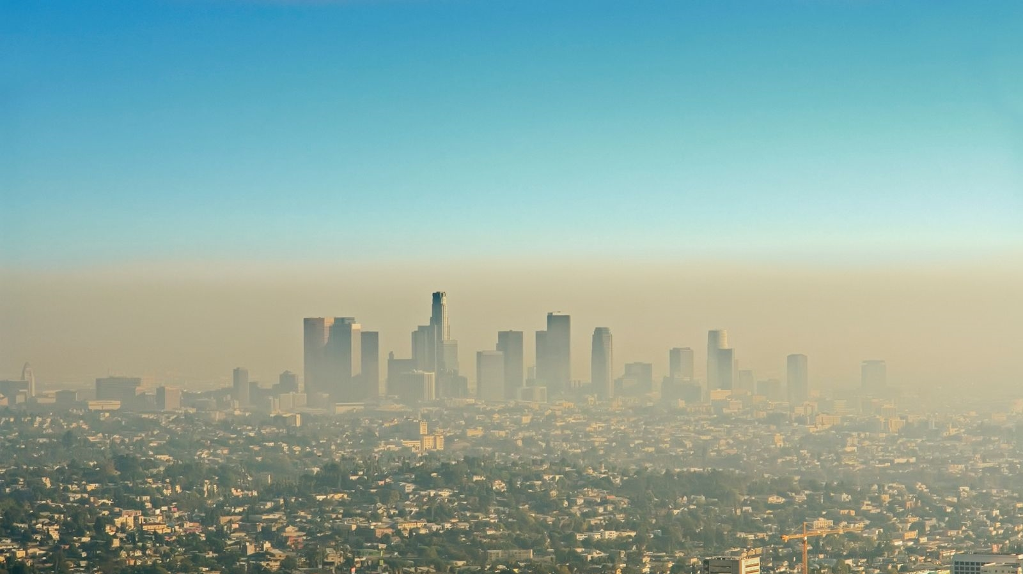

South Coast AQMD Regional Air Quality and Call to Action
I710 Clean Truck Working Group
January 25, 2022

Slide 18
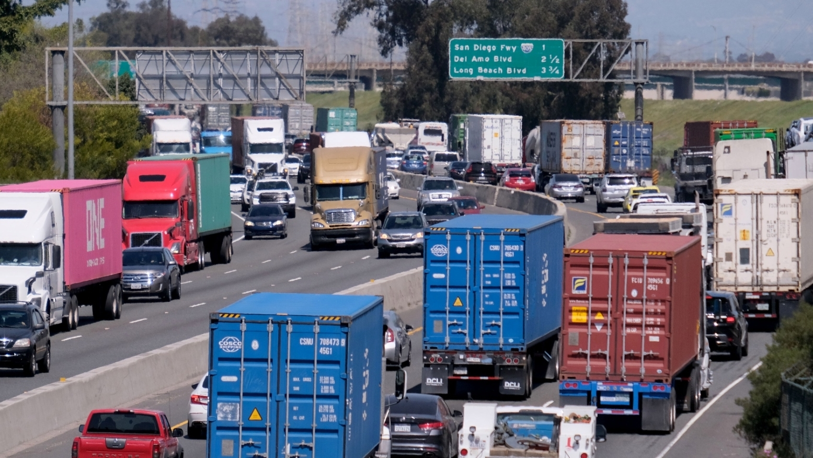
OVERVIEW
Our regions suffer from some of the worst air quality in the country
Heavy Duty trucks are the largest source of smog-forming emissions
The technology for trucks over 90% cleaner than current trucks is available and cost-effective
Delaying deployment is causing significant health impacts

Slide 19

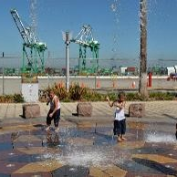
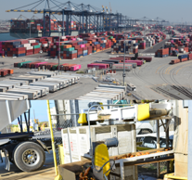
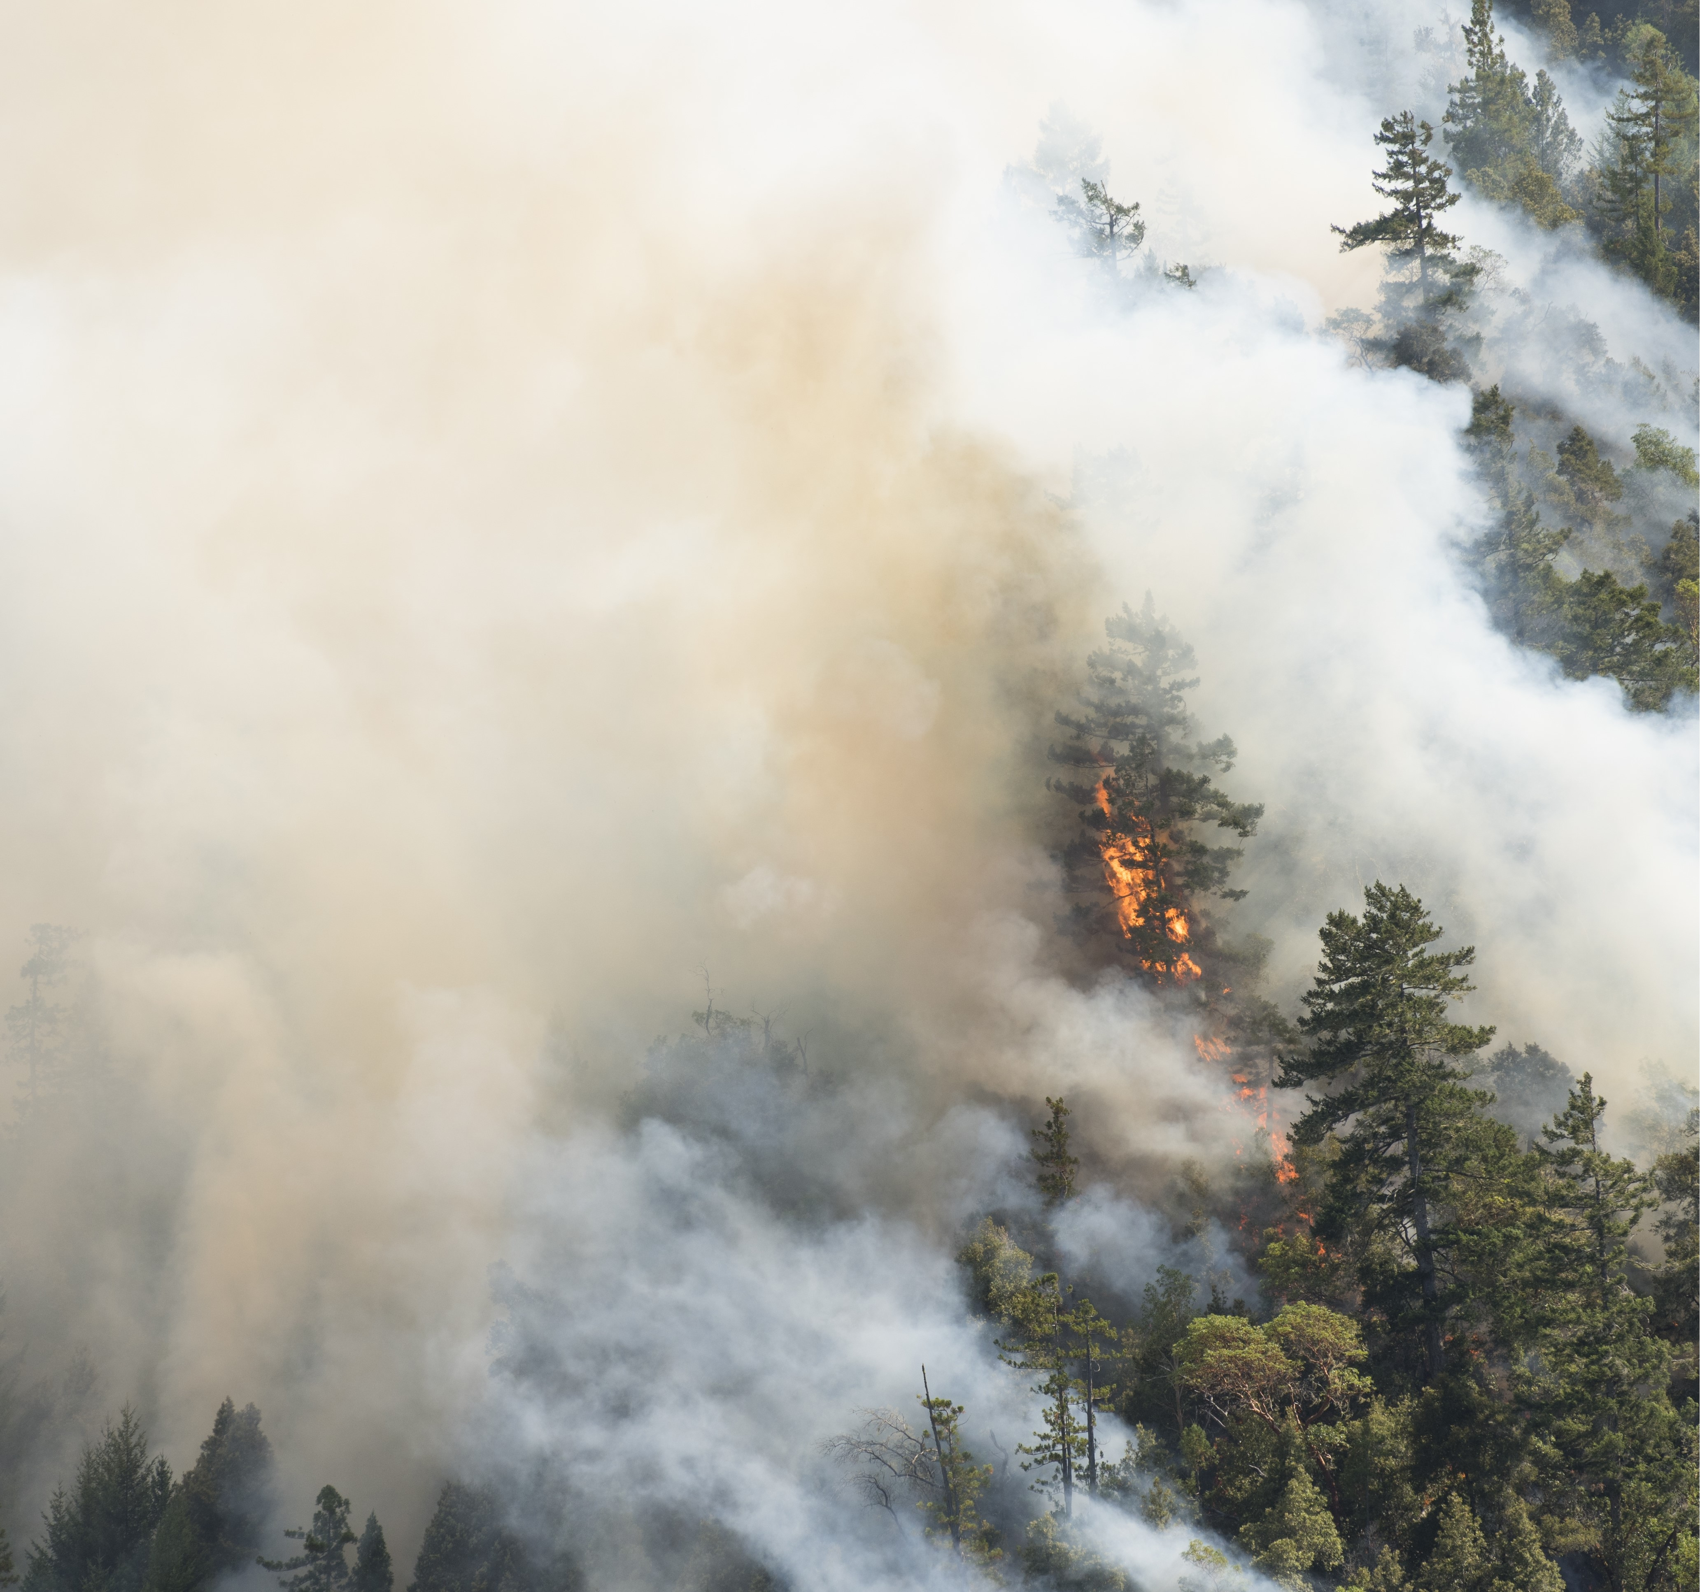
BACKGROUND
~17 Million People
Environmental Justice
Economy
Climate
Our jurisdiction would be 5th largest state after New York.
Nearly 67% of CA EJ population lives in South Coast region.
CA’s economy is 5th largest in the world. Southern CA Ports are the gateway to the nation.
Year-round fire season, drought, and heat-waves impact air quality, public health and the economy.
19

Slide 20
South Coast AQMD Attainment Challenges - Upcoming Attainment Deadlines
Standard* | Concentration | Latest Attainment Year
2015 8-hr Ozone | 70 ppb | 2037
2008 8-hr Ozone | 75 ppb | 2031
1997 8-hr Ozone | 80 ppb | 2023
1979 1-hr Ozone | 120 ppb | 2022
2012 Annual PM2.5 | 12 μg/m³ | 2025
2006 24-hr PM2.5 | 35 μg/m³ | 2019

Slide 21
ADDRESSING TRUCK EMISSIONS are CRITICAL to ACHIEVING AIR QUALITY GOALS
Transition to zero and near-zero emission technologies is essential to meeting air quality goals

Slide 22
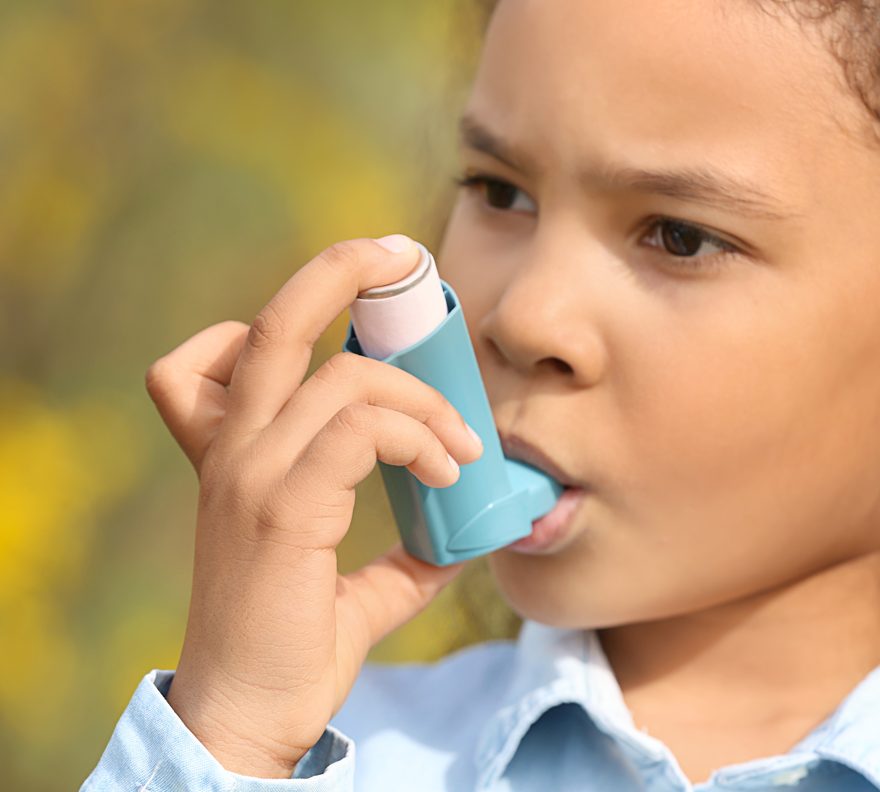
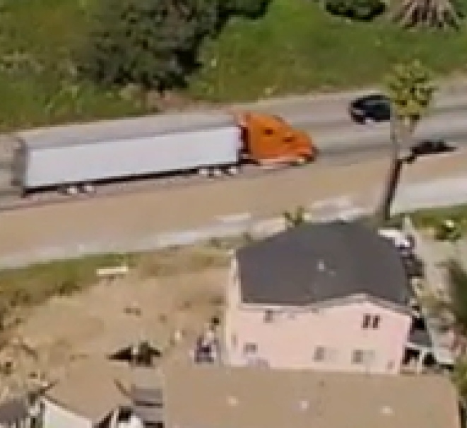
NEED FCOSTS OF NOT MEETING CLEAN AIR ACT REQUIREMENTS: OR REVISED NOx EMISSION STANDARD FOR HEAVY-DUTY TRUCKS
Continued poor air quality for our residents
Premature death, higher hospitalization rates, increased asthma, more sever asthma attacks
Tens of billions of dollars per year in monetized health impacts
Impact is greater in environmental justice communities
Potentially millions of dollars in extra costs on major sources every year
Potentially billions of dollars in lost transportation revenue affecting tens of billions of dollars in projects
Potentially significant curtailing of economic activity

Slide 23
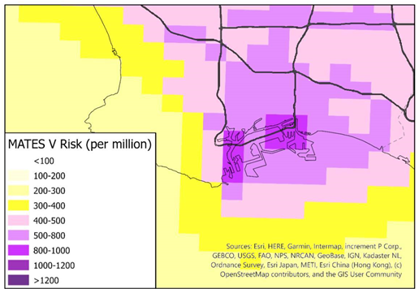
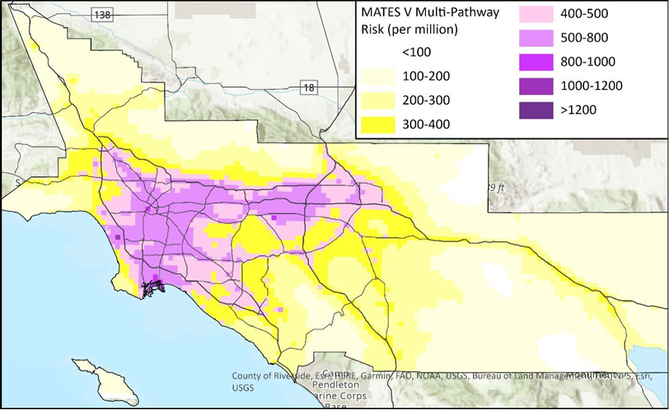
MATES
Multiple Air Toxics
Exposure Study (MATES V)

Slide 24
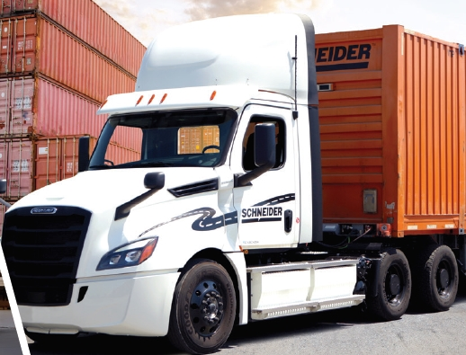

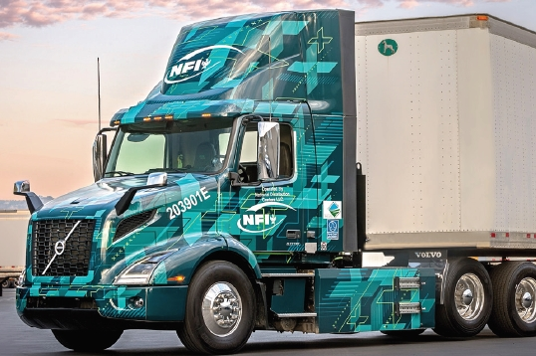
State of Technology
South Coast AQMD leading efforts to commercialize heavy-duty, class 8 Zero Emission Trucks – Volvo, Daimler, Petebilt, Kenworth, BYD
Scale of Zero Emission Truck commercialization is in infancy

Slide 25
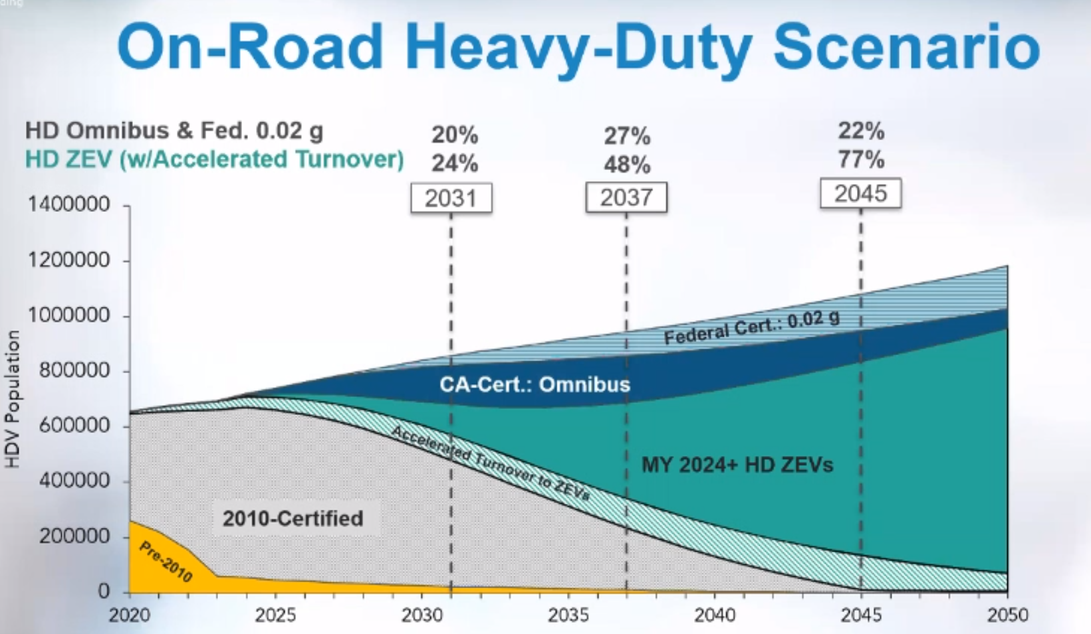
DIESEL

Slide 26
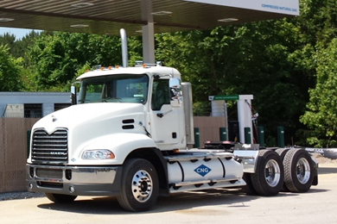
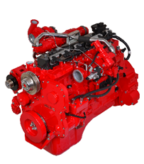
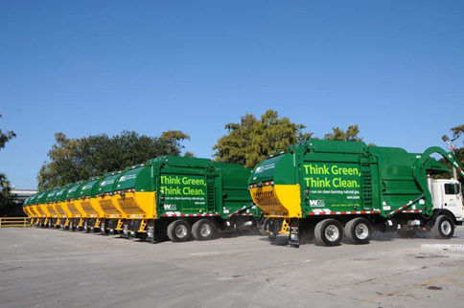
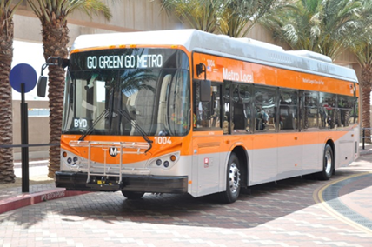
Near-Zero Engines
8.9L engine certified at 0.02 g/bhp-hr NOx in 2016
12L engine certified at 0.02 g/bhp-hr NOx in 2018

Slide 27
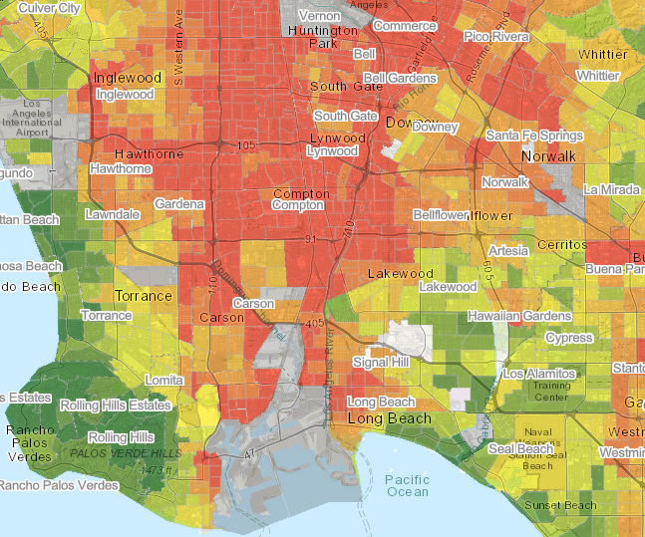
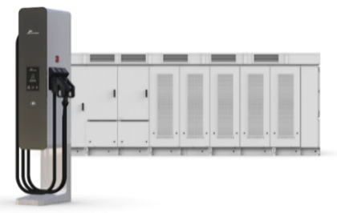
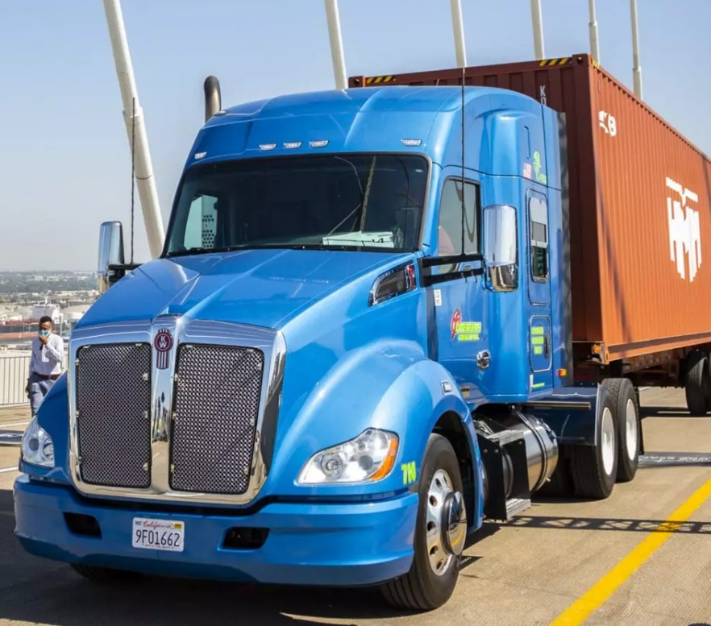
Summary
Diesel emissions from trucks represent a significant on-going health concern, especially in disadvantaged communities
South Coast AQMD is leading the state and nation in commercializing Zero Emission class 8 trucks
The scale to commercialize and adopt ZETs (incl. infrastructure) is not on pace to meet our air quality goals
NZE offers near-term, lower cost emission reductions

Slide 28
Working Group Discussion #2:
Notes:
Erika

Slide 29
South Coast AQMD: Guiding Questions
How do we balance the desired end state (ZE technology) with the needed interim steps to reduce air pollution, meet federal requirements and improve public health for EJ communities?
Besides public health impacts that continue year over year, what does LA County risk by the South Coast basin not meeting the 2023 standards requirement?
How do NZE trucks (NG, etc.) compare to – and differ from – existing diesel trucks in terms of energy production, emissions, availability and public health outcomes—especially for I-710 South Corridor communities?
Are there strategies that could ensure that NZE adoption to replace diesel is a temporary step as LA County pursues a ZE-only future?

Slide 30
Governor’s Budget –
Prospects for 2022 for Clean Truck/
Infrastructure Funding
Notes:
Erika

Slide 31
Speakers
Michael Turner
Deputy Executive Officer, Government Relations
Metro

Slide 32
Discussion #3:
Governor’s Budget –
Prospects for 2022 for Clean Truck/
Infrastructure Funding
Notes:
Erika

Slide 33
Governor's Budget – Focusing Questions
Metro's Clean Truck Program
How do we best leverage the state's existing and future resources?
Metro's role,
How can we best utilize Metro's $50 million commitment?
How can we best partner with the Ports on their efforts?
Metro secures ZE trucks for LA County
Will Metro's clean truck program buy truck, and/or lease trucks?
Consideration: State programs are generally first come first served.
Should Metro consider using its funding to focus on ZE infrastructure delivery more than ZE trucks to support existing ZE truck funding at the Ports/AQMD?

Slide 34
Can’t attend the meeting? Reach out to us!
Michael Cano, Deputy Executive Officer, Countywide Planning & Development Metro One Gateway Plaza, MS 99-13-1 Los Angeles, CA 90012
213.922.4710
710corridor@metro.net
metro.net/projects/i-710-corridor
@metrolosangeles
losangelesmetro

