Slide 1
Caltrans/Metro Local Delivery Workshop
2021 FTIP UPDATES
February 2021

Slide 2
Overview
Federal Transportation Improvement Program (FTIP) Overview & Updates
How to enter a new project in the FTIP on ProgramMetro
Obligation Plan

Slide 3
What is the FTIP?
Federally required programming document
Receive environmental approval and permits
Obtain FTA and FHWA grant approval (discretionary formula)
Access (“Obligated”) federal funds
Achieve on-time project delivery
Get reimbursed for eligible expenses

Slide 4
2021 FTIP Amendments
 | ADMINISTRATIVE | FORMAL
CRITERIA | Minor changes | Major changes
 | Cost Increase <50% | Cost Increase >50% or in specific phase
 | Cost Increase <$20 million | Cost Increase >$20 million
 | Funding Source/Year changes | Scope changes
 | Lead agency change | Project cancellation
 | Cost decrease without deleting phase | Adding/Deleting phase
 |  | New projects
 |  | Moving prior funds to quad years
Approving Agencies | Metro, SCAG (approx. 30 days) | Metro, SCAG, Caltrans, FTA/FHWA (approx. 90 days)
Visit ProgramMetro for most up-to-date Amendment schedule

Slide 5
2021 FTIP Adoption and Status
Adoption expected in mid-April 2021
When adopted, it will replace the 2019 FTIP
Amendments 1 & 2 of 2021 FTIP (21-01, 21-02) will be approved almost concurrently with 2021 Adoption (21-00)
New Performance Measures requirement
Amendment 21-03 Formal Amendment is due March 30th, 2021

Slide 6
2021 FTIP Amendment Schedule
Amendment # | Amendment Type | Due to METRO | Estimated Approval
21-03 | Formal | March 30, 2021 | Mid July 2021
21-04 | Administrative | May 25, 2021 | Mid July 2021
21-05 | Formal | Est. June 22, 2021 | Early October 2021

Slide 7
Entering a New Project into the FTIP

Slide 8
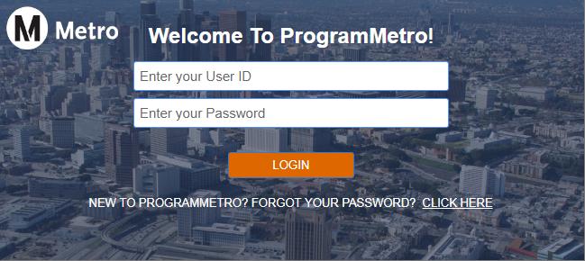
ProgramMetro – Log In
To use ProgramMetro, go to https:\\program.metro.net/secure2/login
User must have an account. Select “CLICK HERE” to apply for access
Users must be verified by their supervisors, via Verification Letter provided by Metro FTIP staff, before access can be granted

Slide 9
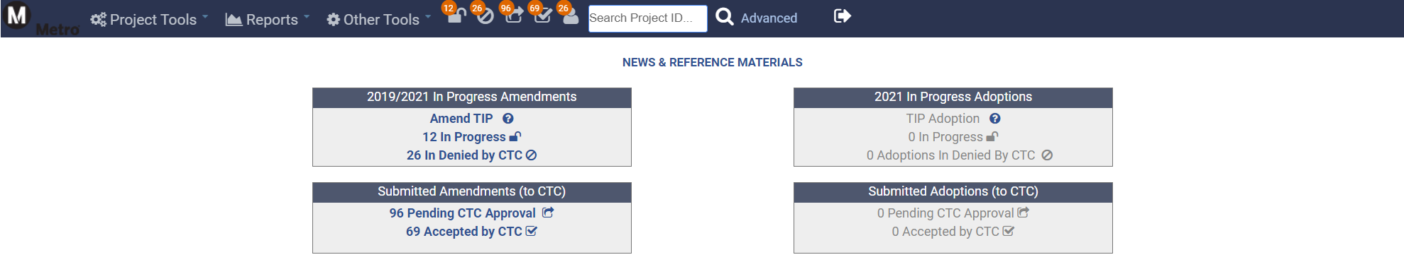
ProgramMetro – Home Page
Home Page Button
Log Out Icon

Slide 10
ProgramMetro – Amending Projects
To add a new project, or mark a project completed/deleted from ProgramMetro Home Page, use the box titled “2019/2021 In Progress Amendments”
To review a submitted project or check if a project has been accepted, use the box titled “Submitted Amendments (to CTC)”

Slide 11
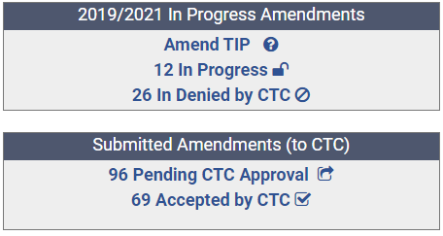
ProgramMetro – Project Status
Amend TIP: Starting point to enter a New Project or amend an Existing Project.
In Progress: Access projects that have been edited but not yet submitted to Metro for approval.
In Denied: Projects Metro and/or SCAG rejected for follow up.
Pending: Projects submitted to Metro but still under review.
Accepted: Projects have been reviewed and accepted by Metro.

Slide 12
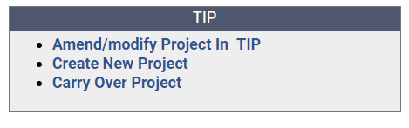
ProgramMetro – Adding New Projects
To add a New Project to 21-03, select “Amend TIP”
On the following page, select “Create New Project”

Slide 13
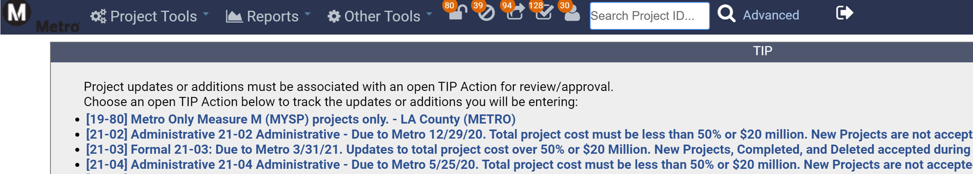
ProgramMetro – Adding New Projects
Select: [21-03] Formal 21-03

Slide 14
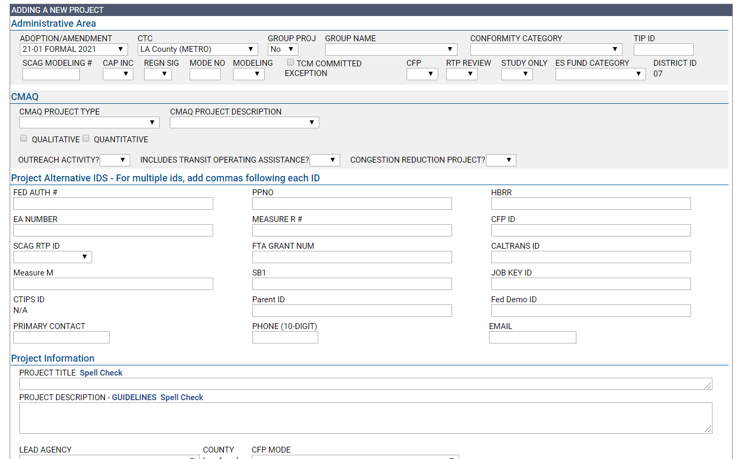
ProgramMetro – Adding New Projects
After 21-03 is selected, the following screen appears:
Fill out as much information as possible

Slide 15
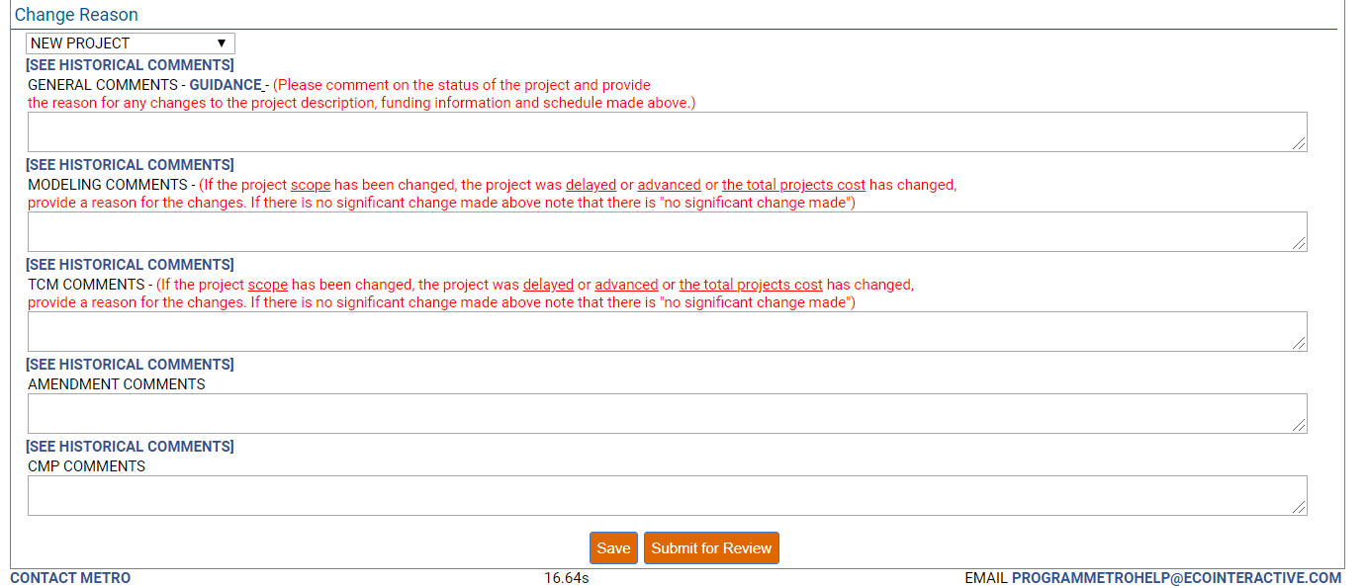
ProgramMetro – Adding New Projects
Two options at bottom of page: SAVE and SUBMIT FOR REVIEW.
SAVE = Saves project info for agency to review, update, and submit at a later time.
SUBMIT FOR REVIEW = Project info is complete and ready for Metro’s review.

Slide 16
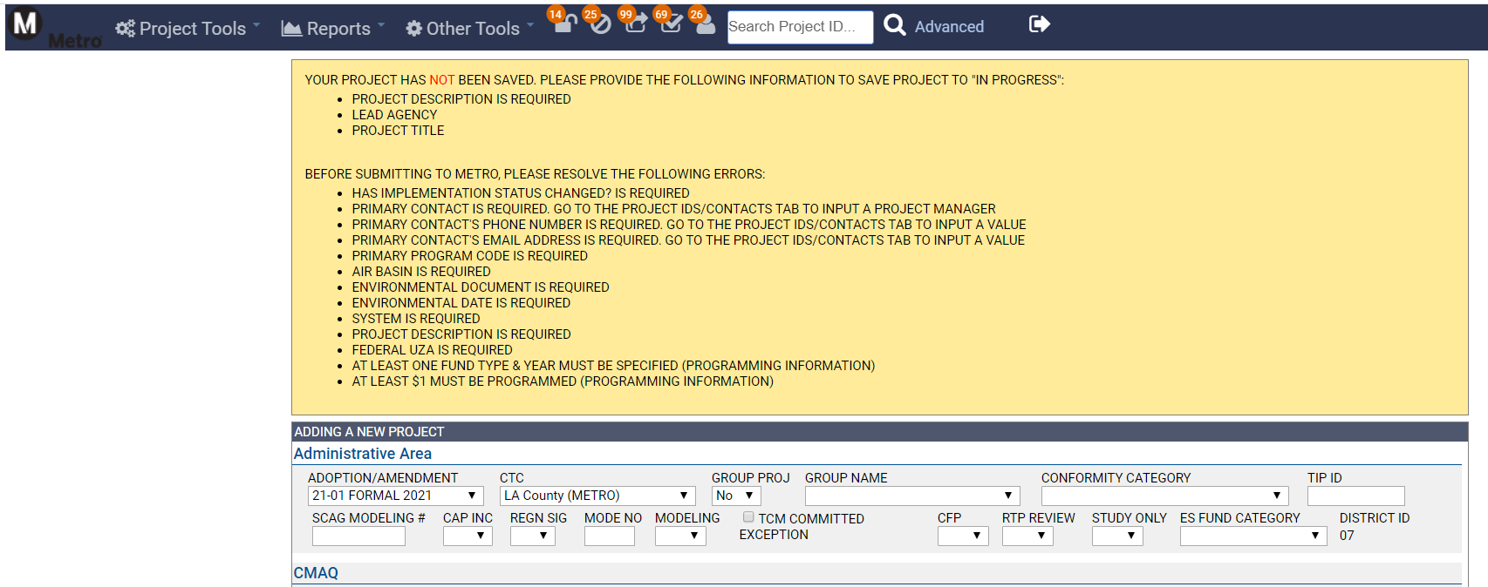
ProgramMetro – Adding New Projects
Error messages will appear if fields are not populated correctly

Slide 17
New Project Checklist
Project Information
Clearly indicate scope in project description field
Provide accurate project limits and attach location map(s)
Upload project funding justification (funding awards, Board reports, etc.)
NOTE: Electric bus purchases and chargers should be programmed as different projects
Programming
Program funds for years of obligation
Programming dollars are in thousands, not actual amount
Project phases and amounts must match support document
Make sure to program local matching funds, including Toll Credits/TDC

Slide 18
New Project Checklist
Project Schedule
Project completion date cannot be earlier than programming date
Toll Credits/Transportation Development Credits
Allows federal funds to be used up to 100% of project cost
Not an actual source of funding (not cash)
FHWA projects: Toll Credits (TC)
FTA projects: Transportation Development Credits (TDC)

Slide 19
Obligation Plan

Slide 20
Obligation Plan
An annual federally required document that local agencies submit to CTCs
List of projects that plan to obligate specific federal funds via an excel sheet from February 1st, 2021 to September 30th, 2021 (FFY20/21)
Due to Metro February 28th, 2021
Obligation Plan Memo sent out by Nick Zhao & Yerandy Pacheco

Slide 21
Obligation Plan
Projects funded by the following federal funds:
1) STBGP
i) RSTP
ii) STP-L
2) CMAQ
3) HBP
4) HSIP
5) SRTS
This year’s Obligation Plan does not require ATP and STIP (included in previous years)
List should NOT contain projects without any of the five funds above and do NOT plan on obligating this year
Certification Letter to be signed by agency & returned to Metro

Slide 22
Metro Contacts
NAME | TITLE | PHONE | EMAIL
Ashad Hamideh | Senior Director | (213) 922-5539 | HamidehA@metro.net
Nancy Marroquin | Senior Manager | (213) 418-3086 | MarroquinN@metro.net
Michael Richmai | Senior Manager | (213) 922-2558 | RichmaiM@metro.net
James Simpson | Transportation Planner | (213) 922-2923 | SimpsonJa@metro.net
Nick Zhao | Transportation Associate I | (213) 922-2069 | ZhaoJi@metro.net
Yerandy Pacheco | Administrative Intern | (213) 922-7478 | PachecoY@metro.net

Slide 23
Thank you

