Slide 1
Funding Program
Plan
Design
Build
O&M

Slide 2

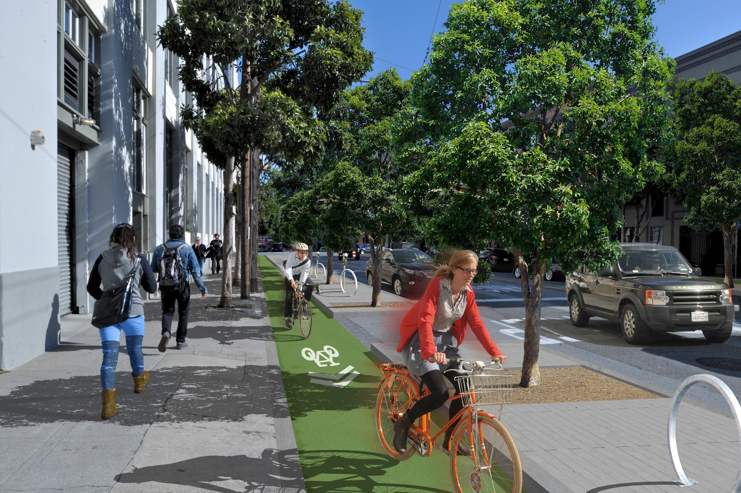
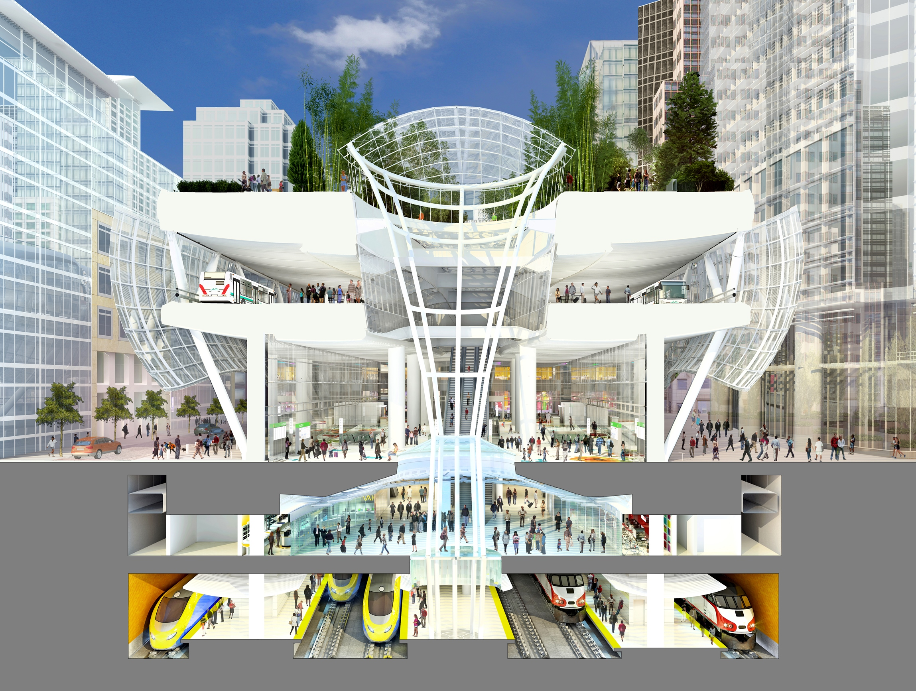


Improve Quality of Life, Economy, Equity, Safety, Sustainability
This Photo by Unknown Author is licensed under CC BY-NC-ND
This Photo by Unknown Author is licensed under CC BY-NC-ND
This Photo by Unknown Author is licensed under CC BY-SA
Accessibility
Bike
Walk
Multimodal Safety
Sustainability

Slide 3
Successful Delivery
Innovation
Efficiency
Partnership

Slide 4
Local Assistance Program https://dot.ca.gov/programs/local-assistance/fed-and-state-programs
Federal Program
State Program
Earmark Repurposing
Emergency Relief Program
Federal Lands Access Program (FLAP)
Highway Bridge Program
Highway Infrastructure Program (HIP)
Highway Safety Improvement Program (HSIP)
Intelligent Transportation Systems Program (ITS)
Other Federal Programs
Sec 130 Railroad-Highway Grade Crossing Hazards Elimination Program
Active Transportation Program (ATP)
Bike Program
Safe Route To School Program (SRTS)
SB1
State Transportation Improvement Program (STIP)

Slide 5
Program Update
ATP
Sustainable Transportation Planning
Quick-Build Project adopted December 2020
Statewide, small urban & rural March 2021
MPO selected projects June 2021
Grant Application Due Feb 12, 2021
Grant Announcement June 2021
Begin Project Fall 2021
Completion Winter-Summer 2024

Slide 6
Program Update
HSIP
HBP
Cycle 10 Application closed on 11-02-2020
Award announcement around Spring 2021
Recommend request allocation of LSRP fund within 9 months after award
Cycle 11 Application around May 2022
LRSP or equivalent is required to apply
End of September Survey Project/Program need
End of October New Program list FSTIP amend

Slide 7
Sustainability Transportation Planning Grant
https://dot.ca.gov/programs/transportation-planning/regional-planning/sustainable-transportation-planning-grants
Sustainable Communities Grants ($29.5 million)
Strategic Partnerships Grants ($4.5 million)

Slide 8
California Transportation Commission https://catc.ca.gov/programs
California Strategic Growth Council
https://sgc.ca.gov/

Slide 9
Your limitation – it’s only your imagination

