Slide 1
OFFICE OF PROJECT IMPLEMENTATION
Sujaya Kalainesan – South Office
Felicia Haslem – North Office
DIVISION OF LOCAL ASSISTANCE

Slide 2
HOT TOPICS
FL Dates
Inactives
PED
OA Management
PED
Inactives

Slide 3
PED ISSUES
Roughly 400 projects are past their Project End date (PED)
Work done after the PED is not reimbursable
Look-ahead report shows many, many projects are in jeopardy
These projects need their PED extended ASAP!

Slide 4
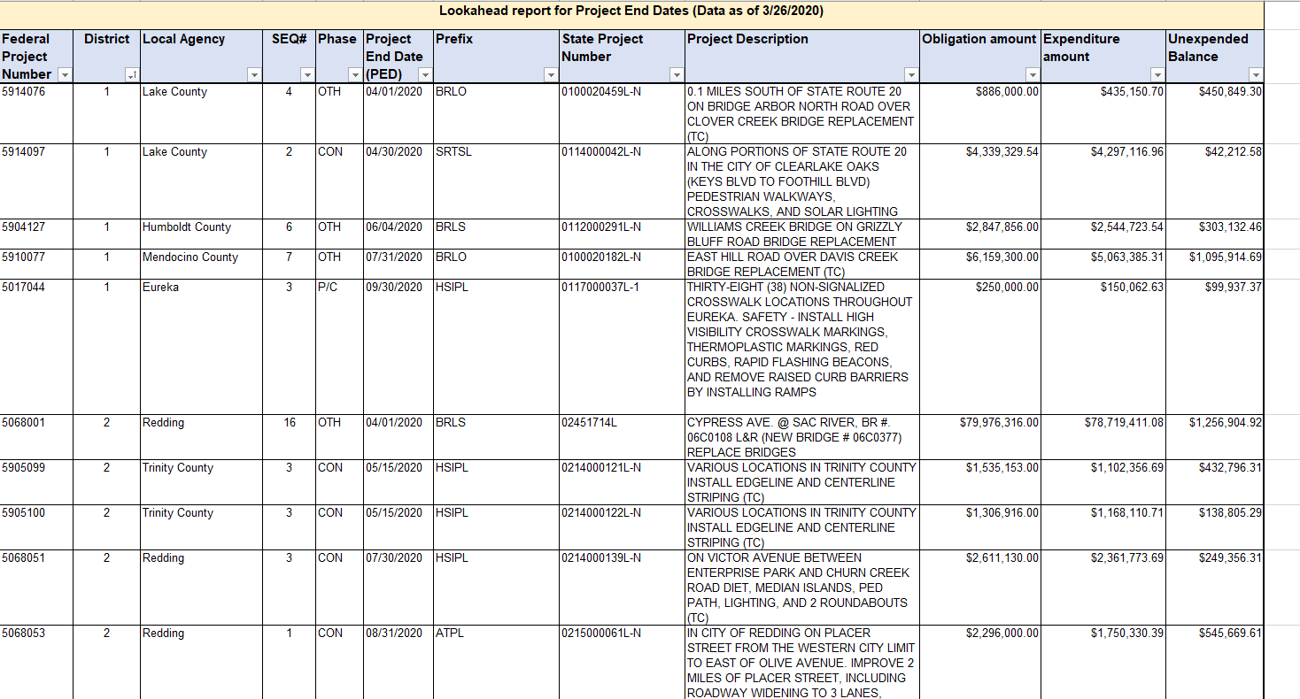
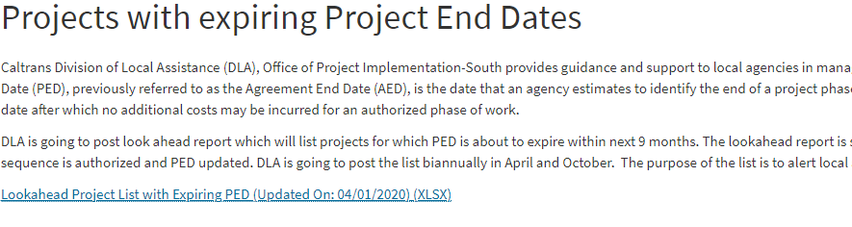
EXISTING REPORTS - PED

Slide 5

Tips to Avoid Project End Date Ineligibility
Extend PED prior to expiration
Review PED report
Request extension ASAP after realizing on PED list
Time between expired PED and extension is not eligible for reimbursement
Close projects within 120 days

Slide 6
HOT TOPICS
FL Dates
Inactives
PED
OA Management
Inactives/
PE>10

Slide 7
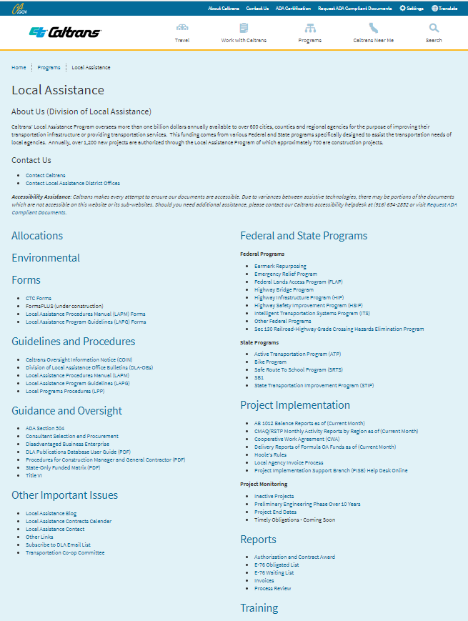
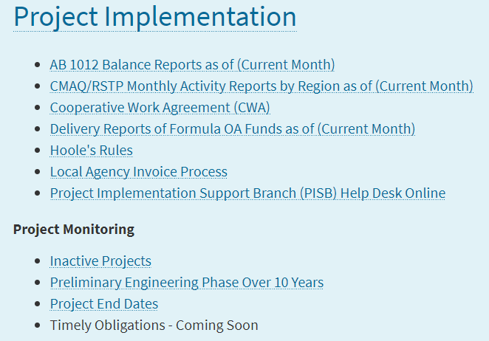
DLA WEBSITE
  https://dot.ca.gov/programs/local-assistance/

Slide 8
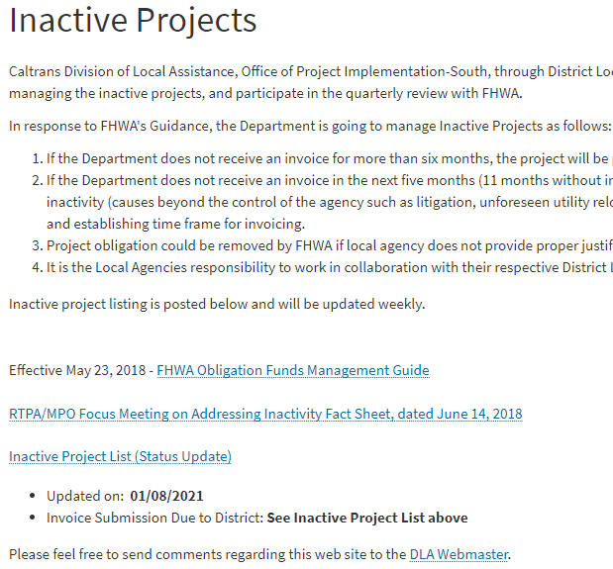
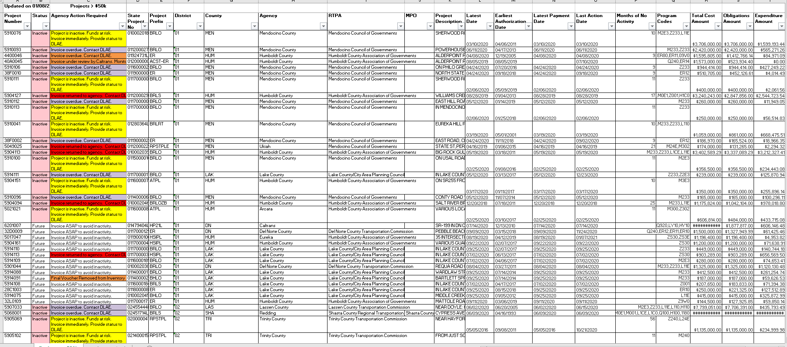
EXISTING REPORTS - INACTIVES

Slide 9
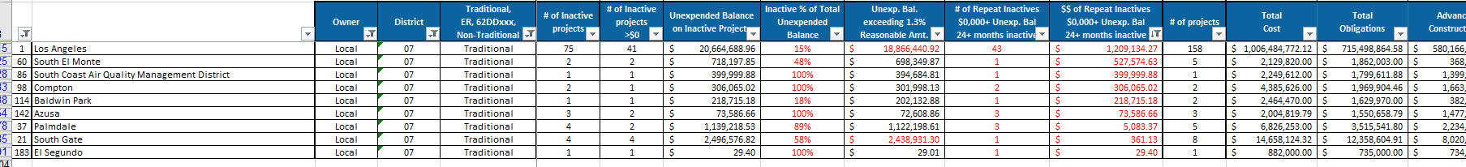
INACTIVE PROJECTS > 24 MONTHS

Slide 10
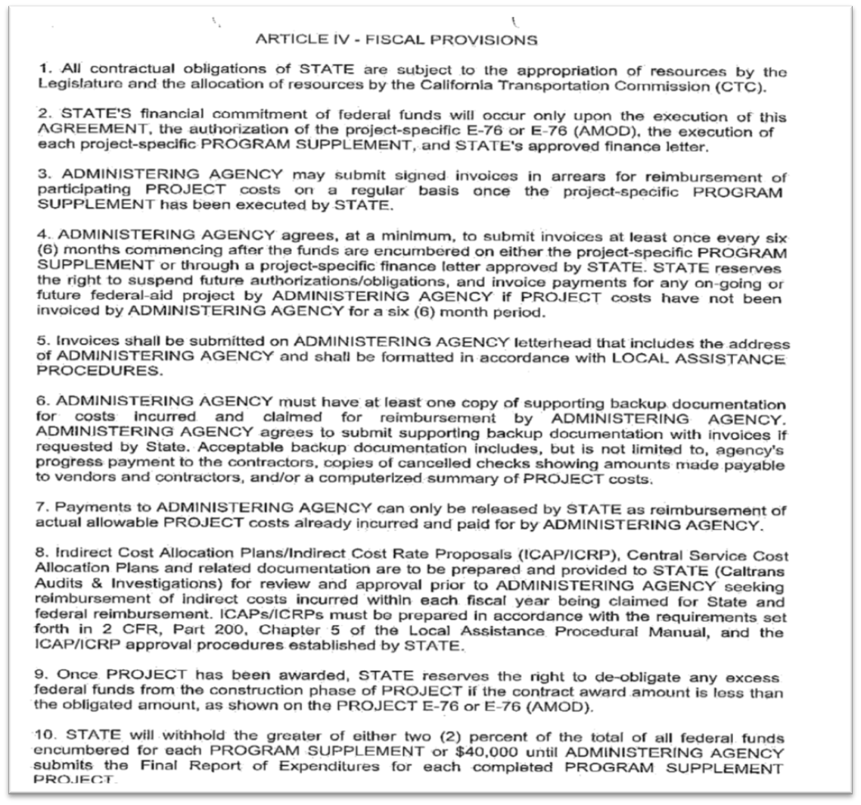
MASTER AGREEMENT
Avoid Inactivity
Notes:
This is the Master Agreement. It’s a fairly lengthy document but two items that are very important are the Agreement number and the date the Master Agreement was executed. We can authorize projects or pay invoices for a local agency without a Master Agreement in place.

Slide 11
Tips to Avoid the Inactive List
Invoice on a regular basis (every 6 months).
Invoice early in a quarter (Jan/Apr/Jul/Oct).
Don’t request funds before you are ready to start the work (and start billing).
Always include Construction Engineering when requesting funds for the Construction phase.
Don’t let your funds lapse. Lapsed funds cannot be invoiced against.

Slide 12
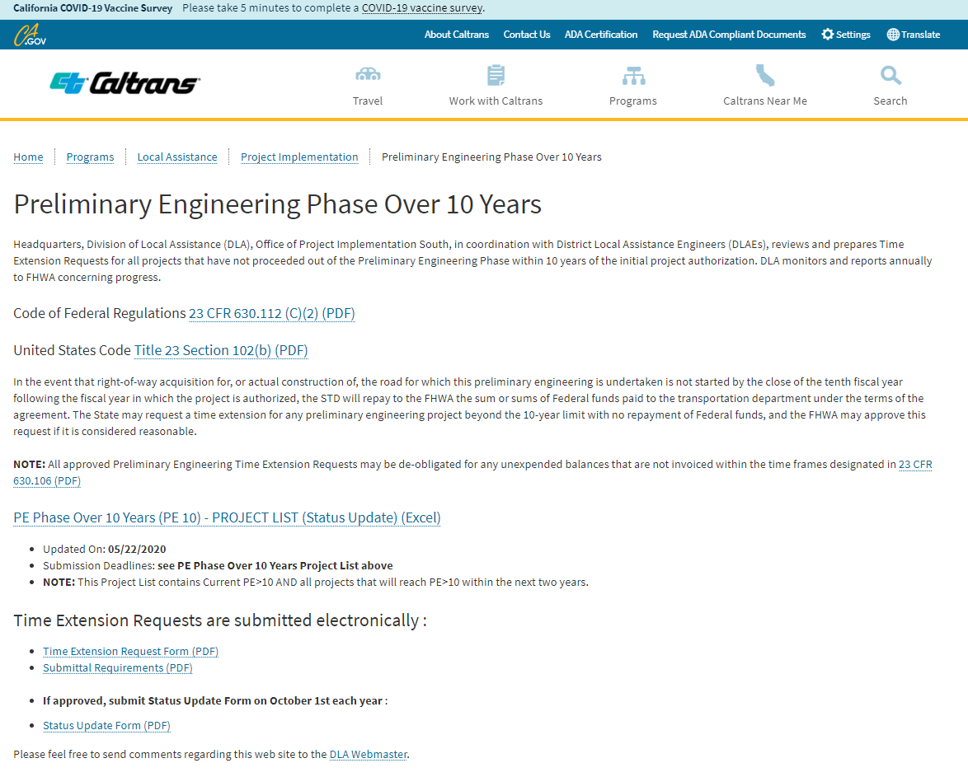
PE OVER 10

Slide 13
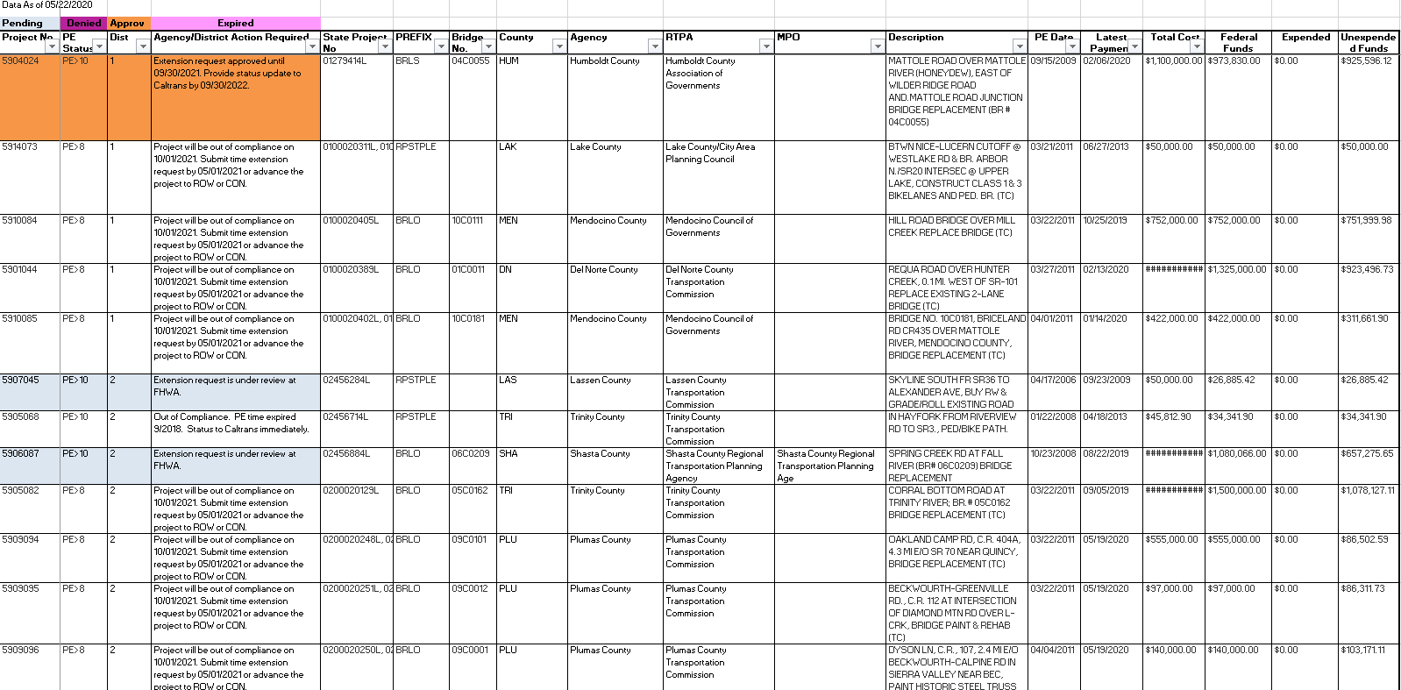
PE > 10

Slide 14
HOT TOPICS
FL Dates
Inactives/PE>10
PED
OA Management
FL Dates

Slide 15
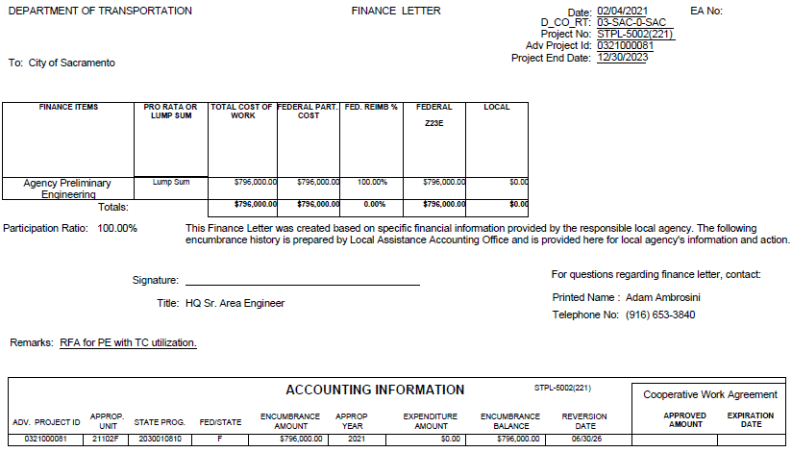
FINANCE LETTER
Is this the most current Finance Letter?
Was it approved/signed by HQ?
Have the funds lapsed?
Not the same as Timely Use of Funds
Notes:
This is your Finance Letter. This will show the funding by phase and what each phase’s reimbursement ratio is. Always make sure you are working with the most current HQ approved version. It is also critical for the Caltrans and the local agency to be aware of their reversion dates. We cannot pay an invoice if the funds have expired.

Slide 16
REVERSION DATE AND CWA
Reversion Date
For State funds, the Reversion Date is established by the State fiscal year from which the allocation is made against.
  The CTC book item will identify the fiscal year of allocation.
  The Revision Date will be June 30, 5 years after the end of the fiscal year of the allocation
  Projects allocated in State Fiscal year 2020/2021 will have a Reversion Date of June 30, 2026
Cooperative Work Agreement (CWA)
All project funds not liquidated prior to Reversion Date will revert unless an executed Cooperative Work Agreement (CWA) extending this date is requested by the Local Agency and approved by the California Department of Finance.
  A CWA approval will add up to 2 additional years for funds to be expended
Invoices need to be submitted by April 1st prior to the Reversion Date to allow enough time for review and payment.
  The invoice must be paid before the Reversion Date
The Timely Use of Funds provisions for STIP/ATP/SB1 Programs, are shorter and more restrictive than the Budget authority timeline.
  If an extension is granted for a project that goes beyond the Date, a CWA time extension will be needed to allow these expenditures.
  CWA Timeline
Third Week December - Eligible projects for CWA time extensions will be identified.
  The information will be shared with the DLAEs and impacted agencies
Second Week January – Local Agencies supply required information
Second Week March - Local Agencies will be informed of approval/denial decisions
  CWA reversion Date is entered into LP2000

Slide 17
BUDGET AUTHORITY REPLENISHMENT (BAR)
  Changes in the BAR file are not a significant deviation from the prior BAR file
    Changes are effective immediately (as of the 19th of January, 2021)
    Changes in invoicing requirements and inactivity
  Replenishments going forward are intended to be a one-time funding extension
    A plan is required for the remainder of the outlay of the phase
  Government Code 16304.3 allowing for CWA
    Not to see replenishments come ahead of CWA
  Replenishment should be an exception to the norm
  Accountability, stewardship of tax payers dollars, and our own due diligence efforts
  District (DLAE) responsibilities and Audits
  Plans for training and better data reporting from HQ

Slide 18
HOT TOPICS
FL Dates
Inactives/PE>10
PED
OA Management
OA Management

Slide 19
OBLIGATIONAL AUTHORITY (OA) MANGEMENT
OA Usage Monitoring - OA Delivery Reports
OA Usage Data and OA Usage Trend
Obligation Authority Best Practices Committee

Slide 20
Delivery Report
  https://dot.ca.gov/programs/local-assistance/

Slide 21
Summary of Past 3 YR OA/AR utilization
FFY | OA | AR Requested | AR Received | AR Utilized | Total OA Utilized (OA + AR Utilized)
19-20 | $1.23 B | $65 M | $181 M | $157 M | $1.39 B
18-19 | $1.20 B | $192 M | $121 M | $121 M | $1.32 B
17-18 | $1.19 B | $188 M | $160 M | $160 M | $1.35 B

Slide 22
OA Utilization and Trend
$119 Mil used
~ $1.149Bil OA remaining

Slide 23
Obligation Authority Best Management Practices Committee
OABMPC - created in Dec 2020
Caltrans and RTPA representatives
Meets monthly to discuss ways to improve OA management
  Changes to the 2009 OA management policy
  Processes and practices
  Strategize communication
  Improve resources and guidance
  Utilize a 100% of local OA and AR available in a given FFY.

Slide 24
TRAINING
Resident Engineers Academy
Federal Aid Series
Labor Compliance Training
DBE training
A&E Contracts
UC Berkeley’s Tech Transfer
SB1 Workshop
Other training: FHWA, AASHTO
Notes:
This is the Master Agreement. It’s a fairly lengthy document but two items that are very important are the Agreement number and the date the Master Agreement was executed. We can authorize projects or pay invoices for a local agency without a Master Agreement in place.

Slide 25

DIRECTION WE ARE HEADED
Performance Based
Accountability
Active monitoring

Slide 26
PROGRAM MANAGEMENT
Delegated Oversight from FHWA
Developing program for managing projects
Actively monitor activity and deadlines
Define and measure performance for compliance with regulations
  LAPM
  CFR
  Monitoring Tool
  Process Reviews

Slide 27
PROJECT MANAGEMENT
Delegated project management to agencies
What happens after the E-76/allocation is submitted?
What are the expectations of the funding program?
How is the project managed?
What tools are available?

Slide 28
MONITORING TOOL
DEMO

