Slide 1
Environmental Requirements for Emergency Relief Projects
Emergency Opening
Permanent Restoration
Permanent Restoration Under Emergency Opening
Office of Environmental Compliance and Outreach
Headquarters Division of Local Assistance
Notes:
Good afternoon everyone,
The first type, Emergency Opening (EO) projects, occur whenever there is a disaster and the road is damaged and unable to support traffic. and the project is covered under an Emergency declared Proclamation by the Governor.
The second type, Permanent Restoration (PR) projects, occur when there are slope restoration and other road improvements and the projects are not declared an Emergency by the Governor. (These projects are processed as a “normal” oversight project.
The third type of project, Permanent Restoration work completed under the Emergency Opening, are projects which include Permanent Restoration work with an Emergency Opening project and the proposed restoration is done within the existing right-of-way. These type of projects must meet very specific criteria in order to qualify as an Permanent Restoration project under Emergency Opening project.

Slide 2
Emergency opening
EO repairs to restore essential travel, minimize the extent of damage, or protect the remaining facilities are normally classified as Categorical Exclusions (CE) under 23 CFR 771.117(c)(9).
Notes:
Second,
Emergency Opening projects to restore Essential Travel, Minimize the extent of Damage, or Protect the remaining facilities are normally classified as
Categorical Exclusions (CE) under 23 CFR 771.117 (c)(9).
(Pause) When selecting (c)9 please make should you distinguish between (c)9(i) or (c)9(ii) on the Categorical Exemption/Categorical Exclusion (CE/CE) form and include a copy of the Emergency Proclamation in the project file. (Pause) If the proposed environmental document for an Emergency Opening is an Environmental Assessment, then you should contact your District Local Assistance Engineer and District Local Assistance Environmental Senior to discuss further.
(Next Slide)

Slide 3
Emergency opening
Emergency Opening (EO) Repair Work may begin IMMEDIATELY.
Local agencies are expected to begin and complete the NEPA (and CEQA) process concurrently with EO work.
Once the Damage Assessment Form (DAF) is provided to the District Local Assistance Environmental point of contact, the NEPA process can began.
Notes:
During disasters, State and Local Transportation Agencies are empowered to begin Emergency Opening repairs immediately.
Local agencies are expected to begin work on, and complete, the Emergency Opening, NEPA/CEQA process concurrently with the Emergency Opening construction work.
This is a very critical time because of the Resource Agencies coordination efforts. Each resource agency has certain time periods that must be met during the Emergency Opening work. (I will discuss these critical time periods later).
Repeat – sometimes work begins before the DAF is received because they have to deal with the emergency first
(Next Slide)

Slide 4
Emergency opening
If the emergency repairs will require work in an area with sensitive species or habitat, work may commence without obtaining permits and approvals from the applicable resource agencies.
However, consultation and coordination with resource and regulatory agencies must begin as soon as possible after the emergency is under control.
Depending on circumstances, coordination and consultation may include:
- USACOE, U.S. Fish and Wildlife, National Marine Fisheries Service,
- Department of Fish and Wildlife, Regional Water Quality Control Board, State Historic Preservation Office, Coastal Commission
Notes:
NEPA APPROVAL is required (DURING OR SHORTLY AFTER WORK IS COMPLETED). (Pause).
So if:
The Emergency repairs will require work in an area with sensitive species or habitat, work may begin without obtaining permits and approvals from the applicable resource agencies. (This is the only time you will hear this, starting work without permits because it is an Emergency Opening project).
However, consultation and coordination with the resource agencies must begin either simultaneously with the Emergency Opening work or as soon as practicable after the emergency is under control.
In the event consultation with the US Fish and Wildlife Service or the National Marine Fisheries Service results in the need for mitigation, the mitigation features are eligible for funding and are not considered Betterments for the purpose of the Emergency Relief Program.
The question often comes up, which mitigation measures are reimbursable? All mitigation measures in the EO phase are reimbursable.
(Next Slide)

Slide 5
Emergency opening
Communicate with your field staff & get ready for the big storms in advance!
Notify your District Local Assistance Engineer (DLAE) of damage sites, discuss ER eligibility, scope your repair work, and begin filling out the DAF right away!
Invite your District’s Local Assistance environmental staff to attend field reviews of the emergency repair sites
Take photos of the damage sites / consider using drone footage to help evaluate and describe your damage sites
Notes:
Caltrans Environmental Staff should be invited to attend the Initial Field Review of the Emergency Repair Site. However, sometimes this is difficult to achieve because Emergency Opening work is done quickly.
Remember to contact your District Local Assistance Engineer (DLAE) to find out who your Local Assistance Environmental Point of Contact is and what information they will l need to begin the NEPA process.
It is also it is important to have a signed Damage Assessment Form (DAF) but it is not required for the Emergency Opening work to begin. (However, it is important to see a signed Damage Assessment Form (DAF) before putting substantial time in a project that may not be approved by Federal Highway Administration (FHWA).

Slide 6
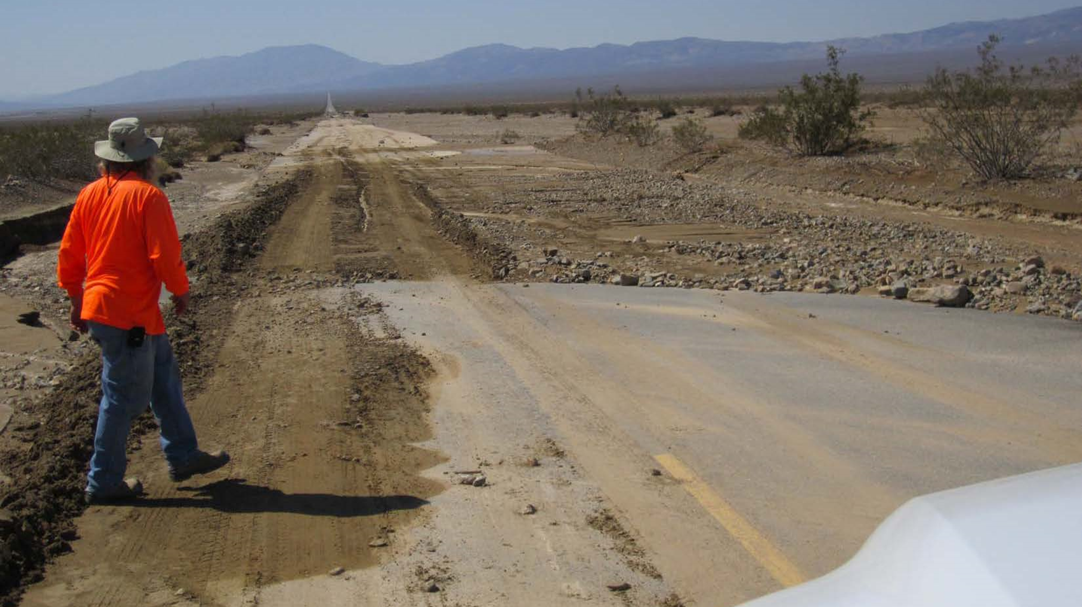
Notes:
Why is it important to take photos of the road closure?
Taking photos of the area before performing any work is very important because:
The photos are required for Emergency Relief Eligibility (PAUSE) (you need proof of pre Emergency Opening work and Post Emergency Opening work);
The photos are useful during the early consultation and coordination efforts with the resource agencies. (The photos are especially useful if there will be mitigation involved during the early consultation efforts with the resource agencies);
and Most importantly, they are REQUIRED for the administrative record.
Best Practices- Good idea of keeping record regular assessment of your Transportation system so that you will have photos of what facility looked liked before Disaster for your documentation in justifying your Emergency Relief request of funds from the Federal Highway Administration.

Slide 7
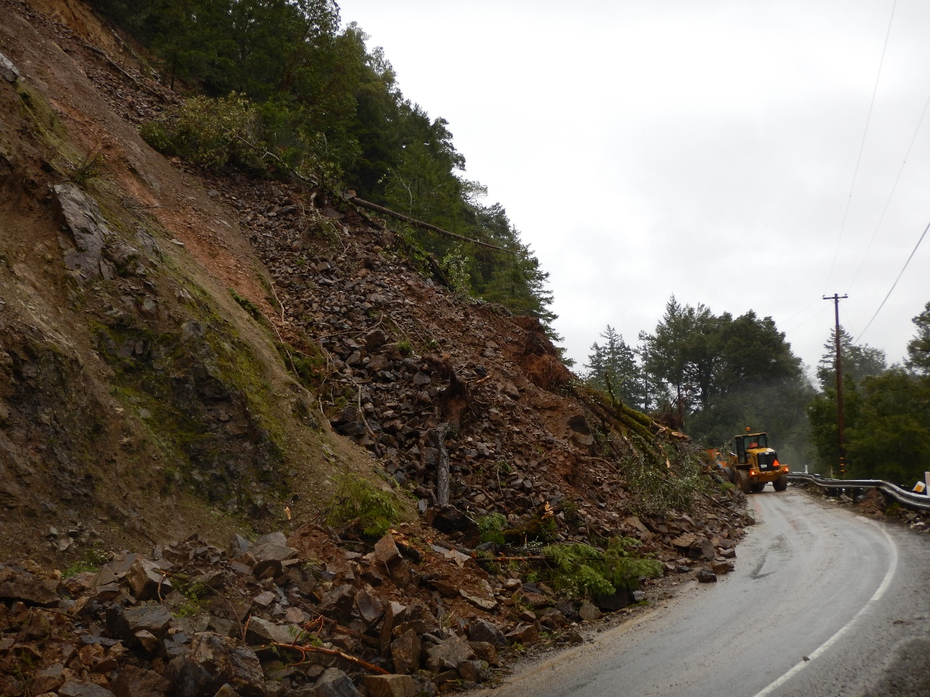
Notes:
And sometimes, silt material can also cause a road closure by covering the existing road. (PAUSE) In this road closure, there would be Emergency Opening work:
Consisting of temporary traffic control
and mud and debri removal. (Pause) Debri removal is subject to Federal agency coordination between Federal Highways and the Federal Emergency Management Agency also know as “FEMA.” Sometimes debri removal is covered by FHWA and other times it is covered by FEMA. What is covered is on a case by case determination since each Emergency is different.
ER funds may participate in debris removal costs on eligible sites on Federal-aid highways that FEMA determines to be ineligible under its program.
Any type of Permanent Restoration work would be determined after the road is cleared.

Slide 8
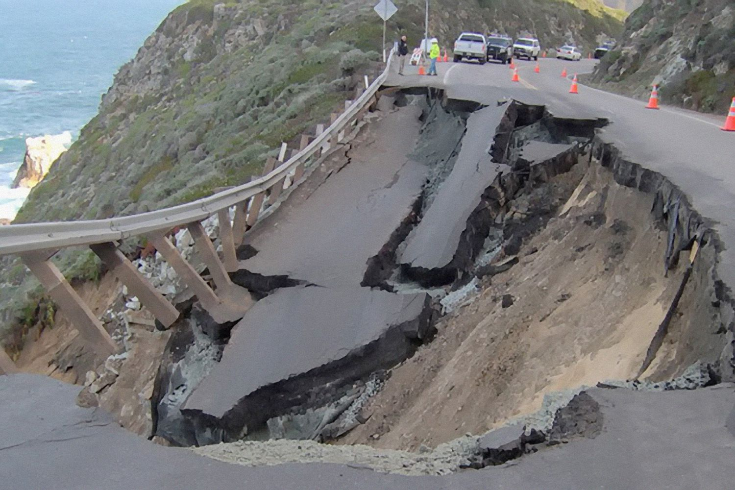
Notes:
Here we have some major erosion which has caused severe damage to the road. This road will require early resource agency coordination. Some of the agencies that will be involved in the early coordination phase of the Emergency Opening may include: the California Coastal Commission (if the project is located within the California Coastal Zone), the National Marine Fisheries Service (NMFS), the U.S. Fish and Wildlife Service (USFWS), the California Department of Fish and Wildlife (CDFW), and the Army Corps of Engineers (ACOE).

Slide 9
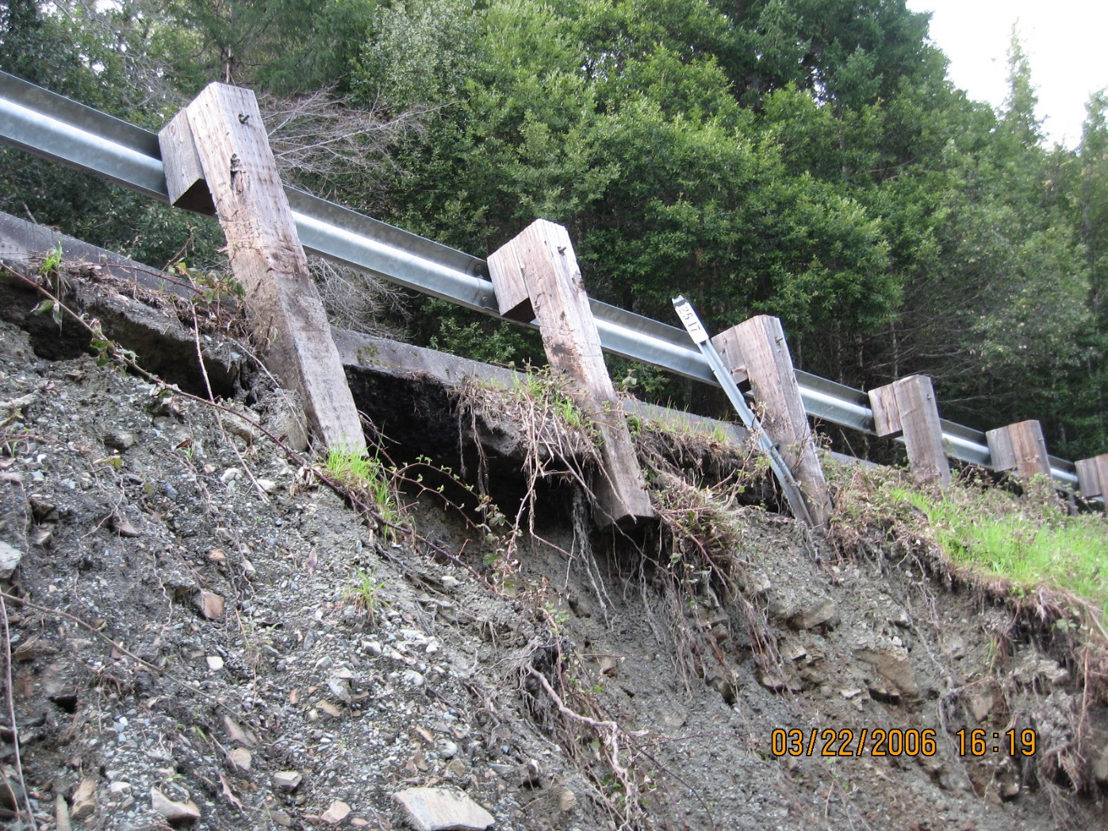
Notes:
And don’t forget about your appurtenances

Slide 10
Emergency opening
Time is of the essence:
  If state threatened or endangered plants and animals or their critical habitat may be affected, then CDFW must be notified within 14 days of the start of work.
  If a Coastal Development Permit will be required, the Coastal Commission must be notified CCC within 14 days of the Governor’s proclamation
  If federally protected plants, animals, and fish or their critical habitat may be affected, then Emergency Section 7 consultation with the USFWS or the National NMFS needs to occur as soon as possible (usually within 48 hours)
  For emergency projects that affect historic properties, Section 106 emergency exemptions only apply to work that begins within 30 days after the emergency has been declared
Notes:
Caltrans Environmental Staff should be invited to attend the Initial Field Review of the Emergency Repair Site. However, sometimes this is difficult to achieve because Emergency Opening work is done quickly.
Remember to contact your District Local Assistance Engineer (DLAE) to find out who your Local Assistance Environmental Point of Contact is and what information they will l need to begin the NEPA process.
It is also it is important to have a signed Damage Assessment Form (DAF) but it is not required for the Emergency Opening work to begin. (However, it is important to see a signed Damage Assessment Form (DAF) before putting substantial time in a project that may not be approved by Federal Highway Administration (FHWA).

Slide 12
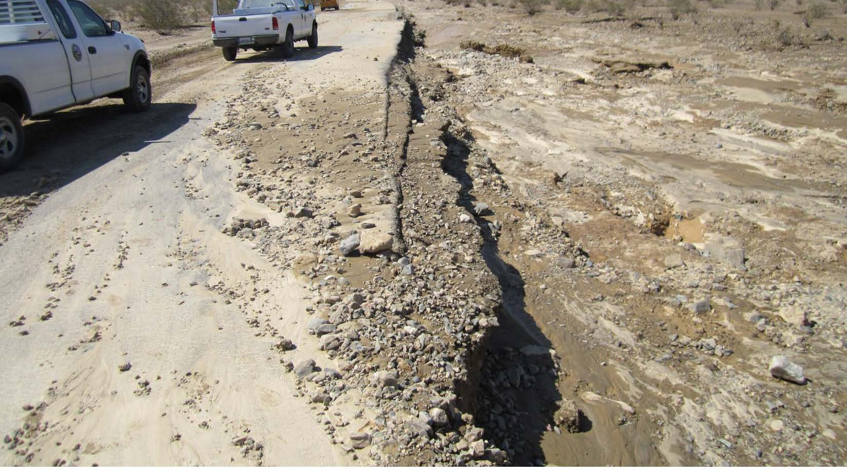
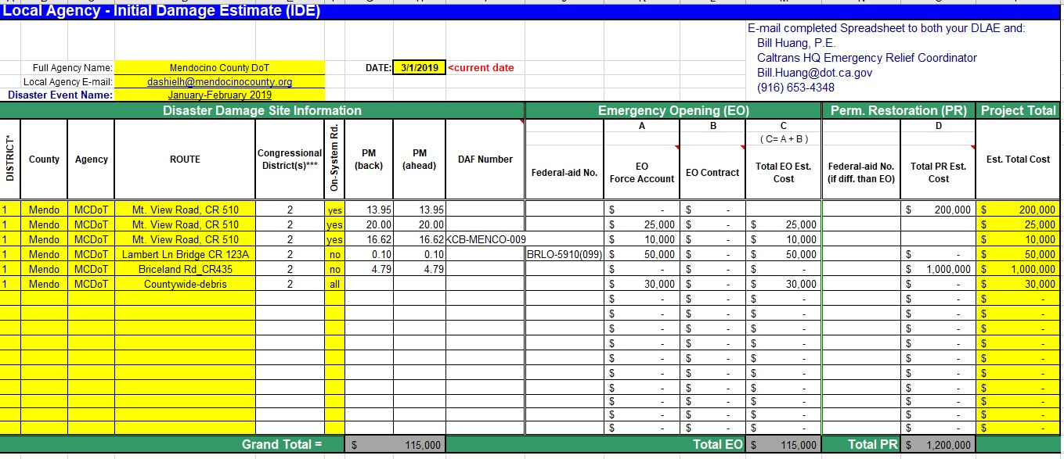
Initial damage estimate form
Notes:
This link shows example of a completed Initial Damage Estimate (IDE) form for Emergency Opening Work. This Initial Damage Estimate form there are photos which show County, Route, and Post Miles where the work will occur. This is a good source of information to get idea of location and resource involved for early resource agency coordination. Use your IDE spreadsheet to talk to environmental resource agencies early in the process.
(This form is currently being updated and can be found here Link: https://dot.ca.gov/Caltrans-near-me/district-1/d1-programs/d1-local-assistance). https://dot.ca.gov/programs/local-assistance/fed-and-state-programs/emergency-relief-program/forms
The DAF process is:
1). Locals prepare IED
2).Locals sends Draft DAF and Emergency form to District--→
2). District reviews (DAF) for ER eligibility (Note: All Damage has to reach $700,000 in order to be Emergency Relief Eligible). The DAF serves as ER application and defines Scope, Cost, and any justification for Betterments.
3). District and Local Agency do a Field Review of Eligible sites.
4). DAF Package Approval
Lupe-Create process line of the above 4 steps?
Lupe-Emphasis on including Environmental Planner in Field Reviews! (District 4, 7, 5, 8, & 11)
(Note to Lupe-make sure you include link to file: Prepare→ER LINKS\Handouts for EO Presentation\Damage Assessment Form.pdf) also, mark slides that have access only to on-ramp. This would be more for internal staff training.
(Next Slide)

Slide 13
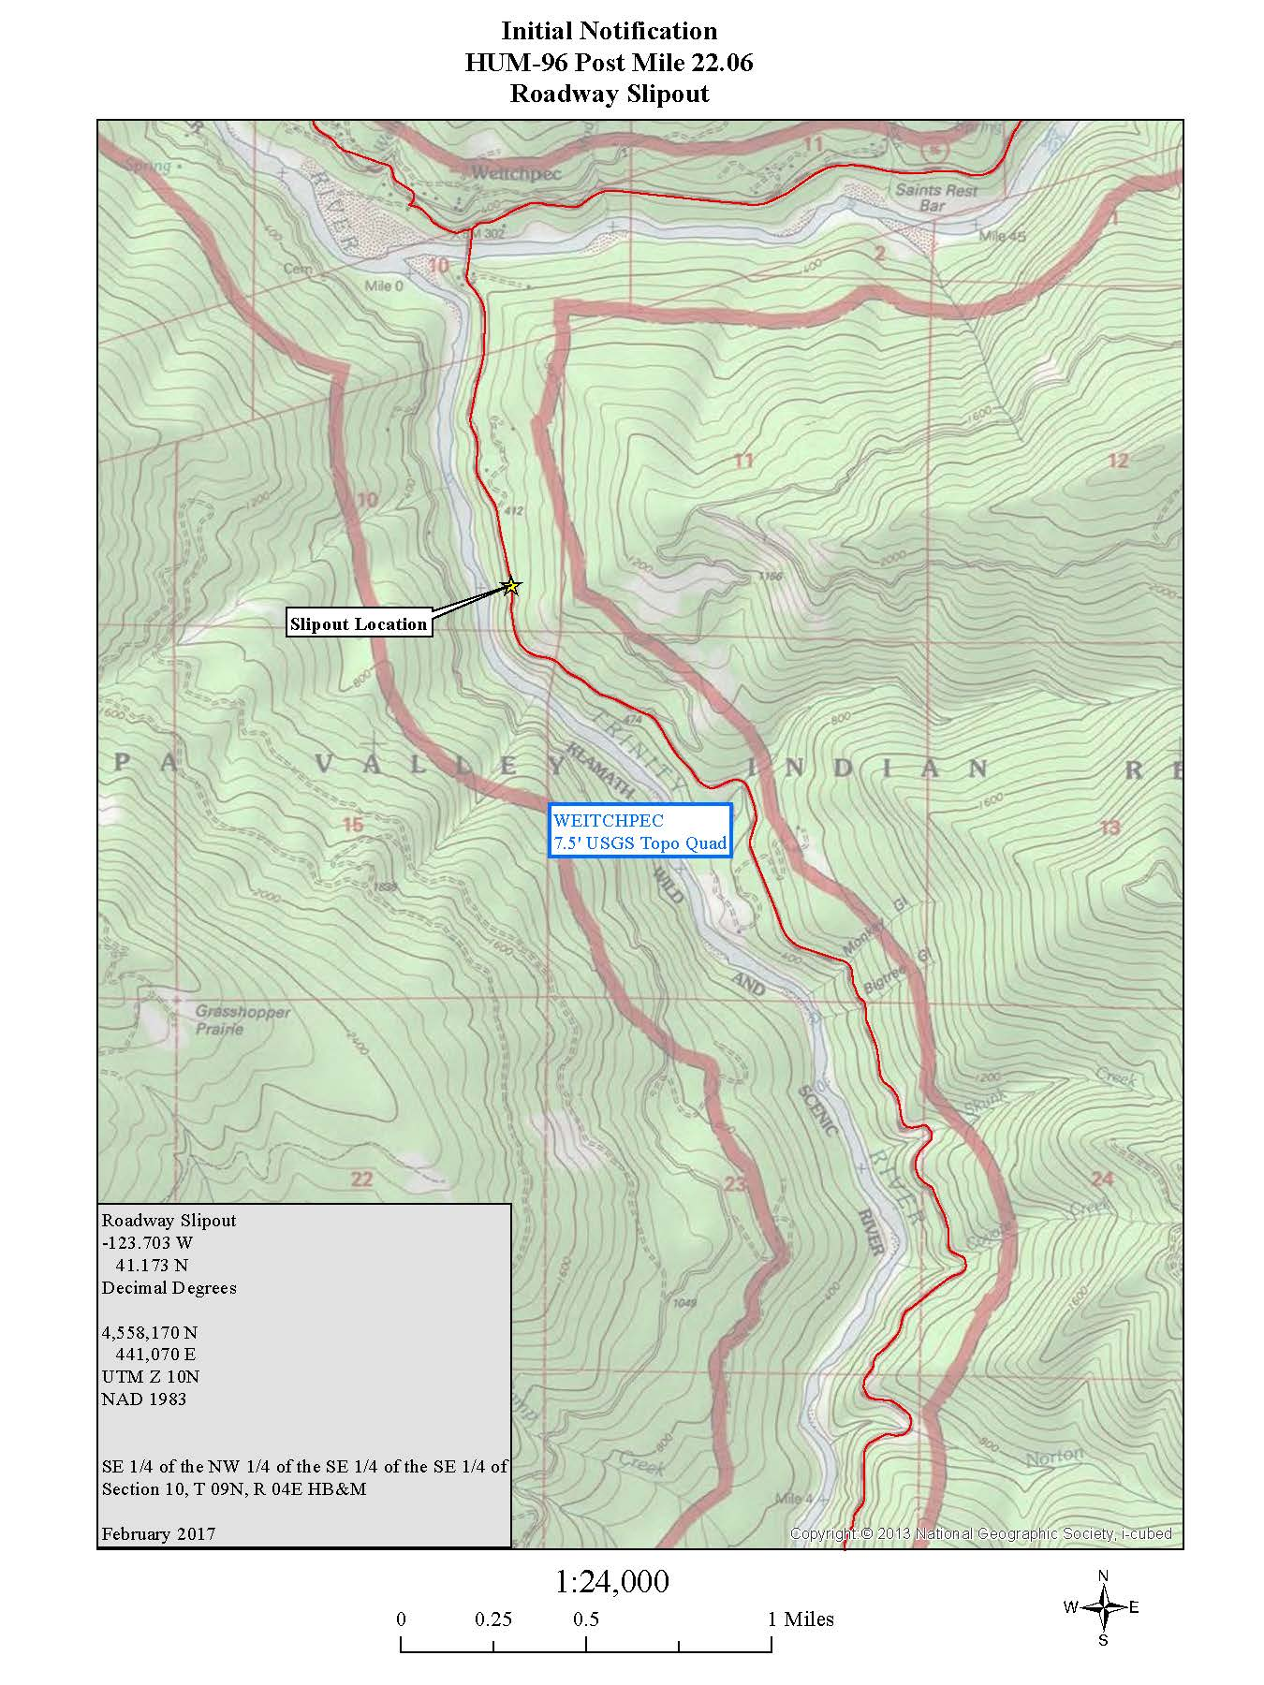
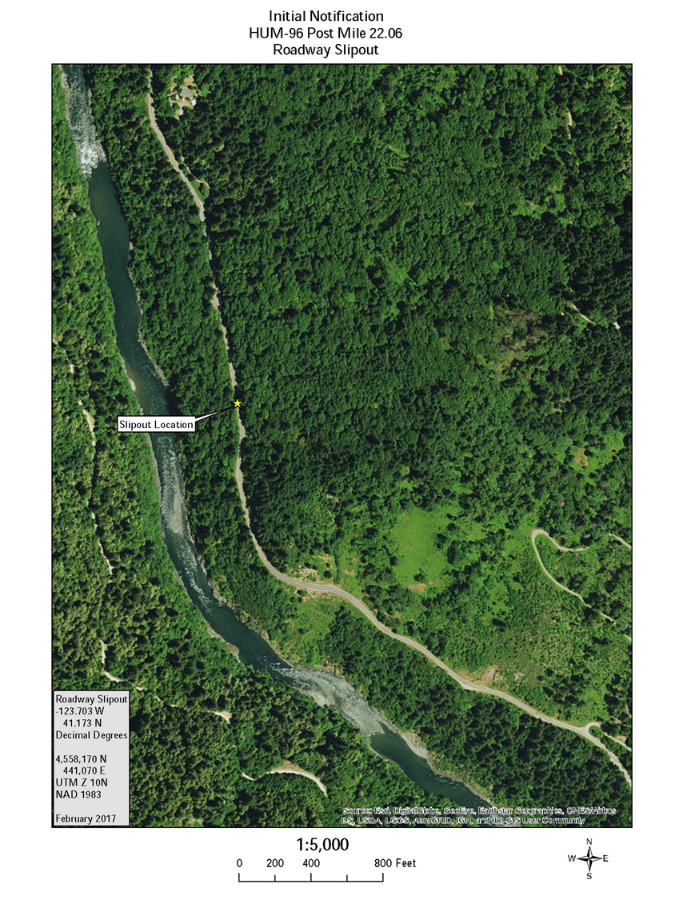
Create Maps and descriptions for Agency Notification

Slide 15
Permanent Restoration
E.O. vs “regular” Nepa projects
Emergency Opening Project:
Field review not always possible.
No PES form required.
Expedited review needed.
Project construction may begin immediately without permits.
Permanent Restoration Project:
Field review occurs.
PES form required.
No expedited review.
Project construction may not proceed before permits have been obtained
Notes:
And here are some notable differences between Emergency Opening projects and regular NEPA projects:
For Emergency Opening projects:
A Field review is not always possible. The priority is to open the roadway.
No PES form is required. (PAUSE) Emergency relief projects are not required to be listed in the Federal State Transportation Implementation Plan/ Federal Transportation Improvement Plan (FSTIP/FTIP) like other local assistance projects.
Because the project is an Emergency Opening project, expedited reviews are expected from all agencies involved.
And project construction may begin immediately without permits.
Unlike the Emergency Opening projects, the Permanent Restoration Projects:
Conduct field reviews with Caltrans DLA staff and local agencies.
A Preliminary Environmental Study (PES) form is required.
No expedited reviews from the jurisdictional agencies is required, and
Project construction should not proceed before permits have been obtained.
(So you can see, there are some key differences between Emergency Opening projects compared to the regular NEPA (Permanent Restoration projects).
(Next Slide)

Slide 16
permanent restoration
ER-eligible permanent restoration projects are like regular Local Assistance projects & follow the same basic environmental process
  Start with your Project Description & the PES Form
  Consistent (even concurrent) with your DAF, but w/ more detail and attachments
Final design (a.k.a. PS&E) can not begin until NEPA is completed
Right of Way work must not begin until NEPA approval.
Construction work must not begin until NEPA approval and Right of Way certification are completed.
Notes:
As you can see, NEPA plays an important role in the Permanent Restoration phase of a project.
Final design work (a.k.a Plans, Specs & Estimate) can not begin until NEPA is completed.
Right of Way work must not begin until NEPA is completed and Local Agency has Authorization to proceed with permanent repairs, right-of-way and (E76) Authorization.
Construction work must not begin until the NEPA document AND Right of Way CERTIFICATION ARE COMPLETED and Local Agency has Authorization to proceed with Permanent Restoration Construction.
(Next Slide)

Slide 18
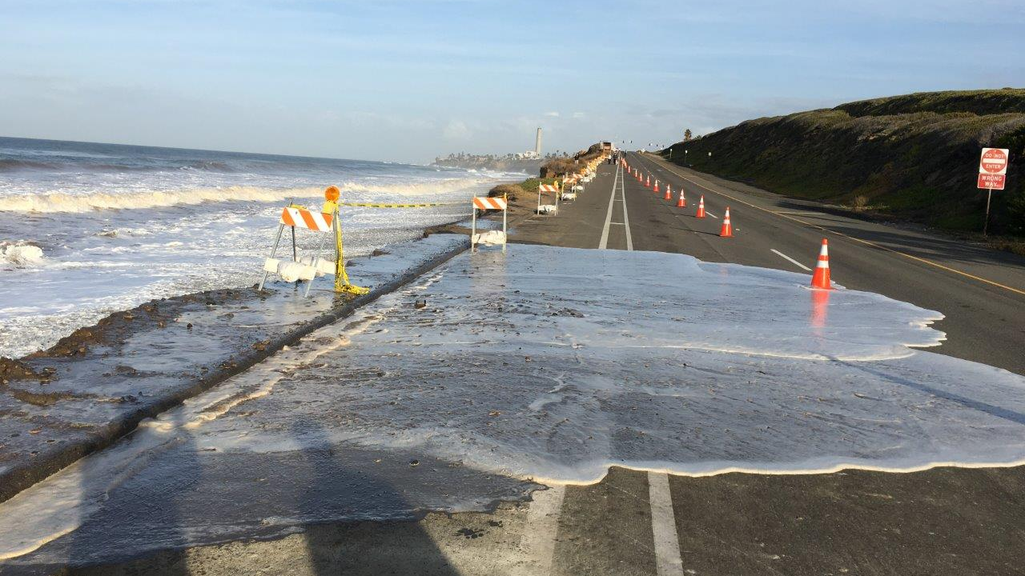

Recommended Field Review Procedure
1. Local Agency sends District draft DAF & draft PES
2. District reviews draft DAF for initial eligibility
3. Local Agency schedules Field Review
4. Review draft DAF & draft PES at Field Review
5. Make any changes during Field Review & sign
Notes:
There are 5 recommended field review procedures steps:
In the First step, the local agency sends the District a draft Damage Assessment Form (DAF) and the draft Preliminary Environmental Study (PES) form to the District Local Assistance Engineer (DLAE).
In the Second step, the District Local Assistance Engineer (DLAE) reviews the draft DAF for initial funding eligibility.
In the Third step, the Local Agency schedules a Field Review. Invitees include:
District Local Assistance Engineer and District Local Assistance Environmental Staff; (Pause) Depending on the project impacts, the invited Environmental Specialists could include: a Biologist, an Architectural Historian, an Archeologist or a Hazardous Waste Specialist.
The Fourth step, Local Agency and Caltrans District staff would review the draft Damage Assessment Form & draft Preliminary Environmental Study form at the Field Review site and;
The Fifth step, would be to revise, if needed, during the Field Review before signing the DAF & PES. (It is very important to have consistent project description with the Damage Assessment Form and the Preliminary Environmental Study).
CHECK WITH BOB-(Note: this slides states that a draft DAF must be submitted with the PES. Bob confirmed that it’s not necessary (E.O. work would already be done most likely).
(Next Slide)

Slide 19
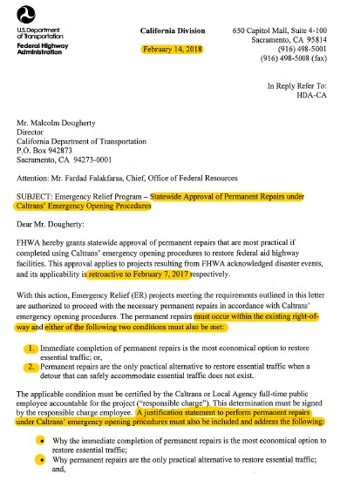
Permanent restoration under emergency opening
February 18, 2018
FHWA Letter
Notes:
Before I begin to discuss Permanent Restoration Under the Emergency Opening Project, I want to mention to you of two letters from the Federal Highway Administration’s California Division office. In order to accelerate restoration efforts, the Federal Highway Administration (FHWA) granted statewide approval of permanent repairs that are most practical if completed using Caltrans’ EO procedures to restore federal aid highway facilities.
For the March 14, 2017 letter, the approval applies to projects resulting from Disaster Events CA 17-1 and CA 17-2 and it’s applicability is retroactive to December 9, 2016 and January 3, 2017. (Other disasters are not covered under this statewide approval).
In the February 18, 2018 letter, the approval applies to projects resulting from FHWA acknowledged disaster events, and it’s applicability is retroactive to February 7, 2017.
Emergency Relief projects meeting the requirements outlined in these letters are authorized to proceed with the necessary permanent repairs in accordance with Caltrans’ EO procedures.
Permanent repairs not meeting the conditions of these letters must proceed with the regular Permanent Restoration (PR) procedures established by Caltrans and supported by the ER Manual. Those projects will require a Damage Assessment Form signed by Federal Highway Administration before any construction begins.
These two letters have specific criteria that must be met.

Slide 20
Permanent restoration under emergency opening
Local agencies may be granted conditional approval from FHWA; very high risk!
Allows PR work to proceed prior to NEPA approval
As soon as possible, contacts your DLAE and Senior Environmental Planner to discuss doing Permanent Restoration work under EO
Caltrans’ DLAE and environmental staff work together to confirm if PR work can begin during EO & any required FHWA approvals & resource agency coordination that will be needed
Notes:
Per the letters, the Local agencies are granted conditional Approval from Federal Highway Administration.
Ideally the local agency should include their Permanent Restoration under Emergency Opening procedures certification with their DAF form, however, sometimes it takes longer for them to get their certification in; this is ok, as long as they eventually get Federal Highway Administration’s agreement that the local agency's project fits the pre-conditions for using Permanent Restoration under Emergency Opening procedures.
This is a very high risk exception to the procedure (PR under EO).
The Letters allows Permanent Restoration work to proceed prior to NEPA Document Completion, Right of Way Certification and Authorization.
Before Permanent Restoration work begins, the Local agency contacts Caltrans Environmental to discuss Permanent Restoration Work.
Caltrans Local Assistance Environmental works with the District Local Assistance Engineer (DLAE) to confirm that PR work can begin prior to NEPA approval.
Caltrans Local Assistance Environmental determines if there are additional avoidance, minimization and or mitigation measures that need to be implemented during the EO work.

Slide 21
Permanent restoration under emergency opening
Permanent repairs must occur within the existing right-of-way
Immediate completion of permanent repairs is the most economical option to restore essential traffic.
Permanent repairs are the only practical alternative to restore essential traffic when a detour that can safely accommodate essential traffic does not exist.
Notes:
According to the letters,
The permanent repairs must occur within the existing right-of-way and either of the following two conditions must also be met:
First, immediate completion of Permanent Repairs is the most economical option to restore essential Traffic.
Second, Permanent Repairs are the Only Practical Alternative to restore essential traffic when a Detour that can safely accommodate essential traffic does not exist.
(Next Slide)

Slide 22
Additional information
For Local Assistance ER Projects: https://dot.ca.gov/programs/local-assistance/fed-and-state-programs/emergency-relief-program
https://dot.ca.gov/programs/local-assistance/fed-and-state-programs/emergency-relief-program/forms
For current emergency declarations: https://dot.ca.gov/programs/local-assistance/fed-and-state-programs/emergency-relief-program/declarations
Notes:
Here are some valuable resource links to help you do your job by saving you time looking up information.
(Next Slide)

Slide 23
District Local Assistance Contacts:
District Senior Environmental Contacts
Districts | DLA Senior Environmental Contacts | Telephone Numbers | E-mail
1 | Darrell Cardiff | (707) 298-0904 | Darrell.Cardiff@dot.ca.gov
2 | Ian Howat | (530) 225-3484 | ian.howat@dot.ca.gov
3 | Laura Loeffler | (530) 741-4592 | Laura.Loeffler@dot.ca.gov
4 | Thomas Holstein | (510) 286-6371 | Thomas.Holstein@dot.ca.gov
5 | Randell Lavack | (805) 549-3182 | Randy.Lavack@dot.ca.gov
6 | Shane Gunn | (559) 445-6310 | shane.gunn@dot.ca.gov
7 | Michael Enwedo | (213) 897-3245 | Michael.Enwedo@dot.ca.gov
8 | Aaron Burton | (909) 383-2841 | Aaron.Burton@dot.ca.gov
9 | Forest Becket | (760) 872-0681 | forest.becket@dot.ca.gov
10 | Dominic Vitali | (209) 948-7427 | Dominic.Vitali@dot.ca.gov
11 | Kevin Hovey | (619) 688-0240 | Hovey.Kevin@dot.ca.gov
12 | Charles Baker | (949) 724-2252 | Charles.Baker@dot.ca.gov
Notes:
So as you begin processing your next Emergency Opening project, please remember that Caltrans has Local Assistance Environmental staff in each District that are assigned to assist you.
Shown here are the Senior Environmental Planners for each District and their contact information.
(Next Slide)

Slide 24
Headquarters Local Assistance Contacts:
Division of Local Assistance
https://dot.ca.gov/programs/local-assistance/
Office of Environmental Compliance and Outreach
https://dot.ca.gov/programs/local-assistance/environmental/local-environmental-issues
Office Chief
Kelly Hobbs: Kelly.Hobbs@dot.ca.gov
Environmental Policy & Training Coordinators
Lupe Jimenez, Districts 2, 6, 9, 11: Lupe.Jimenez@dot.ca.gov
Neil Peacock, Districts 1, 3, 7, 8: Neil.Peacock@dot.ca.gov
Haiyang Zhang, Districts 4, 5, 10, 12: Haiyan.Zhang@dot.ca.gov
Notes:
And for more information about our programs here in the Headquarters Division of Local Assistance, please don’t hesitate to contact us.
The Office of Environmental Compliance and Outreach has a wealth of guidance, templates, and tools available to assist you, as well as several environmental policy and training coordinators that partner with the Districts to develop training.

Slide 25
Questions?

