Slide 1
Active Transportation Program – Cycle 5
Grant Workshop
Cory Wilkerson
Active Transportation & Special Programs
March/April, 2020
1

Slide 2
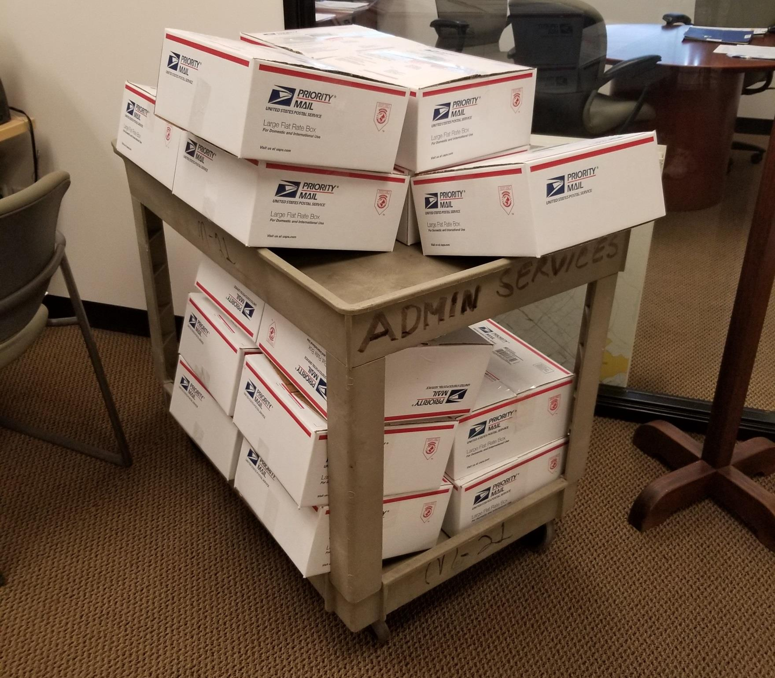
How I Spent My Summer Vacation - 2018

Slide 3
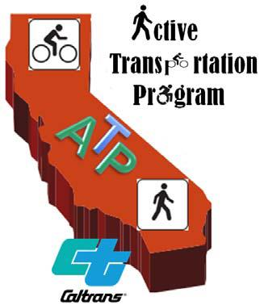
Fruits Of My Labor
ATP Cycle 1 (2014)
  8 Projects (4.8-million)
ATP Cycle 2 (2015)
  6 Projects (13.8-million)
ATP Cycle 3 (2016)
  3 Projects (13.5-million)
ATP Cycle 4 (2018)
  4 Projects (20.9-million)

Slide 4
Program Summary
Competitive Grant Program (Over Subscribed)
Goals
Six Application Types
  Small (Up to $2 million) I or I/NI
  Medium ($2-$7 million) I or I/NI
  Large ($7 million and up) I or I/NI
  Non-Infrastructure Only
  Plans (ATP, Bike, Ped, SRTS in Disadvantaged Communities)
  Quickbuilds (Pilot Project Type)
  Increase walking and biking
  Enhance public health
  Improve safety for non-motorized users
  Assist regional agencies meet SB375 targets
  Ensure DAC’s fully share in the benefits

Slide 5
Funding Availability
Programs 4 Years of Funds
  Fiscal years 2021/22, 2022/23, 2023/24, and 2024/25
Cycle 5 - Funding Estimate
  $445,560 over four years
Funding Distribution
  50% for Statewide Component
  10% for Small Urban and Rural Component
  40% for Metropolitan Planning Organization Component
SCAG MPO Funding Estimate
  $93,419 over four years

Slide 6
SCAG Region – Statewide Success
Cycle 1
  $112,224
  61% of all Statewide Funds
Cycle 2
  $80,338
  45% of all Statewide Funds
Cycles 3 & 3.5
  $83,340
  36% of all Statewide Funds
Cycle 4
  $135,225
  57% of all Statewide Funds

Slide 7
SCAG Regional Program Funding Distribution
SCAG MPO Funding Estimate
  $93,419 over four years
  5% to Sustainable Communities Program
    Planning and Non-Infrastructure Grant Program
Geographic Equity Funding Breakdown
  $88,748 over four years
 | Population | % | $
Imperial | 190,266 | 1% | $882
Los Angeles | 10,253,716 | 54% | $47,506
Orange | 3,222,498 | 17% | $14,930
Riverside | 2,440,124 | 13% | $11,305
San Bernardino | 2,192,203 | 11% | $10,157
Ventura | 856,598 | 4% | $3,969
 | 19,155,405 | 100% | $88,748

Slide 8
Program Changes
Disadvantaged Communities Criteria
  Regional Definition
    Moved to “Other” Category
    Scored by CTC Staff
  Healthy Places Index Added
Pilot: Quick-build Projects Added to Eligible List
Evaluation Process
  CTC/Caltrans debrief with all evaluation teams
  Comments required on all score forms

Slide 9
Program Changes
Large Projects May Apply for Pre-construction Only Phases
Small Project Size Increased from $1.5mil to $2.0mil
Preliminary Study Report Equivalent and Application Consistency
  https://catc.ca.gov/programs/active-transportation-program
  Cycle 5 > February 10 (West Sacramento) > Workshop Recording
Future Changes:
  Points: Project in an Adopted Plan (ATP, SRTS, Bike, Ped, Safety)
  Anti-Displacement policies

Slide 10
Schedule/Next Steps**
March 25-26, 2020 – CTC adopts ATP Guidelines and Call for Projects
April 2, 2020 – SCAG adopts Regional ATP Guidelines
April 29, 2020 – **CTC to potentially change schedule due to COVID-19
June 15, 2020 – Project Applications Deadline (postmark date)
November 16, 2020 – CTC Statewide Recommendations
December 2-3, 2020 – CTC adopts Statewide Projects List
April 2, 2021 – Deadline to submit MPO Recommendations
May 2021 – CTC adopts MPO Projects List

Slide 11
Location
Disadvantaged Census Tracts
  Cal Enviro Screen
  Healthy Places Index
  Median Household Income
School Enrollment Boundaries
  Free and Reduced Priced Meals Eligibility (75% +)
Environmental Justice Areas & Communities of Concern
  Regional Definition (Reduced Severity Points)
Collision Patterns
  High Injury Network

Slide 12
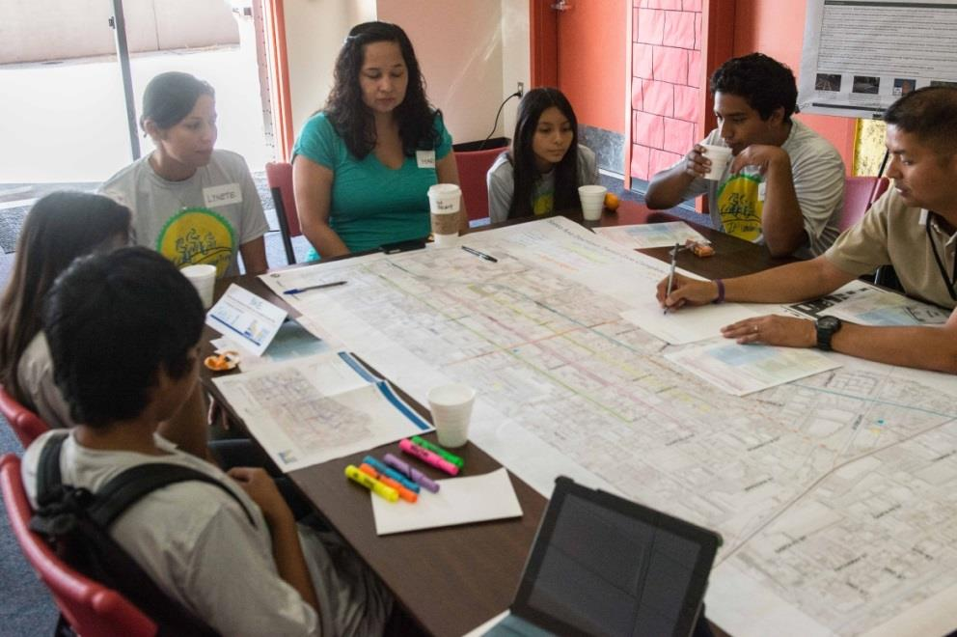
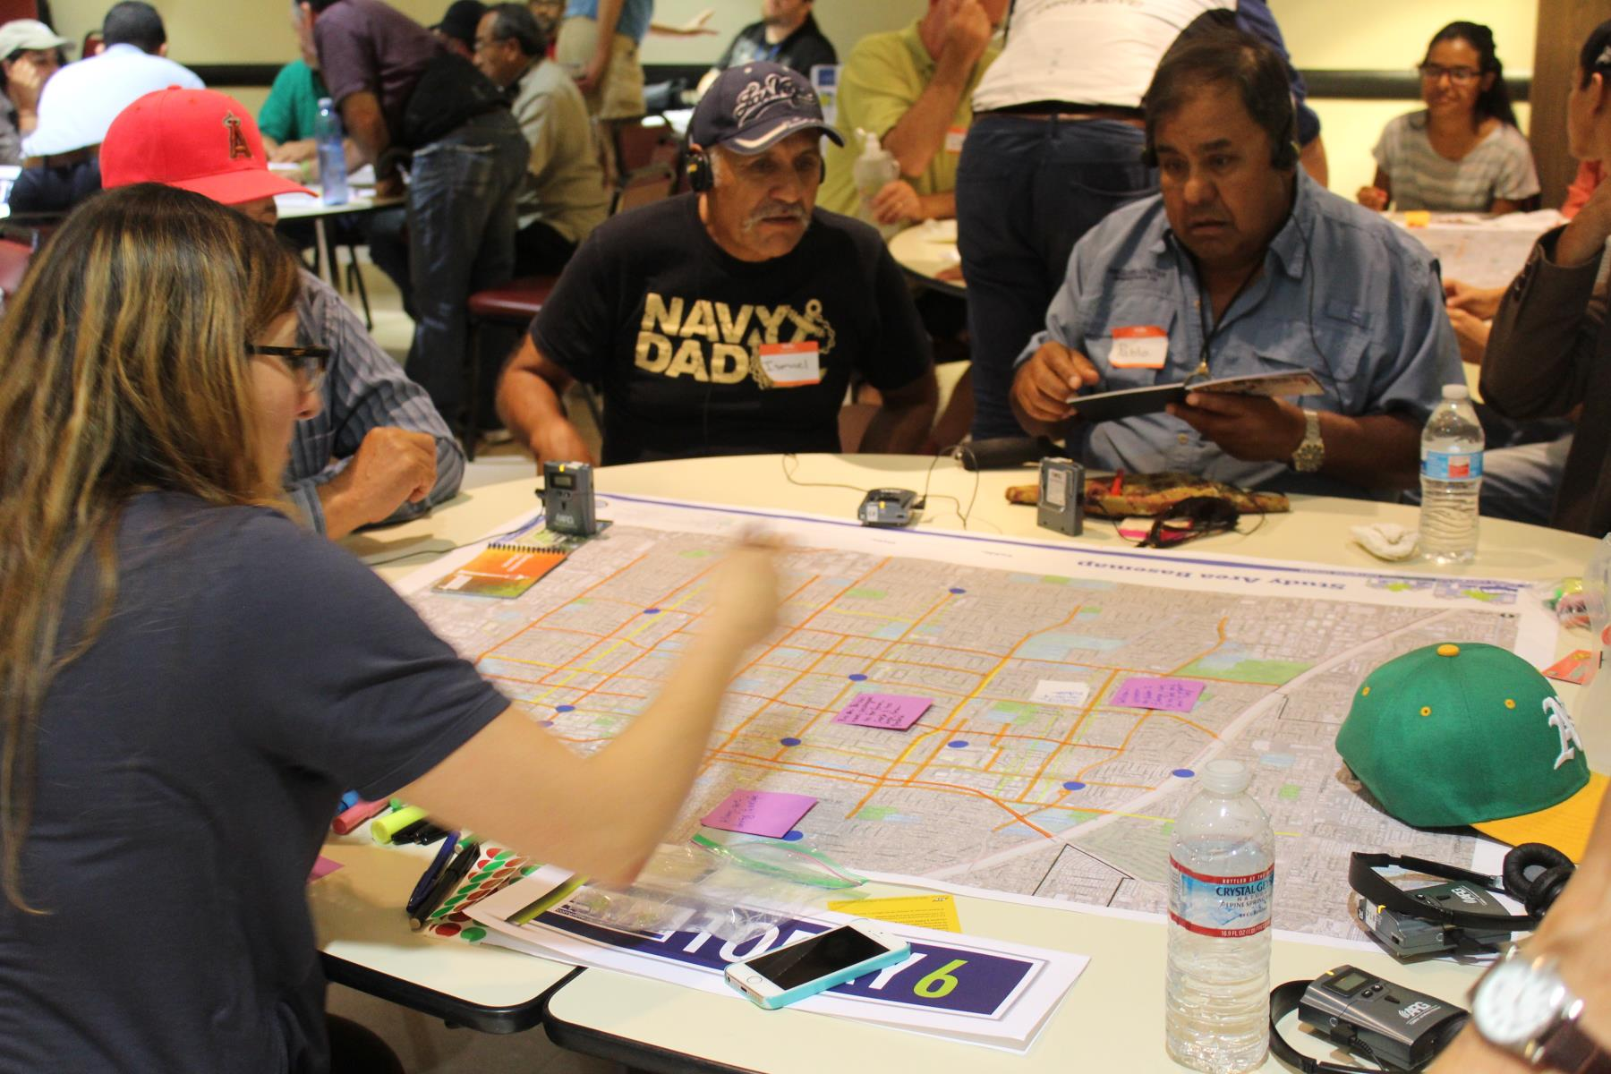
Planning Efforts
Community Outreach vs Community Engagement
  Who identified the project?

Slide 13
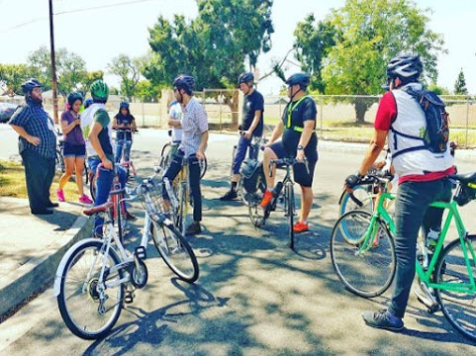
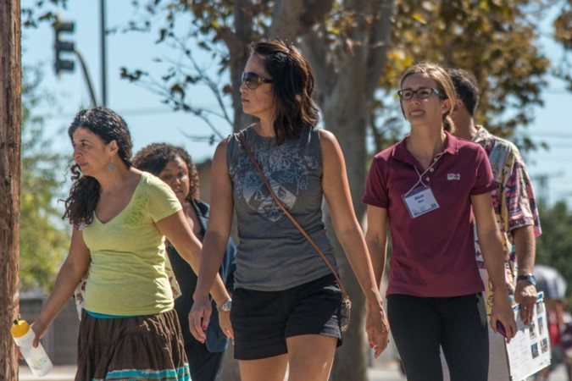
Planning Efforts
Walk/Bike Audits

Slide 14
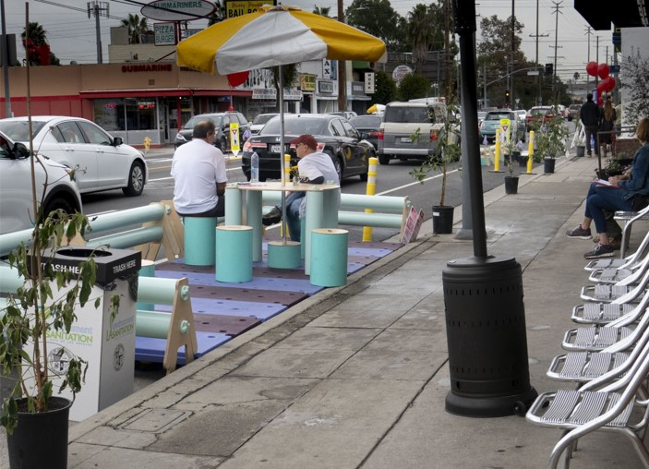
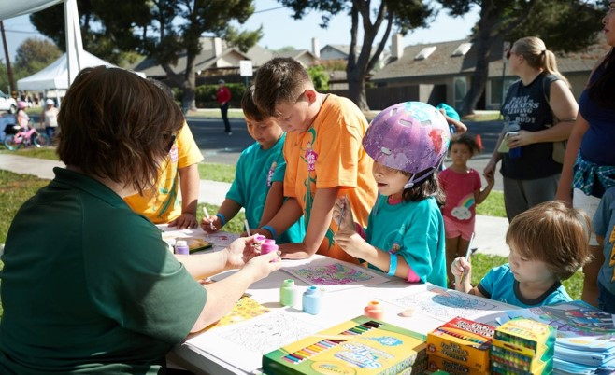
Planning Efforts
Community Events
  Demonstrations
  Go Human Kit of Parts

Slide 15
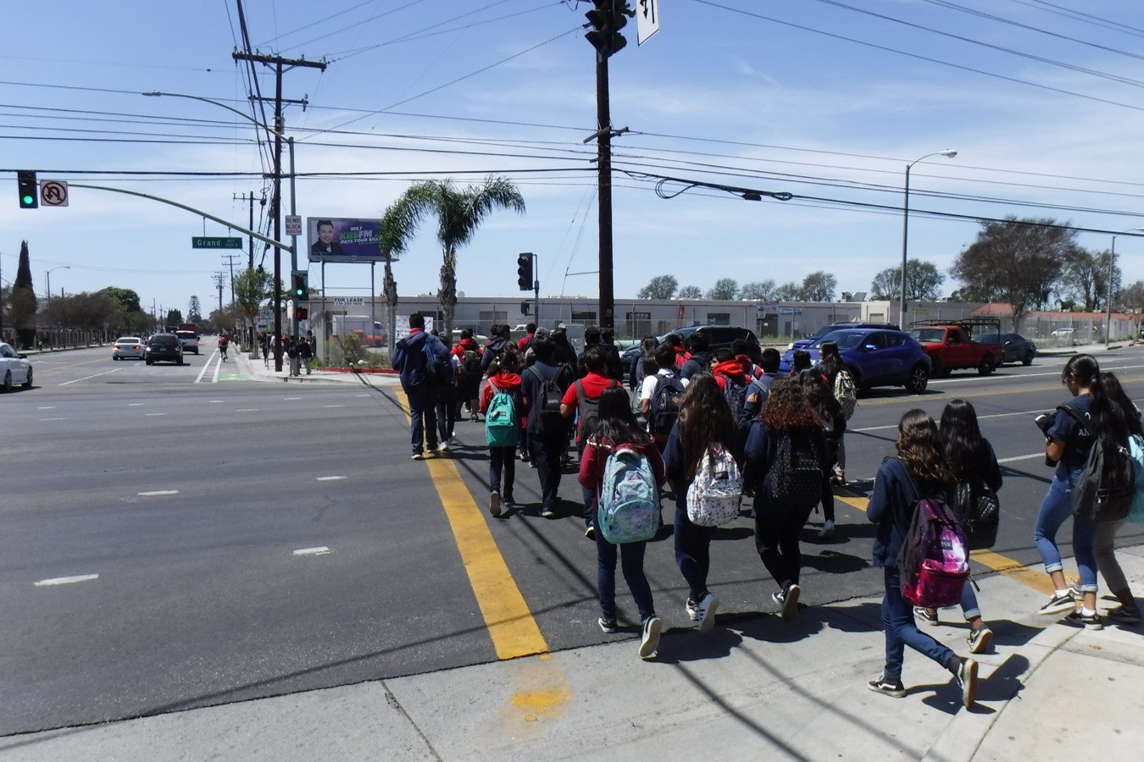
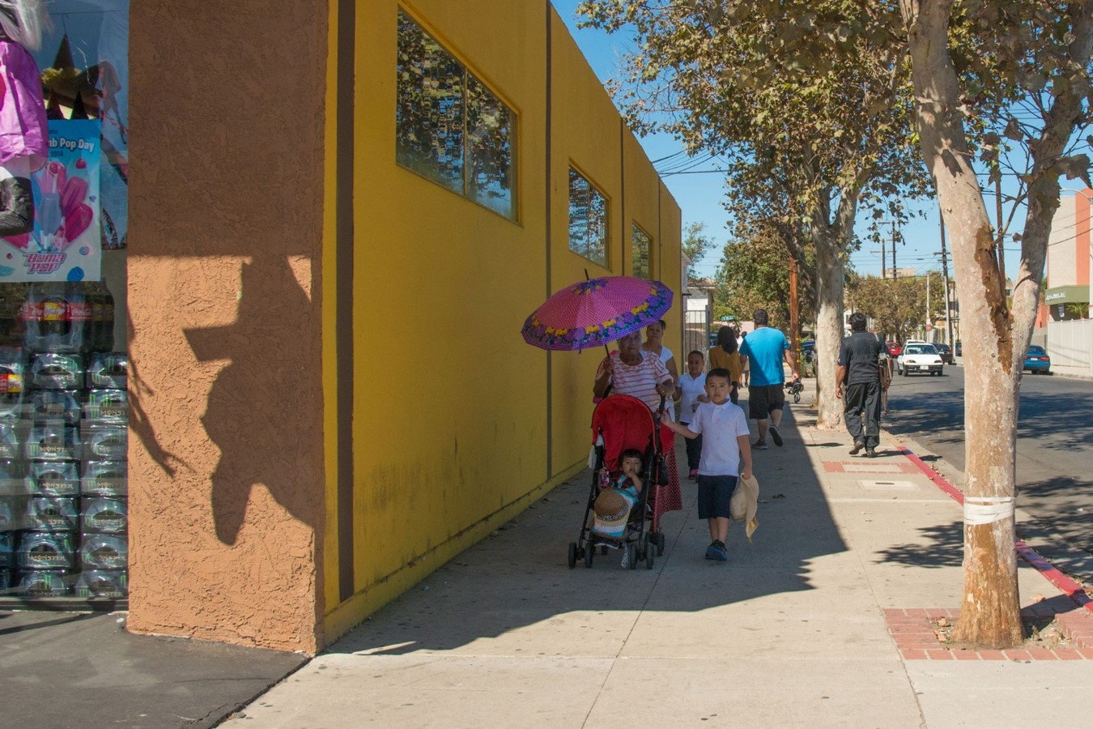
Your Project
Address Needs?
  Safety Countermeasures?
  Community Concerns?
  Health Impacts?
  Students?

Slide 16
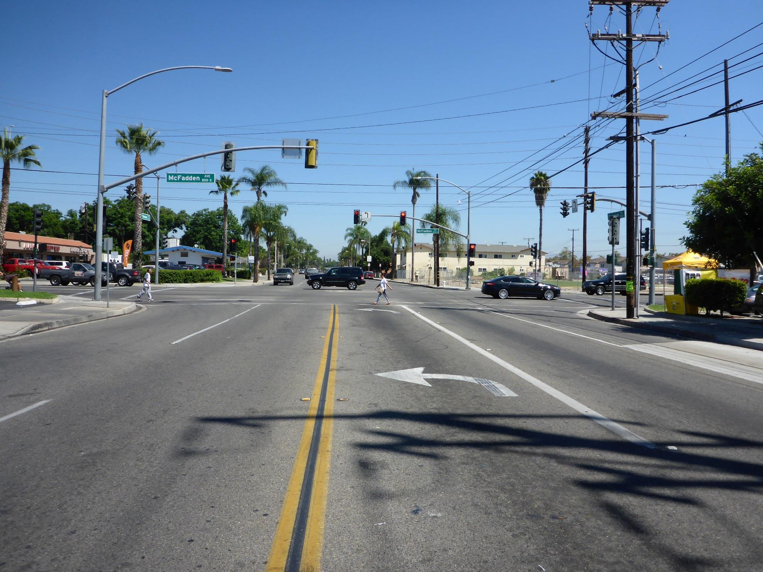
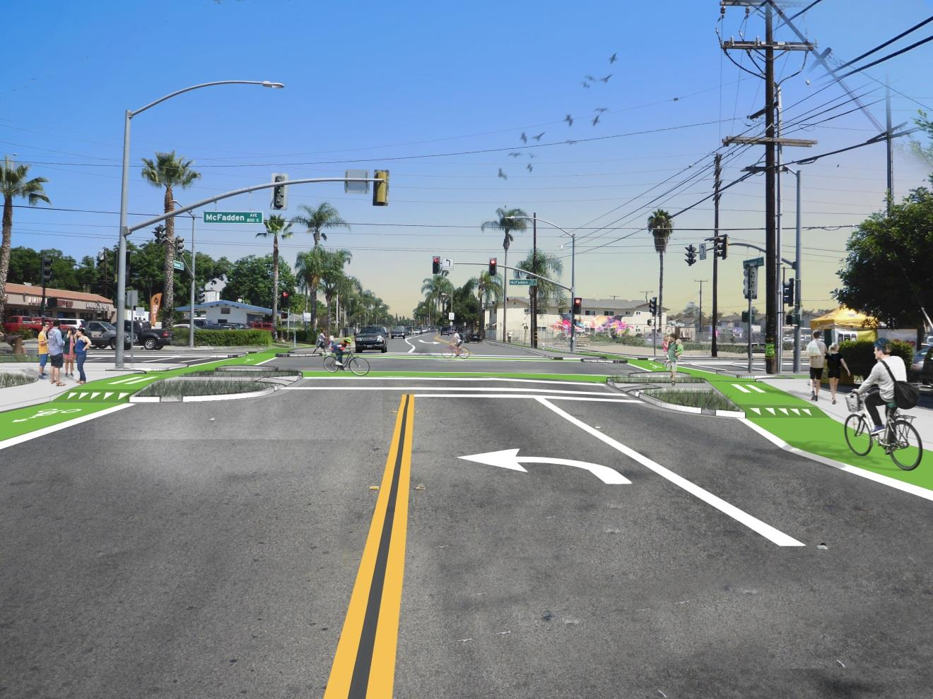
Your Project
Transformative?
  Is the project sexy?

Slide 17
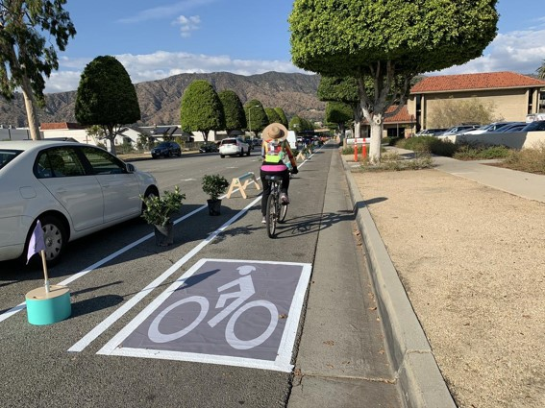
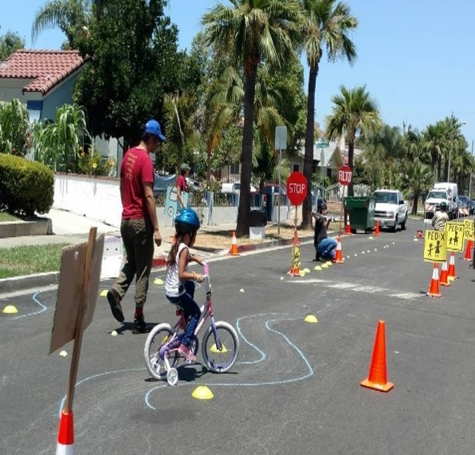
Your Project
Consider adding Non-infrastructure to an Infrastructure Project
  Education Programs
  Demonstration Events

Slide 18
Application Strategies
Planning as a starting point
  ATP, SCAG Sustainable Communities, Caltrans Planning Grants
Scoring rubrics as a tool
Scalable projects
  Statewide vs MPO scale projects
Partnerships
  Community-based Organizations
  Adjacent cities or counties
Tell a story!
  Remember your audience

Slide 19
Thank You!
Cory Wilkerson
wilkerson@scag.ca.gov
(213) 236-1992

