Slide 1
Vermont Transit Corridor
INTERACTIVE STATIONS WORKSHOP
Reimagine Vermont avenue
JUNE 2024

Slide 2
Agenda
Welcome / Purpose of Workshop
Project Overview
Station Design Overview
Interactive Break-out Session
Closing

Slide 3
Code of Conduct (Metro)
Metro is committed to ensuring that all participants can fairly and clearly share ideas, comments, and concerns about this project. To provide a safe and equitable process, we are asking for your help.
During this meeting, please:
Respect the format of the meeting and allow everyone an opportunity to comment
Turn off cell phones and background noise when speaking
Treat fellow community members, agency representatives, Metro staff, and others with respect
Address all comments to Metro staff and consultants – not to other attendees
Maintain a conversational tone
Notes:
Brett

Slide 4
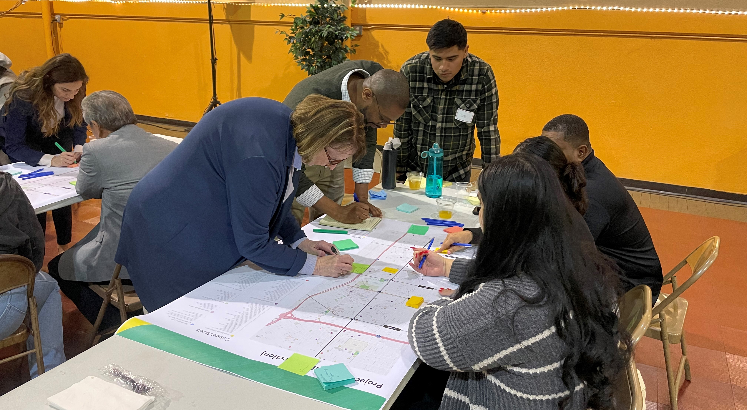
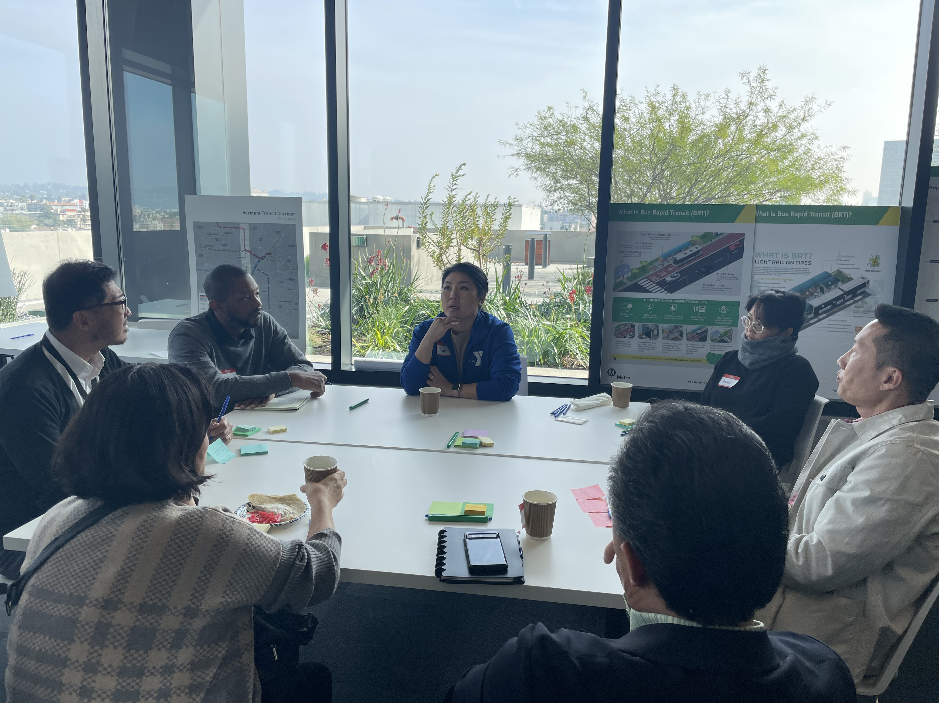
Purpose of the Workshop
Purpose
To facilitate an interactive and fun workshop design session where the Vermont Corridor community has a forum to REIMAGINE their bus stops to become Transit Stations.
Introduce the community to the constraints and realities of the actual station area conditions.
Prioritize optional features for each station.

Slide 5
PROJECT OVERVIEW

Slide 6
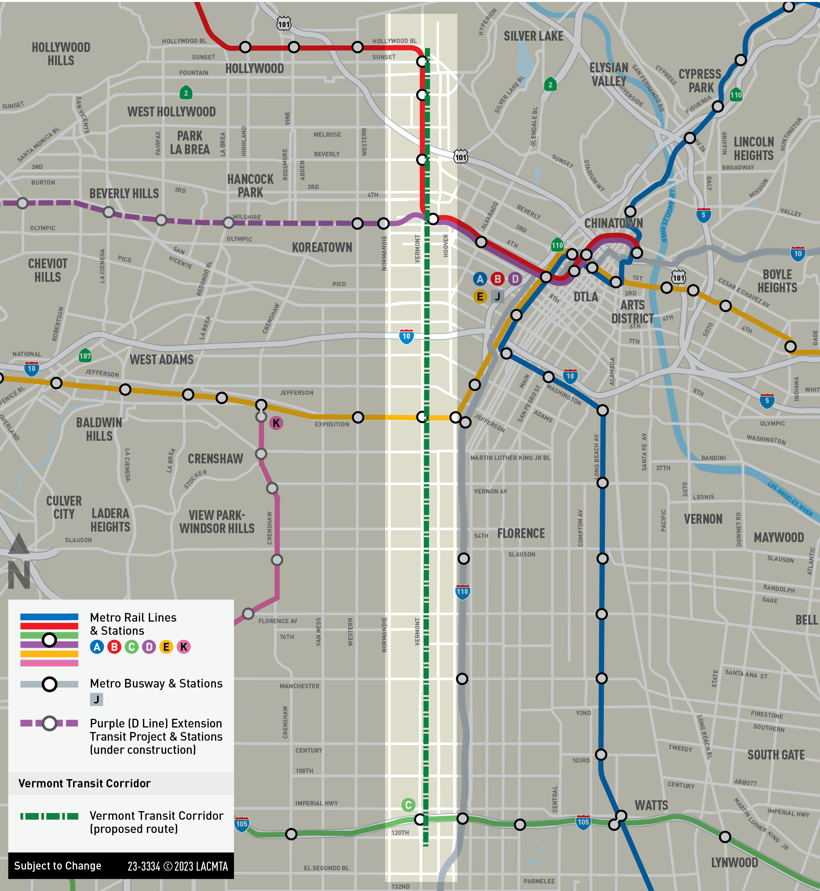
Background
Measure M Project - $425M (2015$) with opening between FY2028-2030
Approximately 12.4 miles from Hollywood Bl to 120th St
Second busiest bus corridor with 36,000 daily boardings
Two technical studies completed - identified both feasible BRT and rail options
June 2022: Completed Community Based Partnership Program (CPP)
September 2022: Board directed staff to advance the Vermont Transit Corridor including:
Near-term service improvements
Medium-term BRT, opening for revenue service no later than FY27
Long-term rail (to be delivered if funding becomes available)

Slide 7
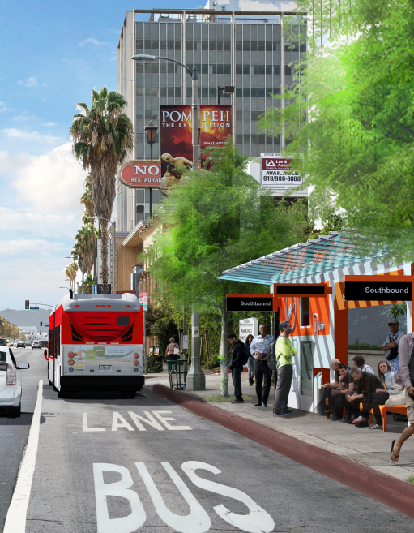
Project Goals and Objectives
Project Goals & Objectives
Improve service performance
Improve service reliability by maintaining consistent travel times
Reduce passenger travel times through the use of several key BRT elements including, dedicated bus lanes, transit signal priority, fewer stops, and other service enhancements
Increase ridership and reduce use of private vehicles by encouraging more people onto public transit
Enhance customer experience
Enhanced stations with a number of passenger amenities (shelters, benches, next bus info, lighting)
Improve pedestrian/bicycle access
Improve safety by separating buses from other vehicles, enhanced lighting at stations, and other safety measures
Invest in the community
Improve mobility & livability
Reduce greenhouse gases for healthier communities

Slide 8
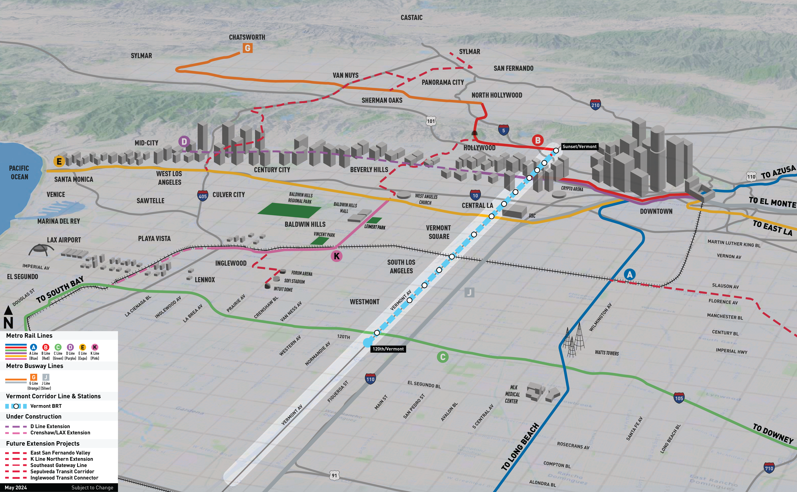
Project Goals and Objectives
Regional Connectivity

Slide 9
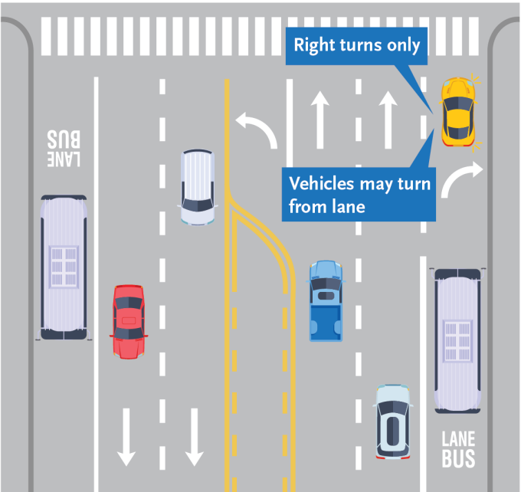
Near-Term Improvements
Separate effort to implement near-term bus service improvements being led by Metro Operations
Curb-running bus lanes
Sunset to Wilshire (7-10am & 3-7pm)
Gage to Vermont/Athens C Line Station (all-day)
Transit Signal Priority upgrade
Project Milestones:
Fall 2023/Winter 2024 – community engagement
Spring 2024 – begin design
Early 2025 – implementation

Slide 10
BRT and Rail Improvements
Part 1 - BRT
Part 2 - Rail
PM/Outreach
Task 10- PM
Task 13- Outreach
Project Definition
Task 10- Planning
Task 12- Rail ACE
Task 14- SMP
Task 15- FLM
Environmental
Task 4-Env Doc
Task 5- Env Study/ Exemption
Task 7- CEQA Process
Environmental
Task 10/11- EIR
PM/Outreach
Task 1 – PM & Outreach
Optional Tasks
Task 8- NEPA (CE/EA/EIS)
Task 9- BRT PE
Project Definition
Task 2- Planning
Task 3- AA/BRT ACE
Task 6- FLM
Optional Task
Task 16- NEPA (EIS)

Slide 11
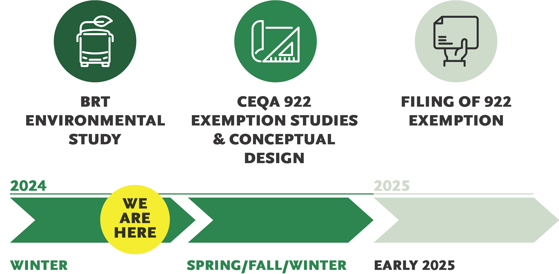


BRT Project Schedule
CEQA SB922
FILING OF SB922
2024
Engagement begins ​CBO engagements​
Equity conversations​
​
CBO engagements​
CBO support for community listening sessions
Metro Board Approval of Proposed BRT Project
ONGOING PUBLIC PARTICIPATION

Slide 12
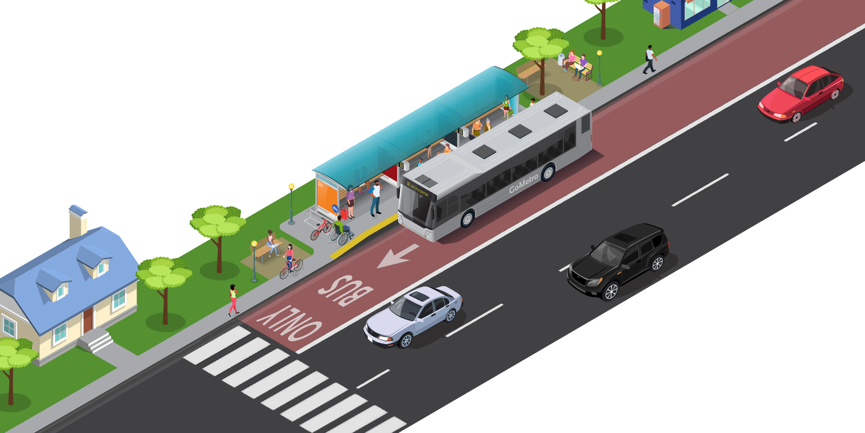
What Makes BRT Different?
Increased Frequency of Service​
More buses per hour
More reliable service
BRT is “Light Rail​ on Rubber Tires​”
Real-Time Information
Next bus arrival times and other useful BRT route information
BRT Stations
Light rail-like stations with enhanced shelters and more passenger amenities for comfort and safety
Ease of Boarding
Off-vehicle fare payment and all-door boarding
BRT Vehicles
Low floors, more seating and multiple doors make it feel like a train
Dedicated Lanes
Dedicated BRT lanes and transit priority help vehicles move through the corridor faster and more reliably

Slide 13







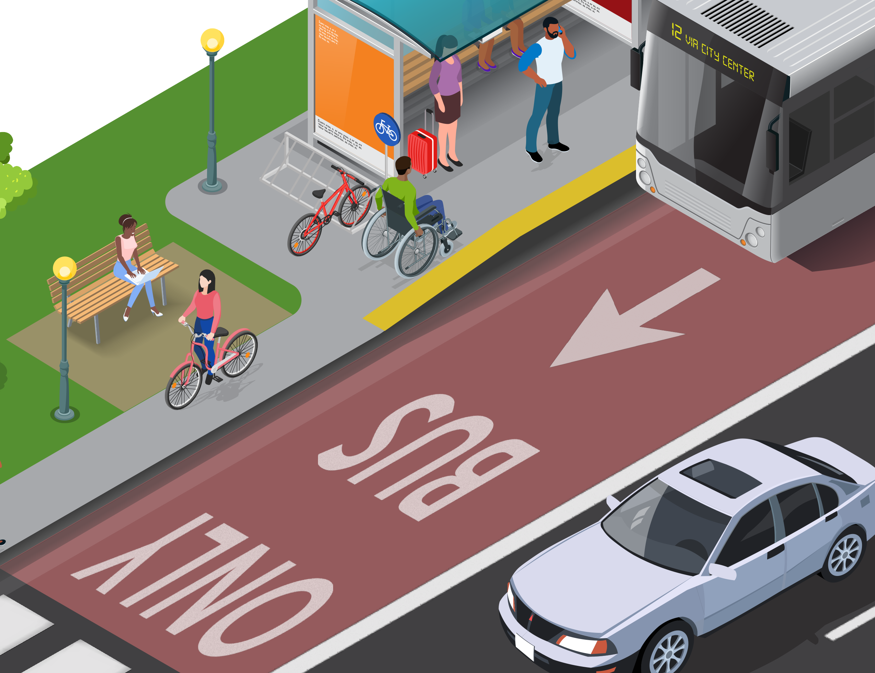
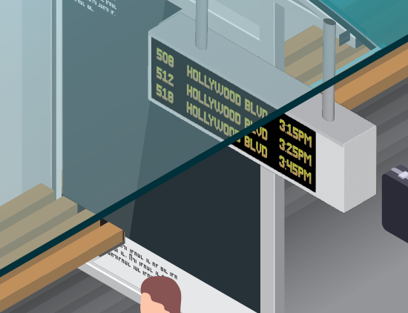
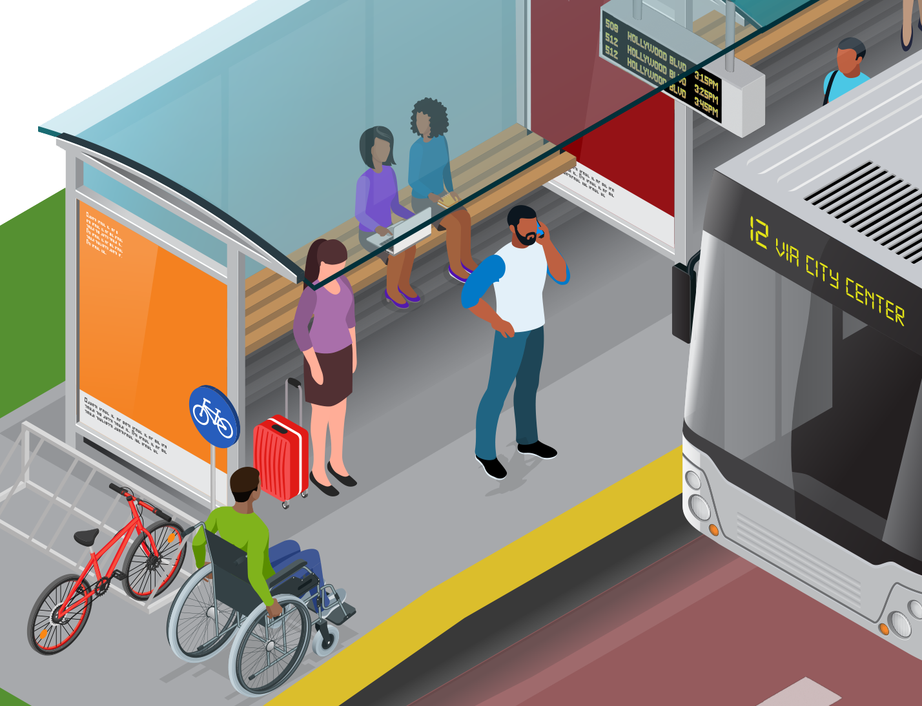
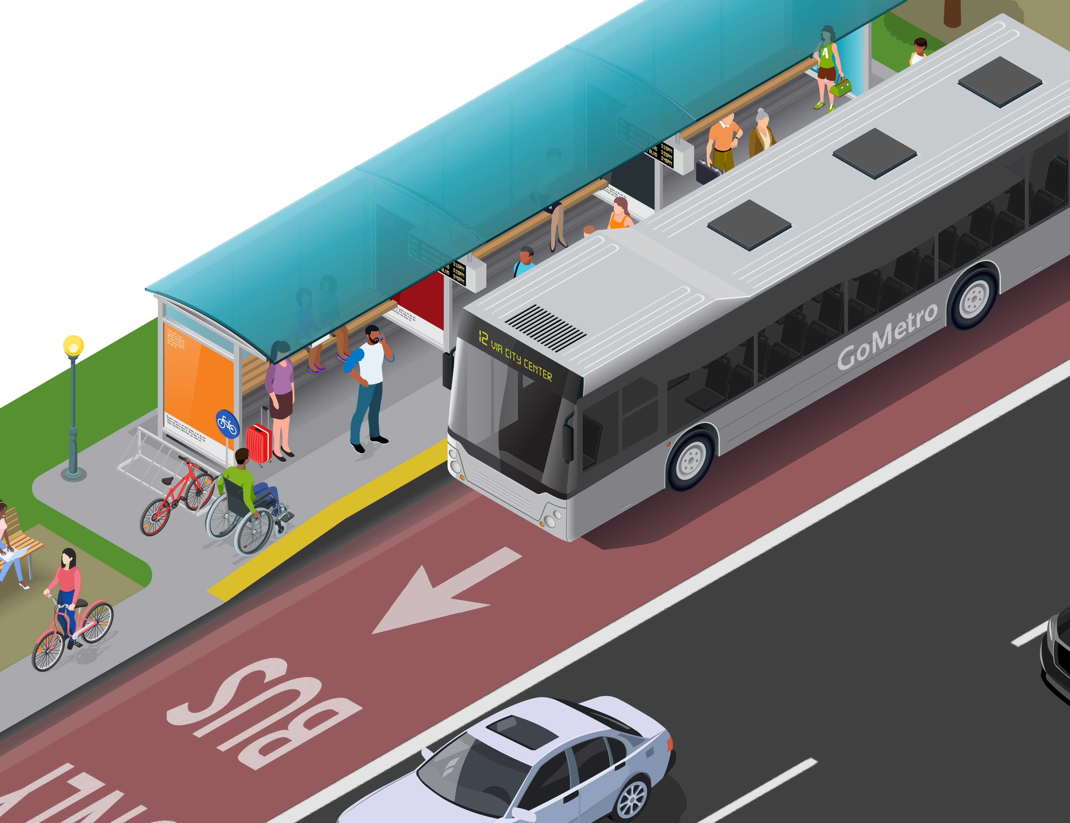
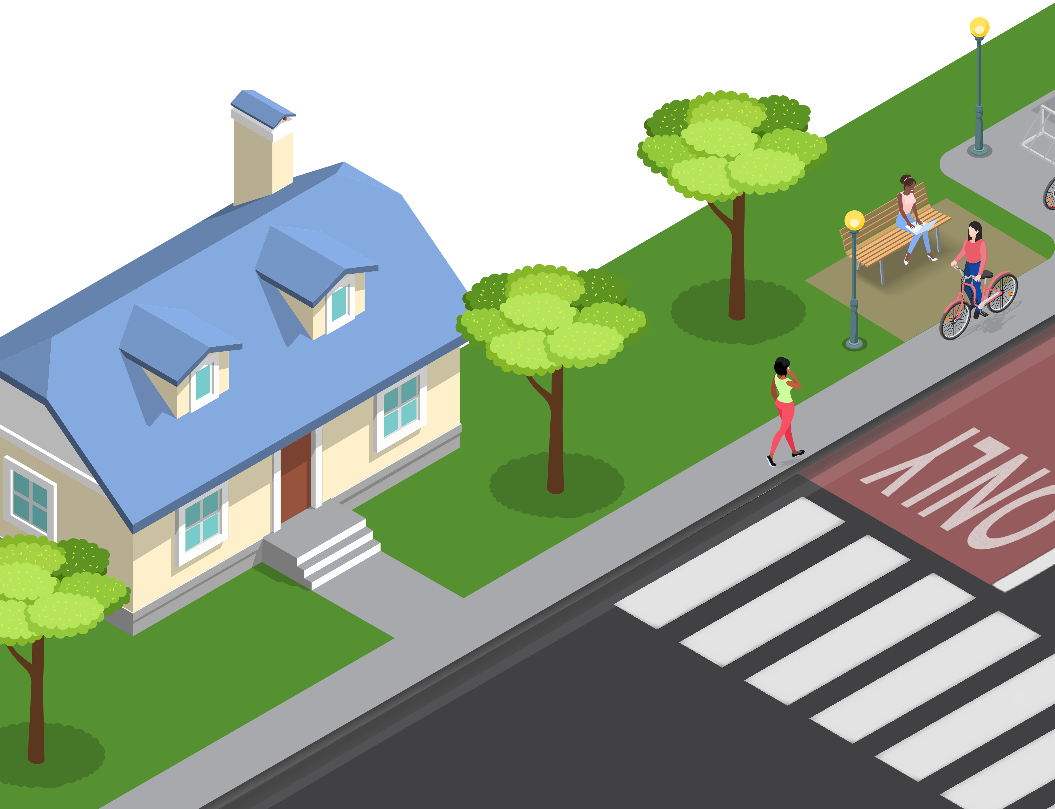
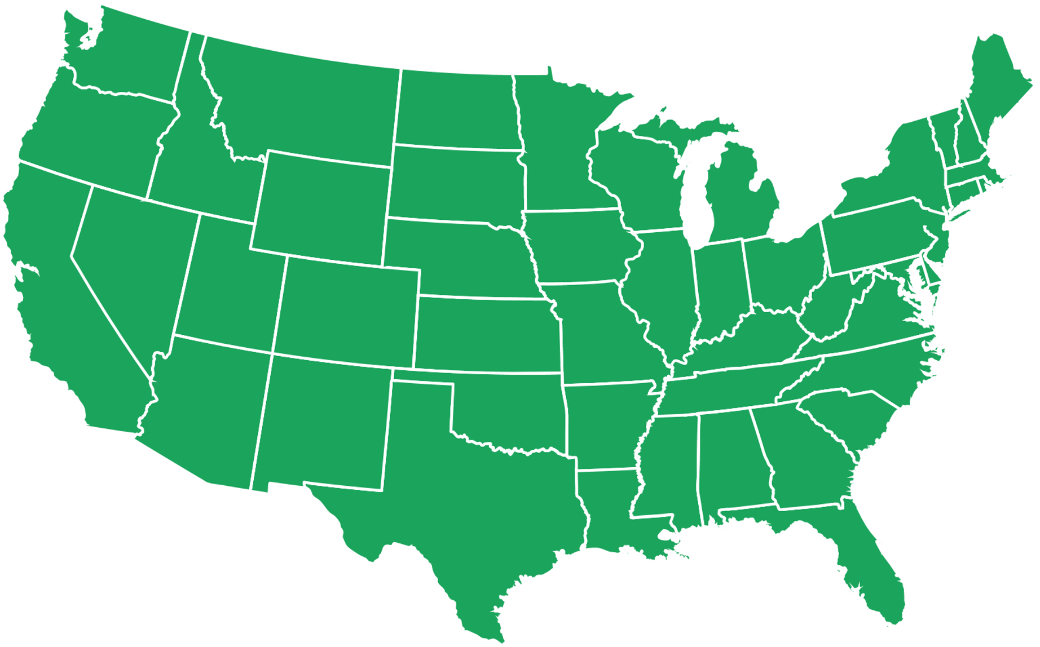

Benefits of BRT
THE BENEFITS OF BUS RAPID TRANSIT (BRT)
Shorter travel times
Better, more reliable service
Increased comfort, safety and security
More options to travel
More livable communities and neighborhoods
Faster speeds, fewer stops, shorter wait times between buses, and all door boarding results in shorter travel times
Passengers can count on the bus being on time, get them where they need to go, and know exactly when the next bus is coming
Enhanced shelters with good lighting, seating, weather protection, makes passengers feel more comfortable, safe and secure
BRT encourages more transit, bicycling and walking; improves access to jobs, schools, entertainment, healthcare, and regional transit system
Neighborhoods are more active, eco-friendly, healthy and people-oriented
13
In the U.S. alone, there are over 250 BRT systems in operation

Slide 14
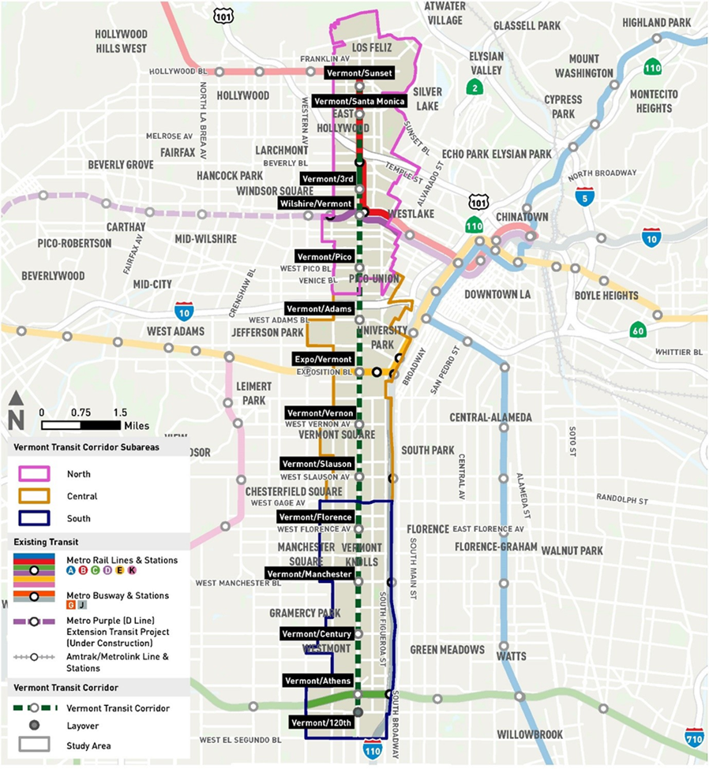
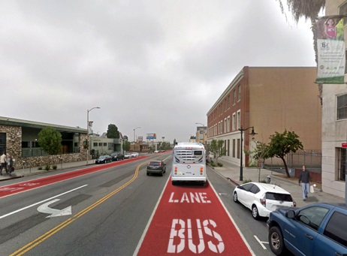
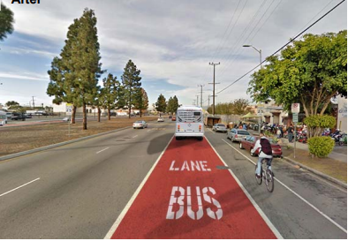
Side-Running BRT
Proposed BRT Project Overview
Side Running BRT – north of Gage
Side Running BRT – south of Gage
Converts travel lane next to curbside parking to bus only lane
12.4 miles dedicated side-running BRT
13 station locations with enhanced shelters and other passenger amenities

Slide 15
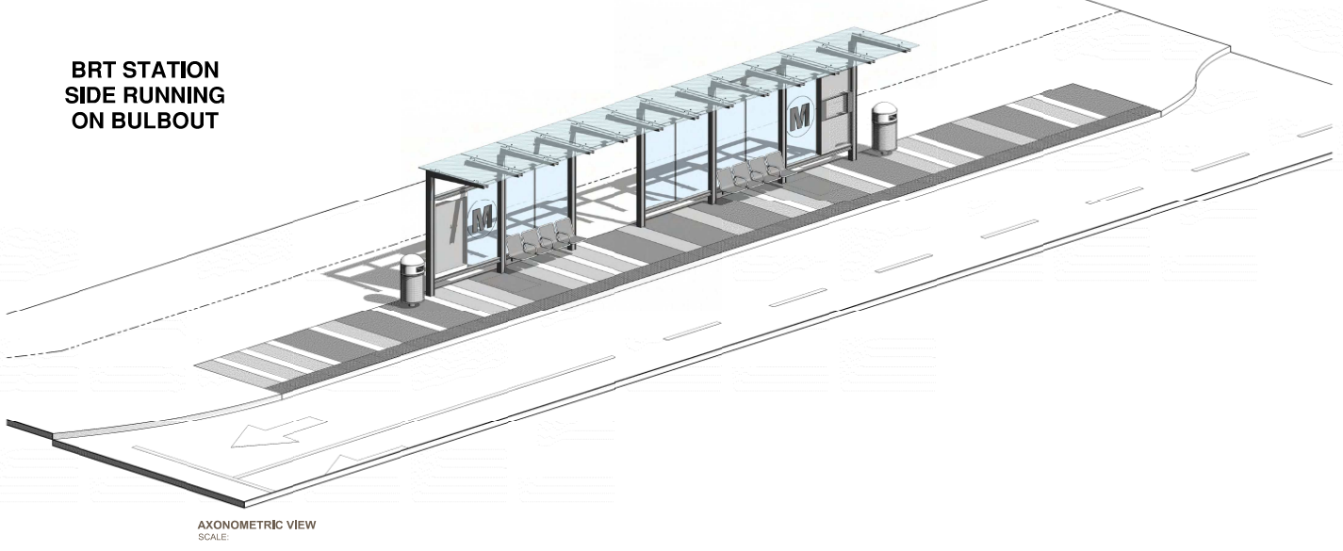
Metro BRT Station Design Features
Metro’s approach to station design is based on the principles of being:
Safe
Integrated and Enhanced Lighting
Clear Sightlines
Electronic Surveillance
Smart
Next Bus Arrival Information
Customer Information Panel
Clean
Durable Materials
Trash Receptacles
Green
Energy Efficient Lighting
Fritted Glass Canopy Shading

Slide 16
STATION DESIGN OVERVIEW

Slide 17
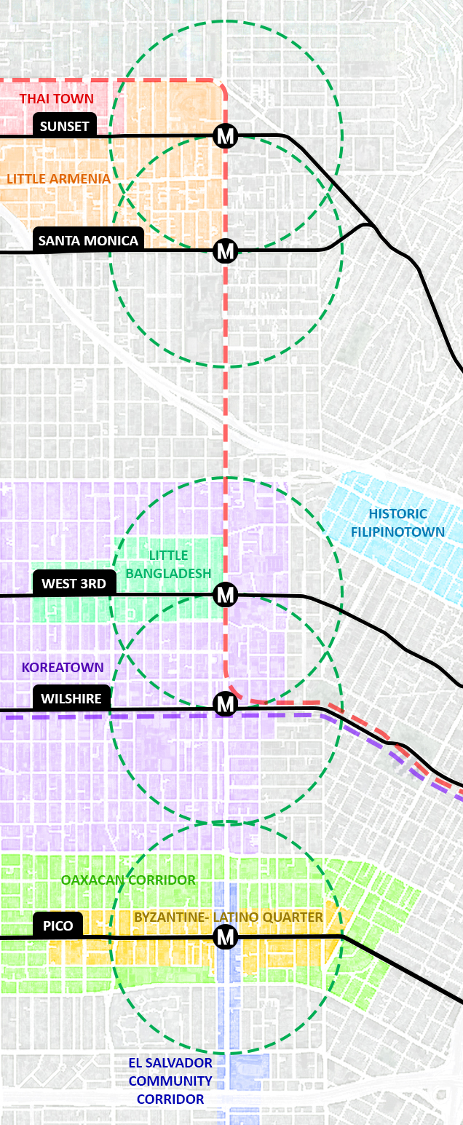
Vermont Corridor Neighborhoods
Little Armenia
Historic Filipinotown
Koreatown
El Salvador Corridor

Slide 18
Vermont Corridor Neighborhoods
Thai Town
Little Bangladesh
Oaxacan Corridor
Byzantine-Latino
Quarter

Slide 19
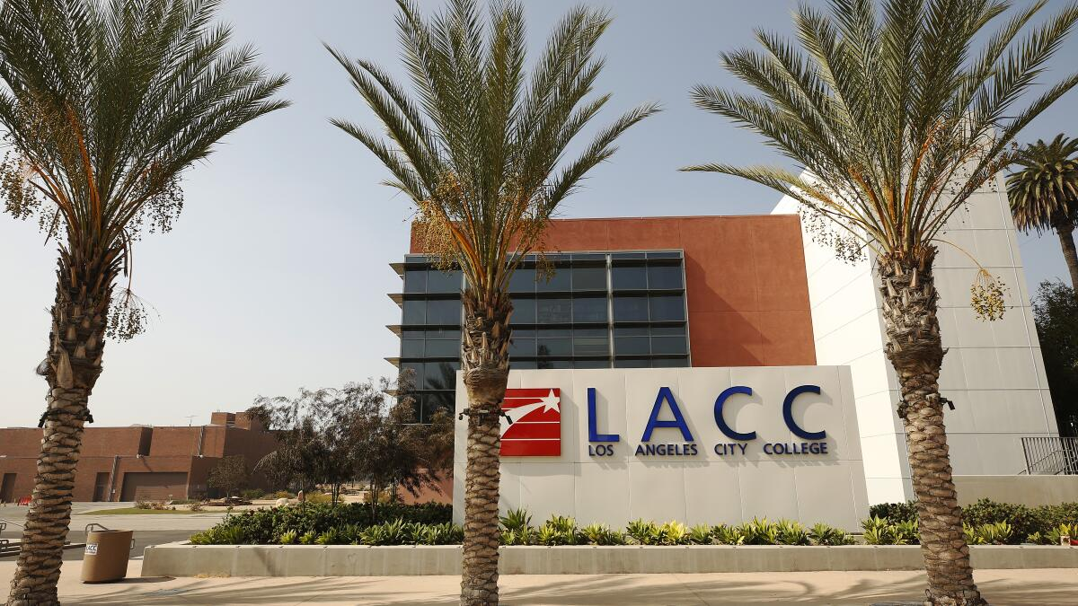
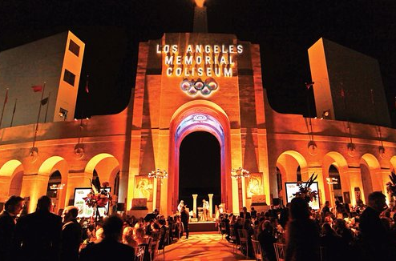
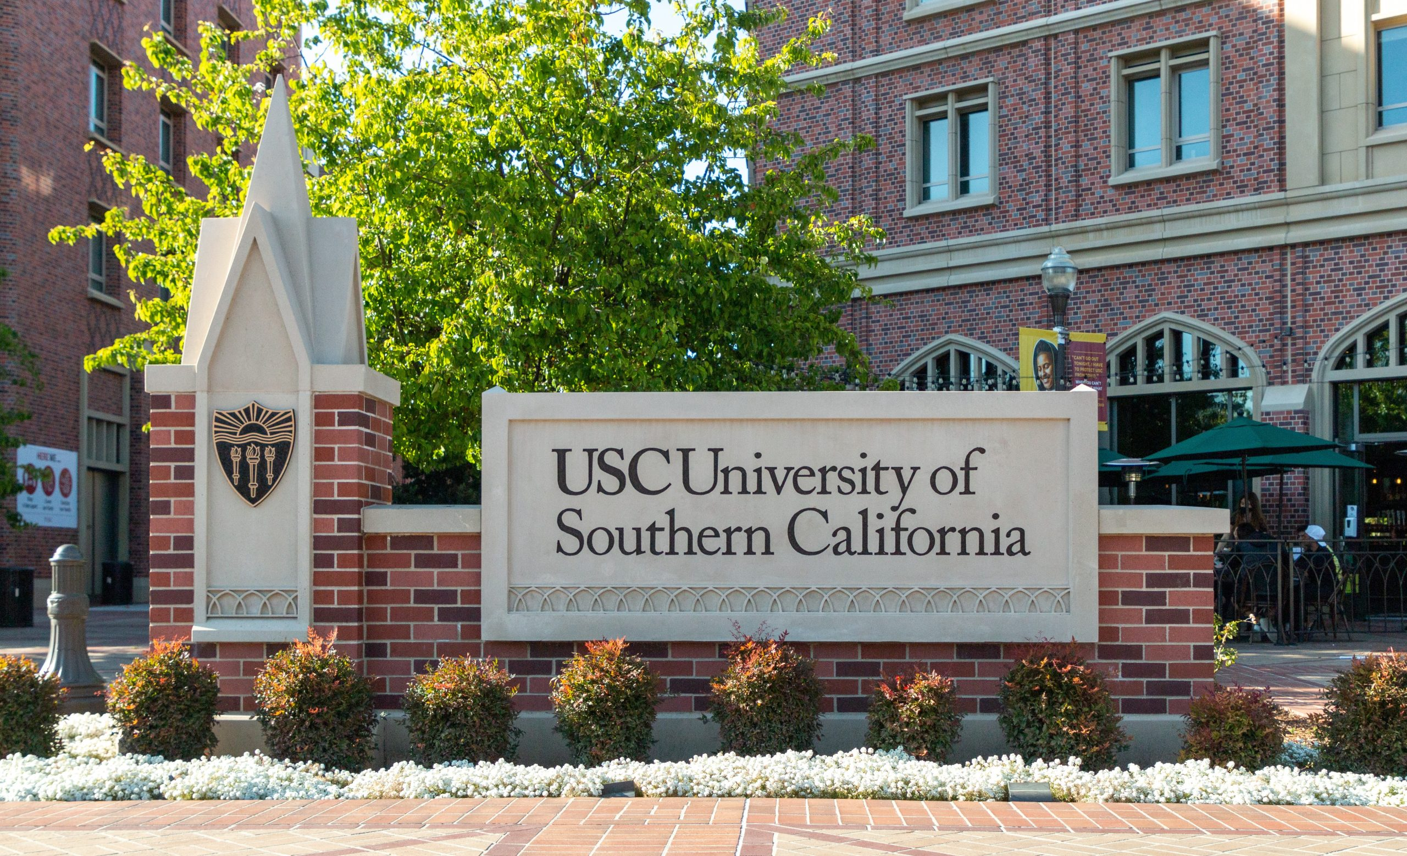
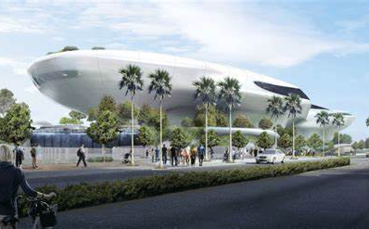
Major Cultural and Educational Destinations
LA City College
LA Coliseum
USC
Lucas Museum

Slide 20



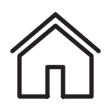
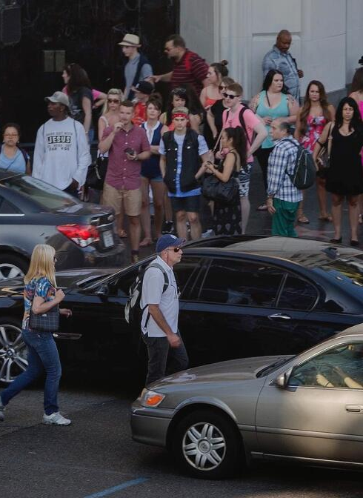
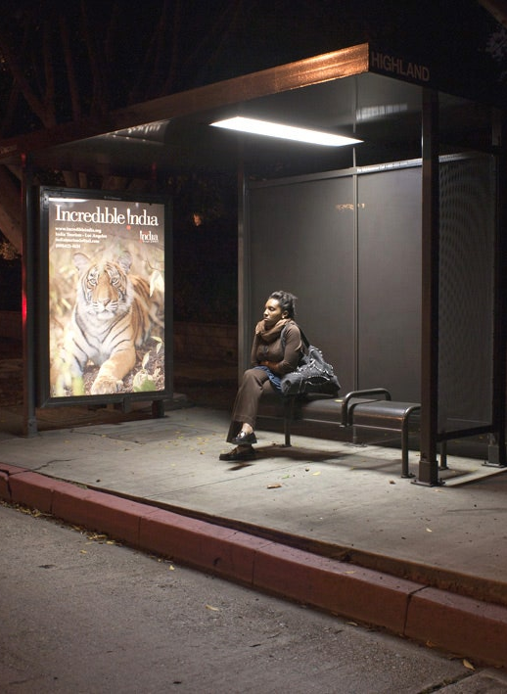
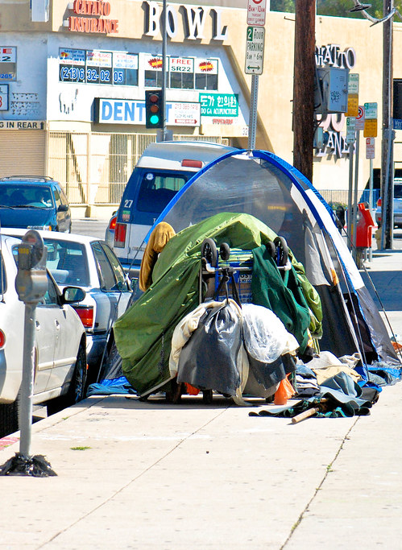
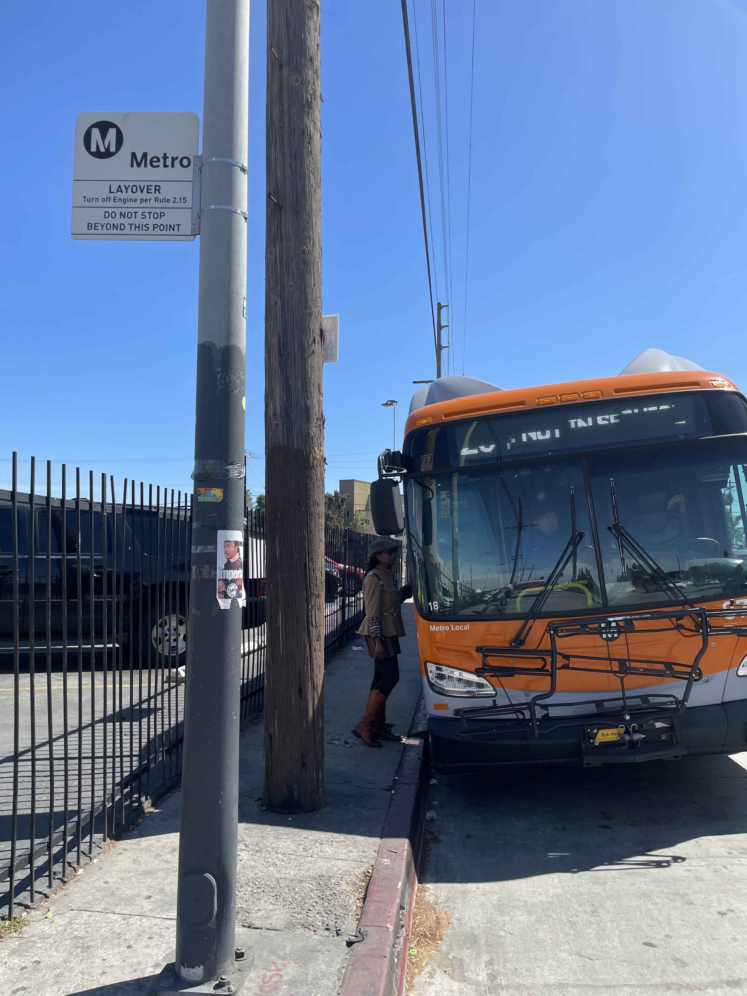
Corridor Challenges
Poor Passenger Experience
Safety
Security
Housing

Slide 21
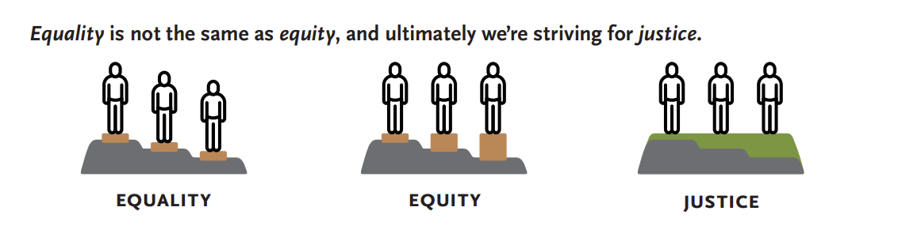

How is Equity Achieved?
Equity is achieved when one’s outcomes in life are not predetermined on their racial, economic or social identities.
Equality of service to both communities does not account for underlying historic inequities.
Equitable investments consider existing disparities and can reduce disparities between communities.
We strive for justice by removing underlying barriers and improving access to opportunities for everyone.
Transportation must target those with the greatest mobility needs first in order to improve access to opportunity for all.
Safety – Passenger Experience – Operations & Maintenance

Slide 22
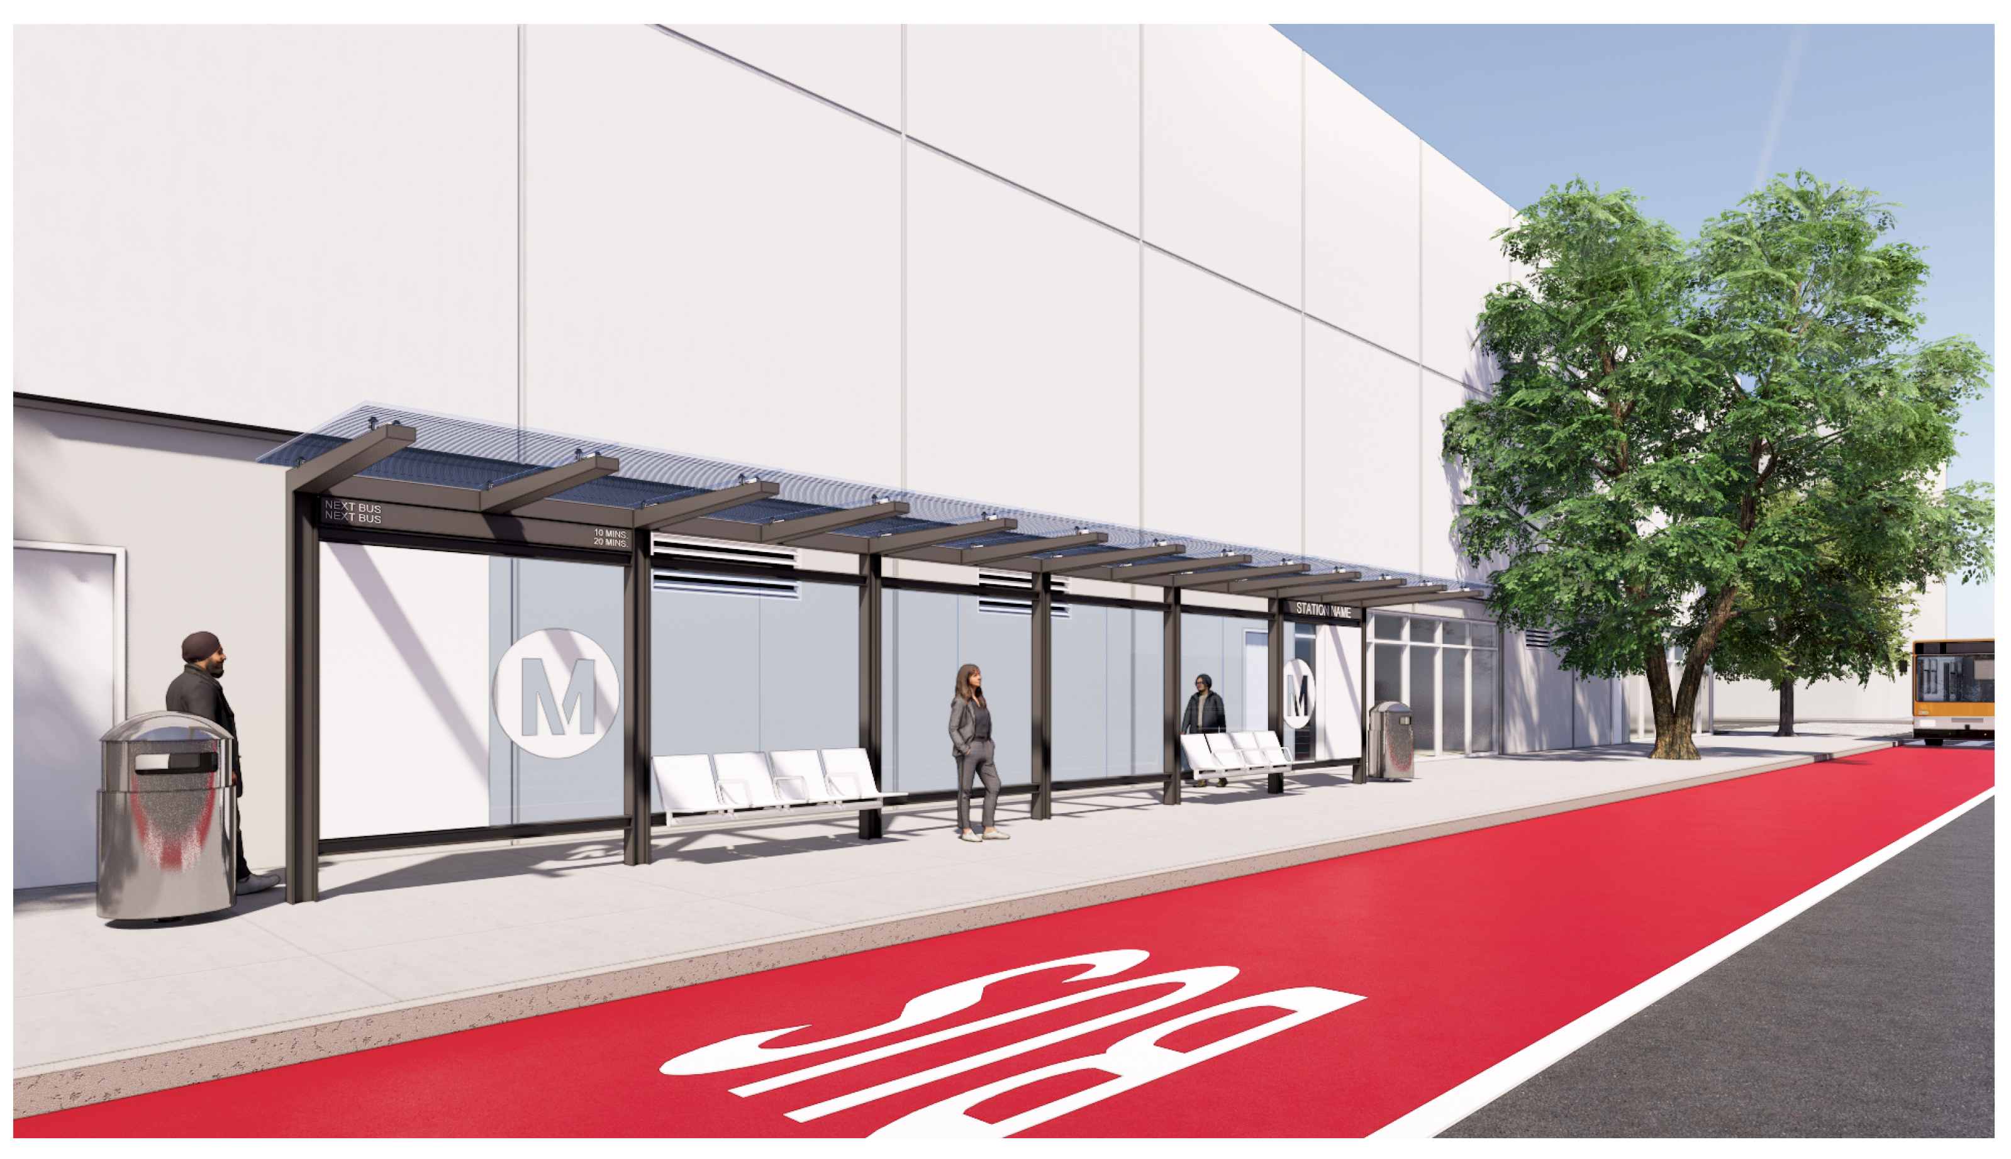
BRT Station Pedestrian Experience - Day
Shade
Comfort
Cleanliness

Slide 23
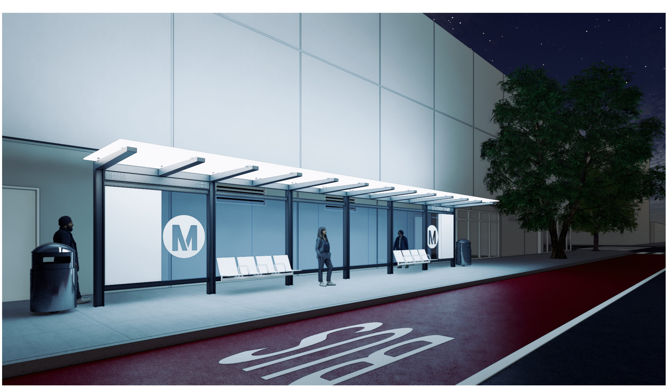
BRT Station Pedestrian Experience – Night
Lighting
Safety
Visibility

Slide 24
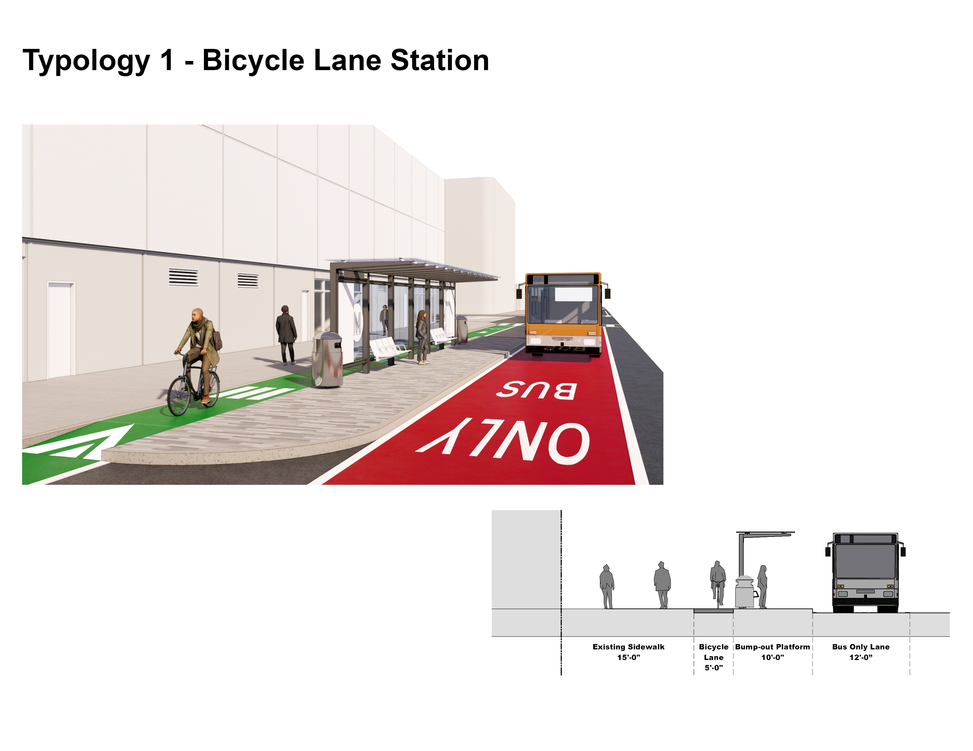
Station Access with Bicycle Lane
Metro Canopy
Bus Lane
Existing Sidewalk
Raised Bike Lane / Crosswalk
Platform on Bulb-Out

Slide 25
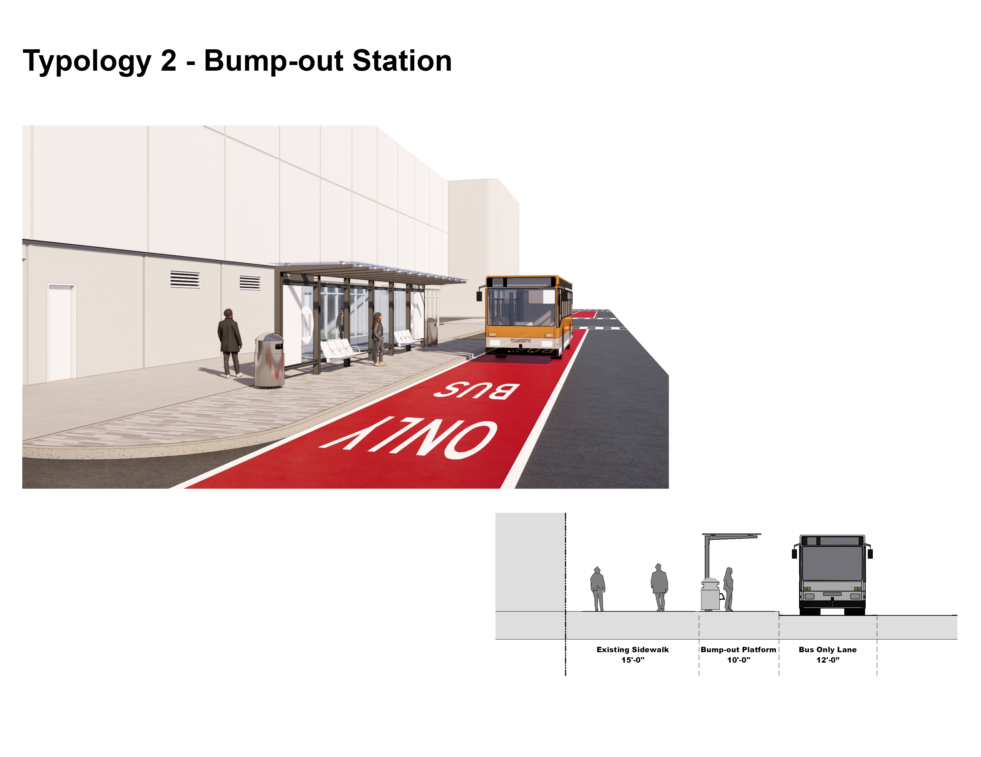
Station Access with Bump-Out
Metro Canopy
Bus Lane
Existing Sidewalk
Platform on Bulb-Out

Slide 26
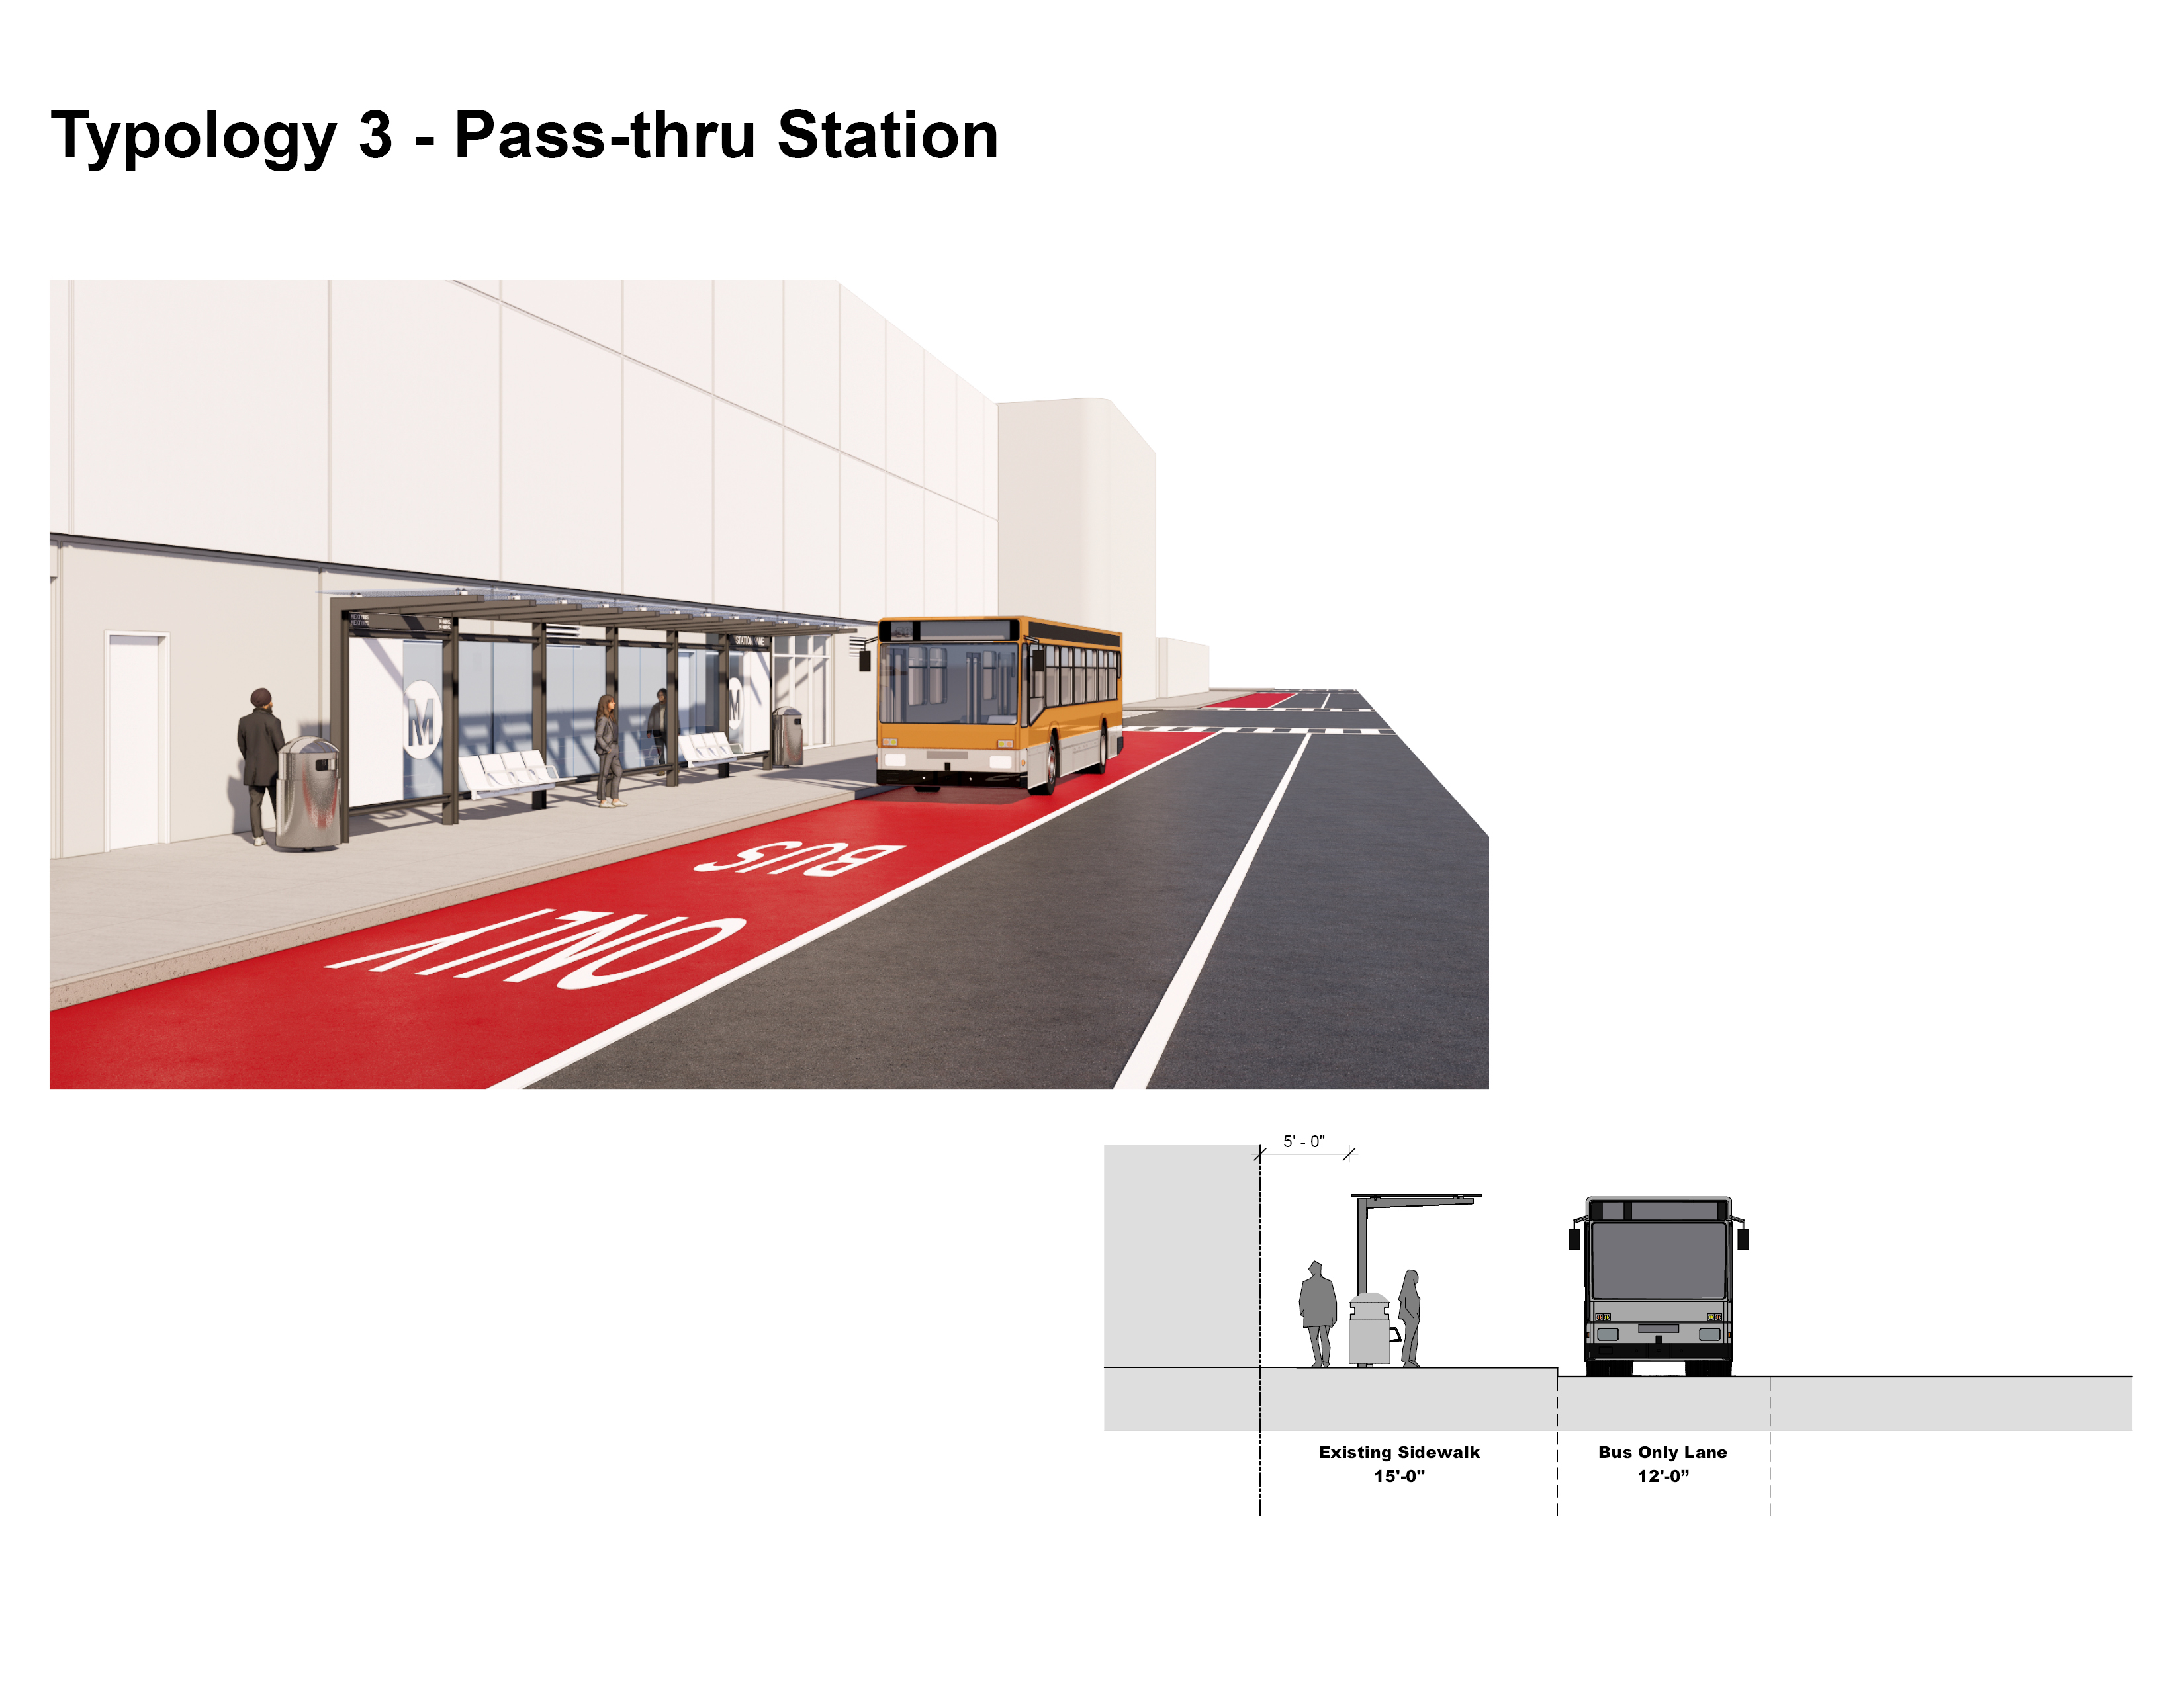
Station Access - Sidewalk
Metro Canopy
Bus Lane
Existing Sidewalk
Platform on Sidewalk

Slide 27






Urban Design Elements
Urban Design Elements:
?
Landscaping
Examples:
Street Trees
Planters
Open Space
Sustainable Strategies
Examples:
Solar Panels
Sustainable Building Materials
Cultural Integration
Examples:
Community Assets
Wayfinding
Artwork
Vendors
Bike Facilities
Examples:
Bike Parking
Raised Platforms
Service Tools
Security
Examples:
Cameras
Lighting
Patrol Officers
Technology Interface
Examples:
Wi-Fi
Real Time Information
Other

Slide 28
BREAK-OUT INSTRUCTIONS

Slide 29
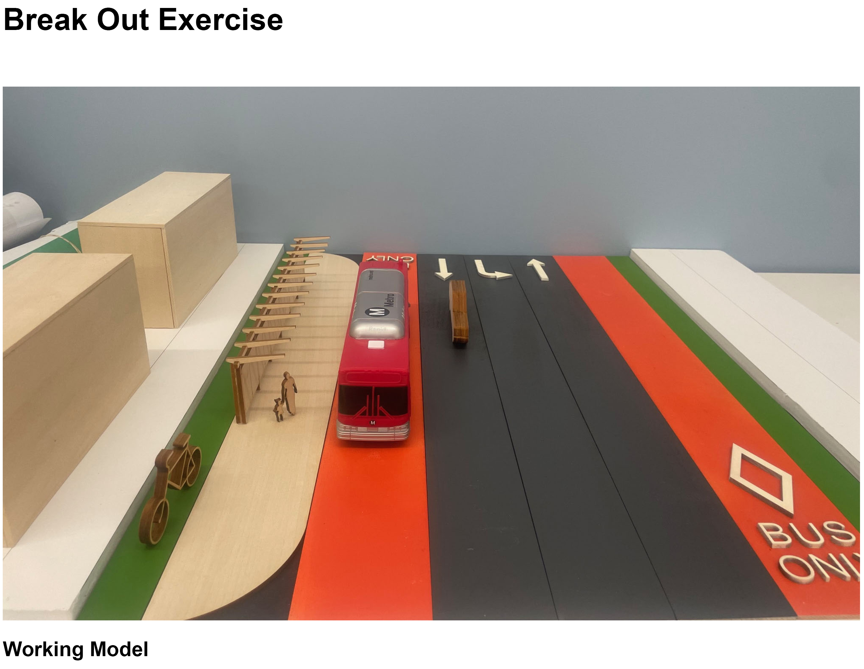
Station Working Model

Slide 30
Break-Out Session Instructions
Step 1: Facilitator places the roadway lanes and station components into the model to illustrate the BRT Project Improvements.
Step 2: Participants discuss Urban Design Elements that may be incorporated into the station area and what those elements mean to them from their perspective.
Step 3: Participants place Urban Design Element tokens into the model and define what that element means to them. Upon placement, prepare responses to the questions to consider.
Step 4: Report Back.
Questions to Consider
What elements are most important to you? How is that different from how you voted in the open house exercise?
What are the design opportunities and challenges at this station?
What are we missing?

Slide 31
Urban Design Elements
Urban Design Elements:
?
Landscaping
Examples:
Street Trees
Planters
Open Space
Sustainable Strategies
Examples:
Solar Panels
Sustainable Building Materials
Cultural Integration
Examples:
Community Assets
Wayfinding
Artwork
Vendors
Bike Facilities
Examples:
Bike Parking
Raised Platforms
Service Tools
Security
Examples:
Cameras
Lighting
Patrol Officers
Technology Interface
Examples:
Wi-Fi
Real Time Information
Other

Slide 32
BREAK-OUT WORKSHOP

Slide 33
REPORT OUT

Slide 34
THANK YOU!

Slide 35

Stay Connected To This Project
Lilian De Loza Gutierrez
Community Relations Director
Metro
One Gateway Plaza, MS 99-13-1
Los Angeles, CA 90012
213.922.7479
delozagutierrez@metro.net
Metro.net/vermont
@metrolosangeles
losangelesmetro
Fulgene Asuncion
Project Manager
Metro
One Gateway Plaza, MS 99-13-1
Los Angeles, CA 90012
213.922.3025
asuncionf@metro.net

