Slide 1
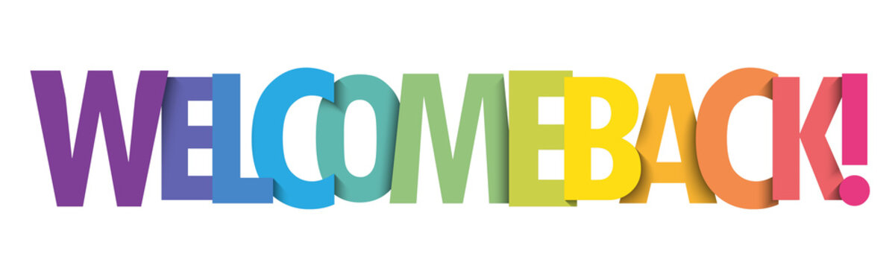
Purple (D Line) Extension Project

Slide 2
Presentation Panelists
Metro Purple Line Extension Team
  Marlon Walker, Community Relations Manager
    Sections 1, 2 & 3 and Division 20
  Mindy Lake, Principal Community Relations Officer
    Section 1, Beverly Hills and Section 2
Contractor Representatives and Presenters
  Scott Donohue, STS Community Relations Coordinator
  Matt Evans, TPOG Project Information Coordinator

Slide 3
Today's Agenda
  City of Beverly Hills Project Overview
  Section 1 Construction Update
  Section 2 Construction Update
  Station Naming for Section 2
  Eat Shop Play
  Business Interruption Fund

Slide 4

Purple Line Extension Alignment

Slide 5
Sections 1, 2, & 3 Status
 | Forecasted Schedule
Section | Section 1 | Section 2 | Section 3
Length | 3.92 Miles | 2.59 Miles | 2.56 Miles
New Stations | Wilshire/La Brea Wilshire/Fairfax Wilshire/La Cienega | Wilshire/Rodeo Century City/Constellation | Westwood/UCLA Westwood/VA Hospital
Pre-Construction Activities | 2014 – 2015 | 2016 – 2018 | 2018 – 2019
Construction | 2015 – 2024 | 2018 – 2025 | 2019 – 2027
Operations | 2024 | 2025 | 2027
*Subject to change. The PLE project team is working to deliver the project consistent with Measure M.

Slide 7
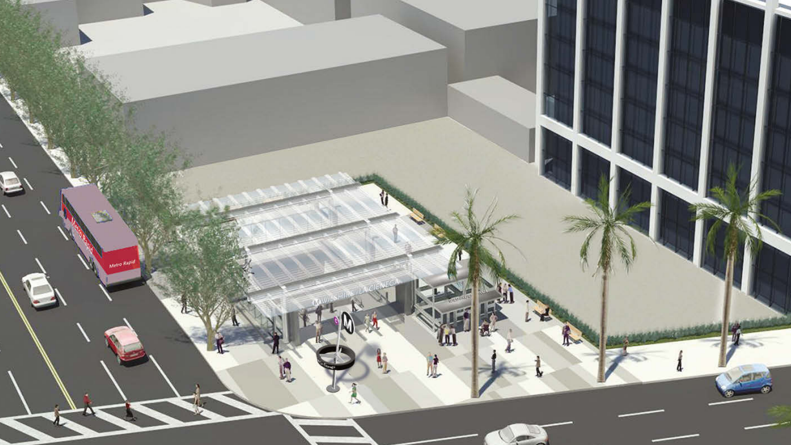
Wilshire/La Cienega Station Rendering

Slide 8
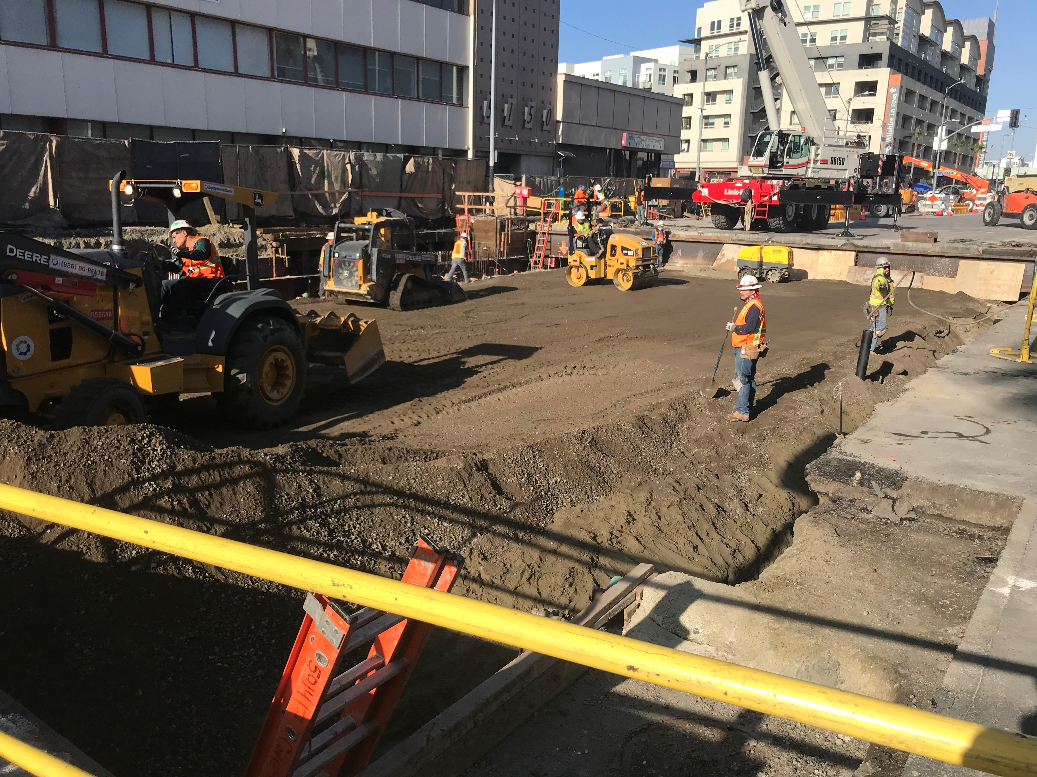
La Cienega Station Backfilling
*Subject to Approval
What: Beginning in September 2022, STS will begin Station Backfilling at La Cienega.
  This is the first of multiple construction activities in advance of decking removal and street restoration.
Why: The Station Roof is approximately 20ft below the street surface. That area will need to be filled with slurry, soil, and utilities.
  STS will need to restore utilities in the street, including sewer, storm drains, and other utilities.
Traffic Control and Work Hours: Intermittent weeknights and weekend days.
  Hours: 8pm to 6am (the following morning) on weeknights
  Hours: 6am to 6pm on Saturdays
  Traffic Control: Wilshire Bl reduced to a single lane in each direction between San Vicente Bl and Le Doux Rd
Backfilling operations at Wilshire Bl and Orange Dr, within the City of Los Angeles

Slide 9
Wilshire/La Cienega Station Appendage Work
Why: Multiple appendages will be required for each station on the Purple Line Extension
Each appendage structure houses a vital function for the stations:
  Emergency exits
  Utility rooms
  Ventilation rooms
  Entrance and exit structures
When: Began in March 2021 through 2023*
Where: Information about specific traffic control and work hours will be available in future community meetings and construction notices
Coordination with impacted businesses will be conducted prior to the start of the next phase of appendage work

Slide 10
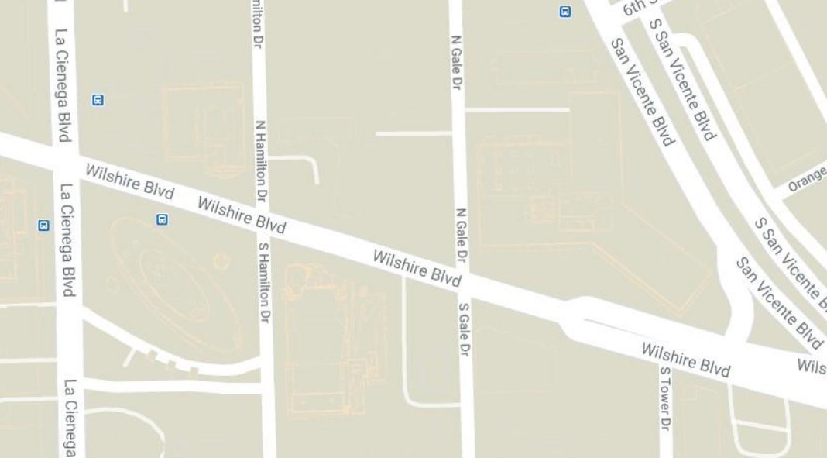
Wilshire/La Cienega Station: Appendage Structures Phase 1A
Phase 1A
Appendage –
Main Entrance
Phase 1A
Station Box
Appendages –
Northeast
Station appendage locations

Slide 11
Wilshire/La Cienega Station Appendage Work
*Dates subject to change.
Phase 1A Traffic Control (March 2021 through November 2022)*
Wilshire Blvd. between San Vicente Blvd. and La Cienega Blvd. reduced to two lanes in each direction.
Left turns from Wilshire Blvd. onto Gale Dr. will be restricted from both directions. Left turns from Tower Dr. onto westbound Wilshire Blvd. will be restricted.
The east/ west crosswalks at Gale will be maintained.
The north sidewalk between San Vicente Blvd. and Gale Dr. will be closed during this phase of work. A pedestrian detour for east/west travel will be in place on the south side of Wilshire. Access to 8383 Wilshire will be maintained.
The loading zone in front of the Saban Theatre on Wilshire Blvd will be closed over the duration of this closure.
A full closure of Gale Dr. north of Wilshire Blvd. will be in place during Phase 1B of this work.

Slide 12
Wilshire/La Cienega Station: Appendage Structures Phase 1B
*Dates subject to change.
Phase 1B Traffic Control (January 7, 2022 through September 2022)*
Wilshire Blvd. between San Vicente Blvd. and La Cienega Blvd. reduced to two lanes in each direction
Gale Dr. north of Wilshire Blvd. will be fully closed through September 2022.
Left turns from Wilshire Blvd. onto Gale Dr. will be restricted.
Left turns from Tower Dr. onto Wilshire Blvd. will be restricted.
The north/south crosswalks at Gale Dr will be closed
The north sidewalk between San Vicente Blvd. and west of Gale Dr. will be closed during this phase of work. A pedestrian detour for east/west travel will be in place on the south side of Wilshire. Access to 8383 Wilshire will be maintained.
The loading zone in front of the Saban Theatre will be closed over the duration of this closure.
Phase 1B
Station Box
Station appendage locations

Slide 13
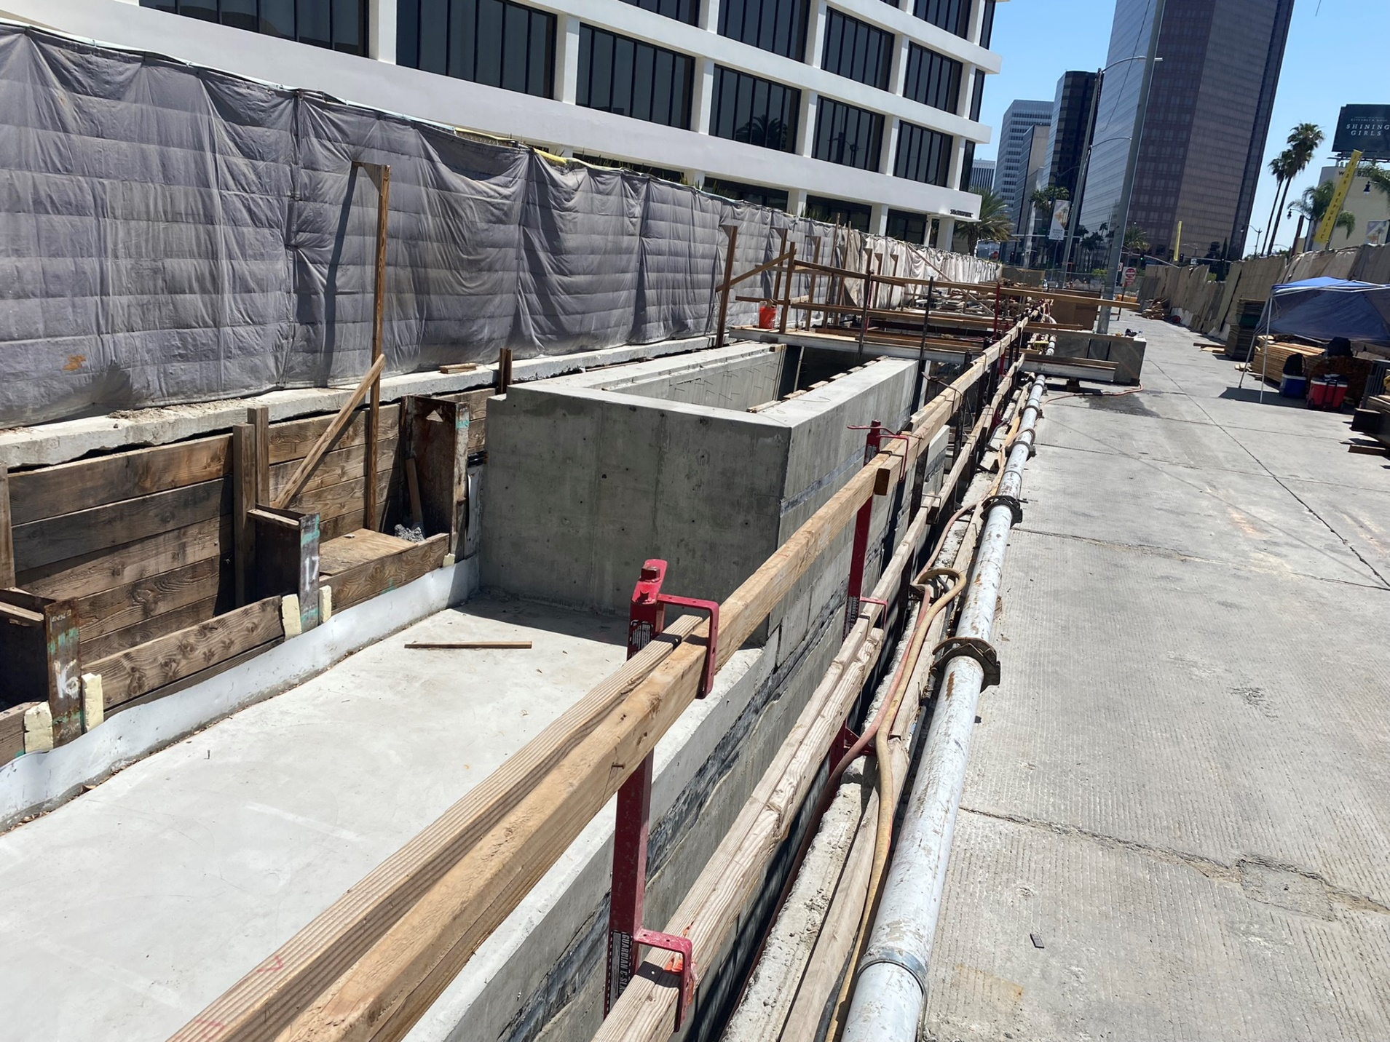
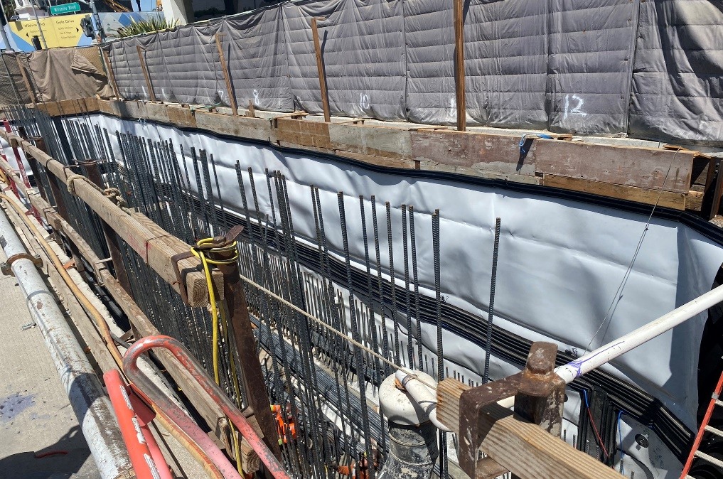
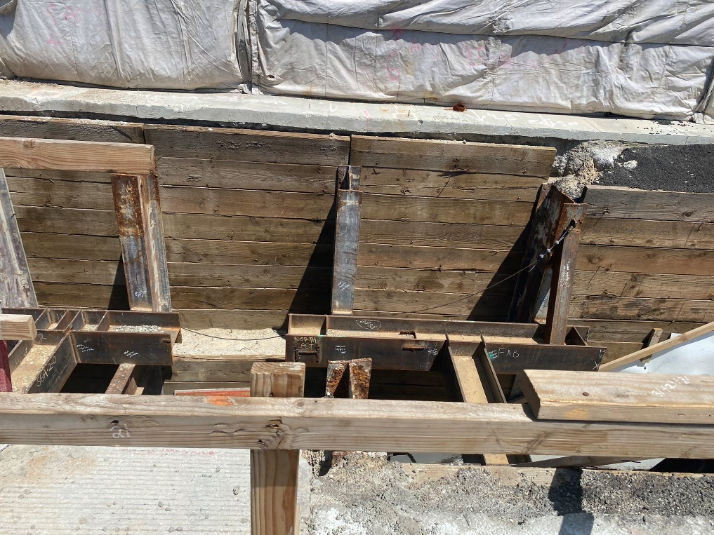
Wilshire/La Cienega Station Appendage Progress – Phase 1A

Slide 14
Replacement Parking
Locations for One Hour Free Parking: Mon-Fri 10am-3pm
  8447 Wilshire Bl:
  Accessible from N Hamilton
  8350 Wilshire Bl:
  Accessible from S Tower
  Please mention "Metro" upon entering the building to receive the 1st hour free

Slide 15
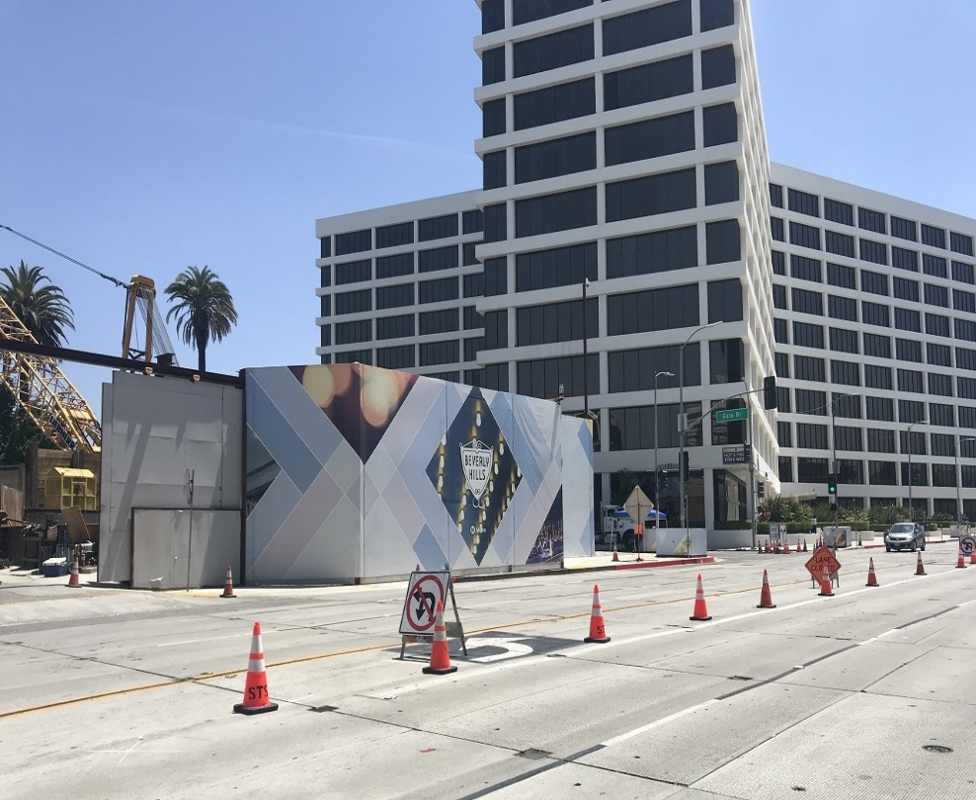
Concrete and Material Deliveries
Where: Structural work on the station underneath Wilshire Bl is generally conducted from the Gale Yard and from Wilshire Bl
Work Hours: 9am to 4pm during bump out implementation
Traffic Controls*:
  Westbound Wilshire Bl will be intermittently reduced to one lane between San Vicente Bl and Hamilton Dr
  Daily closures will be utilized in support of ongoing work activities in the staging yard at Gale Dr
Deck Panel Access – Hamilton Dr (9am to 4pm, weekdays; 7am to 6pm, Saturdays)
  Continuing in June, intermittent deck panel access may be implemented within the Wilshire/Hamilton intersection.
  Wilshire will be reduced to a single lane in each direction between Tower Dr and Stanley Dr
  Left turns from Wilshire to Hamilton will be restricted. Through traffic on Hamilton will be restricted at Wilshire.
Noise Mitigations: will remain in place
  Sound blankets around noisy equipment
  Trucks equipped with low-impact backup alarms
  Nylon straps used to lift material
Outside Gale Staging Yard

Slide 16
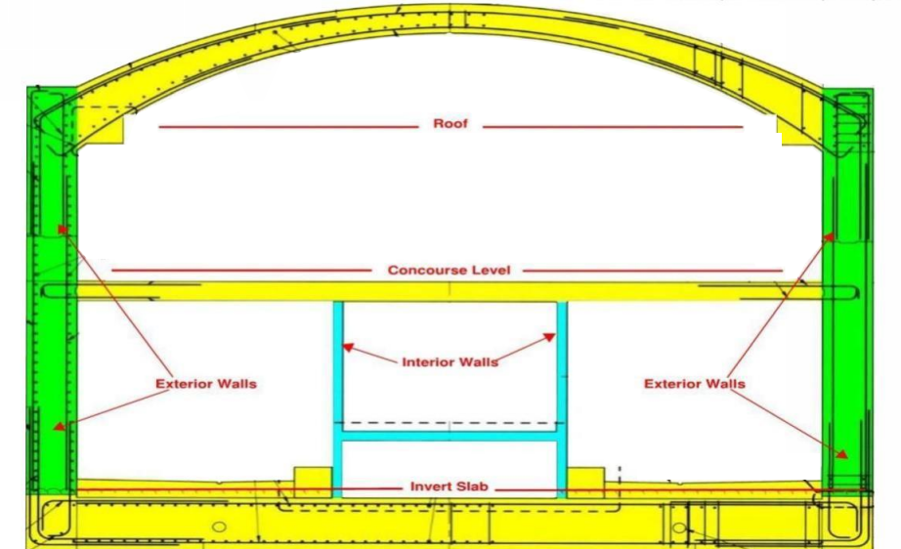
Next Steps: Station Construction
Construction of station roof will continue through 2022
Each roof placement will be 60 feet by 60 feet
Work activities in support of concrete and deliveries will be conducted within the staging yards, and occasionally on Wilshire Bl
Daily construction activities may be conducted underneath Wilshire Bl and from both Staging Yards for 24 hours a day
Illustration of station interior design

Slide 17
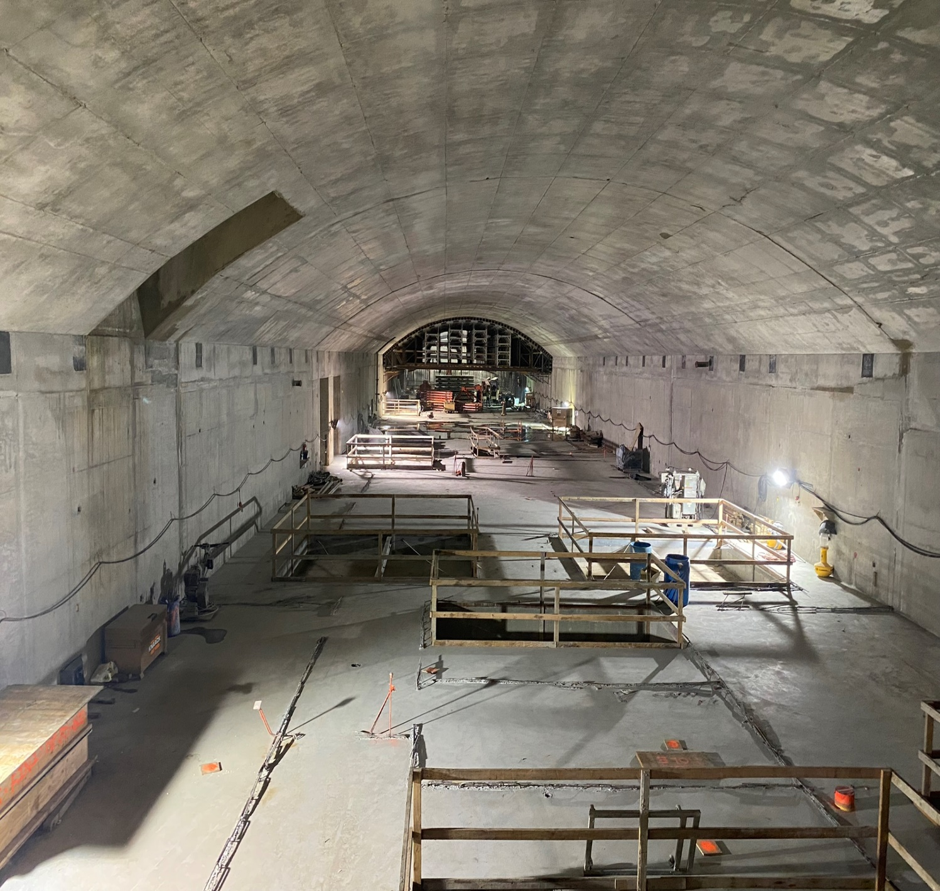
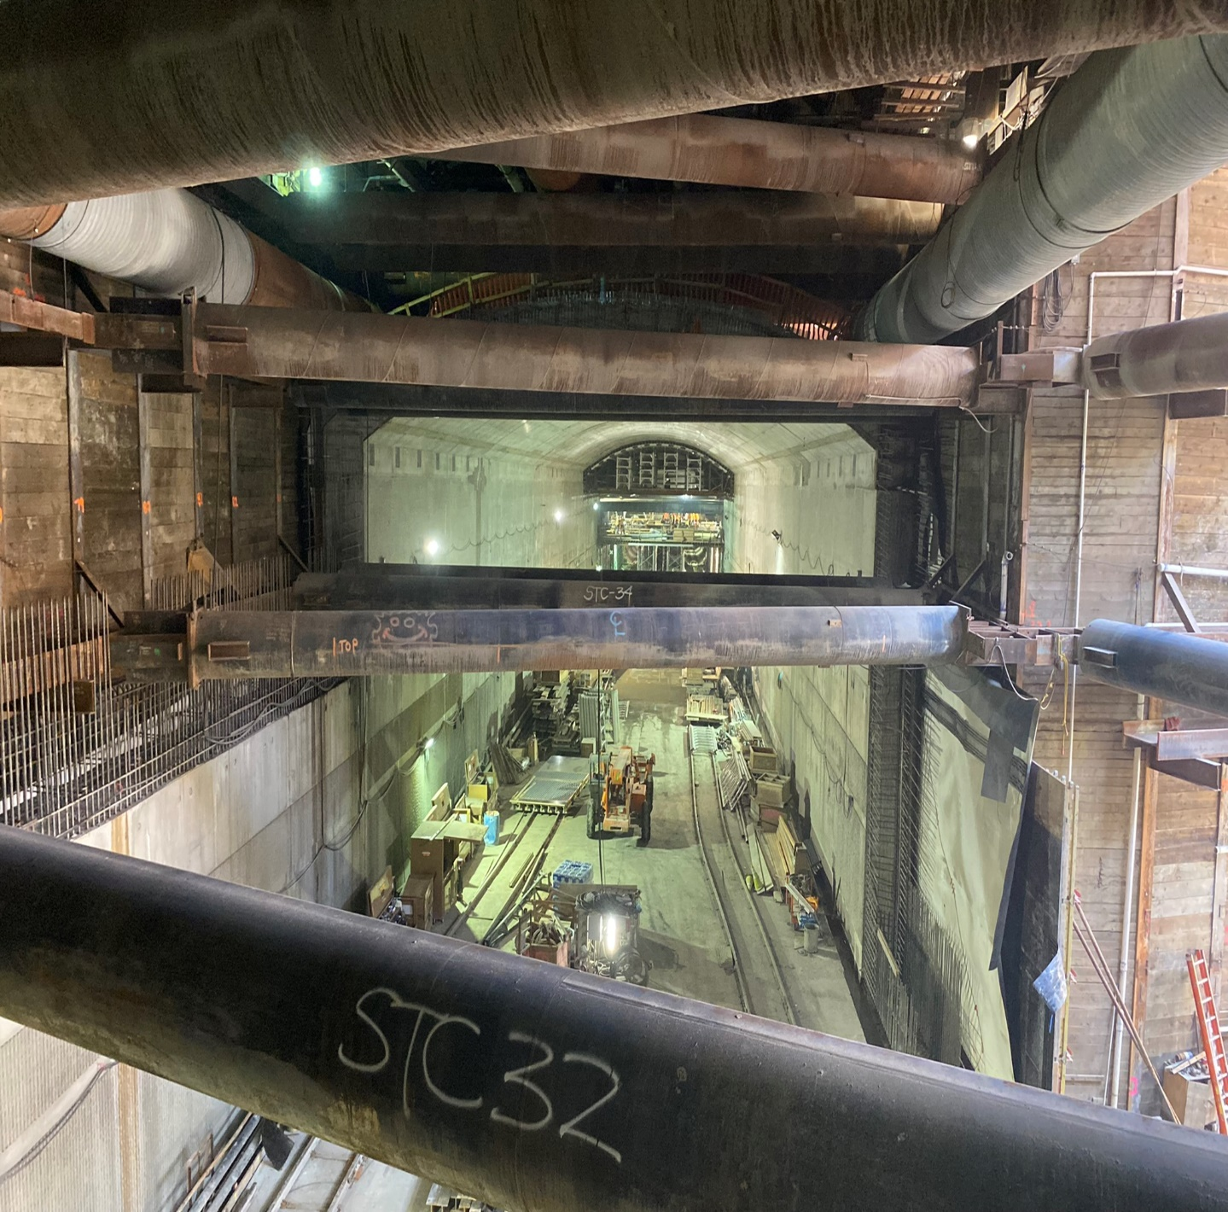
La Cienega Station Progress
Looking East
Looking West

Slide 18
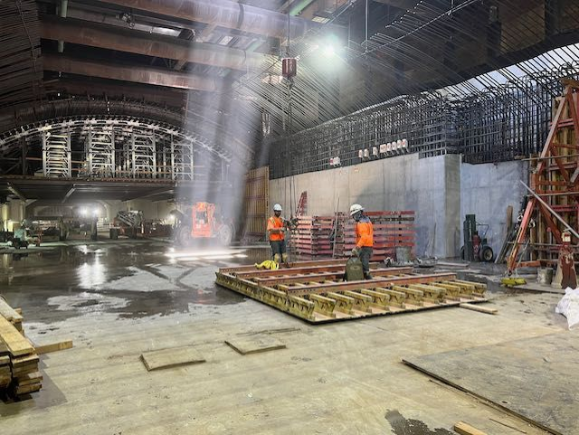
La Cienega Station Progress
Looking East
Photo courtesy of Ken Karagozian

Slide 19
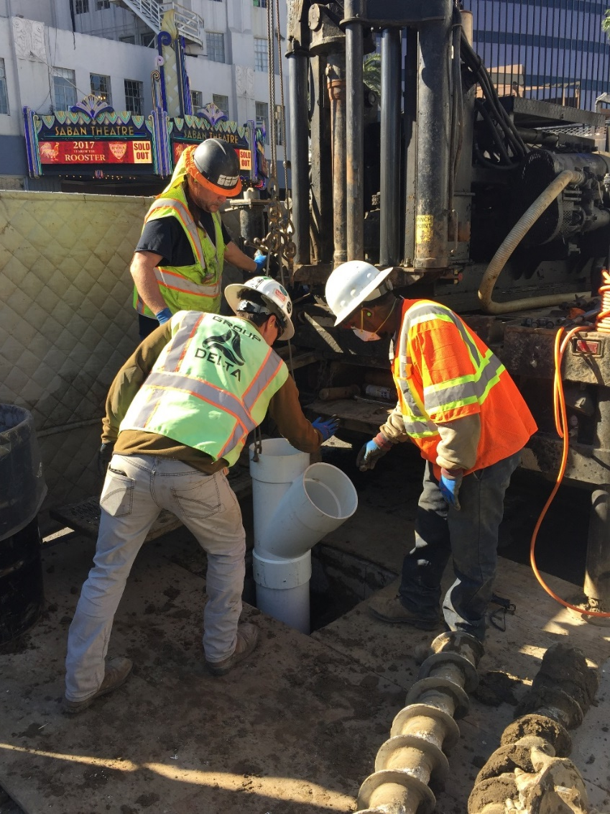
Instrumentation Work
When: Ongoing in 2022
Traffic Controls:
  Intermittent lane reductions on
  Wilshire Bl, La Cienega Bl, and side streets during off-peak hours may be in place to support the maintenance of geotechnical instruments in the Wilshire Bl and La Cienega Bl area
  Intermittent lane reductions may be in place on Wilshire Bl, west of La Cienega Bl, to support coring survey work under Wilshire Bl
Additional details on this work will be available in future construction notices
Example of instrumentation drilling

Slide 20
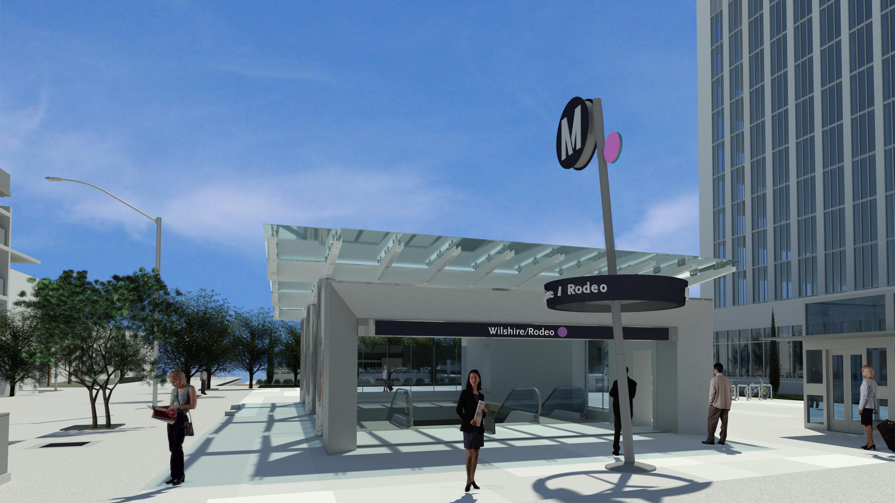
Wilshire/Rodeo Station Rendering

Slide 21
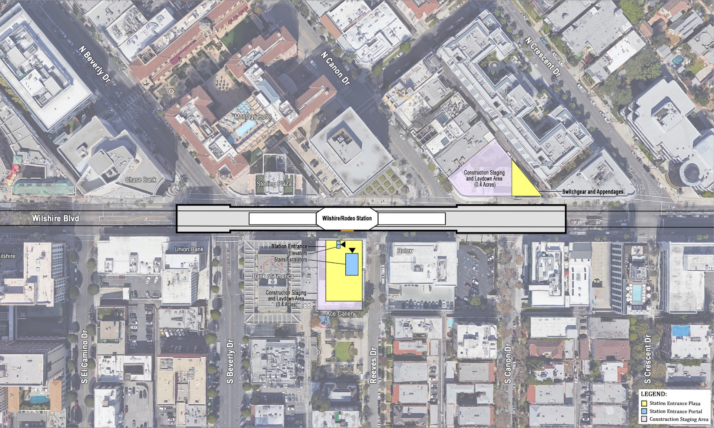
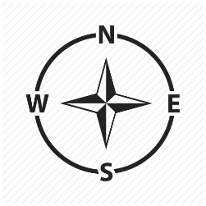
Wilshire/Rodeo Station Box
Rendering shows length of the underground station box on
Wilshire Bl from Cañon Dr to Beverly Dr

Slide 22
Wilshire/Rodeo Station: Permitted Work Hours and Traffic Control
Work hours underneath the deck are 24 hours a day, 7 days a week. Deliveries of material, equipment, and concrete will be ongoing daily from Wilshire Bl. A breakdown of daily work hours on street level:
  From 7am to 9am and 4pm to 8:15pm, Wilshire Blvd. will remain open with three lanes in each direction between El Camino Dr. and Crescent Dr.
  From 9am to 4pm, Wilshire Blvd. may be reduced to two lanes in each direction between El Camino Dr. and Crescent Dr.
  From 8:15pm to 7am, Wilshire Blvd. may be reduced to one lane in each direction between El Camino Dr. and Crescent Dr.
Traffic control may also be implemented on Beverly Dr. At least one through traffic lane will be maintained in both directions between 9am-4pm and 8pm-7am.
From 9am to 4pm, S. Reeves Dr. may be reduced to one lane northbound to accommodate delivery of material and equipment. A flagger will be on site to assist motorists with 2-way traffic.

Slide 23
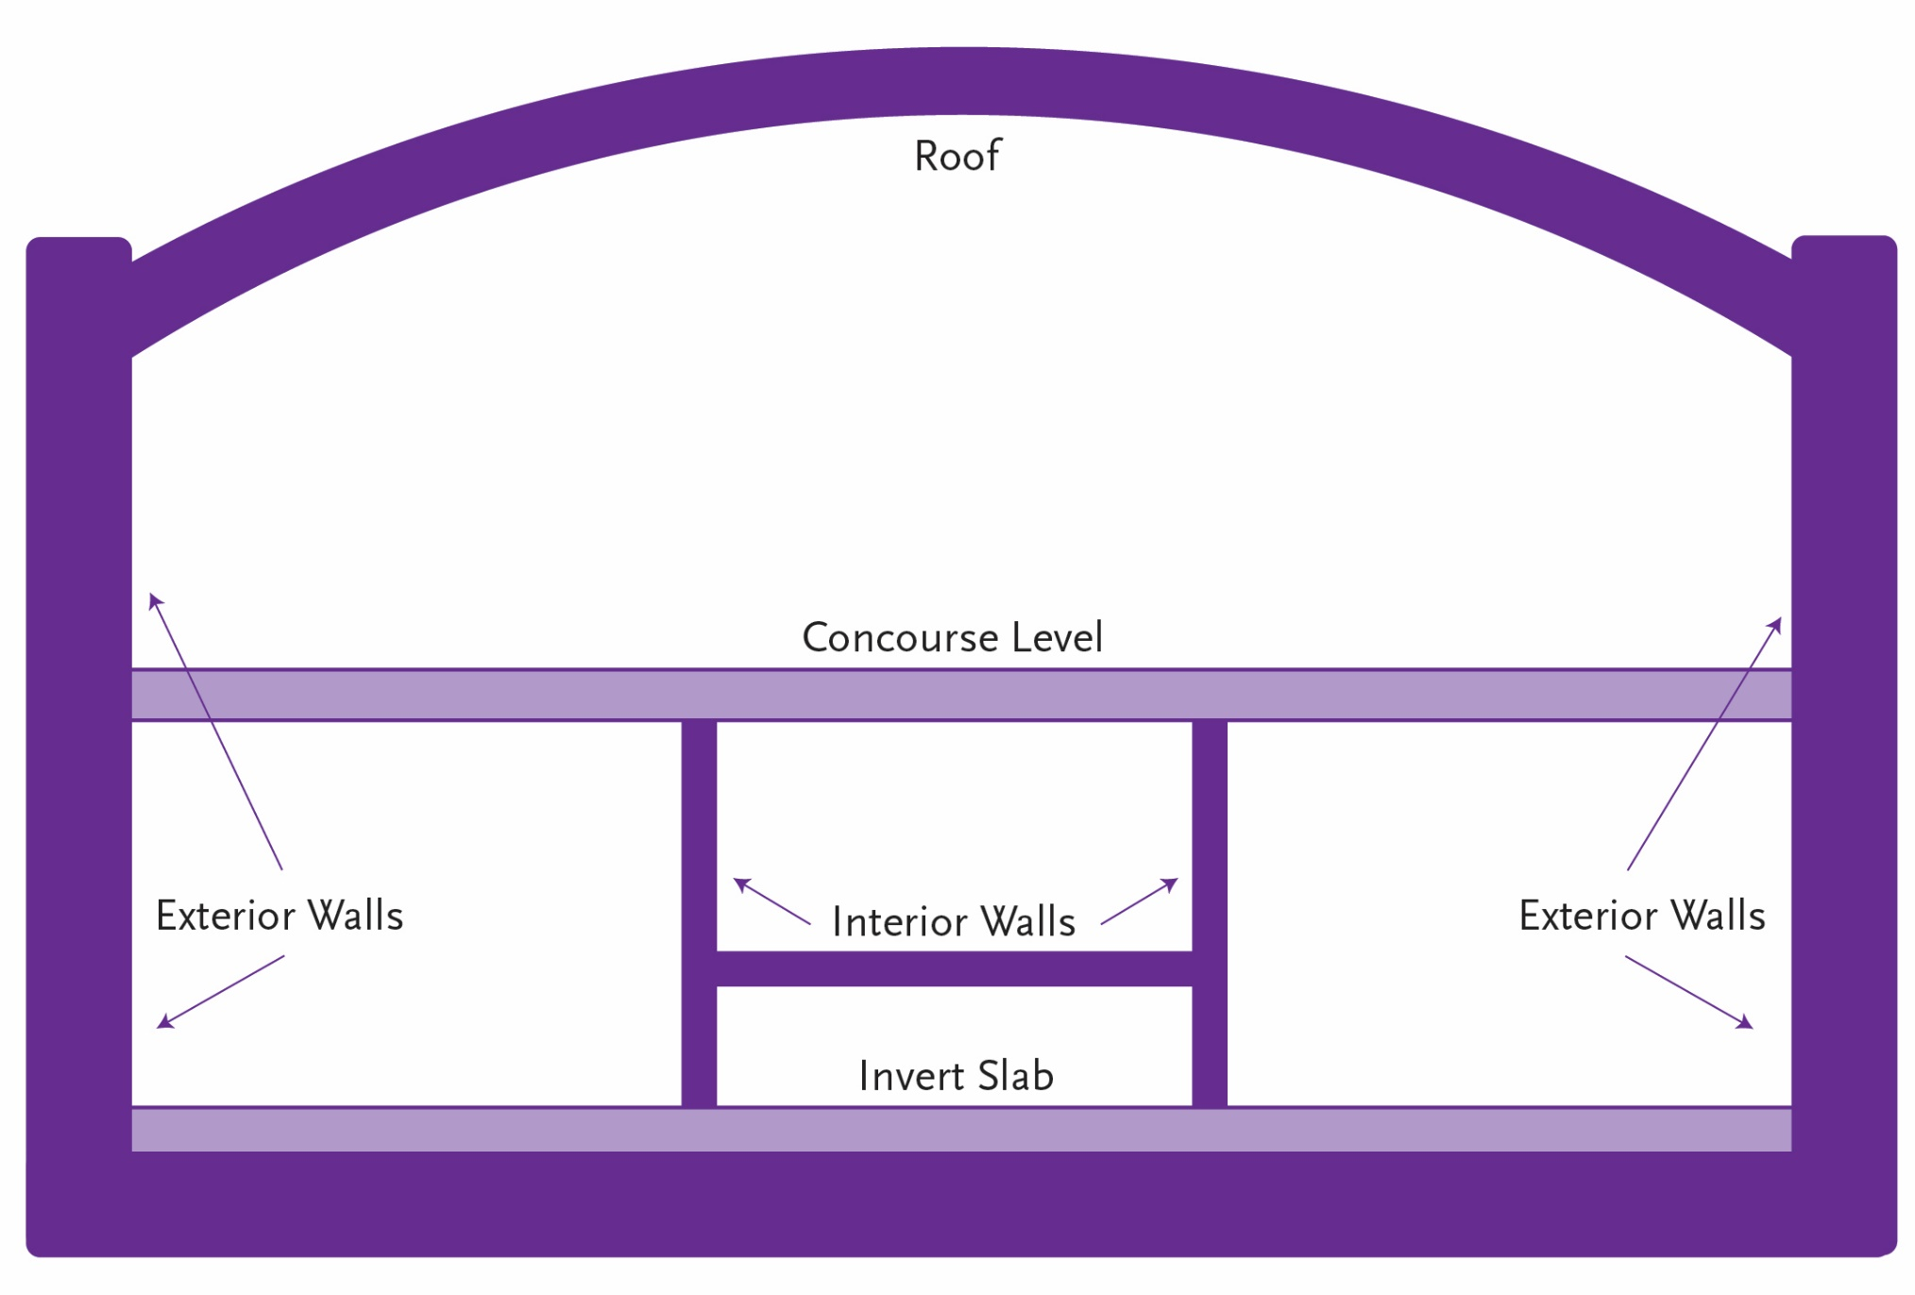
Wilshire/Rodeo Station: Structure Construction through 2024

Slide 24
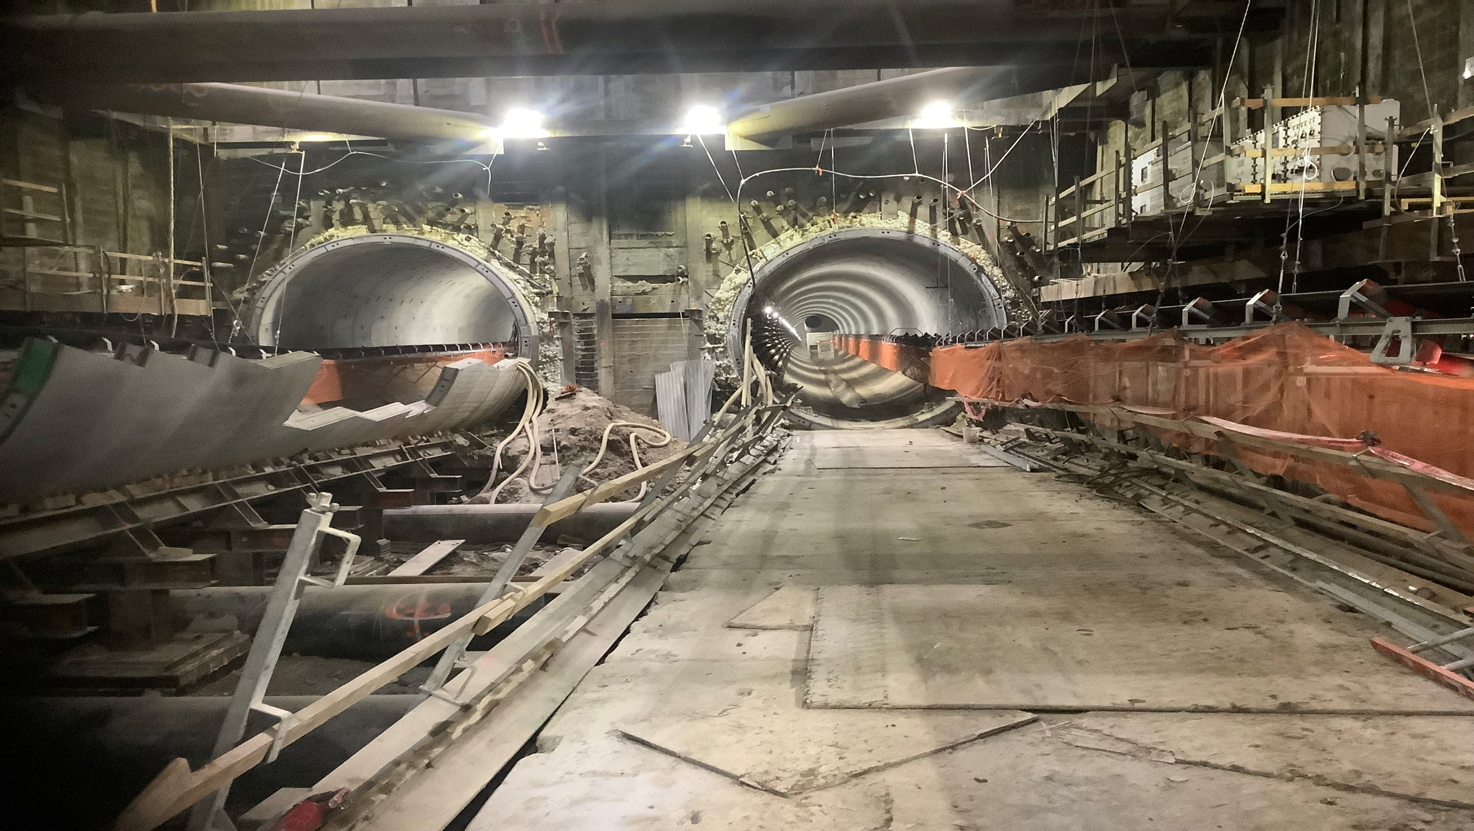
Wilshire/Rodeo Tunneling Progress

Slide 25
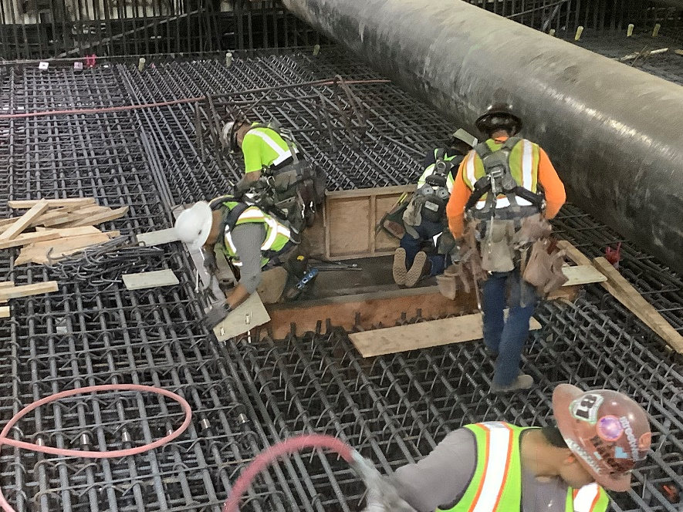
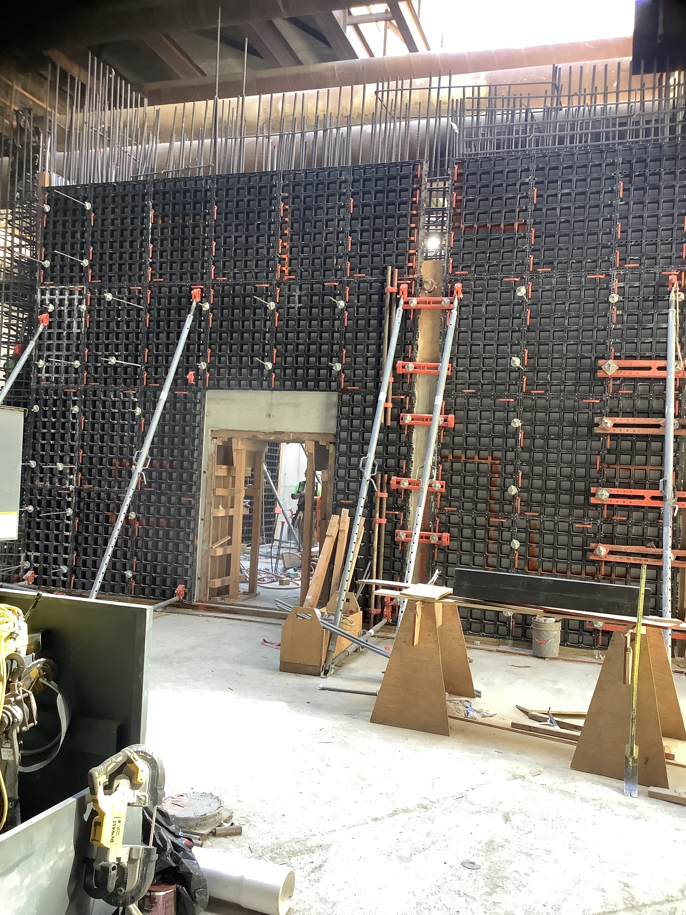
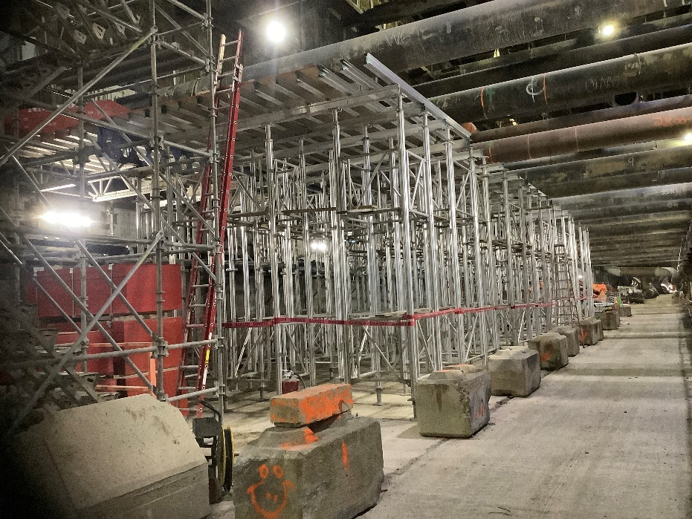
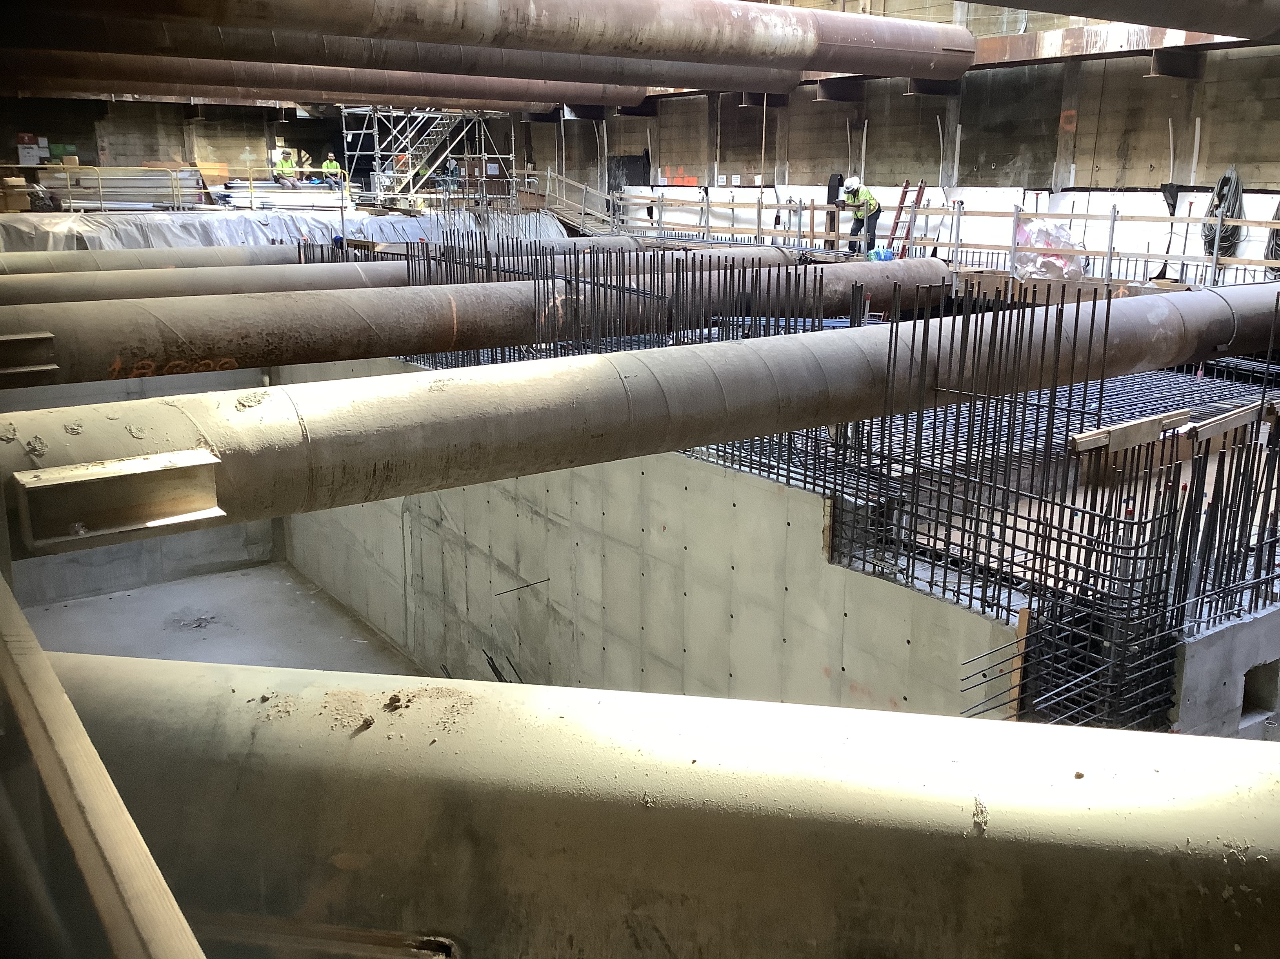
Wilshire/Rodeo Station: Concourse Level Activity
Concourse level progress | Shoring & Walls

Slide 26
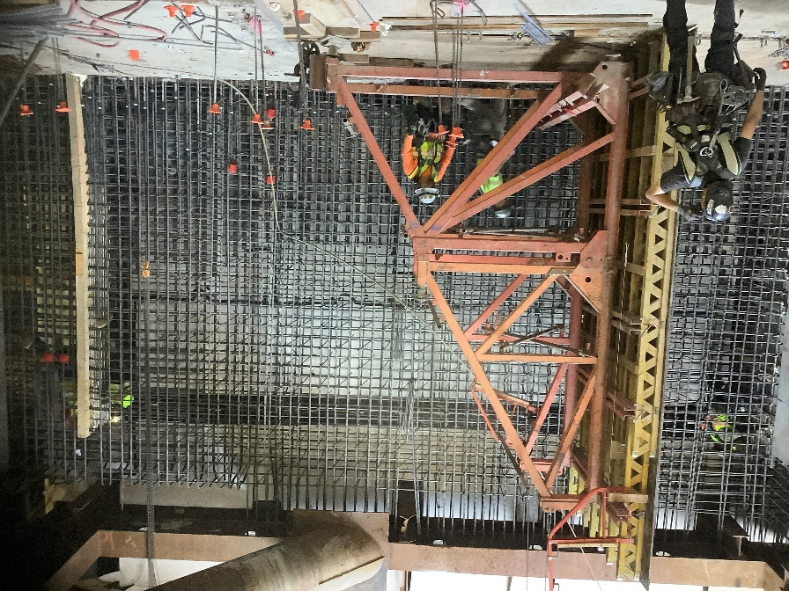
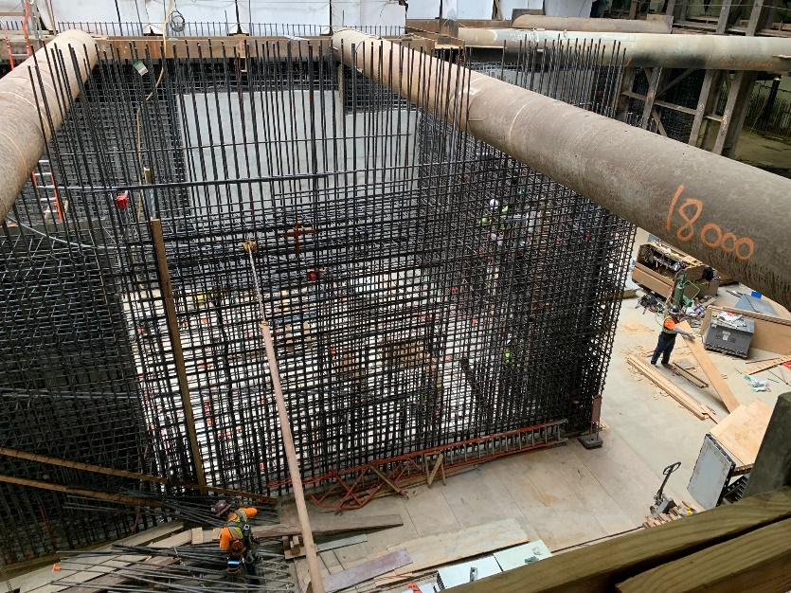
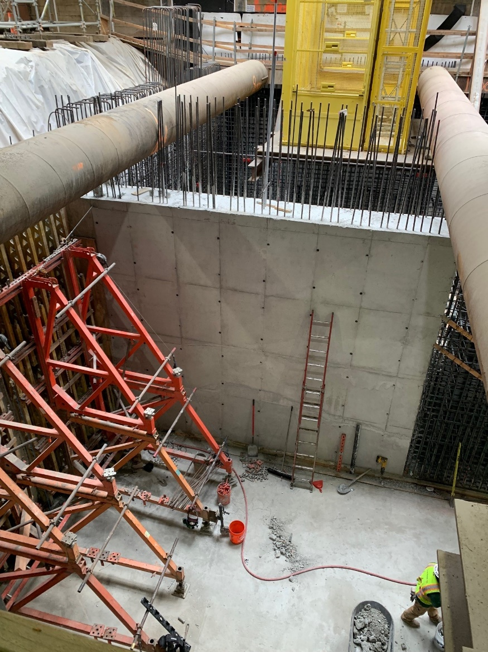
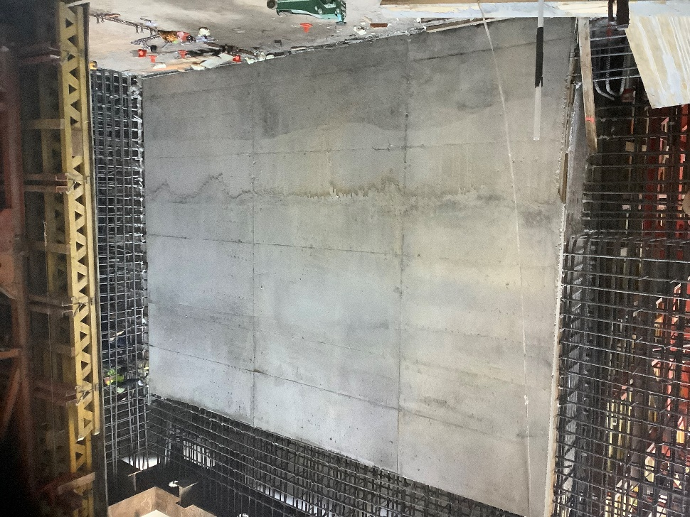
Wilshire/Rodeo Station: Construction Progress
Entrance Wall progress.

Slide 27
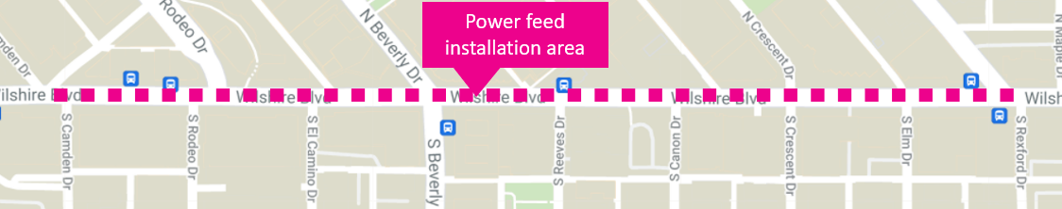
Upcoming Work | SCE Installation
Contractor will begin installation of SCE Permanent Power Feeds to the station.
Where: Wilshire Blvd. between Dayton Way and Rexford Dr.
  Starting east of station box
Duration: Approximately 7 months [Anticipated start on Saturday, September 10]
  Starting east of station box from S Canon Drive to Rexford (Sep – Nov) | Shift to west side after
Work Hours: Weekends, 8am to 8pm* Weekdays 8:15pm to 7am
Traffic Control:
  Wilshire Blvd. may be reduced to one lane in each direction overnight and on weekends
*Pending approval from City Of Beverly Hills

Slide 28
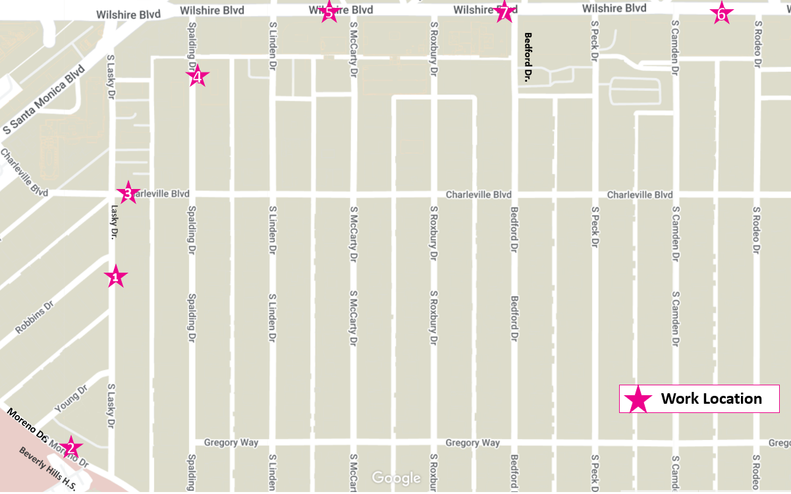
Upcoming Ground Improvement/Cross Passage Work
The contractor began ground improvement work along the tunnel alignment in preparation for the construction of cross passage tunnels.
When: Work started in late May
  Ongoing until late 2022
Where: *14 locations; First 7 work sites noted on map
Work Hours: Monday-Friday 8am-11pm on Wilshire Bl. Closures remain in place 24/7 until each location is completed
Duration: 2-4 weeks/location
*Additional notices detailing dates & closure information will be provided in advance

Slide 29
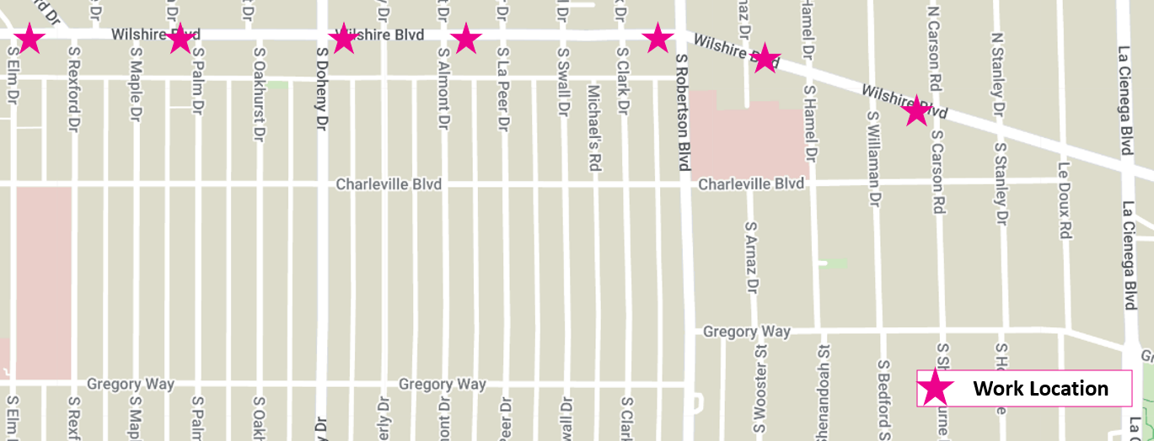
Upcoming Ground Improvement/Cross Passage Work
*Additional notices detailing dates & closure information will be provided in advance

Slide 30
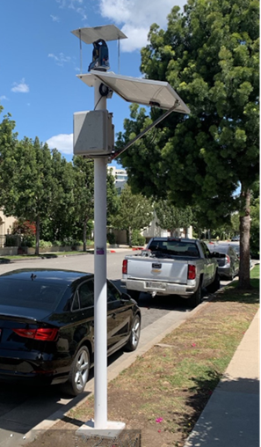
Wilshire/Rodeo Station: Geotechnical Instrumentation
Where: Instruments will be installed within the tunnel alignment and station box area to monitor ground movement, settlement and other geological conditions
  Installations will be within the public right of way and within privately owned properties
Duration: Ongoing
Work Hours On Wilshire Bl:
  Weekdays, 7am to 4pm and 8pm to 7am
Work Hours Off Wilshire Bl:
  Weekdays, 8am to 6pm and 8pm to 7am
Example of 10-foot geotechnical instrumentation pole.

Slide 31
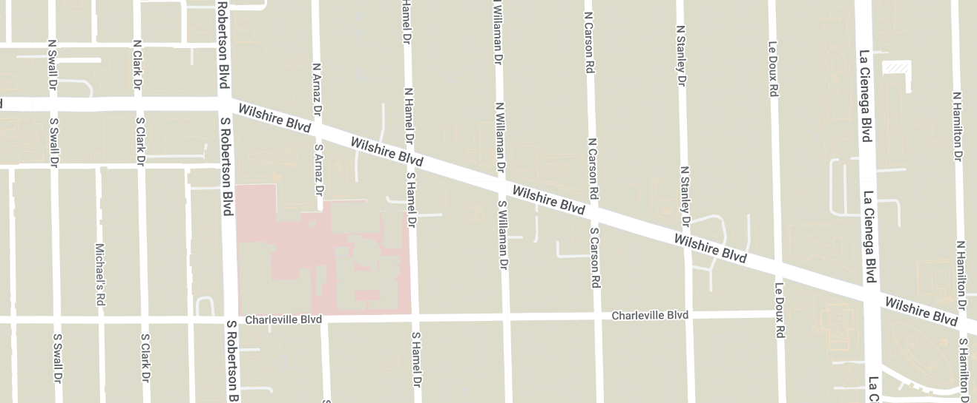
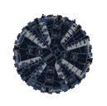
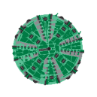
Tunnel Boring Machine (TBM) Update
Tunneling Statistics As of (9/7/2022)
Ruth | 11,510 feet (total journey) 80% complete
Harriet | 11,510 feet (total journey) 90% complete
Both TBM’s have passed through the Wilshire/Rodeo Station
Will continue mining east towards Wilshire/La Cienega
Tunneling Duration: Approximately 2 years from the start
Remaining Duration: 2-3 months

Slide 32
Wilshire/Rodeo Request for Holiday Moratorium Exemption
Metro and the contractor has submitted an application to the City of Beverly Hills requesting a waiver of the 2022 Holiday Moratorium, which would allow work to continue after the Thanksgiving Holiday through New Year’s Eve.
  No work is planned for Thanksgiving Day, the day after Thanksgiving Day, the first night of Hannukah, Christmas Eve, Christmas Day, New Year's Eve or New Year’s Day.

Slide 33
Section 2 Station Naming
Join us at the Beverly Hills Art Show on Saturday and Sunday, Oct. 15 and 16 to learn more about the Wilshire/Rodeo Station naming campaign and Metro Art for the Beverly Hills Station.

Slide 34
Section 2 Station Naming
Join us at the Beverly Hills Art Show on Saturday and Sunday, Oct. 15 and 16 to learn more about the Wilshire/Rodeo Station naming campaign and Metro Art for the Beverly Hills Station.

Slide 35
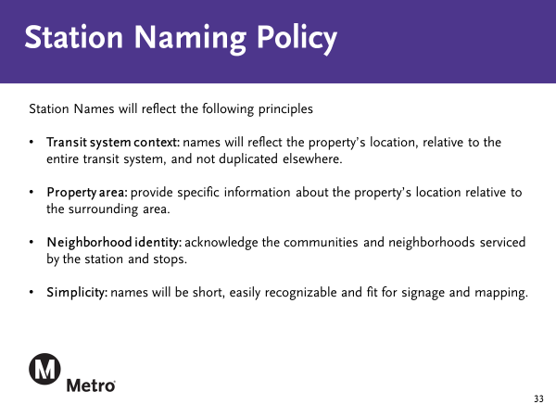
Station Naming Policy

Slide 36





Stay in touch
Eat Shop Play has highlighted local businesses along the Purple Line Extension project in Koreatown, Miracle Mile, Beverly Hills, Century City, and Westwood, especially eateries and specialty businesses operating pick-up and delivery during the past months.
The Eat Shop Play program continues supporting local businesses as construction progresses by promoting them through regular social media posts and newsletters.

Slide 37

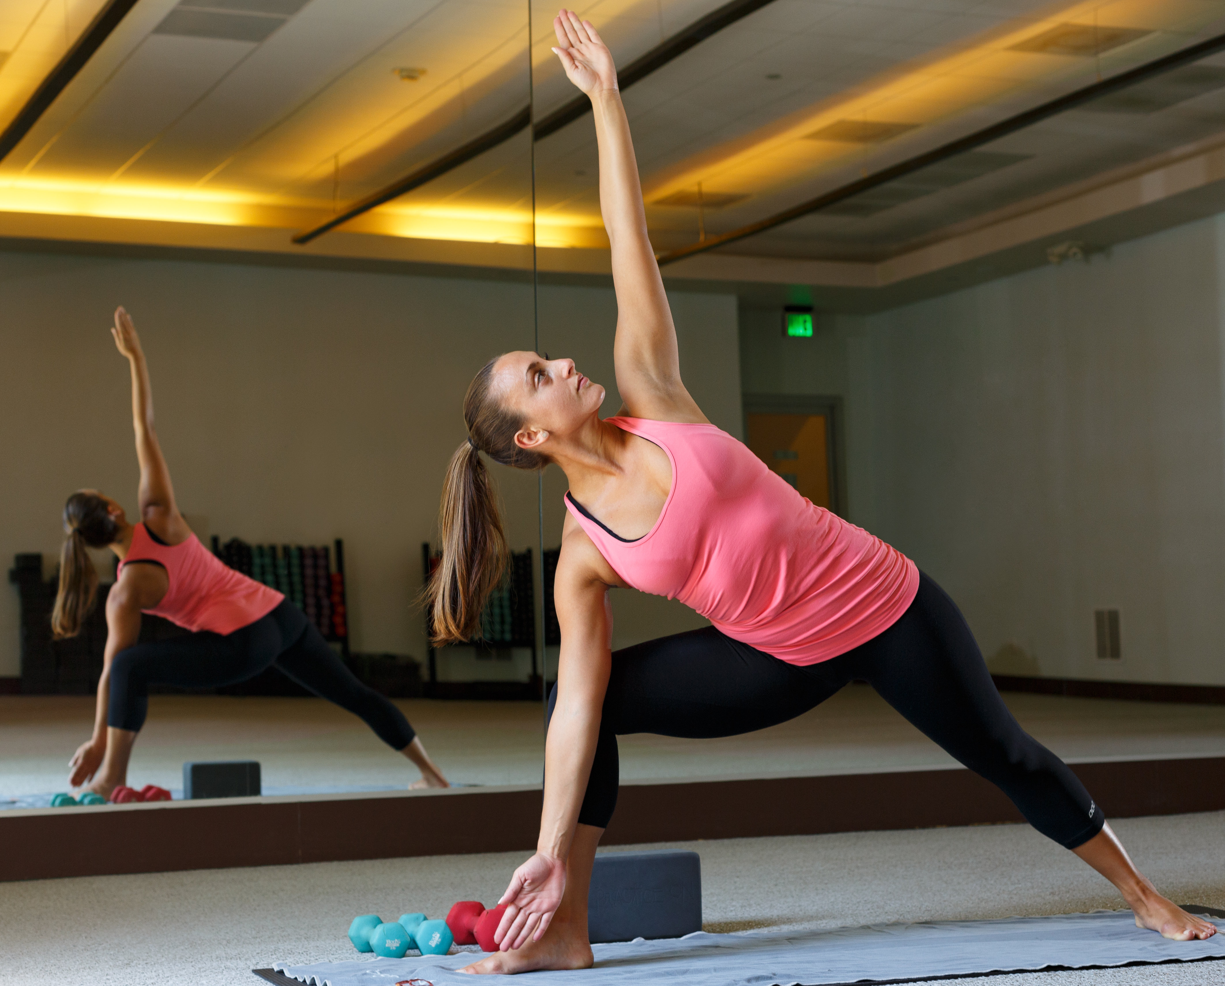
Stay in touch
Hot 8 Yoga
8383 Wilshire Bl #75
​
Hot Yoga classes and teacher training in Beverly Hills.
Business hours​
Mon - Thu: 6am – 10pm
Fri: 6am – 8pm
Sat – Sun: 7:30am – 7pm
(310) 986-6420
www.hot8yoga.com
Notes:
Hot 8 Yoga features luxury, sparkly-clean, state-of-the-art facilities, free 2-hour parking, and hot showers.
They offer 7 different class styles from upbeat fitness to traditional, for weight loss and toning.
If you're going to get hot and sweaty anyway, might as well add Yoga to the mix.

Slide 38
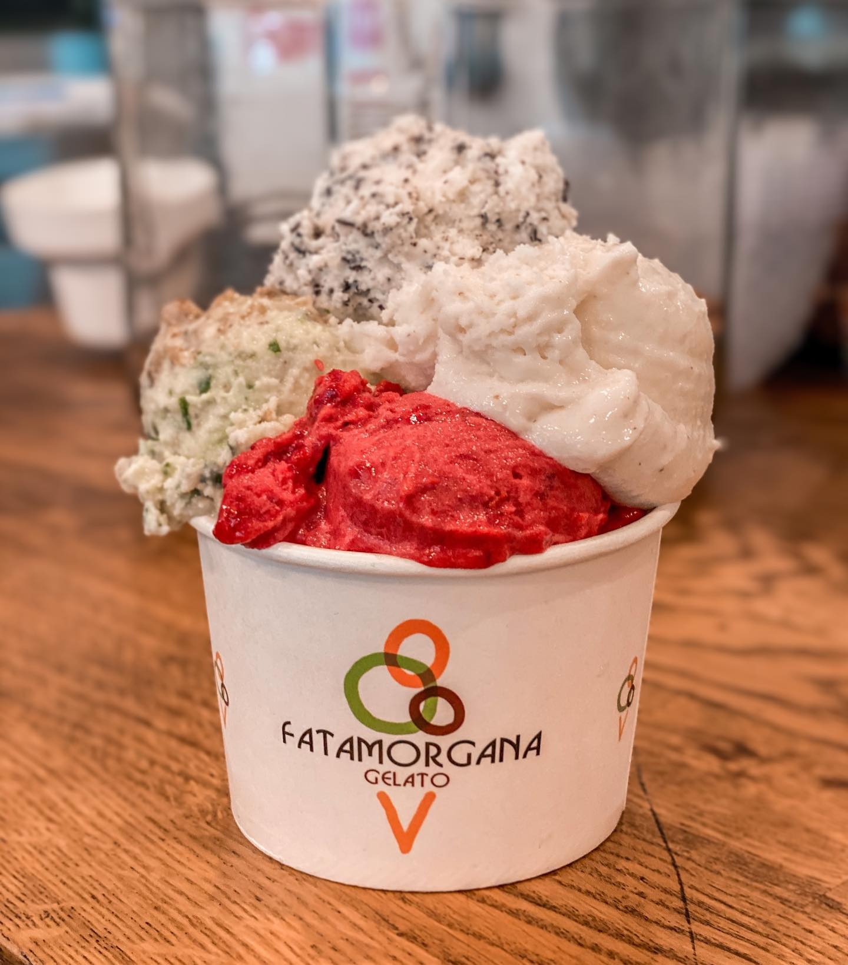
Stay in touch
Fatamorgana Gelato
162 S Beverly Dr
​
Keep Cool with Frozen Italian delights in Beverly Hills
Business hours​
Mon - Sun: 12pm - 10:30pm
​
(424) 278-1629
https://fmgelato.com/
Notes:
Fatamorgana Gelato is a family owned Italian Gelato shop with two locations; one in Beverly Hills and the other in Rome, Italy, where it originated from.
They have 66 flavors to choose from, gluten-free, and 24 vegan flavors. They’re pet-friendly and even have special dog treats.

Slide 39
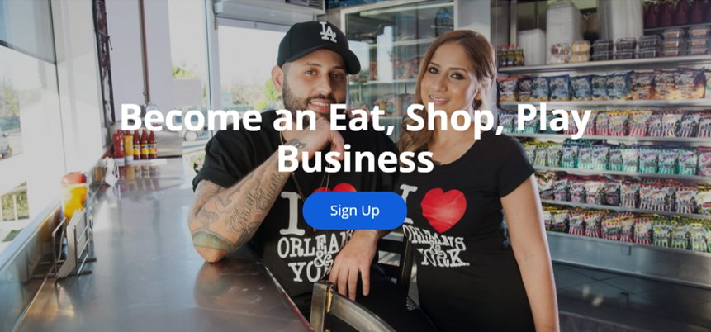
Stay in touch
Contact Us
> For more information on Eat Shop Play visit​
metro.net/eatshopplay ​
> Send an email to eatshopplay@metro.net

Slide 40
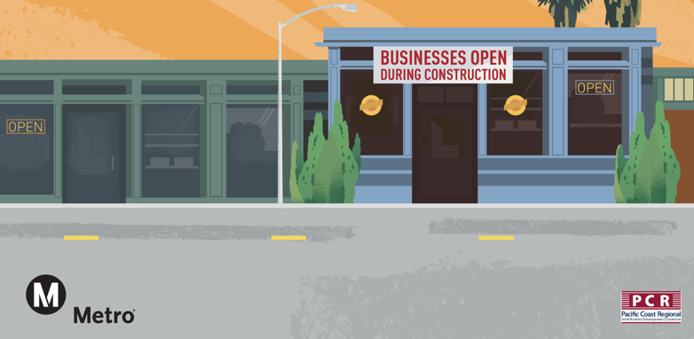
Business Interruption Fund (BIF)

Slide 41
Metro’s Business Interruption Fund
BIF Information and Eligibility
Financial assistance to small “mom & pop” businesses with 25 or fewer full-time employees directly impacted by Metro Rail construction along three project areas​:
  Crenshaw/LAX Transit Project​
  Purple Line Extension, Sections 1, 2 & 3​
  Regional Connector Project, Little Tokyo area & 2nd/Broadway Segment*
Businesses must be located immediately adjacent to the rail corridor and meet other eligibility requirements​
Grant amounts are determined by business revenue loss directly related to period of Metro construction disruption​
Businesses may receive up to $50,000 per impact year
*Segment eligibility based on full street closure with duration greater than six continuous months. Eligibility ended 6/30/17.​

Slide 42
Metro’s Business Interruption Fund
Metro’s Business Interruption Fund (BIF) is accepting applications for transit rail construction impact along the Crenshaw/LAX Transit Project, the Little Tokyo area of the Regional Connector and Sections 1, 2 and 3 of the Purple Line Extension sustained from March 20, 2020, forward (during the COVID-19 pandemic).
Small “mom and pop” businesses that experienced transit rail construction impact during the COVID-19 pandemic may be eligible.
Potentially eligible small business owners may contact BIF Fund Administrator Pacific Coast Regional at 213.739.2999 x223 or Metro at bif@metro.net.
Metro does not cover revenue loss or fixed operating expenses related to COVID-19 impacts.

Slide 43
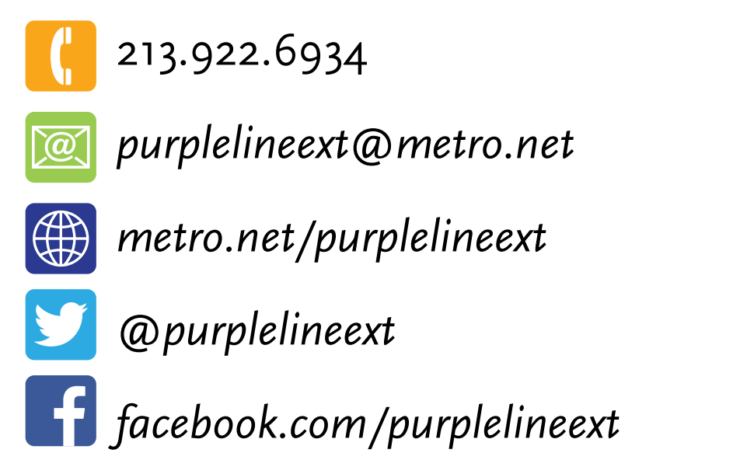
Stay in Touch
Upcoming Meeting Dates
October 12, 2022, 12 Noon: COBH Sections 1&2
All meetings use: https://zoom.us/j/96626476708
Link to webinars available at metro.net/purple
213.922.6934
purplelineext@metro.net
metro.net/purple
@purplelineext
facebook.com/purplelineext

Slide 44
Metro’s Business Interruption Fund
Value of BIF Grants Awarded:
$34,810,759.78*
  *BIF Grants do not cover COVID-19 related impacts.

