Slide 1

Thank you for joining us!

Slide 2
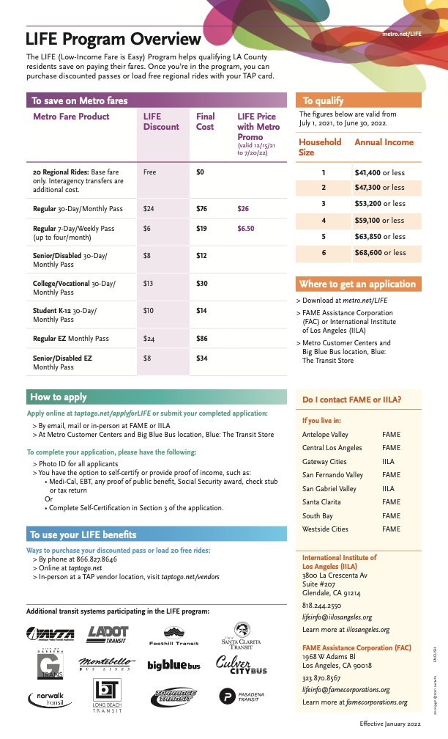
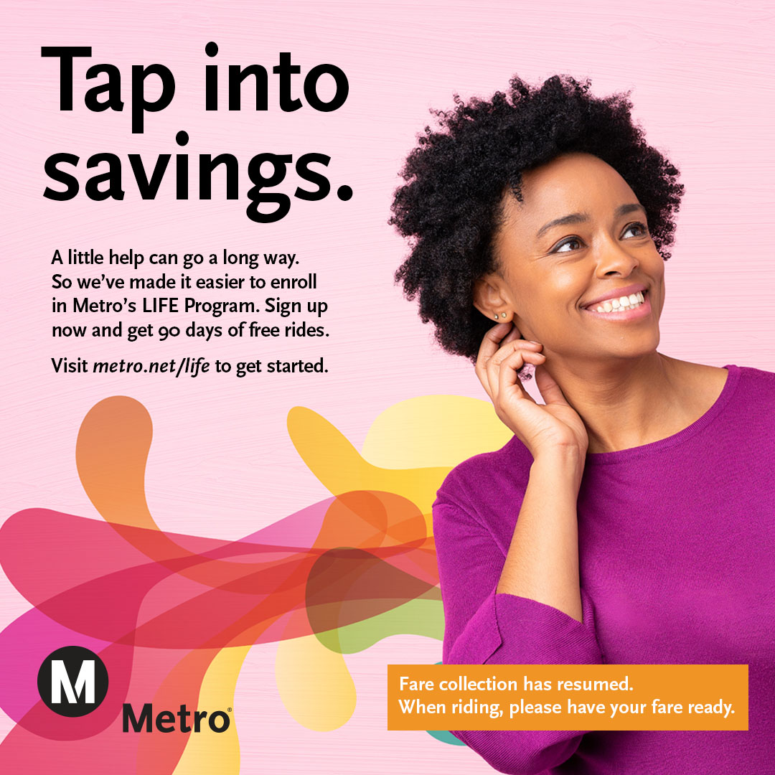
Agency Updates

Slide 3
Discounted Fares/LIFE Program
Fare collection and front door boarding resumed on buses on Jan. 10, 2022
6 months of half price passes for all riders!
1-Day, 7-Day and 30-Day passes at half-price savings that riders can start using on Jan. 10.
The fares will be available on TAP vending machines, taptogo.net and at Metro Customer Centers for purchase until July 20, 2022.
6 Months of discounted LIFE fares:
  New LIFE riders will get 90 days of free rides starting January 10, 2022, when fare collection restarts.
  To Sign up for the LIFE Program visit www.metro.net/riding/life/

Slide 4
Presentation Panelists
Metro Purple Line Extension Team
Kasey Shuda, Community Relations Director - Interim
  Sections 1, 2 & 3 and Division 20
Marlon Walker, Community Relations Manager
  Sections 1, 2 & 3 and Division 20
  Mindy Lake, Principal Community Relations Officer
  Section 1, Beverly Hills and Section 2
Metro Business Interruption Fund Team
Sidney Urmancheev, Transportation Associate
Kyle Wagner, Principal Representative
Metro New Media Team​
Ginny Brideau, Manager, Community Relations New Media Team
Stephanie Molen, Principal Community Relations Officer
Jesus Galeno, Community Relations New Media Team
Contractor Representatives and Presenters
Scott Donohue, STS Community Relations Coordinator
Matt Evans, TPOG Project Information Coordinator

Slide 5
Today's Agenda
  Project Overview
  Section 1 Construction Update | Wilshire/La Cienega
  Section 2 Construction Update | Wilshire/Rodeo
  Eat Shop Play
  Business Interruption Fund

Slide 6

Purple Line Extension Alignment

Slide 7
Sections 1, 2, & 3 Status
 | Forecasted Schedule
Section | Section 1 | Section 2 | Section 3
Length | 3.92 Miles | 2.59 Miles | 2.56 Miles
New Stations | Wilshire/La Brea Wilshire/Fairfax Wilshire/La Cienega | Wilshire/Rodeo Century City/ Constellation | Westwood/UCLA Westwood/VA Hospital
Pre-Construction Activities | 2014 – 2015 | 2016 – 2018 | 2018 – 2019
Construction | 2015 – 2024 | 2018 – 2025 | 2019 – 2027
Operations | 2024 | 2025 | 2027
*Subject to change. The PLE project team is working to deliver the project consistent with Measure M.

Slide 8
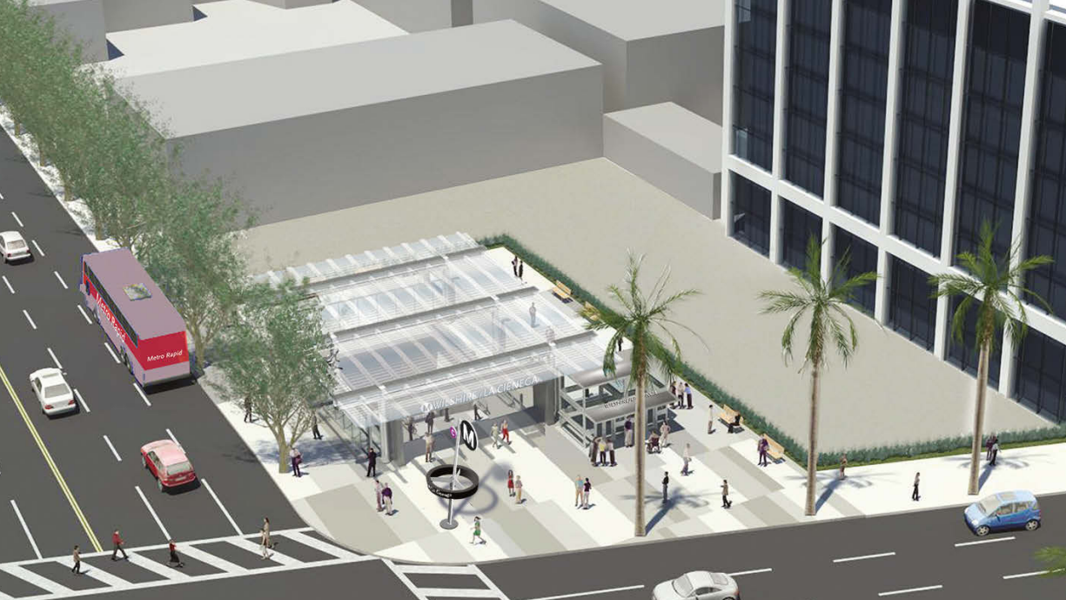
Wilshire/La Cienega Station Rendering

Slide 9
Wilshire/La Cienega Station Appendage Work
Why: Multiple appendages will be required for each station on the Purple Line Extension
Each appendage structure houses a vital function for the stations:
  Emergency exits
  Utility rooms
  Ventilation rooms
  Entrance and exit structures
When: Began in March 2021 through 2023*
Where: Information about specific traffic control and work hours will be available in future community meetings and construction notices
Coordination with impacted businesses will be conducted prior to the start of the next phase of appendage work

Slide 10
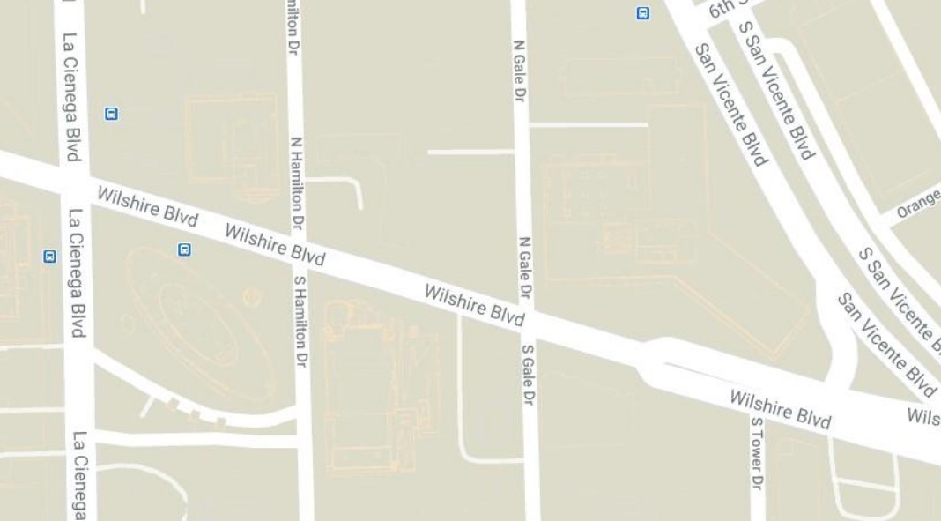
Wilshire/La Cienega Station: Appendage Structures Phase 1A
Phase 1A
Appendage –
Main Entrance
Phase 1A
Station Box
Appendages –
Northeast
Station appendage locations

Slide 11
Wilshire/La Cienega Station Appendage Work
*Dates subject to change.
Phase 1A Traffic Control (March 2021 through November 2022)*
Wilshire Blvd. between San Vicente Blvd. and La Cienega Blvd. reduced to two lanes in each direction.
Left turns from Wilshire Blvd. onto Gale Dr. will be restricted from both directions. Left turns from Tower Dr. onto westbound Wilshire Blvd. will be restricted.
The east/ west crosswalks at Gale will be maintained.
The north sidewalk between San Vicente Blvd. and Gale Dr. will be closed during this phase of work. A pedestrian detour for east/west travel will be in place on the south side of Wilshire. Access to 8383 Wilshire will be maintained.
The loading zone in front of the Saban Theatre on Wilshire Blvd will be closed over the duration of this closure.
A full closure of Gale Dr. north of Wilshire Blvd. will be in place during Phase 1B of this work.

Slide 12
Wilshire/La Cienega Station: Appendage Structures Phase 1B
*Dates subject to change.
Phase 1B Traffic Control (January 7, 2022 through mid-May 2022)*
Wilshire Blvd. between San Vicente Blvd. and La Cienega Blvd. reduced to two lanes in each direction
Gale Dr. north of Wilshire Blvd. will be fully closed for approximately 4 months*
Left turns from Wilshire Blvd. onto Gale Dr. will be restricted.
Left turns from Tower Dr. onto Wilshire Blvd. will be restricted.
The north/south crosswalks at Gale Dr will be closed
The north sidewalk between San Vicente Blvd. and west of Gale Dr. will be closed during this phase of work. A pedestrian detour for east/west travel will be in place on the south side of Wilshire. Access to 8383 Wilshire will be maintained.
The loading zone in front of the Saban Theatre will be closed over the duration of this closure.
Phase 1B
Station Box
Station appendage locations

Slide 13
Wilshire/La Cienega Station Appendage Structures – 1C
*Dates subject to change.
Phase 1C Traffic Control (mid-May 2022 through November 2022)*
  Wilshire Blvd. between San Vicente Blvd. and La Cienega Blvd. reduced to two lanes in each direction
  Southbound Gale Dr. from north of Wilshire Blvd. to Wilshire Blvd. will be closed to through traffic for approximately 7 months.* Northbound traffic on Gale Dr. will be intermittently maintained.
  Left turns from Wilshire Blvd. onto Gale Dr. will be restricted.
  Left turns from Tower Dr. onto Wilshire Blvd. will be restricted.
  The north/south crosswalk on the east side of Gale will be maintained. The west side crosswalk will be closed
  The north sidewalk between San Vicente Blvd. and west of Gale Dr. will be closed during this phase of work. A pedestrian detour for east/west travel will be in place on the south side of Wilshire. Access to 8383 Wilshire will be maintained.
  The loading zone in front of the Saban Theatre will be closed over the duration of this closure.
Phase 1C
Station Box
Appendages –
Northeast
Station Box
Station Box

Slide 14
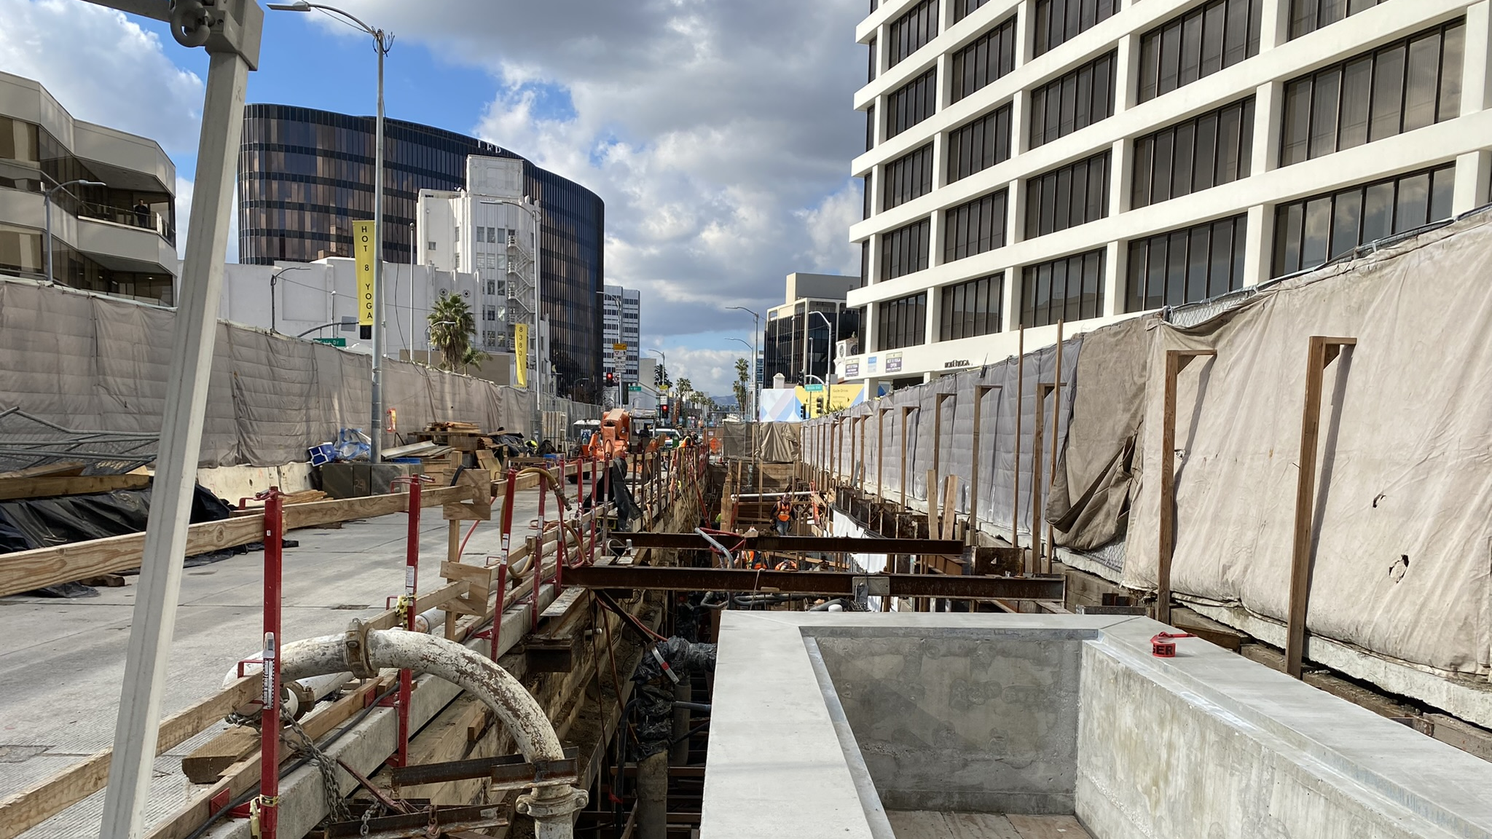
Wilshire/La Cienega Station Appendage Progress – Phase 1A

Slide 15
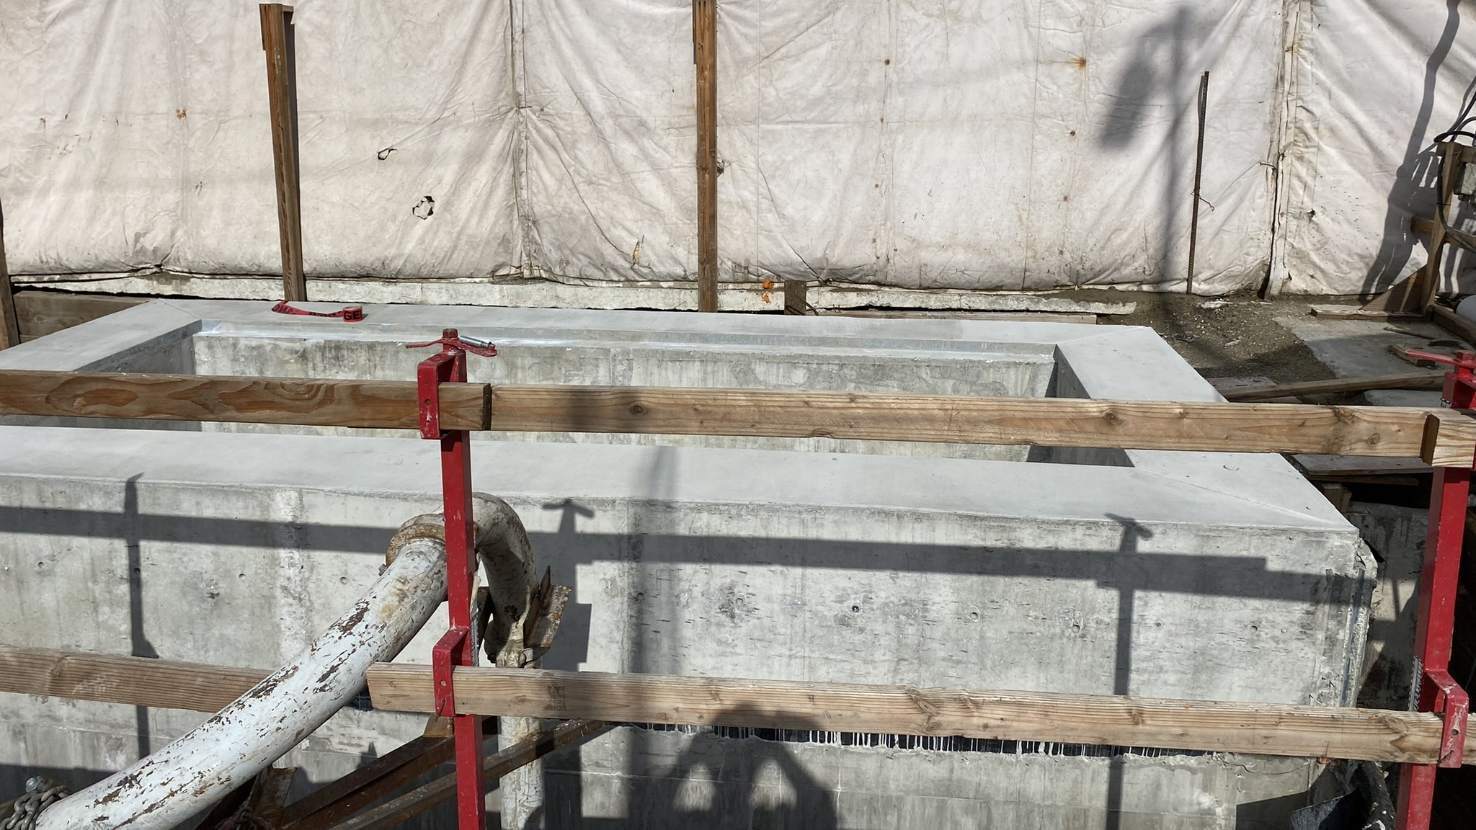
Wilshire/La Cienega Station Appendage Progress – Phase 1A

Slide 16
Replacement Parking
Locations for One Hour Free Parking:
  8447 Wilshire Bl:
  Accessible from N Hamilton
  8350 Wilshire Bl:
  Accessible from S Tower
  Please mention "Metro" upon entering the building to receive the 1st hour free

Slide 17
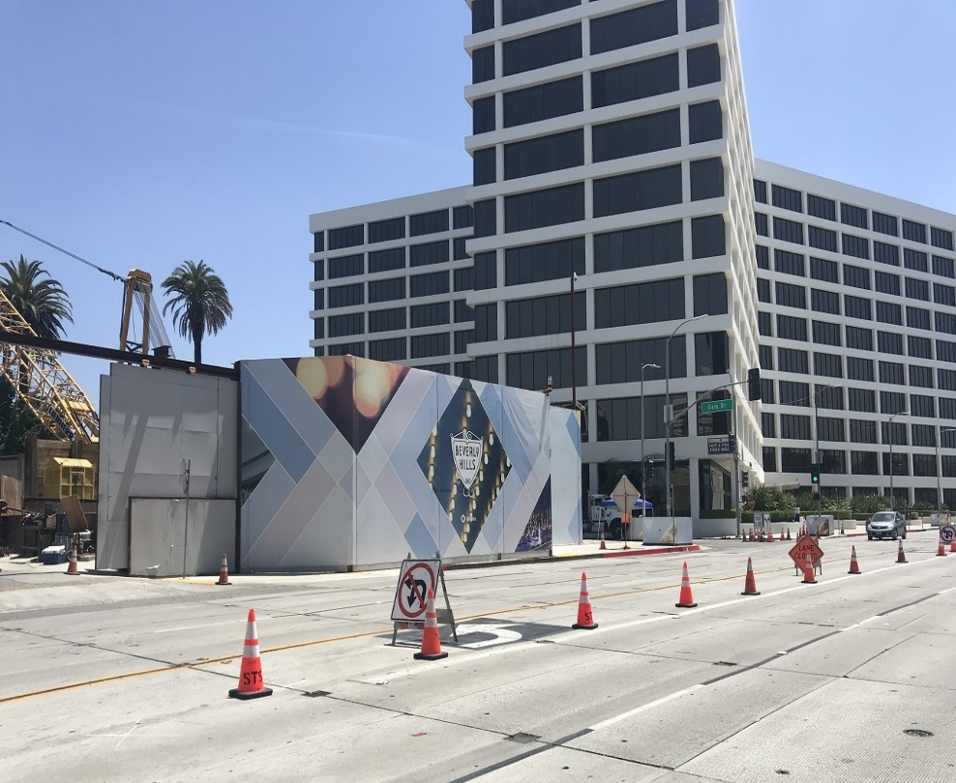
Concrete and Material Deliveries
Where: Structural work on the station underneath Wilshire Bl is generally conducted from the Gale Yard and from Wilshire Bl
Work Hours: 7am to 4pm during bump out implementation
Traffic Controls*:
  Westbound Wilshire Bl will be intermittently reduced to one lane between San Vicente Bl and Hamilton Dr
  Daily closures will be utilized in support of ongoing work activities in the staging yard at Gale Dr
Deck Panel Access – Hamilton Dr (9am to 4pm, weekdays; 7am to 6pm, Saturdays)
  Beginning in April, intermittent deck panel access may be implemented within the Wilshire/Hamilton intersection.
  Wilshire will be reduced to a single lane in each direction between Tower Dr and Stanley Dr
  Left turns from Wilshire to Hamilton will be restricted. Through traffic on Hamilton will be restricted at Wilshire.
Noise Mitigations: will remain in place
  Sound blankets around noisy equipment
  Trucks equipped with low-impact backup alarms
  Nylon straps used to lift material
Outside Gale Staging Yard

Slide 18
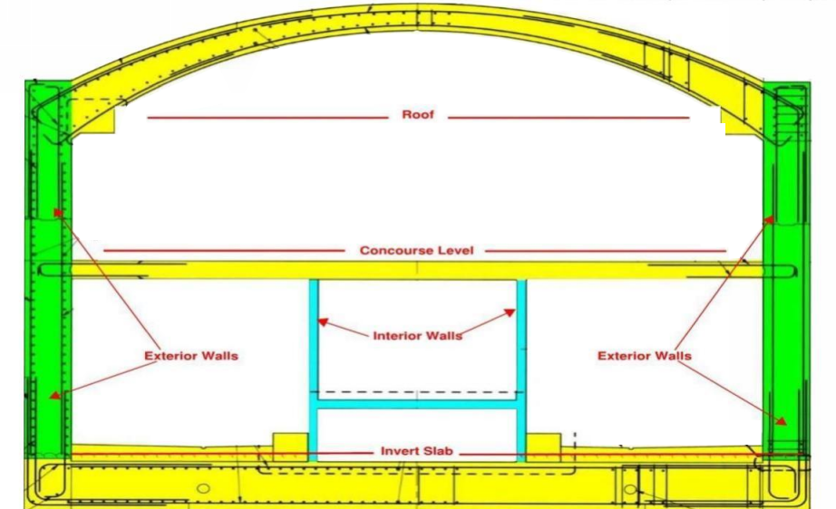
Next Steps: Station Construction
Construction of station roof will continue through 2022
Each roof placement will be 60 feet by 60 feet
Work activities in support of concrete and deliveries will be conducted within the staging yards, and occasionally on Wilshire Bl
Daily construction activities may be conducted underneath Wilshire Bl and from both Staging Yards for 24 hours a day
Illustration of station interior design

Slide 19
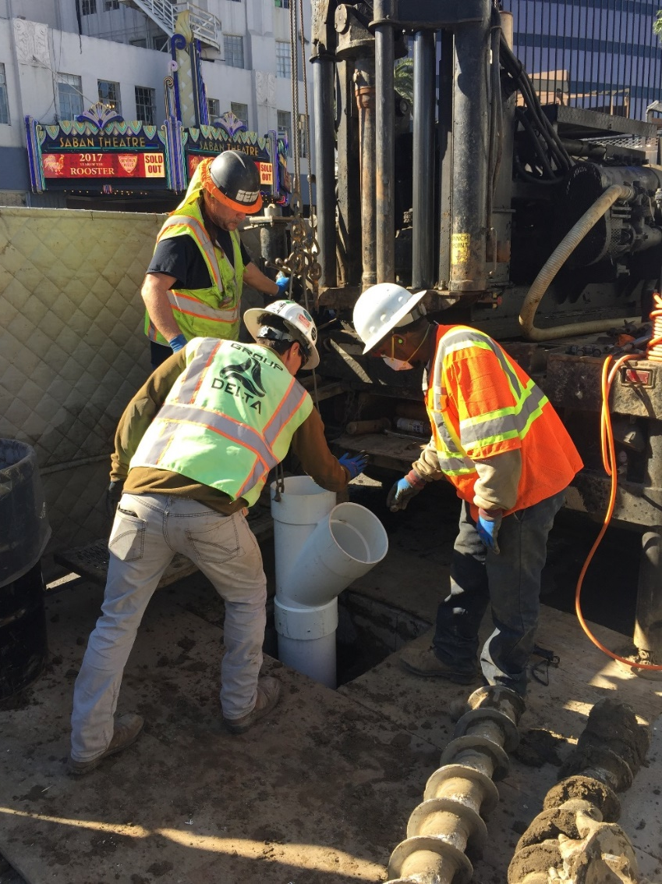
Instrumentation Work
When: Ongoing in 2022
Traffic Controls:
  Intermittent lane reductions on
  Wilshire Bl, La Cienega Bl, and side streets during off-peak hours may be in place to support the maintenance of geotechnical instruments in the Wilshire Bl and La Cienega Bl area
  Intermittent lane reductions may be in place on Wilshire Bl, west of La Cienega Bl, to support coring survey work under Wilshire Bl
Additional details on this work will be available in future construction notices
Example of instrumentation drilling

Slide 20
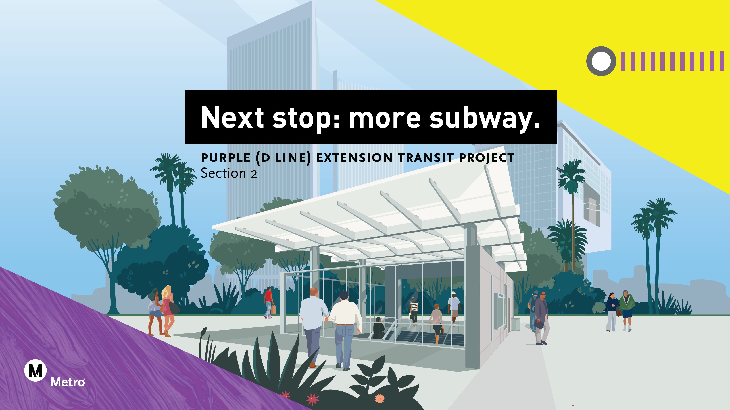

Slide 21
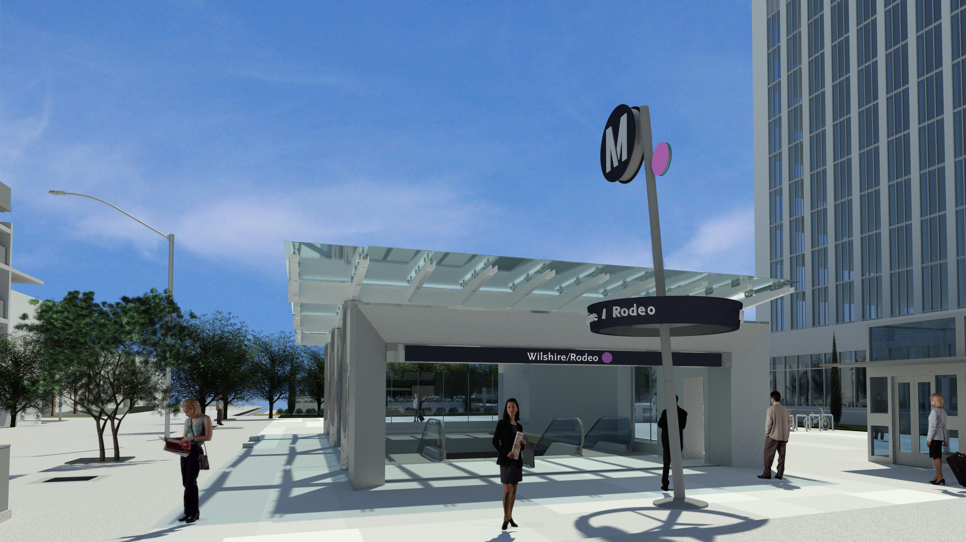
Wilshire/Rodeo Station Rendering

Slide 22
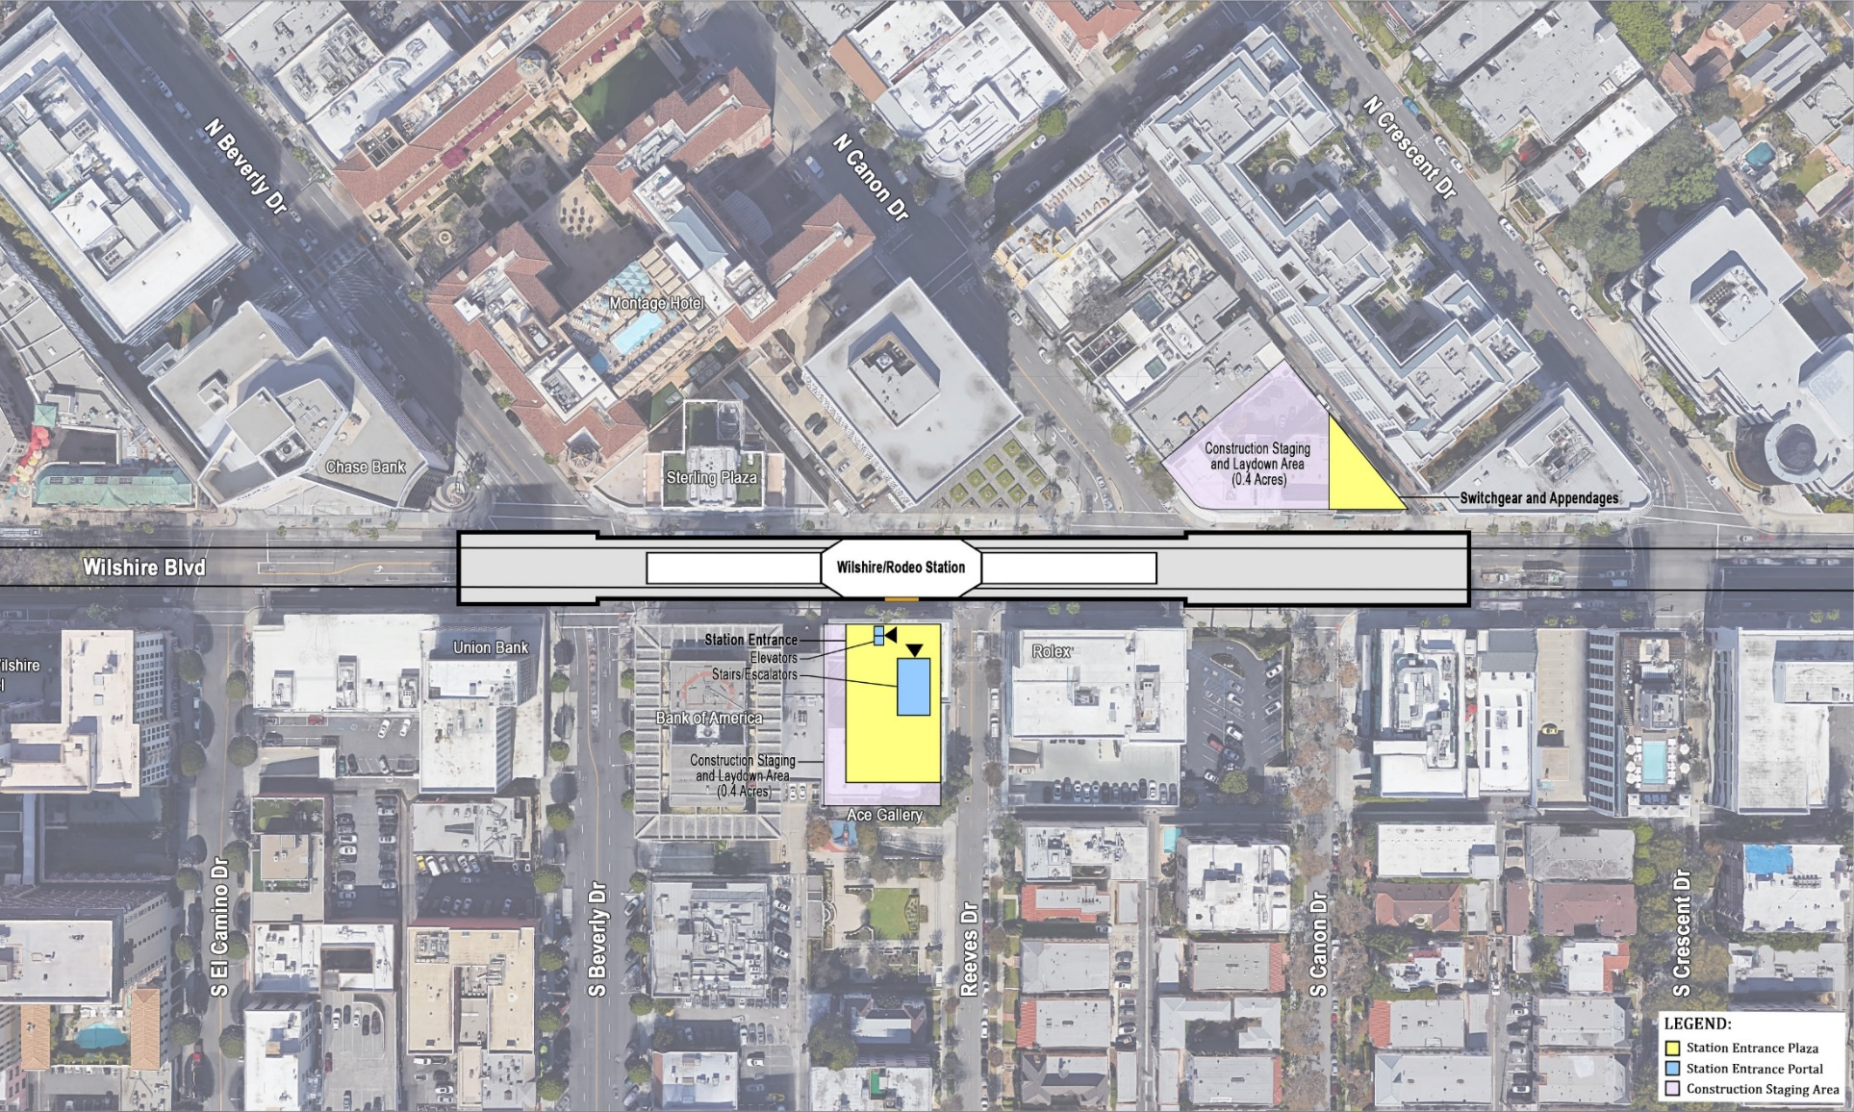
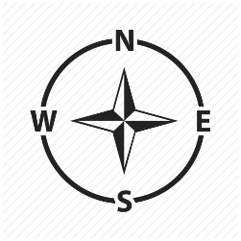
Wilshire/Rodeo Station Box
Rendering shows length of the underground station box on
Wilshire Bl from Cañon Dr to Beverly Dr

Slide 23
Wilshire/Rodeo Station: Permitted Work Hours and Traffic Control
Work hours underneath the deck are 24 hours a day, 7 days a week. Deliveries of material, equipment, and concrete will be ongoing daily from Wilshire Bl. A breakdown of daily work hours on street level:
  From 7am to 9am and 4pm to 8:15pm, Wilshire Blvd. will remain open with three lanes in each direction between El Camino Dr and Crescent Dr.
  From 9am to 4pm, Wilshire Blvd. may be reduced to two lanes in each direction between El Camino Dr and Crescent Dr.
  From 8:15pm to 7am, Wilshire Blvd. may be reduced to one lane in each direction between El Camino Dr and Crescent Dr.
Traffic control may also be implemented on Beverly Dr At least one through traffic lane will be maintained in both directions between 9am-4pm and 8pm-7am.
From 9am to 4pm, S. Reeves Dr may be reduced to one lane northbound to accommodate delivery of material and equipment. A flagger will be on site to assist motorists with 2-way traffic.

Slide 24
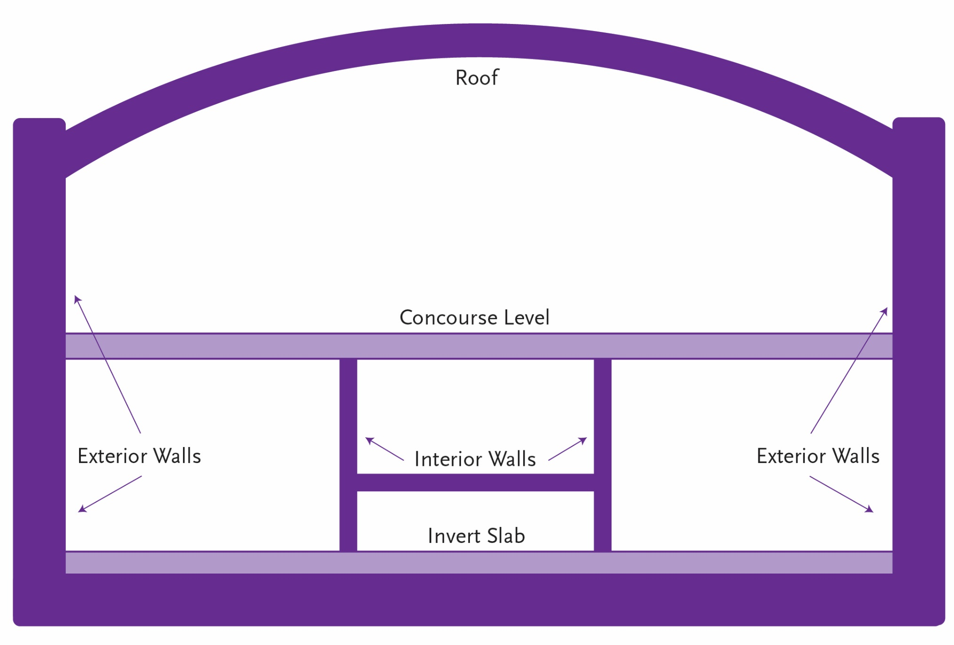
Wilshire/Rodeo Station: Structure Construction through 2024

Slide 25
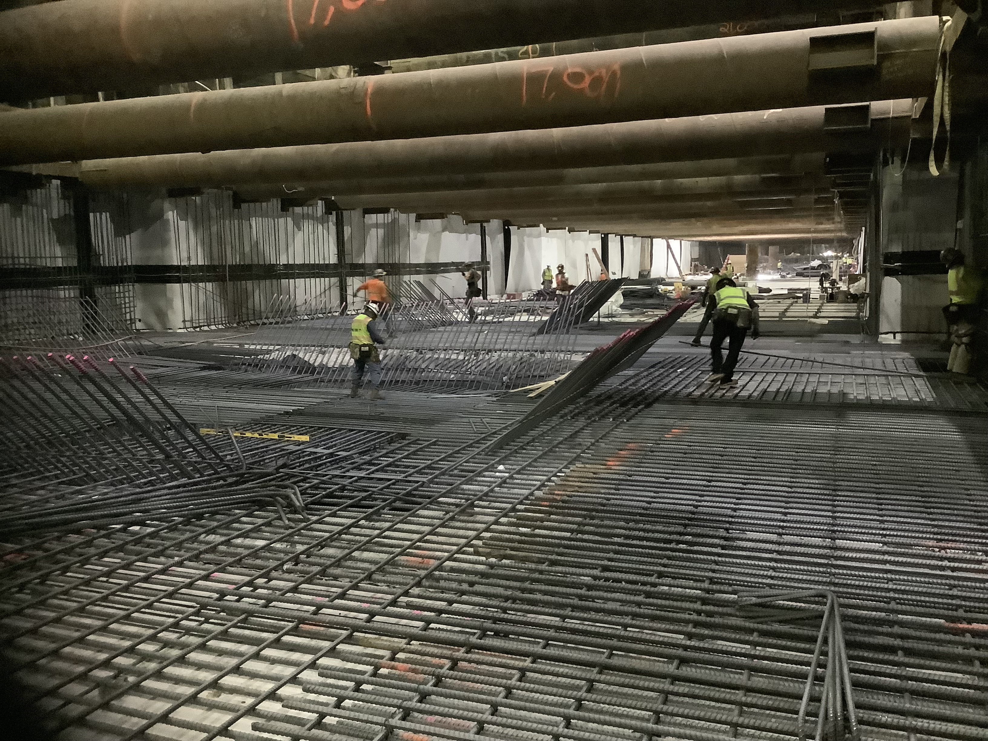
Wilshire/Rodeo Exterior Walls: Progress of installing invert, conduits, rebar, piping

Slide 26
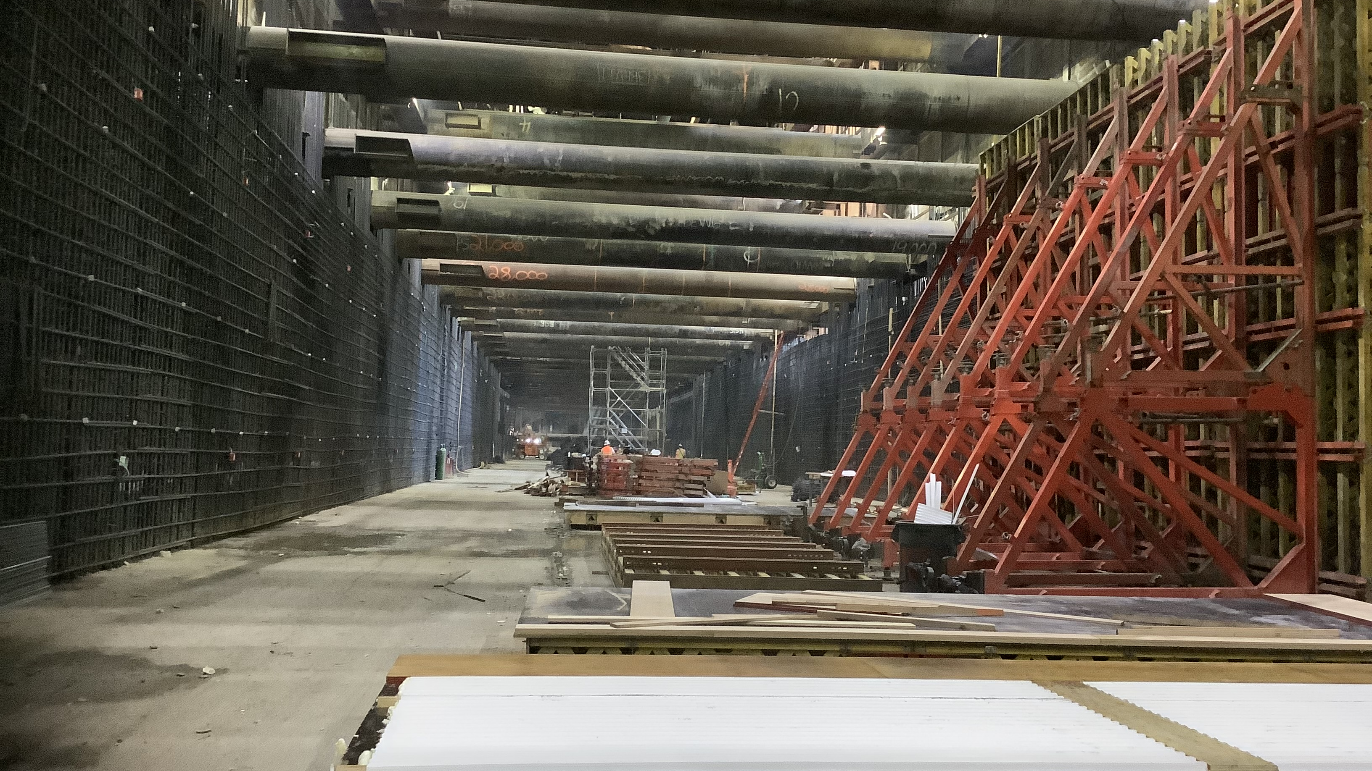
Wilshire/Rodeo Exterior Walls Progress

Slide 27
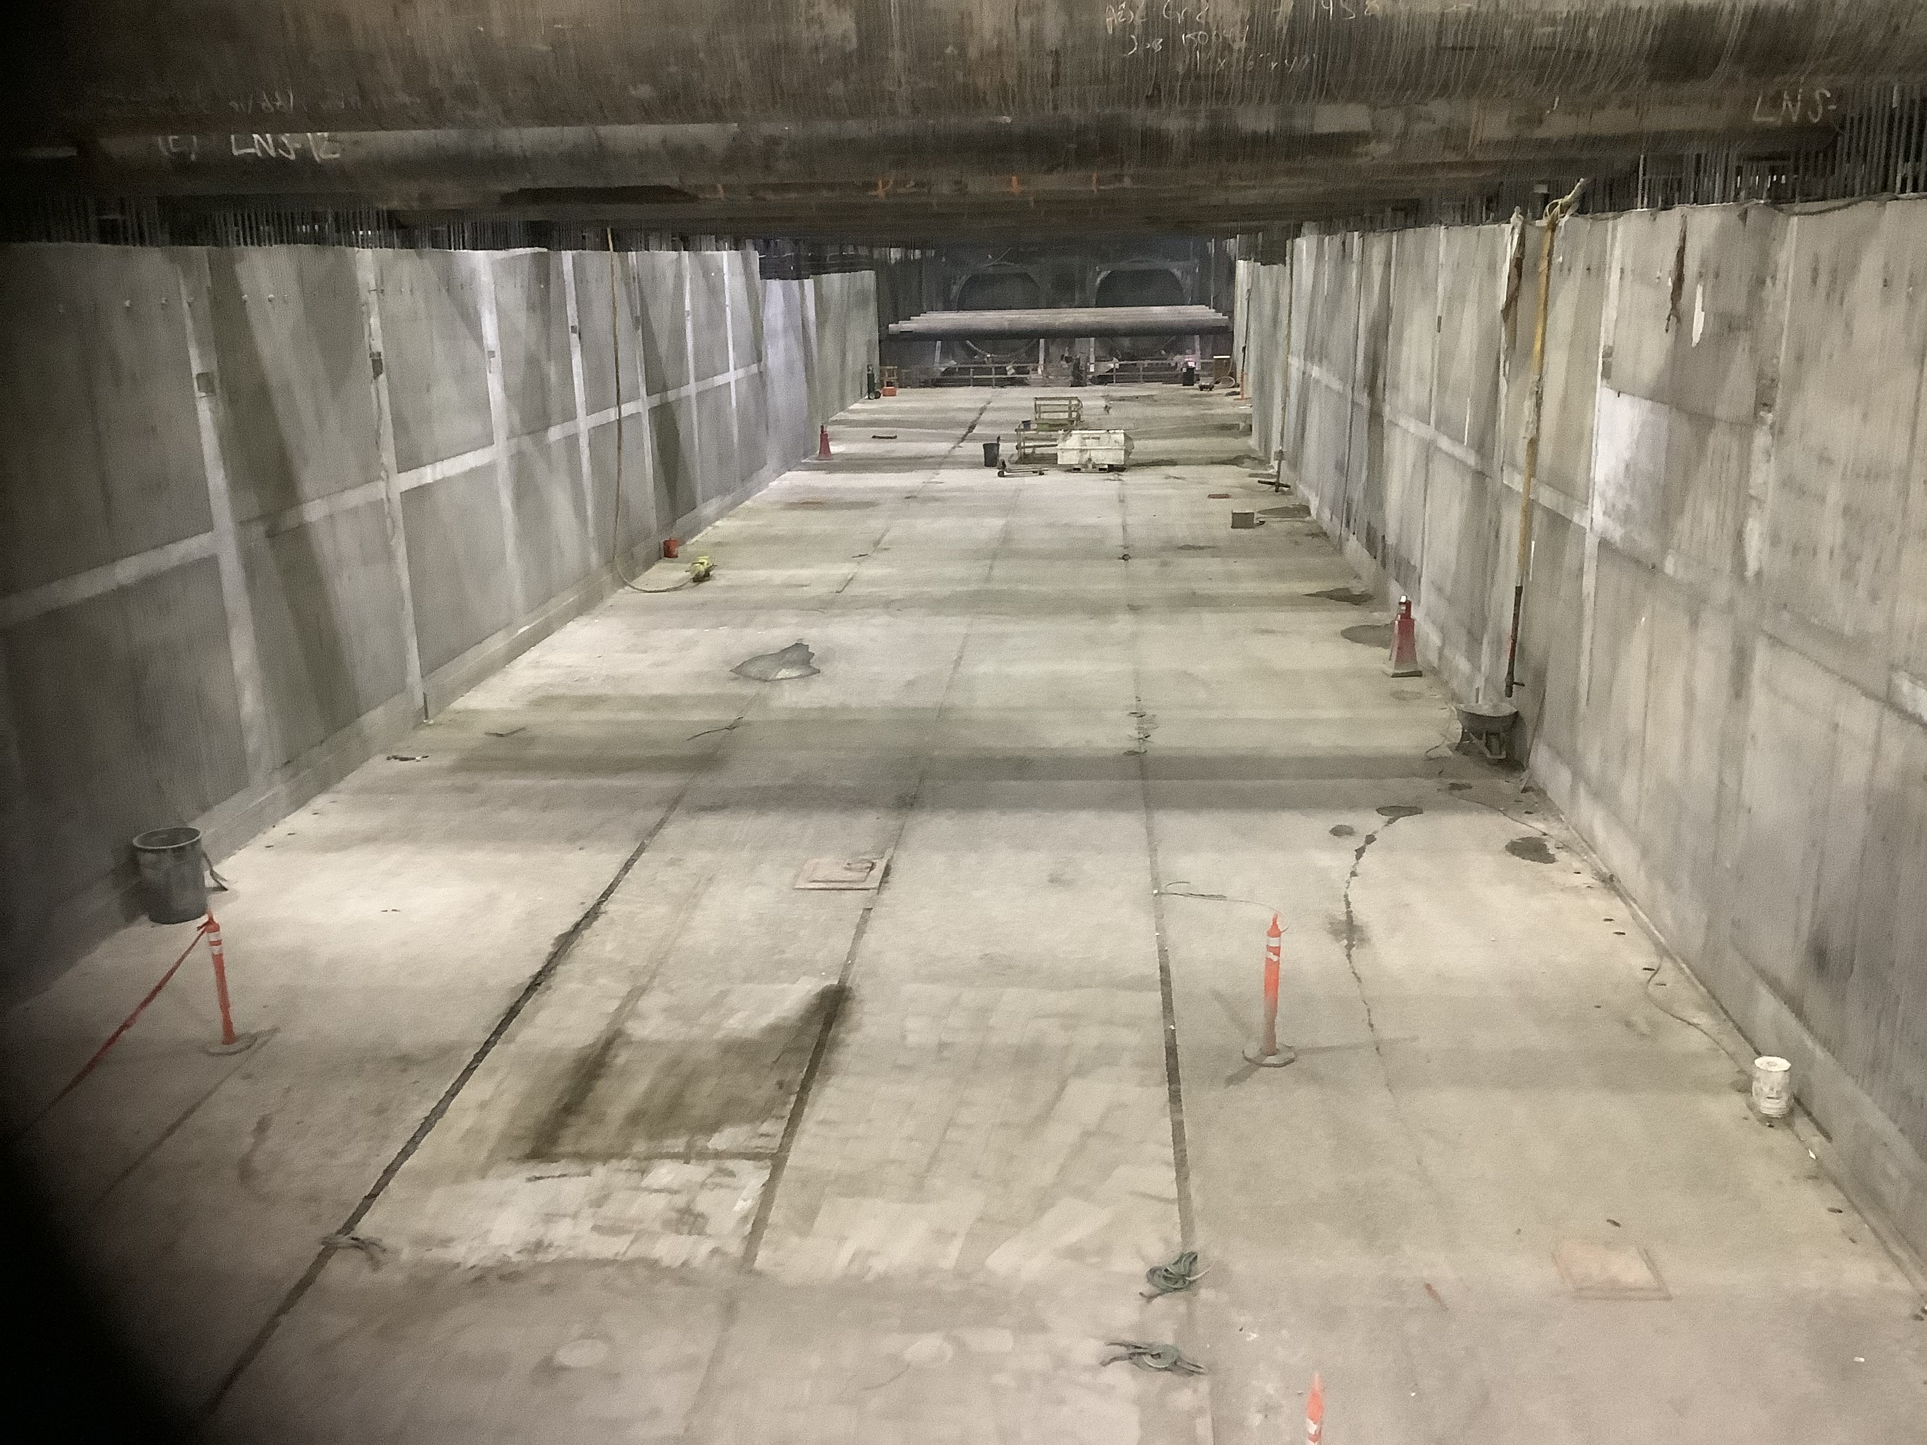
Wilshire/Rodeo Exterior Walls Progress

Slide 28
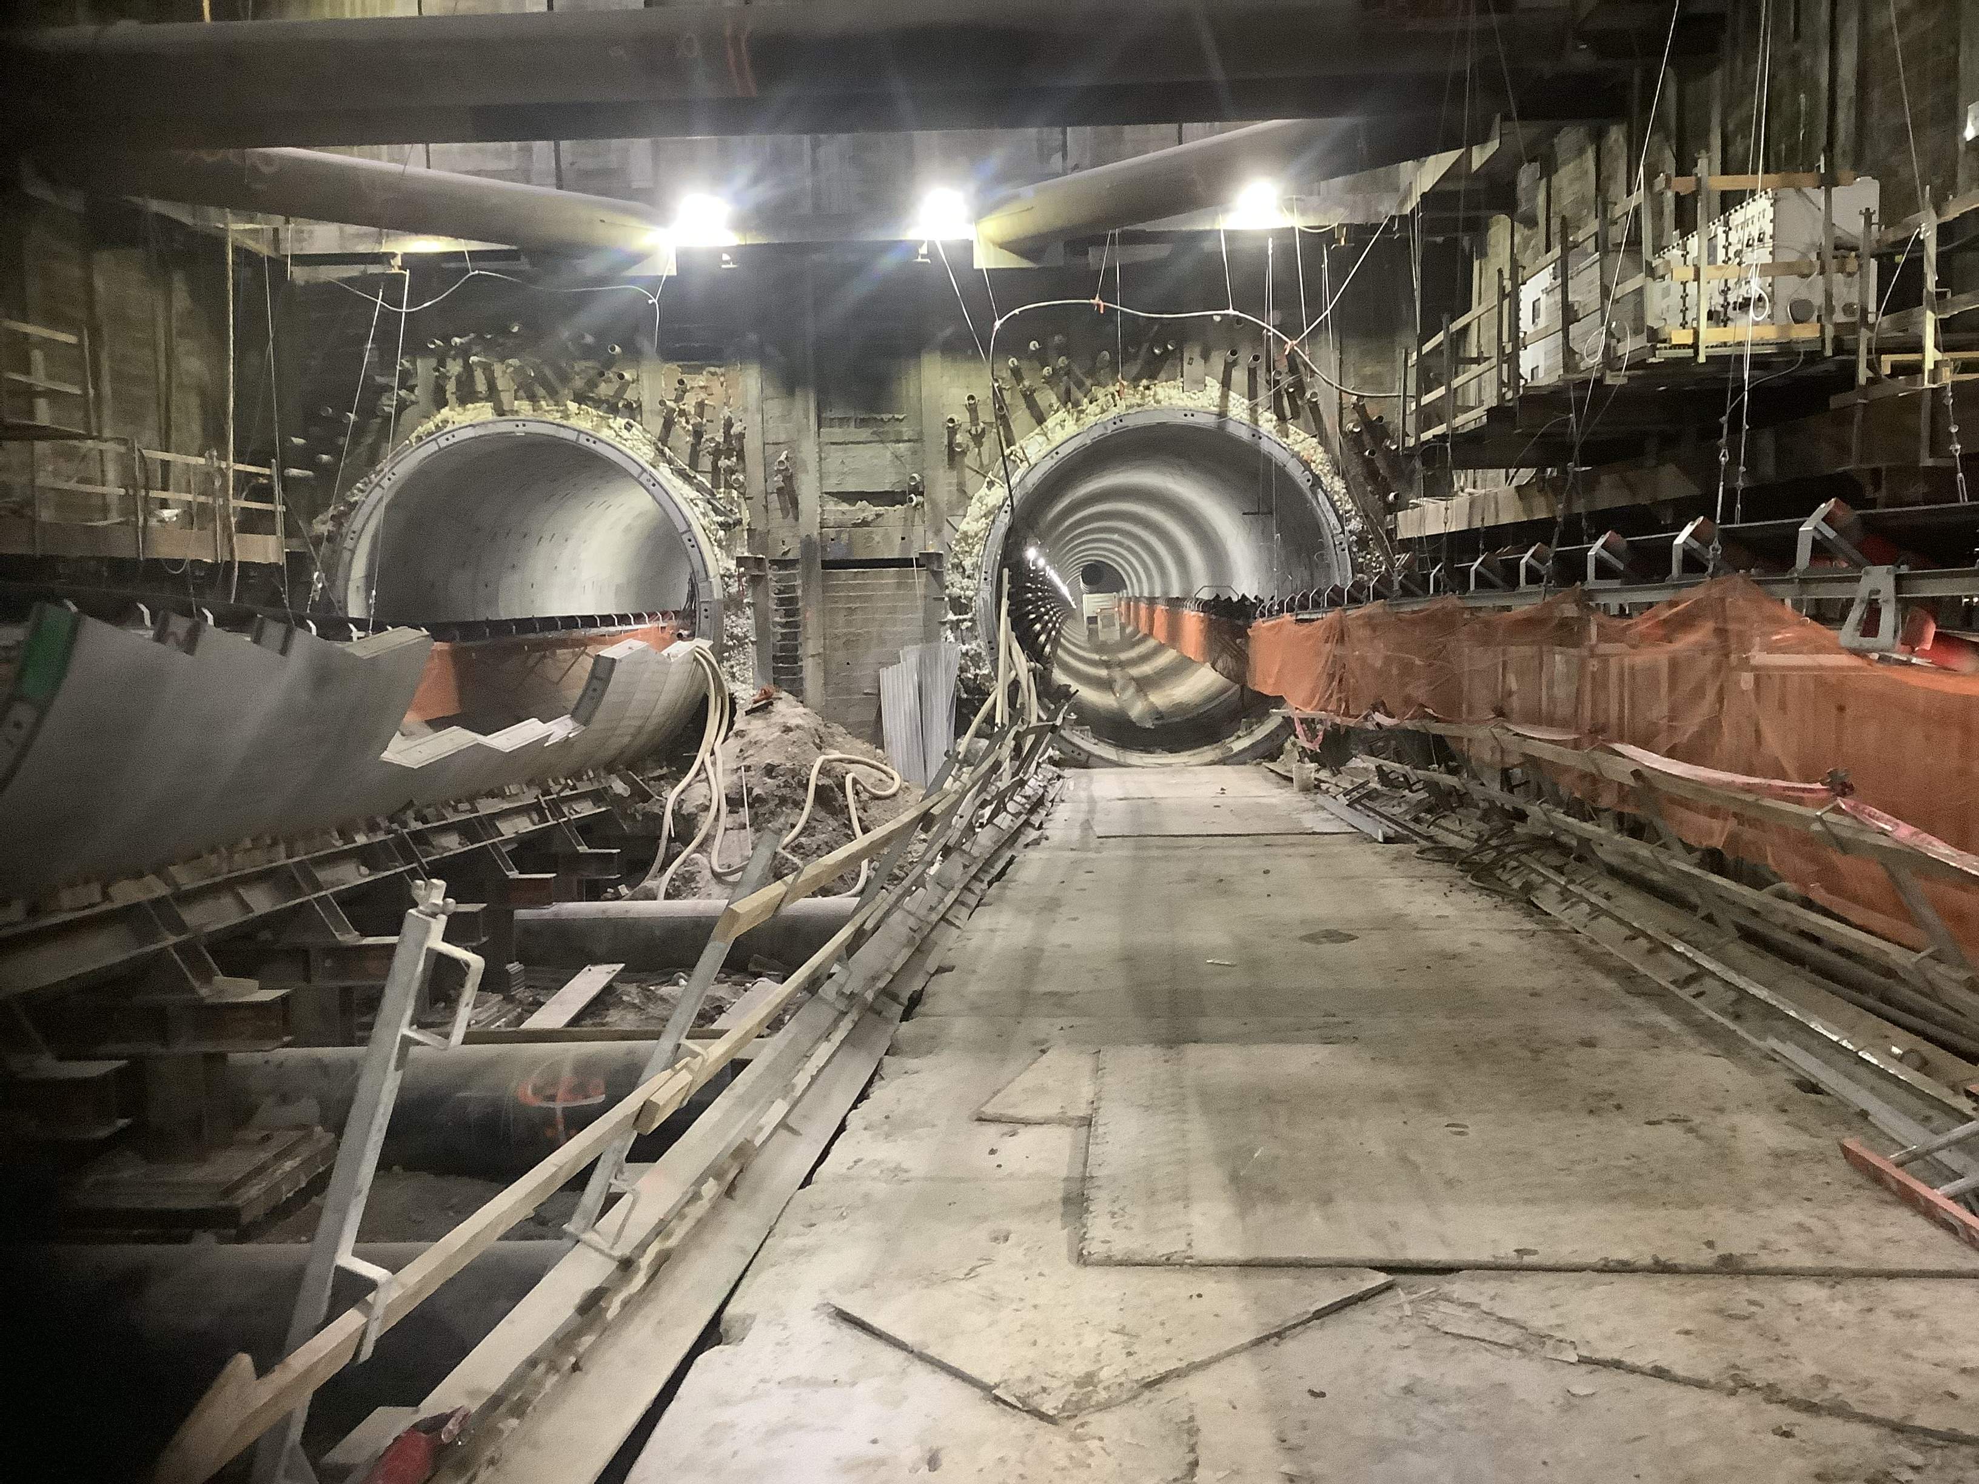
Wilshire/Rodeo Tunneling Progress

Slide 29
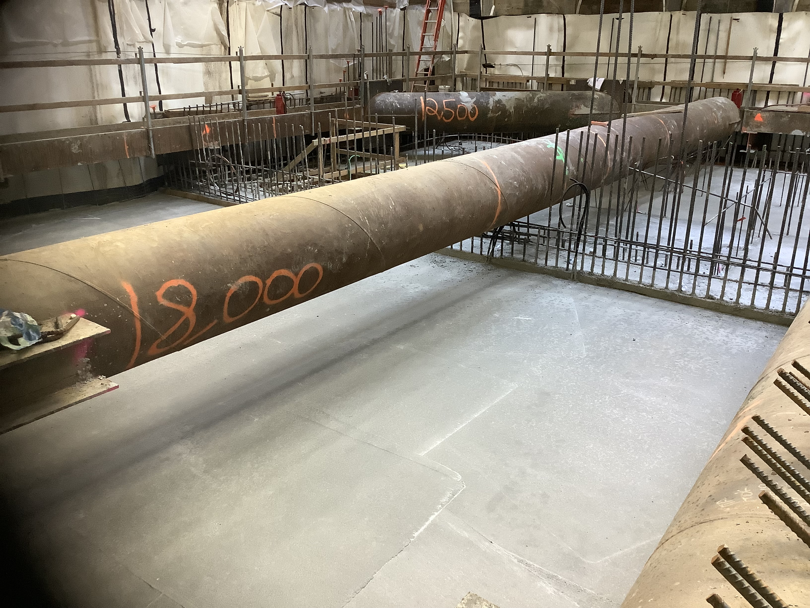
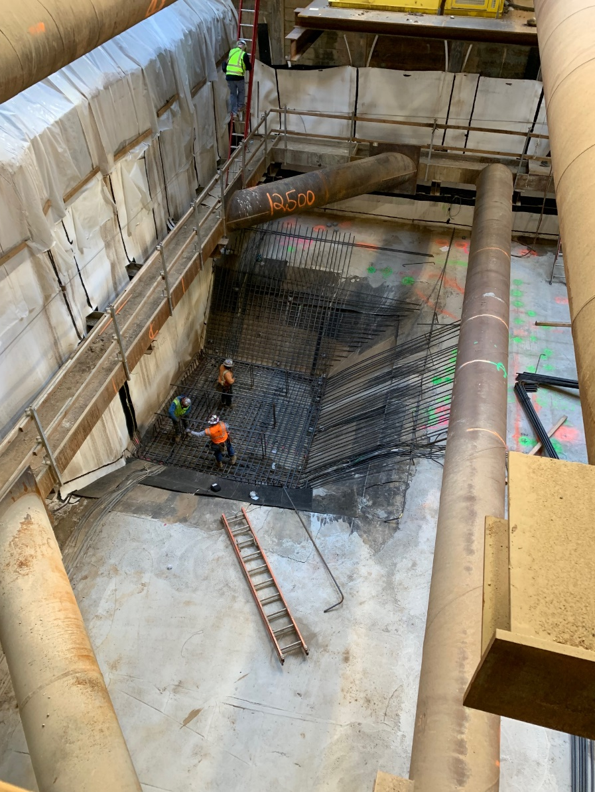
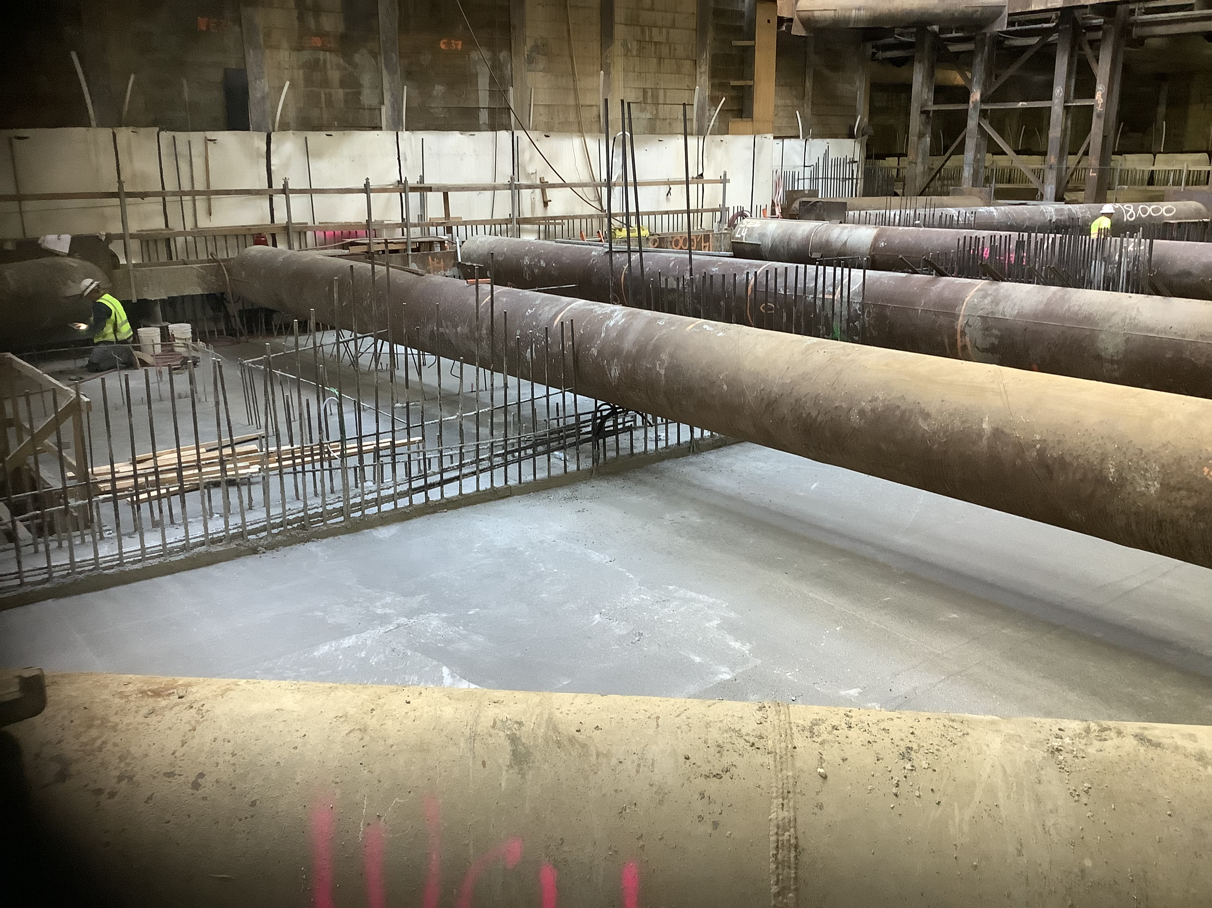
Wilshire/Rodeo Station: Construction Progress
Entrance invert rebar installation progress.

Slide 30
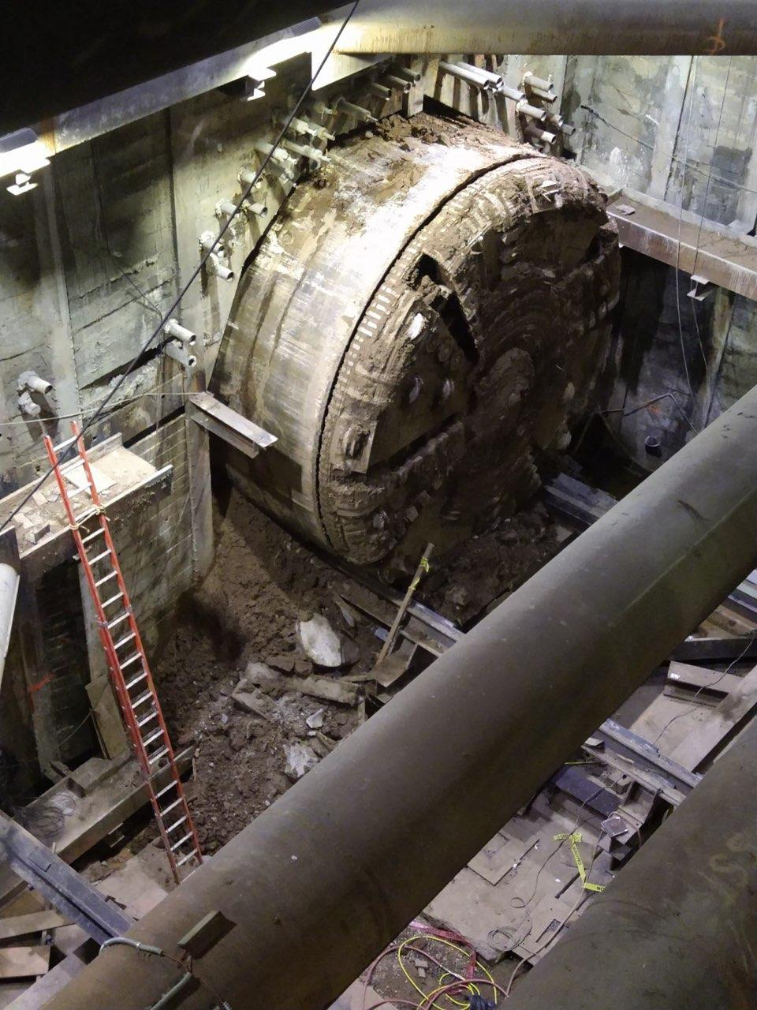
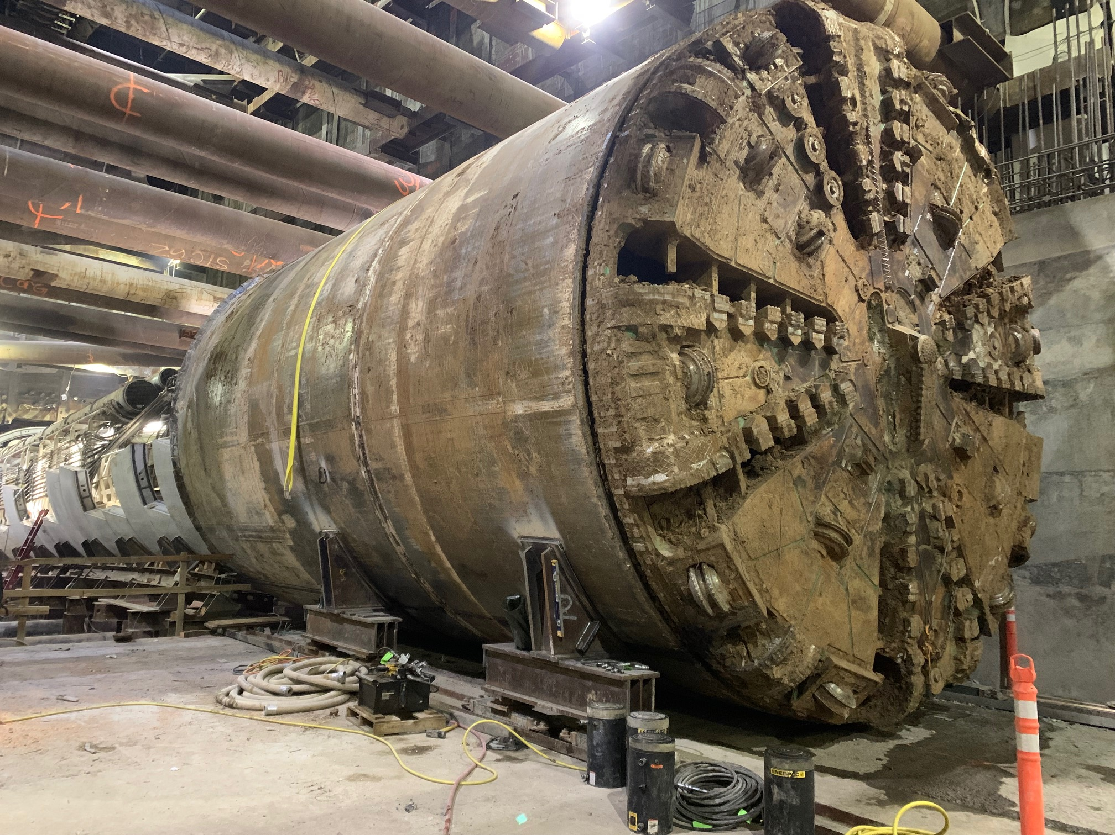
Wilshire/Rodeo Station: TBM Progress

Slide 31
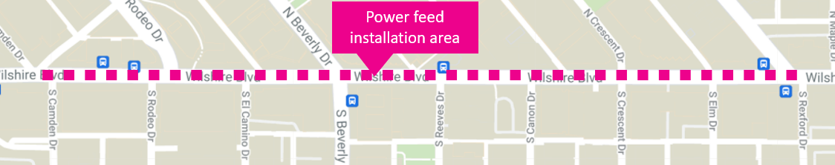
Upcoming SCE Installation Work
Contractor will begin installation of SCE Permanent Power Feeds to the station.
Work Hours: Weekdays, 9am to 4pm and 8pm-7am
Traffic Control:
  Wilshire Blvd. may be reduced to two lanes in each direction during the day and one lane overnight
Where: Wilshire Blvd. between Dayton Way and Rexford Dr.
Duration: ~ 7 months [Anticipated start in May]
*Pending approval from City Of Beverly Hills

Slide 32
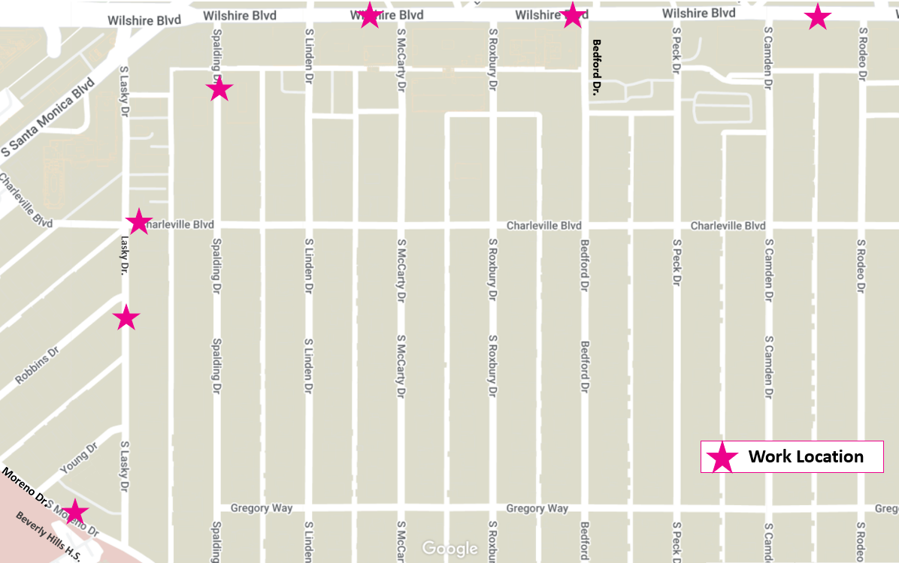
Upcoming Ground Improvement/Cross Passage Work
The contractor will begin ground improvement work along the tunnel alignment in preparation for the construction of cross passage tunnels.
When: Anticipated to begin in mid-May
  (Locations near High School to begin after break)
Where: *14 locations; First 7 work sites noted on map
Work Hours: Monday-Friday 8am-6pm; closures remain in place 24/7 until each location is completed
Duration: 2-3 weeks/location
*Additional notices detailing dates & closure information will be provided in advance

Slide 33
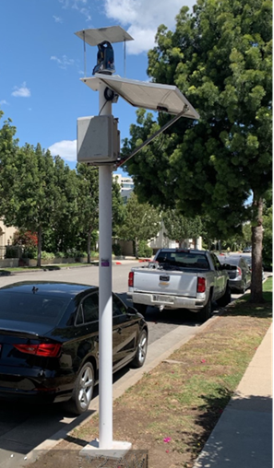
Wilshire/Rodeo Station: Geotechnical Instrumentation
Where: Instruments will be installed within the tunnel alignment and station box area to monitor ground movement, settlement and other geological conditions
  Installations will be within the public right of way and within privately owned properties
Duration: Ongoing
Work Hours On Wilshire Bl:
  Weekdays, 7am to 4pm and 8pm to 7am
Work Hours Off Wilshire Bl:
  Weekdays, 8am to 6pm and 8pm to 7am
Example of 10-foot geotechnical instrumentation pole.

Slide 34
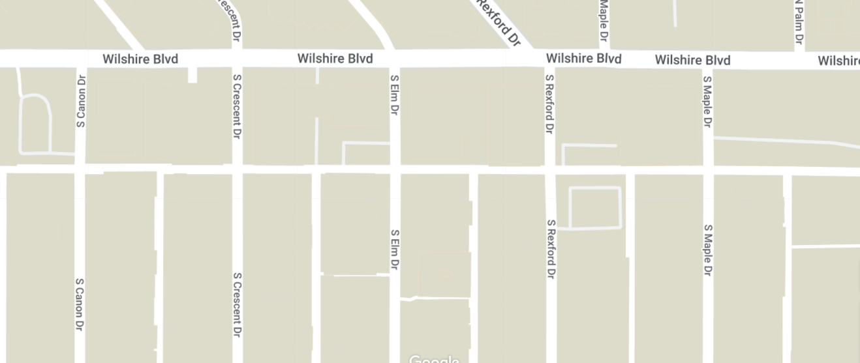
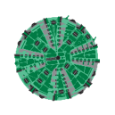
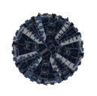
Tunnel Boring Machine (TBM) Update
Tunneling Statistics As of (4/6/2022)
Ruth | 11,510 feet (total journey) 55% complete
Harriet | 11,510 feet (total journey) 55% complete
Both TBM’s have reached the Wilshire/Rodeo Station in Beverly Hills
Will continue mining east towards Wilshire/La Cienega
Tunneling Duration: Approximately 2 years from the start
Remaining Duration: 6-8 months

Slide 35





Stay in touch
Eat Shop Play has been highlighting local businesses in Koreatown, Miracle Mile, Beverly Hills, Century City, Westwood, and West LA especially eateries and specialty businesses operating pick-up and delivery during the past months.
The Eat Shop Play program continues supporting local businesses as construction progresses by promoting them through regular social media posts and newsletters.

Slide 36

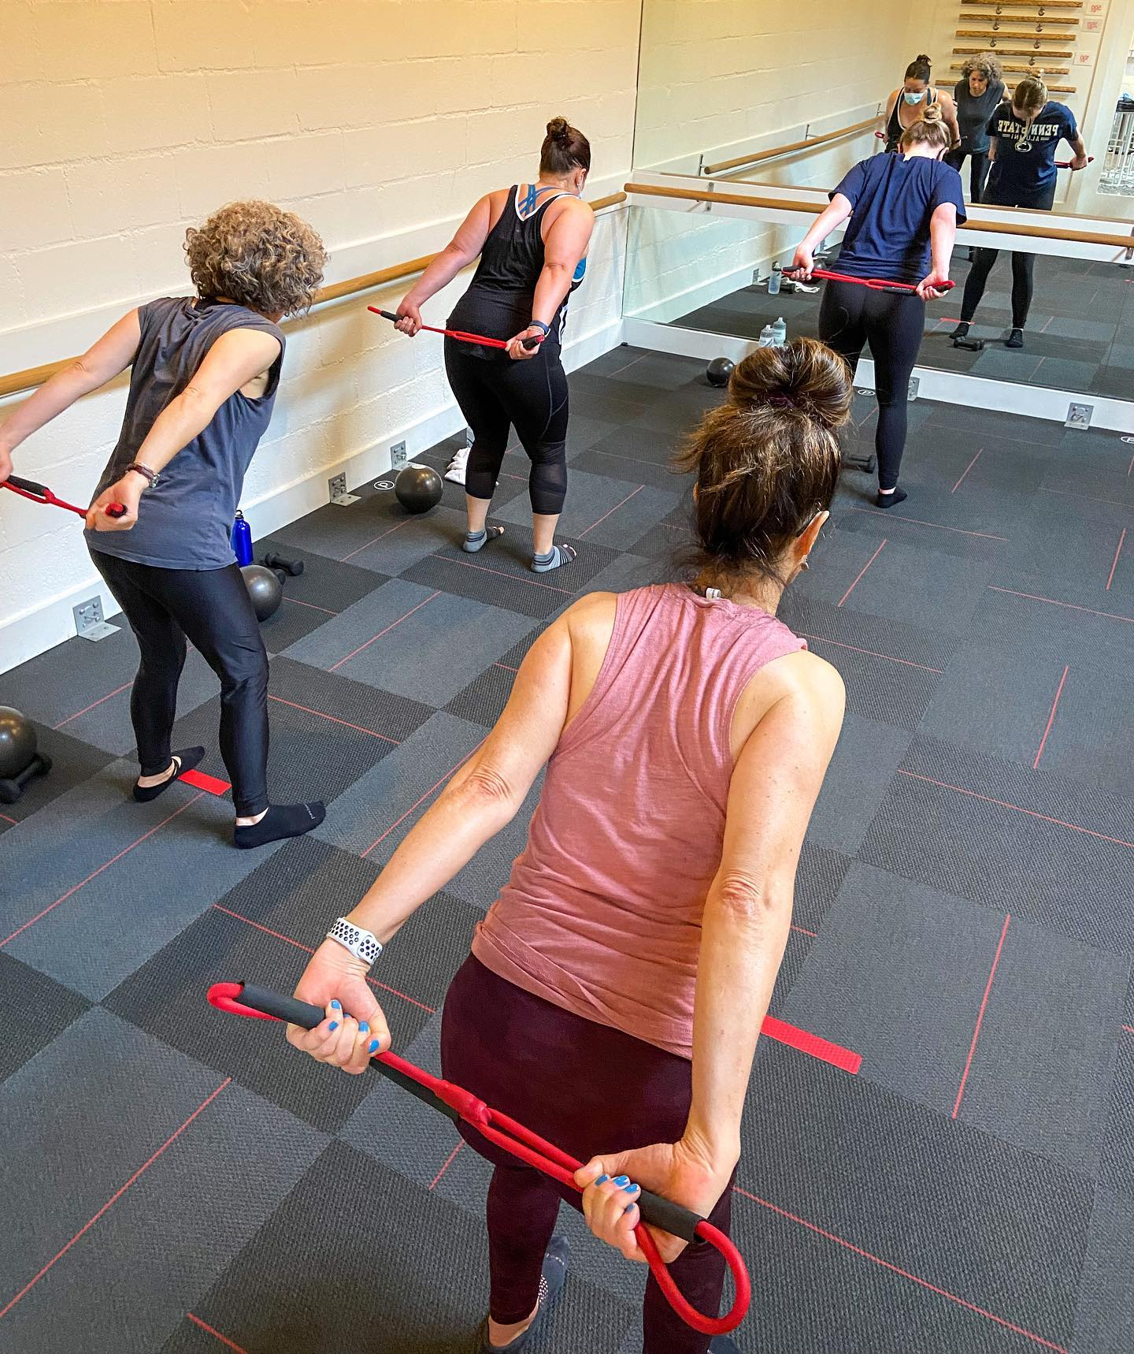
Stay in touch
Pure Barre Beverly Hills
231 S La Cienega Bl
​
Low Impact, High Intensity, Full Body Workouts in Beverly Hills
Business hours​
Mon - Thu: 7am – 7:30pm
Fri: 7am-6:30pm
Sat: 9am – 12:30pm
Sun: 9am-11:30am
​
https://www.purebarre.com/location/beverly-hills-ca
(424) 204-972

Slide 37
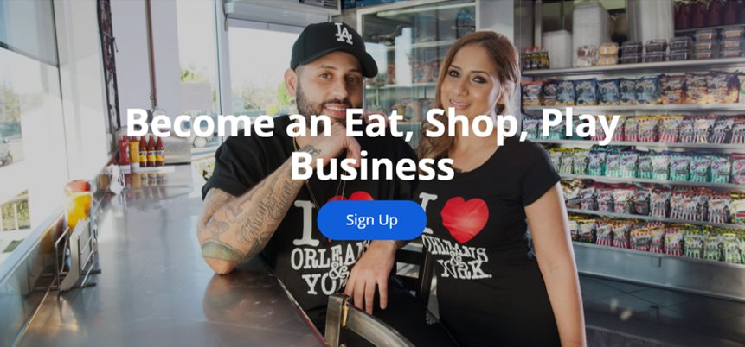
Stay in touch
Contact Us
> For more information on Eat Shop Play visit​
metro.net/eatshopplay ​
> Send an email to eatshopplay@metro.net

Slide 38
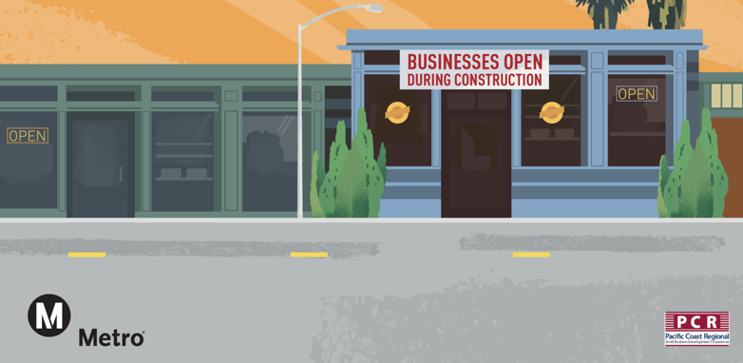
Business Interruption Fund (BIF)

Slide 39
Metro’s Business Interruption Fund
BIF Information and Eligibility
Financial assistance to small “mom & pop” businesses with 25 or fewer full-time employees directly impacted by Metro Rail construction along three project areas​:
  Crenshaw/LAX Transit Project​
  Purple Line Extension, Sections 1, 2 & 3​
  Regional Connector Project, Little Tokyo area & 2nd/Broadway Segment*
Businesses must be located immediately adjacent to the rail corridor and meet other eligibility requirements​
Grant amounts are determined by business revenue loss directly related to period of Metro construction disruption​
Businesses may receive up to $50,000 per impact year
*Segment eligibility based on full street closure with duration greater than six continuous months. Eligibility ended 6/30/17.​

Slide 40
Metro’s Business Interruption Fund
Metro’s Business Interruption Fund (BIF) is accepting applications for transit rail construction impact along the Crenshaw/LAX Transit Project, the Little Tokyo area of the Regional Connector and Sections 1, 2 and 3 of the Purple Line Extension sustained from March 20, 2020, forward (during the COVID-19 pandemic).
Small “mom and pop” businesses that experienced transit rail construction impact during the COVID-19 pandemic may be eligible.
Potentially eligible small business owners may contact BIF Fund Administrator Pacific Coast Regional at 213.739.2999 x223 or Metro at bif@metro.net.
Metro does not cover revenue loss nor fixed operating expenses related to COVID-19 impacts.

Slide 41
Metro’s Business Interruption Fund
Value of BIF Grants Awarded:
$33,805,111.72*
  *BIF Grants do not cover COVID-19 related impacts.

Slide 42
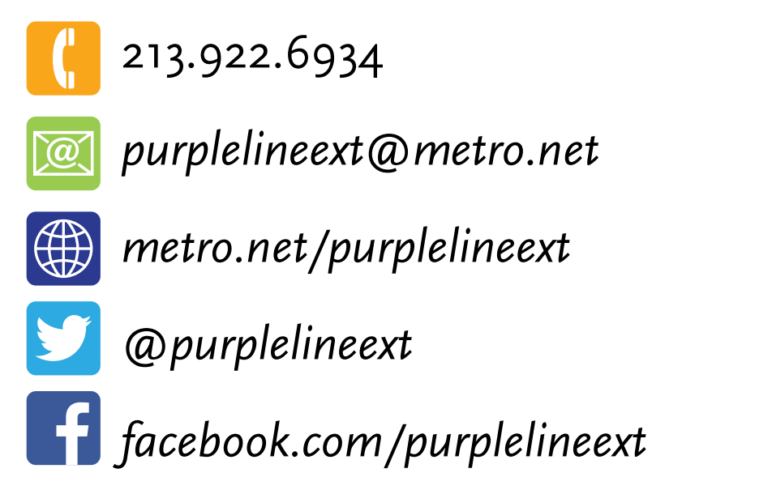
Stay in Touch
2022 Meeting Dates
May 4: Sections 1, 2, and 3
June 1: Sections 1 and 2
All meetings use: https://zoom.us/j/96626476708
Link to webinars available at metro.net/purple
213.922.6934
purplelineext@metro.net
metro.net/purple
@purplelineext
facebook.com/purplelineext

