Slide 2

We will begin soon

Slide 3
Panelist
Metro Purple Line Extension Team
Marlon Walker, Community Relations Manager
Glyssa Robles, Principal Community Relations Officer
Terry Utz, Principal, Technical Specialist, Traffic
Metro New Media Team
Stephanie Molen, Principal Community Relations Officer

Slide 4

Purple Line Extension Alignment

Slide 5
Sections 1, 2, & 3 Status
 | Forecasted Schedule
Section | Section 1 | Section 2 | Section 3
Length | 3.92 Miles | 2.59 Miles | 2.56 Miles
New Stations | Wilshire/La Brea Wilshire/Fairfax Wilshire/La Cienega | Wilshire/Rodeo Century City/ Constellation | Westwood/UCLA Westwood/VA Hospital
Pre-Construction Activities | 2014 – 2015 | 2016 – 2018 | 2018 – 2019
Construction | 2015 – 2024 | 2018 – 2025 | 2019 – 2027
Operations | 2024 | 2025 | 2027
*Subject to change. The PLE project team is working to deliver the project consistent with Measure M.

Slide 6
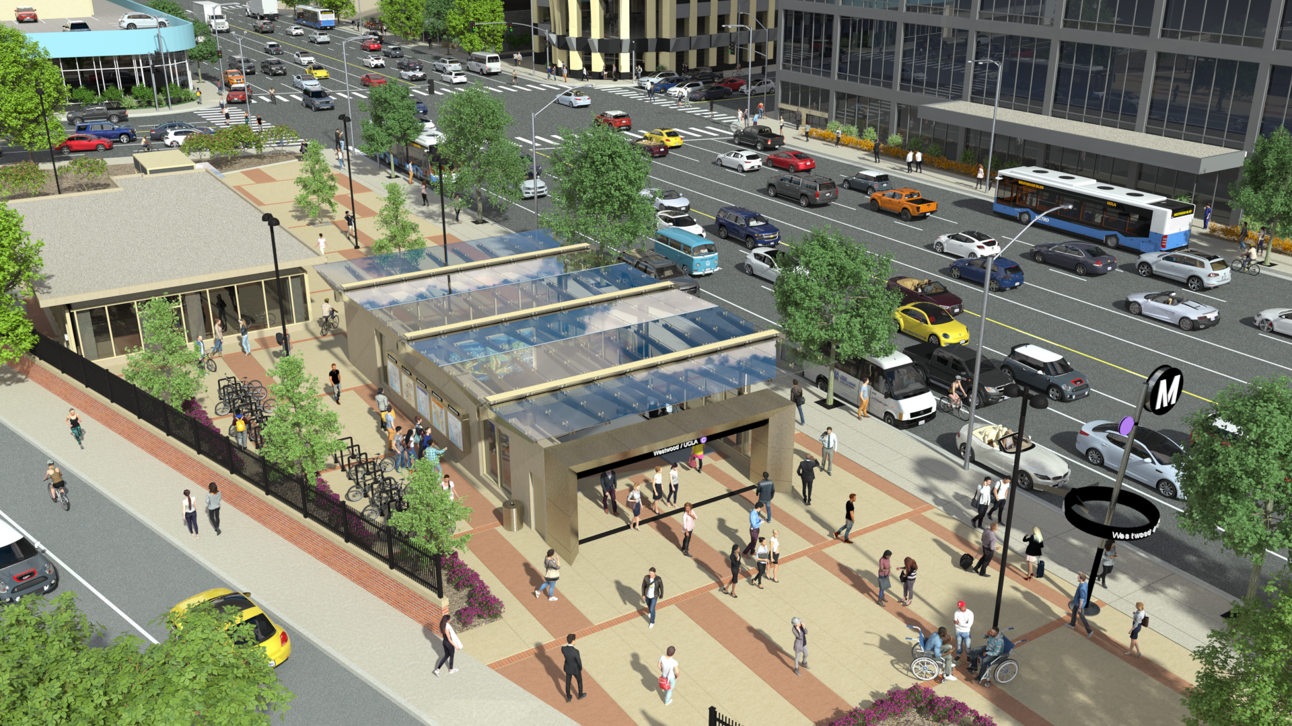
Westwood/UCLA Station Rendering (Northwest)

Slide 7
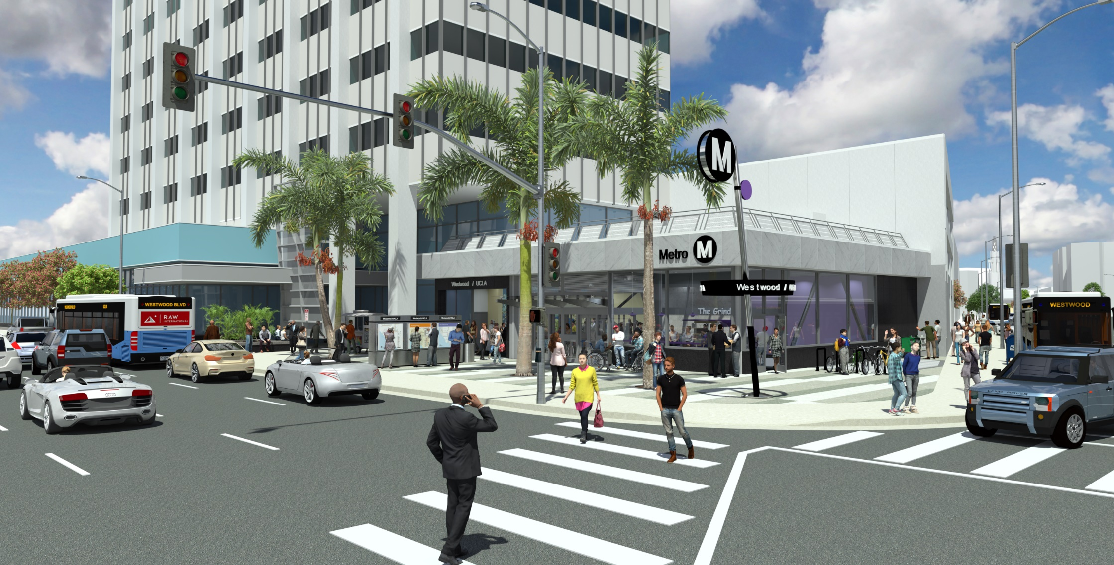
Westwood/UCLA Station Rendering (Northeast)

Slide 8
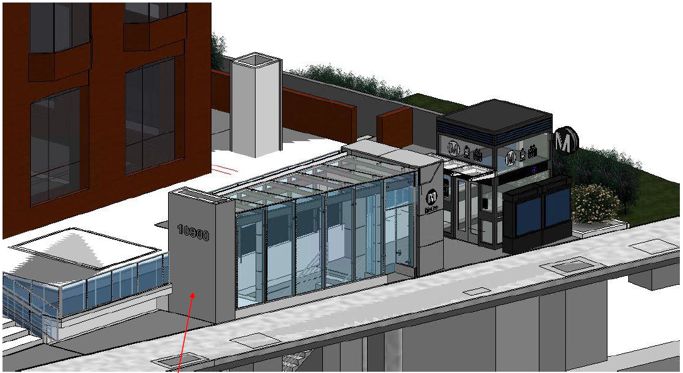
Westwood/UCLA Station Rendering (Southeast)
DRAFT

Slide 9

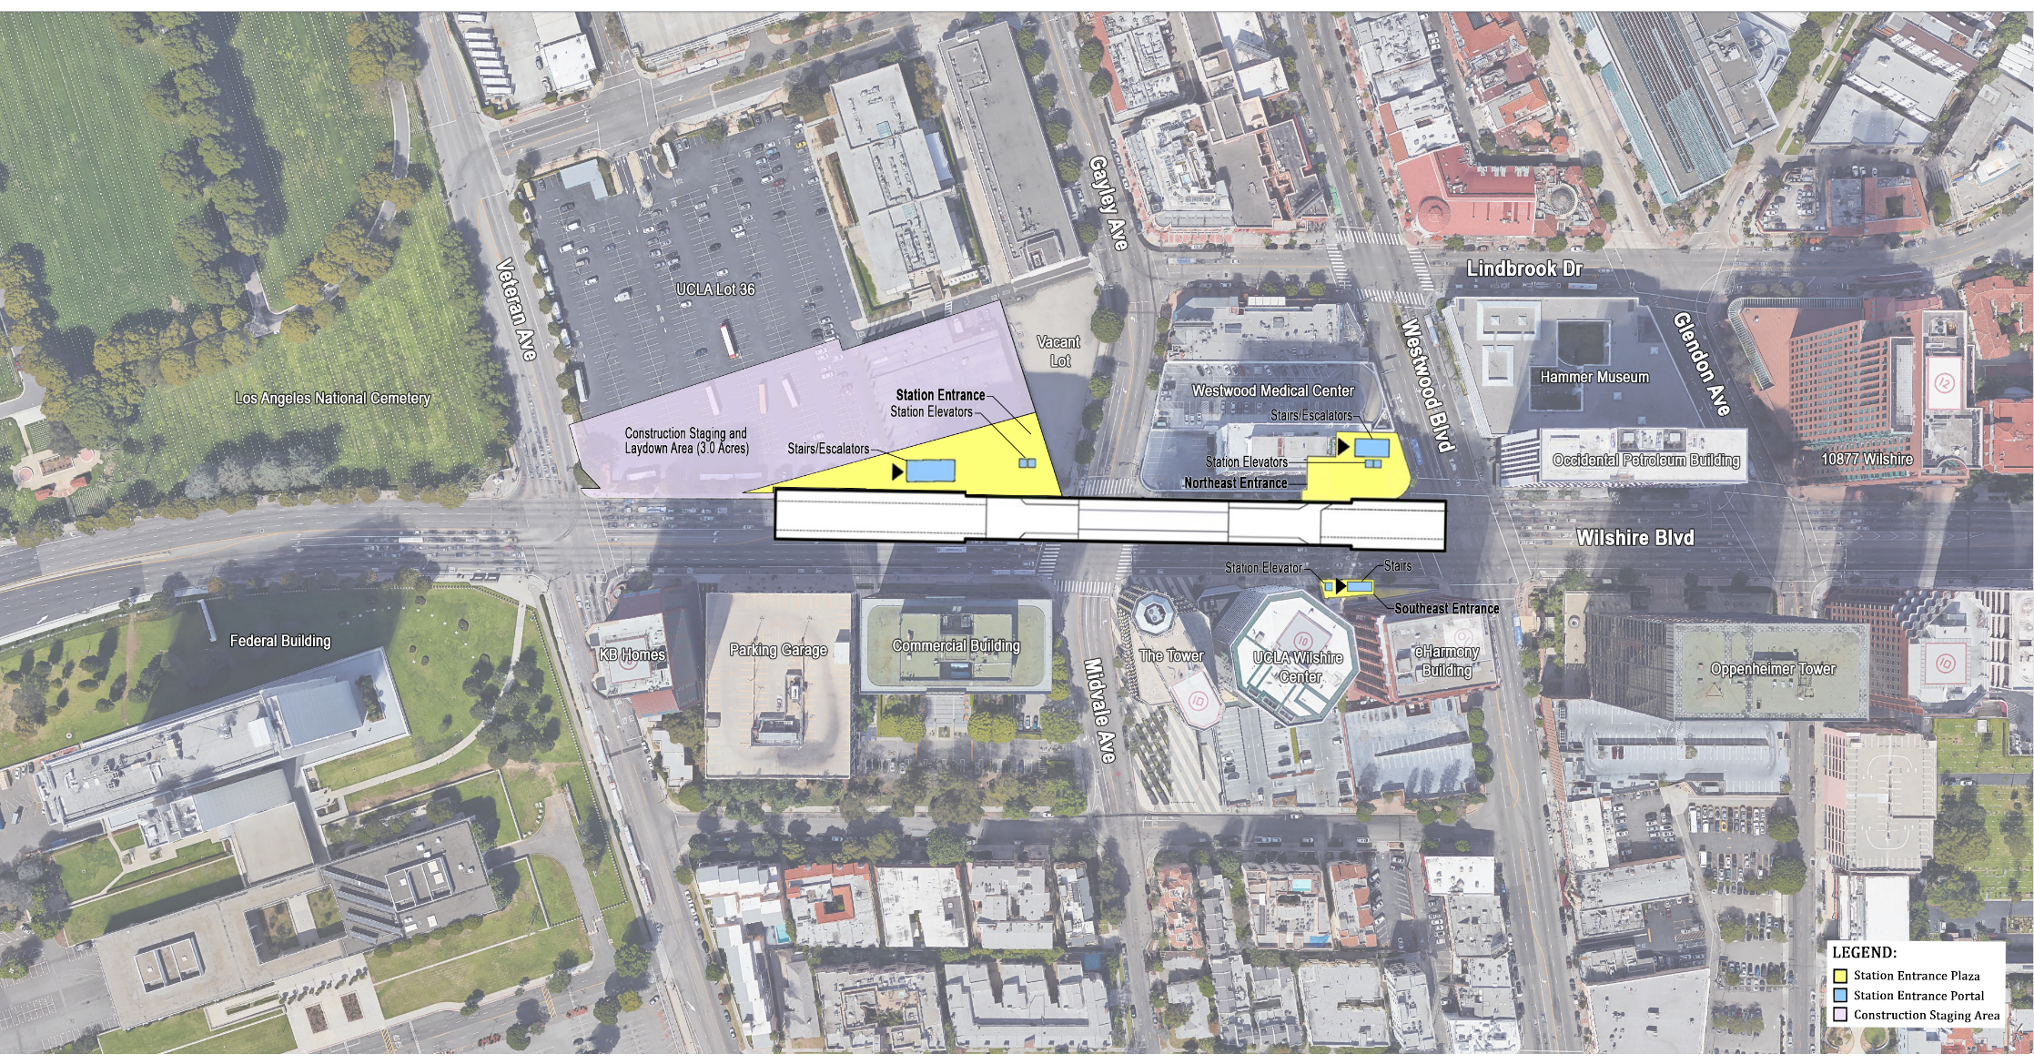
Westwood/UCLA Station Box
Rendering shows length of the underground station box on Wilshire Bl between
Westwood Bl and Veteran Av

Slide 10
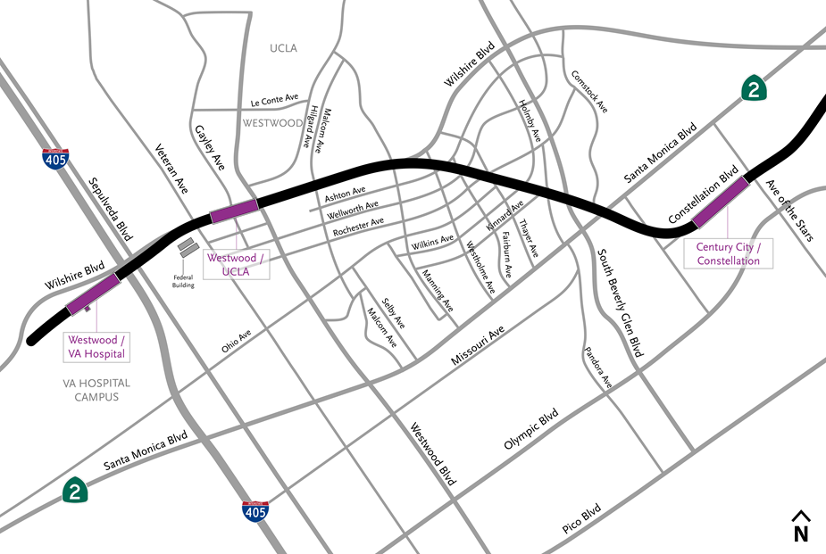
Section 3 Tunnel From Century City to Westwood

Slide 11
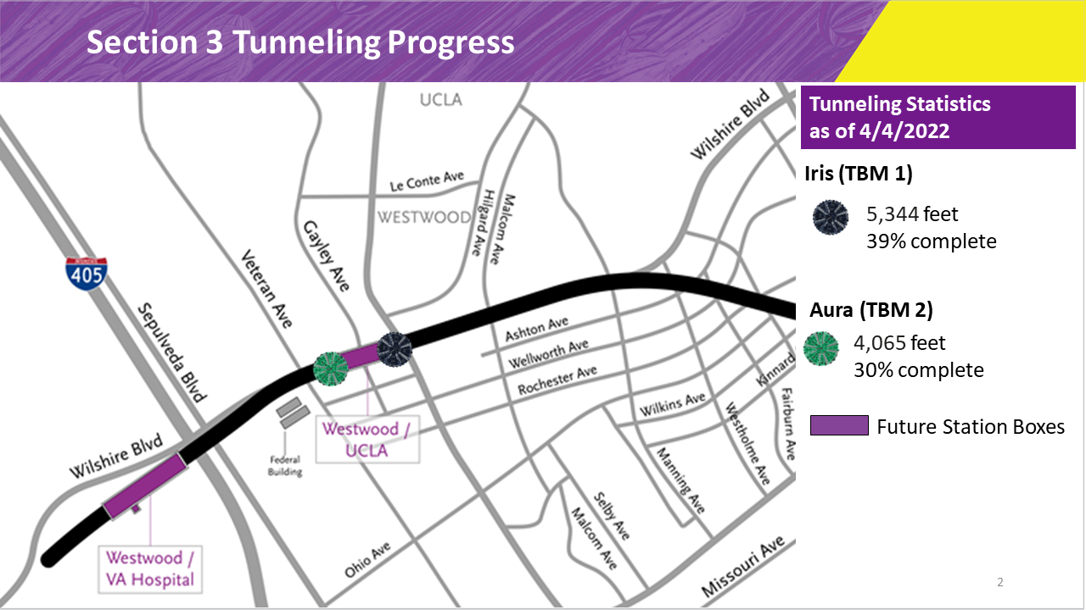

Slide 12
Dewatering Wells on Wilshire Bl
The dewatering wells on Wilshire Bl will be used to maintain and clean the tunnel boring machines (TBMs) underground.
  Work will be done in stages.
  Noisy work will be done during the day.
  Utility service will not be interrupted.
  Access to driveways will be maintained.

Slide 13
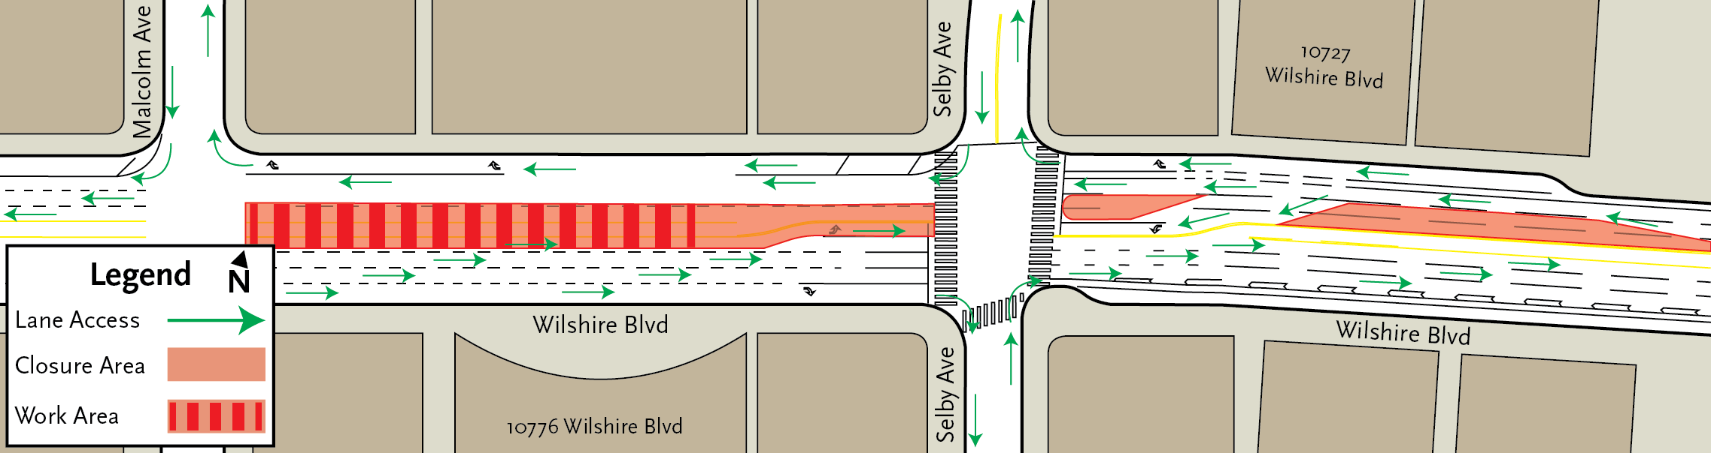
Drilling on Wilshire Bl near Malcolm Av.
April 15, 9pm through April 16, 6pm – Restriping and barrier setup.
April 18 to 29, 9am to 3:30pm- Drilling, installing wells, piping, and manholes.
Access to driveways will be maintained.
Left turns may be restricted.

Slide 14
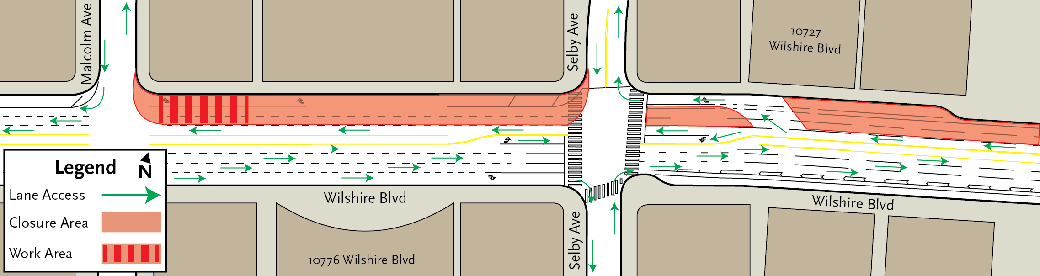
Sewer Lateral on Wilshire Bl near Malcolm Av
May 7, 9am to 3:30pm- Sewer lateral
Utility service will not be interrupted.
Access to driveways will be maintained.
Left turns may be restricted.

Slide 15
Generator in Center Median of Wilshire Bl
May 9, 24/7 for approximately 2 months – Generator in Median.
Wilshire Bl will have 3 lanes open in each direction.
Access to driveways will be maintained.
Left turns may be restricted.

Slide 16
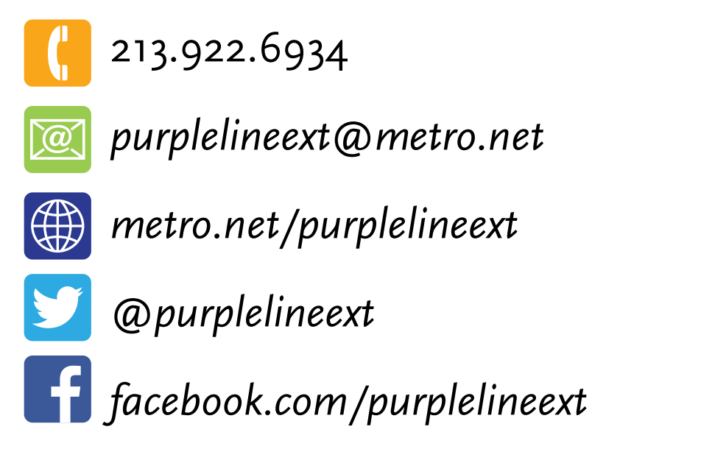
Stay in Touch
Lunch with Us Webinar:
Sections 1, 2, and 3 Construction Update
May 4, 2022, 12pm to 1pm
Section 3 Decking Community Meeting
May 10, 2022, 12pm to 1pm
Link to webinars available at metro.net/purple
213.922.6934
purplelineext@metro.net
metro.net/purple
@purplelineext
facebook.com/purplelineext

