Slide 1

We will begin soon

Slide 2
Presentation Panelists
Metro Purple Line Extension Team
Kasey Shuda, Community Relations Director
  Sections 1, 2 & 3 and Division 20
Marlon Walker, Community Relations Manager
  Sections 1, 2 & 3 and Division 20
Mindy Lake, Principal Community Relations Officer
  Section 1, Beverly Hills and Section 2
Metro Business Interruption Team
Jessica Spearman, Principal Transportation Planner
Sidney Urmancheev, Transportation Associate
Metro New Media Team​
Stephanie Molen, Principal Community Relations Officer ​
Ginny Brideau, Manager, Community Relations New Media Team
Contractor Representatives and Presenters
Scott Donohue, STS Community Relations Coordinator
Yvette Ximenez, TPOG Project Information Coordinator

Slide 3
Metro D Line (Purple) Project
Today's Agenda
  Project Overview
  Section 1 Construction Update
  - La Cienega Station
  Section 2 Construction Update
  - Wilshire/ Rodeo
  Eat Shop Play
  7. Business Interruption Fund

Slide 4

Purple Line Extension Alignment

Slide 5
Sections 1, 2, & 3 Status
 | Forecasted Schedule
Section | Section 1 | Section 2 | Section 3
Length | 3.92 Miles | 2.59 Miles | 2.56 Miles
New Stations | Wilshire/La Brea Wilshire/Fairfax Wilshire/La Cienega | Wilshire/Rodeo Century City/ Constellation | Westwood/UCLA Westwood/VA Hospital
Pre-Construction Activities | 2014 – 2015 | 2016 – 2018 | 2018 – 2019
Construction | 2015 – 2024 | 2018 – 2025 | 2019 – 2027
Operations | 2024 | 2025 | 2027
*Subject to change. The PLE project team is working to deliver the project consistent with Measure M.

Slide 7
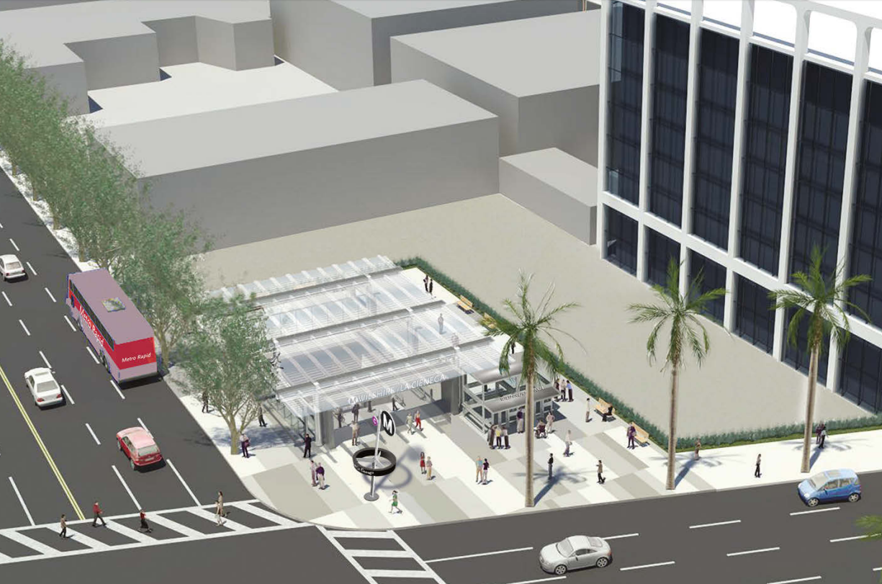
Wilshire/La Cienega Station Rendering

Slide 8
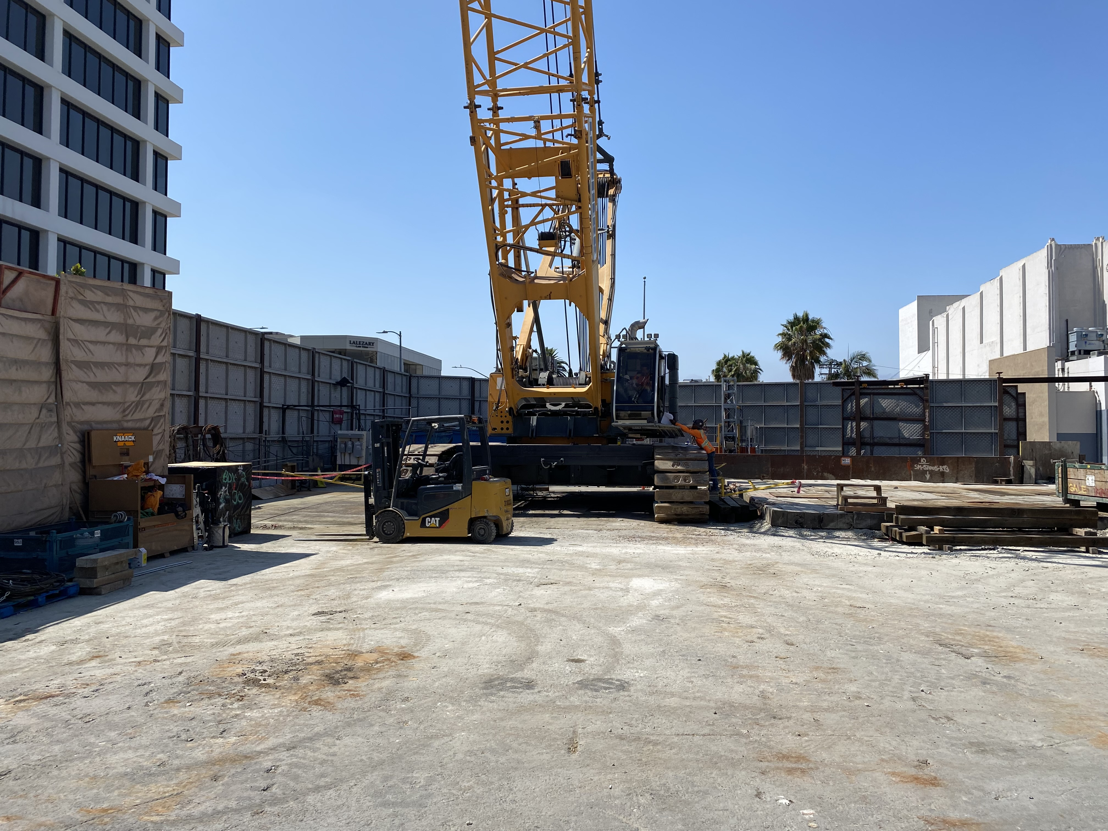
Wilshire/La Cienega Tunnel Boring Machine (TBM) Haul Out
Tunneling has been completed for the Purple Line Extension Section 1
Crews have been disassembling both machines so they can be transported out of the project area. The removal of the TBM components began in early July.
For approximately 12 weeks, crews will remove the TBM components piece by piece. The larger loads will be hauled out Sunday through Thursday, from 9pm to 6am. The smaller loads will be hauled out Monday through Saturday, from 7am to 4pm
City Traffic Control Officers will be onsite to assist traffic flow
Crane will conclude activities by 10pm
CHP will escort oversized loads
Location of TBM load out

Slide 9
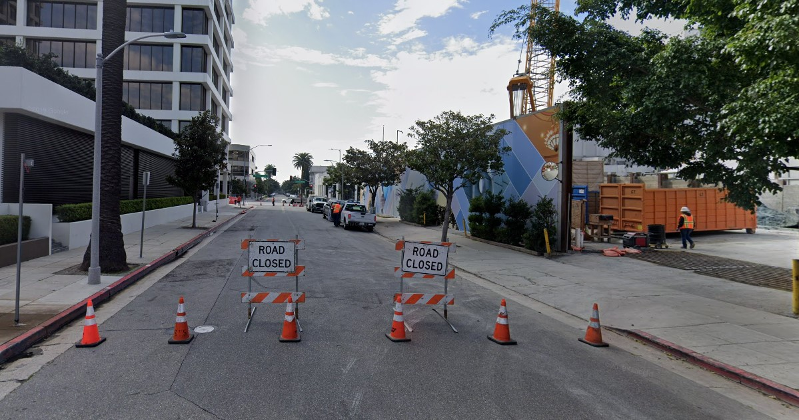
Daily Closure of N Gale Dr
N Gale Dr, north of Wilshire Blvd., will be closed for extended hours while the TBM haul out continues.
During hauling activities, N Gale Dr may be closed from 4am through 2am the following morning.
Closure is a public safety measure due to high volumes of ingress and egress from the property
Material deliveries to the Wilshire/La Cienega Station Box will continue through 2021
Access to N Gale Dr will be maintained from
San Vicente Bl
Gale Dr from north of Wilshire Bl

Slide 10
Wilshire/La Cienega Appendage Work
Why: Multiple appendages will be required for each station on the Purple Line Extension
Each appendage structure houses a vital function for the stations:
  Emergency exits
  Utility rooms
  Ventilation rooms
  Entrance and exit structures
When: Began in March 2021
Where: Information about specific traffic control and work hours will be available in future community meetings and construction notices
Coordination with impacted businesses will be conducted prior to the start of the next phase of appendage work

Slide 11
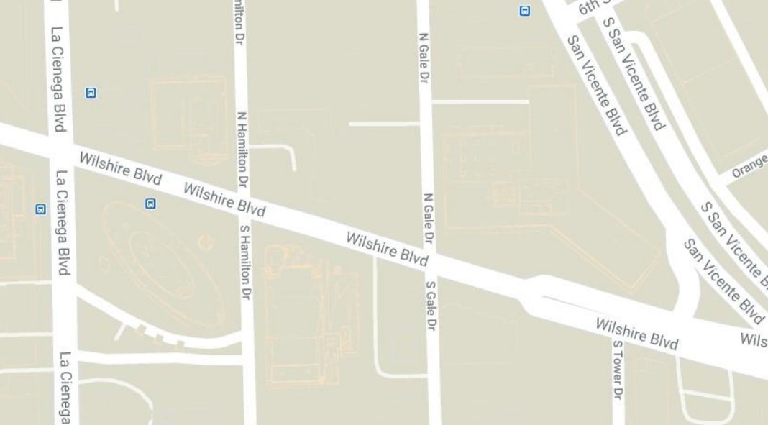
Wilshire/La Cienega Station Appendage Structures – Phase 1A
Phase 1A
Appendage –
Main Entrance
Phase 1A
Station Box
Appendages –
Northeast
Station appendage locations

Slide 12
Wilshire/La Cienega Station Appendage Structures
*Dates subject to change.
Phase 1A Traffic Control (March 2021 through October 2022)*
Wilshire Blvd. between San Vicente Blvd. and La Cienega Blvd. reduced to two lanes in each direction
Left turns from Wilshire Blvd. onto Gale Dr. will be restricted. Left turns from Tower Dr. onto Wilshire Blvd. will be restricted.
The north and south crosswalks at Gale will be maintained
The north sidewalk between San Vicente Blvd. and Gale Dr. will be closed during this phase of work. A pedestrian detour for east/west travel will be in place on the south side of Wilshire. Access to 8383 Wilshire will be maintained.
The loading zone in front of the Saban Theatre on Wilshire Blvd will be closed over the duration of this closure.
Intermittent full closures on Gale Dr. north of Wilshire Blvd. will continue during this phase of work.

Slide 13
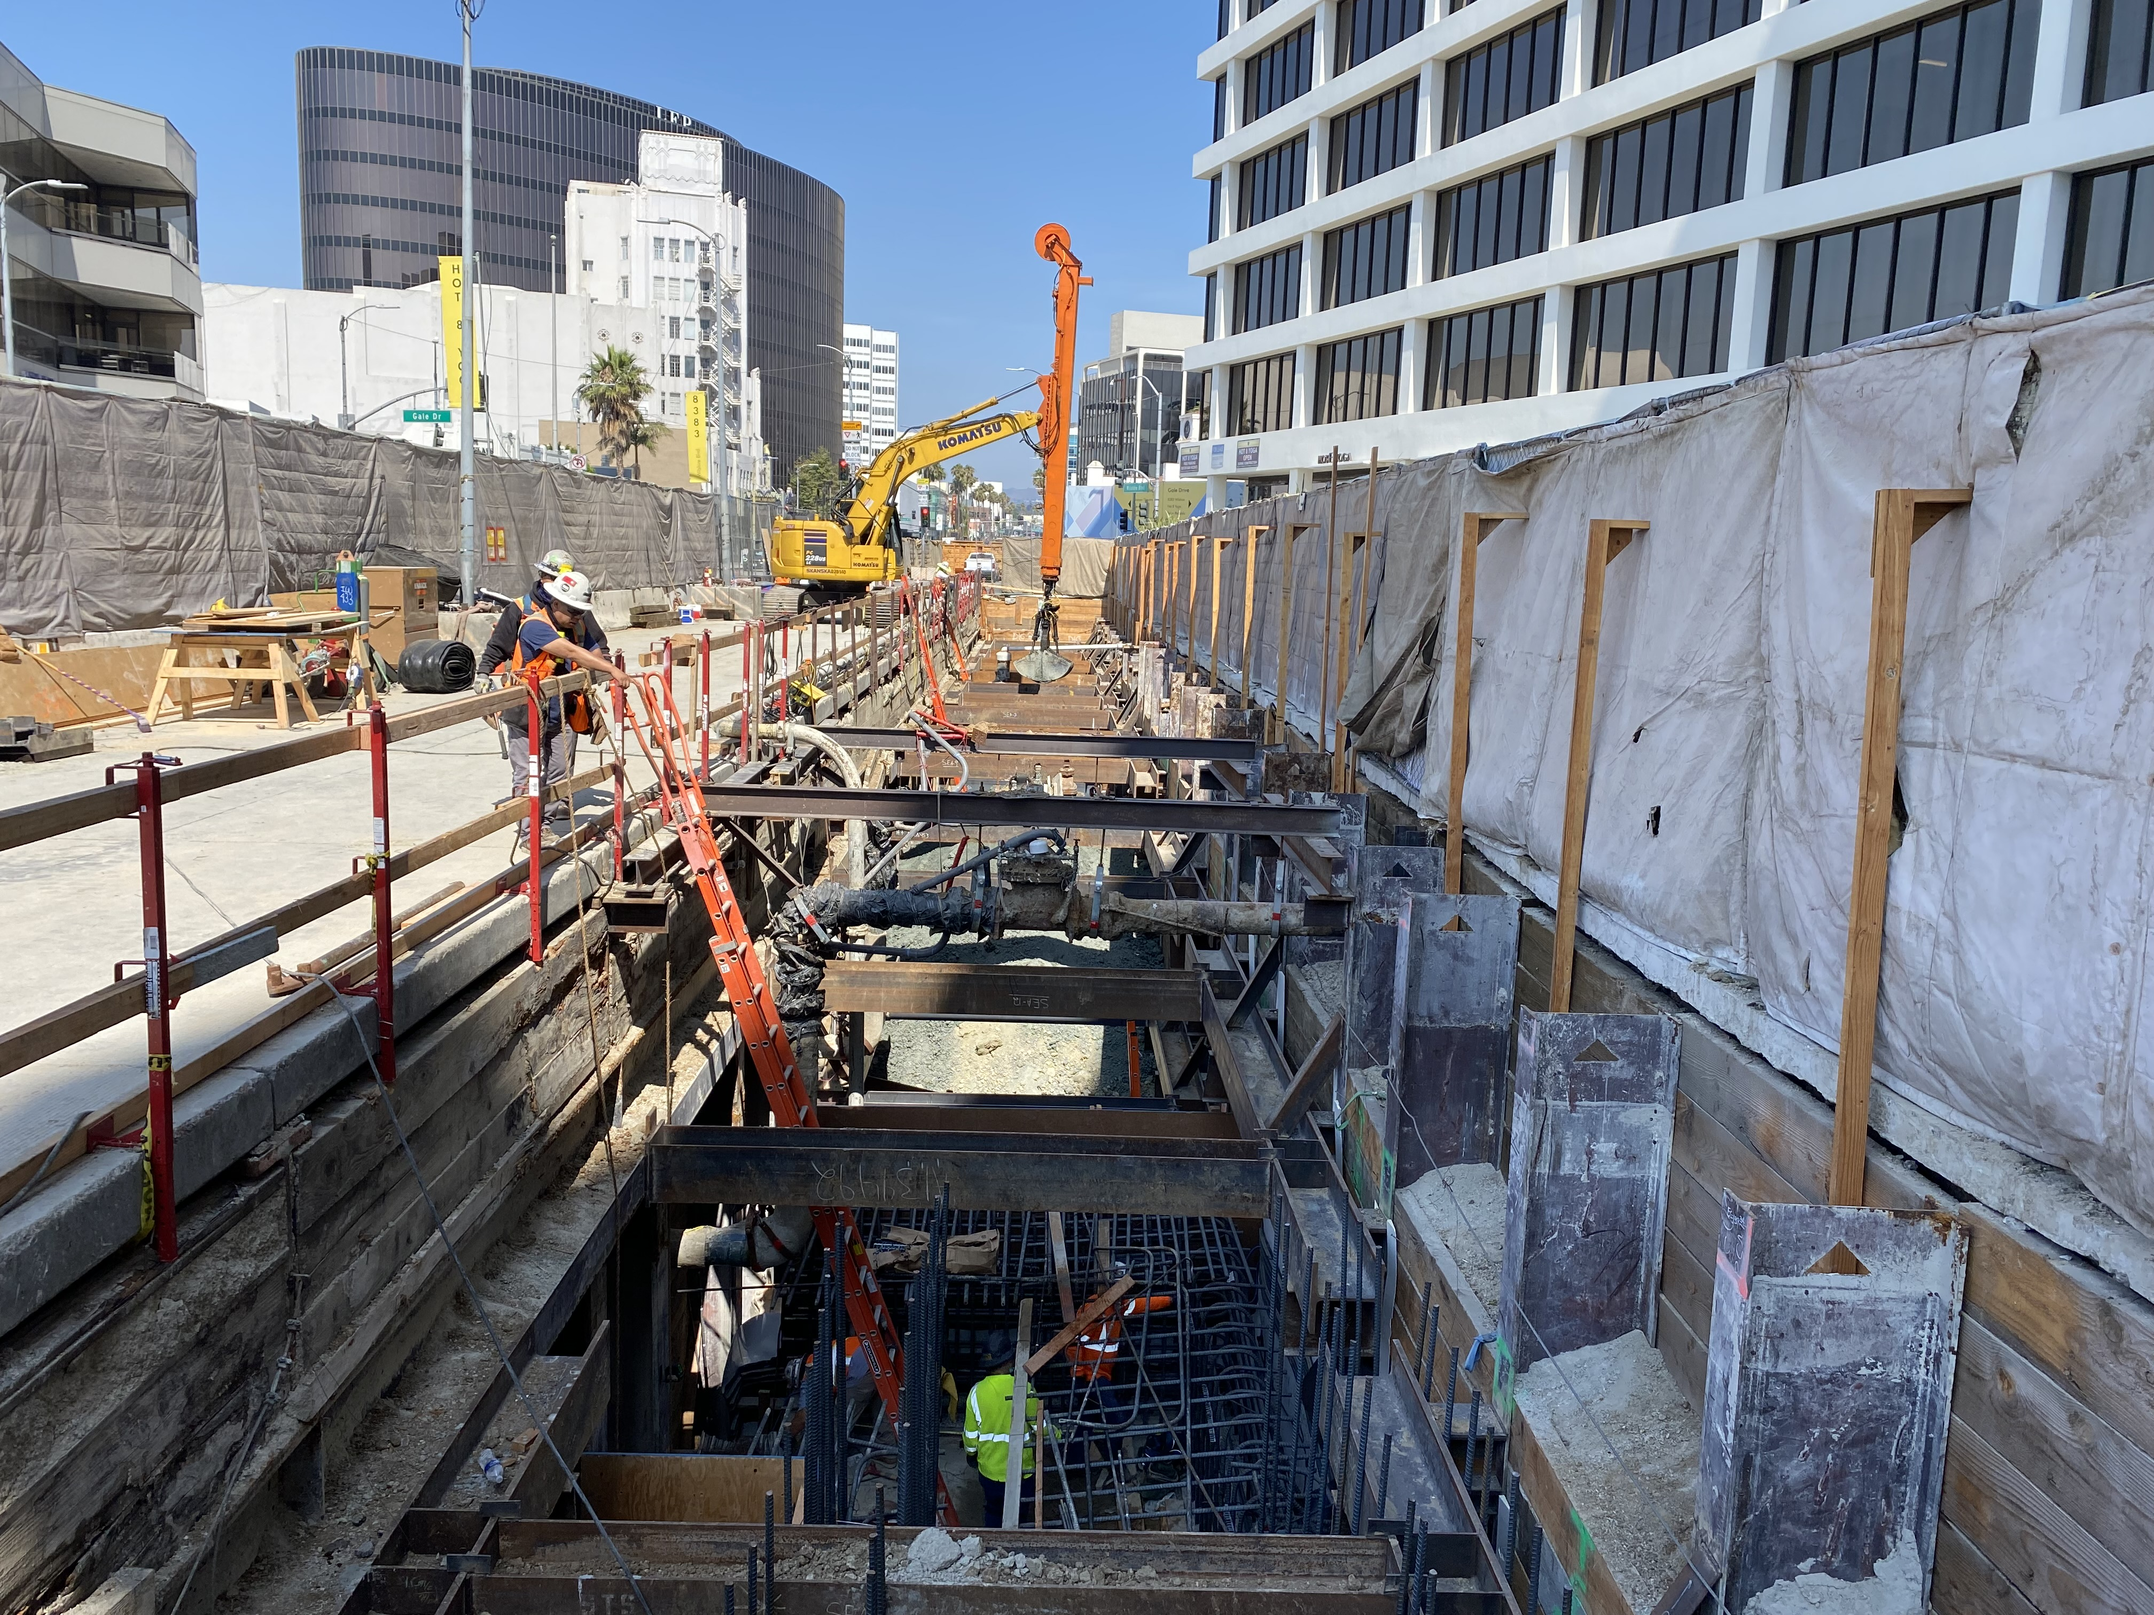
Wilshire/La Cienega Station Appendage Progress – Phase 1A

Slide 14
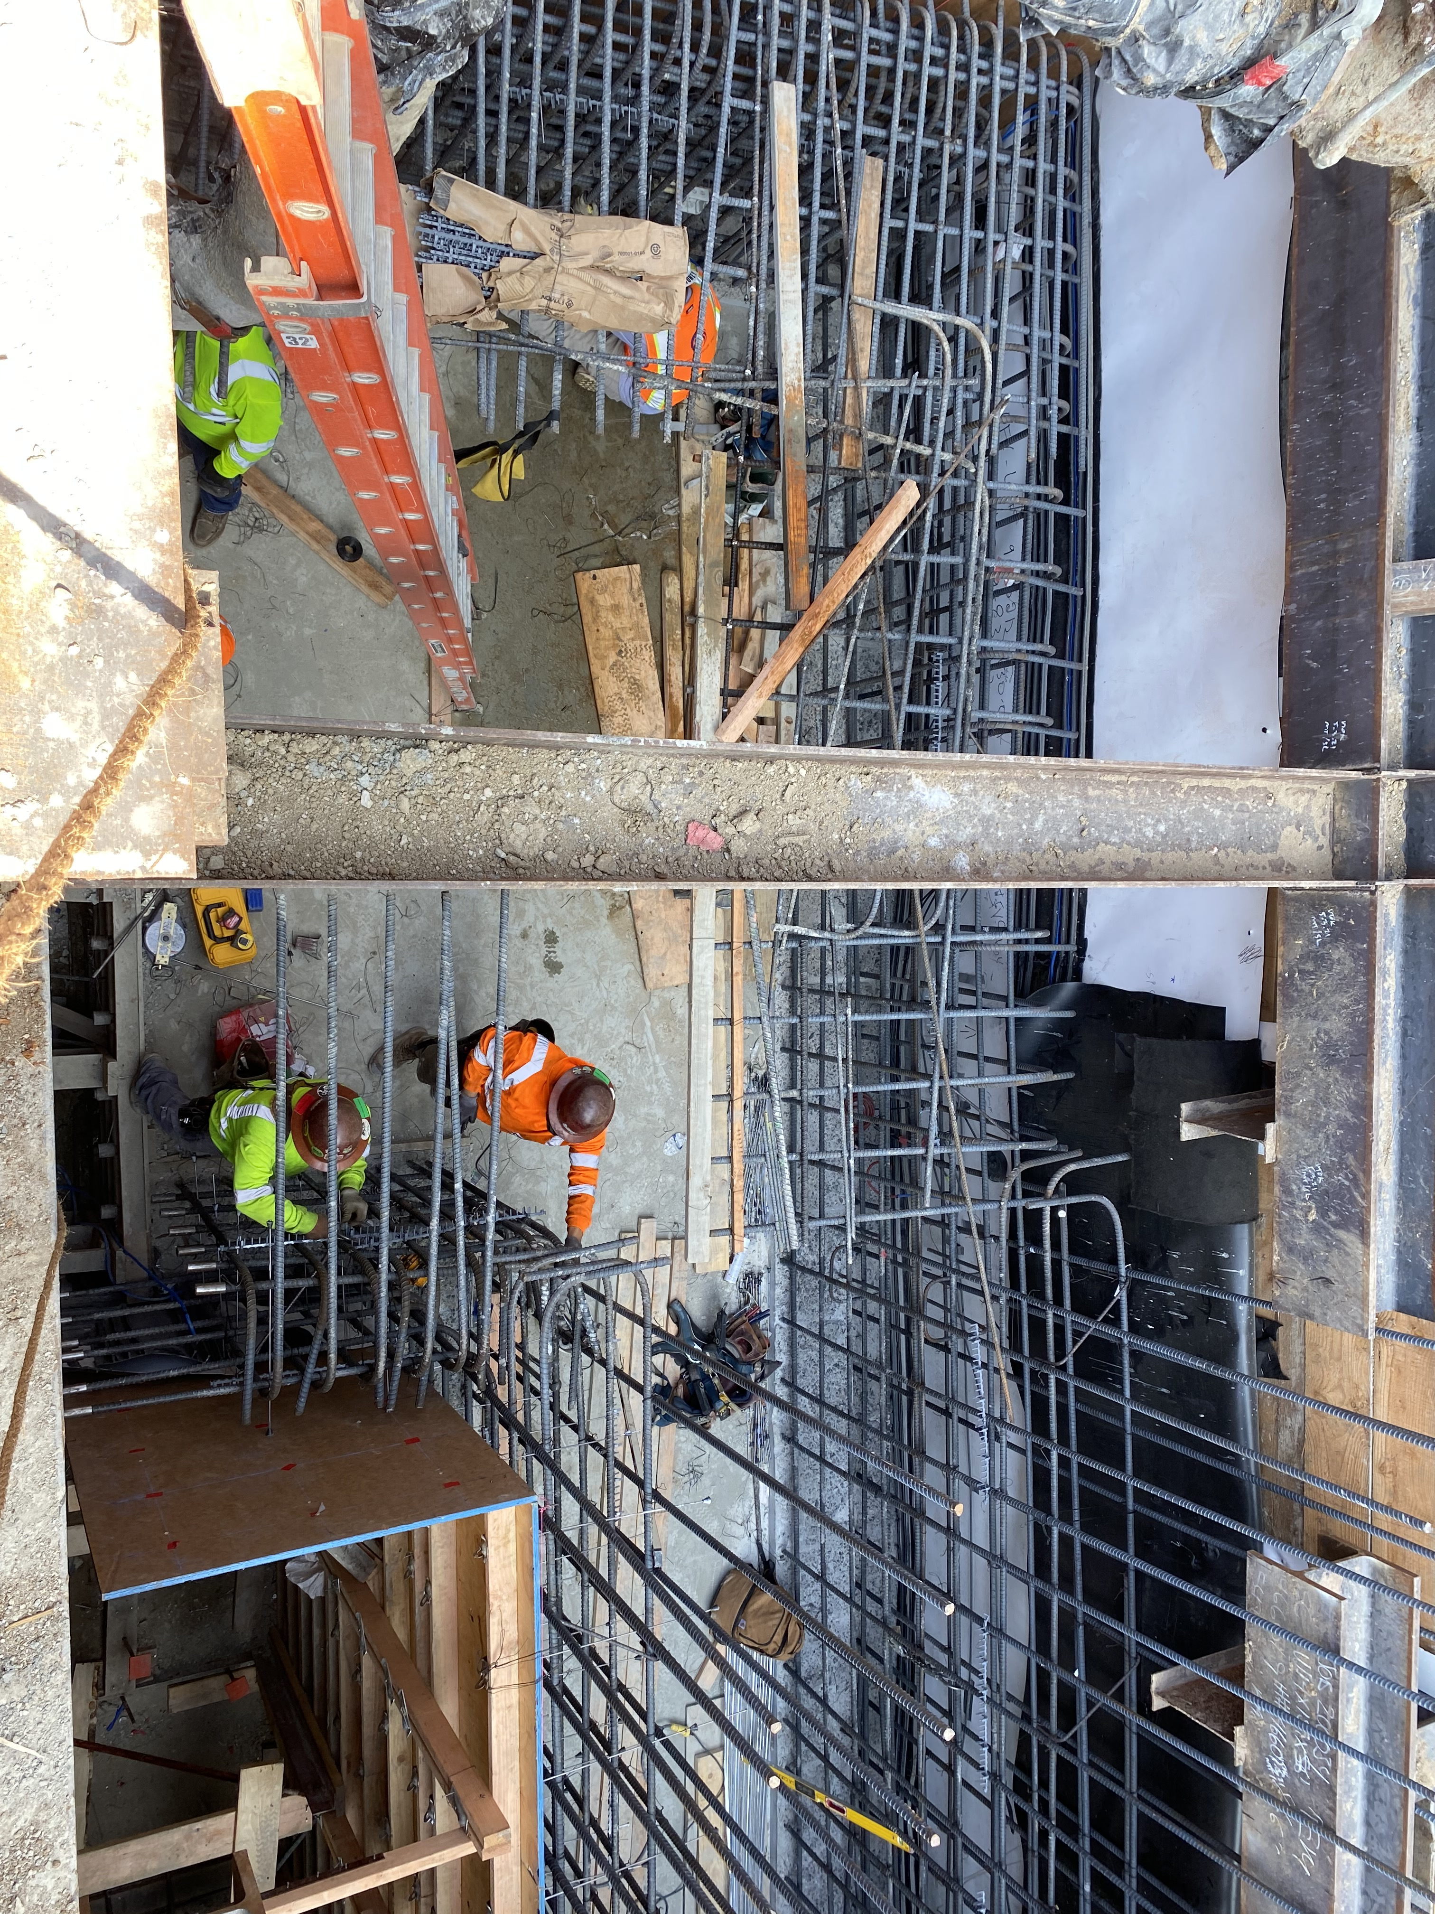
Wilshire/La Cienega Station Appendage Progress – Phase 1A

Slide 15
Replacement Parking
Locations for One Hour Free Parking:
  8447 Wilshire Bl:
  Accessible from N Hamilton
  8350 Wilshire Bl:
  Accessible from S Tower
  Please mention "Metro" upon entering the building to receive the 1st hour free

Slide 16
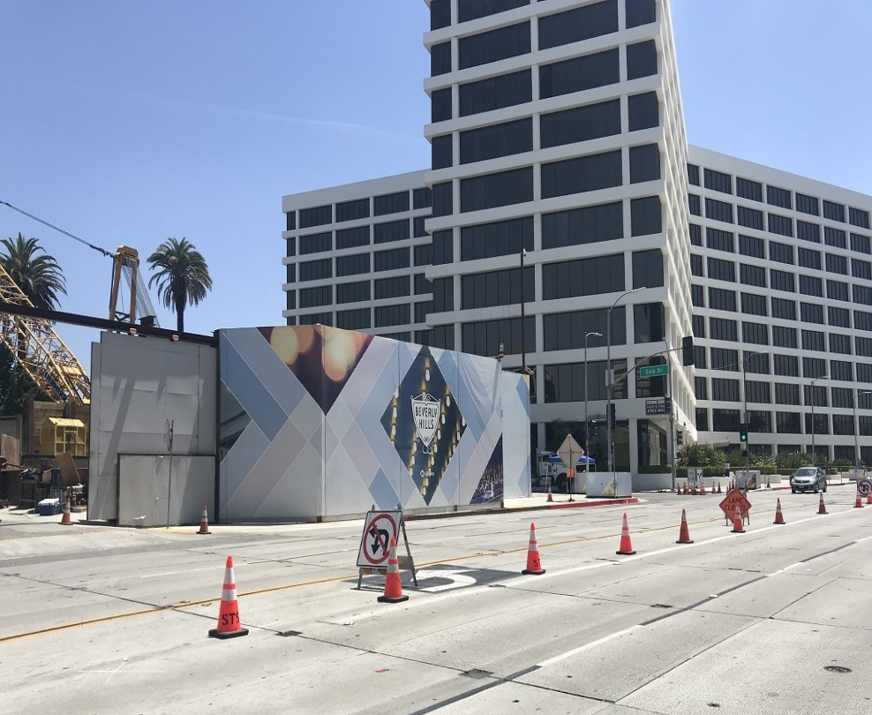
Concrete and Material Deliveries
Where: Structural work on the station underneath Wilshire Bl is generally conducted from the Gale Yard and from Wilshire Bl
Work Hours: 7am to 4pm during Gale closure
9am to 4pm during bump out implementation
Traffic Controls*:
  Westbound Wilshire Bl will be intermittently reduced to one lane between San Vicente Bl and Hamilton Dr
  Daily closures will be utilized in support of ongoing work activities in the staging yard at Gale Dr
*Traffic control implementation varies depending on activity
Noise Mitigations: will remain in place
  Sound blankets around noisy equipment
  Trucks equipped with low-impact backup alarms
  Nylon straps used to lift material
Outside Gale Staging Yard

Slide 17
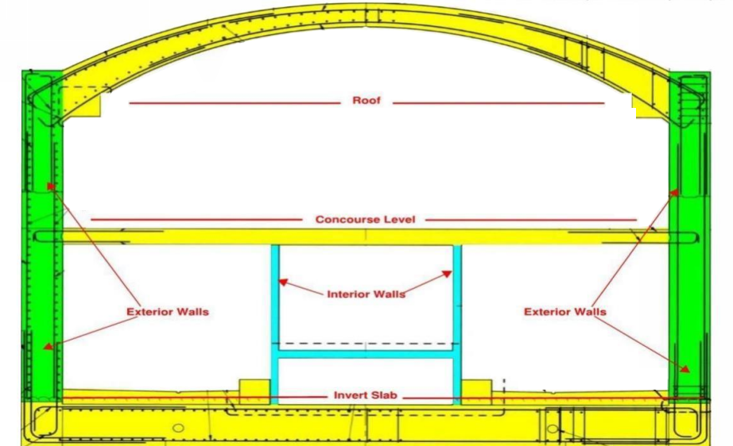
Next Steps: Station Construction
Construction of station roof will continue through 2021
Each roof placement will be 60 feet by 60 feet
Work activities in support of concrete and deliveries will be conducted within the staging yards, and occasionally on Wilshire Bl
Daily construction activities may be conducted underneath Wilshire Bl and from both Staging Yards for 24 hours a day
Illustration of station interior design

Slide 18
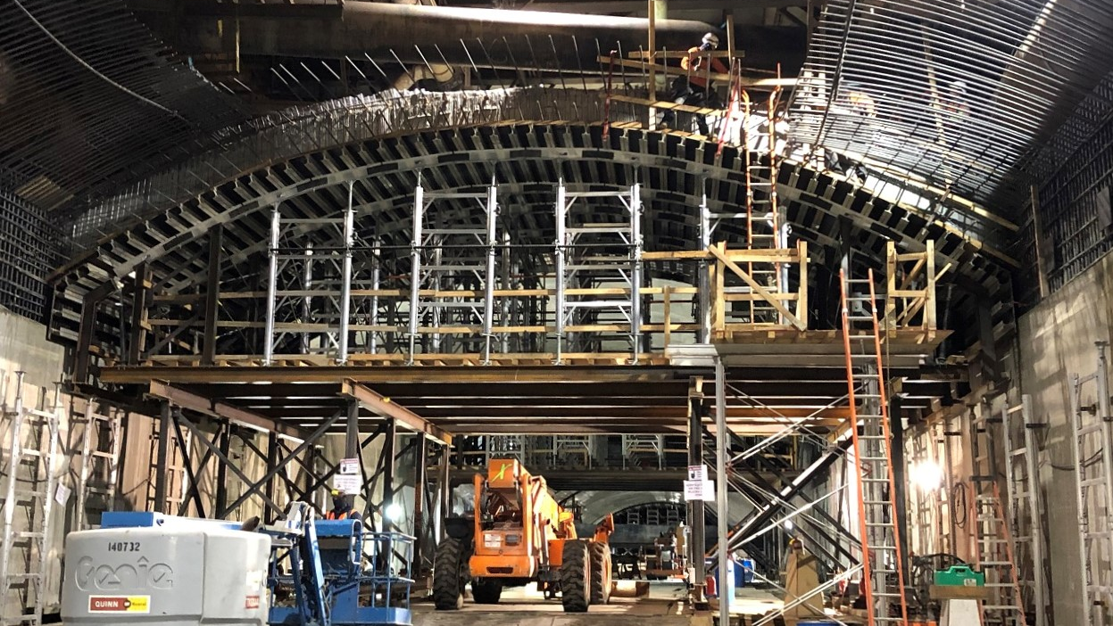
Wilshire/La Cienega Construction Progress

Slide 19
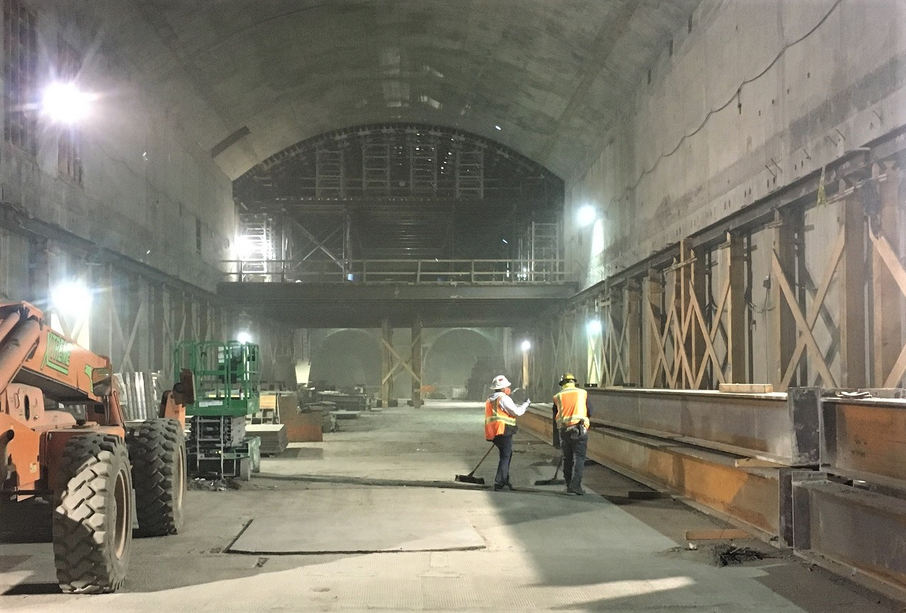
Wilshire/ La Cienega Construction Progress
Completed section of the station roof.

Slide 20
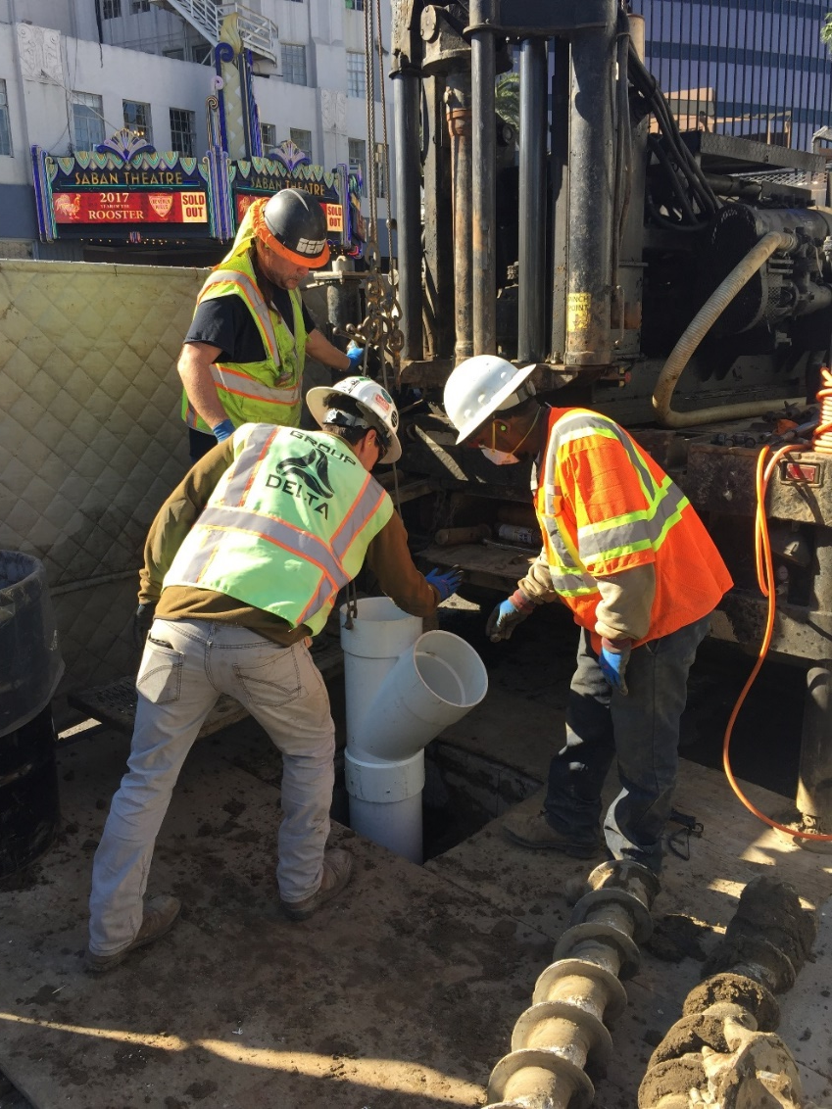
Instrumentation Work
When: Ongoing in 2021
Traffic Controls:
  Intermittent lane reductions on
  Wilshire Bl, La Cienega Bl, and side streets during off-peak hours may be in place to support the maintenance of geotechnical instruments in the Wilshire Bl and La Cienega Bl area
  Intermittent lane reductions may be in place on Wilshire Bl, west of La Cienega Bl, to support coring survey work under Wilshire Bl
Additional details on this work will be available in future construction notices
Example of instrumentation drilling

Slide 21
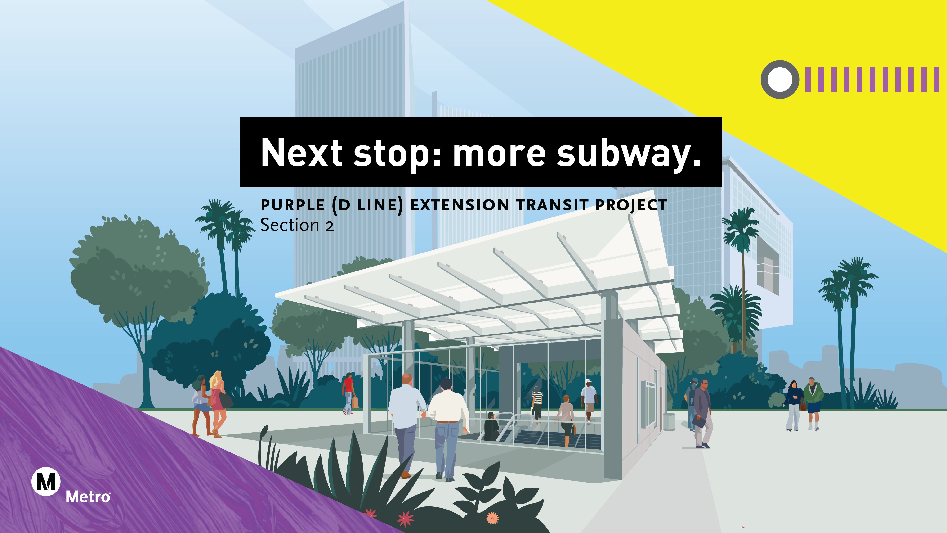

Slide 22
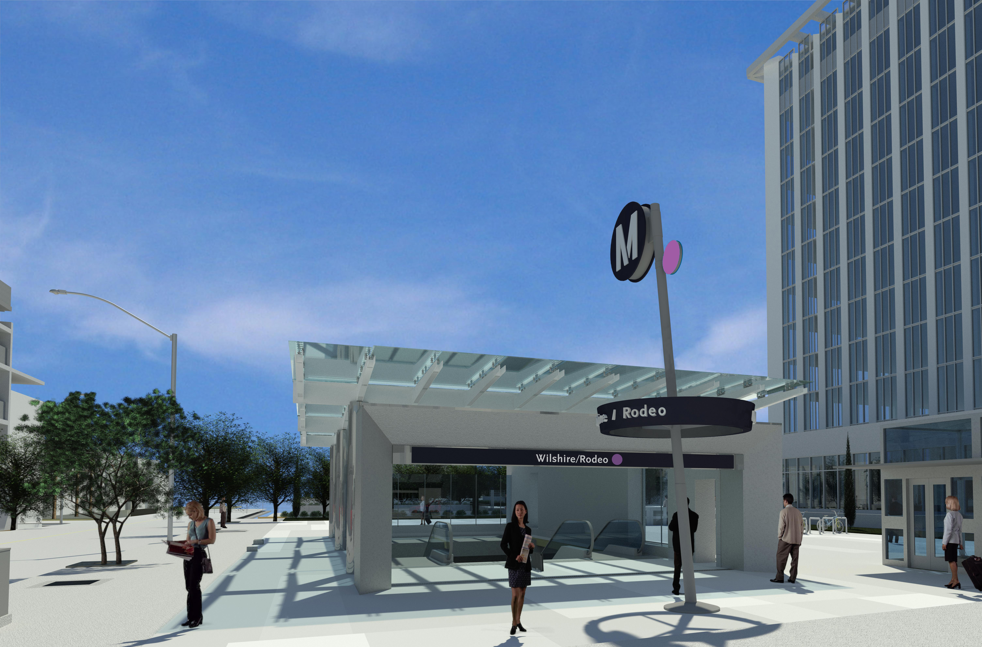
Wilshire/Rodeo Station Rendering

Slide 23
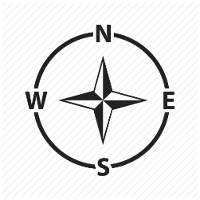
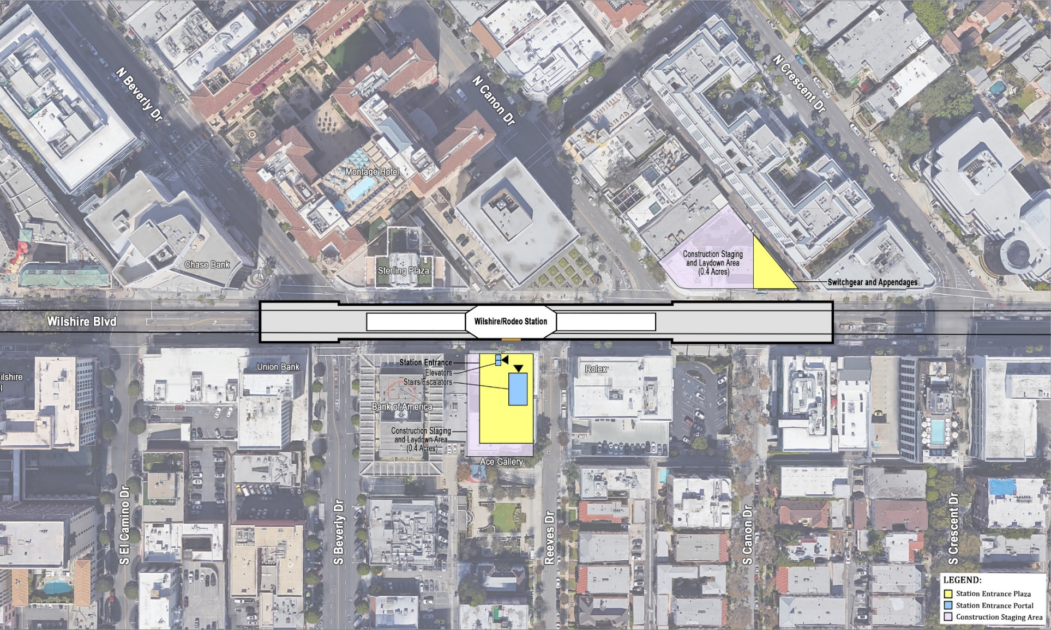
Wilshire/Rodeo Station Box
Rendering shows length of the underground station box on
Wilshire Bl from Cañon Dr to Beverly Dr

Slide 24
Wilshire/Rodeo Permitted Work Hours and Traffic Control
Work hours underneath the deck are 24 hours a day, 7 days a week. Deliveries of material, equipment, and concrete will be ongoing daily from Wilshire Bl. A breakdown of daily work hours on street level:
  From 7am to 9am and 4pm to 8:15pm, Wilshire Blvd. will remain open with three lanes in each direction between El Camino Dr. and Crescent Dr.
  From 9am to 4pm, Wilshire Blvd. may be reduced to two lanes in each direction between El Camino Dr. and Crescent Dr.
  From 8:15pm to 7am, Wilshire Blvd. may be reduced to one lane in each direction between El Camino Dr. and Crescent Dr.
Traffic control may also be implemented on Beverly Dr. At least one through traffic lane will be maintained in both directions.

Slide 25
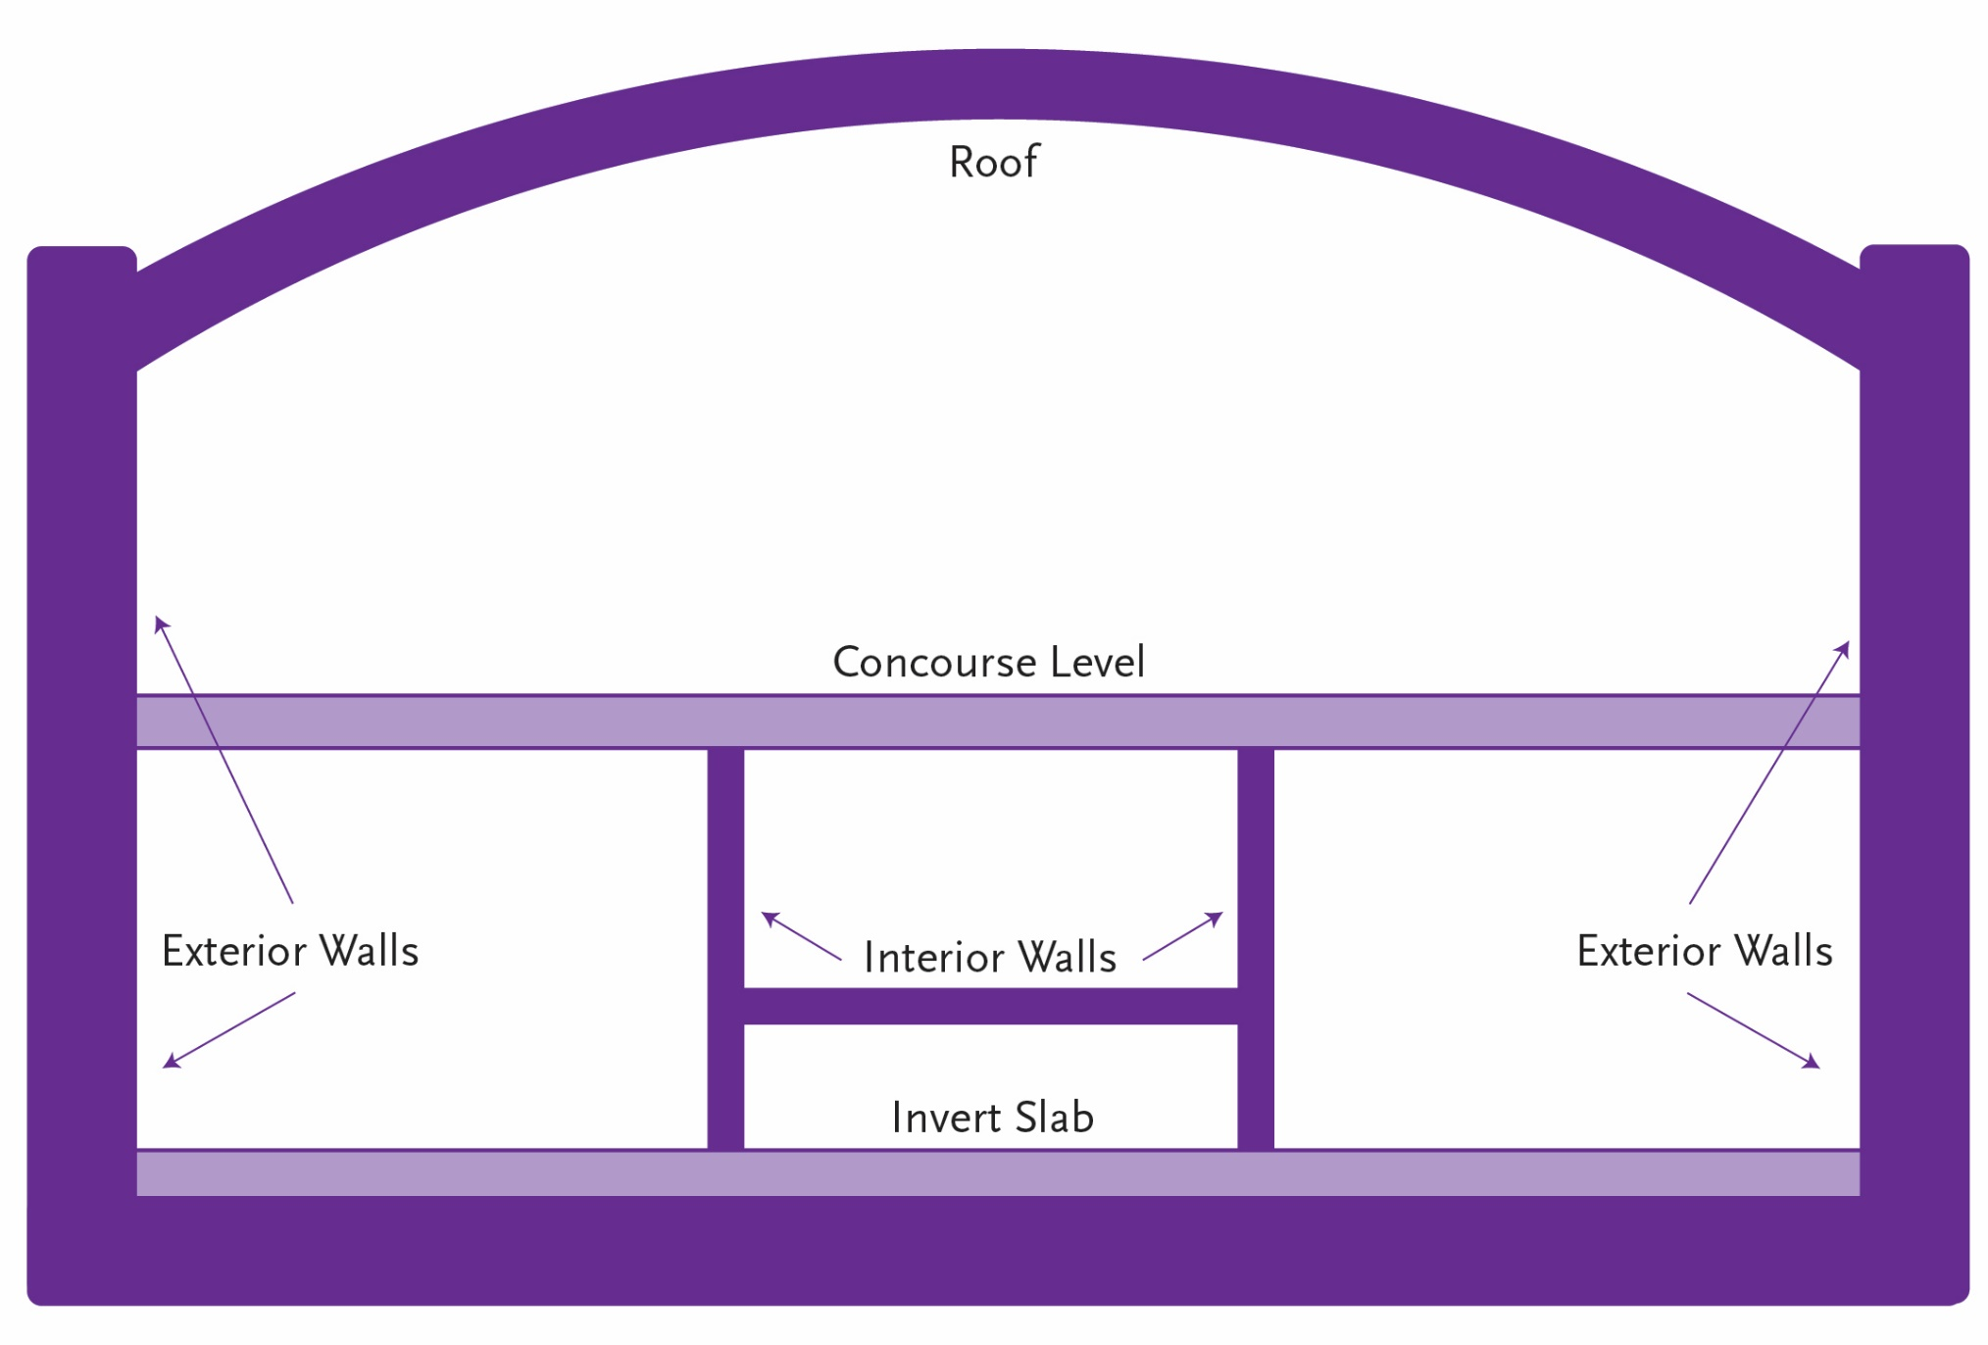
Wilshire/Rodeo Station Structure Construction through 2024

Slide 26
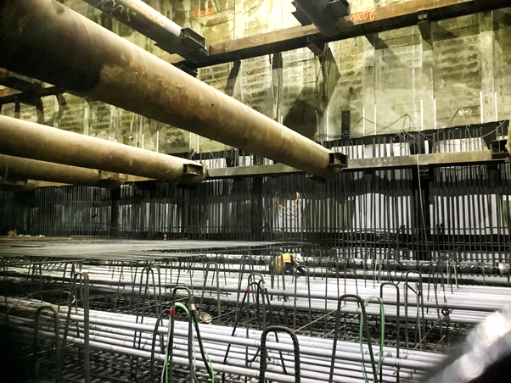
Wilshire/Rodeo Exterior Walls
Progress of installing invert, conduits, rebar, piping, etc.

Slide 27
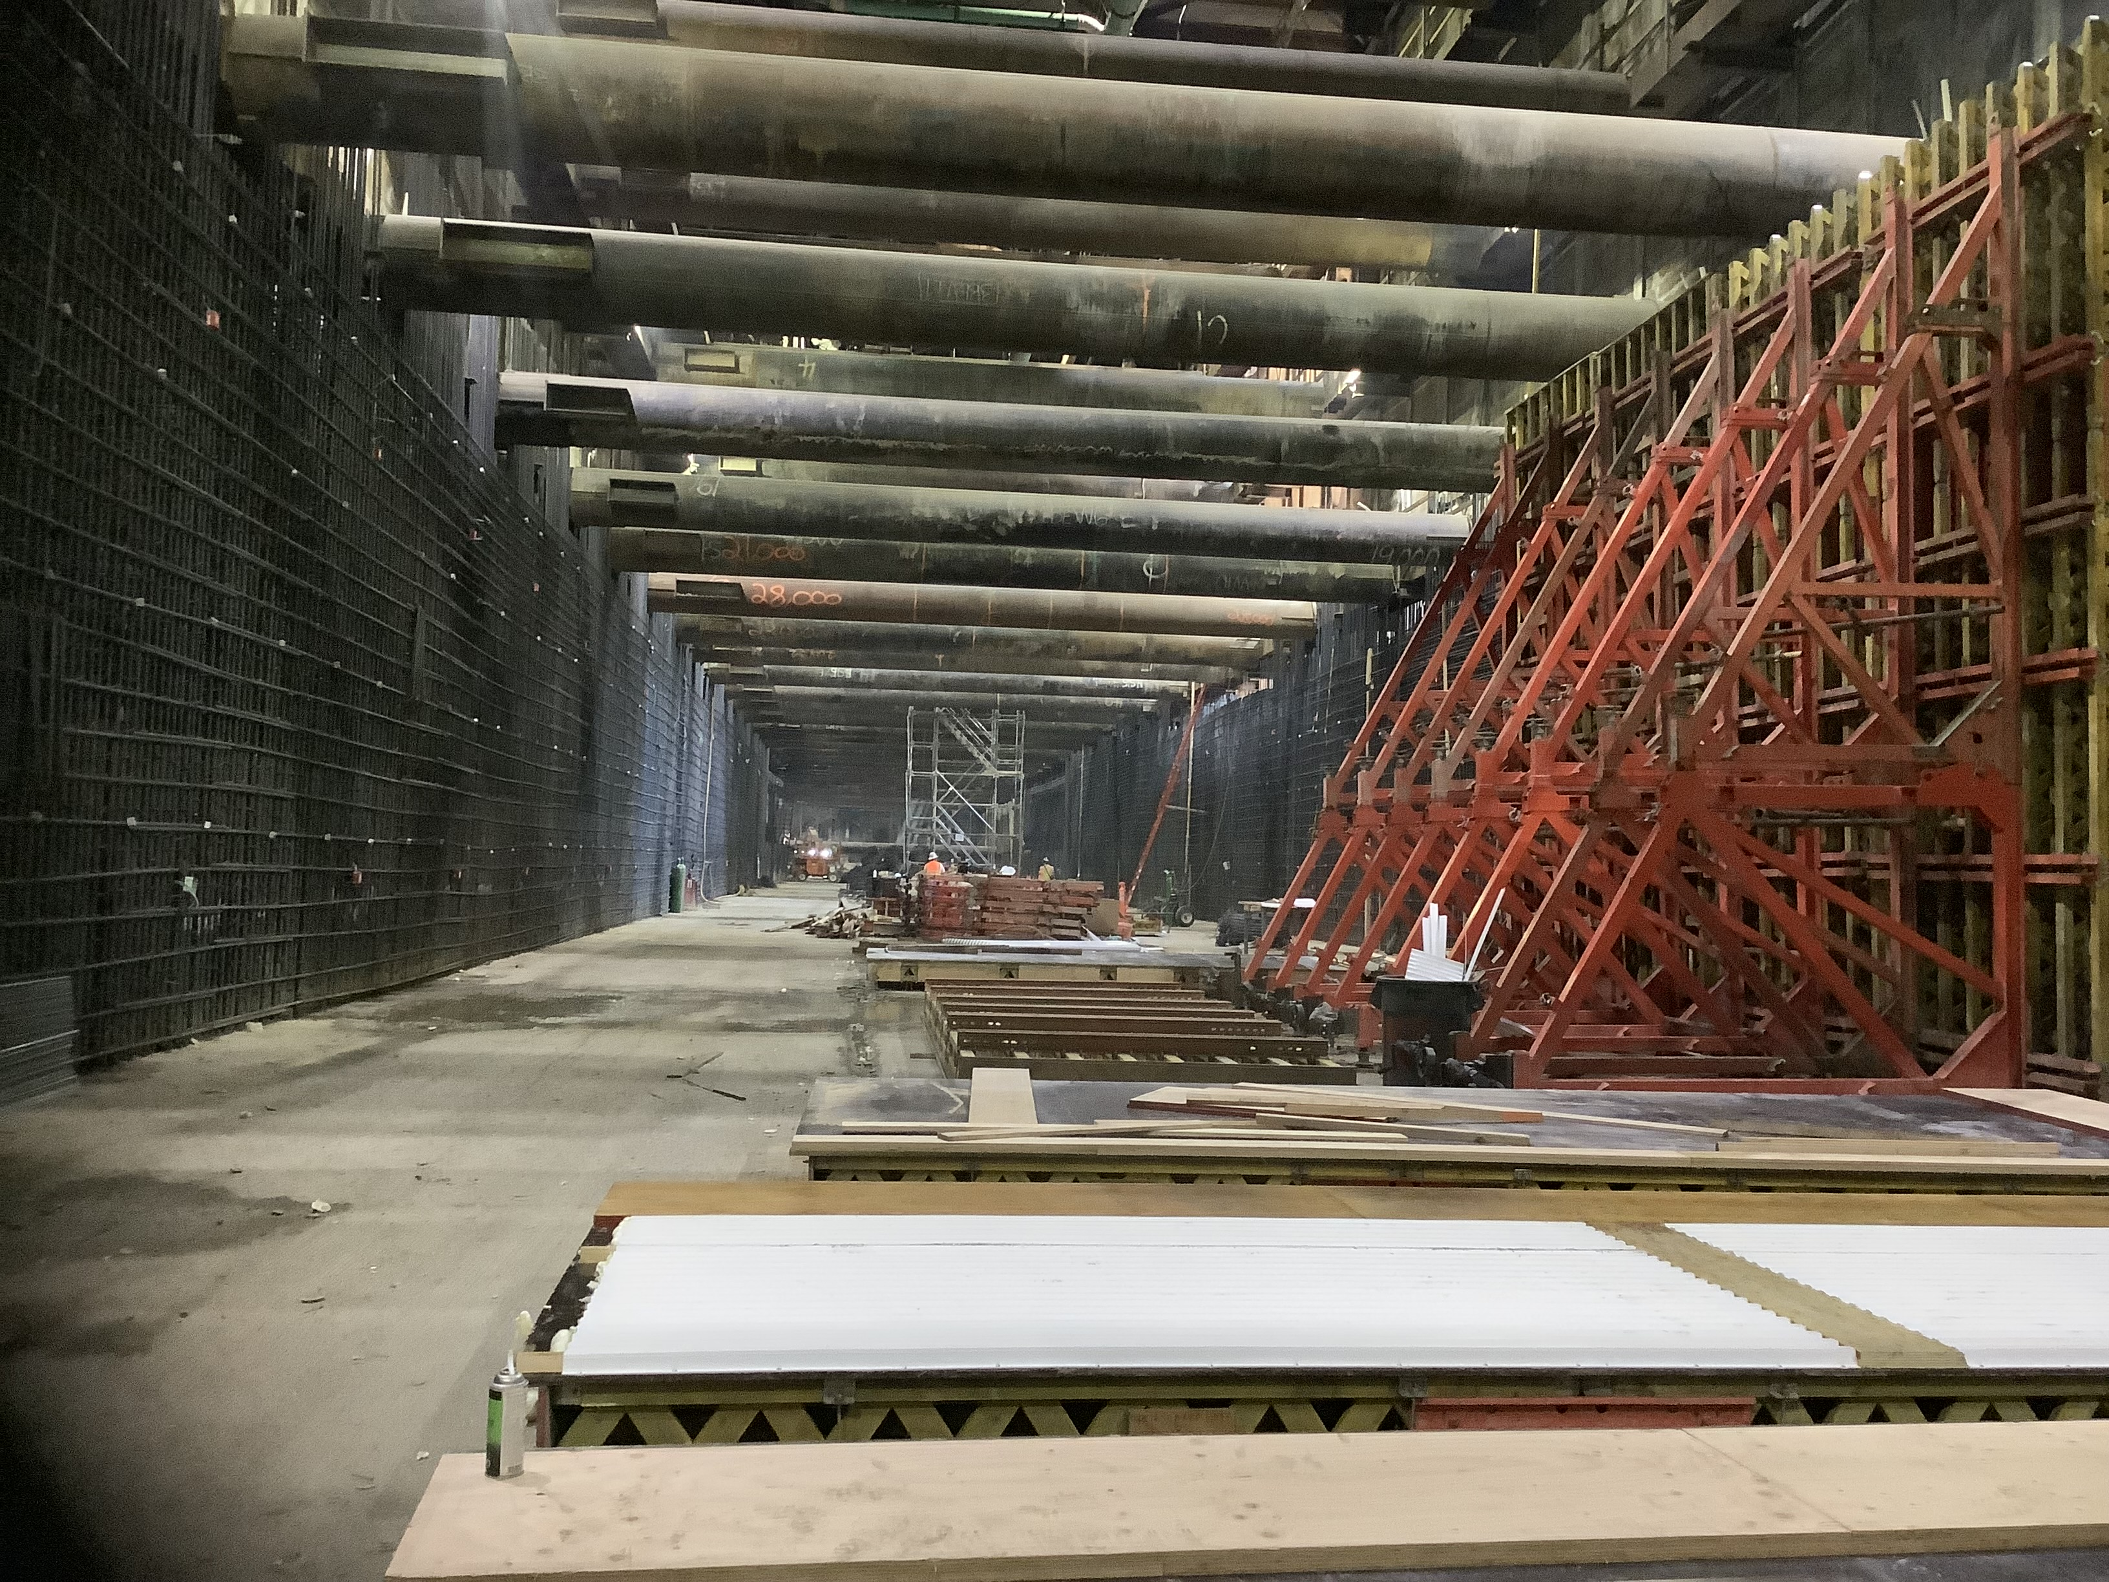
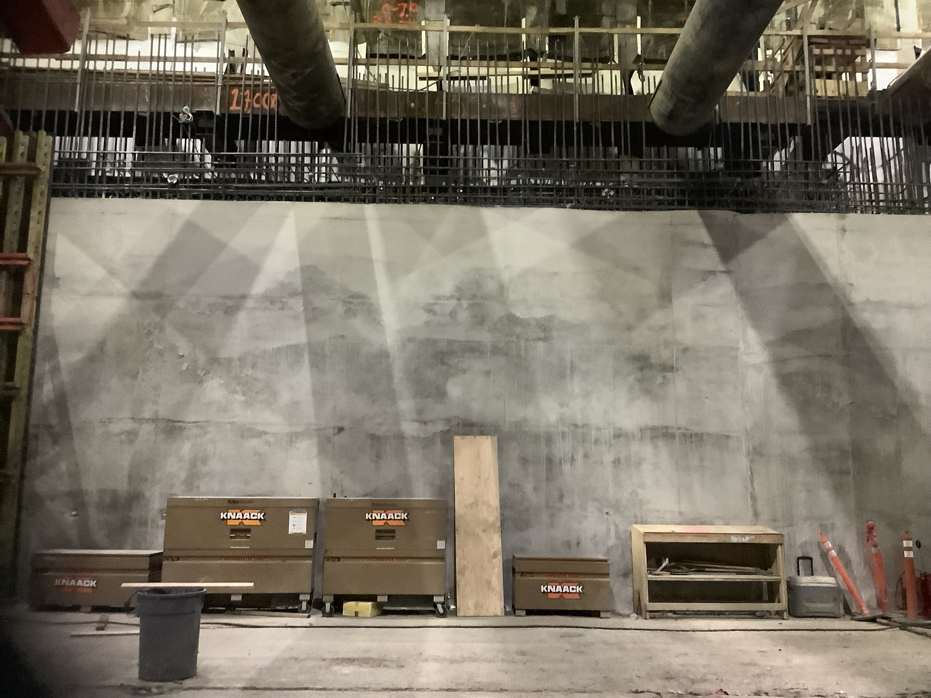
Wilshire/Rodeo Exterior Walls Progress
Progress of installing exterior walls.

Slide 28
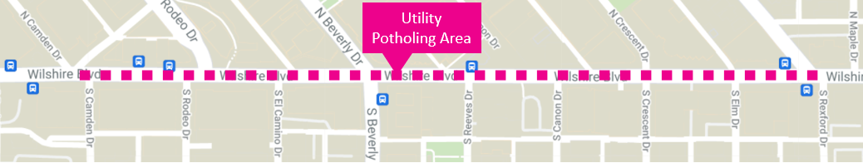
Wilshire/Rodeo Utility Potholing
Contractor will begin potholing to install SCE Permanent Power Feeds to the station.
Where: between Dayton Way and Rexford Dr
Duration: Potholing through mid-October.
  Utility installation to follow (more details to be provided in future notices)
Work Hours: Weekdays, 9am to 4pm
Traffic Control:
  Wilshire Blvd. may be reduced to two lanes in each direction within the work areas
Example of 10-foot geotechnical instrumentation pole.

Slide 29
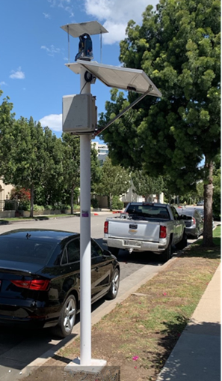
Wilshire/Rodeo Geotechnical Instrumentation
Where: Instruments will be installed within the tunnel alignment and station box area to monitor ground movement, settlement and other geological conditions
  Installations will be within the public right of way and within privately owned properties
Duration: Ongoing
Work Hours On Wilshire Bl:
  Weekdays, 7am to 4pm
Work Hours Off Wilshire Bl:
  Weekdays, 8am to 6pm
Example of 10-foot geotechnical instrumentation pole.

Slide 30
Wilshire/Rodeo Request for Holiday Moratorium Exemption
An application has been sent to the City requesting a waiver of the Holiday Moratorium, which would allow work to continue after the Thanksgiving Holiday through New Year’s Eve.
  No work is planned for Thanksgiving Day, the day after Thanksgiving Day, Christmas Day or New Year’s Day.
This exemption request is being reviewed by the City and If approved by City Council, the contractor will continue ongoing station and entrance construction, tunnel support, and installation and monitoring of geotechnical instrumentation.
The request will be brought forward for City Council consideration at the October 12th city council meeting.

Slide 31
Wilshire/Rodeo: City of Beverly Hills Information
On Tuesday, Sept. 21, Beverly Hills City Council will consider a one-year extension of the North Cañon Dr closure
    Council will also consider the Open Beverly Hills program outdoor permits for businesses.
    The two agenda items will be considered during the same meeting; however, each will be presented to Council separately because the items are not dependent on one another.
City Council initially approved the closure of North Cañon Dr and the wall installation in July 2018 for a minimum of two years up to six years. The wall was constructed in 2019.
Closure provides a safe and consistent traffic pattern for the businesses located on North Cañon Dr.
The 20-foot wall also mitigates construction noise and dust for the businesses on North Cañon.
If approved by City Council, the closure, sound-wall, and cul-de-sac will remain in place for another year to support station construction activities such as deliveries and concrete pours along Wilshire Blvd.

Slide 32

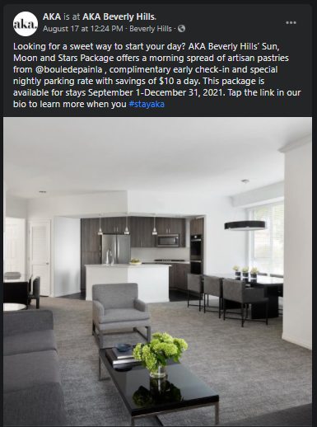
Stay in touch
AKA Hotel
155 N Crescent Dr
Beverly Hills
310.385.1924
https://www.stayaka.com/aka-beverly-hills
Notes:
Eat Shop Play spotlights this month include AKA Hotel, located in Beverly Hills.
AKA Hotel includes one- and two- bedroom suites, as well as additional spaces that can be used as an excellent replacement for a get-away remote work environment. For more information about room types, visit stayaka.com

Slide 33


Stay in touch
Contact Us
> For more information on Eat Shop Play visit​
metro.net/eatshopplay ​
> Send an email to eatshopplay@metro.net

Slide 34
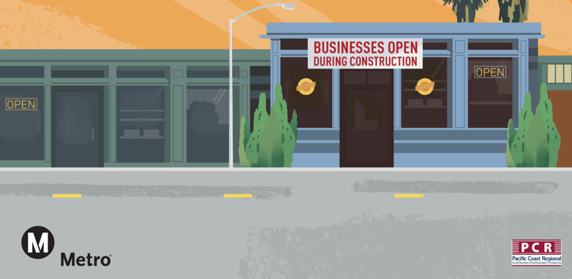
Business Interruption Fund (BIF)

Slide 35
Metro’s Business Interruption Fund
BIF Information and Eligibility
Financial assistance to small “mom & pop” businesses with 25 or fewer full-time employees directly impacted by Metro Rail construction along three project areas​:
  Crenshaw/LAX Transit Project​
  Purple Line Extension, Sections 1, 2 & 3​
  Regional Connector Project, Little Tokyo area & 2nd/Broadway Segment*
Businesses must be located immediately adjacent to the rail corridor and meet other eligibility requirements​
Grant amounts are determined by business revenue loss directly related to period of Metro construction disruption​
Businesses may receive up to $50,000 per impact year
*Segment eligibility based on full street closure with duration greater than six continuous months. Eligibility ended 6/30/17.​

Slide 36
Metro’s Business Interruption Fund
Metro’s Business Interruption Fund (BIF) is accepting applications for transit rail construction impact along the Crenshaw/LAX Transit Project, the Little Tokyo area of the Regional Connector and Sections 1, 2 and 3 of the Purple Line Extension sustained from March 20, 2020, forward (during the COVID-19 pandemic).
Small “mom and pop” businesses that experienced transit rail construction impact during the COVID-19 pandemic may be eligible.
Potentially eligible small business owners may contact BIF Fund Administrator Pacific Coast Regional at 213.739.2999 x223 or Metro at bif@metro.net.
Metro does not cover revenue loss nor fixed operating expenses related to COVID-19 impacts.

Slide 37
Metro’s BIF during COVID-19 Pandemic
Value of BIF Grants Awarded:
$32,066,161.01*
  *BIF Grants do not cover COVID-19 related impacts.

Slide 38
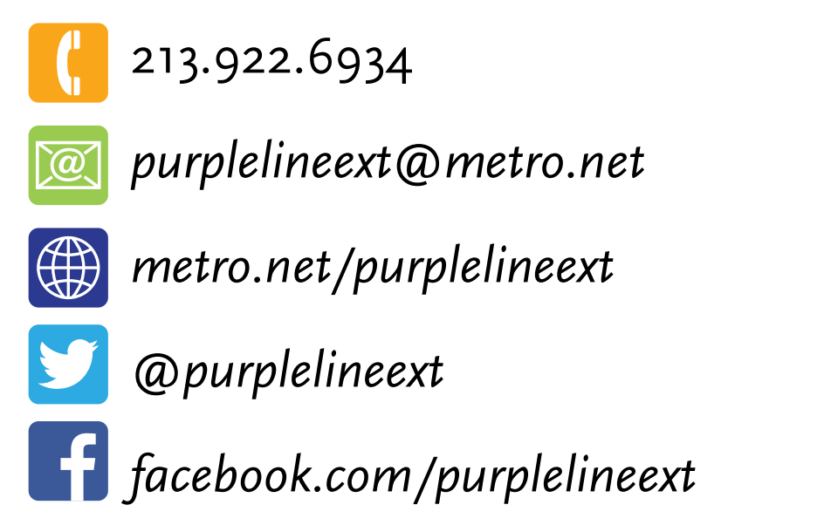
Stay in Touch
Lunch with Us Webinar:
Monthly Construction Update
Beverly Hills Section 1 & 2
October 6, 2021, 12noon
Link to webinars available at metro.net/purple
213.922.6934
purplelineext@metro.net
metro.net/purple
@purplelineext
facebook.com/purplelineext

