Slide 1

Caltrans/Metro Local Delivery Workshop
Federal Transportation Improvement Program (FTIP)
Summer/Fall 2020 Update

Slide 2
WHAT IS THE FTIP?
Federally required programming document
Why list Projects in the TIP?
To receive environmental approval and permits
To obtain FTA or FHWA grant approval (discretionary or formula)
To access (“obligate”) federal funds to be reimbursed for eligible expenses

Slide 3
2019 Ftip Amendments
From 10/1/2020 – mid 4/2021 amendments will be scheduled for emergency type changes for FY20/21
An emergency type change is if funds are lapsing or a project is ready to obligate funds prior to the 2021 FTIP
Administrative Modification:
- Funds increase less than 50% or $20 million
- Lead agency change
- Fund source change
- Cost decrease without deleting a phase

Slide 4
2019 Ftip Amendments
Formal Amendment:
- Funds greater than 50% or $20 million
- Scope change
- Add/delete project phase
- Add modeling project
- Schedule advance / delay
- Moving prior funds to quad years of 2019 FTIP
*Please visit ProgramMetro for most up-to-date Amendment schedule

Slide 5
2019 Ftip Amendments
Remains the active TIP until 21 TIP gets adopted
New projects/amendments accepted on urgency basis for funding lapse or must obligate prior to 2021 FTIP being adopted
Formal Amendment | Administrative Modification | Due to Metro
------ | 19-24 | July 14th, 2020
19-26* | ------ | August 25th, 2020

Slide 6
2021 FTIP Adoption
Adoption expected to be active in mid-April of 2021
When adopted, it will replace the 2019 FTIP
New Performance Measure requirement
Recent changes and new projects need to be added in the upcoming amendments

Slide 7
2021 FTIP AMENDMENTS
Amendment #21-01 and Admin Mod #21-02 are catch-up Amendments for changes made in 2019 FTIP amendments that are not included in 2021 FTIP base

Slide 8
2021 FTIP AMENDMENT DEADLINES
Formal Amendment | Administrative Modification | Due to Metro
21-01 | ------ | September 29th, 2020
----- | 21-02 | December 29th, 2020
21-03 | ----- | March 30th, 2021
----- | 21-04 | May 25th, 2021

Slide 9
Metro contacts
Ashad Hamideh, Senior Director
(213) 922-4299 HamidehA@metro.net
Nancy Marroquin, Senior Manager
(213) 418-3086 MarroquinN@metro.net
James Simpson, Transportation Planner
  (213) 922-2923 SimpsonJa@metro.net
Nick Zhao, Transportation Associate II
(213) 922-2069 ZhaoJi@metro.net
Will Proctor, Administrative Intern
(213) 922-4946 ProctorW@metro.net
Yerandy Pacheco, Administrative Intern
(213) 922-7478 PachecoY@metro.net

Slide 10
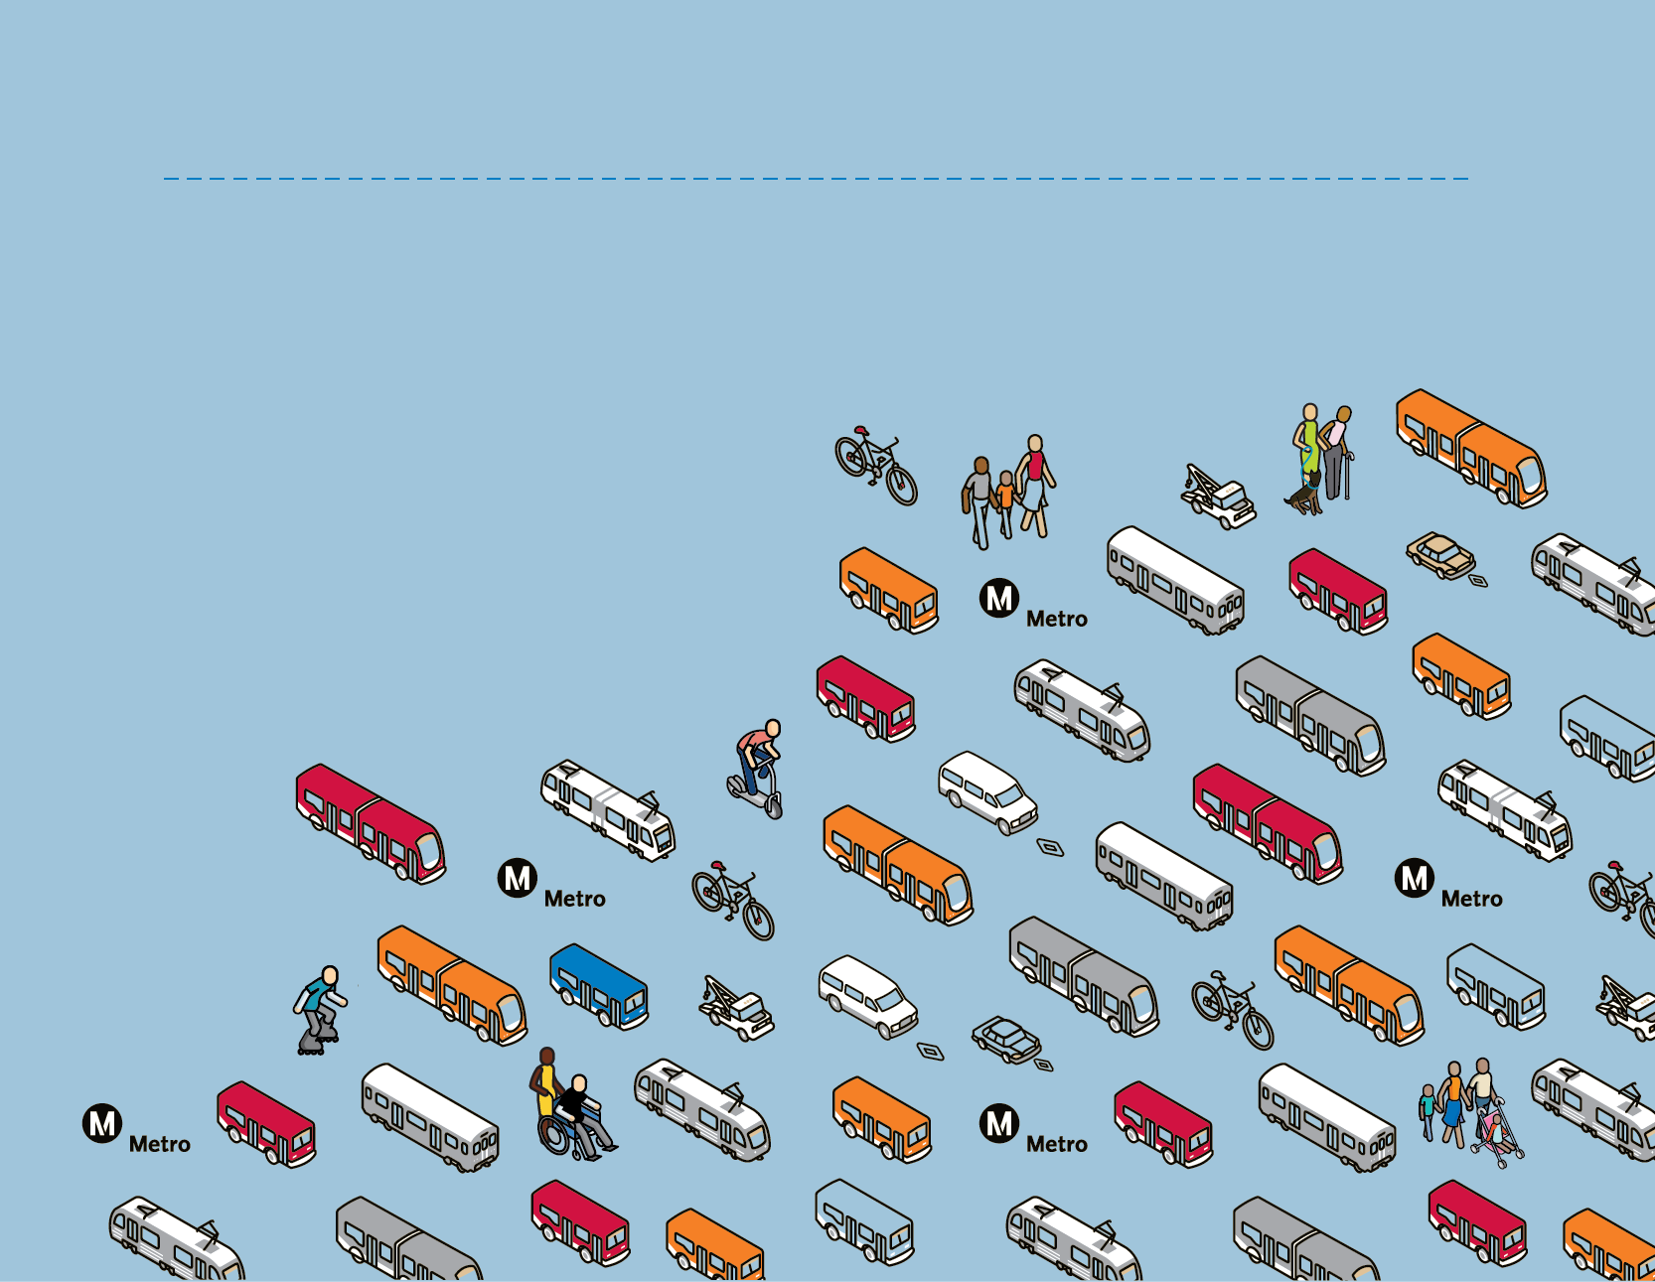
Thank you

