Slide 1
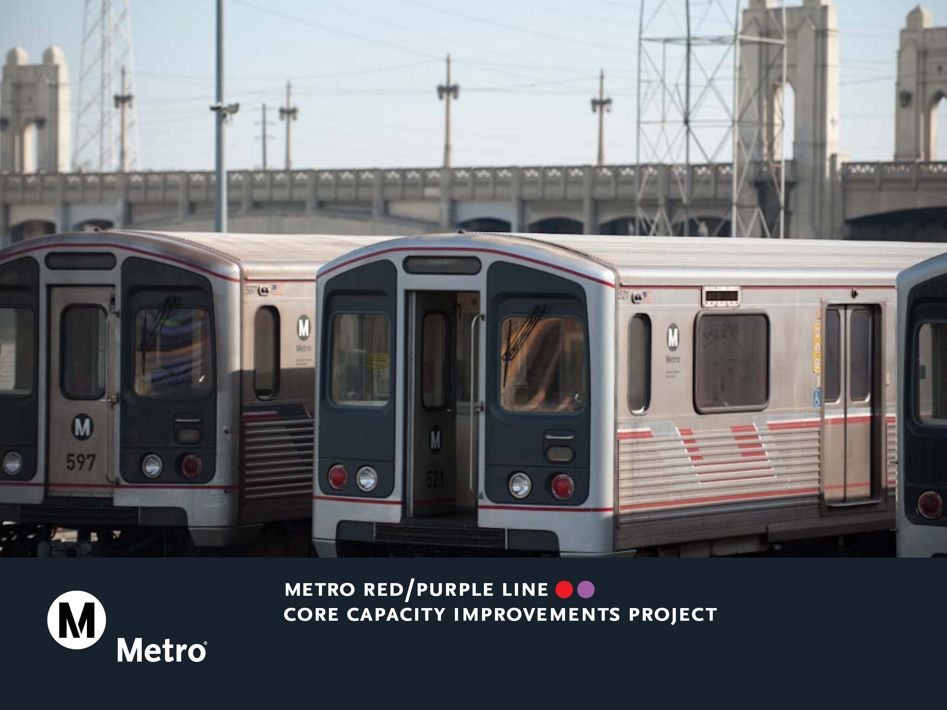
DIVISION 20 IMPROVEMENT PROJECTS
Item 19- Downtown Arts District Connectivity

Slide 2

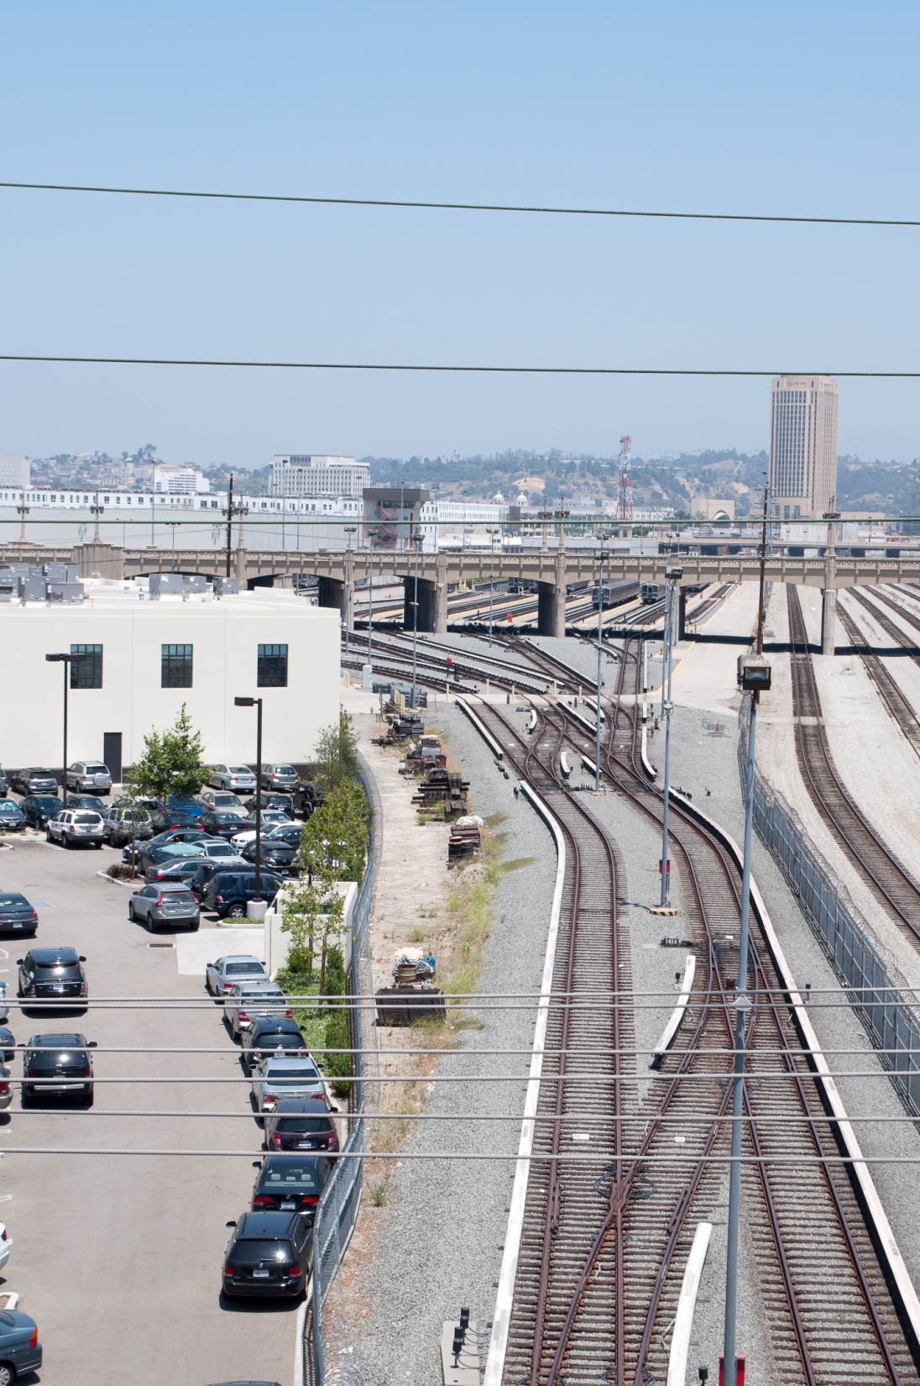
January 26, 2017 Board Motion
“MTA’s first priority for Division 20 must be to support the Purple Line Extension. However, Metro should do everything possible to extend rail service to the Arts District.”
“Work with the City of Los Angeles to develop creative strategies to establish innovative funding mechanisms dedicated to offset the costs of new stations in the Arts District.”
View North from 6th Street
2

Slide 3
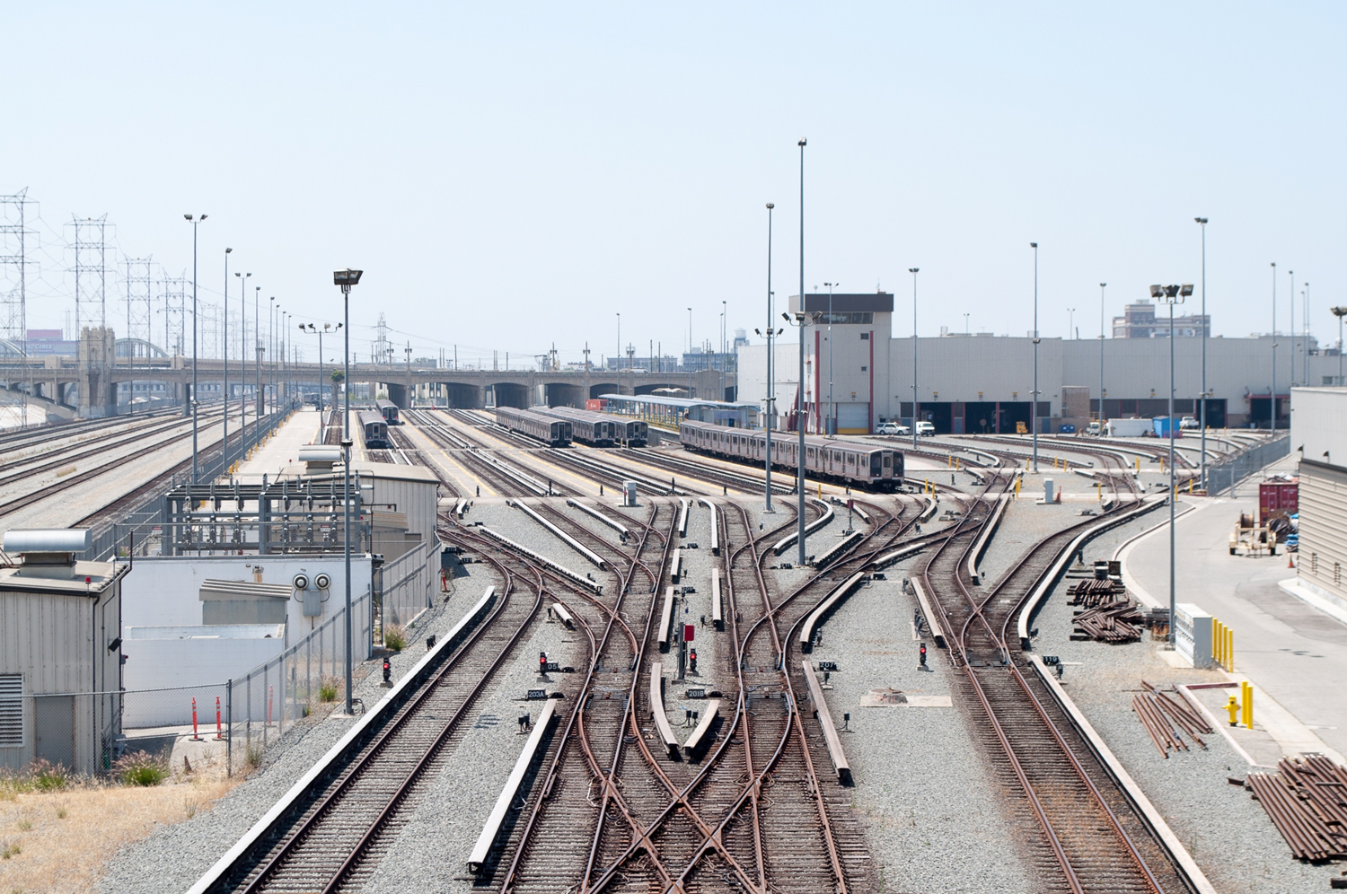
Metro Division 20 Red & Purple Line Railyard
Division 20 accommodates rail storage and maintenance for the Metro Red and Purple Line fleets as well as service functions for LRT lines. The yard is rapidly expanding to accommodate Red & Purple Line Measure M growth while at the same time the Arts District Community is undergoing rapid expansion and growth.
3

Slide 4
Current Metro Project Needs in Division 20
-Needed to Support Service Levels Today
Maintenance of Way/Non-Revenue Vehicle Facility (MOW/NRV)
  Under construction for completion in 2018
  Funded by Metro Purple Line Section 1 Project
Emergency Security Operations Center (ESOC)
  New central location for Metro Security Operations, radio dispatch and emergency coordination
  Final design being completed in 2017
  Funded in part by $112.7 million Prop 1B Grant
4

Slide 5
Current Metro Project Needs in Division 20
-Needed for Service Expansion
Portal & Turnback Improvements
  Essential for Red/Purple Line Service Expansion
  Board approved environmental document and funding for design in March 2017
  Partially funded by $69.2 million Cap & Trade Grant
Storage & Test Tracks
  Increased rail fleet and storage required for Section 2 and 3 of Purple Line
  Measure M acceleration of Purple Line Extension Segment 3 from 2036 to 2024 has advanced deadlines for identifying additional capacity requirements
Arts District Station
  Designed for Purple /Red Line South Extension in the future
5

Slide 6
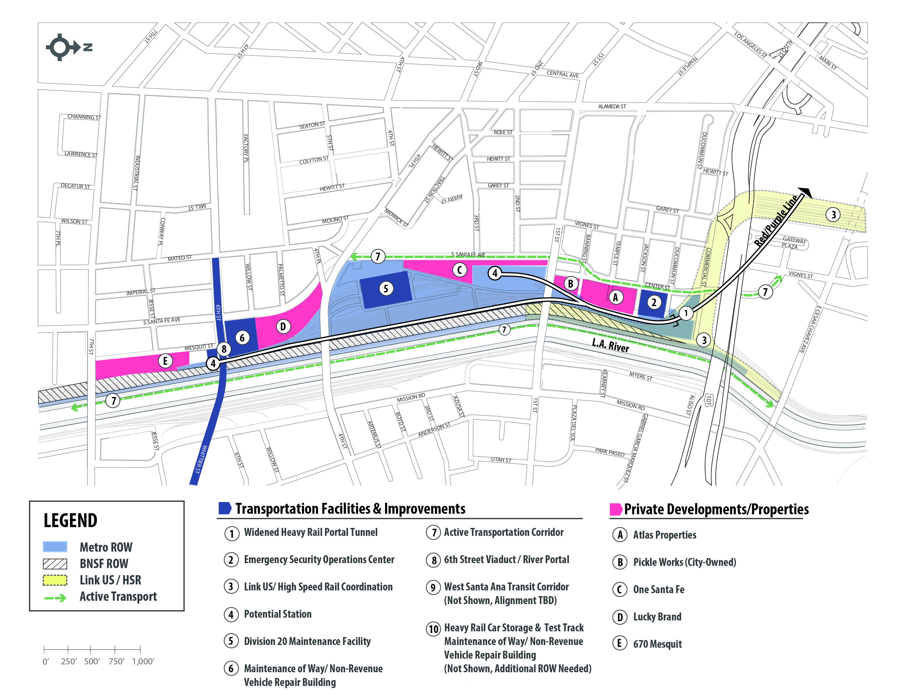
Proposed Division 20 Railyard Improvements
6

Slide 7
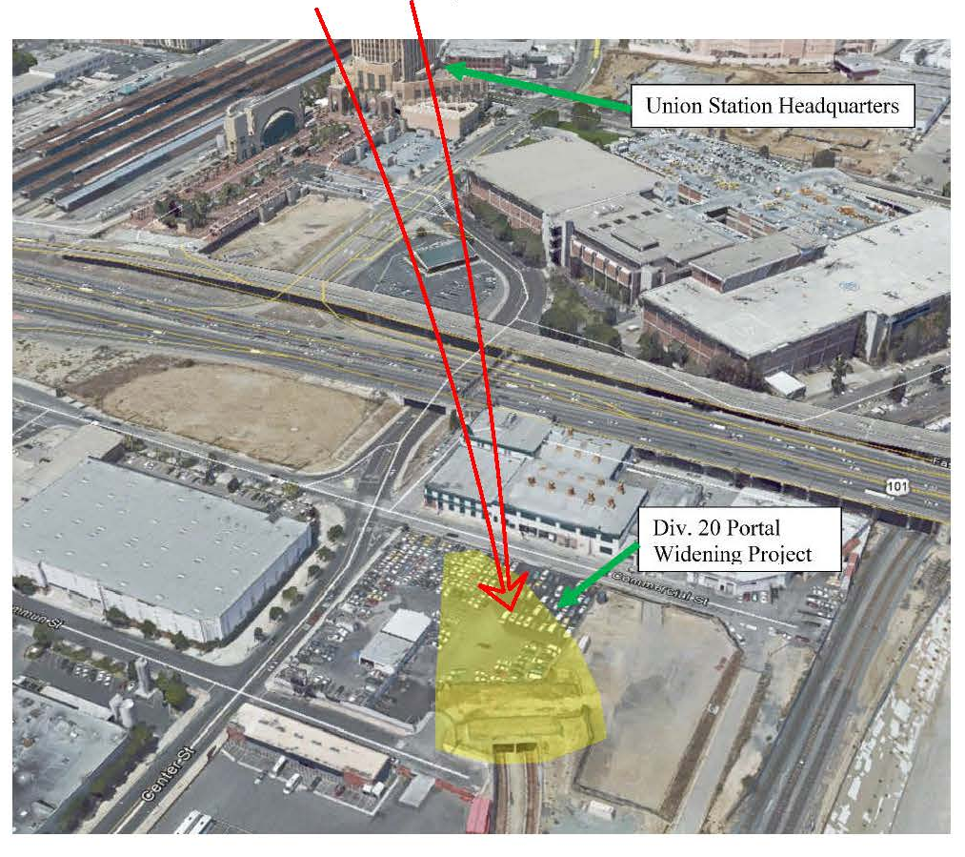
Subway Portal Widening
7

Slide 8
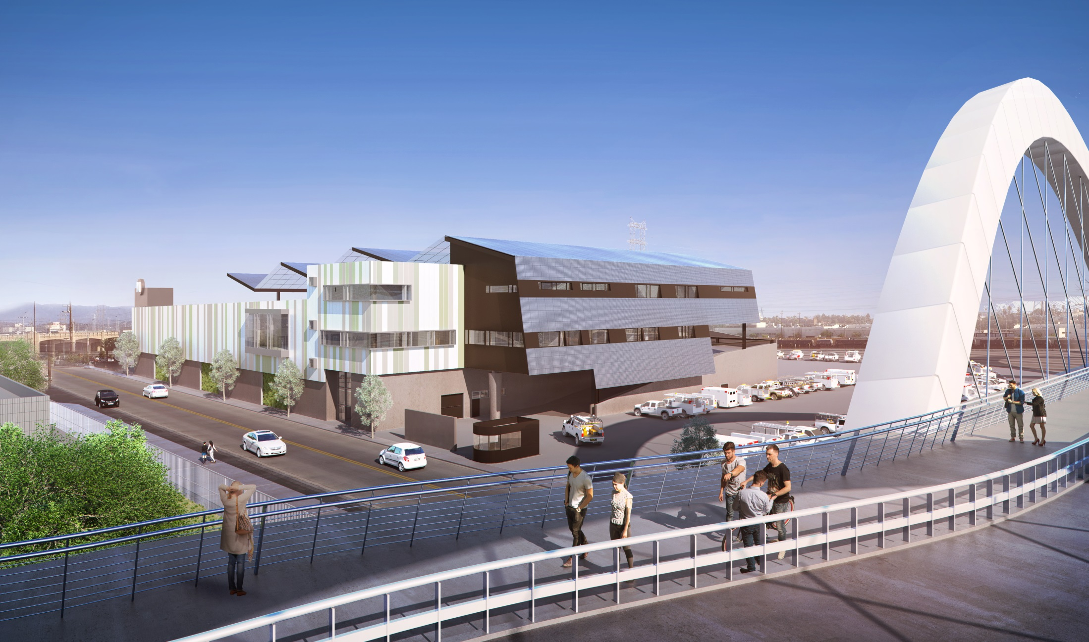
Maintenance of Way/Non-Revenue Vehicle Building
8

Slide 9
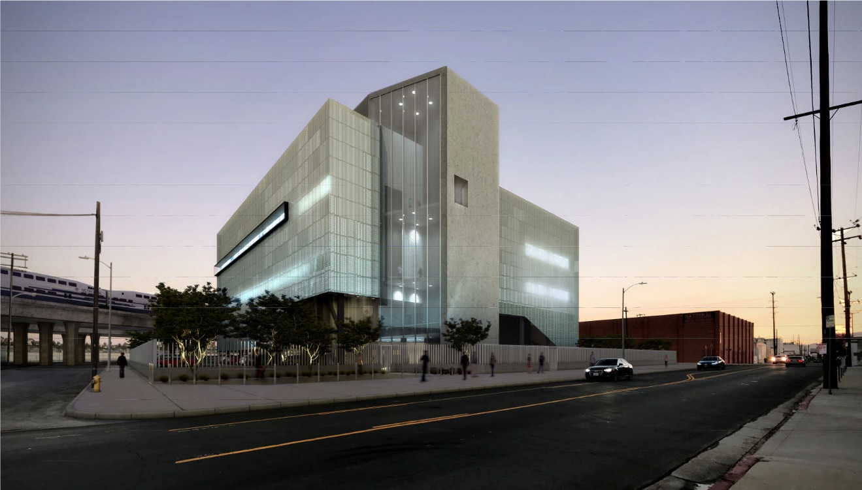
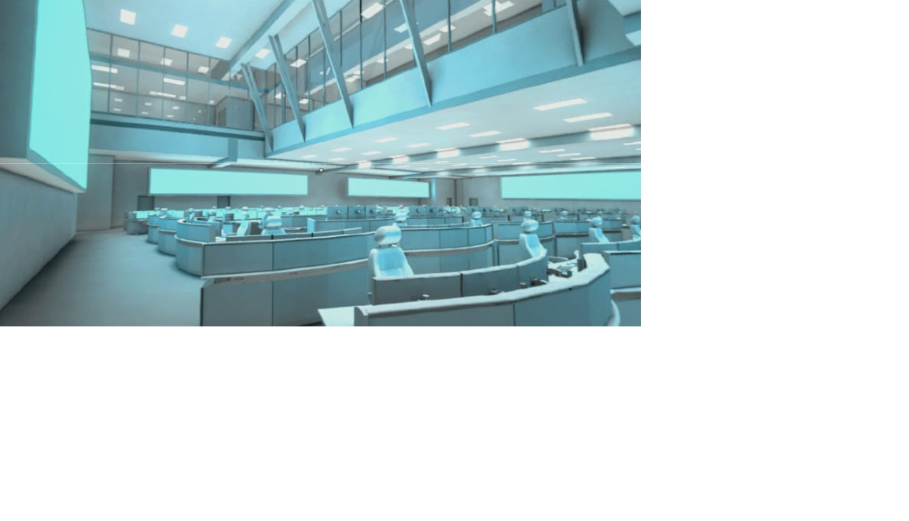
Emergency Security Operations Center
9

Slide 10
Other Planning Projects Adjacent to Division 20
Link Union Station/High Speed Rail
  Converts Union Station from a “single-ended terminal to a through terminal” for Metrolink, Amtrak and potential High Speed Rail
  Preliminary design, engineering and environmental clearance underway with EIS/EIR reviews in 2017
West Santa Ana Branch LRT Corridor
  Scoping for Draft Environmental to commence in April 2017
  Possible alignments in the Arts District or along Alameda
Active Transportation
  LA River Bikepath environmental to commence in mid-2017
  Eastside Access Improvement Project 30% design completed
City of LA 6th Street Viaduct & Park
  Bridge under construction for completion in 2020
  12-acre 6th Street Park, Arts, River and Connectivity Improvements being developed under and adjacent to bridge with connections to LA River and the Arts District
10

Slide 11
Challenges & Opportunities
Limited Space
  Not enough land space currently within Metro’s Division 20 footprint to accommodate current and expanded service needs
  Car storage is paramount – no cars, no service
  Only one new station location serving the Arts District can potentially “fit”
  Need to assess ROW options to meet full range of needs – can’t “piecemeal”
11

Slide 12
Challenges & Opportunities
Timing
  Acceleration of Section 3 opening date from 2036 to 2024 has likewise accelerated key decisions
  FTA Full Funding Grant Agreement timing and provisions are drivers
  Need to coordinate infrastructure planning and delivery decisions with Arts District land use development decisions in the vicinity of Division 20
12

Slide 13
Challenges & Opportunities
Funding
  Funding all elements of Division 20 improvements is essential
  Some funding has been programmed but not all, and timing may need to be adjusted
  Arts District station provides key opportunity for private sector funding partnership, but coordination is key
13

Slide 14
Next Steps
Prepare Integrated Space Plan (Summer/Fall 2017)
Identify Real Estate/ROW Needs (Fall 2017)
Long Range Transportation Plan (2017-2018)
Funding & Implementation (Now and Beyond)
14

