Slide 1
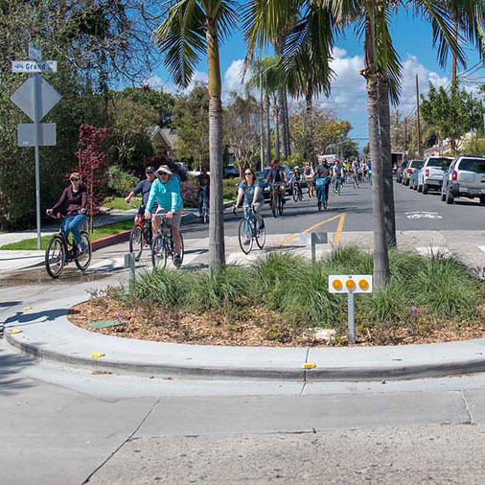
Highway Safety Improvement Program (HSIP)
Cycle 10 HSIP Call for Projects early May- due mid-July
Project list Fall 2020
FTIP January 2021
http://dot.ca.gov/programs.local-assistance/
dale_benson@dot.ca.gov
Caltrans District 7 Office of Local Assistance

Slide 2
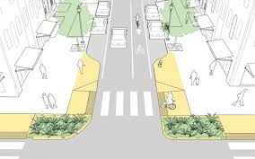
HSIP
California- 3000 traffic fatalities per year
57% local roadways, 43% SHS
Proactive vs. Reactive vs. Comprehensive
Systemic vs. Spot location
Local Roadway Safety Manual
Online Training late May 2020

