Slide 1
Active Transportation Program Updates
State legislative analysis and discretionary grants group
July 29, 2020

Slide 2
Active transportation program cycle 5 SCHEDULE – quick-build applications
Program Milestones | Original Schedule | Amended Schedule
Project Application Deadline – Quick-Build Projects | Jun 15, 2020 | Jul 15, 2020
Staff Recommendation for Quick-Build Projects Posted | Nov 16, 2020 | Sep 15, 2020
Commission Adopts Quick-Build Projects | Dec 2-3, 2020 | Dec 2-3, 2020

Slide 3
Active transportation program cycle 5 SCHEDULE – Statewide &
Small urban/rural
Program Milestones | Original Schedule | Amended Schedule
Project Application Deadline | Jun 15, 2020 | Sep 15, 2020
Staff Recommendation Posted | Nov 16, 2020 | Feb 15, 2021
Commission Adopts Statewide & Small Urban/Rural Projects | Dec 2-3, 2020 | Mar 2021
Commission Adopts MPO Projects | May 2021 | June 2021

Slide 4
Active Transportation program
METRO letters of support schedule
ATP Project Type | Requests Due to Metro | Returned to Agency
All Other Project Types | Aug 7, 2020 | By Sep 1, 2020
Please email Anna Moneymaker at moneymakera@metro.net if you have not received a Project Information Request form.

Slide 5
Submission Details
Hard copy applications must be turned in within 30 days of due date.
Electronic signatures on applications will be accepted for current cycle.

Slide 6
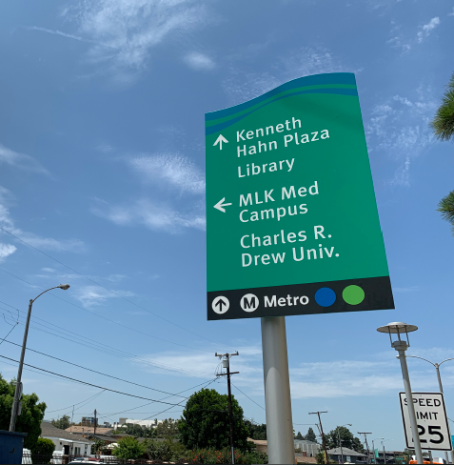
Metro Station Trailblazing design Standards
The Metro Station Trailblazing Design Standards were created for cities and third parties implementing wayfinding signage that guides customers to and from Metro rail stations.
For more information, please contact:
Susan Gray
Director, Art & Design
GrayS@metro.net

Slide 7
Contact information
Patricia Chen
Senior Director
State Legislative Analysis &
Discretionary Grants
ChenP@Metro.net
Anna Moneymaker
Transportation Planner
State legislative analysis &
discretionary grants
MoneymakerA@metro.net
Shelly Quan
Senior Transportation Planner
State Legislative Analysis &
Discretionary Grants
quans@metro.net

