Slide 1
Wilshire/La Brea Decking Removal August 22, 2023
Notes:
Please use this slide if you’re presenting the PowerPoint virtually.
Delete ”we will begin in a few moments” if sending via email or presenting in-person.

Slide 2



Housekeeping
Today’s meeting is being recorded.
Attendee cameras are off and microphones are muted.
During the meeting, comments can be submitted
using the Q&A icon.
For technical support, call or text 213.276.6008
Notes:
There is no master layout for this Housekeeping slide, please duplicate slide as needed.

Slide 3
Code of Conduct
Metro is committed to ensuring that all participants can fairly and clearly share ideas, comments and concerns about this project. To provide a safe and equitable process, we are asking for your help.
During this meeting, please:
Respect the format of the meeting and allow everyone an opportunity to comment
Treat fellow community members, agency representatives, Metro staff and others with respect
Notes:
There is no master layout for this Code of Conduct slide, please duplicate slide as needed.

Slide 4


Slide 5

New fares are Here!
Fare capping is here, which means that paying fare on Metro bus and rail is now simpler for our customers!
Fare capping allows customers to pay per ride with TAP.
Once a customer reaches their set dollar cap for the day or seven-day period, they're no longer charged when they use their TAP card for the rest of the time period.
For more information, visit metro.net/fares

Slide 6
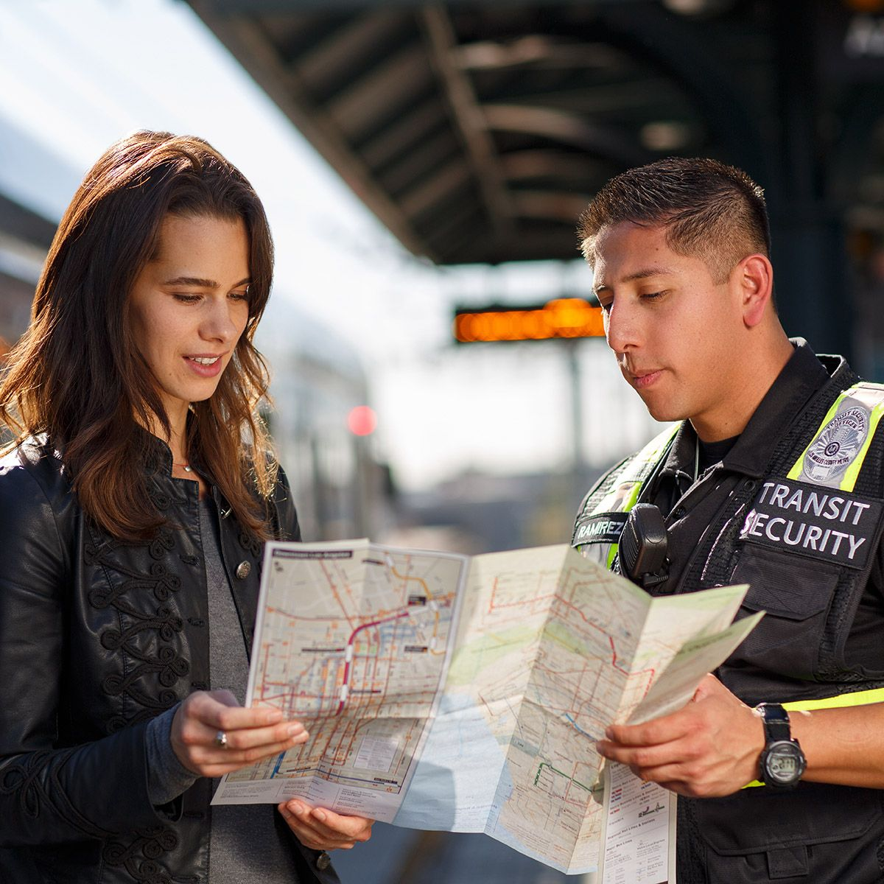

Let’s Ride Safely Together
Keeping riders safe is our number one priority and we're committed to providing you with a great experience on Metro.
Visit metro.net/Safety for more information about our plan that reimagines the way we approach public safety, to ensure all our riders feel safe, comfortable, and welcome on our system. ​​

Slide 7

Notes:
This pilot runs until June 30, 2023.

Slide 8


Slide 9
Agenda
Schedule for temporary decking removal
Range of closures for Wilshire/La Brea Decking Removal
Detours during decking removal
How to stay in touch

Slide 10
Today’s Presenters
Community Relations Team
Ned Racine, Principal Community Relations Officer
Contractor Representative and Presenter
Scott Donohue, STS Community Relations Coordinator

Slide 11
Phase 1 Recap
The first phase of temporary decking removal ranged from La Brea Av to Orange Dr.
The full closures reached from La Brea Av to Highland Av.
The work was originally anticipated to require 10 concurrent weekends, commencing on April 22, 2022. The work ended three weeks early.
As with Phase 2, closing Wilshire Bl entirely increased worker safety and reduced the time needed to do the work.

Slide 12
Wilshire/La Brea: Phase 2 Schedule
Weekend​ | Dates​ | Status/Work Activity​
1​ | September 29 to October 2​ | Decking Removal​
2​ | October 6 to October 9​ | Decking Removal​
3​ | October 13 to October 16​ | Decking Removal ​
4​ | October 20 to October 23​ | Mansfield Av to Detroit St​
5​* | October 27 to October 30​ | Decking Removal​
6* | November 3 to November 6​ | Decking Removal​

Slide 13
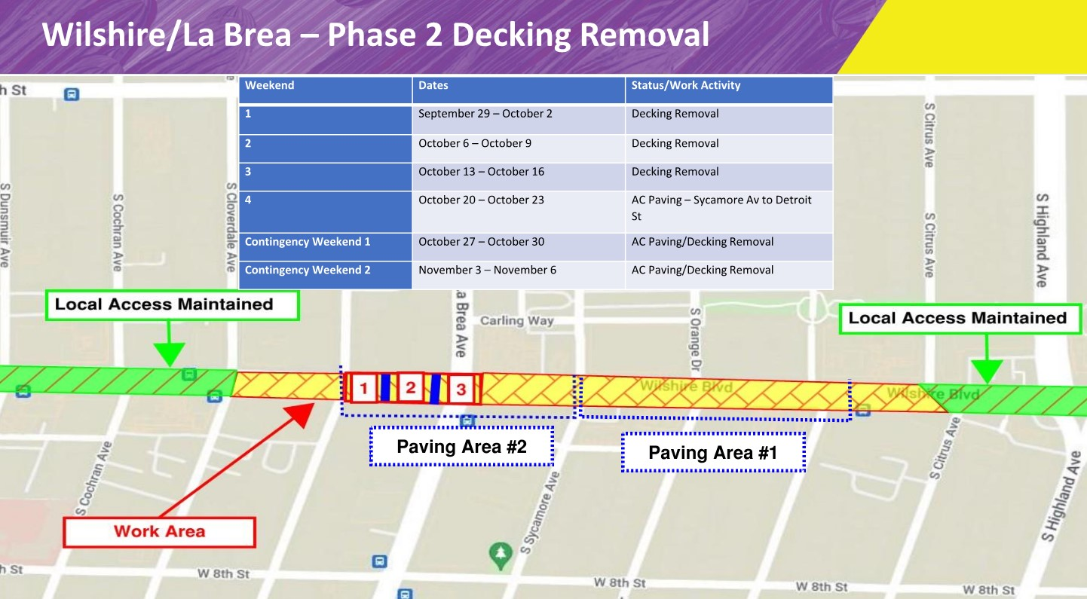
Wilshire/La Brea: Phase 2 Decking Removal

Slide 14
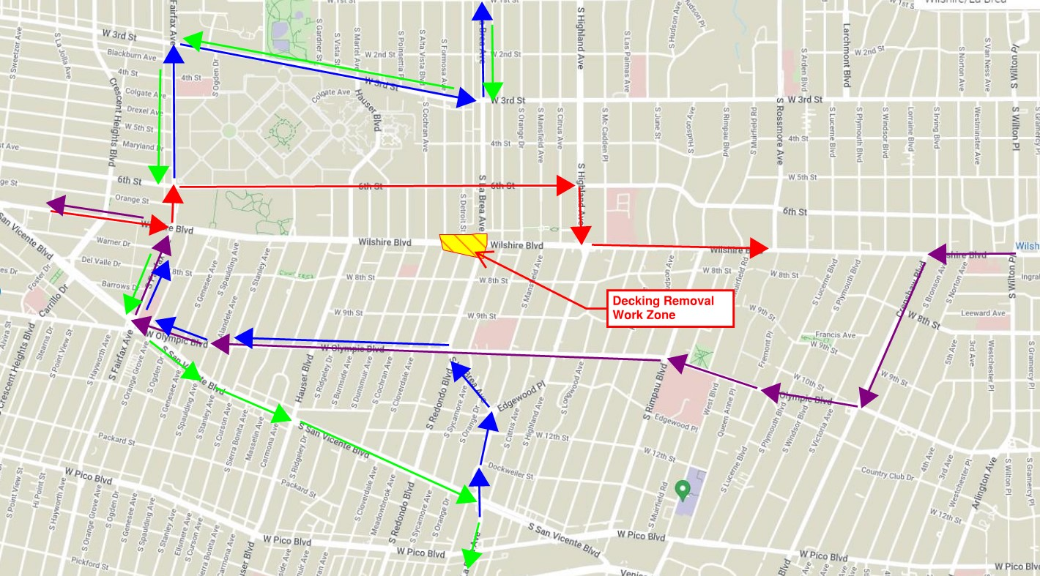
Wilshire/La Brea – Phase 2 Detour Route
Eastbound Wilshire Detour: Eastbound Wilshire Bl > Northbound Fairfax Av > Eastbound 6th St > Southbound Highland Av > Eastbound Wilshire Bl
Westbound Wilshire Detour: Westbound Wilshire Bl > Southbound Crenshaw Bl > Westbound Olympic Bl > Northbound Fairfax Av > Westbound Wilshire Bl
Northbound La Brea Detour: Northbound La Brea Av > Westbound Olympic Bl > Northbound Fairfax Av > Eastbound 3rd St > Northbound La Brea Av
Southbound La Brea Detour: Southbound La Brea Av > Westbound 3rd St > Southbound Fairfax Av > Eastbound San Vicente Bl > Southbound La Brea Av

Slide 15
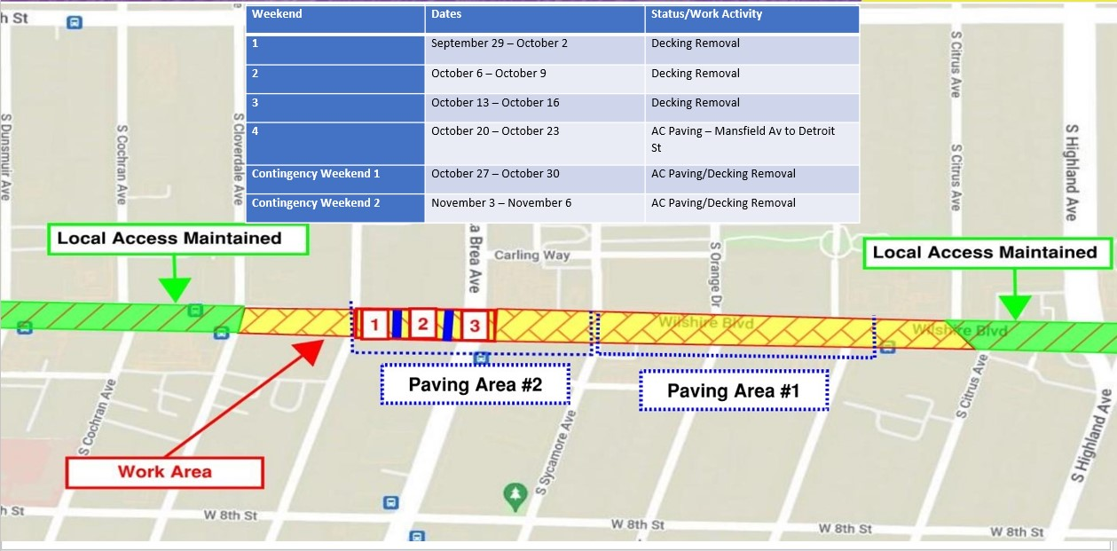
Wilshire/La Brea: Phase 2 Decking Removal Sequence
Decking removal will commence on Fridays at 9pm and continue through 6am the following Monday.
Wilshire Bl will be closed between Citrus Av and Cloverdale Av.
La Brea Av will be closed in both directions at Wilshire Bl.
Decking removal will be conducted on weekends:
  September 29 to October 2
  October 6 to October 9
  October 20 to October 23

Slide 16
Wilshire/La Brea – Phase 2 Decking Removal Sequence
Permanent AC Paving will take place on weekend 4.
STS has requested two contingency weekends to account for any unexpected delays.
AM Peak Hours may be utilized on Monday mornings. This will only be implemented if the road is unsafe for use by Monday at 6am.

Slide 17

Stay in Touch
213.922.6934
purplelineext@metro.net
metro.net/purple
@purplelineext
facebook.com/purplelineext

